Slide 1

DDoS Attack Detection and Mitigation (Real-Time DDoS Detection and Adaptive Mitigation Framework Using Machine Learning)
Final Review · SentinelFlow
Team Details : Batch C15
Under the Esteemed Guidance of
V Meenakshi
[DESIGNATION], Department of CSE
23K91A05E3 MALLELA PALLAVI
24K95A0514 KATTOJU DURGABHAVANI
23K91A05H3 NIMMALA RAKSHITHA
23K91A05K0 PRODHATOOR SHASHI PREETHAM
DEPARTMENT OF COMPUTER SCIENCE AND ENGINEERING · [COLLEGE NAME] · Academic Year [ACADEMIC YEAR]
Notes:
Introduce the team and SentinelFlow: a working real-time DDoS detection and adaptive mitigation system, with an honest evaluation on real CICIDS2017 flows.

Slide 2
Table of Contents
Abstract
Base Paper & Literature Survey
Research Gap, Problem Statement & Objectives
Proposed System & Architecture
Methodology, Data & Algorithm Workflow
Interaction & Data Design
Implementation Highlights
Results: Real-Data Check, Confusion Matrix, Classifiers
Parameter Analysis: Window Length & Severity
Performance, Testing & Comparison with Base Paper
Output Screens
Conclusion, Limitations, Future Scope & References
Dept. of CSE | Batch C15 | Final Review
2
Notes:
The agenda follows the report: problem, design, method, results, comparison, screens, conclusion.

Slide 3
Abstract
DDoS attacks flood a service from many sources; detection without action leaves it down, and blocking legitimate users is itself a denial of service. SentinelFlow classifies rolling traffic windows (Scapy or a built-in simulator) with a 200-tree Random Forest, scores how distributed the traffic is, assigns an explainable severity and quarantines the worst sources temporarily, with automatic recovery.
Honest result: the shipped model was trained on a synthetic fallback. It scores 99.71% on its own split but 71.8% accuracy (63.4% recall, 17.2% false positives) on 225,745 real CICIDS2017 DDoS-day flows.
Retrained on those flows with the same features and settings the forest reaches 99.94% over five seeds (99.74% on a chronological block split).
Window length matters: at 5 s windows the forest alone flags 13.6% of benign windows; the severity layer cuts that to 0.27%.
95 pytest tests and 25 smoke checks pass. Mitigation is application-level only (the OS firewall is never touched) and live capture could not be run end to end here (no Npcap).
Dept. of CSE | Batch C15 | Final Review
3
Notes:
Product first, then the headline honest results: synthetic-trained model does not transfer, retraining fixes it, severity layer removes false alarms, and the limits.

Slide 4
Base Paper
M. M. Trigui, M. S. Islam, M. D. Gambo, M. S. Alam and T. Helmy, "Resource-aware ensemble framework for DDoS detection in SDN via novel game-theoretic feature selection," IEEE Access, vol. 14, pp. 1666-1676, 2026, doi: 10.1109/ACCESS.2025.3618519.
Aspect | Base paper: resource-aware ensemble framework for DDoS detection in SDN
Method | Random Forest importance combined with the Banzhaf Power Index for feature selection; XGBoost, RF, Gradient Boosting, SVM, kNN, AdaBoost, Naive Bayes; four hard-voting ensembles (clf1-clf4)
Data | SDN flow dataset (104,345 records, 23 features) and a CIC-DDoS2023 subset (1,754,109 rows, 47 features); separate models per dataset
Reported | All four ensembles reach 100% accuracy, precision, recall and F1 on both datasets; differences lie in resources
Resources | clf3 and clf4 (SVM) need over 4,000 s to train on the SDN data; clf2 (kNN) over 150 s to classify the SDN test set; clf1 is the lightest and is recommended
Stated future work | Multi-class detection, online learning, federated SDN, a sidecar next to the controller, live testbeds and production traces; mitigation is only outlined
Dept. of CSE | Batch C15 | Final Review
4
Notes:
Trigui et al., IEEE Access 2026. The paper stops at offline detection; closing the loop to mitigation and measuring it is what SentinelFlow adds.

Slide 5
Literature Survey
Work | Year | Approach | Finding / limitation
Trigui et al. [1] (base paper) | 2026 | RF + Banzhaf feature selection; seven classifiers; four hard-voting ensembles; SDN | 100 % on SDN flows and CIC-DDoS2023; SVM/kNN ensembles slow; no live mitigation
Swileh et al. [6] | 2026 | Carpet-bombing DDoS in SDN: RAG + FAISS + LLM, no supervised training; Mininet + Ryu | Accuracy 99.94 % (Gemma-4-31B-IT), about 2 s per request; needs an LLM service
Raghavendran, Robinson [3] | 2026 | WISNE-SDN IoT controller; KNN, XGBoost, Naive Bayes on a testbed dataset | 97 % (KNN), 100 % (XGB) from the abstract; testbed data, detection only
Jadric, Mladenovic [4] | 2025 | Double deep Q-networks for DDoS detection and mitigation (title only) | Batch survey item; abstract not available, results not quoted
Rahman [7] | 2025 | Logistic regression, decision tree, SVM on a CIC dataset sample | SVM 0.971, decision tree 0.827, logistic regression 0.593; detection only
Alduailij et al. [16] | 2022 | Mutual information + RF feature importance; ensemble voting | 99 % on CICIDS2017 and CIC-DDoS2019 (as reported in the base paper)
Becerra-Suarez et al. [18] | 2024 | Tree learners and deep networks with data processing | 99.97 % accuracy, 99.98 % F1 (as reported in the base paper)
Engelen et al. [9] | 2021 | Audit of CICIDS2017: labelling and flow-construction problems | Warns that CICIDS2017 results need care; relevant to every claim made on this dataset
Dept. of CSE | Batch C15 | Final Review
5
Notes:
Rows marked title-only could not be verified beyond their bibliographic records, so no result is quoted. All other figures come from the PDFs or abstracts we read.

Slide 6
Research Gap
The surveyed work applies ensemble detection within software-defined networks; closing the loop from real-time detection to automatic, adaptive mitigation with measured response latency is the gap named in the batch survey.
Reported accuracies of 99-100 % come from offline evaluations on one dataset at a time; few works run a live (or live-like) capture-to-action loop on a commodity host.
False-positive cost is rarely measured at the level where it hurts (a legitimate source quarantined), and carpet-bombing traffic that spreads across many destinations is seldom scored with a distributed-traffic signal.
Dept. of CSE | Batch C15 | Final Review
6
Notes:
The gap from the batch survey: closing the loop from real-time detection to adaptive mitigation with measured latency, and measuring false-positive cost.

Slide 7
Problem Statement
Signature-based defences cannot detect novel or modified attack patterns.
Detection without mitigation leaves the service unavailable while the attack continues.
Blocking legitimate users through false positives is itself a denial of service.
Attack traffic must be classified fast enough to act before resources are exhausted.
Input
Output
Need
Rolling windows of packets (Scapy capture or simulator) reduced to ten flow features
Benign/Attack label, distributed-risk score, severity with factors, quarantine or advice, history
A framework that detects DDoS traffic in real time and applies adaptive mitigation without blocking legitimate users.
Dept. of CSE | Batch C15 | Final Review
7
Notes:
The batch's problem statement and need, then the input and output of the system.

Slide 8
Objectives
1. Acquire a benchmark intrusion dataset and extract network flow features
2. Capture live traffic and compute the same features in real time
3. Train a classifier to distinguish DDoS traffic from legitimate traffic
4. Implement adaptive mitigation that rate-limits or blocks identified attack sources
5. Build a dashboard showing live traffic, detection events and mitigation actions
6. Evaluate detection accuracy, false positive rate and time from detection to mitigation
Dept. of CSE | Batch C15 | Final Review
8
Notes:
The six objectives from the batch document. The conclusion slide gives the status of each.

Slide 9
Proposed System
Per-window pipeline
Scapy / simulator
10-s window
10 features
Random Forest
Risk + severity
Action + SQLite
Mitigation and presentation
Low: monitor
Medium: advise rate limit
High: quarantine top 3
Critical: 2x duration
Auto recovery 40 s
Flask + React console
Distributed-risk layer scores source diversity, destination diversity, rate pressure and baseline deviation: the carpet-bombing signature the forest does not see.
Severity is explainable: every contributing factor is listed next to the verdict, and a benign window can never exceed Medium.
Safe by design: quarantine lives inside SentinelFlow, expires on its own and never touches the OS firewall; Simulation Mode emits no packets.
Dept. of CSE | Batch C15 | Final Review
9
Notes:
The proposed system as two chains. Be explicit that mitigation is an application-level denylist, not a network-level block.

Slide 10
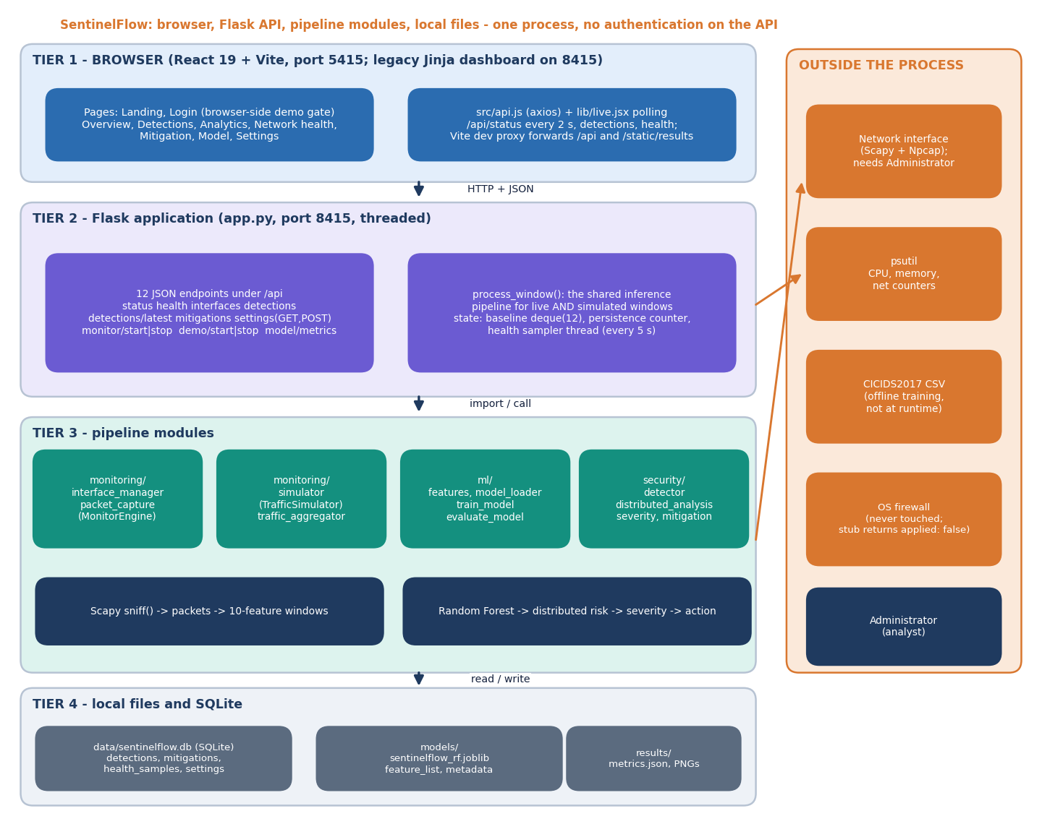
System Architecture
Console: React 19 + Vite, port 5415; nine pages plus the legacy dashboard
API: Flask, port 8415; 12 JSON endpoints, polled every 2 s
Pipeline modules: monitoring, ml, security; one shared process_window()
State: SQLite (4 tables), joblib model, JSON and PNG results
No authentication on the API; it binds to 127.0.0.1
Dept. of CSE | Batch C15 | Final Review
10
Notes:
Four tiers in one process. The React login is a browser-side demo gate; the API itself has no authentication and is localhost-only.

Slide 11
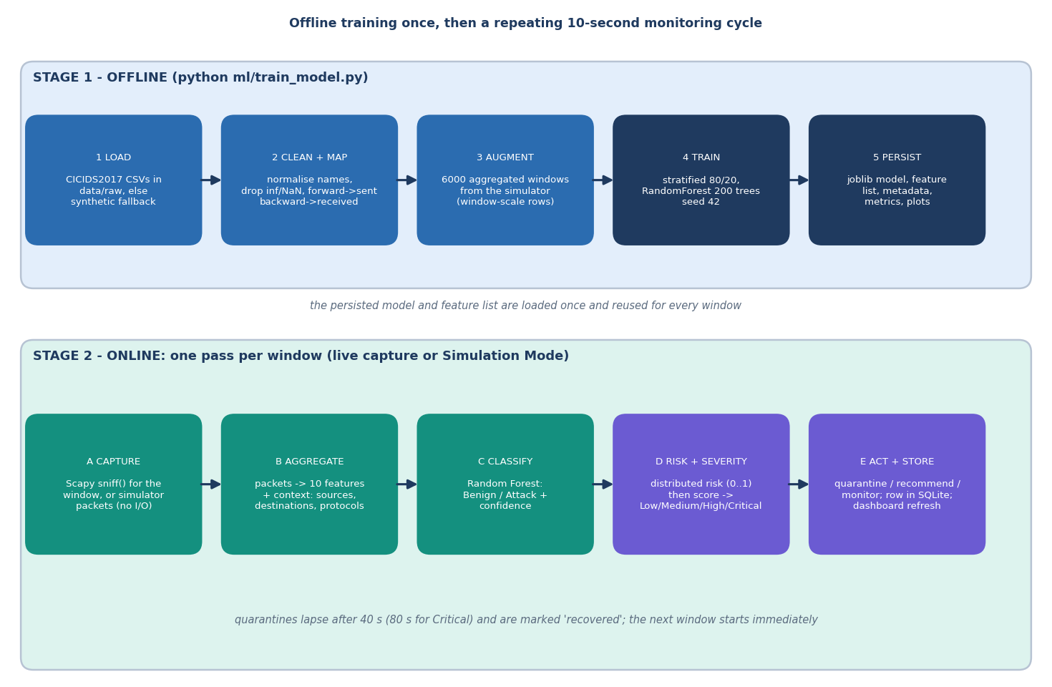
Methodology
Training: clean and map CICIDS2017 flows to ten features (forward = sent, backward = received), add 6,000 simulator windows, stratified 80/20, 200 trees, seed 42.
Online: 10-s windows (2-120 s allowed), same schema, model loaded once.
Added for the evaluation: real-flow check, five seeds, classifier comparison, window-length study, latency and API probes.
Dept. of CSE | Batch C15 | Final Review
11
Notes:
Offline training once, then a repeating online cycle. The extra measurements were added so that every claim rests on real data.

Slide 12
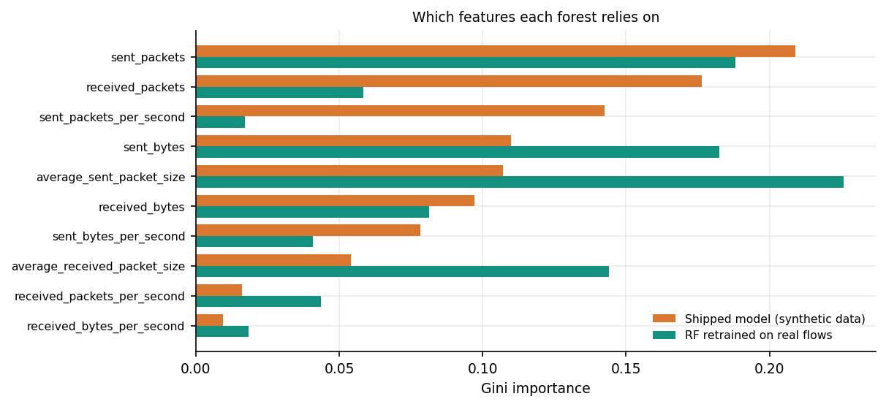
Dataset & Models
24,000
225,745
10
rows behind the shipped model: synthetic flows + 6,000 windows
real CICIDS2017 Friday DDoS-day flows (evaluation)
flow features shared by training and live windows
Data | Size | Used for
Synthetic fallback flows | 18,000 + 6,000 windows | shipped model (CICIDS2017 unreachable at build time)
CICIDS2017 Friday-DDoS [8] | 97,718 benign / 128,027 DDoS | real-data check, retraining, classifier comparison
Simulator windows | 4,000 per length | window-length and severity study
Models | RF 200 trees | shipped; plus DT, HistGB, GaussianNB, LogReg on real flows
Importance differs: the shipped forest weights sent_packets (0.21) and received_packets (0.18) most; the forest retrained on real flows relies on average sent packet size (0.23), sent packets and sent bytes. Dataset licence: 'other' (Hugging Face mirror card); the CSV is not committed.
Dept. of CSE | Batch C15 | Final Review
12
Notes:
The shipped model was trained on a labelled synthetic fallback. The real file is used only for evaluation and retraining in the documentation run.

Slide 13
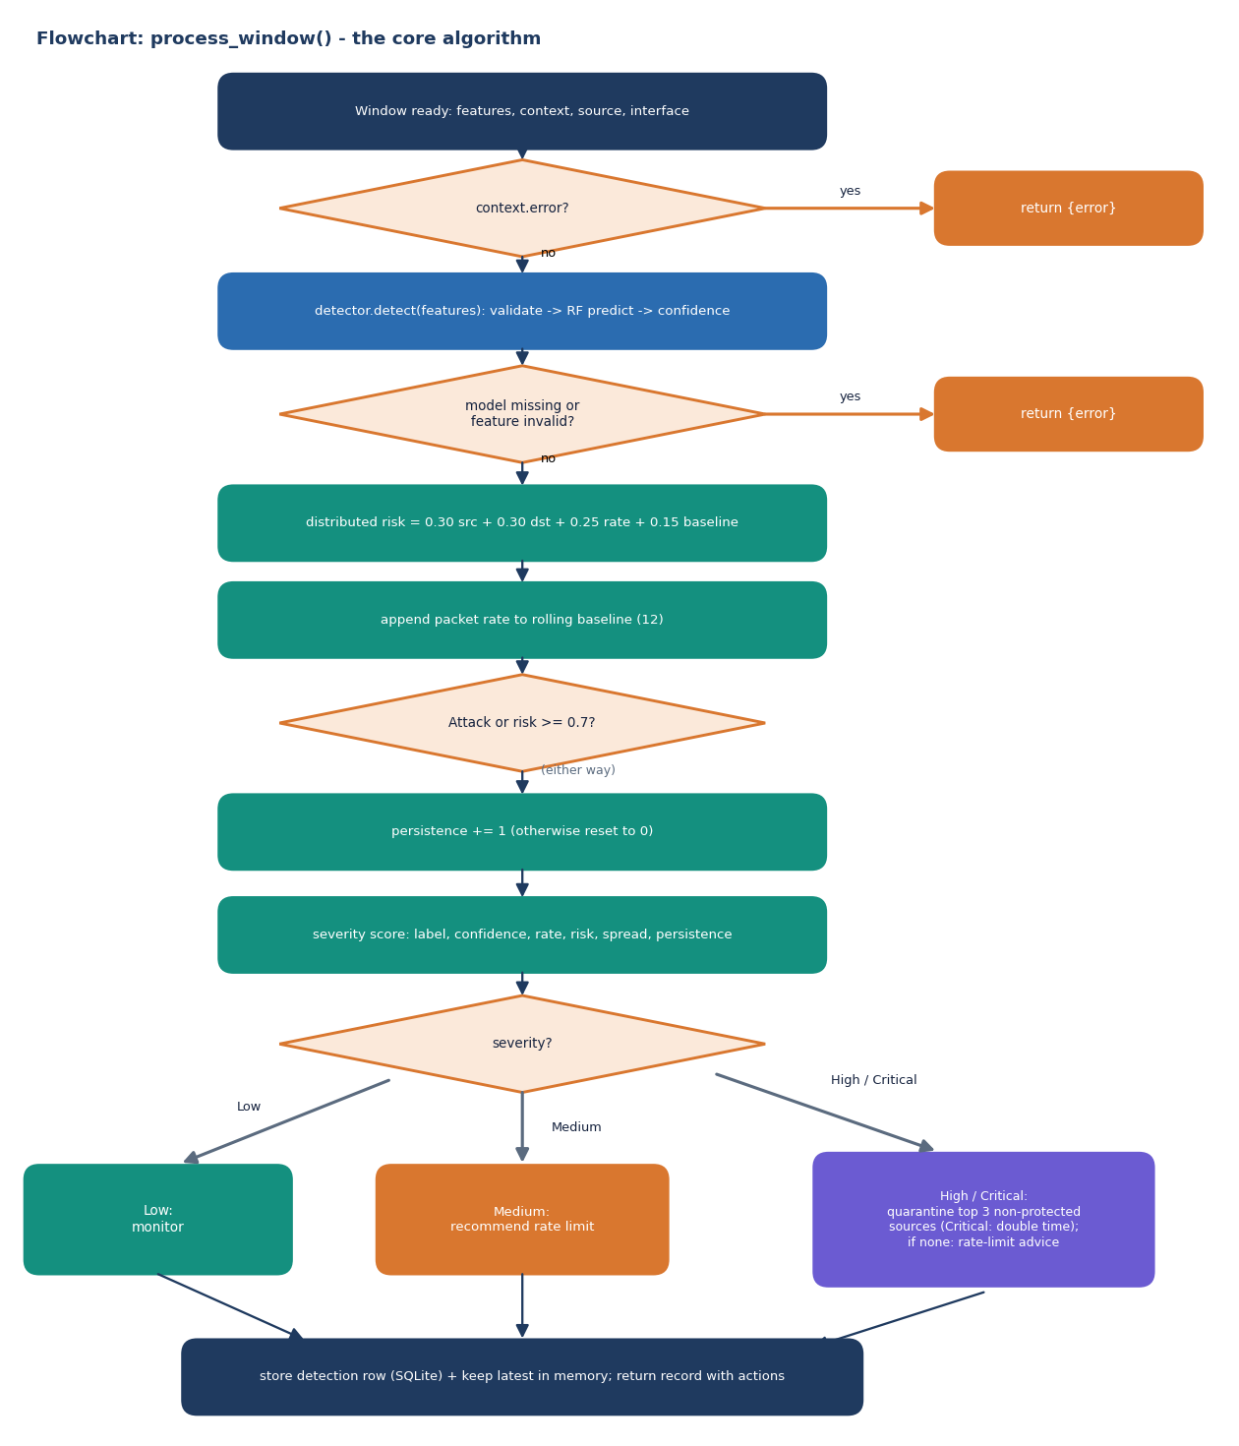
Core Algorithm and Severity Logic
Distributed risk = 0.30 x sources/30 + 0.30 x destinations/15 + 0.25 x rate/1500 + 0.15 x baseline deviation (each capped at 1); Medium from 0.4, High from 0.7.
Severity score: +30 for an Attack label, +15 / +8 for confidence of 90% / 75%, rate steps at 400 / 1,200 / 3,000 packets/s, +10 / +20 for risk of 0.4 / 0.7, +8 for wide spread, +5 / +10 for 2 / 3 persistent windows.
Thresholds: Medium 28, High 50, Critical 70; a Benign window is capped at 45.
High and Critical quarantine the three busiest non-protected sources for 40 s (80 s for Critical); expiry marks the row 'recovered'.
Errors (capture failure, missing model, invalid features) return an error record and store nothing.
Dept. of CSE | Batch C15 | Final Review
13
Notes:
The one function every window passes through. Weights and thresholds are rule-based and visible on the Threat Detail screen.

Slide 14
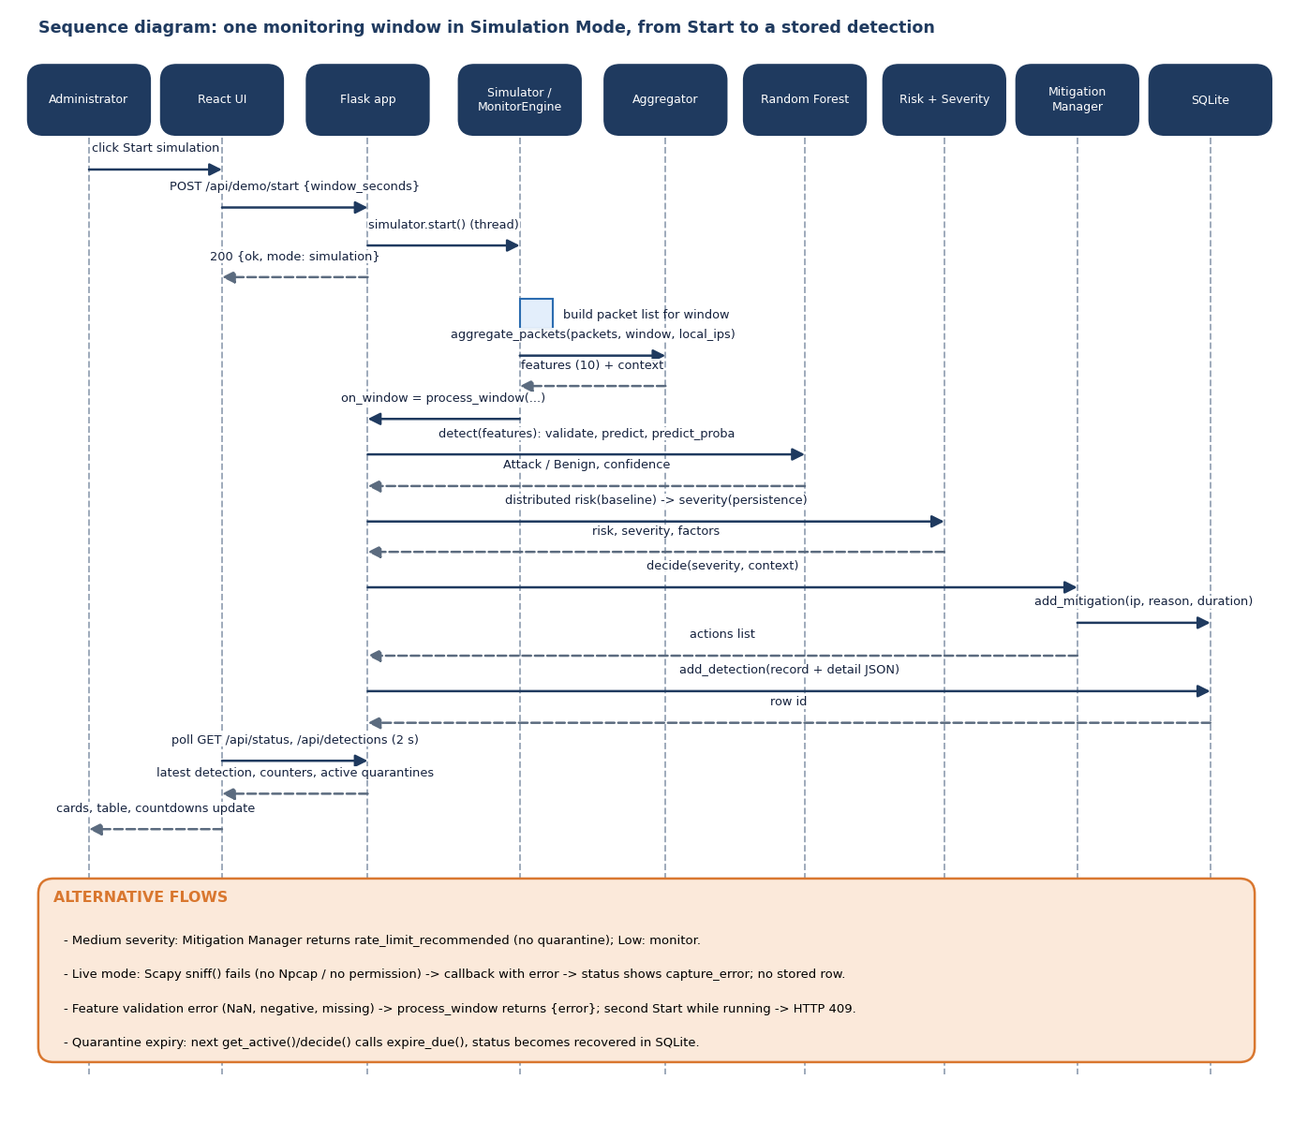
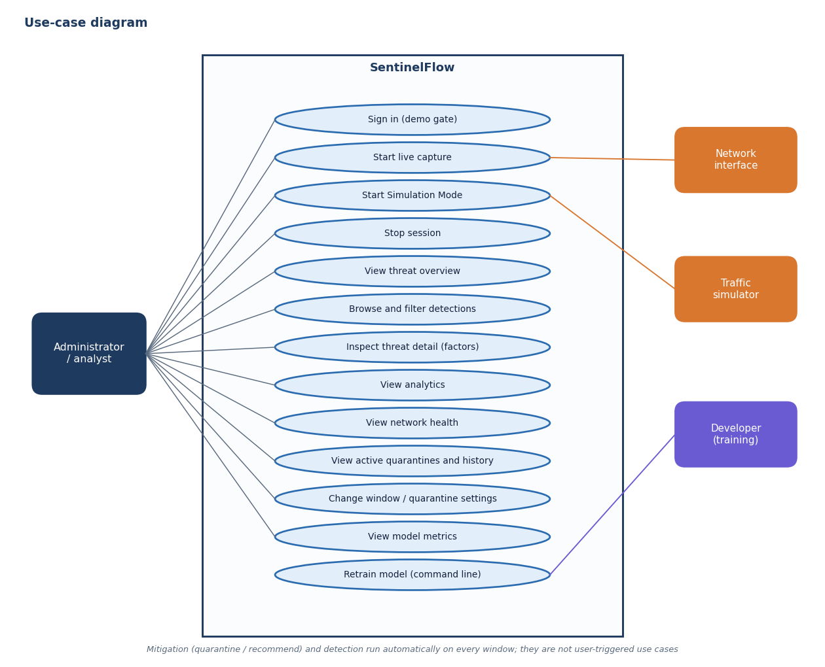
User – System Interaction
Dept. of CSE | Batch C15 | Final Review
14
Notes:
Sequence of one window in Simulation Mode and the use cases of the administrator.

Slide 15
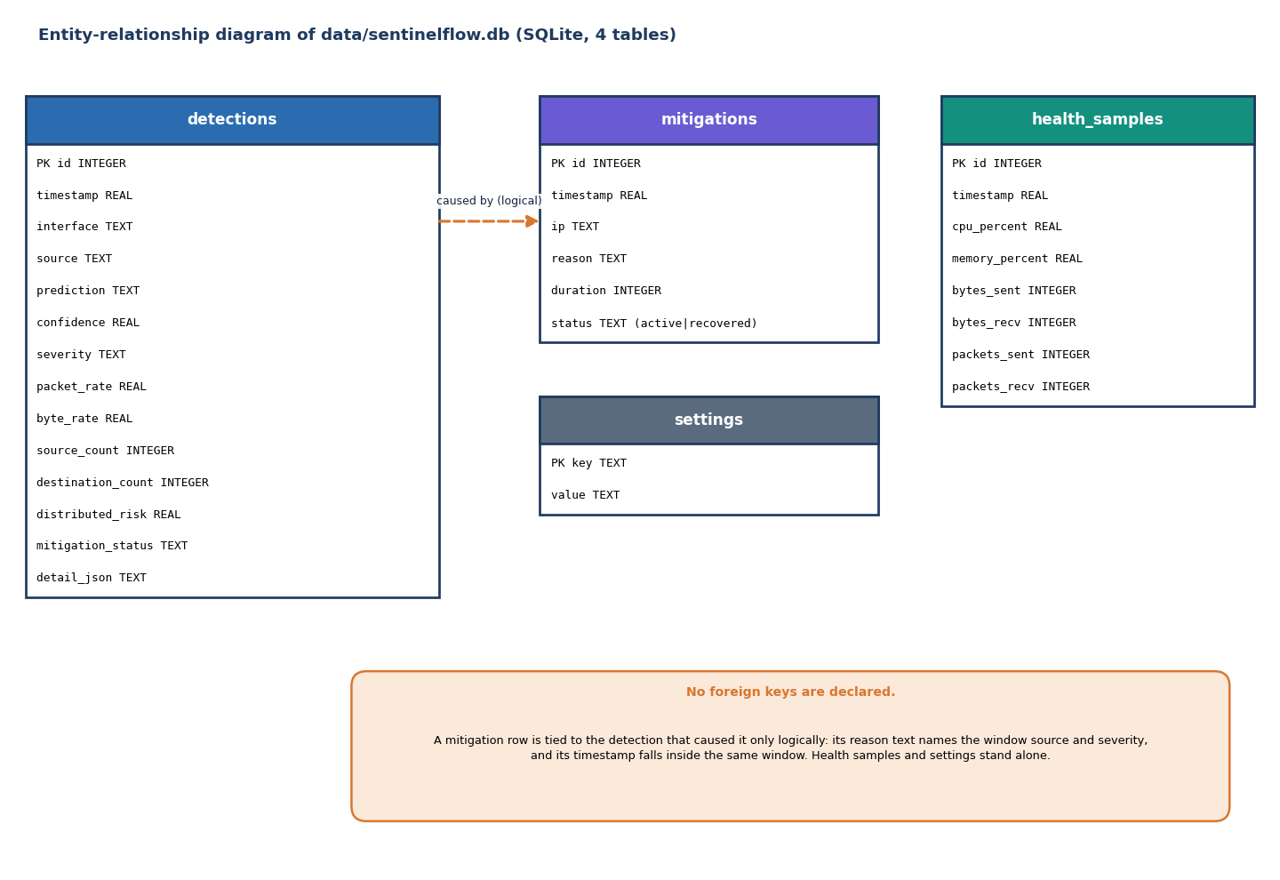
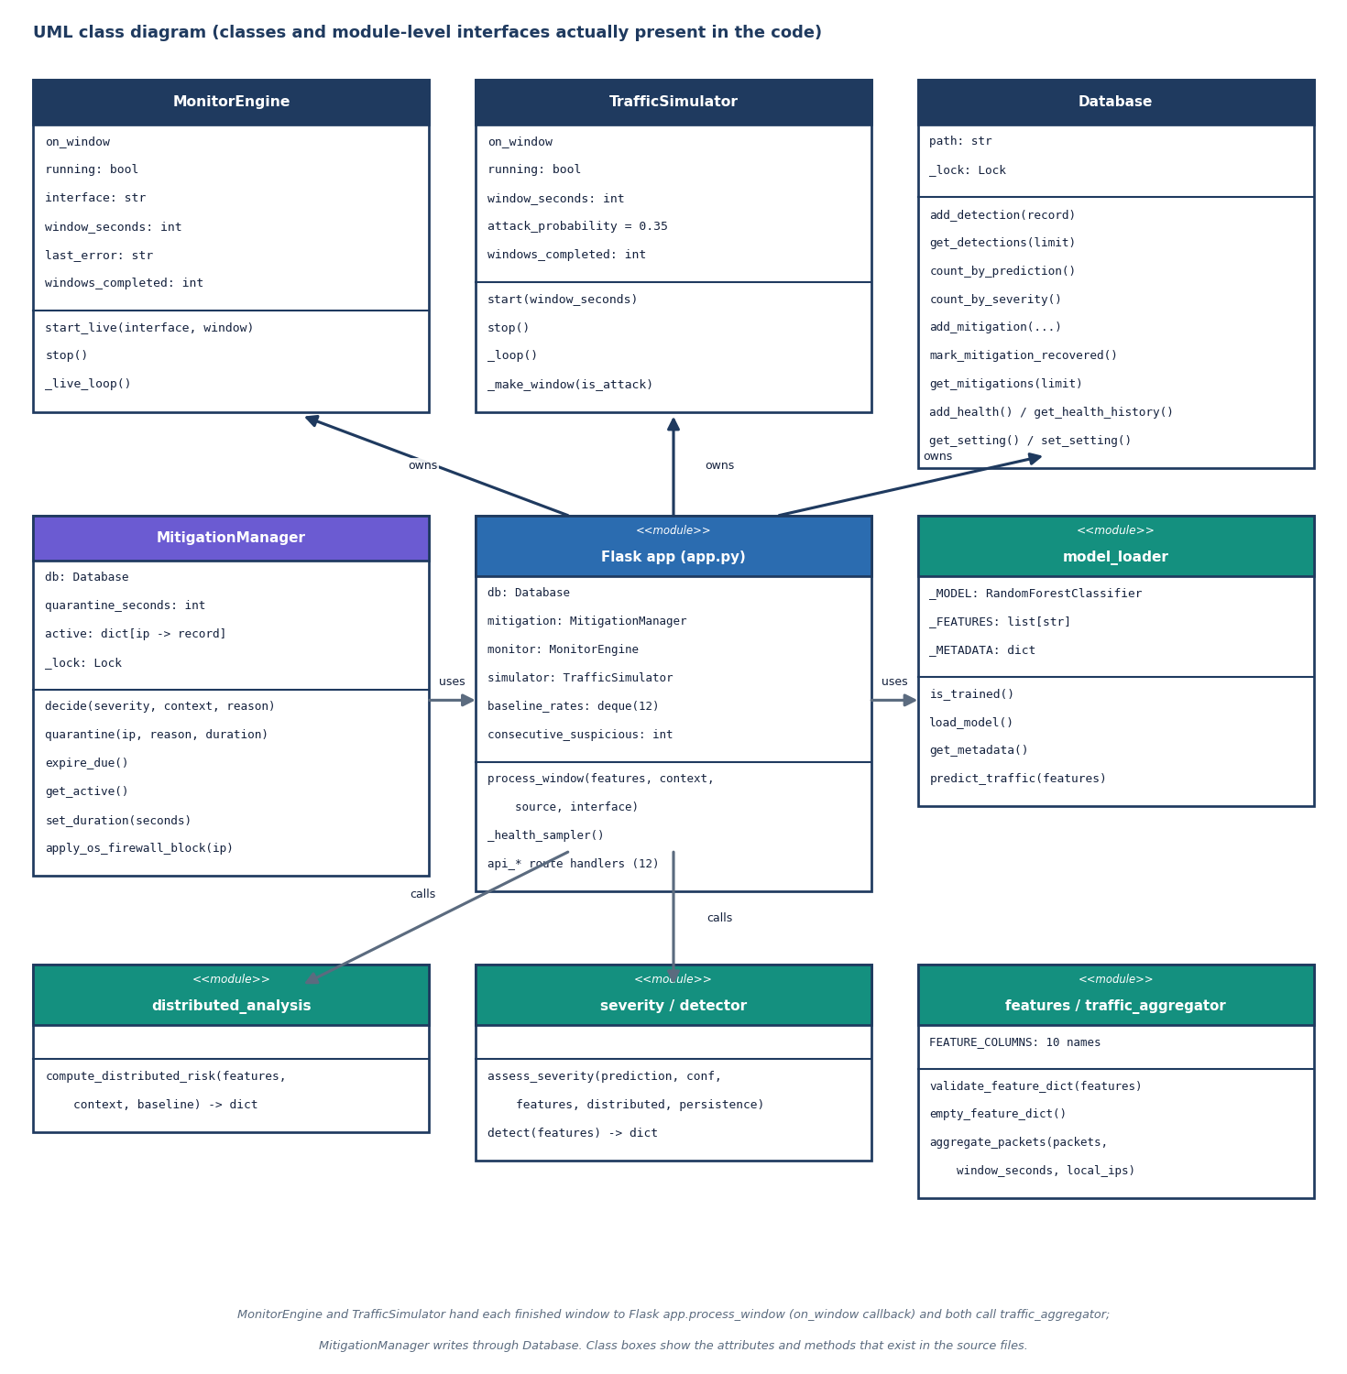
Data and Class Design
SQLite holds four tables (detections, mitigations, health_samples, settings) with no foreign keys; the settings table exists but the API keeps settings in memory. Four real classes plus function modules drawn as <<module>>.
Dept. of CSE | Batch C15 | Final Review
15
Notes:
ER diagram of the database and the class diagram of the code.

Slide 16
Implementation Highlights
12
95 + 25
8
3.3 ms
JSON endpoints
pytest tests + smoke checks
React screens
median /api/status over HTTP
One process_window() serves live capture and Simulation Mode, so the demo exercises the real model, severity and mitigation code.
Settings are validated (window 2-120 s, quarantine 5-3600 s); a second Start returns 409; capture failures surface the real reason (Npcap missing).
Threat Detail lists every severity factor and the distributed-risk components for any stored window.
run.bat prepares the environment, starts the API (8415) and the console (5415); Docker files exist but were not run here.
Not present: OS-level blocking, API authentication, tested live capture, multi-class detection.
Dept. of CSE | Batch C15 | Final Review
16
Notes:
Highlights and honest absences.

Slide 17
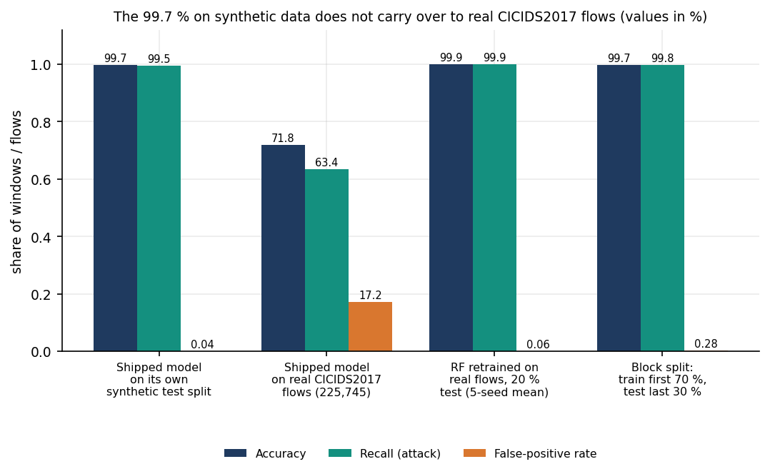
Results – Synthetic Split versus Real Flows
99.71%
71.8%
99.94%
99.74%
shipped model, own synthetic test (4,800 rows)
shipped model on 225,745 real flows
retrained RF on real flows, 5-seed mean
retrained, chronological block split
On real flows the shipped model keeps only 63.4% recall and raises 17.2% false positives; ROC-AUC is 86.1%, so the 0.5 threshold, not the ranking, is the main problem.
Retraining with the product's own features and settings gives 99.94% (±0.01), FPR 0.06%.
Caveats: one attack type, random flow splits overlap in time, and CICIDS2017 labels have known flaws [9].
A flow-trained forest applied to simulator windows calls every window benign (recall 0.0%, ROC-AUC 100%): flow-scale and window-scale features differ, which is why the product adds window rows to training.
Dept. of CSE | Batch C15 | Final Review
17
Notes:
The central honest finding. 99.71 percent on the synthetic split does not carry over; the same forest retrained on real flows reaches 99.94 percent.

Slide 18
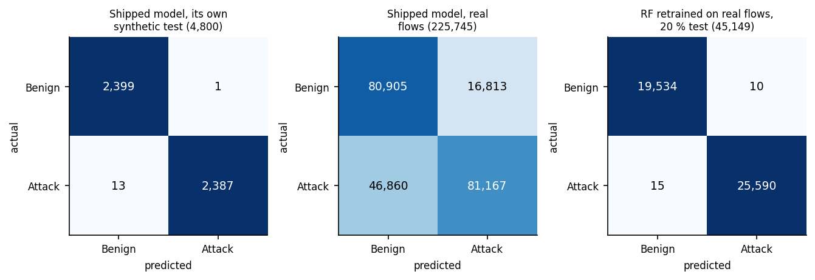
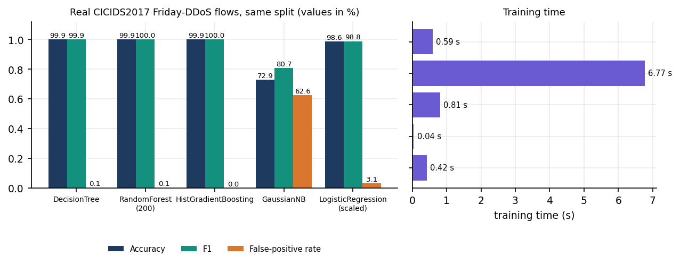
Confusion Matrices & Classifier Comparison
Same real split: decision tree 99.94%, RF 99.94%, HistGradientBoosting 99.95%; logistic regression 98.59%; Gaussian NB 72.9%.
Counts and bytes alone give 99.91%: the DDoS day separates on size and count.
Random Forest is kept for the product: tree models tie, the RF gives a calibrated confidence for severity.
Experiment | Acc. | Prec. | Recall | F1 | FPR
Shipped, own split | 99.71% | 99.96% | 99.46% | 99.71% | 0.04%
Shipped, real flows | 71.79% | 82.84% | 63.40% | 71.83% | 17.21%
Retrained RF, seed 42 | 99.94% | 99.96% | 99.94% | 99.95% | 0.05%
Block split | 99.74% | 99.57% | 99.77% | 99.67% | 0.28%
False-positive rate = FP / (FP + TN). Shipped on its own split: 1 false positive and 13 false negatives in 4,800 windows.
Dept. of CSE | Batch C15 | Final Review
18
Notes:
Confusion matrices for the three situations, the precision/recall/F1 table, and a comparison with other classifiers on the same real split (the base paper compared classifiers too).

Slide 19
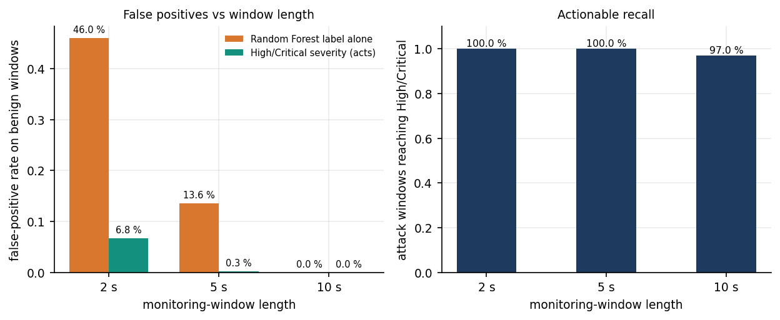
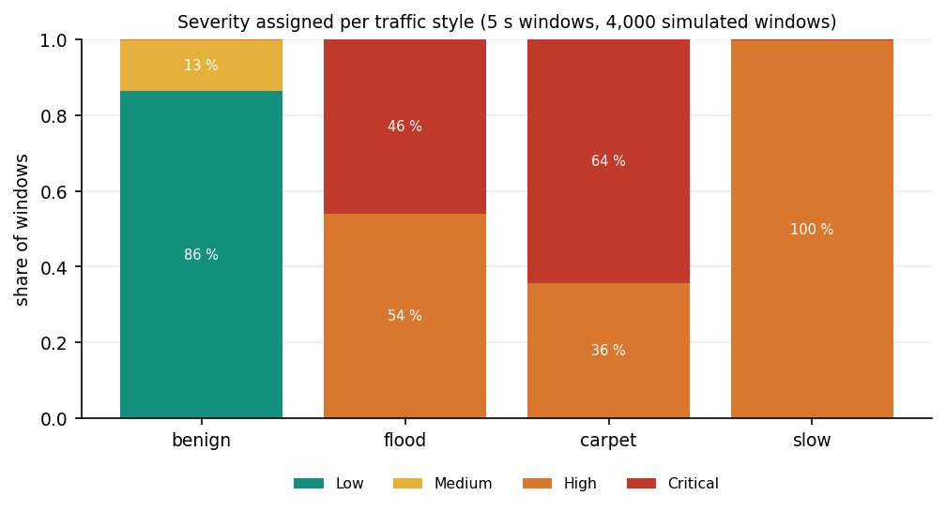
Parameter Analysis – Window Length and Severity Thresholds
Window | RF label: FPR | High/Critical: FPR | High/Critical: recall | Risk >= 0.7 alone: recall
2 s | 46.0% | 6.77% | 100.0% | 31.9%
5 s | 13.6% | 0.27% | 100.0% | 19.2%
10 s | 0.0% | 0.00% | 97.0% | 9.0%
4,000 simulator windows per length (35% attack); model calibrated on 10 s windows.
The severity layer removes most false alarms; at 10 s, 44 weaker attack windows stay at Medium.
10 s RF accuracy is 100% only because training rows came from the same generator.
The risk score alone is precise but misses most attacks.
Left chart: false positives on benign windows and attack windows reaching High/Critical. Right chart: severity per traffic style at 5 s.
Dept. of CSE | Batch C15 | Final Review
19
Notes:
Window length is the key parameter: at 2 s and 5 s the forest alone raises many false alarms; the severity thresholds absorb most of them. The distributed-risk score alone is a weak detector.

Slide 20
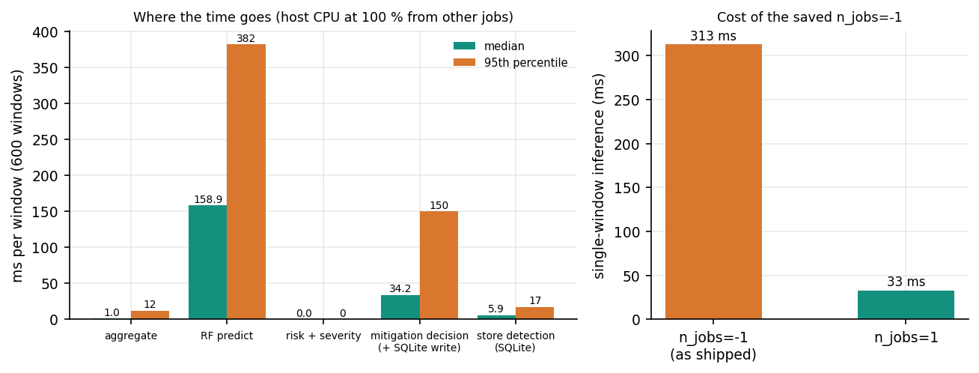
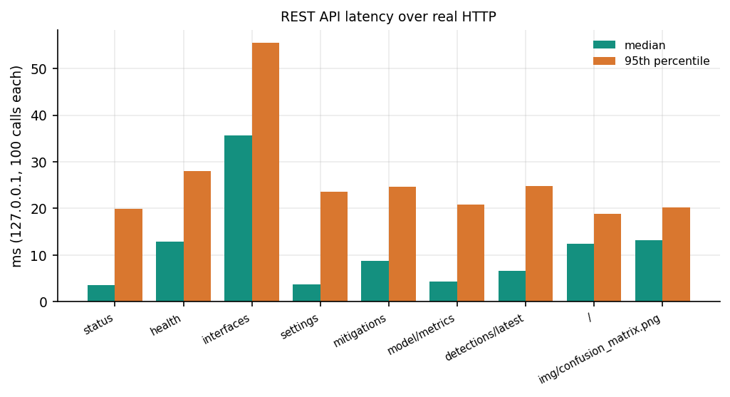
Performance & Testing
217 ms
313 vs 33 ms
3.3 ms
25/25
features to mitigation decision, median (p95 489)
one-window inference, n_jobs=-1 (as saved) vs 1
/api/status median, 100 calls
malformed-input probes handled
Check | Result
pytest (units + API, scratch SQLite) | 95 of 95 passed; smoke test 25 of 25 backend checks on the running server
Not tested | live capture end to end (no Npcap), load, concurrent users, Docker build, real attack timeline
Measured on an i5-12500 with the CPU at 100% from other jobs, so absolute times are upper bounds. The real delay is the window length (10 s default).
Dept. of CSE | Batch C15 | Final Review
20
Notes:
Decision latency is dominated by forest inference with the saved n_jobs=-1. Detection to mitigation here means from the finished feature vector to the decision; a window must close first.

Slide 21
Comparison with Base Paper
Aspect | Base paper [1] | SentinelFlow (this project)
Data | SDN flows (104,345 rows) and CIC-DDoS2023 subset (1.75 M rows) | CICIDS2017 DDoS day (225,745 flows) and a synthetic fallback
Features | 23 and 47 columns, RF + Banzhaf selection | 10 fixed flow features shared with live windows
Models | Seven classifiers, four voting ensembles | One 200-tree RF; DT, HistGB, NB, LogReg compared (RF 99.94%)
Result | 100% on both datasets | 99.94% retrained on real flows; 71.8% for the shipped synthetic model
Resources | SVM ensembles over 4,000 s training; kNN over 150 s inference | RF trains in 6.9 s; model 1.24 MB
Mitigation | Future work (throttling or blackholing outlined) | Implemented: application-level quarantine with recovery
Datasets and protocols differ: indicative only.
Our result is lower than 100%.
No superiority is claimed.
Not taken from the base paper: Banzhaf feature selection and voting ensembles. Added against it: severity, mitigation, recovery, a simulator and an evaluation that separates synthetic from real data.
Dept. of CSE | Batch C15 | Final Review
21
Notes:
State plainly that datasets and protocols differ. Their 100 percent is on SDN and CIC-DDoS2023; ours is CICIDS2017 DDoS-day flows.

Slide 22
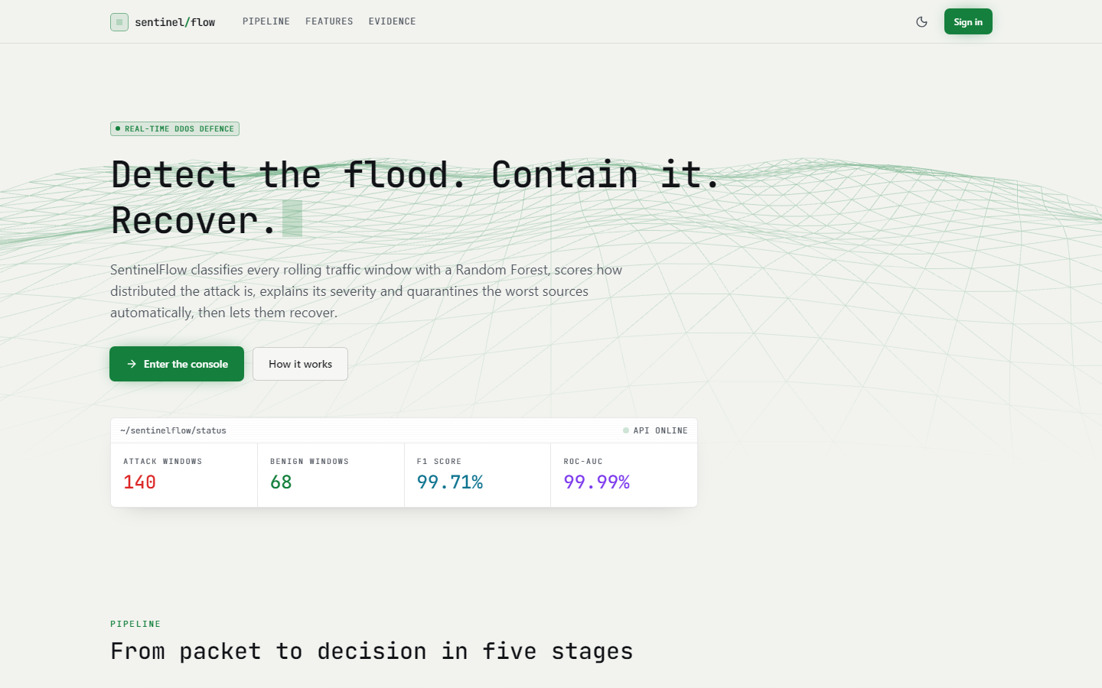
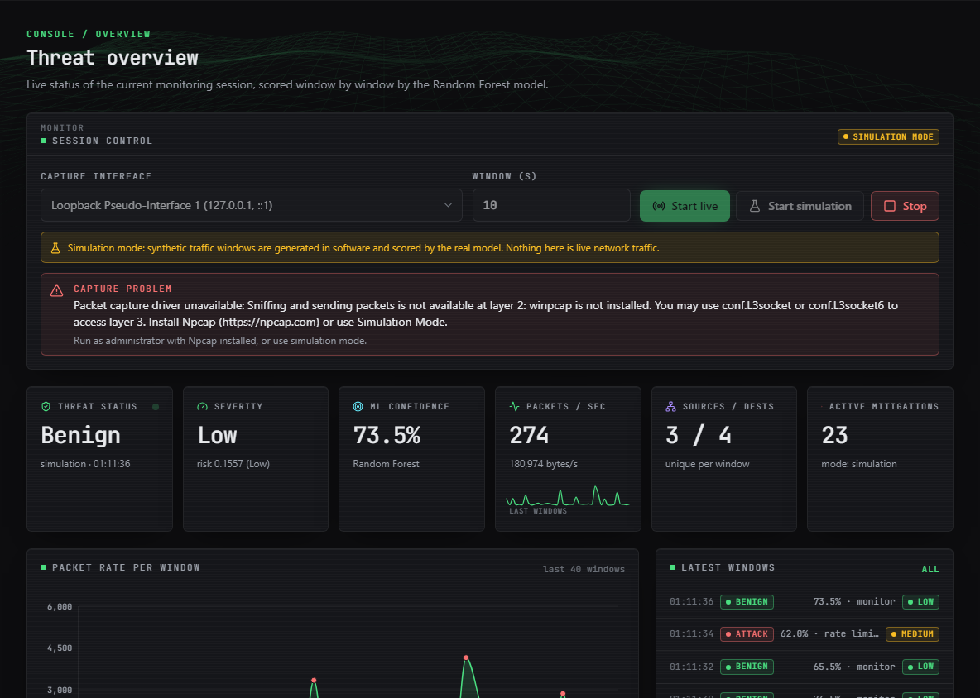
Output – Landing Page and Threat Overview
Left: landing page with live counters from the API (attack/benign windows, F1 and ROC-AUC of the shipped model). Right: threat overview (Simulation Mode data scored by the real model); the red banner is the real 'capture problem' message because Npcap is not installed.
Dept. of CSE | Batch C15 | Final Review
22
Notes:
Real captures of the running console. The overview banner is the genuine capture error; live capture could not be run on this machine.

Slide 23
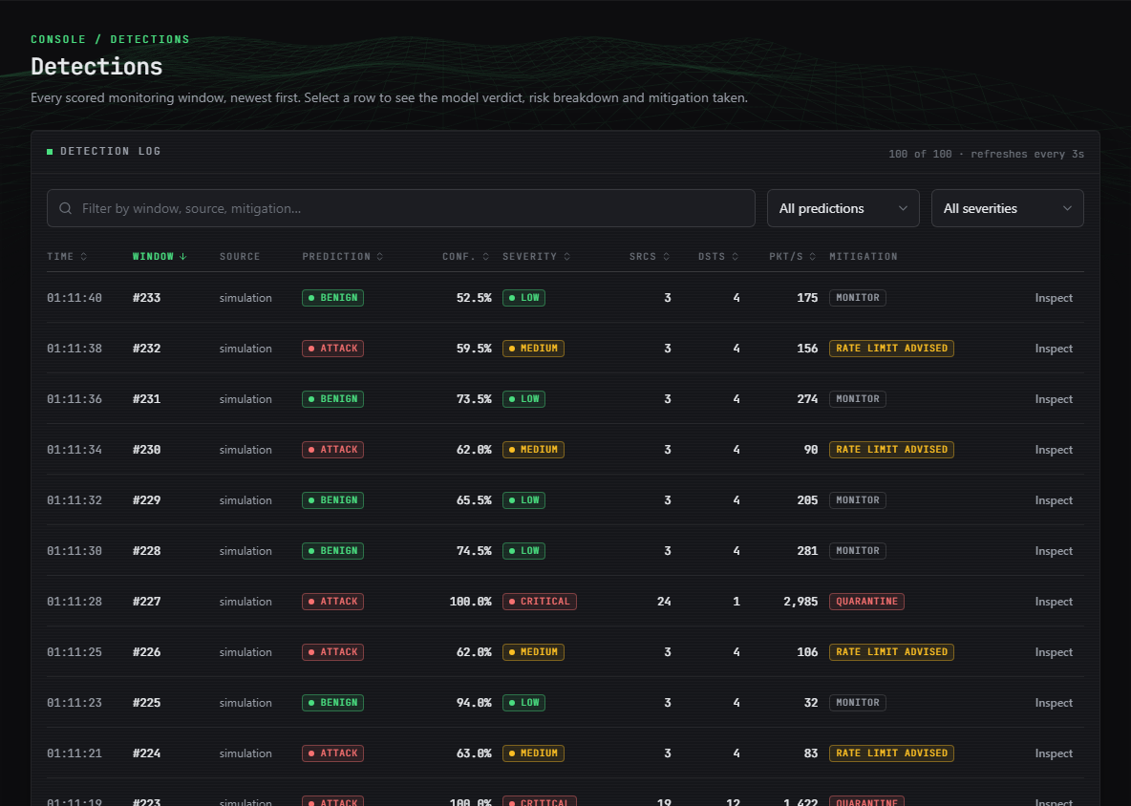
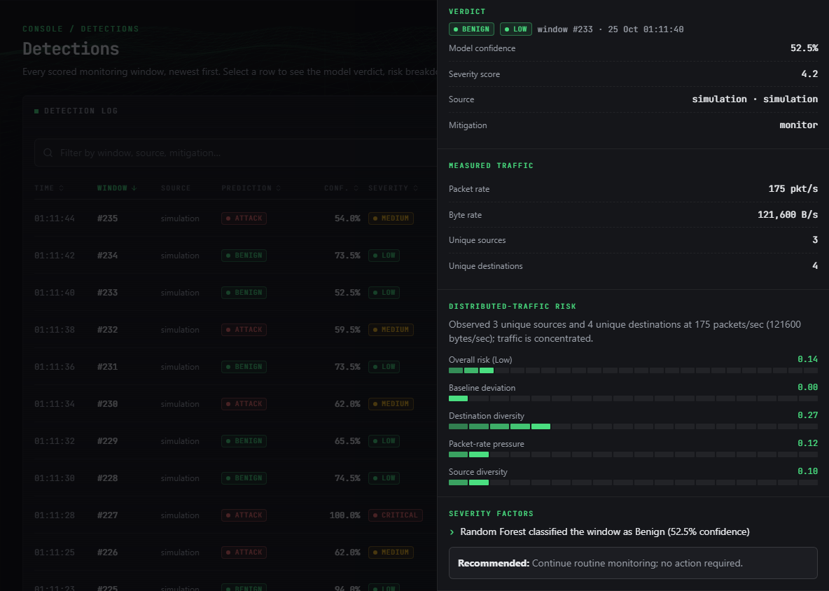
Output – Detections and Threat Detail
Left: every scored window with prediction, confidence and severity (Simulation Mode data scored by the real model). Right: Threat Detail of one window with measured traffic, distributed-risk components and the severity factors behind the verdict.
Dept. of CSE | Batch C15 | Final Review
23
Notes:
The detection log and the explanation drawer. Each verdict lists its factors.

Slide 24
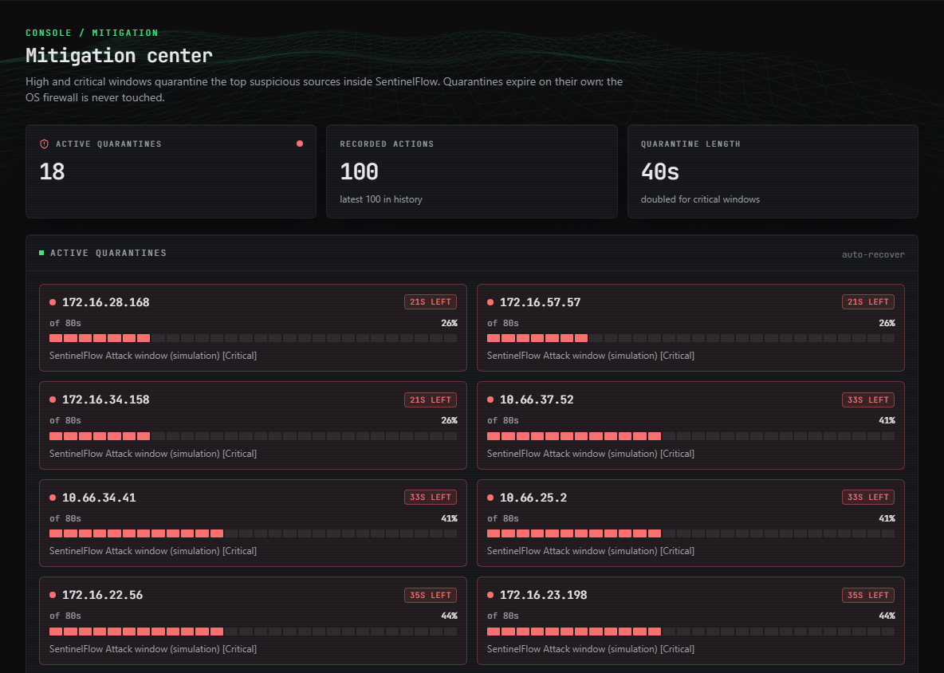
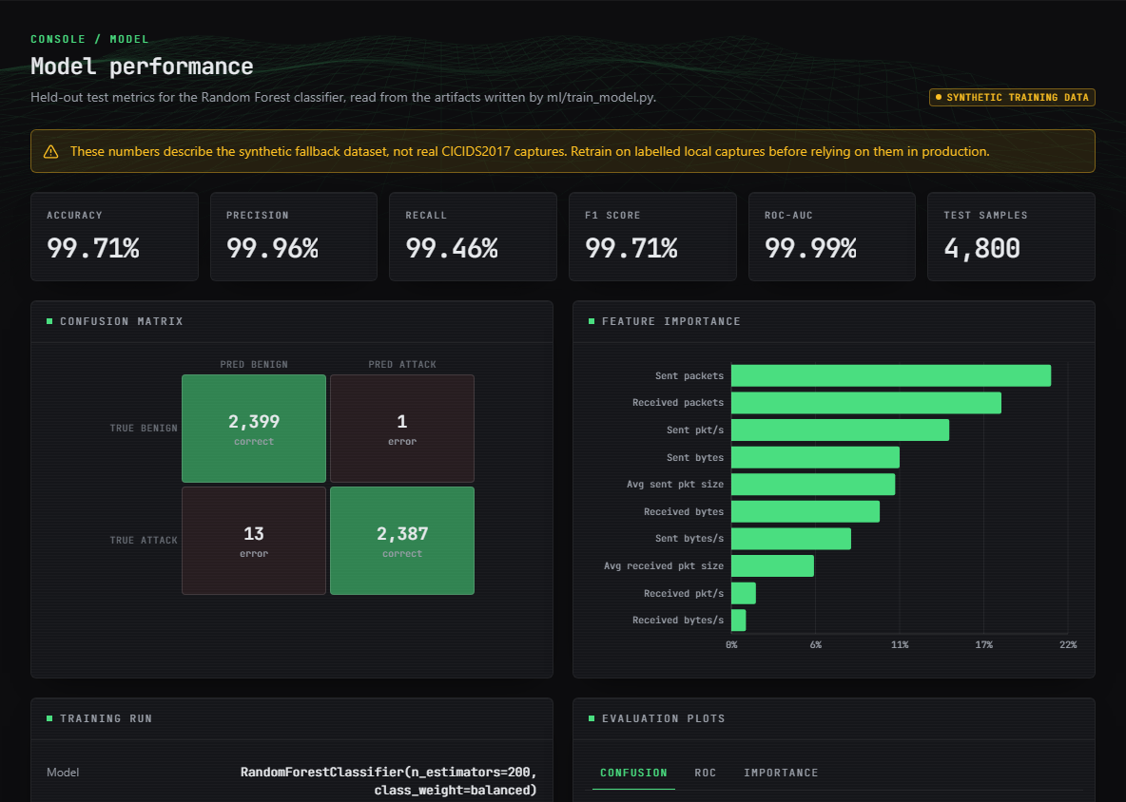
Output – Mitigation Center and Model Performance
Left: active quarantines with countdowns and automatic recovery (Simulation Mode data scored by the real model); application-level only. Right: Model page with the shipped metrics and the 'synthetic training data' warning.
Dept. of CSE | Batch C15 | Final Review
24
Notes:
Quarantines count down and expire. The model page warns that the displayed metrics describe synthetic data.

Slide 25
Conclusion & Objectives vs Outcomes
A working, tested detection and mitigation system (95 tests, 25 smoke checks); retrained on real flows the forest reaches 99.94%, but the shipped synthetic-trained model scores 71.8% on them.
The severity layer cuts false alarms (5 s windows: 13.6% to 0.27%); mitigation is an application-level quarantine; live capture is untested.
# | Objective | Outcome
1 | Acquire dataset, extract flow features | Partly: pipeline reads CICIDS2017; shipped model synthetic; real file evaluated here
2 | Capture live traffic, same features | Implemented (Scapy); not verified live; verified via simulator and unit tests
3 | Train DDoS classifier | Achieved: 99.94% on real flows after retraining; shipped model 71.8%
4 | Adaptive mitigation (rate limit / block) | Partly: quarantine with auto recovery inside the app; rate limiting only advised
5 | Dashboard of traffic, detections, mitigation | Achieved: nine-page React console plus legacy dashboard
6 | Evaluate accuracy, FPR, detection-to-mitigation time | Achieved offline (FPR 0.06% real; 0.27% pipeline at 5 s); decision 217 ms, no real attack timeline
Dept. of CSE | Batch C15 | Final Review
25
Notes:
Be explicit about which objectives were met, partly met or not met.

Slide 26
Limitations & Future Scope
Known limitations
Future scope
Shipped model trained on synthetic data; landing page shows 99.71% without that caveat
One real attack type (DDoS day); CICIDS2017 label flaws; random splits overlap in time
Calibrated on 10 s windows; short windows raise false alarms before severity
Quarantine never changes the OS firewall; no packet is dropped
Live capture untested (no Npcap); saved n_jobs=-1 slows inference
API has no authentication; interface setting not length-checked
No real attack timeline, SDN deployment or multi-class detection
Retrain on real labelled captures and ship the real-data model
Train on several window lengths; set n_jobs=1 for single-window inference
Optional OS-firewall or SDN rule installation behind an explicit opt-in
Test live capture with Npcap and a controlled traffic generator; measure real recovery time
Multi-class attacks, online learning and a sidecar next to an SDN controller
Authentication, input-length checks and use of the settings table
Retest on newer datasets such as CIC-DDoS2023
Dept. of CSE | Batch C15 | Final Review
26
Notes:
Limitations first, then concrete next steps.

Slide 27
References
[1] M. M. Trigui, M. S. Islam, M. D. Gambo, M. S. Alam and T. Helmy, "Resource-aware ensemble framework for DDoS detection in SDN via novel game-theoretic feature selection," IEEE Access, vol. 14, pp. 1666-1676, 2026, doi: 10.1109/ACCESS.2025.3618519.
[3] N. Raghavendran and Y. H. Robinson, "IoT-based WISNE-SDN detection and DDoS attack mitigation using machine learning techniques," PeerJ Comput. Sci., vol. 12, Art. no. e3572, Feb. 2026, doi: 10.7717/peerj-cs.3572.
[6] M. N. Swileh, S. Zhang and K. Lei, "Intelligent detection and mitigation of carpet-bombing DDoS attacks in SDN using retrieval-augmented generation and large language models," arXiv:2605.26307, May 2026.
[7] M. A. Rahman, "Detection of distributed denial of service attacks based on machine learning algorithms," arXiv:2502.00975, Feb. 2025.
[8] I. Sharafaldin, A. Habibi Lashkari and A. A. Ghorbani, "Toward generating a new intrusion detection dataset and intrusion traffic characterization," in Proc. 4th Int. Conf. Inf. Syst. Secur. Privacy (ICISSP), Funchal, Portugal, Jan. 2018, pp. 108-116, doi: 10.5220/0006639801080116.
[9] G. Engelen, V. Rimmer and W. Joosen, "Troubleshooting an intrusion detection dataset: The CICIDS2017 case study," in Proc. 2021 IEEE Secur. Privacy Workshops (SPW), May 2021, pp. 7-12, doi: 10.1109/SPW53761.2021.00009.
[10] R. Sommer and V. Paxson, "Outside the closed world: On using machine learning for network intrusion detection," in Proc. 2010 IEEE Symp. Secur. Privacy, 2010, pp. 305-316, doi: 10.1109/SP.2010.25.
[11] J. Mirkovic and P. Reiher, "A taxonomy of DDoS attack and DDoS defense mechanisms," ACM SIGCOMM Comput. Commun. Rev., vol. 34, no. 2, pp. 39-53, Apr. 2004, doi: 10.1145/997150.997156.
[12] L. Breiman, "Random forests," Mach. Learn., vol. 45, no. 1, pp. 5-32, Oct. 2001, doi: 10.1023/A:1010933404324.
[13] F. Pedregosa et al., "Scikit-learn: Machine learning in Python," J. Mach. Learn. Res., vol. 12, pp. 2825-2830, 2011.
[15] A. Zaman, S. A. Khan, N. Mohammad, A. A. Ateya, S. Ahmad and M. A. ElAffendi, "Distributed denial of service attack detection in software-defined networks using decision tree algorithms," Future Internet, vol. 17, no. 4, p. 136, Mar. 2025, doi: 10.3390/fi17040136.
[16] M. Alduailij, Q. W. Khan, M. Tahir, M. Sardaraz, M. Alduailij and F. Malik, "Machine-learning-based DDoS attack detection using mutual information and random forest feature importance method," Symmetry, vol. 14, no. 6, p. 1095, May 2022, doi: 10.3390/sym14061095.
[18] F. L. Becerra-Suarez, I. Fernandez-Roman and M. G. Forero, "Improvement of distributed denial of service attack detection through machine learning and data processing," Mathematics, vol. 12, no. 9, p. 1294, Apr. 2024, doi: 10.3390/math12091294.
[25] P. Biondi et al., "Scapy: Interactive packet manipulation program," software documentation. [Online]. Available: https://scapy.net
The full numbered list of 29 references is in the report.
Dept. of CSE | Batch C15 | Final Review
27
Notes:
Selected references; the complete numbered list is in the report.

Slide 28
THANK YOU
Questions & Suggestions
Dept. of CSE | Batch C15 | Final Review
28
Notes:
Invite questions.

