Slide 1
PolicyLens
REVIEW 2 · DESIGN, METHODOLOGY AND PROGRESS
AI Health Insurance Assistance Using LLM + RAG
Presented by
Under the guidance of
G.PRANATHI 23K91A6764
CH.AISHWARYA 23K91A6747
BHAVANSH MANE 23K91A6728
B.DEEKSHITH 24K95A6701
[GUIDE NAME], [DESIGNATION]
Department of Computer Science and Engineering (Data Science)
[COLLEGE NAME] · Batch A1 (CSE-DS, Section A) · [ACADEMIC YEAR]
Notes:
Review 2 covers design, methodology and progress of PolicyLens.

Slide 2
Contents
01
02
03
04
Recap
Architecture
Methodology
Dataset
05
06
07
08
Dataset and preparation
Model and configuration
Decision logic
Data flow, modules, database
09
10
11
12
Technology stack
Progress
Preliminary results and screens
Testing, challenges, next steps
Notes:
Twelve parts, from a recap of Review 1 through the design and the pipeline to progress, results, testing and next steps.

Slide 3


Recap: problem and proposed system
Problem
Proposed system
Policies are long and technical; agents are slow; general chatbots are not grounded in the user's own policy; claim filing has no guided pre-check.
A RAG pipeline: clause-aware parsing, hybrid retrieval, Gemini answers from the retrieved clauses only, an independent faithfulness score, and calculated claim rules.
Upload policy PDF
Parse + segment + index
Policy Card + risks
Retrieve + cited answer
Claim plan, compare
Notes:
Recap of Review 1: the problem and the proposed system as a five-step pipeline.

Slide 4
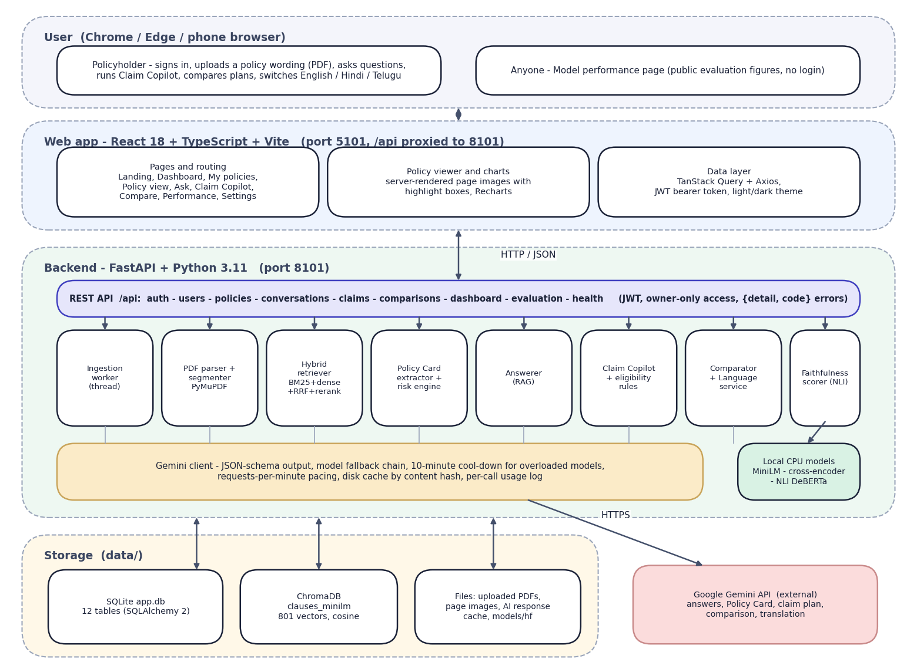

System architecture
Client: React 18 + TypeScript + Vite (port 5101), TanStack Query, Recharts.
Application: FastAPI (port 8101): JWT sign-in, owner-only access, 42 route handlers.
Retrieval: BM25 + MiniLM/ChromaDB, rank fusion, cross-encoder re-rank.
AI: Gemini (JSON schema, fallback chain) and a local NLI faithfulness scorer.
Data: SQLite with 12 tables, vector index, PDFs and page images.
Notes:
The browser talks only to the Vite server, which proxies /api to FastAPI. Retrieval, faithfulness and the rules run locally; only language generation uses the Gemini API.

Slide 5
Methodology: end-to-end workflow
Upload + validate
Parse + segment
Index (BM25, vectors)
Policy Card + risks
Retrieve + re-rank
Generate + cite
Score + guide
Clauses, not chunks
Grounded generation
Independent checks
Numbered clauses with pages and highlight boxes make every citation checkable on the original page.
Gemini sees only the retrieved, tagged clauses; tags it was not given are removed.
An NLI model scores support; rules calculate waiting periods, co-pay and the estimate.
Notes:
End-to-end workflow in seven steps. The central idea: the language model only sees retrieved clauses and everything it returns is checked.

Slide 6
Dataset and input sources
Dataset | Size | Use
Sample policy wordings (public, insurers' sites) | 4 policies, 166 pages, 73,001 words | Product samples, evaluation source
Questions (hand-written) | 57: 51 answerable, 6 out-of-scope | Retrieval and answer evaluation
Hindi / Telugu questions | 5 | Multilingual check
Claim scenarios | 14 (5 covered, 1 partly, 7 not, 1 needs info) | Claim Copilot
Policy Card checks | 52 hand-checked values | Extraction accuracy
Training data | None: nothing is trained; whole set is test data | -
Notes:
The wordings are public documents that insurers publish; they are stored unmodified. The evaluation set was written by hand from them. There is no train/test split because no model is trained.

Slide 7



Data preparation: parse, segment, index
Parsing
Segmentation
Indexing
PyMuPDF lines with page, position and font; running headers and footers removed; two-column reading order restored; letter-spaced headings joined; tables read by row; scans rejected.
Clause starts at 4.2.1, Def. 5, Excl03 and headings; exclusion-coded list items become clauses; heading path; 12-380 word chunks with highlight boxes. 801 clauses from four policies.
BM25 Okapi (k1 1.4, b 0.7) with an insurance synonym list, and 384-d MiniLM embeddings in ChromaDB (cosine). One Gemini call then builds the Policy Card.
Notes:
Preprocessing here is turning a printed PDF into clean, numbered, indexed clauses.

Slide 8
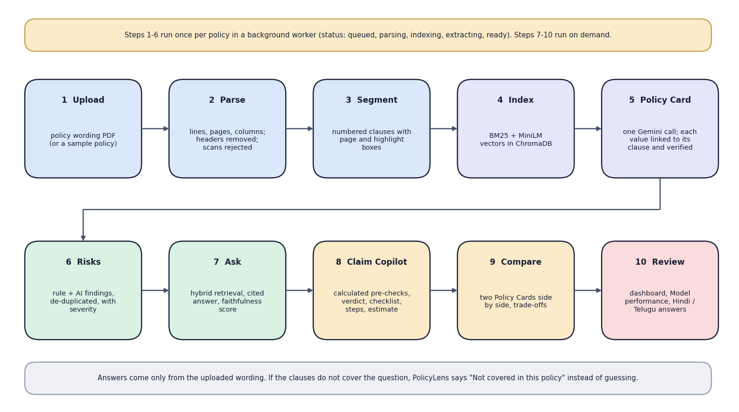

Pipeline architecture (no model is trained)
Component | Detail
Dense retrieval | all-MiniLM-L6-v2, 384-d
Re-ranker | ms-marco-MiniLM-L6-v2
Faithfulness | nli-deberta-v3-xsmall
Generator | Gemini, JSON schema
All pre-trained; three small models run on the CPU, only generation uses the Gemini API.
Notes:
Every model is pre-trained and used as is. The pipeline is the design contribution.

Slide 9
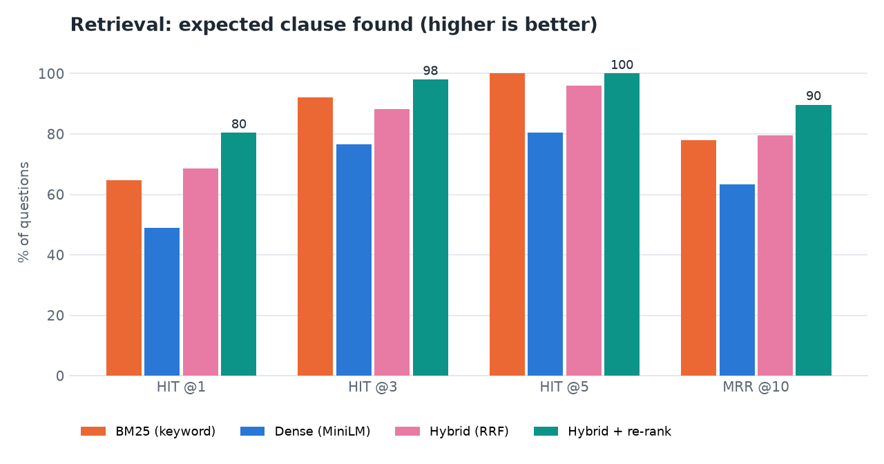

Pipeline configuration (nothing is trained)
Setting | Value
Candidates per retriever | 30
Fusion | RRF, k = 60
Re-rank pool | fused top 20 + top 8 each
Clauses to the LLM | top 7 (+ up to 4 context)
Abstain if | re-rank < 0.004 and BM25 < 9.0
Temperature | 0.2 answers, 0.1 card
Gemini chain | 3.8-flash, 3.6-flash, 3.5-flash-lite
Retrieval ablation: hybrid + re-rank is best on hit@1, hit@3 and MRR
Notes:
Settings were chosen by measurement on the evaluation set: for example, adding each retriever's top 8 to the re-rank pool recovered questions where one retriever alone found the clause.

Slide 10
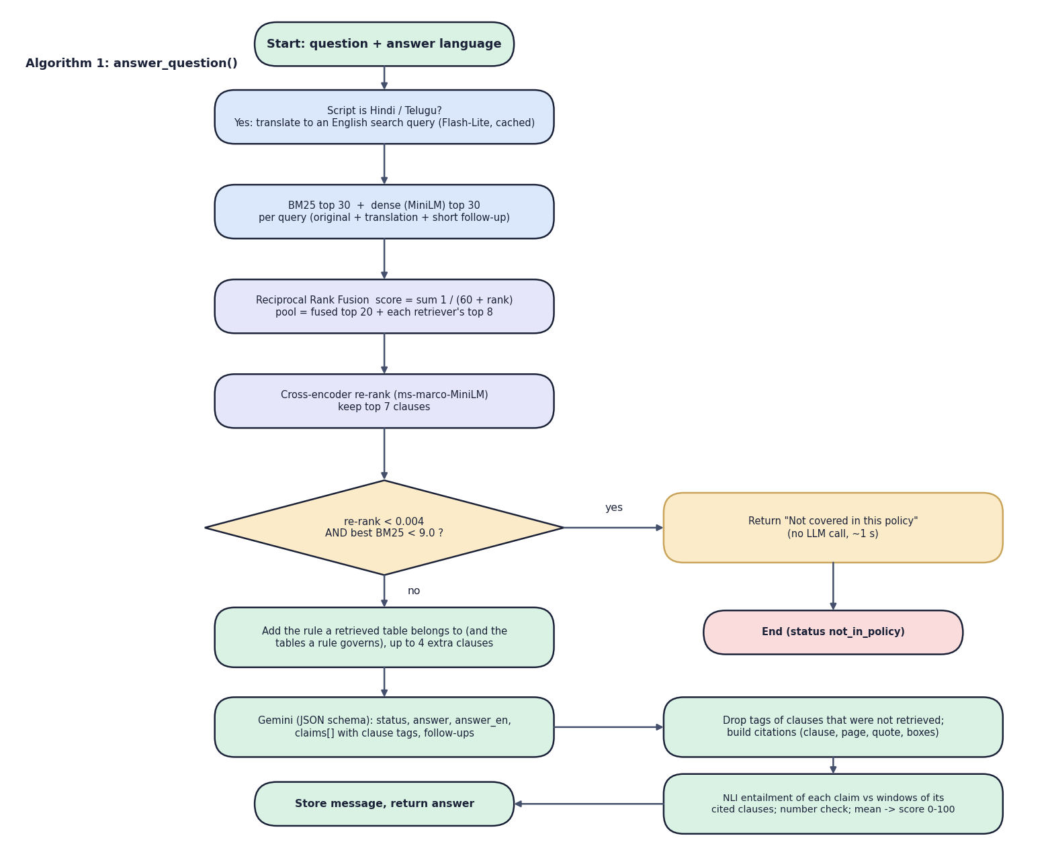

Decision logic
Abstain
If the best re-rank score is below 0.004 and the best BM25 score below 9.0, answer "not covered in this policy" without calling the model.
Cite
Gemini cites clause tags; tags that were not retrieved are removed; each claim is scored by an NLI model.
Claims
Waiting periods, age/network co-payment, sub-limits and the estimate are calculated; a failed waiting period is never "covered".
Notes:
Decision logic: when to answer, how to cite and score, and which parts of a claim check are rules rather than model output.

Slide 11
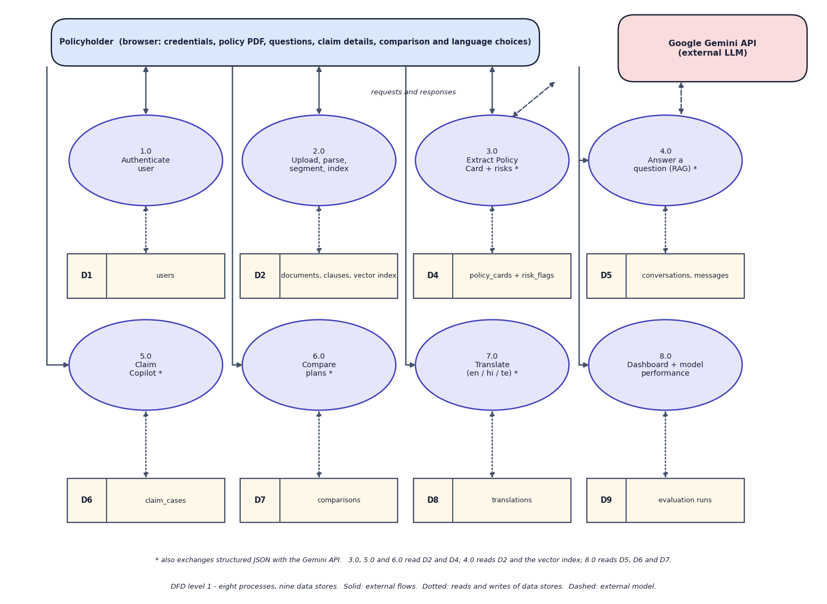
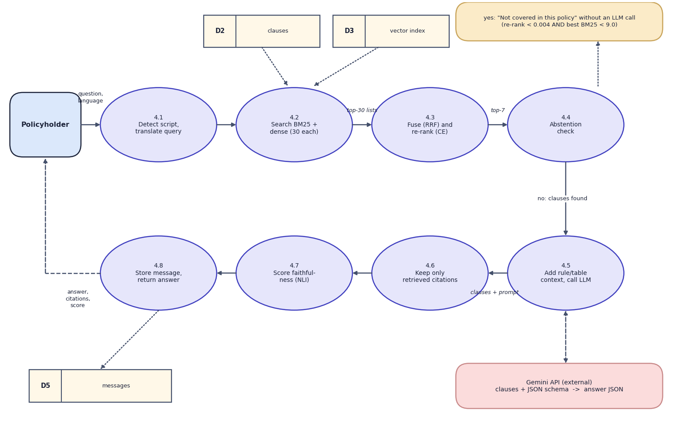

Data flow and modules
DFD level 1 (left) and level 2 expansion of 'Answer a question' (right)
Module | Responsibility
Ingestion | validate, parse, segment, index, build card and risks in a background worker
Retrieval + answering | BM25 + dense, fusion, re-rank, abstention rule, cited answer, faithfulness
Claim Copilot + compare | calculated pre-checks and estimate, verdict, checklist; two-policy comparison
Notes:
Level 1 shows eight processes and nine data stores; level 2 opens the question-answering process.

Slide 12
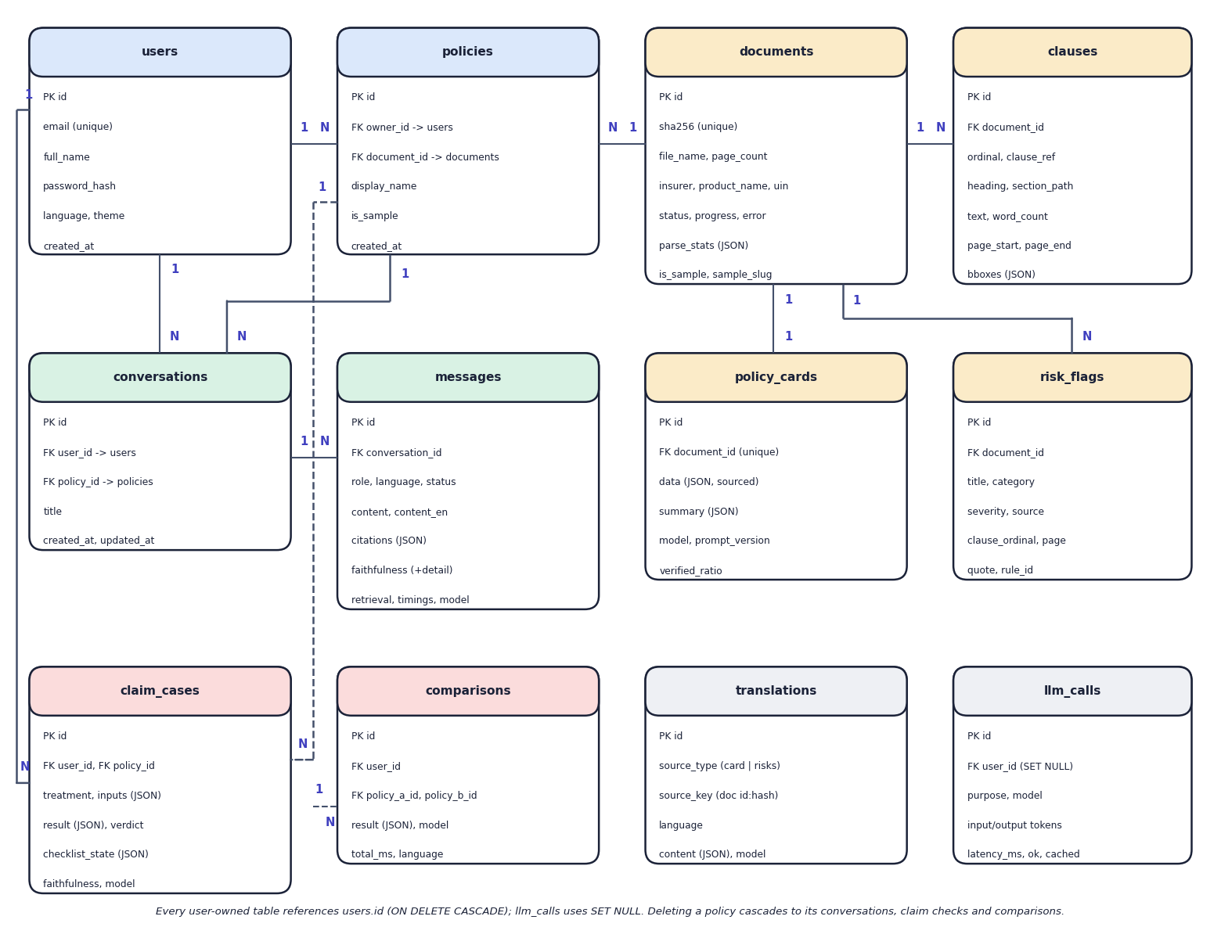
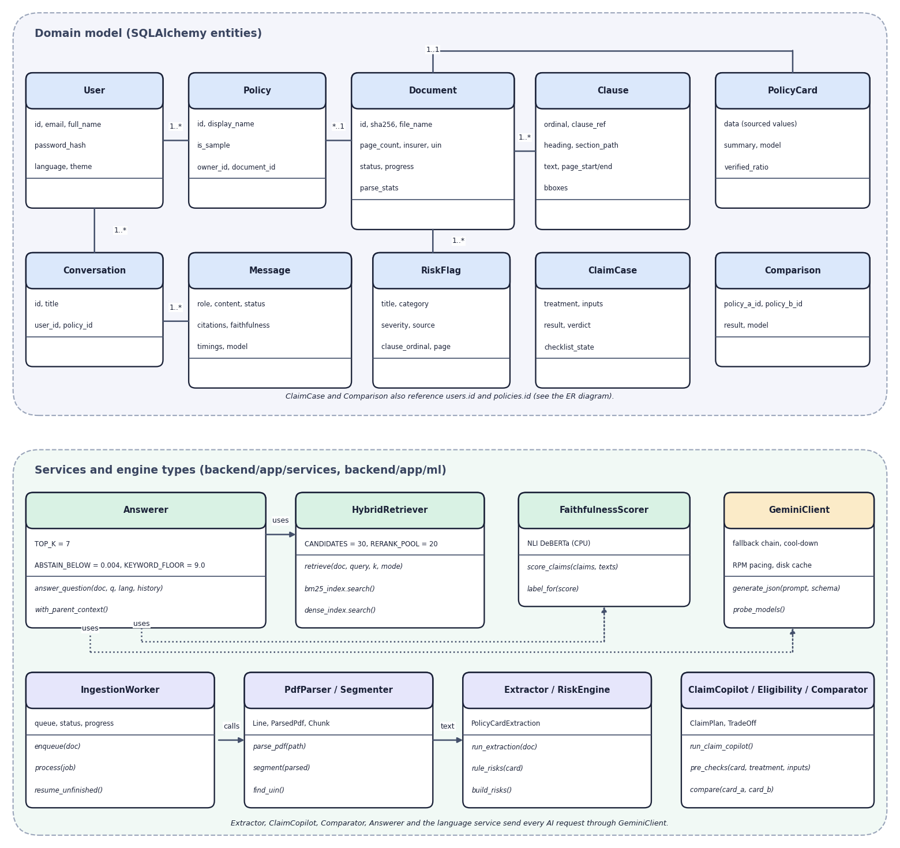

Database design and UML
ER diagram, 12 tables (left) and UML class diagram (right)
Table | Key fields | Relations
documents | sha256, page_count, insurer, uin, status, parse_stats | 1:N clauses, risk_flags; 1:1 policy_cards
clauses | ordinal, clause_ref, section_path, text, pages, bboxes | N:1 documents
messages | role, content, citations, faithfulness, timings, model | N:1 conversations
Notes:
Twelve tables created by SQLAlchemy. Documents are shared by content hash. Structured results are stored as JSON columns.

Slide 13






Technology stack
Language
Retrieval
Frontend
Python 3.11, TypeScript
rank-bm25, ChromaDB, sentence-transformers, PyMuPDF
React 18, Vite, Tailwind CSS, shadcn/ui, TanStack Query, Recharts
Backend
AI
Testing
FastAPI, Pydantic v2, SQLAlchemy 2, PyJWT, bcrypt
Google Gemini (google-genai), three local CPU models, torch
pytest (25 tests), strict TypeScript build, Playwright captures
Notes:
Everything runs on one laptop; the Gemini API key is the only credential.

Slide 14
Implementation progress
Component | Status
Upload, parsing, clause segmentation, viewer | Completed
Policy Card with verified sources; risk highlights | Completed
Hybrid retrieval, cited answers, faithfulness score | Completed
Claim Copilot with calculated pre-checks | Completed
Plan comparison; English, Hindi, Telugu | Completed
Dashboard and Model performance page | Completed
Evaluation harness, 3 runs, 25 backend tests | Completed
User acceptance testing with real users | Not done
42
API route handlers
12
database tables
25/25
backend tests passing
Notes:
Every planned feature is implemented. The one open item is user-acceptance testing with real policyholders.

Slide 15
Preliminary results: retrieval and answers
51 / 51
answers correct and correctly cited
6 / 6
out-of-scope questions declined, 0 false
87.0
mean faithfulness; median answer 4.3 s
Notes:
Evaluation run eval-20260922-0027 on 51 answerable questions, 6 out-of-scope, 5 multilingual, 14 claim scenarios and 52 card values; all with the smallest Gemini model because of free-tier quota.

Slide 16
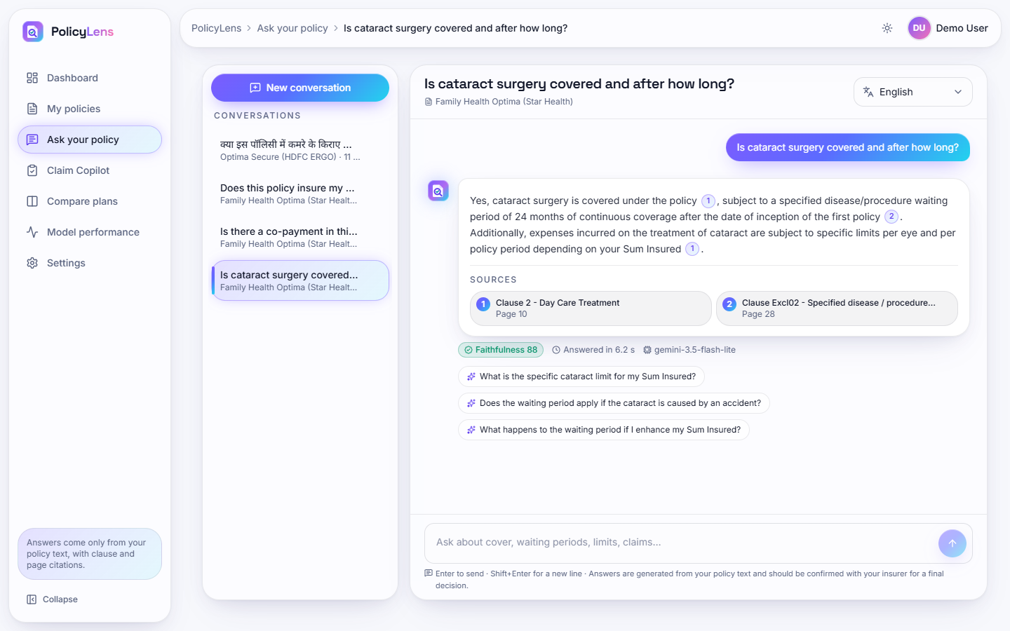
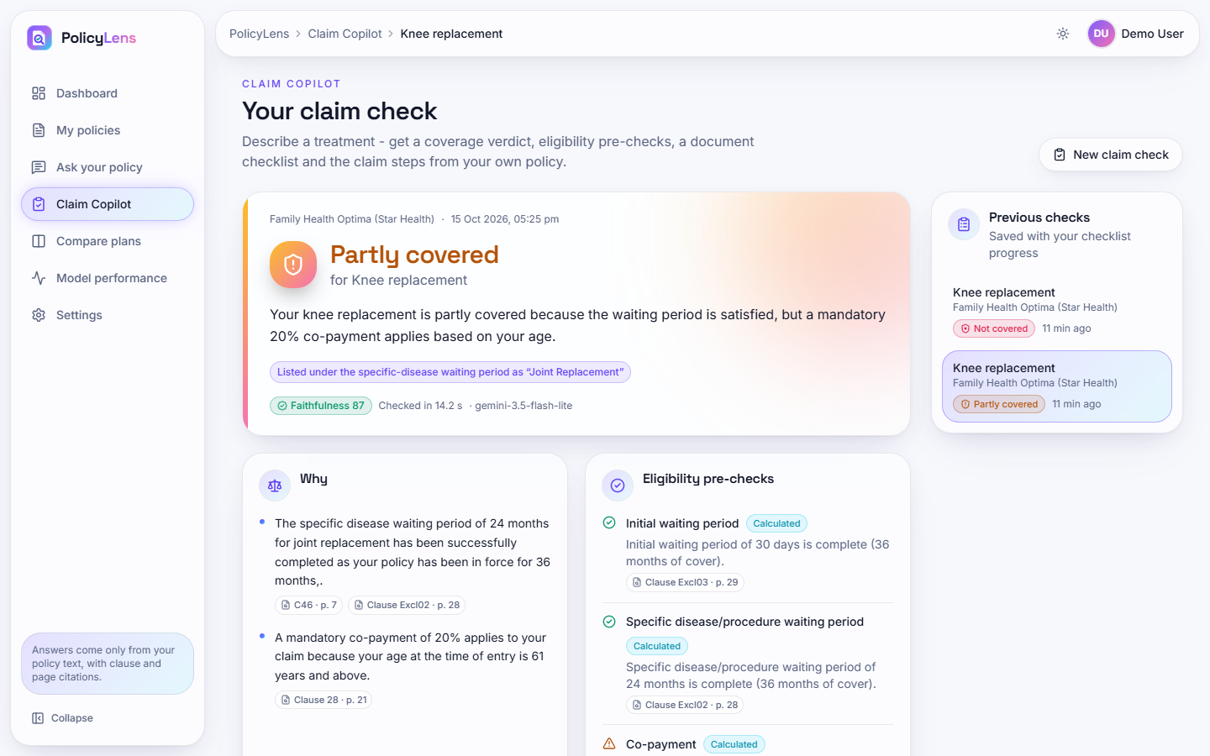


Output screens
Cited answer: 24-month waiting period, two sources, faithfulness 88
Claim Copilot: knee replacement is partly covered (20% co-payment)
Notes:
Real captures of the running application with the four sample policies and live Gemini answers.

Slide 17
Testing and observations
Test group | Tests | Result
Authentication and accounts | 6 | Passed
Parser and clause segmentation | 3 | Passed
Faithfulness scoring | 3 | Passed
Rules, fusion, risks, estimate | 6 | Passed
Policy flow, search, chat, claims | 7 | Passed
Total | 25 | 25 passed
25 backend tests pass in about 15 s on a synthetic policy; Gemini is never called in tests.
Web build: strict TypeScript and Vite production build succeed.
Evaluation: relevant clause in the top 5 for 51/51; 51/51 answers correct and cited; 14/14 claim verdicts; 51/52 card values.
Edge cases: scanned PDFs rejected; uncited tags removed; out-of-scope questions declined.
Not done: user-acceptance, load and security testing.
Notes:
25 backend tests plus the measured evaluation and a scripted end-to-end demo run. The frontend is checked by a strict TypeScript compile and a production build.

Slide 18



Challenges and corrective actions
Wordings are messy
Finding the clause
Unsupported answers
Two-column layouts, running headers, tables: a rule-based parser and segmenter restore order and clause numbers.
BM25 and embeddings each miss cases; fusion plus a cross-encoder gives hit@5 of 100%.
Citations are filtered to retrieved clauses and an NLI score is shown; it is a heuristic, not a verdict.
Knowing when to decline
Quota and overload
Translation quality
Neither score alone separates the cases; the pair (re-rank < 0.004, BM25 < 9.0) does.
A fallback chain of three Gemini models, a cool-down and a cache keep answers coming.
One Telugu card line mixes scripts; recorded as a limitation.
Notes:
Six challenges and how each was handled.

Slide 19
Next steps
Evaluate on unseen policies
User acceptance testing
Final report
Final presentation and demo
Write a fresh question set on policy wordings not used in development and re-measure (the current figures are partly tuned).
Collect feedback from policyholders on answers, citations and claim checks (not yet done).
Re-run the evaluation with the larger Gemini models; add plan-variant selection.
Document every diagram, test and result in the report.
Notes:
What remains: unseen-policy evaluation and real-user feedback, then the report and the final demo.

Slide 20
Thank you
Questions and suggestions are welcome.
Notes:
Thank you. Questions are welcome.

