Slide 1

PolicyLens: AI Health Insurance Assistance Using LLM + RAG
Final Review
Team Details : Batch A1
Under the Esteemed Guidance of
[GUIDE NAME]
[DESIGNATION], Department of CSE (Data Science)
23K91A6764 G.PRANATHI
23K91A6747 CH.AISHWARYA
23K91A6728 BHAVANSH MANE
24K95A6701 B.DEEKSHITH
DEPARTMENT OF COMPUTER SCIENCE AND ENGINEERING (DATA SCIENCE) · Academic Year [ACADEMIC YEAR]
Notes:
Final review of PolicyLens: an AI health-insurance assistant using retrieval-augmented generation and a large language model.

Slide 2
Table of Contents
Abstract
Base Paper & Literature Survey
Research Gap & Problem Statement
Objectives
Proposed System & Architecture
Methodology & Pipeline
Design & Implementation
Results, Testing & Comparison
Output Screens
Conclusion & Future Scope
References
Dept. of CSE (Data Science) | Batch A1 | Final Review
2

Slide 3
Abstract
Health insurance policies are long and technical, so users struggle to find coverage, exclusions, waiting periods and claim steps; agents are slow and general chatbots are not grounded in the user's own policy.
PolicyLens combines retrieval-augmented generation with Google Gemini: the policy is parsed into numbered clauses; a hybrid retriever finds the relevant ones; the model answers from those clauses only, with citations.
A Policy Card lists key terms with their clause and page; an independent NLI model scores each answer's support; the assistant says "not covered in this policy" when the wording is silent.
Claim Copilot adds calculated eligibility pre-checks, a verdict, a document checklist and a cost estimate; plans can be compared; English, Hindi and Telugu are supported.
Evaluation on 4 real wordings: relevant clause in the top 5 for 51/51 questions, 51/51 answers correct and cited, 6/6 out-of-scope declined, 14/14 claim verdicts, mean faithfulness 87.0, median answer 4.3 s.
Keywords: health insurance, RAG, LLM, question answering, faithfulness, claim guidance.
Dept. of CSE (Data Science) | Batch A1 | Final Review
3
Notes:
Abstract: problem, approach, application, and the headline measurements.

Slide 4
Base Paper
M. A. A. Albayati and O. Findik, "A hybrid transformer-based framework for multi-document summarization of Turkish legal documents," IEEE Access, vol. 13, pp. 37165-37181, 2025, doi: 10.1109/ACCESS.2025.3545750.
Task: multi-document summarisation of Turkish court rulings; 2,000 consumer-rights rulings scraped from a public site.
Method: TF-IDF and TextRank select important sentences; LED, Long-T5, BART-large and GPT-3.5 Turbo generate abstractive summaries from them.
Reported results: TF-IDF content F1 0.47; GPT-3.5 Turbo ROUGE-1 55%, ROUGE-2 35%, ROUGE-L 42%, ROUGE-Sum 44%.
Our reading: overlap with reference summaries does not show whether statements are supported; no citations; no question answering or guidance. We adopt select-then-generate and change task, domain and evaluation.
Dept. of CSE (Data Science) | Batch A1 | Final Review
4
Notes:
The base paper summarises legal rulings; PolicyLens applies its select-then-generate idea to cited question answering over insurance wordings.

Slide 5
Literature Survey
Author / Year | Methodology | Dataset | Key Results | Limitations
Albayati and Findik, 2025 (base) [1] | TF-IDF/TextRank, then LED, Long-T5, BART, GPT-3.5 Turbo | 2,000 Turkish court rulings | GPT-3.5 Turbo ROUGE-1 55%, ROUGE-2 35%, ROUGE-L 42% | Summaries only; no citations or QA
Beauchemin et al., 2024 [2] | RAG with GPT-4o | Quebec auto-insurance corpus; 82 expert answers | Better on average; 5-13% false statements | Auto insurance; one model
Maharjan and Yadav, 2026 [6] | Plain LLM vs basic RAG vs RAG + cross-encoder | Public-health policy documents | Faithfulness 0.347 / 0.621 / 0.797 | Not insurance wordings
Knollmeyer et al., 2025 [5] | Knowledge-graph-enhanced RAG | Manufacturing documents | Not read | Different domain
Multi-strategy RAG, 2026 [3]; Iran chatbot, 2023 [4] | RAG for medical-insurance QA; service chatbot | Not retrieved | Not retrieved | Listed in batch survey only
Dept. of CSE (Data Science) | Batch A1 | Final Review
5
Notes:
[1], [2] and [6] were read in detail. [3] and [4] could not be retrieved and [5]'s results were not read, so no results are claimed for them.

Slide 6
Research Gap
Author / Paper | Research Gap
Base paper [1] | Summarisation of rulings: no question answering, no citations, no per-statement support, no guidance
Beauchemin et al. [2] | RAG still produced 5-13% false statements; no per-answer support score; one insurance line
Maharjan and Yadav [6] | Shows re-ranking helps and segmentation is a bottleneck; other domain, no claim guidance
General chatbots and websites | Answer from training data or compare premiums; not grounded in the user's policy; no claim pre-check
All reviewed work | No system joins attribute extraction, clause-grounded cited answers, abstention, claim guidance and a repeatable evaluation on several real wordings
Dept. of CSE (Data Science) | Batch A1 | Final Review
6
Notes:
The gap is grounded, cited, scored answers plus claim guidance, with measured evidence on real wordings.

Slide 7
Problem Statement
Health insurance policies are long and technical, so users cannot easily find coverage, exclusions and conditions.
Users depend on agents and helplines that give slow, generic and inconsistent answers.
General chatbots may produce answers that are not supported by the user's actual policy.
Claim filing lacks guidance on eligibility and required documents, leading to delays and rejections.
Need: an assistant that answers strictly from the user's own policy, cites the supporting clauses and guides claims step by step.
Dept. of CSE (Data Science) | Batch A1 | Final Review
7

Slide 8
Objectives
Extract key policy attributes automatically from uploaded health insurance documents.
Build a RAG pipeline that retrieves the policy clauses relevant to each user question.
Generate plain-language answers with an LLM, grounded in and citing the retrieved clauses.
Provide guided claim support with eligibility pre-checks, evidence checklists and procedural steps.
Summarise risks, exclusions and cost-coverage trade-offs to support plan comparison.
Evaluate the assistant for answer accuracy, faithfulness and response time.
Dept. of CSE (Data Science) | Batch A1 | Final Review
8

Slide 9
Proposed System
1. Upload - a policy wording PDF (or one of four samples); scans, encrypted and oversize files are refused.
2. Parse and segment - numbered clauses with pages and highlight boxes; exclusion codes become clauses.
3. Index - BM25 and MiniLM embeddings in ChromaDB.
4. Policy Card and risks - one Gemini call, every value verified against its quote; rule and AI risks.
5. Ask - hybrid retrieval, cited answer, faithfulness score; "not covered in this policy" when silent.
6. Claim Copilot - calculated pre-checks, verdict, checklist, steps, estimate.
7. Compare, translate, review - two plans side by side; English, Hindi, Telugu; dashboard.
Dept. of CSE (Data Science) | Batch A1 | Final Review
9

Slide 10
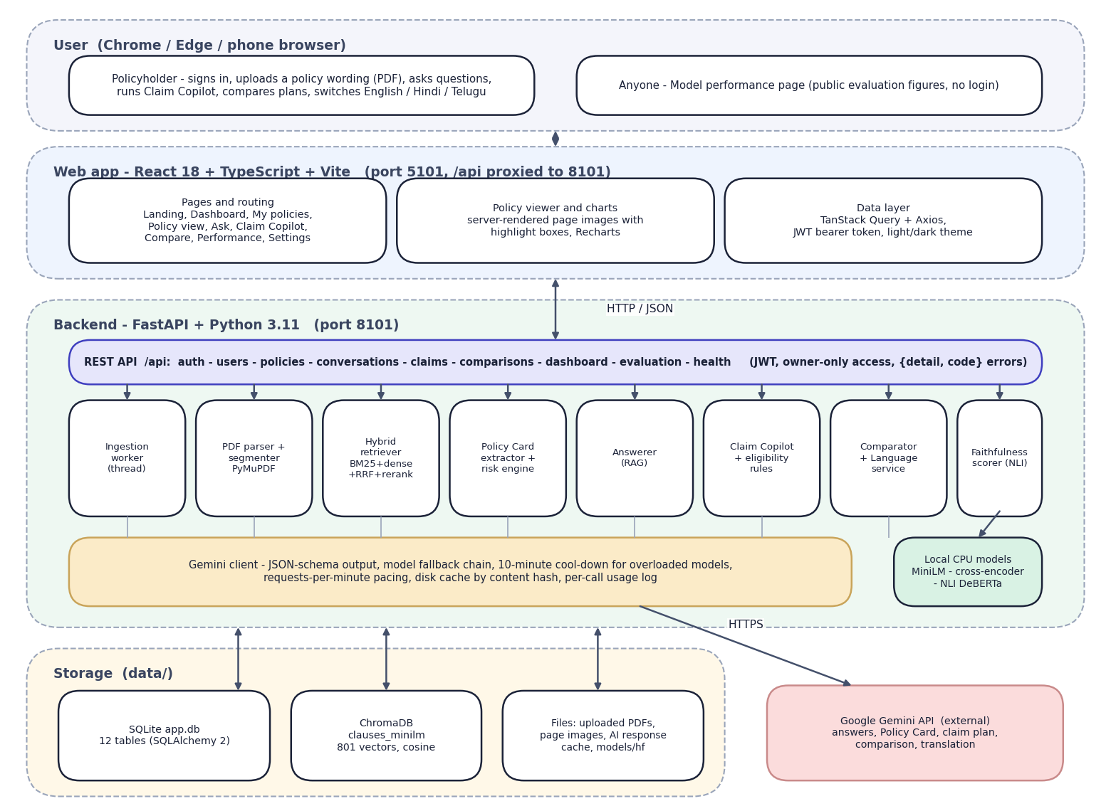

System Architecture
Layered architecture: browser, React web app, FastAPI backend with retrieval and answering services, local models, storage, Gemini API
Dept. of CSE (Data Science) | Batch A1 | Final Review
10

Slide 11
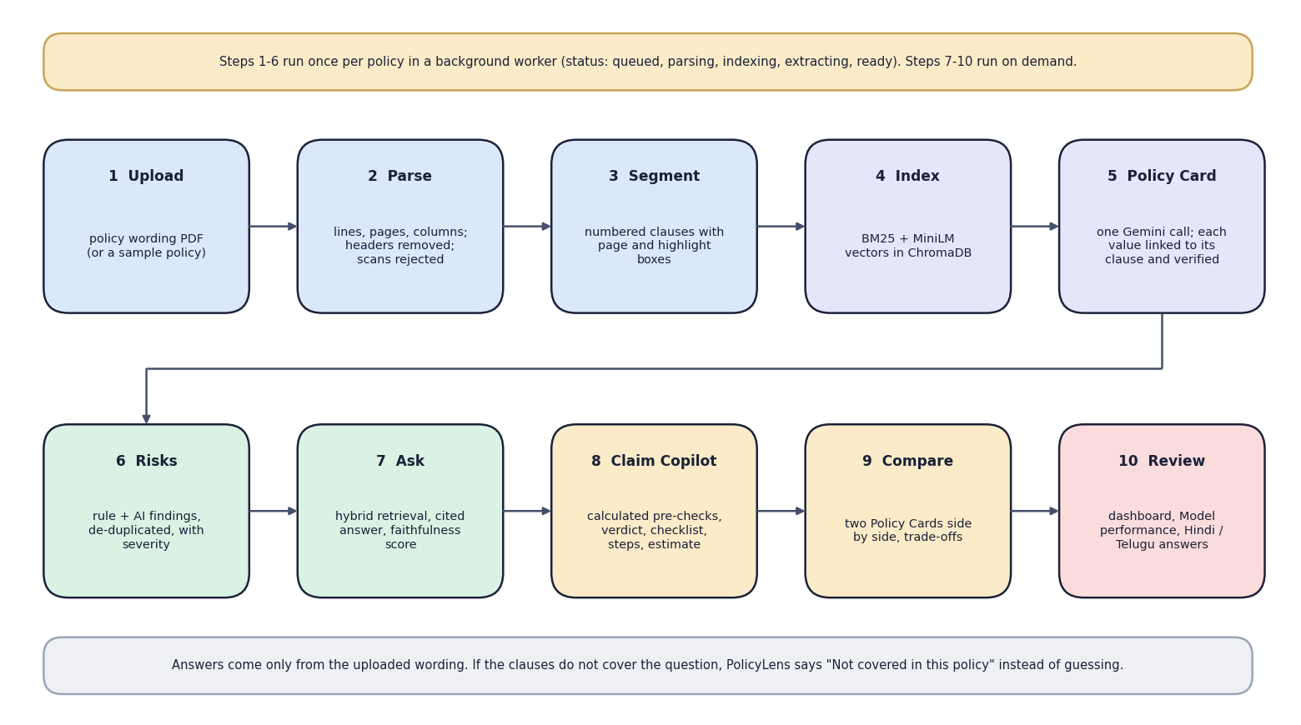

Methodology
End-to-end workflow: upload, parse, segment, index, Policy Card, risks, ask, Claim Copilot, compare, review
Dept. of CSE (Data Science) | Batch A1 | Final Review
11

Slide 12
Dataset, Features & Models
Data: four public policy wordings (Star Health, HDFC ERGO, Niva Bupa, Care Health): 166 pages, 73,001 words, 801 clauses; no personal data.
Evaluation set (hand-written): 57 questions (51 answerable, 6 out-of-scope), 5 Hindi/Telugu, 14 claim scenarios, 52 Policy Card values. All of it is test data; nothing is trained.
Features: clause text with heading path; BM25 terms with insurance synonyms; 384-d MiniLM embeddings.
Models (pre-trained, not fine-tuned): Gemini for generation; all-MiniLM-L6-v2; ms-marco-MiniLM-L6-v2 cross-encoder; nli-deberta-v3-xsmall.
Settings: 30 candidates per retriever, RRF k 60, re-rank pool 20 + 8, top 7 clauses, abstain if re-rank < 0.004 and BM25 < 9.0, temperature 0.2.
Why no training: the task is reading, not predicting; no labelled public set; wordings change every year.
Dept. of CSE (Data Science) | Batch A1 | Final Review
12
Notes:
There is no train/validation/test split because no model is trained; the whole evaluation set is test data.

Slide 13
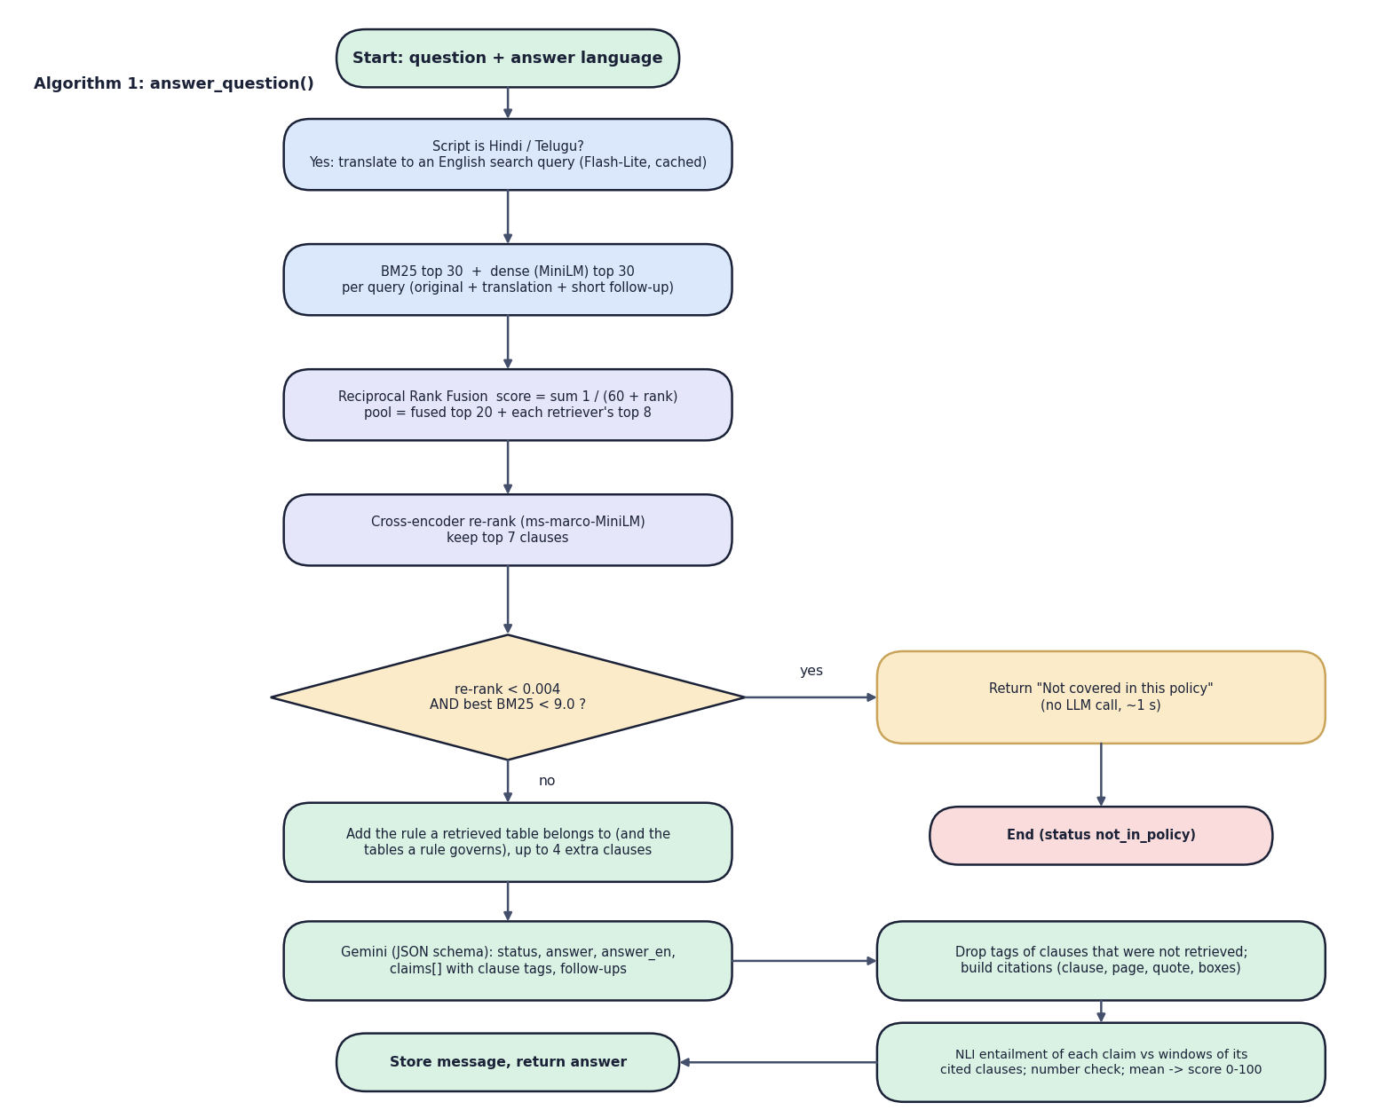

Decision Workflow
Core algorithm answer_question(): translate, retrieve, fuse, re-rank, abstain or generate, filter citations, score faithfulness
Dept. of CSE (Data Science) | Batch A1 | Final Review
13

Slide 14
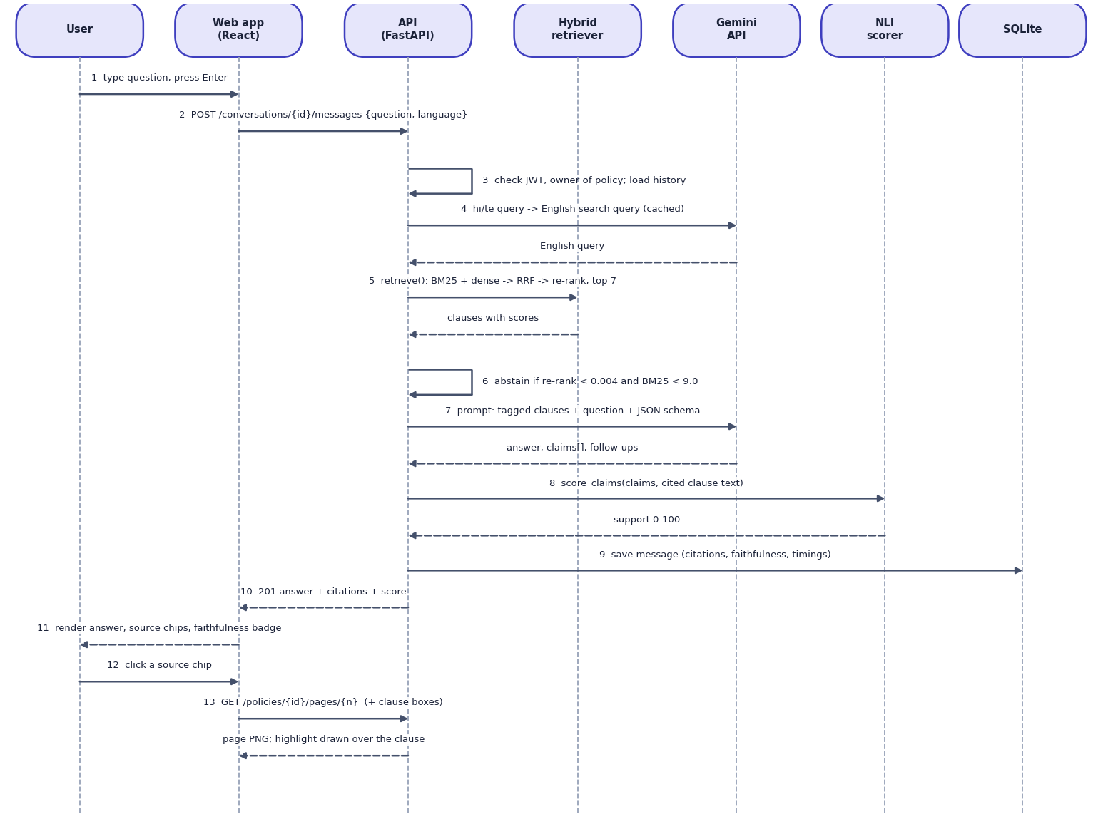

User–System Interaction
Sequence: ask a question, receive a cited answer with a faithfulness score, open the source page
Dept. of CSE (Data Science) | Batch A1 | Final Review
14

Slide 15
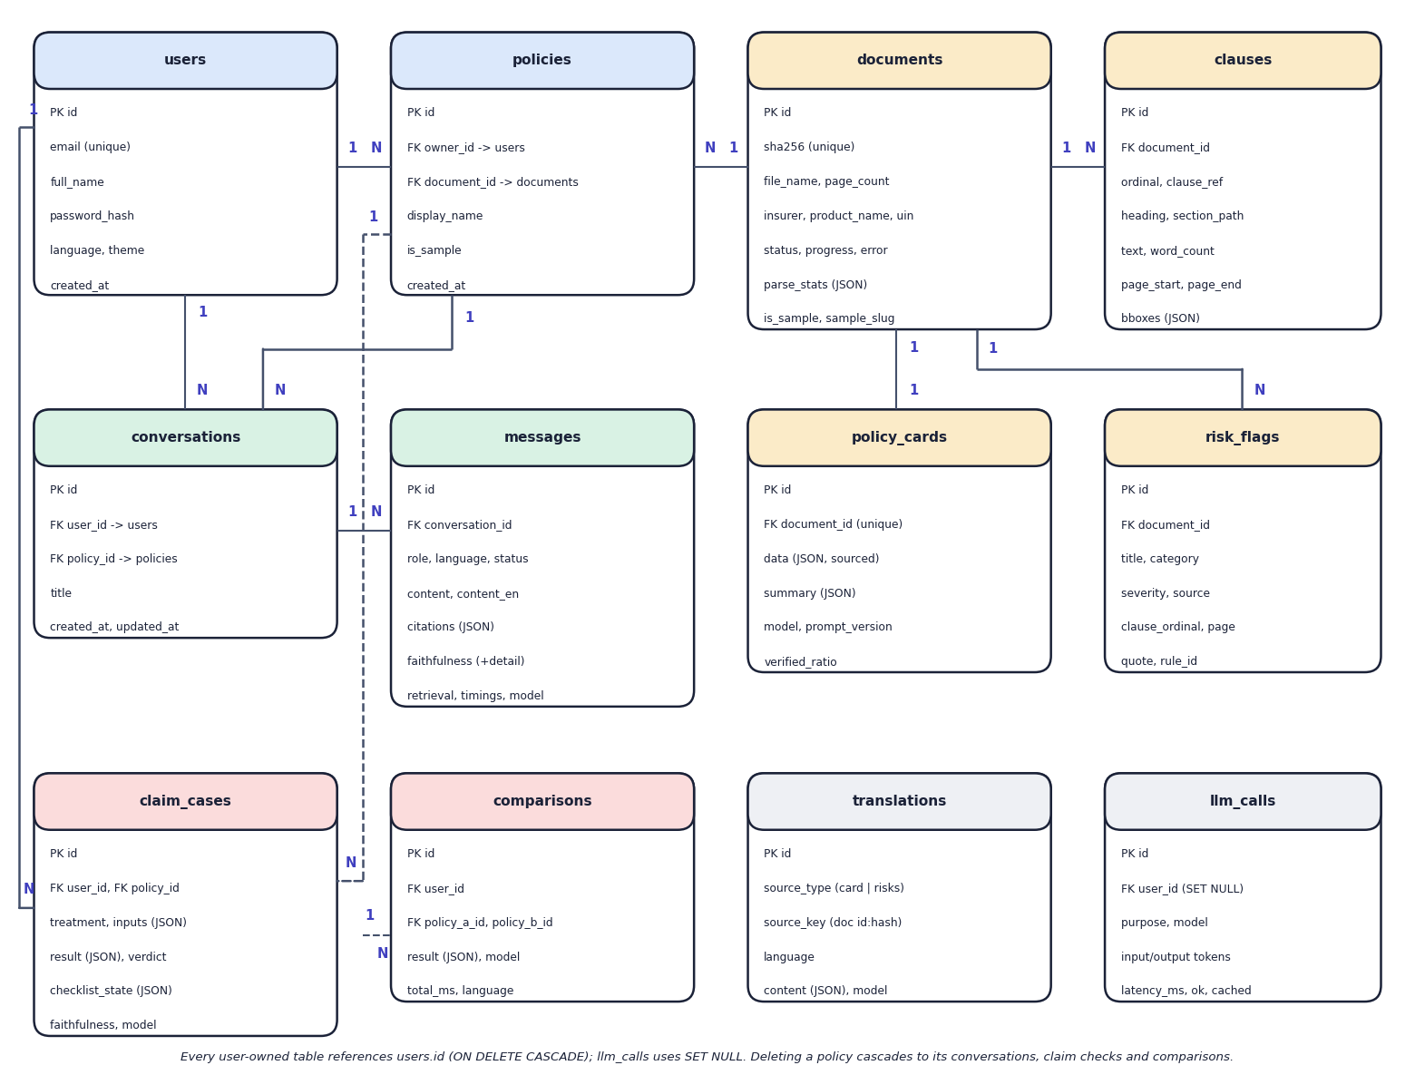

Database Design
Entity–relationship diagram (12 SQLite tables)
Dept. of CSE (Data Science) | Batch A1 | Final Review
15

Slide 16
Implementation Highlights
Module | Implementation
Parser + segmenter | PyMuPDF lines; header/footer removal; column order; clause starts and IRDAI exclusion codes; 12-380 word chunks with highlight boxes
Retrieval | BM25 Okapi (k1 1.4, b 0.7) + MiniLM/ChromaDB; Reciprocal Rank Fusion (k 60); cross-encoder re-rank; top 7
Answerer + faithfulness | Tagged clauses to Gemini with a JSON schema; uncited tags dropped; NLI entailment + number check -> score 0-100
Claim Copilot | Calculated waiting-period, co-payment, sub-limit checks and estimate; Gemini plan; a failed waiting period is never "covered"
Gemini client | JSON schema, three-model fallback chain, 10-minute cool-down, pacing, disk cache, usage log
Web app + security | React 18 + FastAPI; bcrypt, JWT 24 h, owner-only data, upload validation; 42 routes; 25 backend tests
Dept. of CSE (Data Science) | Batch A1 | Final Review
16

Slide 17
Results – Evaluation (run eval-20260922-0027)
Measure | PolicyLens | Note
Relevant clause in top 5 | 100% (51/51) | BM25 alone 100%, dense alone 80.4%
Relevant clause ranked first | 80.4% | BM25 64.7%, hybrid 68.6%
Answer accuracy / citation accuracy | 100% / 100% (51/51) | all key facts; right clause or page
Faithfulness mean / median | 87.0 / 91.7 | 45 well, 8 partly, 3 weakly supported
Out-of-scope declined | 6/6, 0 false | 51 answerable never declined
Claim verdicts / card values | 14/14 / 51/52 | 98.1% card accuracy
Answer time median / p95 | 4.3 s / 18.2 s | live Gemini, smallest model
4 real wordings, 57 questions, 14 claim scenarios, 52 card values; held-out test only; small set partly tuned on itself; model: gemini-3.5-flash-lite.
Dept. of CSE (Data Science) | Batch A1 | Final Review
17
Notes:
Nothing is trained, so there is no accuracy of a trained model; these are measured retrieval, answer, citation, faithfulness and verdict results.

Slide 18
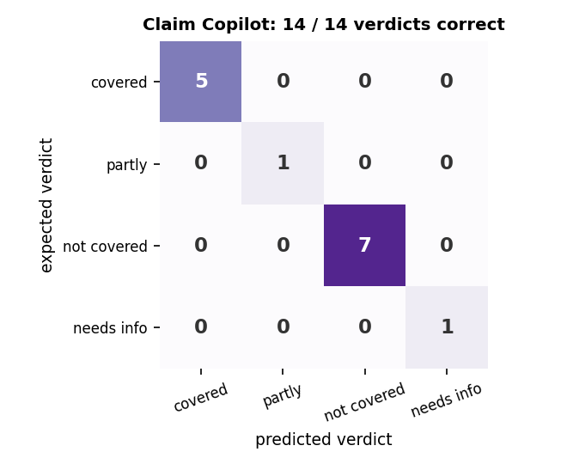
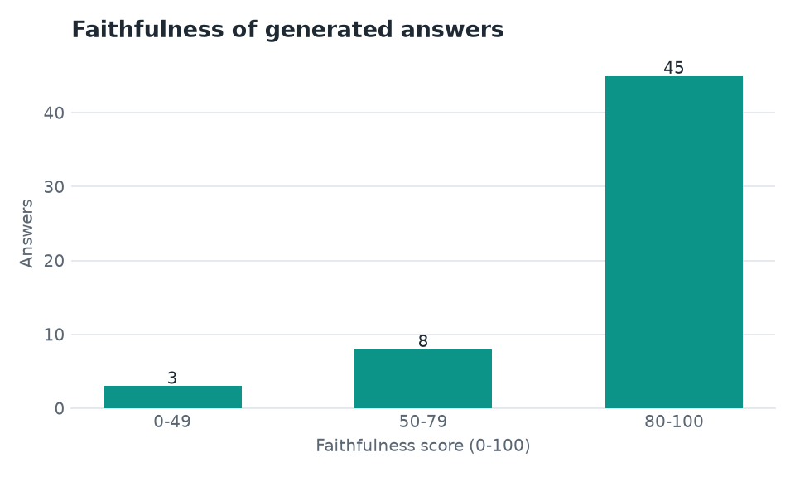


Claim Verdicts & Faithfulness
Claim Copilot confusion matrix: 14 of 14 verdicts correct
Faithfulness of 56 answers: 45 well, 8 partly, 3 weakly supported
Dept. of CSE (Data Science) | Batch A1 | Final Review
18
Notes:
The confusion matrix of the four claim verdicts and the distribution of the faithfulness score.

Slide 19
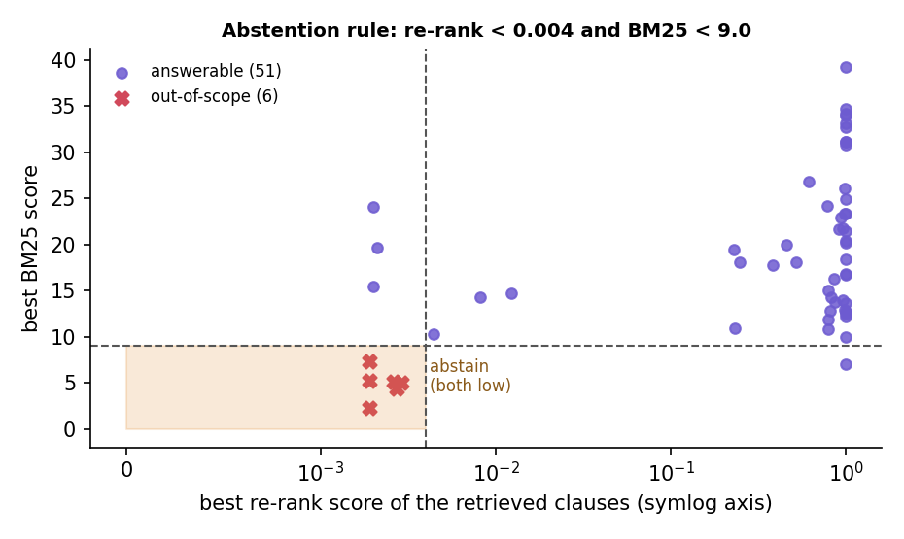
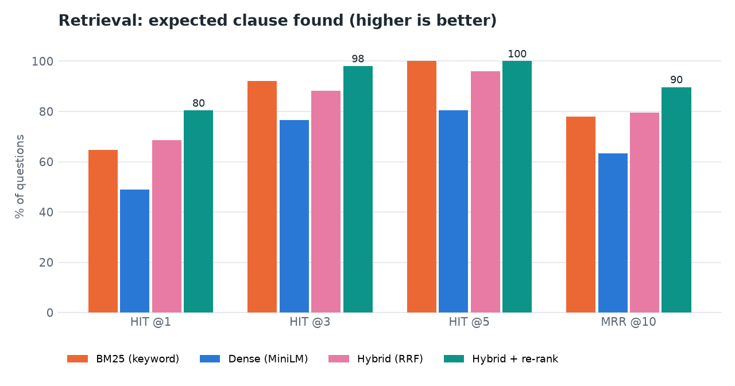


Threshold & Parameter Analysis
Abstention rule: only the pair of scores separates the 6 out-of-scope questions
Retrieval ablation: re-ranking lifts hit@1 from 0.686 to 0.804
Dept. of CSE (Data Science) | Batch A1 | Final Review
19
Notes:
Scores measured through the live API for all 57 questions: no answerable question is below both floors, all six out-of-scope questions are.

Slide 20
Performance & Testing
Measurement | Result
Retrieval time (median) | BM25 1.1 ms; dense 10.7 ms; hybrid 11.0 ms; hybrid + re-rank 879 ms
Answer time | median 4.3 s, p95 18.2 s; stages: retrieval 0.86 s, Gemini 2.5 s, faithfulness 0.83 s
Claim check | mean 13.8 s on four live calls; policy parsing 3.2-4.2 s
Automated tests | 25 passed, 0 failed (auth 6, faithfulness 3, parser 3, policy flow 7, units 6)
Web build | strict TypeScript + Vite production build succeed
Live demo (15 Oct 2026) | cited answer 6.2 s; abstained question 1.7 s; Hindi answer 10.0 s; claim check 14.2 s
Dept. of CSE (Data Science) | Batch A1 | Final Review
20
Notes:
Not measured: concurrent-user load, memory use, other hardware; user-acceptance testing was not performed.

Slide 21
Comparison with Base Paper (context only – different datasets)
System | Data | Method | Support for statements | Reported / measured | Extras
Base paper [1] | 2,000 Turkish court rulings | TF-IDF/TextRank + LED, Long-T5, BART, GPT-3.5 Turbo | Not measured; no citations | ROUGE-1 55%, ROUGE-2 35%, ROUGE-L 42% | -
RAG study [6] | Public-health policy documents | Mistral-7B + MiniLM + cross-encoder re-rank | Faithfulness measure | Faithfulness 0.347 / 0.621 / 0.797 | -
PolicyLens | 4 English health-insurance wordings (801 clauses) | BM25 + dense + RRF + cross-encoder; Gemini JSON schema | Clause + page citations; NLI score 0-100; abstention | hit@5 100%, answers 51/51, citations 100%, faithfulness 87.0 | Policy Card, Claim Copilot, compare, 3 languages
Different tasks, data, languages and metrics: no numeric head-to-head is possible, so the comparison is of approach. Faithfulness values are on different scales.
Dept. of CSE (Data Science) | Batch A1 | Final Review
21

Slide 22
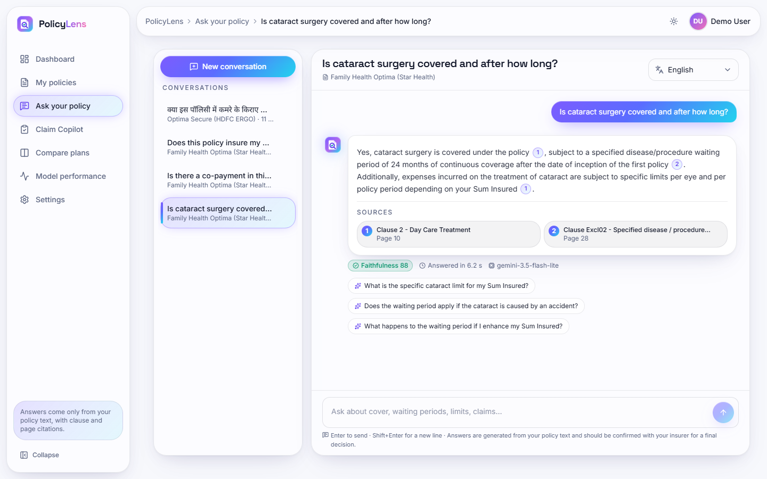
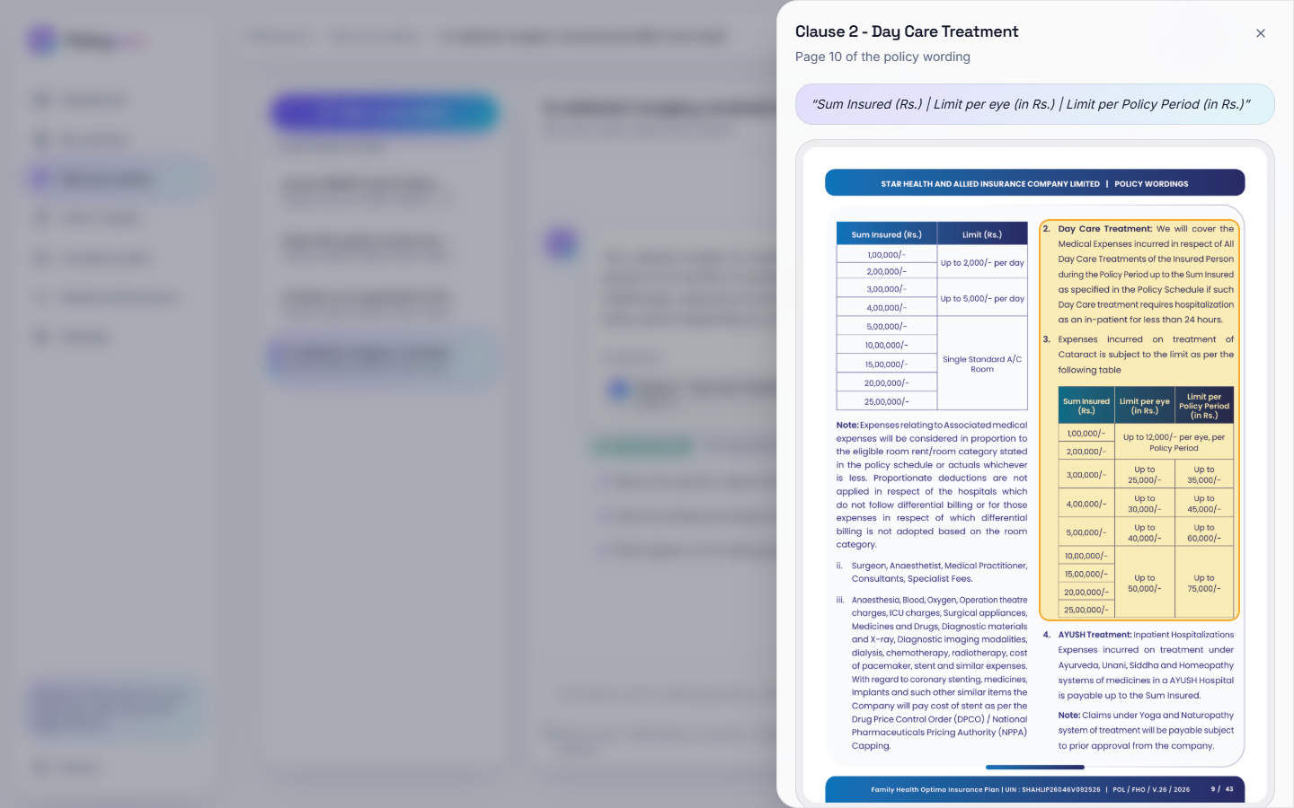


Output – Cited Answer and Source Page
Answer with two sources, faithfulness 88 and follow-ups
A source chip opens the original page with the clause outlined
Dept. of CSE (Data Science) | Batch A1 | Final Review
22

Slide 23
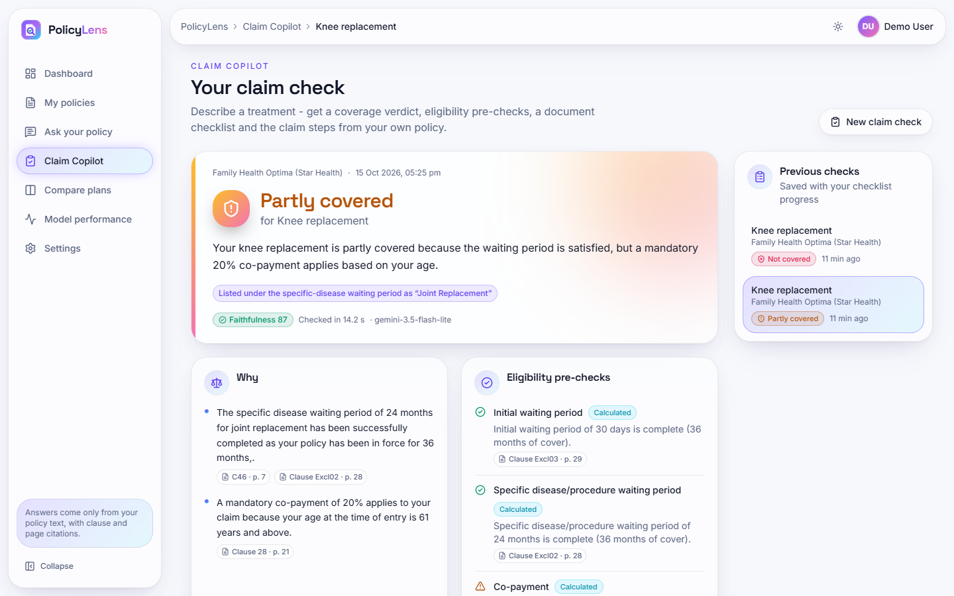
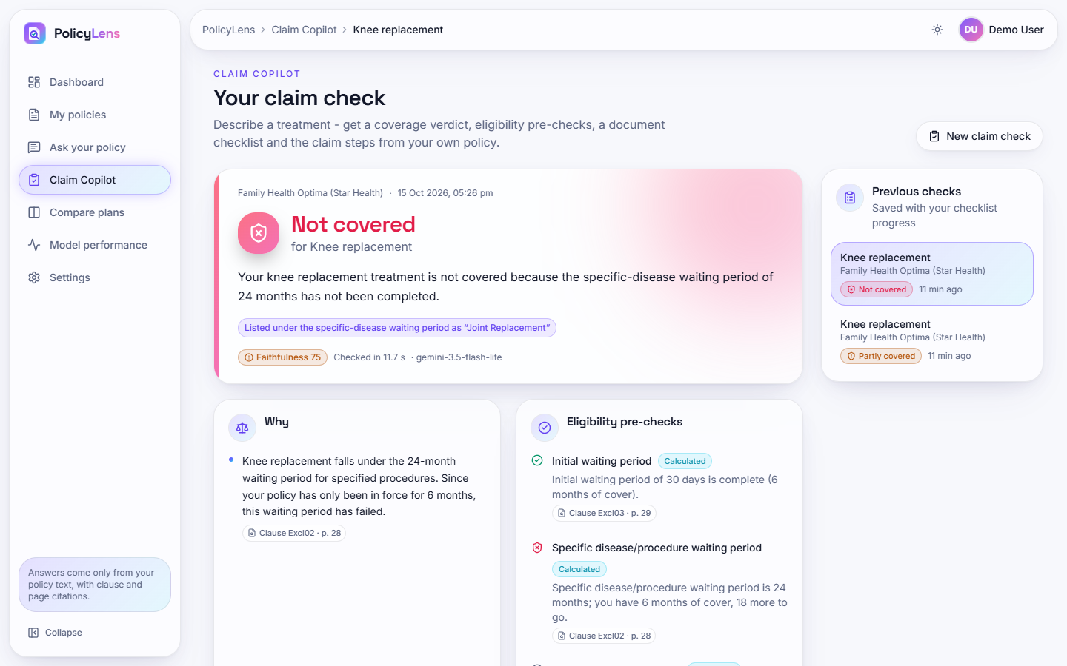


Output – Claim Copilot
Knee replacement, 36 months of cover: partly covered (20% co-payment)
Cover from April 2026: not covered, waiting period incomplete
Dept. of CSE (Data Science) | Batch A1 | Final Review
23

Slide 24
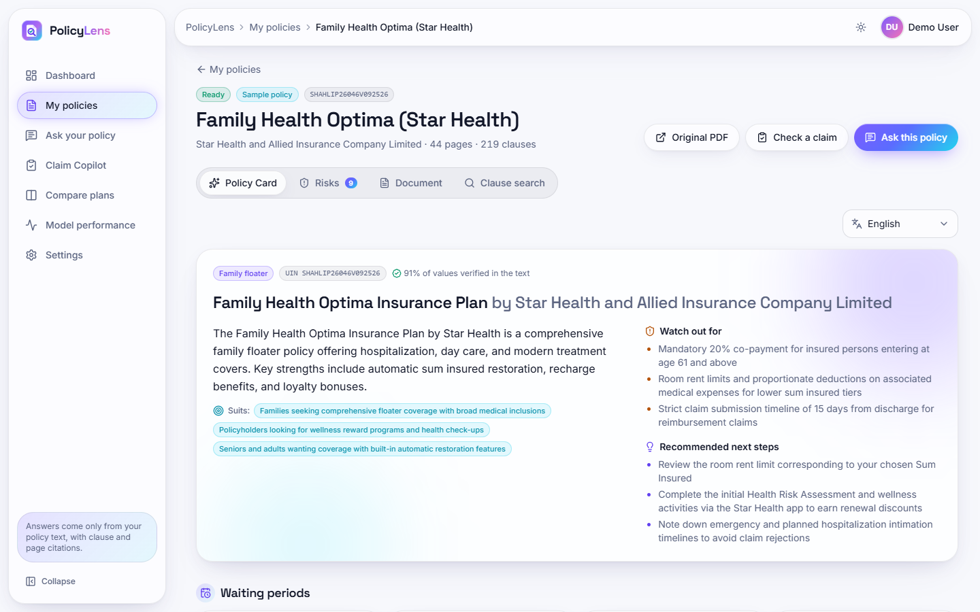
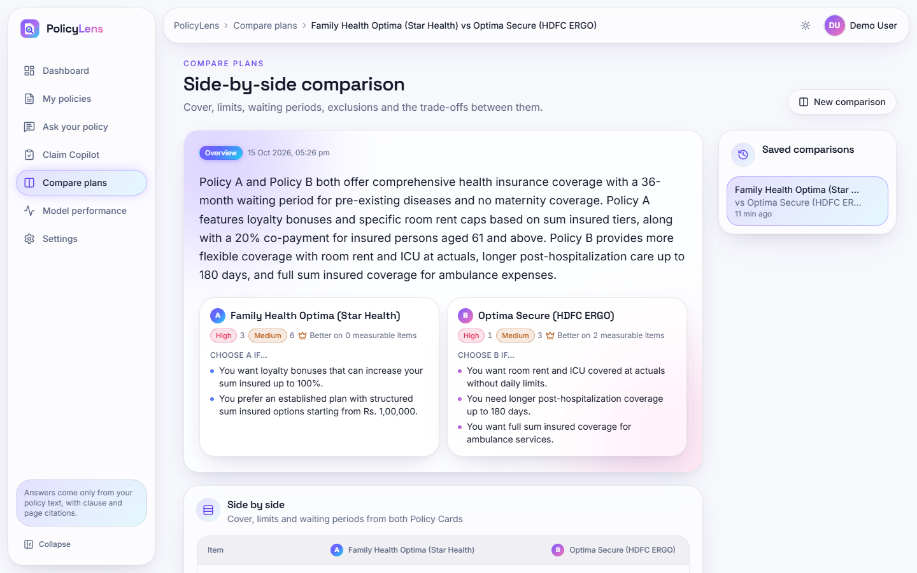


Output – Policy Card and Plan Comparison
Policy Card with values linked to clause and page
Star Health against HDFC ERGO: overview and choose-A / choose-B
Dept. of CSE (Data Science) | Batch A1 | Final Review
24

Slide 25
Conclusion
Built PolicyLens: grounded, cited, scored health-insurance answers, a verified Policy Card, claim guidance and plan comparison.
Relevant clause in the top 5 for 51/51 questions; 51/51 answers correct and cited; 6/6 out-of-scope declined with no false abstentions; 14/14 claim verdicts; 51/52 card values.
Mean faithfulness 87.0; median answer time 4.3 s; hybrid + re-rank beats BM25 alone and dense alone at the top of the list.
25 backend tests pass; the web build succeeds; every screen was captured from the running application.
Limits: small set partly tuned on itself; smallest Gemini model; heuristic faithfulness; mixed-script Telugu line; no user study; no numeric comparison with the base paper.
Dept. of CSE (Data Science) | Batch A1 | Final Review
25

Slide 26
Future Scope
Evaluate on a fresh, larger question set from unseen wordings and with the larger Gemini models.
Plan-variant selection on the Policy Card; OCR for scanned policies.
Better faithfulness scoring and automatic checks of translation quality.
Claim document upload with checklist verification and deadline reminders; renewal comparison.
Server deployment: hosted database and vector store, HTTPS, rate limiting, load testing and a user study.
Dept. of CSE (Data Science) | Batch A1 | Final Review
26

Slide 27
References
[1] M. A. A. Albayati and O. Findik, "A hybrid transformer-based framework for multi-document summarization of Turkish legal documents," IEEE Access, vol. 13, pp. 37165-37181, 2025, doi: 10.1109/ACCESS.2025.3545750.
[2] D. Beauchemin, R. Khoury and Z. Gagnon, "Quebec automobile insurance question-answering with retrieval-augmented generation," in Proc. Natural Legal Language Processing Workshop (NLLP), Miami, FL, USA, 2024, pp. 48-60, doi: 10.18653/v1/2024.nllp-1.5.
[3] "A medical insurance question answering system based on multi-strategy retrieval-augmented generation," in Proc. 2026 5th Int. Symp. Computer Applications and Information Technology (ISCAIT), 2026 (listed in the batch literature survey; not independently retrieved).
[4] "Artificial intelligence chatbot in Iran Health Insurance Organization: A new era in service providing," Iranian Journal of Health Insurance, 2023 (listed in the batch literature survey; not independently retrieved).
[5] S. Knollmeyer, O. Caymazer and D. Grossmann, "Document GraphRAG: Knowledge graph enhanced retrieval augmented generation for document question answering within the manufacturing domain," Electronics, vol. 14, no. 11, Art. 2102, 2025, doi: 10.3390/electronics14112102.
[6] A. Maharjan and U. Yadav, "Chunking, retrieval, and re-ranking: An empirical evaluation of RAG architectures for policy document question answering," arXiv:2601.15457, Jan. 2026.
[7] P. Lewis et al., "Retrieval-augmented generation for knowledge-intensive NLP tasks," in Advances in Neural Information Processing Systems (NeurIPS), vol. 33, 2020, pp. 9459-9474.
[8] S. Robertson and H. Zaragoza, "The probabilistic relevance framework: BM25 and beyond," Foundations and Trends in Information Retrieval, vol. 3, no. 4, pp. 333-389, 2009.
[9] G. V. Cormack, C. L. A. Clarke and S. Buettcher, "Reciprocal rank fusion outperforms Condorcet and individual rank learning methods," in Proc. 32nd Int. ACM SIGIR Conf. Research and Development in Information Retrieval, 2009, pp. 758-759.
[10] N. Reimers and I. Gurevych, "Sentence-BERT: Sentence embeddings using Siamese BERT-networks," in Proc. EMNLP-IJCNLP, 2019, pp. 3982-3992.
[11] W. Wang, F. Wei, L. Dong, H. Bao, N. Yang and M. Zhou, "MiniLM: Deep self-attention distillation for task-agnostic compression of pre-trained transformers," in Advances in Neural Information Processing Systems (NeurIPS), vol. 33, 2020, pp. 5776-5788.
[12] R. Nogueira and K. Cho, "Passage re-ranking with BERT," arXiv:1901.04085, 2019.
[13] P. He, J. Gao and W. Chen, "DeBERTaV3: Improving DeBERTa using ELECTRA-style pre-training with gradient-disentangled embedding sharing," arXiv:2111.09543, 2021.
[14] A. Williams, N. Nangia and S. Bowman, "A broad-coverage challenge corpus for sentence understanding through inference," in Proc. NAACL-HLT, 2018, pp. 1112-1122.
[15] T. Bajaj et al., "MS MARCO: A human generated machine reading comprehension dataset," arXiv:1611.09268, 2016.
[16] Z. Ji et al., "Survey of hallucination in natural language generation," ACM Computing Surveys, vol. 55, no. 12, Art. 248, 2023.
[17] Gemini Team, Google, "Gemini: A family of highly capable multimodal models," arXiv:2312.11805, 2023.
[18] V. Karpukhin et al., "Dense passage retrieval for open-domain question answering," in Proc. EMNLP, 2020, pp. 6769-6781.
[19] C.-Y. Lin, "ROUGE: A package for automatic evaluation of summaries," in Text Summarization Branches Out, ACL Workshop, Barcelona, Spain, 2004, pp. 74-81.
Dept. of CSE (Data Science) | Batch A1 | Final Review
27

Slide 28
THANK YOU
Questions & Suggestions
Dept. of CSE (Data Science) | Batch A1 | Final Review
28
Notes:
Thank you. Questions are welcome.

