Slide 1
Customer Churn Prediction in Telecom Industry
REVIEW 2 · DESIGN, METHODOLOGY AND PROGRESS
Design, methodology and progress: five classifiers compared, risk bands, drivers and retention actions in a web application
Presented by
Under the guidance of
ANANTULA SAI NIKHILA SRAVANI 23K91A0512
AVULA ANUDEEP 23K91A0518
B SANDEEP 24K915A0503
DARAGANI VINOD KUMAR 23K91A0558
B. SRIKANTH, Assistant Professor, Department of CSE
Department of Computer Science and Engineering
TKR College of Engineering and Technology (Autonomous) · Batch A14 (CSE-A) · [ACADEMIC YEAR]
Notes:
This review shows how the system is designed and built: data, model, what is implemented, the first measured results and the open items.

Slide 2
Contents
01
02
03
Recap and architecture
Methodology and dataset
Preprocessing and models
04
05
06
Training and decision logic
Data flow, data model and UML
Technology stack
07
08
09
Implementation progress and results
Output screens and testing
Challenges and next steps
Notes:
Agenda for the design and progress review.

Slide 3
Recap: problem and proposed system
!
Problem
i
Proposed system
B
Base paper link
Churn is noticed after the customer has gone, offers are uniform, scores come without reasons and imbalanced data hides the churn class.
Clean and encode the data, compare five classifiers, pick the best on F1, then show risk bands, drivers, what-if and rule-based retention actions.
Takes the motivation (explain churn, tie it to retention) from the base paper; does not reproduce its perturbation explainer, LIME or XGBoost/LightGBM/CatBoost models.
Notes:
One-minute recap of Review 1. We deliver the application and measure it honestly; the base paper is a research framework on the real Telco data.

Slide 4
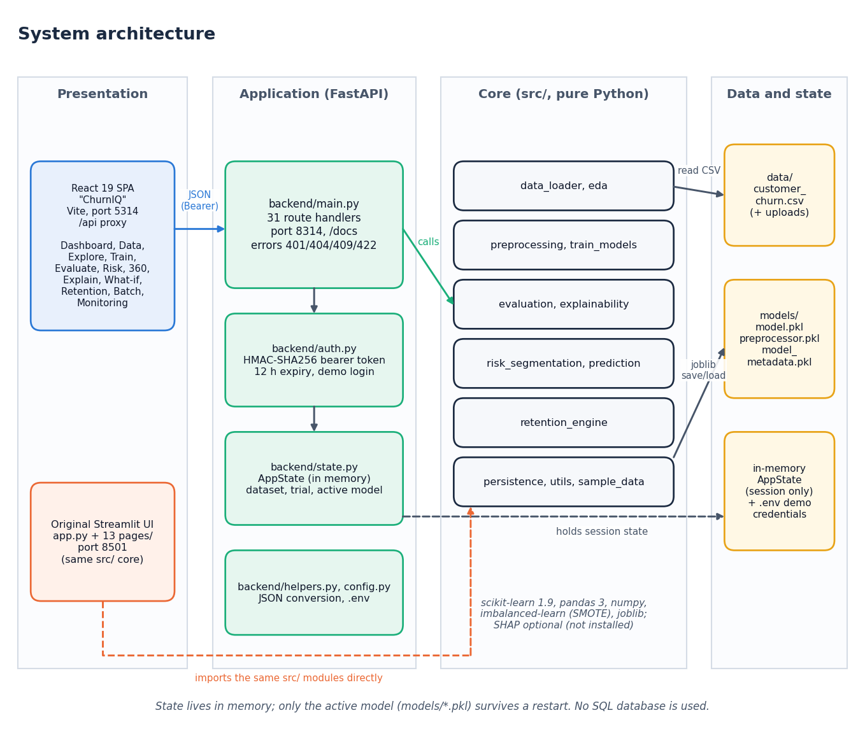
System architecture
Presentation: React 19 + Vite SPA "ChurnIQ" (port 5314) and the original Streamlit app.
Application: FastAPI (port 8314): 31 route handlers, HMAC-signed bearer token, in-memory AppState.
Core: 12 pure-Python modules in src/, shared by both front ends and untouched by the API layer.
Data and state: CSV, joblib model files, session state in memory. No SQL database.
Notes:
Four tiers. The FastAPI layer imports the src/ modules, so no model code was rewritten for the web interface.

Slide 5
Methodology: end-to-end workflow
Load CSV
Profile + clean
Split 80/20
Fit preprocessor
Balance + train
Evaluate + select
Save + score
No leakage
Selection on F1
Reproducible
Imputer, scaler and encoder are fitted on the training split only; SMOTE touches only the transformed training split.
The best model is chosen on F1 by default, never on accuracy alone; the metric is user-selectable.
Seed 42; one script writes every metric to JSON; the same functions serve the app and the experiments.
Notes:
The workflow is exactly what the Model Training page runs. Leakage is avoided by fitting every transformer on the training split only.

Slide 6
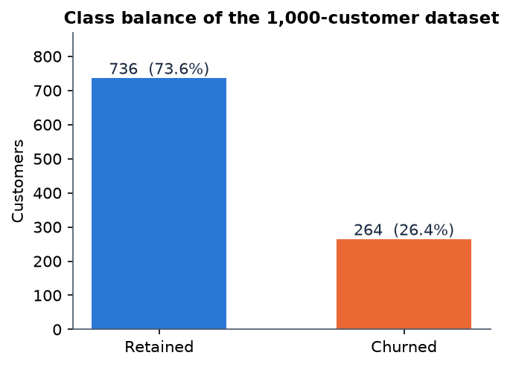
Dataset
1,000
19
26.4%
Synthetic
customers, 21 columns
features: 4 numeric, 15 categorical
churn rate (264 churned, 736 retained)
generated by src/sample_data.py, seed 42
Same column schema as the public Telco data (customerID, tenure, Contract, MonthlyCharges, Churn ...), but the rows are generated: churn comes from a latent logistic score plus noise.
No real operator data were available, so no claim is made about real-world accuracy.
Stratified 80/20 split: 800 training and 200 test rows, 53 churners in the test set; 0 duplicates, 0 missing cells.
Notes:
Be explicit that the data are synthetic, generated with the Telco schema. The base paper uses the real 7,043-row Telco data; the two are not comparable.

Slide 7
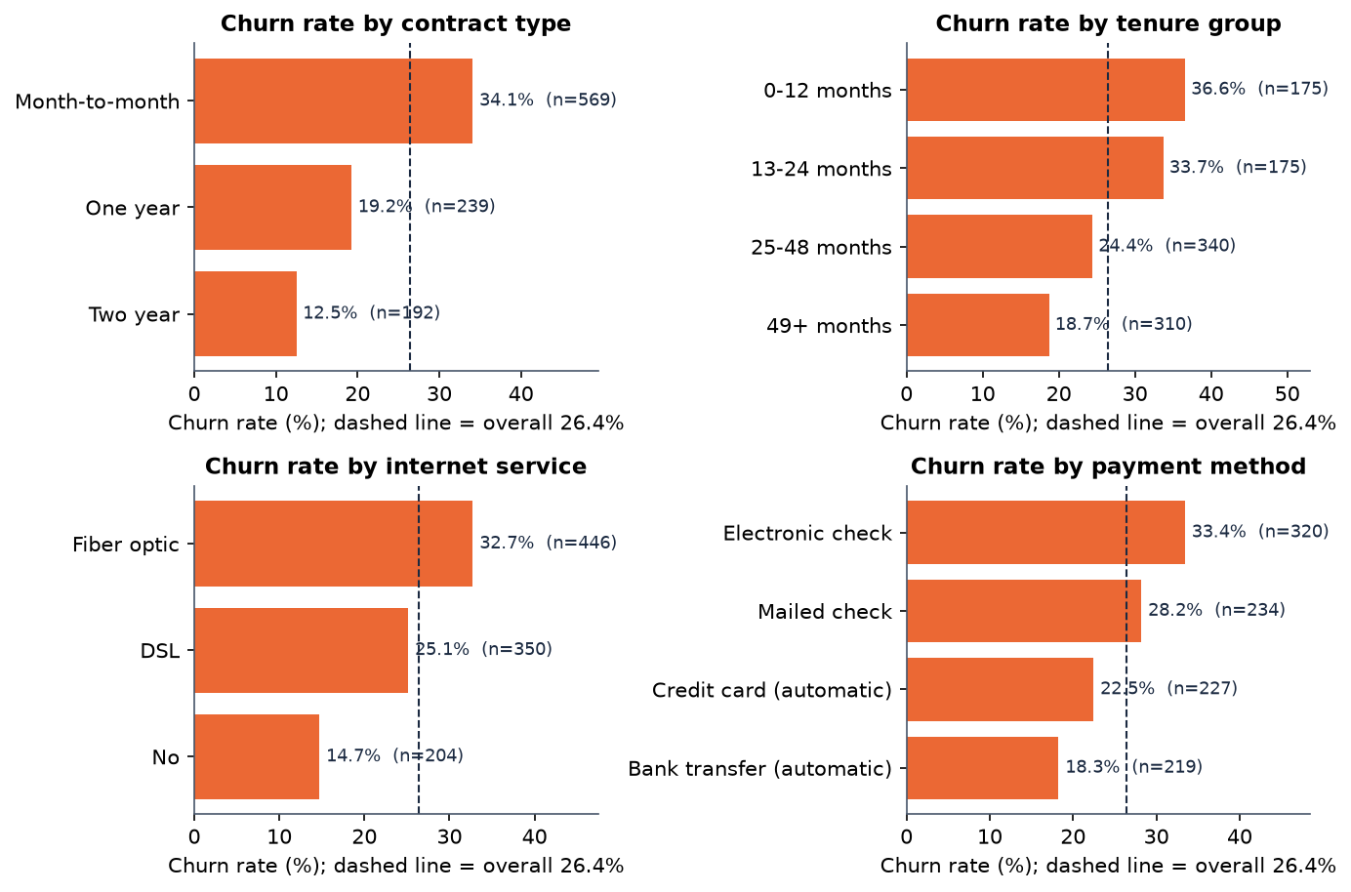
Data preprocessing
Step | What the code does
Detect | target (Churn) and ID (customerID) columns; blank TotalCharges coerced to numbers
Clean | drop exact duplicates; report missing cells
Numeric | median imputation, then StandardScaler (4 columns)
Categorical | most-frequent imputation, then OneHotEncoder(handle_unknown=ignore): 15 columns
Result | 45 model inputs; unseen categories at scoring time are ignored, not fatal
Churn rate by contract, tenure, internet service and payment method (all 1,000 rows): month-to-month 34.1% against 12.5% on a two-year contract.
Notes:
Preprocessing is one scikit-learn ColumnTransformer, fitted on the training split. The figure is the exploratory view the Explore page shows.

Slide 8
Models compared
Model | Settings (from src/train_models.py) | Imbalance handling
Logistic Regression | max_iter 2000 | class_weight balanced
Decision Tree | max_depth 8, min_samples_leaf 10 | class_weight balanced
Random Forest | 300 trees, max_depth 12, min_samples_leaf 5 | class_weight balanced
Gradient Boosting (optional) | 200 trees, depth 3, learning rate 0.08 | no class_weight option
Hist Gradient Boosting (optional) | max_depth 6, learning rate 0.08 | no class_weight option
Logistic Regression, Decision Tree and Random Forest are the required three. The two boosted models are optional; because they take no class_weight, "class weights" does not rebalance them, and the app says so.
Notes:
Five scikit-learn models behind one registry. Selecting the model on F1 is the default; recall, precision, accuracy and ROC-AUC can be chosen instead.

Slide 9
Training configuration
Setting | Value
Split | stratified, test size 20% (adjustable 10-40%), random_state 42
Imbalance | class_weight=balanced (default) | SMOTE on the training split only | none
Selection metric | F1-score (default); accuracy, precision, recall, ROC-AUC selectable
Risk bands | Low < 30, Medium 30-60, High 60-80, Critical >= 80; editable, validated on the server
Batch cut-off | predicted churn when probability >= 50%
Hardware | Intel Core i5-12500, CPU only; all five models train in 2.96 s
Notes:
These are the defaults of the Model Training page. The measured run uses exactly these settings.

Slide 10
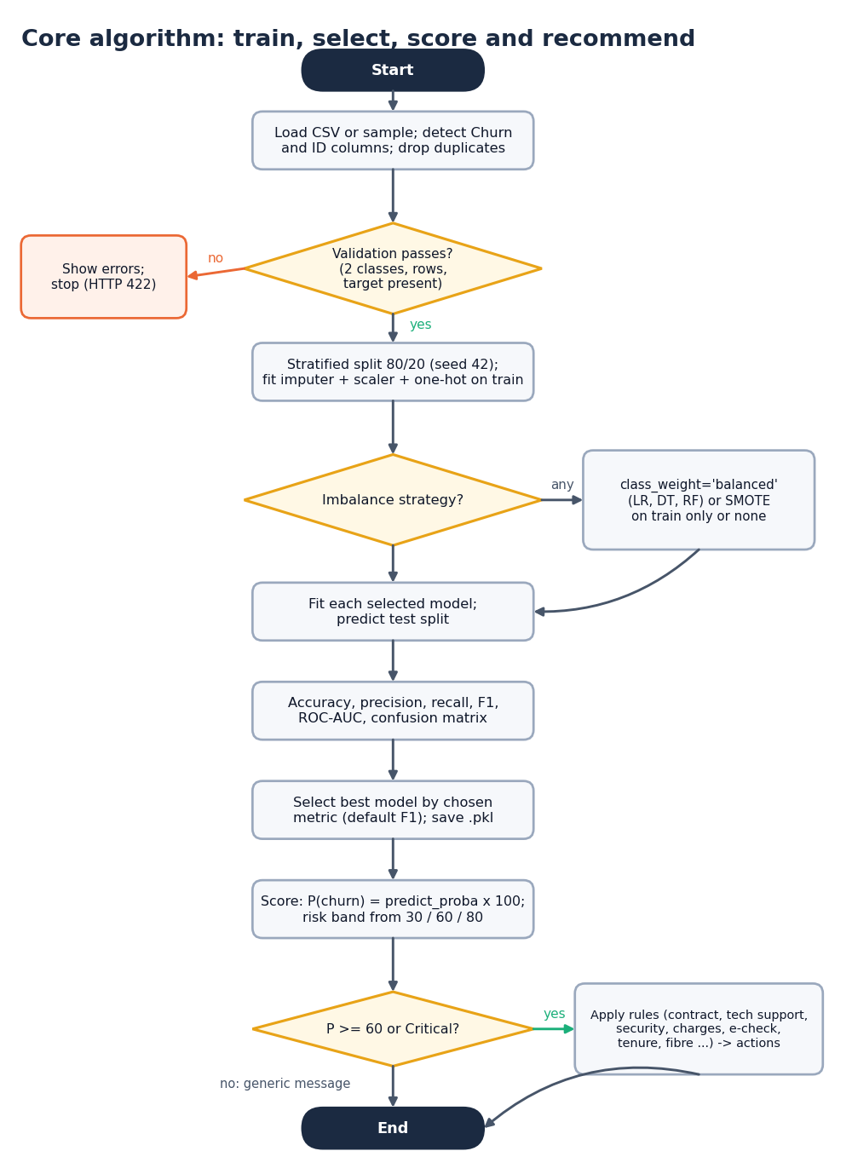
Decision logic
Validate. Two classes, enough rows and a target column; otherwise HTTP 422 and nothing is trained.
Decide. Probability = predict_proba x 100; the band follows the editable 30 / 60 / 80 thresholds.
Explain. Local: coefficient x value (top 5 up, top 5 down). Global: built-in and permutation importance. SHAP is optional and not installed here.
Act. Ten IF/THEN rules (contract, tech support, security, charges, e-check, tenure, fibre ...) fire at probability >= 60 or Critical band; two fallbacks cover lower risk.
Caution. Scores are rankings, not calibrated probabilities.
Notes:
The rule engine is a set of heuristics written by the team; its business effect has not been measured.

Slide 11
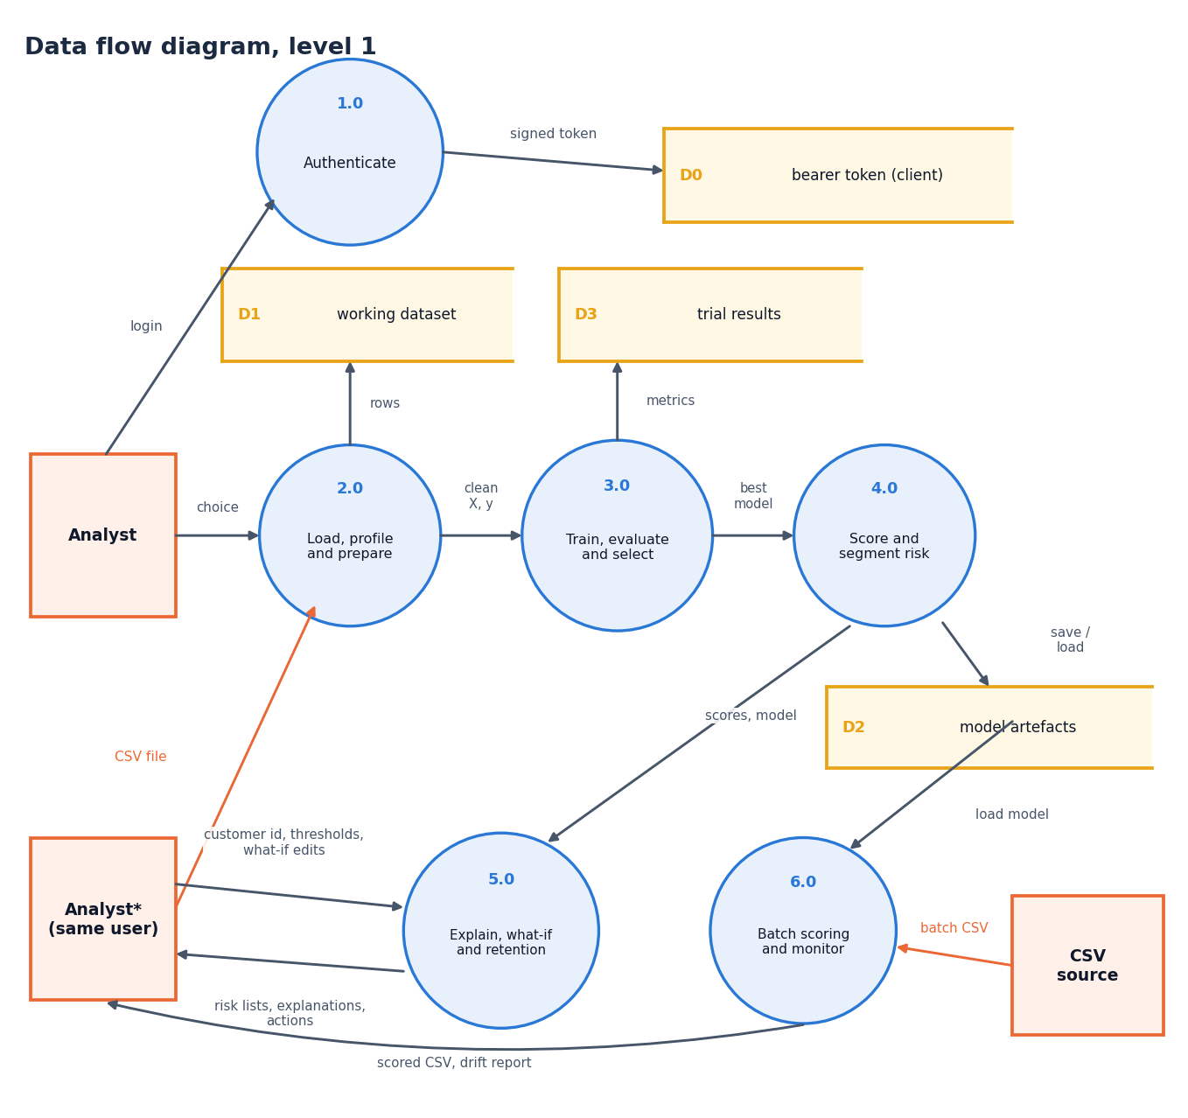
Data flow and modules
Module | Role
data_loader, eda | profile, target / ID, EDA charts
preprocessing | clean, ColumnTransformer, split, SMOTE
train_models, evaluation | registry, metrics, best model
explainability | importance, local drivers
risk_segmentation, prediction | bands, scores, batch
retention_engine | 10 rules + 2 fallbacks
persistence | joblib save / load
Notes:
Level-1 data flow: six processes. Level 0 and level 2 are in the report.

Slide 12
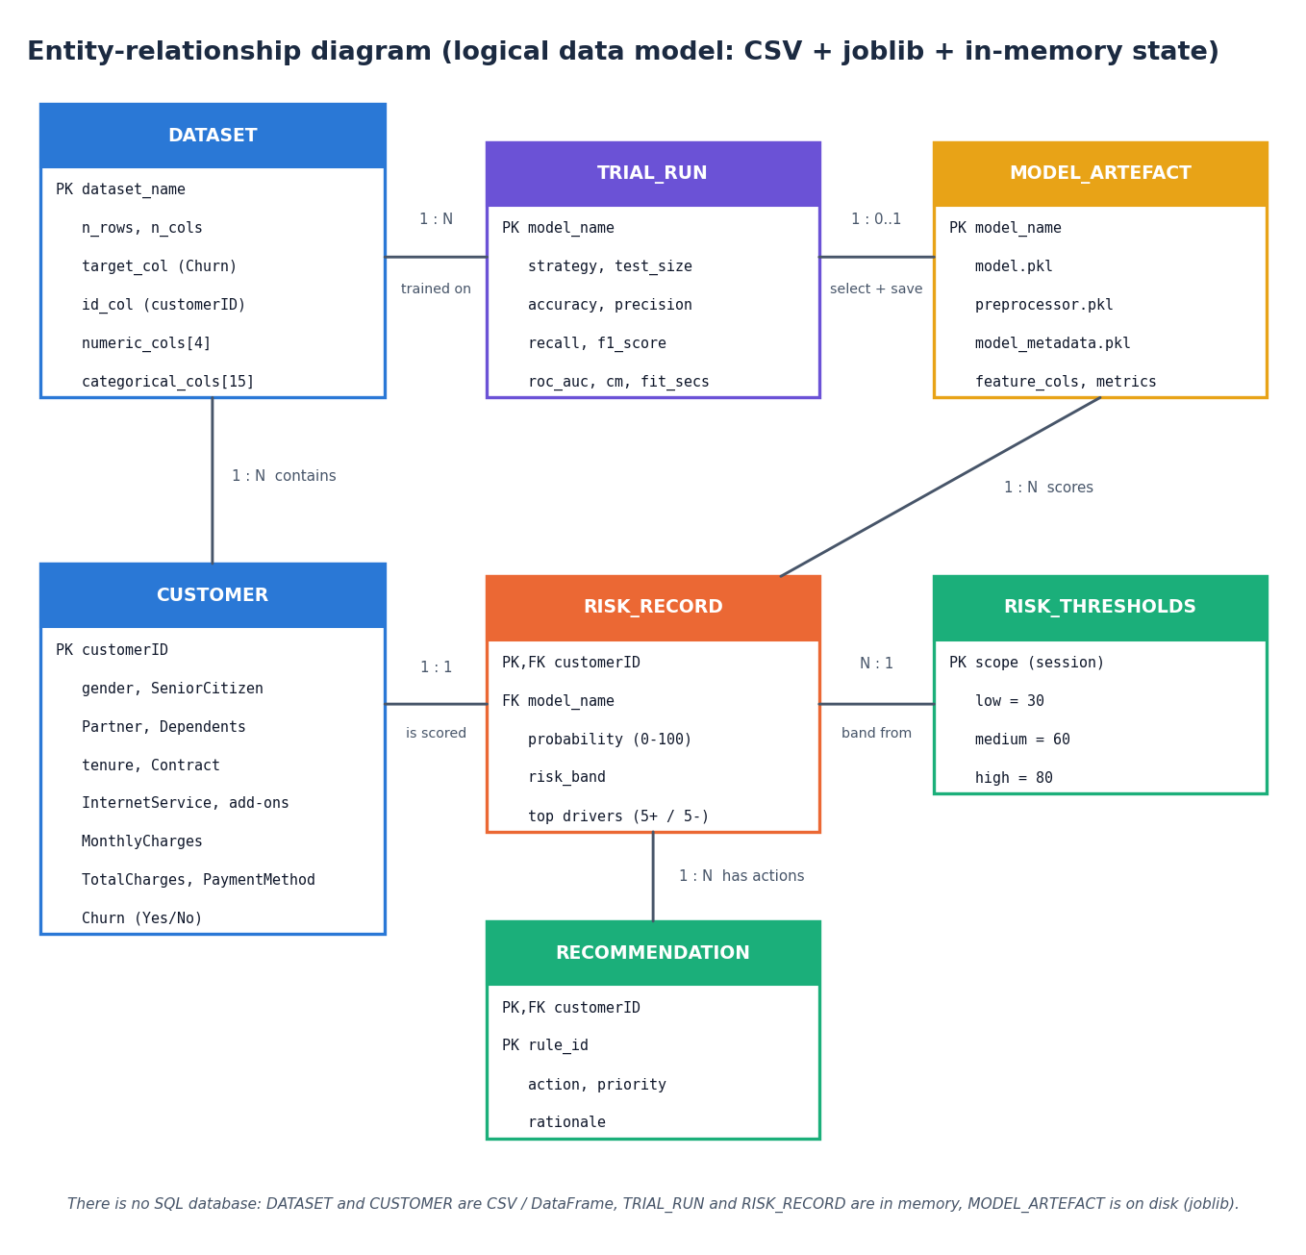
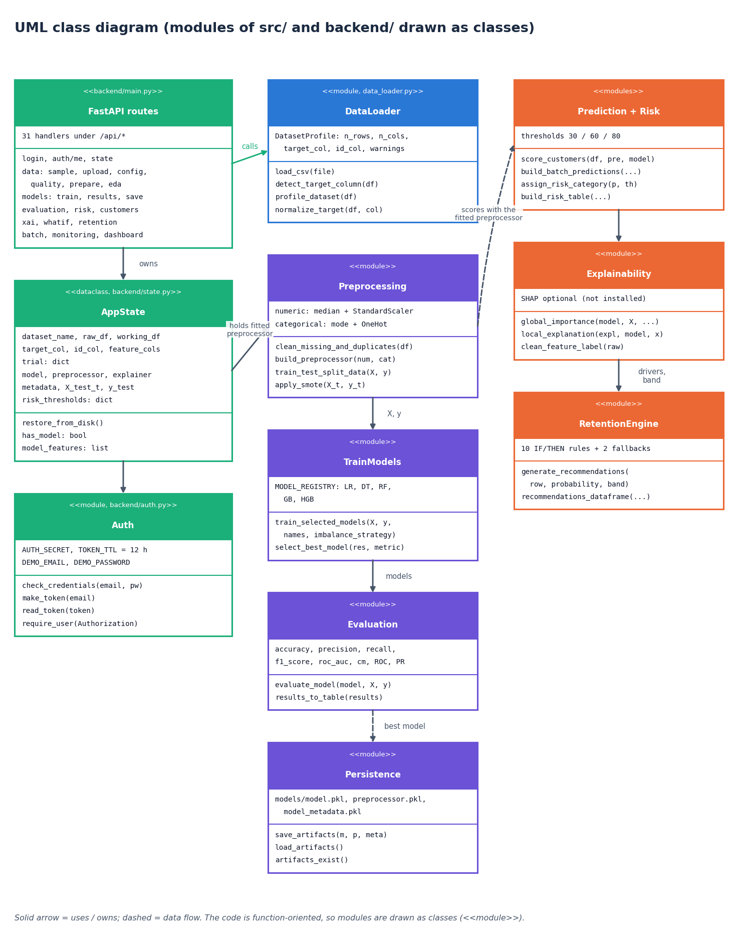
Data model and UML
There is no SQL database: the ER diagram is the logical data model (CSV, joblib files, in-memory state). The code is function-oriented, so the UML draws modules as classes (full-size diagrams are in the report).
Notes:
State plainly that there is no database. The logical model shows the entities the code handles; the UML draws modules as classes.

Slide 13
Technology stack
Layer | Technology
Machine learning | scikit-learn 1.9.1, imbalanced-learn (SMOTE), pandas 3.0.6, numpy 2.4.6, joblib
Explainability | built-in importance, permutation importance, coefficient x value; SHAP optional (not installed)
API | FastAPI 0.143.3, uvicorn; HMAC-SHA256 bearer token (standard library)
Original UI | Streamlit app (13 pages) over the same core, port 8501
Front end | React 19, Vite 8, React Router, Recharts, Framer Motion (kit V4)
Testing | pytest (44 tests), a 63-check API smoke test, Playwright for screenshots
Run | run.bat creates the virtual environment and starts ports 8314 / 5314 (Python 3.11.9, Windows)
Notes:
Everything is open source and runs on one machine; run.bat starts the stack.

Slide 14
Implementation progress
Component | Status | Evidence
Data load, profile, EDA, preprocessing | Done | src/, 44 pytest tests
Five-model training, evaluation, selection | Done | scripts/run_experiments.py, metrics.json
Risk bands, Customer 360, what-if, retention rules | Done | smoke test, 16 screenshots
Batch scoring and drift monitoring | Done | smoke test (63 checks)
FastAPI layer and React interface | Done | 31 routes, 16 page components
SHAP explanations | Code path only | shap not installed: fallbacks used, SHAP unmeasured
LIME, perturbation explainer, boosted libraries, database | Not implemented | out of scope; listed as limits
Notes:
State of the code base. The gaps are SHAP (present but unexercised) and the base paper's own explainer.

Slide 15
Preliminary results: 200-row test split
0.486
0.722
0.660
0.385
F1, Logistic Regression (best)
ROC-AUC, Logistic Regression
recall: 35 of 53 churners found
precision (56 false alarms)
i
Reading
80/20 split, seed 42, class weights; 53 churners in the test set, so results move by 0.03-0.10 between splits (see stability). ROC-AUC about 0.72 is moderate, and the data are synthetic.
Notes:
First measured numbers: Logistic Regression F1 0.486, ROC-AUC 0.722, recall 0.660, precision 0.385. Random Forest is within noise (F1 0.472). Gradient boosting has the highest accuracy (0.745) but a recall of only 0.283, which is why selection is on F1.

Slide 16
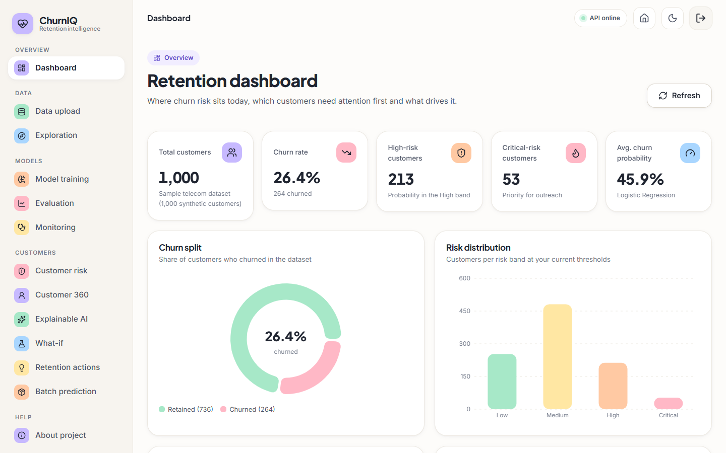
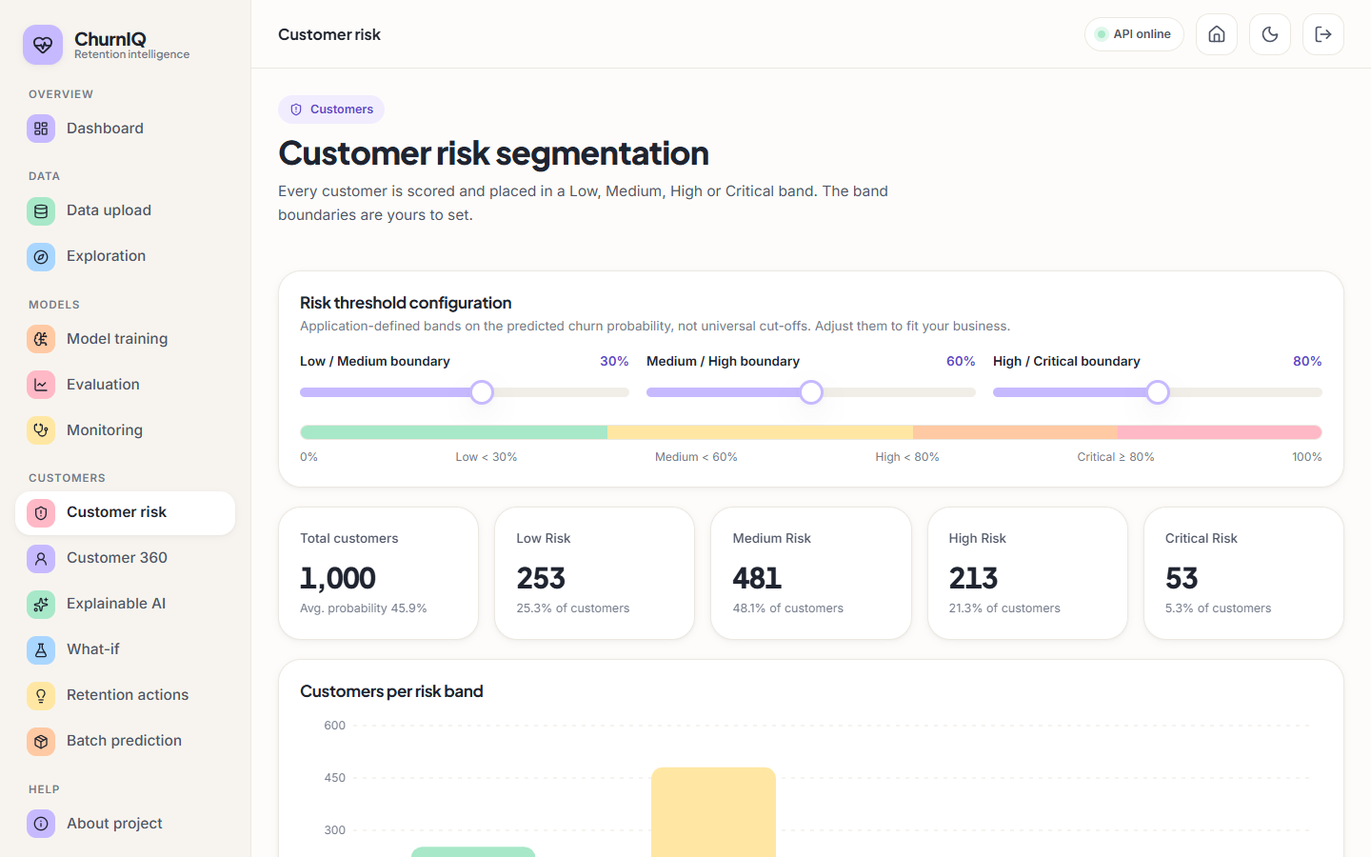
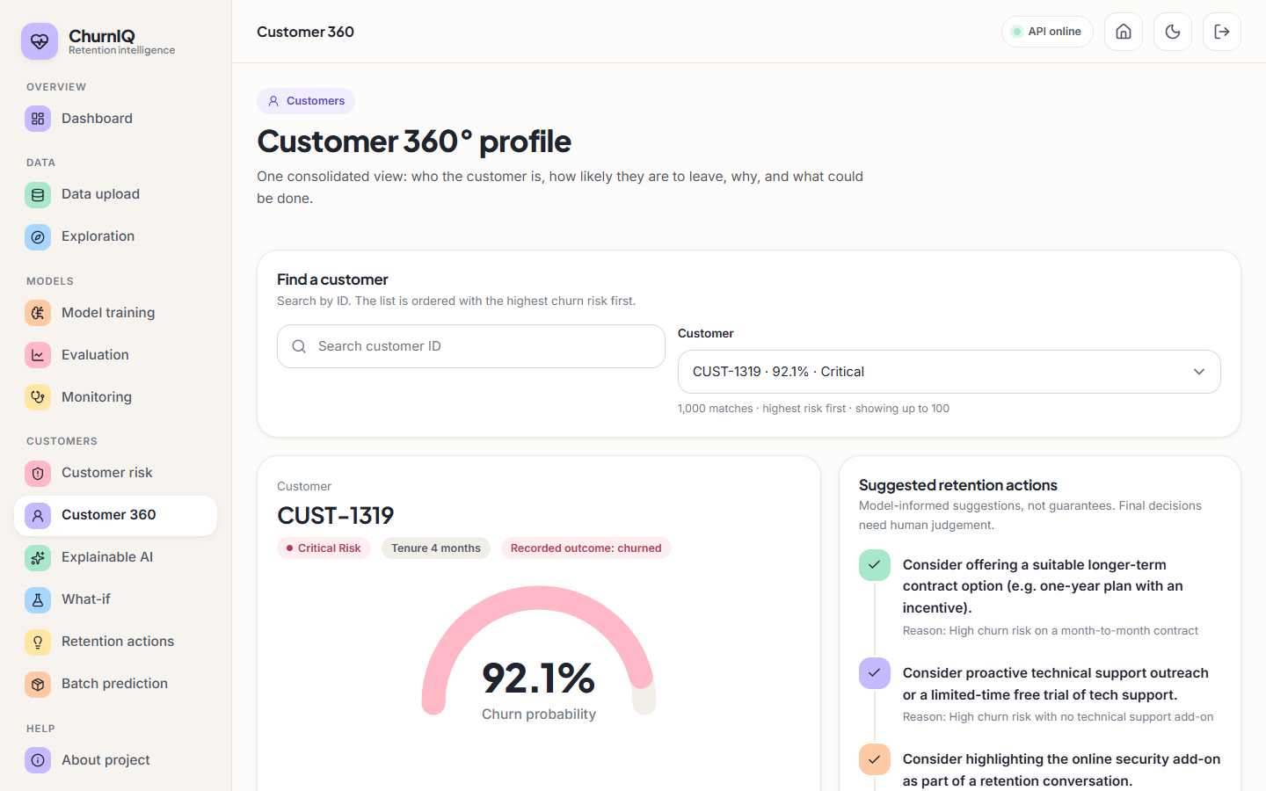
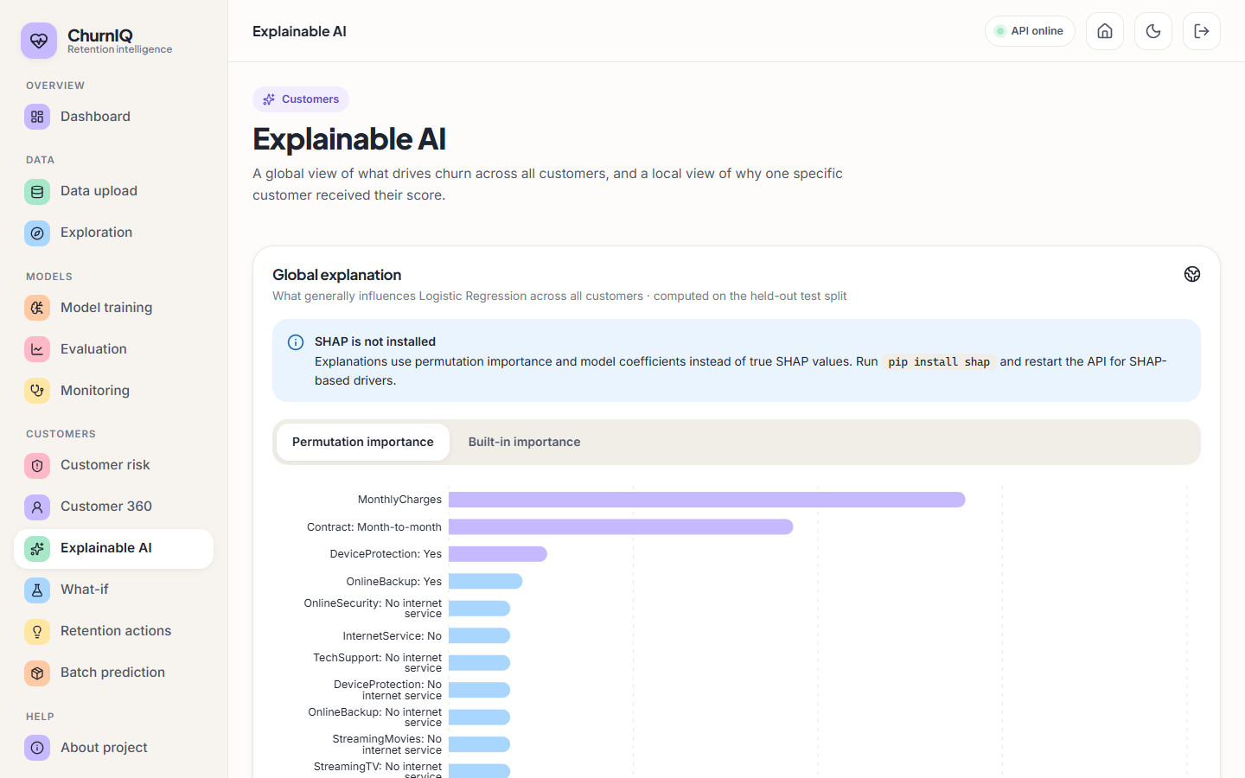
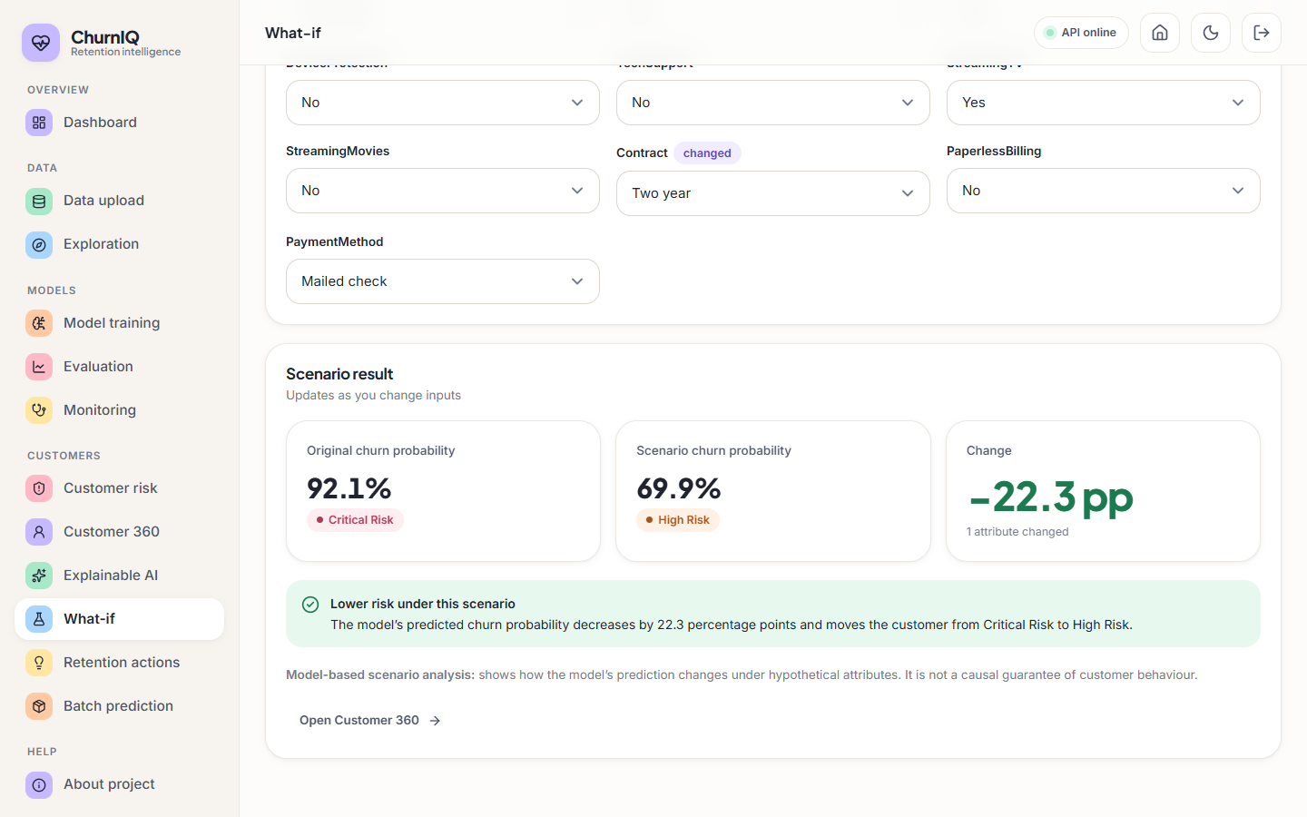
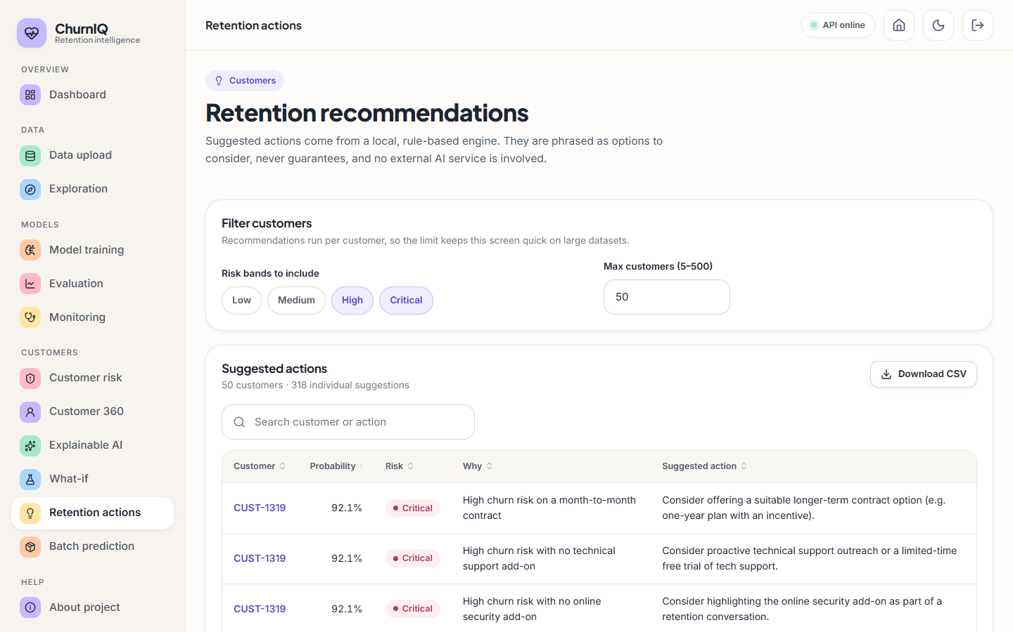
Output screens
Dashboard
Customer risk
Customer 360
Explainable AI
What-if
Retention actions
Notes:
Real screenshots from the running ChurnIQ application with 1,000 sample customers and three trained models.

Slide 17
Initial testing and observations
44
63
16
360-1440 px
pytest tests passed (venv and system Python)
live API smoke-test checks passed
screens captured, console clean
light and dark, no horizontal overflow
Observation | Action
A 200-row test split with 53 churners gives noisy metrics | Added 5-fold cross-validation and five random splits
Accuracy looks fine without imbalance handling (0.745) while recall collapses (0.189) | Selection on F1 and class weights by default
Tests showed pandas 3 string columns slip past dtype == object checks | Fixed in data_loader.py with a helper; regression tests added
Notes:
The tests run offline with the real code. The observations drove three changes. No load test, penetration test or user study has been done.

Slide 18
Challenges and corrective actions
Challenge | Corrective action
No real operator data available | Synthetic sample with the Telco schema; every document states it
SHAP is not installed | Built-in importance, permutation importance and coefficient x value; SHAP not claimed
Random Forest differs between scikit-learn versions on 200 rows (accuracy 0.665 vs 0.720) | Environment of record fixed (scikit-learn 1.9.1); both runs archived
pandas 3 string dtype broke type detection | Found by unit tests; fixed and covered by regression tests
Requests via localhost take an extra ~2 s on Windows (IPv6 tried first) | Measured against 127.0.0.1; documented as a quirk
Tiny test set | Cross-validation and seed spread reported beside the single split
Notes:
Each challenge was met with a concrete change in code or in how results are reported.

Slide 19
Next steps
1
Evaluate
2
Compare
3
Document
4
Extend (future)
Finish the stability study, the imbalance comparison, threshold and calibration analysis.
Set the results against the base paper, stating where data and protocol differ.
Final report, paper and deck with every figure regenerated from JSON.
Real operator data, SHAP and perturbation explainers, calibration, measured campaign effect.
Notes:
Plan to the final review. The extensions at the right are out of scope for this submission.

Slide 20
Thank you
Questions and suggestions are welcome.
Notes:
Likely questions: why synthetic data; why Logistic Regression is best here; why no SHAP numbers; why no database.

