Slide 1

Customer Churn Prediction in Telecom Industry
Final Review
Team Details : Batch A14
Under the Esteemed Guidance of
B. SRIKANTH
Assistant Professor, Department of CSE
23K91A0512 Anantula Sai Nikhila Sravani
23K91A0518 Avula Anudeep
24K915A0503 B Sandeep
23K91A0558 Daragani Vinod Kumar
DEPARTMENT OF COMPUTER SCIENCE AND ENGINEERING · TKR College of Engineering and Technology (Autonomous) · Academic Year [ACADEMIC YEAR]
Notes:
Introduce the team and the project: a machine learning retention system that predicts churn, explains it and suggests actions.

Slide 2
Table of Contents
Abstract
Base Paper & Literature Survey
Research Gap & Problem Statement
Objectives
Proposed System & Architecture
Methodology, Dataset & Model
Decision Workflow, Interaction & Data Model
Implementation Highlights
Results: Metrics, Stability, Threshold & Calibration
Performance, Testing & Comparison with Base Paper
Output Screens
Conclusion, Future Scope & References
Dept. of CSE | Batch A14 | Final Review
2
Notes:
The agenda follows the report: problem, design, method, results, comparison, screens, conclusion.

Slide 3
Abstract
Customers who leave a telecom provider cost far more to replace than to keep, yet churn is noticed only after they have gone, and a churn score with no reason gives the retention team nothing to act on.
We built ChurnIQ: cleaning and encoding, five classifiers (Logistic Regression, Decision Tree, Random Forest, Gradient Boosting, Hist Gradient Boosting), imbalance handling, selection on F1, risk bands, per-customer drivers, what-if and rule-based retention actions.
On a 1,000-customer synthetic dataset with the Telco schema, Logistic Regression is best: F1 0.486, ROC-AUC 0.722, recall 0.660 on a 200-row test split (53 churners). Results vary by 0.03-0.10 between splits and are moderate, not strong.
A FastAPI service and a React interface add batch scoring, drift monitoring and a demo login; 44 pytest tests and a 63-check smoke test pass.
Data are synthetic, SHAP is not installed (fallback explanations), probabilities are uncalibrated and the retention rules are unmeasured heuristics: all stated as limits.
Dept. of CSE | Batch A14 | Final Review
3
Notes:
Read the first two bullets, then the headline numbers with their protocol. End on the honest limits.

Slide 4
Base Paper
S.-V. Oprea and A. Bara, "Explaining Customer Churn Through Unified Perturbation-Based XAI Soft Computing," IEEE Access, vol. 14, pp. 24460-24478, 2026, doi: 10.1109/ACCESS.2026.3663648.
Aspect | Base paper
Method | LR, SVC, RF, balanced RF, CatBoost, XGBoost, LightGBM; unified perturbation-based explainer (RNP, FA, IM, AP) compared with SHAP and LIME
Data | Real Telco churn data, 7,043 customers, 21 columns, 26.5% churn; 70/30 split (2,113 test rows)
Reported results | Recall is the objective: up to 0.9077 (CatBoost); Spearman 0.8125 with SHAP; runtime SHAP 289.4 s, LIME 35.1 s, perturbation 18.5 s
Stated limits | Recall as the primary objective may change rankings under other metrics; one structured dataset; CRM integration proposed, not built
Dept. of CSE | Batch A14 | Final Review
4
Notes:
A research framework on the real Telco data. We take its motivation; we do not reproduce its explainer or its model set.

Slide 5
Literature Survey
Work | Approach | Data | Reported result | Limitation
Oprea and Bara, 2026 [1] (base paper) | Unified perturbation-based explainer (RNP, FA, IM, AP) compared with SHAP and LIME; LR, SVC, RF, balanced RF, CatBoost, XGBoost, LightGBM | Telco churn, 7,043 customers, 30% test (2,113) | Recall up to 0.9077 (CatBoost); Spearman 0.8125 with SHAP; runtime 18.5 s vs SHAP 289.4 s | One dataset; recall as the single objective; CRM integration proposed, not built
Sikri et al., 2024 [2] | Ratio-based data balancing as a pre-processing step; single and ensemble classifiers | Imbalanced telecom churn data (details not extracted) | Ensembles beat single models; best XGBoost at a 75:25 ratio (accuracy, precision, recall, F-score) | Abstract-level reading only; no per-customer explanation described
El Attar and El-Hajj, 2026 [3] | Eight models incl. XGBoost, LightGBM, soft-voting ensemble; SHAP feature analysis | IBM Telco, 7,043 customers, 80/20 split (1,409 test) | XGBoost accuracy 0.84, AUC 0.932; Logistic Regression 0.78 and 0.864 | Single dataset; authors note SHAP is not causal
Rasool et al., 2025 [4] | Stacking ensemble of tree models with SHAP | Kaggle Churn in Telecoms, 3,333 customers | Accuracy 94.75%, recall 73.20%, F1 80.23% | No temporal modelling; telecom data only
Lundberg and Lee, 2017 [7] | SHAP: additive Shapley-value attributions for any model | Method paper | Unifies several attribution methods | Costly on large data: 289.4 s in the experiment of [1]
Ribeiro et al., 2016 [8] | LIME: local surrogate model around one prediction | Method paper | Faithful local explanation of any classifier | Moderate fidelity and lower consistency than SHAP in [1]
Slack et al., 2020 [9] | Adversarial attacks on LIME and SHAP | Method paper | Shows perturbation-based explainers can be fooled | Perturbation-based explanations need cautious reading
Details read from each paper's own page. Three papers named in the batch survey could not be located online by title and were not analysed.
Dept. of CSE | Batch A14 | Final Review
5
Notes:
Results are quoted as the authors report them; the datasets and splits differ, so the numbers are not comparable with each other or with ours.

Slide 6
Research Gap
Prediction + explanation: most surveyed work compares classifiers; per-customer explanation is a separate step or a research method.
Explanation to action: even with SHAP, mapping drivers to a concrete retention step is left to the reader.
Cost: SHAP took 289.4 s in the base paper's experiment; lighter ways to rank drivers are useful.
Imbalance and metrics: accuracy hides the minority class; recall, precision and F1 must be shown together.
Usability: few works deliver an application an analyst can run end to end.
Dept. of CSE | Batch A14 | Final Review
6
Notes:
The surveyed work compares classifiers on churn datasets and, in the base paper, concentrates on how to explain them quickly. The gap this project addresses is pairing accurate prediction with per-customer explanation so that retention action can be targeted rather than generic: a working application that scores every customer, shows the drivers of each score and maps them to concrete actions.

Slide 7
Problem Statement
Given a table of telecom customer records (tenure, contract type, monthly charges, internet service, payment method and related fields), predict for each customer the probability of leaving, group customers into risk bands, show which attributes drive each prediction, and turn the result into a concrete retention action, all in an application that a retention analyst can run without writing code. The predictor must cope with the minority-class imbalance of churn data and must be evaluated with metrics that are not fooled by it.
Input
Output
Record
Customer records as CSV (sample: 1,000 rows, 19 features)
Churn probability, risk band, drivers, retention actions
Metrics, saved model, batch-scored CSV
Dept. of CSE | Batch A14 | Final Review
7
Notes:
The statement has three parts: predict and band, explain, act.

Slide 8
Objectives
1. Acquire a telecom customer dataset and perform exploratory analysis of churn behaviour.
2. Clean the data, encode categorical fields and address class imbalance between churned and retained customers.
3. Train and compare Logistic Regression, Decision Tree and Random Forest classifiers.
4. Evaluate using accuracy, precision, recall, F1-score and ROC-AUC.
5. Identify the features that contribute most strongly to churn risk.
6. Present at-risk customers and their risk drivers through a retention dashboard.
Dept. of CSE | Batch A14 | Final Review
8
Notes:
Six objectives of the proposal. The conclusion states how each was met.

Slide 9
Proposed System
Load data
Prepare + balance
Train + select
Score + band
Explain + act
Five scikit-learn classifiers behind one registry; best model chosen on F1 (selectable), saved with joblib and restored at start-up.
Risk bands Low / Medium / High / Critical at 30 / 60 / 80, editable and validated on the server; Customer 360 view for one customer.
Local drivers (coefficient x value) and global importance (built-in, permutation); what-if scenarios; ten rule-based retention actions.
FastAPI service and React interface (ChurnIQ) over the same core as the original Streamlit app; demo sign-in; batch scoring; drift check.
Dept. of CSE | Batch A14 | Final Review
9
Notes:
The proposed system in one line of boxes, then the four properties that matter.

Slide 10
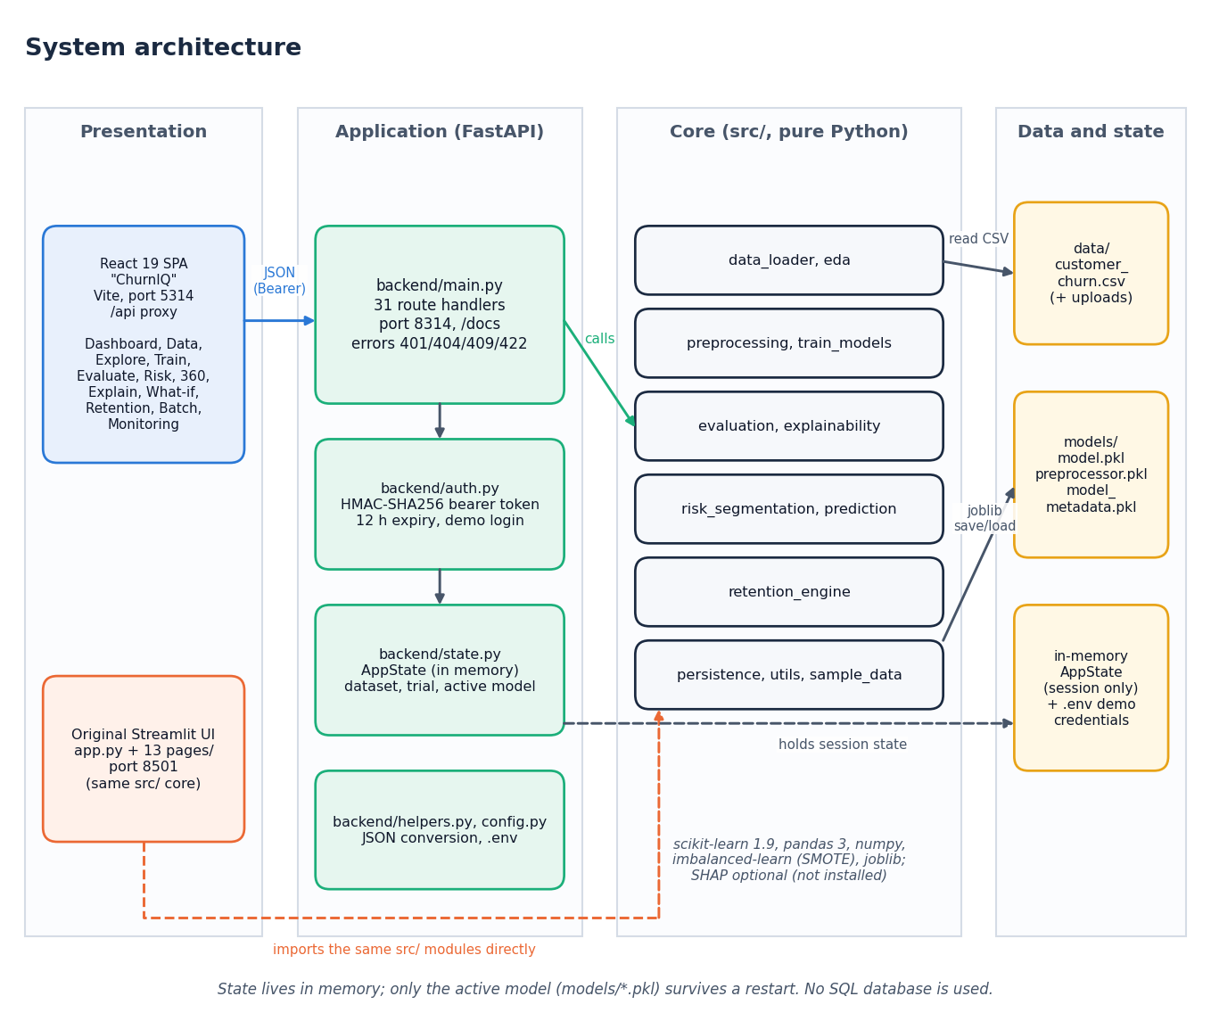
System Architecture
Presentation: React SPA (port 5314); original Streamlit UI (8501)
Application: FastAPI (8314), 31 routes, HMAC-signed bearer token, in-memory AppState
Core: 12 pure-Python modules in src/
Data and state: CSV files, joblib model files, memory; no SQL database
Dept. of CSE | Batch A14 | Final Review
10
Notes:
Four tiers; the core is shared by both interfaces.

Slide 11
Methodology
Load CSV
Profile + clean
Split 80/20
Fit preprocessor
Balance + train
Evaluate
Save + score
Stratified split, test size 20% (seed 42). Median imputation + StandardScaler for 4 numeric columns; mode imputation + one-hot for 15 categorical columns (45 model inputs). Fitted on the training split only.
Imbalance: class_weight=balanced (default), SMOTE on the transformed training split only, or none. Selection on F1 by default.
Beyond one split: 5-fold stratified cross-validation and five random splits, because the 200-row test set holds only 53 churners.
Every number is written to JSON by scripts/run_experiments.py and regenerated into the documents.
Dept. of CSE | Batch A14 | Final Review
11
Notes:
The workflow is what the Model Training page runs, plus the extra protocols added because the test split is small.

Slide 12
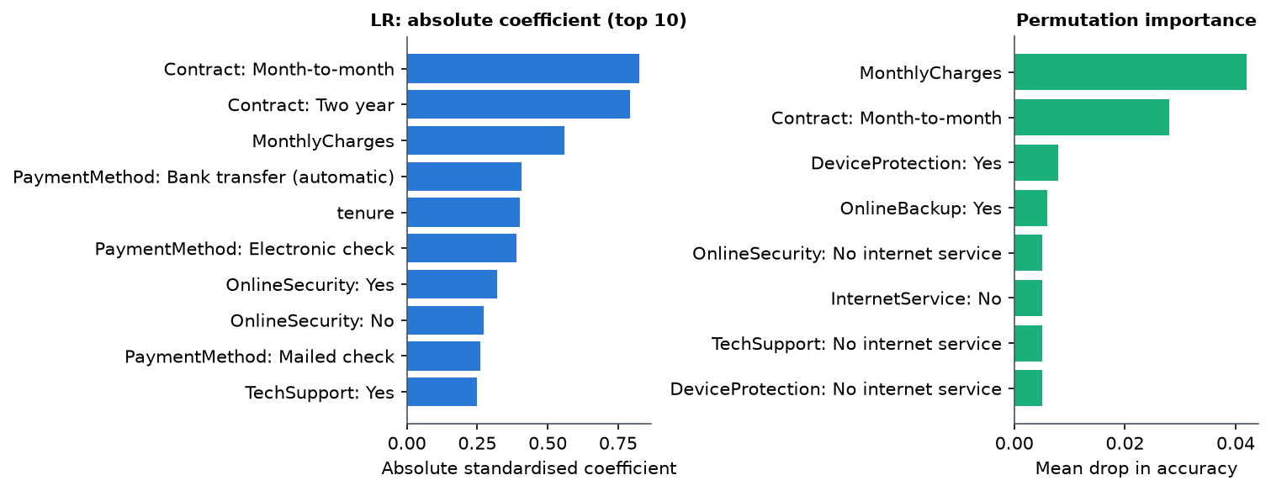
Dataset, Features & Drivers
1,000
customers, 21 columns (synthetic)
26.4%
churn: 264 churned, 736 retained
19 -> 45
raw features -> encoded inputs
Logistic Regression drivers: contract type, monthly charges, tenure, payment method; permutation importance agrees on monthly charges and month-to-month contracts.
The data were generated with these relationships, so recovering them checks the pipeline: it is not evidence about real customers.
Dept. of CSE | Batch A14 | Final Review
12
Notes:
Dataset and drivers. Be explicit that the rows are generated with the Telco schema and that the drivers are a check on the pipeline.

Slide 13
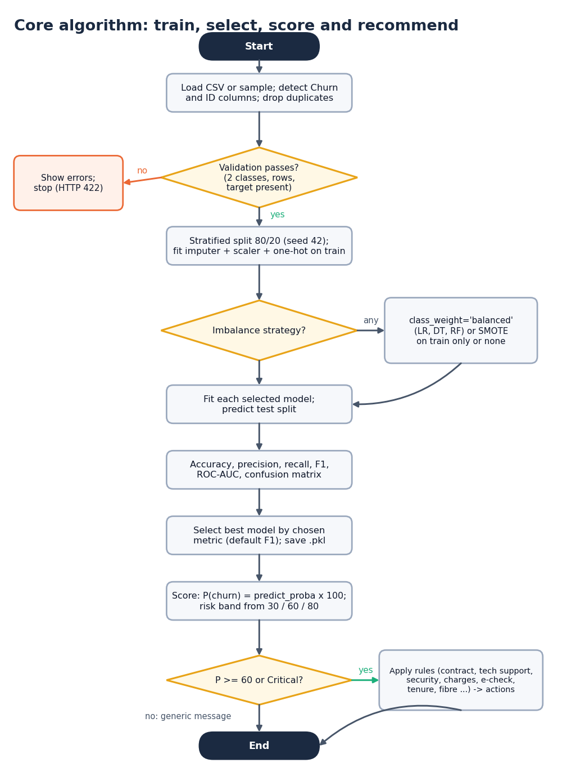
Decision Workflow
Validate: two classes, rows and a target; failures return HTTP 422 and train nothing.
Decide: probability = predict_proba x 100; band from the 30 / 60 / 80 thresholds; batch cut-off 50%.
Explain: coefficient x value (top 5 up, top 5 down); SHAP optional, not installed.
Act: ten IF/THEN rules fire at probability >= 60 or Critical; two fallbacks otherwise. Heuristics: effect not measured.
Dept. of CSE | Batch A14 | Final Review
13
Notes:
The training and scoring path in decision form.

Slide 14
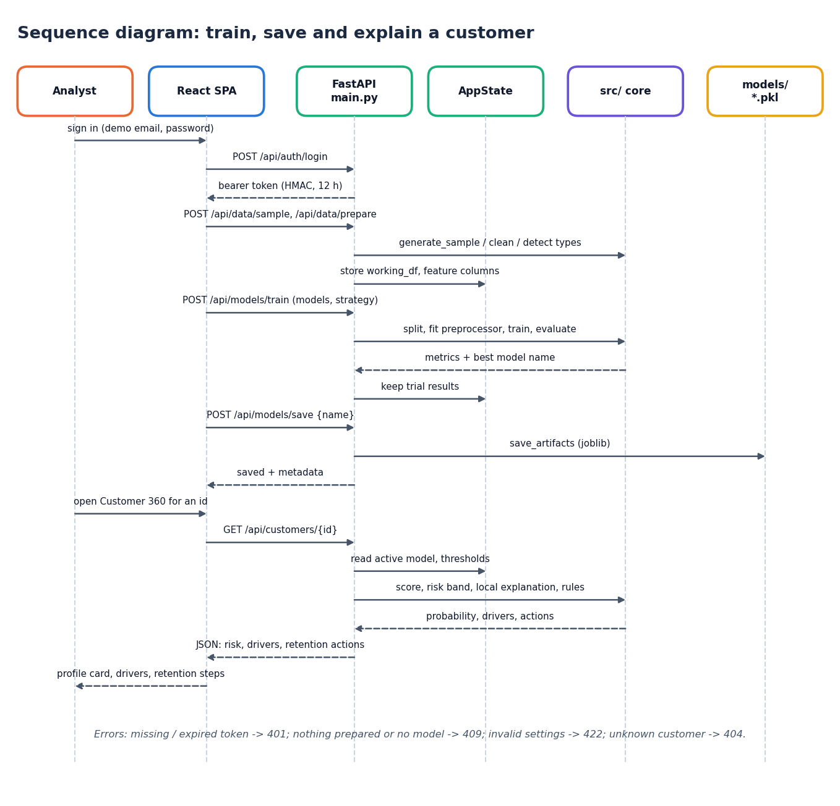
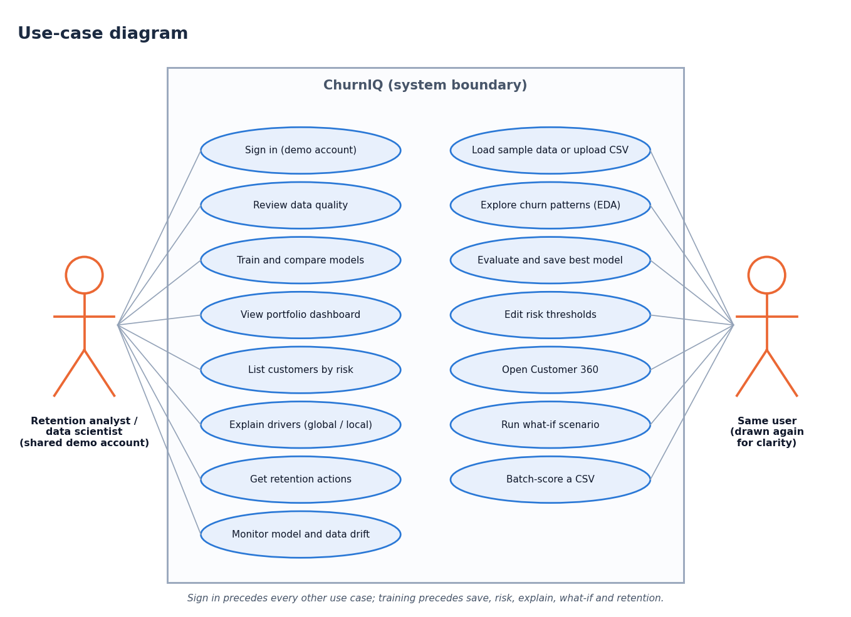
User – System Interaction
Dept. of CSE | Batch A14 | Final Review
14
Notes:
Sequence of one train-save-explain session and the use cases of the analyst.

Slide 15
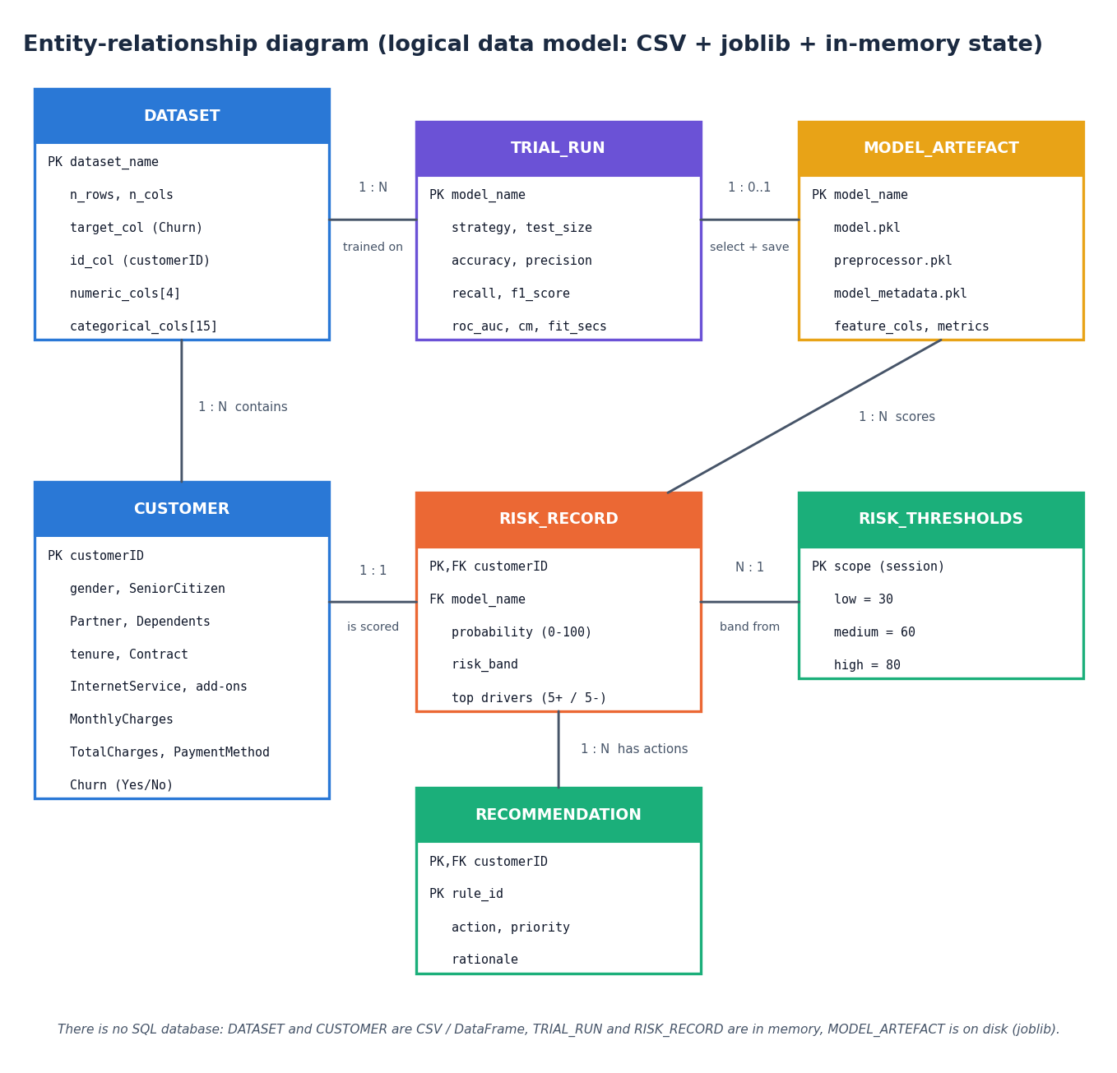
Data Model (logical)
Entity | Where it lives
DATASET, CUSTOMER | CSV / DataFrame
TRIAL_RUN, RISK_RECORD | in memory (AppState)
MODEL_ARTEFACT | models/*.pkl (joblib)
RISK_THRESHOLDS | in memory, editable
RECOMMENDATION | computed per customer
There is no SQL database: only the active model survives a restart. This is the logical data model of what the code handles.
Dept. of CSE | Batch A14 | Final Review
15
Notes:
State plainly that there is no database; the diagram is a logical model.

Slide 16
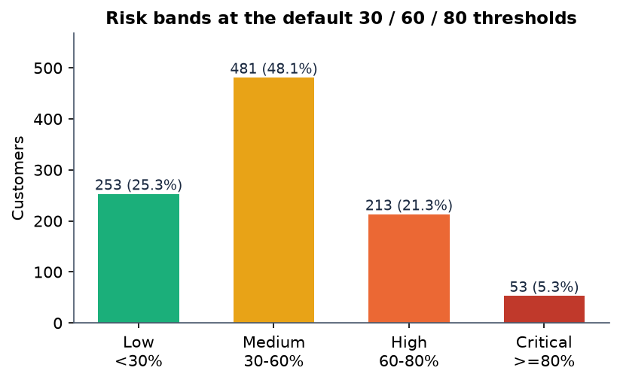
Implementation Highlights
31
44
16
1
REST route handlers
pytest tests
React page components
command to start (run.bat)
HMAC-SHA256 bearer token (12 h), 401 on protected routes; server-side validation (422) of settings and uploads.
In-memory session state; the active model is restored from models/*.pkl at start-up.
Batch scoring validates columns, scores every row and can add top-3 drivers; drift check compares new data with the training data.
Same src/ core serves the Streamlit app, the API and the experiment scripts.
Dept. of CSE | Batch A14 | Final Review
16
Notes:
Highlights: security basics, session state, batch and drift, shared core. Risk bands: Low 253, Medium 481, High 213, Critical 53 of the 1,000 customers at the default thresholds (scored on the training data too, so this is the portfolio view, not generalisation).

Slide 17
Results – Model Performance (80/20 split, seed 42)
Model | Accuracy | Precision | Recall | F1 | ROC-AUC
Logistic Regression | 0.630 | 0.385 | 0.660 | 0.486 | 0.722
Decision Tree | 0.615 | 0.338 | 0.472 | 0.394 | 0.608
Random Forest | 0.665 | 0.405 | 0.566 | 0.472 | 0.711
Gradient Boosting | 0.745 | 0.536 | 0.283 | 0.370 | 0.697
Hist Gradient Boosting | 0.710 | 0.400 | 0.189 | 0.256 | 0.685
Logistic Regression is best on F1 (0.486), ROC-AUC and recall; Random Forest is within one standard deviation (F1 0.472); Decision Tree is weakest.
Gradient boosting has the highest accuracy (0.745) but finds only 15 of 53 churners (recall 0.283): why selection is on F1. Class weights were used; test set 200 rows.
Dept. of CSE | Batch A14 | Final Review
17
Notes:
Protocol: 800 training rows, 200 test rows (53 churners), class weights, seed 42. ROC-AUC about 0.72 is moderate.

Slide 18
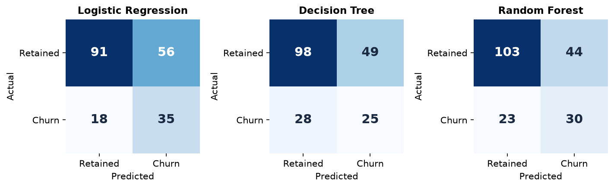
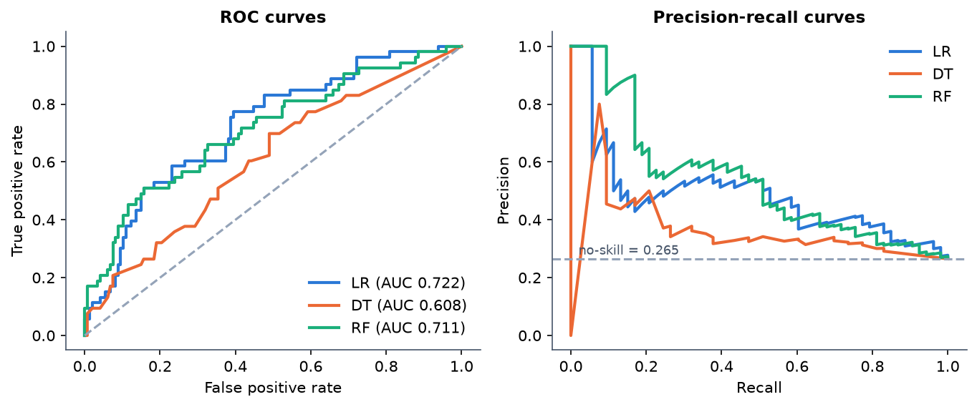
Confusion Matrices & ROC / Precision-Recall
Model | TN | FP | FN | TP
Logistic Regression | 91 | 56 | 18 | 35
Decision Tree | 98 | 49 | 28 | 25
Random Forest | 103 | 44 | 23 | 30
Gradient Boosting | 134 | 13 | 38 | 15
Hist Gradient Boosting | 132 | 15 | 43 | 10
Logistic Regression: 35 of 53 churners found, 56 of 147 loyal customers flagged (precision 0.385).
The curves for LR and RF are close; the Decision Tree is lower (AUC 0.608).
Test split: 200 rows, 53 churners.
Dept. of CSE | Batch A14 | Final Review
18
Notes:
Rows are the true class and columns the prediction. Cost: a false alarm is a wasted offer; a miss is a lost customer. The business costs were not measured.

Slide 19
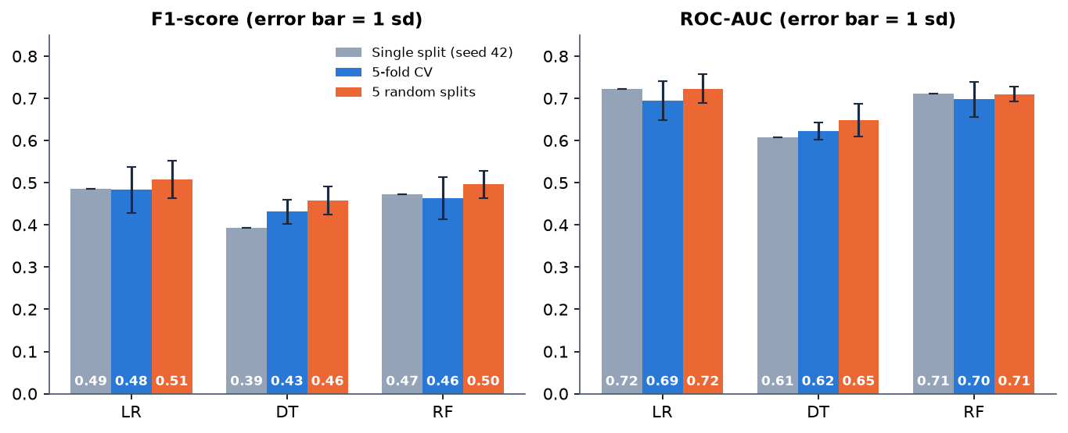
Stability: Cross-Validation and Five Splits
Mean ± standard deviation over folds or seeds; each fold holds 200 rows.
LR and RF are within one standard deviation of each other on F1 and ROC-AUC.
The single split is not unusual, but the spread (0.03-0.10) shows how noisy 53 churners are.
Model | F1 (5-fold CV) | F1 (5 splits) | ROC-AUC (5-fold CV) | ROC-AUC (5 splits)
Logistic Regression | 0.483 ± 0.055 | 0.507 ± 0.044 | 0.695 ± 0.046 | 0.723 ± 0.034
Decision Tree | 0.431 ± 0.028 | 0.457 ± 0.033 | 0.623 ± 0.020 | 0.648 ± 0.040
Random Forest | 0.463 ± 0.051 | 0.496 ± 0.033 | 0.697 ± 0.042 | 0.710 ± 0.017
Dept. of CSE | Batch A14 | Final Review
19
Notes:
Cross-validation and five random splits, class weights. The ranking LR ~ RF > DT is stable; the gap between LR and RF is not.

Slide 20
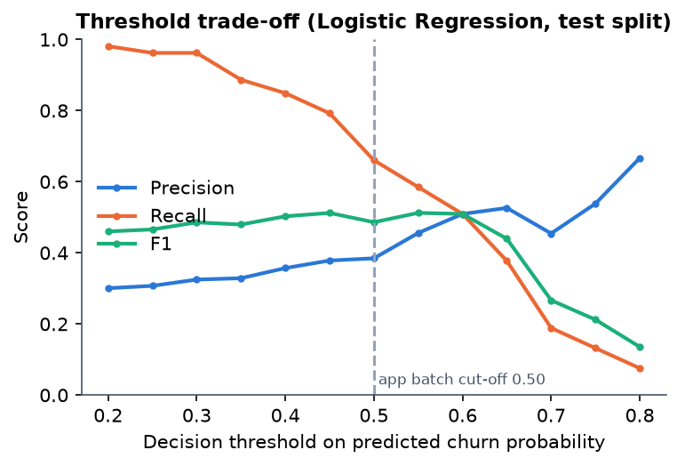
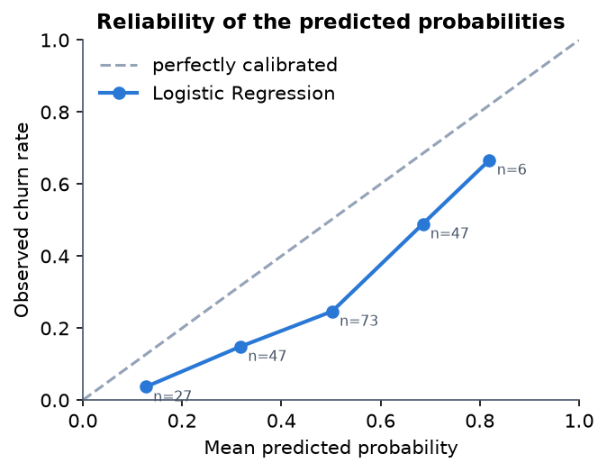
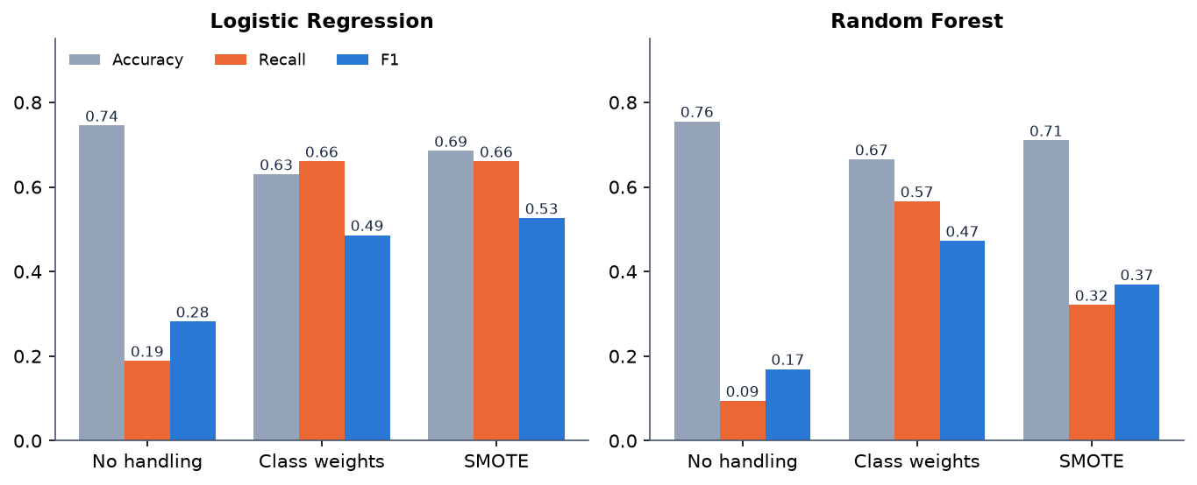
Threshold, Calibration & Imbalance
Threshold 0.50: precision 0.385, recall 0.660; 0.30: recall 0.962, precision 0.325. F1 is flat from 0.40 to 0.60.
Calibration: Brier 0.213 against 0.195 for a constant predictor; mean prediction 0.46 vs 0.27 observed. Scores are rankings, not probabilities.
Top 20% by score (40 customers) holds 21 of 53 churners: lift 2.0x.
Without imbalance handling accuracy looks fine (LR 0.745, RF 0.755) while recall collapses (LR 0.189, RF 0.094).
Class weights (default) and SMOTE restore recall; SMOTE gave LR its best single-split F1 (0.526) but was tried on one split only.
Dept. of CSE | Batch A14 | Final Review
20
Notes:
Threshold, calibration and imbalance on the Logistic Regression test predictions (200 rows). With 20-60 contacts the lift counts are small.

Slide 21
Performance & Testing
19.1 ms
35.4 ms
2.96 s
94 ms
score one customer (median, 200 runs)
score all 1,000 customers
train and evaluate five models
API dashboard call (median of 10)
Test layer | What it covers | Result
pytest (src/ core, token auth) | sample data, preprocessing, SMOTE, training, risk bands, batch, rules, persistence | 44 passed (pandas 3 and pandas 2)
API smoke test | 63 checks: auth, data, train, evaluation, risk, explain, what-if, retention, batch, drift | 63 PASS, 0 FAIL
Browser walk (Playwright, Chrome) | 16 screens with real data at 1440 x 900; 360-1440 px, light and dark | console clean, no overflow
Not done | load test, penetration test, user study, other browsers, SHAP path | stated as limits
Over 127.0.0.1 on an i5-12500 CPU. Via the name localhost every request costs an extra ~2 s on this Windows machine (IPv6 tried first); not a code fault.
Dept. of CSE | Batch A14 | Final Review
21
Notes:
Latency on a CPU-only desktop. Single-customer scoring was 2.85 ms under scikit-learn 1.5.0 / pandas 2.2.1 and 19 ms in the pandas 3 environment of record.

Slide 22
Comparison with Base Paper (context only – different data)
Aspect | Base paper [1] | This project
Data | Real Telco churn, 7,043 customers, 26.5% churn | Synthetic, 1,000 customers, same schema, 26.4% churn
Split | 70/30 (2,113 test rows) | 80/20 stratified (200 test rows, 53 churners)
Models | LR, SVC, RF, balanced RF, CatBoost, XGBoost, LightGBM | LR, DT, RF (required) + GB, HGB (scikit-learn only)
Objective | Recall is the primary objective | F1 by default, user-selectable
Reported | Recall 0.4112 (LR) to 0.9077 (CatBoost); LR accuracy 0.7120 | LR on synthetic data: recall 0.660, accuracy 0.630, ROC-AUC 0.722
Explanation | SHAP, LIME, unified perturbation explainer; runtime comparison | Built-in + permutation importance, coefficient x value; SHAP code present, not run
Beyond the paper | — | Risk bands, Customer 360, what-if, retention rules, batch, drift, web UI
Not like-for-like: different data, size, split and model set. The numbers are context, not a ranking; we do not claim to match or beat the paper.
Dept. of CSE | Batch A14 | Final Review
22
Notes:
State plainly that the base paper uses real Telco data and a different protocol. Our data are synthetic; the drivers we recover were built into the generator.

Slide 23
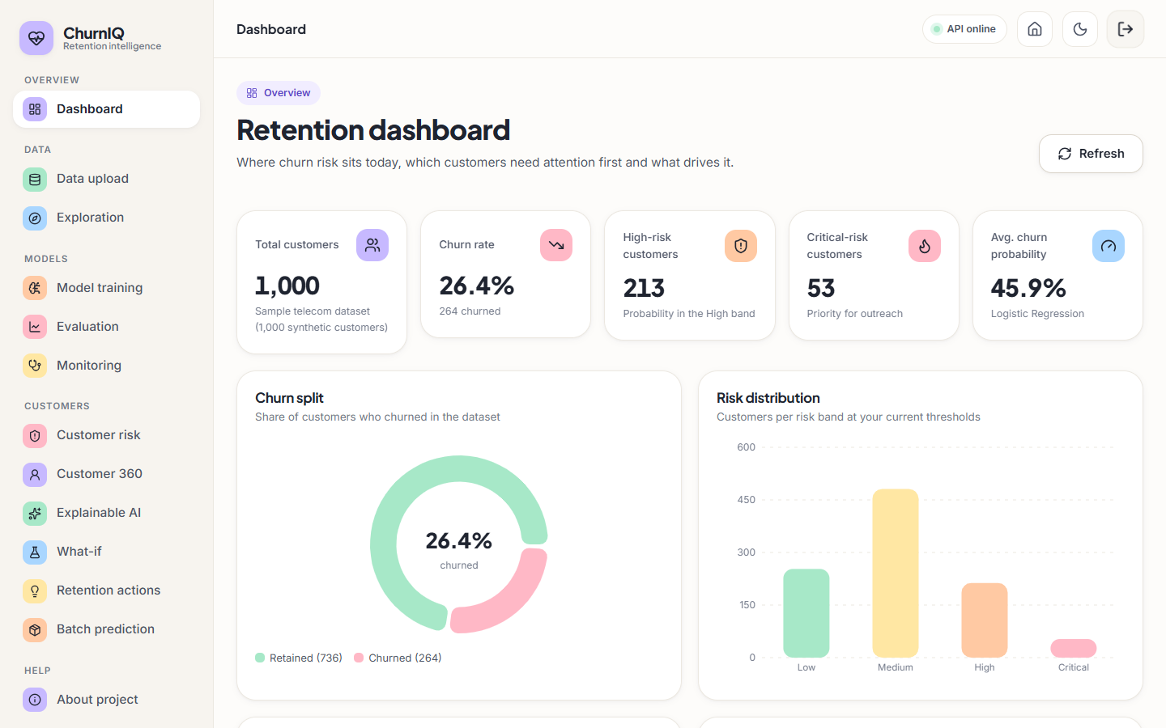
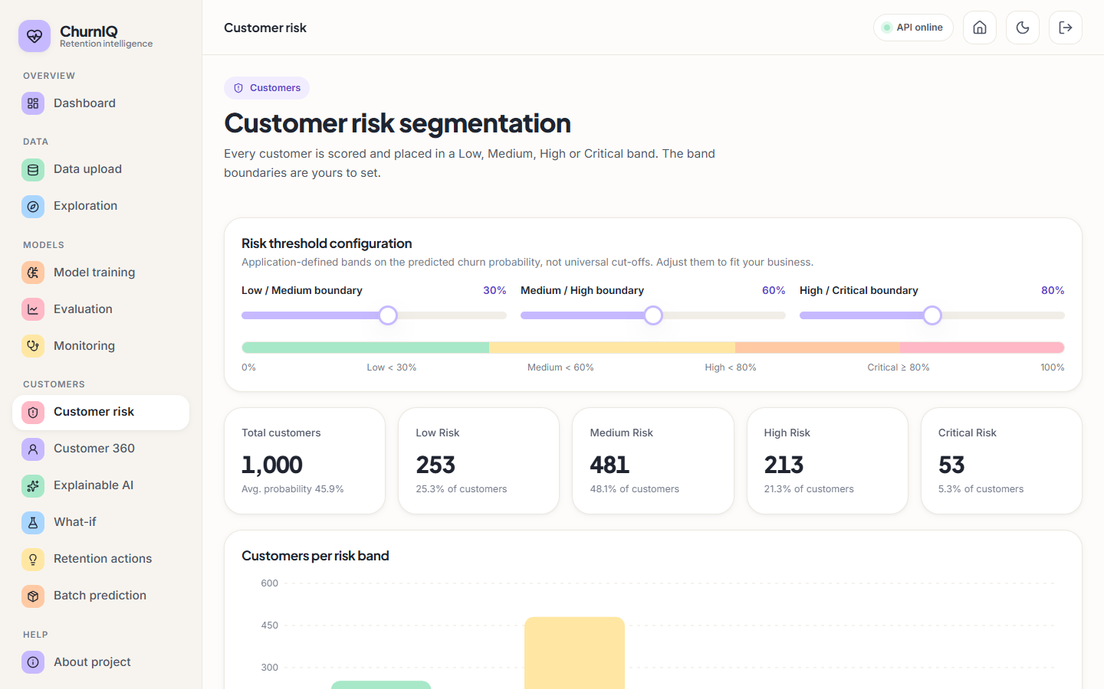
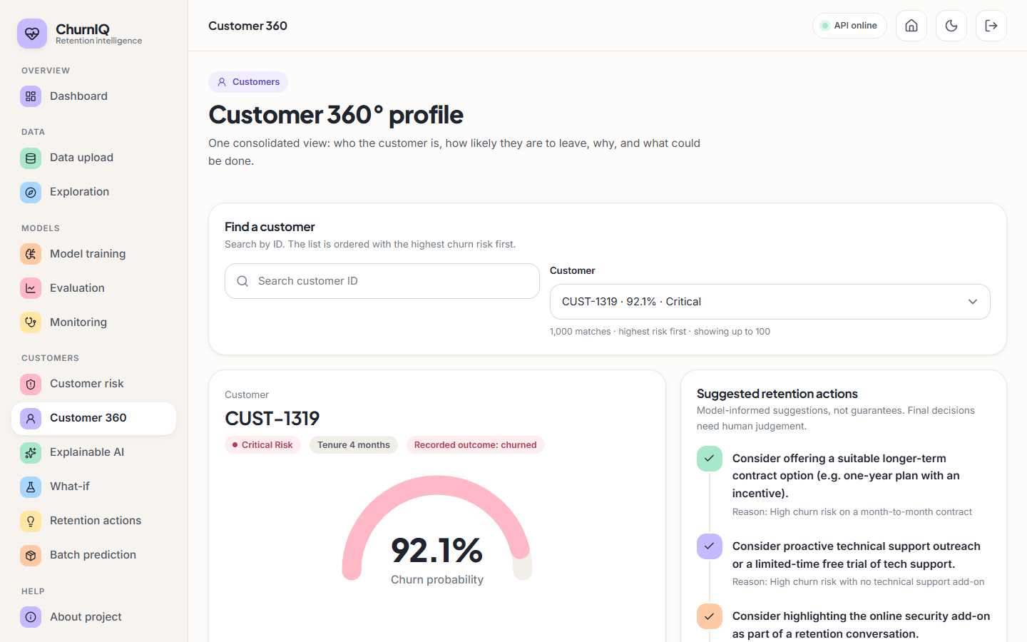
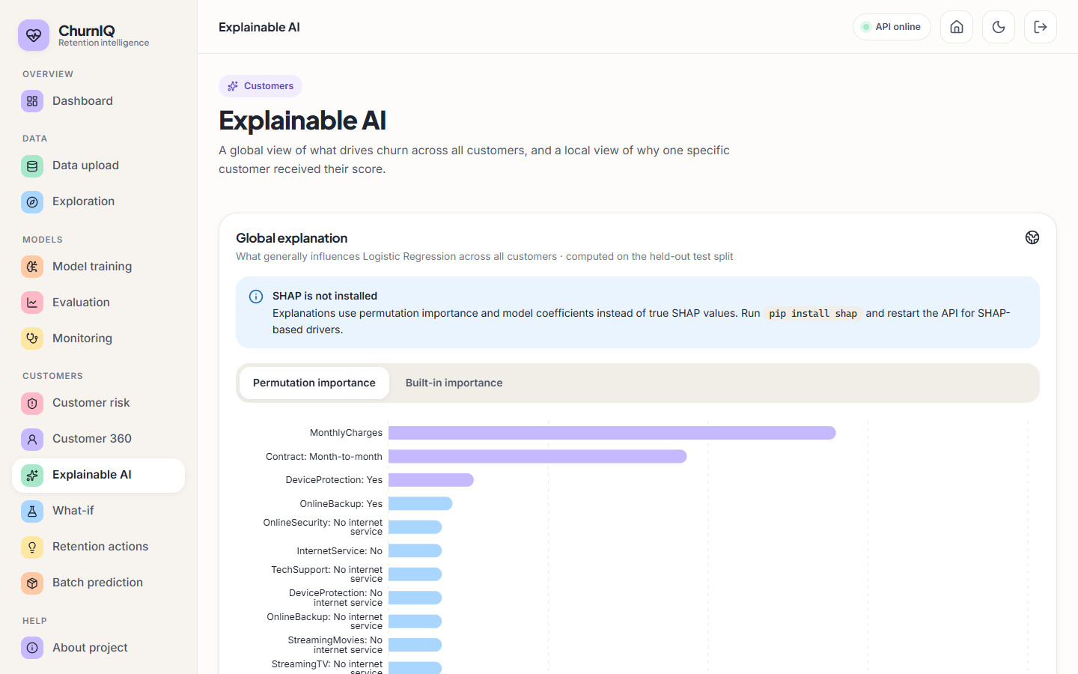
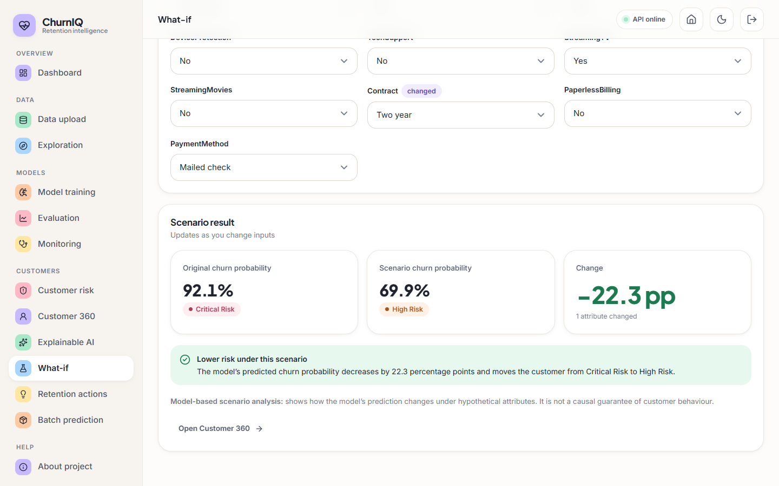
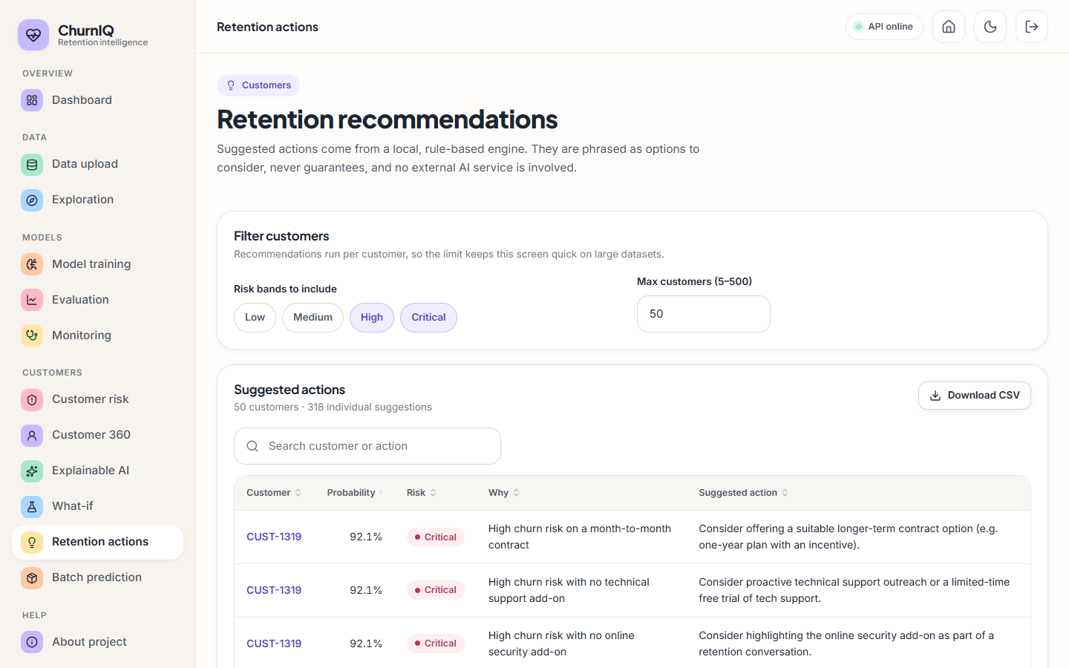
Output Screens – Analysis
Dashboard
Customer risk
Customer 360
Explainable AI
What-if
Retention actions
Dept. of CSE | Batch A14 | Final Review
23
Notes:
Real screenshots with 1,000 sample customers and three trained models: dashboard, risk segmentation, Customer 360, explanations, what-if and retention actions.

Slide 24
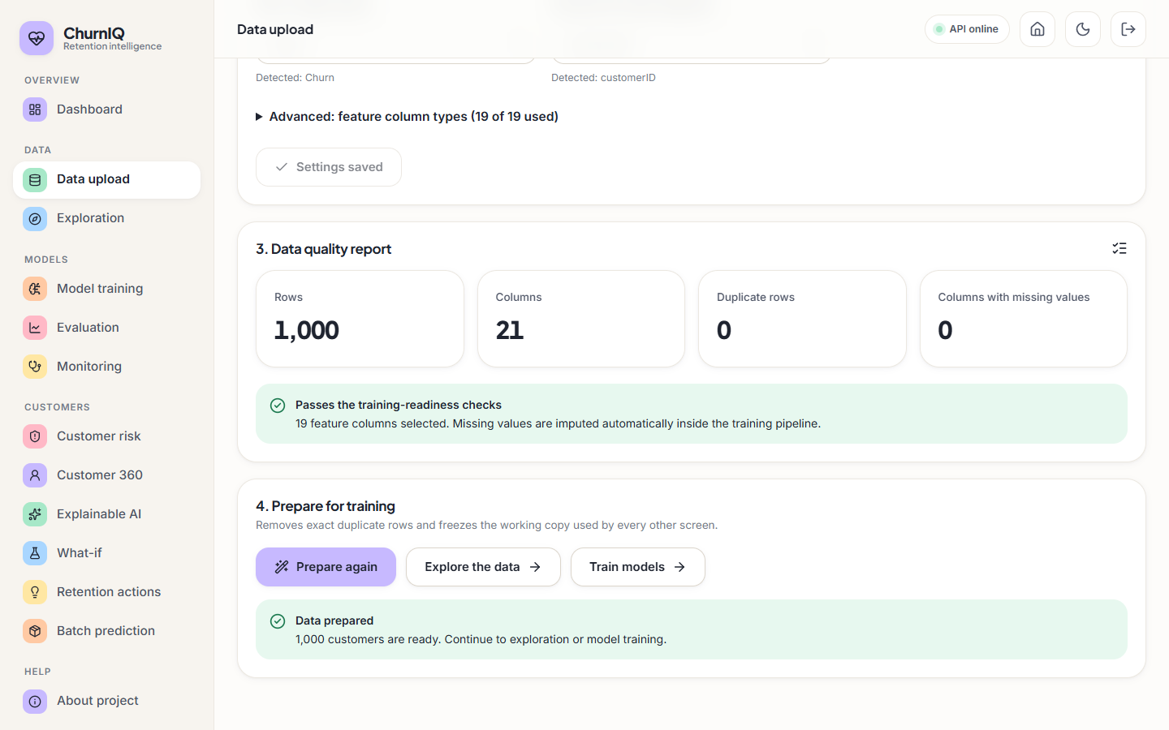
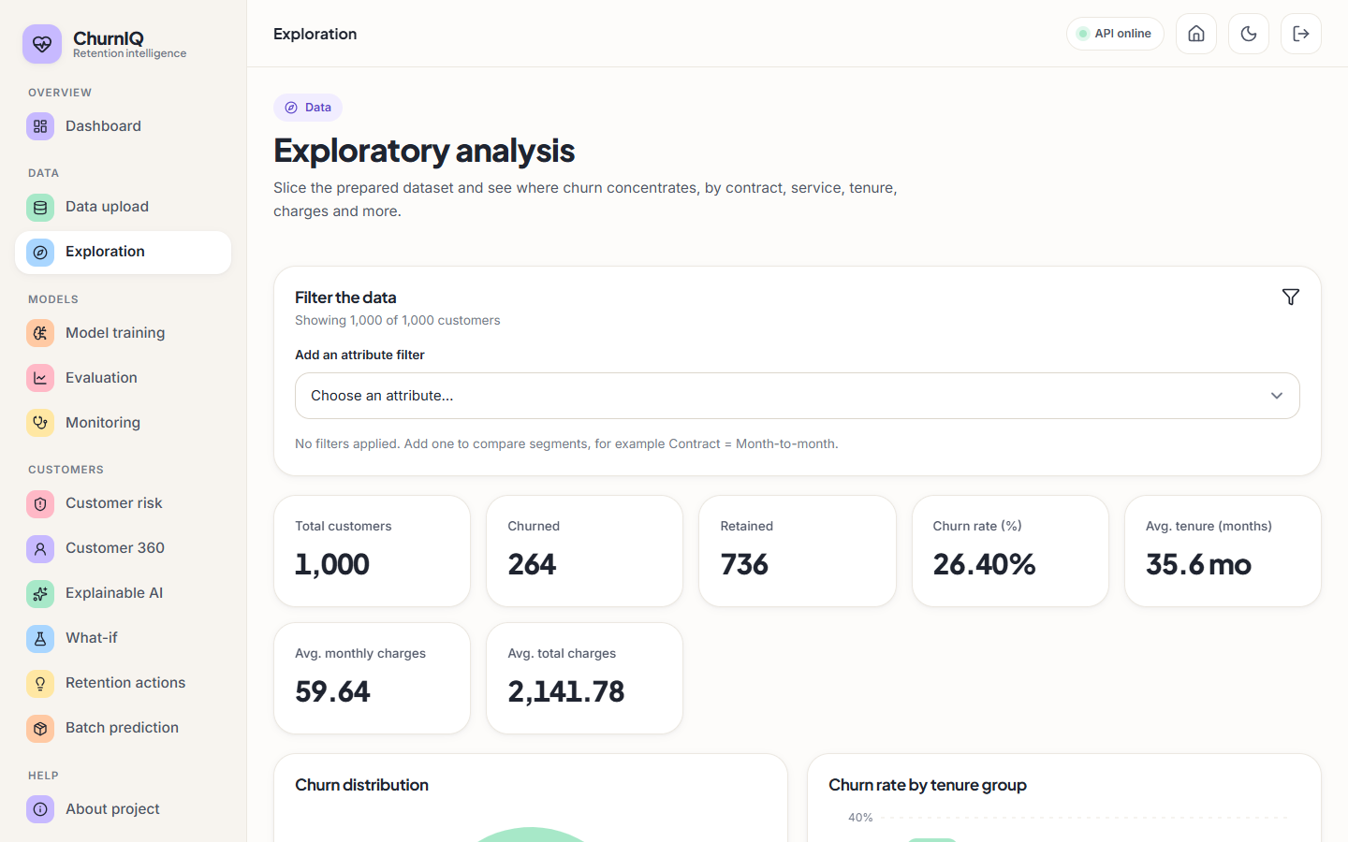
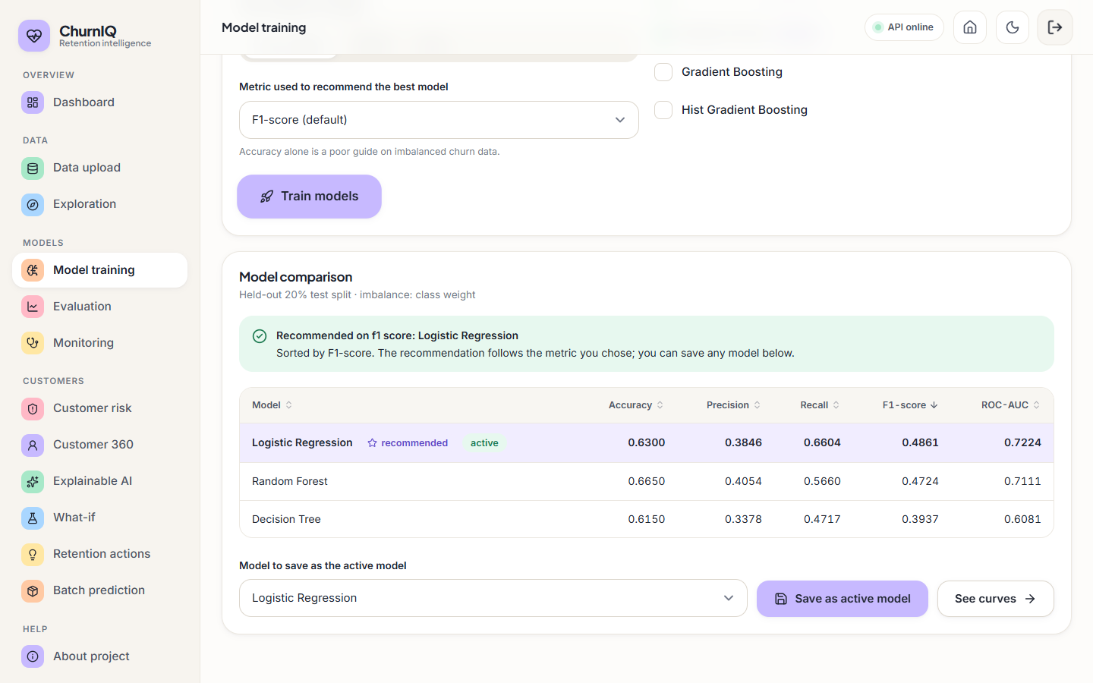
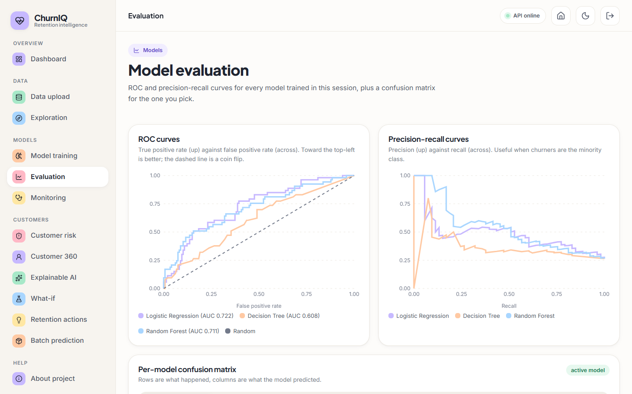
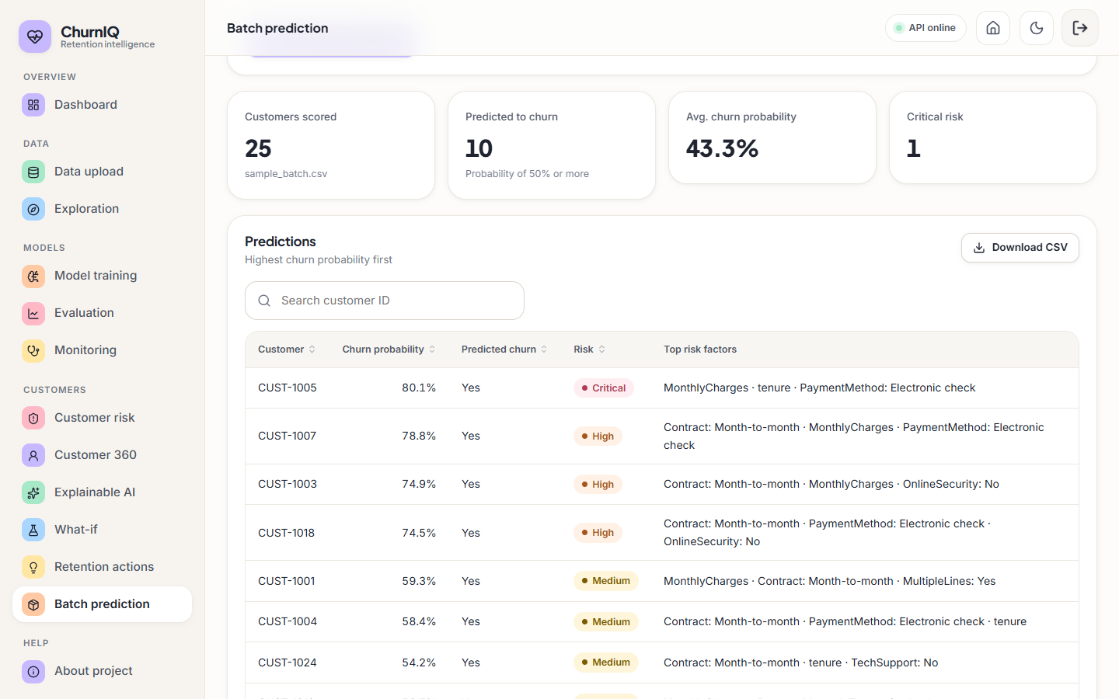
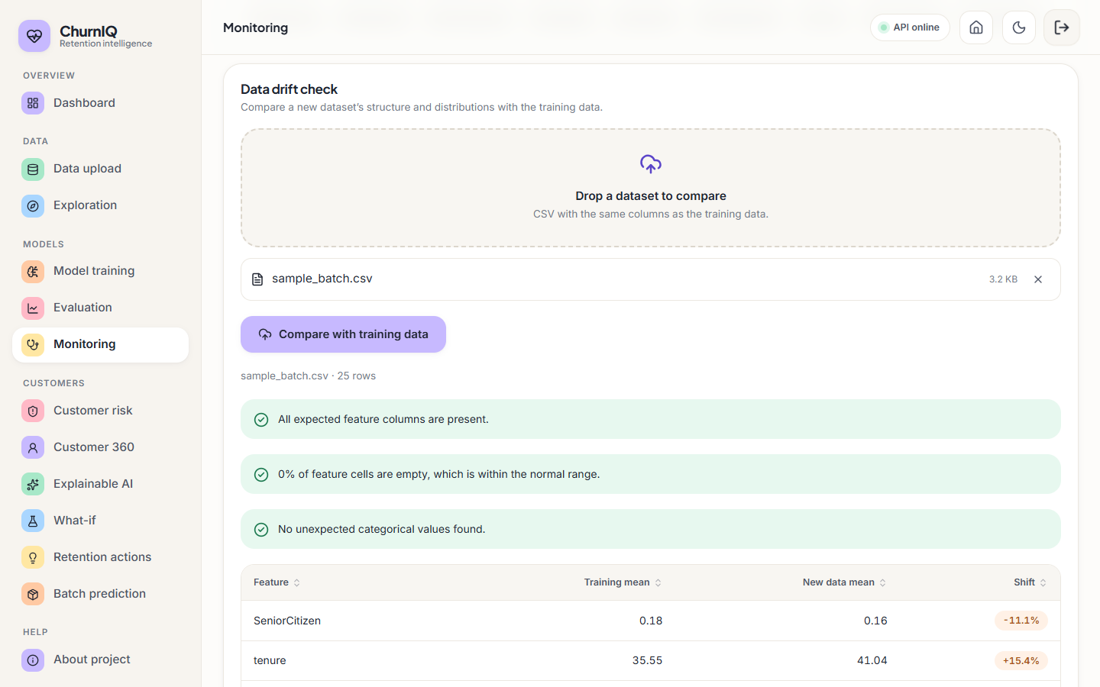
Output Screens – Data, Training and Operations
Data
Explore
Model training
Evaluation
Batch prediction
Monitoring
Dept. of CSE | Batch A14 | Final Review
24
Notes:
Data upload and quality, exploration, training, evaluation, batch scoring and monitoring.

Slide 25
Conclusion
Delivered: an end-to-end churn retention system: data profiling, five models, risk bands, drivers, what-if, retention rules, batch scoring, drift check, tests and documentation.
Measured: Logistic Regression F1 0.486, ROC-AUC 0.722, recall 0.660 on a 200-row split; 5-fold CV F1 0.483 ± 0.055. Moderate, and noisy.
Finding: contract type, monthly charges and tenure drive risk, as built into the synthetic data; imbalance handling is essential (recall 0.19 without it).
Not achieved or not measured: real operator data, SHAP results, calibration (Brier no better than a constant), business effect of the rules, user study.
Dept. of CSE | Batch A14 | Final Review
25
Notes:
All six objectives were addressed; the evaluation is on synthetic data and is stated that way.

Slide 26
Future Scope
Validate on real operator data (for example the public Telco data used in the base paper) and report the comparison on a matched protocol.
Install SHAP and add the base paper's perturbation explainer and LIME; compare their rankings and runtimes with the current fallbacks.
Calibrate probabilities (isotonic or Platt) and choose the threshold by campaign cost and offer value.
Measure the retention rules in a controlled campaign; add gradient-boosting libraries and a drift schedule.
Real accounts and roles, persistent storage, containerised deployment.
Dept. of CSE | Batch A14 | Final Review
26
Notes:
Concrete next steps, ordered by value.

Slide 27
References
[1] S.-V. Oprea and A. Bara, "Explaining customer churn through unified perturbation-based XAI soft computing," IEEE Access, vol. 14, pp. 24460-24478, 2026, doi: 10.1109/ACCESS.2026.3663648.
[2] A. Sikri, R. Jameel, S. M. Idrees and H. Kaur, "Enhancing customer retention in telecom industry with machine learning driven churn prediction," Sci. Rep., vol. 14, no. 1, 2024, doi: 10.1038/s41598-024-63750-0.
[3] A. El Attar and M. El-Hajj, "Explainable AI-driven customer churn prediction: a multi-model ensemble approach with SHAP-based feature analysis," Front. Artif. Intell., vol. 9, Feb. 2026, doi: 10.3389/frai.2026.1748799.
[4] H. A. Rasool, K. K. Aljawaheri and A. A. M. Karram, "Explainable customer churn prediction in telecom using ensemble learning and SHAP analysis," Math. Model. Eng. Probl., pp. 4373-4386, Dec. 2025, doi: 10.18280/mmep.121226.
[7] S. M. Lundberg and S.-I. Lee, "A unified approach to interpreting model predictions," in Proc. Adv. Neural Inf. Process. Syst. (NeurIPS), vol. 30, 2017.
[8] M. T. Ribeiro, S. Singh and C. Guestrin, "'Why should I trust you?': Explaining the predictions of any classifier," in Proc. 22nd ACM SIGKDD Int. Conf. Knowl. Discovery Data Mining, 2016, pp. 1135-1144, doi: 10.1145/2939672.2939778.
[9] D. Slack, S. Hilgard, E. Jia, S. Singh and H. Lakkaraju, "Fooling LIME and SHAP: Adversarial attacks on post hoc explanation methods," in Proc. AAAI/ACM Conf. AI, Ethics, Soc., 2020, doi: 10.1145/3375627.3375830.
[11] N. V. Chawla, K. W. Bowyer, L. O. Hall and W. P. Kegelmeyer, "SMOTE: Synthetic minority over-sampling technique," J. Artif. Intell. Res., vol. 16, pp. 321-357, 2002, doi: 10.1613/jair.953.
[12] H. He and E. A. Garcia, "Learning from imbalanced data," IEEE Trans. Knowl. Data Eng., vol. 21, no. 9, pp. 1263-1284, Sep. 2009.
[13] L. Breiman, "Random forests," Mach. Learn., vol. 45, no. 1, pp. 5-32, Oct. 2001, doi: 10.1023/A:1010933404324.
[14] F. Pedregosa et al., "Scikit-learn: Machine learning in Python," J. Mach. Learn. Res., vol. 12, pp. 2825-2830, 2011.
[19] IBM, "Telco customer churn," sample data set (7,043 customers, 21 columns), distributed through Kaggle; also used in [1] and [3].
[20] J. H. Friedman, "Greedy function approximation: A gradient boosting machine," Ann. Statist., vol. 29, no. 5, pp. 1189-1232, 2001.
Dept. of CSE | Batch A14 | Final Review
27
Notes:
Selected references; the complete list is in the report.

Slide 28
THANK YOU
Questions & Suggestions
Dept. of CSE | Batch A14 | Final Review
28
Notes:
Invite questions.

