Slide 1
CropSight
REVIEW 2 · DESIGN, METHODOLOGY AND PROGRESS
Smart Crop Delivery with AI-Based Price and Quality Intelligence
Presented by
Under the guidance of
G.PRANAVI 23K91A6765
G.SIRI CHANDANA 23K91A6763
A.NIKHIL 23K91A6715
G.VISHNU VARDHAN 23K91A6754
K. Mounika, [DESIGNATION]
Department of Computer Science and Engineering (Data Science)
[COLLEGE NAME] · Batch A17 (CSE-DS, Section A) · [ACADEMIC YEAR]
Notes:
Review 2 covers the design, methodology and progress of CropSight.

Slide 2
Contents
01
02
03
04
Recap
Architecture
Methodology
Dataset
05
06
07
08
Data preparation
Model and configuration
Decision logic
Data flow, modules, database
09
10
11
12
Technology stack
Progress
Preliminary results and screens
Testing, challenges, next steps
Notes:
Twelve parts: recap, architecture, methodology, data, preparation, models, decision logic, data flow and database, technology, progress, results and screens, testing and next steps.

Slide 3


Recap: problem and proposed system
Problem
Proposed system
Farmers see fluctuating prices, inconsistent manual quality grading, unmonitored storage and transport, and little decision support or direct access to buyers.
A farmer-buyer-distributor platform: photo-based quality grade with SHAP, price forecast with best day to sell, buyer ranking, a marketplace and live sensor monitoring.
Crop photo upload
11 vision features, Random Forest grade
Price forecast, 31 days
Buyer ranking, best day
Order, transit, live sensors
Notes:
Recap of Review 1. The base paper [1] is pre-harvest (soil, irrigation, crop and fertiliser advice); CropSight applies the IoT + ML + explainable-AI idea after harvest.

Slide 4
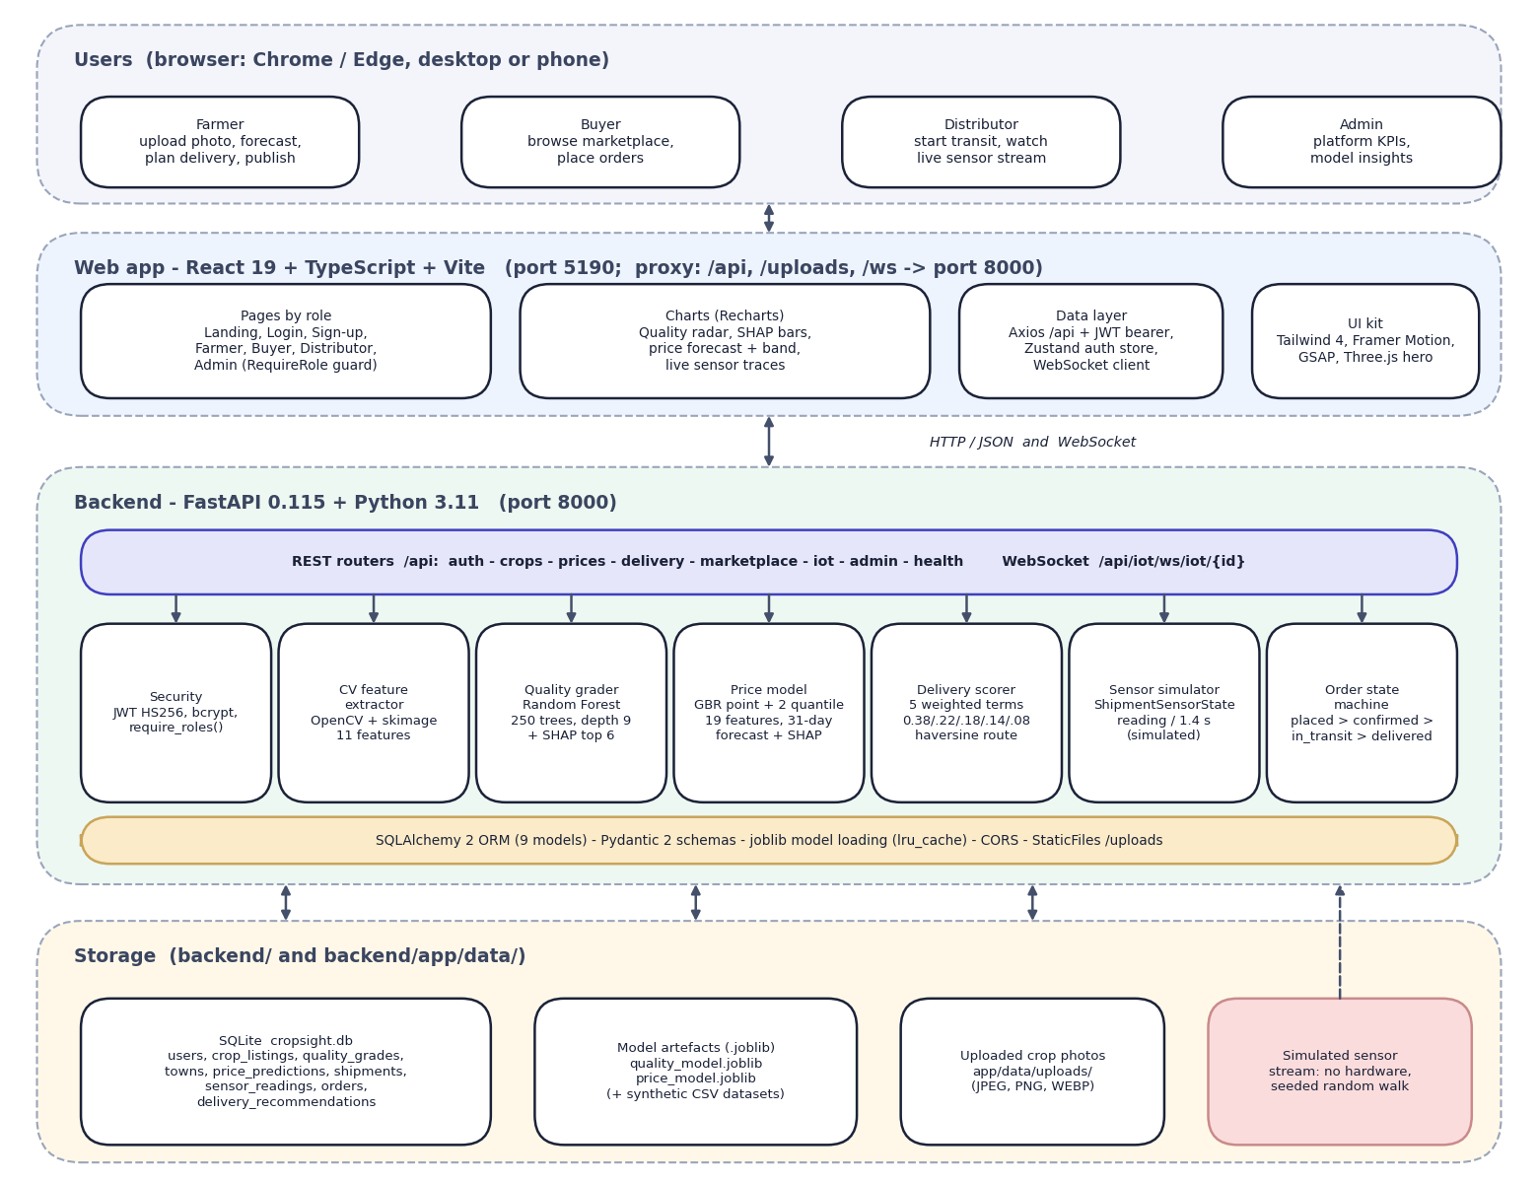

System architecture
Client: React 19 + TypeScript + Vite (port 5190); the dev server proxies /api, /uploads and /ws.
API: FastAPI (port 8000), 21 endpoints (20 REST + 1 WebSocket); JWT sign-in and role guards.
ML services: OpenCV / scikit-image features, Random Forest grader, Gradient Boosting price model, SHAP.
Rule services: buyer scoring, order state machine, simulated sensor stream.
Data: SQLite (9 tables), uploaded photos, .joblib model files.
Notes:
Everything runs on one machine. The browser talks only to the Vite server, which proxies to FastAPI. No external AI service is used.

Slide 5
Methodology: end-to-end workflow
Generate synthetic data
Extract 11 vision features
Train Random Forest grader
Train price GBR + quantile bands
Evaluate: seeds, baselines
Real-photo check
Serve: FastAPI + React
Real vision, synthetic labels
Explained and disclosed
Reproducible
Features are computed from the real pixels of the uploaded photo; the grade classes were learned from generated feature data.
SHAP shows what drove each grade and price; the admin screen states that the training data is synthetic.
Fixed seeds; scripts/exp_*.py regenerate every figure into experiments/*/metrics.json.
Notes:
Seven-step workflow from data generation to serving, then a real-photo check that was added to test the synthetic-trained grader.

Slide 6
Dataset and input sources
Dataset | Size | Use
Synthetic quality features | 6,000 rows, 11 features, 4 grades | Train and test the grader
Synthetic market series | 23,360 rows, 2022-2024, 8 crops x 8 regions | Train and test the price model
Fresh and Rotten Fruits [8] (CC BY 4.0) | 3,200 photos, 8 fruits | Real-photo check
Vegetable photos [9] (CC BY 4.0) | 120 scanned of 4,319; 4 used | Demo screens
Demo database | 8 users, 8 towns, 1 seeded listing | Marketplace demo
Notes:
No real labelled crop-quality set and no real price series were available, so both models use synthetic data. Two public real-photo sets were used only to test the grader and to produce the demo screens.

Slide 7



Data preparation and features
Image features
Market features
Synthetic data
Photo centred on a 256 x 256 white canvas; HSV foreground mask (Otsu on saturation; whole image if the mask is under 3 % or over 98 %). 11 features: colour (5), GLCM texture (3), edge density, blemish ratio, size score.
19 inputs: month sin/cos, rainfall, temperature, demand, supply, fuel index, days to harvest, year trend, grade premium, region factor and 8 crop one-hots. The daily context is hash-seeded per crop, region and date, not a live feed.
Quality: a normal distribution per grade in feature space; 360 of 6,000 labels (6 %) moved to a neighbouring grade. Price: base x grade x region x demand/supply x season x weather x freshness x fuel^0.15 x trend, plus N(0, 3.5 %) noise.
Notes:
Preparation = turning a photo into 11 numbers, building the 19 market inputs, and generating the two training sets.

Slide 8
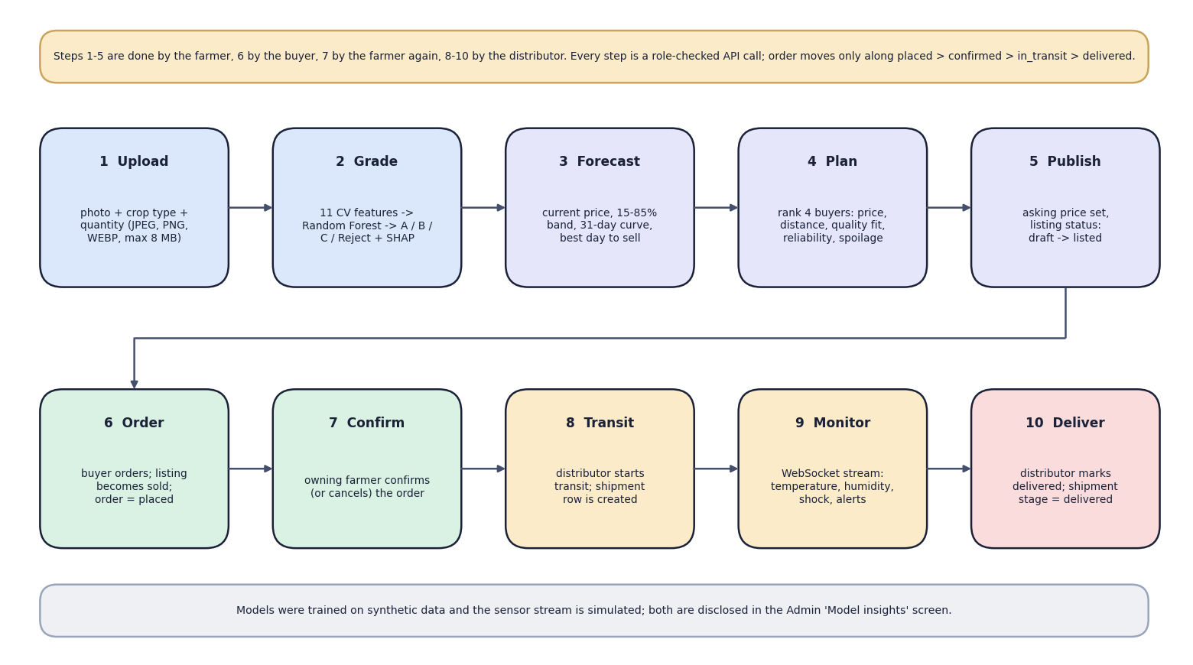

Models and explanation
Component | Detail
Grader | Random Forest, 250 trees
Price | Gradient Boosting, 300 trees
Band | Quantile GBR, 15 % / 85 %
Explanation | SHAP TreeExplainer
Classical machine learning on the CPU; no deep network and no GPU.
Notes:
The abstract speaks of deep learning for grading; the implemented grader is a Random Forest on hand-crafted features.

Slide 9
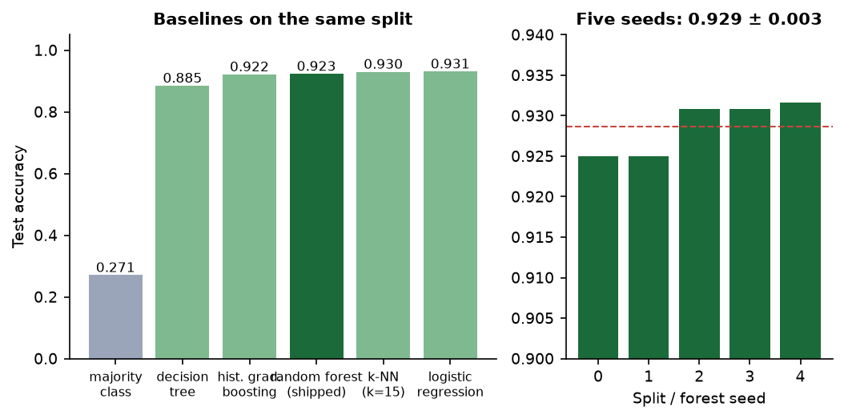

Training configuration
Setting | Value
Grader data | 6,000 synthetic rows, 6 % label noise
Grader split | 80/20 stratified (4,800 / 1,200), seed 42
Random Forest | 250 trees, depth 9, min leaf 4
Price data | 23,360 synthetic rows, 19 features
Price split | 85/15 random (19,856 / 3,504)
Gradient Boosting | 300 trees, depth 4, learning rate 0.06
Quantile bands | alpha 0.15 / 0.85, 250 trees, depth 3
Baselines on the same split (left) and five seeds: 0.929 +- 0.003 (right)
Notes:
A logistic-regression baseline scores 0.931 and k-NN 0.930, so the synthetic classes are close to linearly separable; the shipped forest scores 0.923.

Slide 10
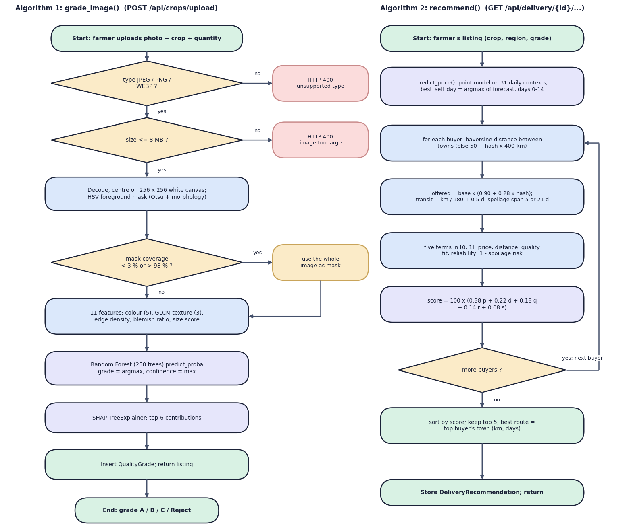

Decision logic
Grade
Class with the highest forest probability; confidence = that probability; top-6 SHAP features explain it.
Best day to sell
Price model on 31 successive days; best day = highest price in days 0-14; band from the 15 % / 85 % models.
Buyer ranking
Score x100 = 0.38 price + 0.22 distance + 0.18 quality fit + 0.14 reliability + 0.08 (1 - spoilage); top 5 shown.
Notes:
Decision logic: how a grade is chosen, how the best selling day is picked and how buyers are scored. The buyer offers are simulated from the reference price; the engine is a transparent formula, not a trained model.

Slide 11
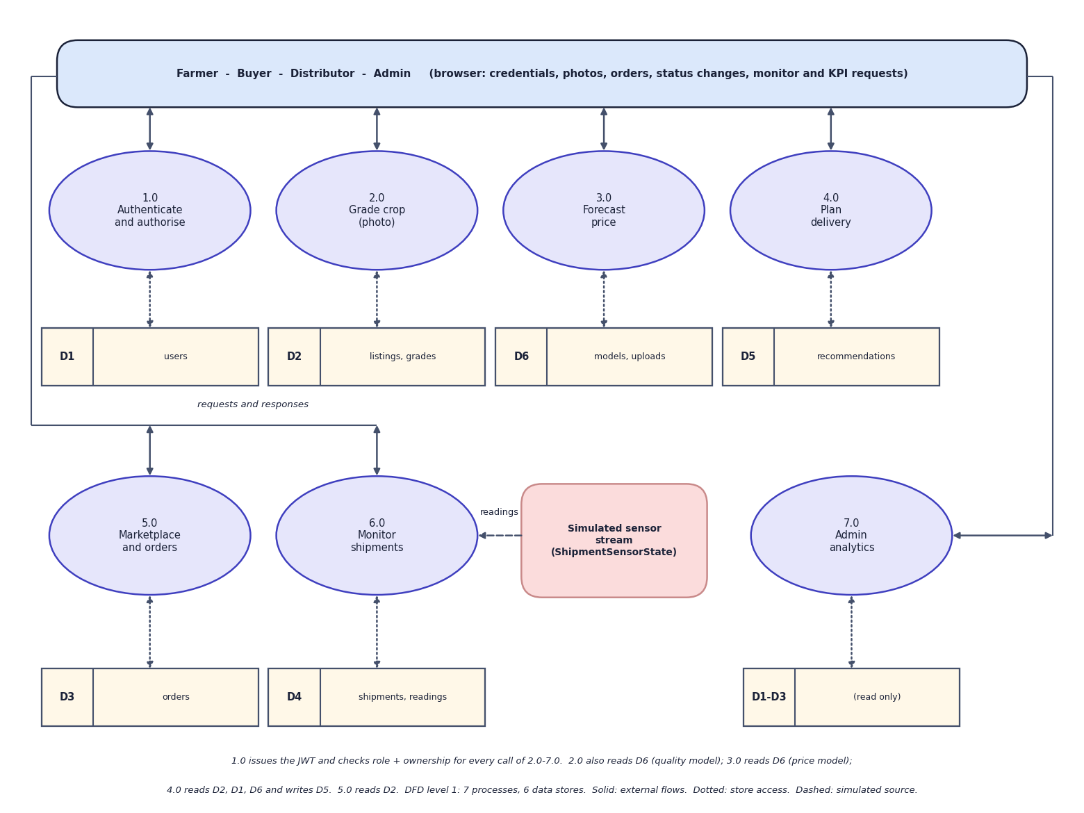
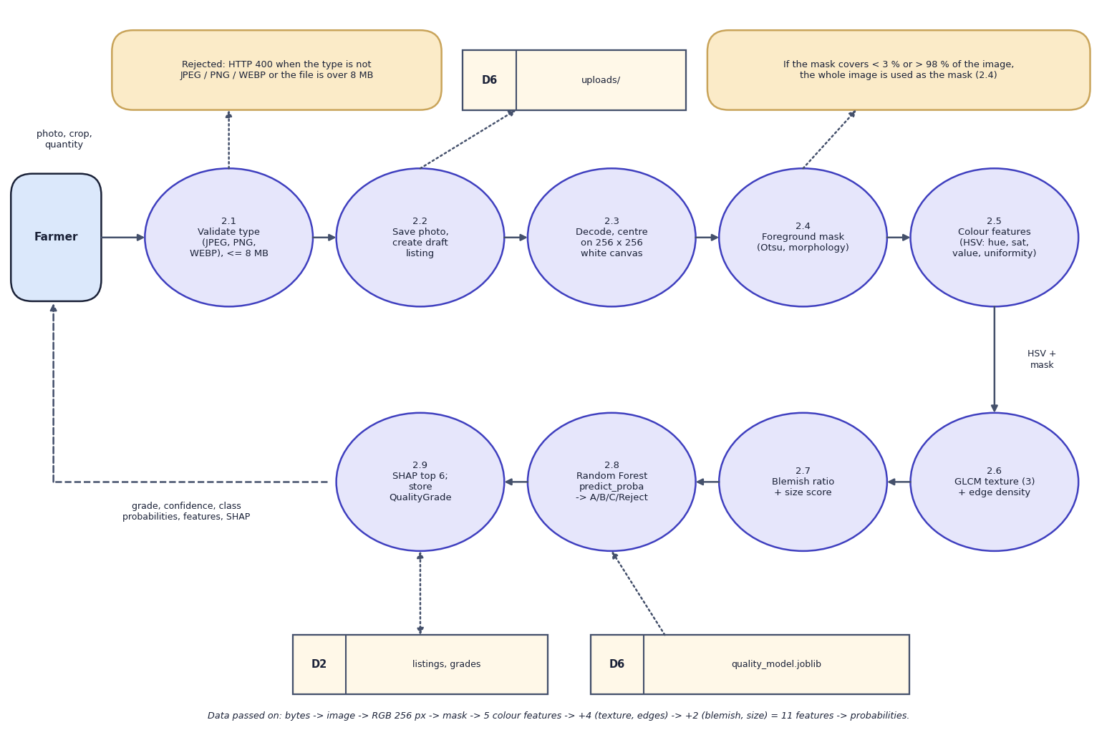

Data flow and modules
DFD level 1 (left) and level 2 expansion of 'Grade crop' (right)
Module | Responsibility
Grading | validate photo, 11 vision features, Random Forest, SHAP, store grade
Price and delivery | 31-day forecast with band and best day; weighted buyer score and route
Marketplace and monitoring | listings, order state machine, role guards, simulated sensor stream over WebSocket
Notes:
Level 1 splits the system into seven processes and six data stores; level 2 opens the grading process.

Slide 12
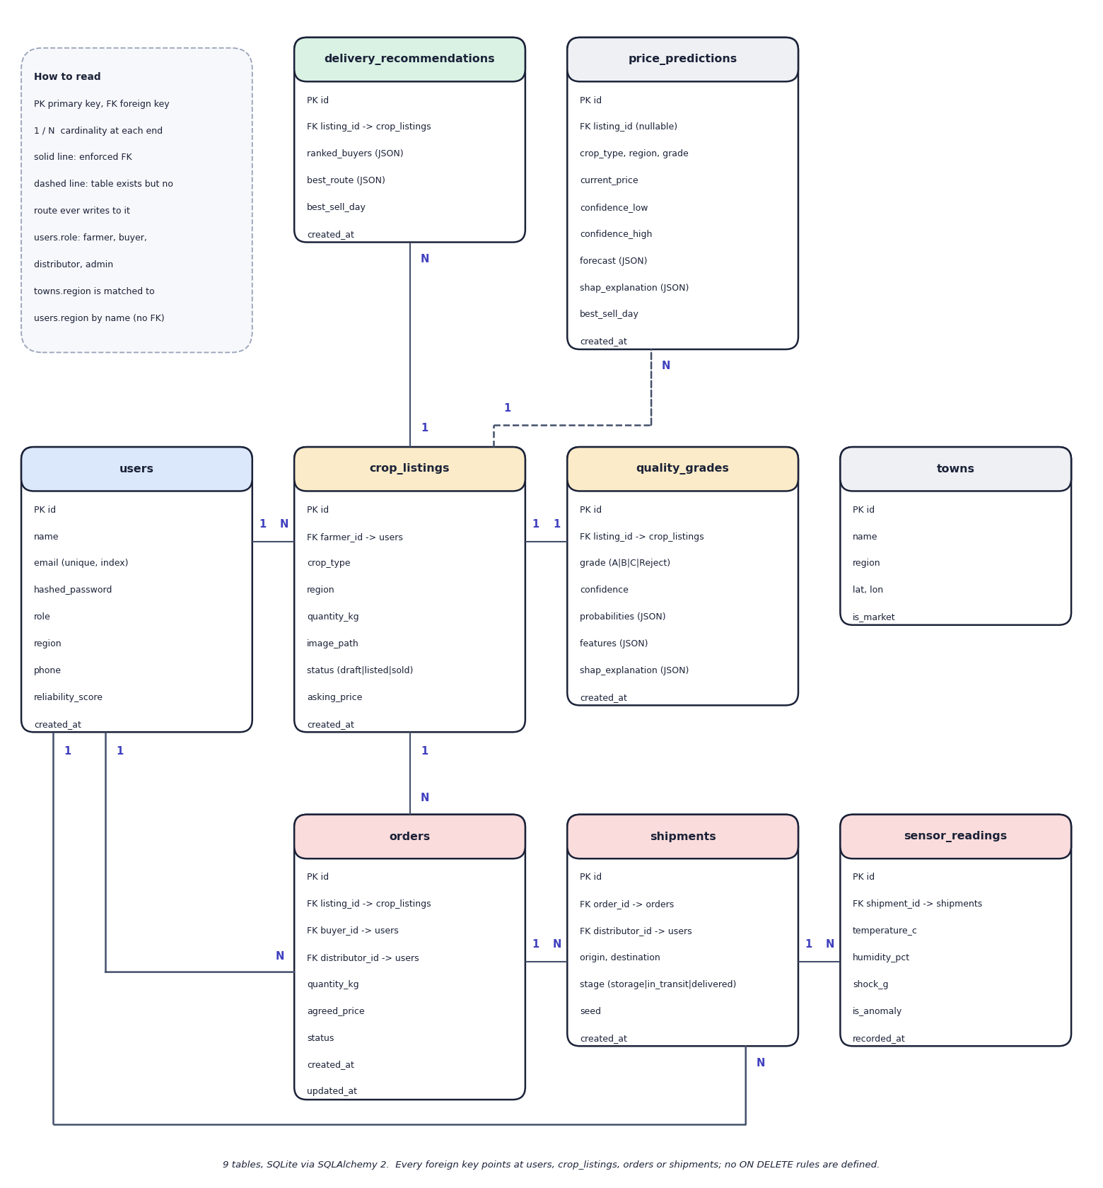
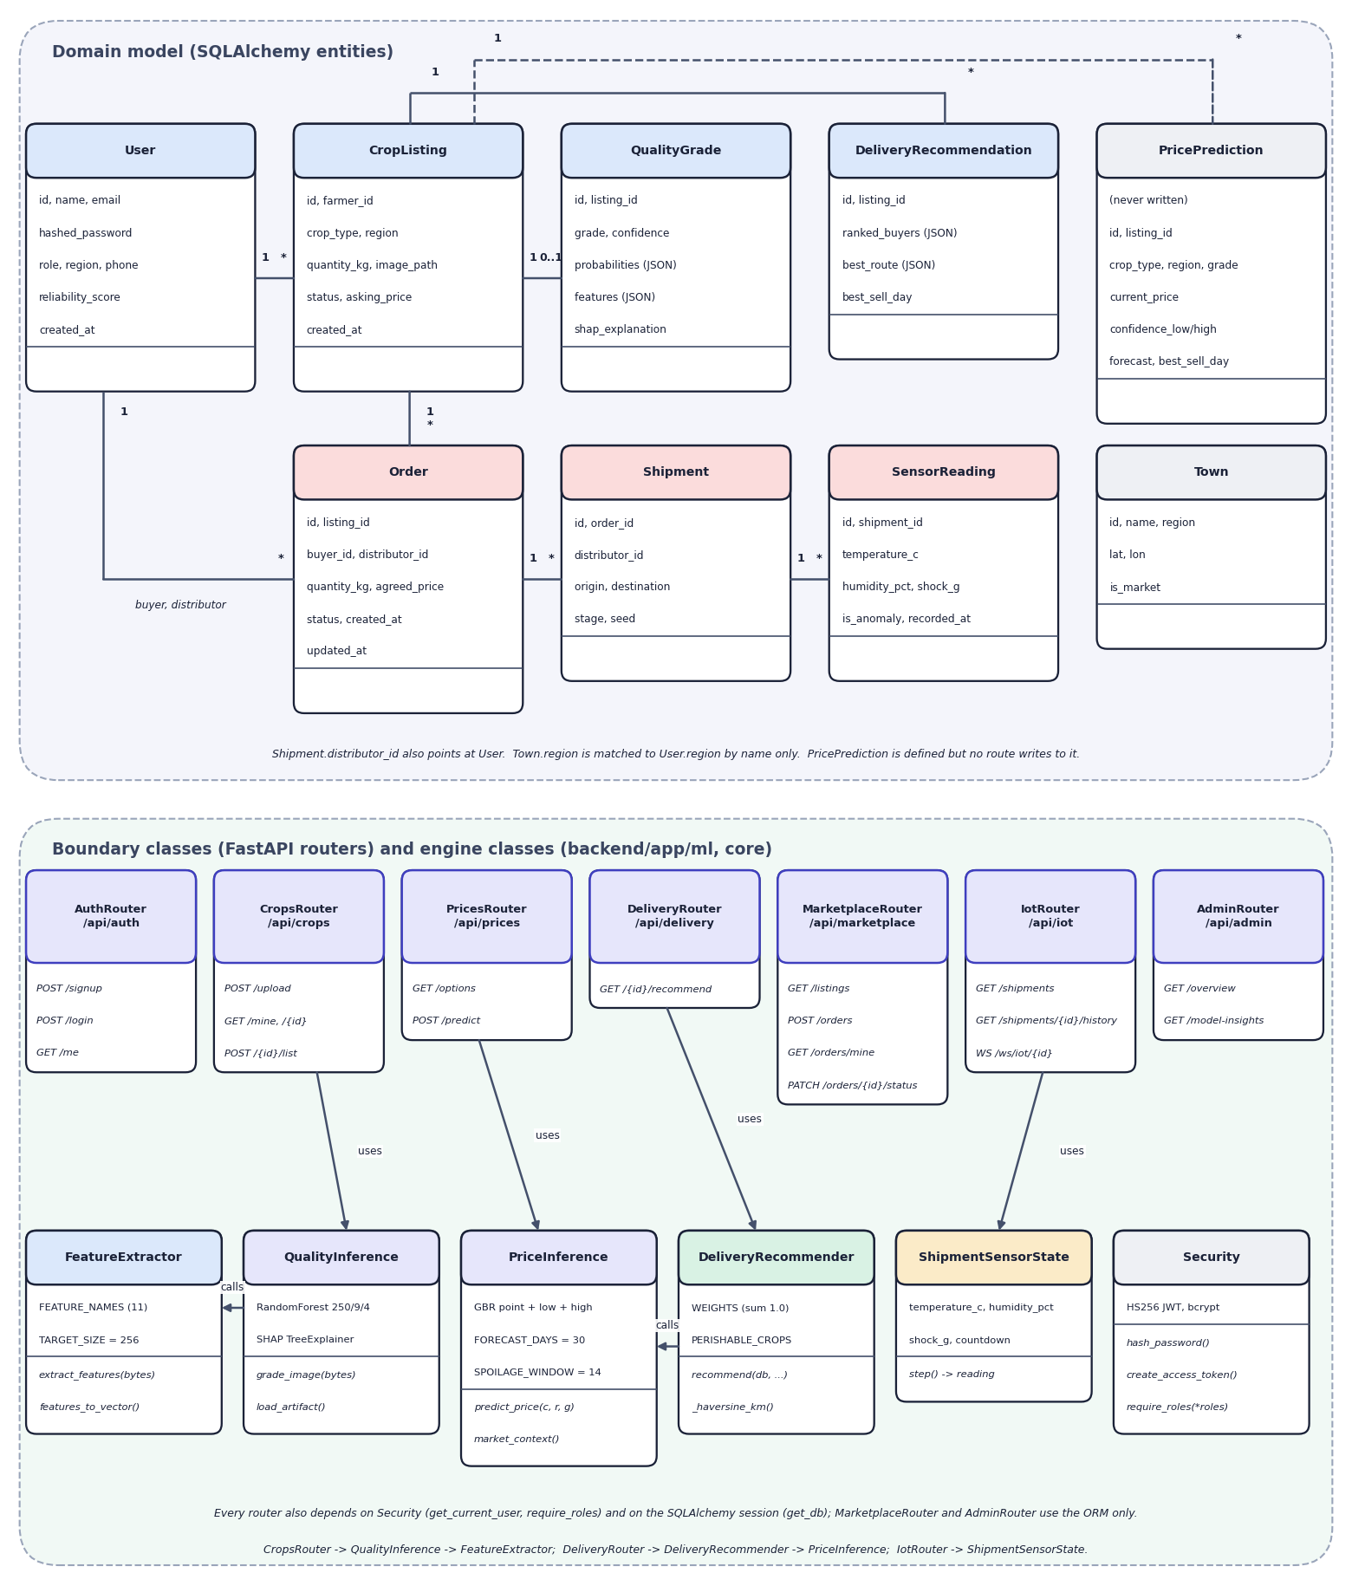

Database design and UML
Table | Key fields | Relations
users | email, role, region, reliability | 1:N listings, orders
crop_listings | crop, quantity, status, price | 1:1 quality_grades
quality_grades | grade, confidence, SHAP (JSON) | N:1 listing
orders, shipments | status, buyer, distributor | 1:N sensor_readings
ER diagram, 9 tables (left) and UML class diagram (right)
Notes:
Nine SQLite tables created by SQLAlchemy. Structured results (probabilities, features, SHAP, forecasts) are stored as JSON columns. The price_predictions table exists but no route writes to it.

Slide 13






Technology stack
Language
Machine learning
Vision
Python 3.11, TypeScript
scikit-learn 1.5.2 (Random Forest, Gradient Boosting), SHAP 0.46, NumPy, pandas
OpenCV 4.10, scikit-image 0.24 (GLCM texture), Pillow
Backend
Frontend
Storage and tests
FastAPI 0.115, SQLAlchemy 2.0, Pydantic 2, JWT (python-jose), bcrypt, WebSocket
React 19, Vite 8, Tailwind CSS 4, Recharts, Framer Motion, Three.js, Zustand
SQLite, joblib model files, pytest (36 pass, 3 expected fail), Playwright captures
Notes:
All versions are the ones pinned in requirements.txt and package.json. There is no external AI service.

Slide 14
Implementation progress
Component | Status
Photo upload, 11 vision features, Random Forest grade, SHAP | Completed
Price model, 31-day forecast, 15-85 % band, best day | Completed
Delivery planner: weighted buyer score and route | Completed
Marketplace, order state machine, role guards | Completed
Live monitor: sensor simulator over WebSocket | Completed (simulated)
Admin overview and model insights | Completed
Experiments, 39 tests, latency measurements | Completed
Real crop-image and price data; real sensors; user testing | Not done
21
API endpoints (20 REST + 1 WebSocket)
9
database tables
36
tests pass; 3 expected failures
Notes:
All planned features are implemented. The open items are real training data, real sensors and user-acceptance testing.

Slide 15
Preliminary results: grading accuracy
92.3 %
grader test accuracy, synthetic data
0.992
price model R2 (MAE 164.6, MAPE 5.1 %)
50.4 %
shipped grader on real photos (chance 50 %)
Notes:
Synthetic scores recover the generator, not field performance. On 3,200 real fruit photos (fresh versus rotten, mapped to grades A/B versus C/Reject) the shipped grader gives grade B to about 99 % of photos and sits at chance (AUC 0.57); the same 11 features retrained on real labels reach 90.6 % in 5-fold cross-validation (66.9 % on unseen fruit types). The price noise floor is MAPE 2.8 %.

Slide 16
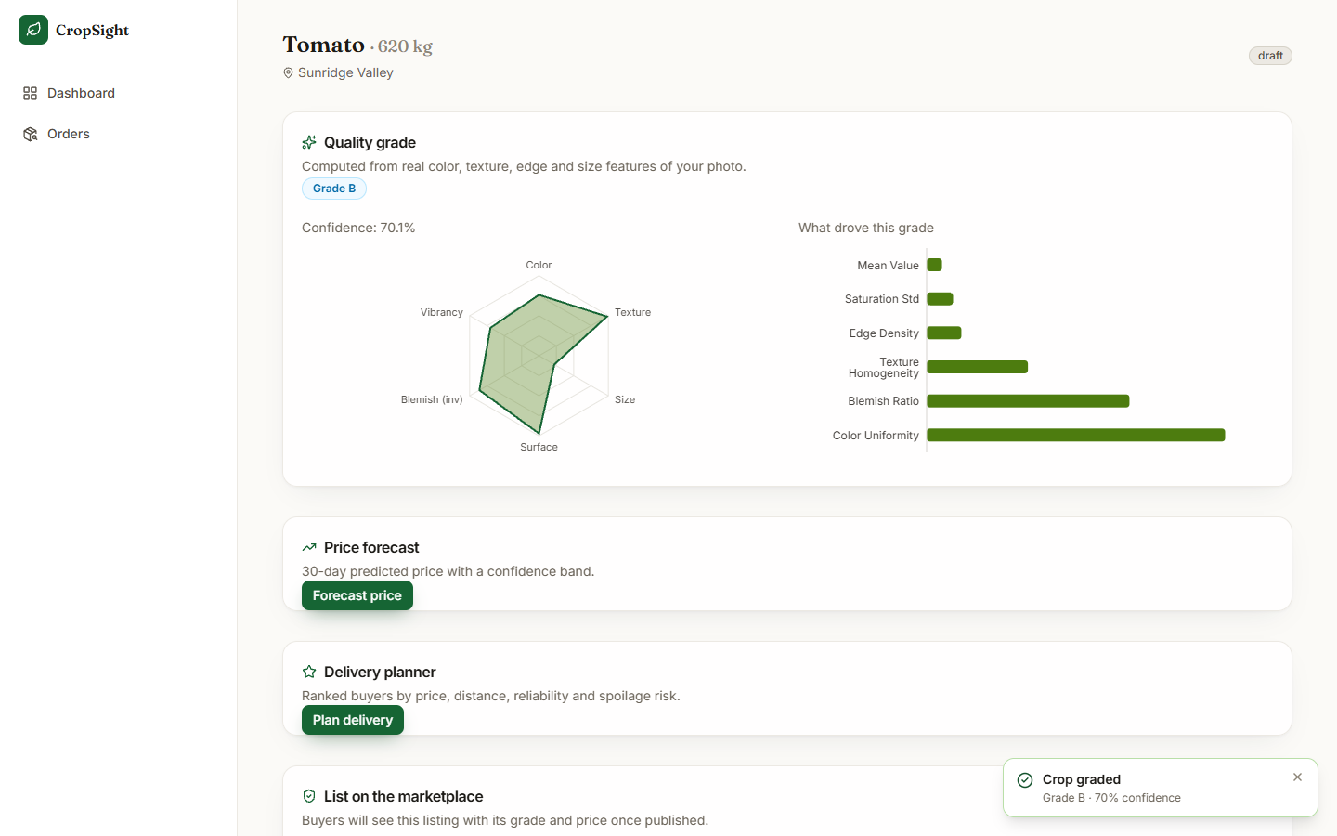
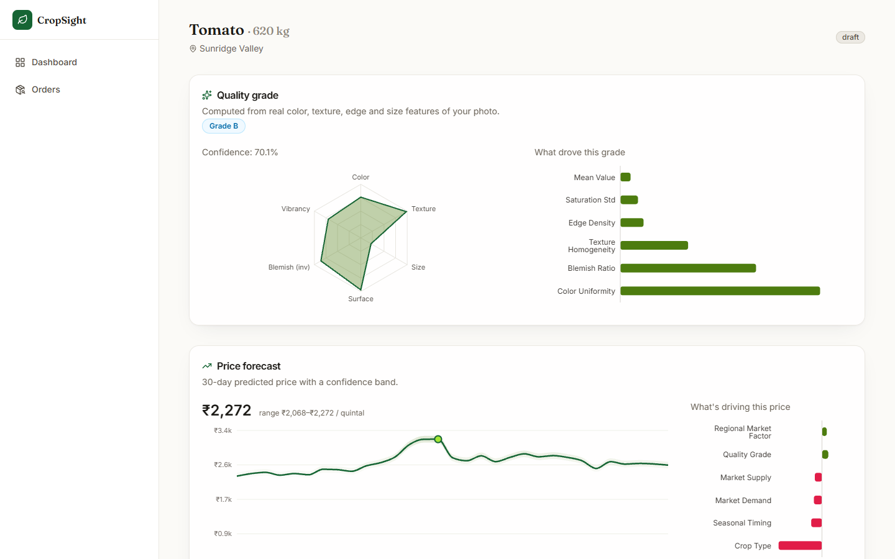


Output screens
Real tomato photo graded B (70.1 %): radar of features and SHAP drivers
Price forecast: INR 2,272 per quintal, 30-day curve and drivers
Notes:
Real captures of the running application with real photographs (tomato from a public vegetable dataset, CC BY 4.0).

Slide 17
Testing and observations
Test group | Tests | Result
Health, authentication, role guards | 9 | 9 passed
Listings, grading, vision features | 12 | 11 passed, 1 expected fail
Price and delivery | 8 | 7 passed, 1 expected fail
Marketplace and orders | 5 | 4 passed, 1 expected fail
IoT, simulator, admin | 5 | 5 passed
Total | 39 | 36 passed, 3 expected fail
36 tests pass in about 30 s; 3 tests assert hardened behaviour and fail today: a corrupt image gives HTTP 500 and leaves a gradeless draft, unknown crops are priced, order quantity and price are not validated.
API median times: health 1.6 ms, upload and grade 174 ms, price 55 ms, delivery plan 100 ms, login 325 ms.
Delivery ranking: top buyer unchanged in 97.7 % of weight perturbations.
Found while testing: admin volume is 100x too high (INR per quintal x kg).
Not done: user-acceptance, load and security testing.
Notes:
Expected-fail tests are reported as such rather than hidden. Latencies were measured on a live server over 127.0.0.1 on an i5-12500 with other jobs running.

Slide 18



Challenges and corrective actions
No real training data
Synthetic-to-real gap
Circular price score
No labelled crop photos or price series: both models use synthetic data, disclosed in the app.
On 3,200 real photos the grader is at chance (50.4 %); the same features retrained on real labels reach 90.6 %.
R2 0.992 recovers the generator (noise floor MAPE 2.8 %); weather features carry about zero importance.
Simulated sensors
Unvalidated inputs
Unit error in a KPI
A random walk without mean reversion: 97 % of alarm steps are drift. Real sensors are needed.
Corrupt image: HTTP 500 and a gradeless draft; order quantity and price unchecked. Logged as expected-fail tests.
Admin volume multiplies INR per quintal by kg, so it reads 100x too high; found while capturing screens.
Notes:
Six challenges and findings, each backed by a measurement in REPORT_FACTS.md.

Slide 19
Next steps
Collect real labelled photos
Retrain and validate
Harden and fix
Final report and demo
Collect a labelled set of real crop photos with grades and retrain the grader; test on unseen photos.
Replace the hash-generated market context with a real mandi price series and validate over time.
Fix the admin unit error, validate inputs, clean up failed uploads, make the sensor alarm clear, authenticate the WebSocket.
Collect feedback from farmers and buyers (not yet done); complete the report and final demo.
Notes:
What remains: real data first, then the hardening items found in testing, then the report and final demonstration.

Slide 20
Thank you
Questions and suggestions are welcome.
Notes:
Thank you. Questions are welcome.

