Slide 1

CropSight: Smart Crop Delivery with AI-Based Price and Quality Intelligence
Final Review
Team Details : Batch A17
Under the Esteemed Guidance of
K. Mounika
[DESIGNATION], Department of CSE (Data Science)
23K91A6765 G.PRANAVI
23K91A6763 G.SIRI CHANDANA
23K91A6715 A.NIKHIL
23K91A6754 G.VISHNU VARDHAN
DEPARTMENT OF COMPUTER SCIENCE AND ENGINEERING (DATA SCIENCE) · Academic Year [ACADEMIC YEAR]
Notes:
Final review of CropSight: a farmer-to-buyer platform that grades crop quality from a photo, forecasts the price, plans delivery and monitors the shipment.

Slide 2
Table of Contents
Abstract
Base Paper & Literature Survey
Research Gap & Problem Statement
Objectives
Proposed System & Architecture
Methodology & Pipeline
Design & Implementation
Results, Real-Photo Check, Testing & Comparison
Output Screens
Conclusion & Future Scope
References
Dept. of CSE | Batch A17 | Final Review
2

Slide 3
Abstract
Farmers face unpredictable prices, manual and inconsistent quality grading, unmonitored storage and transport, and little decision support after harvest.
CropSight is a web platform for farmers, buyers, distributors and admins: a crop photo is graded A/B/C/Reject from 11 computer-vision features by a Random Forest and explained with SHAP.
A gradient-boosted model forecasts a 31-day price with a 15-85 % band and a best day to sell; a weighted score ranks buyers and routes; a simulated IoT stream monitors temperature, humidity and shock.
Measured: grader 92.3 % on its synthetic test set; price model R² 0.992 (synthetic series); 36 tests pass; upload + grade 174 ms median.
Honest finding: both models are trained on synthetic data. On 3,200 real fruit photos the shipped grader is at chance (50.4 %), while the same features retrained on real labels reach 90.6 %.
Keywords: crop quality grading, price forecasting, delivery planning, IoT, explainable AI.
Dept. of CSE | Batch A17 | Final Review
3
Notes:
Abstract: problem, approach, headline measurements and the honest real-photo result.

Slide 4
Base Paper
A. Khaliq, A. Khan, S. Jan, M. Umair, A. Gulshair, A. Ali, and U. A. Shah, "AI-driven smart agriculture: An integrated approach for soil analysis, irrigation, and crop-fertilizer recommendations," IEEE Access, vol. 13, pp. 141124-141138, 2025, doi: 10.1109/ACCESS.2025.3594162.
Task: pre-harvest smart agriculture - irrigation advice, soil analysis, crop and fertiliser recommendation from soil, weather and crop data, with IoT sensors, a weather API and a chatbot.
Method: Transformer-based Tabular Learning (irrigation), TabNet regressor and classifier (soil, fertiliser), Sparse Weighted Fusion Transformer (crop); XAI explains soil and fertiliser predictions.
Reported results: irrigation 99.13 %; soil RMSE 1.51, R² 98.7 %; crop 98.75 %; fertiliser 99.3 %.
Our reading: strong tabular results, but everything happens before harvest. We adopt its IoT + deep learning + XAI idea and apply it after harvest to quality grading, price and delivery.
Dept. of CSE | Batch A17 | Final Review
4
Notes:
The base paper is read from the PDF in Documentary/. CropSight differs in task, data and models, so the numbers cannot be compared directly.

Slide 5
Literature Survey
Author / Year | Methodology | Dataset | Key Results | Limitations
Khaliq et al., 2025 (base) [1] | TTL, TabNet, SwiFT + XAI, IoT, weather API | Soil, weather, fertiliser, crop data (tabular) | Irrigation 99.13 %; soil R² 98.7 %; crop 98.75 %; fertiliser 99.3 % | Pre-harvest only; no grading, price or delivery
Wang and Zhang, 2026 [6] | 17 forecasting approaches incl. zero-shot time-series foundation models | USDA ERS monthly commodity prices, 1997-2025 | Beat USDA futures-based forecasts on 3 of 4 commodities; Time-MoE +54.9 % on wheat | US commodity prices; no farmer-level decisions
Feng and Zong, 2026 [7] | ConvLSTM + coordinate attention + ASPP; LCMST-Net | Large-scale crop images (not examined in detail) | Accuracy 0.979 (ConvLSTM), 0.982 (LCMST-Net) | Recognises crop types; no quality grade, price or delivery
Leaf-disease multi-task [2]; quality-inspection grading [3] | Image-based diagnosis / grading | Not retrieved | Not retrieved | Listed in batch survey only
Crop price prediction, 2023 [4] and 2024 [5] | Machine-learning price prediction | Not retrieved | Not retrieved | Listed in batch survey only
Dept. of CSE | Batch A17 | Final Review
5
Notes:
[1], [6] and [7] were read from their PDFs. [2]-[5] could not be retrieved, so no results are claimed for them.

Slide 6
Research Gap
Author / Paper | Research Gap
Base paper [1] | Pre-harvest decisions only: soil, irrigation, crop and fertiliser. No post-harvest quality grading, price forecast or delivery planning
Price forecasting [4], [5], [6] | Predict price only; not linked to the crop's quality grade, to buyers or to transport and spoilage
Image-based work [2], [3], [7] | Recognise crops, diseases or grade from images; no price forecast, buyer ranking or cold-chain monitoring
Existing practice (batch survey) | Manual grading is subjective; middlemen set mandi prices; portals such as e-NAM publish prices without forecasts; storage and transport are rarely monitored
All reviewed work | No system joins grading, price forecast, buyer and route recommendation, shipment monitoring and a marketplace with explanations - and none is shown to work on real farm data. CropSight prototypes the joined system
Dept. of CSE | Batch A17 | Final Review
6
Notes:
The gap is the joined post-harvest workflow; the prototype does not yet close the evidence gap because its models use synthetic data.

Slide 7
Problem Statement
Crop quality is graded manually and inconsistently, which affects the price a farmer receives.
Farmers cannot predict prices or choose the best time to sell.
Storage and transport conditions are not monitored, causing post-harvest losses.
Middlemen and limited market access reduce farmer income.
Need: an integrated platform that grades quality, forecasts prices, recommends buyers and routes, monitors the supply chain and connects farmers to buyers - with explanations for every decision.
Dept. of CSE | Batch A17 | Final Review
7

Slide 8
Objectives
Grade crop quality automatically from images - done with classical ML (Random Forest on 11 CV features), not deep learning.
Forecast crop prices from market, weather and demand data - done with gradient boosting on a synthetic series.
Monitor storage and transport with IoT sensors - done as a simulated WebSocket stream (no hardware).
Explain grading and pricing decisions with XAI - SHAP top-6 factors on every grade and forecast.
Recommend buyers, routes and the best time to sell - weighted score and best day within a 14-day window.
Connect farmers, distributors and buyers - role-gated marketplace with an order state machine.
Dept. of CSE | Batch A17 | Final Review
8

Slide 9
Proposed System
Upload - farmer adds a crop photo (JPEG/PNG/WEBP, max 8 MB), crop, quantity and region.
Grade - OpenCV + scikit-image extract 11 features; Random Forest returns A/B/C/Reject with probabilities and SHAP.
Forecast - gradient boosting gives today's price, a 15-85 % band, 31 days and the best day to sell.
Plan delivery - buyers ranked by price, distance, quality fit, reliability and spoilage risk.
Publish and order - listing goes to the marketplace; buyer orders; farmer confirms.
Transit and monitor - distributor starts transit; a shipment is created and a sensor stream is shown live.
Oversee - admin KPIs and a model-insights page that discloses the synthetic training data.
Dept. of CSE | Batch A17 | Final Review
9

Slide 10
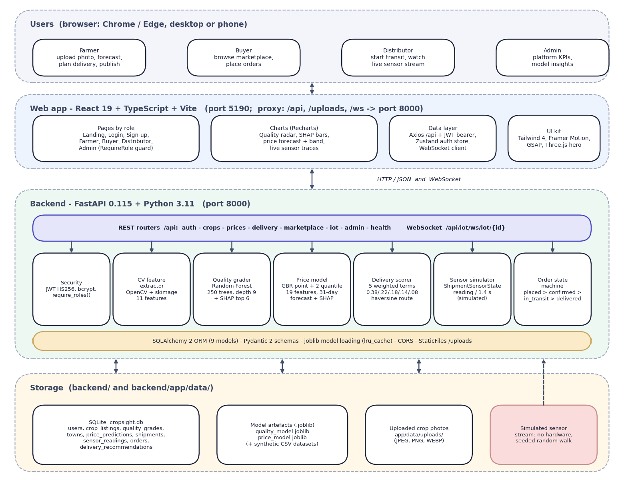

System Architecture
• React 19 + Vite web app: farmer, buyer, distributor and admin screens
• FastAPI backend: 7 routers, 21 endpoints (20 REST + 1 WebSocket), JWT + bcrypt, role guards
• Models: Random Forest grader + SHAP; Gradient Boosting price model with quantile bands; weighted delivery score
• Storage: SQLite (9 tables), uploaded photos, .joblib model files
• Sensor stream: simulated, one reading every 1.4 s over WebSocket
Dept. of CSE | Batch A17 | Final Review
10

Slide 11
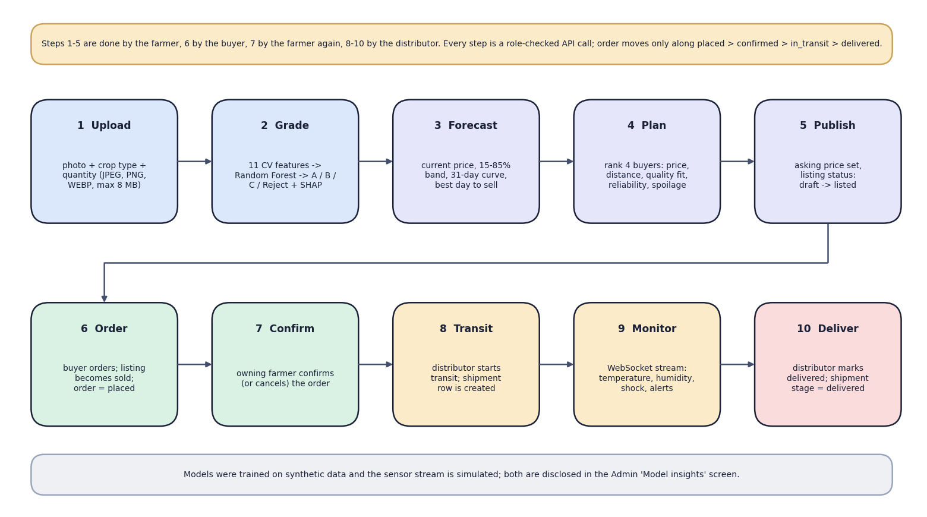

Methodology
End-to-end workflow: upload, grade, forecast, plan, publish, order, confirm, transit, monitor, deliver
Dept. of CSE | Batch A17 | Final Review
11

Slide 12
Dataset, Features & Models
Grader data (synthetic): 6,000 feature rows, 1,500 per grade, 11 features, 6 % of labels moved to a neighbouring grade; 80/20 stratified split (4,800 / 1,200).
Price data (synthetic): 23,360 rows = 8 crops x 8 regions x every 3rd day, 2022-2024; INR 402-19,176 per quintal; 85/15 split (19,856 / 3,504).
Real photos used only for checking: 3,200 fresh/rotten fruit photos (CC BY 4.0) and tomato, onion and potato photos for the demo screens.
Features: hue, saturation, value, uniformity, GLCM texture (3), edge density, blemish ratio, size score; price: season, rainfall, temperature, demand, supply, fuel, days to harvest, grade, region, crop.
Models: Random Forest (250 trees, depth 9); Gradient Boosting (300 trees, depth 4) + 2 quantile models (alpha 0.15 / 0.85); SHAP TreeExplainer.
Delivery score = 0.38 price + 0.22 distance + 0.18 quality fit + 0.14 reliability + 0.08 (1 - spoilage risk); not trained.
Dept. of CSE | Batch A17 | Final Review
12
Notes:
No real crop-image or market-price dataset was available; both models are trained on synthetic data and the app says so in its admin page.

Slide 13
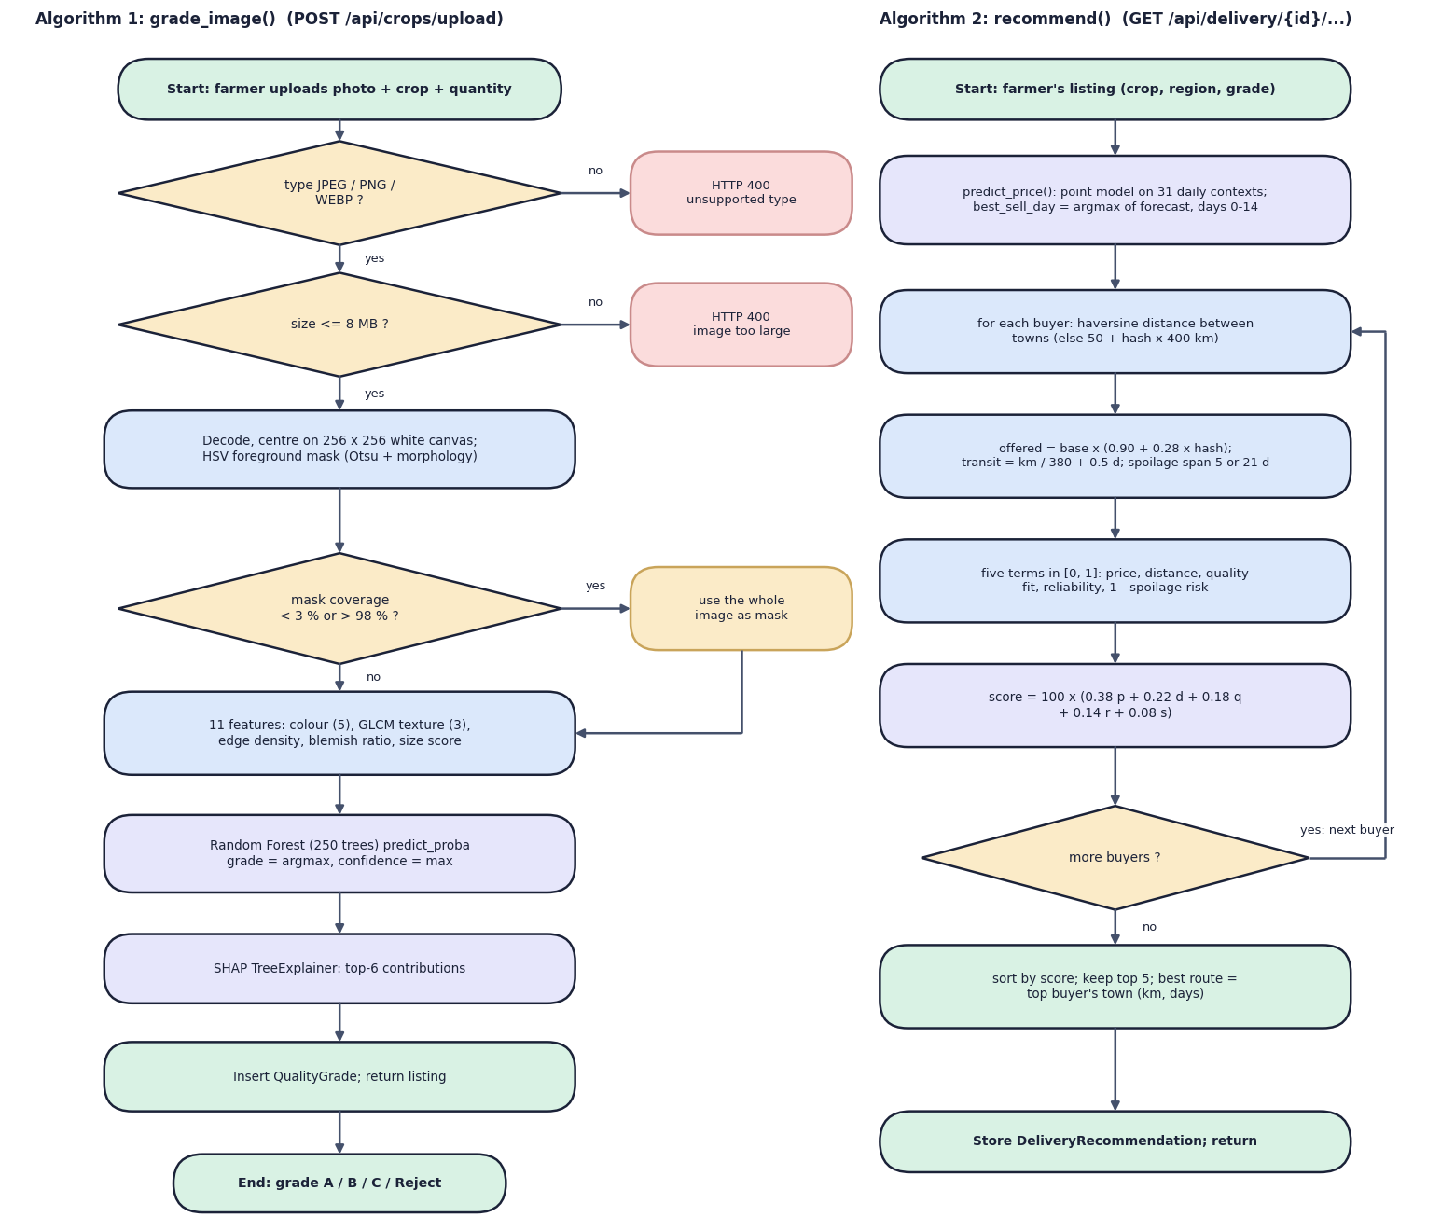

Decision Workflow
• Grading: validate type and size, centre on a 256 px canvas, foreground mask (whole image if mask < 3 % or > 98 %), 11 features, Random Forest, SHAP
• Delivery: for every buyer compute haversine distance, offered price, five normalised terms and a weighted score x100; return the top 5
• Best sell day = highest forecast price within days 0-14 (spoilage window)
Dept. of CSE | Batch A17 | Final Review
13

Slide 14
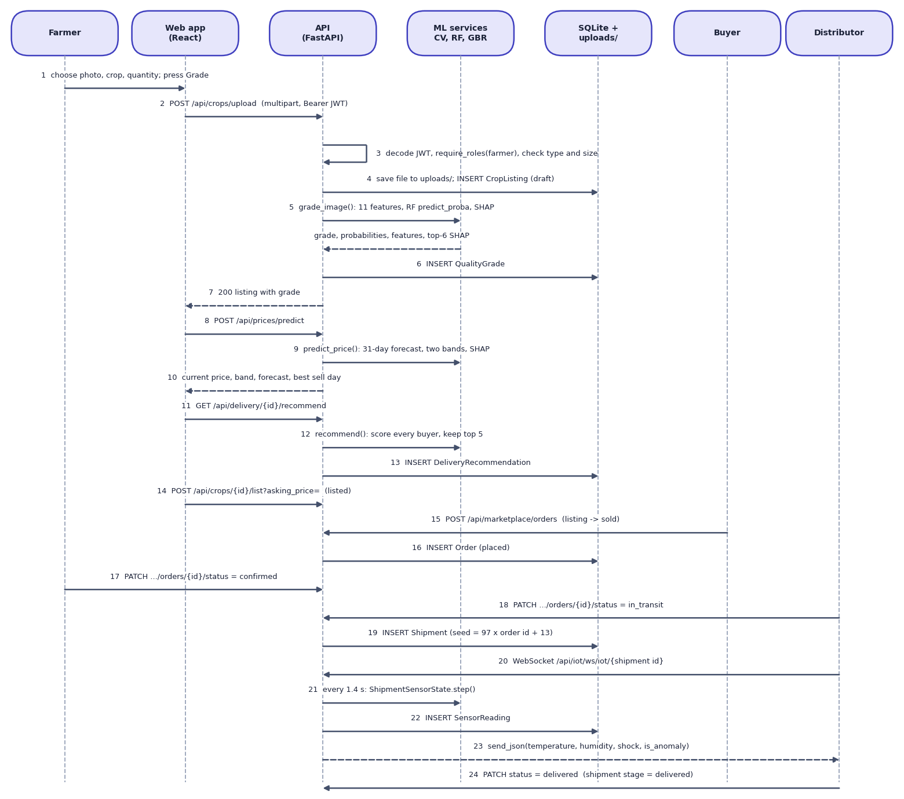

User–System Interaction
• Farmer uploads a photo; the API checks the JWT and role, saves the file and a draft listing, then grades and stores the result
• Forecast and delivery plan are requested from the listing; publishing sets the status to listed
• Buyer orders (listing becomes sold); farmer confirms; distributor starts transit and a shipment with a WebSocket stream is created
Dept. of CSE | Batch A17 | Final Review
14

Slide 15
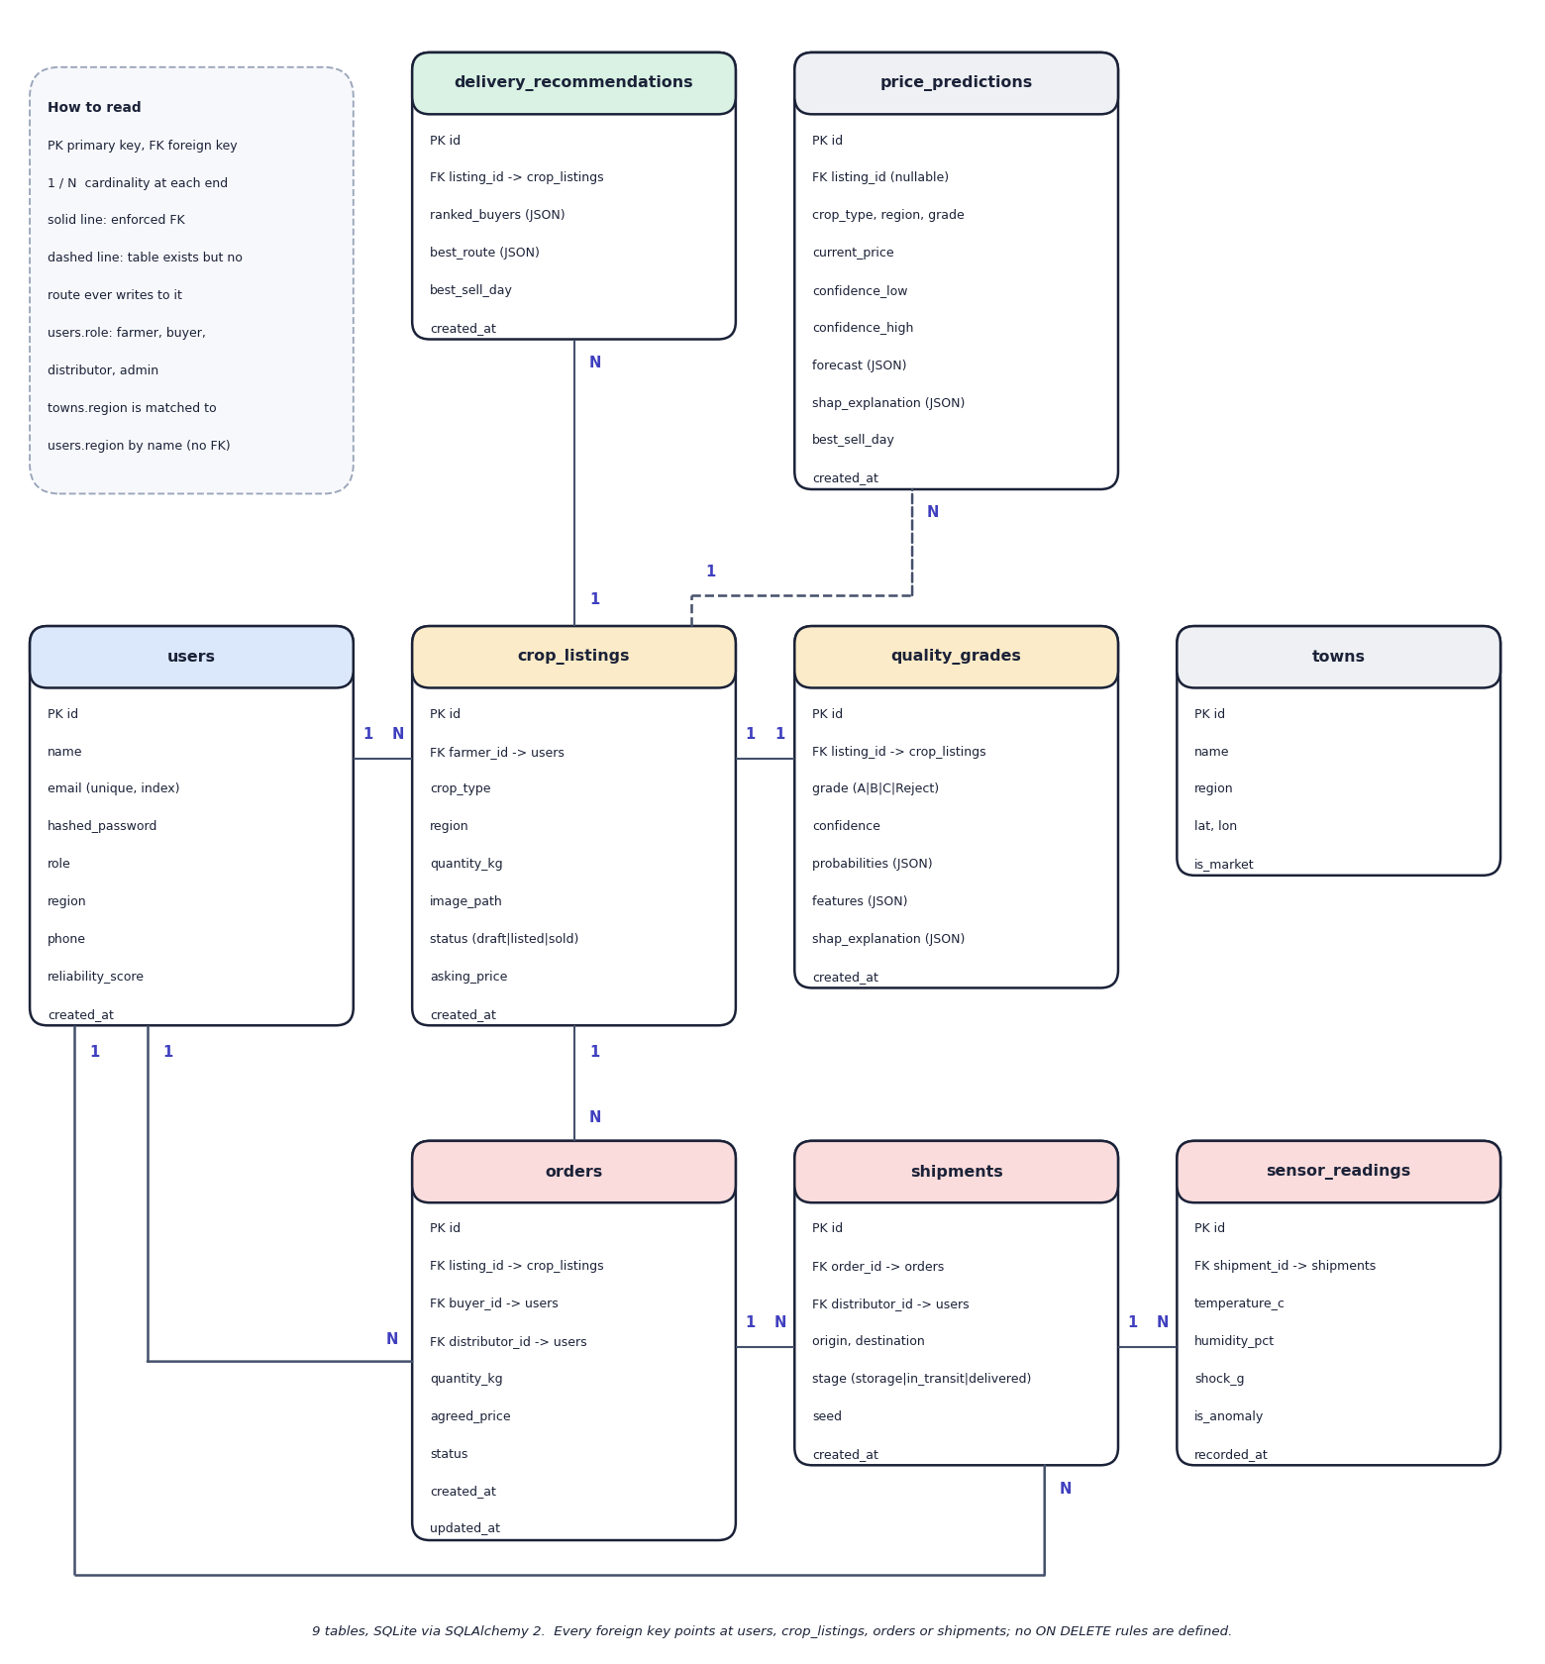

Database Design
• 9 SQLite tables: users, crop_listings, quality_grades, towns, price_predictions, shipments, sensor_readings, orders, delivery_recommendations
• One grade per listing; orders link a listing, a buyer and a distributor
• Shipments hold the sensor readings; recommendations are stored per listing
• price_predictions exists in the schema but no route writes to it
Dept. of CSE | Batch A17 | Final Review
15

Slide 16
Implementation Highlights
Module | Implementation
Grading | OpenCV HSV mask (Otsu), GLCM texture, Canny edges, blemish and size features; Random Forest 250 trees; SHAP top 6
Price | Gradient Boosting 300 trees + two quantile models; 31-day context walk; best day = argmax over days 0-14
Delivery | Weighted score of price, distance (haversine), quality fit, reliability, spoilage; top 5 buyers and a route
IoT | Seeded random-walk sensor simulator with injected events; WebSocket every 1.4 s; readings stored per shipment
Marketplace | Order state machine placed - confirmed - in transit - delivered; role checks on every transition
Web app + security | React 19, TypeScript, Tailwind, Recharts; bcrypt, JWT 7 days, role guards; 21 endpoints; 36 backend tests
Dept. of CSE | Batch A17 | Final Review
16

Slide 17
Results – Measured Performance
Measure | Result | Note
Grader accuracy, synthetic test (1,200 rows) | 92.3 % (macro F1 0.924) | 5 seeds 92.9 ± 0.3 %; every error is between neighbouring grades
Price model MAE / R² / MAPE (3,504 rows) | INR 164.6 / 0.992 / 5.08 % | noise floor MAPE 2.8 %; 2024 hold-out R² 0.988
15-85 % price band coverage | 69.3 % | nominal 70 %; mean width 23.1 % of price
Shipped grader on 3,200 real fruit photos | 50.4 % (AUC 0.57) | chance = 50 %; 99 % of photos graded B
Same 11 features retrained on real labels | 90.6 % (AUC 0.97) | 5-fold CV; unseen fruit types 66.9 %
Delivery top-1 stability | 97.7 % | weights x0.5-1.5, 256 cases, worst case 74 %
IoT simulator in alarm | 91.6 % of steps | all 50 shipments by step 400 (9.3 min)
Automated tests | 36 passed, 3 expected-fail | the 3 document real gaps
Grader and price figures are on synthetic test sets (they measure recovery of the generator, not field performance); real-photo rows are the independent check.
Dept. of CSE | Batch A17 | Final Review
17
Notes:
Both models are synthetic-trained. The real-photo rows show the grader does not transfer; the feature extractor itself does carry signal.

Slide 18
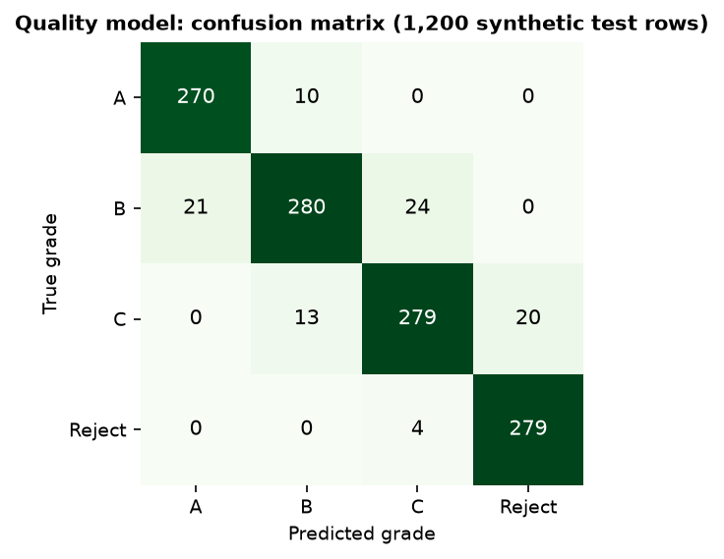
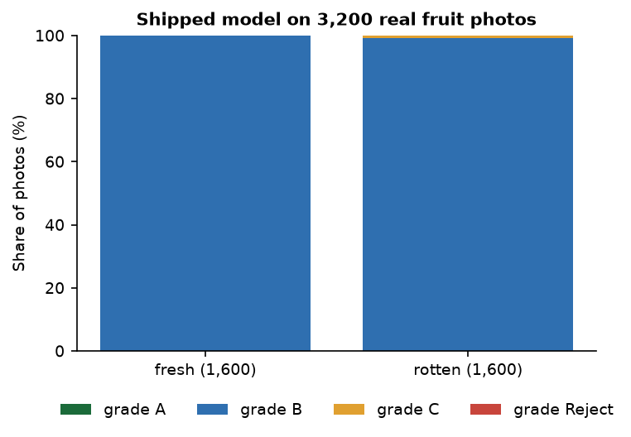


Confusion Matrix & Real-Photo Check
Synthetic test set: 1,108 of 1,200 correct (92.3 %); all 92 errors are between neighbouring grades
3,200 real photos: 99.8 % of fresh and 99.1 % of rotten fruit are graded B
Dept. of CSE | Batch A17 | Final Review
18
Notes:
Left: confusion matrix on the shipped model's synthetic test split. Right: the shipped model on real photographs of fresh and rotten fruit.

Slide 19
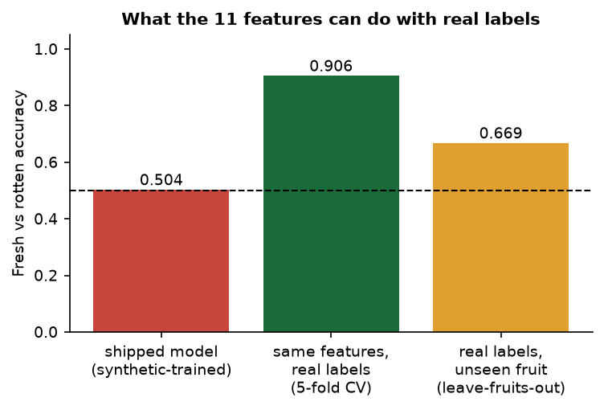
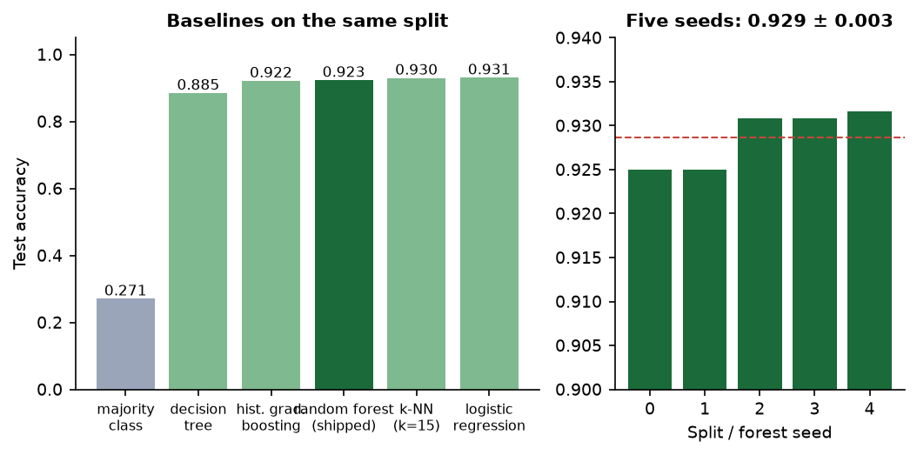


Baselines, Seeds & Real-Label Retraining
Same split: logistic regression 93.1 % and k-NN 93.0 % match the forest (92.3 %); five seeds 92.9 ± 0.3 %
Fresh vs rotten: shipped model 50.4 %, same features trained on real labels 90.6 %, unseen fruits 66.9 %
Dept. of CSE | Batch A17 | Final Review
19
Notes:
Baselines show the synthetic classes are close to linearly separable (dropping any one feature group costs at most 1.2 points). Retraining on real labels shows the features carry signal while the shipped classifier does not transfer.

Slide 20
Performance & Testing
Measurement | Result
API response, median / 95th percentile | health 1.6 / 4.7 ms; marketplace 17.7 / 36.5; price predict 54.9 / 119.4; delivery 99.8 / 147.9; upload + grade 173.9 / 207.3; login (bcrypt) 325.3 / 349.0 ms
In-process model time | price forecast 13.1 ms median (p95 29.9); delivery ranking 64.7 ms (p95 107.1)
Automated tests | 36 passed, 3 expected-fail, 0 failed in 30 s: auth, role guards, grading, price, delivery, order lifecycle, IoT, admin
Defects found | corrupt image -> HTTP 500 and an orphan draft listing; unvalidated crop, region and order quantity/price; admin volume overstated 100x (INR per quintal x kg); unauthenticated WebSocket
Machine | Intel Core i5-12500, 15.7 GB RAM, no GPU; both models train in about 20 s
Not measured | concurrent load, memory, other hardware or browsers, user acceptance, real sensors
Dept. of CSE | Batch A17 | Final Review
20
Notes:
Latencies are from a live server on 127.0.0.1 while other jobs ran on the same machine.

Slide 21
Comparison with Base Paper (context only – different datasets)
System | Task and data | Method | Reported / measured | Explainability and extras | Comparable?
Base paper [1] | Pre-harvest irrigation, soil, crop, fertiliser advice; tabular soil/weather/crop data | TTL, TabNet, SwiFT; IoT sensors; weather API | Irrigation 99.13 %; soil RMSE 1.51, R² 98.7 %; crop 98.75 %; fertiliser 99.3 % | XAI, chatbot | -
Wang and Zhang [6] | Monthly US commodity prices 1997-2025 | Zero-shot time-series foundation models | Beat USDA futures-based forecasts on 3 of 4 commodities | - | No: price only
CropSight | Post-harvest grading, price, delivery; synthetic features and price series; 3,200 real photos for checking | Random Forest (11 CV features), Gradient Boosting + quantiles, weighted score, simulated sensors | Grader 92.3 % synthetic, 50.4 % on real photos; price R² 0.992 synthetic | SHAP on every grade and forecast; marketplace; live monitor | No: different task and data
Different tasks, data and metrics: no numeric head-to-head is possible. The base paper's figures are on tabular pre-harvest data; ours are partly on synthetic data.
Dept. of CSE | Batch A17 | Final Review
21
Notes:
State plainly: no claim that CropSight beats the base paper; the comparison is of scope and approach.

Slide 22
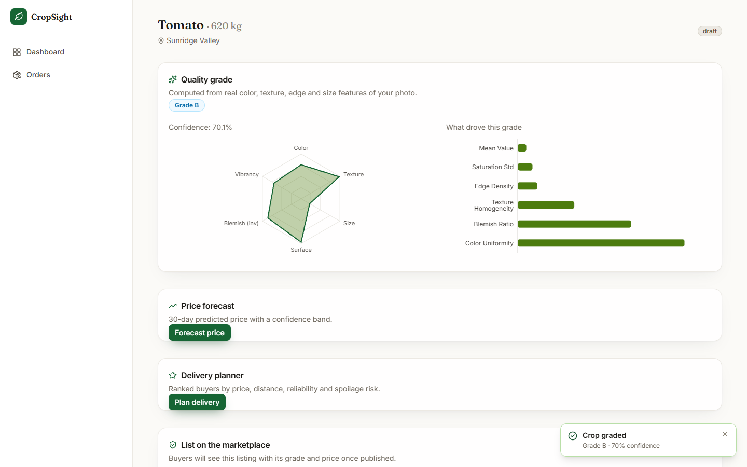
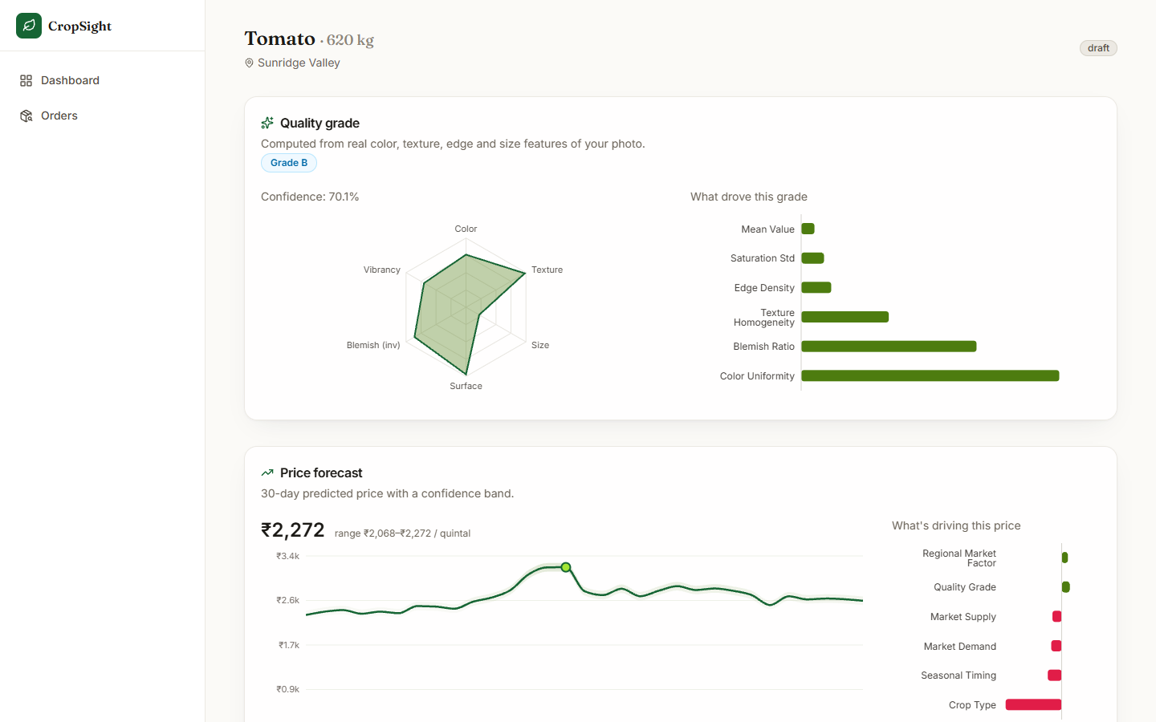


Output – Grading and Price Forecast
Real tomato photo graded B (70.1 %): radar of features and SHAP drivers
Forecast INR 2,272 per quintal with band, 30-day curve and drivers
Dept. of CSE | Batch A17 | Final Review
22

Slide 23
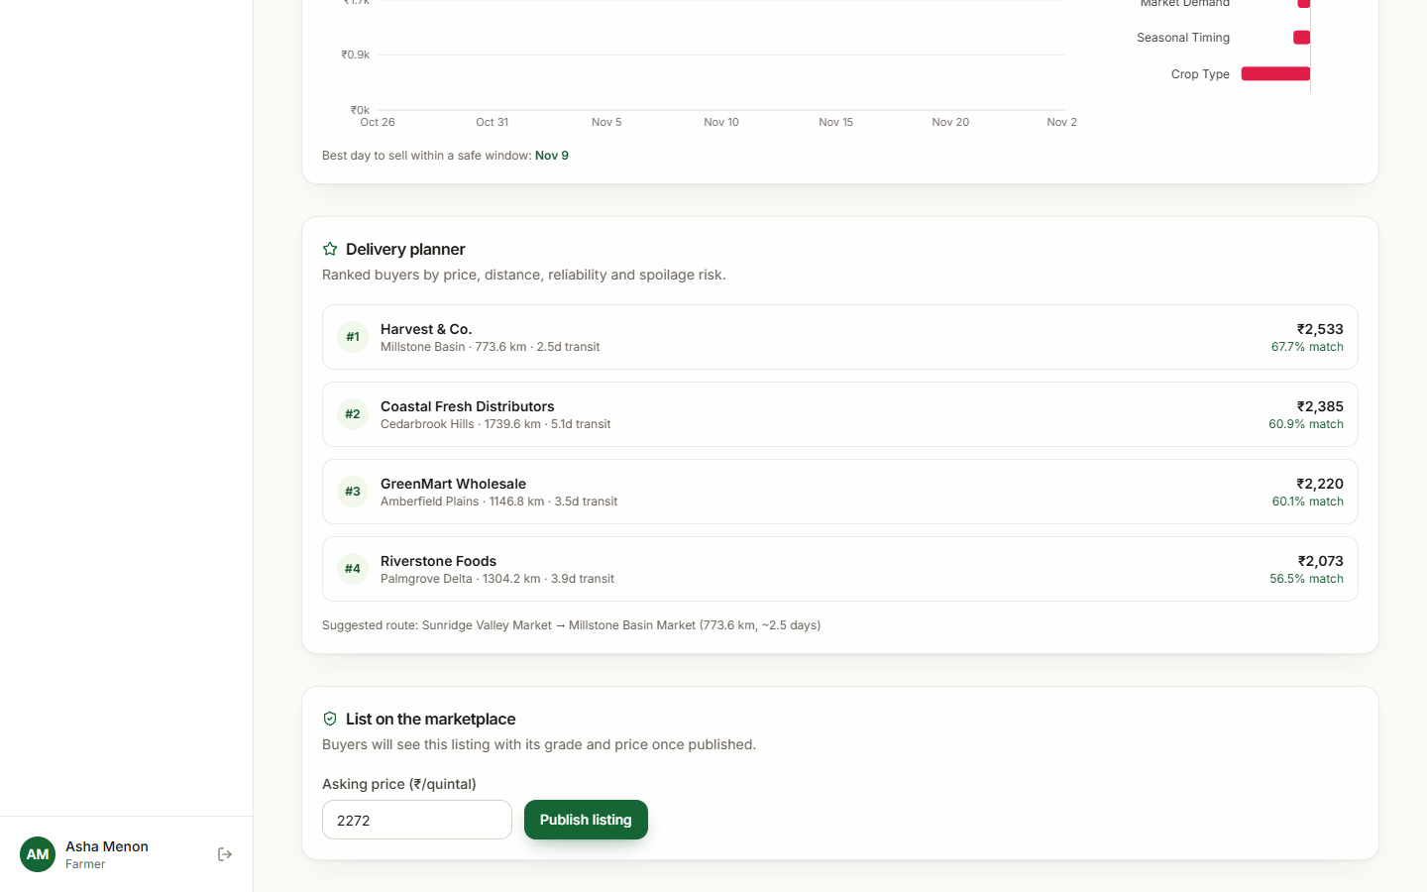
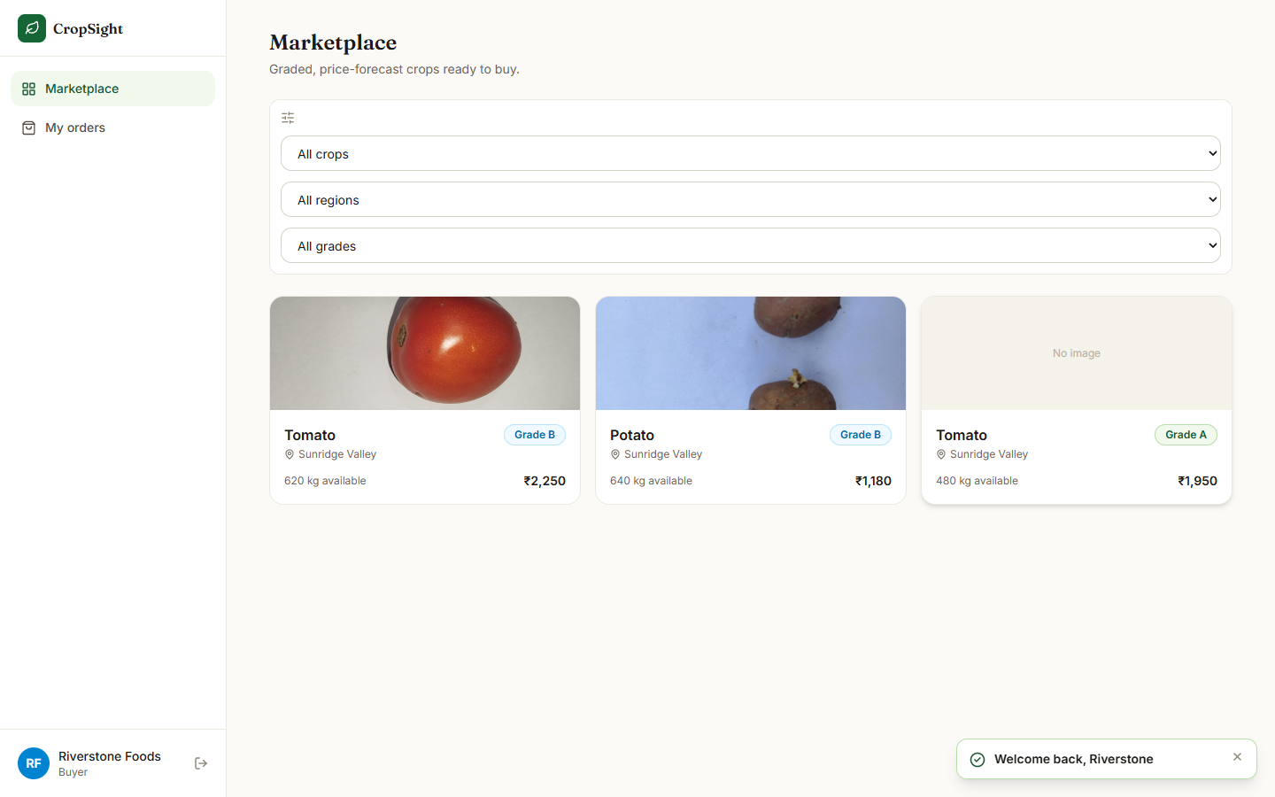


Output – Delivery Planner and Marketplace
Four buyers ranked (top: 67.7 % match) with a suggested route
Buyer marketplace: graded listings with photo, grade and price
Dept. of CSE | Batch A17 | Final Review
23

Slide 24
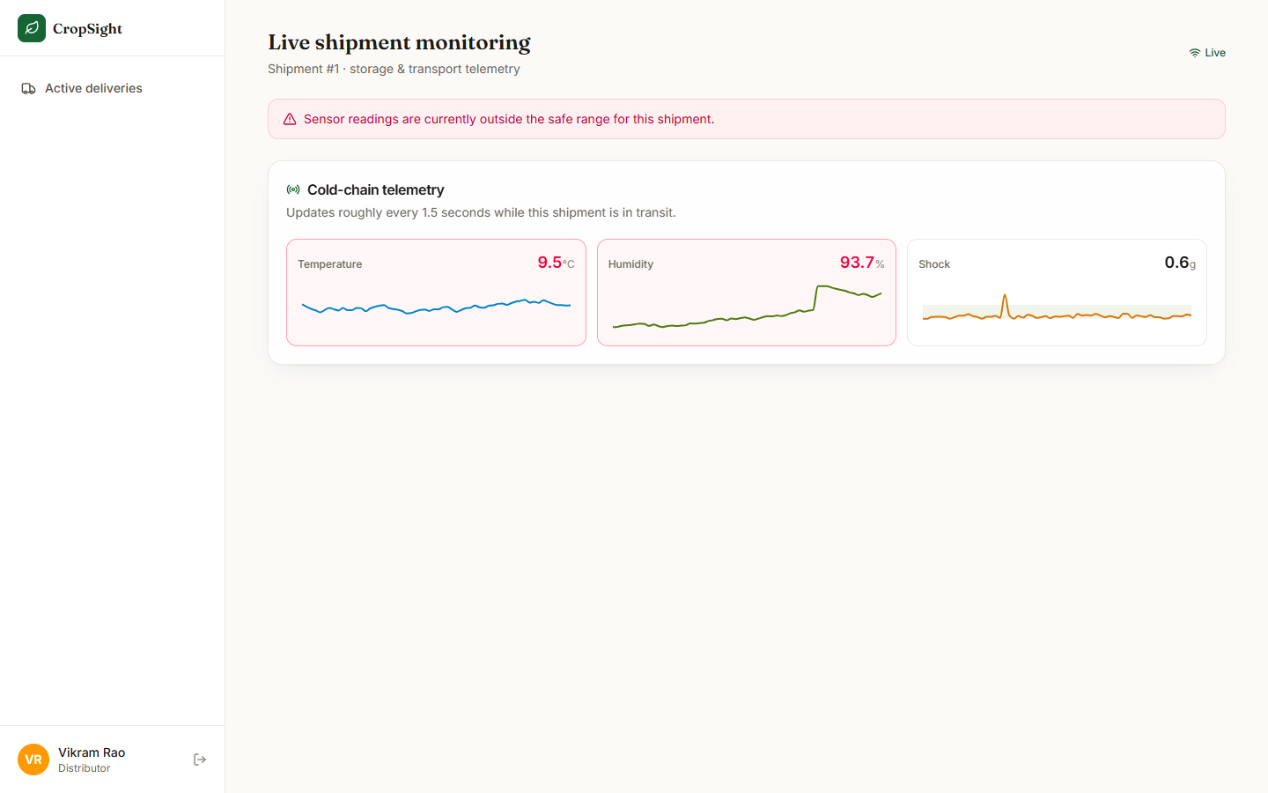
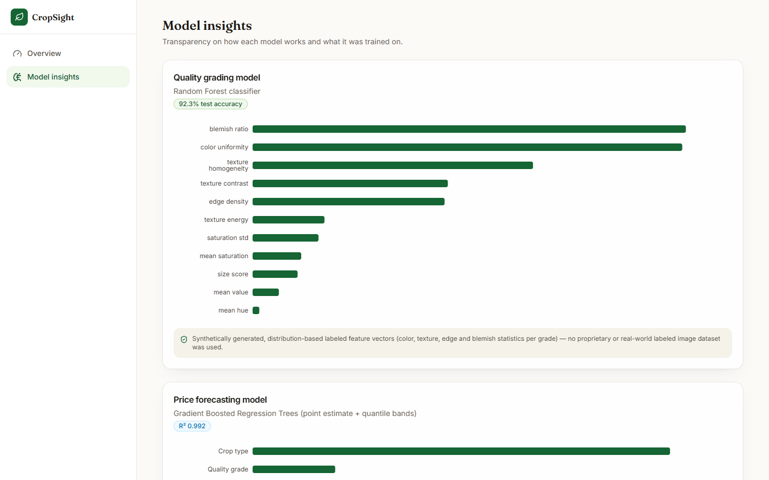


Output – Live Monitoring and Model Insights
Simulated shipment stream: alert banner when readings leave the safe band
Admin model insights: 92.3 % accuracy, R² 0.992 and the synthetic-data disclosure
Dept. of CSE | Batch A17 | Final Review
24

Slide 25
Conclusion
Built CropSight: a role-based platform that grades a crop photo with explanations, forecasts price, ranks buyers and routes, streams shipment sensors and runs an order lifecycle.
Measured: grader 92.3 % and price R² 0.992 on synthetic test sets; 36 tests pass; upload + grade 174 ms median.
Key finding: both models are trained on synthetic data; on 3,200 real fruit photos the shipped grader is at chance (50.4 %), while the same features retrained on real labels reach 90.6 %.
Limits: classical ML rather than deep learning; simulated sensors whose alarm drifts into permanent alarm; hash-based market context; defects found (100x admin volume, unvalidated inputs).
Objectives are met as a working prototype, not as field-validated performance.
Dept. of CSE | Batch A17 | Final Review
25

Slide 26
Future Scope
Collect real labelled crop images and retrain the grader (the features already reach 90.6 % on real labels); consider a CNN.
Replace the synthetic price series by real mandi data and a true time-series forecaster; validate on a time-based split.
Connect real IoT sensors; add mean reversion and event-based alarms; authenticate the WebSocket.
Fix the defects: unit error in admin volume, input validation, corrupt-image handling, authorisation gaps, secrets.
Real buyer quotes and road routing; payments; deployment with a hosted database, HTTPS and load testing; a user study.
Dept. of CSE | Batch A17 | Final Review
26

Slide 27
References
[1] A. Khaliq, A. Khan, S. Jan, M. Umair, A. Gulshair, A. Ali, and U. A. Shah, "AI-driven smart agriculture: An integrated approach for soil analysis, irrigation, and crop-fertilizer recommendations," IEEE Access, vol. 13, pp. 141124-141138, 2025, doi: 10.1109/ACCESS.2025.3594162.
[2] "Cross-task consistent multi-task learning for fine-grained crop leaf disease diagnosis and severity grading," in Proc. 2026 7th Int. Conf. Computer Vision, Image and Deep Learning (CVIDL), 2026 (listed in the batch literature survey; not independently retrieved).
[3] "Design of agricultural product quality inspection and e-commerce grading system based on image recognition," in Proc. 2nd Int. Conf. Artificial Intelligence, Deep Learning, and Neural Networks (AIDLNN 2025), 2026 (listed in the batch literature survey; not independently retrieved).
[4] "Crop and market price prediction system using machine learning," Int. Research J. Modernization in Engineering Technology and Science (IRJMETS), 2023 (listed in the batch literature survey; not independently retrieved).
[5] "Crop price prediction using machine learning," J. Electrical Systems, 2024 (listed in the batch literature survey; not independently retrieved).
[6] L. Wang and B. Zhang, "The promise of time-series foundation models for agricultural forecasting: Evidence from commodity prices," arXiv:2601.06371, Jan. 2026.
[7] L. Feng and S. Zong, "Large-scale crop image recognition based on ConvLSTM spatiotemporal feature extraction and LCMST-Net model," IEEE Access, vol. 14, pp. 10719-10734, 2026, doi: 10.1109/ACCESS.2026.3653414.
[8] N. Sultana, M. Jahan, and M. S. Uddin, "An extensive dataset for successful recognition of fresh and rotten fruits," Data in Brief, vol. 44, Art. no. 108552, 2022, doi: 10.1016/j.dib.2022.108552.
[9] Project-AgML, "Vegetable classification (Bangladesh)," Hugging Face dataset repository, CC BY 4.0. [Online]. Available: https://huggingface.co/datasets/Project-AgML/vegetable_classification_bangladesh
[10] L. Breiman, "Random forests," Machine Learning, vol. 45, no. 1, pp. 5-32, 2001.
[11] J. H. Friedman, "Greedy function approximation: A gradient boosting machine," Annals of Statistics, vol. 29, no. 5, pp. 1189-1232, 2001.
[12] R. Koenker and G. Bassett, "Regression quantiles," Econometrica, vol. 46, no. 1, pp. 33-50, 1978.
[13] S. M. Lundberg and S.-I. Lee, "A unified approach to interpreting model predictions," in Advances in Neural Information Processing Systems (NeurIPS), vol. 30, 2017, pp. 4765-4774.
[14] S. M. Lundberg et al., "From local explanations to global understanding with explainable AI for trees," Nature Machine Intelligence, vol. 2, no. 1, pp. 56-67, 2020.
[15] R. M. Haralick, K. Shanmugam, and I. Dinstein, "Textural features for image classification," IEEE Trans. Systems, Man, and Cybernetics, vol. SMC-3, no. 6, pp. 610-621, 1973.
[16] J. Canny, "A computational approach to edge detection," IEEE Trans. Pattern Analysis and Machine Intelligence, vol. PAMI-8, no. 6, pp. 679-698, 1986.
[17] N. Otsu, "A threshold selection method from gray-level histograms," IEEE Trans. Systems, Man, and Cybernetics, vol. SMC-9, no. 1, pp. 62-66, 1979.
[18] F. Pedregosa et al., "Scikit-learn: Machine learning in Python," J. Machine Learning Research, vol. 12, pp. 2825-2830, 2011.
[19] S. van der Walt et al., "scikit-image: Image processing in Python," PeerJ, vol. 2, Art. no. e453, 2014.
[20] G. Bradski, "The OpenCV library," Dr. Dobb's Journal of Software Tools, 2000.
[21] M. T. Ribeiro, S. Singh, and C. Guestrin, "'Why should I trust you?': Explaining the predictions of any classifier," in Proc. 22nd ACM SIGKDD Int. Conf. Knowledge Discovery and Data Mining, 2016, pp. 1135-1144.
[22] S. O. Arik and T. Pfister, "TabNet: Attentive interpretable tabular learning," in Proc. AAAI Conf. Artificial Intelligence, vol. 35, no. 8, 2021, pp. 6679-6687.
[23] M. Jones, J. Bradley, and N. Sakimura, "JSON Web Token (JWT)," RFC 7519, Internet Engineering Task Force, May 2015.
Dept. of CSE | Batch A17 | Final Review
27

Slide 28
THANK YOU
Questions & Suggestions
Dept. of CSE | Batch A17 | Final Review
28
Notes:
Thank you. Questions are welcome.

