Slide 1
Fashion Demand Forecasting Using Machine Learning And Domain Adaptation
REVIEW 2 · DESIGN, METHODOLOGY AND PROGRESS
Design, methodology and progress: XGBoost demand forecasting with importance-weighted domain adaptation on H&M retail data
Presented by
Under the guidance of
B Shilpa 23K91A0547
B Hari Narayana 23K91A0544
A Rani Thejaswini 23K91A0516
A Sanjana 23K91A0511
Deepthi, [DESIGNATION]
Department of Computer Science and Engineering
TKR College of Engineering & Technology · Batch A17 (CSE-A) · [ACADEMIC YEAR]
Notes:
This review shows how TrendCast is designed and built, what is implemented, the first measured results on a real subset of the H&M data, and the open items. Introduce the four team members and the guide.

Slide 2
Contents
01
02
03
04
Recap and architecture
Methodology and dataset
Preprocessing and model
Training and decision logic
05
06
07
08
Data flow, modules, UML
Technology stack
Implementation progress
Preliminary results
09
10
11
12
Output screens
Testing
Challenges
Next steps
Notes:
Agenda for the design and progress review.

Slide 3
Recap: problem and proposed system
!
Problem
i
Proposed system
B
Base paper link Mishra et al.
A forecasting model trained in one retail context loses accuracy in another whose data distribution differs. Fashion adds short product life, seasonality and trends that move inside a season, and planners distrust forecasts they cannot explain.
TrendCast cleans retail transactions, builds daily demand per article, forecasts it with XGBoost, moves a model from a source domain to a shifted target with importance weights, and shows the result in a gated web console with an optional AI explanation.
The base paper pairs LightGBM with four explainability levels on UCI Online Retail II (RMSE 33.71, R2 0.243). We keep gradient boosting and the leakage-safe lag features, and add domain adaptation. Different data: only relative findings are comparable.
Notes:
Recap of Review 1. The base paper stops at one market and one-day-ahead forecasts; our gap is moving a gradient-boosted model across domains and testing that honestly.

Slide 4
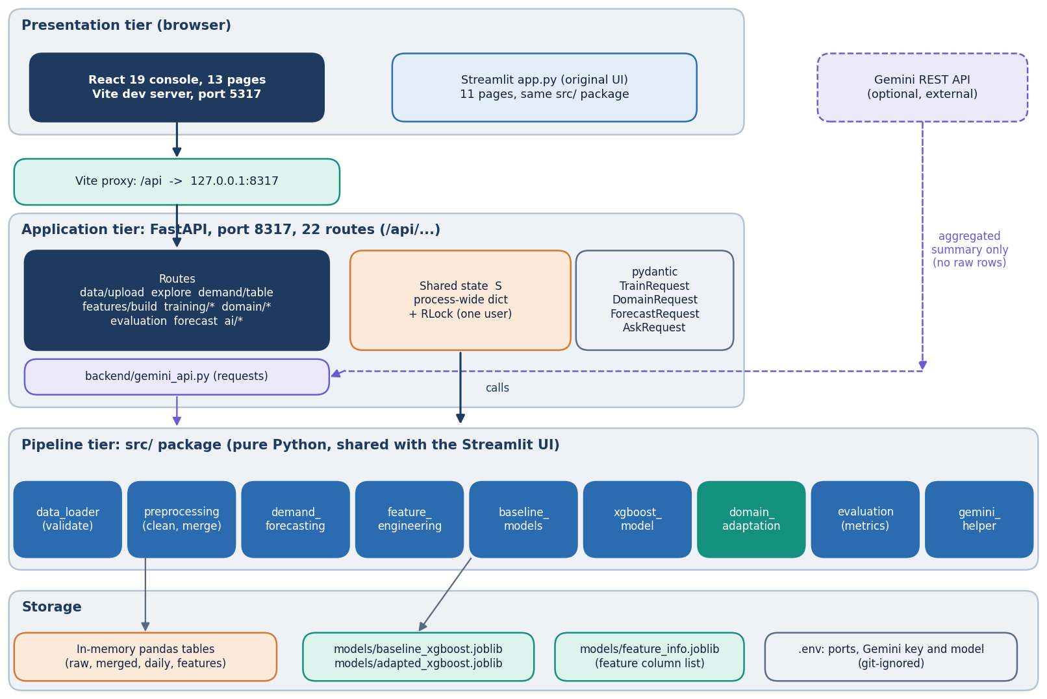
System architecture
Layered, no database
Console: React 19 + Vite on port 5317, 13 pages; the original Streamlit app (11 pages) still runs on the same code.
API: FastAPI on port 8317, 22 routes under /api; downstream routes answer 409 until the earlier step is done.
Pipeline: src/ modules for loading, cleaning, daily demand, features, baselines, XGBoost, domain adaptation and metrics.
State: one process-wide dictionary with a lock; only the trained models are saved (models/*.joblib).
Notes:
The routes live in backend/main.py (626 lines) and call src/ functions; no pipeline logic was rewritten in the API layer.

Slide 5
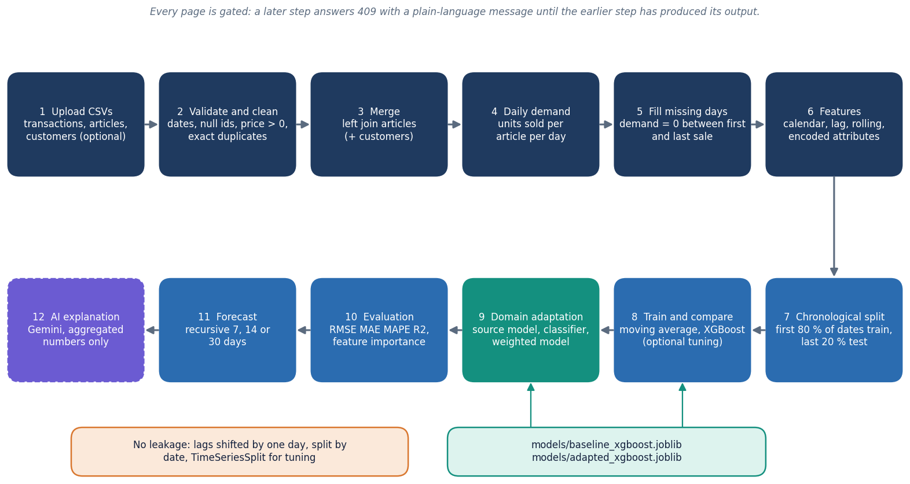
Methodology: clean, aggregate, forecast, adapt, evaluate
Prepare
Validate and clean the CSVs, join articles, count units per article per day, fill idle days with zero, add shifted lag and rolling features.
Forecast
Split by date (80/20), compare the moving average with XGBoost, optionally tune with time-ordered cross-validation.
Adapt and judge
Train on a source domain, test on the later half of a target domain, re-weight source rows by p/(1-p), report before and after as measured.
High-level workflow as implemented in the API.
Notes:
Every step is gated in the console. The domain step uses the same feature table and the same XGBoost defaults as the main model.

Slide 6
Dataset: a real subset of H&M retail transactions
684,392
300
31,094
276,168
transaction rows read (2018-09-20 to 2019-01-04)
best-selling articles of the first shard
article-day rows after filling idle days
customers in the subset
 | Real subset (all reported results) | Synthetic sample (smoke tests only)
Source | H&M Personalized Fashion Recommendations (Kaggle data, Hugging Face parquet mirror); first of 7 transaction shards | scripts/make_sample_data.py, H&M schema
Size | 684,392 rows; channel 1 227,131, channel 2 378,047 after cleaning | 70,974 rows, 90 articles, 4,000 customers
Target | units sold per article per day (mean 19.46, median 14, max 566; 2.0 % zero days) | same definition
Split | chronological: train 2018-09-20 to 2018-12-13 (24579 rows), test 2018-12-14 to 2019-01-04 (6515 rows) | not used for metrics
Limits | 107 days only; test window holds the Christmas peak and January; no earlier year; not redistributed | simulated, not real sales
Notes:
The shipped sample is synthetic, so the real subset was built from the public H&M files. Licence: Kaggle competition terms, academic use; the files are not redistributed. Channels 1 and 2 are only codes in the data.

Slide 7
Data preprocessing and feature construction
Parse dates, drop bad rows
Join articles
Units per article-day
Fill idle days with 0
Shifted lags and rolls
31 model inputs
79,214
31
exact-duplicate rows dropped (11.6 % of the subset); repeat purchases look like duplicates, so demand is understated
inputs: price, channel, 6 encoded attributes, 14 calendar, 9 lag and rolling
Lags 1, 7, 14, 28 and rolling mean 7, 14, 28 and std 7, 28 are computed on values shifted by one day, so a day never sees its own demand.
Month and weekday get sine and cosine encodings; product attributes are label-encoded, not one-hot.
Idle days between an article's first and last sale become demand 0: 613 rows added, 1.97 % of the table.
Known limit: price and channel are the target day's own mean price and most frequent channel, so they are planned inputs at best.
Notes:
Leakage guards: shifted lag and rolling features, chronological split, TimeSeriesSplit for tuning, domain column excluded from the domain classifier.

Slide 8
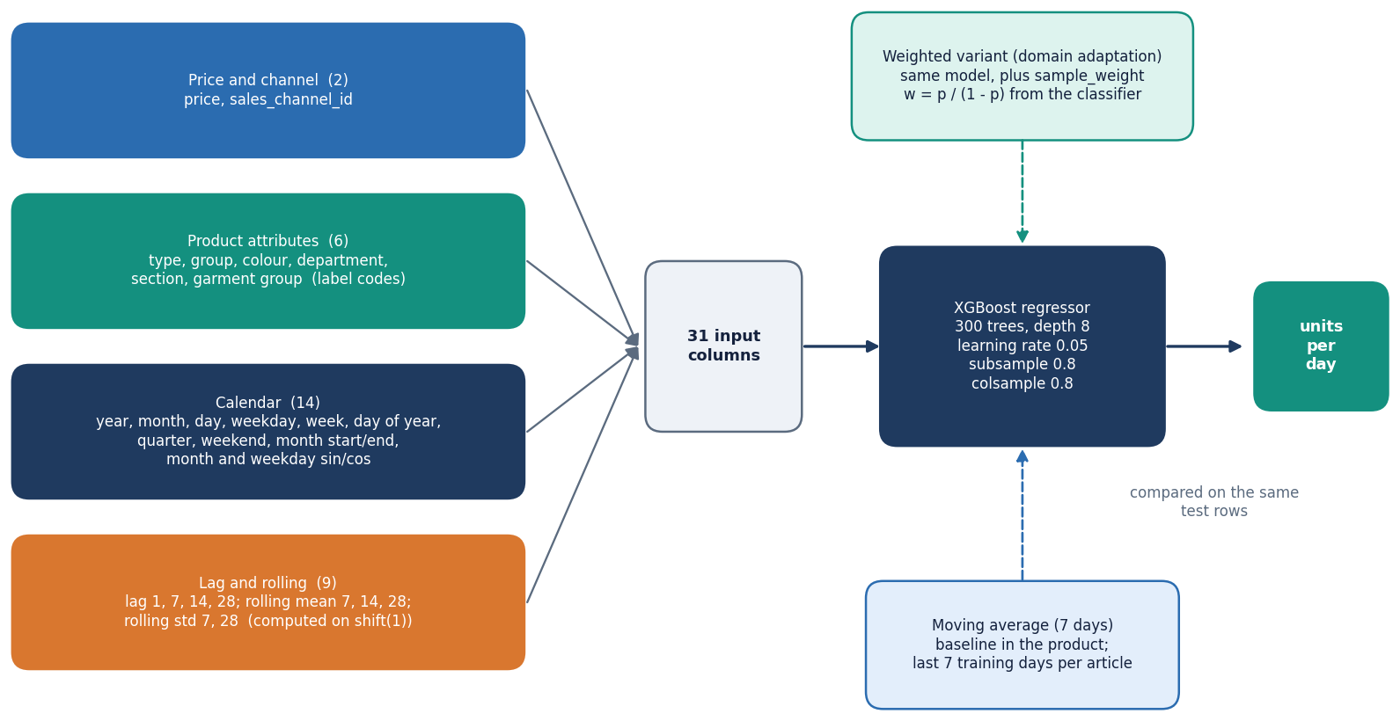
Model architecture
Main model: one XGBoost regressor (300 trees, depth 8, learning rate 0.05) on the 31 inputs.
Baseline in the product: mean of the article's last 7 days.
Weighted variant: the same XGBoost with a per-row sample weight from the domain classifier.
Offline comparison models: random forest, LightGBM, naive lag-1.
Feature groups feeding one XGBoost regressor, with the baselines.
Notes:
XGBoost was chosen because it handles mixed numeric and encoded features, is fast on CPU and accepts sample weights, which the adaptation step needs.

Slide 9
Training and evaluation configuration
Setting | Value
Split | chronological 80/20 by date; train 24579 rows, test 6515 rows; domain tests hold out the later 50 % of target dates
XGBoost | 300 trees, depth 8, learning rate 0.05, subsample 0.8, colsample 0.8, seed 42; fit 1.9 s on CPU; seeds 42 to 46 for stability
Tuning | RandomizedSearchCV, 10 iterations x 3 time-ordered folds; 31 s; best: depth 12, 400 trees, learning rate 0.01
Baselines | moving average (7 d, in the product); random forest 200 trees, LightGBM 300 trees, naive lag-1 and lag-7 (offline)
Domain adaptation | logistic regression (1000 iterations) separates source from target; weight = p/(1-p), clipped at 20; weighted XGBoost
Metrics | RMSE, MAE, MAPE with zero-demand rows excluded, R2; WAPE added offline
Machine | Intel Core i5-12500, 15.7 GB RAM, no GPU; Python 3.11.9, XGBoost 2.0.3, scikit-learn 1.5.0
Notes:
All numbers in later slides use exactly this configuration. Tuning is time-ordered so it never trains on the future.

Slide 10
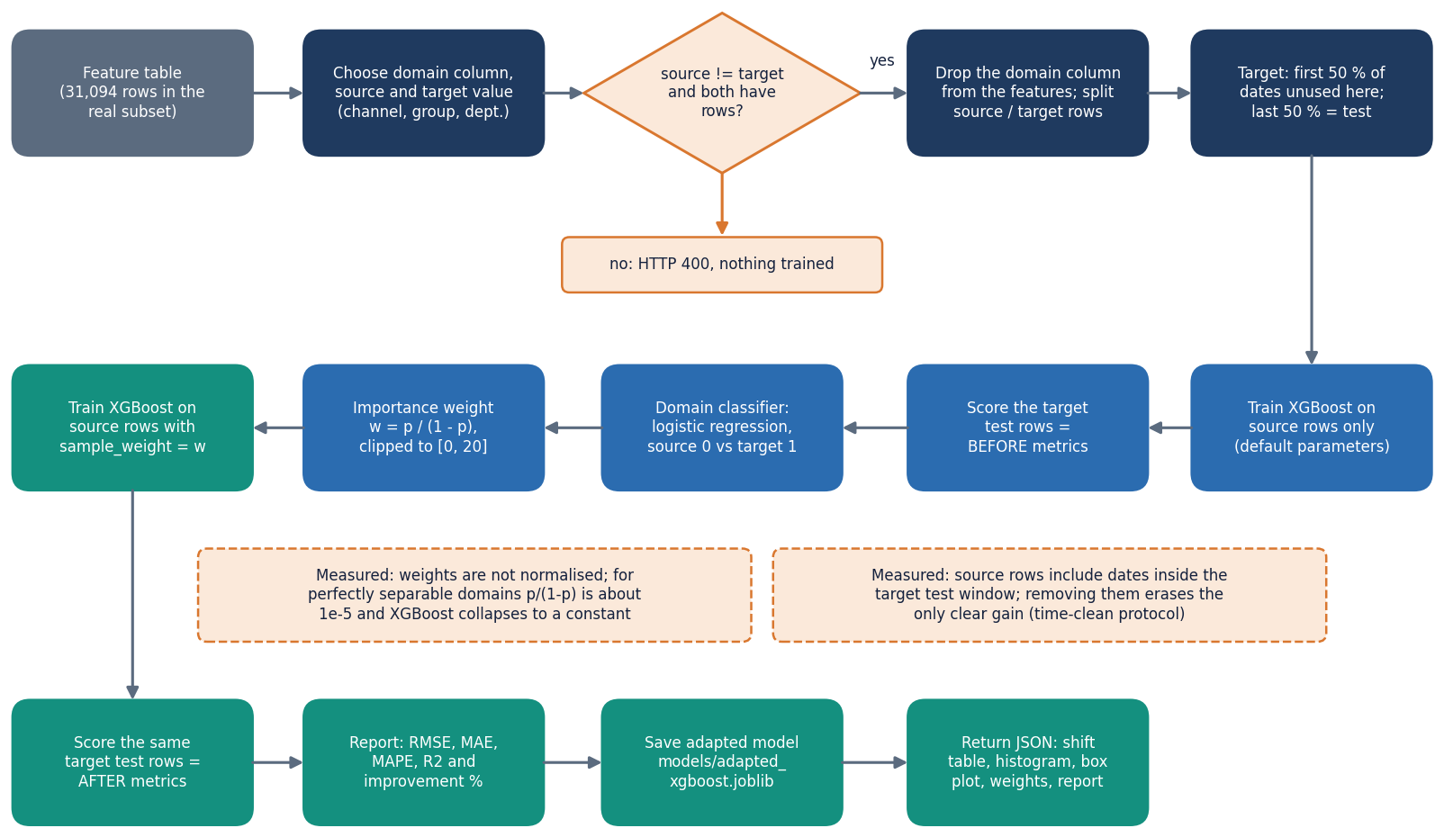
Decision logic: importance-weighted domain adaptation
Weight rule: w = p / (1 - p), where p is the domain classifier's probability that a source row looks like target; clipped at 20.
Gating: both domains need rows, source and target must differ, and the target must have enough dates to hold out a test half; otherwise the API answers 400.
Report as measured: RMSE, MAE, MAPE and R2 before and after; a worse result is shown as worse.
Our checks: shuffled weights, pooled source plus target-train, a target-only model, weights rescaled to mean 1, and a time-clean source that stops before the target test dates.
Notes:
The classifier excludes the domain column, otherwise it could read the label directly. The extra checks are offline in scripts/run_experiments.py.

Slide 11
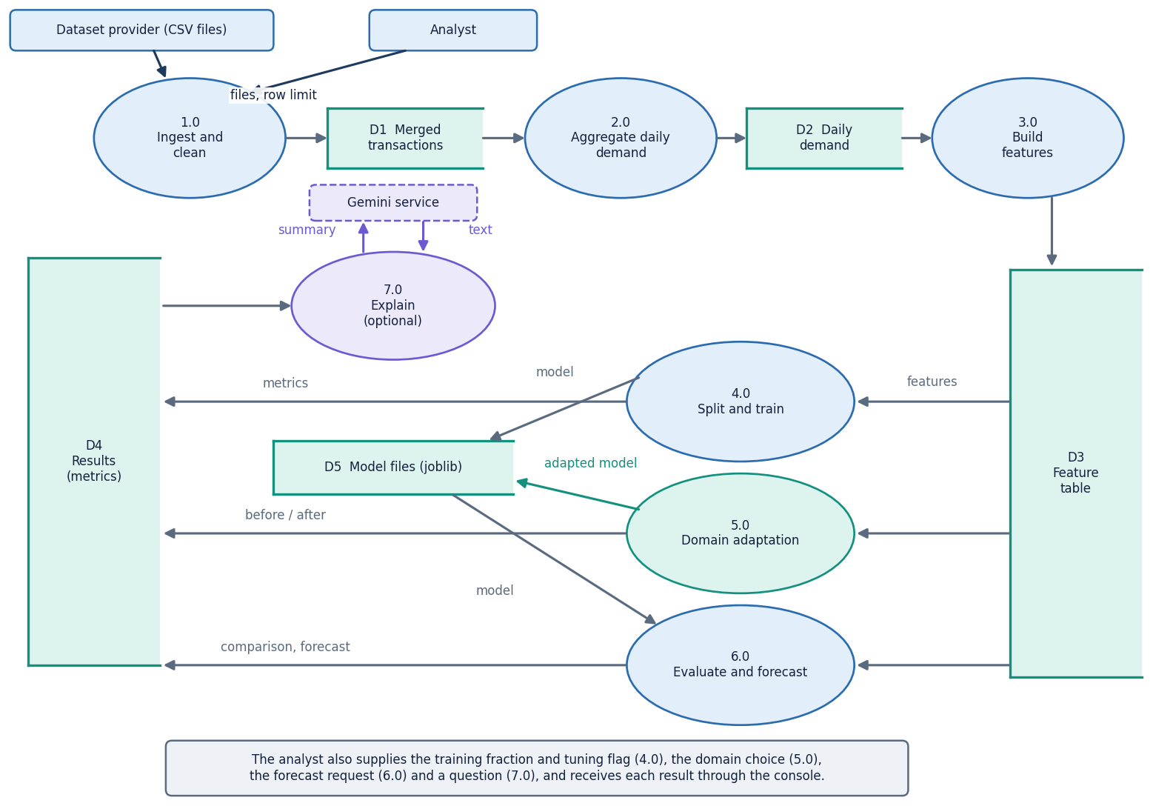
Data flow and modules
Module | Lines | Role
data_loader.py | 104 | column validation
preprocessing.py | 135 | clean, merge, quality report
demand_forecasting.py | 121 | daily demand, idle-day fill
feature_engineering.py | 165 | calendar, lag, rolling, encoding
baseline_models.py | 106 | date split, moving average
xgboost_model.py | 95 | train, tune, importance
domain_adaptation.py | 141 | classifier, weights
evaluation.py | 117 | metrics, before/after
backend/main.py | 626 | 22 API routes
DFD level 1: seven processes and the data stores.
Notes:
Module sizes counted from the files. The API layer is thin: it validates, takes the lock, calls src/ and shapes the JSON.

Slide 12
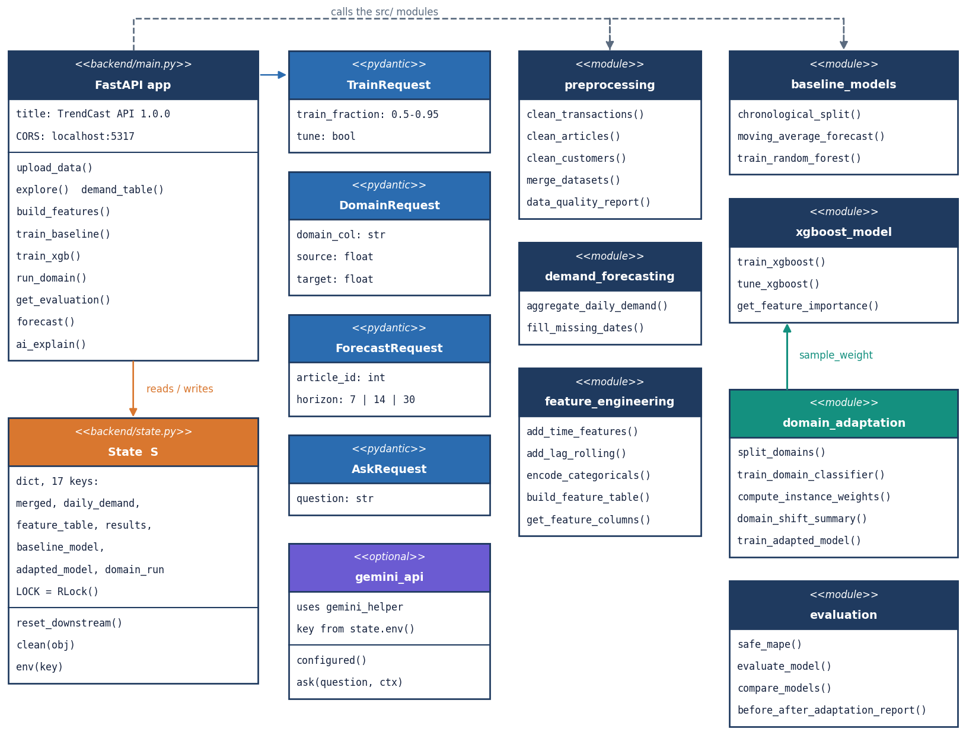
Database design and UML
Logical entities (no database)
Transaction, Article and Customer tables are joined on article_id and customer_id.
Transactions are counted per date and article into DailyDemand, which becomes one FeatureRow per article-day.
A training run writes a ModelFile; a domain run writes an adapted ModelFile and a DomainRun record; a Forecast is dated rows for one article.
Only models/*.joblib survive a restart; the logical ER diagram is in the report.
UML class diagram: API, request models, state and src/ modules.
Tables live in memory per process; models/baseline_xgboost.joblib, adapted_xgboost.joblib and feature_info.joblib persist.
Notes:
A database was not needed for a single-user tool. The ER diagram is logical: the relations are shared columns between pandas tables.

Slide 13
Technology stack
1
2
3
4
Python 3.11.9
XGBoost 2.0.3
FastAPI 0.143.3
React 19 + Vite 8
pandas 2.2.1, NumPy 1.26.4
main model; scikit-learn 1.5.0 for baselines, tuning, metrics
22 routes; uvicorn; pydantic request models
13 pages, Recharts charts
5
6
7
8
Streamlit 1.66.0
LightGBM 4.7.0
pytest, Playwright
Gemini REST (optional)
original 11-page interface, kept
offline baseline only
39 tests; screenshots from the real UI
AI Insights; aggregated numbers only
Everything runs on CPU on a single machine; there is no GPU, cloud service or database requirement.
Notes:
Versions are those installed on the measuring machine.

Slide 14
Implementation progress
Component | Status | Evidence
Data pipeline and features | Done | 31 inputs, shifted lags, 31,094 rows built in 0.9 s
Baseline, XGBoost, tuning | Done | XGBoost RMSE 11.09 vs moving average 12.89
Domain adaptation | Done, mixed result | helped 2 of 6 source-target pairs
Evaluation and importance | Done | gain importance in the app; SHAP only offline
Recursive 7 / 14 / 30-day forecast | Done, weak | error 41 % over days 1-7, 124 % over days 15-30 (WAPE)
FastAPI and React console | Done | 22 routes, 13 pages, gated by 409 messages
AI Insights (Gemini) | Built | external service returned 503 and timeouts when we captured it
Not implemented | Open | cold-start mode, inventory impact and SHAP inside the app
Notes:
Honest status: the pipeline and console are complete; two items are open (cold start, in-app inventory impact) and the long-horizon forecast is weak.

Slide 15
Preliminary results on real H&M data
Source -> target | RMSE before | RMSE after | Change
Online -> Store | 10.80 | 9.50 | +11.9 %
Store -> Online | 19.00 | 18.99 | +0.0 %
Upper body -> Lower body | 13.90 | 14.80 | -6.5 %
Lower body -> Upper body | 11.91 | 12.78 | -7.3 %
Knitwear -> Trouser | 17.23 | 25.21 | -46.3 %
Jersey Basic -> Blouse | 12.20 | 16.99 | -39.4 %
Test RMSE, 2018-12-14 to 2019-01-04; lower is better (XGBoost = mean of 5 seeds).
XGBoost beats the moving-average baseline (11.09 vs 12.89) but not repeating yesterday (9.22); lag and rolling features carry the model.
Domain adaptation as shipped: 2 of 6 pairs improved, mean -14.6 %; the one clear gain (+11.9 %) falls to -2.8 % when source rows may not overlap the target test dates.
Department pairs collapse (e.g. Knitwear -> Trouser -46 %): weights near 1e-5 stop XGBoost splitting; rescaling to mean 1 gives +1.9 %.
Notes:
Results are reported as measured, including the negative ones. Pair labels use store/online only as our convention; the data code the channels 1 and 2.

Slide 16
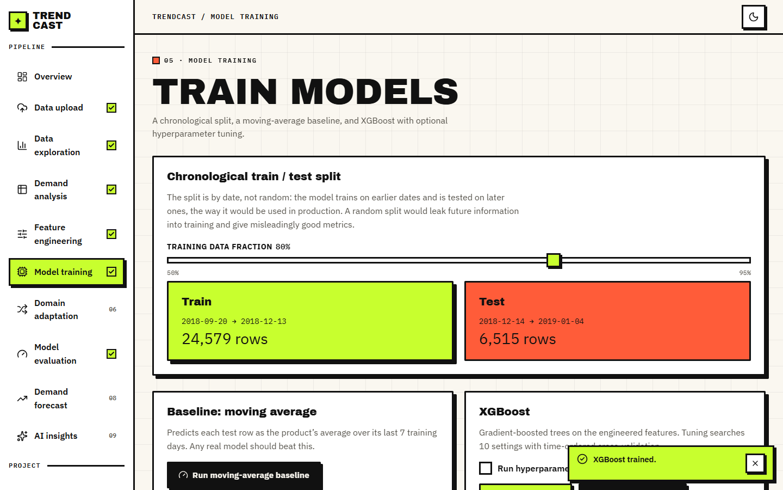
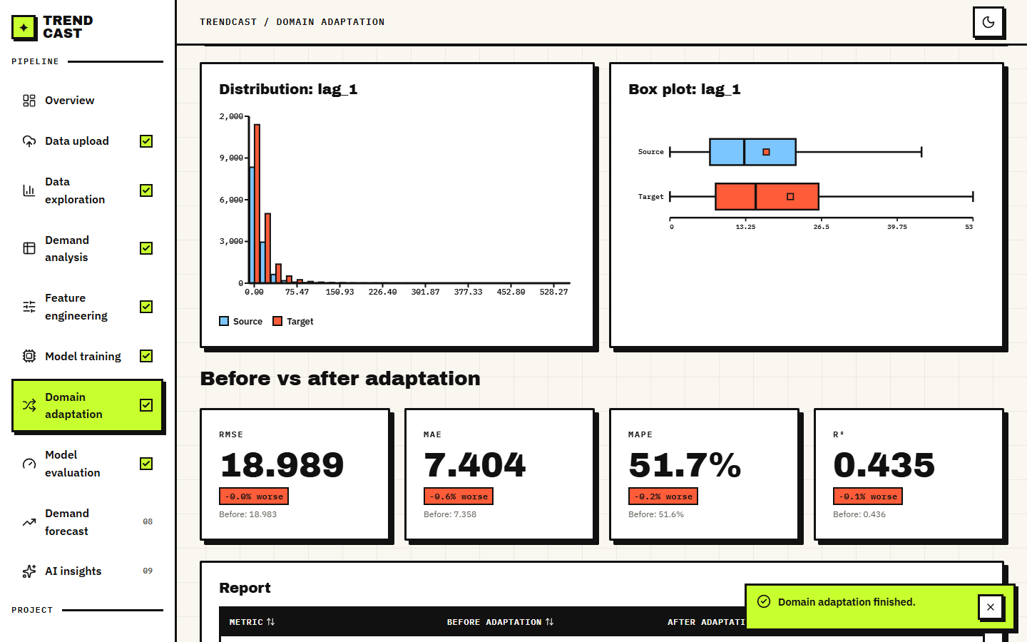
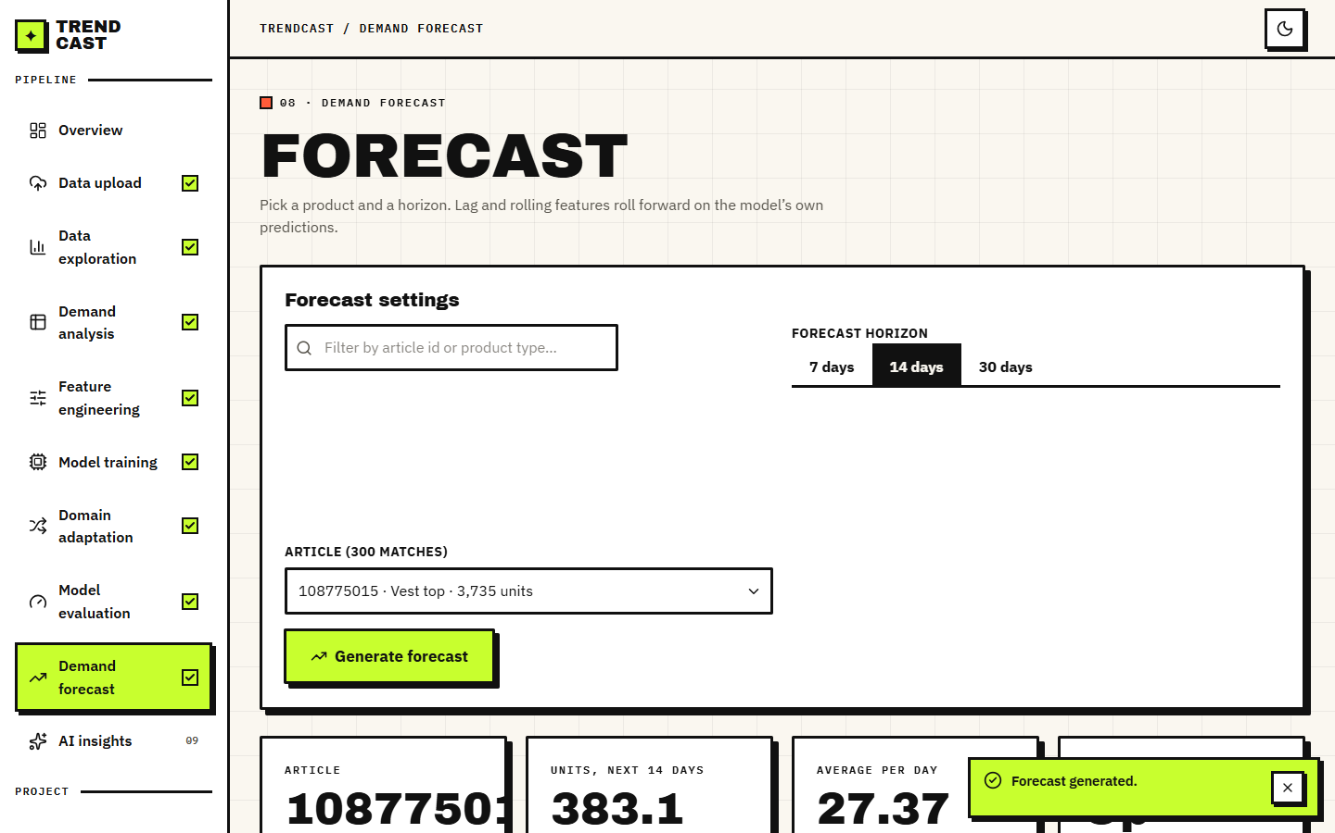
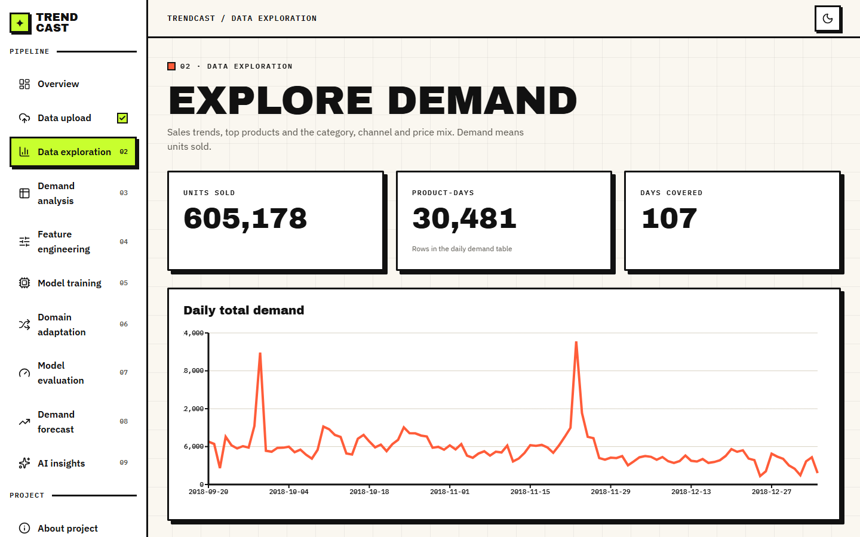
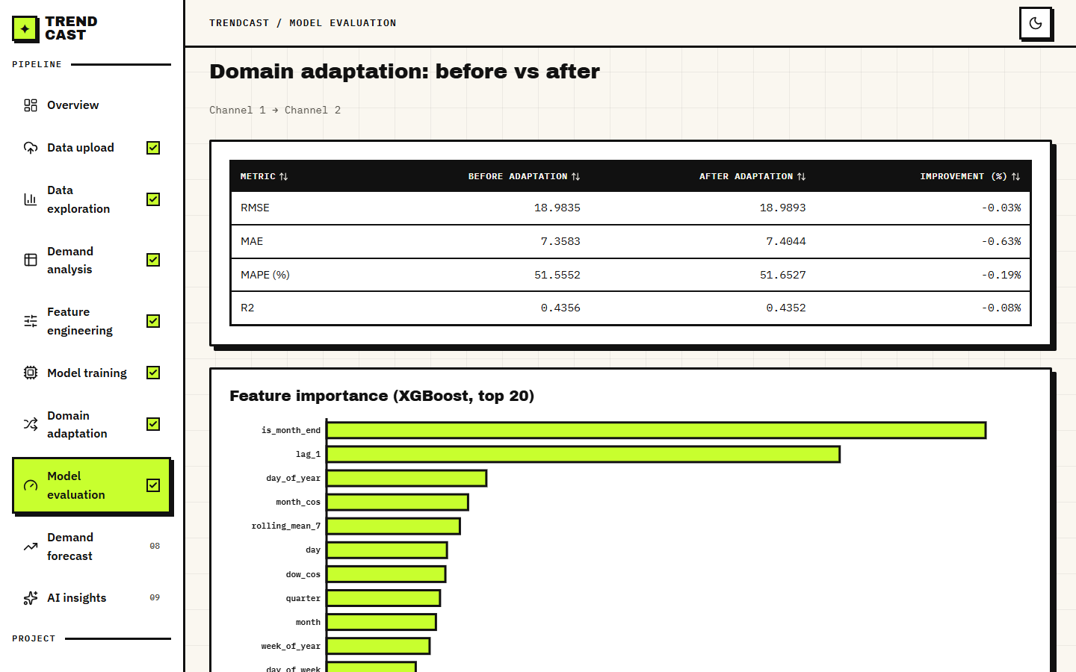
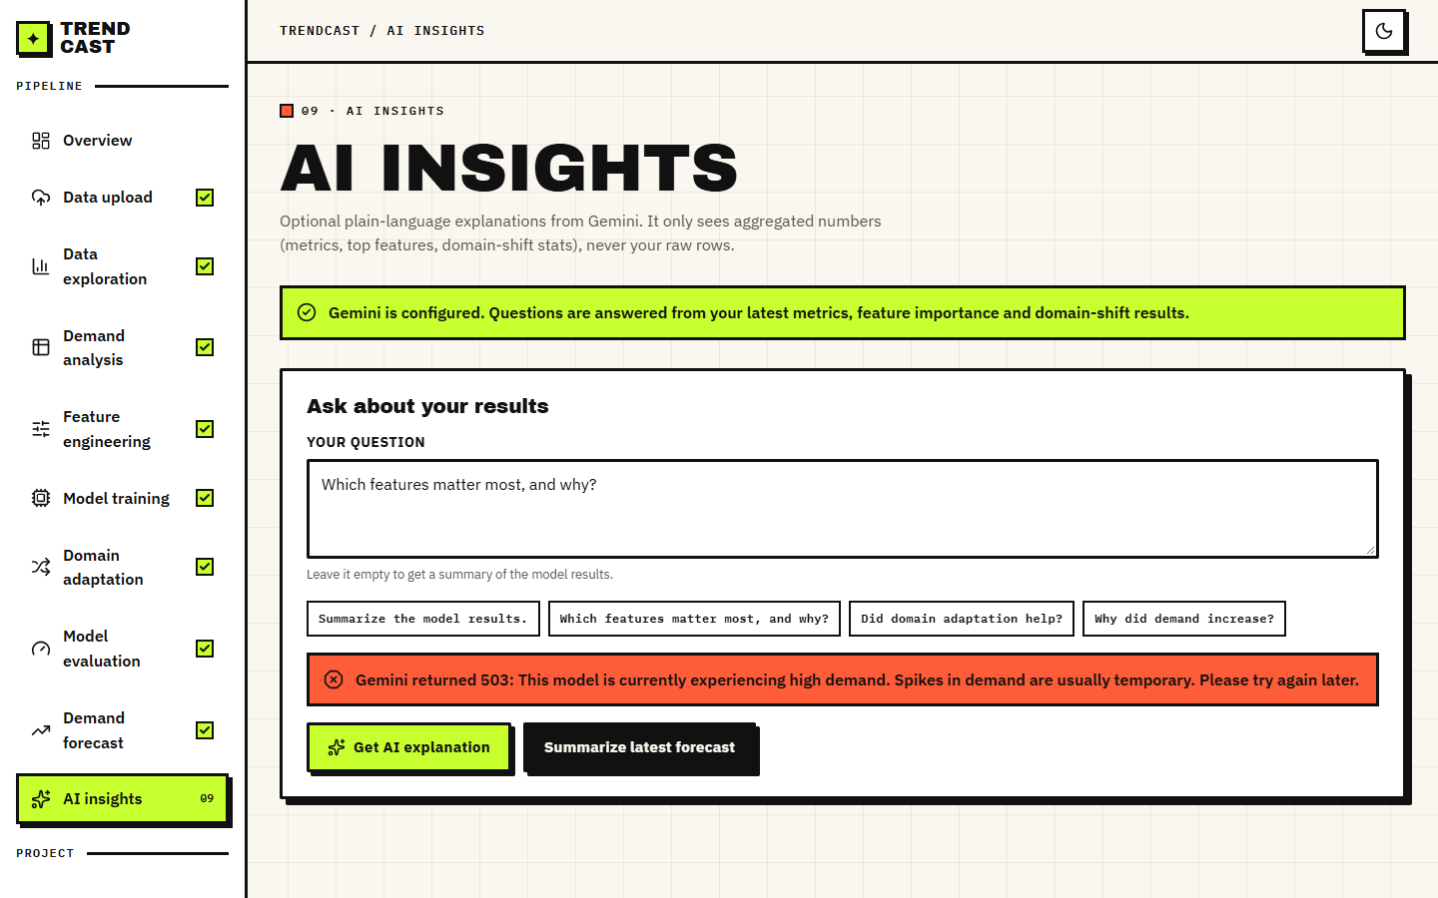
Output screens
Model training: XGBoost test metrics on the real subset
Domain adaptation: before and after cards, channel 1 to channel 2
Demand forecast: history and 14-day forecast for one article
Data exploration
Feature importance, top 20
AI Insights: Gemini returned 503, shown as an error
Notes:
All screens are captures of the running application with the real H&M subset loaded. The AI Insights capture shows the real service error.

Slide 17
Initial testing and observations
39 / 39
26 / 26
25
156 ms
pytest tests pass (22 unit, 17 API)
end-to-end smoke checks on a live backend
browser screenshots; 3 problems, all the Gemini call (502)
median 30-day forecast request
Stage (real subset, 684k rows) | Seconds
Upload, clean, merge | 3.5
Build features | 0.9
Train XGBoost (default) | 1.1
Train XGBoost (tuned) | 29.6
Domain adaptation run | 3.7
What the tests cover: cleaning rules, aggregation, no-leakage lag features, date split, metrics, weights, and all API gates and errors.
Edge cases checked: wrong columns, empty file, same source and target, bad horizon, article with too little history, new upload resets later steps.
Not done: user study, load test, security audit, browsers other than Chrome. There is no sign-in by design.
Timings are from a busy machine; treat them as upper bounds.
Notes:
Unit and API tests use small synthetic frames; the experiments use the real subset.

Slide 18
Challenges and corrective actions
Challenge | What we found | Action
Shipped data is synthetic | A metric on it would say nothing about fashion retail | Built a real subset from the public H&M files
Adaptation gain not robust | +11.9 % on one pair becomes -2.8 % without time overlap | Added shuffled, pooled, target-only and time-clean controls
Weights collapse | Perfectly separable domains give weights near 1e-5 | Diagnosed; mean-1 rescaling fixes it offline
Weak long forecasts | Recursive error reaches 124 % (WAPE) over days 15-30 | Reported; direct multi-horizon models planned
Duplicates removed | 11.6 % of rows dropped as exact duplicates | Documented; repeat-purchase handling is future work
LightGBM crash | Importing it after pandas crashed on this machine | Import it first in the experiment script
Gemini unavailable | 503 and timeouts during capture | Kept optional; the screen shows the clear error
Notes:
Each challenge is a measured finding, not a guess; the evidence is in docs/REPORT_FACTS.md.

Slide 19
Next steps
1
Fix and re-measure
2
Extend the product
3
Deliver
Normalise the importance weights, make the time-clean protocol the default, refresh all calendar features in the recursive forecast, and re-run the six pairs.
Add a cold-start mode for unseen articles, SHAP and inventory impact (under- and over-stock units) in the console, and more months of H&M data.
Finish the final report and IEEE paper from the measured results, rehearse the final demo, and keep every number tied to the metrics files.
Notes:
The open items are the ones identified by the measurements, in priority order.

Slide 20
Thank you
Questions and suggestions are welcome.
Notes:
Close the review and invite questions.

