Slide 1

Fashion Demand Forecasting Using Machine Learning And Domain Adaptation
Final Review · TrendCast
Team Details : Batch A17
Under the Esteemed Guidance of
Deepthi
[DESIGNATION], Department of CSE
23K91A0547 B SHILPA
23K91A0544 B HARI NARAYANA
23K91A0516 A RANI THEJASWINI
23K91A0511 A SANJANA
DEPARTMENT OF COMPUTER SCIENCE AND ENGINEERING · TKR College of Engineering & Technology · Academic Year [ACADEMIC YEAR]
Notes:
Introduce the team and TrendCast: fashion demand forecasting with XGBoost and importance-weighted domain adaptation, measured on real H&M data.

Slide 2
Table of Contents
Abstract
Base Paper & Literature Survey
Research Gap, Problem Statement & Objectives
Proposed System & Architecture
Methodology, Data & Domain-Adaptation Workflow
Interaction & Data Design
Implementation, Performance & Testing
Results: Models, Errors, Parameter Analysis, Domain Adaptation
Comparison with Base Paper
Output Screens
Conclusion, Future Scope & References
Dept. of CSE | Batch A17 | Final Review
2
Notes:
The agenda follows the report: problem, design, method, results, comparison, screens, conclusion.

Slide 3
Abstract
Fashion demand shifts with season, price and channel, and a model trained in one retail context loses accuracy in another. TrendCast turns H&M-style transactions into daily units per article, forecasts them with XGBoost and adds importance-weighted domain adaptation, in a FastAPI + React product.
Measured on a real subset of the H&M data (605,178 cleaned rows, 300 best-selling articles, 107 days): XGBoost reaches RMSE 11.09 (R² 0.33) against 12.89 for the product's moving average, but not against the one-line 'repeat yesterday' forecast (9.22).
Domain adaptation as built helps on 2 of 6 source-target pairs (mean RMSE change -14.6%). The one clear gain (+11.9%) disappears when source rows may not overlap the target test dates.
The 7/14/30-day recursive forecast is worse than a flat 7-day mean (WAPE 41% on days 1-7, 124% on days 15-30).
39 pytest tests and 26 smoke checks pass; 25 real screenshots. Not shown: inventory savings, new-store transfer, cold-start in the product.
Dept. of CSE | Batch A17 | Final Review
3
Notes:
Give the product, then the honest result: the pipeline works, the model beats the app's baseline, domain adaptation is not reliably better, and multi-day forecasts are weak.

Slide 4
Base Paper
L. N. Mishra, B. Senapati, S. K. Nayak and A. J. Rangari, "Explainable retail demand forecasting: A hybrid LightGBM-SHAP framework for inventory optimization," IEEE Access, vol. 14, pp. 43613-43633, 2026, doi: 10.1109/ACCESS.2026.3675540.
Aspect | Base paper: explainable retail demand forecasting, hybrid LightGBM-SHAP framework
Data | UCI Online Retail II: 1.07 million transactions, 4,631 SKUs; daily SKU demand, one-day-ahead; products kept with >= 1,000 units and >= 150 active days
Model | LightGBM with Optuna tuning (30 trials, 3-fold TimeSeriesSplit) on 41 engineered features (temporal, lag, rolling, ...); strictly backward-looking features
Explainability | Four levels: permutation importance, partial dependence, SHAP (instance level) and ICE curves for heterogeneity between products
Reported | RMSE 33.71, R² 0.243, MASE 0.799 vs six baselines (naive lag-1, 7-day moving average, linear, random forest, XGBoost 33.89, CatBoost 33.83); rolling statistics the dominant group
Stated limits | One dataset (UK wholesaler); assumes stationary relationships; no promotions or holidays as inputs; one-day horizon; SHAP cost at scale; no domain shift handling
Dept. of CSE | Batch A17 | Final Review
4
Notes:
Mishra et al., IEEE Access 2026. TrendCast keeps its ideas of backward-looking features, a gradient-boosted learner and explanation, and adds the missing piece the authors name as a limit: moving a model to a differently distributed context.

Slide 5
Literature Survey
Work | Year | Approach | Finding / limitation
Mishra et al. [1] (base) | 2026 | LightGBM + SHAP/ICE explanations; 41 features | RMSE 33.71, R² 0.243 on UCI data; one market, no domain shift
Chen & Guestrin [2] | 2016 | XGBoost: regularised tree boosting, weighted rows | Default tabular learner; assumes one data distribution
Makridakis et al. [6] | 2022 | M5 retail competition (as summarised in the base paper) | Boosted trees with hand-built features matched deep learning
Shimodaira [10]; Bickel et al. [12] | 2000; 2009 | Importance weighting for covariate shift; weights from a logistic classifier | The method TrendCast implements; weights can be extreme
Ben-David et al. [14] | 2010 | Target error bounded by source error plus domain divergence | Unrelated domains transfer badly; bound is loose
Thomassey [17] | 2010 | Clothing sales forecasting: fuzzy, neural, data mining | Volatile, seasonal, short-lived items; pre-boosting era
Ekambaram et al. [18] | 2020 | Multi-modal attention model for new fashion products | Needs images and a large product history
Skenderi et al. [20]; Zhou et al. [22] | 2021; 2026 | Image + Google Trends sales; diffusion for new-product life cycles | Cold-start work; not weighted transfer of a tabular model
Batch survey [26]-[29] | 2026 | Four inventory / forecasting titles | Titles only; could not be verified online, no result quoted
Dept. of CSE | Batch A17 | Final Review
5
Notes:
Only facts checked against the papers or their abstract pages are used. The four batch-survey titles could not be located online, so nothing is claimed from them.

Slide 6
Research Gap
The base paper's own limitation: one dataset, one market, stationary assumption - no handling of a shifted target context.
Fashion new-item models (Ekambaram, Skenderi, Zhou) need images, external signals or a large product history; a plain tabular model is not covered.
Importance weighting for covariate shift is well established in theory (Shimodaira, Bickel) but is rarely shown inside a retail demand pipeline.
Reported adaptation gains are seldom checked against controls (time-clean split, shuffled weights, pooling the data), so gains may come from leakage.
Forecasts without a clear explanation of drivers are not trusted by planners (base paper); a deployed tool also needs honest multi-day accuracy.
Dept. of CSE | Batch A17 | Final Review
6
Notes:
Five gaps. TrendCast builds the adaptation workflow and then tests it against controls instead of only reporting the best pair.

Slide 7
Problem Statement
Forecasting models trained on one market lose accuracy when applied to another.
New products have no sales history, so conventional forecasting cannot cover them.
Fashion trends shift within a season, invalidating models trained on older data.
Forecasts delivered without explanation are not trusted by inventory planners.
Need: a demand forecasting system that adapts across markets and categories and explains the drivers behind each forecast.
Input
Output
Record
Transactions, articles and optional customers CSVs; split, tuning and domain choices
Data-quality report, model metrics, domain-shift report, feature importance, 7/14/30-day forecast
Experiment metrics (JSON), 39 tests, 25 screenshots of the running console
Dept. of CSE | Batch A17 | Final Review
7
Notes:
Four problem points from the batch statement, then input, output and record.

Slide 8
Objectives
1. Collect historical fashion retail sales data and engineer seasonal, pricing and category features.
2. Train gradient-boosting models such as XGBoost to forecast demand at product and category level.
3. Apply domain adaptation to transfer the model across markets and product categories.
4. Compare adapted and non-adapted models on a target market with a different data distribution.
5. Explain forecast drivers so planners understand why demand is predicted to move.
6. Evaluate using MAE, RMSE and MAPE, and translate error into inventory impact.
Dept. of CSE | Batch A17 | Final Review
8
Notes:
The six objectives from the batch document. The conclusion slide gives the status of each.

Slide 9
Proposed System
Forecasting pipeline
Upload CSVs
Clean + merge
Daily demand
31 features
Split by date
XGBoost
Domain adaptation (source domain -> shifted target domain)
Source-only model
Domain classifier
Weights p/(1-p)
Weighted XGBoost
Before vs after
Forecast + explain
Every step is gated: a page refuses to run until the earlier step has produced its output (HTTP 409 with a plain-language message).
Leakage guards: lags and rolling statistics are shifted, the split is by date, tuning uses TimeSeriesSplit, MAPE skips zero-demand rows.
The same src/ package serves the original 11-page Streamlit app and the new 13-page React console; Gemini explanations are optional and see only aggregates.
Dept. of CSE | Batch A17 | Final Review
9
Notes:
The proposed system as two chains. The adaptation chain is the project's addition to a standard boosted-tree forecaster.

Slide 10
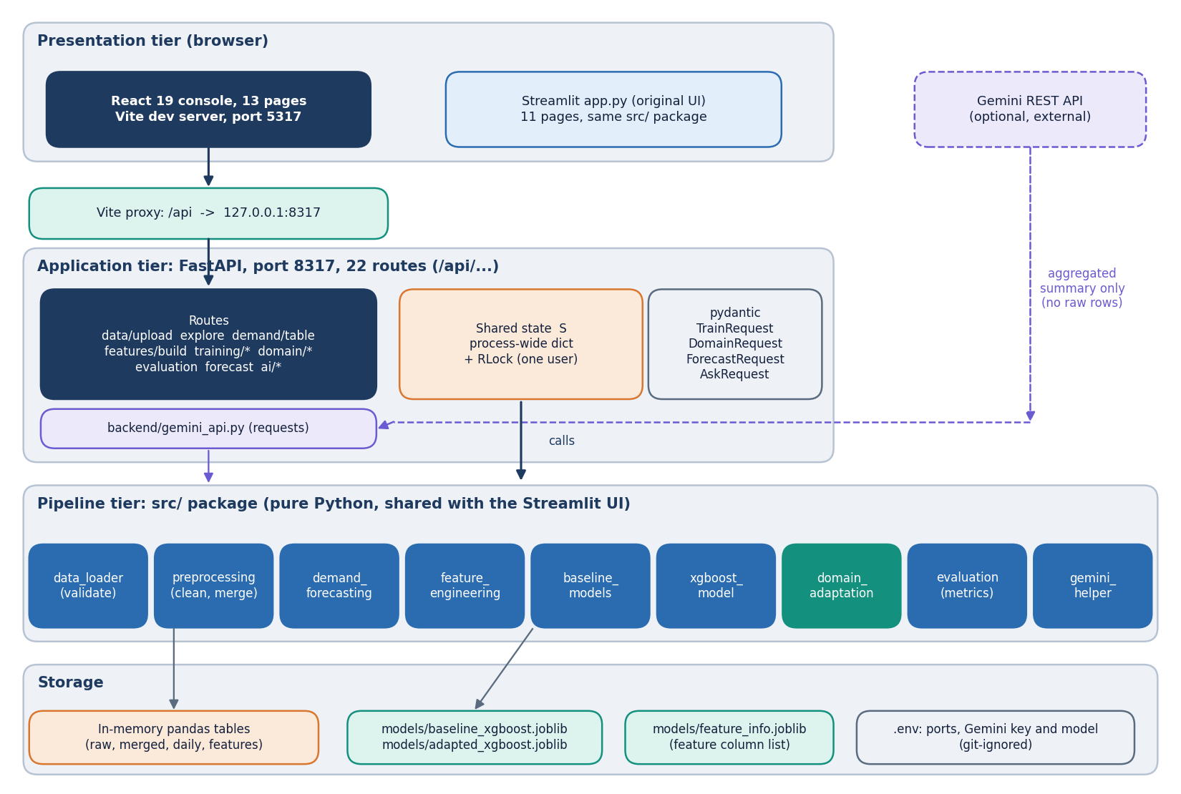
System Architecture
Console: React 19 + Vite, port 5317; 13 pages
API: FastAPI, port 8317; 22 routes, no sign-in (single-user tool)
Pipeline: src/ package (loading, cleaning, daily demand, features, XGBoost, adaptation, evaluation)
State: one process-wide dictionary behind a lock; no database; trained models saved as joblib files
Optional: Gemini REST call with aggregated numbers only
Dept. of CSE | Batch A17 | Final Review
10
Notes:
Four tiers. No database: uploaded tables and results live in memory; only models are written to disk.

Slide 11
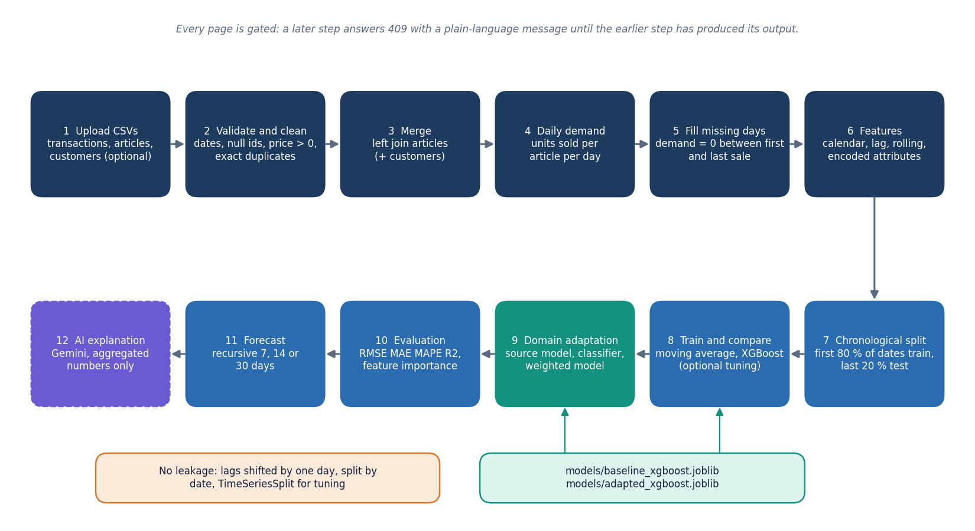
Methodology
Target: units sold per article per day (rows of the cleaned transaction table).
Features: price, channel, 6 encoded attributes, 14 calendar, 9 lag / rolling (shifted by one day).
Split: first 80% of the dates train, last 20% test; no random split.
Models: 7-day moving average baseline; XGBoost (300 trees, depth 8) with optional tuning.
Adaptation: logistic domain classifier, weight p/(1-p) clipped at 20, weighted XGBoost.
Dept. of CSE | Batch A17 | Final Review
11
Notes:
Method in one picture: ingest, aggregate, engineer, split, train, adapt, evaluate, forecast.

Slide 12
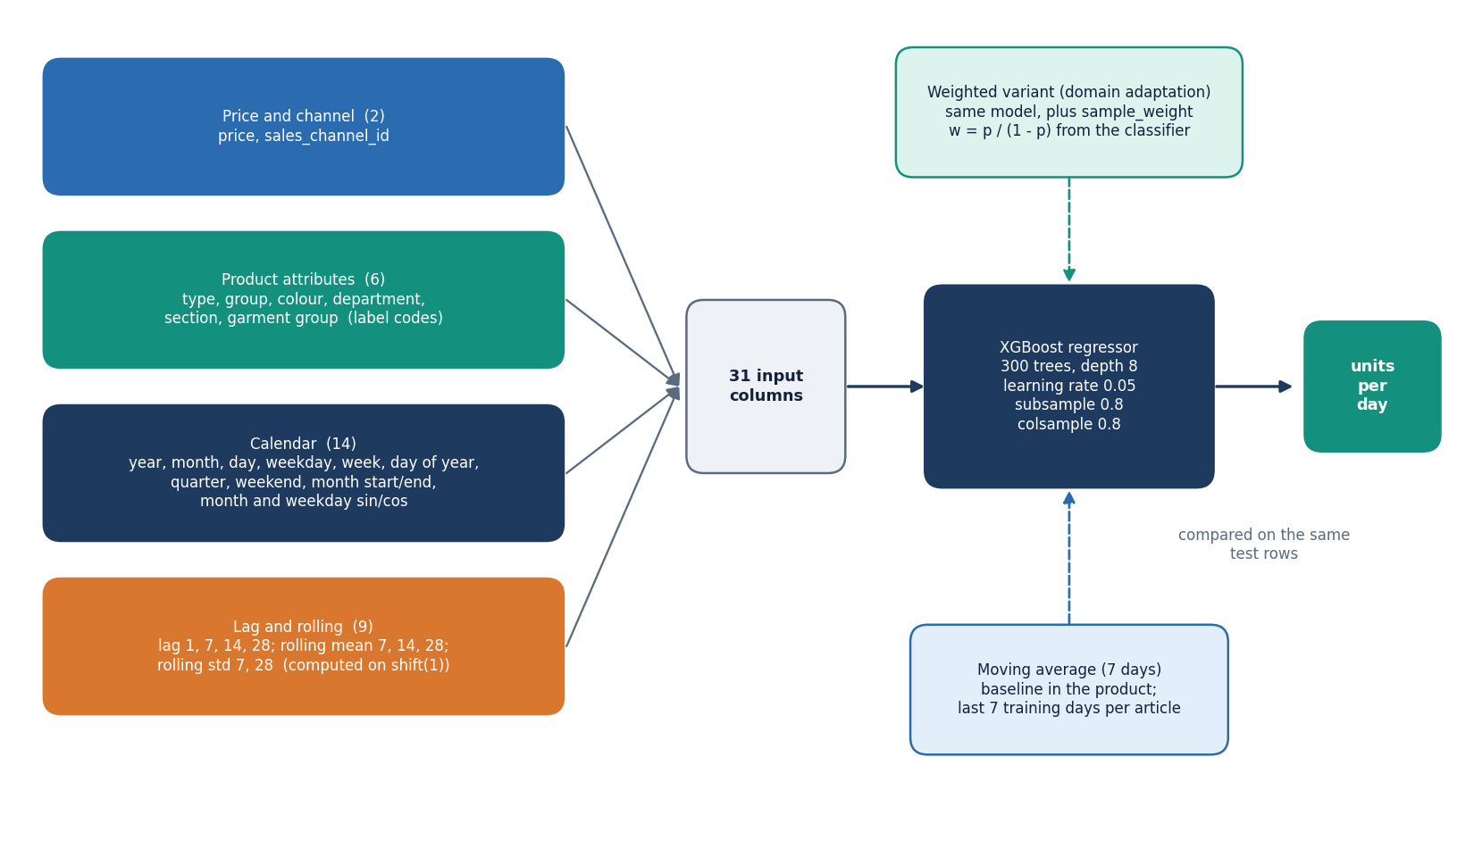
Dataset, Features & Model
684,392
31,094
107 days
real H&M rows, 300 articles
article-days x 31 inputs
2018-09-20 to 2019-01-04
Item | Detail
Source | H&M Personalized Fashion Recommendations [23]; first shard, 300 best sellers
Cleaning | 79,214 exact-duplicate rows dropped (11.6%)
Split | train 24579 rows to 2018-12-13; test 6515 rows
Zero-demand rows | 1.97% after gap filling
Test window | Christmas peak and January sales
Not in the data | promotions, regions, fabric, prices of competitors
Models: moving average, random forest, LightGBM (baselines), XGBoost default and tuned. Synthetic sample data are used only for smoke tests.
Dept. of CSE | Batch A17 | Final Review
12
Notes:
A real 107-day slice of H&M. The test window is the hardest part of the year to forecast and the training window holds no earlier year.

Slide 13
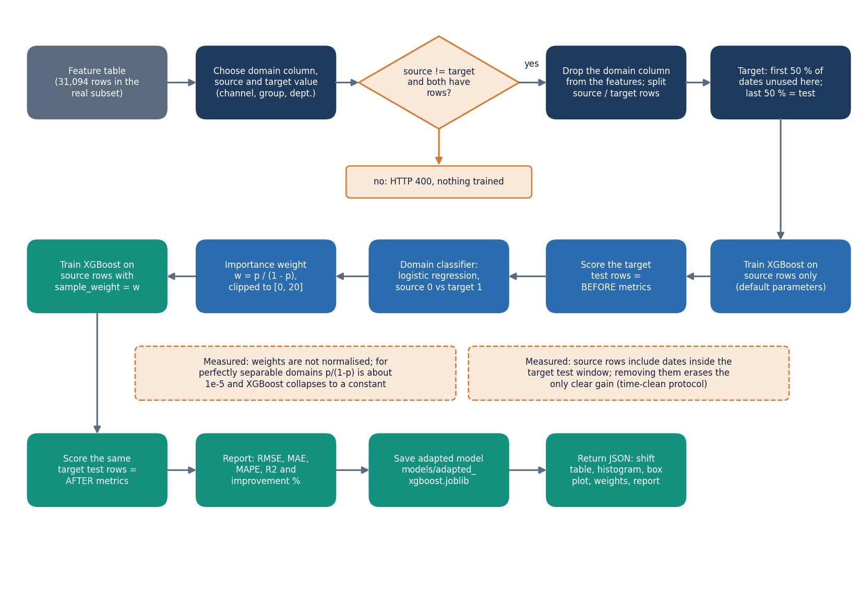
Domain-Adaptation Workflow
Choose a domain column (channel, product group, department) with a source and a target value; hold out the later half of the target dates.
Source-only XGBoost gives the 'before' metrics on the held-out target rows.
Domain classifier (logistic regression, domain column excluded): accuracy shows how different the domains are.
Weight w = p/(1-p), clipped at 20; weighted XGBoost gives the 'after' metrics, reported as measured.
Dept. of CSE | Batch A17 | Final Review
13
Notes:
The core algorithm of the project: implemented in src/domain_adaptation.py and the /api/domain/run route.

Slide 14
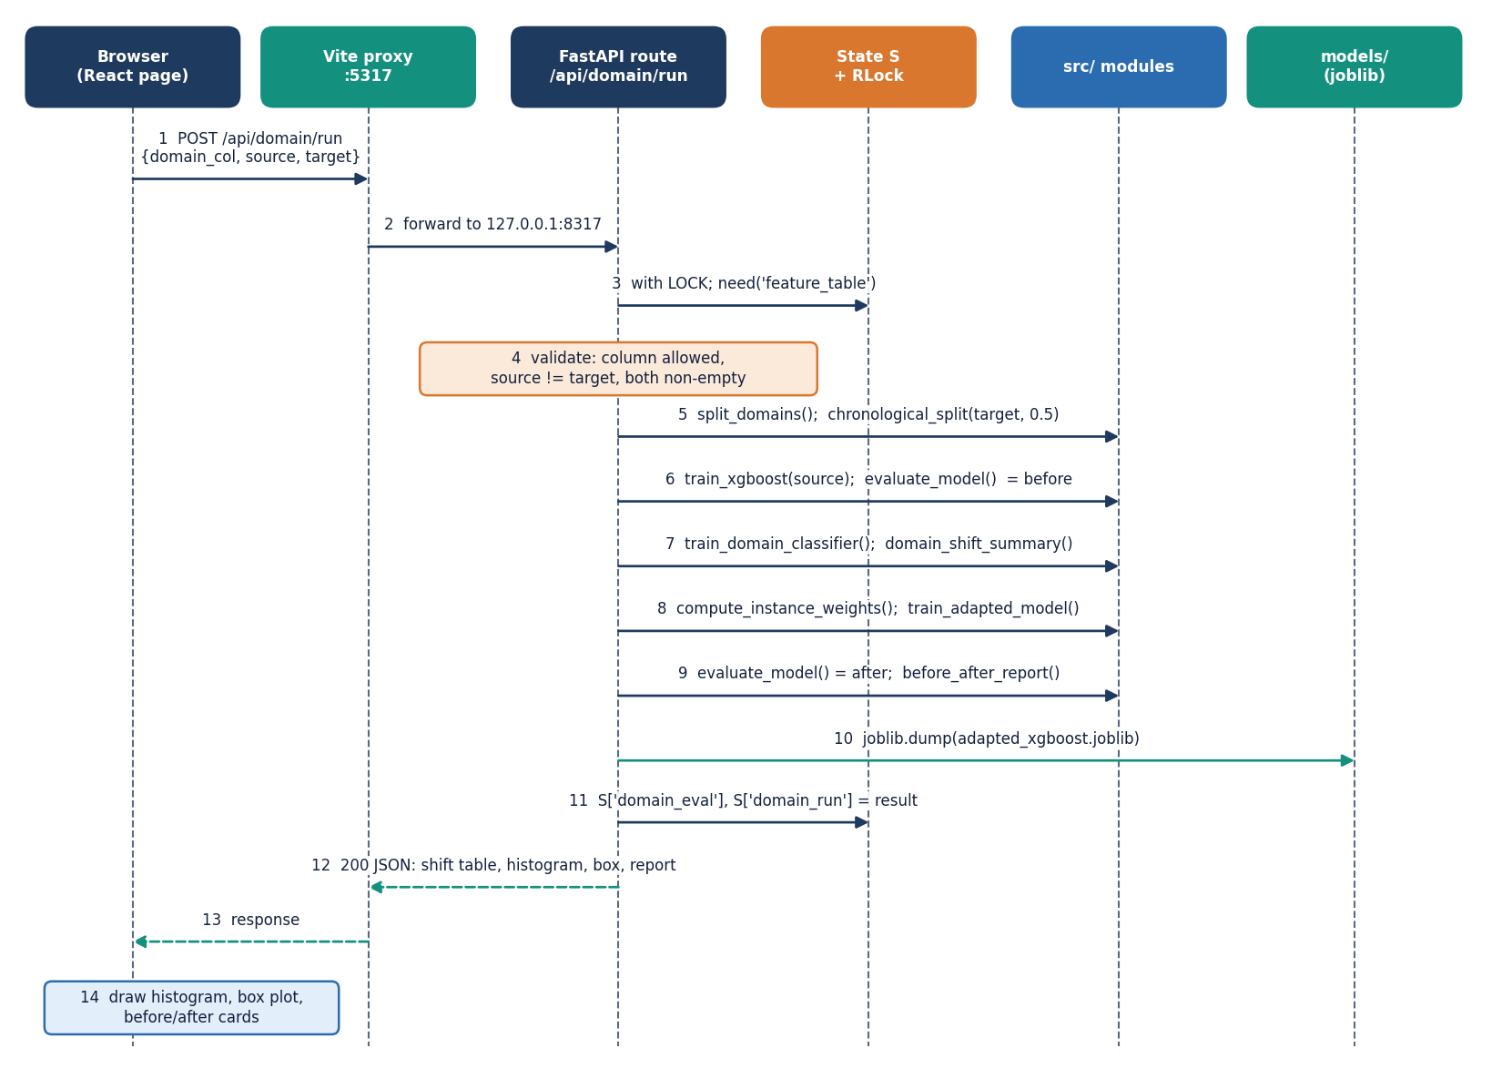
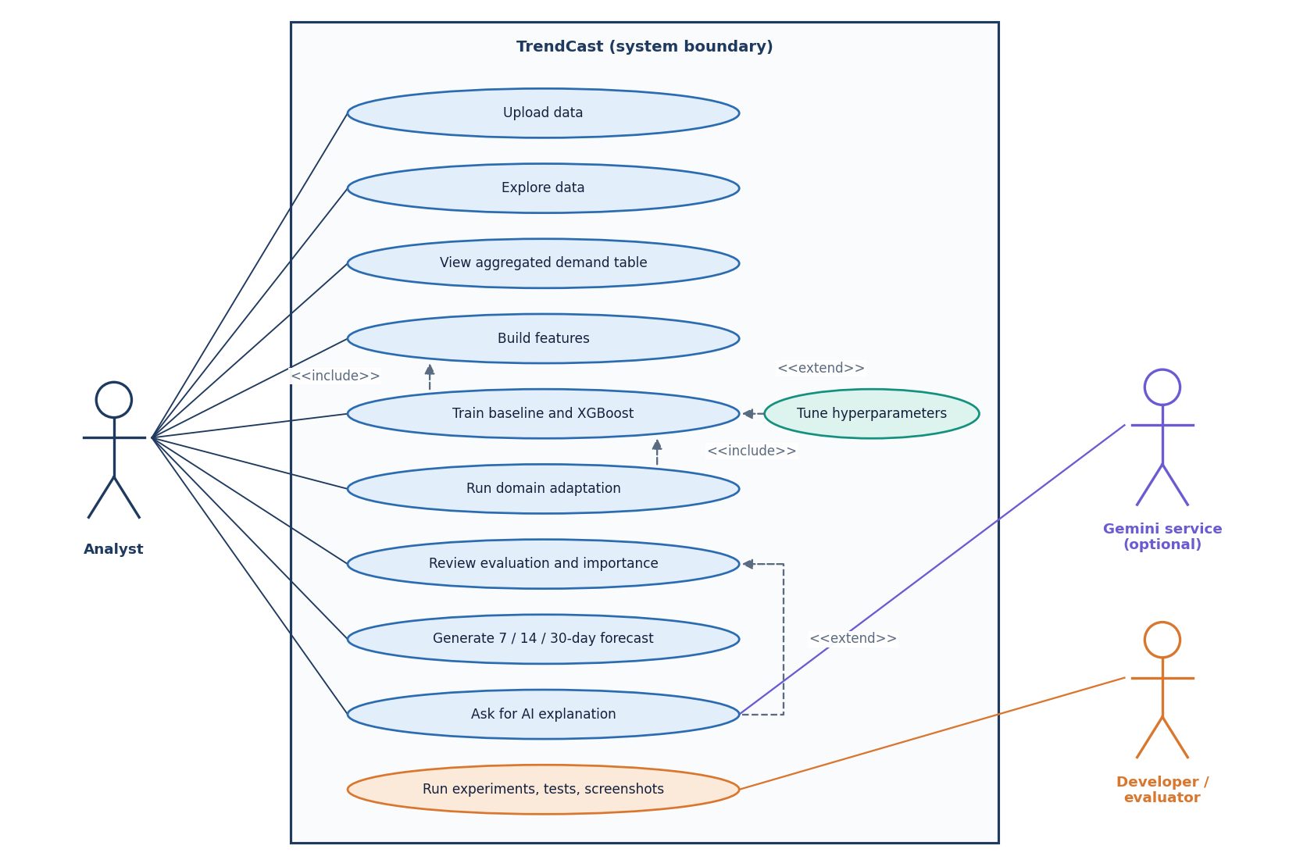
User - System Interaction
Dept. of CSE | Batch A17 | Final Review
14
Notes:
Sequence of the domain-adaptation run and the use cases of the analyst.

Slide 15
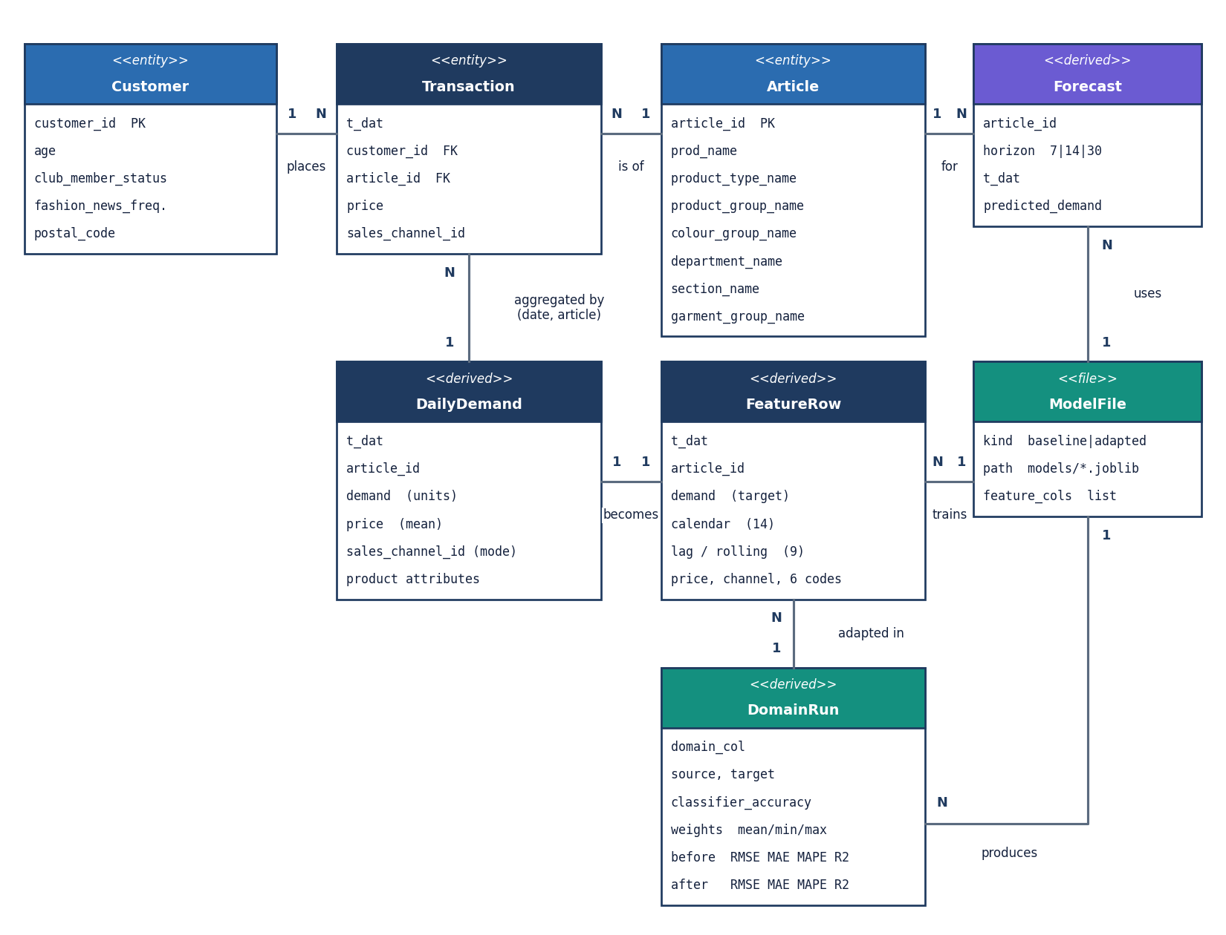
Data Design (no database)
Store | Content
transactions / articles / customers | uploaded CSVs, cleaned, in memory
daily demand | one row per article-day
feature table | 31 model inputs + target
results dictionary | metrics of the models trained
models/*.joblib | baseline, adapted XGBoost, feature list
.env | ports, Gemini key (git-ignored)
No foreign keys and no persistence of data: only the model files survive a restart.
Dept. of CSE | Batch A17 | Final Review
15
Notes:
TrendCast has no database. The ER diagram shows logical entities.

Slide 16
Implementation, Performance & Testing
22
39 + 26
13
156 ms
API routes
pytest tests + smoke checks, all pass
React pages, 25 real screenshots
median 30-day forecast request
Stage (real subset, 684k rows) | Seconds
Upload + clean + merge | 3.5
Build features | 0.9
Train XGBoost (default) | 1.1
Train XGBoost (tuned, 10 x 3) | 29.6
Domain adaptation run | 3.7
22 unit tests (cleaning, leakage-free lags, split, metrics, weights) and 17 API tests (gating, validation, full flow).
Smoke test: 26 live checks incl. bad file -> 400, same source/target -> 400, bad horizon -> 400.
Browser walk-through: 25 screens; only console problems were Gemini 502s.
Measured on an i5-12500, 15.7 GB, no GPU, other jobs running.
Not tested: load, many users, Chrome-only, full-size H&M.
Dept. of CSE | Batch A17 | Final Review
16
Notes:
Implementation facts and the testing that was actually run, with its limits.

Slide 17
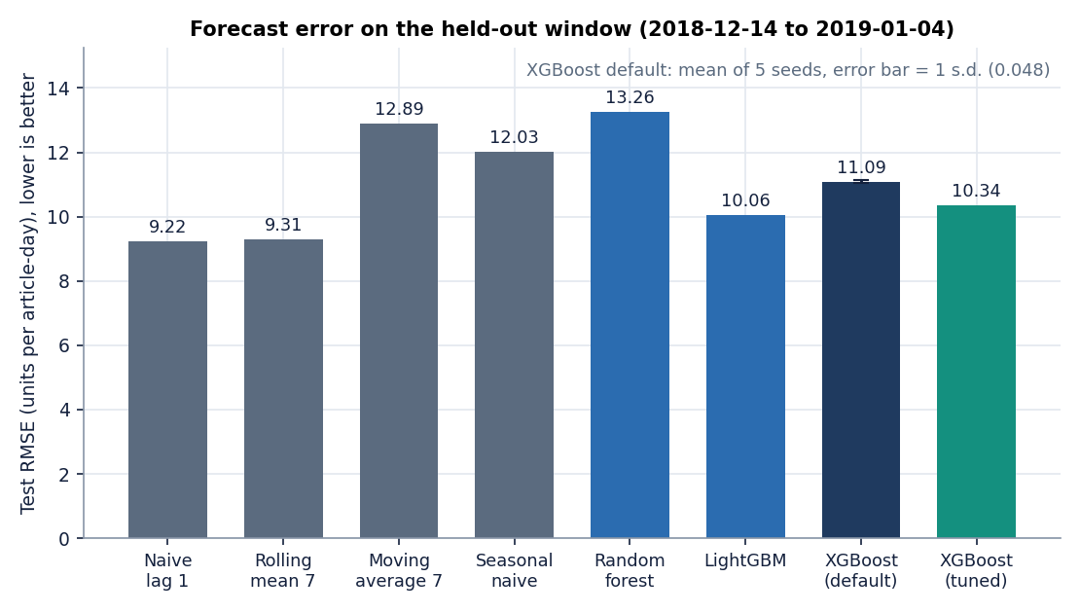
Results - Model Performance (chronological 80/20 split)
Model | RMSE | MAE | R²
Moving average (app baseline) | 12.89 | 8.09 | 0.101
Naive: repeat yesterday | 9.22 | 5.65 | 0.540
Rolling mean 7 | 9.31 | 5.65 | 0.531
Random forest | 13.26 | 7.53 | 0.049
LightGBM | 10.06 | 6.71 | 0.452
XGBoost default (5 seeds) | 11.09 | 7.08 | 0.335
XGBoost tuned | 10.34 | 6.88 | 0.421
XGBoost default: RMSE 11.09 ± 0.05 over 5 seeds; fits in 1.9 s.
Beats the app's moving average, does NOT beat repeating yesterday.
Test: 2018-12-14 to 2019-01-04, 6515 rows; MAPE on non-zero rows is 143% (low-volume days).
Dept. of CSE | Batch A17 | Final Review
17
Notes:
Be explicit: on this window a one-line naive forecast is better than the boosted tree. Rolling-origin backtests show XGBoost beats the moving average in all three folds and beats lag-1 in one.

Slide 18
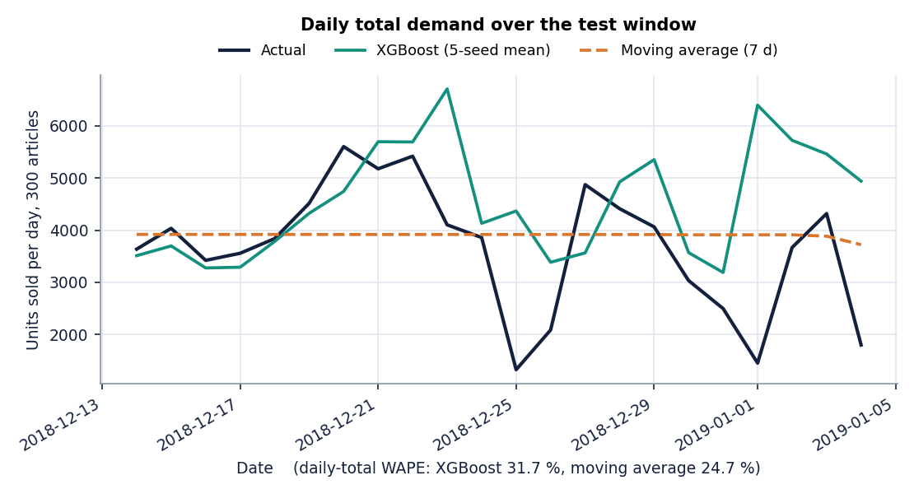
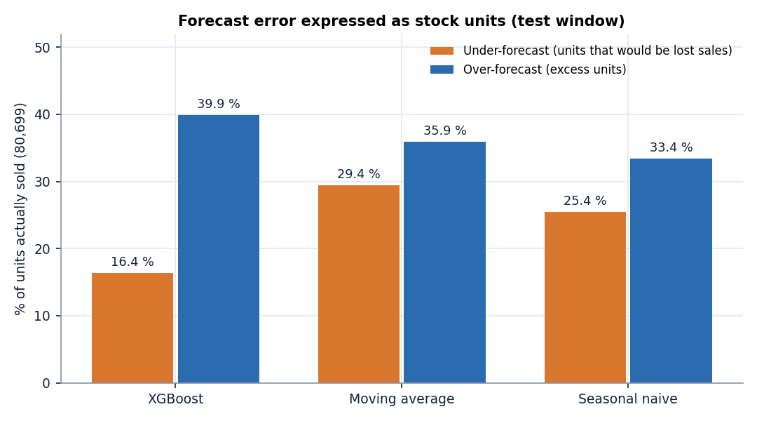
Error Breakdown - Predicted vs Actual and Inventory Units
Forecast | Total bias | Under-forecast (lost sales) | Over-forecast (excess) | WAPE
XGBoost | +23.6% | 16.4% of demand | 39.9% | 56.3%
Moving average (7d) | +6.5% | 29.4% | 35.9% | 65.3%
80,699 units sold in the test window. Units are offline measurements; the app itself shows no inventory view. XGBoost over-forecasts the window overall.
Dept. of CSE | Batch A17 | Final Review
18
Notes:
Confusion-matrix equivalent for a regression task: predicted vs actual daily totals and the split of error into lost-sales and excess units.

Slide 19
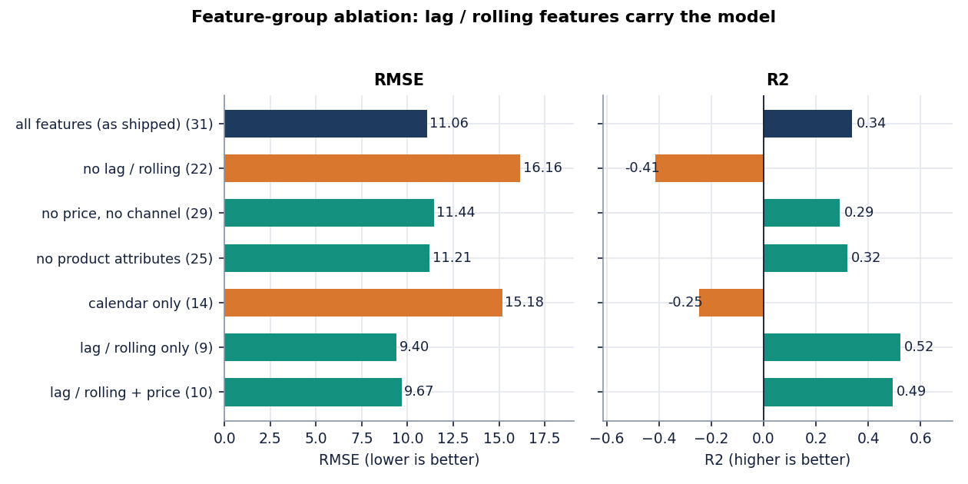
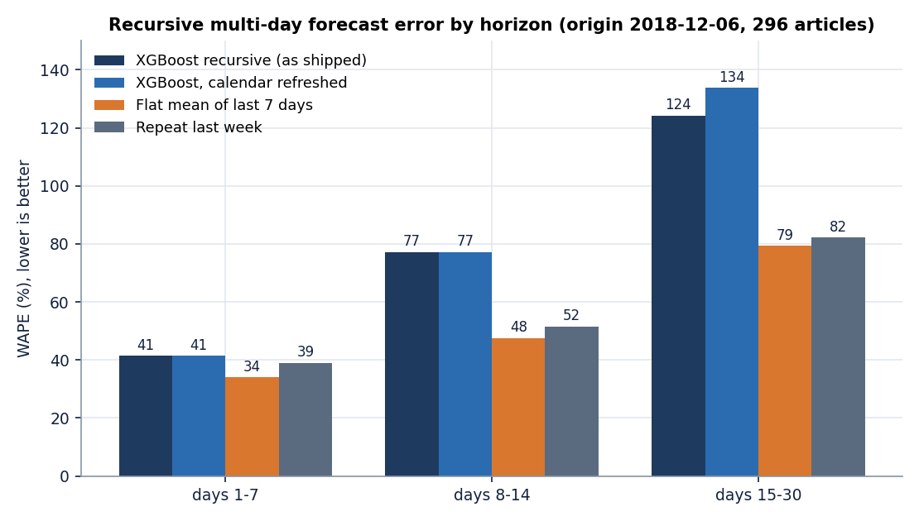
Parameter Analysis - Features, Tuning and Horizon
Feature groups: lag / rolling only gives RMSE 9.40 (R² 0.52), better than all 31 features (11.06); without lag / rolling R² is -0.41. Absolute-time features cannot extrapolate past the training dates.
Tuning (RandomizedSearchCV, 10 iterations x 3 TimeSeriesSplit, 31 s): RMSE 11.09 -> 10.34; best depth 12, learning rate 0.01.
Recursive forecast WAPE by horizon: 41% / 77% / 124% (days 1-7 / 8-14 / 15-30) against 34% / 48% / 79% for a flat 7-day mean.
Dept. of CSE | Batch A17 | Final Review
19
Notes:
Parameter analysis: which inputs matter, what tuning buys, and how fast the multi-day forecast degrades. The app's loop also freezes four calendar features; refreshing them did not help.

Slide 20
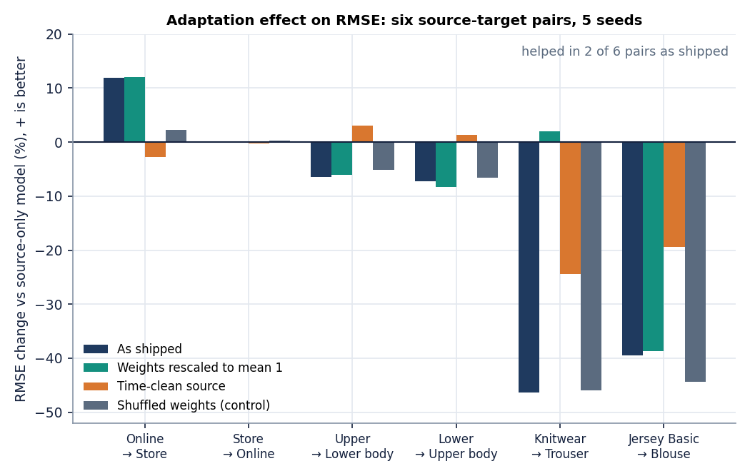
Results - Domain Adaptation (6 pairs x 5 seeds)
Pair | RMSE before | adapted | change | pooled
Channel 2 -> 1 | 10.80 | 9.50 | +11.9% | 9.78
Channel 1 -> 2 | 19.00 | 18.99 | +0.0% | 17.84
Upper -> Lower body | 13.90 | 14.80 | -6.5% | 13.51
Lower -> Upper body | 11.91 | 12.78 | -7.3% | 12.13
Knitwear -> Trouser | 17.23 | 25.21 | -46.3% | 16.88
Jersey Basic -> Blouse | 12.20 | 16.99 | -39.4% | 11.54
Mean change -14.6% as built; -6.5% with mean-1 weights; -7.1% time-clean. 'pooled' = source + early target rows, no weights.
Helped on 2 of 6. The channel 2 -> 1 gain (+11.9%) turns into -2.8% when source rows are limited to dates before the target test window.
When the domain classifier separates domains perfectly (department pairs, accuracy 100%), weights are about 1e-5 and XGBoost stops splitting (R² about 0); rescaling to mean 1 removes the collapse.
Unweighted pooling beats weighted adaptation on 5 of 6 pairs.
Dept. of CSE | Batch A17 | Final Review
20
Notes:
The central finding. Domain adaptation as implemented is not reliably better; the controls explain why.

Slide 21
Comparison with Base Paper (context only - different datasets)
Aspect | Base paper (LightGBM-SHAP) | TrendCast (XGBoost + adaptation)
Data | UCI Online Retail II, 1.07 M transactions, 4,631 SKUs | H&M subset, 605,178 rows, 300 articles, 107 days
Task | One-day-ahead SKU demand | One-day-ahead evaluation plus 7/14/30-day recursive forecast
Best model | LightGBM, RMSE 33.71, R² 0.243 | XGBoost RMSE 11.09 (R² 0.33); tuned 10.34
Vs 7-day moving average | 2.86 RMSE better (about 7.8%) | 1.80 RMSE better (about 14%)
Vs naive lag-1 | 14.06 RMSE better (about 29%) | lag-1 is 1.86 RMSE better than XGBoost
Dominant features | Rolling statistics (R² -0.064 when removed) | Lag / rolling (R² -0.41 when removed)
Explainability | PFI, PDP, SHAP, ICE | Gain importance in app; TreeSHAP offline (rank agreement 0.40)
Domain shift | Not addressed (stated limit) | Implemented; helps 2 of 6 pairs
RMSE values sit on different scales (different units sold per SKU-day), so only relative findings are compared: boosted trees beat the moving average, and lag / rolling features dominate in both studies.
Dept. of CSE | Batch A17 | Final Review
21
Notes:
Say plainly that the datasets differ. Agreement: boosting beats the moving average and rolling/lag features dominate. Difference: the naive lag-1 forecast is much stronger on our short, dense window.

Slide 22
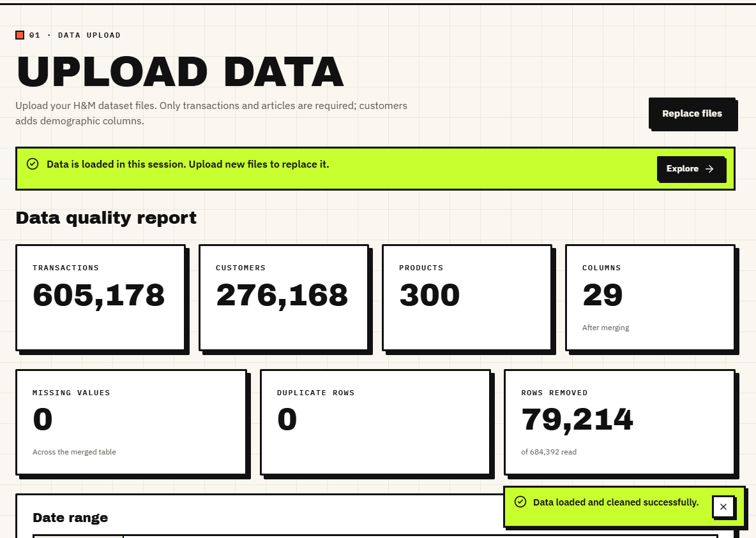
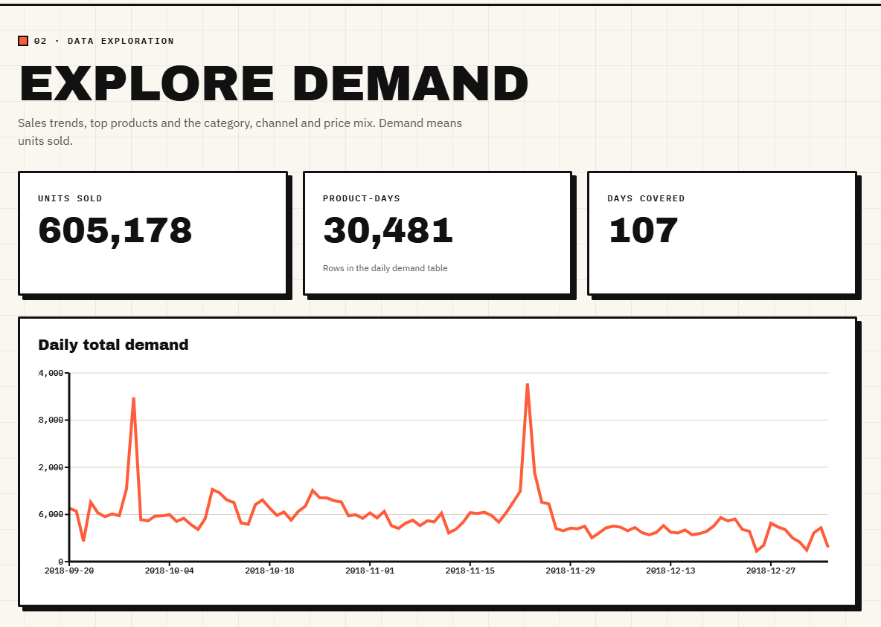
Output - Data Upload and Exploration
Data-quality report on the real subset: 605,178 transactions, 276,168 customers, 300 products, 79,214 rows removed
Explore demand: 605,178 units, 30,481 product-days, 107 days; daily totals show the two demand peaks
Dept. of CSE | Batch A17 | Final Review
22
Notes:
Real H&M subset loaded in the running console.

Slide 23
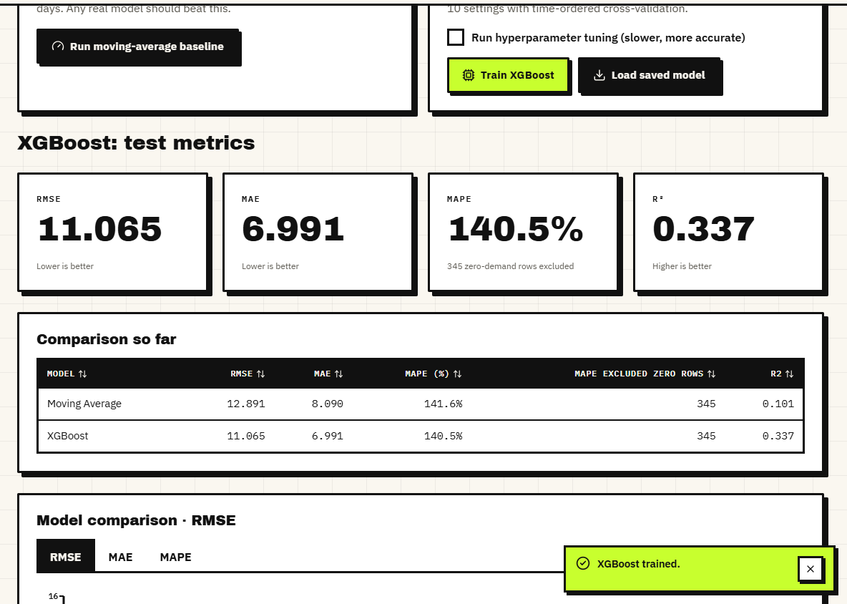
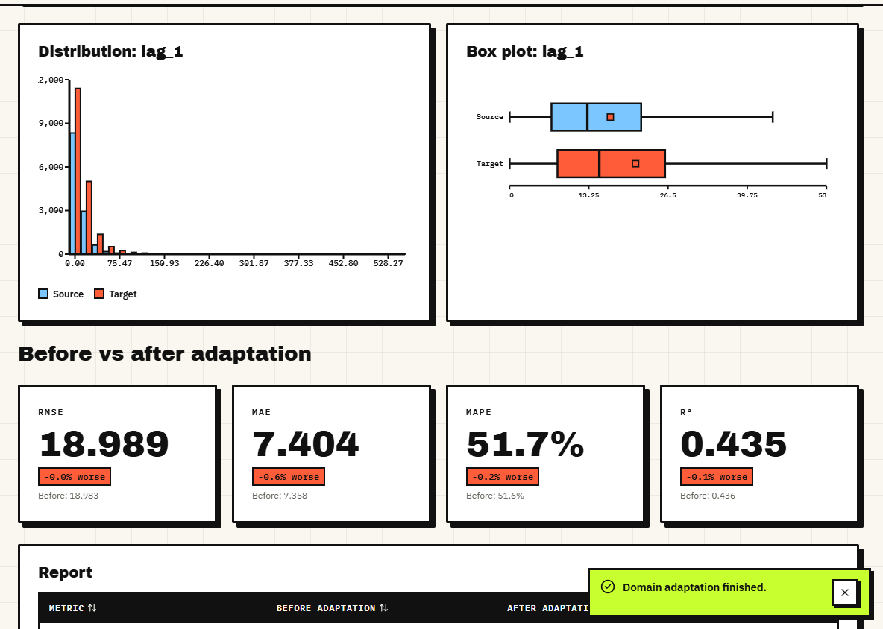
Output - Model Training and Domain Adaptation
Training page: XGBoost (RMSE 11.065, R² 0.337) against the moving average (RMSE 12.891, R² 0.101)
Domain adaptation channel 1 -> 2: RMSE 18.983 -> 18.989; the page shows the change as 'worse', unedited
Dept. of CSE | Batch A17 | Final Review
23
Notes:
The domain screen shows an honest zero-effect result on the default pair.

Slide 24
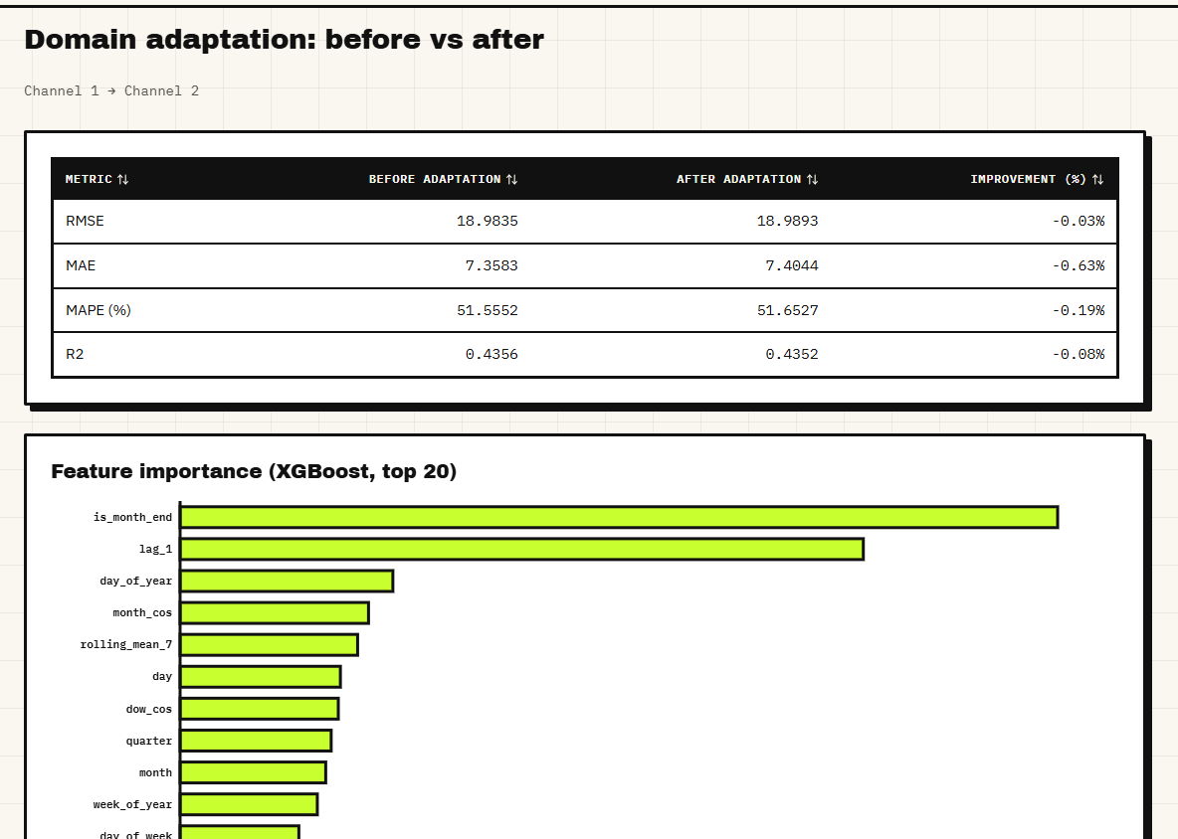
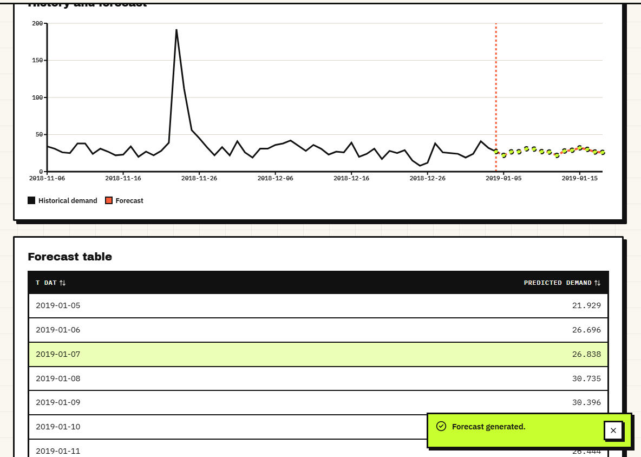
Output - Evaluation and Forecast
Evaluation: before/after table and gain-based feature importance (top: is_month_end, lag_1, day_of_year)
Forecast: history and 14-day forecast with the forecast table for one article
Dept. of CSE | Batch A17 | Final Review
24
Notes:
Evaluation and forecast pages. The AI Insights page showed Gemini 503 / timeouts during capture and is not used here.

Slide 25
Conclusion
TrendCast is a working, tested forecasting product on real H&M data whose honest measurements show where the method helps and where it does not.
# | Objective | Outcome
1 | Real data, seasonal / price / category features | Met: H&M subset, 31 inputs, shifted lags, date split; no promotions in the data
2 | XGBoost at product and category level | Met at article level; no separate category model
3 | Domain adaptation across markets / categories | Implemented for channel, group, department; markets = 2 channels
4 | Compare adapted vs non-adapted | Done: helps 2/6, mean -14.6%; not reliable
5 | Explain forecast drivers | Partly: gain importance in app, TreeSHAP offline only
6 | MAE / RMSE / MAPE and inventory impact | Metrics met; inventory units offline only, no cost savings shown
Key findings: boosted trees beat the moving average but not repeat-yesterday; lag / rolling features carry the model; weights must be normalised; adaptation needs time-clean testing.
Dept. of CSE | Batch A17 | Final Review
25
Notes:
Be explicit about which objectives were met, partly met or not met. The abstract's claim of fewer shortages and less overstock is not demonstrated.

Slide 26
Limitations & Future Scope
Known limitations
Future scope
107 days, 300 best-selling articles, one data shard; no multi-year seasonality
Cleaning drops 11.6% duplicate rows that are real repeat purchases
Target-day price and channel are inputs; frozen in recursive forecasts
Source rows overlap the target test dates; weights not normalised
No cold-start mode; SHAP and inventory impact offline only
Gemini AI Insights unavailable during capture (503 / timeout)
Single user, no authentication, no load test
Normalise weights; make the time-clean protocol the default
Add a cold-start mode from product attributes (R² 0.27 offline)
Keep rolling-origin backtests and a lag-1 baseline in the app
Direct multi-horizon or probabilistic forecasts
SHAP in the app; inventory cost simulation
Full H&M data, promotions and regions; CORAL / adversarial adaptation
Authentication, persistence, multi-user roles
Dept. of CSE | Batch A17 | Final Review
26
Notes:
Limitations first, then concrete next steps drawn from the measured defects.

Slide 27
References
[1] L. N. Mishra, B. Senapati, S. K. Nayak and A. J. Rangari, "Explainable retail demand forecasting: A hybrid LightGBM-SHAP framework for inventory optimization," IEEE Access, vol. 14, pp. 43613-43633, 2026, doi: 10.1109/ACCESS.2026.3675540.
[2] T. Chen and C. Guestrin, "XGBoost: A scalable tree boosting system," in Proc. 22nd ACM SIGKDD Int. Conf. Knowledge Discovery and Data Mining, Aug. 2016, pp. 785-794.
[3] G. Ke, Q. Meng, T. Finley, T. Wang, W. Chen, W. Ma, Q. Ye and T.-Y. Liu, "LightGBM: A highly efficient gradient boosting decision tree," in Proc. Advances in Neural Information Processing Systems (NIPS), 2017, pp. 3146-3154.
[4] S. M. Lundberg and S.-I. Lee, "A unified approach to interpreting model predictions," in Proc. Advances in Neural Information Processing Systems (NIPS), 2017, pp. 4765-4774.
[5] S. M. Lundberg et al., "From local explanations to global understanding with explainable AI for trees," Nature Machine Intelligence, vol. 2, no. 1, pp. 56-67, Jan. 2020.
[6] S. Makridakis, E. Spiliotis and V. Assimakopoulos, "M5 accuracy competition: Results, findings, and conclusions," International Journal of Forecasting, vol. 38, no. 4, pp. 1346-1364, Oct. 2022.
[10] H. Shimodaira, "Improving predictive inference under covariate shift by weighting the log-likelihood function," Journal of Statistical Planning and Inference, vol. 90, no. 2, pp. 227-244, 2000.
[12] S. Bickel, M. Brueckner and T. Scheffer, "Discriminative learning under covariate shift," Journal of Machine Learning Research, vol. 10, pp. 2137-2155, 2009.
[11] M. Sugiyama, M. Krauledat and K.-R. Mueller, "Covariate shift adaptation by importance weighted cross validation," Journal of Machine Learning Research, vol. 8, pp. 985-1005, 2007.
[14] S. Ben-David, J. Blitzer, K. Crammer, A. Kulesza, F. Pereira and J. W. Vaughan, "A theory of learning from different domains," Machine Learning, vol. 79, no. 1-2, pp. 151-175, 2010.
[17] S. Thomassey, "Sales forecasts in clothing industry: The key success factor of the supply chain management," International Journal of Production Economics, vol. 128, no. 2, pp. 470-483, Dec. 2010.
[18] V. Ekambaram, K. Manglik, S. Mukherjee, S. S. K. Sajja, S. Dwivedi and V. Raykar, "Attention based multi-modal new product sales time-series forecasting," in Proc. 26th ACM SIGKDD Int. Conf. Knowledge Discovery and Data Mining, 2020, pp. 3110-3118, doi: 10.1145/3394486.3403362.
[20] G. Skenderi, C. Joppi, M. Denitto and M. Cristani, "Well Googled is half done: Multimodal forecasting of new fashion product sales with image-based Google Trends," arXiv:2109.09824, 2021 (rev. 2024).
[22] R. Zhou, Z. Zhang, J. Han, Y. Peng and X. Zhang, "Cold-start forecasting of new product life-cycles via conditional diffusion models," arXiv:2604.20370, Apr. 2026.
[23] H&M Group, "H&M Personalized Fashion Recommendations," Kaggle competition data (articles, customers, transactions), 2022. [Online]. Available: https://www.kaggle.com/competitions/h-and-m-personalized-fashion-recommendations
[24] F. Pedregosa et al., "Scikit-learn: Machine learning in Python," Journal of Machine Learning Research, vol. 12, pp. 2825-2830, 2011.
The full numbered list of 29 references, including the batch survey titles [26]-[29], is in the report.
Dept. of CSE | Batch A17 | Final Review
27
Notes:
Selected references; the complete numbered list is in the report.

Slide 28
THANK YOU
Questions & Suggestions
Dept. of CSE | Batch A17 | Final Review
28
Notes:
Invite questions.

