Slide 1
AI-Based Financial Identification Based On Demography and Financial Forecasting
REVIEW 2 · DESIGN, METHODOLOGY AND PROGRESS
Design, methodology and progress: a trained XGBoost profile classifier with SHAP explanations, a Holt-Winters forecast, a Flask API and a React interface
Presented by
Under the guidance of
MOHD AHMED 23K91A05F7
MANNE UPENDER 23K91A05E6
PADALA RAJESH 23K91A05H7
MADAGOUNI HARSHAVARDHAN GOUD 23K91A05D5
Guide: B SRIKANTH
Department of Computer Science and Engineering
TKR College of Engineering and Technology (Autonomous) · Batch C9 (CSE-C) · [ACADEMIC YEAR]
Notes:
This review shows how the system is designed and built: the data and model, what has been implemented, the first measured results and the open items.

Slide 2
Contents
01
02
03
Recap and architecture
Methodology and dataset
Preprocessing and model
04
05
06
Training and decision logic
Data flow, data model and UML
Technology stack
07
08
09
Implementation progress and results
Output screens and testing
Challenges and next steps
Notes:
Agenda for the design and progress review.

Slide 3
Recap: problem and proposed system
!
Problem
i
Proposed system
B
Base paper link
Financial assessment uses few parameters and a static score; non-linear demographic effects are missed, the future is not considered and the result cannot be explained.
Twelve validated inputs become engineered features; an XGBoost model gives a strength score, profile and risk band; SHAP explains it; Holt-Winters adds a 12-month outlook; a what-if screen compares scenarios.
Reuses the explainable-ML framework of the Korean hospital study (feature engineering, four model families, SHAP) for individuals. Group K-Fold, temporal validation and counterfactual analysis do not apply to one-row-per-person data.
Notes:
One-minute recap of Review 1: the base paper is about organisations; we apply the same framework to individuals and deliver it as a tested application.

Slide 4
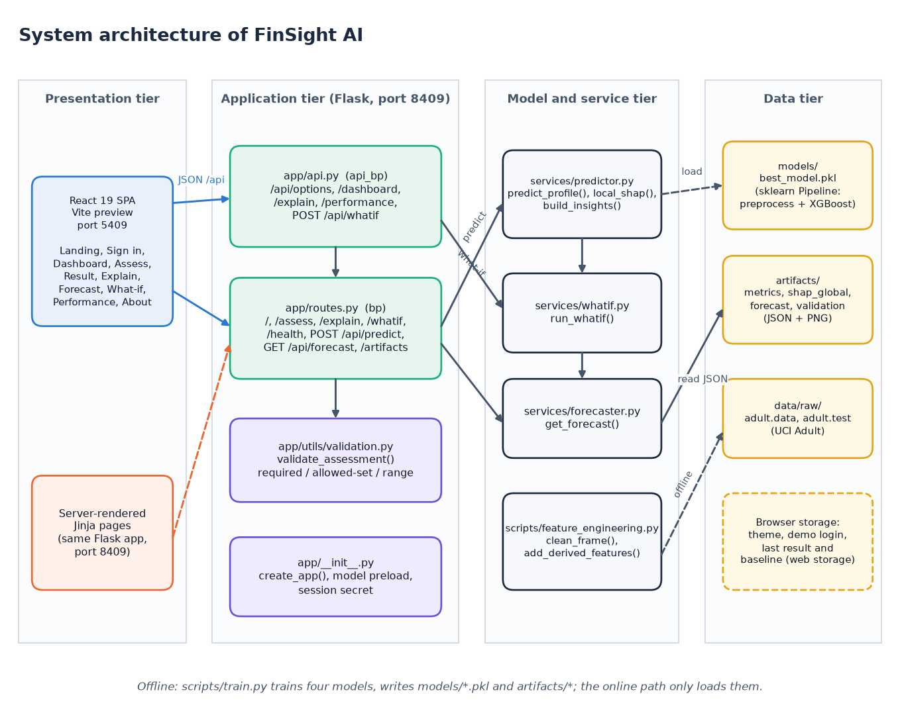
System architecture
Four tiers
Presentation: React single-page app on port 5409; original Jinja pages on 8409.
Application: Flask on port 8409, routes, JSON API, validation.
Model and service tier: predictor, SHAP, what-if, forecast loader.
Data: pickled pipelines, JSON artifacts, UCI Adult CSV files.
Notes:
Four tiers. The online path only loads what scripts/train.py wrote offline.

Slide 5
Methodology: end-to-end workflow
UCI Adult data
Clean + 12 derived features
Stratified 80/20 split
Pipeline x4 models
5-fold CV + test
Select by ROC-AUC
SHAP + forecast + JSON
Leakage-safe
Stratified, one row per person
Reproducible
Imputation, one-hot encoding and scaling sit inside each scikit-learn Pipeline, so they are fitted on training folds only.
A stratified 80/20 split and 5-fold CV preserve the 24 % positive share; no entity-grouped or temporal split applies to this data.
Seed 42 everywhere; train.py writes metrics, validation, SHAP, forecast and plots to JSON/PNG, re-derived by report_metrics.py.
Notes:
The training script is one command and writes every number to disk. Preprocessing lives in the pipelines used at prediction time too.

Slide 6
Dataset
48,842
15
39,073 / 9,769
23.9%
records, UCI Adult / Census Income
raw columns (14 inputs + income)
stratified train / test split
earn more than 50K (positive class)
Public data (UCI, Kohavi 1996), 32,561 + 16,281 rows; target income above 50K is used as a financial-profile signal, not a credit label.
Missing values marked '?': workclass 2,799, occupation 2,809, native-country 857.
The data are 1994 US census records and have no time dimension, so forecasting uses a separate, documented synthetic index.
Notes:
UCI Adult: one row per person, so a stratified split does not leak individuals. Income is a proxy, which is stated as a limit throughout.

Slide 7
Data preprocessing and feature engineering
'?' to missing
Median / 'Unknown' impute
12 derived features
One-hot encode
Scale (LR only)
Derived feature | Rule
net-capital, capital-intensity | gains minus losses; gains plus losses
log-capital-gain / -loss | log(1 + value), for the linear model
hours-band | Part-time <30, Full-time 30-40, Extended 41-60, Very-long
age-band, education-tier | 5 age bands; Secondary, Higher-secondary, Tertiary
region, employment-stability | from native country; from workclass and hours
has-capital-gain / -loss, capital-position | flags; Net-loss, No-capital, Moderate-gain, High-gain
26
Feature set
10 numeric and 16 categorical features feed the ColumnTransformer. The census weight fnlwgt has no meaning for a new user and is imputed with the training median.
Notes:
Every derived column is computed from the raw fields only; the same function runs at training and at prediction time.

Slide 8
Models compared
Model | Configuration | Role
Logistic Regression | C = 1.0, max_iter 2000, standardised numerics | Interpretable linear baseline
Random Forest | 300 trees, unlimited depth | Bagged-tree comparator
Gradient Boosting | scikit-learn defaults, random_state 42 | Boosted-tree comparator
XGBoost | 400 trees, depth 6, learning rate 0.05, subsample 0.9, colsample 0.9, lambda 1 | Selected: best ROC-AUC
No tuning
No rebalancing
Tree models
hyperparameters fixed in advance, as in the base paper
24 % positive class kept as is; threshold analysis instead
chosen for non-linearity and exact TreeSHAP
Notes:
Four model families like the base paper (minus its MLP). Hyperparameters were set once, not searched; selection is by ROC-AUC. The 24 % share is noted as a mild imbalance.

Slide 9
Training and evaluation configuration
Setting | Value
Split / seed | stratified 80/20 on the target, random_state 42: train 39,073, test 9,769
Cross-validation | 5-fold stratified, shuffled, scored by ROC-AUC on the training split
Primary metric / threshold | ROC-AUC for selection; accuracy, precision, recall, F1 at probability 0.5
SHAP | TreeExplainer (tree_path_dependent) on a 500-row sample for global importance; live per request
Forecast | Holt-Winters, additive trend and seasonality (12), 12-month horizon, 95% band from residual sd
Hardware | Intel Core i5-12500 (12th Gen), 15.7 GB RAM, CPU only; Python 3.11.9
Notes:
The whole evaluation protocol on one slide. Selection on the test AUC with no separate validation set is noted as a limitation; the CV ranking agrees.

Slide 10
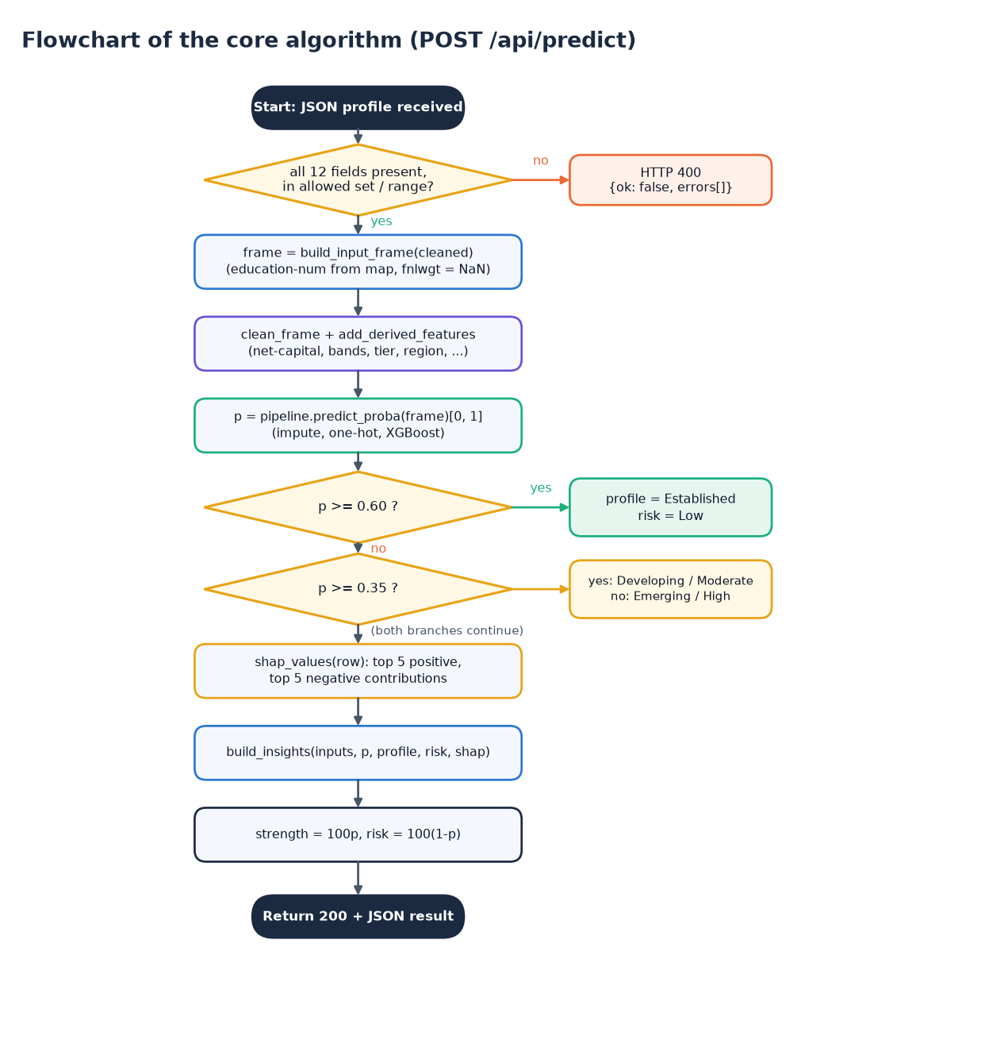
Decision logic
Validate first. All 12 fields present, in the allowed set and range; otherwise HTTP 400 with messages and no model call.
Score. p = P(income > 50K) from the Pipeline, shown as the financial-strength score.
Explain. Live SHAP: top five strengthening and weakening factors, in plain language.
Score p | Profile | Risk band
p >= 0.60 | Established | Low
0.35 <= p < 0.60 | Developing | Moderate
p < 0.35 | Emerging | High
Notes:
Band cut-offs are fixed in profile_from_proba. On the test split they give Emerging 7.2 %, Developing 44.0 % and Established 85.2 % actual income-above-50K rates.

Slide 11
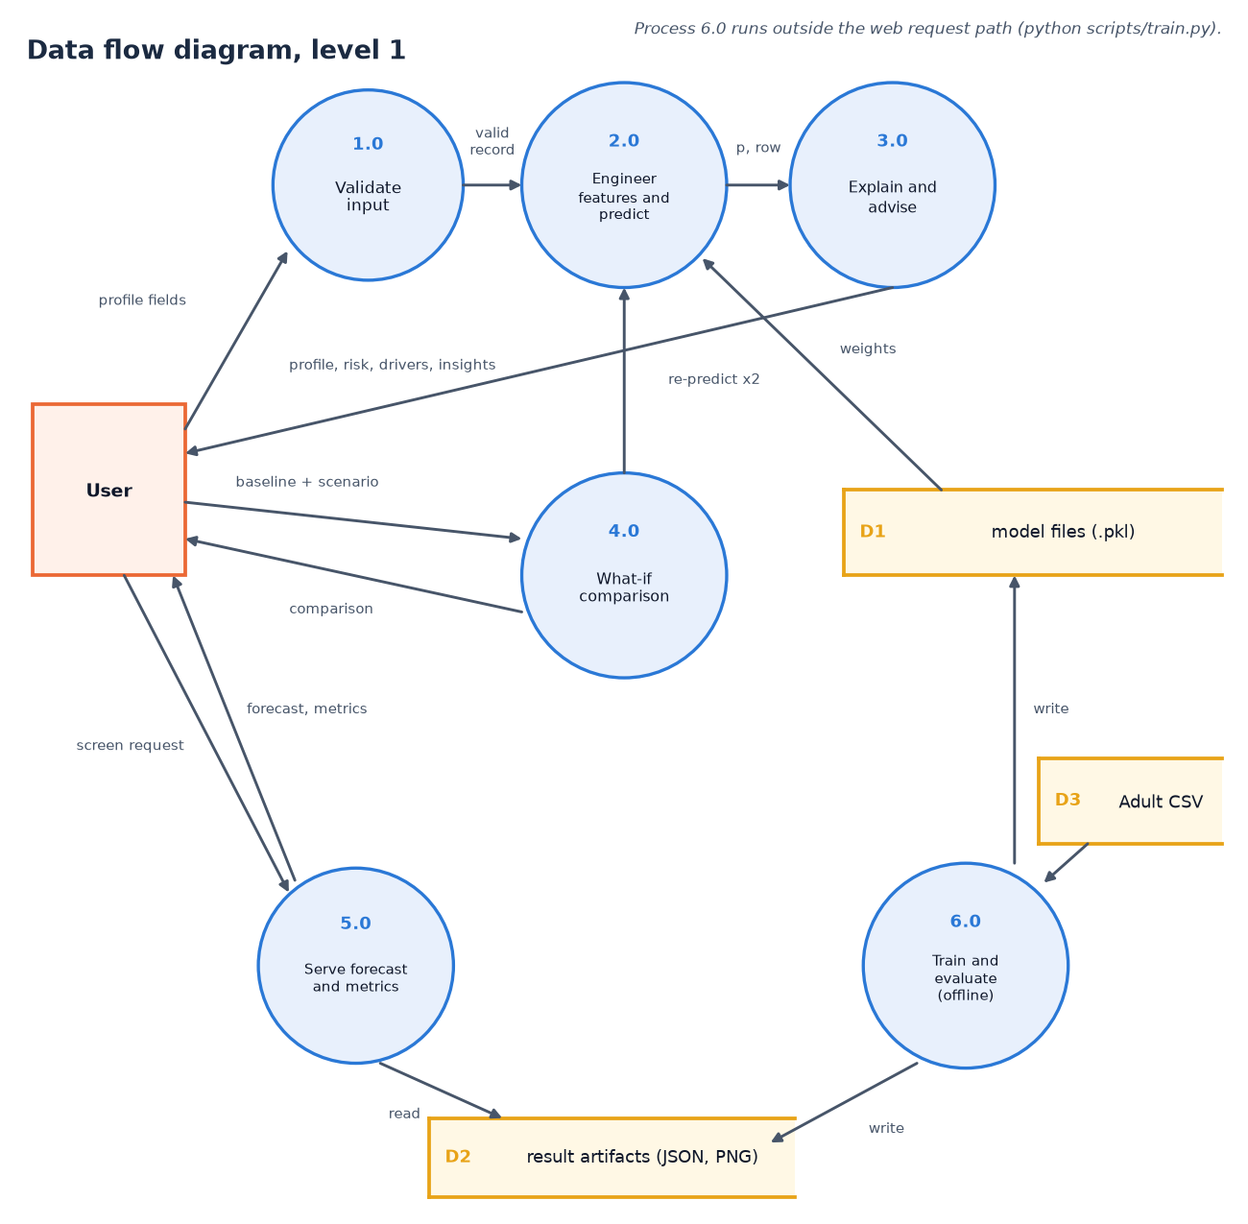
Data flow and modules
Module | Role
app/routes.py, api.py | pages and JSON routes
app/utils/validation.py | input checks
app/services/predictor.py | predict, SHAP, insights
app/services/whatif.py | baseline vs scenario
scripts/feature_engineering.py | cleaning, features, encoder
scripts/train.py, forecast.py | offline training
frontend/src | React screens
Notes:
Level-1 data flow: six processes, one of them offline. Levels 0 and 2 are in the report.

Slide 12
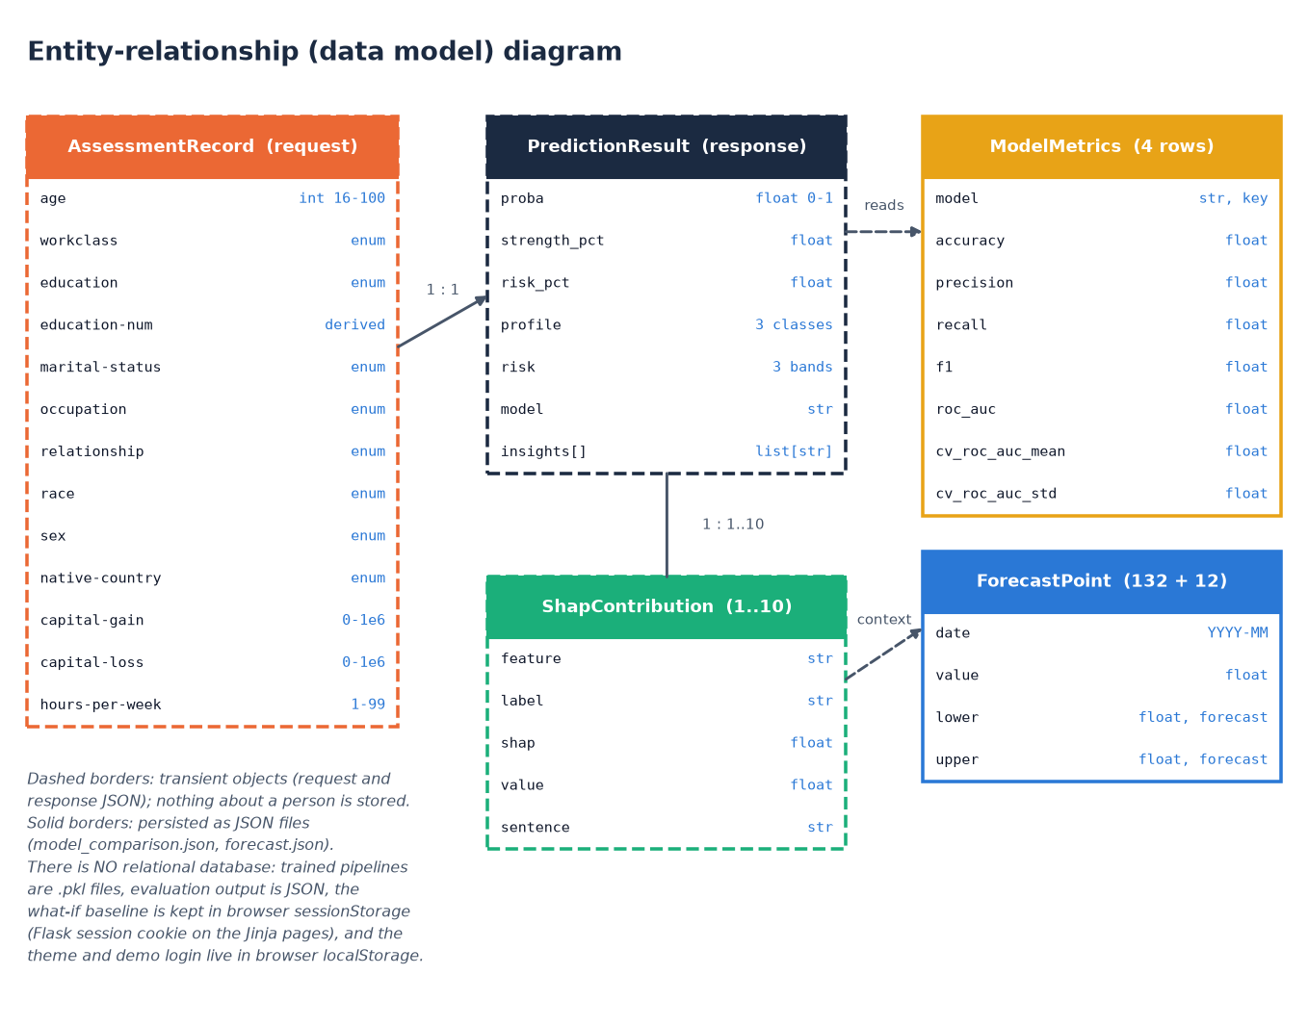
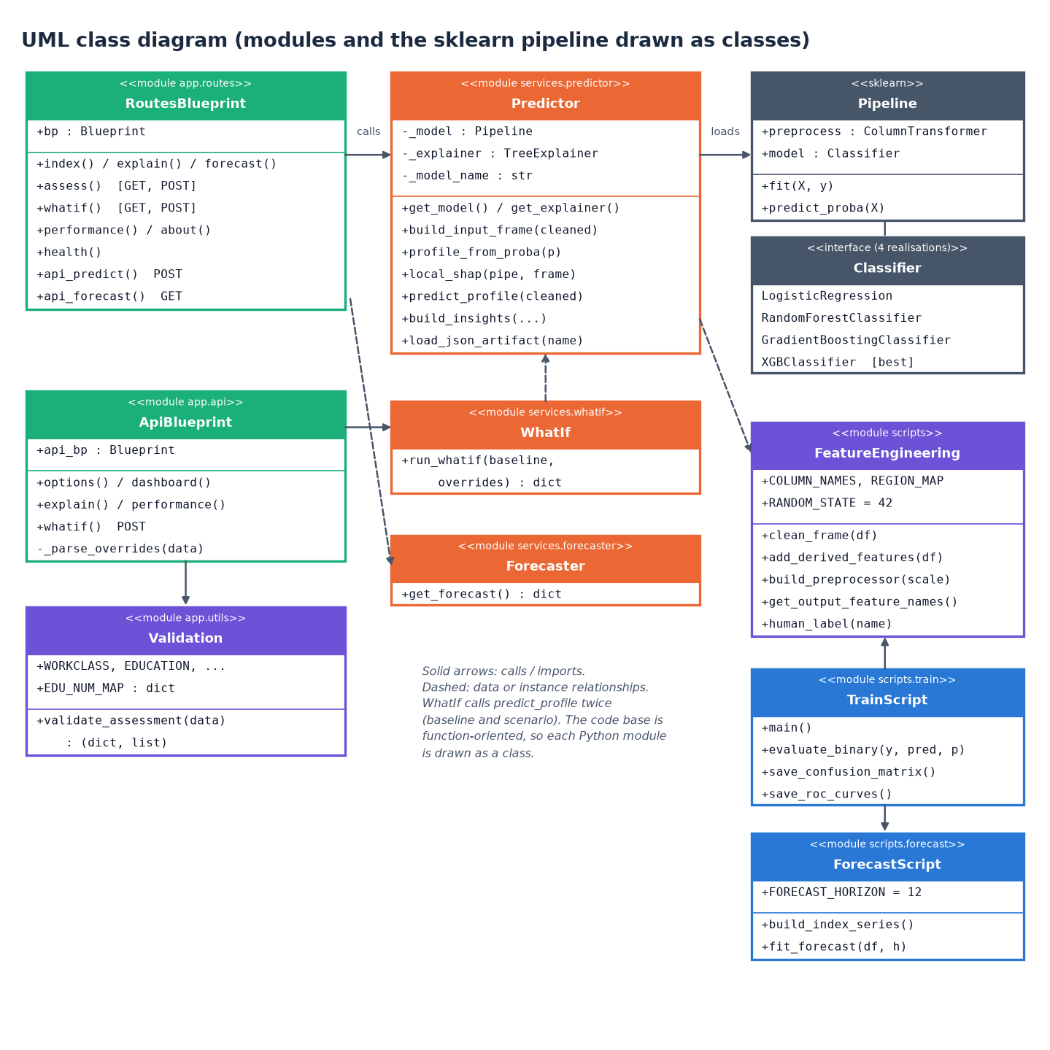
Data model and UML
No relational database: trained pipelines are .pkl files, evaluation output is JSON, the what-if baseline is kept in browser session storage and nothing about a person is stored. The UML draws modules as classes because the code is function-oriented.
Notes:
The batch brief mentions MySQL; the delivered system deliberately stores no personal data, so there is no RDBMS. Requests and responses are the entities.

Slide 13
Technology stack
Layer | Technology
Data and ML | pandas, NumPy, scikit-learn 1.9.1, XGBoost 3.2.0, statsmodels 0.15.0
Explainability | SHAP 0.51.0 (TreeExplainer), matplotlib
API | Flask 3.1.3 (JSON API and original Jinja pages), joblib model loading
Front end | React 19, Vite, React Router, Recharts, Framer Motion
Testing | pytest, Flask test client, scripts/smoke_test.py, Playwright screen capture
Run | run.bat creates the venv, trains if needed, builds the front end; API 8409, front end 5409
Notes:
All open source and local; no external service is called at run time.

Slide 14
Implementation progress
Component | Status | Evidence
Cleaning, 12 derived features, encoders | Done | scripts/feature_engineering.py, 2 tests
Four-model training, CV, selection | Done | scripts/train.py, artifacts/*.json
SHAP global and live local explanations | Done | predictor.py, shap_global.json
Holt-Winters 12-month forecast | Done (synthetic data) | forecast.json, 12 points + 95% band
Flask API (16 routes), validation, what-if | Done | 7 API/page tests, smoke test 35/35
React interface (11 pages), sample login | Done | 19 real screenshots
Real macro indicators, database, fairness audit | Not implemented | listed as future work
Notes:
State of the code base. The honest gaps are real macroeconomic data, persistence and a fairness audit.

Slide 15
Preliminary results: held-out test split
87.8%
0.932
0.724
0.929
accuracy
ROC-AUC
F1 (threshold 0.5)
5-fold CV AUC (sd 0.0011)
i
Reading
XGBoost leads on every headline metric. n = 9,769 test records; at 0.5 recall is 66.6% and precision 79.2%. Protocol and caveats (income is not credit, test-set selection) are on the next slides.
Notes:
First measured numbers, all from artifacts/metrics.json and model_comparison.json. The final review adds confusion matrices, the threshold sweep and calibration.

Slide 16
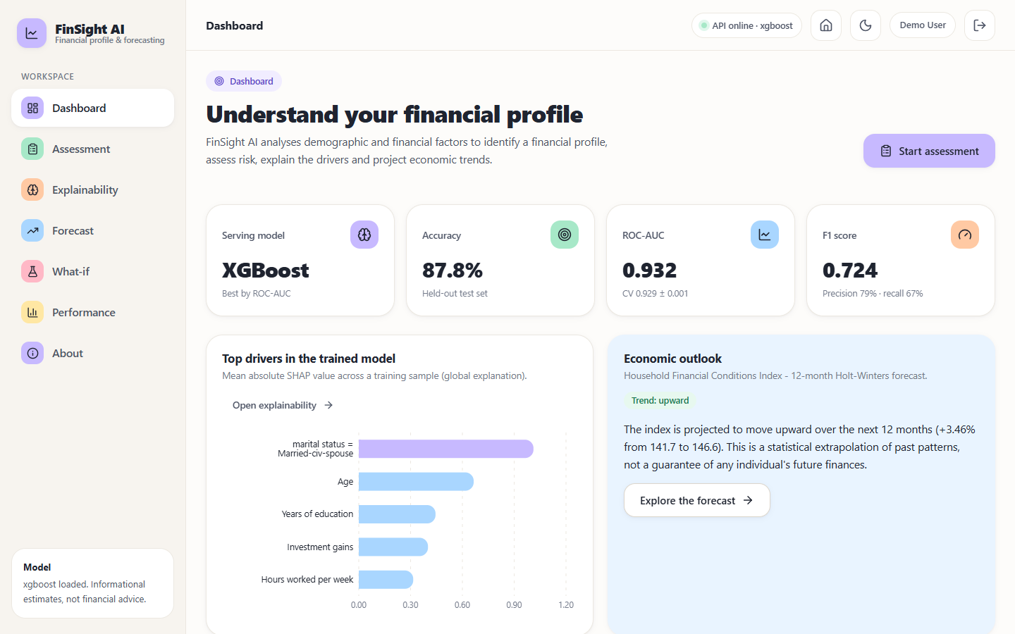
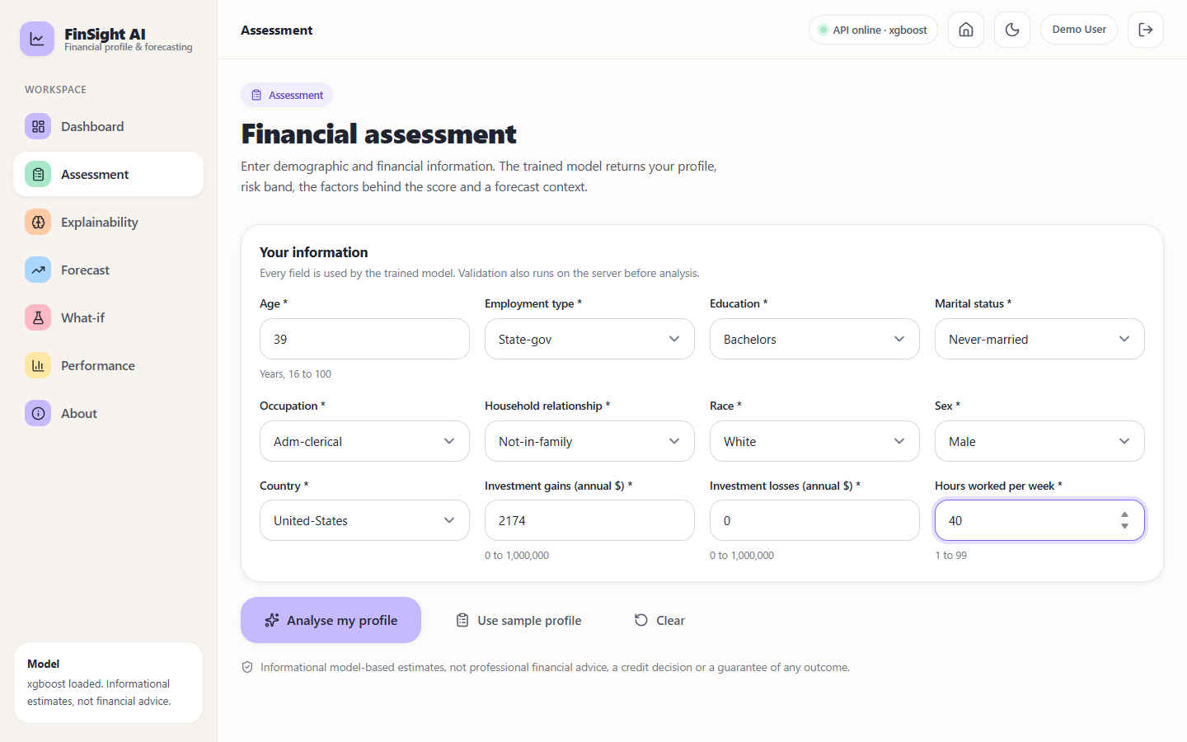
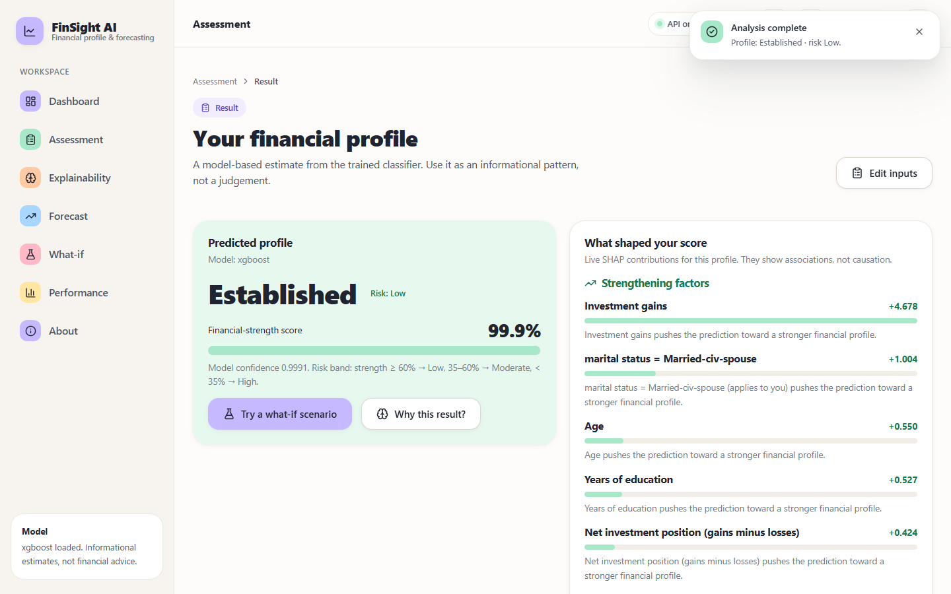
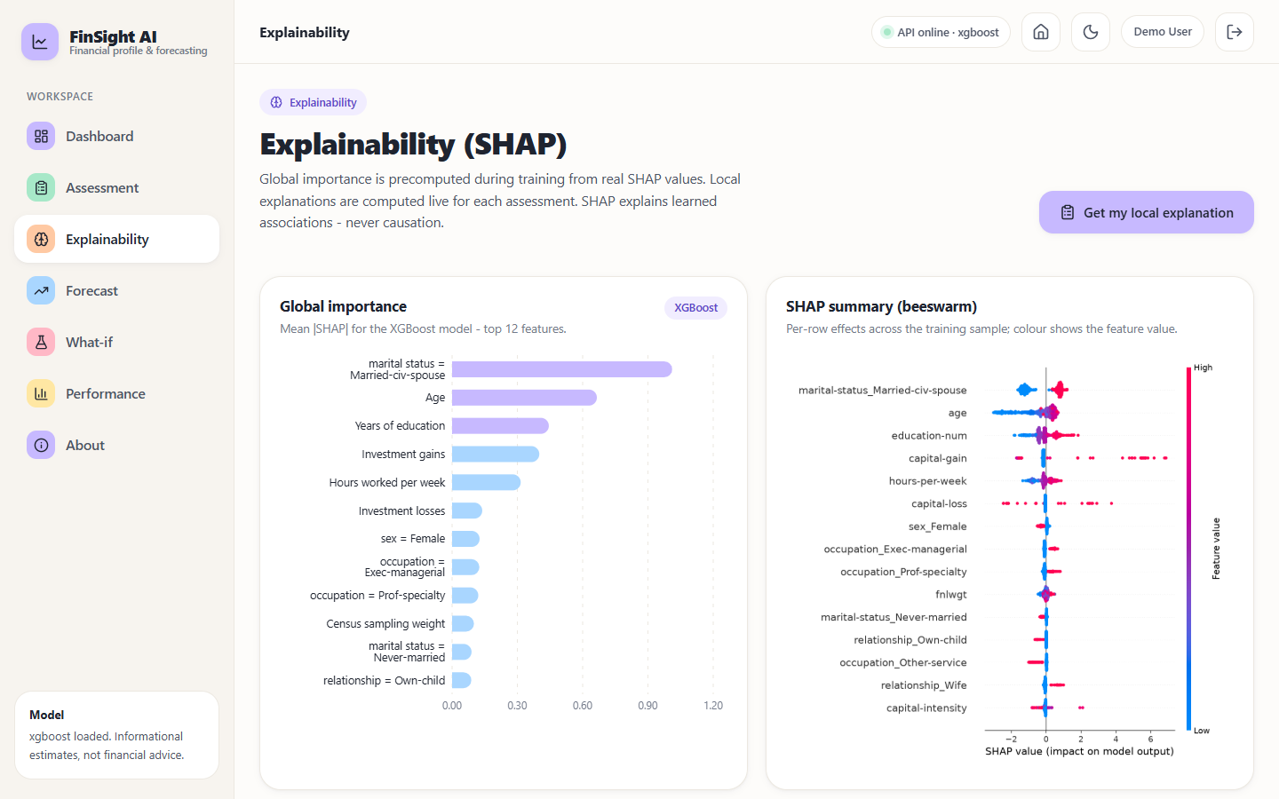
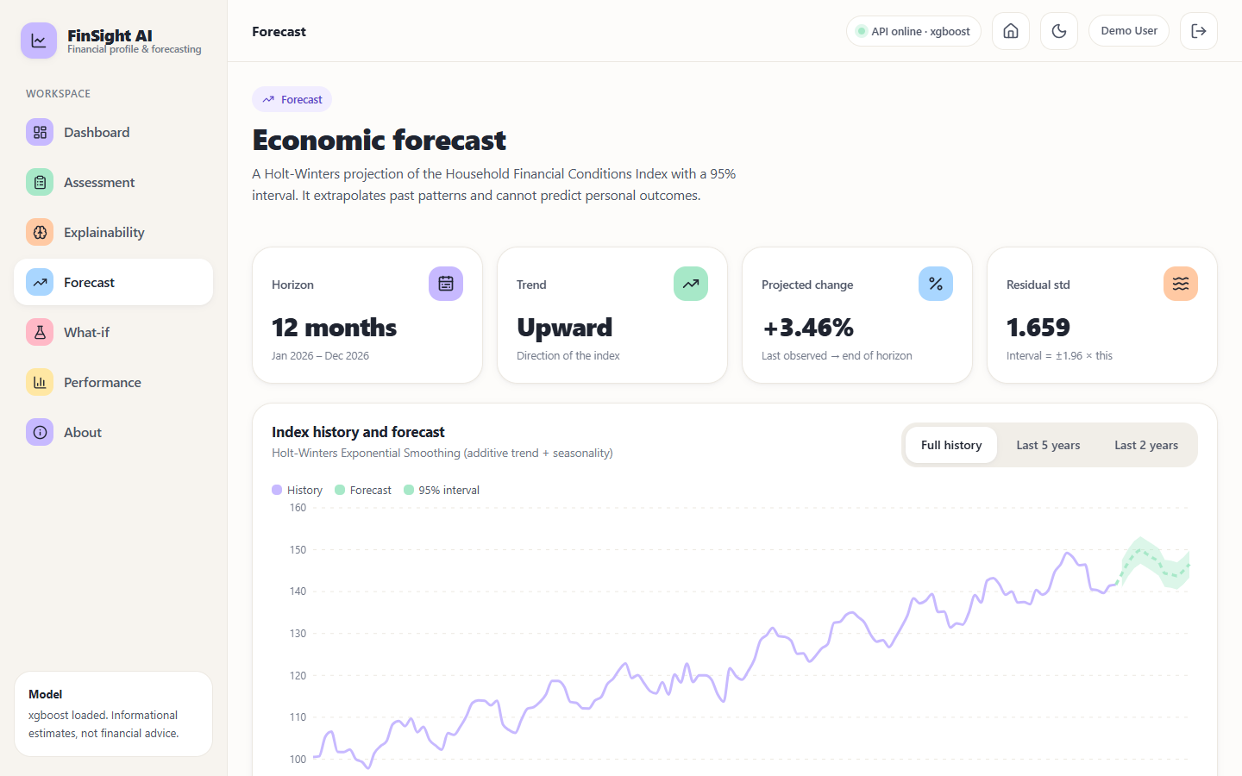
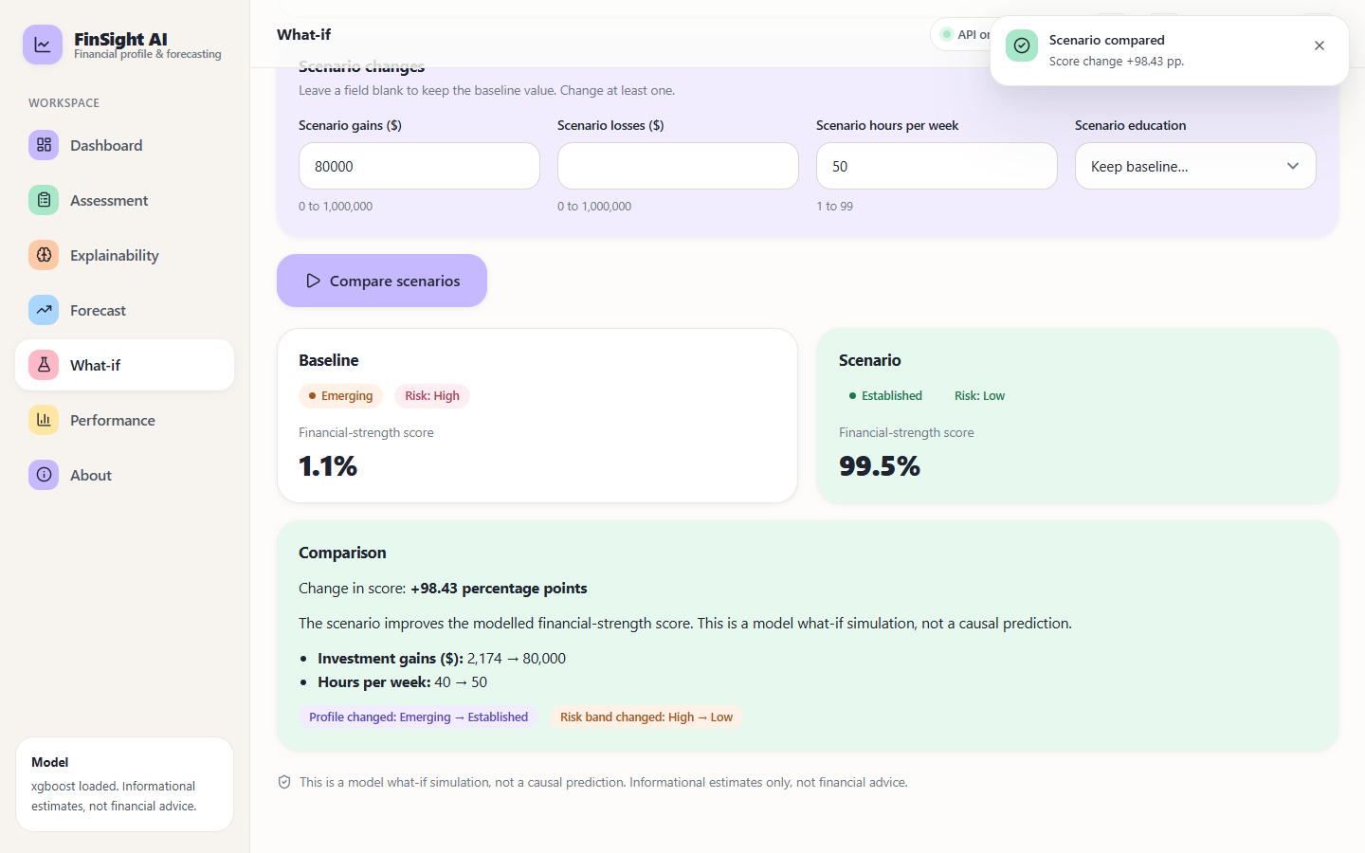
Output screens
Dashboard
Assessment form
Result with SHAP drivers
Explainability
12-month forecast
What-if comparison
Notes:
Real screenshots from the running application with the trained model and live predictions.

Slide 17
Initial testing and observations
9
35/35
69 ms
136 ms
pytest tests passed
live smoke-test checks
median POST /api/predict
median POST /api/whatif
Observation | Action
Saved pipelines were written by an older scikit-learn / XGBoost and warn on load | Metrics were re-derived from the loaded models and match exactly; versions are documented
Invalid input (age 7, -5) reaches the API | Server-side validation returns HTTP 400 with a message; the form shows it (screen 13)
Large what-if changes move the score by about 98 points | Result is labelled a model simulation, not a causal prediction
Notes:
The suite runs offline against the real model. Latency was measured on 127.0.0.1 with 40 calls each, CPU only.

Slide 18
Challenges and corrective actions
Challenge | Corrective action
Census data has no time dimension, so it cannot forecast | Separate monthly index, documented as synthetic, modelled with Holt-Winters
Income is a proxy, not creditworthiness | Profile and risk band wording; limit stated on every analysis screen
Positive class is 23.9%; recall 66.6% at 0.5 | Threshold analysis shows the precision-recall trade-off
Sex, race and marital status are inputs and influential | Disclosed as a fairness limitation; audit listed as future work
Docker files cover only the Flask pages | Documented; run.bat starts both servers locally
Notes:
Each challenge was met by a concrete change or an explicit statement of the limit.

Slide 19
Next steps
1
Evaluate
2
Compare
3
Document
4
Extend (future)
Confusion matrices, threshold sweep, calibration and observed rates per profile band on the test split.
Set the results against the base paper, stating where data and protocol differ.
Final report, paper and deck with every figure regenerated from JSON.
Real macro indicators, fairness audit, persistence, tuning and external validation.
Notes:
Plan to the final review. The extensions at the right are out of scope for this submission.

Slide 20
Thank you
Questions and suggestions are welcome.
Notes:
Likely questions: why XGBoost; why a synthetic forecast; why income as the target; what about fairness.

