Slide 1

AI-Based Financial Identification Based On Demography and Financial Forecasting
Final Review
Team Details : Batch C9
Under the Esteemed Guidance of
B Srikanth
[DESIGNATION], Department of CSE
23K91A05F7 Mohd Ahmed
23K91A05E6 Manne Upender
23K91A05H7 Padala Rajesh
23K91A05D5 Madagouni Harshavardhan Goud
DEPARTMENT OF COMPUTER SCIENCE AND ENGINEERING · TKR College of Engineering and Technology (Autonomous) · Academic Year [ACADEMIC YEAR]
Notes:
Introduce the team and the project: FinSight AI, an explainable financial-profile and forecasting application.

Slide 2
Table of Contents
Abstract
Base Paper & Literature Survey
Research Gap & Problem Statement
Objectives
Proposed System & Architecture
Methodology, Dataset & Model
Decision Workflow, Interaction & Data Model
Implementation Highlights
Results, Threshold Analysis, Performance & Testing
Comparison with Base Paper
Output Screens
Conclusion, Future Scope & References
Dept. of CSE | Batch C9 | Final Review
2
Notes:
The agenda follows the report: problem, design, method, results, comparison, screens, conclusion.

Slide 3
Abstract
Financial assessment relies on narrow parameters and static scores: non-linear demographic effects are missed, the future is ignored and results cannot be explained.
FinSight AI turns 12 demographic and financial inputs into a profile (Emerging, Developing, Established), a risk band and a strength score, explains it with live SHAP drivers, adds a what-if comparison and a 12-month Holt-Winters outlook.
Four models were compared on 48,842 UCI Adult records inside leakage-safe pipelines; XGBoost was selected: 87.8% accuracy, 0.932 ROC-AUC, F1 0.724 on 9,769 held-out records (CV AUC 0.929).
Served by a Flask API and a React interface; 9 automated tests and a 35-check smoke test pass; a prediction takes a median 69 ms on a CPU.
Limits: income is a proxy, not creditworthiness; the forecast series is synthetic; sex, race and marital status are model inputs and no fairness audit was done.
Dept. of CSE | Batch C9 | Final Review
3
Notes:
Read the first two bullets, then the headline numbers with their protocol (stratified held-out split). End on the honest limits.

Slide 4
Base Paper
Y. Kim and E. J. Sun, "An Explainable Machine Learning Framework for Organizational Financial Distress Detection: Evidence From Korean Hospital Panel Data," IEEE Access, vol. 14, pp. 100337-100350, 2026, doi: 10.1109/ACCESS.2026.3709346.
Aspect | Base paper
Framework | Four stages: domain-adaptive feature engineering, multi-model training, SHAP global and local interpretation, domain-specific validation
Data | 165 Korean hospitals, 825 hospital-year rows (2019-2023), 236 line items reduced to 11 features; deficit target (41.2 % positive)
Reported results | Group K-Fold AUC: XGBoost 0.842, Gradient Boosting 0.840, Random Forest 0.831, Logistic Regression 0.776, MLP 0.772; 2023 hold-out 0.780; Altman Z'' 0.680
Explanation | SHAP: material cost ratio (0.777) and labor cost ratio (0.729) dominate; counterfactual subsidy analysis and fixed-effects regression
Stated limits | SHAP is associational; compositional ratios destabilise single attributions; ensembles cannot extrapolate; organisations, not individuals
Dept. of CSE | Batch C9 | Final Review
4
Notes:
The base paper is a framework for organisations. We keep its four stages and apply them to individuals, where validation by entity or time does not apply.

Slide 5
Literature Survey
Work | Methodology | Dataset | Key Results | Limitations
Kim and Sun [1] (base) | Four-stage explainable ML: feature engineering, LR / RF / GB / XGBoost / MLP, SHAP, domain validation | 165 Korean hospitals, 825 hospital-year rows, 2019-2023 | XGBoost AUC 0.842 (hospital-level Group K-Fold); 0.780 on 2023 hold-out; Altman Z'' 0.680 | Organisations, not individuals; small panel; SHAP is associational
Abid [2] | Five ML and four deep models forecasting CDS-implied default probability | Sovereign credit data for Egypt, Morocco and Saudi Arabia | Linear regression best; RNN and GRU competitive | Three countries; sovereign risk, not individual profiles
Maurino [3] | Effect of missing values, noise, outliers and label errors on 10 credit-risk models (Pucktrick library) | One open-source credit-risk dataset | Some errors can raise F1 (up to 17% for specific models); noise and mislabelling generally hurt | Binary task, one dataset; fairness not studied
Zhang et al. [4] | PrivacyCredit: privacy-preserving credit-risk learning with alternative data (vertical federated learning) | Real credit data linked with alternative data | Same performance as the insecure plaintext combination | Needs partner data; no demographic explanation layer
Barboza et al. [10] | Comparison of ensembles with statistical models for bankruptcy prediction | Listed firms | Ensembles outperform traditional statistical models (as summarised in the base paper) | Corporate setting
Grinsztajn et al. [23] | Benchmark of tree-based models against deep learning on tabular data | Many tabular datasets | Tree-based models still outperform deep models on typical tabular data | General benchmark, not finance-specific
Dept. of CSE | Batch C9 | Final Review
5
Notes:
Representative work on explainable and ensemble credit-risk models. Results marked as summarised in the base paper come from its own related-work section.

Slide 6
Research Gap
Population: explainable ML for financial distress targets organisations and sovereigns; individual demographic profiling is far less covered.
Explanation: accuracy is the usual headline; per-person explanations a non-expert can read are rarely part of the tool.
Future view: models describe the present; a forecast of economic conditions is seldom combined with the profile.
Usability: few works deliver a reproducible, tested application with a validated input form.
Honest scope: proxy targets are often presented as credit risk; the limits should be stated.
Dept. of CSE | Batch C9 | Final Review
6
Notes:
Explainable machine learning for financial distress has been developed for organisations and sovereigns, while work on individuals concentrates on accuracy and uses a narrow set of financial parameters. None of the surveyed works combines individual demographic profiling, a per-person explanation, a forecast of economic conditions and a usable web interface in one reproducible system. This project fills that gap on public data.

Slide 7
Problem Statement
Given an individual's demographic and financial details, identify a financial profile and risk band, show which factors drove it, and forecast how economic conditions may move, through a web interface a non-expert can read and a regulator can question.
Input
Output
Context
12 validated demographic and financial fields
Profile, risk band, strength score, SHAP drivers, insights
12-month forecast and what-if comparison
Dept. of CSE | Batch C9 | Final Review
7
Notes:
The statement has three parts: identify, explain, give context.

Slide 8
Objectives
1. Collect a dataset combining demographic attributes with financial and transactional parameters.
2. Preprocess the data, handle missing values and encode categorical demographic fields.
3. Train models to classify financial profile and estimate credit or distress risk.
4. Build a forecasting component that projects future financial position.
5. Add an explainability layer showing which factors drove each assessment.
6. Evaluate using accuracy, precision, recall and ROC-AUC, and deploy through a web interface.
Dept. of CSE | Batch C9 | Final Review
8
Notes:
The six objectives of the proposal. The conclusion states for each whether it was met in full or in part.

Slide 9
Proposed System
Validated inputs
Feature engineering
XGBoost score
SHAP explanation
Forecast + what-if
Twelve inputs are validated server-side, engineered into 26 columns and scored by the best of four models selected on a held-out split.
Score p becomes a profile and risk band (Established p >= 0.60, Developing 0.35 to 0.60, Emerging below 0.35) with a plain-language explanation.
Holt-Winters 12-month outlook with a 95 % band and a what-if screen that compares a baseline with a changed scenario, both labelled as simulation.
Flask JSON API and React interface with a sample login; informational use only.
Dept. of CSE | Batch C9 | Final Review
9
Notes:
The proposed system in one row of boxes, then the four properties that matter.

Slide 10
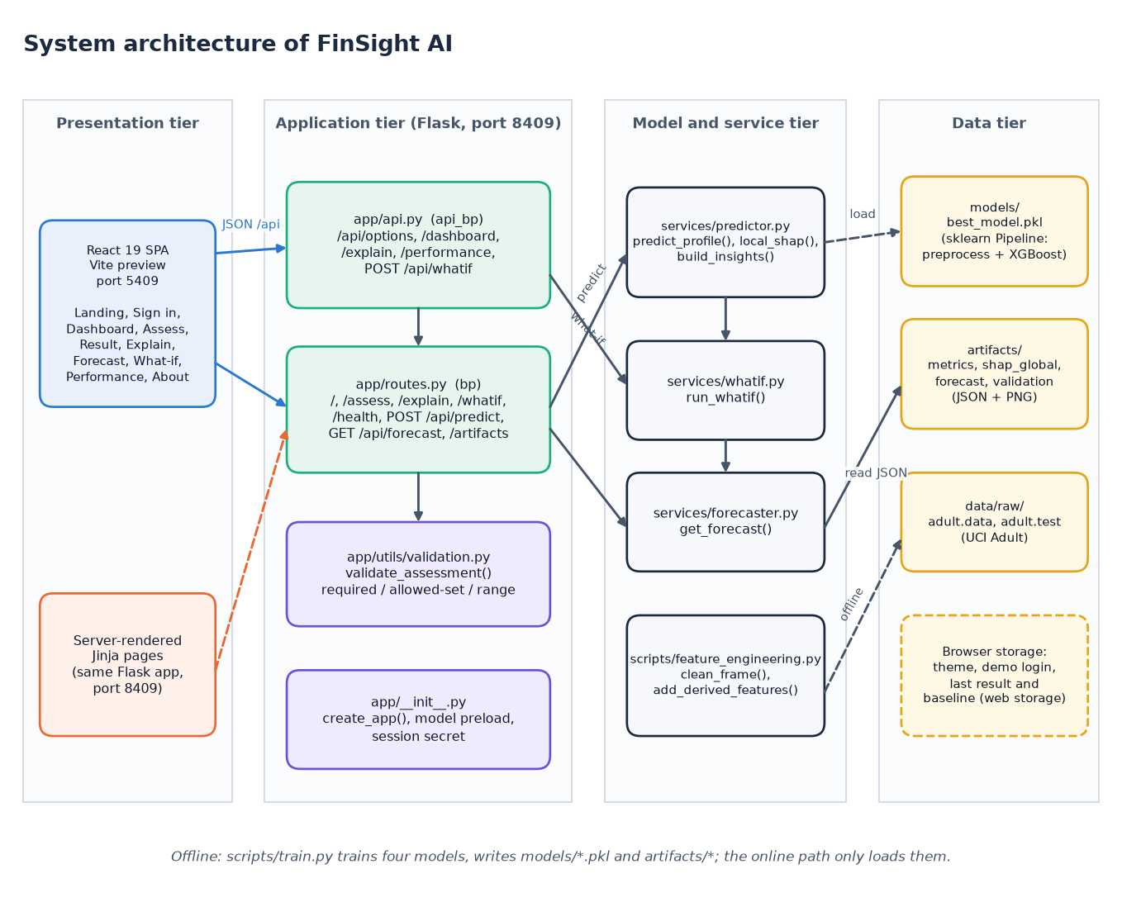
System Architecture
Presentation: React SPA (5409), Jinja pages
Application: Flask API (8409), validation
Services: predictor, SHAP, what-if, forecast
Data: .pkl pipelines, JSON artifacts, UCI CSV
Dept. of CSE | Batch C9 | Final Review
10
Notes:
Four tiers; the online path only loads artifacts written by the offline training script.

Slide 11
Methodology
UCI Adult
Clean + derive
Stratified split
4 pipelines
5-fold CV + test
SHAP + forecast
JSON artifacts
Imputation, one-hot encoding and scaling live inside each scikit-learn Pipeline (fitted on training data only).
Stratified 80/20 split (seed 42): 39,073 train, 9,769 test; 5-fold stratified CV scored by ROC-AUC; selection by ROC-AUC.
One row per person, so entity-grouped and temporal validation of the base paper do not apply; the forecast is validated separately by a hold-out of 12 months.
Every metric, SHAP value and plot is written to JSON/PNG and re-derived by scripts/report_metrics.py.
Dept. of CSE | Batch C9 | Final Review
11
Notes:
The workflow and the reasons for the validation choices.

Slide 12
Dataset, Features & Model
48,842
Model | Setting
Logistic Regression | C 1.0, scaled
Random Forest | 300 trees
Gradient Boosting | defaults
XGBoost | 400 trees, depth 6, lr 0.05
UCI Adult records (1994 census)
26 columns
14 raw + 12 derived features
23.9%
earn more than 50K
Derived: net capital, capital intensity, log gains and losses, hours / age bands, education tier, region, employment stability, capital position.
Missing '?' values (workclass 2,799; occupation 2,809; country 857) imputed inside the pipeline; census weight fnlwgt median-imputed.
Dept. of CSE | Batch C9 | Final Review
12
Notes:
Dataset and model families in one view. The data are 1994 US records; income above 50K is used as a financial-profile signal.

Slide 13
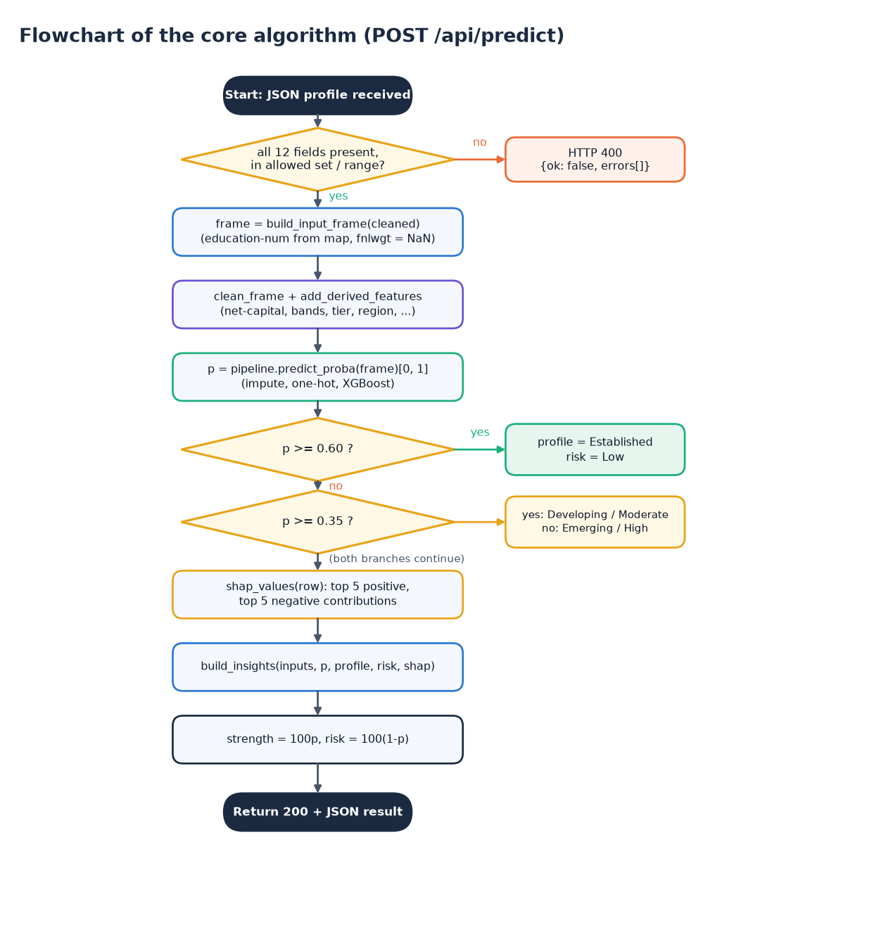
Decision Workflow
Validate: all 12 fields present, in the allowed set and range; otherwise HTTP 400 and no model call.
Score: p = P(income > 50K) from the selected pipeline; strength = 100 p, risk = 100 (1 - p).
Explain: live TreeSHAP; top five positive and negative contributions become sentences.
Score p | Profile | Risk | Test rows | Actual >50K
p >= 0.60 | Established | Low | 1,605 | 85.2%
0.35 to 0.60 | Developing | Moderate | 1,041 | 44.0%
p < 0.35 | Emerging | High | 7,123 | 7.2%
Dept. of CSE | Batch C9 | Final Review
13
Notes:
The prediction route as a decision. The right-hand table shows that the bands are meaningful: the share who actually earn above 50K rises from 7.2 % to 85.2 %.

Slide 14
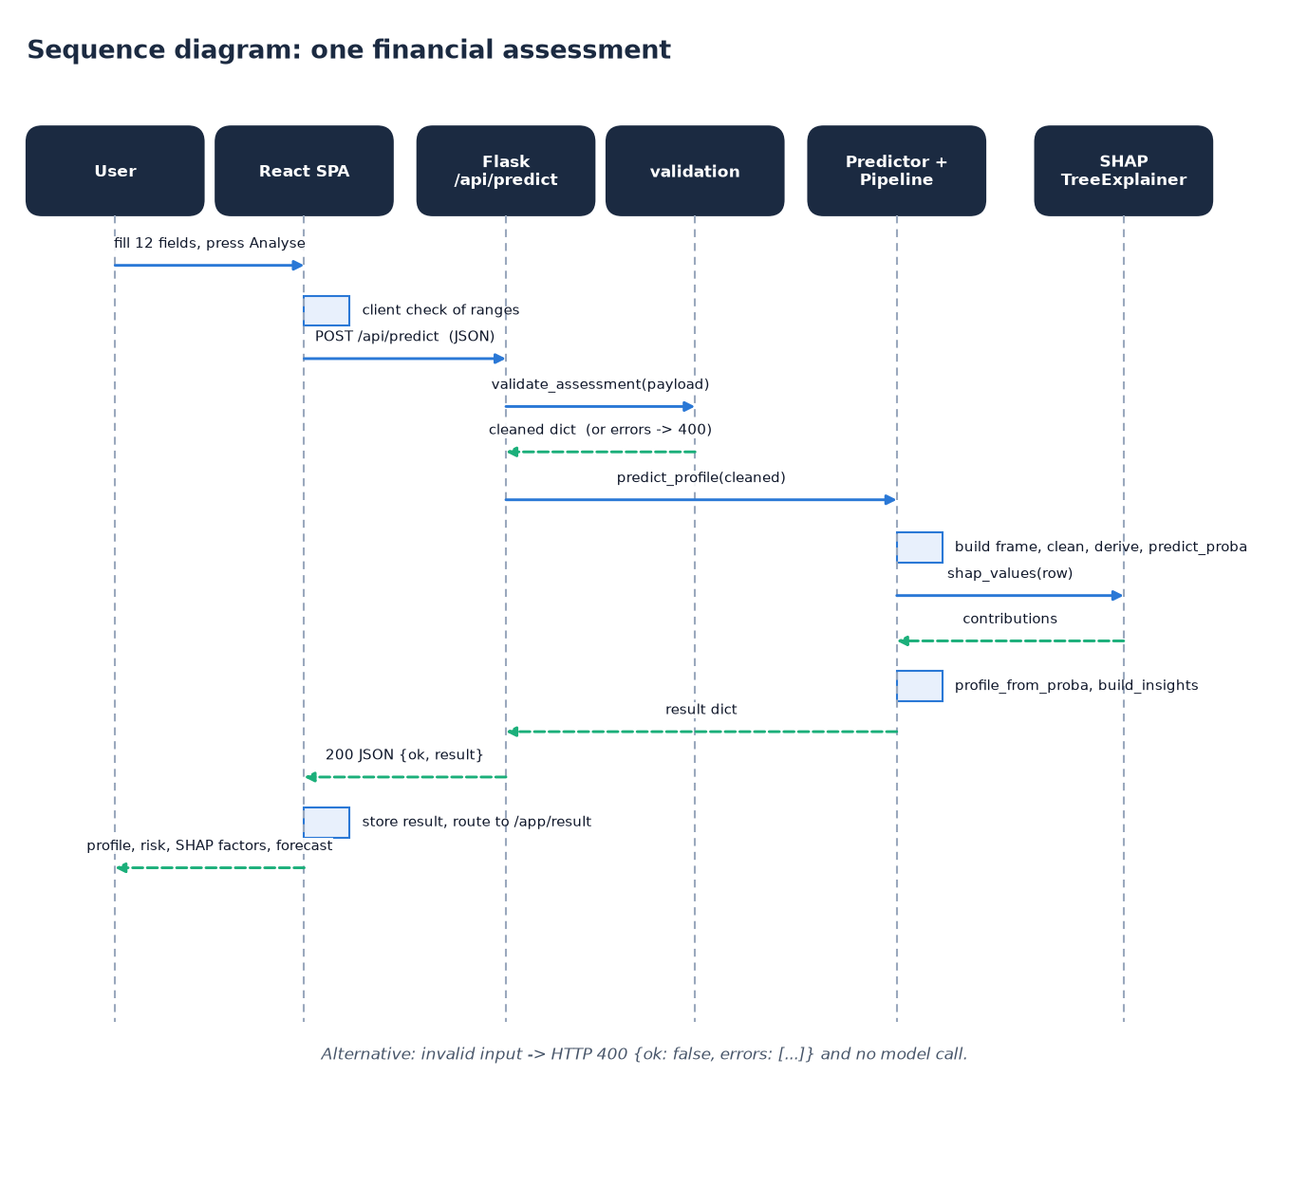
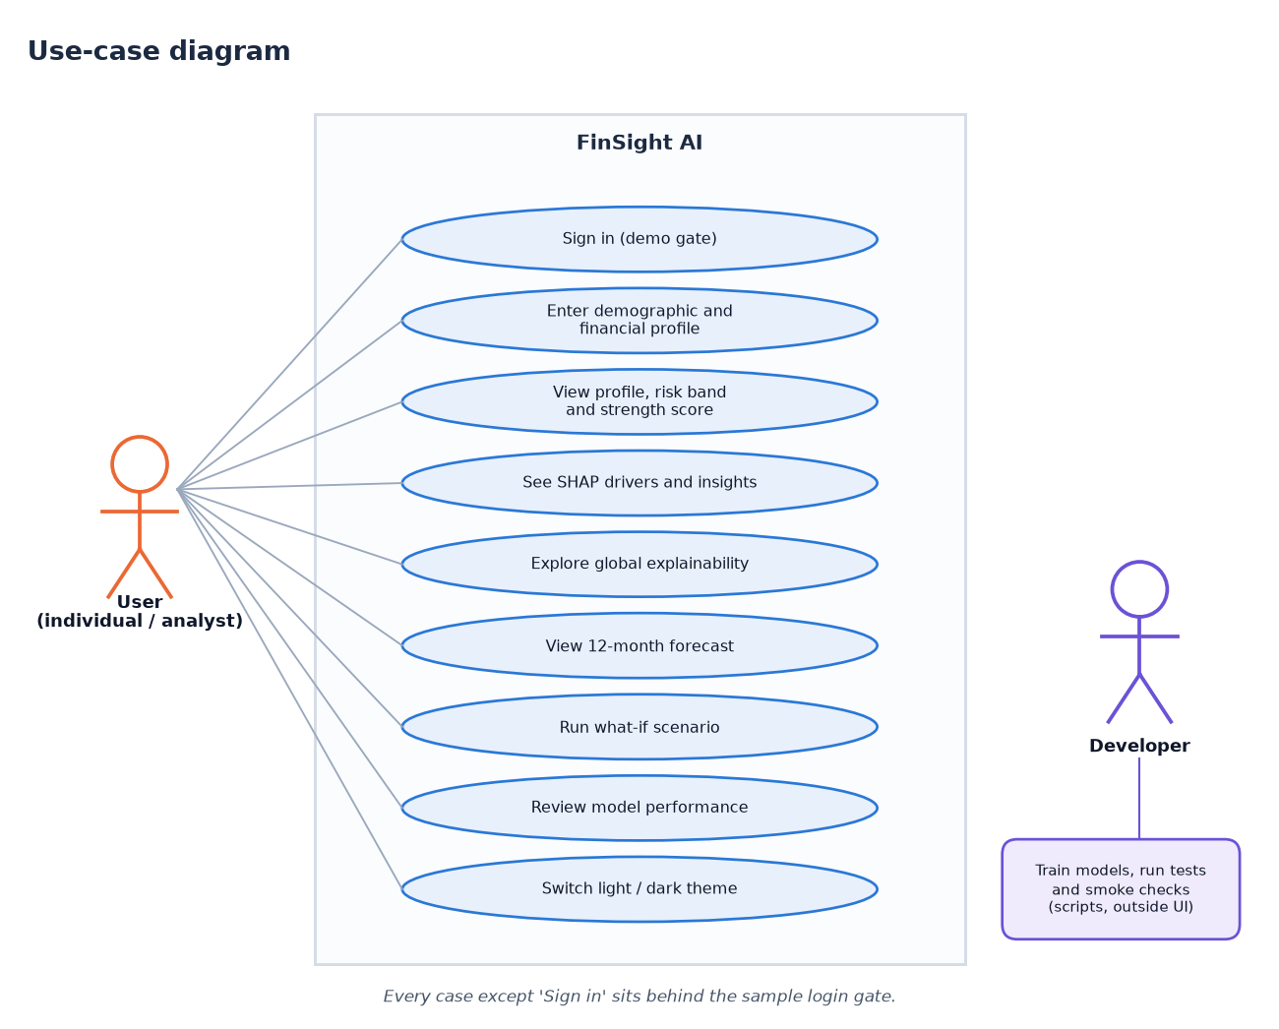
User – System Interaction
Dept. of CSE | Batch C9 | Final Review
14
Notes:
Sequence of one assessment and the use cases of the user and the developer.

Slide 15
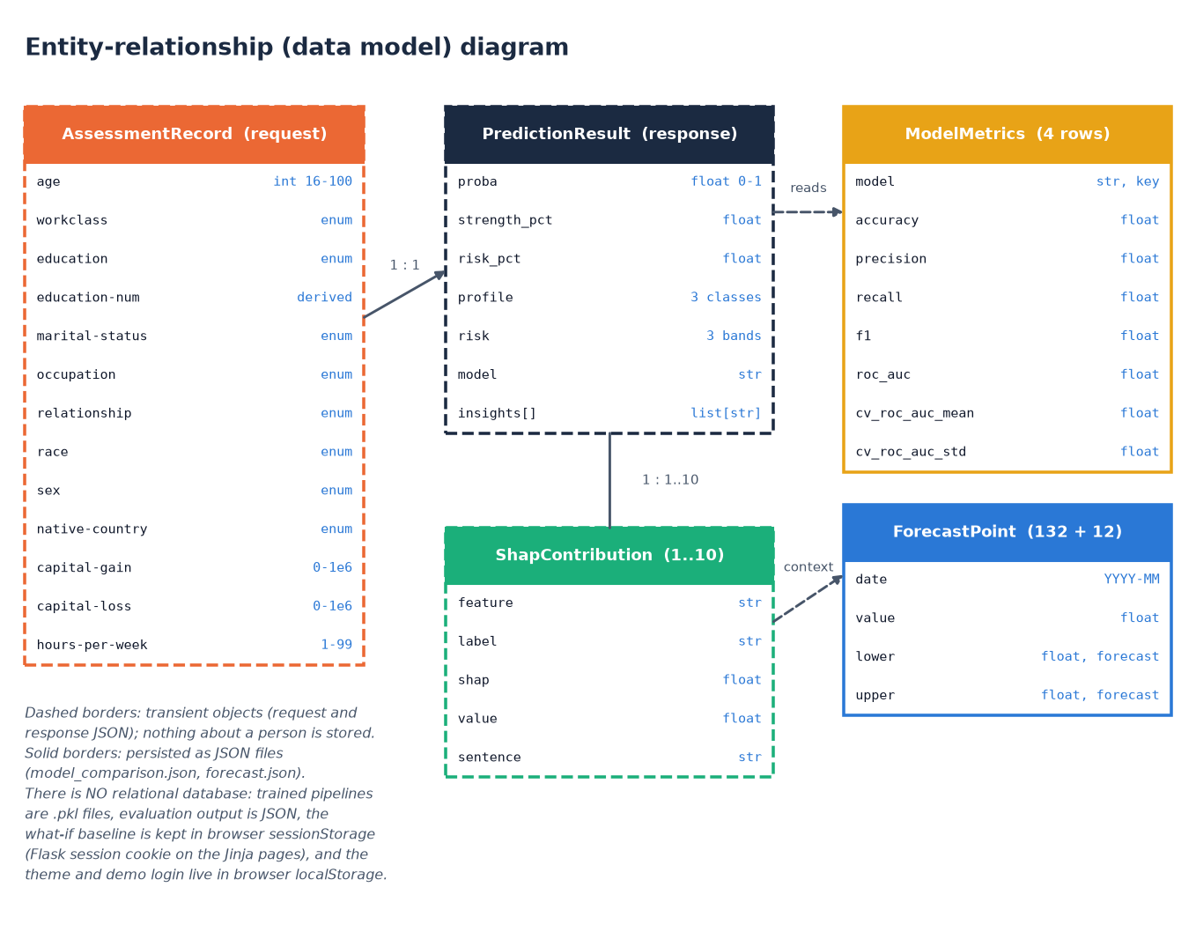
Data Model (no relational database)
Stored item | Where
Trained pipelines (4 + best) | models/*.pkl
Metrics, validation, SHAP | artifacts/*.json, *.png
Forecast series + 95% band | artifacts/forecast.json
What-if baseline | browser sessionStorage
Theme, demo login | browser localStorage
Person's inputs / results | not stored
Dept. of CSE | Batch C9 | Final Review
15
Notes:
The batch brief mentions MySQL; the delivered system stores no personal data on purpose, so the data model is request, response and JSON artifacts.

Slide 16
Implementation Highlights
16
9
11
1
Flask routes (pages + JSON)
pytest tests
React pages
command to start (run.bat)
Server-side validation of every field (required, allowed set, numeric range) with clear 400 messages; the form shows them inline.
Model and explainer are loaded once at start-up; live SHAP per request, with one-hot features read correctly ('absence of occupation = Sales').
What-if re-runs the same pipeline for baseline and scenario and reports score, profile and risk changes, labelled non-causal.
Forecast and performance screens read the JSON artifacts written by training, so the screens always match the evaluated model.
Sample login is a browser-only demo gate and not real authentication.
Dept. of CSE | Batch C9 | Final Review
16
Notes:
Highlights: validation, single model load, live SHAP wording, simulation labelling, artifacts as the single source of truth.

Slide 17
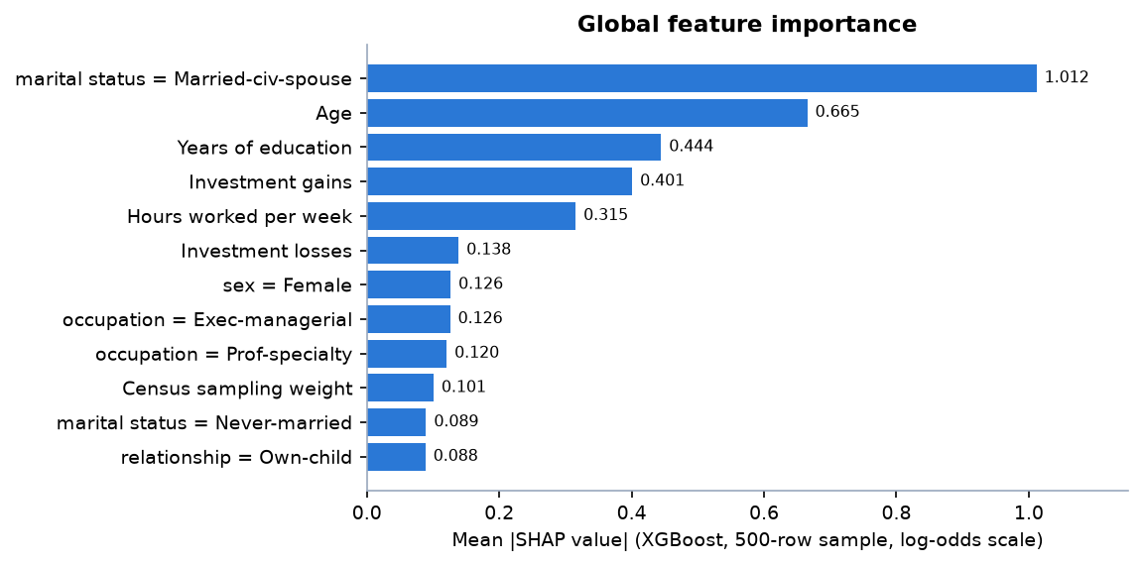
Results – Model Performance (held-out test split)
Model | Accuracy | Precision | Recall | F1 | ROC-AUC | CV AUC
Logistic Regression | 0.860 | 0.757 | 0.611 | 0.676 | 0.914 | 0.913 ± 0.001
Random Forest | 0.860 | 0.740 | 0.637 | 0.685 | 0.910 | 0.908 ± 0.002
Gradient Boosting | 0.870 | 0.791 | 0.619 | 0.694 | 0.925 | 0.920 ± 0.002
XGBoost * | 0.878 | 0.792 | 0.666 | 0.724 | 0.932 | 0.929 ± 0.001
* selected model. n = 9,769 (2,338 positive). PR-AUC 0.838, Brier score 0.086, specificity 0.945.
0.932
87.8%
66.6%
XGBoost ROC-AUC
accuracy
recall at 0.5
Dept. of CSE | Batch C9 | Final Review
17
Notes:
Protocol: stratified 80/20 split, seed 42; CV on the training split. XGBoost leads on every headline metric. The model was selected on the test AUC; the CV ranking is the same. Right: global SHAP importance, led by marital status = Married-civ-spouse, age, years of education, investment gains and hours.

Slide 18
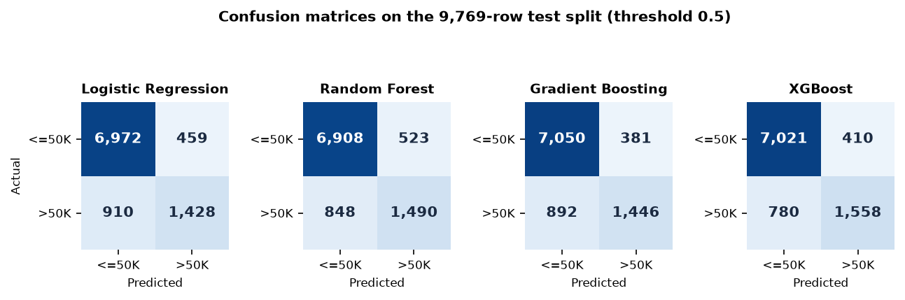
Confusion Matrix & Per-class Metrics
Class (XGBoost) | Support | Predicted correctly | Precision | Recall
<=50K (negative) | 7,431 | 7,021 | 0.900 | 0.945
>50K (positive) | 2,338 | 1,558 | 0.792 | 0.666
410 false positives, 780 false negatives
Dept. of CSE | Batch C9 | Final Review
18
Notes:
Rows are the true class, columns the prediction. The model misses 780 of 2,338 high-income people and wrongly flags 410 of 7,431 others: recall is the weak side at the default threshold.

Slide 19
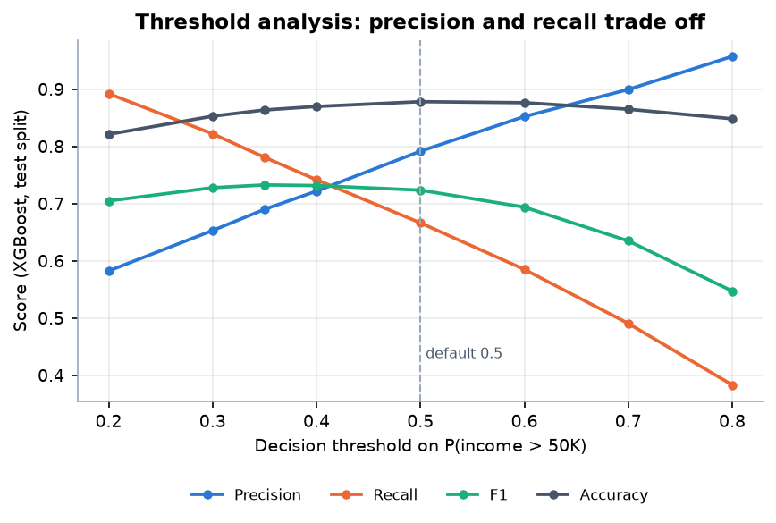
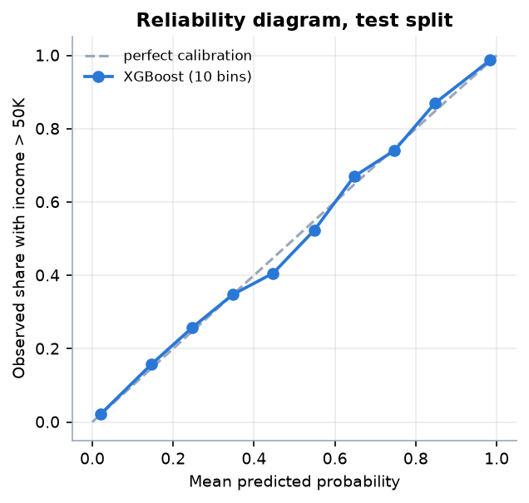
Threshold & Calibration Analysis
Predicted and observed rates track closely: 0.021 vs 0.022 in the lowest bin, 0.984 vs 0.987 in the highest; the largest gap is 0.447 vs 0.406.
Threshold | 0.30 | 0.35 | 0.40 | 0.50 (default) | 0.60 | 0.70
Precision | 0.653 | 0.690 | 0.722 | 0.792 | 0.852 | 0.900
Recall | 0.822 | 0.781 | 0.742 | 0.666 | 0.585 | 0.491
F1 | 0.728 | 0.733 | 0.732 | 0.724 | 0.694 | 0.635
Dept. of CSE | Batch C9 | Final Review
19
Notes:
Lowering the threshold to 0.35 lifts recall to 78.1 % and F1 to 0.733 at the cost of precision (69.0 %). The application uses the 0.35 and 0.60 cut-offs for the profile bands, not a yes/no decision.

Slide 20
Performance & Testing
69 ms
136 ms
7 ms
52 ms
median predict (p95 117 ms)
median what-if (two predictions)
median forecast / performance read
in-process prediction incl. SHAP
Test layer | What it covers | Result
Unit (pytest) | derived features, missing-value handling in the pipeline | 2 passed
API / page (pytest) | health, 7 pages, hard-coded-output check, invalid input, /api/predict, /api/forecast, what-if, artifacts | 7 passed
Live smoke test | API on 8409 and proxy on 5409: options, dashboard, explain, performance, forecast, predict, what-if, errors | 35/35 checks passed
Forecast back-test | fit 2015-2024, predict 2025 of the synthetic series: MAE 1.43, MAPE 1.00 %, naive MAE 4.50 | method check only
Not done | load or concurrency tests, browser matrix, user study, security audit | stated as a limit
Dept. of CSE | Batch C9 | Final Review
20
Notes:
Latency measured on 127.0.0.1 with 40 calls each on Intel Core i5-12500 (12th Gen), CPU only. The forecast back-test only shows that the method recovers its own synthetic generator; it says nothing about real data.

Slide 21
Comparison with Base Paper (context only – different problems)
Aspect | Base paper [1] | This project
Task and target | Organisational distress: hospital deficit (net income < 0), 41.2 % positive | Individual profile: income > 50K, 23.9 % positive
Data | 165 hospitals, 825 hospital-year rows, 11 features | 48,842 individuals, 26 columns
Validation | Hospital-level Group K-Fold; temporal 2019-22 to 2023 | Stratified 80/20 + 5-fold CV (one row per person)
XGBoost AUC | 0.842 (Group K-Fold); 0.780 temporal | 0.932 test; 0.929 CV
Logistic Regression AUC | 0.776 | 0.914
Top SHAP feature | material cost ratio (0.777) | marital status = Married-civ-spouse (1.012)
Beyond prediction | Counterfactual subsidy analysis, fixed-effects regression | Forecast, what-if, working web application
Not a like-for-like comparison: different entities, target, size and validation. The higher AUC here reflects a larger, differently defined and easier problem, not a better method; the comparable finding is that boosted trees beat Logistic Regression in both studies.
Dept. of CSE | Batch C9 | Final Review
21
Notes:
State plainly that datasets and protocols differ. Where results are comparable in kind: XGBoost beats the linear baseline in both studies, by about 0.07 AUC in the base paper and 0.02 here.

Slide 22
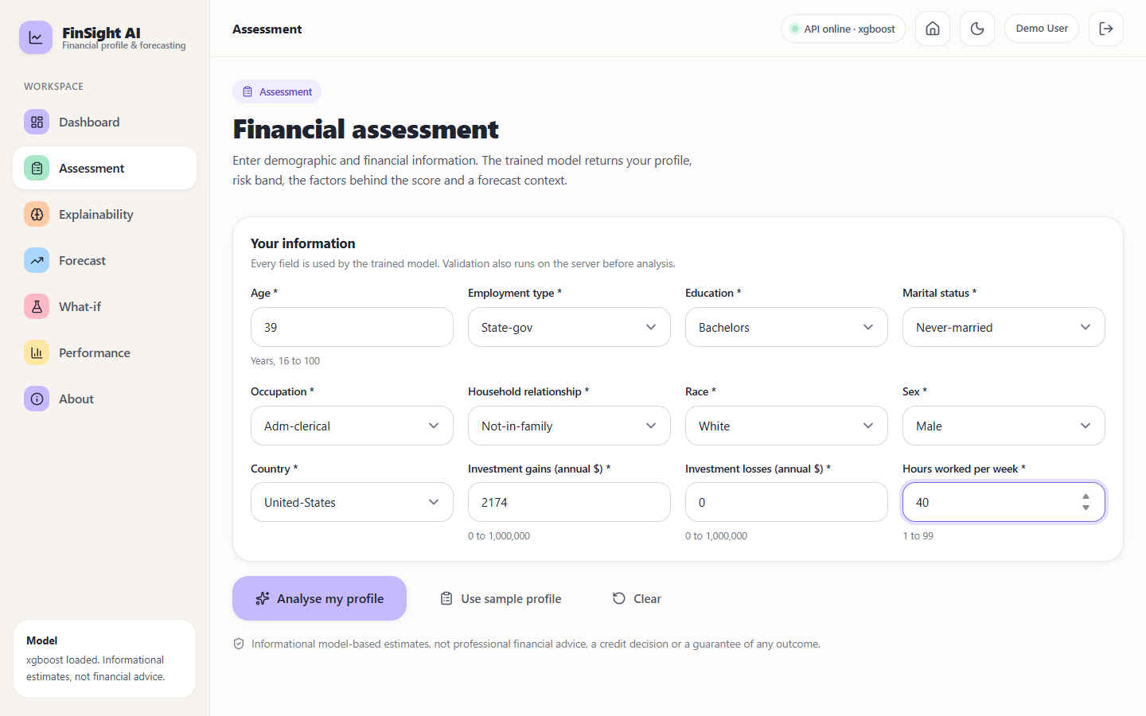
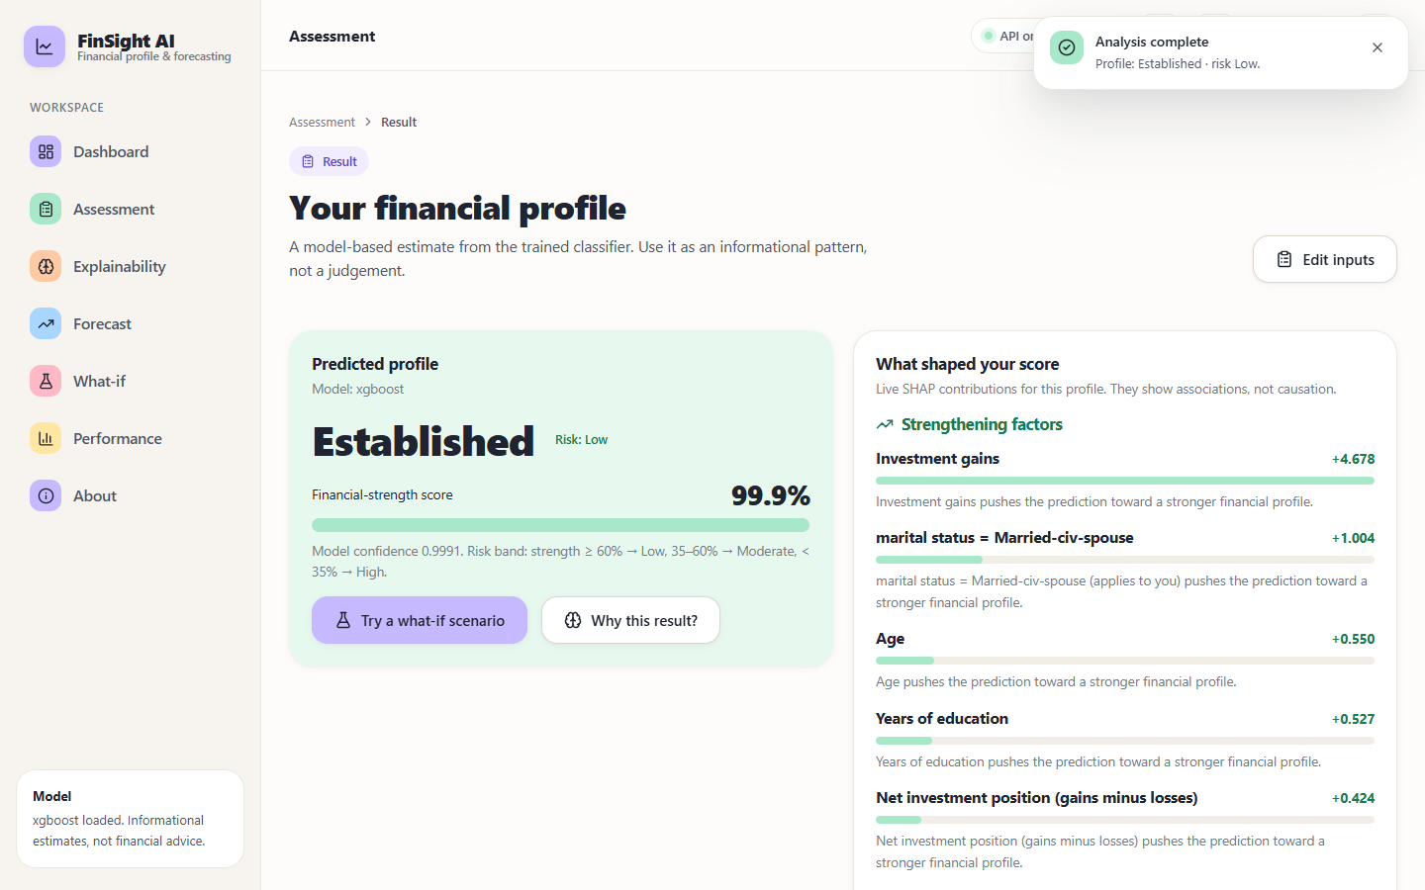
Output – Assessment and Result
Assessment form with 12 validated inputs
Result: Established profile, Low risk, 99.9 % strength, live SHAP factors
Dept. of CSE | Batch C9 | Final Review
22
Notes:
Left: the validated assessment form. Right: the result with the profile, risk band, strength score and the SHAP factors that strengthen or weaken it.

Slide 23
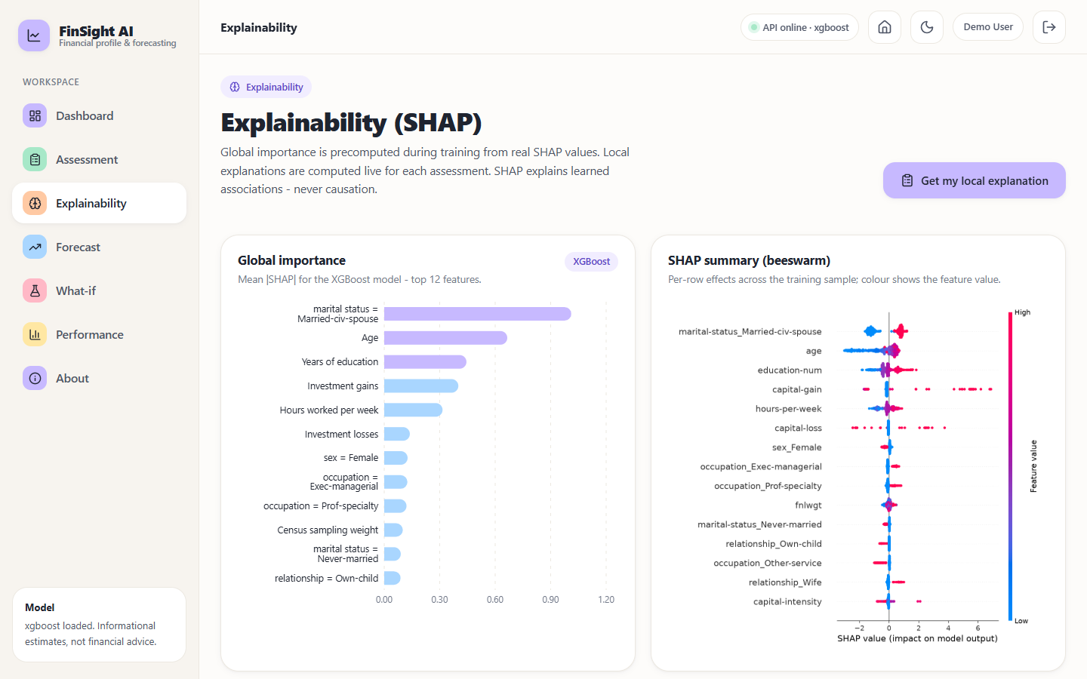
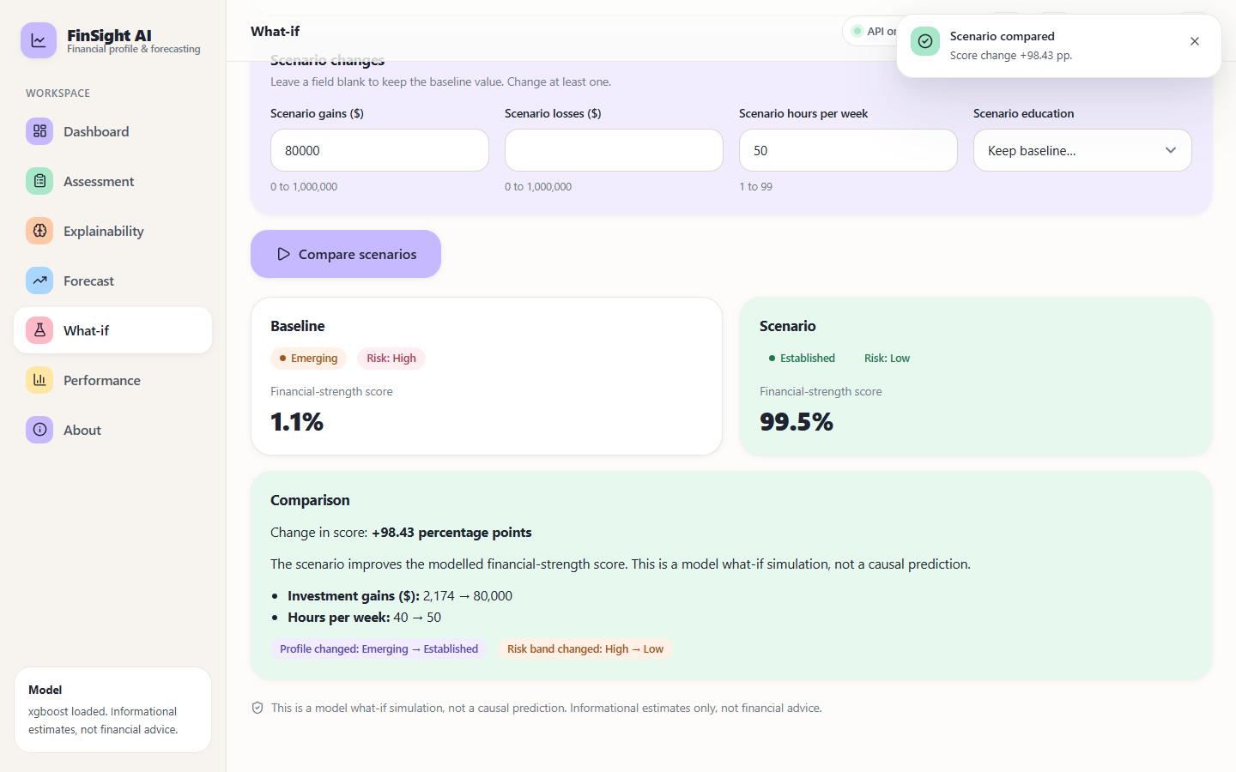
Output – Explainability and What-if
Global SHAP importance and beeswarm
What-if: gains 2,174 to 80,000 and hours 40 to 50 move the score from 1.1 % to 99.5 %
Dept. of CSE | Batch C9 | Final Review
23
Notes:
Left: global SHAP. Right: baseline versus scenario; the large jump is a model simulation, not a causal prediction, and extrapolates from sparse high-gain data.

Slide 24
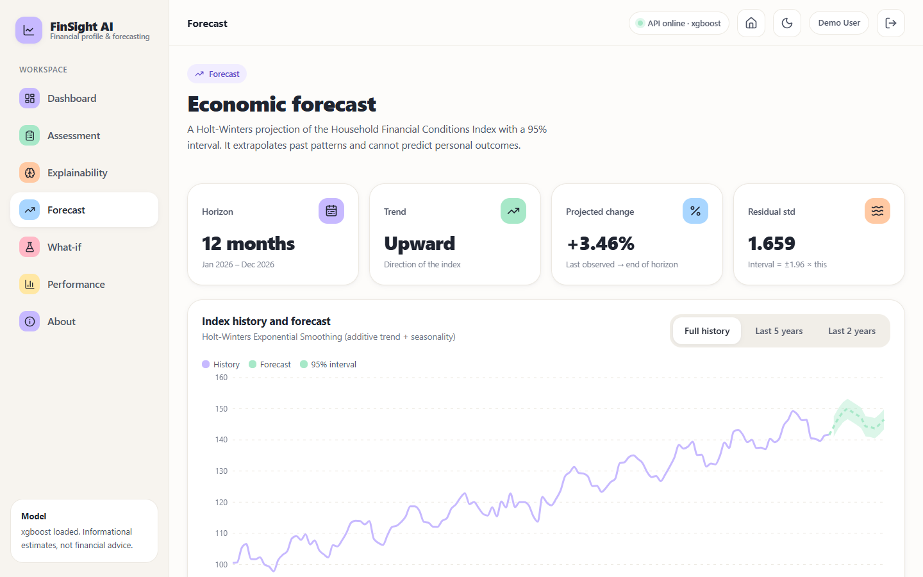
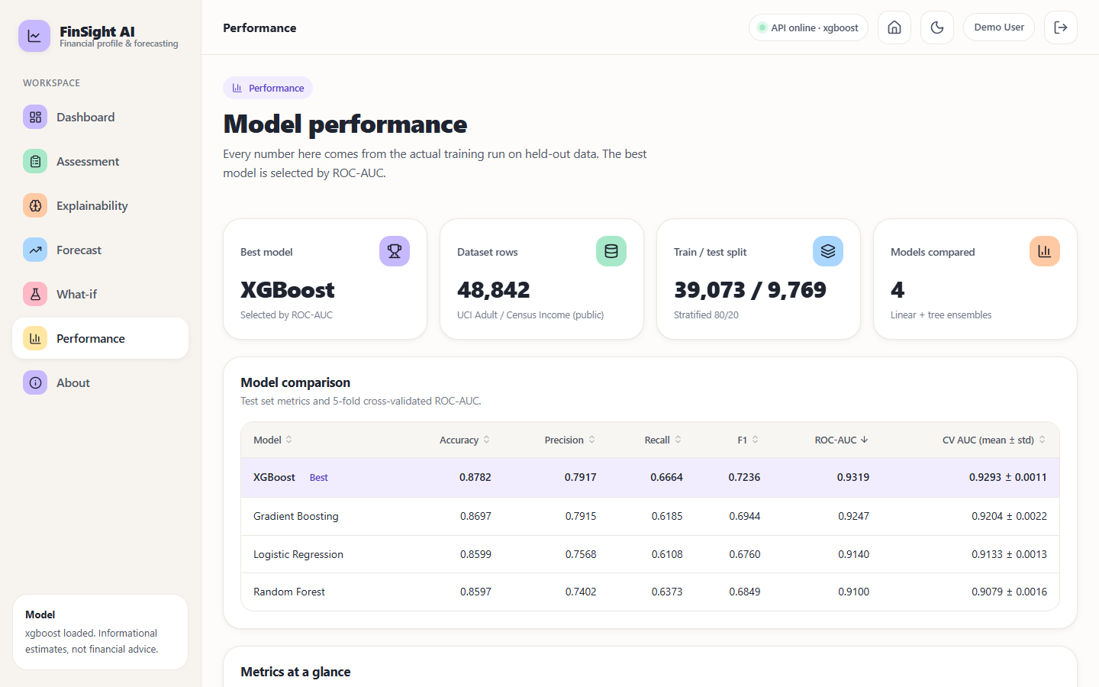
Output – Forecast and Performance
12-month Holt-Winters forecast on the synthetic index (141.7 to 146.6, +3.46 %)
Model comparison, validation protocol and statistics
Dept. of CSE | Batch C9 | Final Review
24
Notes:
The forecast screen is labelled as an illustrative series. Back-test on its own generator: MAE 1.43, MAPE 1.00 %.

Slide 25
Conclusion
Delivered: an end-to-end explainable financial-profile system: validation, feature engineering, four compared models, SHAP explanations, what-if, forecast, API, React interface, tests and documentation.
Measured: XGBoost reaches 87.8% accuracy, 0.932 ROC-AUC and F1 0.724 on 9,769 held-out records; the bands separate people well (observed >50K rate 7.2% / 44.0% / 85.2%).
Objectives: 1 dataset (met in part: no transaction data), 2 preprocessing (met), 3 classification and risk (met in part: income proxy), 4 forecast (met in part: synthetic series), 5 explainability (met), 6 evaluation and deployment (met).
Finding: boosted trees beat the linear baseline by about 0.02 AUC here (Random Forest does not); recall of the high-income class (66.6 % at 0.5) is the weak point and trades against precision.
Limits: income is not creditworthiness; no fairness audit; no real macro data; not financial advice.
Dept. of CSE | Batch C9 | Final Review
25
Notes:
Five of six objectives were met in full or in part; none is claimed beyond what the data supports.

Slide 26
Future Scope
Real macroeconomic indicators (inflation, lending rates, GDP) and real time series to replace the synthetic index; panel or temporal models.
A fairness audit of sex, race and marital-status effects with mitigation (for example equalised odds) before any use on people.
A credit-specific target (repayment or default) on consented data, with calibration and external validation on current populations.
Hyperparameter search, a separate validation set and significance tests (DeLong) for model selection.
Persistence with user accounts, audit log and containerised deployment of the full stack.
Dept. of CSE | Batch C9 | Final Review
26
Notes:
Concrete next steps, ordered by value.

Slide 27
References
[1] Y. Kim and E. J. Sun, "An explainable machine learning framework for organizational financial distress detection: Evidence from Korean hospital panel data," IEEE Access, vol. 14, pp. 100337-100350, 2026, doi: 10.1109/ACCESS.2026.3709346.
[2] A. Abid, "Forecasting sovereign credit risk amidst a political crisis: A machine learning and deep learning approach," J. Risk Financial Manag., vol. 18, no. 6, Art. no. 300, Jun. 2025, doi: 10.3390/jrfm18060300.
[3] A. Maurino, "How data quality affects machine learning models for credit risk assessment," in Proc. Workshop AI Data Sci. Digit. Finance, held with ACM Int. Conf. AI Finance (ICAIF), Singapore, 2025.
[4] H. Zhang, J. Xu, J. He, and X. Fang, "Privacy-preserving credit risk prediction with alternative data," arXiv:2606.10333, Jun. 2026.
[5] E. I. Altman, "Financial ratios, discriminant analysis and the prediction of corporate bankruptcy," J. Finance, vol. 23, no. 4, pp. 589-609, Sep. 1968.
[7] L. Breiman, "Random forests," Mach. Learn., vol. 45, no. 1, pp. 5-32, 2001.
[8] J. H. Friedman, "Greedy function approximation: A gradient boosting machine," Ann. Statist., vol. 29, no. 5, pp. 1189-1232, Oct. 2001.
[9] T. Chen and C. Guestrin, "XGBoost: A scalable tree boosting system," in Proc. 22nd ACM SIGKDD Int. Conf. Knowl. Discovery Data Mining, Aug. 2016, pp. 785-794.
[10] F. Barboza, H. Kimura, and E. Altman, "Machine learning models and bankruptcy prediction," Expert Syst. Appl., vol. 83, pp. 405-417, Oct. 2017.
[14] S. M. Lundberg and S.-I. Lee, "A unified approach to interpreting model predictions," in Proc. Adv. Neural Inf. Process. Syst., vol. 30, 2017, pp. 4765-4774.
[15] S. M. Lundberg et al., "From local explanations to global understanding with explainable AI for trees," Nature Mach. Intell., vol. 2, no. 1, pp. 56-67, Jan. 2020.
[17] N. Bussmann, P. Giudici, D. Marinelli, and J. Papenbrock, "Explainable machine learning in credit risk management," Comput. Econ., vol. 57, no. 1, pp. 203-216, Jan. 2021.
[18] A. Gramegna and P. Giudici, "SHAP and LIME: An evaluation of discriminative power in credit risk," Frontiers Artif. Intell., vol. 4, Art. no. 752558, Sep. 2021.
[23] L. Grinsztajn, E. Oyallon, and G. Varoquaux, "Why do tree-based models still outperform deep learning on typical tabular data?" in Proc. Adv. Neural Inf. Process. Syst., 2022, pp. 507-520.
[24] F. Pedregosa et al., "Scikit-learn: Machine learning in Python," J. Mach. Learn. Res., vol. 12, pp. 2825-2830, 2011.
[31] R. Kohavi, "Scaling up the accuracy of Naive-Bayes classifiers: A decision-tree hybrid," in Proc. 2nd Int. Conf. Knowl. Discovery Data Mining (KDD), 1996, pp. 202-207.
[33] P. R. Winters, "Forecasting sales by exponentially weighted moving averages," Manage. Sci., vol. 6, no. 3, pp. 324-342, Apr. 1960.
[40] N. Mehrabi, F. Morstatter, N. Saxena, K. Lerman, and A. Galstyan, "A survey on bias and fairness in machine learning," ACM Comput. Surv., vol. 54, no. 6, Art. no. 115, 2021.
Dept. of CSE | Batch C9 | Final Review
27
Notes:
Selected references numbered as in the report; the complete list is in the project report.

Slide 28
THANK YOU
Questions & Suggestions
Dept. of CSE | Batch C9 | Final Review
28
Notes:
Invite questions.

