Slide 1
Adaptive Learning Intelligence Platform Using Educational Document Analysis and Personalized Learning Analytics
REVIEW 2 · DESIGN, METHODOLOGY AND PROGRESS
Design, methodology and progress: a TF-IDF retrieval-augmented study assistant with quizzes and an adaptive roadmap
Presented by
Under the guidance of
A Dhanush 23K91A0501
Ale Vijayalaxmi 23K91A0508
Burri Mallikarjun 23K91A0549
Atragada Nagatrimurthulu 23K91A0517
Raghavendra, [DESIGNATION]
Department of Computer Science and Engineering
TKR College of Engineering & Technology · Batch A1 (CSE-A) · [ACADEMIC YEAR]
Notes:
This review shows how the platform is designed and built: data, algorithms, what is implemented, the first measured results and the open items.

Slide 2
Contents
01
02
03
Recap and architecture
Methodology and dataset
Preprocessing and algorithms
04
05
06
Experiment configuration and decision logic
Data flow, database and UML
Technology stack
07
08
09
Implementation progress and results
Output screens and testing
Challenges and next steps
Notes:
Agenda for the design and progress review.

Slide 3
Recap: problem and proposed system
!
Problem
i
Proposed system
B
Base paper
Students keep syllabi, notes and question banks as scattered files. Portals store them without reading them, and a general chatbot answers from the internet, not from the student's own syllabus.
Upload PDF, DOCX or TXT, extract subjects and topics, answer questions only from the uploaded text with the source passage shown, generate quizzes, and turn quiz accuracy into a ranked study roadmap.
SAC-RAG [1] routes questions by type, retrieves with BM25 plus dense vectors and compresses the context with an LLM (38 to 58 percent fewer tokens). We build the retrieve-then-answer core and measure how far it gets.
Notes:
Recap of Review 1: the gap between file storage and understanding, our working system, and what the base paper adds beyond it.

Slide 4
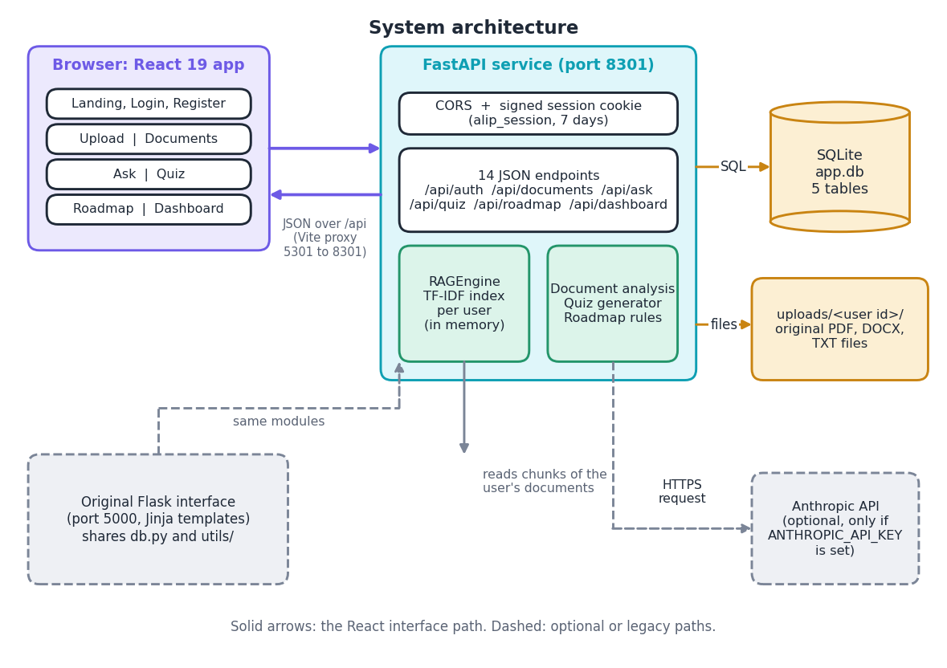
System architecture
Layers
Presentation: React 19 app (port 5301) and the original Flask pages (port 5000).
Application: FastAPI (port 8301), 14 endpoints, signed session cookie, CORS for the front end only.
Core: text extraction, a per-user TF-IDF index (RAGEngine) and the quiz generator, shared by both interfaces.
Storage: SQLite with 5 tables and the uploaded files; Claude is optional and used only if a key is set.
Notes:
The FastAPI layer imports the original Flask project's modules, so both interfaces use the same retrieval and quiz code.

Slide 5
Methodology: end-to-end workflow
Upload PDF / DOCX / TXT
Extract and clean text
Chunk 180 / 30 words
Subject, unit and topic hints
Store in SQLite
TF-IDF index per user
Retrieve top 4, answer with sources
One shared core
Grounded by construction
Measured, not assumed
The Flask pages and the React front end call the same functions, so the answers, quizzes and roadmap behave identically in both.
The extractive answer is made of sentences copied from the retrieved chunks, and every answer lists the file, passage and match score.
72 questions over 672 chunks compare seven retrievers; scripts regenerate every number.
Notes:
The workflow is also drawn as a diagram in the report. Nothing is trained: the retriever fits a TF-IDF vocabulary on the user's own chunks after every upload.

Slide 6
Evaluation data
36
100,444
672
72
Wikipedia articles in 6 subjects
words of notes
chunks of 180 words (30 overlap)
hand-written questions (+12 off-topic)
No real student documents were available, so each subject file is built from six English Wikipedia articles (CC BY-SA 4.0, pinned revisions) in the Subject / Unit layout the analyser reads.
72 questions, 24 each of fact, definition and reasoning (the question types of [1]). The gold evidence is a sentence copied from the text; a chunk is a hit if it contains it.
12 off-topic questions test whether the system refuses.
The bundled 619-word demo notes were used for the screenshots.
Notes:
Be upfront: this is a notes-style corpus built for measurement, not data from real students. The gold evidence strings are verified to occur exactly once in the corpus.

Slide 7
Document analysis and preprocessing
1
Extract and clean
2
Chunk
3
Subjects, units and topics
PDF pages with pypdf, DOCX paragraphs with python-docx, TXT as UTF-8. Spaces and blank lines are collapsed. Table text in DOCX and scanned PDFs without a text layer give nothing.
Word windows of 180 words with a 30-word overlap, so a sentence cut at a boundary survives in the next chunk. The 619-word demo file gives 4 chunks; the corpus gives 672.
Regular expressions read Subject, Course, Unit n and Chapter n lines (36 of 36 unit headings found in the corpus); TF-IDF keywords fill up to 12 topics. UNIT-I, Module 1 and numbered headings are missed (0 of 5).
Result of the analysis: a document row with subject and topics, and the chunk rows that form the knowledge repository.
Notes:
Heading detection is regex based. On a five-unit test syllabus, formats Unit 1:, Unit 1 - and Chapter 1: found 5 of 5; UNIT-I, Unit I:, Module 1: and 1. found 0 of 5.

Slide 8
Algorithms
Component | Algorithm and parameters
Retrieval | TF-IDF with unigrams and bigrams, English stop words, cosine similarity, top 4 chunks with score above 0 [7]
Extractive answer | split chunks into sentences, TF-IDF rank against the question, keep the top 4 with score above 0, join
Optional LLM answer | Claude receives the question and chunks, told to answer only from them; any error falls back to the extractive answer
Quiz | top 40 TF-IDF terms; blank the first whole-word occurrence in a shuffled sentence; 3 other terms as options; 5 questions
Roadmap | accuracy per topic: High below 50 percent, Medium below 80, otherwise Low; sorted by priority then accuracy
0
trained parameters in the shipped code
1-2 grams
TF-IDF vocabulary fitted per user
CPU only
197 ms to index 672 chunks
Notes:
SAC-RAG classifies the question with an LLM and uses BM25 plus dense retrieval and an LLM compressor [1]. We use none of these: retrieval is lexical and compression is sentence selection.

Slide 9
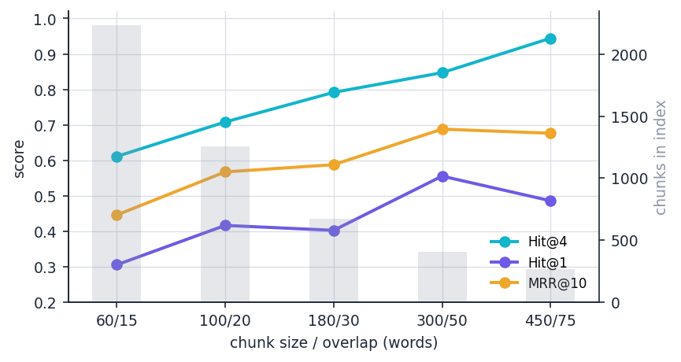
Experiment configuration (nothing is trained)
Setting | Value
Corpus | 6 subject files, 36 articles, 100,444 words, 672 chunks (180 / 30)
Questions | 72 hand-written: 24 fact, 24 definition, 24 reasoning; 12 off-topic
Metrics | Hit@k (evidence inside top-k chunks), MRR@10, answer-key recall, words removed
Retrievers | 7: shipped TF-IDF, unigram, BM25 [6], LSA [8], BM25 + LSA, dense BGE-small [9], BM25 + dense
Quiz study | 30 seeds x 6 files x 5 questions = 900; 30 reviewed by hand
Hardware | Intel Core i5-12500 (6 cores, 12 threads), 15.7 GB, no GPU; Python 3.11.9, scikit-learn 1.5.1 [16]
Chunk size trade-off for the shipped retriever: Hit@4 rises from 0.611 (60 words) to 0.792 (180, shipped) and 0.847 (300), but larger chunks carry more words per hit.
Notes:
The product has no training stage. Experiments fix seeds (quiz seeds 0 to 29) and the evidence strings, so every table can be regenerated with scripts/run_experiments.py.

Slide 10
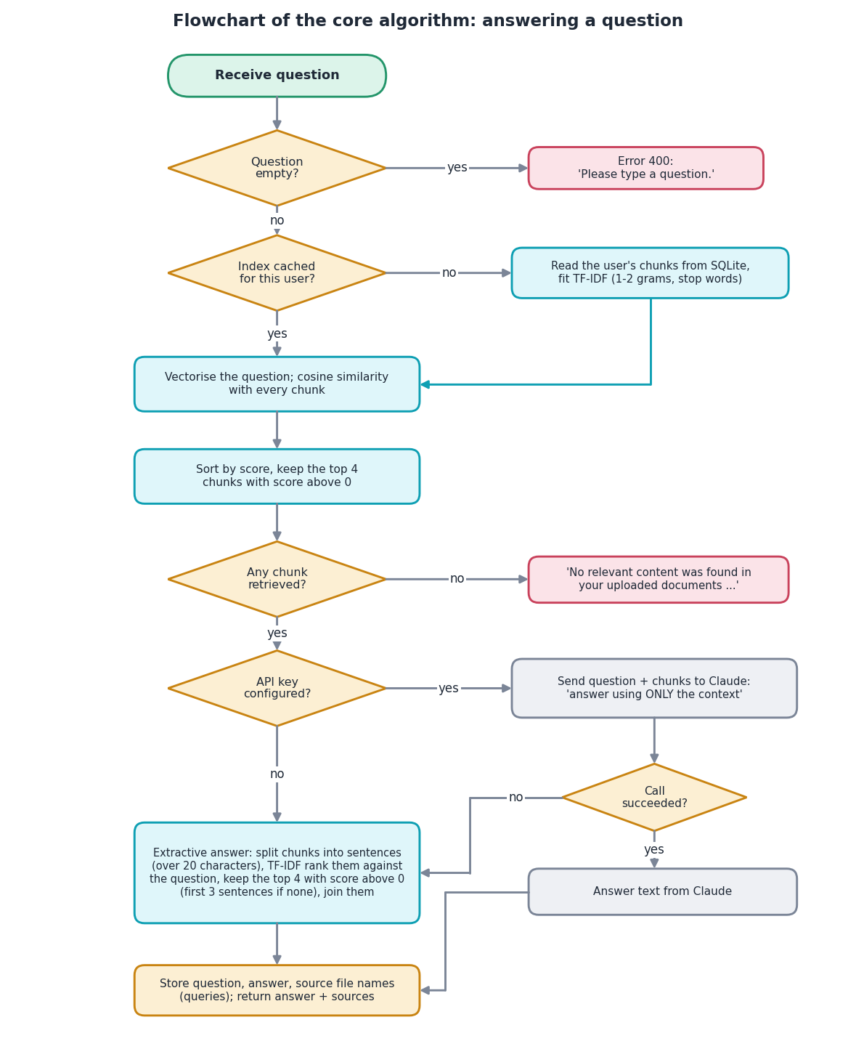
Decision logic
Refuse only if nothing overlaps. An empty question is rejected; a question with no shared term gets 'No relevant content found'.
No relevance threshold. 9 of 12 off-topic questions still received an answer; a threshold near 0.12 to 0.15 would refuse 75 to 83 percent of them.
LLM is optional. With a key the answer comes from Claude, with a context-only instruction; otherwise (or on any error) the extractive answer is used.
Roadmap priority. Below 50 percent High, below 80 percent Medium, else Low.
Notes:
This is the flowchart of RAGEngine.generate_answer. The abstention gap is a measured weakness reported in the results.

Slide 11
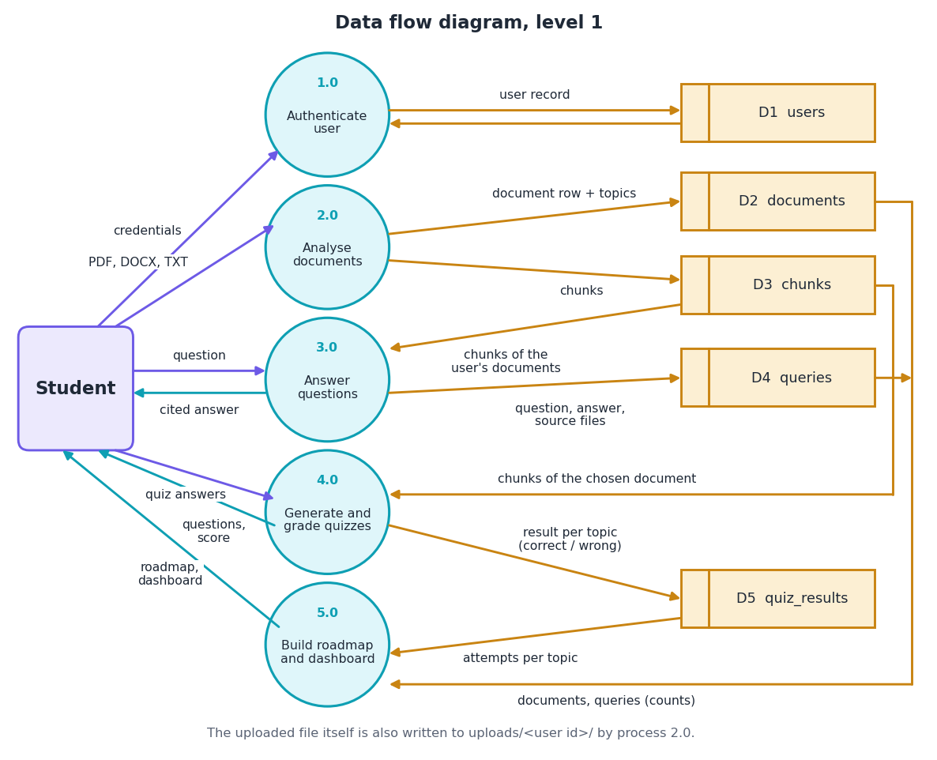
Data flow and modules
Module | Role
utils/text_extraction.py | extract, clean, chunk, topics
utils/rag_engine.py | TF-IDF index, retrieve, answer
utils/quiz_generator.py | cloze quiz questions
db.py | SQLite schema, 5 tables
backend/main.py | 14 FastAPI routes
app.py + templates/ | original Flask pages
frontend/src | React pages and charts
Notes:
Level-1 data flow. The Python modules are the original project code; the FastAPI layer and the React front end are the new layers.

Slide 12
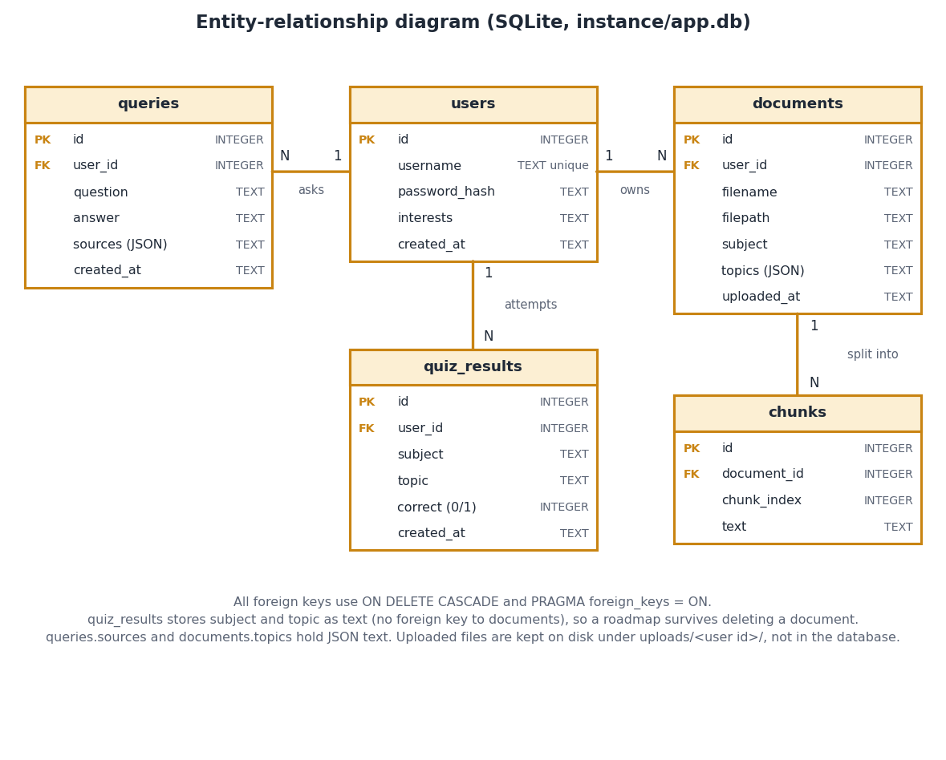
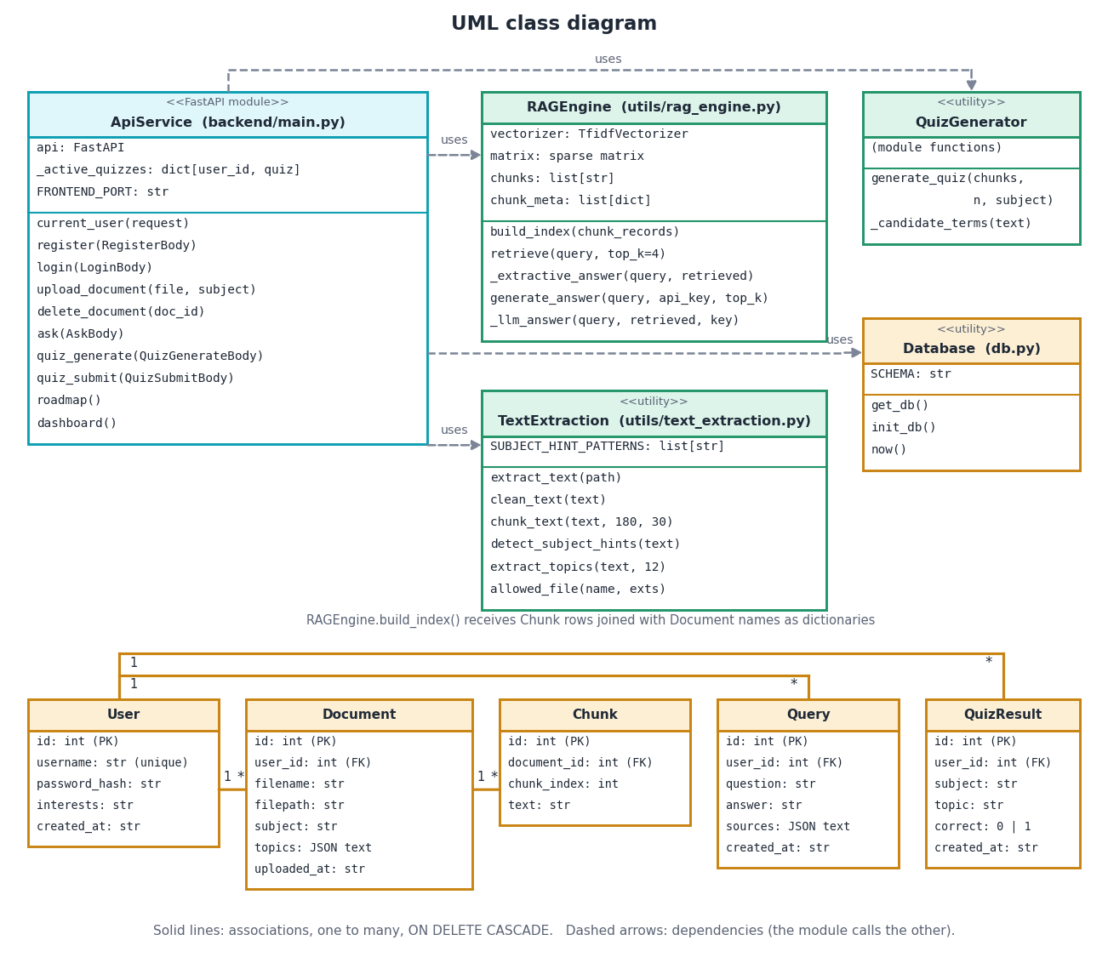
Database design and UML
SQLite with five tables (users, documents, chunks, queries, quiz_results), foreign keys with cascade delete; the uploaded files live on disk under uploads/<user>/.
Notes:
quiz_results keeps subject and topic as text, so the roadmap survives deleting a document.

Slide 13
Technology stack
Layer | Technology
Retrieval and analysis | scikit-learn 1.5.1 (TF-IDF, cosine), NumPy 1.26.4, pypdf 4.3.1, python-docx 1.1.2
API | FastAPI 0.115.0, Uvicorn 0.30.6, Pydantic, Starlette sessions (port 8301)
Original UI | Flask 3.0.3, Jinja templates, Bootstrap (port 5000)
Front end | React 19, TypeScript, Vite 8.3, Tailwind 4, TanStack Query, Recharts, framer-motion (port 5301)
Storage | SQLite (5 tables) and uploaded files on disk
Optional generation | Anthropic API (Claude), only when ANTHROPIC_API_KEY is set
Testing | pytest (84 tests), API smoke test, Playwright for screenshots
Notes:
Python 3.11.9 on Windows 11. run.bat creates the virtual environment, installs packages and starts both servers.

Slide 14
Implementation progress
Component | Status | Evidence
Upload, extraction, chunking, subject and topic hints | Done | 36 of 36 unit headings found
TF-IDF retrieval, extractive answer with sources | Done | Hit@4 0.792
Quiz, grading, roadmap, dashboard | Done | 900 of 900 questions generated
FastAPI (14 endpoints) and React interface | Done | 24 of 24 smoke checks
Claude answer mode | Coded | not measured, no API key
Dense embeddings, question-type routing, LLM compression | Not done | SAC-RAG features absent
Relevance threshold, revision schedule | Not done | 9 of 12 off-topic answered
Notes:
State of the code base. The honest gaps are the missing semantic retrieval and compression stages of the base paper, and the missing relevance threshold.

Slide 15
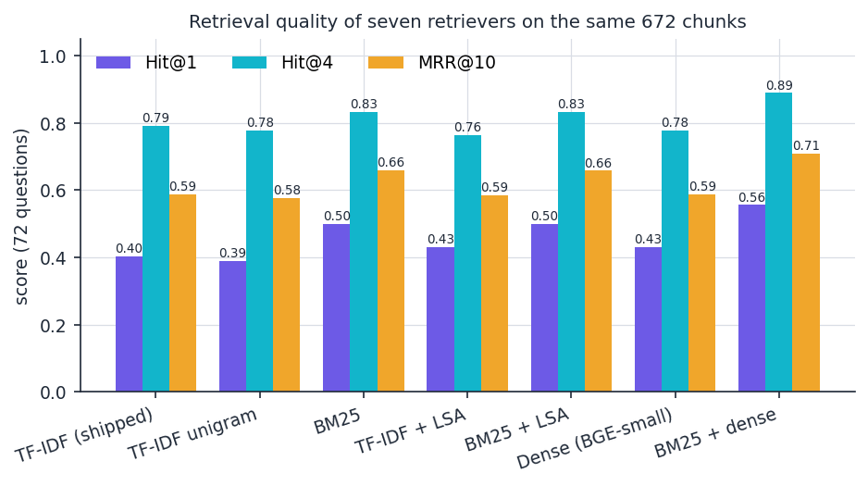
Preliminary results: retrieval and compression
0.792
0.833
0.889
87.5%
Hit@4, shipped TF-IDF
Hit@4, BM25
Hit@4, BM25 + dense (best)
words removed by sentence selection
i
Reading
72 questions, 672 chunks. The shipped retriever finds the evidence at rank 1 in 40% of questions. Sentence selection cuts 720 words to about 90 but answer-key recall falls from 0.861 to 0.667. SAC-RAG reports 38 to 58 percent fewer tokens for 1 to 2 points of EM on other data [1].
Notes:
Bootstrap 95 percent intervals are wide with 72 questions (Hit@4 0.69 to 0.88), so only the larger gaps matter: BM25 over TF-IDF at Hit@1 and the hybrid being best. The comparison with SAC-RAG is of the trade-off, not of the numbers: different data and no LLM.

Slide 16
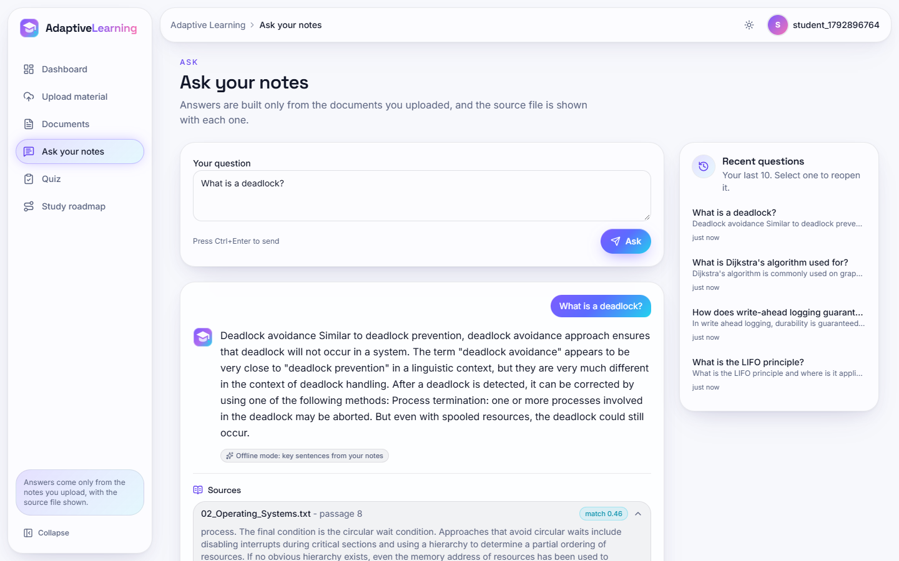
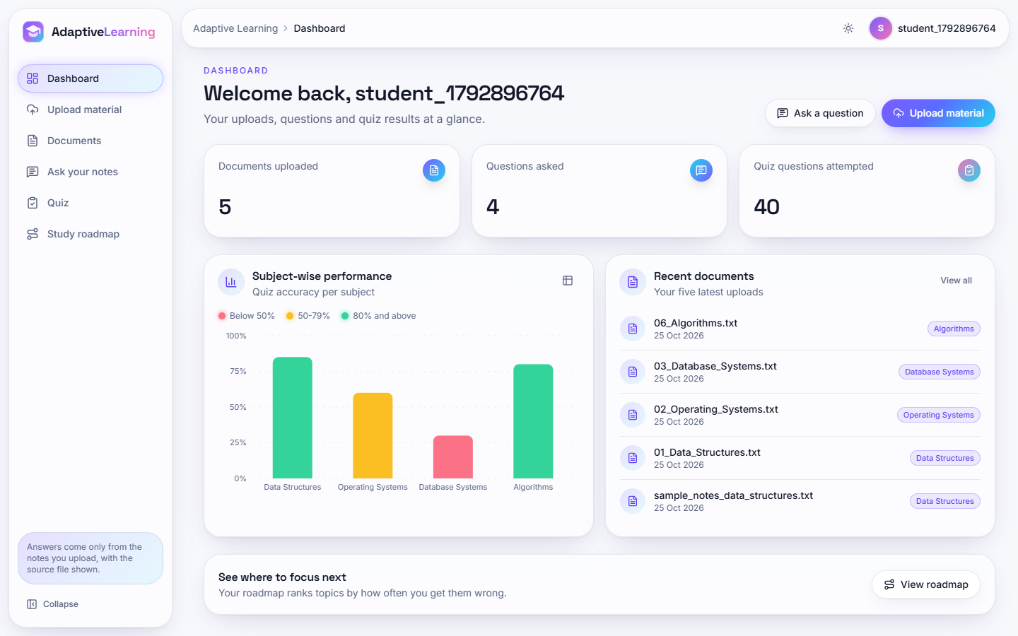
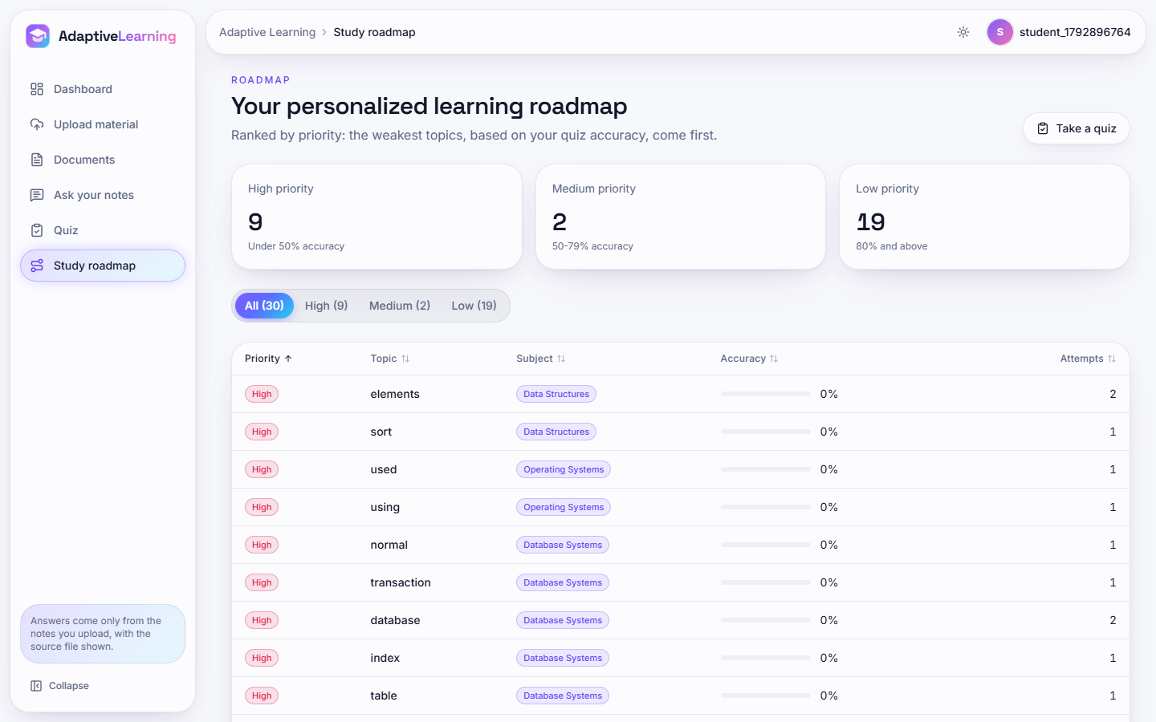
Output screens
Ask your notes: 'What is a deadlock?' answered from 02_Operating_Systems.txt, passage 8 (match 0.46), offline extractive mode. Right: dashboard with subject accuracy and the study roadmap. Real application, five uploaded documents.
Notes:
Real screenshots from the running application captured with Playwright. The quiz answers behind the dashboard were scripted to simulate a student with different mastery per subject.

Slide 17
Initial testing and observations
84 / 84
24 / 24
30 ms
23 ms
pytest tests passed
API smoke checks
median POST /api/ask (672 chunks)
median quiz generation
Observation | Action
9 of 12 off-topic questions still get an answer | Add a relevance threshold (0.12 to 0.15)
Definition questions: key in the chunks 0.917, in the answer 0.500 | Rank sentences for definitions, not word overlap
Quiz answer still visible in the question stem in 18.2% of questions | Blank every occurrence of the term
Two uploads with one file name share one file on disk | Store files under unique names
Notes:
84 tests: 45 API, 15 text extraction, 11 security, 9 retrieval, 4 quiz. Latency measured on 127.0.0.1 with one user; quiz submit showed 1 to 2 second outliers on 1 or 2 of 30 calls, cause not isolated.

Slide 18
Challenges and corrective actions
Challenge | Corrective action
No real student documents or ground truth to measure against | Built a 36-article corpus and 72 questions with verifiable evidence strings
Lexical retrieval misses paraphrases (Hit@1 0.403) | Measured BM25, LSA, dense and hybrid retrievers as reference points
Math markup in the Wikipedia text polluted topics and chunks | Stripped it and regenerated the corpus from pinned revisions
Roadmap topics are single keywords, some generic | Reported; unit headings as topics listed as future work
Timings fluctuate on a shared PC | Medians of repeated runs, two API runs reported
Notes:
Each challenge led to a concrete change in the measurement setup or in how results are reported.

Slide 19
Next steps
1
Retrieve better
2
Stay grounded
3
Better practice
4
Validate
Add BM25 and a dense model in a hybrid (Hit@4 0.889 in our test) and route questions by type as in [1][11].
Add a relevance threshold, measure the Claude answer mode and improve sentence choice for definitions.
Blank all term occurrences, use unit headings as roadmap topics, add knowledge tracing [17].
Test with real student syllabi in several heading styles and run a small user study.
Notes:
Plan to the final review and beyond; items 1 and 2 close the largest gaps to the base paper and to the stated objectives.

Slide 20
Thank you
Questions and suggestions are welcome.
Notes:
Likely questions: why Wikipedia text; why not embeddings in the product; how answers stay grounded; what is missing against SAC-RAG.

