Slide 1
AI Based Personal Finance Manager
REVIEW 2 · DESIGN, METHODOLOGY AND PROGRESS
Design, methodology and progress: categorise, forecast, score and advise from a user's own transactions
Presented by
Under the guidance of
Mekala Kalyan 23K91A05F0
Rajanala Sai Hemanth 23K91A05K3
Middala Surya Teja Reddy 23K91A05F2
Manga Akash 23K91A05E5
N Padmavathi, [DESIGNATION]
Department of Computer Science and Engineering
TKR College of Engineering & Technology · Batch C11 (CSE-C) · [ACADEMIC YEAR]
Notes:
This review shows how FINJARVIS is designed and built, what is implemented, the first measured results from our own experiments and tests, and the open items. Introduce the four team members and the guide.

Slide 2
Contents
01
02
03
04
Recap and architecture
Methodology and data
Import and preprocessing
Models and configuration
05
06
07
08
Decision logic and data flow
Database, UML, technology
Implementation progress
Preliminary results
09
10
11
12
Output screens
Testing
Challenges
Next steps
Notes:
Agenda for the design and progress review.

Slide 3
Recap: problem and proposed system
!
Problem
i
Proposed system
B
Base paper and scope
Manual expense recording is tedious and abandoned. Apps report past spending but do not forecast. Generic advice ignores the person's own income and commitments.
FINJARVIS: users record or import transactions; a TF-IDF and logistic-regression model labels them; a linear trend forecasts next month; six weighted components give a 0-100 health score; an assistant answers from the user's own data.
Kharat et al. [1] combine BERT, Q-learning, LSTM and Isolation Forest. We built simpler, inspectable modules. Not built: anomaly detection, reinforcement-learning budgets, LSTM/ARIMA, loan tracker, scheduler. Flask and MySQL became FastAPI and SQLite.
Notes:
Recap of Review 1. The base paper's four-model design is the reference; our build is deliberately simpler, and the gaps are stated openly at this point so that results are read correctly.

Slide 4
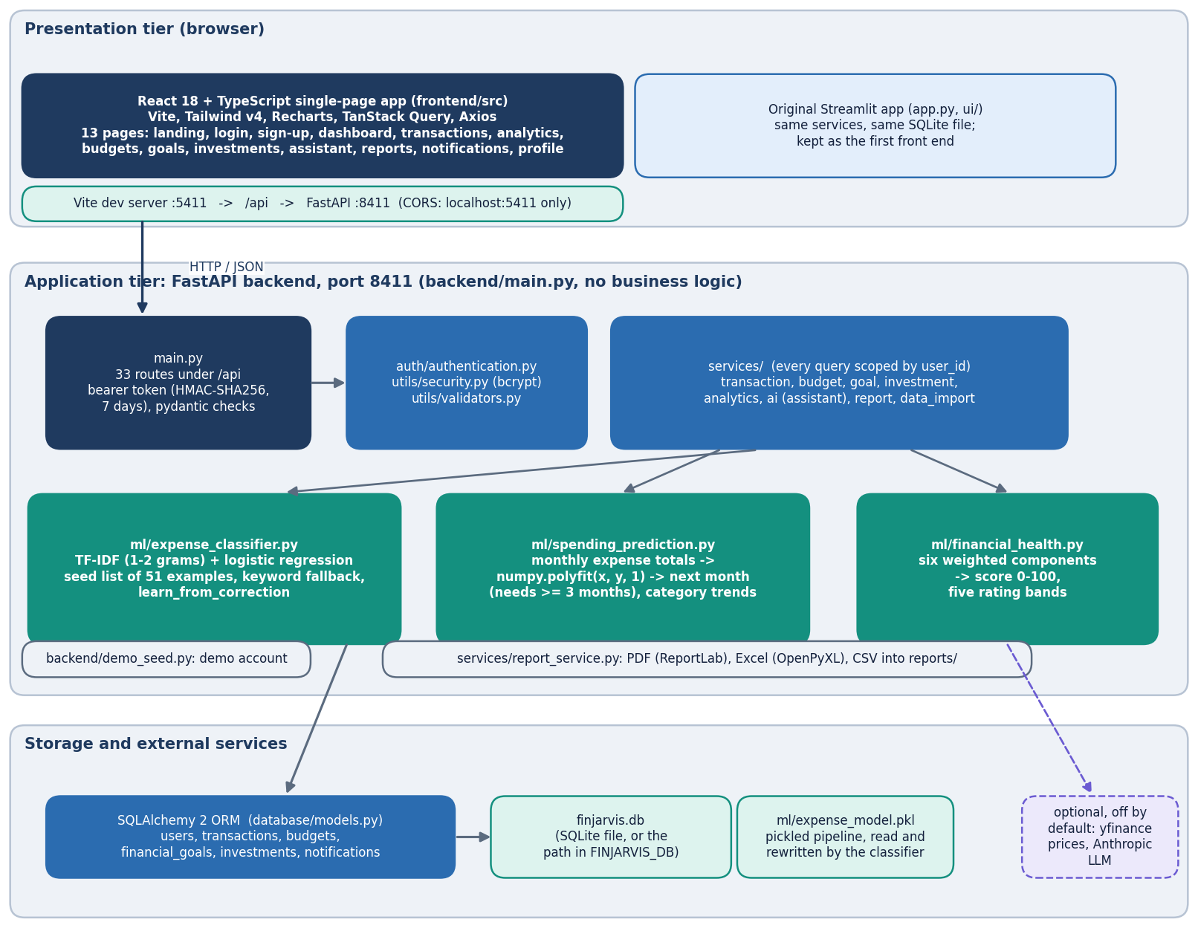
System architecture
Layered, one database file
Dashboard: React 18 + Vite on port 5411, Tailwind, Recharts, TanStack Query; 13 pages.
API: FastAPI on port 8411, 33 routes in backend/main.py with a bearer-token dependency.
Services: transactions, budgets, goals, investments, analytics, assistant, reports, import.
ML modules: expense classifier, spending prediction, financial health.
Storage: SQLAlchemy over SQLite (finjarvis.db, 6 tables). The original Streamlit UI still uses the same code.
Notes:
backend/main.py is 804 lines including the seed module; the routes call the same service functions the Streamlit pages call and keep no business rules of their own.

Slide 5
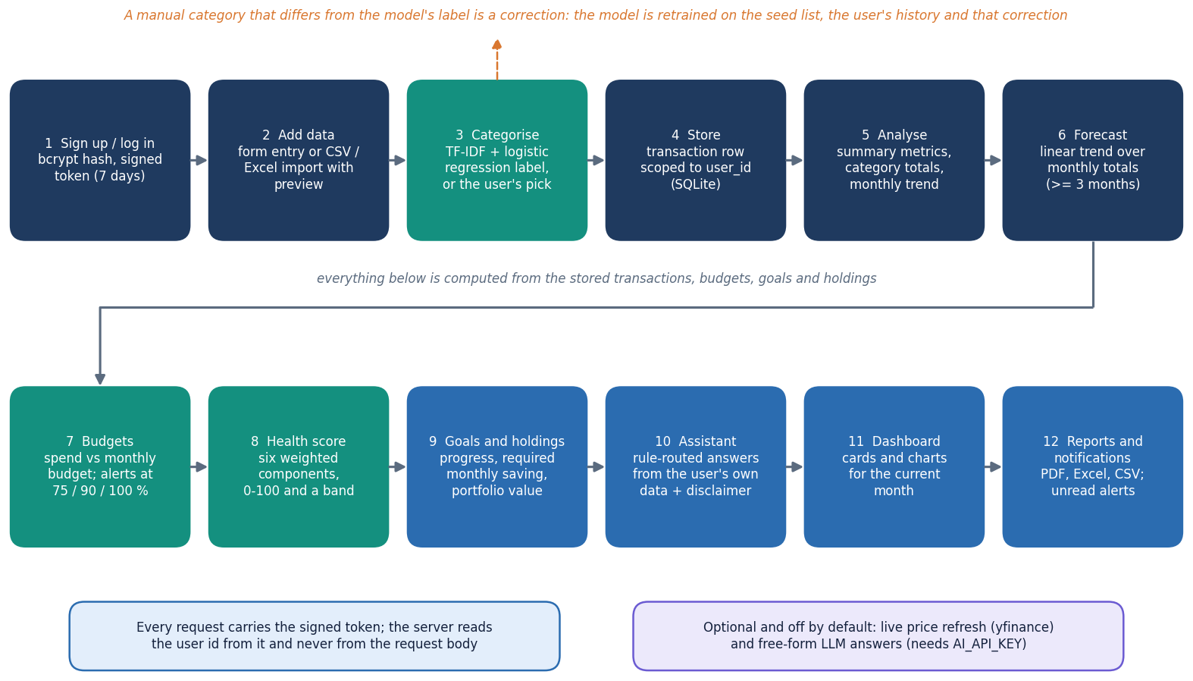
Methodology: record, categorise, analyse, advise
Record
Manual entry or CSV/Excel import with preview; bad rows are skipped with a message. Auto-detect labels a description with the classifier.
Analyse
Monthly totals feed a linear-trend forecast; income, expenses, budgets, goals and holdings feed the health score.
Advise
Budget alerts at 75, 90 and 100 % (checked when the dashboard or notifications are opened); rule-routed answers from the user's data; PDF, Excel and CSV reports.
High-level workflow as implemented in the API.
Notes:
Every step shown is implemented in services/ and ml/; the workflow diagram mirrors the routes.

Slide 6
Data: a 51-example seed list; no public corpus
51
198
34
68
training descriptions in 11 categories (3 to 6 each)
team-written probe descriptions, 3 tiers of 66, never used for training
rows in the bundled sample CSV (fictional, Jun-Aug 2026)
transactions in the demo account (6 months, synthetic)
 | Seed list (ml/expense_classifier.py) | Probe set (scripts/probe_data.py)
Origin | 51 short English, Indian-merchant style phrases written by the project | 198 descriptions written by the team before scoring
Tiers | Food 6, Transport 6, Entertainment 6, Bills 5, Shopping 5, Education 5, Healthcare 5, Travel 4, Rent 3, Investments 3, Salary 3 | A seed-like wording; B upper-case UPI/POS/NEFT narrations with a seed keyword; C unseen merchants and phrases
Use | the only data the shipped model is trained on (no train/test split exists in the app) | evaluation only; not an independent benchmark
Licence | own work; the demo data is fictional and contains no real personal data | own work
Notes:
There is no public training corpus: the categoriser learns from a 51-example list. Evaluation uses a probe set the team wrote, so the numbers describe this system and are not an independent benchmark.

Slide 7
Import and data preparation
Read CSV / Excel
Check 5 columns
Parse date and amount
Skip bad rows
Blank category: classifier
Commit rows
84 / 84
35.2 rows/s
injected bad rows skipped (bad dates, negative or non-numeric amounts, blank descriptions) in a 1,000-row test file
commit speed: 916 rows in 26.0 s, one database session per row
Required columns: date, description, amount, category, type; each skipped row gets a 'Row n' warning, so the user sees what was dropped.
Unknown type becomes an expense; a blank category is labelled by the classifier (all 916 imported rows were auto-labelled in the test).
Sign-up rules: username 3-30 characters, password 8+ with upper, lower, digit and special character; passwords are stored as bcrypt hashes.
Text is lower-cased and split into word 1-2-grams by TF-IDF; there is no other cleaning, stop-word removal or SMOTE.
Known gap: import is slow because every row is committed in its own database session.
Notes:
The preprocessing is validation and light text normalisation; the base paper's SMOTE balancing and 50 categories are not used here.

Slide 8
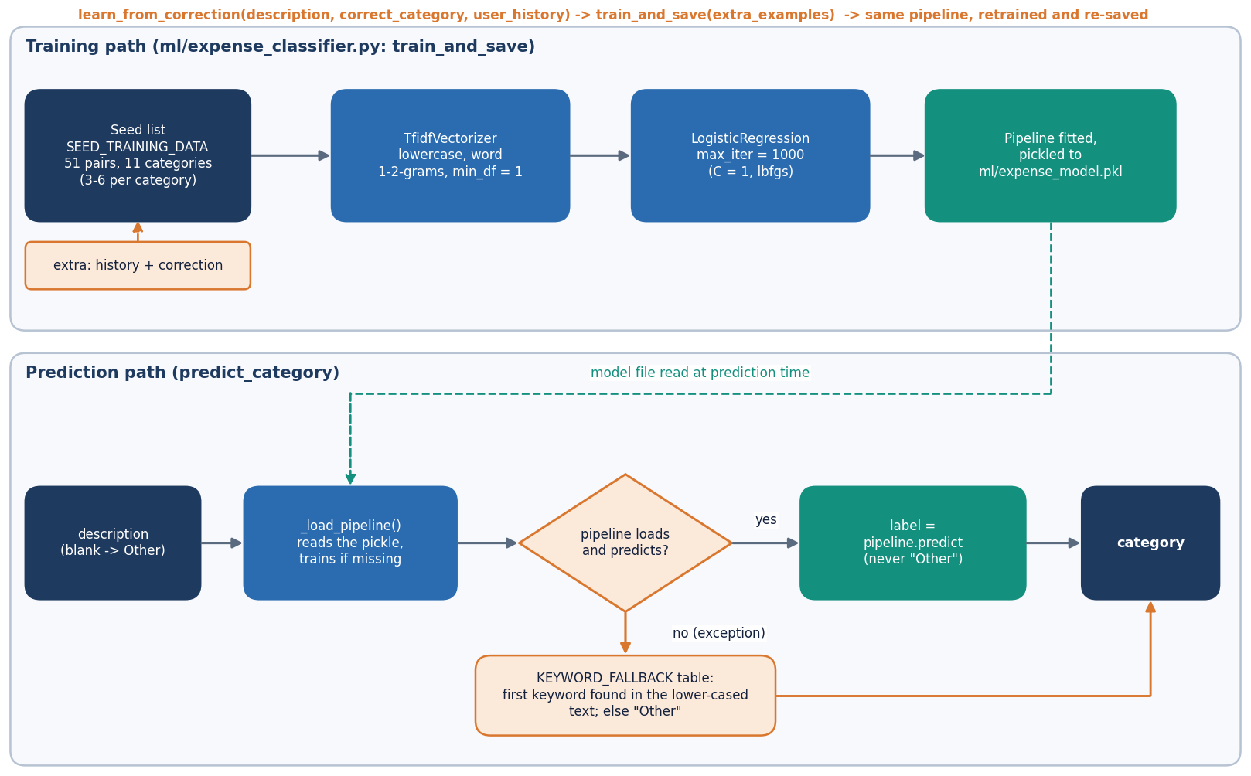
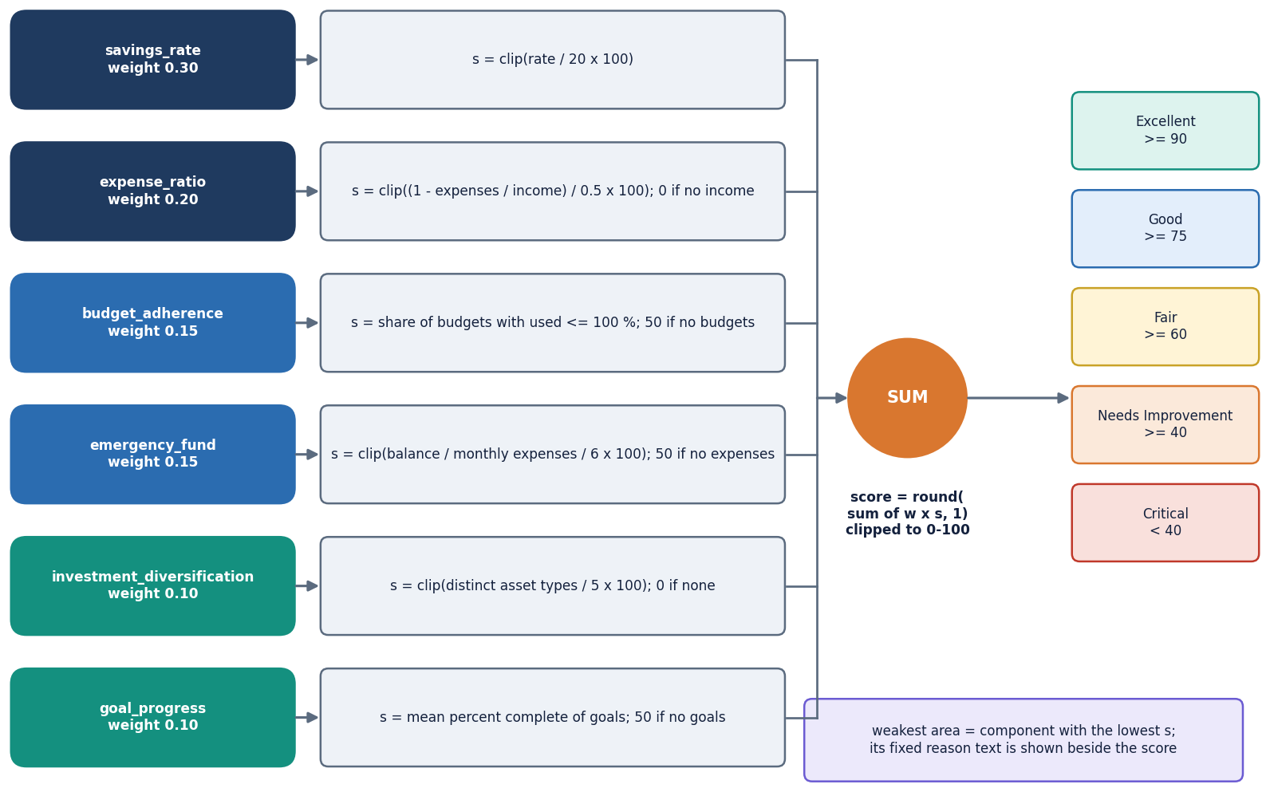
Models: categoriser, forecast and health score
Categoriser: TfidfVectorizer (word 1-2-grams) then LogisticRegression; a keyword table is used only if the model cannot load; the model never outputs 'Other'. A correction retrains it on the seed plus the user's history.
Forecast: least-squares line over monthly expense totals, clipped at 0; needs 3 months; trend label 'increasing' if the slope is above 1, 'decreasing' below -1.
Health score: sum of six weighted components (0.30, 0.20, 0.15, 0.15, 0.10, 0.10) clipped to 0-100, mapped to five rating bands with the weakest area named.
Notes:
All three are small, explainable models; each decision can be traced to a word weight, a slope or a component score.

Slide 9
Model and experiment configuration
Setting | Value
Categoriser | TfidfVectorizer(ngram_range=(1,2), min_df=1) + LogisticRegression(max_iter=1000, C=1); 51 seed examples; retrain 5.2 ms; predict 0.84 ms
Forecast | numpy.polyfit degree 1 over monthly expense totals; MIN_MONTHS_REQUIRED = 3; recent average = mean of the last 3 months
Health score | weights: savings rate 0.30, expense ratio 0.20, budget adherence 0.15, emergency fund 0.15, diversification 0.10, goal progress 0.10; bands 90 / 75 / 60 / 40
Budget alerts | 75 %, 90 % and 100 % of a monthly category budget; checked when GET /api/dashboard or /api/notifications is read (no timer); one notification per identical message
Evaluation | 198-description probe set; leave-one-out on the seed; rolling-origin backtest on 6 months; 2,000-user synthetic simulation per setting
Tests | pytest (38 tests) and a 49-check smoke test on a throw-away database
Machine | Intel Core i5-12500 (6 cores), 15.7 GB RAM, Windows 11, Python 3.11.9, scikit-learn 1.9.1, no GPU
Notes:
There is no training run in the deep-learning sense: the classifier fits in milliseconds. The configuration is what the code uses.

Slide 10
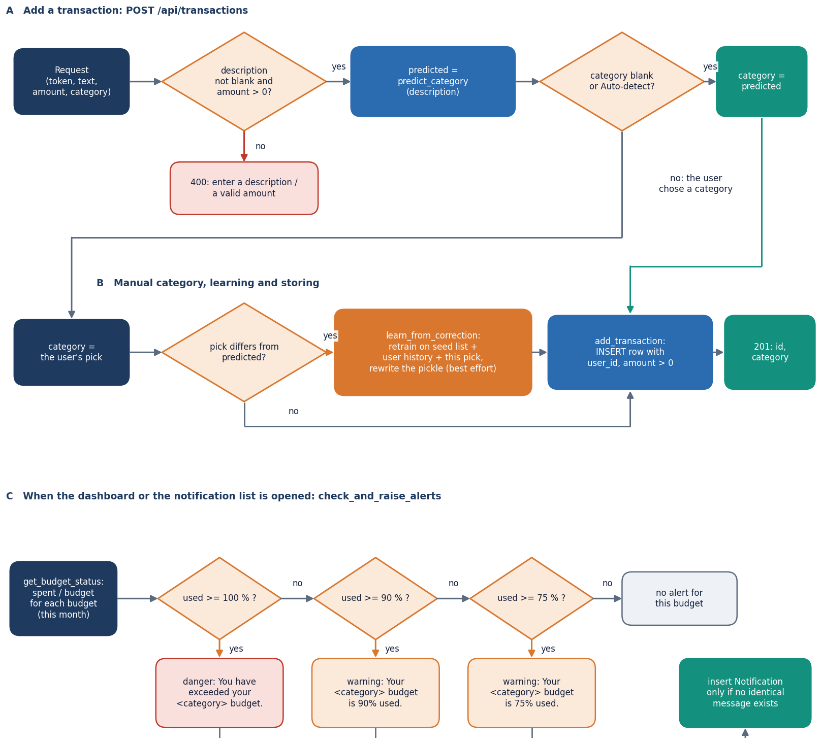
Decision logic: categorise a transaction, check alerts
Categorise: Auto-detect uses the model's label; a manual category that differs from the prediction triggers a retrain.
Budget check: when the dashboard or notification list is opened, spend / budget >= 75, 90 or 100 % writes a notification (not on save, not on a timer).
Assistant routing: can-I-save, reduce-expenses, health, where-spending, category-spend, optional LLM, fixed help text.
Limit: unseen text gives a zero vector, so the label comes from the intercepts (mostly Transport); no confidence threshold is applied.
Notes:
The limit on this slide is a measured finding: 48 of the 56 probe errors were predicted as Transport.

Slide 11
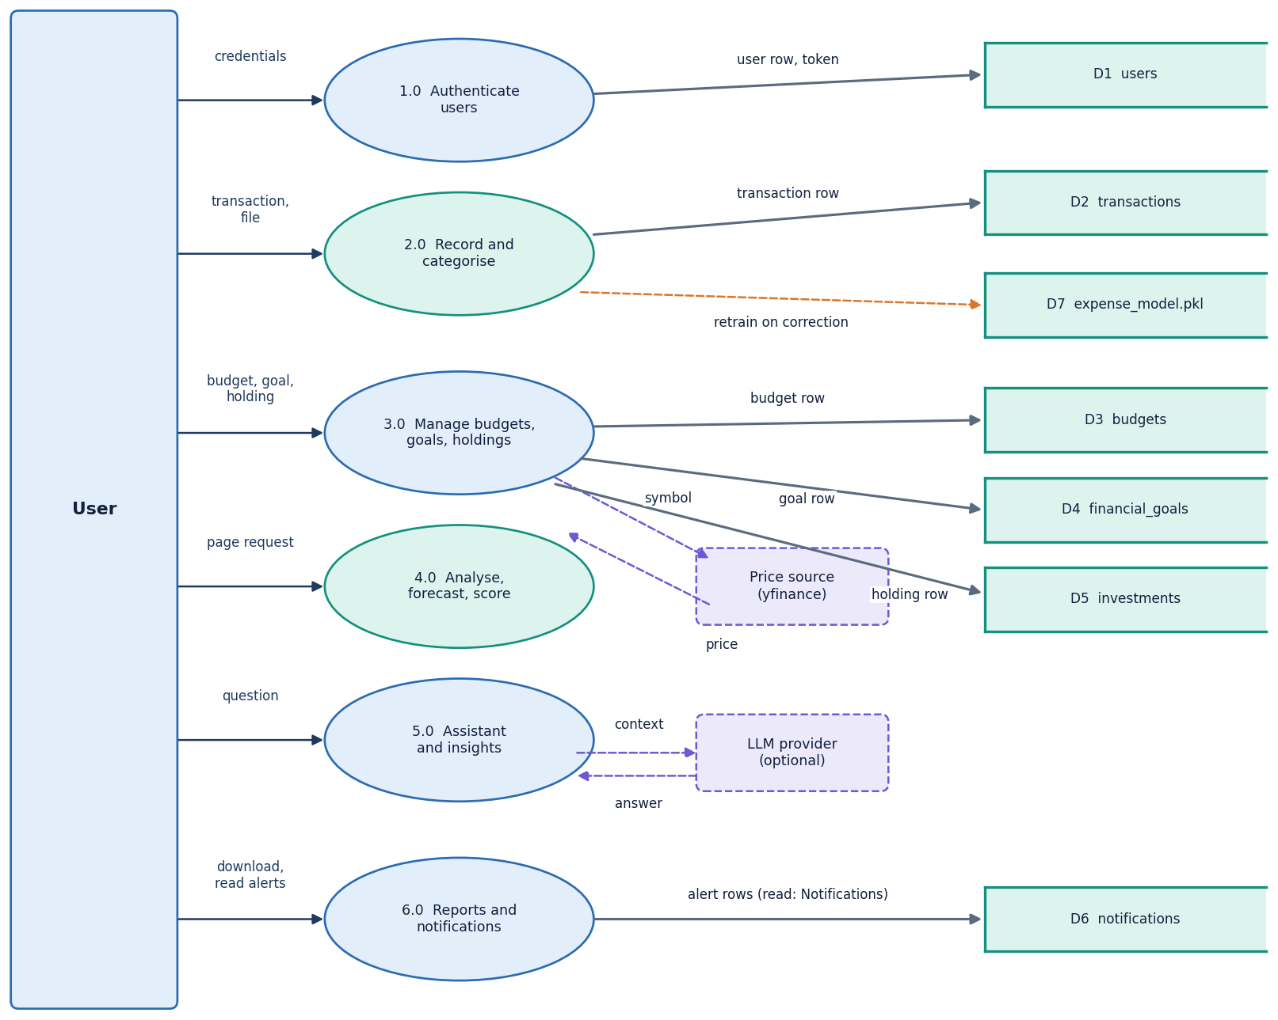
Data flow and modules
Module group | Lines | Role
backend/ | 804 | 33 routes, demo seed
services/ | 925 | business logic, import, reports
ml/ | 313 | classifier, forecast, health
database/ | 152 | 6 SQLAlchemy tables
auth, utils/ | 158 | bcrypt, tokens, validators
tests/ | 359 | 38 pytest tests
scripts/ (measurement) | 760 | experiments, probes, smoke test
DFD level 1: the main processes and the data stores.
Notes:
Line counts are taken from the files. The API layer is thin: it validates, calls a service and shapes the JSON.

Slide 12
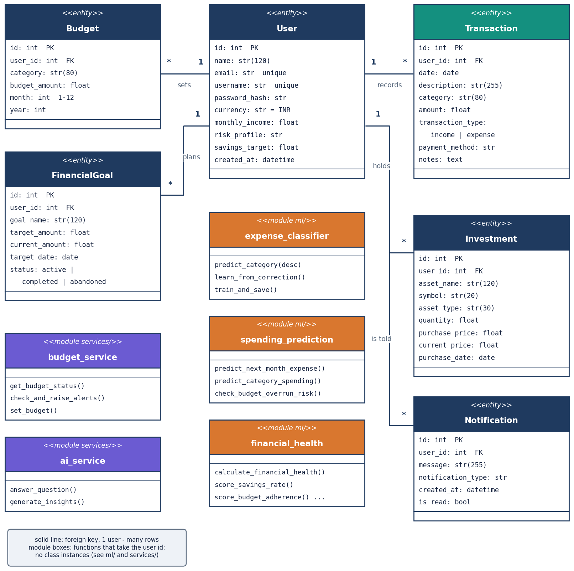
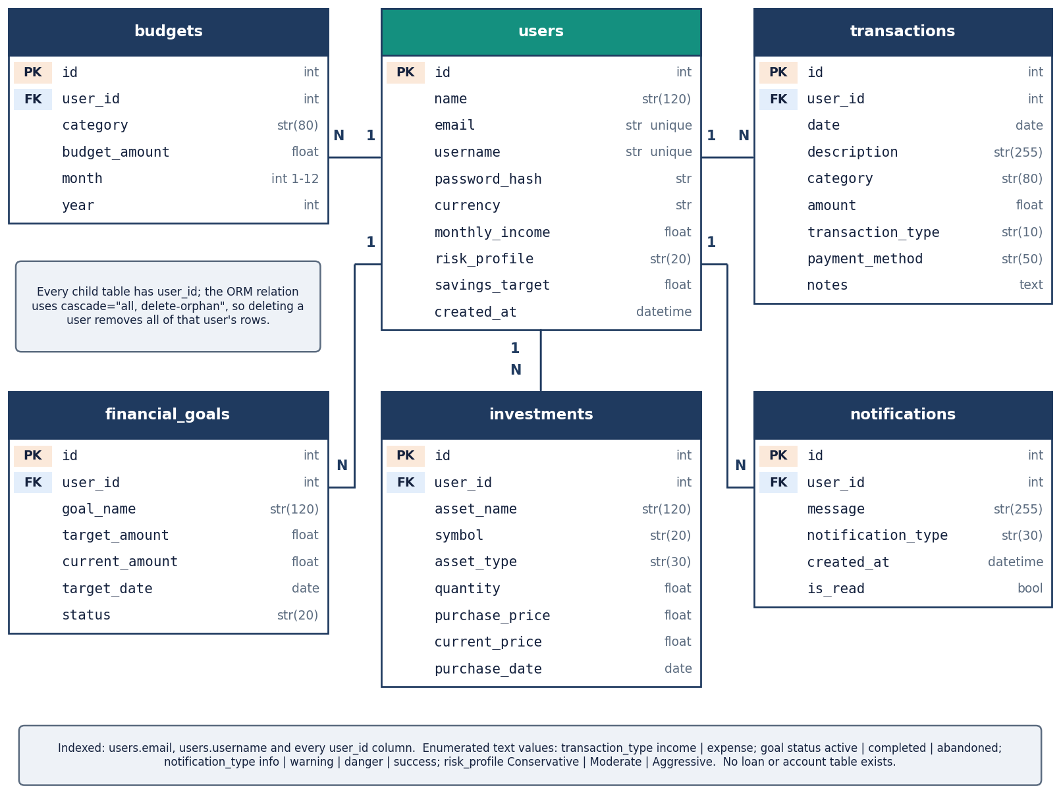
Database design and UML
UML class diagram: entities, services and ML modules.
ER diagram of the SQLite database (finjarvis.db).
users 1-N transactions, budgets, financial_goals, investments and notifications; every child row carries user_id and is deleted with the user.
Notes:
All queries filter by user_id, which is what keeps one user's data away from another; the smoke test checks this with a second account.

Slide 13
Technology stack
1
2
3
4
Python 3.11.9
FastAPI 0.159
SQLAlchemy 2.1
passlib + bcrypt 4.0.1
backend language; scikit-learn 1.9.1, pandas 3.0, numpy 2.4
33 routes; uvicorn 0.54; pydantic 2.14
6 tables on SQLite; one file, no server
bcrypt pinned (bcrypt 5 breaks passlib); HMAC-signed tokens
5
6
7
8
ReportLab, OpenPyXL
React 18 + Vite 8
pytest, Playwright
Optional extras
PDF and Excel reports; CSV from pandas
TypeScript, Tailwind v4, Recharts, TanStack Query
38 tests; screenshots from the real UI
Anthropic LLM answers and yfinance live prices; not used in any measurement
Everything runs on one machine on CPU; no external service is needed for any measured feature.
Notes:
Versions are those installed in the project's virtual environment on the measuring machine.

Slide 14
Implementation progress
Component | Status | Evidence
Accounts, import, manual entry | Done | bcrypt, signed tokens, user scoping; import skips 84 of 84 bad rows
Expense categoriser | Done, simple | TF-IDF + LR: 71.7 % on probe set, 18.2 % on unseen merchants
Forecast and health score | Done, simple | linear trend (3-month minimum); 6-component score; sensitivity tested on 5,000 profiles
Budgets, goals, investments, alerts | Done | alerts at 75/90/100 %; 6 asset types; optional live prices
Assistant and reports | Done, rule layer | 14 of 20 answerable questions handled; PDF, Excel, CSV downloads
React dashboard | Done | 13 pages; 19 captured screens on the demo account
Anomaly detection, RL budgeting, LSTM | Not built | objective 4 and base-paper modules; not attempted
Loan tracker, scheduled digests | Not built | named in the abstract; no table, route or job exists
Notes:
Honest status: the core flow is complete in simple form; one objective (anomaly detection) and two abstract features (loan tracker, scheduler) are not built.

Slide 15
Preliminary results: categoriser and forecast
Forecast method (3 test points) | MAE (INR) | MAPE %
Linear trend (app) | 9,597 | 28.4
Mean of all history | 8,385 | 21.4
Mean of last 3 | 9,301 | 24.8
Last value | 9,565 | 27.8
Demo account, one-step-ahead backtest of months 4-6; app forecast for November: INR 39,471.
Accuracy (%) per probe tier; overall 71.7 % (142 of 198), macro-F1 = 0.761.
The model is perfect on seed-like text and near-perfect on statement strings, but only 18.2 % on unseen merchants; 48 of 56 errors are predicted as Transport.
Leave-one-out on the 51 seed pairs is 11.8 %: the seed list is tiny and non-redundant. One correction fixes a repeat merchant (18.2 % to 100 %) but barely helps new ones.
The linear trend is not better than a plain mean on this short history (MAPE 28.4 % vs 21.4 %); a synthetic simulation shows it needs about 7 or more months.
Probe set and demo data are ours, not independent; the base paper's 92.3 % BERT accuracy is on different data and is not comparable.
Notes:
Numbers are from experiments/metrics.json. The headline 71.7 % hides the split between known wording and unseen merchants, which is why the tiers are shown.

Slide 16
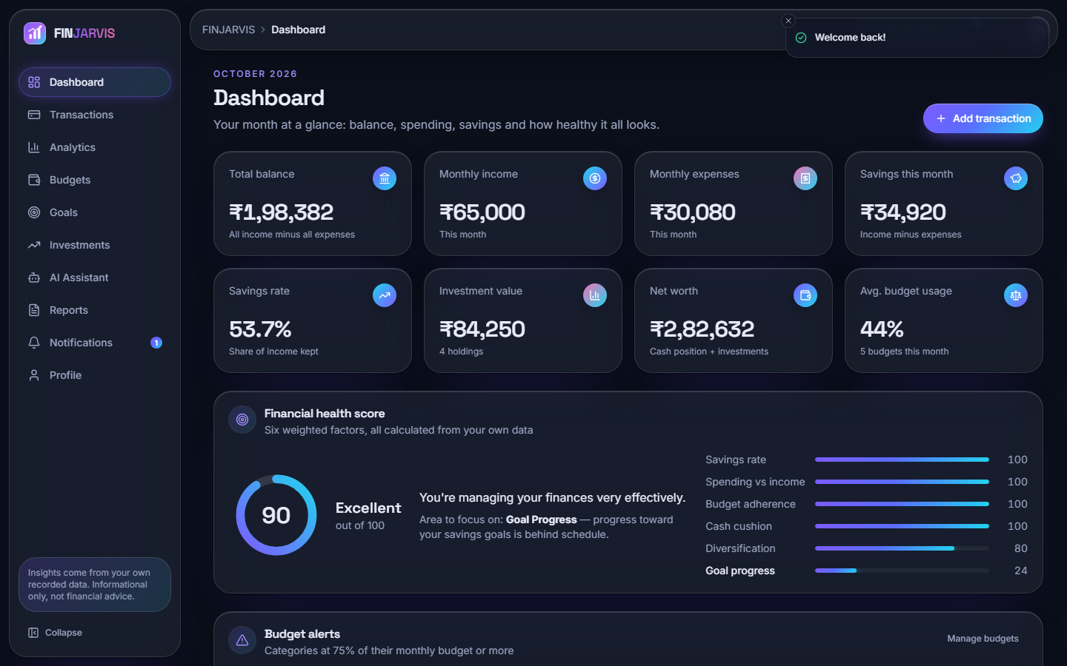
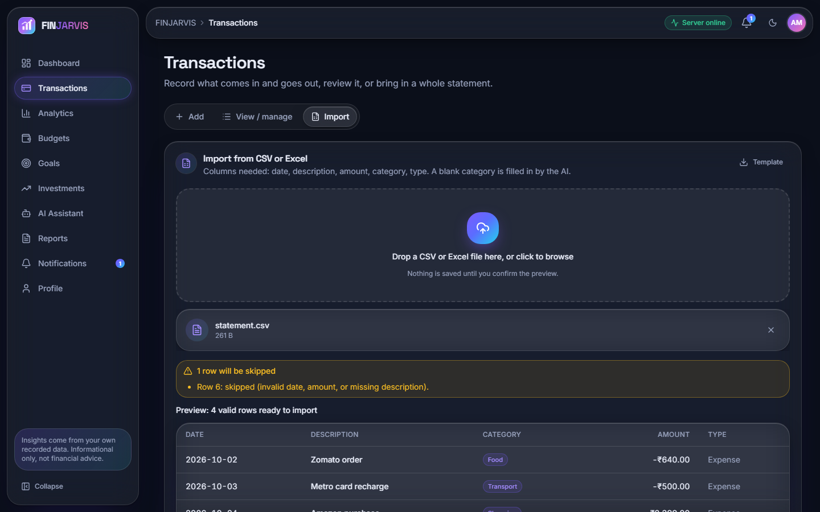
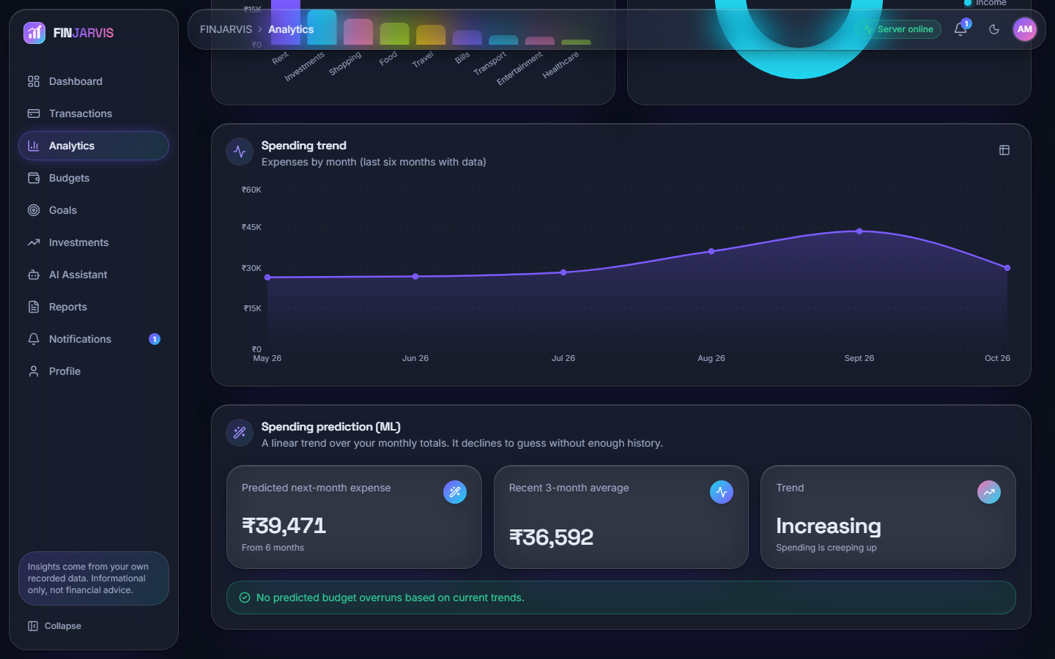
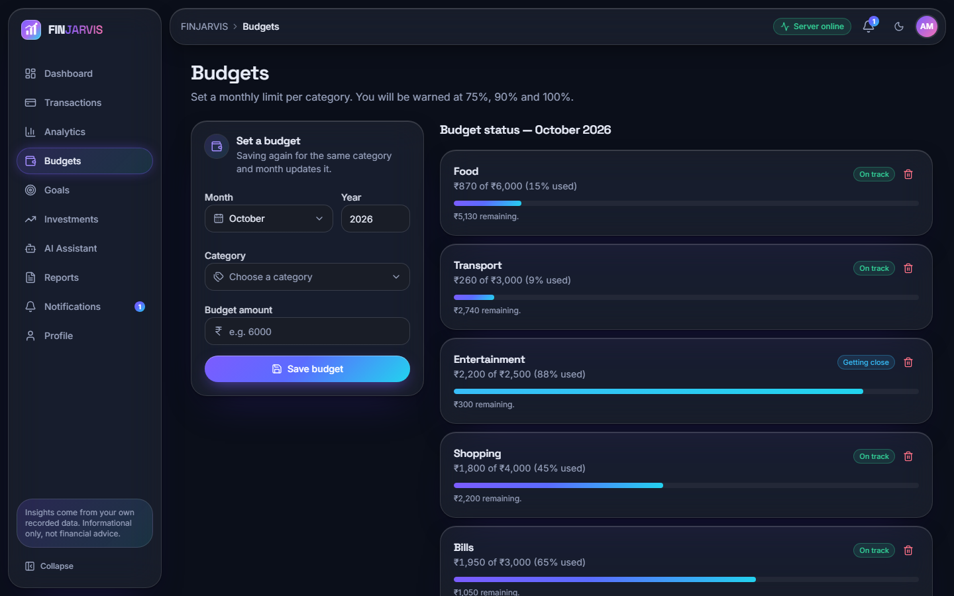
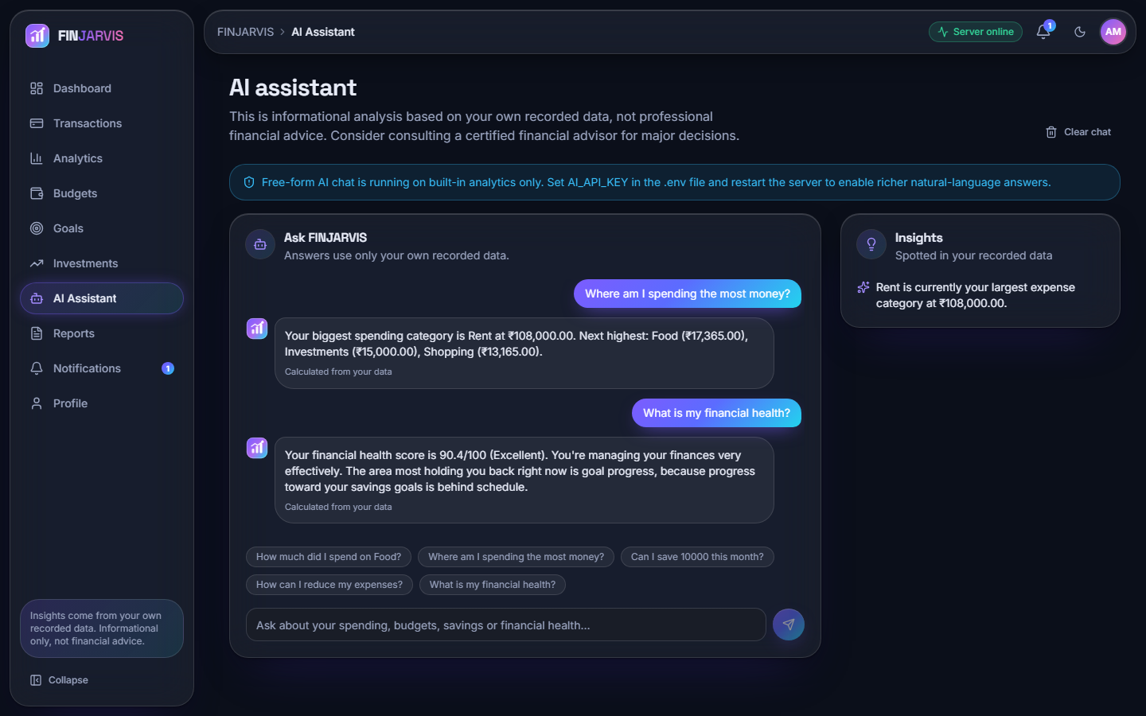
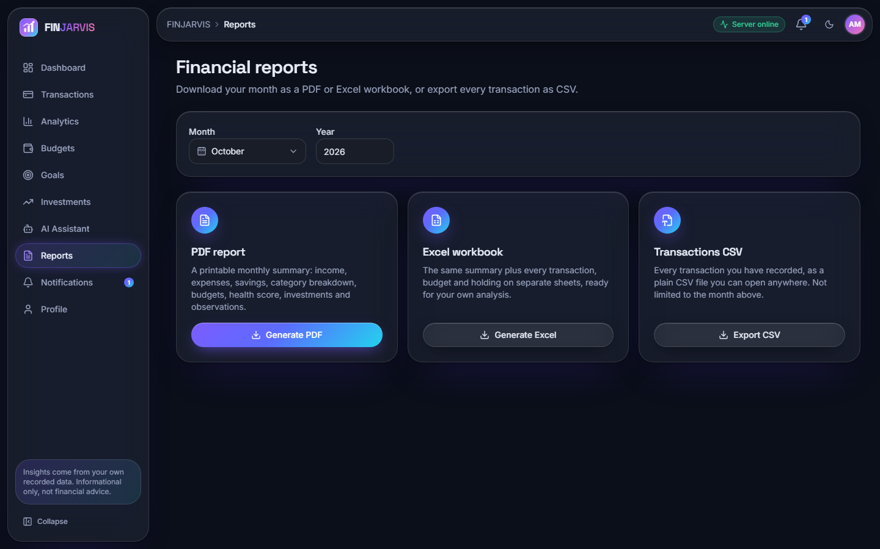
Output screens
Dashboard: balance, savings, health score 90
CSV/Excel import with preview and auto-categories
Spending prediction: next month INR 39,471
Budgets with usage and alerts
AI assistant answering from the user's data
Reports: PDF, Excel and CSV downloads
Notes:
All screens are captures of the running application on the fictional demo account (68 transactions); nothing is mocked.

Slide 17
Initial testing and observations
38 / 38
49 / 49
6 / 6
14 / 20
pytest tests pass (auth 9, budget 6, health 6, ML 9, transactions 8)
end-to-end smoke checks on a throw-away database
off-topic assistant questions correctly declined
answerable questions handled from the data
Check | Result
Weak password / wrong password | rejected
Tampered token | rejected (401)
Protected route without token | 401
Second user sees first user's data | no (scoped by user_id)
Duplicate e-mail on profile | rejected
Bad analytics date range | rejected
Food total vs direct SUM | INR 17,365, identical
What the tests cover: sign-up and login rules, budgets and alerts, the health score, classifier and forecast, add / edit / delete / filter of transactions, import, reports, profile.
Found by measurement: unseen merchants mislabelled, six assistant questions missed (e.g. 'biggest expense'), one quirk: 'overspending on shopping?' returns a total, not a budget comparison.
Not done: browser-level automated UI tests, concurrency, security scan, LLM layer, live price refresh.
Notes:
Tests and checks are real runs on 2026-10-22. The assistant questions were written by the team; the numbers describe the rule layer only.

Slide 18
Challenges and corrective actions
Challenge | What we found | Action
No labelled data | Only 51 seed phrases; no public corpus used | Wrote a 198-item probe set and reported tiers, not one headline number
Unseen merchants | Tier C accuracy 18.2 %; errors collapse to Transport | Measured; confidence abstention shown offline (not in app); corrections retrain
Short history | Trend no better than a mean below ~7 months | Reported; minimum of 3 months is too low for this method
Assistant coverage | 6 of 20 answerable questions fall to help text | Listed the misses; LLM layer is optional and untested
Shared model file | One ml/expense_model.pkl serves all users: a correction by one user retrains it for everyone | Documented as a design weakness; per-user models are future work
Slow import | 35.2 rows/s, one session per row | Documented; batch the commit
Library versions | bcrypt 5 breaks passlib; pickle made with sklearn 1.5.0 | Pinned bcrypt 4.0.1; retrain the model to remove the warning
Abstract vs build | Flask + MySQL, loans, scheduler, anomaly detection in the abstract | FastAPI + SQLite; the gaps are reported, not hidden
Notes:
Each challenge is a measured finding; the evidence is in docs/REPORT_FACTS.md.

Slide 19
Next steps
1
Improve
2
Complete
3
Deliver
Add a confidence threshold so unsure labels ask the user, grow the seed list from real corrections, and raise the forecast minimum or blend with a recent mean.
Decide with the guide whether to add a simple anomaly rule (z-score on category amounts) and a loan tracker; widen assistant intents; set a real secret key.
Finish the final report, IEEE paper and presentation from the measured results, and keep every number tied to the metrics files.
Notes:
The open items are those identified by our own measurements, in priority order.

Slide 20
Thank you
Questions and suggestions are welcome.
Notes:
Close the review and invite questions.

