Slide 1

AI Based Personal Finance Manager
Final Review · FINJARVIS
Team Details : Batch C11
Under the Esteemed Guidance of
N Padmavathi
[DESIGNATION], Department of CSE
23K91A05F0 MEKALA KALYAN
23K91A05K3 RAJANALA SAI HEMANTH
23K91A05F2 MIDDALA SURYA TEJA REDDY
23K91A05E5 MANGA AKASH
DEPARTMENT OF COMPUTER SCIENCE AND ENGINEERING · TKR College of Engineering & Technology · Academic Year [ACADEMIC YEAR]
Notes:
Introduce the team and FINJARVIS: a personal finance manager that categorises spending, forecasts the next month, scores financial health and answers questions from the user's own data.

Slide 2
Table of Contents
Abstract
Base Paper & Literature Survey
Research Gap, Problem Statement & Objectives
Proposed System & Architecture
Methodology, Data & Core Algorithms
Interaction & Data Design
Implementation, Performance & Testing
Results: Categoriser, Threshold Analysis, Forecast, Health Score, Assistant
Comparison with the Base Paper
Output Screens
Conclusion, Future Scope & References
Dept. of CSE | Batch C11 | Final Review
2
Notes:
The agenda follows the report: problem, design, method, results, comparison, screens, conclusion.

Slide 3
Abstract
Managing money across many digital transactions is tedious, and most tools only report the past. FINJARVIS is a web platform where a user records or imports transactions, sees a dashboard, sets budgets and goals, tracks investments, asks questions and downloads reports. FastAPI + SQLite backend, React console, 33 API routes, 6 tables.
Three data-driven parts: a TF-IDF + logistic-regression expense categoriser (51 seed examples, 11 categories), a least-squares linear-trend forecast of next month's spending, and a 0-100 financial health score from six weighted, explainable components. A rule-routed assistant answers from the user's own records.
Verified by 38 pytest tests and 49 smoke checks; API calls take 67 ms (dashboard) to 136 ms (PDF report) median on 127.0.0.1.
Measured honestly: the categoriser scores 71.7 % on a 198-description probe set but only 18.2 % on unseen merchants; the linear trend is no better than a plain average with fewer than ~7 months of history.
Not built: anomaly detection, reinforcement-learning budgeting, LSTM or BERT models, loan tracking, scheduled digests. The abstract's Flask + MySQL became FastAPI + SQLite. The optional LLM layer was not tested.
Dept. of CSE | Batch C11 | Final Review
3
Notes:
Product first, then the three data-driven modules, the evidence and the honest limits, including what was not built.

Slide 4
Base Paper
R. Kharat, S. Solapurkar, A. Tikkas, M. Uttarwar and A. Yadav, "A smart AI-based personal finance assistant: A multi-model approach for expense categorization, budgeting, forecasting and anomaly detection," International Journal for Research in Applied Science and Engineering Technology (IJRASET), vol. 13, no. XI, pp. 167-180, Nov. 2025, doi: 10.22214/ijraset.2025.75019.
Aspect | Kharat et al.: multi-model AI personal finance assistant (IJRASET, Nov. 2025)
Problem | Manual categorisation and static budgeting make personal financial planning inefficient and impersonal
Method | Four modules: fine-tuned BERT categoriser (16 -> 50 classes, SMOTE), Q-learning budget recommender, LSTM savings forecaster, Isolation Forest anomaly detector; Streamlit UI
Evaluation | BERT accuracy 92.3 %, precision 90.8 %, recall 91.5 %, F1 91.1 %; LSTM RMSE 137.2, MAE 89.5, R2 0.63; Isolation Forest precision 93 %, recall 94 %, F1 94 %
Data | Synthetic and real-world transactions labelled by the authors; synthetic savings series; synthetic outliers; 80/20 splits; none released
Not covered | A runnable open web product, authentication, import, reports, and a measurement of how the simple baselines behave
Also read | To (2026) goal-directed design and gamification [2]; Theerthala (2025) behaviourally grounded finance LLM data [3]
Dept. of CSE | Batch C11 | Final Review
4
Notes:
Registered base paper from the batch documents. Its numbers are quoted as reported; the data are the authors' own and not released.

Slide 5
Literature Survey
Work | Approach | Reported result / limitation
Kharat et al. [1] (base) | BERT + Q-learning + LSTM + Isolation Forest, Streamlit | 92.3 % categoriser accuracy; LSTM R2 0.63; IF F1 94 %; synthetic or private data
Dilip and Janaki [4] | XGBoost + LSTM hybrid with SHAP explanations | Metrics named (RMSE, MAE, MAPE, R2) but no numeric results in the text read
Abiya et al. [5] | Isolation Forest + K-Means for expense leakage | Synthetic data; no metrics in the abstract
To [2] | Goal-directed design and gamification for a finance app | Usability study (small samples); no forecasting or categorisation model
Theerthala [3] | Behavioural-finance data for a personal-finance LLM | 8B model comparable to 14-32B baselines at ~80 % lower cost; advice text only
Devlin et al. [8]; Liu et al. [10] | BERT and Isolation Forest (methods) | General methods used by the base paper; not implemented here
Hyndman and Koehler [16]; Makridakis et al. [17] | Forecast accuracy measures; simple vs complex methods | Basis for comparing the linear trend with simple averages (MAPE, MAE)
Batch survey [6], [7] | Two further titles | Not verified; no result quoted
Dept. of CSE | Batch C11 | Final Review
5
Notes:
Only what the papers themselves state is quoted. FinSenseAI's text says its models are 'intended to be evaluated', so no number is attributed to it.

Slide 6
Research Gap
The base paper builds four models but releases no running application; its data are synthetic or private and cannot be re-measured.
Related systems report either no number (FinSenseAI, leakage detection) or usability findings without any model (To).
Commercial finance applications are costly and closed; students and individuals lack an open, customisable web platform.
Nobody reports how a simple, inspectable categoriser or trend model behaves on input it has not seen, or with short histories.
Advice should come from the user's own recorded data, with a disclaimer, not from a generic template.
Gap: an affordable, runnable web platform that delivers categorisation, forecasting, health scoring and advice, and measures where each simple module breaks.
Dept. of CSE | Batch C11 | Final Review
6
Notes:
The gap from the batch literature survey, made concrete.

Slide 7
Problem Statement
Manual expense recording is tedious and is quickly abandoned.
Existing applications report past spending but do not forecast what is coming.
Generic budgeting advice ignores individual income patterns and commitments.
Unusual transactions go unnoticed until the statement is reviewed much later.
Need: a personal finance platform that categorises spending automatically, forecasts future expenditure and gives advice grounded in the user's own data.
Input
Output
Record
Sign-up, manual or imported (CSV / Excel) transactions, budgets, goals, holdings, questions
Auto-category, dashboard, next-month forecast, health score, alerts, assistant answers, PDF / Excel / CSV reports
38 tests, 49 smoke checks, experiment metrics (JSON), 19 screenshots of the running app
Dept. of CSE | Batch C11 | Final Review
7
Notes:
The four problem points are taken from the batch problem statement. The fourth (unnoticed unusual transactions) is NOT solved: no anomaly detector was built.

Slide 8
Objectives
1. Build secure user accounts with transaction import and manual entry.
2. Categorise expenses automatically from transaction descriptions using text classification.
3. Forecast upcoming expenses and savings using time-series models over spending history.
4. Detect anomalous transactions that deviate from a user's established pattern.
5. Generate personalised budget recommendations and alerts on threshold breaches.
6. Visualise spending, category breakdown and forecasts on an interactive dashboard.
Dept. of CSE | Batch C11 | Final Review
8
Notes:
The six objectives from the batch document. The conclusion slide gives the status of each, including the gaps.

Slide 9
Proposed System
User journey
Sign up / log in
Add or import
Auto-categorise
Budgets + alerts
Dashboard + forecast
Ask + report
Intelligence layer (ml/ and services/)
TF-IDF + LR categoriser
Linear-trend forecast
Health score (6 parts)
Budget alerts 75/90/100 %
Rule-routed assistant
Insights + disclaimer
Auto-detect uses the classifier's label; a manual category that differs from the prediction retrains the model on the user's history plus the correction.
The forecast refuses to predict with fewer than 3 months of data; the assistant answers only from the user's own records and always shows a disclaimer.
Alerts are written to notifications when a budget reaches 75, 90 and 100 % of its limit (one per identical message).
Every table and query is scoped by user_id; passwords are bcrypt-hashed; tokens are signed bearer tokens (7-day expiry).
Dept. of CSE | Batch C11 | Final Review
9
Notes:
The proposed system as two chains: what the user does, and which module answers each need.

Slide 10
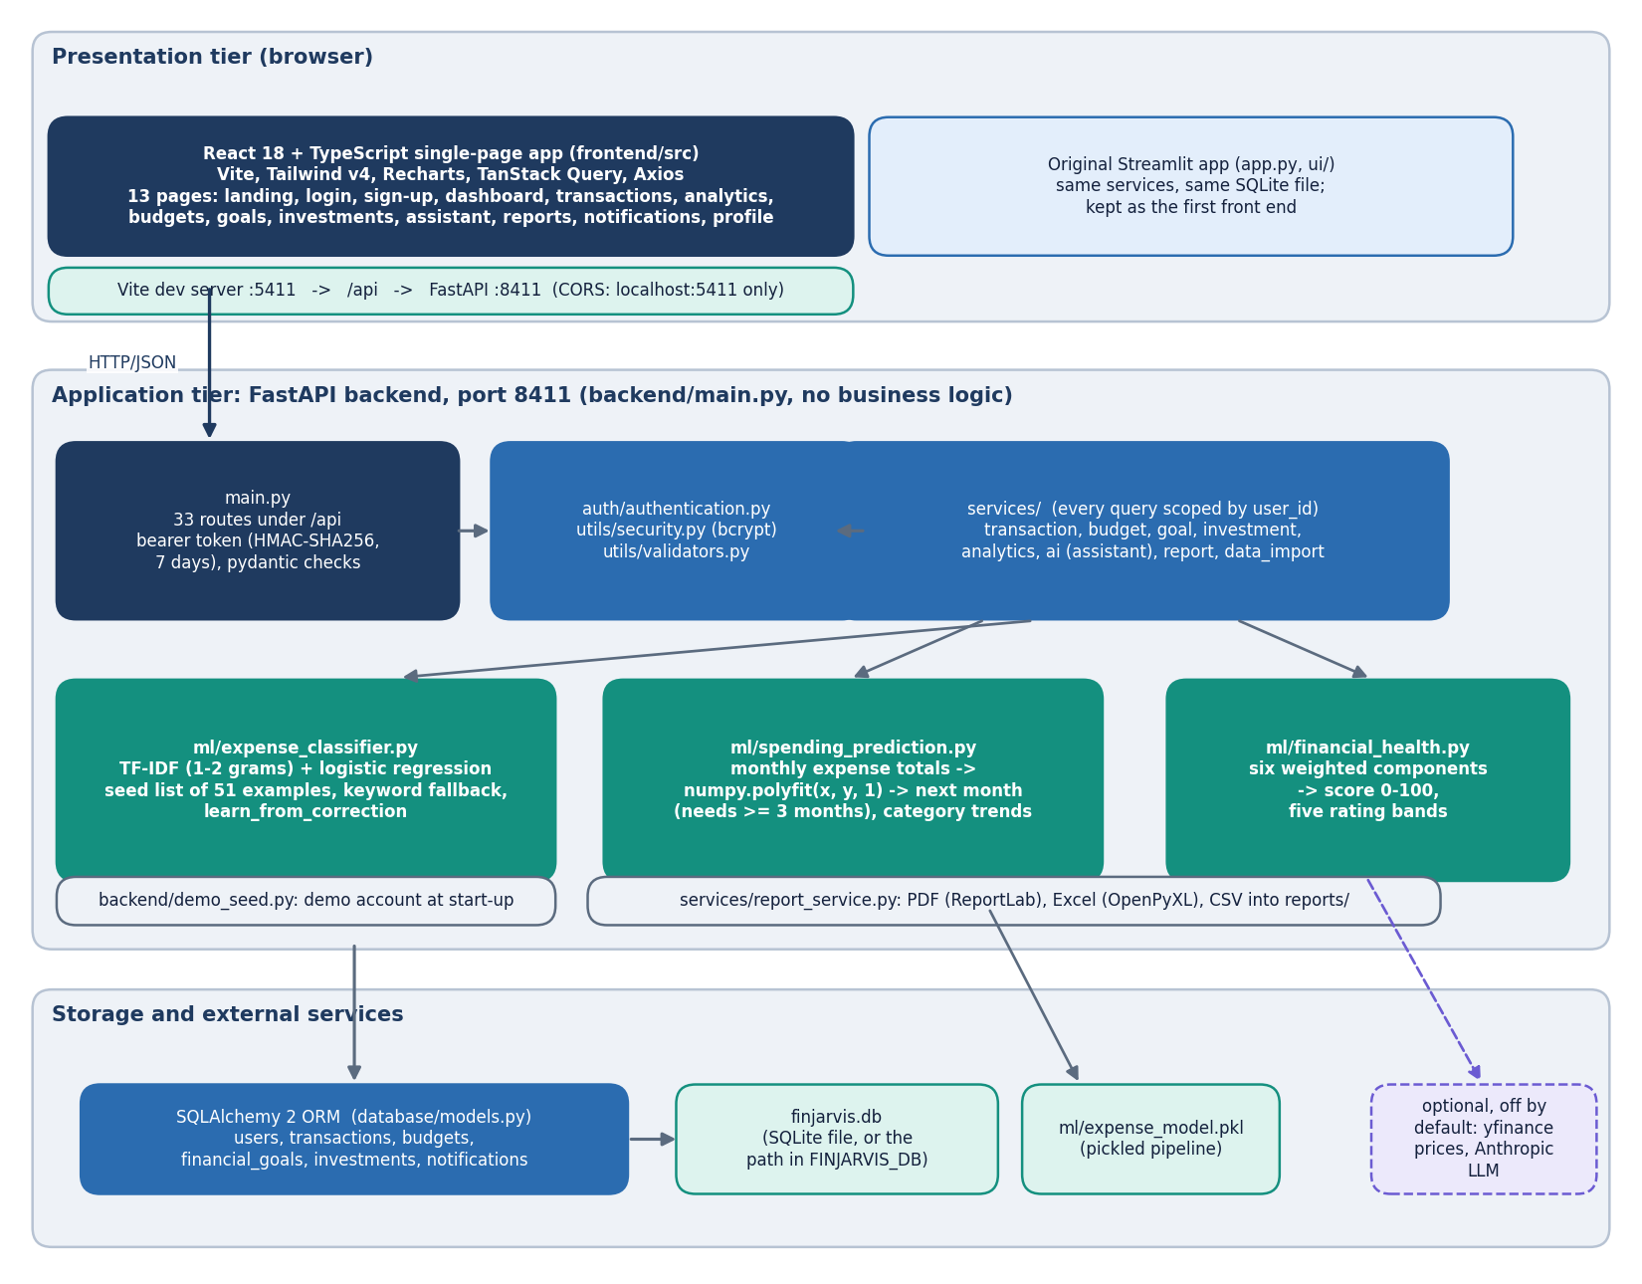
System Architecture
Console: React 18 + TypeScript (Vite, Tailwind, Recharts), port 5411; 13 pages
API: FastAPI, port 8411; 33 routes; bearer-token dependency
Services: transaction, budget, goal, investment, analytics, AI, report, import
ML: expense_classifier, spending_prediction, financial_health
Data: SQLAlchemy over one SQLite file, 6 tables; the original Streamlit app shares the same code
Dept. of CSE | Batch C11 | Final Review
10
Notes:
Layers; the backend folder holds no business logic, every route calls the same service function the Streamlit pages call.

Slide 11
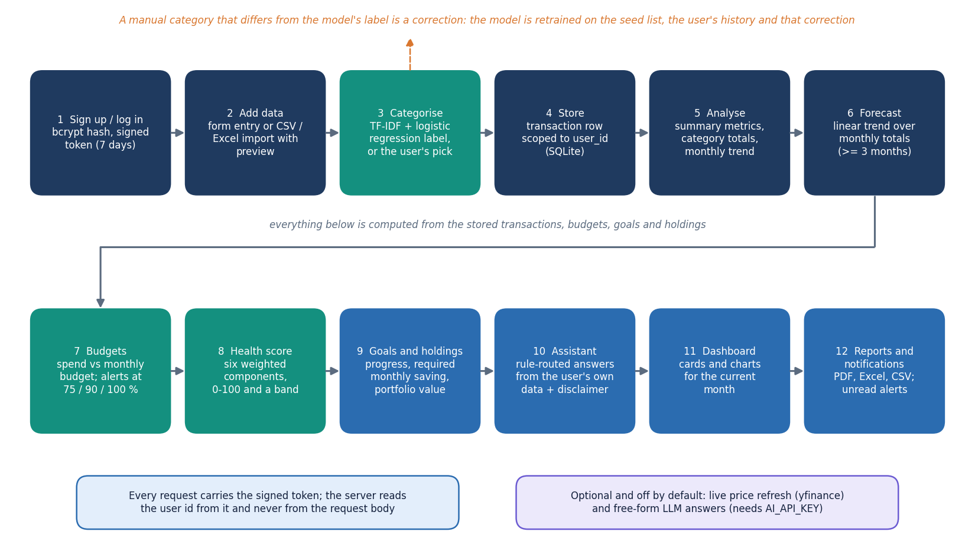
Methodology
Categoriser: TF-IDF (word 1-2-grams) + logistic regression (C = 1) on 51 seed pairs.
Forecast: slope, intercept = polyfit(month index, expense total, 1); next = max(0, slope x n + intercept); trend label if |slope| > 1.
Health = sum of six weights (0.30, 0.20, 0.15, 0.15, 0.10, 0.10) x component score, bands at 40 / 60 / 75 / 90.
Evaluation: probe set, leave-one-out, backtest, simulation, sensitivity sweeps, API timing, tests.
Dept. of CSE | Batch C11 | Final Review
11
Notes:
Method in one picture and the formulas that define the three modules.

Slide 12
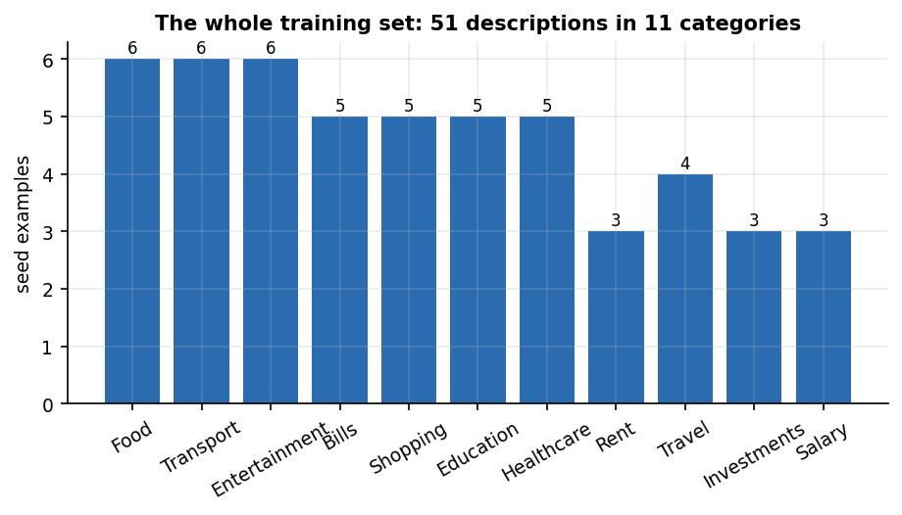
Data and Datasets
51
198
68
seed examples, 11 categories
probe descriptions (3 tiers x 66)
demo-account transactions
Item | Detail
Training data | 51 hand-written (description, category) pairs in ml/expense_classifier.py, 3 to 6 per class
Probe set | 198 descriptions written by the team: A seed-like, B bank-statement strings, C unseen merchants; never used for training
Sample CSV | 34 fictional rows (Jun-Aug 2026); demo user has 6 monthly totals, 5 budgets, 3 goals, 4 holdings
Licence | Own work; all demo data fictional, no real personal data
No split | Nothing is trained on a split; the probe set is not an independent benchmark
The whole training set is tiny: 3 to 6 examples per category, so the model can only recognise words it has seen.
Dept. of CSE | Batch C11 | Final Review
12
Notes:
There is no public corpus. The probe set measures the shipped model but is written by the team, so it is optimistic for tiers A and B and a fair stress test for tier C.

Slide 13
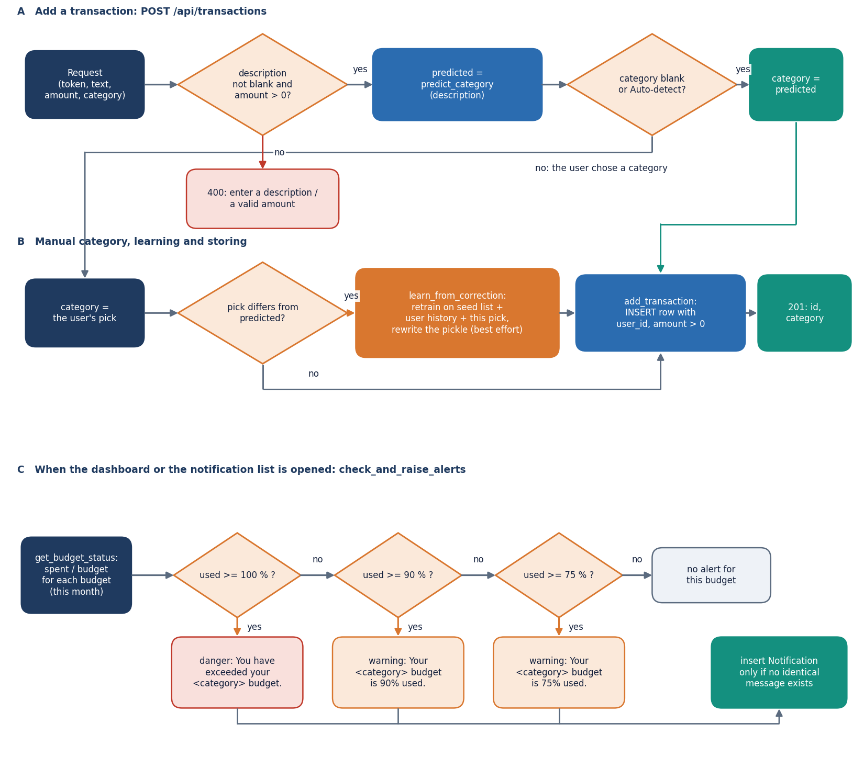
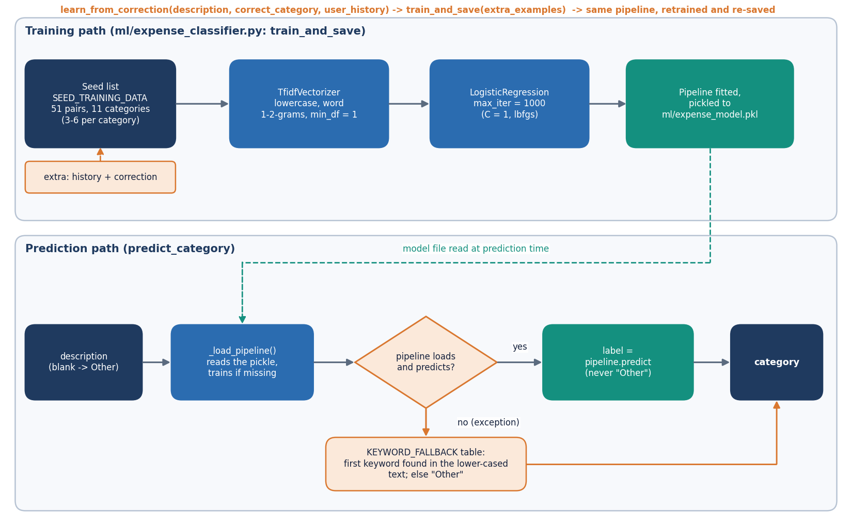
Core Algorithms: Add Transaction, Categoriser, Health Score
Add: validate, predict category if 'Auto-detect', store, check budget thresholds, write alerts.
Predict order: ML model, keyword table only if the model cannot load, else 'Other'; the ML model never outputs 'Other'.
Prediction 0.84 ms per description in-process; retrain from the seed 5.2 ms.
Correction: retrain on seed + the user's history + the correction.
Dept. of CSE | Batch C11 | Final Review
13
Notes:
The add-transaction flow and the categoriser pipeline. Implemented in services/transaction_service.py and ml/expense_classifier.py.

Slide 14
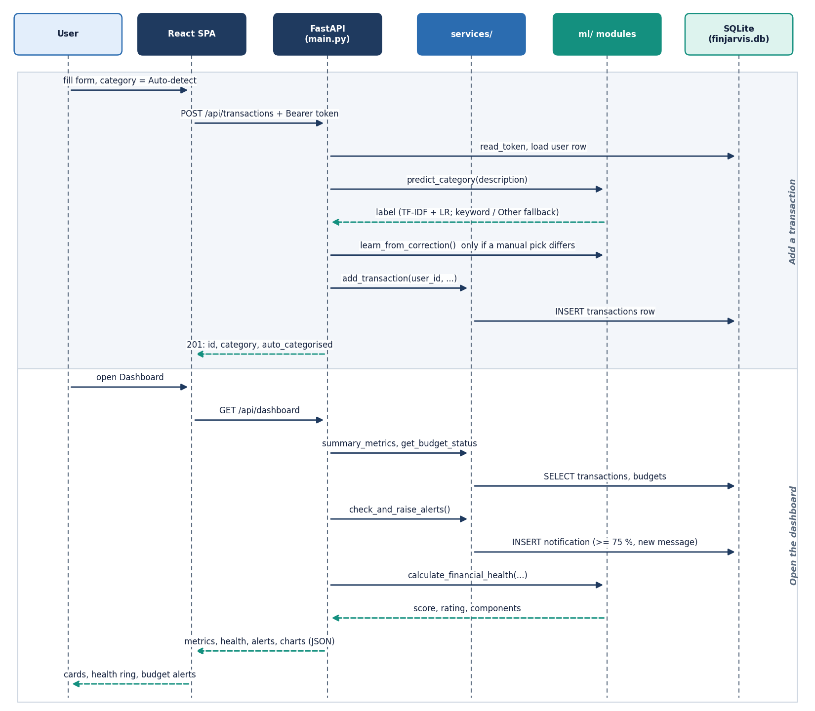
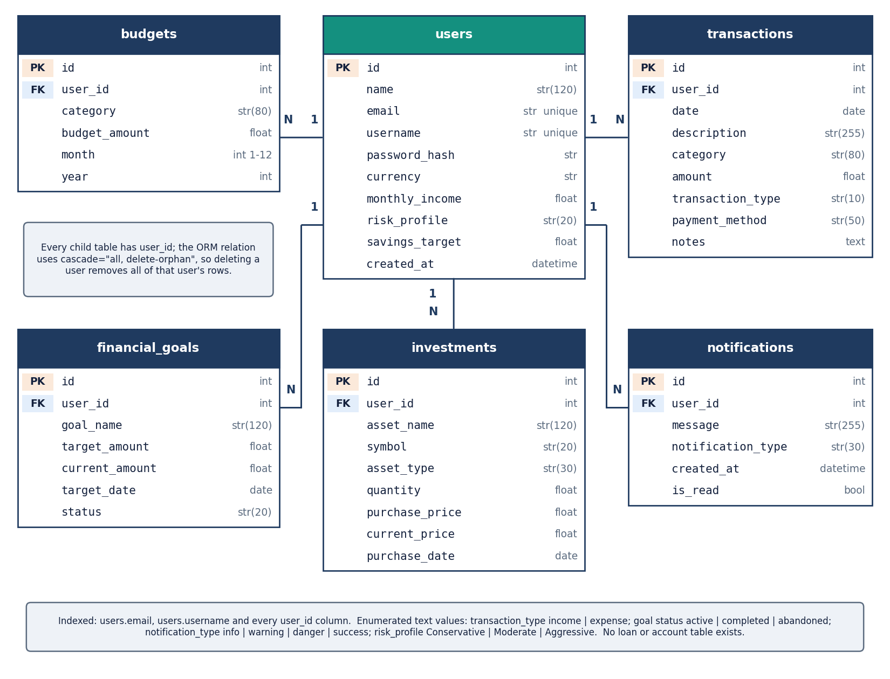
User - System Interaction and Data Design (6 tables)
Left: sequence of adding a transaction. Right: six tables (users, transactions, budgets, financial_goals, investments, notifications); every child table carries user_id and cascades on delete.
Dept. of CSE | Batch C11 | Final Review
14
Notes:
Sequence of adding a transaction and the six-table schema in one SQLite file, created by SQLAlchemy at start-up. The use-case diagram is in the report.

Slide 15
Implementation, Performance & Testing
33
38 + 49
67 ms
305 ms
API routes, 6 tables, 13 pages
pytest tests + smoke checks, all pass
median dashboard request
median login (bcrypt verify)
Endpoint (127.0.0.1) | median ms | p95 ms
Dashboard | 67.2 | 129.3
Analytics + forecast | 72.1 | 128.5
Predict category | 7.9 | 20.5
Add transaction (auto-categorise) | 15.2 | 20.2
Assistant question | 21.6 | 47.9
PDF report | 135.5 | 201.8
Excel report | 209.4 | 341.6
Import preview, 100 rows | 667.0 | 933.3
pytest 38: auth 9, budget 6, financial health 6, ML 9, transactions 8; one temporary SQLite file per test.
Smoke test of 49 checks on a throw-away backend: weak password, wrong password and tampered token rejected; user isolation; CSV import; reports.
Import of 1,000 rows with 84 injected bad rows: all 84 skipped, 916 saved at 35.2 rows/s (one session per row).
Machine: i5-12500, 15.7 GB, Python 3.11.9; single user, warm server. Not tested: load, concurrency, penetration scan, other browsers.
Dept. of CSE | Batch C11 | Final Review
15
Notes:
Implementation facts and the testing that was actually run, with its limits.

Slide 16
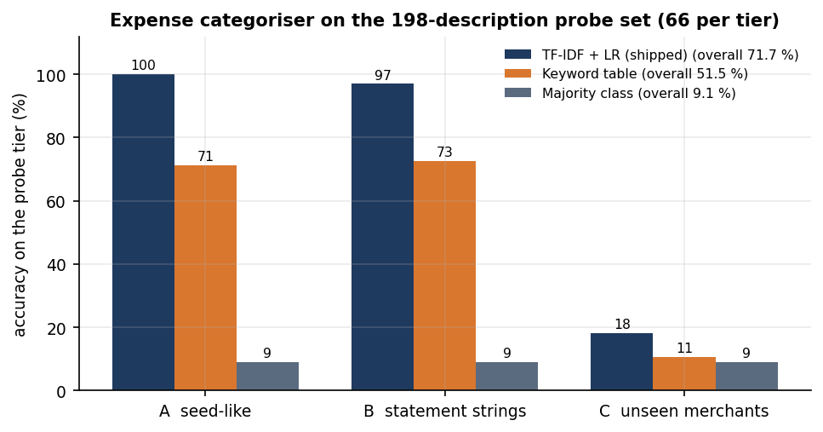
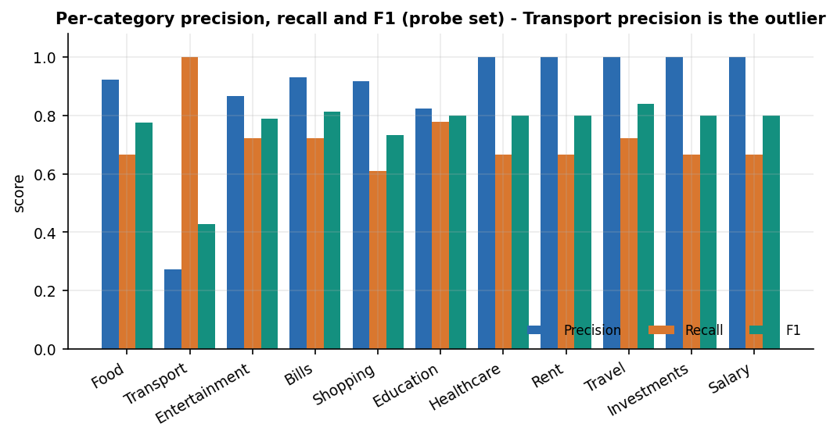
Results - Expense Categoriser (198-description probe set)
Model | Accuracy | Macro-F1 | Tier A | Tier B | Tier C
TF-IDF + LR (shipped) | 71.7% | 0.761 | 100.0% | 97.0% | 18.2%
Keyword table | 51.5% | 0.662 | 71.2% | 72.7% | 10.6%
Majority class (Food) | 9.1% | 0.015 | 9.1% | 9.1% | 9.1%
Tier C (unseen merchants) falls to 18.2 %: the shipped model is barely better than the majority class there.
Leave-one-out on the 51 seed pairs: 11.8 %; the 34-row sample CSV: 100 % (optimistic, same vocabulary).
Mean confidence 0.197 when right vs 0.130 when wrong.
Dept. of CSE | Batch C11 | Final Review
16
Notes:
The classifier headline is 71.7 %, but the breakdown by tier is the honest result. The probe set is team-written, not an independent benchmark.

Slide 17
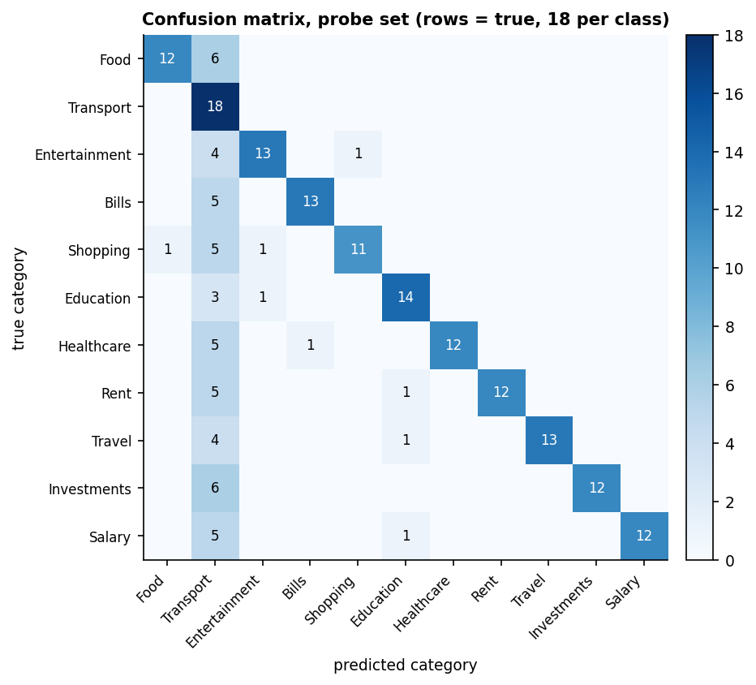
Confusion Matrix - Where the Categoriser Fails
48 of the 56 errors are predicted as Transport: a text with no known word gives a zero feature vector and the decision comes from the intercepts, where Transport is highest.
Transport has recall 1.00 but precision 0.273; Healthcare, Rent, Travel, Investments and Salary have precision 1.00.
Per-category recall ranges from 0.611 (Shopping) to 0.778 (Education).
Tier-B slips: UPI-AMAZON-PAY-8821 -> Entertainment (the seed has 'amazon prime video'); UPI-HOSPITAL-BILL -> Bills.
The ML model never predicts 'Other', and the app applies no confidence threshold, so unseen merchants are labelled silently.
Dept. of CSE | Batch C11 | Final Review
17
Notes:
Rows are true categories, 18 per class. The Transport column is the 'dump' class for unseen text.

Slide 18
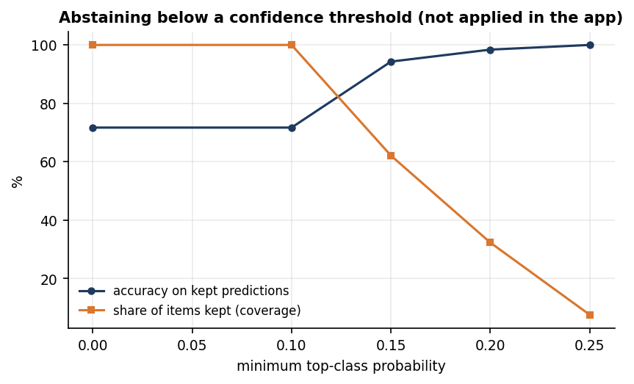
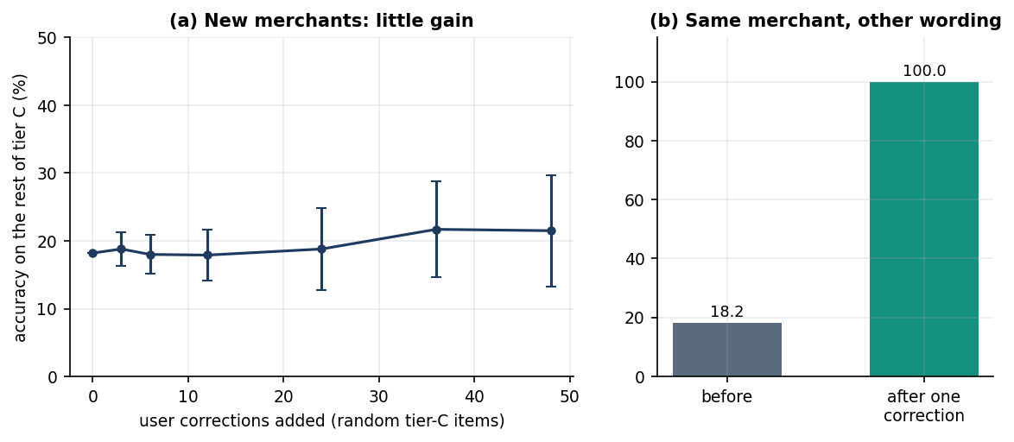
Threshold and Parameter Analysis
Adding 48 random corrections of unseen merchants lifts tier-C accuracy only from 18.2 % to 21.5 %.
One correction fixes the same merchant written three other ways: 18.2 % -> 100 % (198 tests); easy, as variants share tokens.
The 3-month minimum for the forecast is a parameter that proved too low (next slide).
Keeping only predictions with top probability >= 0.15 keeps 62.1 % of items at 94.3 % accuracy; >= 0.20 keeps 32.3 % at 98.4 %; >= 0.25 keeps 7.6 % at 100 %.
The app applies no threshold today; abstaining would send the rest to the user.
Dept. of CSE | Batch C11 | Final Review
18
Notes:
Threshold analysis of the confidence cut-off and the effect of user corrections. Probabilities are low because there are 11 classes and 51 examples.

Slide 19
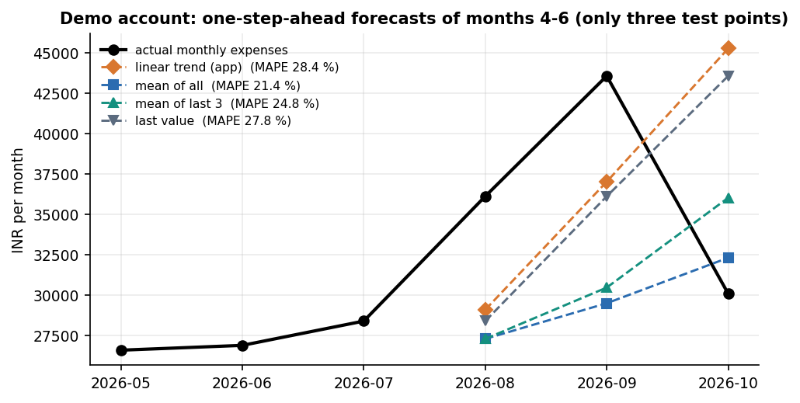
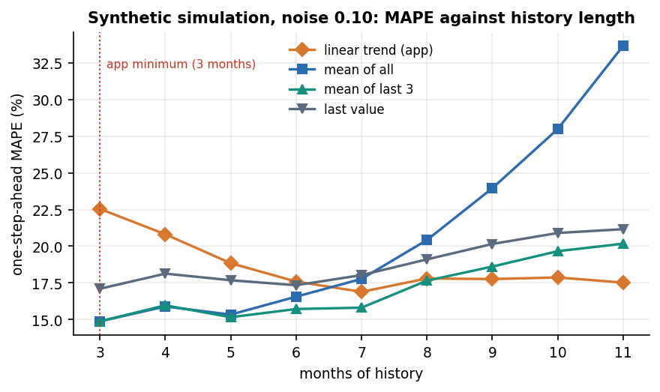
Results - Spending Forecast
Backtest (3 test points) | MAE (INR) | MAPE
Linear trend (app) | 9,597 | 28.4%
Mean of all history | 8,385 | 21.4%
Mean of last 3 | 9,301 | 24.8%
Last value | 9,565 | 27.8%
App output on the full 6-month demo history: next month INR 39,471 (recent 3-month average 36,592, trend increasing).
Simulation (2,000 users): the trend beats a plain average only once ~7+ months exist; a 3-month mean was at least as good in every setting.
Only 3 backtest points: indicative, not conclusive. The base paper's savings LSTM is not comparable.
Dept. of CSE | Batch C11 | Final Review
19
Notes:
The linear trend followed the Aug-Sep rise and overshot October. The 3-month minimum is too low for this method.

Slide 20
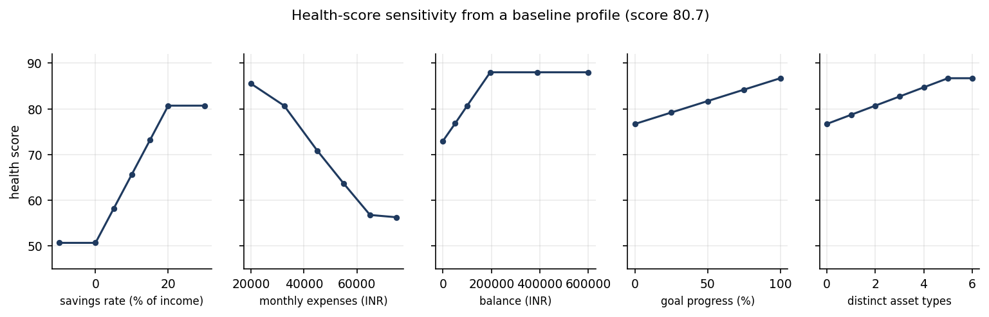
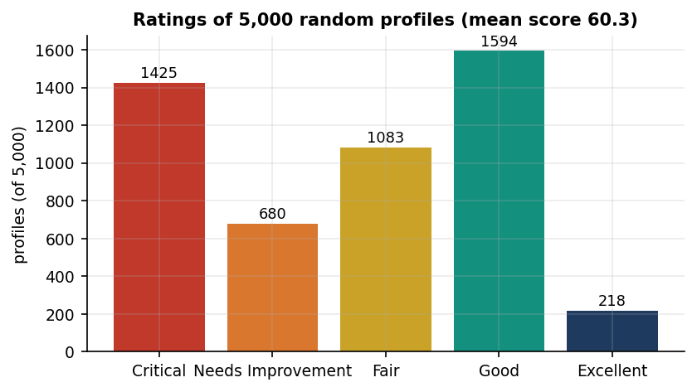
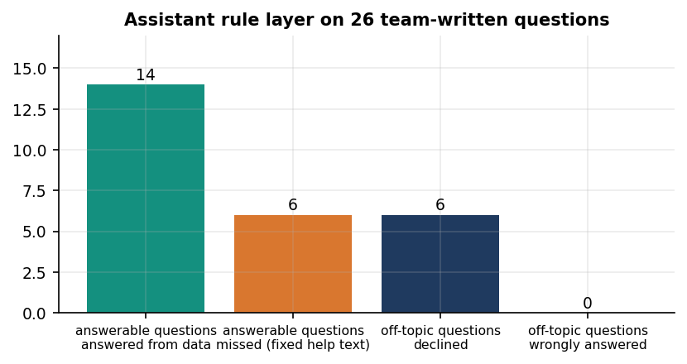
Results - Health Score, Assistant and Import
Demo account health score 90.4 / 100 (Excellent); weakest area goal progress (24).
5,000 random profiles: 8.7 to 98.2, never lower after +5 points of savings rate; saturates at 20 %.
Assistant answered 14 of 20 answerable questions; declined 6 of 6 off-topic; 0 wrong.
Numbers match direct SQL sums (Food INR 17,365; top category Rent INR 108,000).
Weights are expert-chosen, not fitted; savings rate and expense ratio carry 50 % of the score and are correlated. The LLM layer was not run.
Dept. of CSE | Batch C11 | Final Review
20
Notes:
Sensitivity sweeps of the health score, the rule-layer assistant test and the import pipeline result. The assistant missed groceries, biggest expense, eating out, largest purchase, run out of money and which category to cut.

Slide 21
Comparison with the Base Paper (different data and models)
Module | Kharat et al. (base paper) | FINJARVIS (this work) | Comparable?
Categoriser | BERT, 50 classes, own data, 80/20: accuracy 92.3 %, F1 91.1 % | TF-IDF + LR, 11 classes, 51 seeds: probe accuracy 71.7 %, macro-F1 0.761; unseen merchants 18.2 % | No: data, labels, model differ
Forecast | LSTM on synthetic savings: RMSE 137.2, MAE 89.5, R2 0.63 | Linear trend on monthly expenses: MAPE 28.4 % (3 points), MAE INR 9,597 | No: target, units, data differ
Budgeting | Q-learning agent (state, action, reward) | User-set budgets, alerts at 75 / 90 / 100 %, rule-based advice | No RL built
Anomalies | Isolation Forest: P 0.93, R 0.94, F1 0.94 | Not implemented (largest expense only) | Gap
Product | Streamlit prototype, Flask API mention | FastAPI + React, 33 routes, auth, import, reports, 38 tests | Beyond the paper
Data | Synthetic or private, unreleased | Fictional demo data, probe set and scripts in the repository | Re-measurable
Different problems, data and models: no figure of FINJARVIS is claimed to match or beat the base paper. Its BERT, Q-learning, LSTM and Isolation Forest modules were not built here.
Dept. of CSE | Batch C11 | Final Review
21
Notes:
Say plainly that datasets, label sets and model sizes differ, so the numbers are not comparable. Three of the four base-paper modules are not implemented.

Slide 22
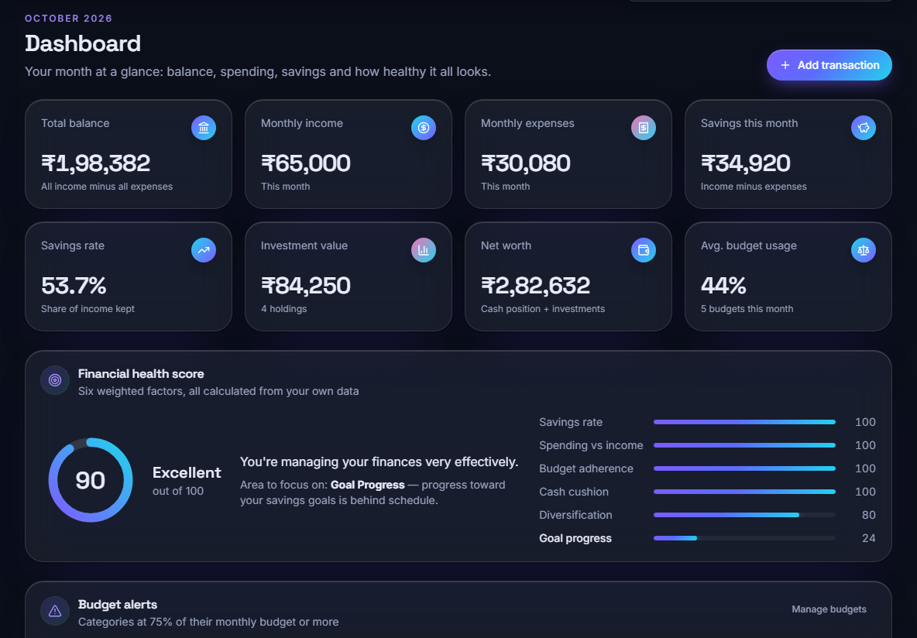
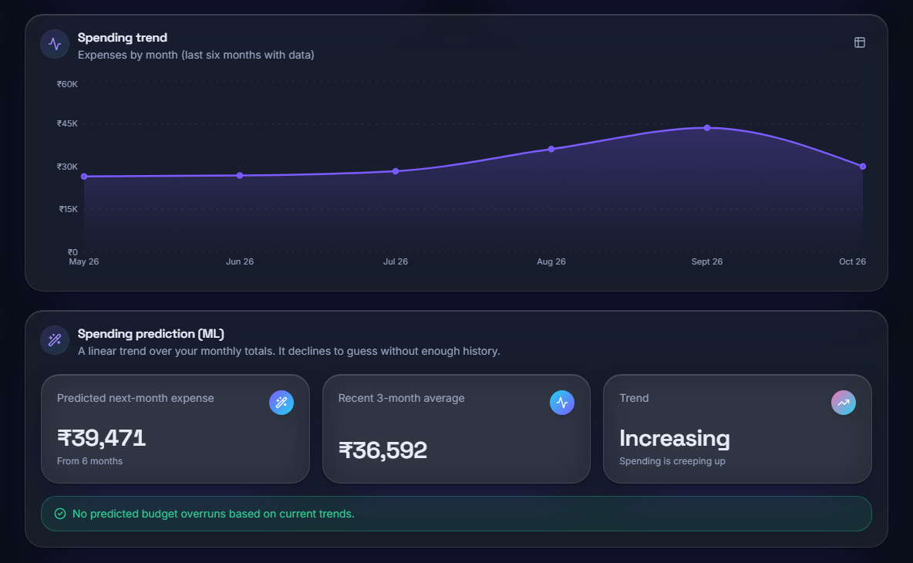
Output - Dashboard and Spending Forecast
Dashboard (demo account, Oct 2026): income INR 65,000, expenses 30,080, savings rate 53.7 %, health score 90 Excellent, weakest area Goal Progress
Analytics: six-month spending trend and ML prediction, next month INR 39,471, recent 3-month average 36,592, trend Increasing
Dept. of CSE | Batch C11 | Final Review
22
Notes:
Real screens of the running app with the fictional demo account.

Slide 23
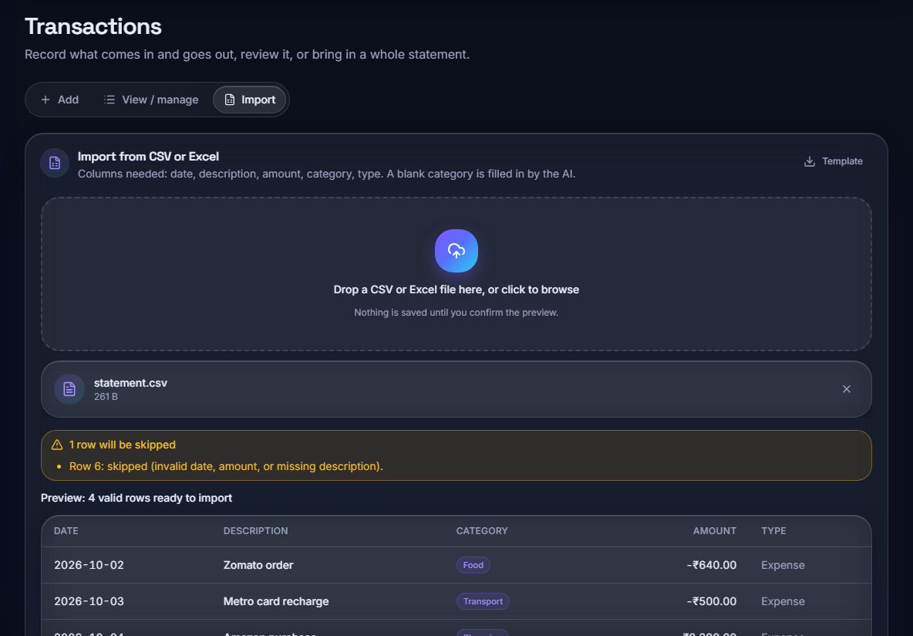
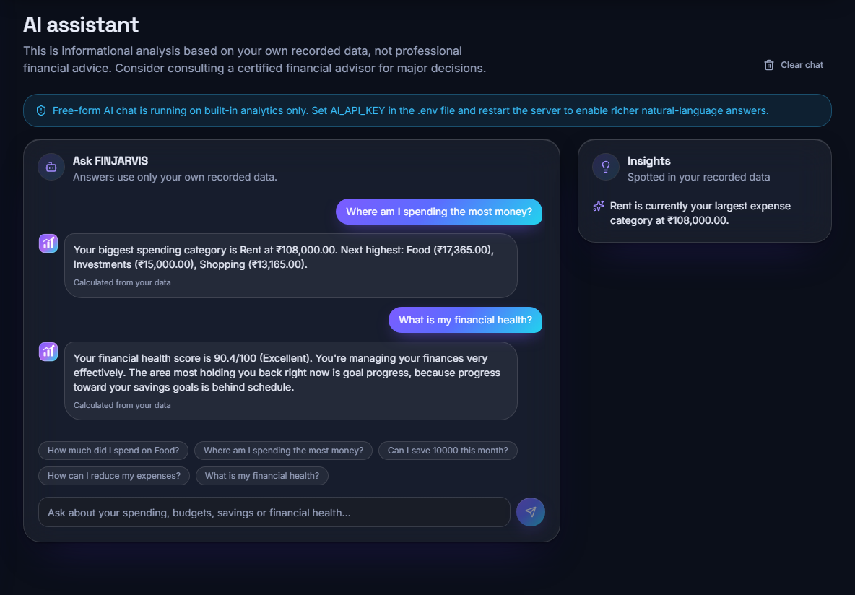
Output - CSV Import and AI Assistant
Import preview: 4 valid rows ready, row 6 skipped (invalid date, amount or description); blank categories are filled by the classifier
Assistant: top category Rent INR 108,000 and health score 90.4 / 100, each marked 'Calculated from your data'; built-in analytics only (no API key)
Dept. of CSE | Batch C11 | Final Review
23
Notes:
The import preview shows nothing is saved until confirmed; the assistant banner states the LLM layer is off.

Slide 24
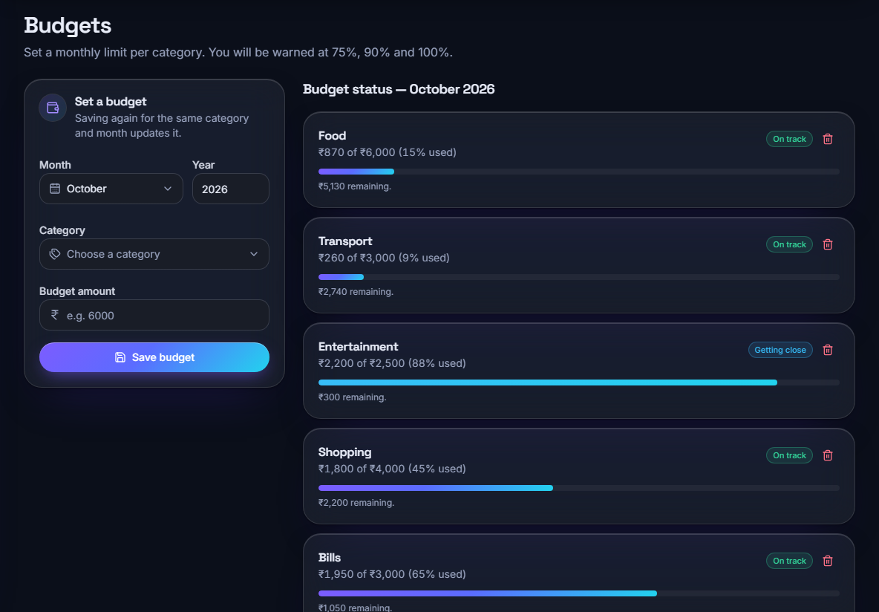
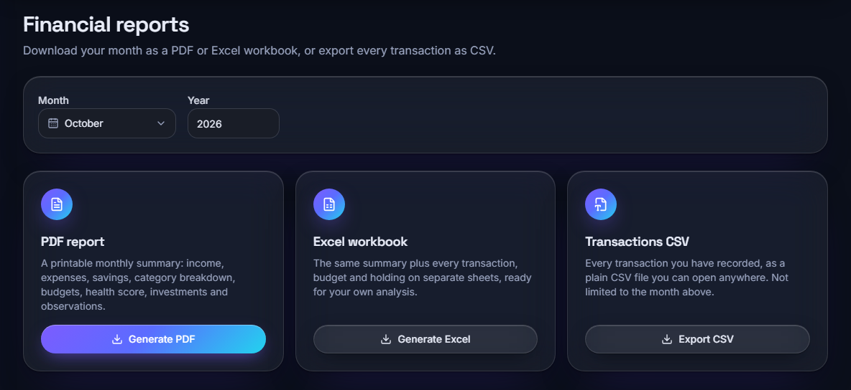
Output - Budgets and Reports
Budget status for October 2026: Food 15 % used, Entertainment 88 % ('Getting close'), Bills 65 %; alerts at 75, 90 and 100 %
Reports: monthly PDF summary, Excel workbook and transactions CSV for the chosen month
Dept. of CSE | Batch C11 | Final Review
24
Notes:
Budgets and downloads. PDF, Excel and CSV generation were timed (135 ms, 209 ms, 18 ms median).

Slide 25
Conclusion
FINJARVIS is a working, tested personal finance manager whose measurements show where each simple module helps and where it falls short.
# | Objective | Outcome
1 | Secure accounts, import and manual entry | Met: bcrypt, signed tokens, CSV / Excel import with preview, 49 / 49 smoke checks
2 | Automatic categorisation | Partly met: 71.7 % on probe set, but 18.2 % on unseen merchants
3 | Forecast expenses and savings (time series) | Partly met: linear trend on expenses only; no ARIMA / LSTM; not better than a mean under ~7 months
4 | Detect anomalous transactions | Not met: no anomaly detector was built
5 | Budget recommendations and alerts | Partly met: user-set budgets, threshold alerts, rule-based advice; no RL
6 | Interactive dashboard | Met: 13 pages, charts, 19 captured screens
Key findings: a tiny seed list limits the categoriser to known vocabulary; corrections help repeat merchants but not new ones; the 3-month forecast minimum is too low.
Dept. of CSE | Batch C11 | Final Review
25
Notes:
Be explicit about which objectives were met, partly met or not met.

Slide 26
Limitations & Future Scope
Known limitations
Future scope
51-example seed list; unseen merchants labelled silently (mostly Transport)
No anomaly detection, RL budgeting, LSTM or BERT; no loans or scheduler
Demo data synthetic; probe set team-written; 3 backtest points
Import commits one row at a time (35 rows/s)
Home-made bearer tokens; default secret if APP_SECRET_KEY unset
Single-user SQLite, no migrations; LLM layer and live prices untested
Train on a public transaction corpus or user-labelled history; add a confidence threshold with abstain
Add an anomaly detector (z-score or Isolation Forest) on the user's own history
Raise the forecast minimum or blend the trend with a moving average
Batch import commits; refresh tokens and a managed secret
Loan tracker, recurring-bill scheduler, bank statement parsing
Run the assistant's LLM layer under test; user study; PostgreSQL
Dept. of CSE | Batch C11 | Final Review
26
Notes:
Limitations first, then concrete next steps drawn from the measured defects.

Slide 27
References
[1] R. Kharat, S. Solapurkar, A. Tikkas, M. Uttarwar and A. Yadav, "A smart AI-based personal finance assistant: A multi-model approach for expense categorization, budgeting, forecasting and anomaly detection," Int. J. Research in Applied Science and Engineering Technology (IJRASET), vol. 13, no....
[2] P. L. To, "Enhancing financial literacy and management through goal-directed design and gamification in personal finance application," arXiv:2601.08640, Jan. 2026.
[3] A. Theerthala, "Synthesizing behaviorally-grounded reasoning chains: A data-generation framework for personal finance LLMs," arXiv:2509.14180 [cs.CL], Sep. 2025.
[4] V. Dilip and R. S. Janaki, "FinSenseAI: An explainable AI-based personal finance recommendation and expense prediction system using hybrid machine learning models," Int. J. Innovative Science and Research Technology, vol. 11, no. 7, pp. 1637-1650, Jul. 2026, doi: 10.38124/ijisrt/26jul842.
[5] F. R. Abiya, S. Parvathy, M. R. Devende, S. R. Ajmalsha and C. Viji, "Personal expense leakage detection and budget optimization using machine learning," Int. J. Research in Applied Science and Engineering Technology (IJRASET), Apr. 2026, doi: 10.22214/ijraset.2026.79467.
[8] J. Devlin, M.-W. Chang, K. Lee and K. Toutanova, "BERT: Pre-training of deep bidirectional transformers for language understanding," in Proc. NAACL-HLT, 2019, pp. 4171-4186.
[10] F. T. Liu, K. M. Ting and Z.-H. Zhou, "Isolation forest," in Proc. 8th IEEE Int. Conf. on Data Mining (ICDM), 2008, pp. 413-422.
[11] S. Hochreiter and J. Schmidhuber, "Long short-term memory," Neural Computation, vol. 9, no. 8, pp. 1735-1780, 1997.
[12] C. J. C. H. Watkins and P. Dayan, "Q-learning," Machine Learning, vol. 8, no. 3-4, pp. 279-292, 1992.
[13] N. V. Chawla, K. W. Bowyer, L. O. Hall and W. P. Kegelmeyer, "SMOTE: Synthetic minority over-sampling technique," J. Artificial Intelligence Research, vol. 16, pp. 321-357, 2002.
[14] F. Pedregosa et al., "Scikit-learn: Machine learning in Python," J. Machine Learning Research, vol. 12, pp. 2825-2830, 2011.
[15] G. Salton and C. Buckley, "Term-weighting approaches in automatic text retrieval," Information Processing & Management, vol. 24, no. 5, pp. 513-523, 1988.
[16] R. J. Hyndman and A. B. Koehler, "Another look at measures of forecast accuracy," Int. J. Forecasting, vol. 22, no. 4, pp. 679-688, 2006.
[17] S. Makridakis, E. Spiliotis and V. Assimakopoulos, "Statistical and machine learning forecasting methods: Concerns and ways forward," PLoS ONE, vol. 13, no. 3, e0194889, 2018.
[19] A. Lusardi and O. S. Mitchell, "The economic importance of financial literacy: Theory and evidence," J. Economic Literature, vol. 52, no. 1, pp. 5-44, 2014.
[20] N. Provos and D. Mazieres, "A future-adaptable password scheme," in Proc. USENIX Annual Technical Conf., FREENIX Track, 1999, pp. 81-91.
The full numbered list of 23 references, including the batch survey titles [6], [7] (not verified), is in the report.
Dept. of CSE | Batch C11 | Final Review
27
Notes:
Selected references; the complete numbered list is in the report.

Slide 28
THANK YOU
Questions & Suggestions
Dept. of CSE | Batch C11 | Final Review
28
Notes:
Invite questions.

