Slide 1
AI-Based Smart Traffic Management
REVIEW 2 · DESIGN, METHODOLOGY AND PROGRESS
Design, methodology and progress: adaptive, emergency-aware and coordinated signal control with YOLOv8 vision and queue forecasting
Presented by
Under the guidance of
Buneti Harshitha 23K91A0548
Bhuvaneshwari Kadike 23K91A0537
Ambati Sai Nikhil Reddy 23K91A0510
Chapala Rohith Reddy 23K91A0551
Laxmi Prasanna, [DESIGNATION]
Department of Computer Science and Engineering
TKR College of Engineering & Technology · Batch A10 (CSE-A) · [ACADEMIC YEAR]
Notes:
This review shows how FlowSense is designed and built, what is implemented, the first measured results from the in-house traffic simulator and from public real-image datasets, and the open items. Introduce the four team members and the guide.

Slide 2
Contents
01
02
03
Recap and architecture
Methodology and datasets
Feature construction and models
04
05
06
Training and decision logic
Data flow, entities and UML
Technology stack
07
08
09
Progress and preliminary results
Output screens and testing
Challenges and next steps
Notes:
Agenda for the design and progress review.

Slide 3
Recap: problem and proposed system
!
Problem
i
Proposed system
B
Base paper link [1]
Fixed-time signals waste green on empty approaches while queues build elsewhere, ambulances wait at red with no priority, and neighbouring junctions act independently so clearing one only moves the queue to the next.
FlowSense puts the whole chain in one product: YOLOv8n vehicle detection and a light-bar rule, a 30-second queue forecaster, an advanced signal controller with emergency green wave and spill-back avoidance, a violation log and a live console.
Lamrabet et al. add a trained YOLO26m light-bar detector over a GA-SGD controller and validate it in SUMO on one roundabout. We keep the emergency-priority idea but build the full chain and measure it in our own simulator. Results are not comparable in absolute terms.
Notes:
Recap of Review 1: the surveyed systems do adaptive control or vehicle detection separately. The gap is one pipeline that detects, adapts timing, prioritises emergency vehicles and coordinates junctions. The base paper's detector is trained; ours is a stock YOLOv8n plus an HSV light-bar rule, so we say plainly that we did not reach its detection quality.

Slide 4
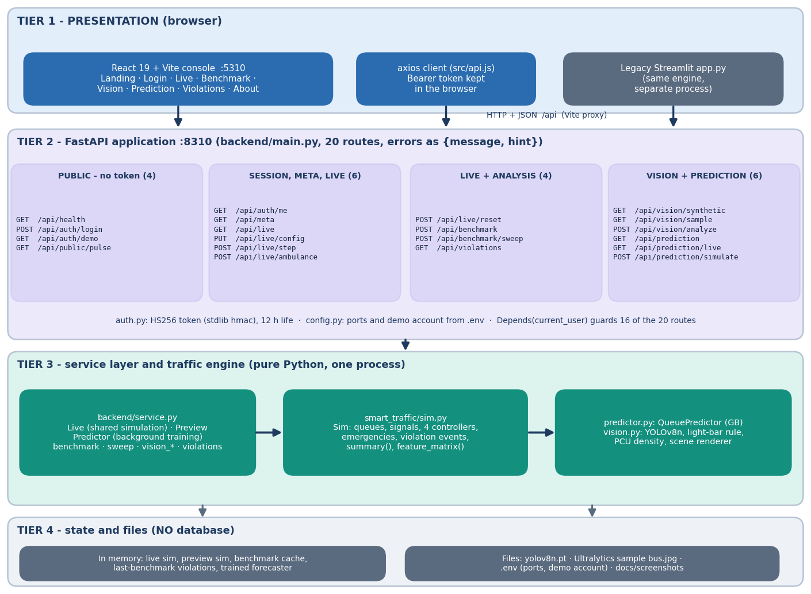
System architecture
Four tiers, no database
Console: React 19 + Vite on port 5310, 8 pages (landing, sign-in, live control, benchmark, vision, prediction, violations, about).
API: FastAPI on port 8310, 20 routes under /api, token sign-in, validation errors with a message and a hint.
Engine: smart_traffic/sim.py (simulator and four controllers), predictor.py (queue forecaster), vision.py (YOLOv8n, light-bar rule, density).
State: one shared live simulation, a benchmark cache and the last violation log live in process memory.
Notes:
Routes live in backend/main.py; service.py wraps the engine and holds no control logic. The legacy Streamlit app (app.py) is still in the project and uses the same engine.

Slide 5
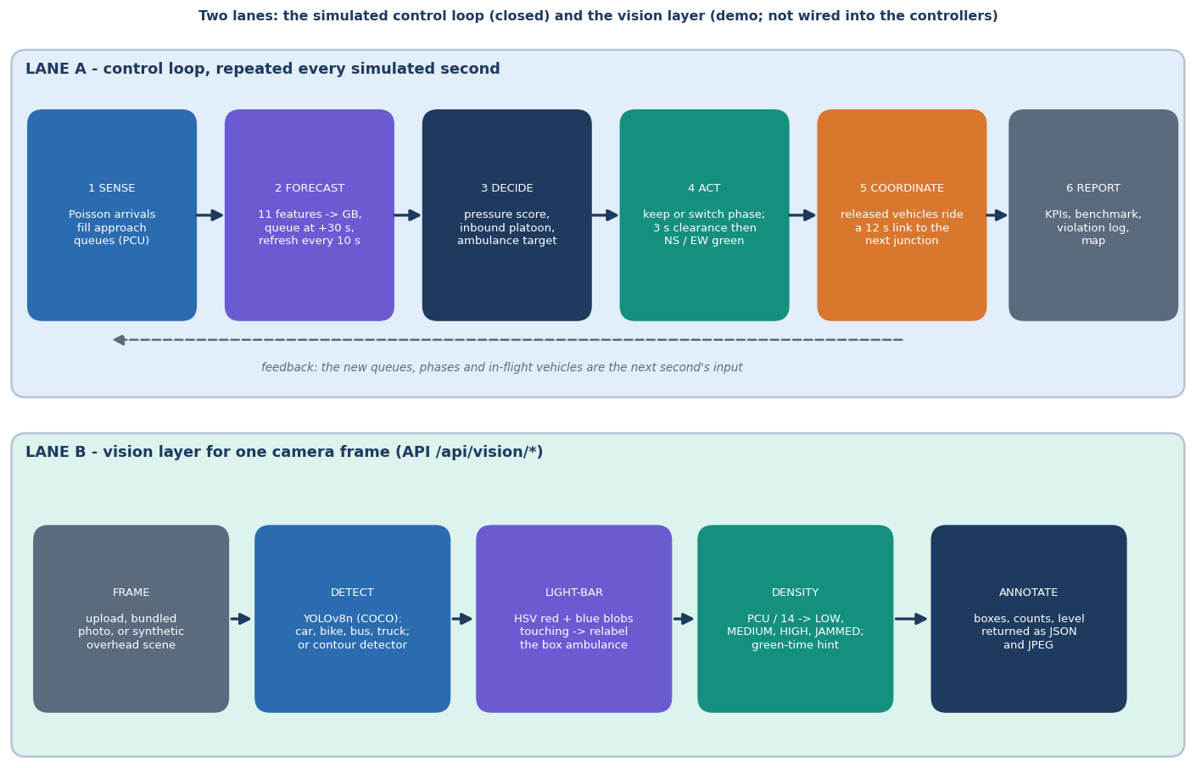
Methodology: detect, forecast, decide, coordinate
Sense
Vehicles enter on the entry roads (Poisson demand, rush-hour profile). The vision layer turns a camera frame into counts, PCU density and an emergency flag.
Forecast and decide
Each second a controller scores both phases per junction. The advanced controller adds a 30 s queue forecast, inbound platoons within 8 s and fairness.
Coordinate
Inter-junction look-ahead damps green toward a full downstream link and clears an ambulance's route up to 15 s ahead (green wave).
High-level workflow as implemented in the simulator and the API.
Notes:
Four controllers face identical random demand so the comparison is like for like. Emergency vehicles are known to the simulated controllers by ground truth; the vision module is a separate demo, not closed loop with them.

Slide 6
Data: simulated demand, forecaster set and real images
26,988 x 11
293
600
5
forecaster training samples x features
real dashcam frames, 1,506 boxes (CC BY 4.0)
real photos: 300 ambulance, 300 other (CC BY 4.0)
benchmark seeds (40-44), 1800 s each
 | Simulator-generated | Public real images (evaluation only)
Source | FlowSense simulator: 2x2 or 3x3 grid, Poisson arrivals, seeded | Visaitech mixed-traffic frames [32]; shravya11 ambulance photos [33]
Forecaster set | 6 runs of 1800 s under the adaptive controller; demand 0.7-1.6, start 07/08/12/17 h; a snapshot every 10 s | none - the forecaster never sees real data
Targets | queue 30 s ahead per approach (mean 5.81, std 12.02, max 138) | boxes: 2-, 3-, 4-wheelers; ambulance yes / no
Split | random 75/25 (shipped) and leave-one-simulation-out (added) | no training: YOLOv8n COCO weights used as shipped, conf 0.3
Limit | assumptions are ours (saturation 0.5 veh/s, link 12 s); not SUMO | dashcam, not junction cameras; first 300 files by name per folder
No private data is used; the base paper's 3,130 light-bar images were not available to us.
Notes:
The control experiments need no external dataset: demand is a seeded Poisson process with a morning and evening peak. The two public image sets are used only to test the shipped vision layer, with no tuning on them.

Slide 7
Feature construction (preprocessing)
Simulator state each second
Queue and PCU queue
Lags 10 s and 30 s
Inflow and inbound
Signal state, time of day
11 features per approach
11
30 s
features per approach: queue, pcu_queue, queue_lag10, queue_lag30, inflow_30s, inbound_15s, is_green, green_time, is_entry, sin_day, cos_day
forecast horizon; predictions clipped to 0-40 vehicles
Vision frames: YOLOv8n is restricted to the COCO classes car, motorcycle, bus and truck; the HSV rule marks red-and-blue blobs that touch after dilation as a light bar.
Density: passenger-car units (car 1, bike 0.5, bus 3, truck 2) divided by a road capacity of 14 PCU gives LOW, MEDIUM, HIGH or JAMMED.
Time of day enters as sin and cos of the hour; the rush-hour demand multiplier peaks at 08:30 and 17:30.
Known limit: feature importance is dominated by the current queue (0.69) and the 30 s lag (0.13); inbound and inflow features add little.
Notes:
feature_matrix() in sim.py builds one row per approach at each snapshot. The same function is used for training and for live forecasting in the advanced controller.

Slide 8
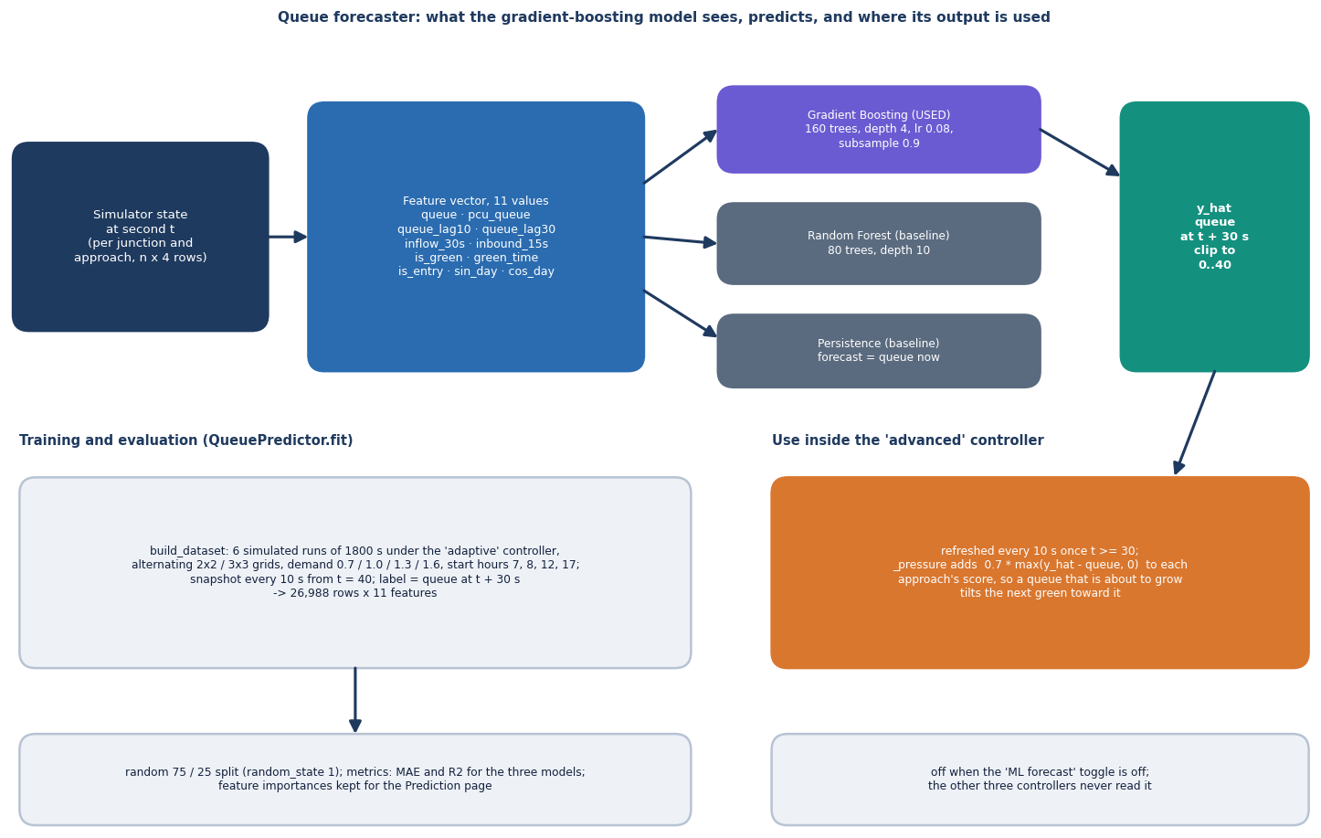
Models: queue forecaster, YOLOv8n and light-bar rule
Forecaster: Gradient Boosting regressor, 160 trees, depth 4; Random Forest and persistence as baselines.
YOLOv8n (Ultralytics, COCO weights): vehicle boxes at confidence 0.3; no fine-tuning.
Light-bar rule: HSV red and blue clusters; a box carrying a cluster is relabelled ambulance.
The base paper's trained YOLO26m light-bar detector is not reproduced.
Forecaster architecture and its closed-loop use inside the advanced controller.
Notes:
Three components with separate jobs. A classical contour detector handles the synthetic overhead scenes; YOLOv8n handles real photos.

Slide 9
Training and evaluation configuration
Setting | Value
Forecaster | GradientBoostingRegressor: 160 trees, depth 4, learning rate 0.08, subsample 0.9, seed 0; fit time 5.9 s on CPU
Baselines | Random Forest (80 trees, depth 10), ridge regression, persistence (queue now = queue in 30 s)
Split | random 75/25 (shipped, seed 1) plus 5 random splits and a leave-one-simulation-out check over the 6 runs (26,988 samples)
Vision | YOLOv8n pretrained on COCO, not trained here; conf 0.3; light-bar thresholds S >= 120, V >= 190 (red H 0-8 / 172-180, blue H 100-130)
Controller benchmark | 4 controllers x 5 seeds (40-44), 1800 s, demand x1.2, start 08:00, 2x2 and 3x3 grids; ablation, demand sweep and emergency-heavy test
Machine | Core i5-12500, 15.7 GB RAM, no CUDA GPU; Python 3.11.9, scikit-learn 1.5.0, ultralytics 8.4.186
Hyper-parameters are those in the shipped code; nothing was tuned on the real images.
Notes:
Hyper-parameters are those in smart_traffic/predictor.py. The experiment scripts (scripts/run_experiments.py, eval_real_vision.py) reuse the shipped code and write metrics.json files.

Slide 10
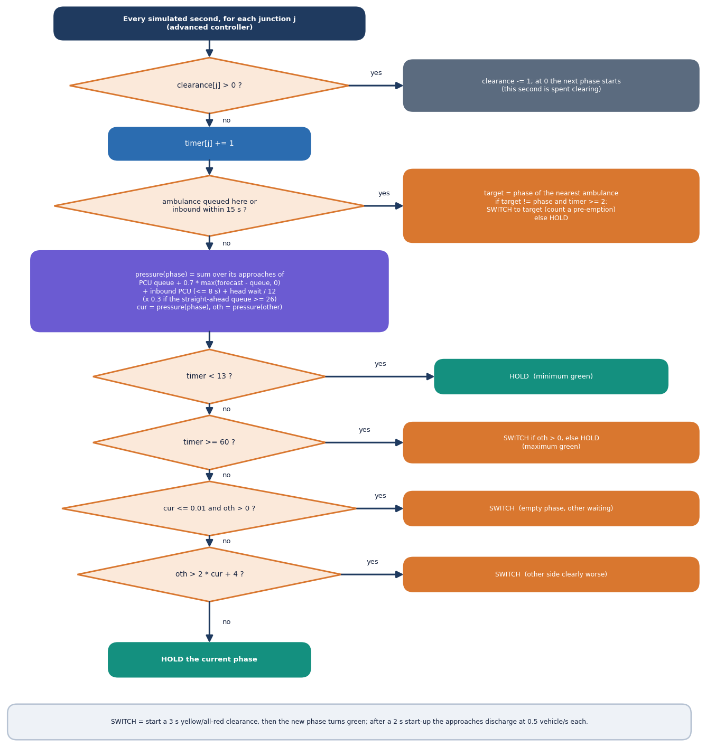
Decision logic: the advanced controller
Rule (per junction, per second) | Action
Ambulance in queue or inbound within 15 s | Force its phase green after >= 2 s
Green shorter than 13 s | Hold
Current phase empty, other has traffic | Switch
Other pressure > 2 x current + 4 | Switch
Green reaches 60 s | Switch if other phase has traffic
Pressure = PCU queue + 0.7 x max(forecast - queue, 0) + inbound PCU within 8 s + head wait / 12, times 0.3 if the straight-ahead downstream queue is within 4 vehicles of capacity (30).
Switching costs 3 s of clearance; start-up lost time is 2 s; saturation discharge 0.5 veh/s.
Notes:
This mirrors Sim._decide and Sim._pressure. The forecast term comes from the Gradient Boosting model every 10 s once 30 s of history exists. The base-paper-style controller uses only the emergency rule at one junction with a 5 s look-ahead.

Slide 11
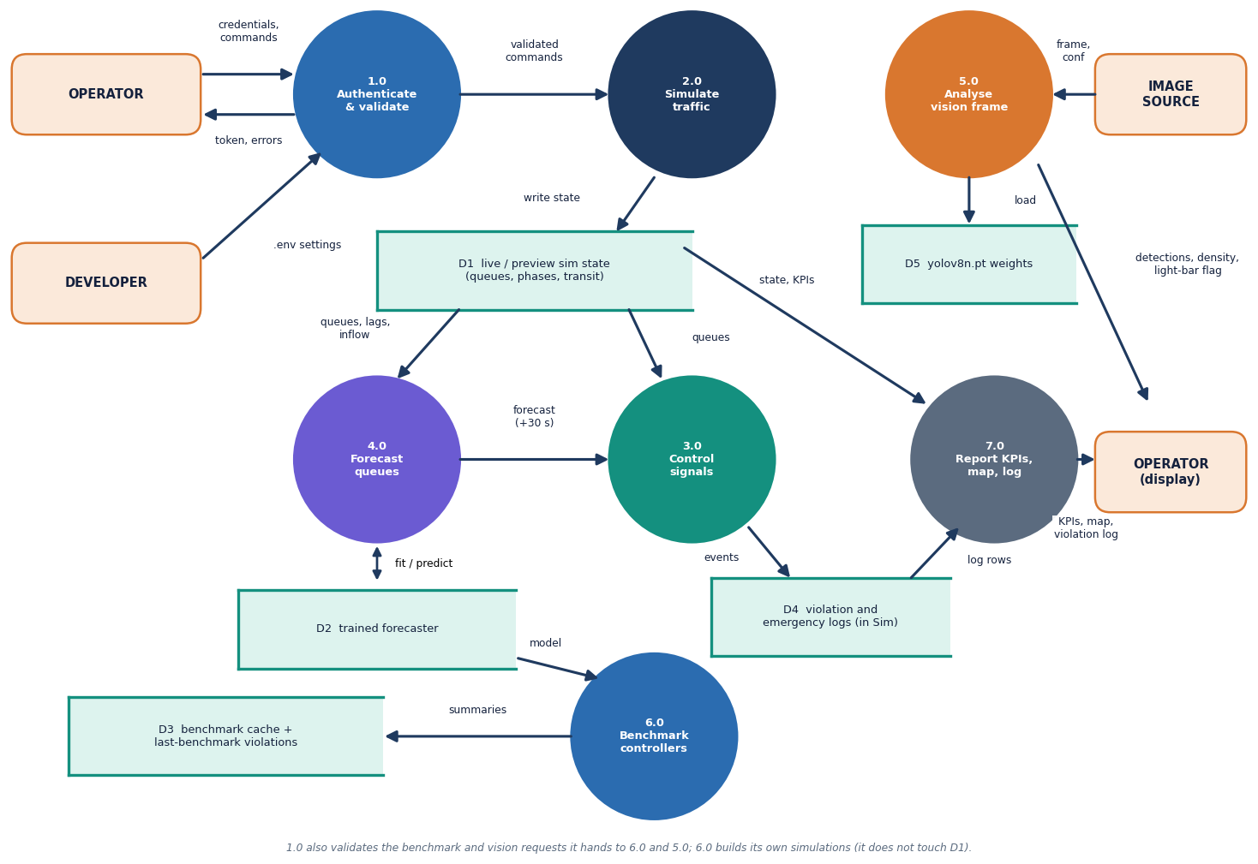
Data flow and modules
Module | Role
smart_traffic/sim.py | simulator, 4 controllers, KPIs
smart_traffic/predictor.py | 30 s queue forecaster
smart_traffic/vision.py | YOLOv8n, light bar, density
backend/service.py | wraps the engine for HTTP
backend/main.py | 20 routes, validation, auth
backend/auth.py | HS256 token, demo account
frontend/src/pages | 8 React pages
scripts/ and tests/ | experiments, smoke test, 38 tests
Level-1 data-flow diagram of the platform.
Notes:
Level 1 has seven processes: authenticate and validate, simulate traffic, control signals, forecast queues, analyse a vision frame, benchmark the controllers, and report KPIs, map and violation log.

Slide 12
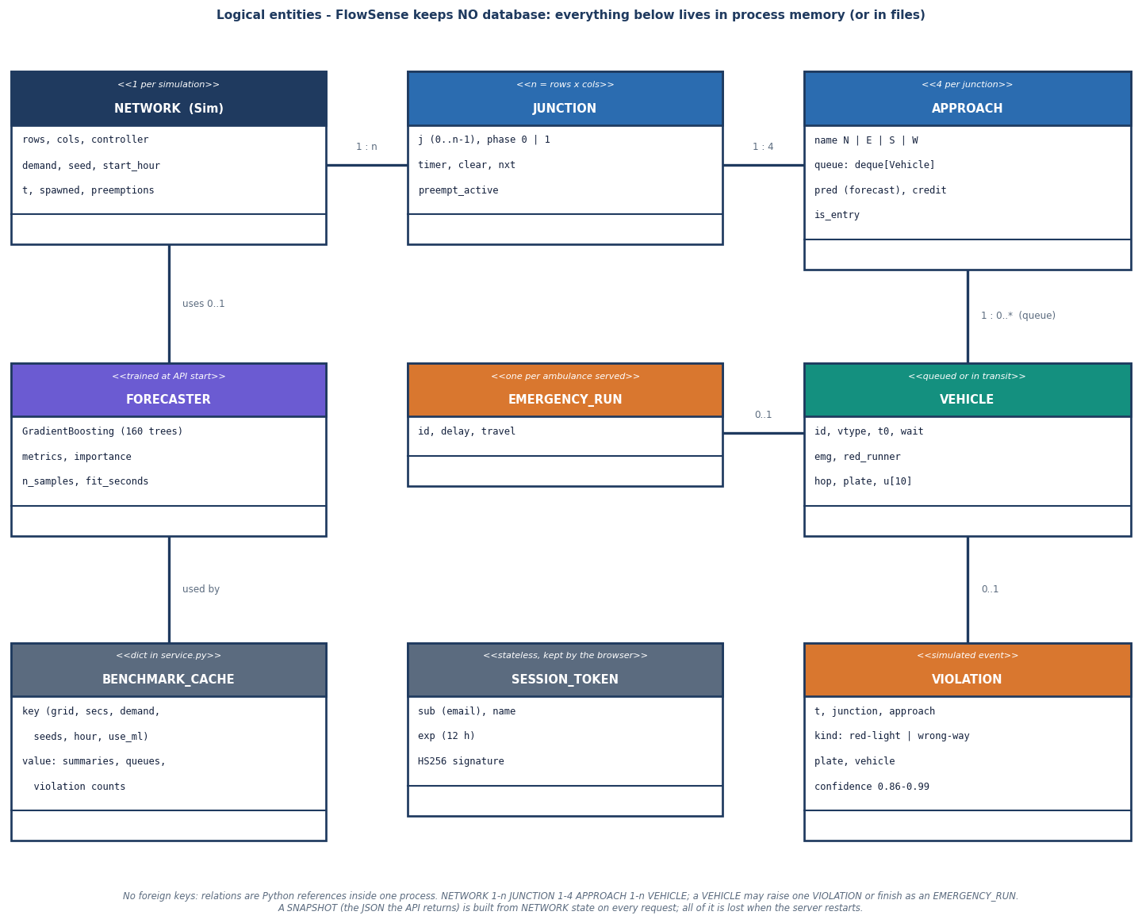
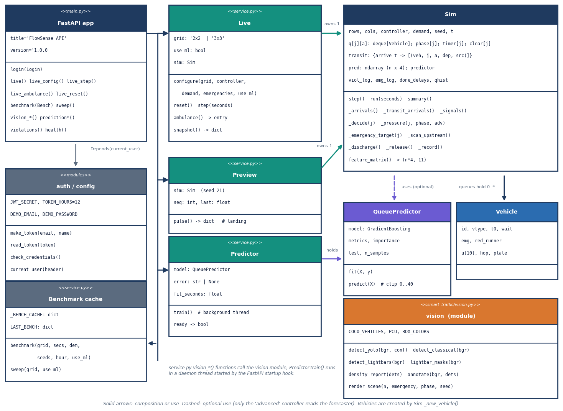
Entities and UML (no database)
FlowSense keeps no database - in-memory entities only. The shared live simulation, benchmark cache and violation log are lost on restart; the ER diagram is logical.
Core classes: Sim, Vehicle, QueuePredictor, vision functions, service Live / Preview.
Notes:
Honest point: persistence of runs, violations and users is future work. There is one demo operator account and one shared live simulation.

Slide 13
Technology stack
Layer | Technology
Language and API | Python 3.11.9, FastAPI 0.143.3, Uvicorn, Pydantic, python-multipart; stdlib HS256 token for the demo sign-in
Simulation | Pure Python and NumPy 1.26.4: 1 s time step, Poisson arrivals, deque queues; thousands of times faster than real time
Machine learning | scikit-learn 1.5.0 (Gradient Boosting, Random Forest, ridge), pandas 2.2.1, NumPy
Vision | Ultralytics 8.4.186 (YOLOv8n on PyTorch 2.14.1 CPU) and OpenCV 4.11.0 for the HSV light-bar rule and annotations
Front end | React 19, Vite 8, Tailwind 4, Recharts, Framer Motion, GSAP; legacy Streamlit app kept in app.py
Testing and capture | pytest 8.2 with FastAPI TestClient, urllib smoke script, Playwright browser capture at 1440 x 900
Run | run.bat creates the virtual environment, installs packages and starts both servers; ports 8310 and 5310
Notes:
Versions are those installed on the measurement PC. On Windows torch must be imported before scikit-learn or OpenCV, so backend/main.py imports it first.

Slide 14
Implementation progress
Component | Status | Evidence
Simulator with fixed, adaptive, emergency-aware and advanced controllers | Done | 24 engine tests; 2x2 and 3x3 grids; 5-seed benchmark
Queue forecaster (Gradient Boosting) used inside the controller | Done | MAE 1.64 on a random split; weak on unseen congestion
Vision layer: YOLOv8n, light-bar rule, PCU density | Done | synthetic and real-image evaluation; stock detector, not fine-tuned
API (20 routes) and React console (8 pages), demo sign-in | Done | 33/33 smoke checks; 38/38 pytest tests
Violation log (red-light, wrong-way) | Simulated | events from ground truth with a drawn confidence; no detector
Trained light-bar or emergency-vehicle detector | Not done | HSV rule recall 1.3% on 300 real ambulance photos
SUMO or CARLA validation, real camera stream, hardware | Not done | in-house simulator only; results not comparable in absolute terms
Database, persistence, multi-user accounts | Not done | in-memory state; one demo operator
Notes:
State of the code base. The honest gaps are the last four rows: violations are simulated, no trained emergency detector, no SUMO, and no persistence.

Slide 15
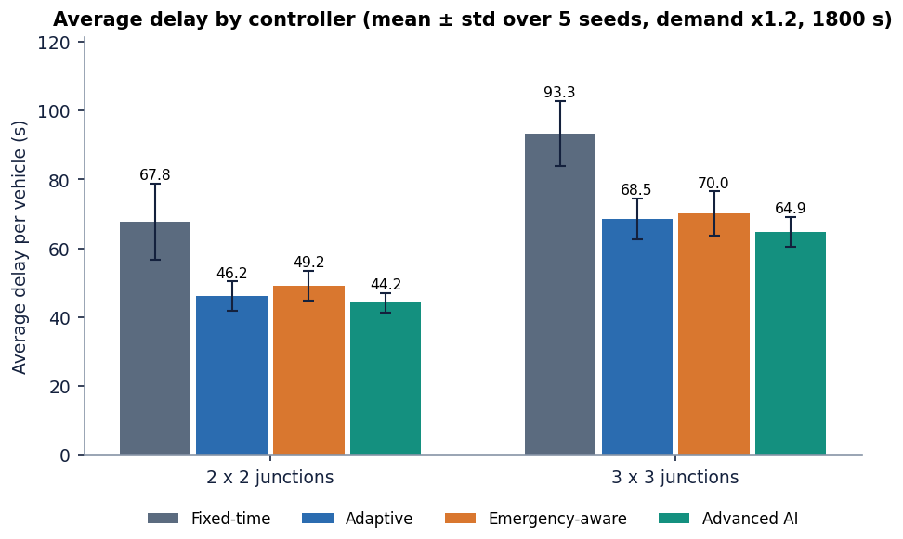
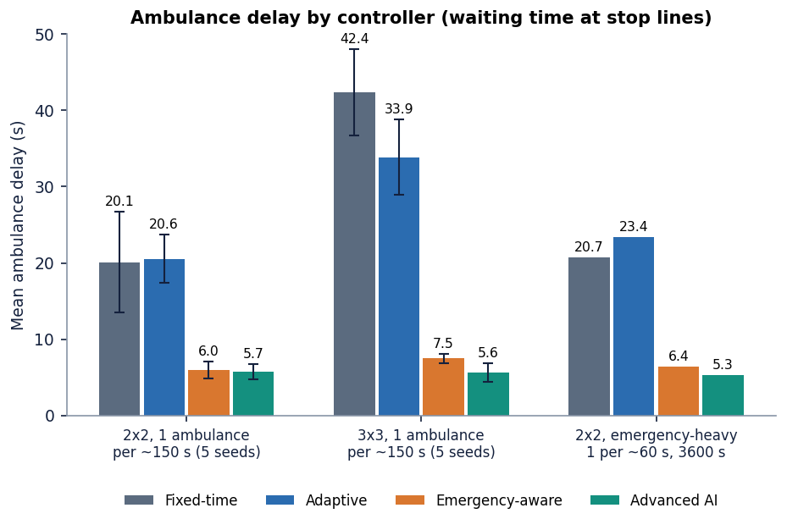
Preliminary results: controller benchmark
-34.8%
-4.3%
5.7 s
+6.5%
average delay, advanced vs fixed-time (2x2; 3x3 -30.5%)
advanced vs plain adaptive: about one std (3x3 -5.3%)
ambulance delay, advanced; fixed-time 20.1 s (-71.5%)
mean delay of the base-paper-style controller vs adaptive: pre-emption costs
2x2, 5 seeds, demand x1.2: fixed 67.8, adaptive 46.2, base-paper-style 49.2, advanced 44.2 s. At low demand (x0.6) advanced is worse than adaptive (26.4 vs 20.6 s). Ablation: no forecast +3.2 s; no pre-emption gives the lowest network delay (42.4 s) but ambulance delay 27.3 s. Own simulator, not SUMO.
Notes:
Headline: the adaptive family beats fixed-time by about a third; most of the gain is adaptivity. Advanced beats plain adaptive by only 4.3 percent on 2x2, within one standard deviation. Ambulance delay drops from 20.1 s to 5.7 s. The UI default benchmark uses three seeds and shows -38 percent vs fixed-time; the tables use five seeds.

Slide 16
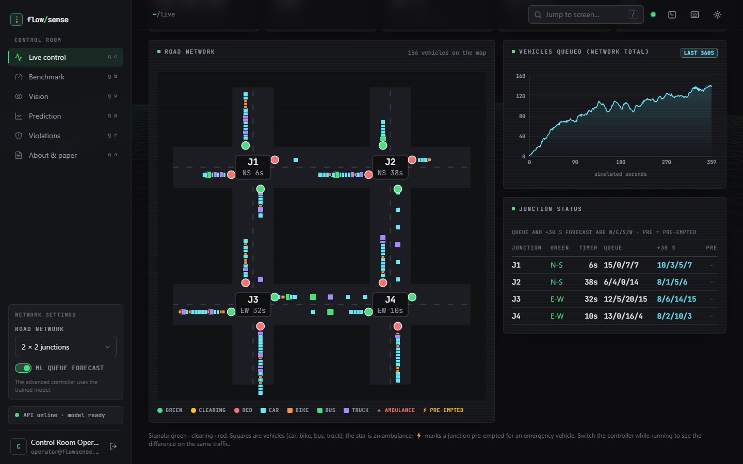
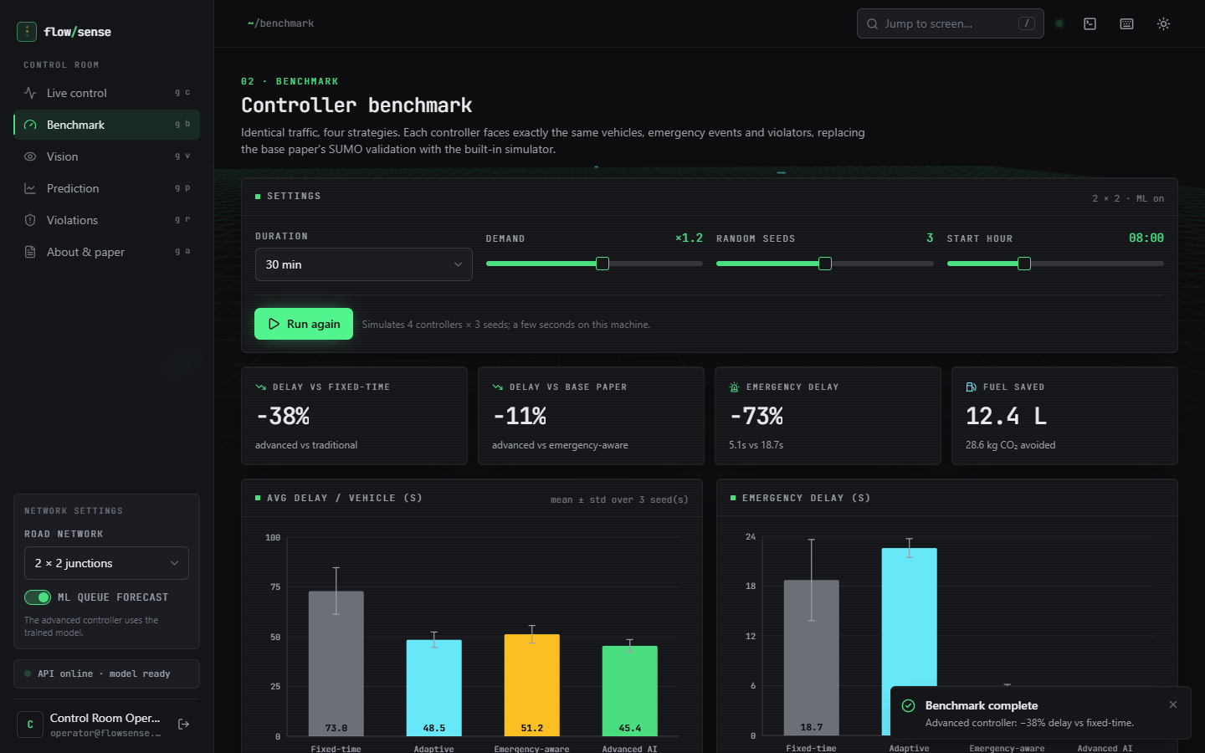
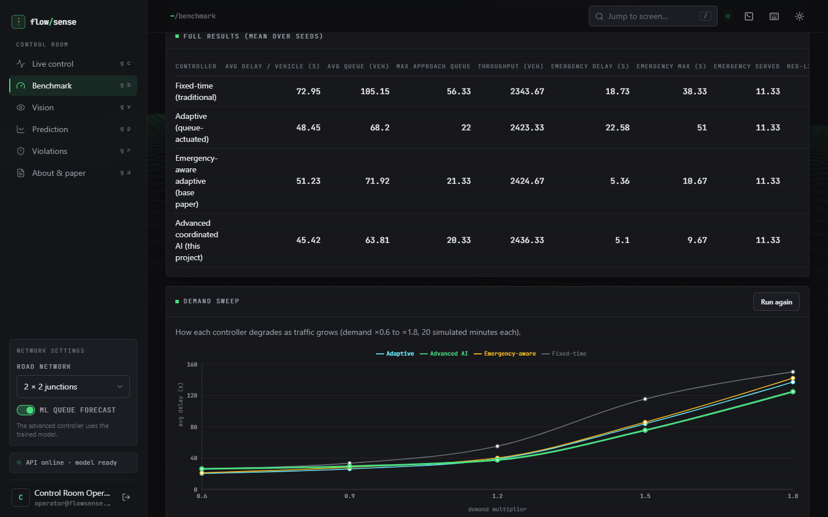
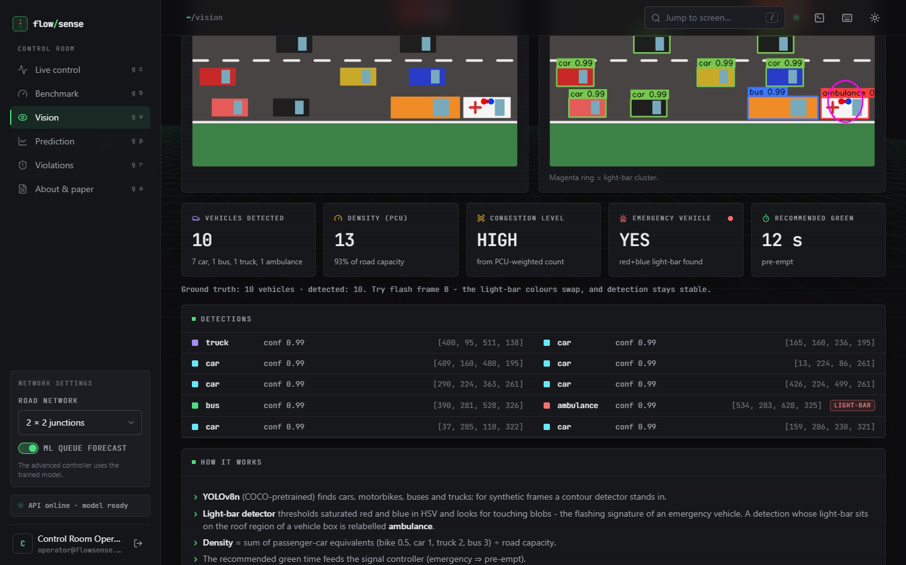
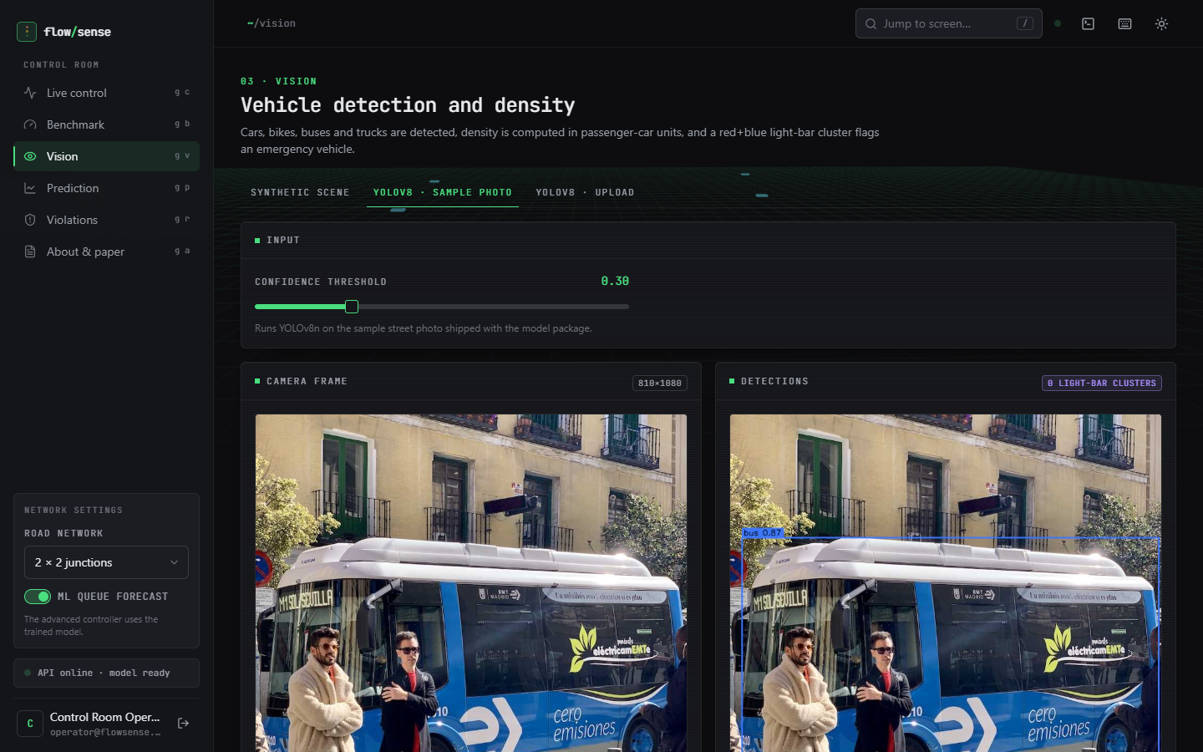
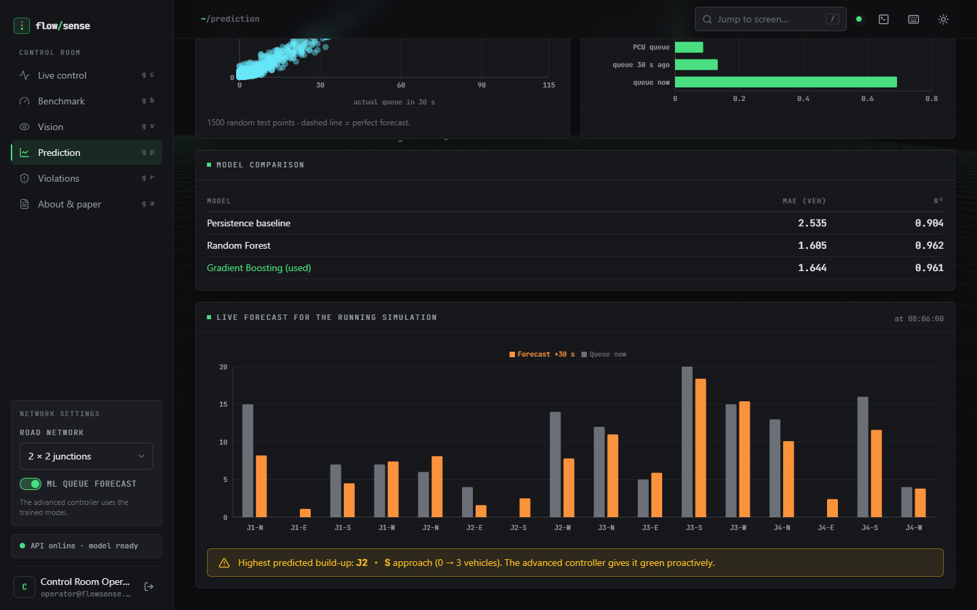
Output screens
Live control: road map, queue chart, junction status
Benchmark: four controllers on identical traffic
Delay against demand, four controllers
Vision: synthetic scene, PCU density and green time
Vision: YOLOv8n on the sample street photo
Prediction: model comparison and live 30 s forecast
Real captures of the running application at 1440 x 900, with live simulation data. Benchmark screens use the UI defaults (3 seeds).
Notes:
Real screenshots from the running console. The benchmark screen shows fixed 73.0, adaptive 48.5, emergency-aware 51.2 and advanced 45.4 s for the UI default of three seeds.

Slide 17
Initial testing and observations
38 / 38
33 / 33
4.6 ms
503 ms
pytest tests passed (24 engine, 14 API)
smoke-test checks passed against the live API
mean API time for a 2 s simulation step (127.0.0.1)
mean YOLOv8n sample-photo call incl. first model load
Observation | Action
Forecaster looks strong on a random split (R2 0.959) but R2 is 0.04 leave-one-run-out | Reported both; failure on the one heavily congested run explained
Synthetic vision recall 97.6% but 300 real ambulance photos: light-bar recall 1.3% | Stated in every result; trained detector listed as next step
torch fails to load (WinError 1114) if numpy or pandas are imported first on this host | torch-first import in the backend, tests and scripts
Advanced is worse than adaptive at low demand (x0.6) | Shown in the demand sweep; load-aware gains listed as next step
Notes:
Tests cover the simulator, controllers, forecaster, vision rules and the API through FastAPI's TestClient; the smoke script drives the live server. Each observation came from running the code and is recorded rather than hidden.

Slide 18
Challenges and corrective actions
Challenge | Corrective action
No traffic dataset or SUMO set-up came with the project | Built a seeded simulator with four controllers on identical demand; labelled it as such and not comparable with the base paper
Emergency detection: the base paper trains YOLO26m on 3,130 light-bar images | Tested our rule on real photos (a light-bar cluster in 4 of 300) and said so; training a detector is the first next step
Real dashcam traffic: YOLOv8n recall 24% of all vehicles, 8% of 2-wheelers, 0% of 3-wheelers | Reported per class; fine-tuning on mixed-traffic data planned
Forecaster fails outside its training range (MAE 14.7 vs persistence 5.5 on the congested run) | Leave-one-simulation-out check added; wider demand coverage in training listed
CPU-only machine shared with other jobs | Simulator is fast (5,515x real time for the 2x2 advanced run); YOLO timings reported as indicative
Notes:
Each challenge was met by a concrete design choice or by measuring it and saying so in the report.

Slide 19
Next steps
1
Train a detector
2
Validate in SUMO
3
Make the forecast robust
4
Productionise
Fine-tune YOLOv8 on a light-bar and mixed-traffic set and close the loop so vision, not ground truth, triggers pre-emption.
Port the four controllers to SUMO or CARLA and repeat the comparison on a real network to allow a fair look at the base paper.
Train on wider demand, add a congestion regime, try sequence models, and keep persistence as a fallback.
Add a database for runs and violations, real violation detection with tracking, user accounts and TLS.
Priority: items 1 and 2 close the largest honest gaps - the missing trained emergency detector and the absence of a standard simulator validation.
Notes:
Plan to the final review. The first two items address the biggest honest gaps.

Slide 20
Thank you
Questions and suggestions are welcome.
Notes:
Likely questions: why not SUMO; why advanced is only a few percent better than adaptive; why the light-bar rule fails on real photos; how the forecaster behaves on unseen congestion; what is simulated and what is detected.

