Slide 1

AI-Based Smart Traffic Management
Final Review · FlowSense
Team Details : Batch A10
Under the Esteemed Guidance of
Laxmi Prasanna
[DESIGNATION], Department of CSE
23K91A0548 BUNETI HARSHITHA
23K91A0537 BHUVANESHWARI KADIKE
23K91A0510 AMBATI SAI NIKHIL REDDY
23K91A0551 CHAPALA ROHITH REDDY
DEPARTMENT OF COMPUTER SCIENCE AND ENGINEERING · TKR College of Engineering & Technology · Academic Year [ACADEMIC YEAR]
Notes:
Introduce the team and FlowSense: one pipeline that detects vehicles, forecasts queues, adapts signal timing, gives ambulances priority and coordinates neighbouring junctions.

Slide 2
Table of Contents
Abstract
Base Paper & Literature Survey
Research Gap, Problem Statement & Objectives
Proposed System & Architecture
Methodology, Data & Controller Logic
Interaction & Data Design
Implementation Highlights
Results: Controllers, Emergency Priority, Vision, Forecaster
Parameter Analysis, Performance & Testing
Comparison with Base Paper
Output Screens
Conclusion, Limitations, Future Scope & References
Dept. of CSE | Batch A10 | Final Review
2
Notes:
The agenda follows the report: problem, design, method, results, comparison, screens, conclusion.

Slide 3
Abstract
Fixed-time signals cannot see queues or ambulances. FlowSense puts vehicle detection, queue forecasting, adaptive timing, emergency priority and inter-junction coordination into one working web product (FastAPI + React).
A seeded simulator runs four controllers on identical traffic. The advanced controller cuts average delay 34.8% (2x2) and 30.5% (3x3) against fixed-time and ambulance delay from 20.1 s to 5.7 s (2x2).
Honestly: it beats plain adaptive control by only 4.3% (within one standard deviation), and a base-paper-style pre-emption controller is 6.5% worse than adaptive on mean delay.
The 30-second queue forecaster scores R² 0.959 on a random split but fails on an unseen heavily congested run (MAE 14.66 vs 5.49 for persistence).
Vision works on synthetic scenes (recall 97.6%) but not on real photos: light-bar recall 1.3% on 600 real images; YOLOv8n 4-wheeler recall 58.6%.
38 pytest tests and 33 smoke checks pass. No SUMO, no trained light-bar detector, no real cameras: the limits are stated on every results slide.
Dept. of CSE | Batch A10 | Final Review
3
Notes:
Give the product, the headline gains, then the honest limits. Say that the simulator is not SUMO and the vision gap on real photos.

Slide 4
Base Paper
M. Lamrabet, M. Alami Chentoufi and R. Ellaia, "Emergency-aware adaptive traffic signal control using YOLO-based light-bar detection and SUMO system-level validation," IEEE Access, vol. 14, pp. 104922-104933, 2026, doi: 10.1109/ACCESS.2026.3710015.
Aspect | Base paper: emergency-aware adaptive signal control with YOLO light-bar detection and SUMO validation
Detector | YOLO26m, one class (roof light-bar, lights ON or OFF), 3,130 images (2,599 / 266 / 265), 100 epochs; precision 0.73, recall 0.69, mAP50 0.73, mAP50-95 0.34; 11.45-13.89 ms on a T4
Control | Pre-optimised GA-SGD signal plan; a priority arbitrator (confidence 0.5, 3 consecutive frames) forces green for the emergency approach, then restores the plan
Validation | SUMO model of the Souissi roundabout, Rabat; Fixed-time vs GA-SGD vs GA-SGD + vision override; selected scenario at demand scale 12
Reported | Ambulance travel 56 s vs 70 s (GA-SGD) and 64 s (fixed); ambulance wait 15 s vs 21 s; total waiting 19,887 s vs 22,827 s and 33,719 s
Stated limits | Moderate dataset; simulation only; one roundabout; light-bar presence only (no flashing-state check); edge hardware not tested
Dept. of CSE | Batch A10 | Final Review
4
Notes:
Lamrabet et al., IEEE Access 2026. We keep its idea (a vision cue triggering emergency priority over an adaptive controller) but extend it to forecasting and corridor coordination; its trained detector and SUMO case are not reproduced.

Slide 5
Literature Survey
Work | Year | Approach | Finding / limitation
Lamrabet et al. [1] (base) | 2026 | YOLO26m light-bar detector + priority override on GA-SGD | SUMO roundabout: ambulance travel 56 s vs 70 s; one network
Goenawan, ASTM [6] | 2024 | YOLOv5 counts + RNN-LSTM 12-hour forecast + cycle-length rule | CARLA: 21 vs ~15 vehicles/min, 5 s vs ~12 s pass delay; no emergency priority
Gupta et al., NeCDM [7] | 2026 | Neighbour-embedded GNN congestion prediction for crowd delivery | Predicts flow at stations; no signal control or vision
Sasikala et al. [9] | 2025 | IoT + GPS + RFID emergency priority and dynamic routes | 35 % faster ambulance response (as cited in [1]); needs infrastructure
Zlatkovic et al. [10] | 2023 | Pre-emption in connected-vehicle environments (VISSIM) | Up to 36 % emergency delay cut (as cited in [1]); needs connected vehicles
Jayakumar et al. [14] | 2024 | Siren audio features with SVM and ensembles | 99.5 % accuracy (as cited in [1]); noise, no localisation
YOLO emergency / vehicle detectors [15], [18] | 2024-25 | YOLOv5-v9 vehicle and emergency-vehicle classes | Appearance-based; small objects and occlusion are hard (as cited in [1])
Batch survey [2]-[5] | 2024-26 | Signal-IQ, density estimation, accelerated EV detection, client-server control | Title-level only; authors and results not verified
Dept. of CSE | Batch A10 | Final Review
5
Notes:
Rows marked 'as cited in [1]' are second-hand from the base paper's related work. The four batch-survey papers could not be verified, so no result is quoted for them.

Slide 6
Research Gap
The surveyed systems do adaptive signal control or vehicle detection separately; no single pipeline detects, adapts timing, prioritises emergency vehicles and coordinates junctions (batch survey).
The base paper validates one roundabout in simulation and gives priority at one junction; corridor coordination and proactive queue forecasting are outside its scope.
ASTM forecasts vehicle counts but has no emergency priority; GNN congestion work does not control signals.
Few papers report seeds, standard deviations or ablations, so the value of each added component is unclear.
Synthetic-scene vision accuracy is rarely tested on real photos, so reported detection numbers may not transfer.
Dept. of CSE | Batch A10 | Final Review
6
Notes:
Five gaps. FlowSense addresses the first, second and fourth directly; the fifth we test with two public real-image sets.

Slide 7
Problem Statement
Fixed signal timings waste green time on empty approaches while queues build on others.
Manual traffic control cannot scale to the number of junctions in a modern city.
Emergency vehicles lose critical minutes waiting at signals with no priority mechanism.
Junctions operate independently, so clearing one simply moves the queue to the next.
Need: a vision-based controller that measures real traffic density, adapts signal timing and gives emergency vehicles priority.
Input
Output
Record
Camera frames (image upload), demand and controller settings, simulated vehicle arrivals
Signal phases and green times, ambulance priority, queue forecasts, density levels, violation log
Benchmark tables, metrics JSON, screenshots of the running console
Dept. of CSE | Batch A10 | Final Review
7
Notes:
Four problem points from the batch statement, then input, output and record.

Slide 8
Objectives
1. Ingest junction-camera video and detect and count vehicles with a YOLO-based model.
2. Estimate traffic density per approach lane from the detection output.
3. Compute adaptive signal timings that allocate green time in proportion to measured density.
4. Detect emergency vehicles and grant priority passage through the junction.
5. Enable coordination between adjacent junctions to smooth traffic along a corridor.
6. Evaluate detection accuracy, average waiting time and emergency vehicle clearance time.
Dept. of CSE | Batch A10 | Final Review
8
Notes:
The six objectives from the batch document. The conclusion slide gives the real status of each.

Slide 9
Proposed System
Perception and forecast
Camera frame
YOLOv8n vehicles
Light-bar rule
PCU density
30 s queue forecast
Green-time advice
Control (advanced controller, per junction)
Queues + PCU
Forecast excess
Inbound platoon
Spill-back damping
Emergency green wave
Phase decision
The same traffic is replayed under four controllers (fixed, adaptive, base-paper style, advanced) so every gain is like-for-like.
Ambulances are cleared by pre-emption plus a 15-second look-ahead that turns neighbouring junctions green ahead of them.
A violation log, benchmark page and live map make the behaviour visible; vision is a separate demo module, not wired into the simulator's loop.
Dept. of CSE | Batch A10 | Final Review
9
Notes:
The proposed system as two chains. Be explicit that vision is not closed-loop with the controllers and that violations are simulated.

Slide 10
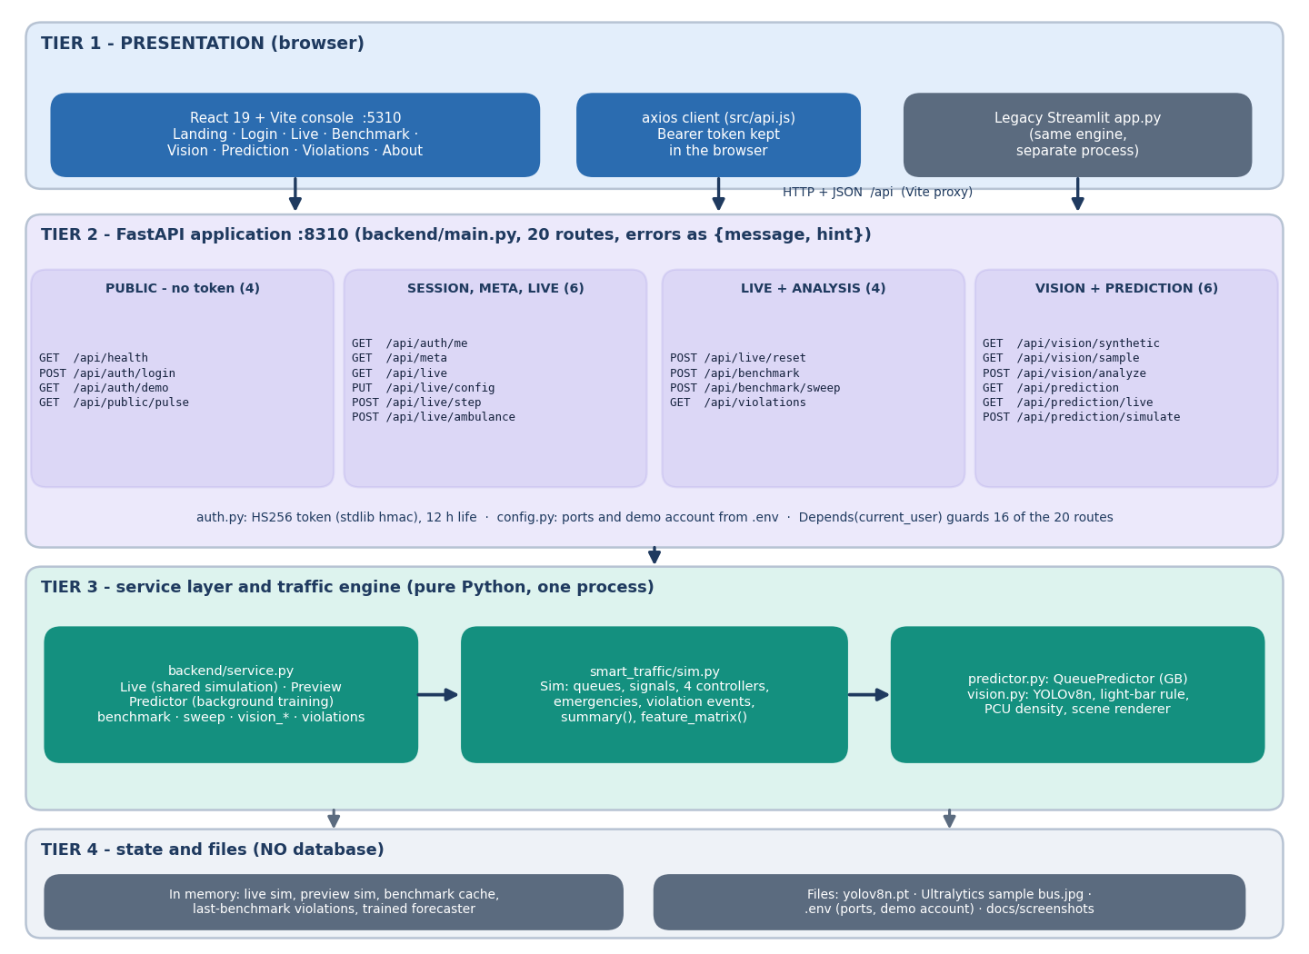
System Architecture
Console: React 19 + Vite, port 5310; 8 pages
API: FastAPI + Uvicorn, port 8310; 20 JSON routes, demo token login
Engine: smart_traffic (simulator, forecaster, vision) imported unchanged by the API service layer
State: one shared live simulation, benchmark cache and violation log in memory; no database
Files: yolov8n.pt, metrics JSON, screenshots
Dept. of CSE | Batch A10 | Final Review
10
Notes:
Four tiers. No database: state lives in process memory. The Streamlit app remains as the original front end.

Slide 11
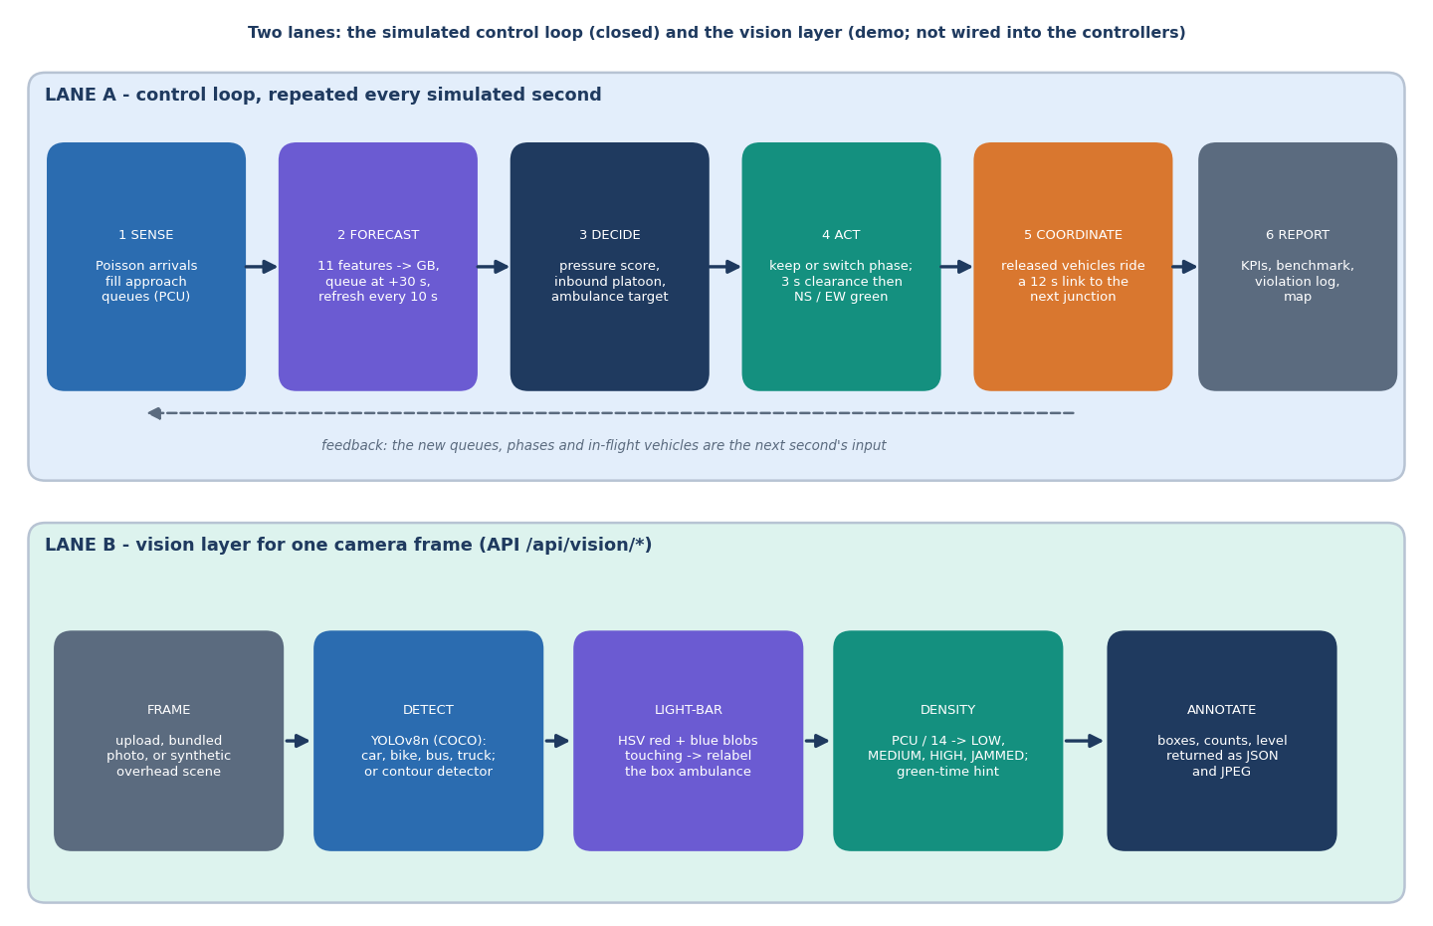
Methodology
Simulator: 1 s ticks, Poisson arrivals with rush-hour profile, saturation 0.5 veh/s, 12 s links, spill-back at 30 vehicles.
Vehicles carry PCU weights (car 1, bike 0.5, truck 2, bus 3).
Forecaster: gradient boosting on 11 features predicts each approach's queue 30 s ahead.
Benchmarks: 5 seeds, 1800 s, demand x1.2; demand sweep, ablation and emergency-heavy tests.
Vision checked on synthetic scenes and two public real-image sets.
Dept. of CSE | Batch A10 | Final Review
11
Notes:
Method in one picture: perceive, forecast, decide, measure. Demand is controller-independent, so controllers face identical vehicles and ambulances.

Slide 12
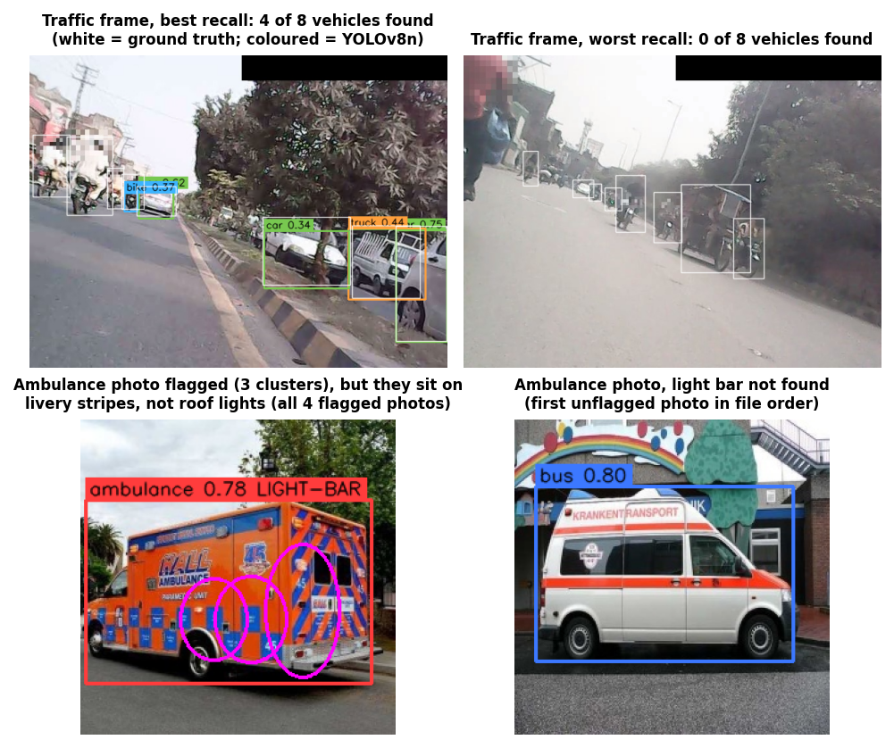
Dataset & Models
26,988
293
600
forecaster samples x 11 features
real frames, 1,467 vehicle boxes
real photos: 300 ambulance, 300 other
Data | Size | Used for
Simulator demand (generated) | seeds 40-44 | controller benchmarks; no external traffic dataset
Forecaster training runs | 6 x 1800 s | 2x2 / 3x3, demand 0.7-1.6, adaptive controller
Visaitech mixed traffic [32] | 293 frames | YOLOv8n on real dashcam traffic (CC BY 4.0)
Ambulance photos [33] | 600 images | light-bar rule on real photos (CC BY 4.0)
Synthetic overhead scenes | 300 scenes | classical detector + light-bar rule
Models: YOLOv8n (COCO weights, not fine-tuned); gradient boosting, random forest and persistence for the forecaster. Right: real photos, a hit and a miss for each test.
Dept. of CSE | Batch A10 | Final Review
12
Notes:
No traffic dataset is needed to drive the simulator. The two public image sets are used only to test the vision layer honestly; nothing is trained on them.

Slide 13
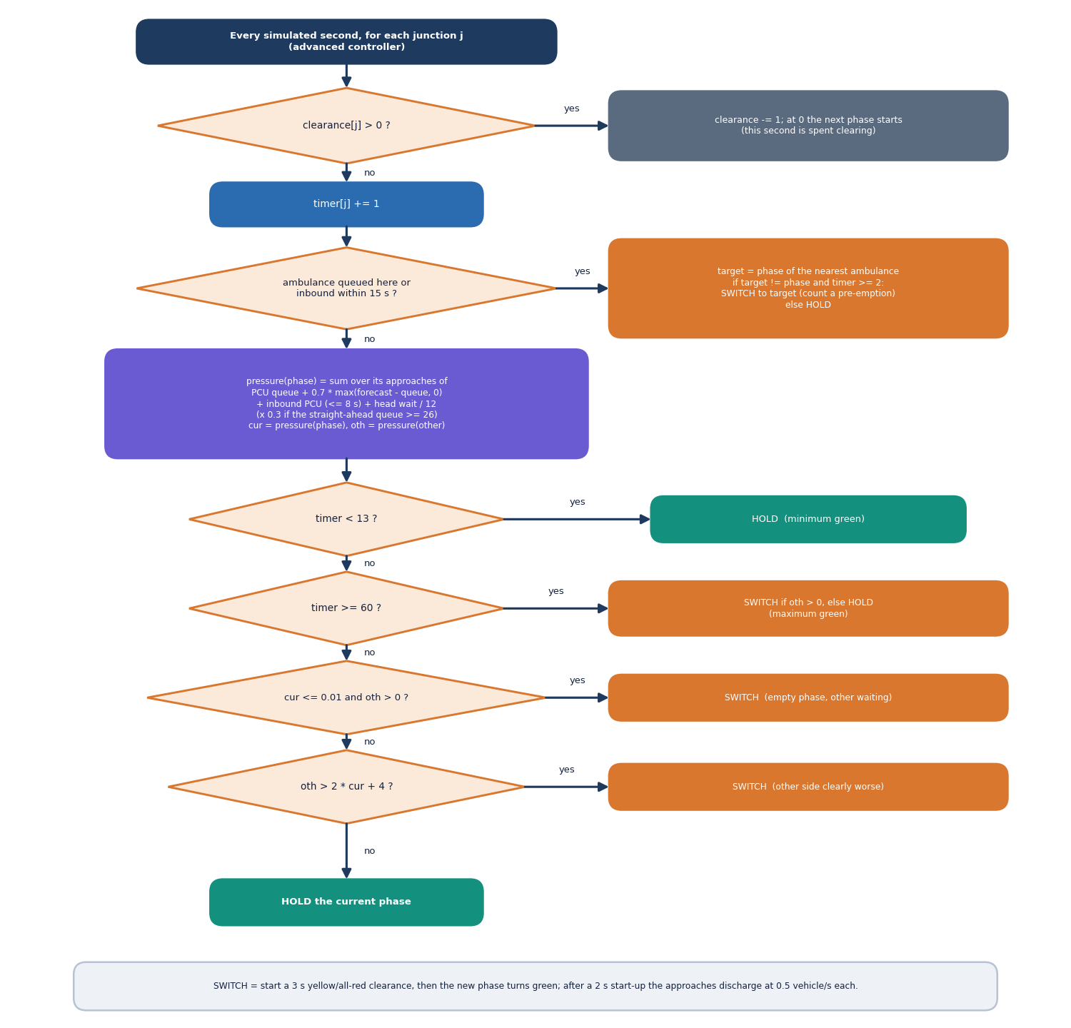
Controller Decision Workflow
Pressure per approach: PCU queue + 0.7 x max(forecast - queue, 0) + inbound PCU within 8 s + head wait / 12.
Spill-back: pressure x 0.3 if the straight-ahead downstream queue is already at capacity - 4.
Switch when the current phase is empty, when the other phase exceeds 2 x current + 4, or at 60 s; minimum green 13 s.
Emergency: the nearest ambulance (queued, or inbound within 15 s) forces its phase green after 2 s.
Compared with the base-paper style, which looks 5 s ahead at one junction only.
Dept. of CSE | Batch A10 | Final Review
13
Notes:
The core algorithm in smart_traffic/sim.py (_pressure, _decide, _emergency_target) as a flowchart.

Slide 14
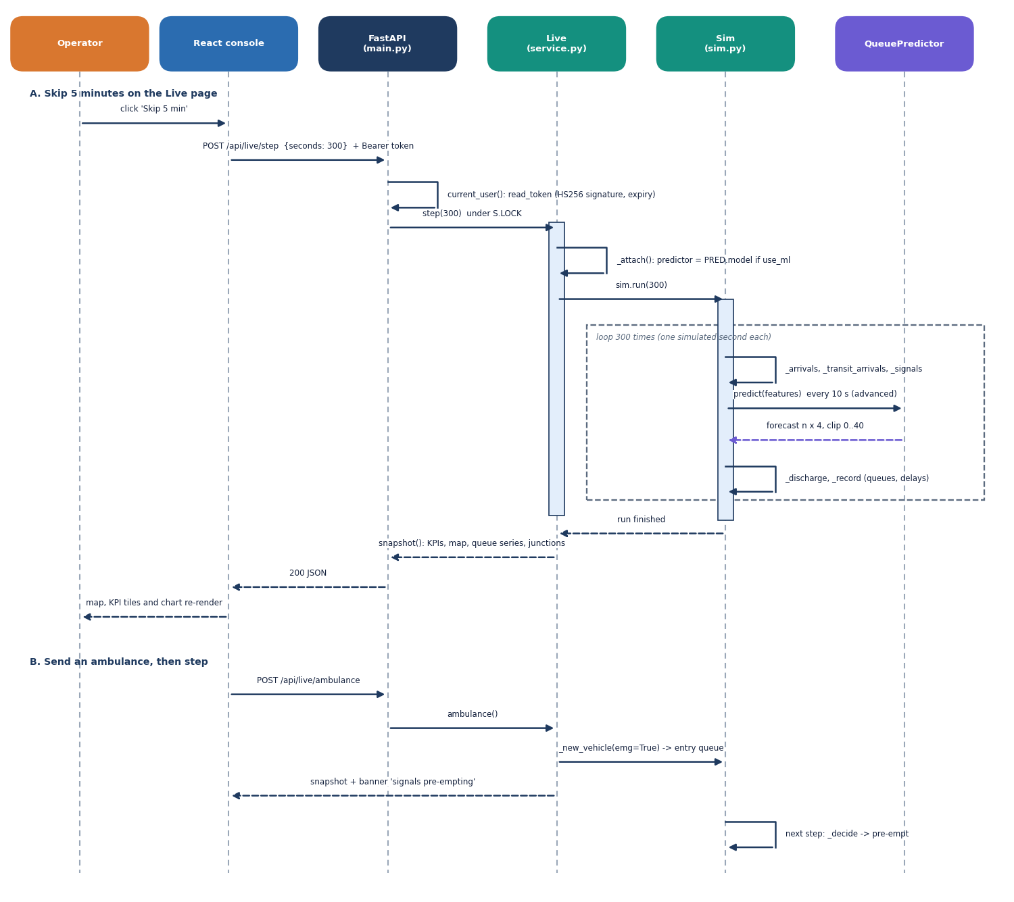
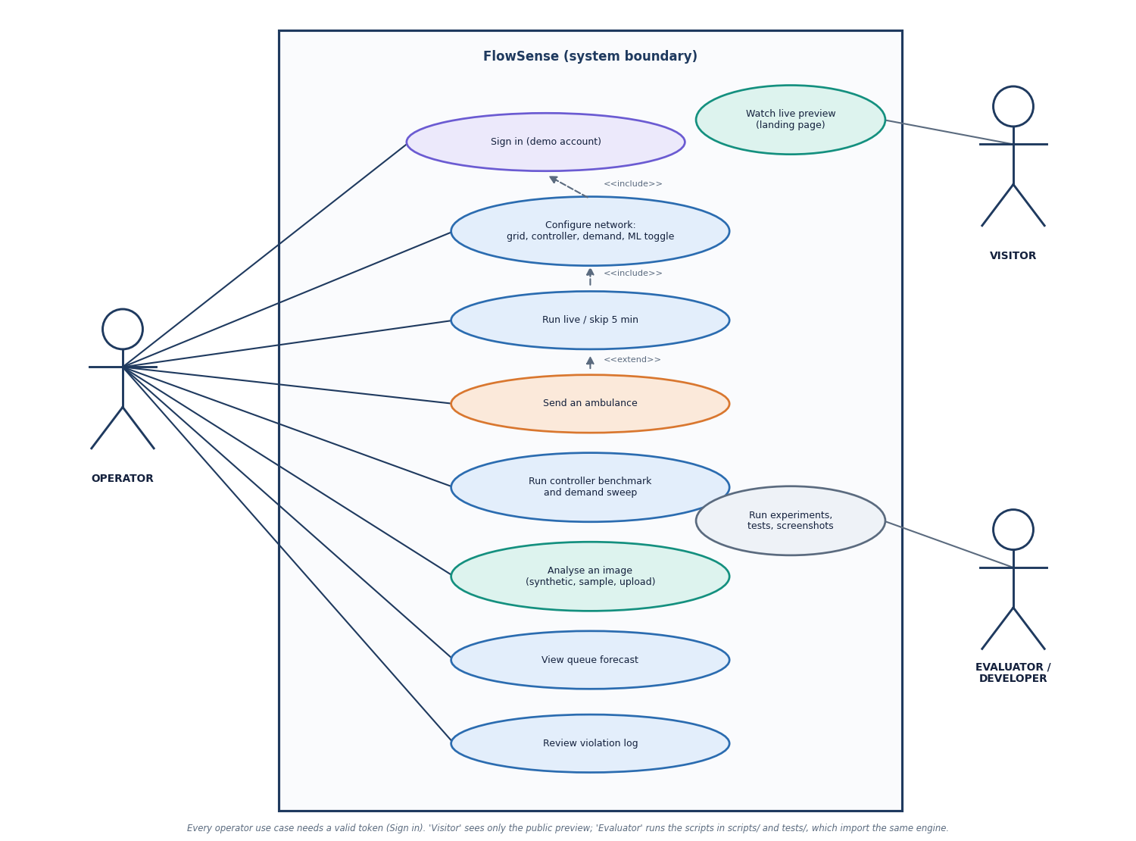
User – System Interaction
Dept. of CSE | Batch A10 | Final Review
14
Notes:
Sequence of the main flow and the use cases of the operator.

Slide 15
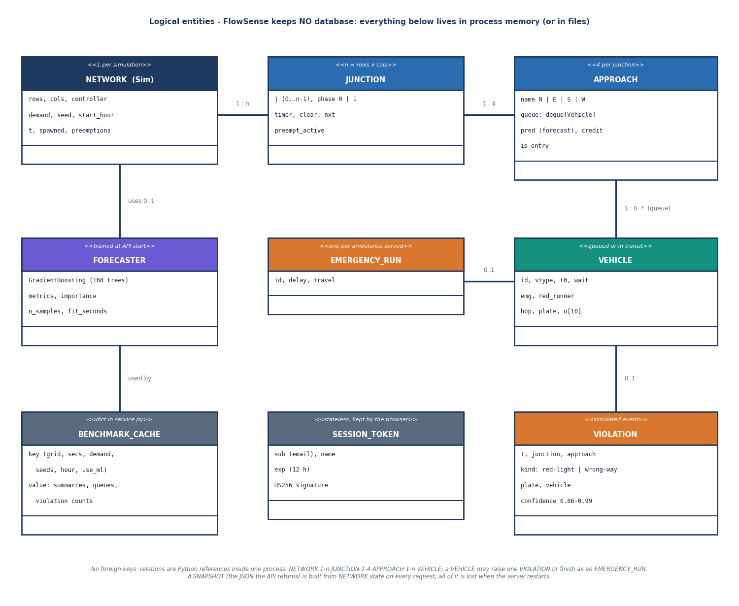
Data Design (no database)
Store | Content
LIVE simulation (memory) | one shared Sim, reset on grid change
PREVIEW simulation | landing-page pulse, separate seed
benchmark cache | keyed by grid, seconds, demand, seeds, ML
last-benchmark violations | feeds the Violations page
predictor (memory) | trained in a background thread, ~6 s
yolov8n.pt, metrics JSON | files on disk
No foreign keys and no persistence: simulation state is lost when the server restarts.
Dept. of CSE | Batch A10 | Final Review
15
Notes:
FlowSense has no database. The ER diagram shows logical entities.

Slide 16
Implementation Highlights
20
38 + 33
8
~5,500x
JSON routes
pytest tests + smoke checks
React pages
simulator speed vs real time (2x2)
Service layer wraps the unchanged engine; HS256 token auth with a demo operator account; readable JSON errors (message + hint) for 401, 413, 415, 422, 503.
The predictor trains in a background thread at start-up; /api/health reports readiness; benchmarks are cached by their settings.
Same traffic for every controller: arrivals and ambulances come from a controller-independent random stream.
Console: live map, benchmark, vision, prediction and violations pages; run.bat starts both servers; Windows needs torch imported before OpenCV.
Not present: database, TLS, multi-user accounts, real camera streams, hardware control.
Dept. of CSE | Batch A10 | Final Review
16
Notes:
Highlights and honest absences.

Slide 17
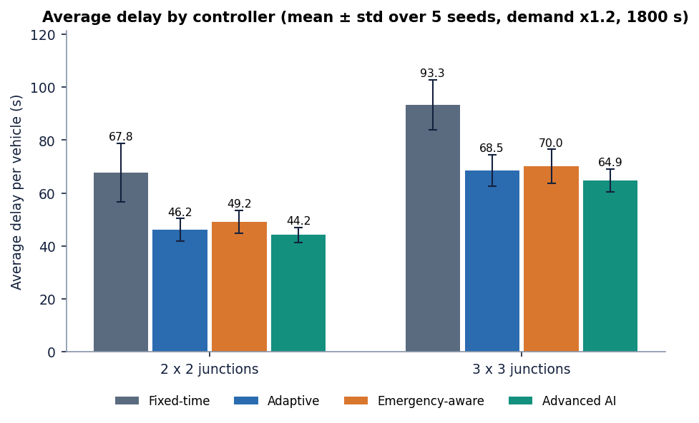
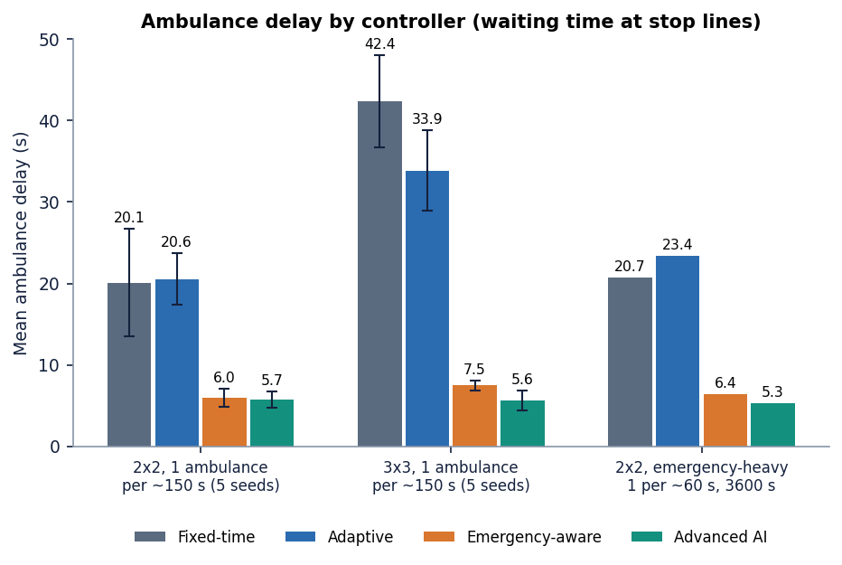
Results – Controller Benchmark
-34.8%
-30.5%
-4.3%
5.7 s
delay vs fixed-time, 2x2 (44.2 ± 2.8 vs 67.8 ± 11.0 s)
delay vs fixed-time, 3x3 (64.9 ± 4.3 vs 93.3 ± 9.5 s)
vs plain adaptive, 2x2: within one std
ambulance delay vs 20.1 s fixed (-71.5%)
Five seeds, 1800 s, demand x1.2. The base-paper-style controller is 6.5% worse than plain adaptive on mean delay (2x2) but cuts ambulance delay to 6.0 s; advanced vs base-paper style: delay -10.1%, ambulance -4.2% (2x2), -24.9% (3x3). Most of the gain over fixed-time is adaptivity itself.
Dept. of CSE | Batch A10 | Final Review
17
Notes:
Mean ± std over five seeds. The advanced controller's edge over plain adaptive control is small; its clearest benefit is ambulance delay.

Slide 18
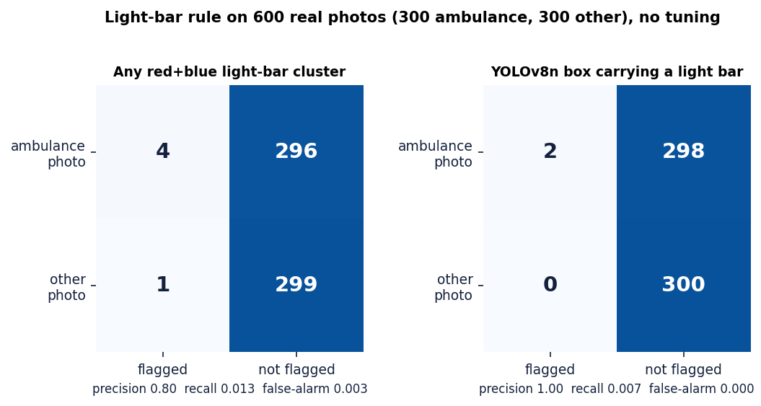
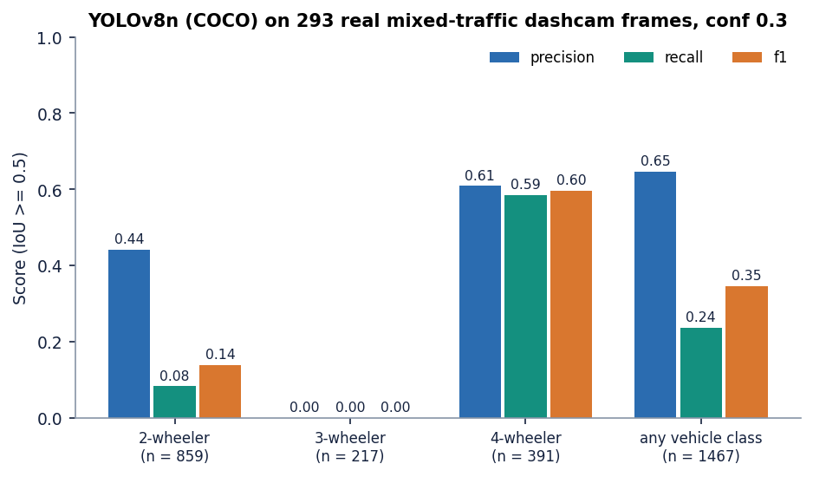
Confusion Matrix & Vision on Real Photos
Light-bar rule on 600 real photos: any red+blue cluster TP 4, FP 1, FN 296, TN 299 (recall 1.3%, false alarms 0.3%); YOLO box + light bar recall 0.7%.
YOLOv8n on 293 real dashcam frames (conf 0.3, IoU 0.5): 4-wheeler P 0.61 / R 0.59; 2-wheeler R 0.08; 3-wheeler R 0.00; all vehicles R 0.24.
Synthetic scenes: recall 97.6%, ambulance recall 100% - but noise sigma 10 gives zero detections and darkening removes every light bar. Base paper's trained detector: P 0.73, R 0.69.
Dept. of CSE | Batch A10 | Final Review
18
Notes:
Equivalent of the confusion matrix for this project: the real-photo test of the emergency rule. In-domain synthetic accuracy does not transfer.

Slide 19
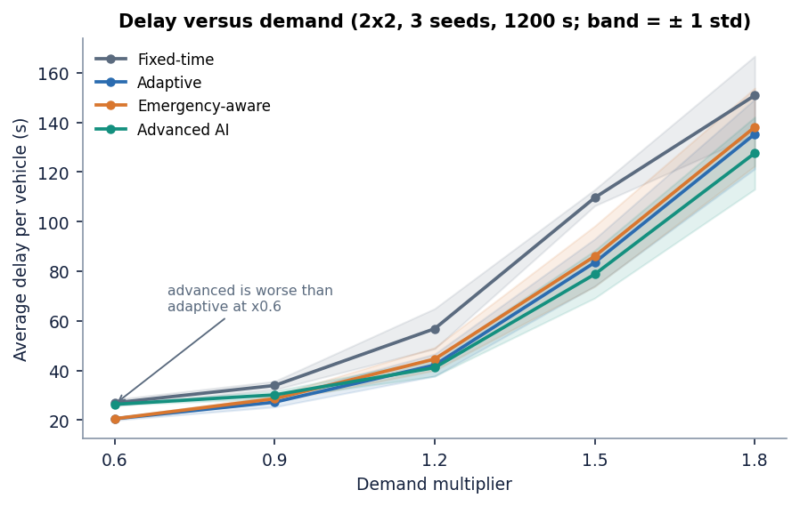
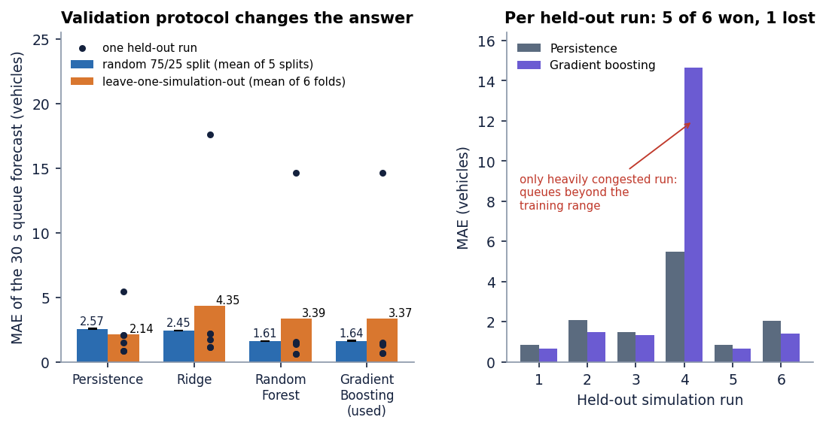
Parameter Analysis – Demand, Ablation, Forecaster
Ablation of the advanced controller | Avg delay (s) | Ambulance delay (s)
advanced (full) | 44.2 ± 2.8 | 5.7
no ML forecast | 47.4 ± 3.9 | 5.3
no platoon look-ahead | 44.9 ± 2.4 | 5.1
no emergency green wave | 44.5 ± 2.2 | 9.0
no emergency pre-emption | 42.4 ± 2.6 | 27.3
Demand sweep (2x2): advanced is worse than adaptive at x0.6 (26.4 vs 20.6 s), better from x1.2 (41.1 vs 42.2 s) to x1.8 (127.6 vs 135.3 s).
No pre-emption gives the lowest network delay but the slowest ambulance: a real efficiency / safety trade-off.
Forecaster: random split MAE 1.64 (persistence 2.57); held-out R² 0.04; beats persistence in 5 of 6 runs, fails on the congested one. Random forest is as good.
Dept. of CSE | Batch A10 | Final Review
19
Notes:
Parameter analysis: demand level, which component matters, and how far the forecaster generalises.

Slide 20
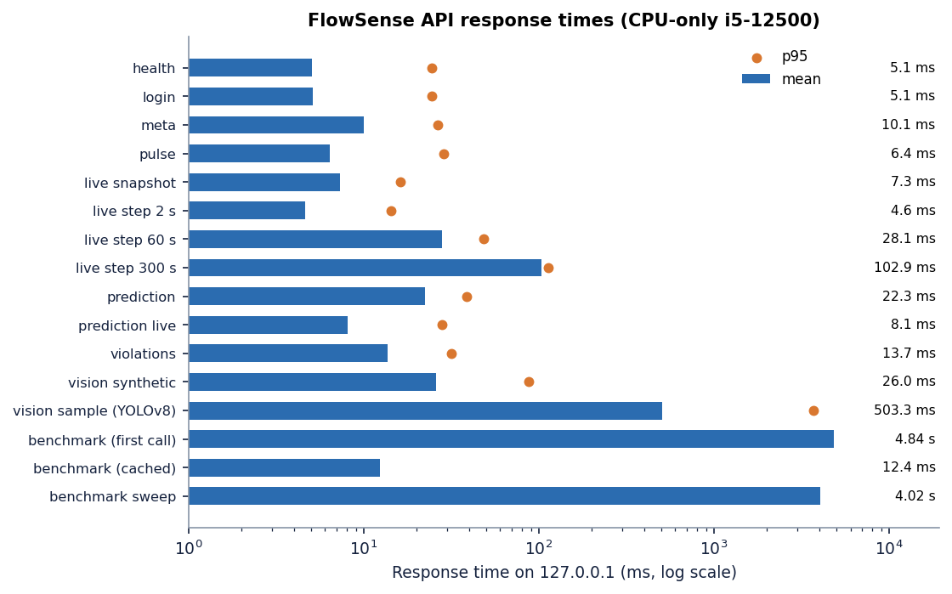
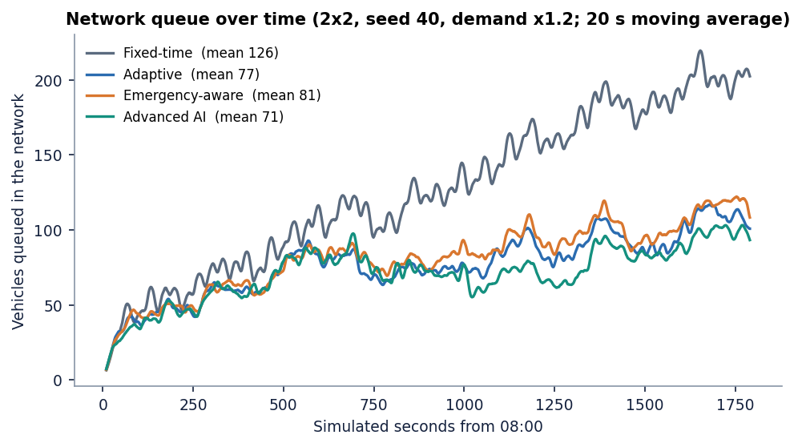
Performance & Testing
4.6 ms
103 ms
26 ms
48 ms
API: advance live sim 2 s
API: skip 5 simulated minutes
API: synthetic-scene detection
YOLOv8n per image, CPU (median)
Check | Result
pytest (engine 24, API 14) | 38 of 38 passed in ~28 s; smoke test 33 of 33 checks
First benchmark (4 controllers x 3 seeds x 1800 s) | 4.8 s; repeats from cache in ~12 ms
Not tested | concurrent users, load, security penetration, real cameras or signal hardware
Dept. of CSE | Batch A10 | Final Review
20
Notes:
Latencies measured on 127.0.0.1 on an i5-12500, CPU only. YOLOv8n takes ~48 ms per image on CPU; the first call also loads the model.

Slide 21
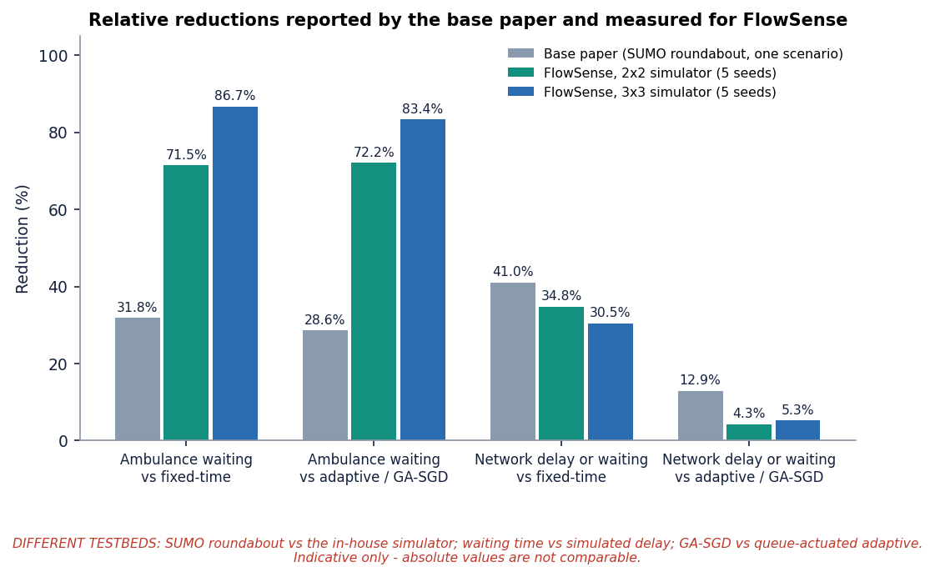
Comparison with Base Paper
Aspect | Base paper [1] | FlowSense (this project)
Detector | YOLO26m light-bar, trained on 3,130 images: P 0.73, R 0.69, mAP50 0.73 | YOLOv8n (not fine-tuned) + HSV light-bar rule; real photos: light-bar recall 1.3%, 4-wheeler recall 59%
Controller | GA-SGD plan + supervisory override | PCU pressure + ML forecast + look-ahead + green wave
Testbed | SUMO, one Rabat roundabout, selected scenario | In-house simulator, 2x2 and 3x3 grids, 5 seeds
Ambulance | Travel 56 s vs 70 s GA-SGD / 64 s fixed (-20 % / -12.5 %) | Delay 5.7 s vs 20.1 s fixed (-72%); -4% vs base-paper style
Network | Total waiting 19,887 s vs 22,827 s / 33,719 s (-12.9 % / -41 %) | Avg delay 44.2 s vs 46.2 s adaptive (-4.3%) / 67.8 s fixed (-34.8%)
Different simulators, networks and metrics: these figures are indicative, not a head-to-head.
The base paper's trained detector is the standard we did not reach.
No superiority is claimed.
Dept. of CSE | Batch A10 | Final Review
21
Notes:
State plainly that testbeds differ. The relative reductions are of the same kind but not comparable in absolute terms.

Slide 22
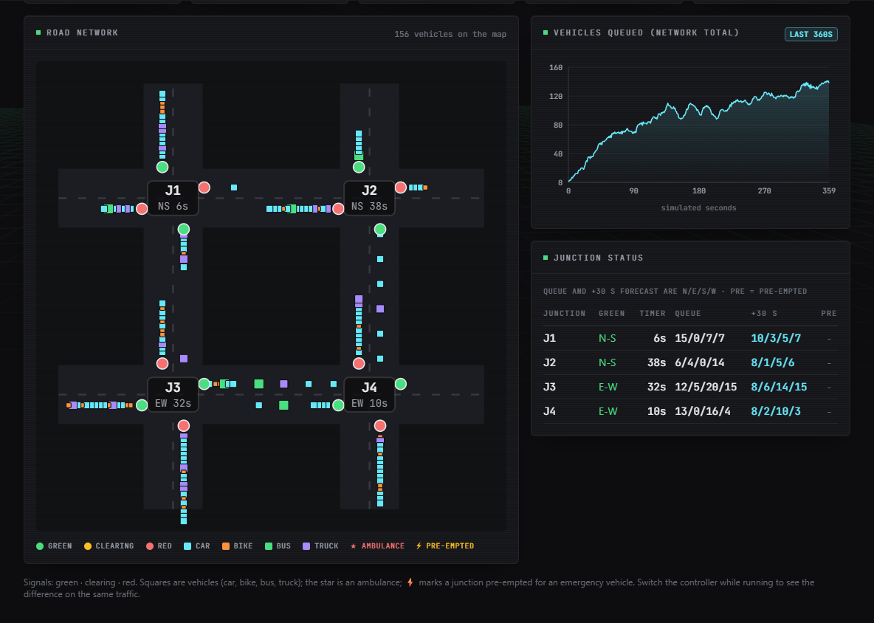
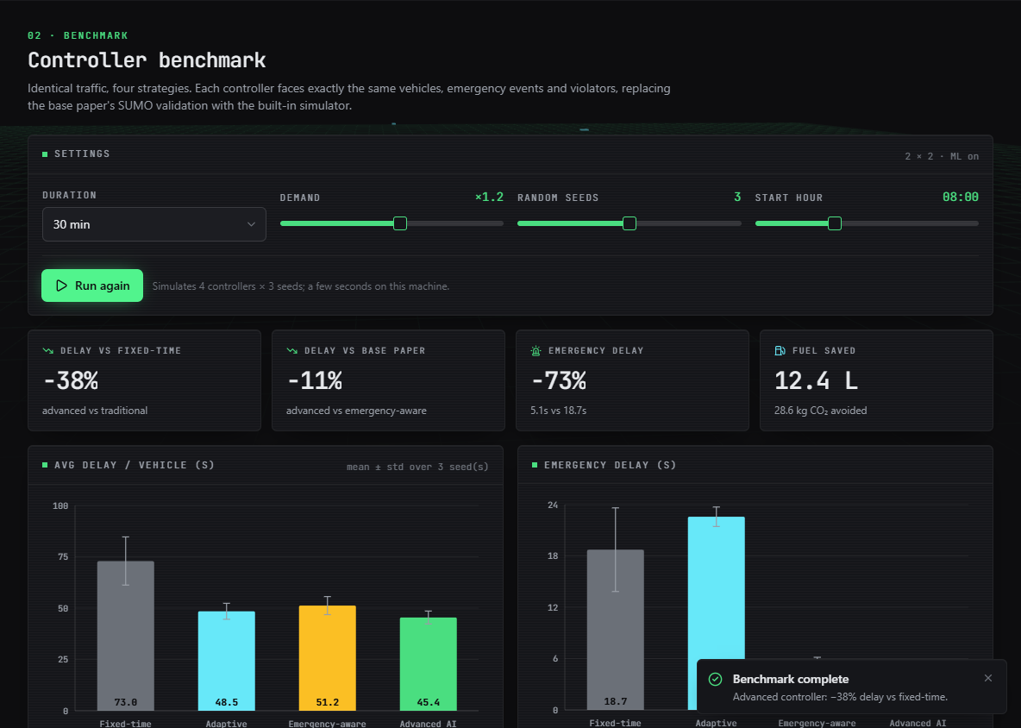
Output – Live Control and Benchmark
Left: live 2x2 network after 360 simulated seconds - signals, queued vehicles, junction table with +30 s forecasts. Right: benchmark with UI defaults (3 seeds): advanced -38% vs fixed-time, -11% vs emergency-aware, ambulance delay 5.1 vs 18.7 s.
Dept. of CSE | Batch A10 | Final Review
22
Notes:
Real captures of the running console. The report tables use 5 seeds, so their numbers differ slightly from this 3-seed screen.

Slide 23
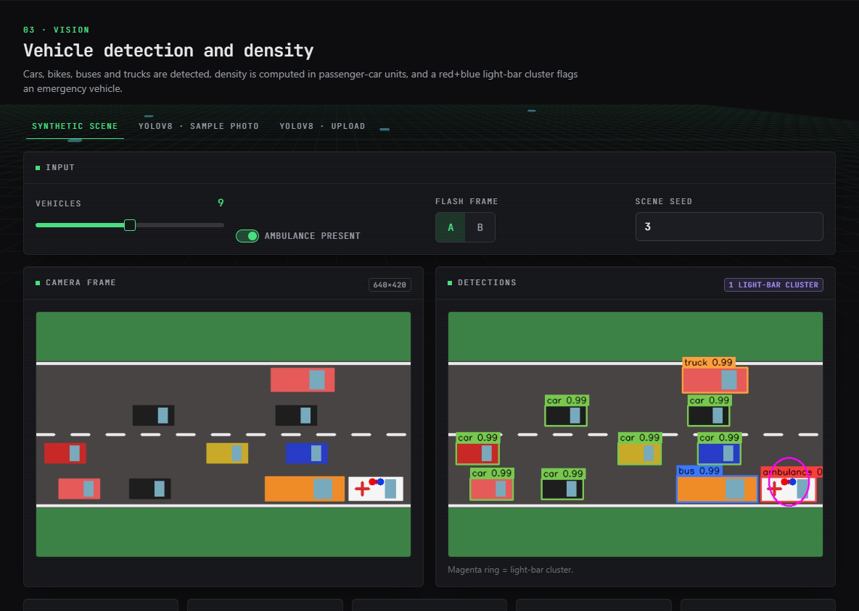
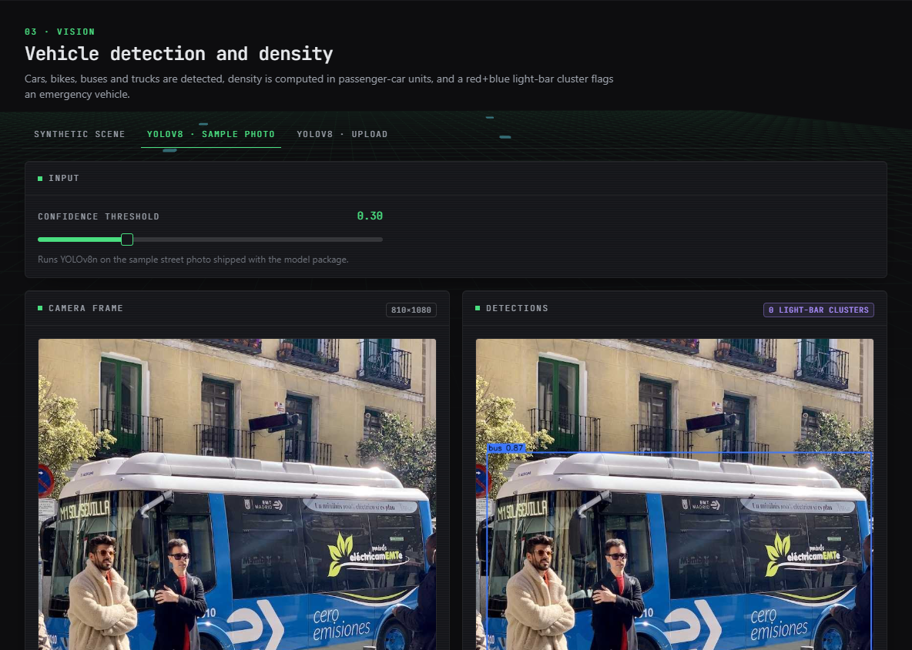
Output – Vision: Synthetic Scene and YOLOv8n
Left: synthetic overhead scene - boxes by class, a magenta ring on the red+blue light-bar cluster and the ambulance label. Right: YOLOv8n on the bundled sample photo detects the bus (0.87). Real-photo accuracy is much lower than on synthetic scenes (see results).
Dept. of CSE | Batch A10 | Final Review
23
Notes:
Vision page: classical detector on a synthetic scene and YOLOv8n on a real photo.

Slide 24
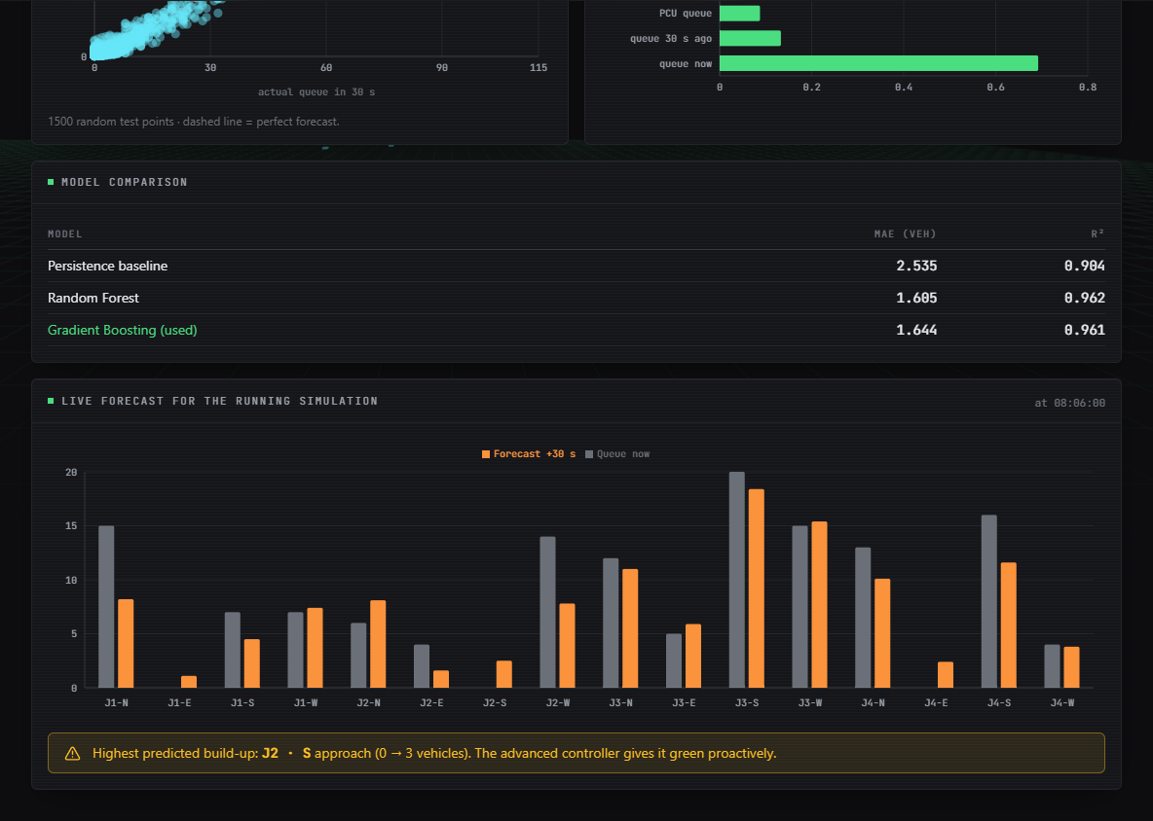
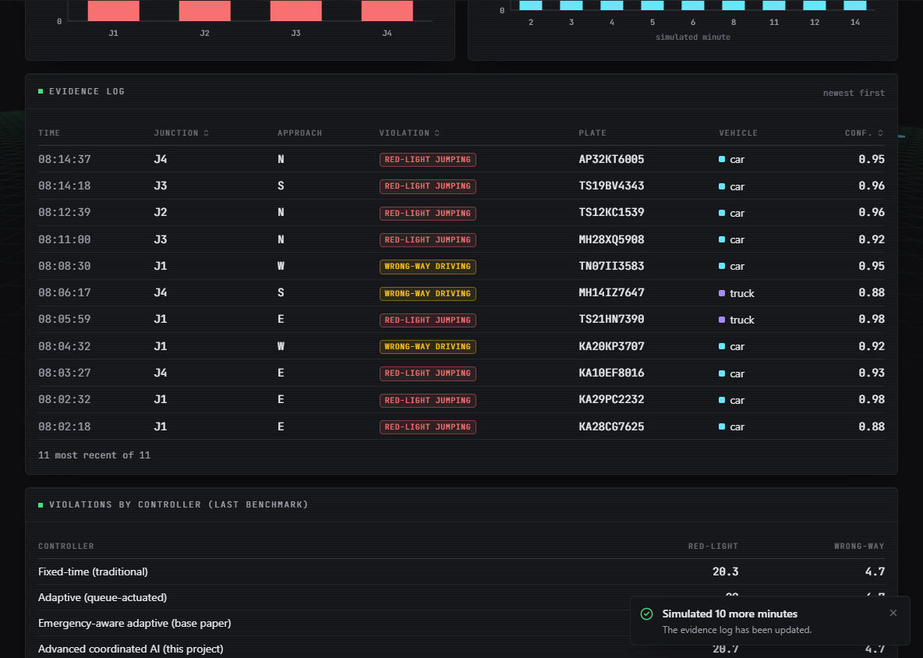
Output – Queue Forecast and Violation Log
Left: model comparison (persistence 2.535, random forest 1.605, gradient boosting 1.644 MAE) and the live per-approach 30 s forecast. Right: simulated red-light and wrong-way events with plate and confidence - generated from ground-truth events, not detected by a model.
Dept. of CSE | Batch A10 | Final Review
24
Notes:
Forecast and violation screens. Say clearly that violations are simulated events.

Slide 25
Conclusion & Objectives vs Outcomes
A working simulator-validated platform: adaptive control cuts delay about a third vs fixed-time (35% / 31%); pre-emption cuts ambulance delay 72-87%; 38 tests and 33 smoke checks pass.
Findings: advanced vs adaptive only -4.3%; pre-emption trades a little network delay for ambulance speed; the forecaster does not extrapolate; real-photo vision is weak (light-bar recall 1.3%).
# | Objective | Outcome
1 | Detect and count vehicles with YOLO | Partly: YOLOv8n on images only (no video stream); real recall 24%, 4-wheelers 59%
2 | Density per approach | Partly: PCU density per frame; per-lane density only in the simulator
3 | Adaptive green time by density | Met in simulation: -34.8% delay vs fixed-time
4 | Emergency vehicle priority | Met in simulation (ground-truth ambulances): 5.7 s vs 20.1 s; real-photo detection not achieved
5 | Coordination between junctions | Partly: simulated look-ahead; only -4.3% over adaptive
6 | Evaluate accuracy, waiting, clearance | Met: measured on simulator and two real-image sets; accuracy on real data is low
Dept. of CSE | Batch A10 | Final Review
25
Notes:
Be explicit about which objectives were met, partly met or not met.

Slide 26
Limitations & Future Scope
Known limitations
Future scope
In-house simulator, not SUMO; absolute numbers are not comparable with the base paper
Ambulances known by ground truth; vision not closed-loop
No trained light-bar detector: real-photo recall 1.3%
Violations simulated, not detected; no tracking or plate reading
Forecaster fails outside its training range (R² ~0.04 held-out)
Advanced controller worse at low demand; gain over adaptive within noise
No database, no cameras or hardware, single demo user, CPU only
Validate in SUMO or CARLA on real junction layouts
Train a light-bar / emergency-vehicle detector on labelled data; check flashing state
Wire vision into the control loop with temporal confirmation
Train the forecaster on wider congestion; try sequence or graph models
Fine-tune YOLO on local mixed traffic incl. three-wheelers
Real camera streams, persistent storage, multi-user roles
Pilot with edge hardware and a signal controller
Dept. of CSE | Batch A10 | Final Review
26
Notes:
Limitations first, then concrete next steps.

Slide 27
References
[1] M. Lamrabet, M. Alami Chentoufi and R. Ellaia, "Emergency-aware adaptive traffic signal control using YOLO-based light-bar detection and SUMO system-level validation," IEEE Access, vol. 14, pp. 104922-104933, 2026, doi: 10.1109/ACCESS.2026.3710015.
[6] C. R. Goenawan, "ASTM: Autonomous smart traffic management system using artificial intelligence CNN and LSTM," arXiv:2410.10929, 2024.
[7] K. Gupta, D. Saxena, A. K. Singh and C.-N. Lee, "Neighbor-embedded graph neural network-based crowd delivery traffic management in smart city," IEEE Trans. Emerg. Topics Comput. Intell., vol. 10, no. 3, 2026, arXiv:2608.22555.
[8] M. Lamrabet, R. Ellaia and M. Alami Chentoufi, "Simulation-based optimization of traffic signals using a hybrid GA-SGD approach: a case study of Morocco," Innov. Infrastruct. Solutions, vol. 10, no. 11, p. 511, Nov. 2025, doi: 10.1007/s41062-025-02319-w.
[9] N. Sasikala, S. Sridhar, S. H. Reddy, S. John and S. Shrinikethan, "Emergency traffic prioritization system with priority-based dynamic route optimization and IoT-enabled dynamic signal control," in Proc. 5th Int. Conf. Intell. Technol. (CONIT), Jun. 2025, pp. 1-5, doi: 10.1109/CONIT65521.2025.11166819.
[10] M. Zlatkovic, Z. Cvijovic, A. Stevanovic and Y. Song, "Concepts of signal control preemption for emergency vehicles in connected vehicle environments," J. Road Traffic Eng., vol. 69, no. 2, pp. 1-7, Jun. 2023, doi: 10.31075/pis.69.02.01.
[14] D. Jayakumar, M. Krishnaiah, S. Kollem, S. Peddakrishna, N. Chandrasekhar and M. Thirupathi, "Emergency vehicle classification using combined temporal and spectral audio features with machine learning algorithms," Electronics, vol. 13, no. 19, p. 3873, Sep. 2024, doi: 10.3390/electronics13193873.
[21] J. Redmon, S. Divvala, R. Girshick and A. Farhadi, "You only look once: unified, real-time object detection," in Proc. IEEE Conf. Comput. Vis. Pattern Recognit. (CVPR), Las Vegas, NV, USA, Jun. 2016, pp. 779-788, doi: 10.1109/CVPR.2016.91.
[22] G. Jocher, A. Chaurasia and J. Qiu, "Ultralytics YOLOv8," version 8.0.0, 2023. [Online]. Available: https://github.com/ultralytics/ultralytics
[24] P. A. Lopez et al., "Microscopic traffic simulation using SUMO," in Proc. 21st IEEE Int. Conf. Intell. Transp. Syst. (ITSC), Maui, HI, USA, Nov. 2018, pp. 2575-2582, doi: 10.1109/ITSC.2018.8569938.
[26] P. Varaiya, "Max pressure control of a network of signalized intersections," Transp. Res. C, Emerg. Technol., vol. 36, pp. 177-195, Nov. 2013, doi: 10.1016/j.trc.2013.08.014.
[27] H. Wei, G. Zheng, H. Yao and Z. Li, "IntelliLight: a reinforcement learning approach for intelligent traffic light control," in Proc. 24th ACM SIGKDD Int. Conf. Knowl. Discovery Data Mining, London, U.K., Jul. 2018, pp. 2496-2505, doi: 10.1145/3219819.3220096.
[28] J. H. Friedman, "Greedy function approximation: a gradient boosting machine," Ann. Statist., vol. 29, no. 5, pp. 1189-1232, Oct. 2001, doi: 10.1214/aos/1013203451.
[32] Visaitech, "Visaitech mixed-traffic vehicle detection dataset (v0.1)," Hugging Face, CC BY 4.0. [Online]. Available: https://huggingface.co/datasets/visaitech/vehicle-mixed-traffic-detection
The full numbered list of 33 references, including the batch survey items [2]-[5], is in the report.
Dept. of CSE | Batch A10 | Final Review
27
Notes:
Selected references; the complete numbered list is in the report.

Slide 28
THANK YOU
Questions & Suggestions
Dept. of CSE | Batch A10 | Final Review
28
Notes:
Invite questions.

