Slide 1
AI Powered Crop Disease Detection and Recommendation System for Sustainable Development
REVIEW 2 · DESIGN, METHODOLOGY AND PROGRESS
A leaf-photograph diagnosis web application with knowledge-based treatment advice, and a measured study of what it recognises
Presented by
Under the guidance of
Pishke Vishal 23K91A05J2
Kyatham Nithisha 23K91A05D1
Mekala Tharun Kuruma 23K91A05F1
Nakka Sreenith 23K91A05H0
V Krishna Teja, [DESIGNATION]
Department of Computer Science and Engineering
[COLLEGE NAME] · Batch C16 (CSE-C) · [ACADEMIC YEAR]
Notes:
This review shows how the system is designed and built, what is implemented, the first measured results on PlantDoc field photographs, and the open problems.

Slide 2
Contents
01
02
03
Recap and architecture
Methodology and dataset
Preprocessing and models
04
05
06
Training and decision logic
Data flow, database and UML
Technology stack
07
08
09
Implementation progress and results
Output screens and testing
Challenges and next steps
Notes:
Agenda for the design and progress review.

Slide 3
Recap: problem and proposed system
!
Problem
i
Proposed system
B
Base paper link
Farmers cannot identify crop disease early, expert help is not at hand, existing tools classify without advising, and advice in English alone is unusable for many.
Photo + crop in; disease, severity, chemical, organic and cultural treatment out, from a 38-class knowledge base, through a web application in English, Hindi and Marathi.
Pakka et al. (2026) generate foliage images to train field classifiers. We do not implement their generator; we take the motivation (field images are scarce) and build the farmer-facing diagnosis and advice around a classifier.
Notes:
One-minute recap of Review 1. The base paper is about training data for in-field classification; our contribution is the application and an honest measurement.

Slide 4
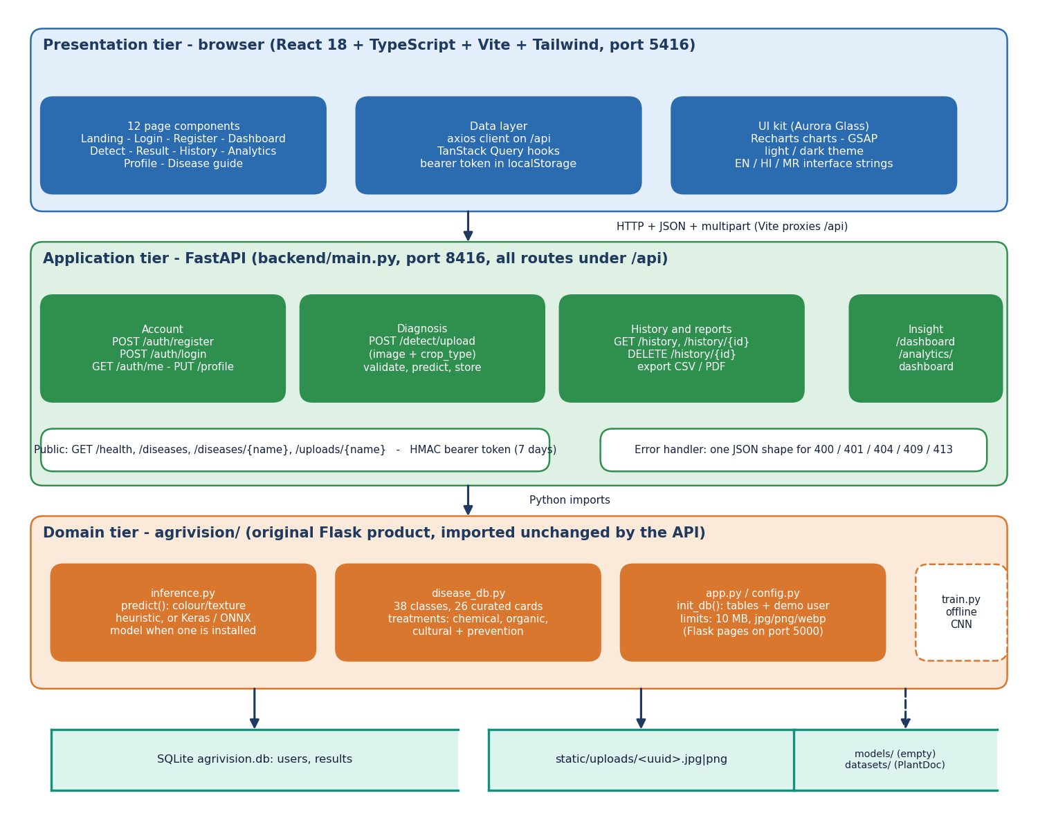
System architecture
Three tiers
Presentation: React 18 app, 12 page components, port 5416.
Application: FastAPI, 16 routes under /api, HMAC bearer token, port 8416.
Domain: the original Flask product (diagnosis, knowledge base, init_db), imported unchanged.
Storage: SQLite (users, results) and an uploads folder.
No trained network is installed: the engine is a colour/texture heuristic.
Notes:
The FastAPI layer imports the same detection and knowledge modules as the Flask app and shares its database file, so both front ends see the same accounts and scans.

Slide 5
Methodology: end-to-end workflow
Photo + crop
Validate upload
Resize + features
Candidate classes
Score, top-3
Knowledge card
Save + show
Two engines, one contract
Measured offline
Reproducible
The heuristic ships; a Keras model from train.py is loaded instead if models/ holds one. Both return a top-3 list that the knowledge base turns into advice.
scripts/run_experiments.py scores the heuristic, the compact CNN, MobileNetV2 and classical baselines on the same 236 test photos.
Seeds 42, 43, 44; JSON output feeds every figure and number in the documents.
Notes:
Top row is the runtime path of every scan (diagram 2 of the report); the boxes below explain how the engines relate and how they were measured.

Slide 6
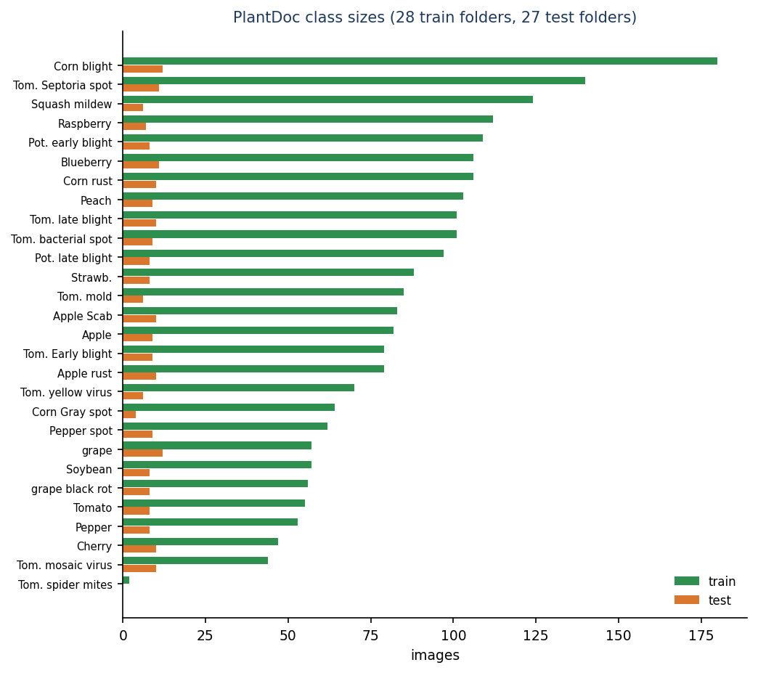
Dataset: PlantDoc field photographs
2,342
236
13
2 to 180
training photos, 28 folders
test photos, 27 folders
crops (14 in the 38-class label set)
photos per training class
Source: PlantDoc (Singh et al., 2020), CC-BY-4.0, web-scraped photographs with real backgrounds, lighting and blur [4].
Released split kept intact: 2,342 train and 236 test. The spider-mite folder has 2 training photos and no test photo, so test scores cover 27 classes.
All 28 folders map one-to-one to the product's 38 classes (PLANTDOC_MAP); 10 knowledge-base classes have no photos here.
The test split has 90 healthy and 146 diseased photos; always answering the largest class (corn leaf blight) scores 5.1 %.
Scored on the 2,342 training photos too, the heuristic gets 8.7%, so its weakness is not a small-test-set accident.
Notes:
PlantDoc is small and hard, which is the point: the literature numbers near 99 percent are for laboratory images. The original authors report 44.5 to 70.5 percent on cropped leaves.

Slide 7
Data preprocessing
1
In the application (inference.py)
2
For training (train.py and our experiments)
Accept JPG, PNG, JPEG, WEBP up to 10 MB; reject empty or unreadable files.
Convert to RGB, resize to 256 x 256, scale to [0, 1].
Compute six numbers: green share (g > r + 0.03 and g > b + 0.01), brown, yellow, dark (mean < 0.25), white (min > 0.72) and the global standard deviation.
Candidate classes come from the crop the farmer chose; 'general' keeps all 38.
Resize every photo to 224 x 224 (bilinear, no cropping), keep as uint8.
In-model augmentation, active only in training: horizontal flip, rotation 0.08, zoom 0.1, contrast 0.1.
Rescale to [0, 1] inside the network; MobileNetV2 uses its own [-1, 1] scaling.
10 % stratified validation split carved from the training folder for early stopping; the test folder is never touched.
Notes:
No leaf cropping or segmentation is done; photos are used as scraped. This is a limit: PlantDoc's authors show cropping helps.

Slide 8
Model: three engines
Engine | What it is | Size
Heuristic (shipped) | Hand-written score per class from six colour/texture numbers; confidence squeezed into 0.62 to 0.99 | no learned parameters
Compact CNN (train.py) | 5 separable-conv blocks (32, 64, 128, 256, 256 filters) with batch norm, max-pool and dropout 0.15, global average pooling, dropout 0.3, dense 256, softmax over 28 classes | 189,655 parameters, 2.4 MB
MobileNetV2 reference | ImageNet weights, new softmax head; head trained first, then the top 30 layers fine-tuned at 1e-4 | 2,293,852 parameters
The docstring of train.py calls the compact CNN 'about 1.1M parameters' and 'PD36-C-style'; it has 189,655 parameters and is not the PD36-C of [2], which has 1,250,694. Neither CNN is part of the shipped application.
Notes:
The shipped engine has no training. The compact CNN is the repository's own training recipe; MobileNetV2 is our reference to show what the data allows with transfer learning.

Slide 9
Training configuration
Setting | Compact CNN | MobileNetV2
Optimiser, rate | Adam 1e-3, halved on validation-loss plateau | Adam 1e-3 (head), 1e-4 (fine-tune)
Batch, input | 32, 224 x 224 | 32, 224 x 224
Epochs | up to 60, early stop on validation accuracy (patience 8) | head up to 20 (patience 4), fine-tune up to 12 (patience 3)
Validation | 10 % stratified split of the training folder | same split
Seeds | 42, 43, 44 (mean ± std reported) | 42, 43, 44
Time on CPU | 478 s per run (mean 28 epochs) | 723 s per run
Machine | Intel Core i5-12500, 15.7 GB RAM, no GPU; TensorFlow 2.21 | same
Also run once: the shipped protocol (test folder as validation) and a no-LR-decay variant; both stay at 12.7 to 13.6 %.
Notes:
Training is cheap on this data (a few thousand photos). Other jobs shared the CPU, so times are indicative.

Slide 10
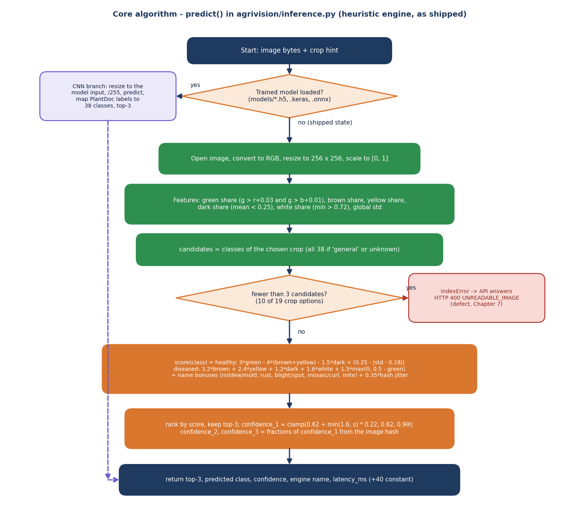
Decision logic
Score. Healthy classes reward green share and penalise brown, yellow and dark pixels; diseased classes reward brown, yellow, dark, white pixels and little green, plus small bonuses by disease name (rust, mildew, blight...).
Confidence. The top score is mapped to 0.62 to 0.99; the second and third scores come from the image hash. The three values add up to more than 100 % on most photos.
Advice. The top-1 class selects a knowledge card: severity, 3 treatments, prevention, 'urgent' for high severity.
Failure. A crop with fewer than 3 candidate classes raises an error (defect D1).
Notes:
The flowchart is the real predict() path. When a trained Keras or ONNX model is present, the left branch replaces the scoring steps.

Slide 11
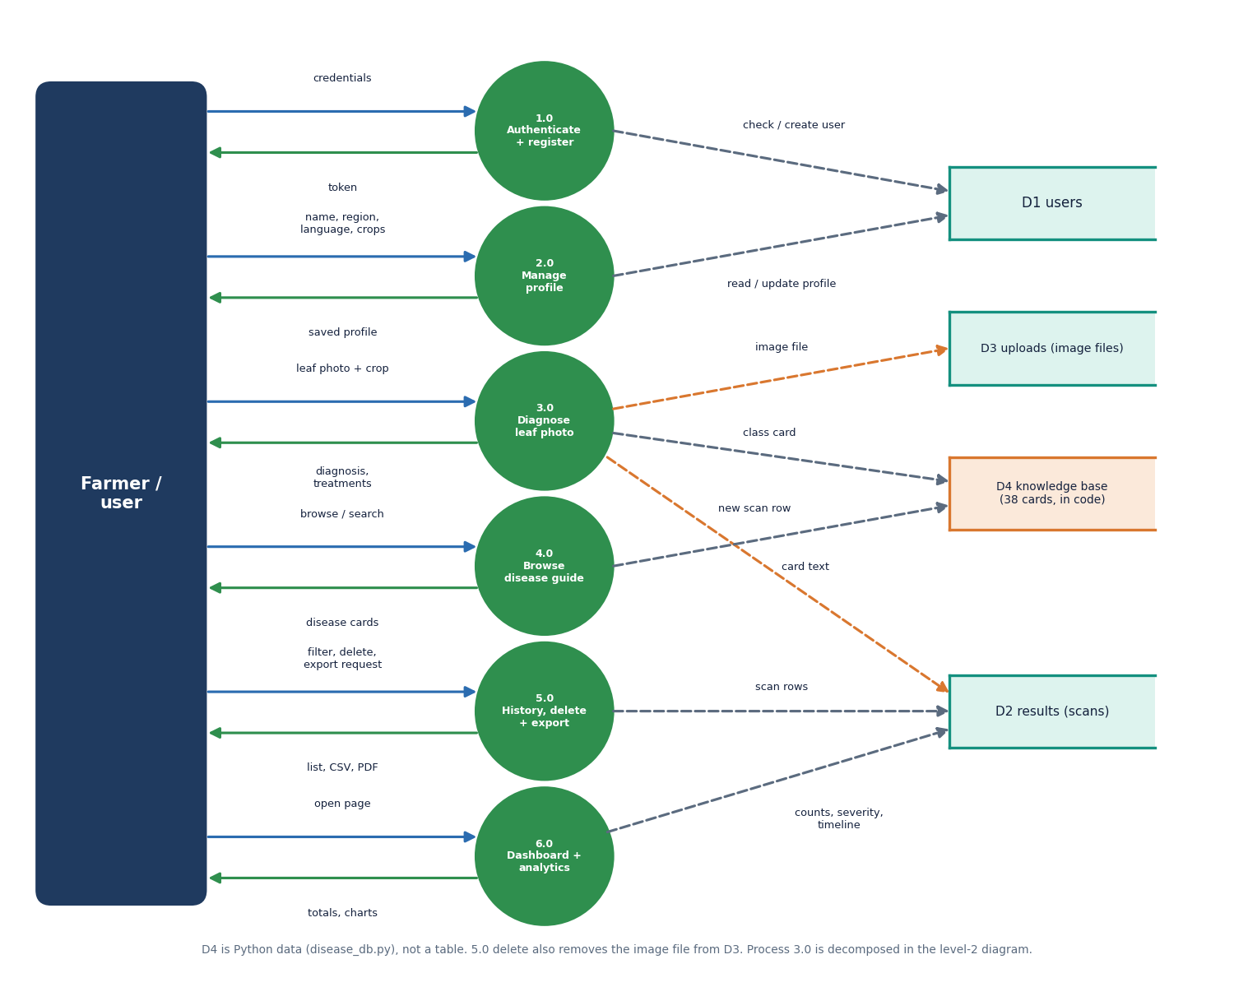
Data flow and modules
Module | Role
inference.py | predict(): heuristic or Keras / ONNX
disease_db.py | 38 classes, treatment cards
app.py, config.py | init_db(), limits, Flask pages
backend/main.py | FastAPI routes, token, exports
train.py | offline CNN training
frontend/src | 12 pages, API client, i18n
scripts/ | tests, experiments, captures
Notes:
Level-1 data flow: authenticate, manage profile, diagnose, browse the guide, history and exports, dashboard. The knowledge base is code, not a table.

Slide 12
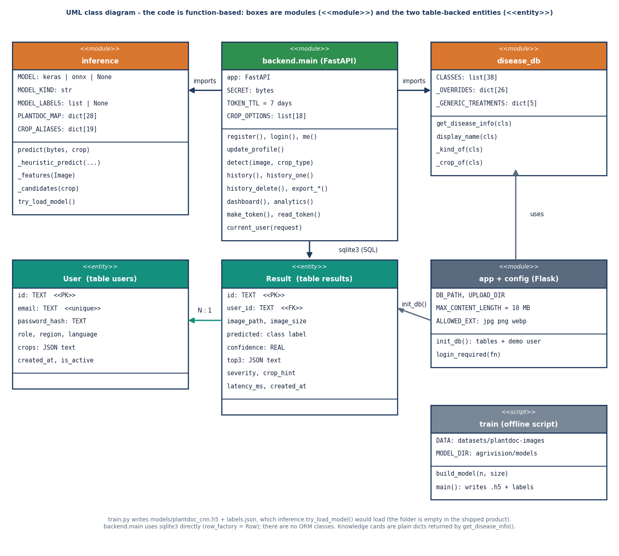
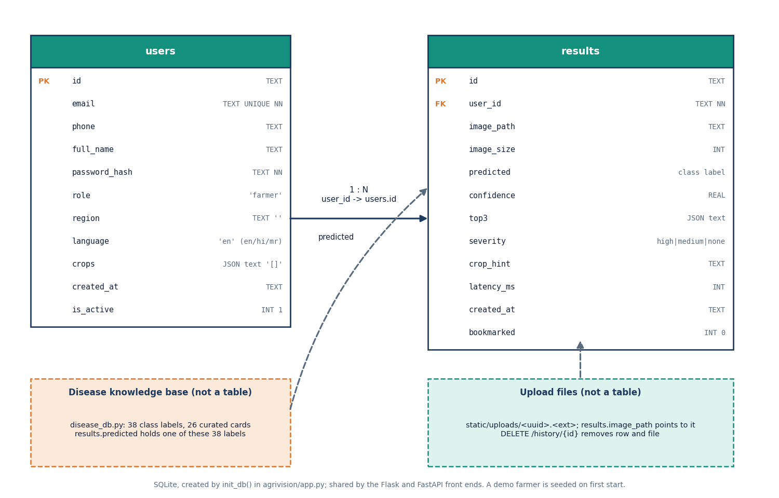
Database design and UML
Two SQLite tables, users 1 : N results; images are files.
Notes:
Two tables created by init_db(). The class diagram shows modules and the two entities because the code has no ORM classes.

Slide 13
Technology stack
Layer | Technology
Diagnosis | Python 3.11, NumPy, Pillow; TensorFlow 2.21 / Keras 3 for the offline CNNs; scikit-learn and OpenCV for the baselines
API | FastAPI, uvicorn, python-multipart; HMAC-signed bearer token; werkzeug password hashes; reportlab for PDF
Original product | Flask 3.1 templates (still runnable on port 5000), SQLite
Front end | React 18, TypeScript 5.9, Vite 8, Tailwind 4, TanStack Query, Recharts, GSAP; EN / HI / MR strings
Testing and capture | Python check scripts (smoke, edge), Playwright with Chrome for screenshots and UI checks
Hardware | Windows 11, Intel Core i5-12500, 15.7 GB RAM, no GPU
Notes:
Everything is open source and starts with run.bat; no GPU or cloud service is needed.

Slide 14
Implementation progress
Component | Status | Evidence
React interface (12 pages, light and dark) | Done | 18 screenshots, build passes, 55 UI checks earlier
FastAPI service (16 routes) | Done | 39/39 smoke checks pass
Knowledge base, 38 classes | Done | 26 curated cards, 3 treatments each
Heuristic diagnosis engine | Done, weak | 9.1 % top-1; fails for 10 of 19 crop keys
CNN training script | Done, defects | label shift and test-set selection (D5, D6)
Trained network inside the app | Not done | MobileNetV2 50.3 % is offline only
Hindi / Marathi | Partial | interface strings only; advice text in English
Fertiliser, yield, weather advice | Not done | proposed in the abstract
Notes:
State of the code base. The honest gaps are the missing trained model in the application, fertiliser, yield and weather advice, and translated advice text.

Slide 15
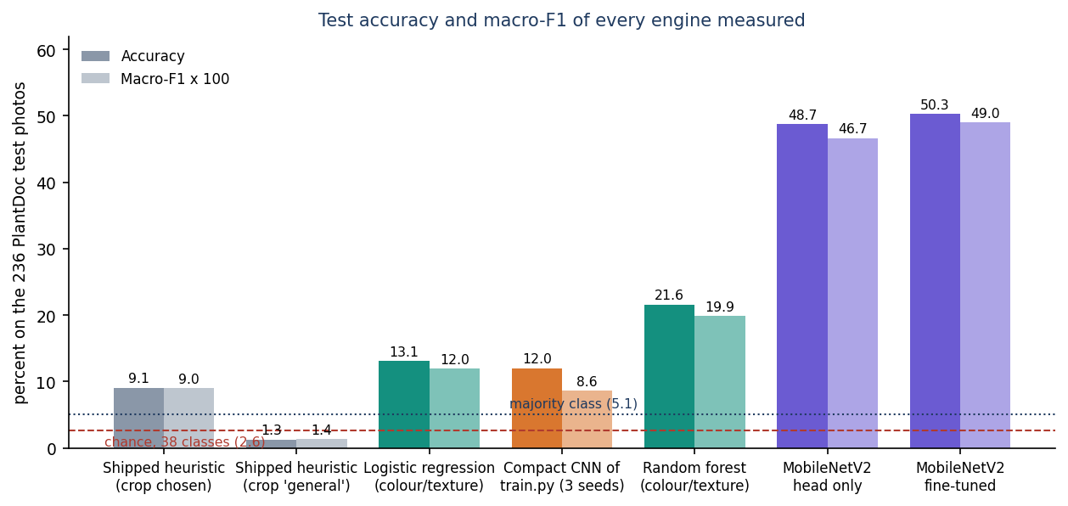
Preliminary results: PlantDoc test split
9.1%
12.0%
21.6%
50.3%
shipped heuristic, top-1 (crop chosen)
compact CNN of train.py (3 seeds)
random forest on colour/texture
MobileNetV2 transfer (3 seeds)
i
Reading
Chance is 2.6 % on 38 classes. MobileNetV2: macro-F1 0.49, top-3 79.8%, healthy-vs-diseased 88.8%. The shipped heuristic does not beat chance on healthy-vs-diseased (35.1% against 61.9 % for always saying diseased). Test set: 236 photos.
Notes:
All figures are on the 236 PlantDoc test photos, mean of 3 seeds except the heuristic (5 hash seeds) and the random forest. Foliagen's 98 percent and PD36-C's 99.53 percent are on other data and cannot be compared. PlantDoc's authors report 44.5 to 70.5 percent for cropped leaves.

Slide 16
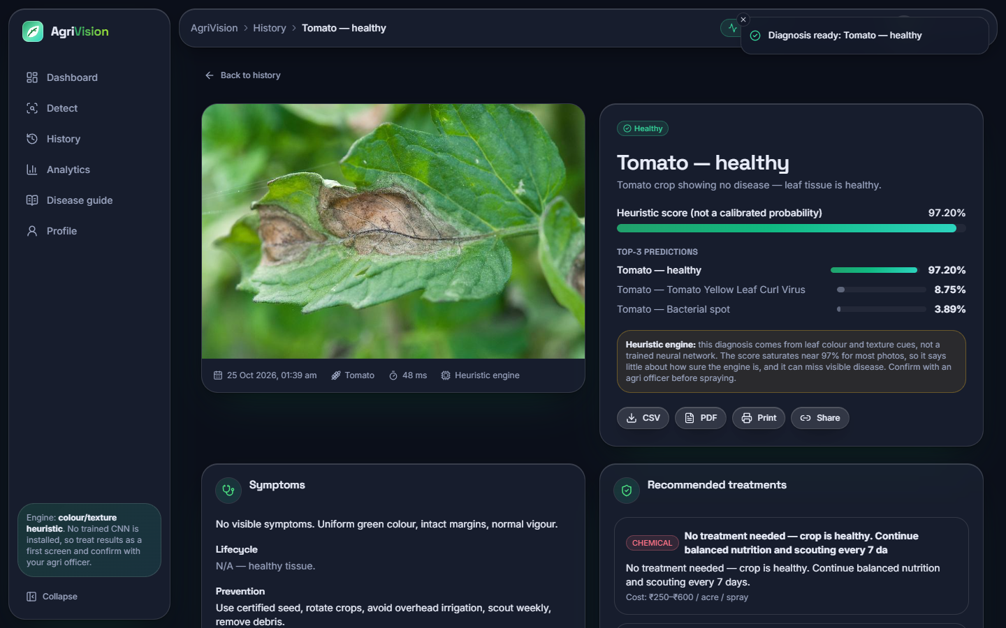
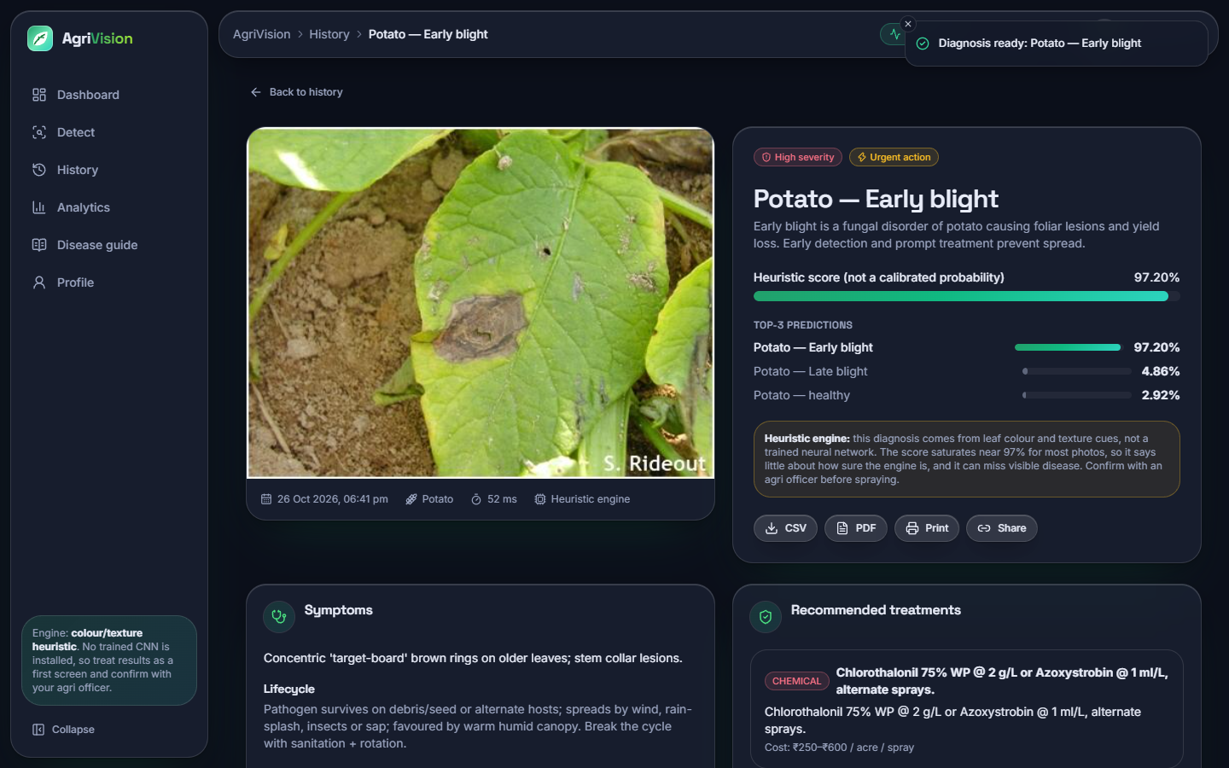
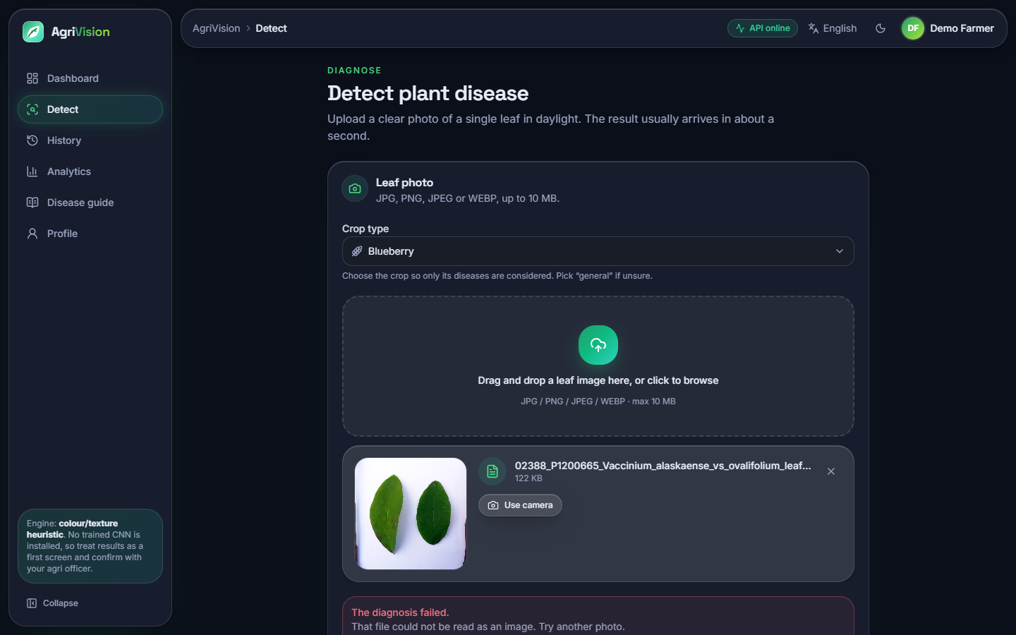
Output screens
Left: a tomato late-blight leaf scored 'healthy 97.2 %' by the heuristic engine (failure). Right: a correct potato early-blight diagnosis with severity and treatments, and the error shown for crop = Blueberry on a valid photo (defect D1).
Notes:
Real screenshots of the running application with PlantDoc test photos. The successes and the failures are shown on purpose.

Slide 17
Initial testing and observations
39/39
46 + 5
23 ms
55
API smoke checks pass
edge checks: passes + defects found
median detect round trip, 127.0.0.1
UI checks (earlier session)
Observation | Where it shows
10 of the engine's 19 crop keys (9 of the 18 offered in the web form) make the heuristic fail: 32.2 % of test photos get no answer | D1, screenshot 16
Three displayed scores add up to more than 100 % on 82 % of answerable photos | D2, Chapter 7
A token signed with the public default secret is accepted; login has no rate limit | D3, D4
Passwords hashed, forged tokens, bad uploads, path tricks and foreign origins all refused | 46 edge checks pass
Notes:
39 smoke checks and 51 edge checks (46 pass, 5 reproduce defects). The UI checks were run in the earlier frontend session.

Slide 18
Challenges and corrective actions
Challenge | What we found / did
No trained model ships; the app answers with a heuristic | Measured it (9.1 %), trained the repository's CNN (12.0 %) and a MobileNetV2 reference (50.3 %)
train.py validates on the test folder and shifts two grape labels | Our runs use a held-out validation split; defect D5 recorded
PlantDoc is small, noisy and imbalanced (2 to 180 per class) | Stratified splits, 3 seeds, per-class scores; no cropping yet
Displayed confidence is not evidence | Documented with a chart; calibration listed as future work
Advice is generic and not agronomist-reviewed | Stated as a limit; expert review planned
Notes:
Each challenge changed either the experiment design or how results are reported.

Slide 19
Next steps
1
Install a real model
2
Fix the defects
3
Improve accuracy
4
Complete the scope
Export the MobileNetV2 weights and labels.json to agrivision/models/ so the application stops using the heuristic.
Crop options with few classes, score sums, secret and rate limit, train.py labels and docstring.
Crop and segment leaves, try EfficientNet-style backbones, add data, report per-crop scores.
Translate advice text, add fertiliser, weather and yield advice, and ask an agronomist to review.
Notes:
Plan to the final review. None of these items is claimed as done.

Slide 20
Thank you
Questions and suggestions are welcome.
Notes:
Likely questions: why the shipped engine is weak; why PlantDoc; why not 99 percent; what is installed in the app today.

