Slide 1

AI Powered Crop Disease Detection and Recommendation System for Sustainable Development
Final Review · AgriVision
Team Details : Batch C16
Under the Esteemed Guidance of
V Krishna Teja
[DESIGNATION], Department of CSE
23K91A05J2 Pishke Vishal
23K91A05D1 Kyatham Nithisha
23K91A05F1 Mekala Tharun Kuruma
23K91A05H0 Nakka Sreenith
DEPARTMENT OF COMPUTER SCIENCE AND ENGINEERING · [COLLEGE NAME] · Academic Year [ACADEMIC YEAR]
Notes:
Introduce the team and the project: AgriVision, a leaf-photograph diagnosis and treatment-advice web application, and a measured study of how well it recognises disease on field photographs.

Slide 2
Table of Contents
Abstract
Base Paper & Literature Survey
Research Gap, Problem Statement & Objectives
Proposed System & Architecture
Methodology, Dataset & Models
Decision Logic, Interaction & Database Design
Implementation Highlights
Results, Confusion Matrix & Parameter Analysis
Performance, Testing & Defects
Comparison with Base Paper
Output Screens
Conclusion, Future Scope & References
Dept. of CSE | Batch C16 | Final Review
2
Notes:
The agenda follows the report: problem, design, method, results, comparison, screens, conclusion.

Slide 3
Abstract
Crop disease costs farmers a large share of their harvest and the expert who could name it is rarely at the field in time.
AgriVision lets a farmer upload a leaf photo, pick the crop and read the most likely disease, its severity and chemical, organic and cultural treatment advice for 38 classes, in an interface available in English, Hindi and Marathi (React + FastAPI + SQLite).
Measured on PlantDoc field photos (2,342 train, 236 test): the engine shipped in the app is a colour/texture heuristic and is right on 9.1 ± 1.0% of photos with the crop chosen and fails on 32.2% (a crop-option defect); the compact CNN of the training script reaches 12.0 ± 0.5%; a reference MobileNetV2 reaches 50.3 ± 0.9% (not yet in the app).
39 API checks pass; further tests record five defects. Fertiliser, yield and weather advice from the original proposal are not implemented.
Dept. of CSE | Batch C16 | Final Review
3
Notes:
State the system, then the honest measurement: the shipped heuristic is close to chance, a transfer-learning model reaches about 50 percent on this hard dataset.

Slide 4
Base Paper
N. Pakka, T. Wilkerson, L. Chen and N.-F. Tzeng, "Foliagen: Framework for crop foliage image generation from individual leaf images," IEEE Access, 2026, doi: 10.1109/ACCESS.2026.3727421.
Aspect | Foliagen (Pakka et al., IEEE Access, 2026)
Aim | Generate large, annotated crop foliage image sets from single-leaf photos, because annotated in-field foliage datasets are scarce
Method | Background removal (rembg), phyllotactic leaf placement per crop, a chosen disease rate gamma (1 to 20 %); no generative AI
Data | ASDID (10,722 soybean leaves, 7 diseases), a Kaggle soybean set, PlantVillage tomato; real foliage set MH-SoyaHealthVision
Evaluation | VGG19, ResNet50, DenseNet121, Swin Transformer, CBAM-ConvNeXt on 2 x RTX 6000 Ada GPUs; Adam 1e-4, batch 8
Result | Up to 98 % accuracy on natural foliage when 5 % of it is added to generated data; pre-training on generated data helps fine-tuning
Use here | Motivates the gap (field photos, scarce data); the project does not implement Foliagen: it builds the diagnosis + advice application
Dept. of CSE | Batch C16 | Final Review
4
Notes:
The base paper is about data generation for foliage classifiers. We take its motivation, not its method, and say so.

Slide 5
Literature Survey
Author / Year | Methodology | Dataset | Key results | Limitations
Sherifi et al. 2026 [2] | PD36-C compact CNN, 1.25 M parameters, desktop app | 87 k images, 38 classes (lab style) | 99.53 % test accuracy | Clean backgrounds; no advice
Kanakala, Ningappa 2025 [3] | CNN and LSTM, Adam 1e-4 | 70,295 train / 17,572 val, 38 classes | CNN 96.4 % val; LSTM 93.43 % | Random split of lab-style set
Singh et al. 2020 [4] | PlantDoc benchmark: VGG16, InceptionV3, InceptionResNetV2 | 2,598 field photos, 27 classes | 44.5-70.5 % (cropped), 13.7-29.7 % (raw) | Small, hard, noisy
Mohanty et al. 2016 [6] | AlexNet / GoogLeNet on PlantVillage | 54,306 images, 14 crops | 99.35 % held-out | Lab backgrounds; weak on other sources
Ferentinos 2018 [7] | Five CNNs, lab and field backgrounds | 87,848 images, 58 classes | 99.53 % best | Mostly lab; no advice
Barbedo 2018 [8] | Factors that limit deep learning on leaves | Review and experiments | Accuracy drops with condition variety | Describes, does not build
Four further survey papers named in the project proposal could not be verified; they are listed in the report as such and not quoted.
Dept. of CSE | Batch C16 | Final Review
5
Notes:
Lab-style datasets give 96 to 99 percent; the PlantDoc authors show that field photos give 14 to 70 percent.

Slide 6
Research Gap
Stated gap: The surveyed work addresses leaf image generation and classification. The gap is joining reliable disease classification to actionable, multilingual treatment and fertiliser recommendation.
Lab versus field: classifiers with 96 to 99 % accuracy are trained and tested on laboratory images; on field photographs the same models fall far lower [4], [8].
Label without advice: the surveyed classifiers stop at the disease name [2], [3]; the base paper [1] produces training data, not guidance for the farmer.
Language: advice is given in English only, which is unusable for many farmers.
Honest evaluation: few applications report accuracy on field photos or document the defects of their own engine.
Dept. of CSE | Batch C16 | Final Review
6
Notes:
Five gaps. We build for the second to fourth and measure the first and fifth.

Slide 7
Problem Statement
Given one photograph of a crop leaf and the crop the farmer chose, name the most likely disease (or 'healthy'), say how severe it is, and return treatment and prevention advice from a knowledge base, through a web application a non-expert can use, with the interface in English, Hindi or Marathi - and report honestly how accurate the diagnosis is on field photographs.
Input
Output
Evidence
One leaf photo (JPG, PNG, WEBP, up to 10 MB) and the crop chosen by the farmer
Top-3 classes, severity, three treatments, prevention, saved to a history
PlantDoc test split, three seeds, defects and gaps stated
Need: a system that identifies crop disease from a leaf photograph and returns treatment advice in the farmer's own language.
Dept. of CSE | Batch C16 | Final Review
7
Notes:
The statement has three parts: diagnose from a photo, return advice in the farmer's language, and report the accuracy honestly.

Slide 8
Objectives
1. Assemble a labelled dataset of healthy and diseased crop leaf images across target crops.
2. Preprocess and augment the images to handle variation in lighting, angle and background.
3. Train a CNN model to classify leaf images into specific disease categories.
4. Map each identified disease to a treatment and fertiliser recommendation.
5. Deliver diagnosis and advice through a web interface with multilingual support.
6. Evaluate classification accuracy per disease class and validate recommendations against agronomic guidance.
Dept. of CSE | Batch C16 | Final Review
8
Notes:
The six objectives of the proposal. The conclusion states which were met.

Slide 9
Proposed System
Leaf photo + crop
Validate, resize 256 px
Colour / texture features
Score + rank classes
Knowledge card + advice
React web app: sign-in, Detect, Result, History, Analytics, Dashboard, Disease guide, Profile; English, Hindi, Marathi interface; light and dark theme.
FastAPI service (16 routes, bearer-token login) over the original Flask product: same detection engine, same knowledge base, same SQLite file.
Engine as shipped: a colour/texture heuristic. A trained Keras or ONNX model placed in models/ would be loaded instead; the training script and the PlantDoc label map exist.
Knowledge base: 38 classes, 14 crops; each disease has symptoms, severity, chemical, organic and cultural treatments and prevention.
Dept. of CSE | Batch C16 | Final Review
9
Notes:
The pipeline as a row of boxes, then four properties. Say plainly that the shipped engine is a heuristic.

Slide 10
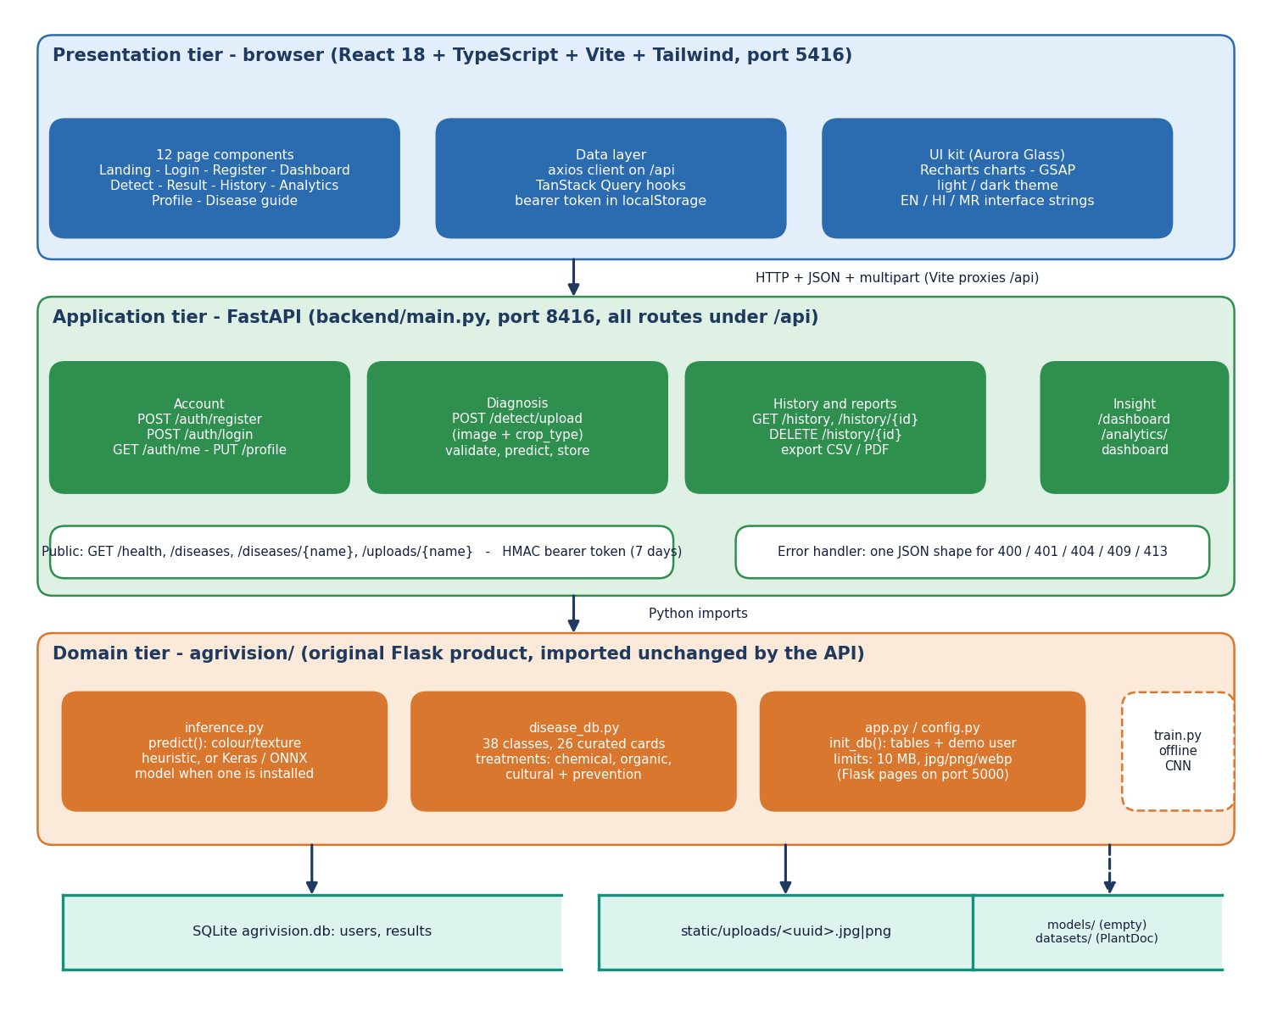
System Architecture
Presentation: React 18 + Vite + TypeScript + Tailwind, 12 page components, port 5416
Application: FastAPI, 16 routes under /api, HMAC bearer token, one JSON error shape, port 8416
Domain: agrivision/ inference engine and 38-class knowledge base, imported unchanged
Storage: SQLite (users, results) and an uploads folder; models/ is empty
Launch: run.bat builds the environment and starts both servers
Dept. of CSE | Batch C16 | Final Review
10
Notes:
Three tiers plus storage; the API layer imports the original Flask modules rather than reimplementing them.

Slide 11
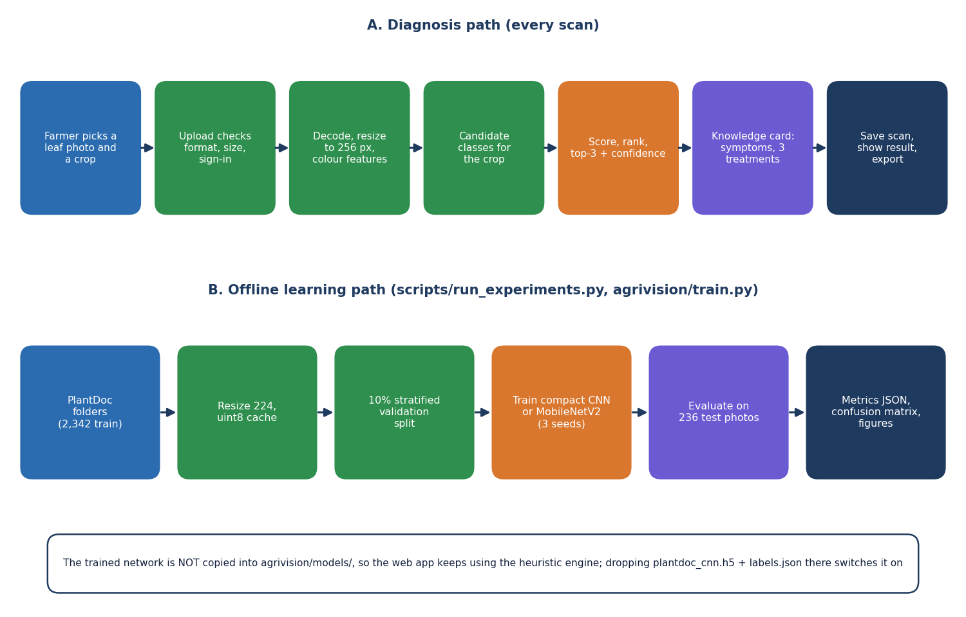
Methodology
Diagnosis path: upload checks, 256 px resize, six colour/texture features, candidate classes of the chosen crop, scored top-3, knowledge card.
Learning path (offline): PlantDoc folders, 224 px cache, 10 % validation split, compact CNN or MobileNetV2, 3 seeds, test on 236 photos.
The trained network is not copied into models/, so the app keeps the heuristic.
Dept. of CSE | Batch C16 | Final Review
11
Notes:
Two paths. The offline path is how every accuracy figure in this deck was measured.

Slide 12
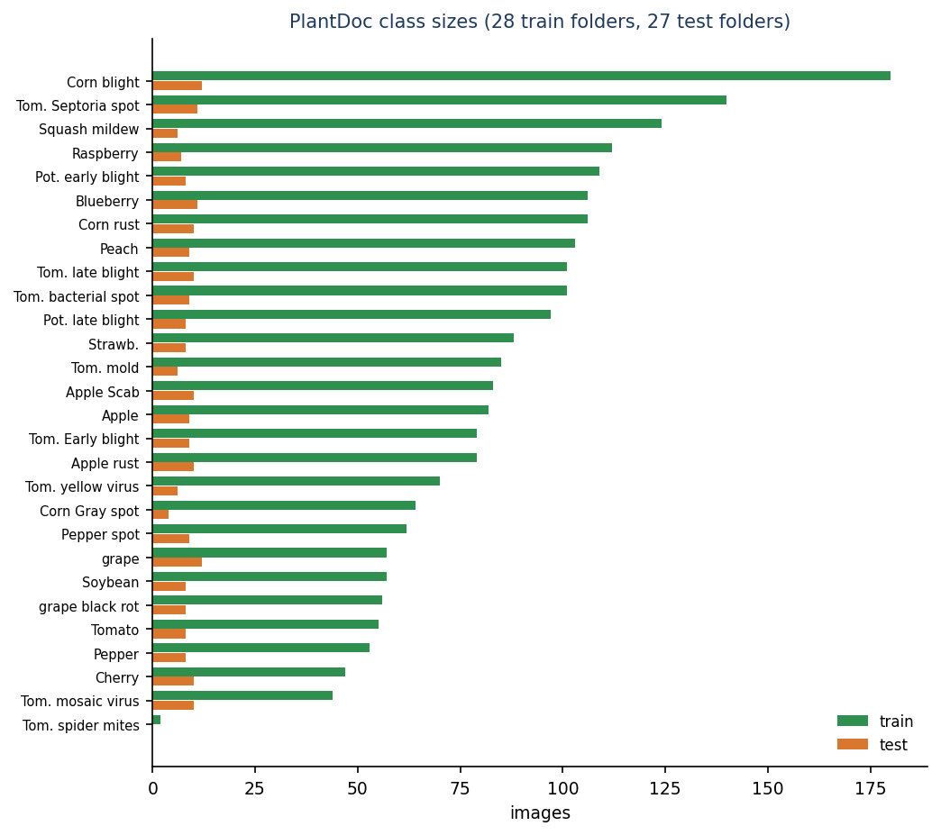
Dataset, Preprocessing & Models
PlantDoc (Singh et al.), CC-BY-4.0, web-scraped field photos: 2,342 train + 236 test, 28 train folders, 27 test folders (spider mites has 2 train photos, no test photo); 13 crops; 2 to 180 images per class.
Preprocessing: resize to 224 x 224, 10 % stratified validation split; in-model flip, rotation 0.08, zoom 0.1, contrast 0.1. The app's heuristic resizes to 256.
Compact CNN (train.py): 5 separable-convolution blocks, batch norm, GAP, dense 256; 189,655 parameters (the docstring says about 1.1 M); Adam 1e-3, batch 32.
MobileNetV2 reference: ImageNet weights, 2.29 M parameters; head trained, then top 30 layers fine-tuned at 1e-4.
Baselines: random forest and logistic regression on colour histograms and edge statistics.
Dept. of CSE | Batch C16 | Final Review
12
Notes:
Small, imbalanced field data. Note the parameter count of the compact CNN differs from its docstring.

Slide 13
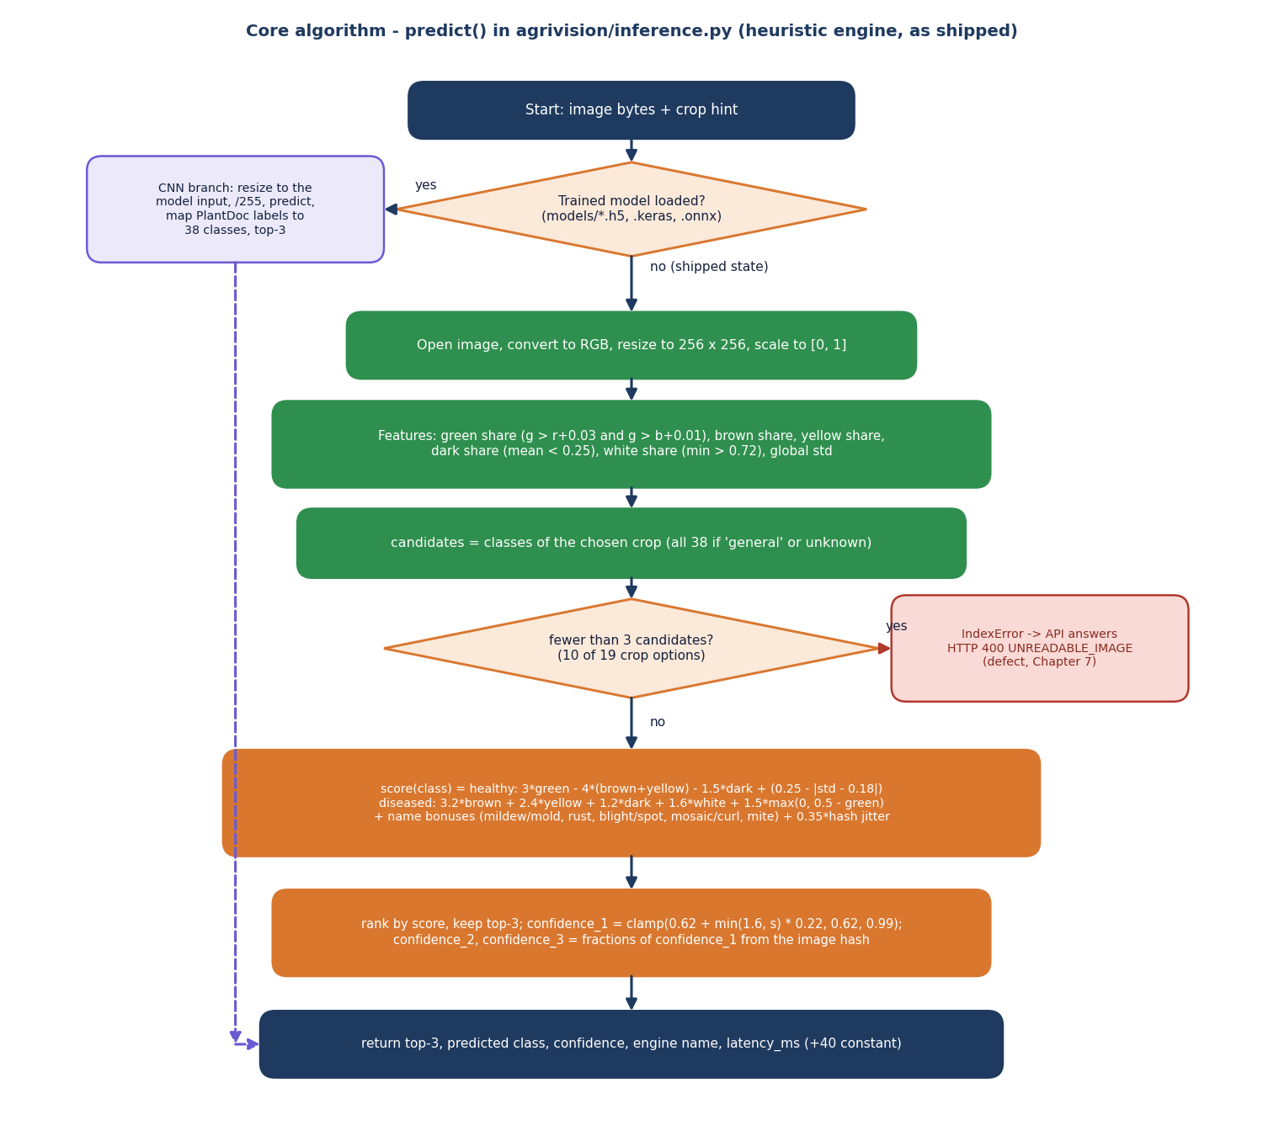
Decision Logic of the Shipped Engine
Features from a 256 px copy: green, brown, yellow, dark and white pixel shares and the global standard deviation.
Candidates: the classes of the chosen crop, or all 38 on 'general'.
Healthy score rewards green and penalises brown/yellow; disease scores reward brown, yellow, dark and white plus name cues (rust, blight, mildew, mosaic, mite).
Confidence is clamp(0.62 + 0.22 x score, 0.62, 0.99): it never reports low confidence.
With fewer than 3 candidate classes (10 of 19 crop keys; 9 of the 18 in the web form) the code raises IndexError and the API returns HTTP 400 (defect D1).
Dept. of CSE | Batch C16 | Final Review
13
Notes:
The heart of the shipped engine. The confidence formula explains why almost every photo shows about 97 percent.

Slide 14
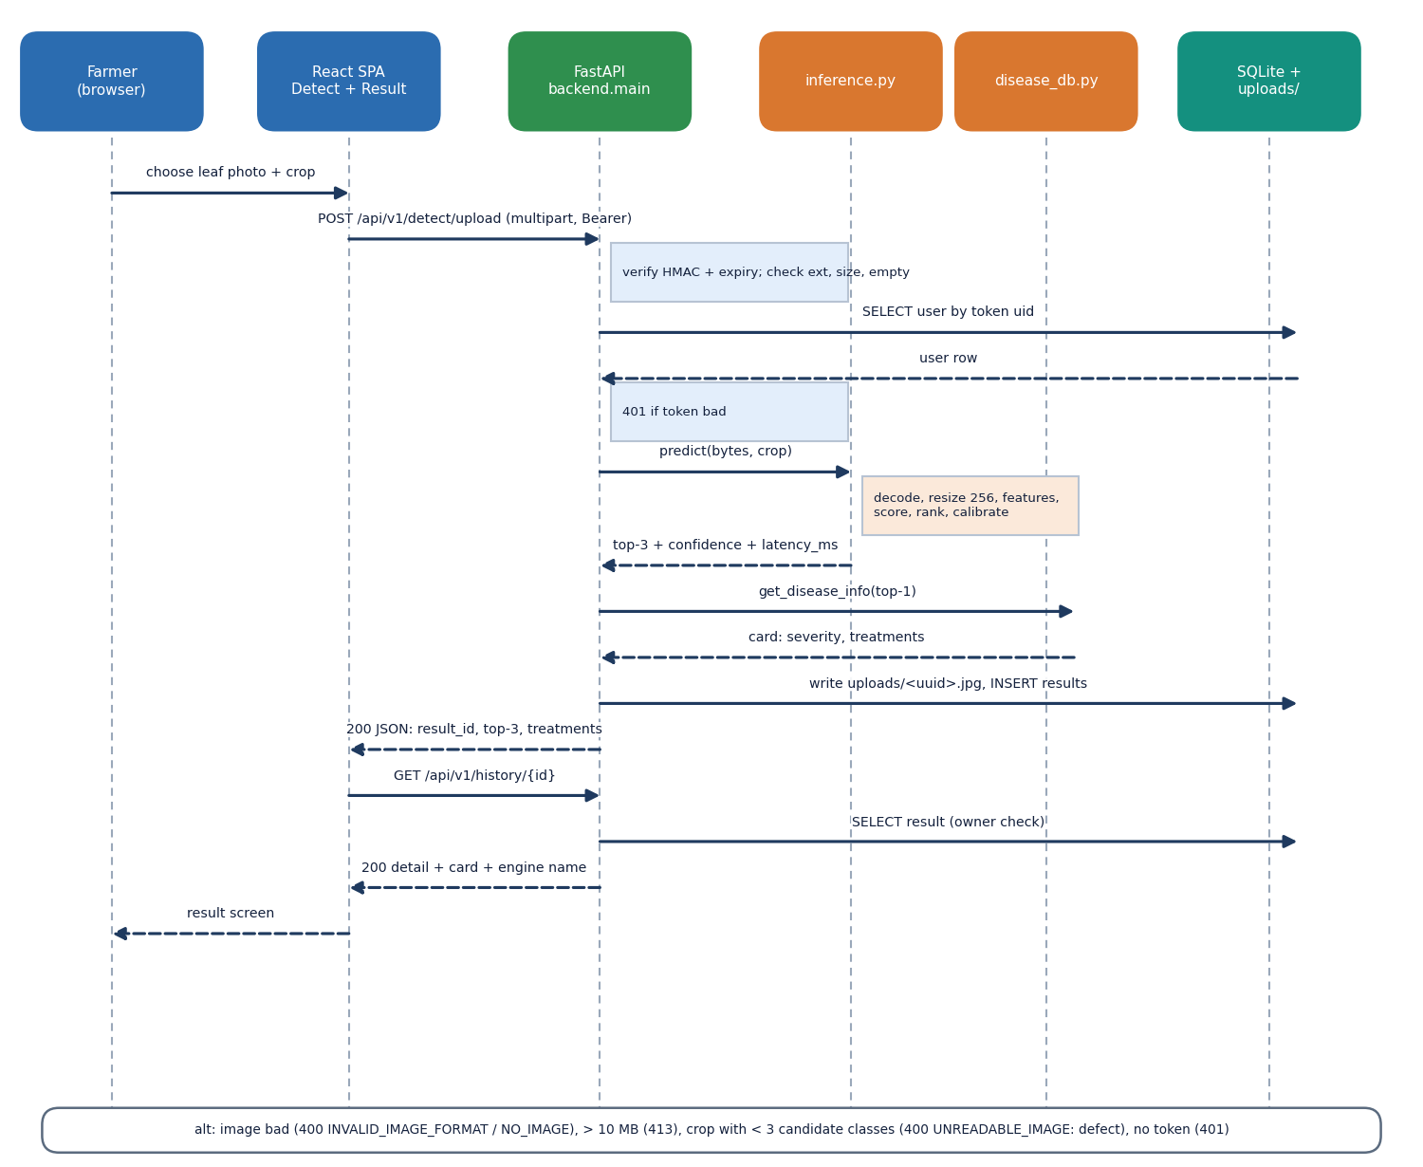
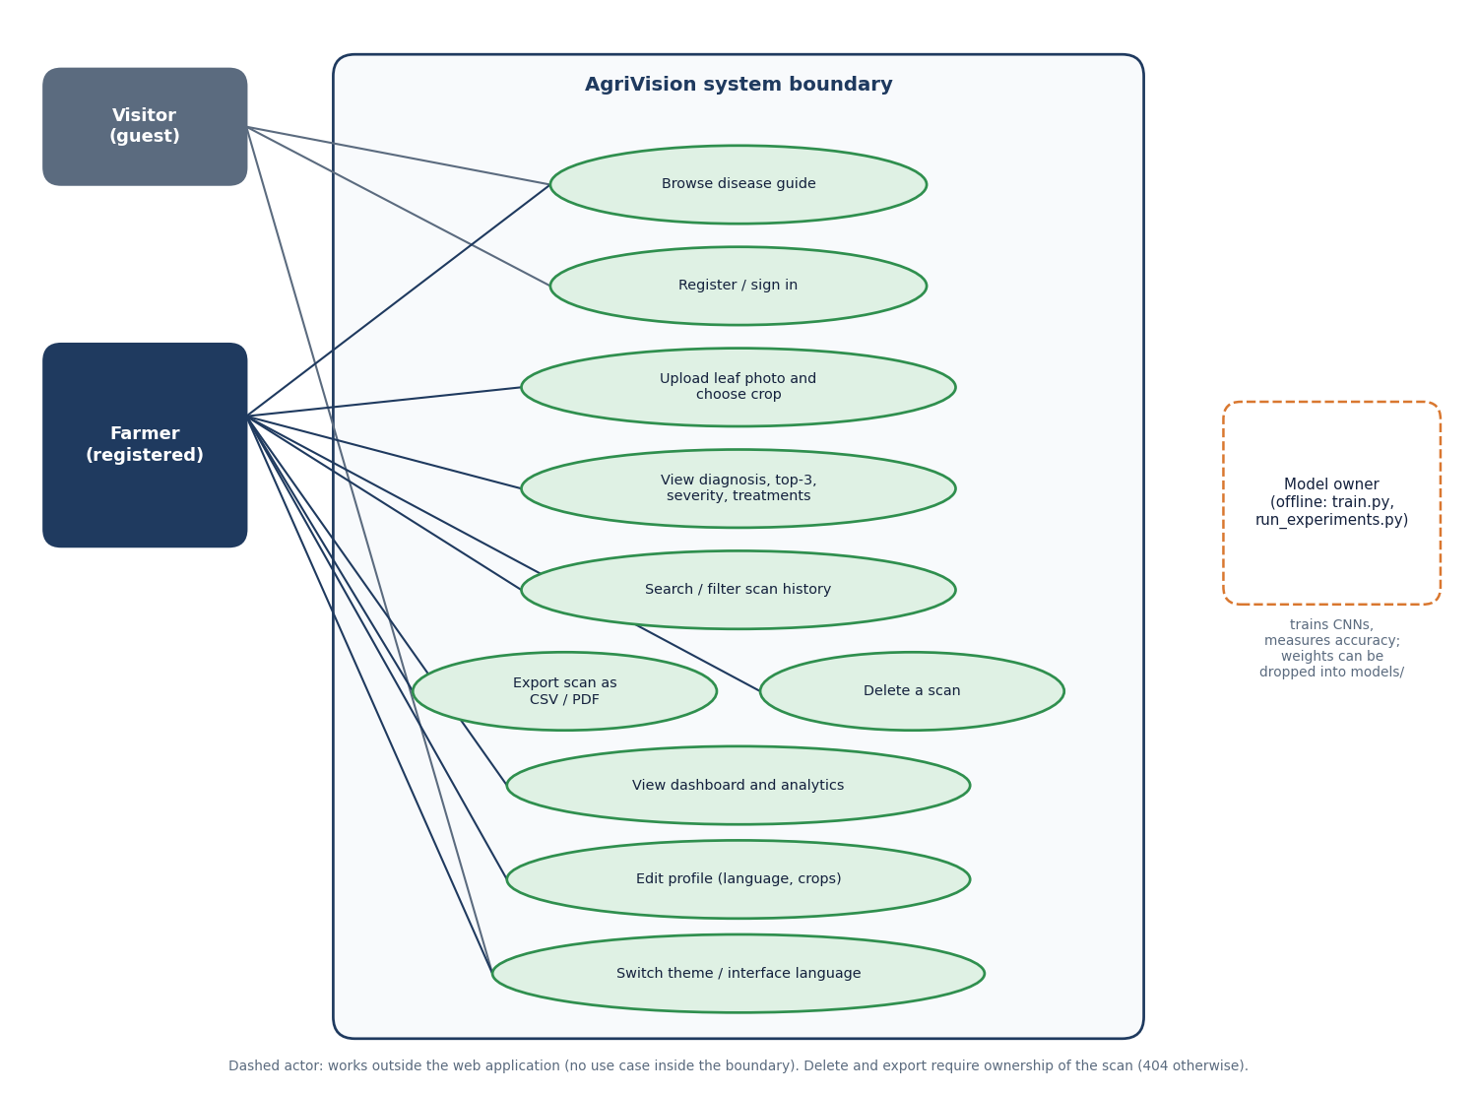
User–System Interaction
Left: one diagnosis from upload to result screen. Right: use cases of the farmer, the visitor and the offline model owner.
Dept. of CSE | Batch C16 | Final Review
14
Notes:
Sequence of a scan through React, FastAPI, the engine, the knowledge base and SQLite; then the use cases.

Slide 15
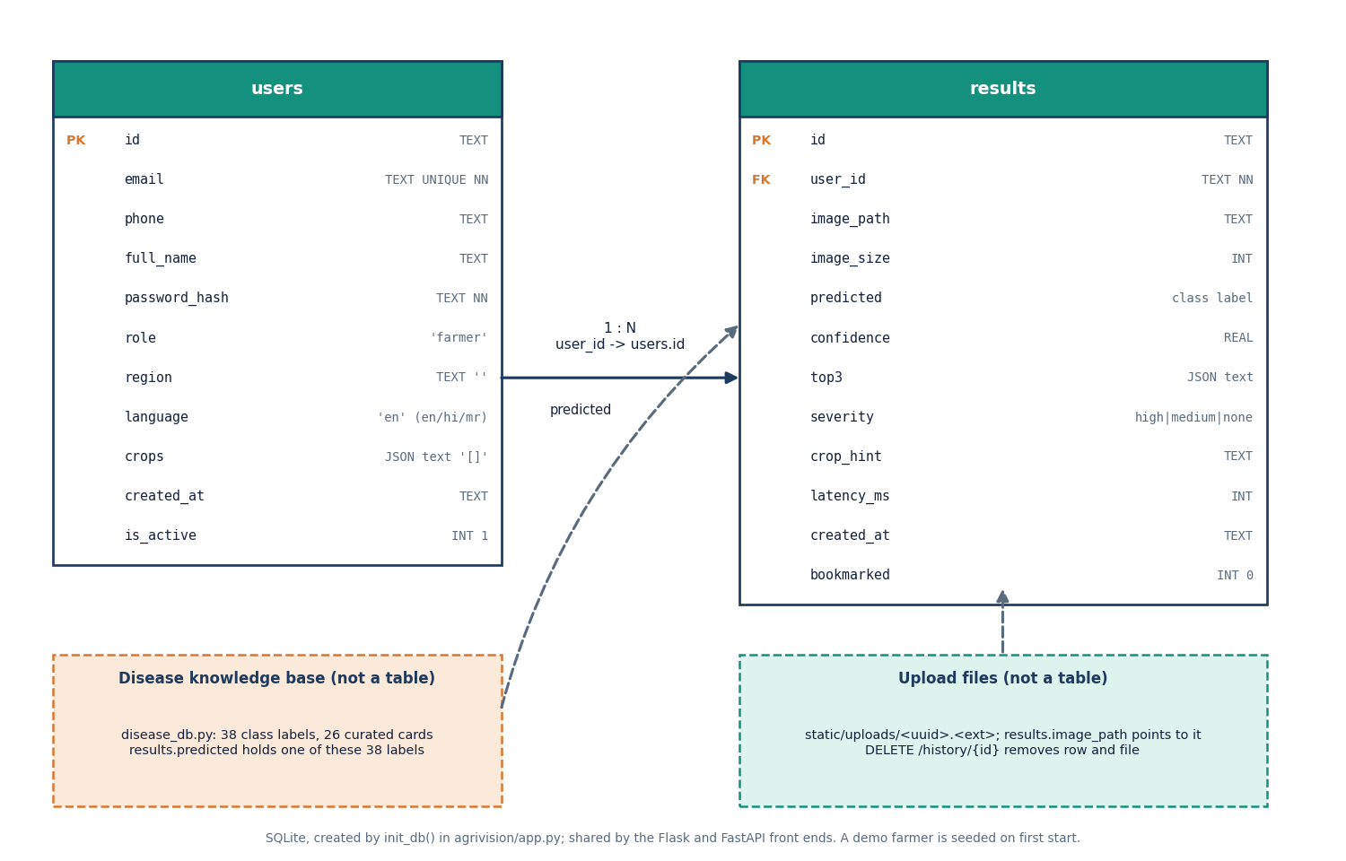
Database Design
SQLite file shared by the Flask and FastAPI front ends; created by init_db(); a demo farmer is seeded.
users: 11 columns; passwords stored as scrypt salted hashes.
results: 12 columns, one row per scan, top-3 as JSON text; user_id is a foreign key.
The 38-class knowledge base is code (disease_db.py), not a table; images are files named by random UUID.
Dept. of CSE | Batch C16 | Final Review
15
Notes:
Two tables. Deleting a scan removes the row and the image file.

Slide 16
Implementation Highlights
Component | What was built
Front end | React 18, Vite 8, TypeScript 5.9, Tailwind 4; 12 page components, 5,647 lines; axios + TanStack Query; EN / HI / MR interface strings; light and dark theme; phone layout
API layer | FastAPI, 437 lines, 16 routes; HMAC-signed bearer token (7 days); upload checks (type, 10 MB, empty); owner checks on every scan; CSV and PDF export
Engine | inference.py: heuristic, or Keras / ONNX model if models/ holds one; PlantDoc-to-38-class label map
Knowledge base | disease_db.py: 38 classes, 26 curated cards, 3 treatments each with cost text, severity, prevention, lifecycle
Data | SQLite users + results, uploads folder; run.bat one-click start; own scripts: smoke, edge, UI checks, experiments (1,448 lines)
Dept. of CSE | Batch C16 | Final Review
16
Notes:
What exists in the repository. The engine row is the important one.

Slide 17
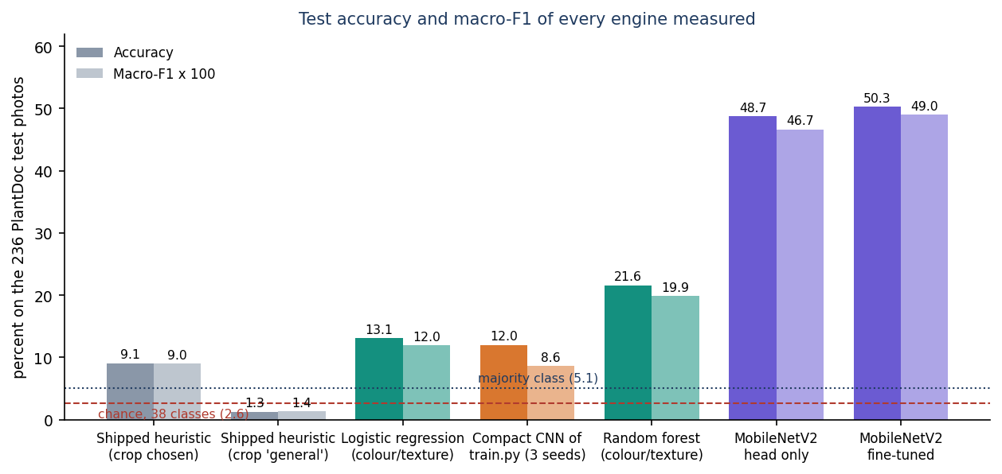
Results – Accuracy of Every Engine
Engine (236 test photos) | Accuracy | Macro-F1 | Top-3
Shipped heuristic, crop chosen | 9.1 ± 1.0% | 0.090 | 34.9%
Shipped heuristic, crop 'general' | 1.3 ± 0.7% | 0.014 | 4.2%
Logistic regression (colour/texture) | 13.1 % | 0.120 | 28.4 %
Compact CNN of train.py (3 seeds) | 12.0 ± 0.5% | 0.086 | 30.9%
Random forest (colour/texture) | 21.6 % | 0.199 | 36.0 %
MobileNetV2 fine-tuned (3 seeds) | 50.3 ± 0.9% | 0.490 | 79.8%
Chance is 36.0 % with the crop known and 2.6 % on 38 classes; always answering the most frequent class gives 5.1 %.
With hash seed 0 (what run.bat uses) the heuristic scores 10.6 % top-1; 32.2% of photos get no answer (defect D1).
Only the transfer-learning reference is clearly above chance, and it is not part of the shipped app.
Dept. of CSE | Batch C16 | Final Review
17
Notes:
The central result slide. Read the heuristic row first and then the MobileNetV2 row; the compact CNN of the training script does not learn the task.

Slide 18
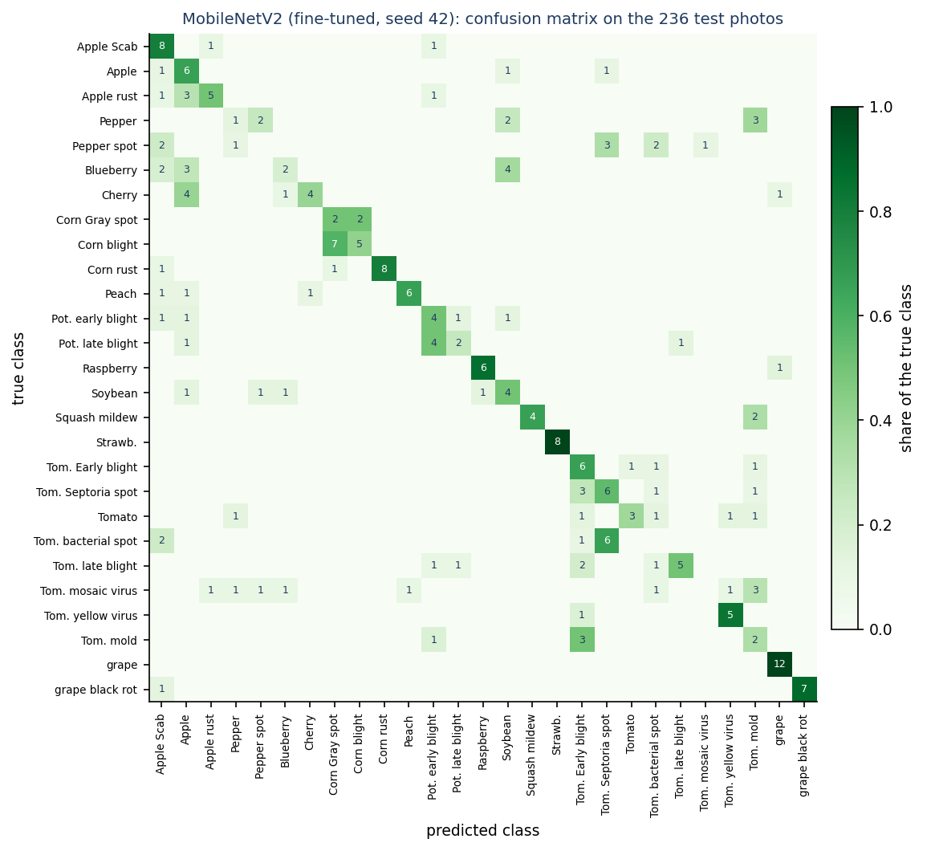
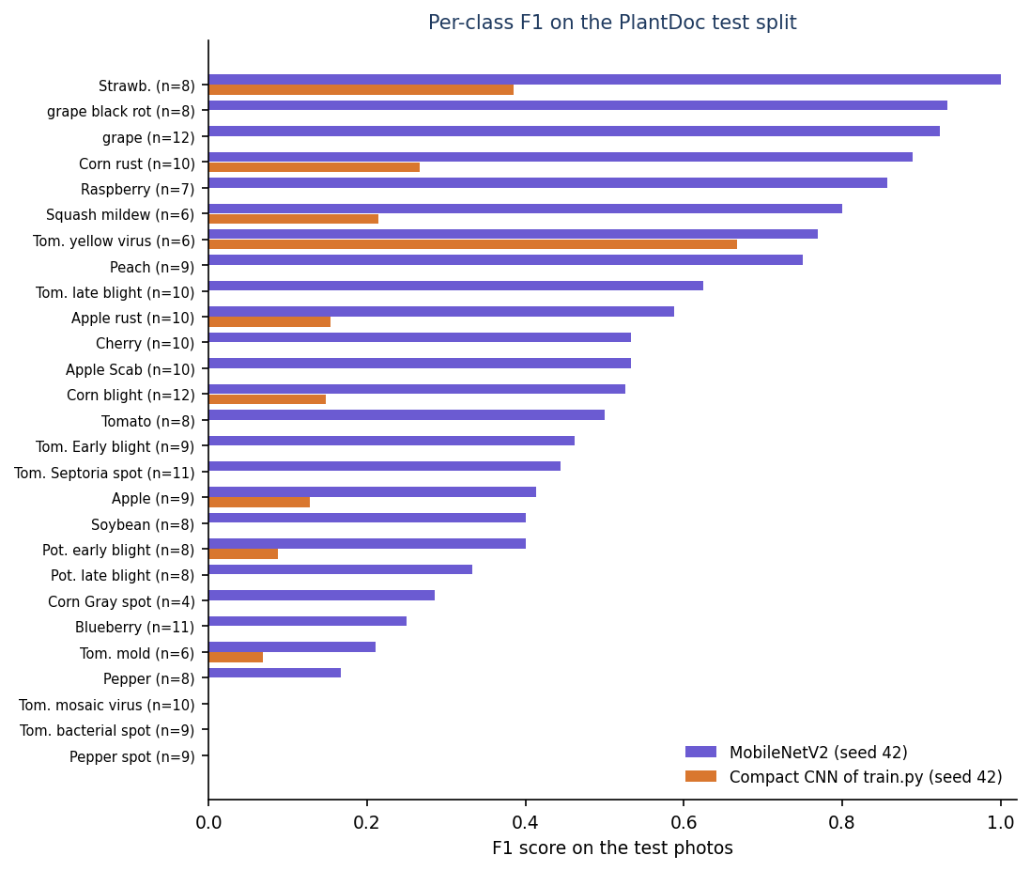
Confusion Matrix & Per-class F1
MobileNetV2: healthy recall 85.6 ± 2.4%, diseased recall 90.9 ± 1.2%.
Best: Strawberry 1.00, grape black rot 0.93, grape 0.92, corn rust 0.89.
Zero F1: bell pepper leaf spot, tomato bacterial spot, tomato mosaic virus.
Spots on leaves look alike in photos.
Seed 42, 236 test photos; the compact CNN's F1 is near zero on most classes.
Dept. of CSE | Batch C16 | Final Review
18
Notes:
Confusions concentrate among similar spot diseases of tomato and pepper; the compact CNN only separates a few classes.

Slide 19
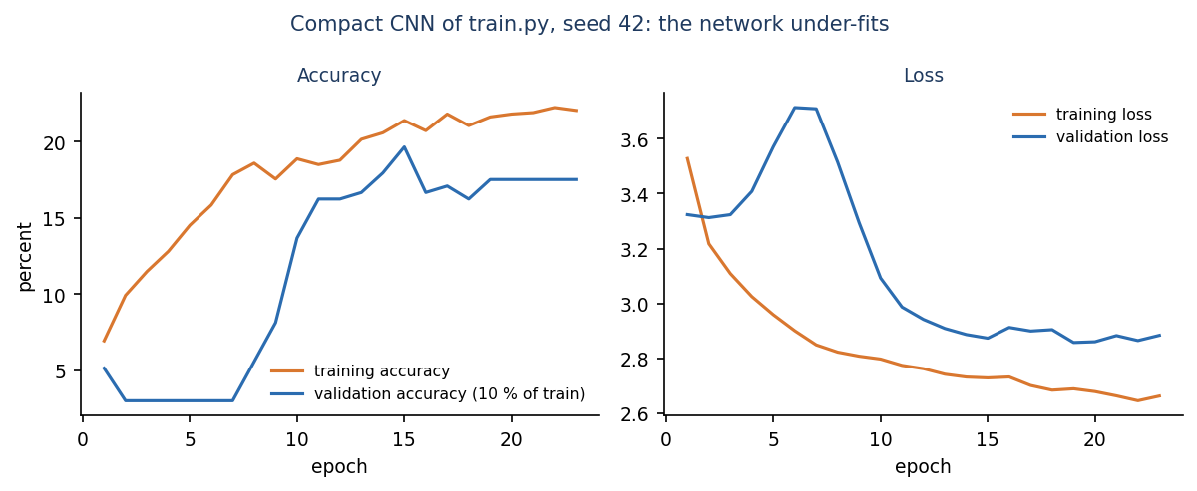
Parameter Analysis: Protocol, Fine-tuning, Crop Choice
Setting | Accuracy | Macro-F1
Compact CNN, held-out validation (3 seeds) | 12.0 ± 0.5% | 0.086
shipped protocol: test folder as validation | 13.6 % | 0.090
no LR decay, up to 100 epochs (seed 42) | 12.7 % | 0.092
MobileNetV2, head only (3 seeds) | 48.7 ± 1.4% | 0.467
MobileNetV2, + top-30-layer fine-tune | 50.3 ± 0.9% | 0.490
Heuristic: crop chosen / 'general' | 9.1 ± 1.0% / 1.3 ± 0.7% | 0.090 / 0.014
Selecting the checkpoint on the test folder (the shipped script) inflates the CNN by 1.6 points on the seed measured; it did not change the conclusion.
The CNN under-fits (training accuracy 22.2 ± 2.8%), so longer training or no LR decay did not help; transfer learning adds about 38 points.
Fine-tuning adds only 1.6 points over the trained head; choosing the crop helps the heuristic but triggers defect D1.
Dept. of CSE | Batch C16 | Final Review
19
Notes:
Protocol effects. The big lever is the pre-trained backbone, not the training schedule.

Slide 20
Performance, Testing & Defects
Check | Result
API smoke test | 39 / 39 pass
Unit, API edge and security tests | 51 checks: 46 pass, 0 fail, 5 defects
Browser UI checks | 55 passed (frontend session; not re-run here)
Detect, 100 real photos | median 23 ms, p95 82 ms (client, 127.0.0.1)
Other API calls | median 3-14 ms
CPU inference per photo | CNN 70 ms, MobileNetV2 89 ms
Defects recorded
D1 10 of 19 crop keys crash the engine (HTTP 400)
D2 top-3 scores sum to up to 112 %
D3 default token secret is public
D4 no login rate limit
D5 train.py validates on test, shifts grape labels
D6 docstring says 1.1 M parameters, model has 189,655
D7 reported latency padded by 40 ms
Not measured: concurrent load, many users, a field trial, a user study. Security checks passed: hashed passwords, forged / expired tokens refused, owner checks, 10 MB limit, path traversal blocked.
Dept. of CSE | Batch C16 | Final Review
20
Notes:
Tests pass for the plumbing; the defects are about the engine and defaults. Do not hide them.

Slide 21
Comparison with Base Paper (context only)
Work | Task | Data | Hardware | Reported | Comparable?
Foliagen [1] (base) | Generate foliage images; train classifiers | Soybean, tomato; generated + UAV set | 2 x RTX 6000 Ada | Up to 98 % (5 % real added) | No
PD36-C [2] | 38-class CNN, 1.25 M parameters | 87 k lab-style images | Not stated here | 99.53 % test | No
Kanakala [3] | CNN / LSTM, 38 classes | 70,295 / 17,572 lab-style | Not stated here | CNN 96.4 % val | No
PlantDoc paper [4] | VGG16, Inception on field photos | 2,598 photos, 27 classes | V100 GPU | 44.5-70.5 % cropped | Closest data
This project | Diagnosis + advice web app; measured engines | PlantDoc, 2,342 / 236 | CPU only | 50.3 ± 0.9% (MobileNetV2); app 9.1 ± 1.0% | -
Numbers are not comparable: the base paper generates training data for foliage classification, the lab-style sets are far easier than field photos, and hardware differs. The honest reading is that on real field photographs the achievable accuracy without cropping or more data is about 50 %, in line with the PlantDoc authors' own results.
Dept. of CSE | Batch C16 | Final Review
21
Notes:
Do not claim to beat any of these. The closest comparison is the PlantDoc paper, and our reference MobileNetV2 lies in its range.

Slide 22
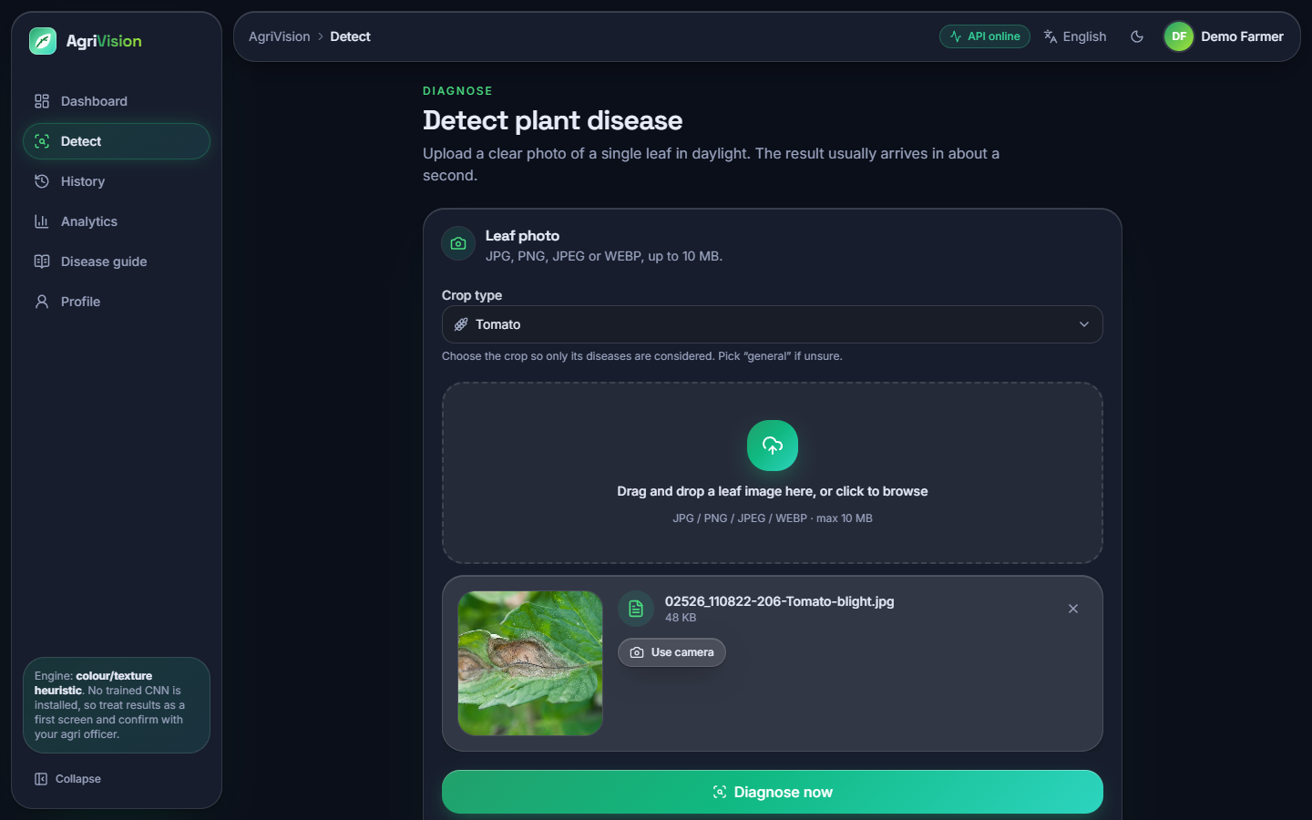
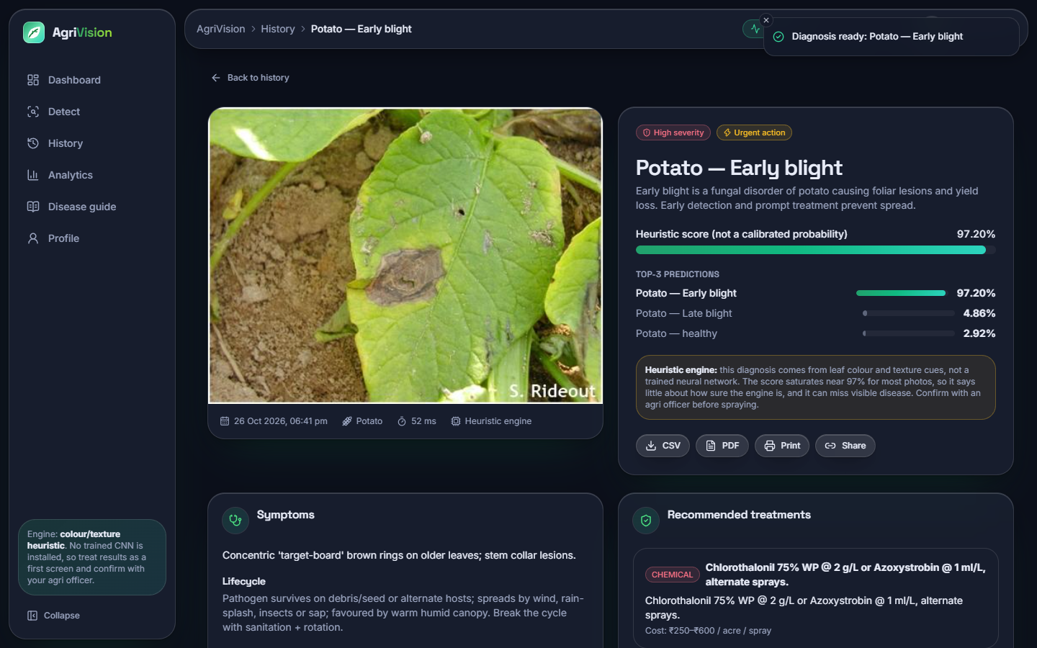
Output – Detect and a Correct Diagnosis
Detect: a tomato late-blight photo from the PlantDoc test set is chosen with crop = Tomato; the 10 MB limit and the accepted formats are stated on the drop zone.
Result: Potato early blight (high severity, urgent), top-3 list, treatments. Correct here; the score 97.2 % is a heuristic score, not a probability, as the amber note says.
Dept. of CSE | Batch C16 | Final Review
22
Notes:
A correct case. Only 25 of the 160 photos the heuristic can answer are right, so this is the exception.

Slide 23
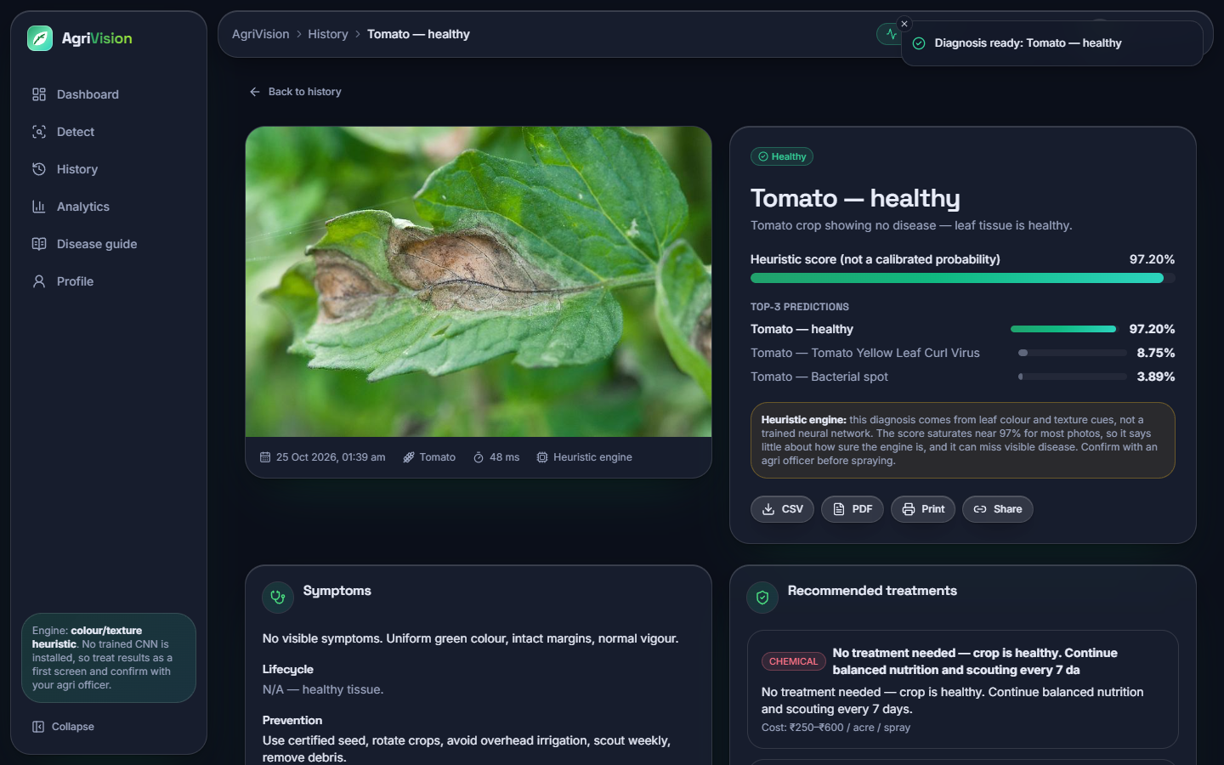
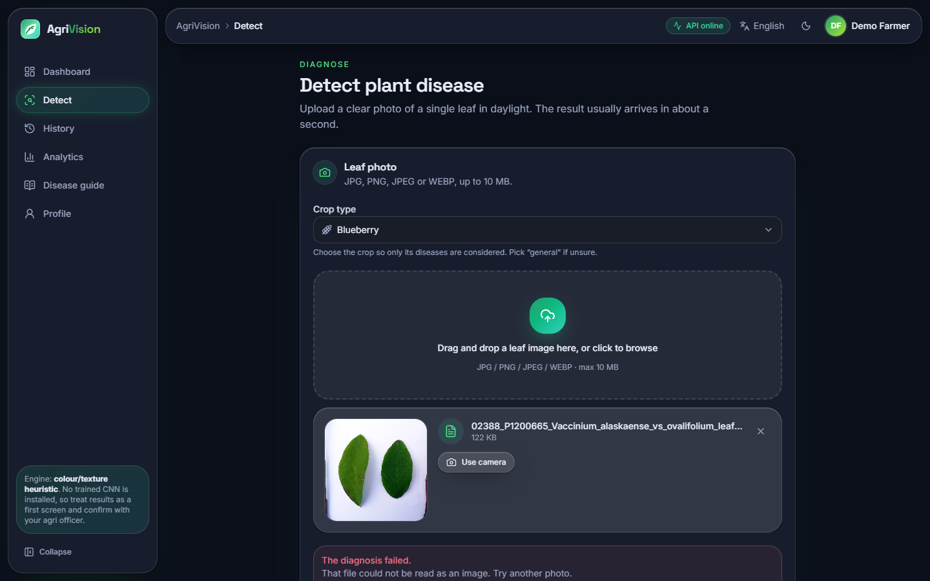
Output – Failure Cases
A tomato leaf with a large brown lesion is called Tomato healthy, 97.2 %. Five of the demo scans are lesioned leaves called healthy.
Crop = Blueberry on a valid photo: 'The diagnosis failed. That file could not be read as an image' (defect D1, API status 400).
Dept. of CSE | Batch C16 | Final Review
23
Notes:
Two real failures captured from the running application.

Slide 24
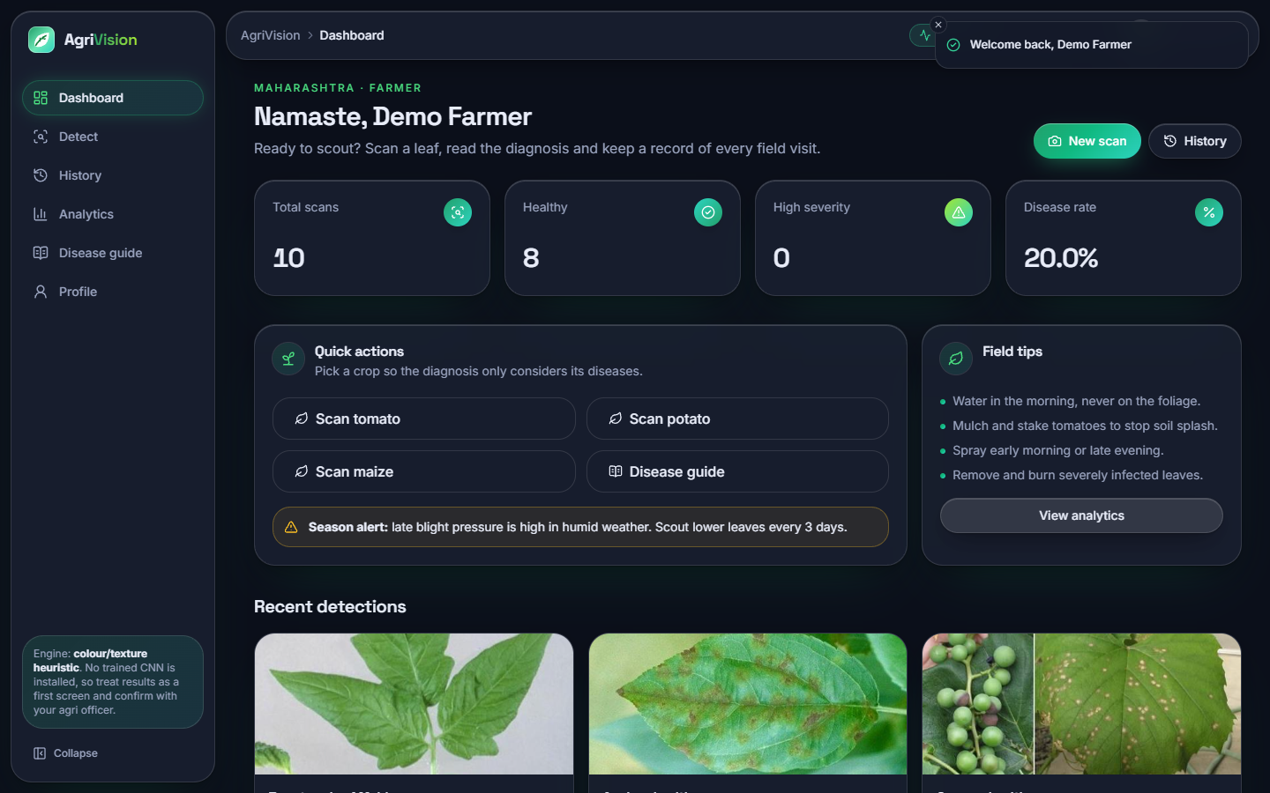
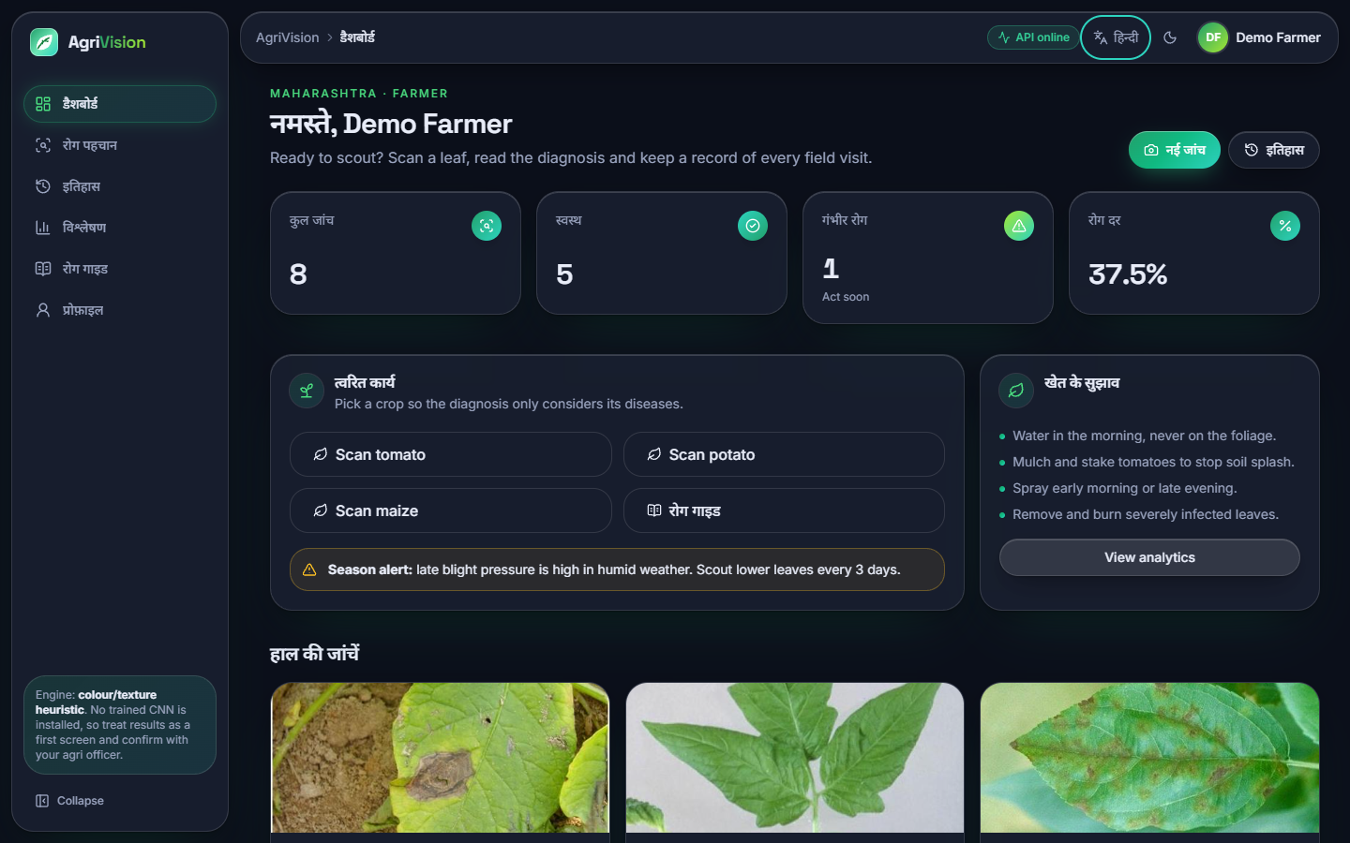
Output – Dashboard and Languages
Dashboard with real scans: totals, healthy count, high-severity count, disease rate, quick actions and recent detections.
Hindi interface: menus, headings and statistics are translated; sentences and the disease text stay in English (partial multilingual support).
Dept. of CSE | Batch C16 | Final Review
24
Notes:
The application chrome works in three languages; the knowledge base text does not yet.

Slide 25
Conclusion
Delivered: a working web application: sign-in, leaf upload, top-3 diagnosis with severity, three treatment types and prevention for 38 classes, history, CSV / PDF export, dashboard, analytics and a three-language interface; FastAPI layer over the original Flask product.
Measured: the shipped heuristic reaches 9.1 ± 1.0% on PlantDoc test photos and fails on 32.2%; the shipped CNN recipe 12.0 ± 0.5%; MobileNetV2 50.3 ± 0.9%. 39 + 46 checks pass; 5 defects found.
Objectives: 1 met, 2 partly, 3 trained but not accurate and not shipped, 4 treatment mapping met (no fertiliser dose), 5 met for the web interface and partly for language, 6 per-class accuracy measured, advice not validated.
Limits: PlantDoc only, one small dataset, no field trial; advice not checked by an agronomist; not a substitute for an expert.
Dept. of CSE | Batch C16 | Final Review
25
Notes:
Be explicit: the application works, the engine in it does not diagnose reliably yet.

Slide 26
Future Scope
Install a transfer-learning model (MobileNetV2 class, about 50 % here) in models/ and show its probabilities honestly; add Grad-CAM to show what the model looked at.
Fix D1 to D7: fewer than three candidates, score normalisation, secret from the environment, login throttling, train.py labels and validation.
More and better data: own field photographs, cropped leaves, more images for rare classes, Foliagen-style generated foliage for augmentation.
Add the proposed fertiliser, yield and weather modules; translate the disease and treatment text into Hindi and Marathi.
Agronomist review of every treatment and dose; a pilot with farmers; offline use on a phone.
Dept. of CSE | Batch C16 | Final Review
26
Notes:
The first two follow directly from the findings.

Slide 27
References
[1] N. Pakka, T. Wilkerson, L. Chen and N.-F. Tzeng, "Foliagen: Framework for crop foliage image generation from individual leaf images," IEEE Access, 2026, doi: 10.1109/ACCESS.2026.3727421.
[2] S. Sherifi, E. Rustemi, S. Ismaili, E. Rufati and F. Idrizi, "A compact and efficient 1.251 million parameter machine learning CNN model PD36-C for plant disease detection: A case study," arXiv:2604.11332, Apr. 2026.
[3] S. Kanakala and S. Ningappa, "Detection and classification of diseases in multi-crop leaves using LSTM and CNN models," J. Innovative Image Processing, vol. 7, no. 1, pp. 161-181, Mar. 2025, doi: 10.36548/jiip.2025.1.008.
[4] D. Singh, N. Jain, P. Jain, P. Kayal, S. Kumawat and N. Batra, "PlantDoc: A dataset for visual plant disease detection," in Proc. 7th ACM IKDD CoDS and 25th COMAD, Hyderabad, India, 2020, pp. 249-253; arXiv:1911.10317.
[5] D. P. Hughes and M. Salathe, "An open access repository of images on plant health to enable the development of mobile disease diagnostics," arXiv:1511.08060, 2015.
[6] S. P. Mohanty, D. P. Hughes and M. Salathe, "Using deep learning for image-based plant disease detection," Frontiers in Plant Science, vol. 7, Art. no. 1419, 2016.
[7] K. P. Ferentinos, "Deep learning models for plant disease detection and diagnosis," Computers and Electronics in Agriculture, vol. 145, pp. 311-318, 2018.
[8] J. G. A. Barbedo, "Factors influencing the use of deep learning for plant disease recognition," Biosystems Engineering, vol. 172, pp. 84-91, 2018.
[9] M. Sandler, A. Howard, M. Zhu, A. Zhmoginov and L.-C. Chen, "MobileNetV2: Inverted residuals and linear bottlenecks," in Proc. IEEE/CVF Conf. Comput. Vision Pattern Recognit. (CVPR), 2018, pp. 4510-4520.
[12] D. P. Kingma and J. Ba, "Adam: A method for stochastic optimization," in Proc. 3rd Int. Conf. Learning Representations (ICLR), 2015; arXiv:1412.6980.
[13] J. Deng, W. Dong, R. Socher, L.-J. Li, K. Li and L. Fei-Fei, "ImageNet: A large-scale hierarchical image database," in Proc. IEEE Conf. Comput. Vision Pattern Recognit. (CVPR), 2009, pp. 248-255.
[19] F. Pedregosa et al., "Scikit-learn: Machine learning in Python," J. Mach. Learn. Res., vol. 12, pp. 2825-2830, 2011.
[20] M. Abadi et al., "TensorFlow: A system for large-scale machine learning," in Proc. 12th USENIX Symp. Operating Systems Design and Implementation (OSDI), 2016, pp. 265-283.
Dept. of CSE | Batch C16 | Final Review
27
Notes:
Selected references; the complete numbered list is in the report.

Slide 28
THANK YOU
Questions & Suggestions
Dept. of CSE | Batch C16 | Final Review
28
Notes:
Invite questions.

