Slide 1
Secure File Storage System with Encryption and Role-Based Access Control (RBAC)
REVIEW 2 · DESIGN, METHODOLOGY AND PROGRESS
Design, methodology and progress: files are encrypted in the browser with AES-256-GCM, keys are wrapped with RSA-OAEP, and access is enforced by Owner, Editor and Viewer roles with a hash-chained audit log
Presented by
Under the guidance of
Pramod Reddy Yalala 23K91A05J9
Pendela Vyshnavi 23K91A05J1
Luke Abraham Sam 23K91A05D4
Mudavath Suresh 23K91A05G2
D V V Deepthi, [DESIGNATION]
Department of Computer Science and Engineering
TKR College of Engineering & Technology · Batch C13 (CSE-C) · [ACADEMIC YEAR]
Notes:
This review shows how CipherVault is designed and built, what is implemented, the first measured results and the open items. Introduce the four team members and the guide.

Slide 2
Contents
01
02
03
04
Recap and architecture
Methodology and data
Client-side processing and crypto design
Configuration and decision logic
05
06
07
08
Data flow, modules, UML
Technology stack
Implementation progress
Preliminary results
09
10
11
12
Output screens
Testing
Challenges
Next steps
Notes:
Agenda for the design and progress review.

Slide 3
Recap: problem and proposed system
!
Problem
i
Proposed system
B
Base paper link
Files kept on a server are readable by the provider, its administrators and anyone holding a database backup. Without roles any signed-in user may reach another user's files, tampering goes unnoticed, and an incident cannot be reconstructed.
CipherVault encrypts every file in the browser with AES-256-GCM, wraps the file key for each recipient with RSA-2048-OAEP, enforces Owner, Editor and Viewer roles on the server, checks SHA-256 on every download and records each action in a hash-chained audit log.
Nekouie et al. secure health-record access with attribute-based encryption, a blockchain ledger and an LLM attribute extractor. We adopt only the motivation (fine-grained access control, a tamper-evident record of access) and the idea of costing each primitive. Techniques and hardware differ, so numbers are not compared.
Notes:
Recap of Review 1. The base paper's timings are calculated from OpenSSL primitive costs on a server and a Raspberry Pi, not measured end to end, so we report our own measurements and compare design choices only. The closest architecture is Sowmiya et al. (IJEDR, 2026).

Slide 4
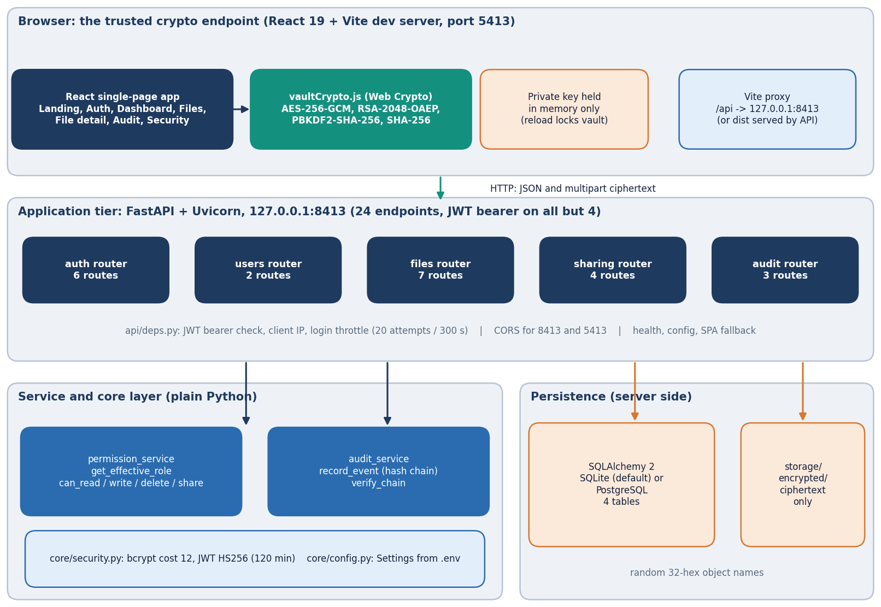
System architecture
The browser is the crypto endpoint
App: React 19 + Vite; Web Crypto API; port 5413 in development, or served by the API.
API: FastAPI on port 8413; 24 endpoints in five routers (auth, users, files, sharing, audit).
Server holds ciphertext, IVs, wrapped keys, hashes, public keys and the audit log, never plaintext or private keys.
Storage: SQLite by default (PostgreSQL through Docker), ciphertext as files under random names.
Notes:
Routes live in backend/app/api; permission_service and audit_service hold the RBAC rules and the hash chain. The server never decrypts anything.

Slide 5
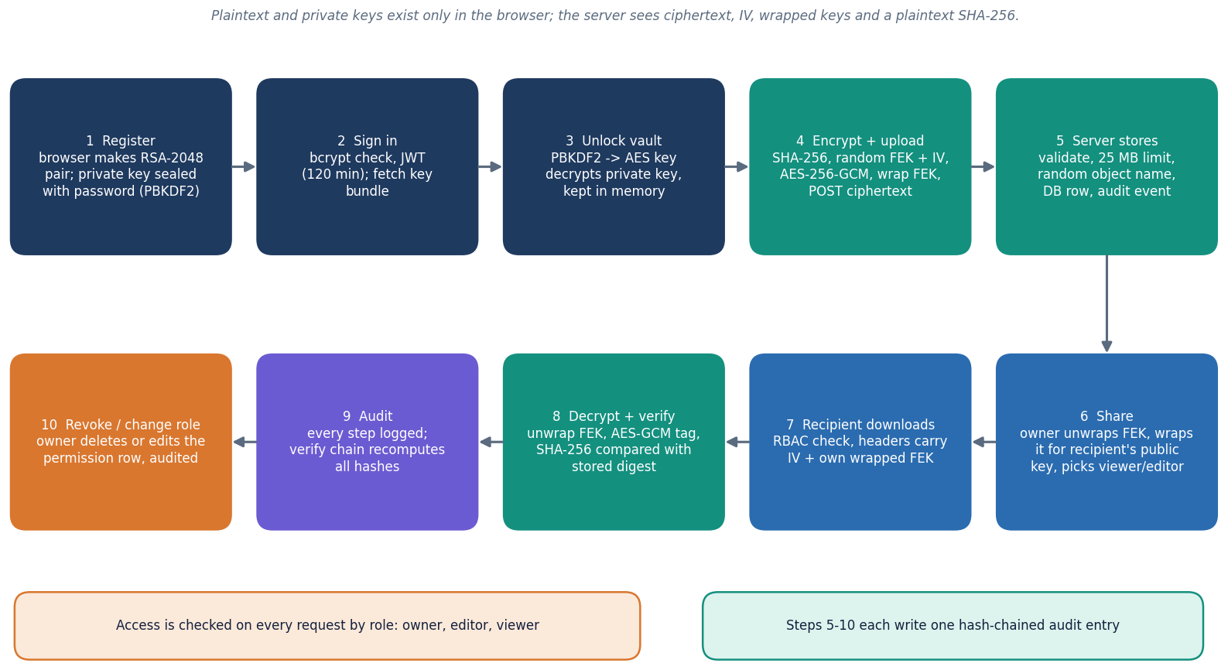
Methodology: encrypt, store, share, verify
Register and unlock
The browser makes an RSA-2048 key pair; the private key is encrypted with a key derived from the password (PBKDF2) before it is stored. Unlocking decrypts it in memory only.
Encrypt, upload, share
A fresh AES key encrypts the file; the key is wrapped with the owner's public key. Sharing re-wraps the key for the recipient, so the server never sees it.
Download and verify
RBAC is checked, the wrapped key is unwrapped, AES-GCM decrypts, SHA-256 is compared. Every step writes a hash-chained audit entry.
High-level workflow as implemented in the application.
Notes:
Revoking access deletes the recipient's wrapped key on the server; it cannot recall a key or ciphertext that was already downloaded.

Slide 6
Data: demo vault and measurement workloads
0
5
36
461
ML datasets: nothing is trained or classified
fictional demo files, 3 demo accounts
RBAC cells tested: 4 principals x 9 operations
audit entries used in the tamper study
Workload | What it is | Size and repetitions
Demo vault | Fictional files created by the in-app demo login for owner, editor and viewer accounts (example.com addresses); used for screenshots | 5 files, 706 B of plaintext in total
Crypto size sweep | Random bytes encrypted, decrypted and hashed with Web Crypto in Chrome 155 | 1 KiB, 64 KiB, 1 MiB, 10 MiB, 25 MiB; 50, 50, 20, 8, 4 runs
Encrypted vs plain transfer | The same endpoint used with and without browser encryption | 1 KiB, 1 MiB, 10 MiB; 30, 20, 15 runs
Access control and tamper | Exhaustive RBAC matrix; 2,000 ciphertext bit flips; nine audit-log tamper classes of about 200 trials each | one file, four principals; one audit chain
Limits | Synthetic data only, no user study; the host CPU was shared with other jobs, so timings are indicative | single machine, loopback
Notes:
This is security software, so there is no training data. The demo accounts and files are fictional, and the numbers come from workloads we generated: random bytes of fixed sizes and scripted attacks on the audit log.

Slide 7
Client-side processing before upload
Read file
SHA-256 of plaintext
Random 256-bit key + 12-byte IV
AES-256-GCM encrypt
Wrap key (RSA-OAEP)
Upload multipart
16 B
256 B
authentication tag added by AES-GCM: ciphertext is 16 bytes longer than the file
wrapped file key: one RSA-2048-OAEP block, per recipient
Registration: the browser generates the RSA-2048 key pair (median 102 ms) and encrypts the private key with PBKDF2 (120,000 iterations, median 32.8 ms).
The server validates what it can without seeing plaintext: IV decodes to 12 bytes, SHA-256 is 64 hex characters, wrapped key is base64 (256 bytes when sharing), file name at most 512 characters.
Uploads above 25 MB are refused with HTTP 413 (measured); the whole file is encrypted in memory, so there is no chunking yet.
The ciphertext is stored under a random 32-hex name; the original file name stays in the database as clear metadata.
Notes:
These are the steps in frontend/src/lib/vaultCrypto.js and vault.js. Nothing leaves the browser before step six except the encrypted bytes and the wrapped key.

Slide 8
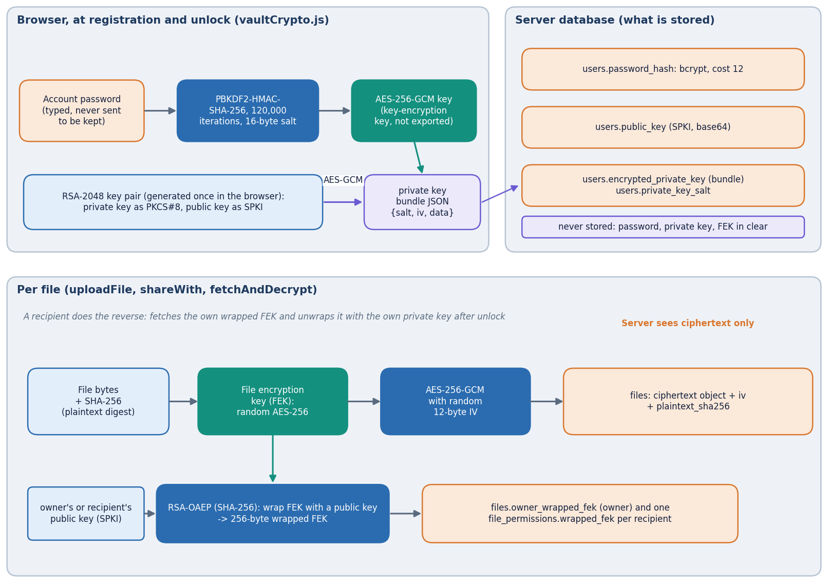
Cryptographic design (no ML model)
File key: a random AES-256-GCM key per file; a new random 12-byte IV for each encryption.
Key wrapping: RSA-2048-OAEP with SHA-256, one wrapped copy per recipient, stored in file_permissions.
Private key: exported as PKCS#8 and encrypted with an AES-256-GCM key derived from the password by PBKDF2-HMAC-SHA-256.
Passwords are separate: bcrypt on the server, never used as a key.
All primitives come from the browser's Web Crypto API; none is written by hand.
Key hierarchy: password, private key, file key, ciphertext.
Notes:
Hybrid encryption was chosen because RSA is too slow and too small for files, while AES-GCM gives confidentiality and integrity in one pass.

Slide 9
System and cryptographic configuration
Setting | Value
File cipher | AES-256-GCM, random 12-byte IV, 16-byte tag; whole file in memory; at most 25 MB
Key wrap | RSA-2048-OAEP with SHA-256, exponent 65537, 256-byte wrapped key
Private-key protection | PBKDF2-HMAC-SHA-256, 120,000 iterations, 16-byte salt, AES-256-GCM
Passwords and sessions | bcrypt cost 12, at least 8 characters; JWT HS256, 120 minutes; login throttle 20 attempts per 300 s per IP and email (in memory)
Integrity and audit | SHA-256 of the plaintext stored and checked on download; audit hash = SHA-256 of previous hash, time, user, file, action, success, details
Storage | SQLite by default, PostgreSQL via Docker; ciphertext under storage/encrypted with random 32-hex names
Measuring machine | Intel i5-12500 (6 cores / 12 threads), 15.7 GB RAM, Windows 11, Python 3.11.9, Chrome 155.0.8059.85, loopback 127.0.0.1
Notes:
The same configuration applies to every measurement. The project's iteration count (120,000) is lower than the 310,000 reported by the IJEDR paper; this is listed as a limitation.

Slide 10
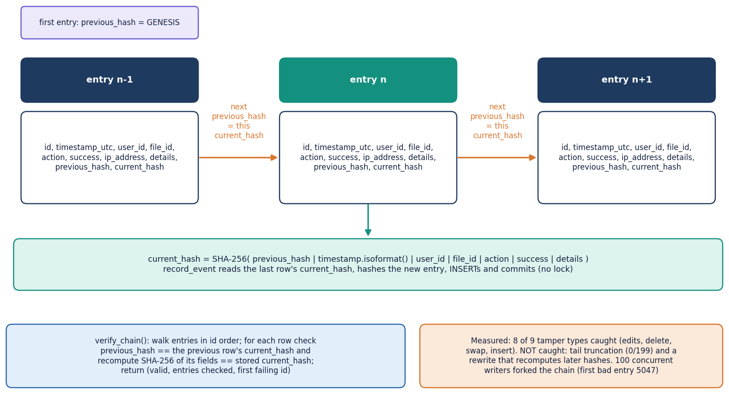
Decision logic: RBAC rules and the audit chain
Role | Read | Update | Share / role / revoke | Delete, file audit
Owner | yes | yes | yes | yes
Editor | yes | yes | no | no
Viewer | yes | no | no | no
Stranger | no | no | no | no
The role is computed per request from ownership and the file_permissions row; denied requests return 403 and write an unauthorized_access entry.
Measured: all 36 of 36 cells matched the rules; unauthenticated, forged, expired, wrong-secret and alg=none tokens all returned 401.
Audit chain: 8 of 9 tamper classes are always caught; deleting the last entries is not (0 of 199).
Audit entries are linked by SHA-256. The verifier checks internal consistency only: there is no secret key or external anchor.
Notes:
The rules are in permission_service.py (four small functions). The chain code is audit_service.py. A full rewrite that recomputes every later hash is also not detected, and concurrent writers can fork the chain; both are open items.

Slide 11
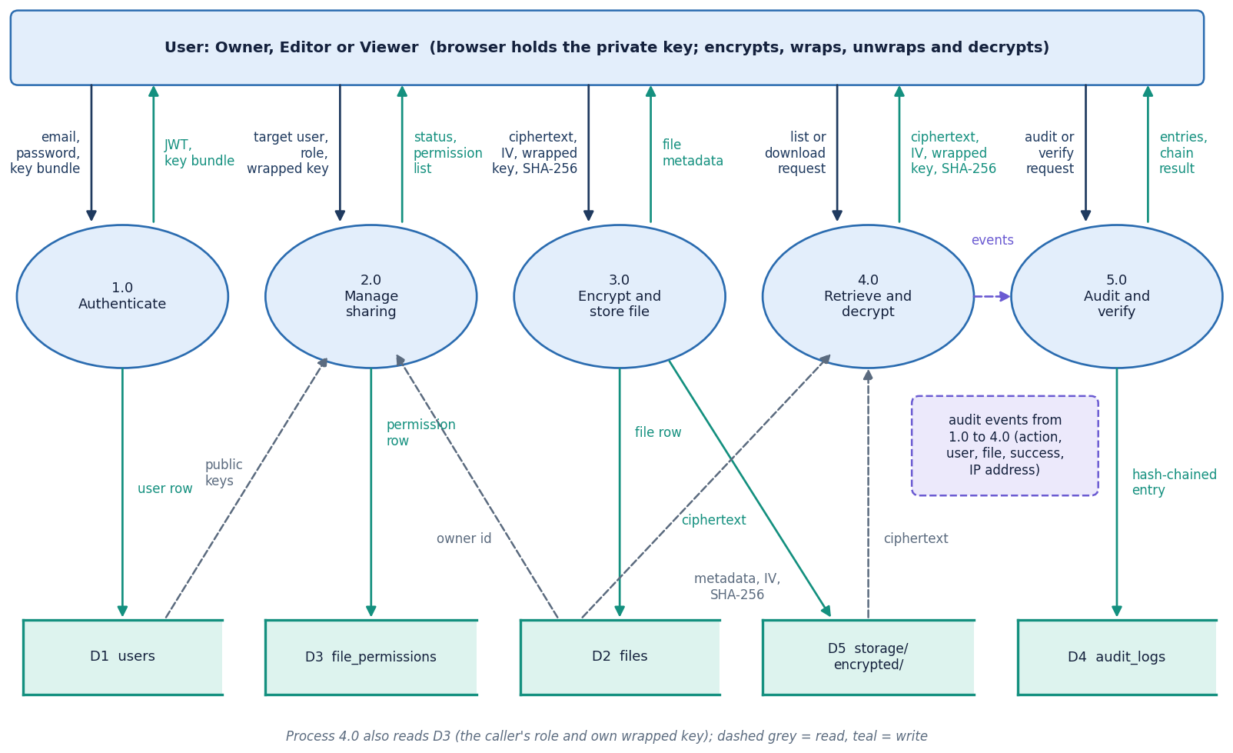
Data flow and modules
Module | Lines | Role
api/files.py | 279 | upload, download, update, delete
api/sharing.py | 119 | share, role change, revoke
api/auth.py + users.py | 140 | accounts, keys, directory
api/audit.py | 61 | history, chain verify
services/ (2 files) | 99 | hash chain, RBAC rules
db/models.py | 88 | 4 tables
core/ + api/deps.py | 131 | bcrypt, JWT, settings
lib/vaultCrypto.js | 108 | browser cryptography
DFD level 1: the processes and the data stores.
Notes:
Counted from the files: the backend is 1,184 lines in 20 files, the frontend source 6,831 lines in 39 files. Each route validates, checks the role, performs the change and writes an audit entry.

Slide 12
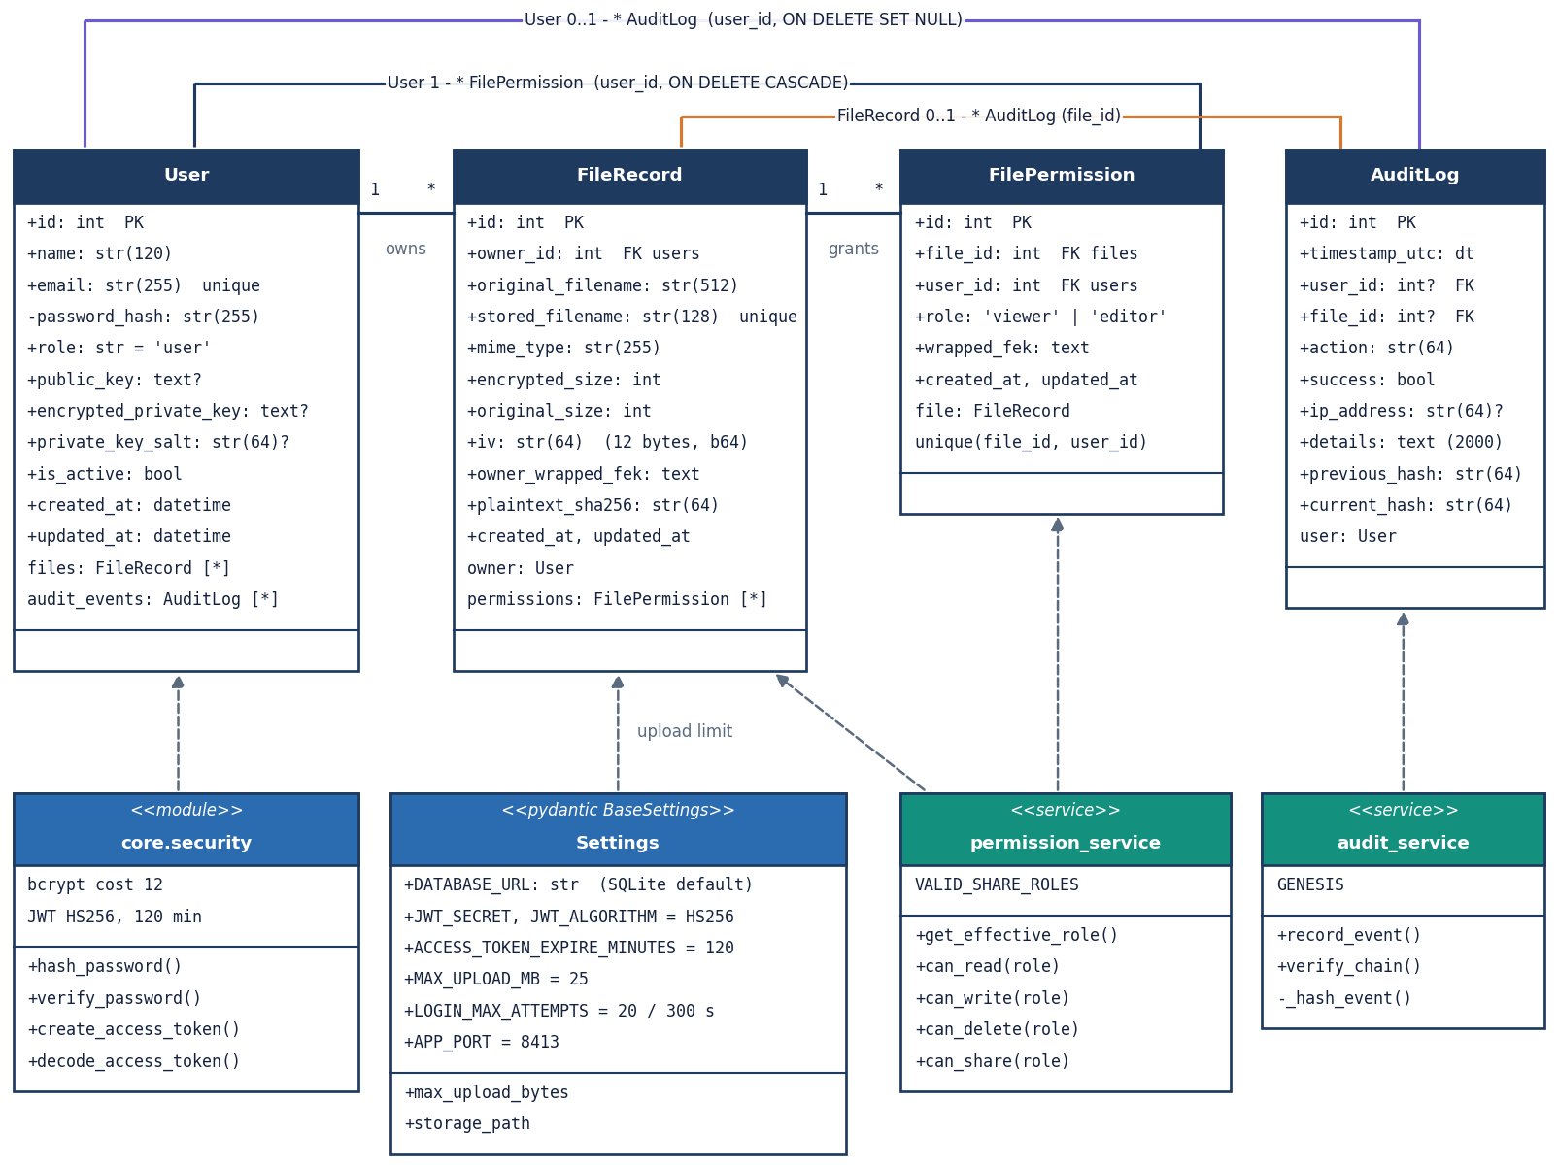
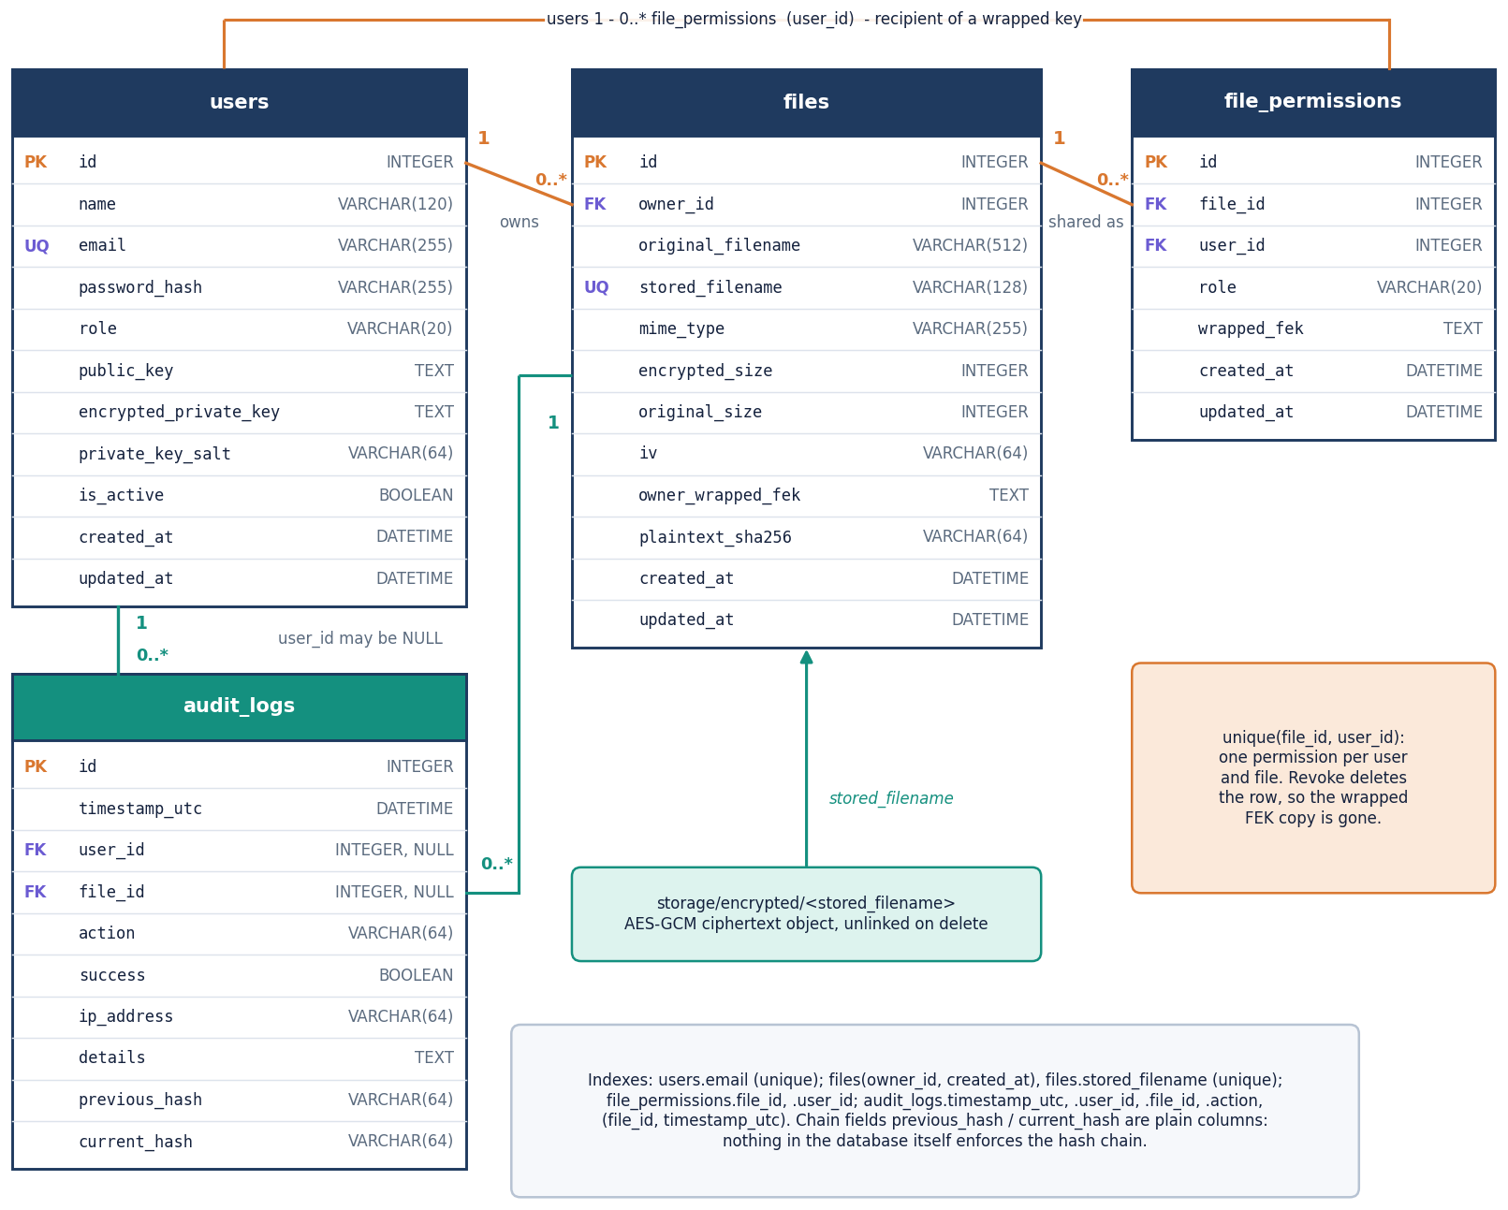
Database design and UML
UML class diagram. users own many files; file_permissions links a user to a file with a role and that user's wrapped key (unique per file and user).
Entity-relationship diagram. audit_logs keeps previous_hash and current_hash per event; its user and file links are nullable, so entries survive deletion.
Notes:
SQLAlchemy 2.0 declarative models. Deleting a file removes its permissions by cascade and its ciphertext object in the route; the audit entry stays.

Slide 13
Technology stack
1
2
3
4
Python 3.11+
SQLAlchemy 2.0
PyJWT + bcrypt
Web Crypto API
FastAPI, uvicorn, pydantic; REST under /api
SQLite by default, PostgreSQL via psycopg
session tokens and password hashing (cost 12)
AES-GCM, RSA-OAEP, PBKDF2, SHA-256 in the browser
5
6
7
8
React 19 + Vite 8
Recharts + three.js
pytest + httpx
Docker Compose
single-page app, React Router 7
dashboard charts and landing hero; Framer Motion, GSAP
21 backend tests; Playwright for the UI walk
PostgreSQL deployment option and run.bat for one-click local use
Everything runs locally on one machine; no cloud service or external key manager is used yet.
Notes:
requirements.txt gives minimum versions; the frontend versions are those in package.json.

Slide 14
Implementation progress
Component | Status | Evidence
Registration, login, JWT sessions | Done | bcrypt cost 12; forged, expired and alg=none tokens all rejected (401)
Client-side encryption and key wrapping | Done | AES-256-GCM + RSA-2048-OAEP; 2,000 of 2,000 bit flips detected
RBAC and sharing | Done | 36 of 36 access-matrix cells as expected; revoked user gets 403
Integrity check and audit log | Done, with gaps | 8 of 9 tamper classes caught; tail truncation and concurrent writers are not handled
React interface | Done | landing, dashboard, files, file detail, sharing, audit log, security, 360 px layout
MFA, chunked upload, key rotation, KMS | Not implemented | named as future work; not in the code
Tests | Done | pytest 21/21; API walk 17/17; browser walk 18/18
Notes:
All six objectives of Review 1 have an implementation; the gaps are in the audit log and in features beyond the original scope.

Slide 15
Preliminary results
Measurement | Result
AES-GCM encrypt, 10 MiB | 23.8 ms median
AES-GCM encrypt, 25 MiB | 53.8 ms median
RSA-2048 wrap / unwrap | 0.030 / 0.71 ms
Login (bcrypt cost 12) | 308 ms median
RBAC matrix | 36 of 36 cells correct
Ciphertext bit flips | 2,000 of 2,000 caught
Browser end to end, encrypted vs plain transfer on the same endpoint (loopback).
Cost of encryption is small: for a 10 MiB file the encrypted upload takes 14 ms more than a plain one (7%) and the verified download 27 ms more; AES itself takes about 23.8 ms.
The audit chain verifies in 404 ms for 5,000 entries, but it does not catch deleted tail entries (0 of 199) or a full re-hash.
100 concurrent failed logins broke the chain (first bad entry 5047): the audit writer assumes one writer at a time. Reported, not yet fixed.
Notes:
Results are reported as measured, including the negative ones. The host was shared with other jobs, so run-to-run spread reached about three times at 10 MiB; treat the numbers as indicative. The base paper's costs are calculated on other hardware and are not comparable.

Slide 16
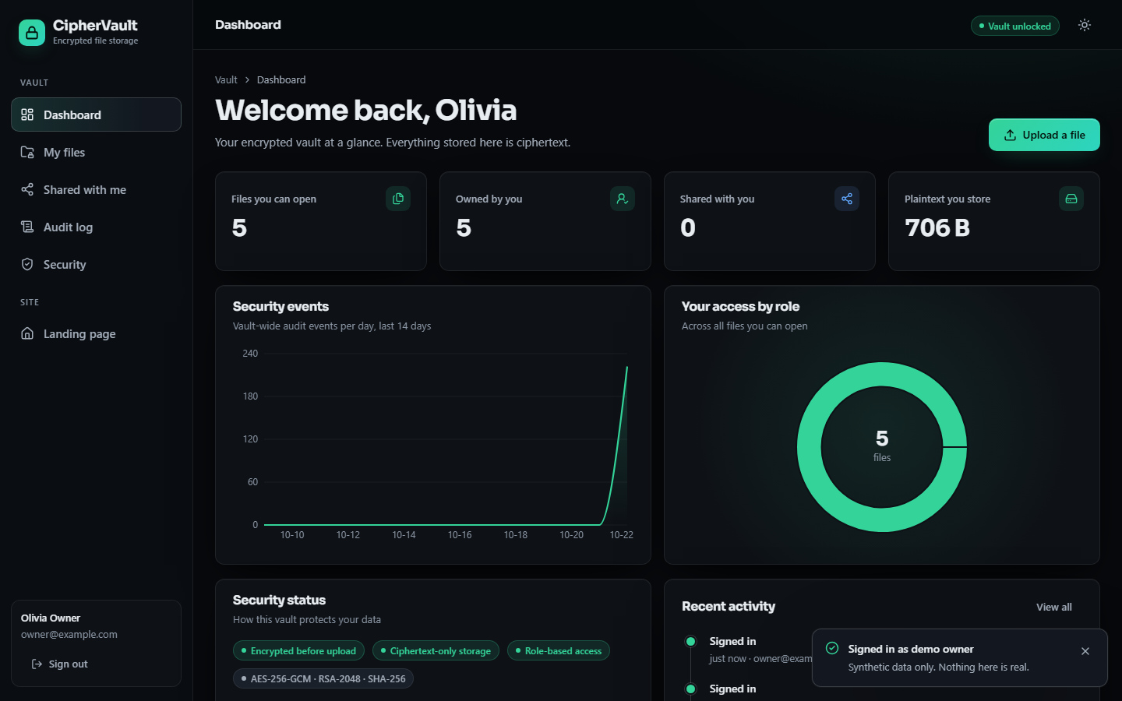
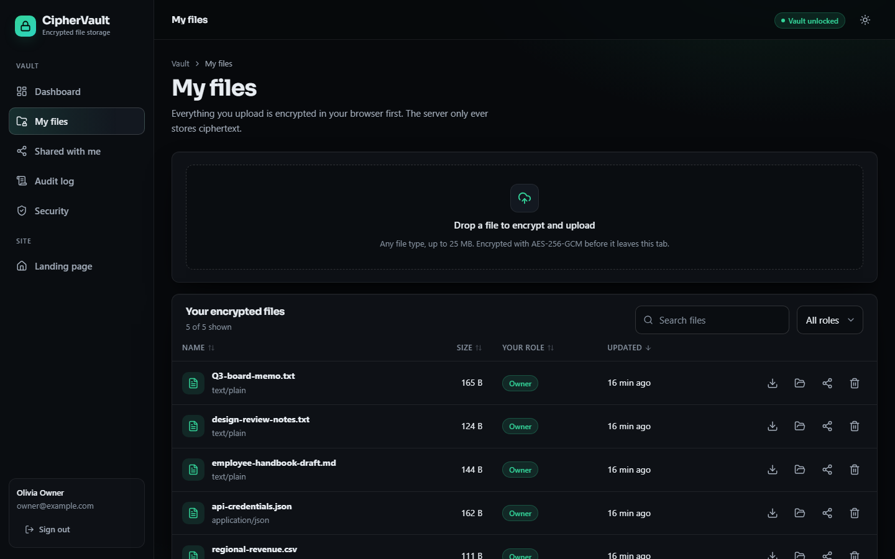
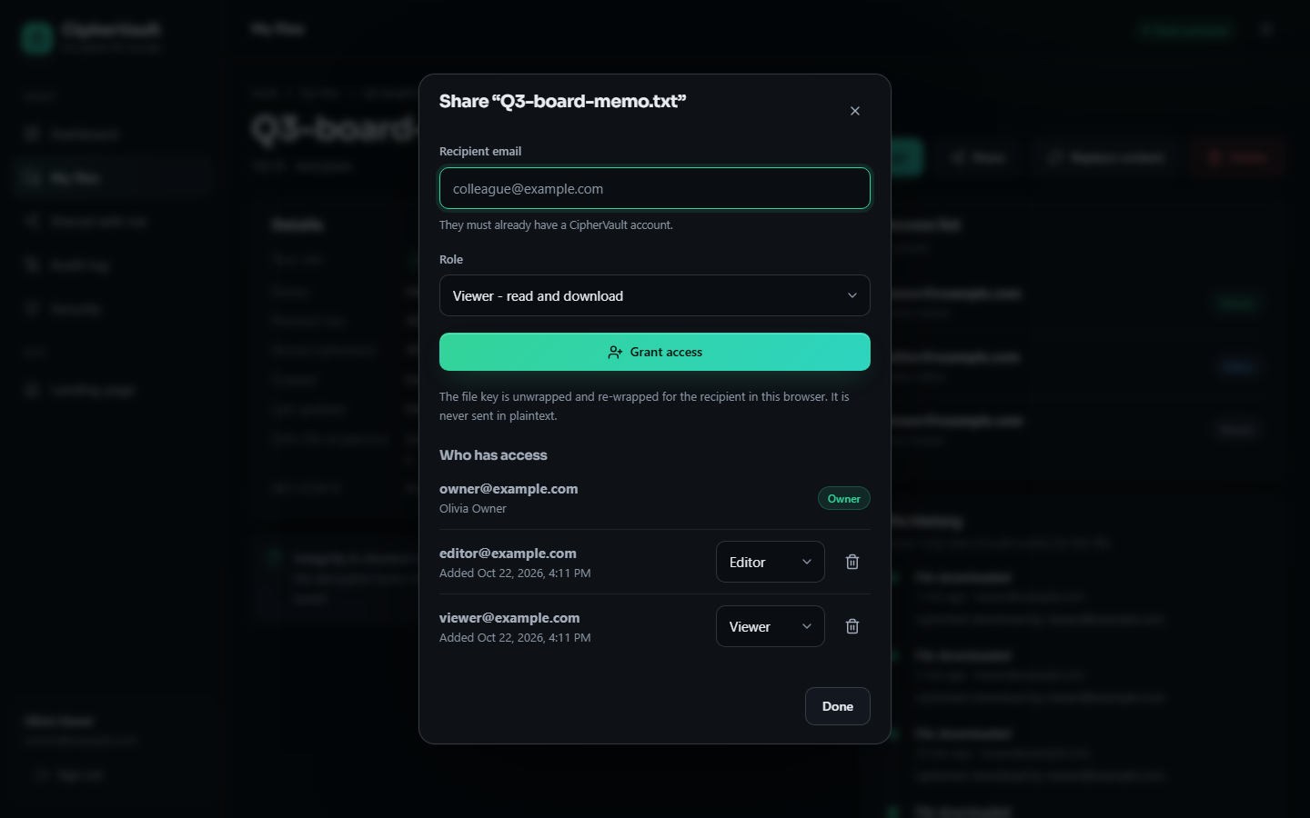
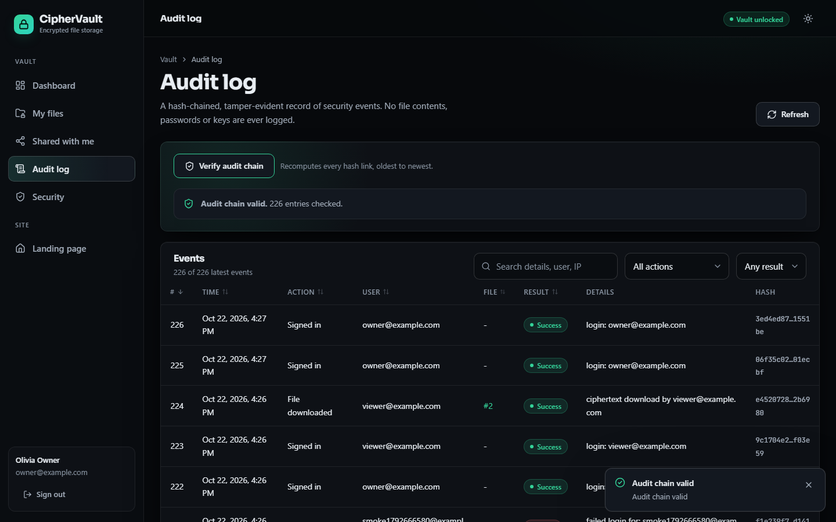
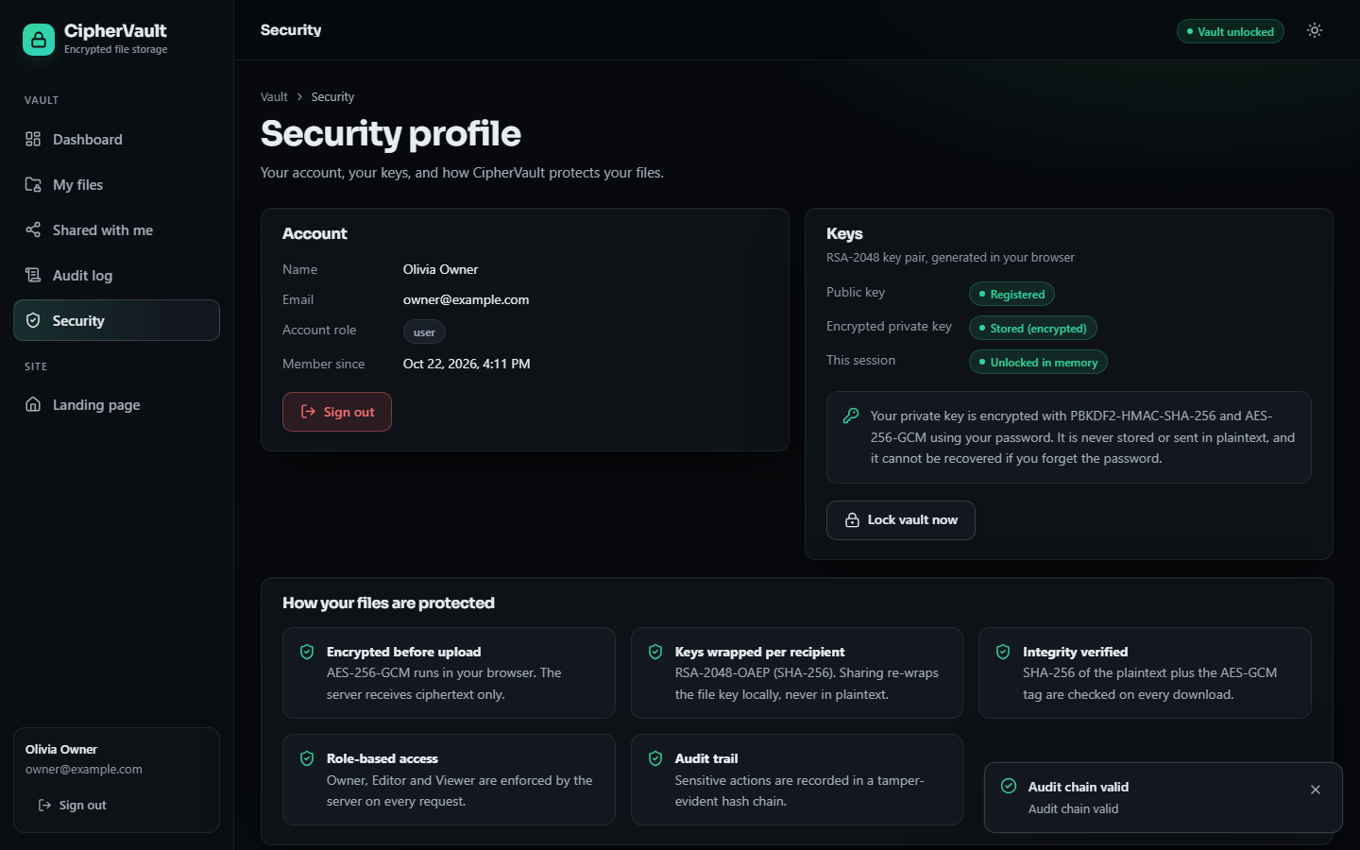
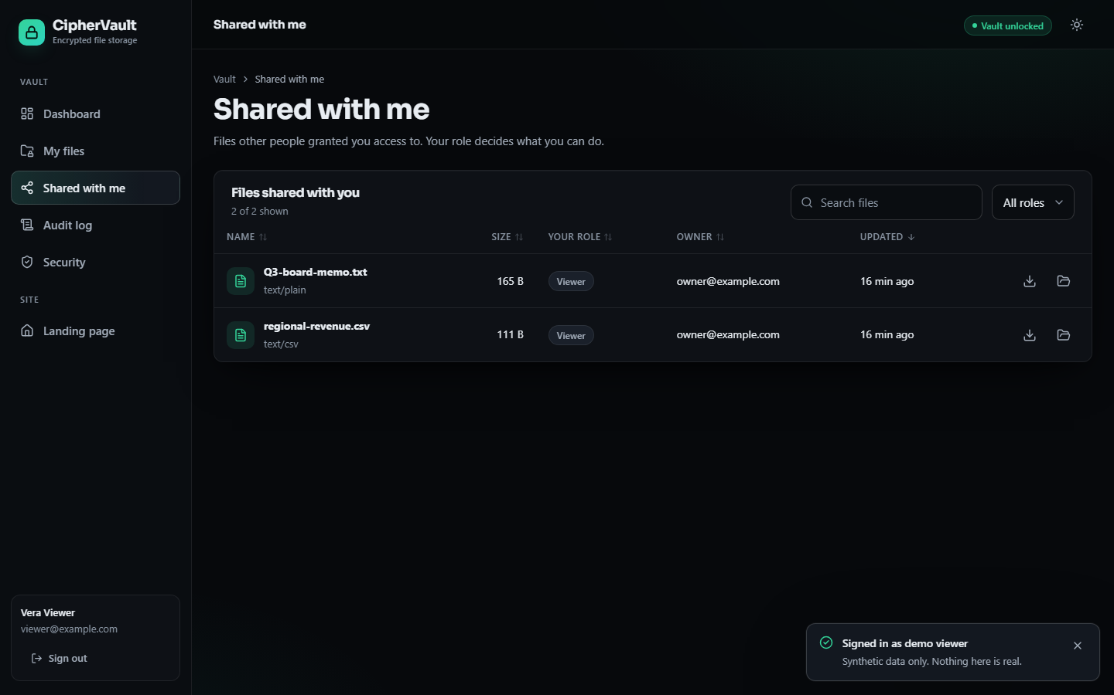
Output screens
Dashboard: files, roles, security events
My files: ciphertext sizes and roles
Sharing: grant Editor or Viewer access
Audit log with chain verification
Security profile: keys and crypto settings
Viewer account: files shared with me
Notes:
All screens are captures of the running application with the fictional demo data. More screens follow in the final presentation.

Slide 17
Initial testing and observations
21 / 21
17 / 17
18 / 18
17 / 17
pytest tests pass in about 13 s
API end-to-end checks pass
real-browser UI walk steps pass
checks in the evaluation script pass
Operation (n calls) | Median ms | p95 ms
Health check (60) | 1.68 | 2.69
GET /api/auth/me (60) | 6.32 | 17.7
Login, bcrypt cost 12 (15) | 308 | 349
List 65 files (20) | 40.3 | 58.9
Upload 1 MiB (15) | 44.5 | 70.3
Download 1 MiB (15) | 22.4 | 34.0
What the tests cover: registration and login, encrypted upload and download, owner, editor, viewer and stranger access, share, role change, revoke, the audit chain and the crypto round trip.
What they do not cover: more than a few users at once, files above 25 MB, Firefox and Safari, PostgreSQL, a Docker build, screen readers.
Not done: user study, load test, independent security audit.
Timings are from one machine with 127.0.0.1 as host.
Notes:
The study that found the audit-log weaknesses is a script that edits the database directly and then calls the verifier; it is in scripts/measure_metrics.py.

Slide 18
Challenges and corrective actions
Challenge | What we found | Action
Audit log trust | Deleting the last entries goes unnoticed (0 of 199); a full re-hash is not detected | Plan an HMAC key or an external anchor for the latest hash
Concurrent writers | 100 parallel failed logins left the chain invalid (first bad entry 5047) | Serialise the read-then-write of the last hash
Revocation | Deleting the wrapped key cannot recall a key or file already downloaded | Document it; re-key on revoke is future work
Who sees the audit log | GET /api/audit lists the global event history to any signed-in user | Restrict to the user's own events and owned files
Trust in the web app | The server serves the JavaScript that does the encryption | State it as a limit; signed builds are future work
Measuring honestly | Chrome's timer has 0.1 ms steps and the CPU was shared | Timed batches of 200 operations; reported spread
Notes:
Each challenge is a measured finding, not a guess; the evidence is in docs/REPORT_FACTS.md and the metrics file.

Slide 19
Next steps
1
Fix and re-measure
2
Close the gaps
3
Deliver
Lock the audit writer, add a keyed or anchored chain head, restrict the global audit list, then repeat the tamper and concurrency studies with the same scripts.
Chunked streaming above 25 MB, MFA, key rotation and re-keying on revoke, a PostgreSQL run, and a key-management service for the JWT secret.
Finish the final report and the IEEE paper from the measured results, rehearse the demo, and keep every number tied to the metrics files.
Notes:
The open items are the ones identified by the measurements, in priority order.

Slide 20
Thank you
Questions and suggestions are welcome.
Notes:
Close the review and invite questions.

