Slide 1

Secure File Storage System with Encryption and Role-Based Access Control (RBAC)
Final Review · CipherVault
Team Details : Batch C13
Under the Esteemed Guidance of
D V V Deepthi
[DESIGNATION], Department of CSE
23K91A05J9 Pramod Reddy Yalala
23K91A05J1 Pendela Vyshnavi
23K91A05D4 Luke Abraham Sam
23K91A05G2 Mudavath Suresh
DEPARTMENT OF COMPUTER SCIENCE AND ENGINEERING · TKR College of Engineering & Technology · Academic Year [ACADEMIC YEAR]
Notes:
Introduce the team and CipherVault: files are encrypted in the browser, the server enforces roles and keeps a hash-chained audit log. Everything shown was measured on one desktop.

Slide 2
Table of Contents
Abstract
Base Paper & Literature Survey
Research Gap, Problem Statement & Objectives
Proposed System & Architecture
Methodology, Data & Cryptographic Primitives
Decision Workflow, Interaction & Database Design
Implementation
Results: Cryptographic Cost, Overhead, Access Control & Integrity
Parameter Analysis, Performance & Testing
Comparison with the Base Paper and the Closest Architecture
Output Screens
Conclusion, Limitations, Future Scope & References
Dept. of CSE | Batch C13 | Final Review
2
Notes:
The agenda follows the report: problem, design, method, results, comparison, screens, conclusion.

Slide 3
Abstract
Files kept on a storage provider are readable by the provider, by insiders and by anyone who reaches the database. CipherVault moves encryption to the browser: every file is encrypted with its own AES-256-GCM key before upload, the key is wrapped for each authorised user with RSA-2048-OAEP, and the server stores only ciphertext.
The server enforces Owner / Editor / Viewer roles on every request, checks plaintext SHA-256 and the GCM tag on download (in the browser), and records each sensitive action in a SHA-256 hash-chained audit log.
Measured on one i5-12500 desktop in Chrome and over loopback: AES-256-GCM of a 25 MiB file takes 53.8 ms; a 10 MiB encrypted upload adds about 14 ms to a plain one; the role matrix matched 36 of 36 cells; 2000 of 2000 ciphertext bit flips were rejected.
Honest limits found while measuring: 1 of 9 audit-tampering classes (tail truncation, 0 of 199) are not detected, a full re-hash is not detected, and concurrent writers fork the chain.
21 pytest tests, a 17-check API run and an 18-step browser walk all pass.
Dept. of CSE | Batch C13 | Final Review
3
Notes:
Give the product, then the honest result: the cryptography is cheap; the audit chain detects most but not all tampering.

Slide 4
Base Paper
A. Nekouie, M. Vafaei Jahan, M. H. Moattar and R. Sheibani, "Secure electronic health record access control via blockchain, dual-attribute encryption, and large language model-based attribute extraction," Scientific Reports, vol. 16, art. 8673, 2026, doi: 10.1038/s41598-026-39690-2.
Aspect | Base paper: secure EHR access control (Nekouie et al., Scientific Reports, 2026)
Method | Elliptic-curve ciphertext-policy dual-attribute encryption; ClinicalBERT extracts data attributes from clinical notes; several key-generation centres (no key escrow); Hyperledger Fabric ledger holds public keys and policies; 23 protocol phases
Evaluation | Analytic: cost calculated from operation counts times OpenSSL primitive timings on an HPE server (E5-2620 v3) and a Raspberry Pi 3 B+; no dataset, no ClinicalBERT accuracy reported
Reported cost | Proposed scheme about 8,506 microseconds in total at x = 5 attributes on the Pi (formula 1362.5x + 1694); ten compared schemes 8,812 to 71,323 microseconds
Limits for our aim | Not a file store: no upload / download time, no role check latency, no audit-log cost; heavy key-centre and ledger infrastructure
What we adopt | Untrusted storage that sees only ciphertext; a stored hash checked after decryption; revocation and audit as part of the design; cost reported per primitive
Dept. of CSE | Batch C13 | Final Review
4
Notes:
The declared base paper solves a different problem (attribute-based encryption for health records). We adopt its trust model and measurement habit, not its machinery; its timings are calculated, not measured.

Slide 5
Literature Survey
Work | Approach | Limitation relevant here
Nekouie et al., Scientific Reports 2026 (base paper) [1] | Electronic-health-record sharing: elliptic-curve ciphertext-policy attribute-based encryption (ABE) over both user... | Not a file-storage product (no upload, download, role model or audit-log latency); cost is analytic, not a...
Sowmiya et al., IJEDR 2026 [2] | Zero-trust cloud file storage: client-side AES-256-GCM, RSA-2048 key wrapping (OAEP-SHA256), Owner / Editor /... | Evaluation protocol is only sketched (no hardware, no per-operation timings, no tamper-method list); key recovery...
Thenmozhi, Saralesh and Sakthi, Geocrypt [6] | RSA-encrypted file exchange with access gated by physical location and time-limited sessions; Ethereum smart... | Location can be spoofed on the client; blockchain adds latency and a test-net dependency; no role model beyond...
Saginayev et al., Computing & Engineering 2024 [7] | Hybrid cryptography for cloud file storage: AES-256 for data, RSA for key management, SHA-256 hash before... | Abstract-level evidence only; no role model, audit trail or timing study was read
Backendal, Haller and Paterson, MEGA [8] | Cryptanalysis of the MEGA end-to-end encrypted storage service: five attacks on its key hierarchy and file encryption | A lesson, not a system: unauthenticated or malleable key wrapping and encryption modes break an otherwise...
Goh et al., SiRiUS [10] | File layer over untrusted network storage (NFS, CIFS and similar) with its own read / write cryptographic access... | Design for network file systems rather than a web application; the abstract describes no tamper-evident audit log
Kallahalla et al., Plutus [11] | Cryptographic storage with filegroups to reduce the number of keys users exchange, separate read and write access,... | Design for a file-system client (OpenAFS), not a web application; no tamper-evident audit log is described in the...
Schneier and Kelsey, secure audit logs [31] | Forward-secure, hash-chained audit logs for untrusted machines | Designed for a machine that may later be compromised, with a separate verifier; a plain unsigned hash chain...
Dept. of CSE | Batch C13 | Final Review
5
Notes:
Eight of the surveyed works. The three batch-survey titles we could not locate online are listed only in the report and no results are quoted from them.

Slide 6
Research Gap & Problem Statement
Research gap
Problem statement
Attribute-based encryption and blockchain designs for records report calculated primitive costs, not a working file store.
The closest file-storage paper reports +320 ms, 98.6% access accuracy and 100% tamper detection without hardware, per-operation timings or tamper methods.
No work found measures browser-side AES-GCM, key wrapping, role checks and a hash-chained audit log on one machine, and reports what the chain does not detect.
Files stored without client-side encryption are readable by the storage provider.
Without role-based control any authenticated user may reach another user's files.
Tampering goes undetected when no integrity check is made on retrieval.
Without audit logs a security incident cannot be reconstructed afterwards.
Need: a store that encrypts before upload, enforces roles, verifies integrity and logs every action.
Dept. of CSE | Batch C13 | Final Review
6
Notes:
The gap is the measured, complete combination and the honesty about its weak points.

Slide 7
Objectives
# | Objective (batch documents) | How it is realised
1 | Registration and authentication with hashed credentials and JWT sessions | bcrypt cost 12; JWT HS256, 120 min; login throttle 20 per 300 s
2 | Encrypt every uploaded file with AES-256-GCM before storage | In the browser, fresh 256-bit key and 12-byte IV per file; server stores ciphertext only
3 | Role-based access control with ownership checks | Owner / Editor / Viewer checked on every request in permission_service
4 | Verify integrity on download | GCM tag plus SHA-256 of the plaintext compared in the browser
5 | Structured audit log of uploads, downloads, deletes and denials | Hash-chained audit_logs table with a verify endpoint and screen
6 | Evaluate overhead, access-control correctness and integrity | scripts/measure_metrics.py (browser crypto, API, roles, tampering) and 21 + 17 + 18 + 17 passing checks
Dept. of CSE | Batch C13 | Final Review
7
Notes:
The six objectives are taken from the batch documents; the outcome of each is on the conclusion slide.

Slide 8
Proposed System
Browser crypto
3 roles
SHA-256
Hash chain
AES-256-GCM, RSA-2048-OAEP, PBKDF2
Owner / Editor / Viewer, server-enforced
plaintext hash + GCM tag on download
tamper-evident audit log
Register: the browser generates an RSA-2048 key pair; the private key is encrypted with a password-derived key before it is stored.
Upload: the file is hashed, encrypted with a fresh file key, and the key is wrapped with the owner's public key.
Share: the owner unwraps the file key locally and re-wraps it for the recipient; the plaintext key is never sent.
Download: the server checks the role, returns ciphertext plus the caller's wrapped key; the browser decrypts and compares the SHA-256.
Every sensitive action (login, upload, download, share, role change, revoke, delete, denied access) is appended to the chain.
Runs locally with SQLite (PostgreSQL through Docker); ports 8413 (API) and 5413 (UI).
Dept. of CSE | Batch C13 | Final Review
8
Notes:
The server is blind to content by design; roles and the audit log are its job.

Slide 9
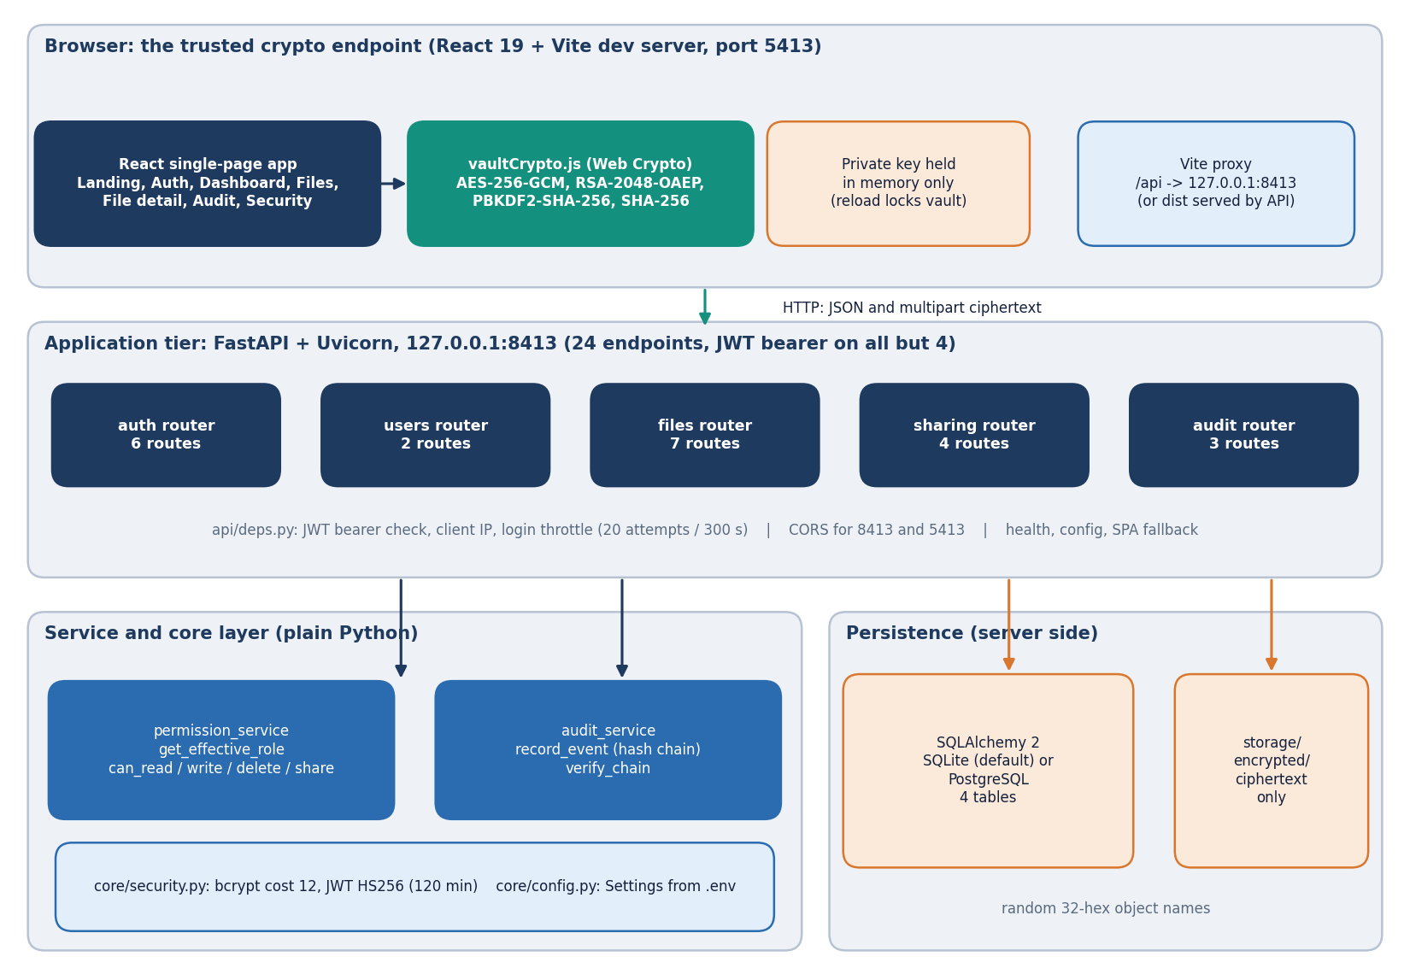
System Architecture
Browser (React 19 + Web Crypto API) is the trusted crypto endpoint.
FastAPI backend, port 8413: auth, users, files, sharing and audit routers; 24 endpoints.
Services: permission_service (roles) and audit_service (hash chain).
SQLAlchemy with 4 tables; SQLite by default, PostgreSQL via Docker.
Ciphertext lives in storage/encrypted under random 32-hex names.
The storage layer is one small module and can be swapped for object storage.
Dept. of CSE | Batch C13 | Final Review
9
Notes:
Walk the diagram top to bottom. The server never holds a plaintext file or a private key.

Slide 10
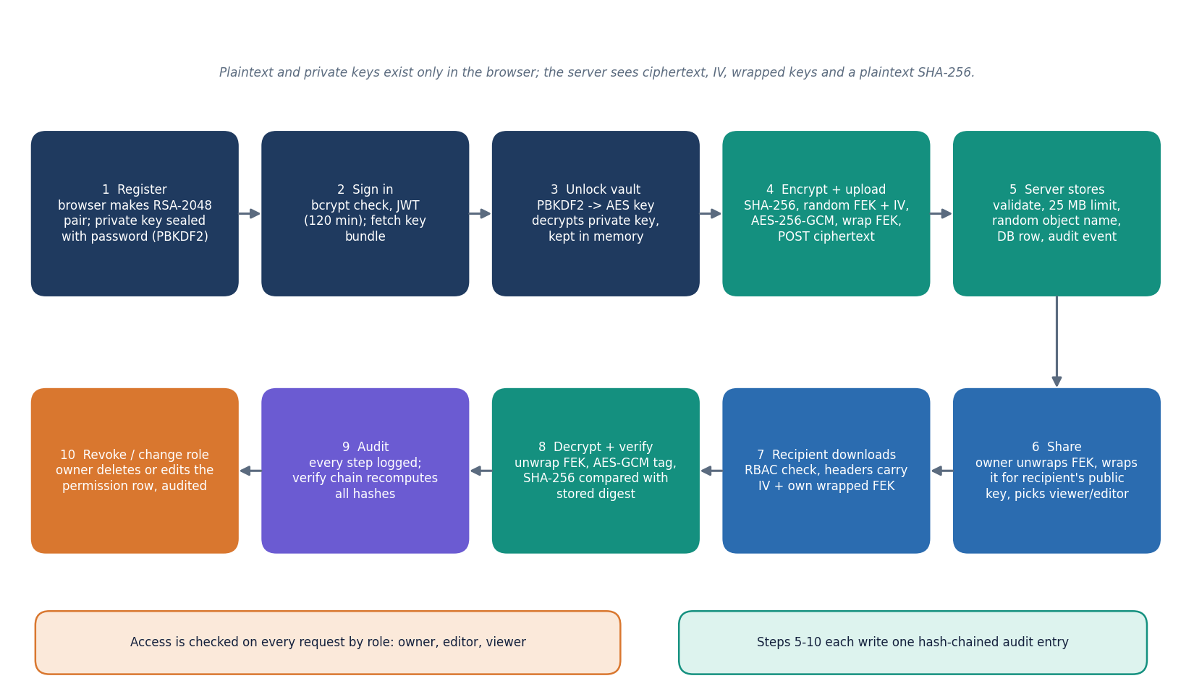
Methodology
1. Register and create keys in the browser.
2. Unlock the vault with the password (PBKDF2 key unlocks the private key).
3. Hash, encrypt and upload.
4. Share by re-wrapping the file key.
5. Download, decrypt and verify the hash.
6. Verify the audit chain at any time; revoke access when needed.
High-level workflow, from registration to chain verification.
Dept. of CSE | Batch C13 | Final Review
10
Notes:
Six steps; steps 3 to 5 are where the cryptography and the role check meet.

Slide 11
Data, Cryptographic Primitives and Tools
Item | Detail
Data | No dataset and no learned model. Demo data are 5 fictional files and 3 demo accounts; measurement payloads are random bytes from 1 KiB to 25 MiB
File cipher | AES-256-GCM, fresh 256-bit file key and random 12-byte IV per file, 16-byte tag
Key wrapping | RSA-2048-OAEP (SHA-256); wrapped key is 256 bytes, one copy per authorised user
Private key | PKCS#8 encrypted with AES-256-GCM under a PBKDF2-HMAC-SHA-256 key (120,000 iterations, 16-byte salt)
Integrity / audit | SHA-256 of the plaintext; audit chain SHA-256(prev | time | user | file | action | success | details)
Passwords, sessions | bcrypt cost 12; JWT HS256, 120 minutes
Stack | FastAPI, SQLAlchemy, SQLite / PostgreSQL, React 19, Vite 8, Web Crypto API, Recharts, three.js; pytest and Playwright
Dept. of CSE | Batch C13 | Final Review
11
Notes:
There is no training data: the 'dataset' is demo data and measurement workloads, and we say so on purpose.

Slide 12
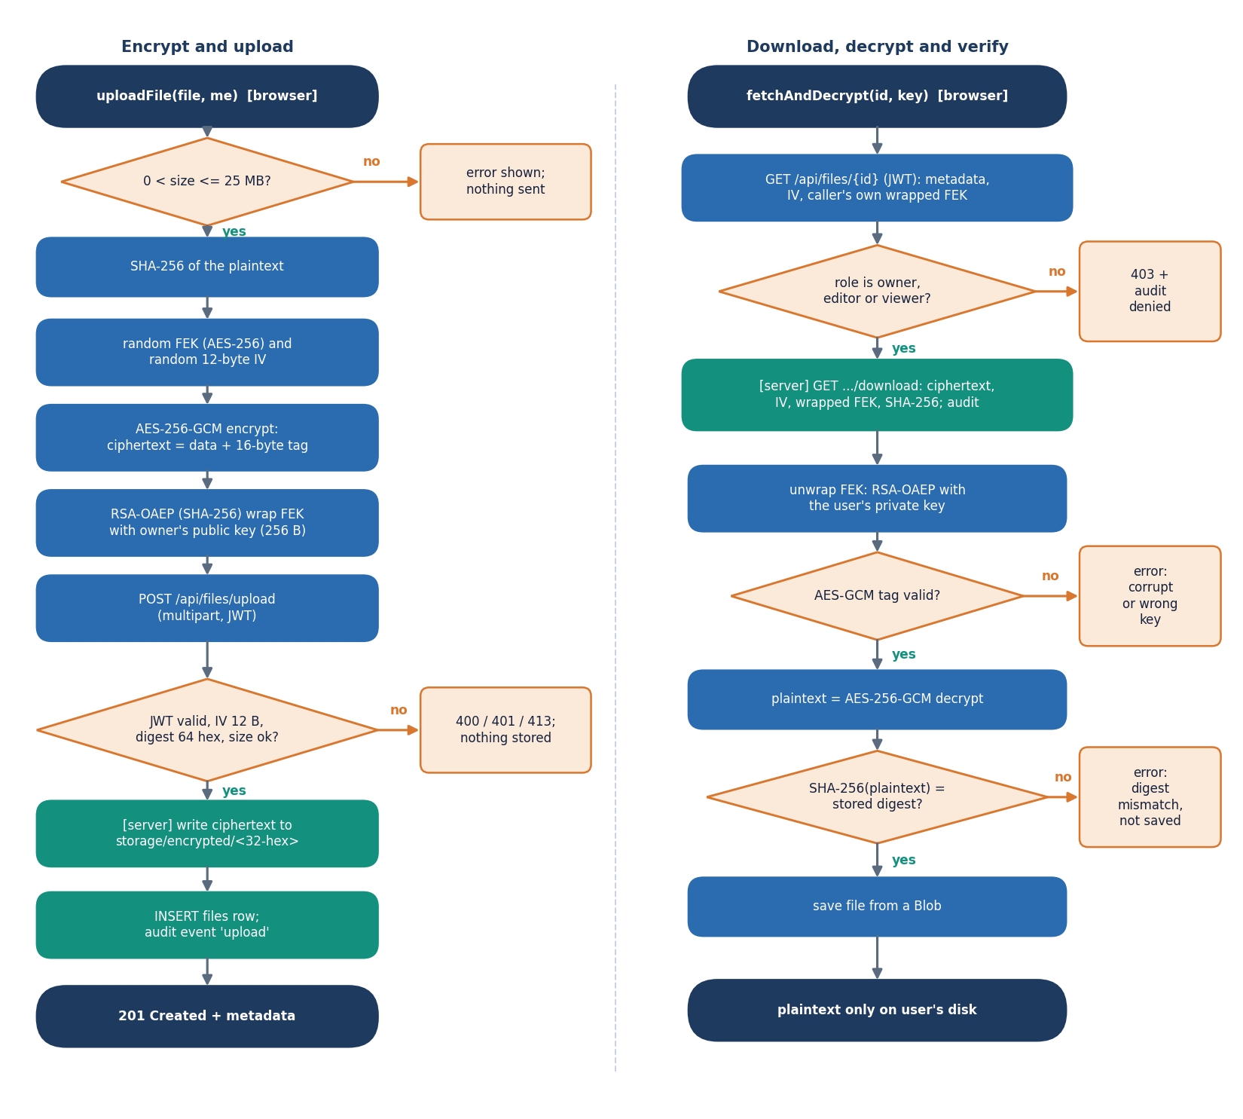
Decision Workflow: Roles and the Core Algorithm
Operation | Owner | Editor | Viewer | Stranger
Read metadata | allow | allow | allow | deny
Download | allow | allow | allow | deny
Replace content | allow | allow | deny | deny
List access | allow | allow | allow | deny
Share | allow | deny | deny | deny
Change role | allow | deny | deny | deny
Revoke | allow | deny | deny | deny
File history | allow | deny | deny | deny
Delete | allow | deny | deny | deny
Roles are resolved per file by permission_service; a denied request returns HTTP 403 and writes an unauthorized_access event. This table is what the live API returned (all 36 cells matched).
Dept. of CSE | Batch C13 | Final Review
12
Notes:
Left: upload and download algorithm. Right: the decision table the server applies; it was measured against the live API.

Slide 13
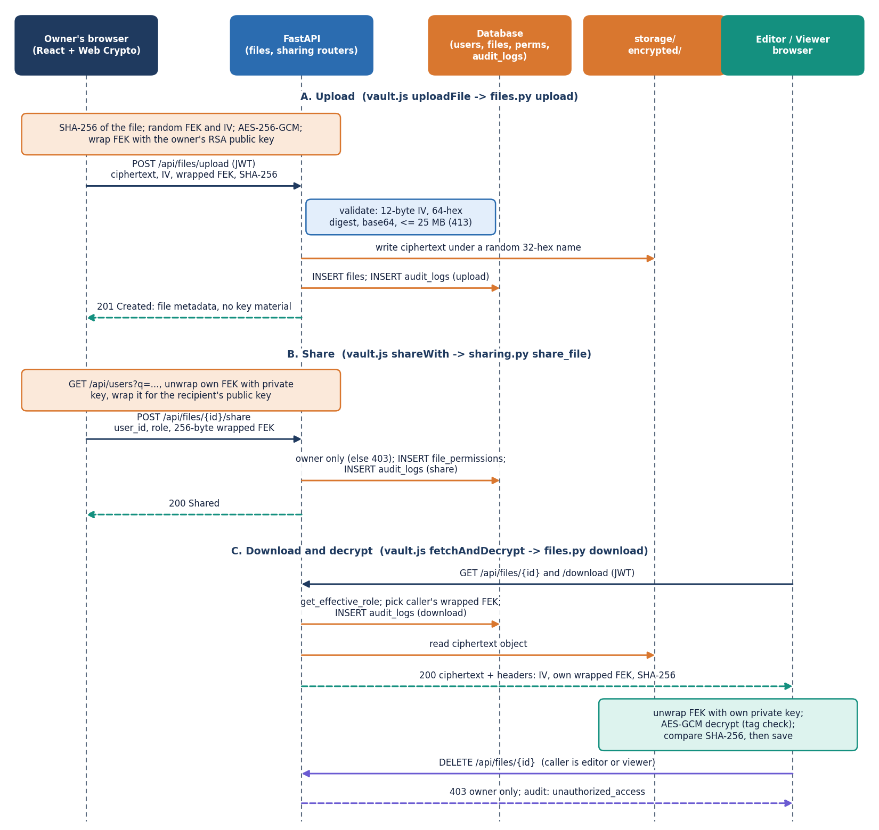
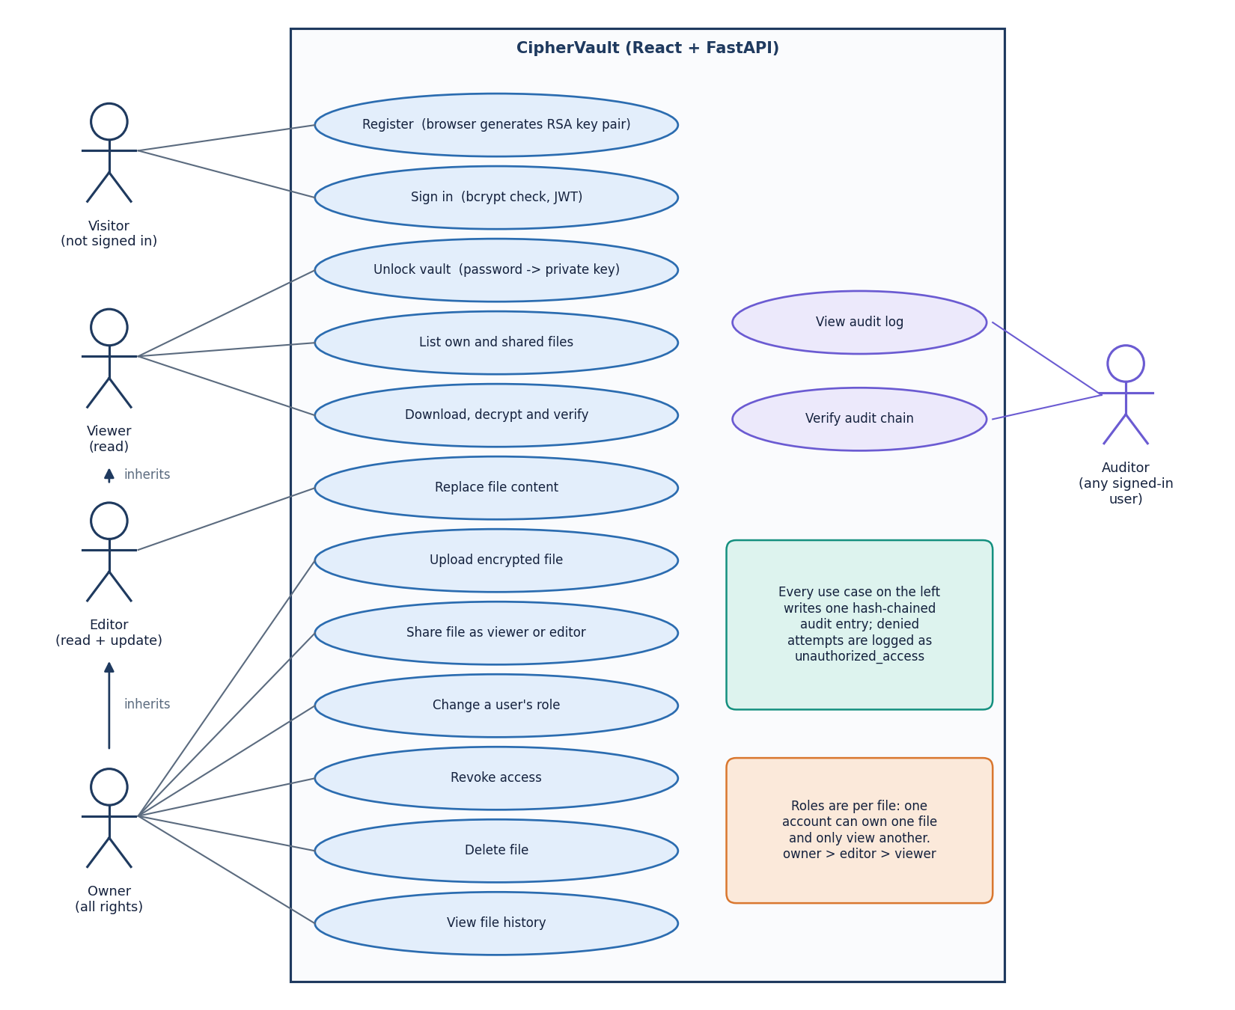
User - System Interaction
Dept. of CSE | Batch C13 | Final Review
13
Notes:
Sequence of upload, share and download between the owner, the server and the recipient; and the use cases per role.

Slide 14
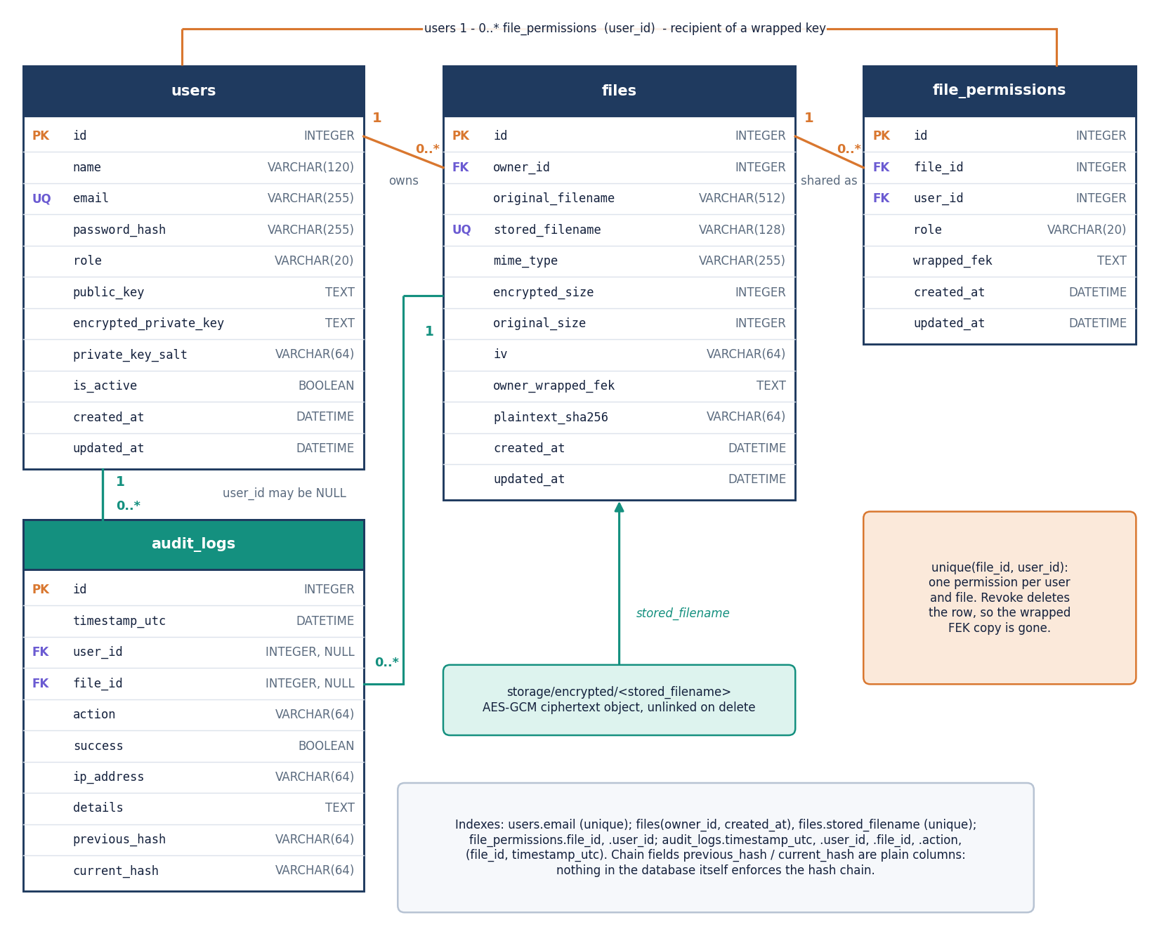
Database Design
users: name, unique email, bcrypt hash, public key, encrypted private-key bundle and salt
files: owner, original and stored (random) names, sizes, IV, owner-wrapped file key, plaintext SHA-256
file_permissions: file, user, role (viewer | editor), recipient-wrapped file key; unique (file, user)
audit_logs: time, user, file, action, success, IP, details, previous and current hash
File and user deletion cascade to permissions; audit rows keep their history (foreign keys set to NULL).
Dept. of CSE | Batch C13 | Final Review
14
Notes:
Four tables. The ER diagram mirrors backend/app/db/models.py.

Slide 15
Implementation Highlights
24 endpoints
21 tests
1,184 lines
6,831 lines
REST API + SPA fallback
pytest, all pass
backend, 20 Python files
frontend, 39 files
Server validates every upload: 12-byte IV, 64-hex SHA-256, base64 fields, 25 MB limit (HTTP 413).
Stored object has a random 32-hex name; the original name is metadata only.
A share must carry a 256-byte RSA-OAEP value; duplicates return 409.
Login throttle in memory; forged, expired, wrong-secret and alg=none tokens all return 401.
Found while measuring: concurrent audit writers fork the chain (read last hash, then commit, no lock).
Whole-file encryption in memory, hence the 25 MB cap; no chunking.
GET /api/audit returns the global event list to any signed-in user.
An editor's update re-encrypts under the existing file key with a fresh IV.
Dept. of CSE | Batch C13 | Final Review
15
Notes:
Strengths on the left, defects found while measuring on the right.

Slide 16
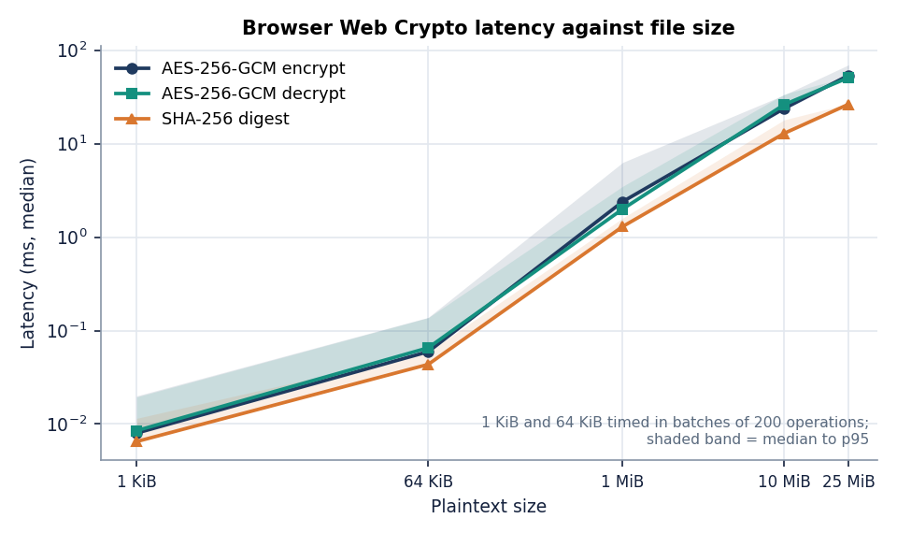
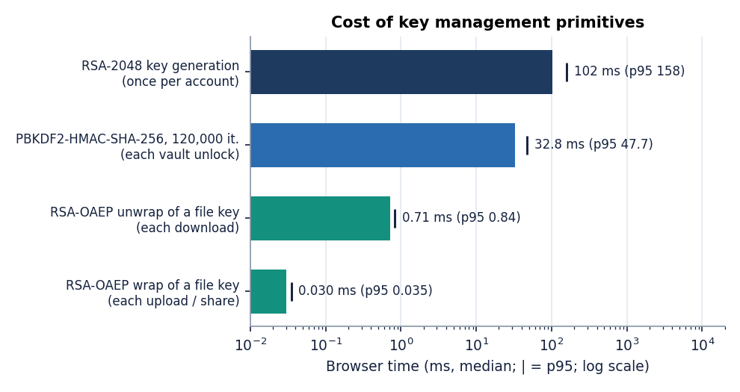
Results - Cost of the Cryptography (Browser)
53.8 ms
23.8 ms
102 ms
32.8 ms
AES-256-GCM encrypt, 25 MiB
AES-256-GCM encrypt, 10 MiB
RSA-2048 key generation
PBKDF2, 120,000 iterations
Chrome 155, medians; wrapping a file key costs 0.030 ms, unwrapping 0.71 ms; AES-GCM adds 16 bytes per file. Encryption cost grows linearly with size.
Dept. of CSE | Batch C13 | Final Review
16
Notes:
Medians in Chrome on an i5-12500 shared with other jobs. Small sizes were timed in batches because Chrome's clock is 0.1 ms.

Slide 17
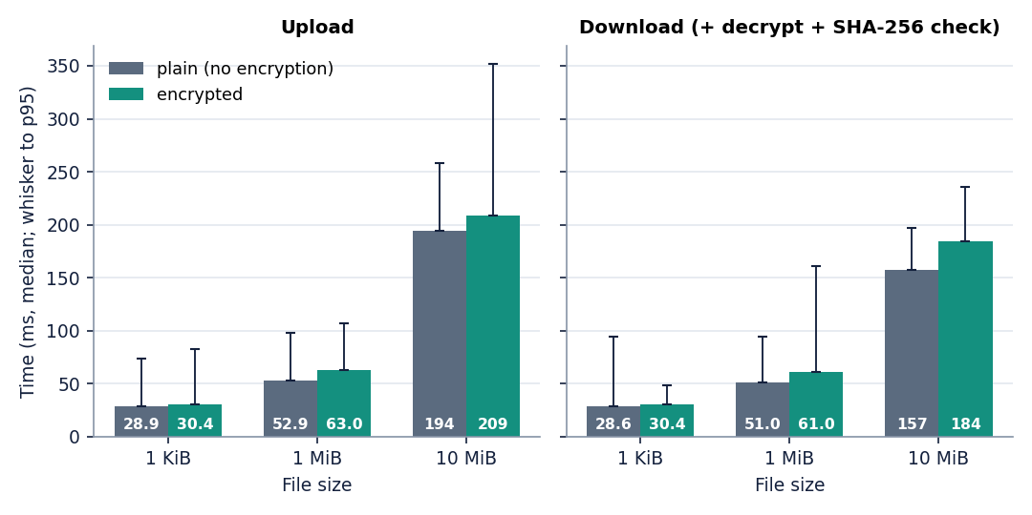
Results - End-to-End Overhead vs Plain Transfer
Size | Upload enc / plain | Download+decrypt / plain
1 KiB | 30.4 / 28.9 ms | 30.4 / 28.6 ms
1 MiB | 63.0 / 52.9 ms | 61.0 / 51.0 ms
10 MiB | 209 / 194 ms | 184 / 157 ms
10 MiB: encryption adds about 14 ms to an upload and 27 ms to a download+decrypt+verify (medians).
Encrypted and plain runs used the same endpoint, in a real browser.
Host CPU was shared with other sessions: run-to-run spread reached about 3x at 10 MiB, so read these as indicative, not exact.
The closest paper reports +320 ms for a 10 MB upload; its hardware and protocol are not published, so the two figures are not compared.
Dept. of CSE | Batch C13 | Final Review
17
Notes:
Same endpoint, same browser, encrypted against plain. State the noise caveat.

Slide 18
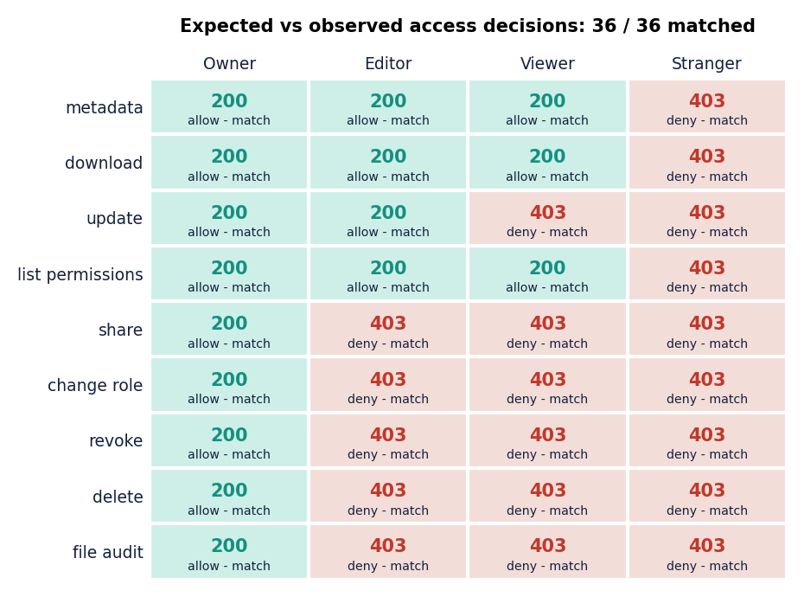
Results - Access Control and Tamper Evidence
Tampering | Detected
Ciphertext bit flip (AES-GCM) | 2000 / 2000
Audit: Edit details | 200 / 200
Audit: Edit action | 200 / 200
Audit: Edit success flag | 200 / 200
Audit: Edit user | 200 / 200
Audit: Edit hash | 200 / 200
Audit: Delete a middle entry | 199 / 199
Audit: Swap two entries | 200 / 200
Audit: Insert a forged entry | 200 / 200
Audit: Truncate the tail | 0 / 199
Audit: rewrite and re-hash every later entry | not detected
Expected vs observed for 4 principals x 9 operations: 36 of 36 matched. No token is accepted when forged, expired, signed with the wrong secret, or alg=none (all 401); unauthenticated calls return 401.
Tail truncation and a full re-hash pass the check: the chain has no secret key or external anchor.
Dept. of CSE | Batch C13 | Final Review
18
Notes:
This is the equivalent of a confusion matrix for a security system: expected against observed decisions, and detected against injected tampering. Say the two misses aloud.

Slide 19
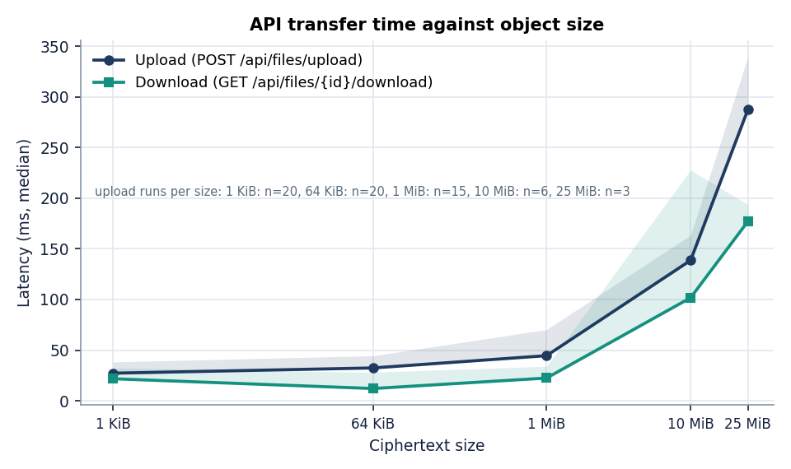
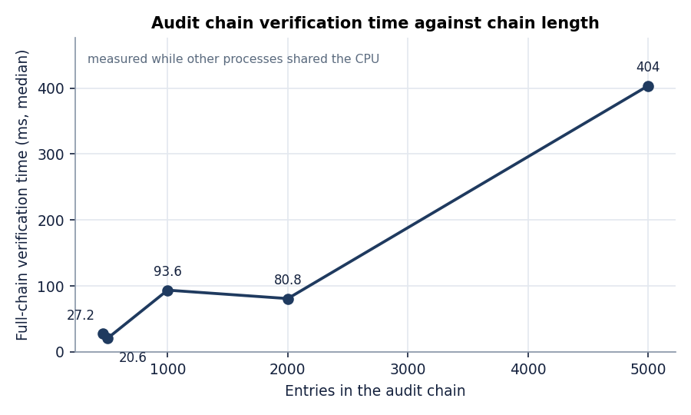
Parameter Analysis - File Size, Key Derivation, Chain Length
File size: API upload median 44.5 ms at 1 MiB, 139 ms at 10 MiB, 288 ms at the 25 MB limit; download 177 ms. Above the limit the server returns HTTP 413.
Key derivation: PBKDF2 at 120,000 iterations costs 32.8 ms per unlock; cost scales with the iteration count (the closest paper uses 310,000; not measured here).
Chain length: verification took 27.2 ms for 461 entries and 404 ms for 5,000; it re-walks every entry (no incremental check).
Dept. of CSE | Batch C13 | Final Review
19
Notes:
Three parameters: file size (the 25 MB cap), PBKDF2 iterations, audit chain length.

Slide 20
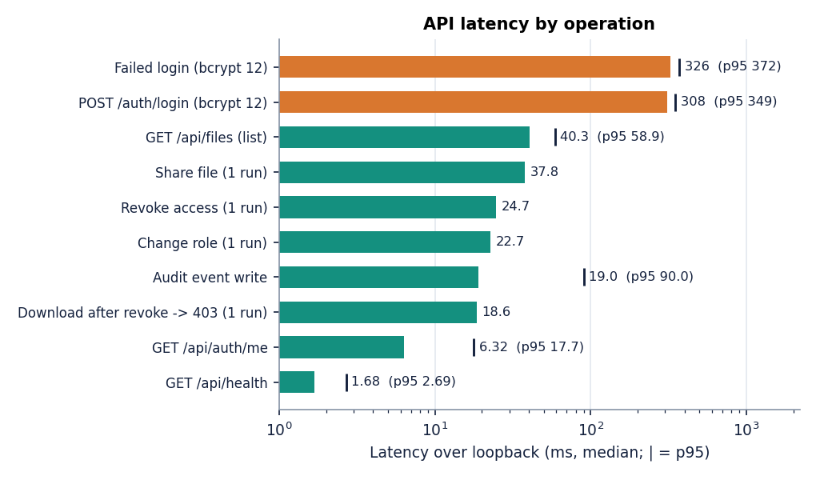
Performance & Testing
21 / 21
17 / 17
18 / 18
17 / 17
pytest tests, 13 s
API end-to-end checks
real-browser UI steps
evaluate.py checks
Login 308 ms (bcrypt cost 12); a call to /auth/me 6.32 ms; share 37.8 ms; revoke 24.7 ms.
After revoke, the next download returned HTTP 403.
Defect: 100 concurrent failed logins on 4 workers left the chain invalid (first bad entry 5047 of 5145); not fixed.
Not tested: multi-user load, files above 25 MB, Firefox / Safari, PostgreSQL path, Docker build, screen-reader audit.
Median latency per operation over loopback.
Dept. of CSE | Batch C13 | Final Review
20
Notes:
Tests are broad but small-scale. The concurrency defect is a real finding and is documented, not hidden.

Slide 21
Comparison with the Base Paper and the Closest Architecture
Aspect | Base paper [1] | Closest paper [2] | CipherVault
Domain | Health records (EHR) | Cloud file storage | General file store
Encryption | EC dual-attribute encryption | Client-side AES-256 + RSA-2048 | Browser AES-256-GCM + RSA-2048-OAEP
Access control | Attribute policies | 3 roles, 50 users | Owner / Editor / Viewer, 36-cell matrix
Audit | Hyperledger Fabric ledger | Signed log entries | SHA-256 hash chain in the database
Evaluation basis | Calculated from primitive timings | Reported, set-up unspecified | Measured, one host, real browser
Cost reported | ~8,506 us total (Pi, x = 5) | +320 ms, 10 MB upload | ~14 ms added, 10 MiB upload
Access / tamper result | No dataset or accuracy | 98.6% access; 100% tamper (50) | 36/36 roles; 8 of 9 audit classes
The three works differ in task, data and conditions, so no score is ranked: the base paper's microsecond figures are calculated from OpenSSL timings on a Raspberry Pi and an HPE server; the closest paper does not publish its hardware or tamper method; CipherVault is measured on a shared desktop. Only the qualitative aims (provider-blind storage, integrity check, revocation, audit) are comparable.
Dept. of CSE | Batch C13 | Final Review
21
Notes:
Say plainly that nothing is score-comparable. Differences that matter: PBKDF2 120,000 vs 310,000, no chunking, no MFA, tail truncation undetected.

Slide 22
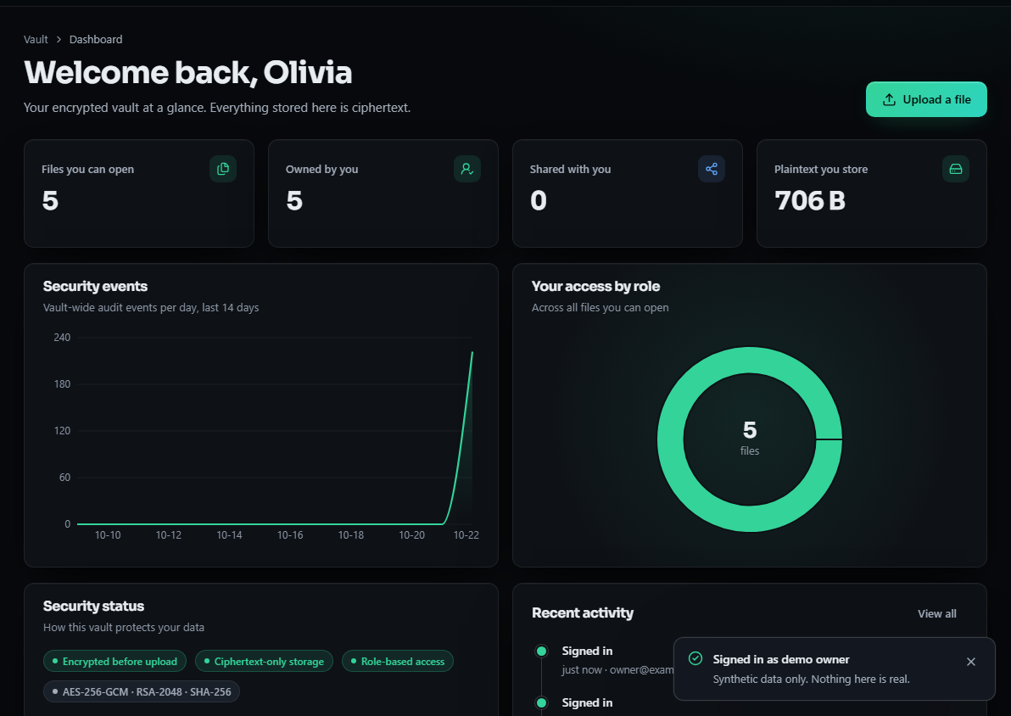
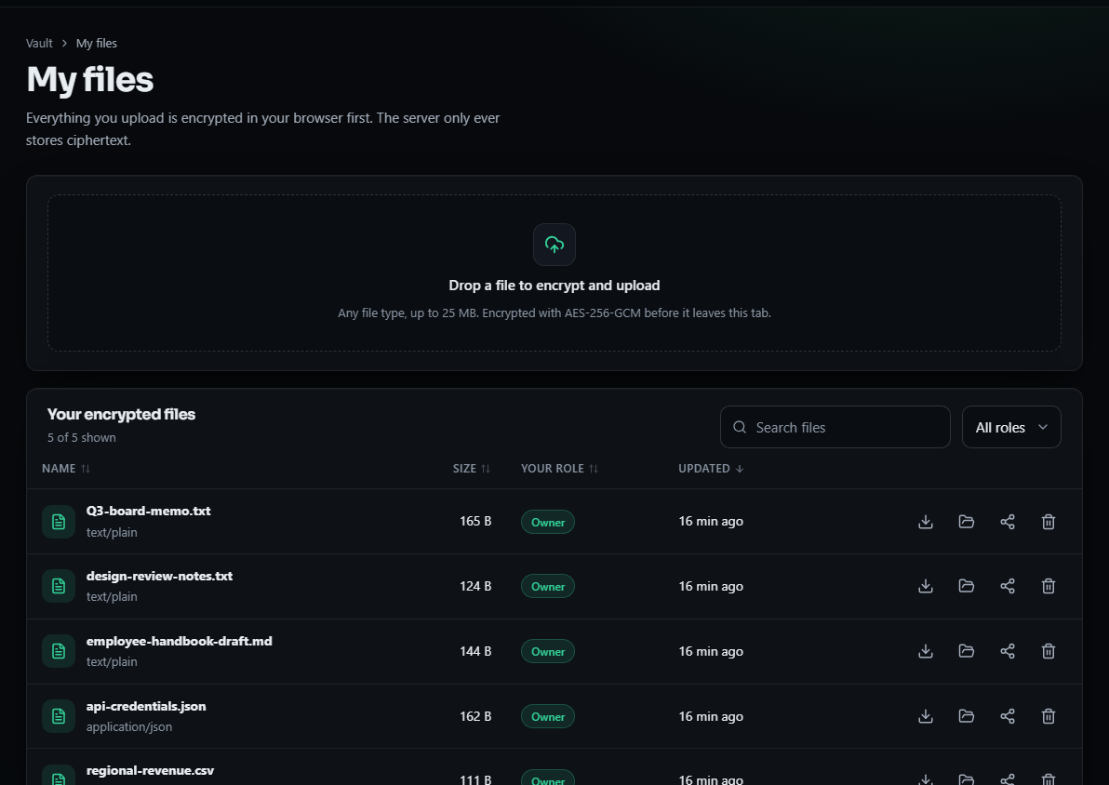
Output - Dashboard and Encrypted File List
Dashboard for the demo owner: files, role split and vault-wide audit events per day (demo and measurement activity).
My files: drop zone (any type, up to 25 MB, encrypted before it leaves the tab) and the owner's files with role badges and actions.
Dept. of CSE | Batch C13 | Final Review
22
Notes:
Real captures of the running app with demo data.

Slide 23
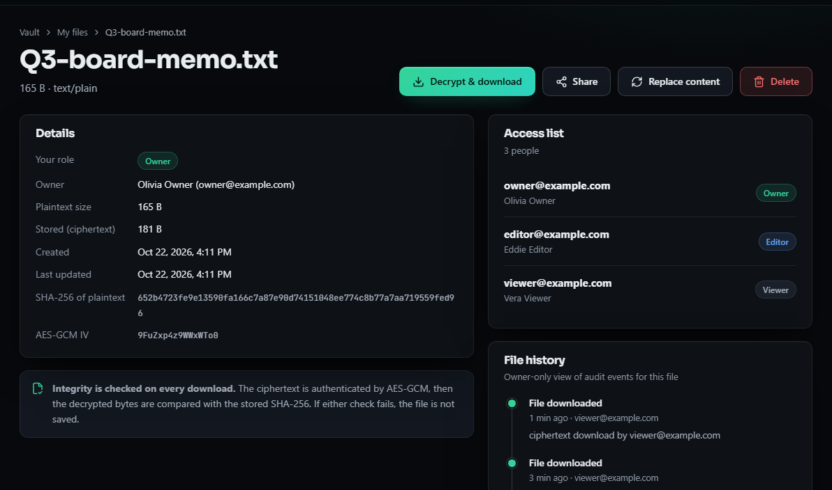
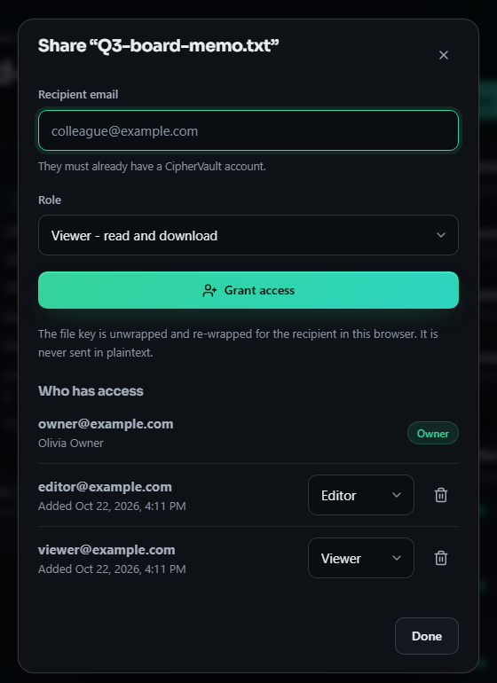
Output - File Details and Sharing
File detail: sizes, plaintext SHA-256, AES-GCM IV, the access list (owner, editor, viewer) and the owner-only file history, including a denied delete by the viewer.
Share dialog: the file key is unwrapped and re-wrapped for the recipient in the browser; role can be changed or revoked.
Dept. of CSE | Batch C13 | Final Review
23
Notes:
The history on the left shows a real denied delete (owner only).

Slide 24
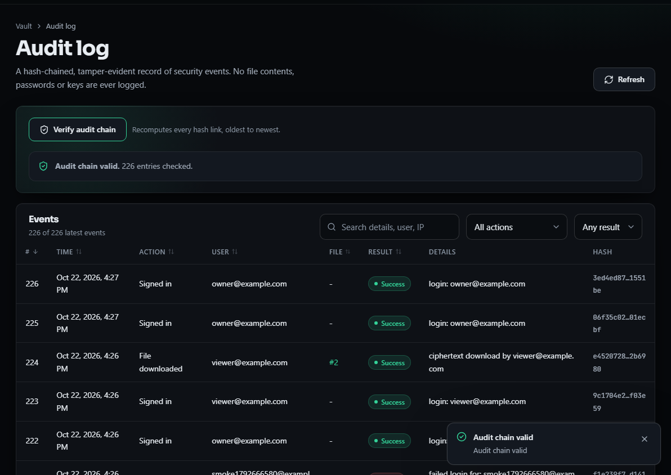
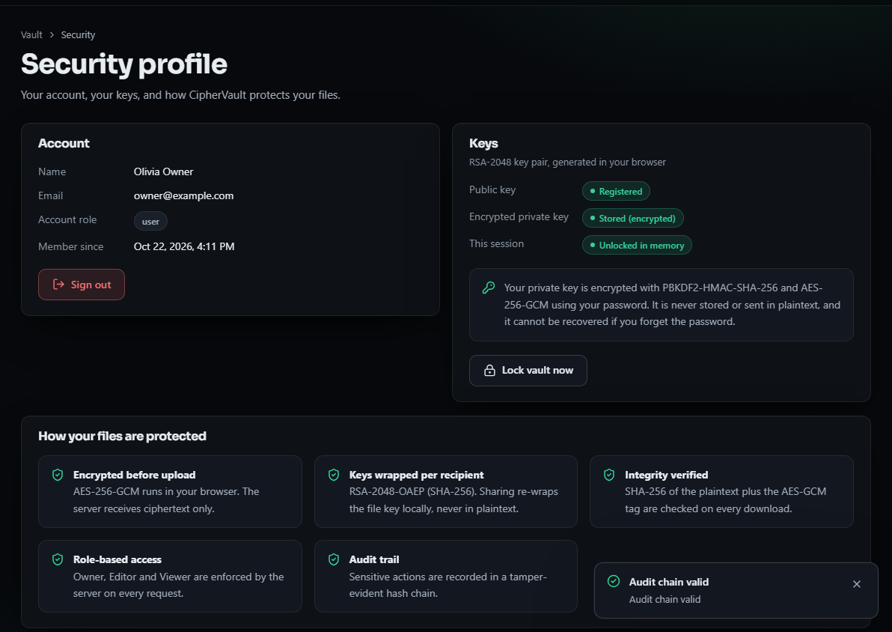
Output - Audit Log and Security Profile
Audit log: hash-chained events with success or failure and a Verify audit chain button (chain valid, 226 entries at capture time).
Security profile: key status (public key registered, private key stored encrypted, unlocked in memory) and the five protections.
Dept. of CSE | Batch C13 | Final Review
24
Notes:
The audit screen is where tamper evidence is visible to the user.

Slide 25
Conclusion
CipherVault is a working, tested secure file store: encryption is cheap, roles behaved exactly as specified, and the audit chain detects most tampering, but not truncation or a full rewrite.
# | Objective | Outcome
1 | Registration, bcrypt, JWT | Met
2 | AES-256-GCM before storage | Met, in the browser; 2000/2000 bit flips rejected
3 | RBAC with ownership checks | Met: 36/36 matrix cells
4 | Integrity on download | Met: GCM tag and SHA-256 compared in the browser
5 | Audit log of actions and denials | Met with limits: 8 of 9 tamper classes caught; concurrent writers fork the chain
6 | Evaluation of overhead, access control, integrity | Met on one shared host; indicative timings, no user study
Key finding: the cost of client-side encryption is small next to network and API time; the weak point is audit integrity, not confidentiality.
Dept. of CSE | Batch C13 | Final Review
25
Notes:
Be explicit about which objectives were met in full and which with limits.

Slide 26
Limitations & Future Scope
Known limitations
Future scope
Audit chain: tail truncation and a full re-hash undetected; concurrent writers fork it
Revocation cannot recall a key or ciphertext already downloaded; no re-keying
The server ships the JavaScript that does the crypto (MEGA-style trust)
Clear metadata (name, size, type, owner, time); password loss means data loss
No MFA; JWT in sessionStorage; in-memory login throttle; whole-file encryption, 25 MB cap
Timings from one shared host; no user study
Sign chain entries or anchor the head hash externally; serialise audit writes
Re-key the file on revoke; chunked encryption for large files
TOTP multi-factor sign-in; higher PBKDF2 iterations; HttpOnly cookies
Restrict GET /api/audit to a user's own events
Object storage and key-management service; PostgreSQL load test
Subresource integrity or a signed web app to reduce the served-JS risk
Dept. of CSE | Batch C13 | Final Review
26
Notes:
Limitations first, then future work drawn from the measured defects.

Slide 27
References
[1] A. Nekouie, M. Vafaei Jahan, M. H. Moattar and R. Sheibani, "Secure electronic health record access control via blockchain, dual-attribute encryption, and large language model-based attribute extraction," Scientific Reports, vol. 16, art. no. 8673, 2026, doi: 10.1038/s41598-026-39690-2.
[2] G. Sowmiya, R. Nivas and E. Vikram, "Secure cloud file storage architecture with client-side encryption and access control," Int. J. Eng. Develop. Res. (IJEDR), vol. 14, no. 2, pp. 576-579, Apr. 2026, paper IJEDR2602501.
[6] P. Thenmozhi, V. D. Saralesh and R. Sakthi, "Geocrypt: Location-based secure file encryption and access control," ITM Web of Conferences, vol. 82, art. no. 03019, 2026, doi: 10.1051/itmconf/20268203019.
[7] E. Saginayev, A. Niyazov, A. Razaque, Zh. Kalpeyeva and A. Urazgaliyeva, "Secure file storage on cloud using hybrid cryptography," Computing & Engineering, vol. 2, no. 2, pp. 1-7, 2024, doi: 10.51301/ce.2024.i2.01.
[8] M. Backendal, M. Haller and K. G. Paterson, "MEGA: Malleable encryption goes awry," in Proc. IEEE Symp. Security and Privacy (SP), 2023, pp. 146-163.
[10] E.-J. Goh, H. Shacham, N. Modadugu and D. Boneh, "SiRiUS: Securing remote untrusted storage," in Proc. Network and Distributed System Security Symp. (NDSS), 2003.
[11] M. Kallahalla, E. Riedel, R. Swaminathan, Q. Wang and K. Fu, "Plutus: Scalable secure file sharing on untrusted storage," in Proc. 2nd USENIX Conf. File and Storage Technologies (FAST), San Francisco, CA, USA, 2003, pp. 29-42.
[15] D. F. Ferraiolo, R. Sandhu, S. Gavrila, D. R. Kuhn and R. Chandramouli, "Proposed NIST standard for role-based access control," ACM Trans. Inf. Syst. Secur., vol. 4, no. 3, pp. 224-274, Aug. 2001, doi: 10.1145/501978.501980.
[21] M. Dworkin, "Recommendation for block cipher modes of operation: Galois/Counter Mode (GCM) and GMAC," NIST Special Publication 800-38D, Nov. 2007.
[24] K. Moriarty, Ed., B. Kaliski, J. Jonsson and A. Rusch, "PKCS #1: RSA cryptography specifications version 2.2," IETF RFC 8017, Nov. 2016.
[26] K. Moriarty, Ed., B. Kaliski and A. Rusch, "PKCS #5: Password-based cryptography specification version 2.1," IETF RFC 8018, Jan. 2017.
[28] N. Provos and D. Mazieres, "A future-adaptable password scheme," in Proc. USENIX Annual Technical Conf., Monterey, CA, USA, Jun. 1999, pp. 81-92.
[29] M. Jones, J. Bradley and N. Sakimura, "JSON Web Token (JWT)," IETF RFC 7519, May 2015.
[30] M. Watson, Ed., "Web Cryptography API," W3C Recommendation, Jan. 26, 2017. [Online]. Available: https://www.w3.org/TR/2017/REC-WebCryptoAPI-20170126/
[31] B. Schneier and J. Kelsey, "Secure audit logs to support computer forensics," ACM Trans. Inf. Syst. Secur., vol. 2, no. 2, pp. 159-176, May 1999.
[32] S. A. Crosby and D. S. Wallach, "Efficient data structures for tamper-evident logging," in Proc. 18th USENIX Security Symp., Montreal, QC, Canada, Aug. 2009, pp. 317-334.
The full numbered list of 34 references is in the report.
Dept. of CSE | Batch C13 | Final Review
27
Notes:
Selected references; the complete numbered list is in the report.

Slide 28
THANK YOU
Questions & Suggestions
Dept. of CSE | Batch C13 | Final Review
28
Notes:
Invite questions.

