Slide 1
Graph Neural Network Analysis for Scalable Fake Profile Detection and Botnets
REVIEW 2 · DESIGN, METHODOLOGY AND PROGRESS
Design, methodology and progress: GCN, GAT and GraphSAGE on a social graph, with botnet clusters and a moderator review loop
Presented by
Under the guidance of
Bijja Naga Lakshmi 23K91A0538
Divvela Srivatshav 23K91A0564
Adumulla Durga 23K91A0504
Burugula Koushik 23K91A0550
Neelima, [DESIGNATION]
Department of Computer Science and Engineering
TKR College of Engineering & Technology · Batch A9 (CSE-A) · [ACADEMIC YEAR]
Notes:
This review shows how BotGraph is designed and built, what is implemented, the first measured results on the 908-account test split and the open items. Introduce the four team members and the guide.

Slide 2
Contents
01
02
03
Recap and architecture
Methodology and dataset
Preprocessing and model
04
05
06
Training and decision logic
Data flow, database and UML
Technology stack
07
08
09
Progress and preliminary results
Output screens and testing
Challenges and next steps
Notes:
Agenda for the design and progress review.

Slide 3
Recap: problem and proposed system
!
Problem
i
Proposed system
B
Base paper link [1]
Fake profiles appear faster than moderators can remove them, per-account classifiers miss botnets whose profiles look normal, bot behaviour changes quickly, and fake accounts are a small share of the data (here 12.6 percent).
BotGraph treats accounts as nodes and interactions as edges. GCN, GAT and GraphSAGE learn from each account's neighbourhood, Louvain over the learned embeddings exposes botnet clusters, and moderators confirm or dismiss what is flagged.
PruferNET (Saha et al., IEEE Access 2026) uses GraphSAGE on the Facebook graph to classify nodes by spanning-tree depth. We keep the graph-learning idea and data family, but the task is fake-account detection, which that paper does not address. Results are not comparable.
Notes:
Recap of Review 1. The survey gap was applying relational learning to fake-profile and botnet detection at platform scale. PruferNET is an influence-classification paper, so we use it as the closest graph-learning reference, not as a result to beat.

Slide 4
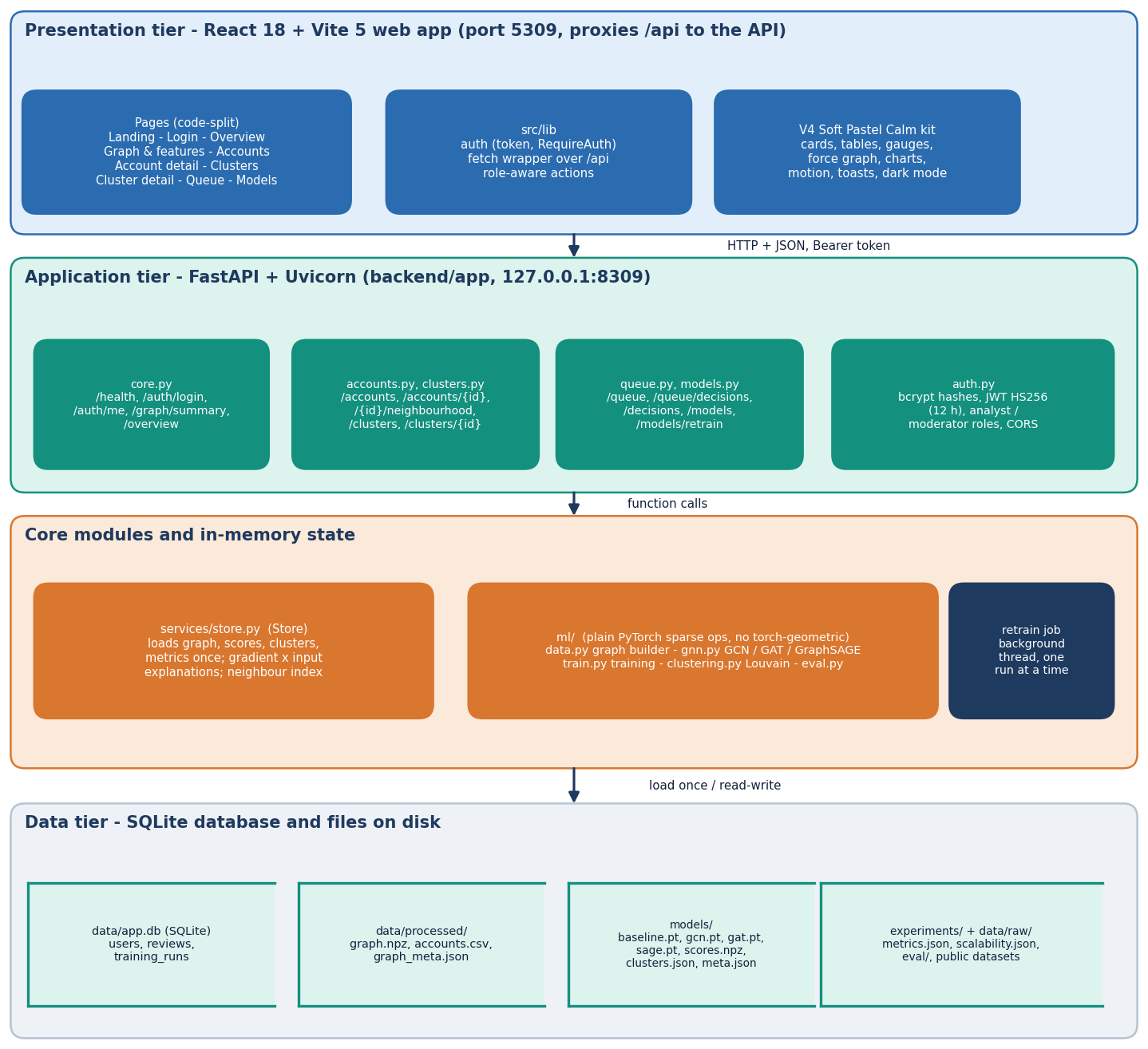
System architecture
Pipeline, API and web app
ml/: graph builder, 23 features, GCN / GAT / GraphSAGE and a baseline, Louvain clustering, evaluation.
backend/app: FastAPI on port 8309, 18 routes, JWT roles, SQLite; loads the graph, scores and clusters once at start-up.
frontend/: React 18 + Vite on port 5309, 10 screens, light and dark.
Files: data/processed, models/*.pt, scores.npz, clusters.json, experiments/*.json.
No call to an outside service at run time.
Notes:
The three layers are separate: ml/ writes artefacts, the API serves them and stores users, decisions and retraining runs in SQLite, the web app consumes the API.

Slide 5
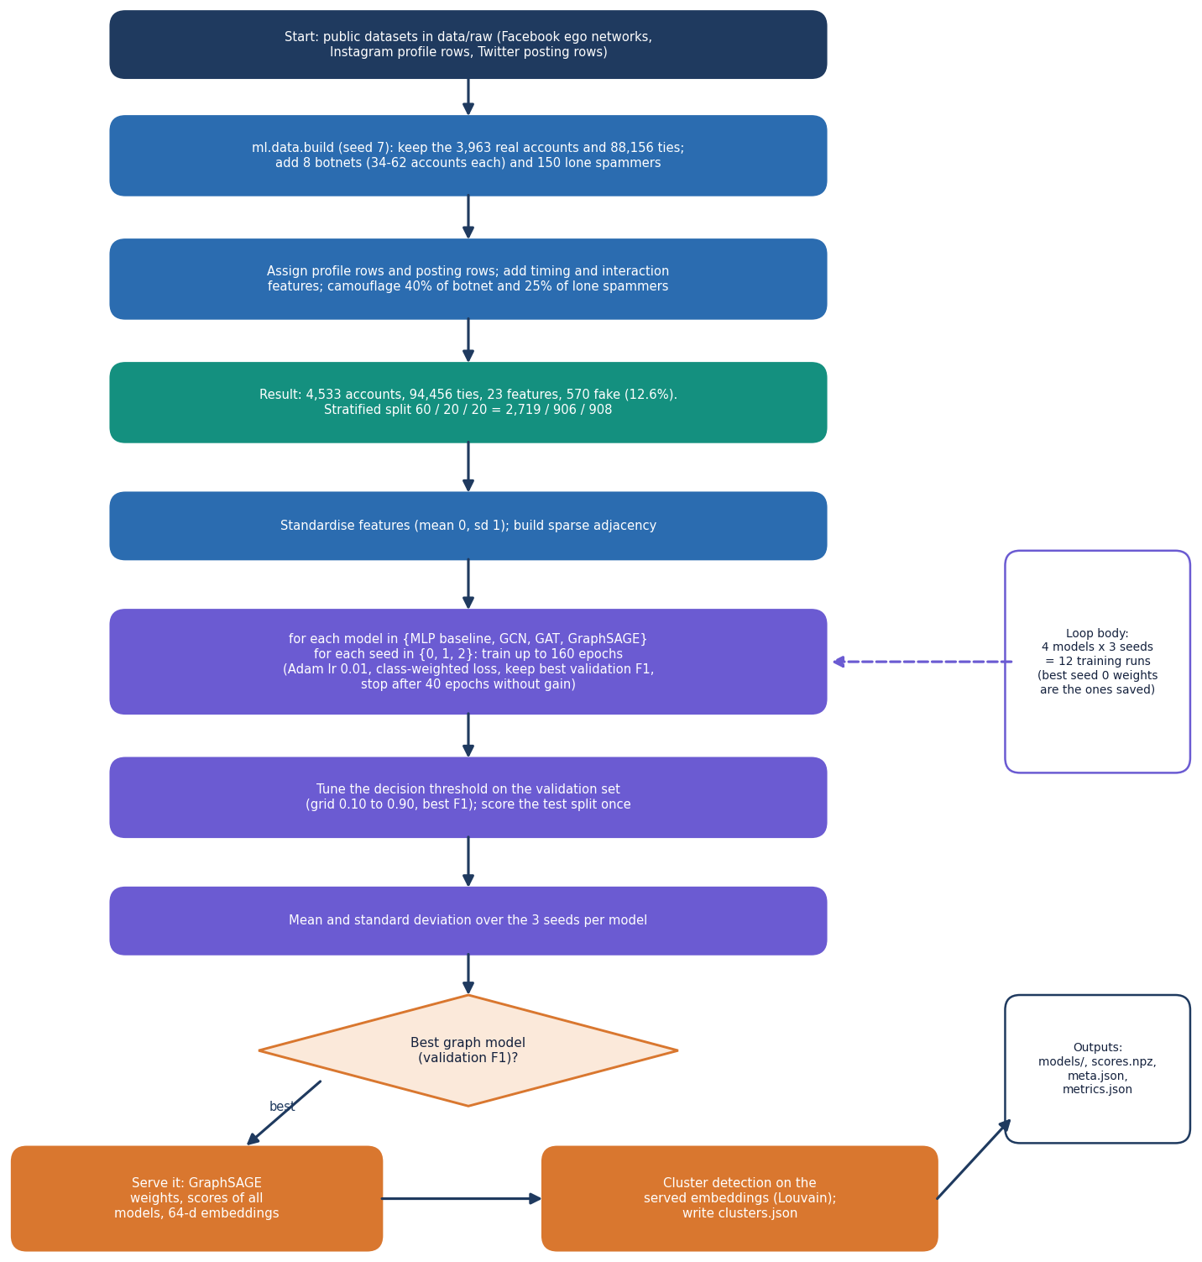
Methodology: from graph to moderator decision
1. Build the graph
Real Facebook topology (3,963 accounts, 88,156 ties) plus 570 injected fake accounts (6,300 ties); 23 features per account.
2. Train and compare
Baseline MLP, GCN, GAT and GraphSAGE on one 60/20/20 split, 3 seeds each; threshold tuned on validation.
3. Cluster
Louvain over embeddings of accounts scored at 0.30 or more; groups under 5 accounts dropped.
4. Review
Moderators confirm or dismiss; decisions become labels at the next retrain.
Notes:
The same four steps run in ml/train.py (steps 1 to 3) and in the queue and retrain routes (step 4). Retraining never touches the test split.

Slide 6
Dataset: real topology, injected botnets
4,533
94,456
570 (12.6%)
2,719 / 906 / 908
accounts (nodes)
undirected ties (edges)
fake accounts
train / validation / test
Part | Source and licence | Status
Topology | SNAP Facebook social circles, ten ego networks: 3,963 accounts, 88,156 ties | Real
Profile attributes | Instagram fake / spammer / genuine accounts, 696 labelled rows, CC BY 3.0 | Real rows, resampled and jittered
Posting behaviour | Twitter bot detection set, 50,000 rows, CC0 (its label carries almost no signal) | Real rows, act as realistic noise
Botnets | 8 botnets (34-62 accounts) and 150 lone spammers, seed 7; 6,300 injected ties | Synthetic, known answer
Timing, interaction, handles | peak hour, burstiness, interactions per week, usernames and display names | Synthetic, seeded
Nothing is scraped from a live platform. Results describe this benchmark, not real botnets on any platform.
Notes:
Be frank about the synthetic parts. 198 of the bots get a genuine-looking profile and 231 genuine accounts a fake-looking one on purpose, otherwise the profile alone would solve the task and the graph would add nothing. The split is stratified and identical for every model.

Slide 7
Preprocessing and node features
Public datasets
Merge onto topology
Inject botnets and camouflage
23 node features
Standardise (mean 0, sd 1)
Stratified 60/20/20
Feature group | Count | Examples
Profile metadata | 12 | profile picture, digits in username, bio length, followers / following (log), ratio
Posting behaviour | 4 | average retweets (log), mentions, post length, hashtags per post
Temporal pattern | 6 | account age (log days), posts per day, burstiness, peak-hour share, peak hour sin / cos
Interaction frequency | 1 | interactions per week (log)
Members of one botnet share a creation window and a peak posting hour, so those two traits are common to a cluster without making any single member stand out.
Camouflage: 40 percent of botnet accounts and 25 percent of lone spammers get a genuine-looking profile; 6 percent of genuine accounts get a fake-looking one.
Notes:
Features are listed in ml/data.py. Standardisation uses statistics of the whole feature matrix and is saved with the scores so the API can explain a score.

Slide 8
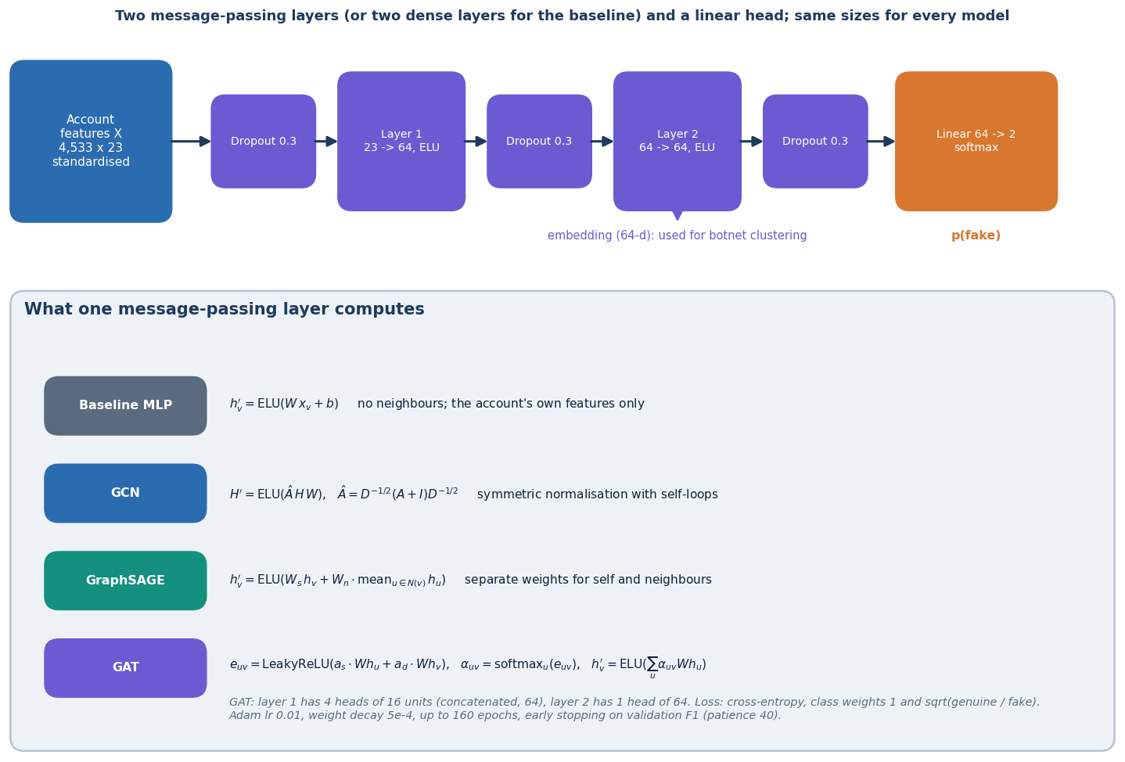
Model architecture: three message-passing layers
GCN: symmetric-normalised neighbour average with self-loops, A_hat X W.
GraphSAGE: W_self x + W_neigh mean(neighbours); the account keeps its own weight.
GAT: 4 attention heads, then one head; edge softmax built from scatter_reduce and index_add.
Baseline: two dense layers on the account's own features, no graph.
All written in plain PyTorch sparse operations, no torch-geometric.
Two layers, 64 hidden units, linear head with two outputs; layer stack from ml/gnn.py.
Notes:
Every model has the same depth and width so the comparison isolates the aggregation rule. Plain PyTorch was chosen because torch-geometric wheels often fail to build on Windows.

Slide 9
Training configuration
Setting | Value
Split | stratified 60/20/20 by label: 2,719 train, 906 validation, 908 test (114 fake); the same for every model
Architecture | 2 message-passing layers, 64 hidden units, dropout 0.3, linear head
Optimiser | Adam, learning rate 0.01, weight decay 0.0005, up to 160 epochs
Loss | cross-entropy with the fake class weighted by the square root of the imbalance (negatives / positives)
Model selection | best validation F1 epoch kept, early stopping with patience 40; threshold tuned on validation F1
Seeds | 3 seeds (0, 1, 2) per model; tables report mean ± standard deviation on the test split
Cost on this PC | 12th Gen Intel Core i5-12500 (6 cores, 12 threads), 16 GB RAM, Windows 11 Pro, CPU only: per run GraphSAGE 11.7 s, GCN 10.4 s, GAT 40.6 s, baseline 3.0 s
Same settings for every architecture; nothing was tuned on the test split.
Notes:
Settings are in ml/config.py. Training is full-batch because the graph is small; the whole pipeline runs on a laptop CPU in minutes.

Slide 10
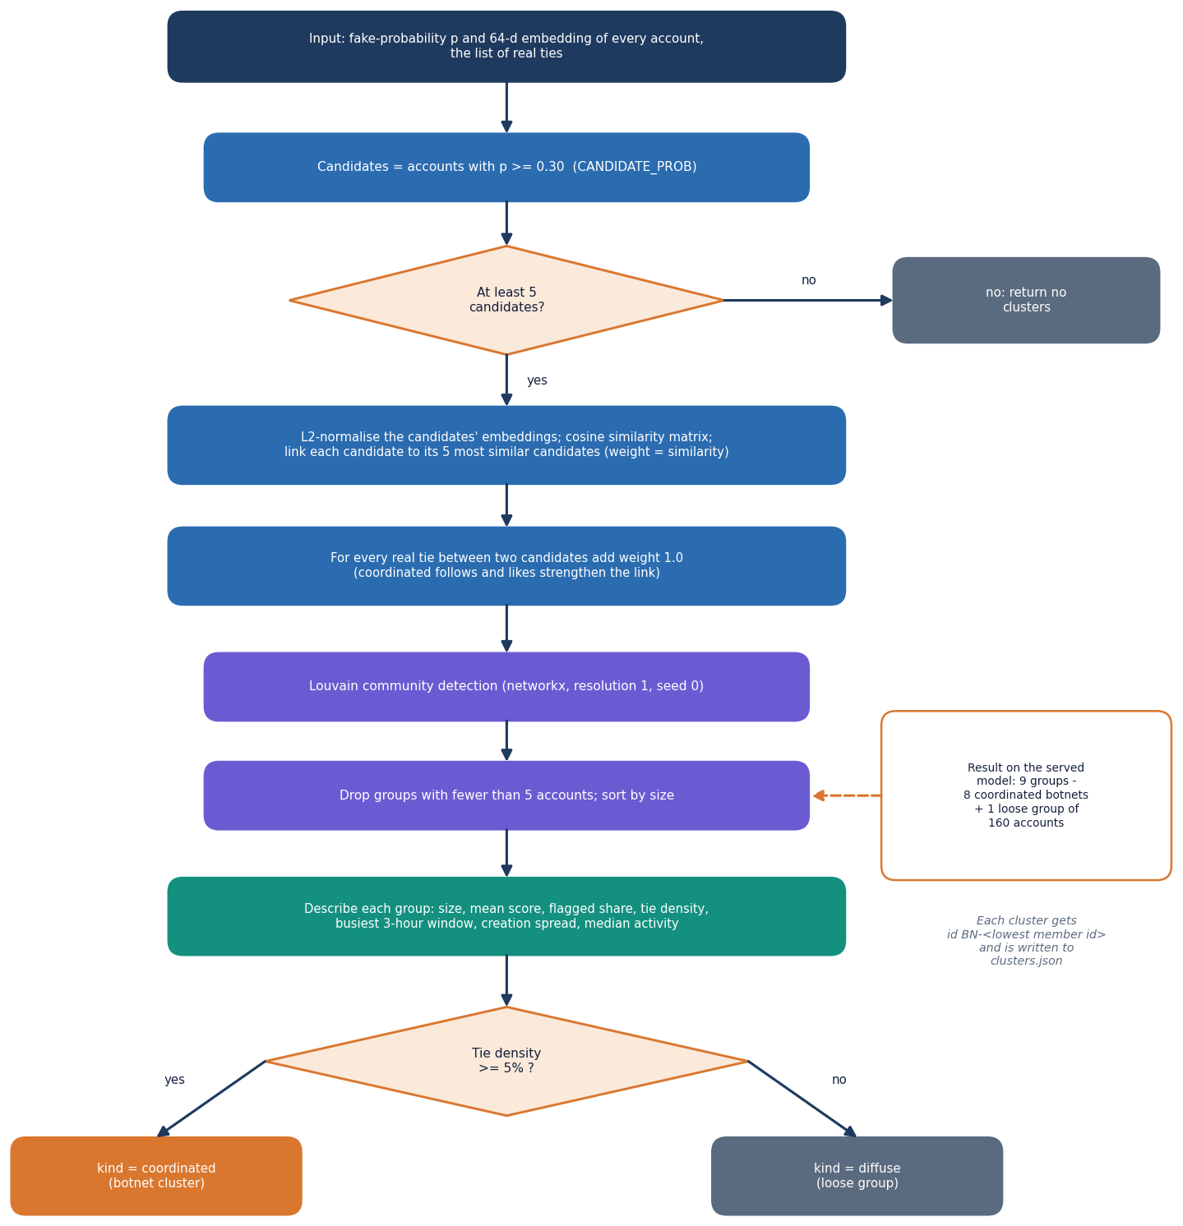
Decision logic: threshold, clusters and queue
Verdict. An account is flagged when its fake-probability is at or above the threshold tuned on validation F1 (0.5 for the served GraphSAGE).
Clusters. Candidates at 0.30 or more are linked to their 5 most cosine-similar candidates plus every real tie; Louvain; groups under 5 dropped. A group is coordinated when tie density is at least 5 percent, otherwise a loose group.
Queue. Flagged accounts and undecided clusters, highest score first. A cluster decision applies to all members; used decisions cannot be undone.
Sweep (served scores, test split). At 0.3: precision 0.908, recall 0.947; at 0.5: 0.972 / 0.921; at 0.9: 0.989 / 0.798.
Model | Threshold (seed 0) | Test F1
Feature-only baseline (MLP) | 0.500 | 0.827
GCN | 0.675 | 0.837
GAT | 0.475 | 0.900
GraphSAGE | 0.500 | 0.939
Thresholds were chosen on the validation set only.
Notes:
The flowchart mirrors ml/clustering.py. The queue rule is in backend/app/routes/queue.py: a decision on a cluster is stored once with its member list.

Slide 11
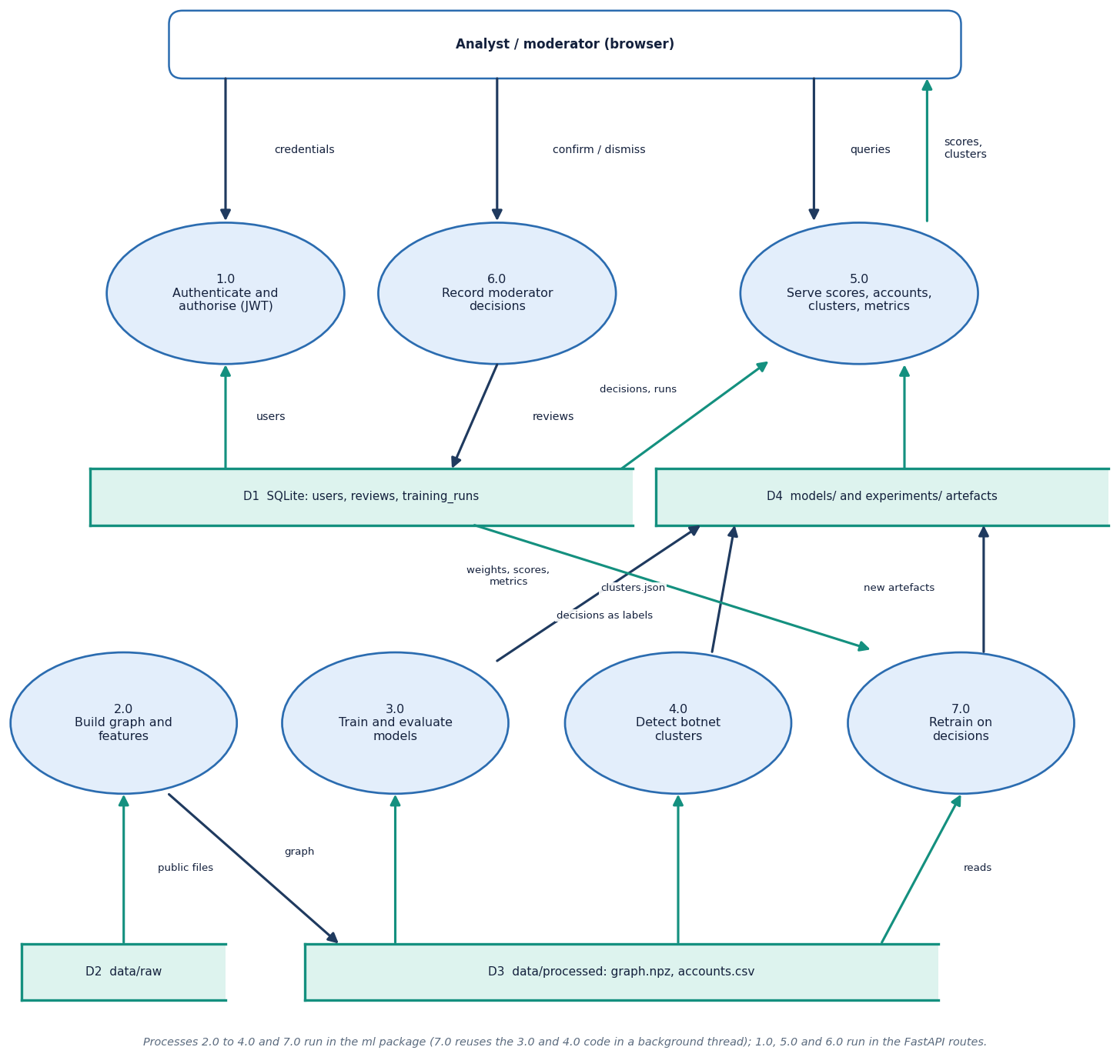
Data flow and modules
Module | Role
ml/data.py | graph builder, features
ml/gnn.py | GCN, GAT, GraphSAGE, metrics
ml/train.py | four models x 3 seeds, artefacts
ml/clustering.py | Louvain clusters, recovery
ml/eval.py | scalability sweep
backend/app/routes/ | core, accounts, clusters, queue, models
backend/app/services/store.py | loads artefacts once
frontend/src/ | pages, kit components, graph view
Level-1 data-flow diagram of the running system.
Notes:
Level 1 separates request validation, scoring and explanation, cluster serving, the moderator queue and retraining.

Slide 12
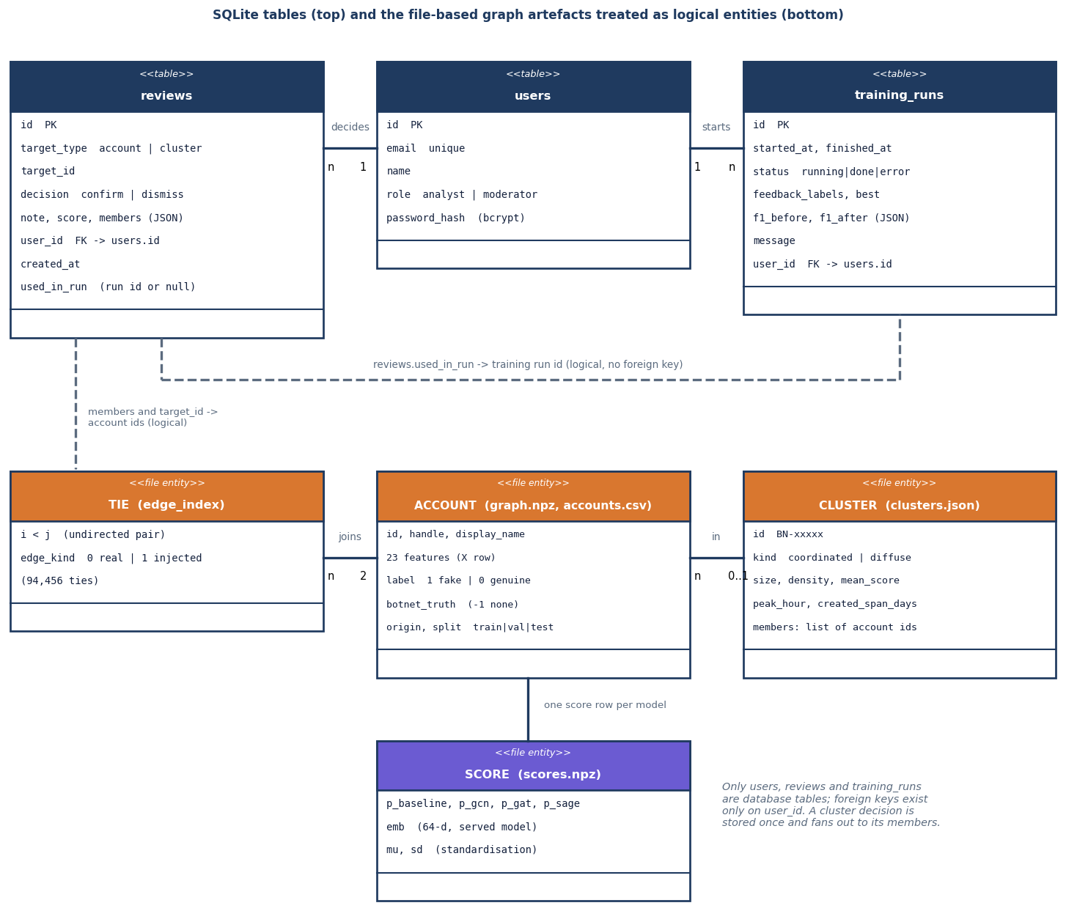
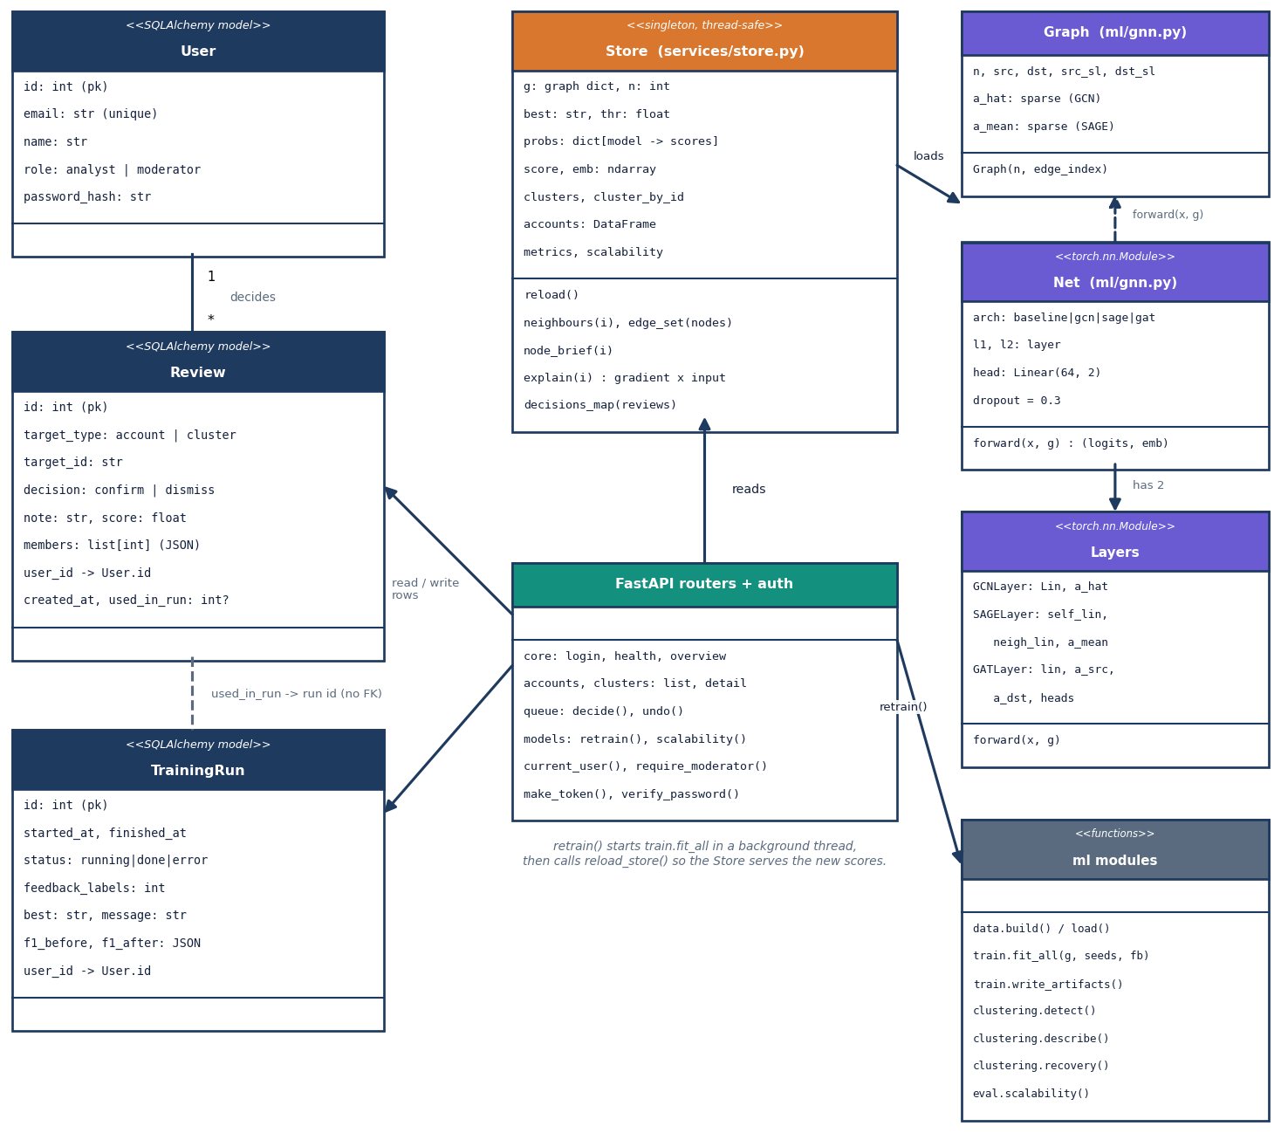
Database and UML
Three SQLite tables: users, reviews (moderator decisions) and training_runs. Graph, scores and clusters are files.
Core classes of the pipeline, the models and the API store.
Notes:
reviews keeps the target, decision, note, score at the time, member list and the training run that used it. training_runs keeps F1 before and after for every model.

Slide 13
Technology stack
Layer | Technology
Language and API | Python 3.11, FastAPI, Uvicorn, SQLAlchemy 2 with SQLite, PyJWT (HS256, 12 hours), bcrypt
Graph learning | PyTorch (CPU) sparse tensors: GCN, GraphSAGE and GAT layers written directly, no torch-geometric
Analysis | NumPy, pandas, scikit-learn (metrics, ROC), networkx (Louvain communities)
Data | SNAP Facebook circles, Instagram and Twitter labelled sets (all small enough to commit), seeded injected botnets
Front end | React 18, Vite 5, React Router 6, Recharts, react-force-graph-2d, Framer Motion, GSAP; kit V4 Soft Pastel Calm
Testing and capture | scripts/smoke_test.py (36 checks, scratch database), ui_checks.py, capture_screens.py (Playwright, 1440 x 900)
Run | setup.bat / run.bat on Windows; ports 8309 (API) and 5309 (web app)
Notes:
Versions are in backend/requirements.txt and frontend/package.json. On the measurement PC PyTorch 2.14 (CPU) and Node 24 were used; the pinned range is torch 2.2 to 2.5.

Slide 14
Implementation progress
Component | Status | Evidence
Graph builder and 23 node features | Done | 4,533 accounts, 94,456 ties, documented schema
GCN, GAT, GraphSAGE and no-graph baseline | Done | one split, 3 seeds, six metrics each
Botnet clusters from embeddings | Done | 8/8 injected botnets recovered
API (18 routes), JWT roles, SQLite, retraining | Done | 36/36 smoke checks
Moderator queue and retraining on decisions | Done | test split never touched; F1 before / after logged
React web app, 10 screens, light and dark | Done | 18 real screenshots at 1440 x 900
Scalability sweep | Done | to 36,264 accounts and 755,648 ties on CPU
Text / language features, temporal graphs, live ingestion | Not done | outside the implemented scope
Prufer / MST structural features from the base paper | Not done | listed as future work
Notes:
State of the code base. The honest gaps are the last two rows: the batch abstract mentions linguistic cues, which are not implemented, and the base paper's Prufer features are not used.

Slide 15
Preliminary results: does the graph help?
0.939
0.827
+11.2 pts
8 / 8
F1, GraphSAGE (served)
F1, no-graph baseline
GraphSAGE over baseline
injected botnets recovered
Model | Acc | ROC-AUC | PR-AUC
Baseline (MLP) | 0.959 | 0.967 | 0.907
GCN | 0.964 | 0.988 | 0.939
GAT | 0.977 | 0.978 | 0.946
GraphSAGE | 0.985 | 0.990 | 0.974
GraphSAGE seed 0 on the 908 test accounts: 105 of 114 fake caught, 9 missed, 3 genuine wrongly flagged. GCN gains little (+1.0) and its recall (0.743) is below the baseline's.
Test split, mean over 3 seeds; fake accounts are 12.6% of the data, so F1, precision and recall matter more than accuracy. GraphSAGE F1 stays 0.927-0.952 for thresholds 0.30-0.60. It catches 82 of 82 test botnet members but 23 of 32 lone spammers.
Caution: GraphSAGE on node degree alone scores F1 0.965, above all 23 features (0.942); the injected botnets are densely tied, so the structure is easy. The headline F1 describes this benchmark, not accuracy on a real platform.
Notes:
Headline: all three graph models beat the baseline on F1, but only GraphSAGE and GAT by a wide margin. GraphSAGE: precision 0.975, recall 0.906, F1 0.939. The numbers belong to this benchmark and must not be compared with PruferNET's 99.63 percent accuracy, which measures a different task.

Slide 16
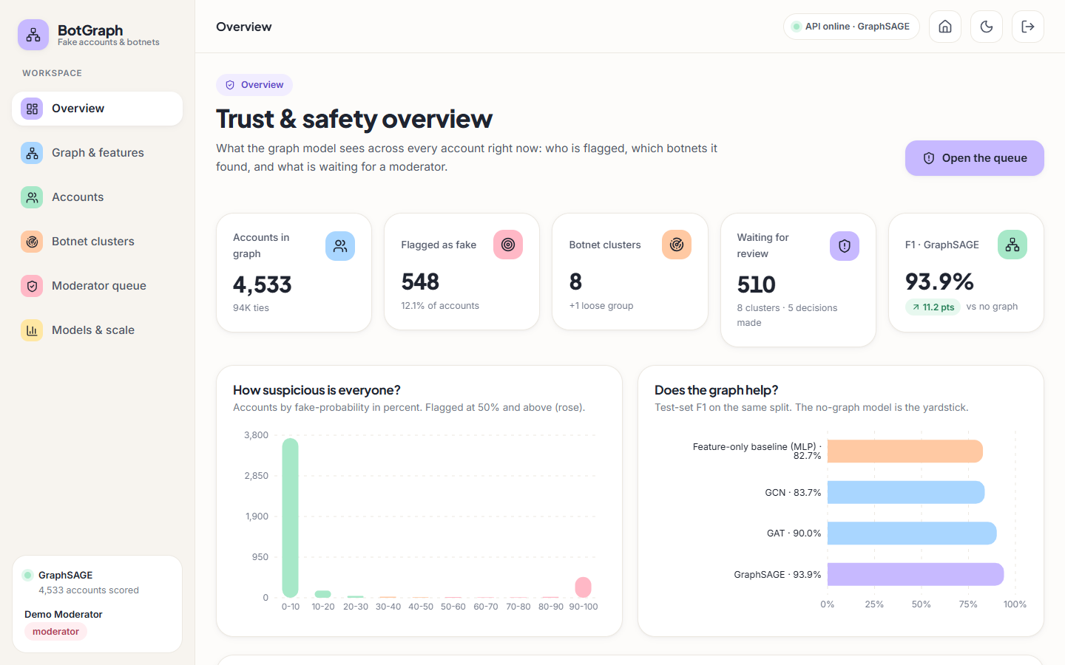
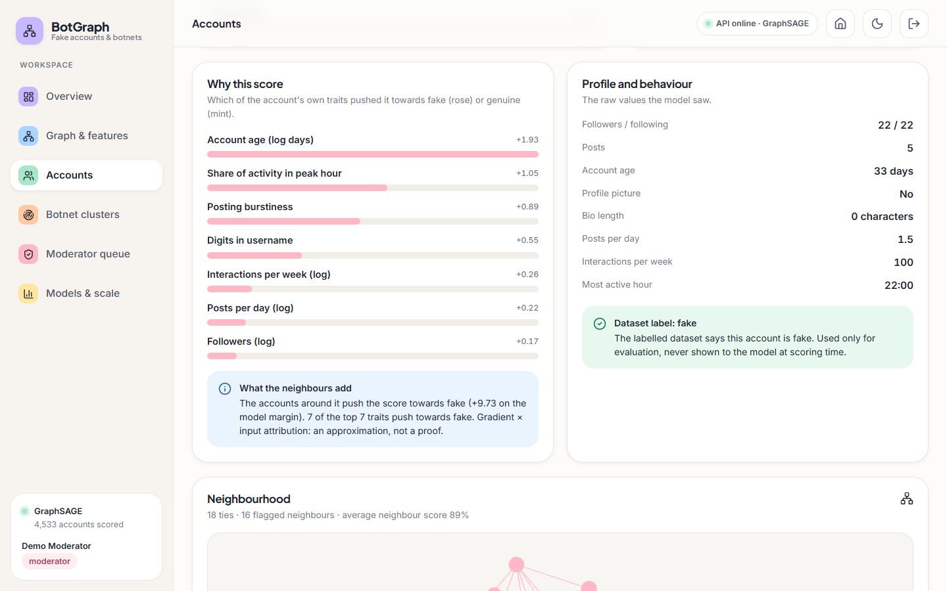
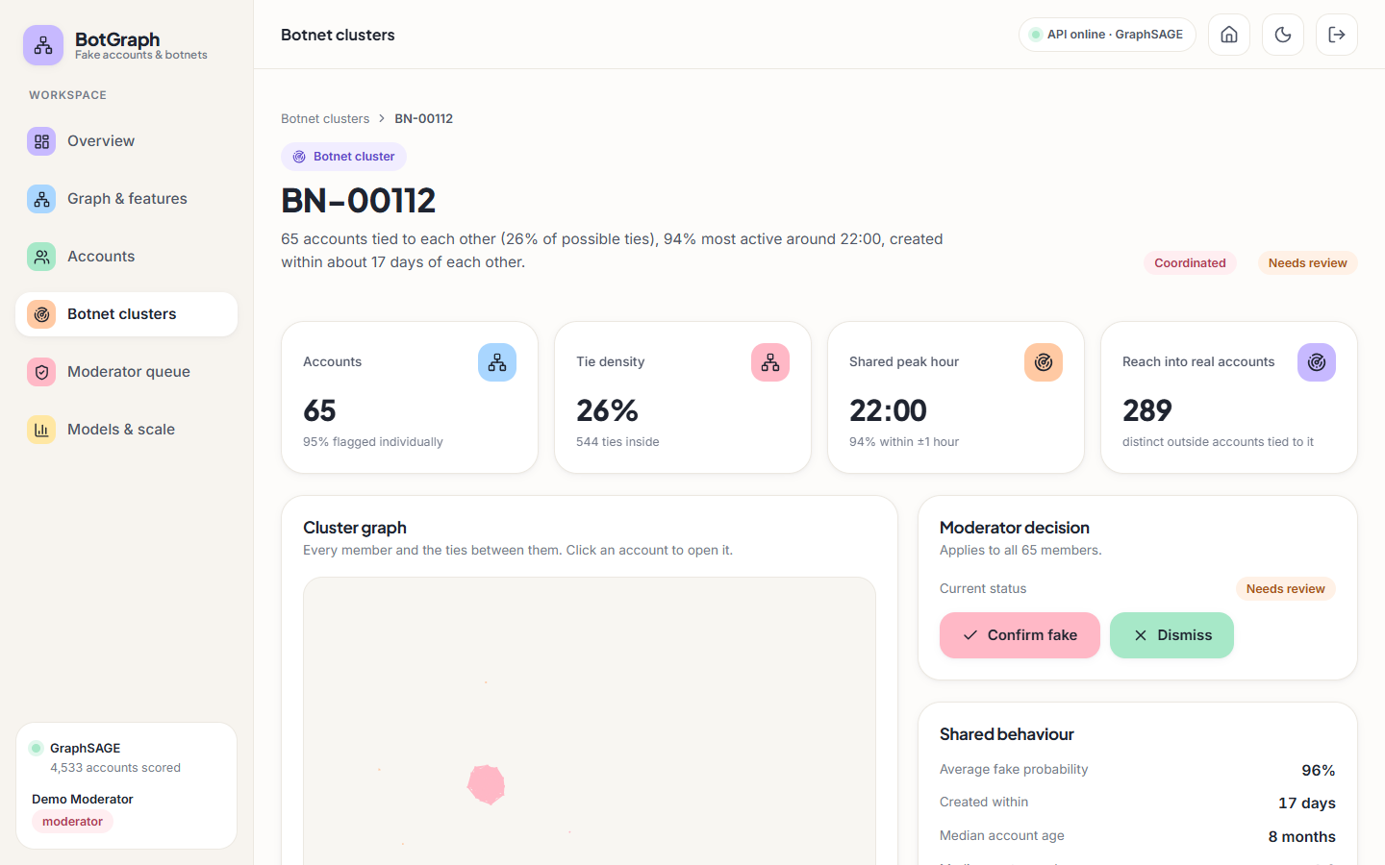
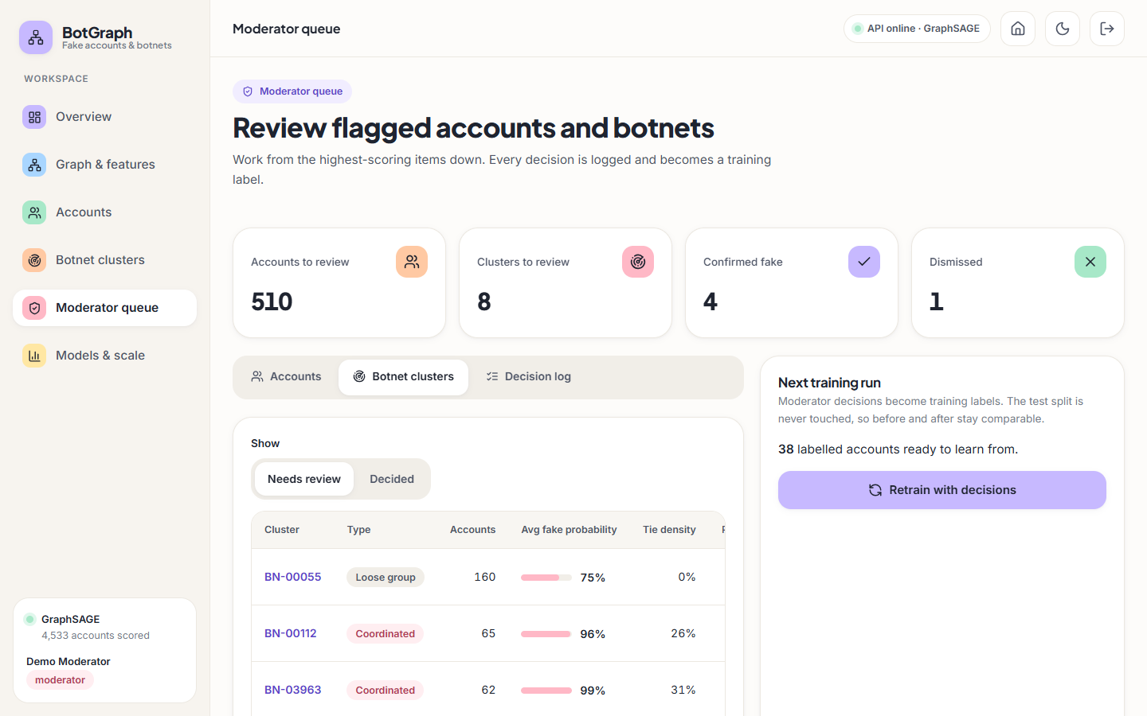
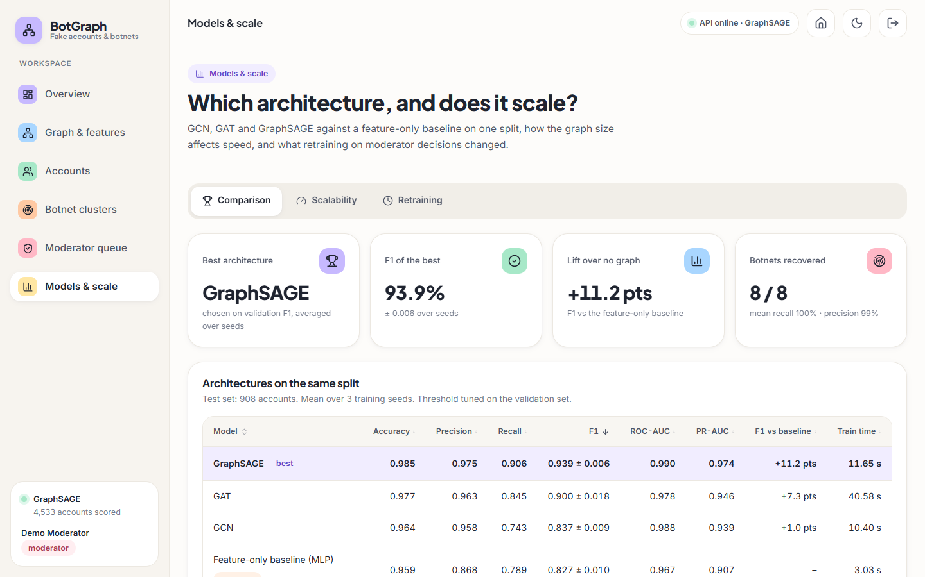
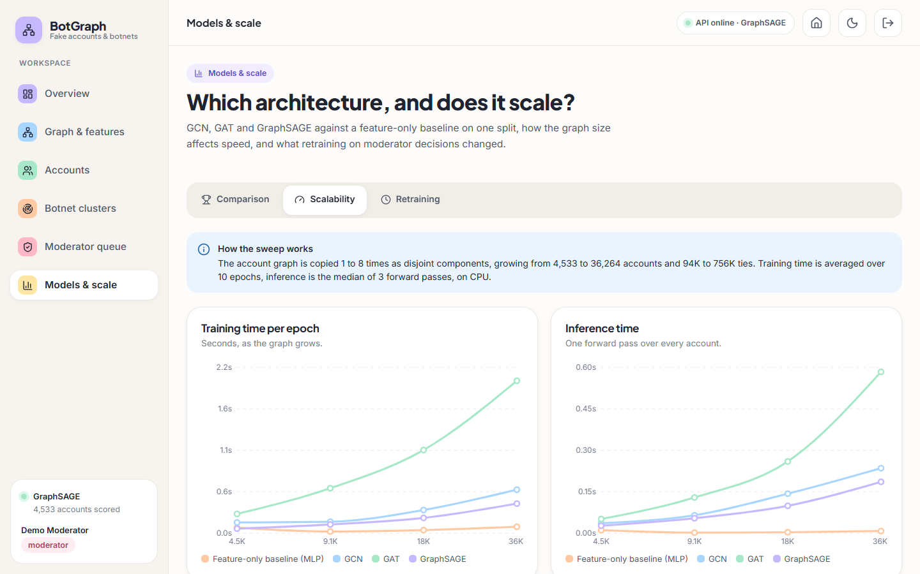
Output screens
Overview: counts, score histogram, F1 per model
Account: reasons for the score, neighbourhood
Botnet cluster BN-00112: tie density 26%, peak hour 22:00
Moderator queue: clusters to review
Models: GraphSAGE best, +11.2 pts over no graph
Scalability: time against graph size
Real captures of the running application at 1440 x 900 with the committed graph and trained models.
Notes:
All screens come from the shipped GraphSAGE model on the committed graph, signed in as the demo moderator. The queue shows a few decisions already made during the capture session.

Slide 17
Initial testing and observations
36 / 36
3-16 ms
28 ms
5.1 s
smoke-test checks passed
median API latency, 10 endpoints
worst p95 over those endpoints
API start-up (graph, scores, clusters)
Observation | Action
No pytest suite; the smoke test is the automated check (auth, roles, 3 models beat baseline, clusters, queue, retraining) | Stated in the report; unit tests listed as next step
torch fails to load (WinError 1114) if fastapi is imported first on the system Python | torch preloaded for the test run; the project .venv is unaffected
GAT results move by a few thousandths between runs (non-deterministic edge softmax sum) | Reported as mean ± std over 3 seeds
Login takes about 233 ms (bcrypt); other calls 3-16 ms median on a shared i5-12500 | Timings reported as upper bounds
Notes:
The smoke test starts its own API on a spare port with a scratch database and model copies, so the shipped files are never touched. Latency is 20 requests per endpoint on 127.0.0.1 against a warm server; login is bcrypt-bound by design.

Slide 18
Challenges and corrective actions
Challenge | Corrective action
torch-geometric wheels often fail to install on Windows | GCN, GraphSAGE and GAT written in plain PyTorch sparse operations
Class imbalance: only 12.6% of accounts are fake | Class-weighted loss, F1 / precision / recall as the headline metrics, threshold tuned on validation
Without camouflage the profile alone would solve the task and the graph would add nothing | 198 bots get genuine-looking profiles, 231 genuine accounts fake-looking ones; a no-graph baseline proves the graph earns its place
GCN barely beats the baseline and loses recall; GAT is noisy and 3-5x slower | Reported as measured, per seed; GraphSAGE chosen on validation F1
Injected botnets and timing features are synthetic; the two labelled sources are not about the same accounts | Real and synthetic parts labelled in the app; claims limited to this benchmark. Ablation: GraphSAGE on node degree alone scores F1 0.965, so densely tied injected botnets favour the graph
Notes:
Each challenge was met by a concrete design choice or by measuring it and saying so in the report.

Slide 19
Next steps
1
Measure more
2
Extend features
3
Scale
4
Harden
Threshold sweep, ablation and error analysis are measured; next are cross-validation over several splits and confidence intervals.
Prufer / spanning-tree structural features from the base paper, and text features for the behavioural cues in the abstract.
Neighbour sampling and GPU training beyond the 36,264-account sweep; test a well-mixed graph, not disjoint copies.
Unit and API test suite, rate limiting, real user management, and evaluation on labelled real botnets.
Priority: items 1 and 4 give the final report stronger evidence; items 2 and 3 are listed as future scope.
Notes:
Plan to the final review. Item 1 is quick and uses the shipped scores; the others are larger pieces of work.

Slide 20
Thank you
Questions and suggestions are welcome.
Notes:
Likely questions: why GraphSAGE and not GAT; how much of the result depends on injected botnets; why PruferNET's accuracy is not compared; what the moderator loop changes.

