Slide 1

Graph Neural Network Analysis for Scalable Fake Profile Detection and Botnets
Final Review · BotGraph
Team Details : Batch A9
Under the Esteemed Guidance of
Neelima
[DESIGNATION], Department of CSE
23K91A0538 BIJJA NAGA LAKSHMI
23K91A0564 DIVVELA SRIVATSHAV
23K91A0504 ADUMULLA DURGA
23K91A0550 BURUGULA KOUSHIK
DEPARTMENT OF COMPUTER SCIENCE AND ENGINEERING · TKR College of Engineering & Technology · Academic Year [ACADEMIC YEAR]
Notes:
Introduce the team and BotGraph: fake accounts and coordinated botnets found from the shape of the social graph.

Slide 2
Table of Contents
Abstract
Base Paper & Literature Survey
Research Gap, Problem Statement & Objectives
Proposed System & Architecture
Methodology, Dataset & Models
Training, Clustering & Data Design
Implementation Highlights
Results: Model Comparison, Confusion Matrix, Threshold
Results: Botnet Clusters & Feature Groups
Performance & Testing
Comparison with Base Paper
Output Screens
Conclusion, Limitations, Future Scope & References
Dept. of CSE | Batch A9 | Final Review
2
Notes:
The agenda follows the report: problem, design, method, results, comparison, screens, conclusion.

Slide 3
Abstract
Fake profiles are created faster than moderators can remove them, and per-account classifiers miss coordinated networks whose single profiles look legitimate. BotGraph treats accounts as nodes and interactions as edges and learns from each account's neighbourhood.
Graph of 4,533 accounts and 94,456 ties with 23 features; GCN, GAT and GraphSAGE compared with a no-graph baseline on one split (mean of 3 seeds).
GraphSAGE is best: F1 0.939 against 0.827 without the graph (+11.2 points); GCN adds only +1.0. Louvain over the embeddings recovers 8 of 8 injected botnets.
A moderator queue turns confirm/dismiss decisions into training labels; scalability measured up to 36,264 accounts and 755,648 ties on CPU.
Caveat: the botnets, the timing and interaction features and the handles are synthetic (seeded). GraphSAGE on node degree alone scores F1 0.965, above all 23 features: the injected structure is easy, so the headline F1 is not real-platform accuracy.
Dept. of CSE | Batch A9 | Final Review
3
Notes:
Problem, method, headline numbers with their protocol, then the caveat that botnets are injected.

Slide 4
Base Paper
A. Saha, N. K. Sarkar and S. Pratihar, "PruferNET: An augmented graph neural network for influential node detection in social networks," IEEE Access, vol. 14, pp. 79940-79959, 2026, doi: 10.1109/ACCESS.2026.3695637.
Aspect | PruferNET: Prufer-sequence structural features with GraphSAGE
Task | 3-class node classification by depth in a minimum spanning tree (Very Shallow / Shallow / Deep) - an influence task, not bot detection
Method | Edge weight 1/(deg u + deg v) -> minimum spanning tree -> Prufer sequence -> frequency, entropy, unique ratio, transition influence, subtree depth; plus degree, closeness, PageRank, trust score
Data | SNAP Facebook, 4,039 nodes and 88,234 edges; Email-Eu-core, 986 nodes and 16,064 edges
Model and split | GraphSAGE, 64 hidden units, dropout 0.5, AdamW lr 0.003, 300 epochs; 60/20/20 split
Reported | Test accuracy 99.63% with Prufer features against 96.54% with traditional features; 5-fold check on Facebook
Not covered | No fake or bot labels, no coordinated clusters, no moderator loop, no scalability measurement
Dept. of CSE | Batch A9 | Final Review
4
Notes:
Saha et al., IEEE Access 2026. BotGraph keeps the data family (SNAP Facebook), the GraphSAGE backbone idea and the 60/20/20 split; the Prufer features are listed as future work.

Slide 5
Literature Survey
Work | Year | Approach | Finding / limitation
Saha et al. [1] (base) | 2026 | GraphSAGE + Prufer-sequence structural features | 99.63% vs 96.54% accuracy on depth classes; no bot labels
RABot (Zhang et al.) | 2026 | Neighbourhood-aware oversampling + RL edge filtering | Targets class imbalance and topological noise; three benchmarks, four GNN backbones
HW-GNN (Liu et al.) | 2025 | Homophily-aware Gaussian-window spectral network | Average +4.3% F1 over existing methods, as reported by the authors
LGB (arXiv 2406.08762) | 2024 | Language model + GNN for sparsely connected accounts | Up to 10.95% over baselines on two datasets, as reported
Batch survey: AdapTGN | 2026 | Adaptive temporal-relational GNN for bot detection | Title only; not independently verified
Batch survey: Arabic fake news | 2026 | GNN for fake-news identification in Arabic | Title only; not independently verified
Batch survey: metadata stacking | 2026 | Account metadata, feature selection, stacking | Title only; nearest match found: Sharma & Borah, IJ-ICT 2026
Dept. of CSE | Batch A9 | Final Review
5
Notes:
Verified from the PDFs (PruferNET, RABot, HW-GNN) or the arXiv record (LGB). The last three rows come from the batch survey with titles only; they are not cited for any number.

Slide 6
Research Gap
The surveyed GNN work applies relational learning to influence and node classification; applying it to fake-profile and botnet detection at platform scale is the gap named in the batch survey.
A per-account score leaves a moderator with thousands of items; the coordinated cluster is the unit they can act on.
Whether the graph earns its place needs a no-graph baseline on the same split, features and training budget, with class imbalance (1 account in 8 is fake) and camouflaged profiles.
Scalability has to be measured: how training and inference time grow with nodes and ties.
Moderator decisions are valuable labels, but retraining on them must keep the test split untouched to stay comparable.
Dept. of CSE | Batch A9 | Final Review
6
Notes:
Five gaps. BotGraph addresses each with a measurement or a feature: baseline comparison, clusters, scalability sweep, moderator retraining.

Slide 7
Problem Statement
Fake profiles are created faster than manual moderation can remove them.
Per-account classifiers miss coordinated networks whose individual profiles appear legitimate.
Bot behaviour evolves quickly, so static rules and signatures become obsolete.
Class imbalance and label noise degrade conventional supervised models.
Need: a graph-based detector that classifies accounts from their relational context and exposes coordinated botnet clusters at scale.
Input
Output
Record
Public datasets assembled into a graph of 4,533 accounts and 94,456 ties, 23 features per account
Fake-probability per account with reasons and neighbourhood, botnet clusters, a moderator queue
Decision log, retraining runs with F1 before and after, measured metrics files
Dept. of CSE | Batch A9 | Final Review
7
Notes:
Four problem points from the batch statement and the stated need, then input, output and record.

Slide 8
Objectives
1. Construct a graph representation of the social platform with accounts as nodes and interactions as edges.
2. Engineer node features covering profile metadata, posting behaviour and interaction frequency.
3. Implement and compare GCN, GAT and GraphSAGE architectures for account classification.
4. Detect coordinated botnet clusters from the learned graph embeddings.
5. Evaluate detection accuracy, precision and recall against labelled fake-account datasets.
6. Assess scalability as the number of nodes and edges grows.
Dept. of CSE | Batch A9 | Final Review
8
Notes:
The six objectives from the batch document. The conclusion slide gives the status of each.

Slide 9
Proposed System
Learn - from graph to scores
Public datasets
Graph + 23 features
GCN / GAT / GraphSAGE
Threshold on validation
Account scores
Act - from scores to moderator decisions
Embeddings
Louvain clusters
Moderator queue
Confirm / dismiss
Retrain on decisions
Every account is scored from its own features and its neighbourhood; a feature-only MLP on the same split shows what the graph adds.
Accounts scoring 0.30 or more are grouped by community detection over the learned embeddings and real ties; dense groups are labelled coordinated, sparse ones loose.
A decision on a cluster applies to all members; retraining never touches the test split, so before and after F1 are comparable.
Dept. of CSE | Batch A9 | Final Review
9
Notes:
The proposed system as two lanes: learn and act.

Slide 10
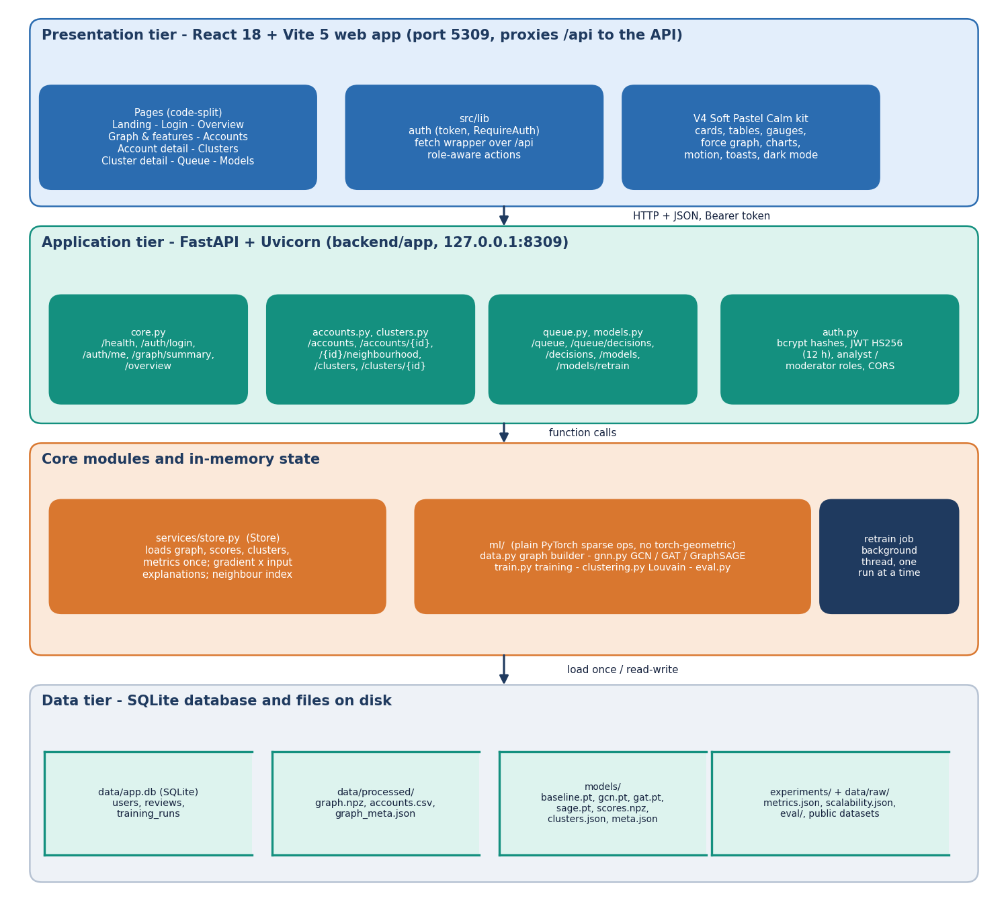
System Architecture
Web app: React 18 + Vite 5 on port 5309, V4 Soft Pastel Calm design kit
API: FastAPI on port 8309, 18 JSON endpoints, JWT roles (analyst, moderator)
ml package: graph builder, GCN / GAT / GraphSAGE in plain PyTorch sparse ops, training, clustering, evaluation
Storage: SQLite for users, decisions and retraining runs; graph, weights, scores and clusters as files loaded once at start-up
No calls to outside services at run time
Dept. of CSE | Batch A9 | Final Review
10
Notes:
Web app, API, ML pipeline and storage. Everything runs on one Windows computer.

Slide 11
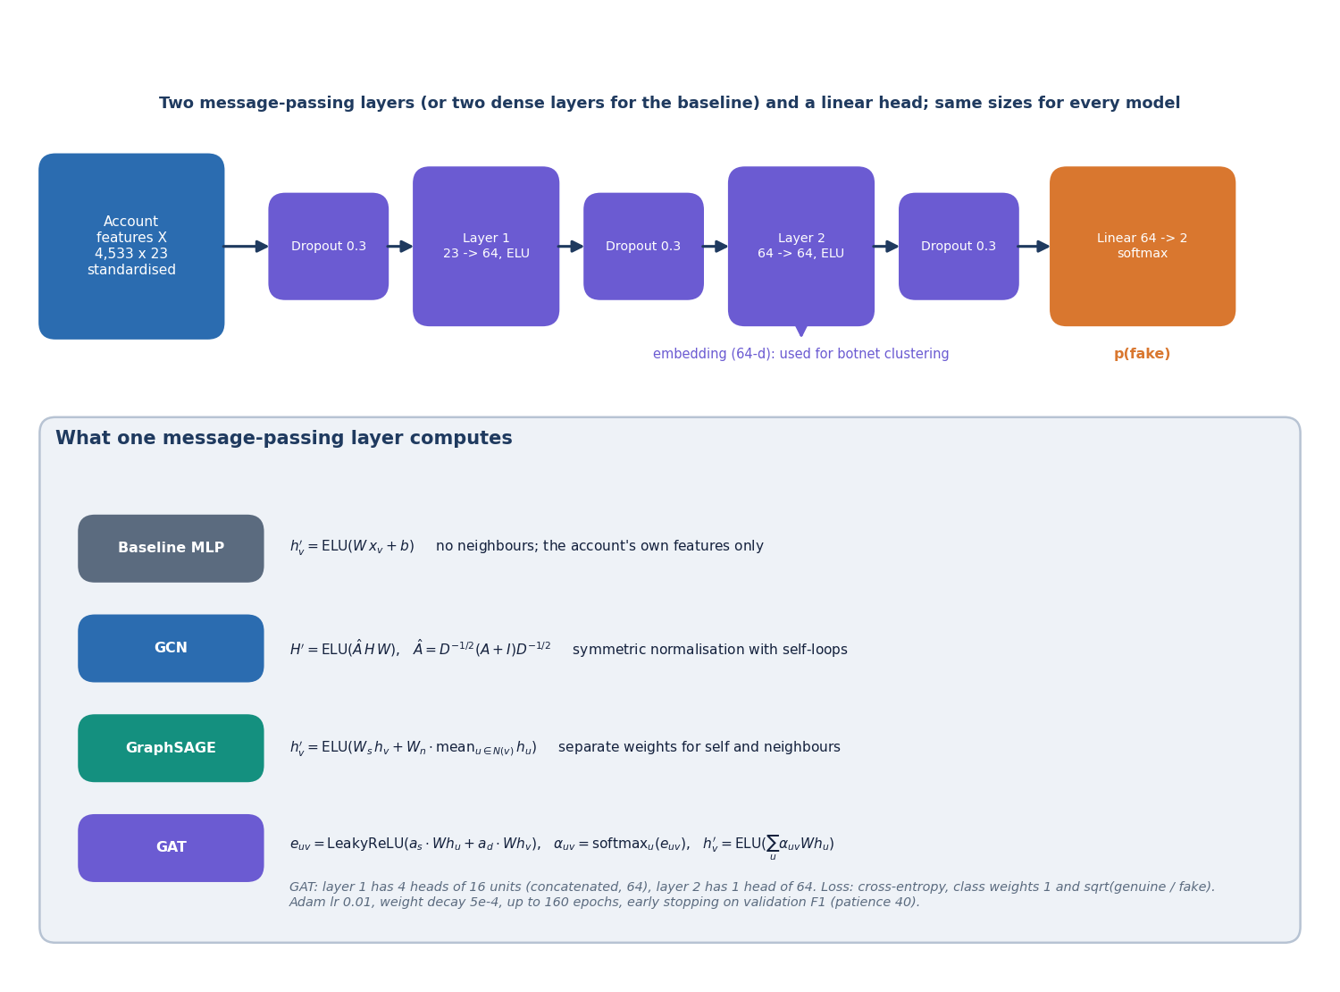
Methodology
23 standardised features: profile 12, posting 4, temporal 6, interaction 1.
Two message-passing layers, 64 hidden units, dropout 0.3; GCN, GraphSAGE and 4-head GAT, plus an MLP baseline.
Adam, lr 0.01, weight decay 5e-4; class-weighted cross-entropy (weight sqrt(neg/pos)); up to 160 epochs, patience 40 on validation F1.
Decision threshold tuned on the validation set; three seeds per model; best architecture chosen on validation F1.
Scores explained by gradient x input attribution (first-order approximation).
Dept. of CSE | Batch A9 | Final Review
11
Notes:
Same split, features and training budget for every model, so differences come from the architecture.

Slide 12
Dataset & Graph
4,533
Source | Licence | Used for
SNAP Facebook social circles (ten ego networks) | public research data | real topology: 3,963 accounts, 88,156 ties
Instagram fake / spammer / genuine accounts (696 rows) | CC BY 3.0 | profile attributes, resampled
Twitter bot detection dataset (50,000 rows) | CC0 | posting behaviour (label carries almost no signal)
Injected botnets (seed 7) | generated | 8 botnets, 150 lone spammers, timing features
accounts (3,963 real + 570 injected)
94,456
ties (88,156 real + 6,300 injected)
570
fake accounts (12.6%): 420 in 8 botnets + 150 lone
Stratified 60/20/20 split: 2,719 train, 906 validation, 908 test (114 fake), the same for every model.
Camouflage by design: 198 bots get a genuine-looking profile and 231 genuine accounts a fake-looking one, so the profile alone cannot solve the task.
Nothing is scraped from a live platform.
Dept. of CSE | Batch A9 | Final Review
12
Notes:
Topology is real; botnets, timing and interaction features and handles are synthetic and seeded so cluster detection can be scored against a known answer.

Slide 13
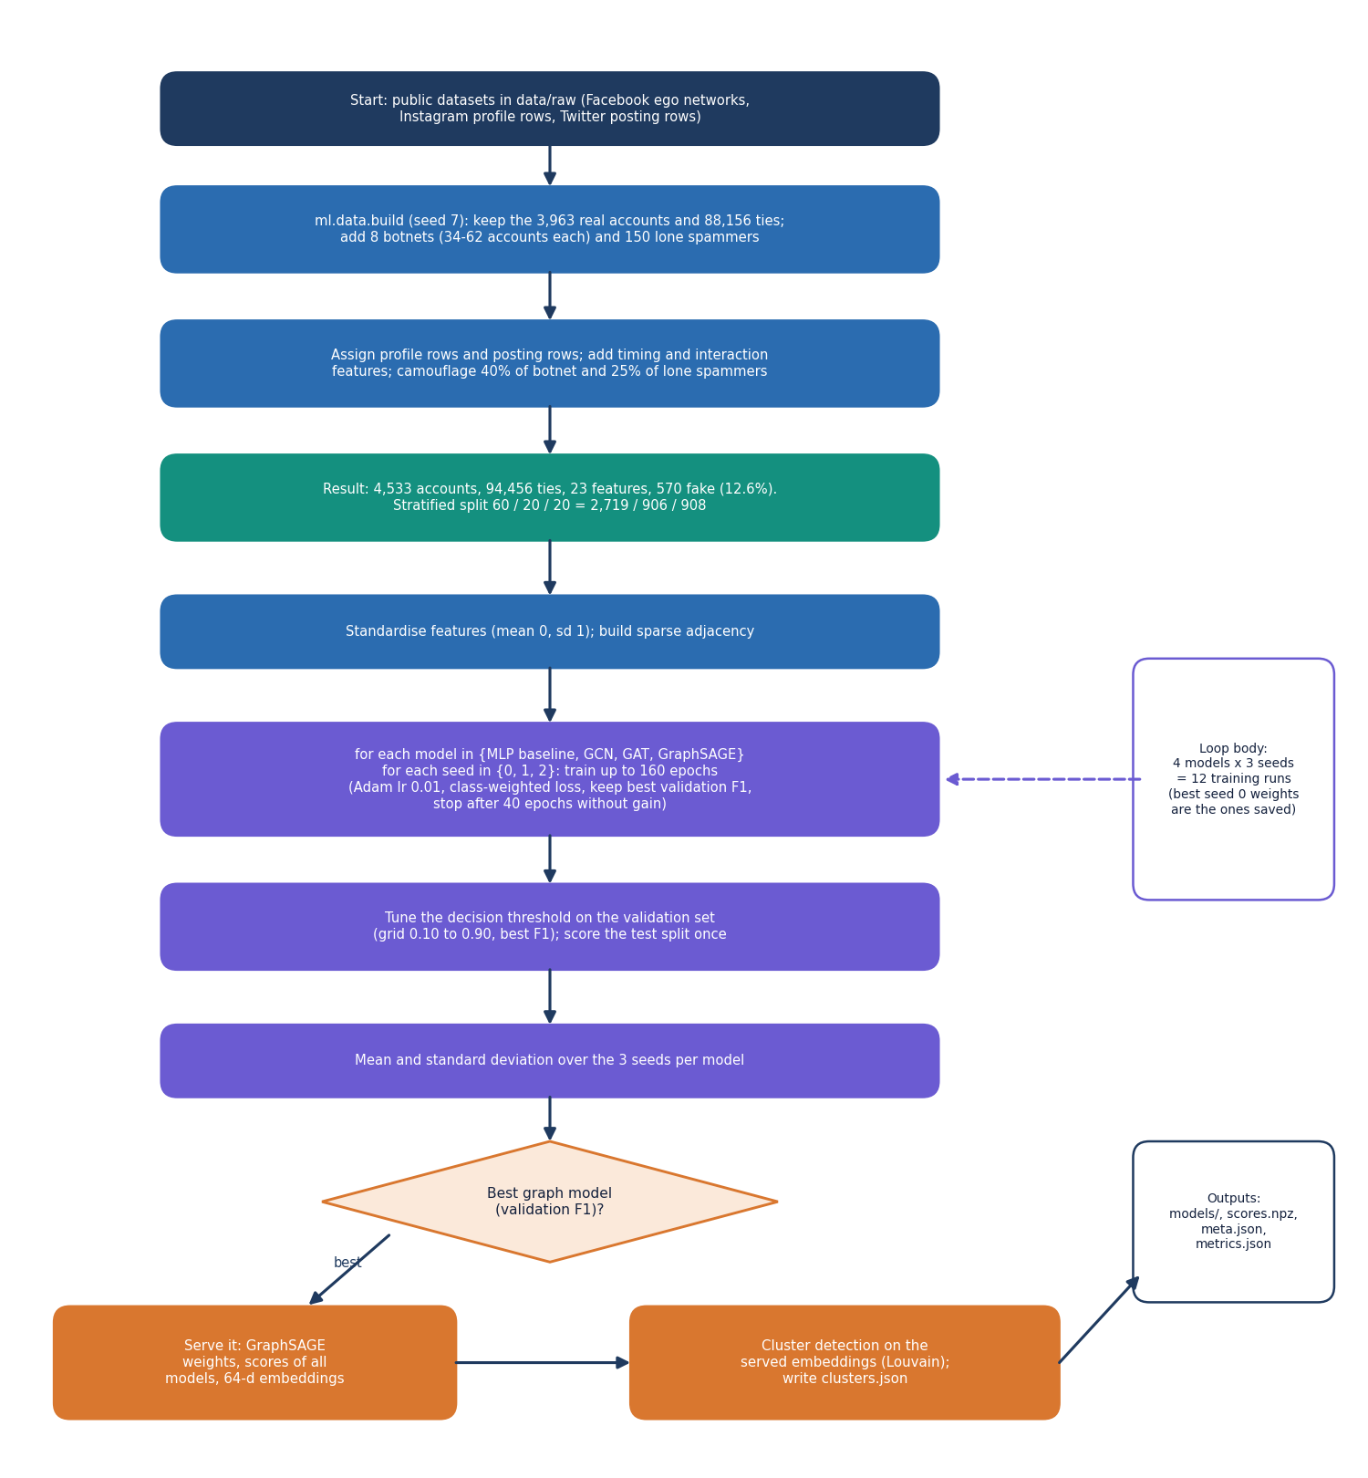
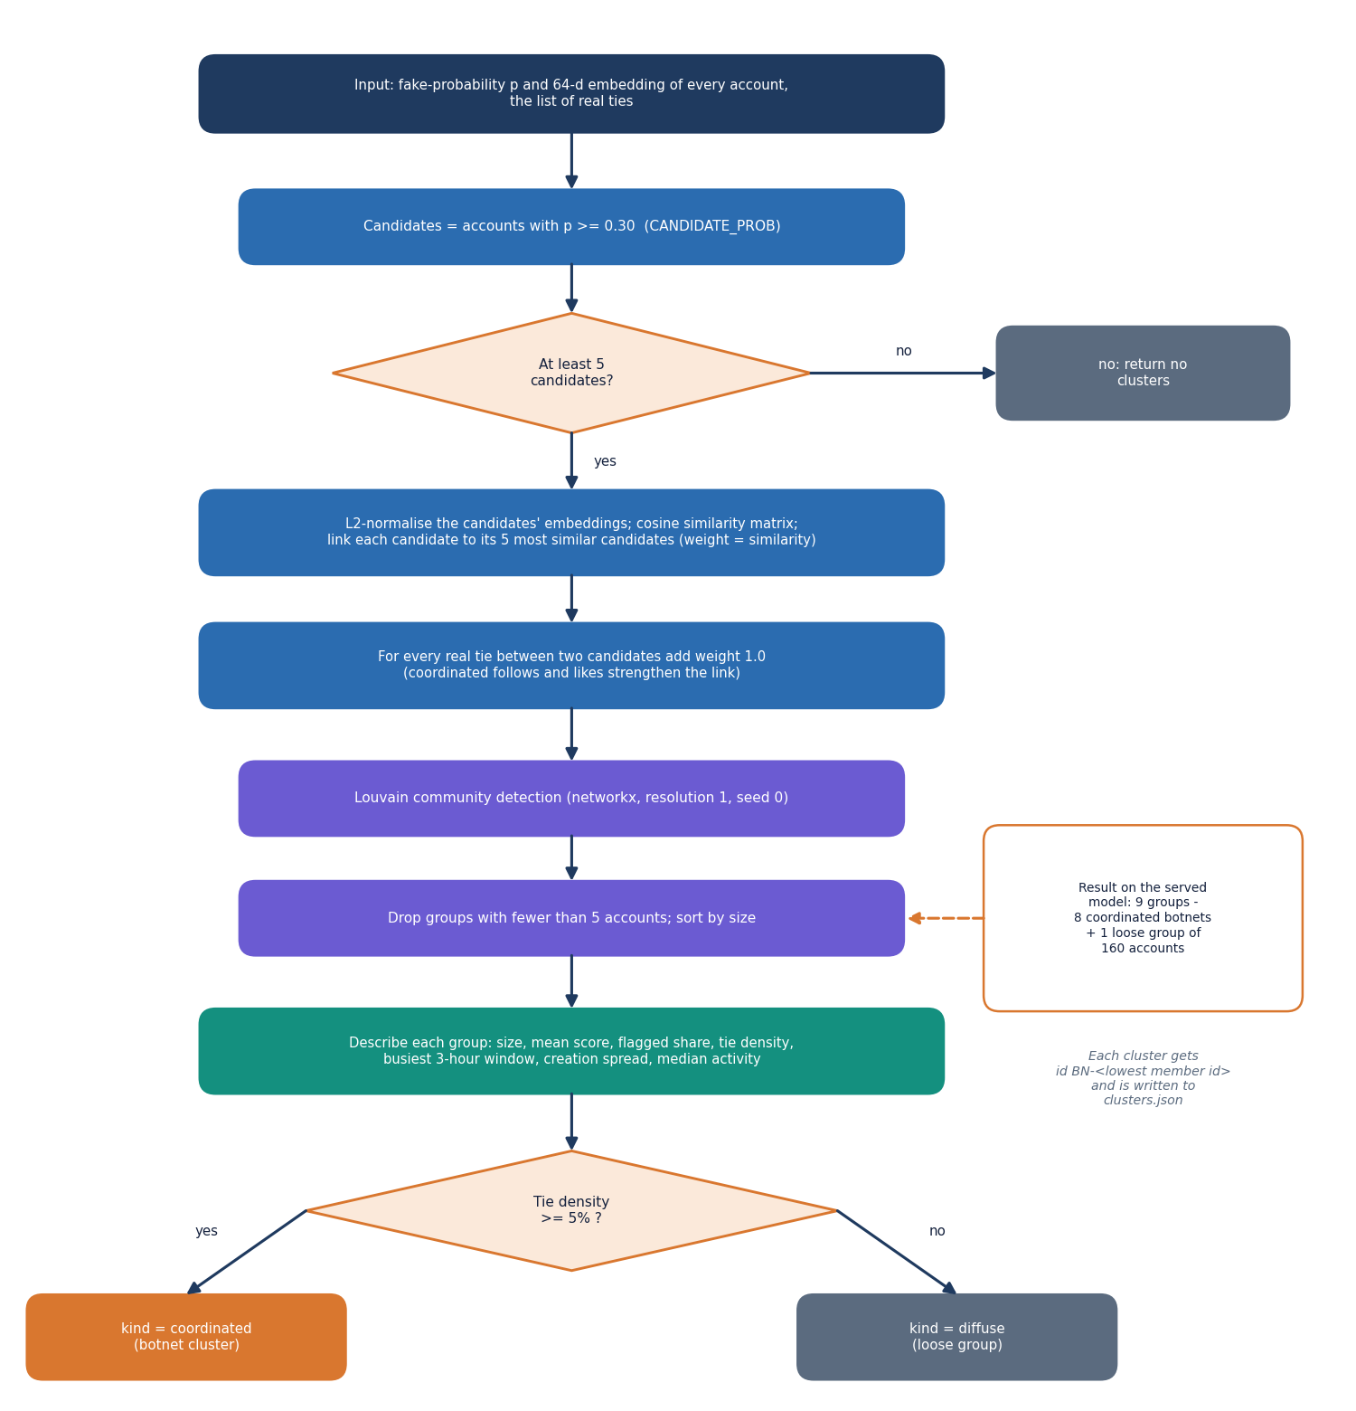
Training & Clustering Workflow
Left: build, 4 models x 3 seeds, threshold on validation, serve best. Right: candidates p >= 0.30, similarity graph + real ties, Louvain, groups < 5 dropped, coordinated if density >= 5%.
Dept. of CSE | Batch A9 | Final Review
13
Notes:
The two core algorithms of the ml package as flowcharts (ml/train.py and ml/clustering.py).

Slide 14
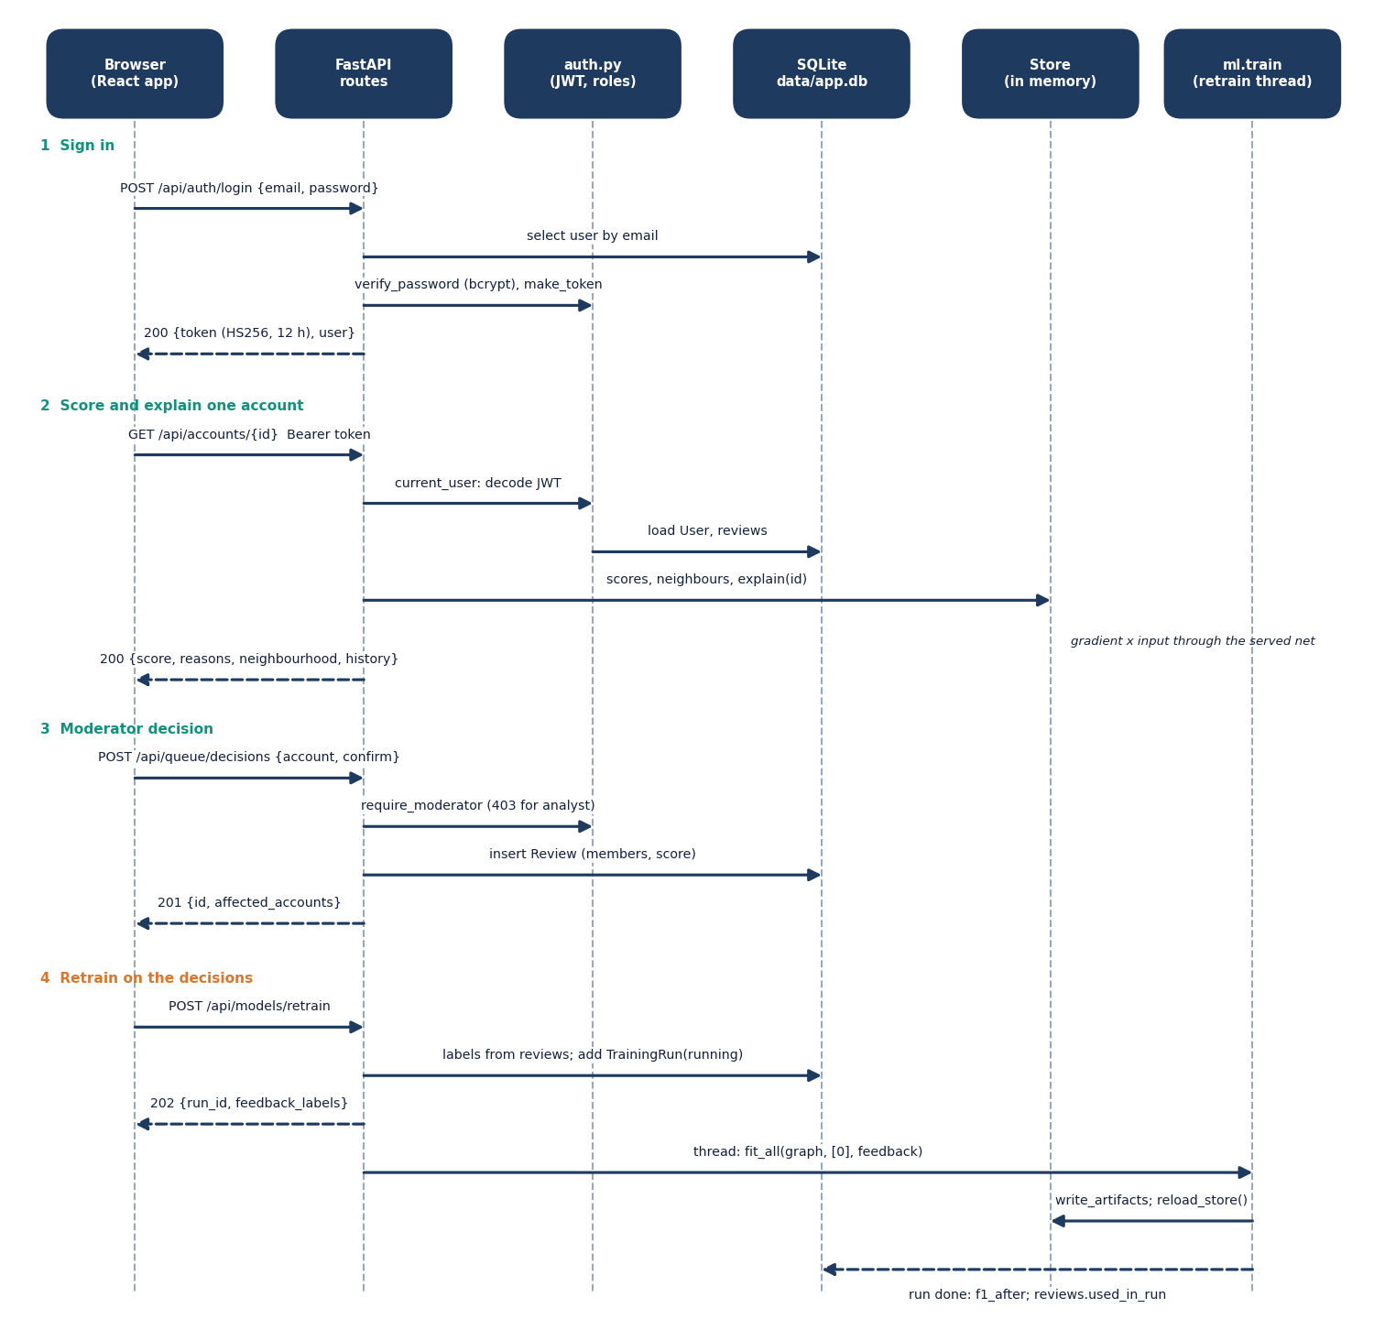
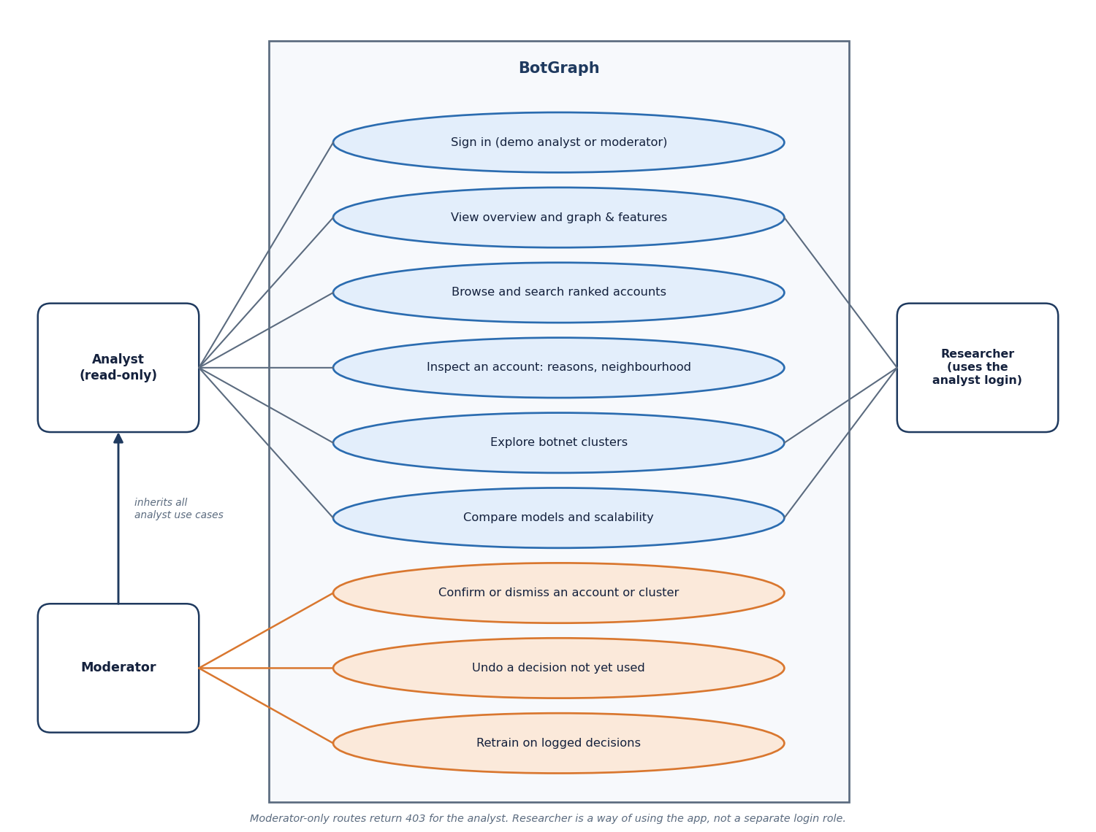
User – System Interaction
Dept. of CSE | Batch A9 | Final Review
14
Notes:
Sequence of sign-in, scoring, a moderator decision and retraining; and the use cases of the analyst, the moderator and the researcher.

Slide 15
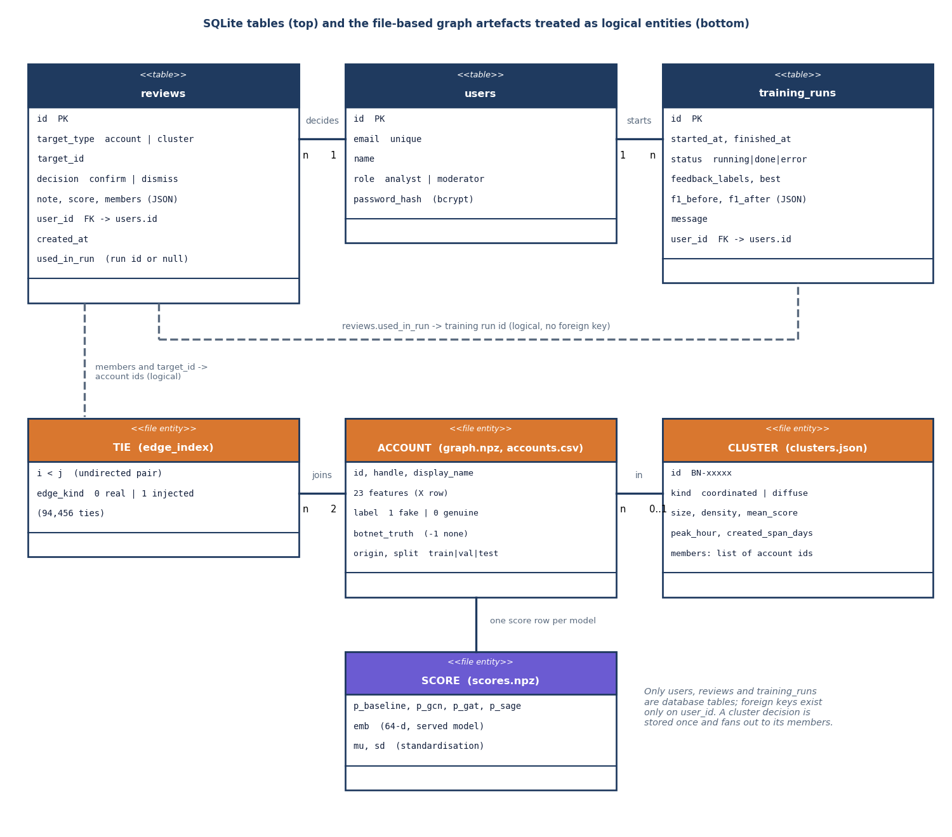
Data Design
Store | Content
users | email, name, role, bcrypt hash
reviews | decision, note, score, members, used_in_run
training_runs | F1 before / after, labels used, status
data/processed/ | graph.npz, accounts.csv
models/ | weights, scores.npz, clusters.json
experiments/ | metrics and scalability JSON
Three SQLite tables hold what moderators do; the graph and the model outputs are files, so the database stays small.
Dept. of CSE | Batch A9 | Final Review
15
Notes:
reviews and training_runs have a foreign key to users; the graph, scores and clusters are logical entities stored as files.

Slide 16
Implementation Highlights
18
36 / 36
10
~2,400
API endpoints
smoke-test checks pass
app screens (React)
lines of Python (ml, backend, scripts)
Models are written against sparse tensors in plain PyTorch; torch-geometric was avoided because its Windows wheels often fail to build.
Login returns a signed JWT (12 hours); passwords are bcrypt hashes; analysts get 403 on decisions and retraining; CORS allows only the web origin.
The API loads graph, scores and clusters once at start-up (5.1 s); every screen has loading, empty and error states.
Retraining runs as a background job: decisions become labels, the test split is never touched, F1 before and after is stored per model.
Not present: password reset, MFA, rate limiting, live platform ingestion, a pytest suite.
Dept. of CSE | Batch A9 | Final Review
16
Notes:
Highlights and honest absences.

Slide 17
Results – Model Comparison
0.939
0.975
0.906
0.990
GraphSAGE F1 (served model)
GraphSAGE precision
GraphSAGE recall
GraphSAGE ROC-AUC
Test split of 908 accounts (114 fake), mean of 3 seeds. F1 lift over the baseline: GCN +1.0, GAT +7.3, GraphSAGE +11.2 points. GCN's precision is high but its recall (0.743) is below the baseline's (0.789). F1 std: GraphSAGE 0.006, GAT 0.018.
Dept. of CSE | Batch A9 | Final Review
17
Notes:
Accuracy is 0.959 for the baseline only because 87.4% of accounts are genuine; F1, precision and recall are the honest metrics here.

Slide 18
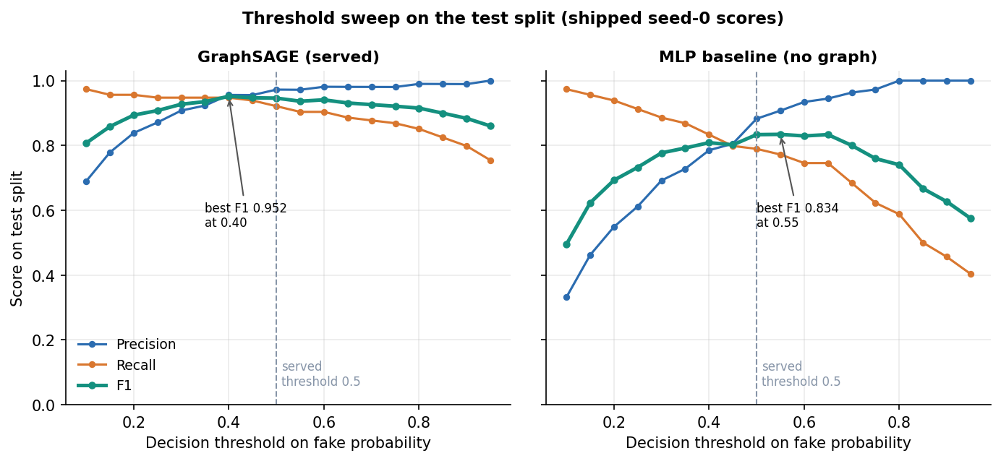
Confusion Matrix & Threshold Analysis
No-graph baseline, test (908), seed 0
GCN, same test split
GraphSAGE (served), same test split
pred genuine
pred fake
pred genuine
pred fake
pred genuine
pred fake
actual genuine
782
98.5% of row
12
1.5% of row
actual genuine
791
99.6% of row
3
0.4% of row
actual genuine
791
99.6% of row
3
0.4% of row
actual fake
24
21.1% of row
90
78.9% of row
actual fake
28
24.6% of row
86
75.4% of row
actual fake
9
7.9% of row
105
92.1% of row
GraphSAGE at the served threshold 0.5: precision 0.972, recall 0.921; 3 false alarms and 9 missed fakes among 908 accounts.
F1 stays between 0.927 and 0.952 for every threshold from 0.30 to 0.60, so the result does not hinge on the tuned value; the sweep peaks at 0.952 (0.40), on the test split itself, so it is analysis only.
Baseline at 0.5: 12 false alarms and 24 misses; to reach recall 0.91 it must accept precision 0.61 (threshold 0.25). GCN: 3 false alarms, 28 misses.
The sweep uses the served scores (seed 0); the served threshold was tuned on validation.
Dept. of CSE | Batch A9 | Final Review
18
Notes:
Rows are the actual class; confusion matrices are from seed 0 (stored per model). The threshold sweep is descriptive, not a tuned result.

Slide 19
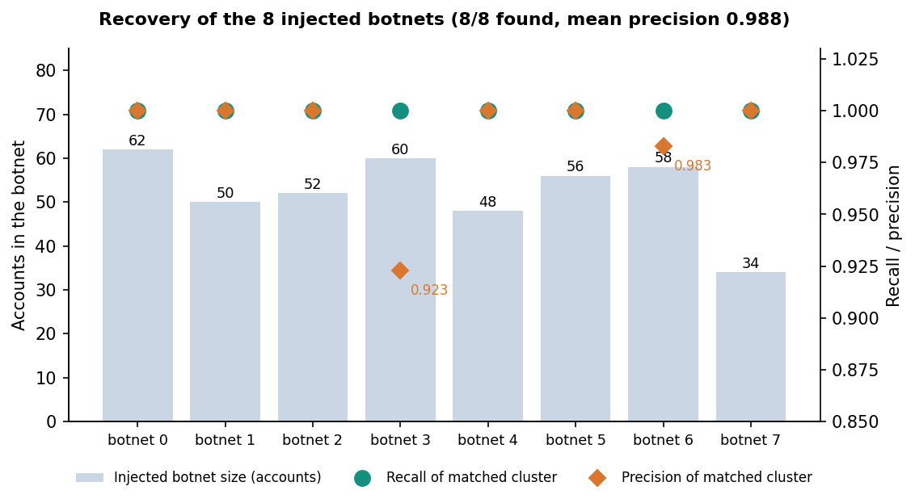
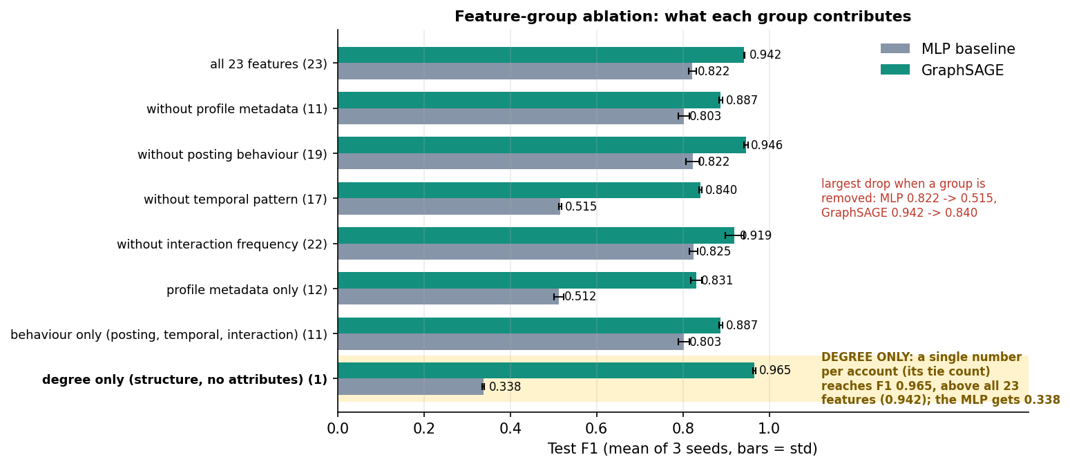
Results – Botnet Clusters & Feature Groups
8 of 8 injected botnets are single Louvain communities: mean recall 1.000, mean precision 0.988; one extra loose group of 160 lone spammers and look-alikes (tie density 0.0014).
Test split, served model: all 82 botnet members caught (baseline 64) but only 23 of 32 lone spammers (baseline 26): all 9 misses are lone spammers of degree 4-8.
Known-answer test on seeded botnets, not evidence about real ones.
Ablation F1 (3 seeds, MLP / GraphSAGE): all 23 features 0.822 / 0.942; without the temporal group 0.515 / 0.840 (largest drop, and those features are synthetic); without posting behaviour 0.822 / 0.946 (adds nothing).
GraphSAGE on node degree alone scores 0.965, above all 23 features: the injected structure is easy, so headline F1 is not real-platform accuracy.
Dept. of CSE | Batch A9 | Final Review
19
Notes:
Botnet recovery per botnet and the feature-group ablation (scripts/run_extra_experiments.py). The ablation retrains in memory, so its all-features row can differ from the main table in the third decimal.

Slide 20
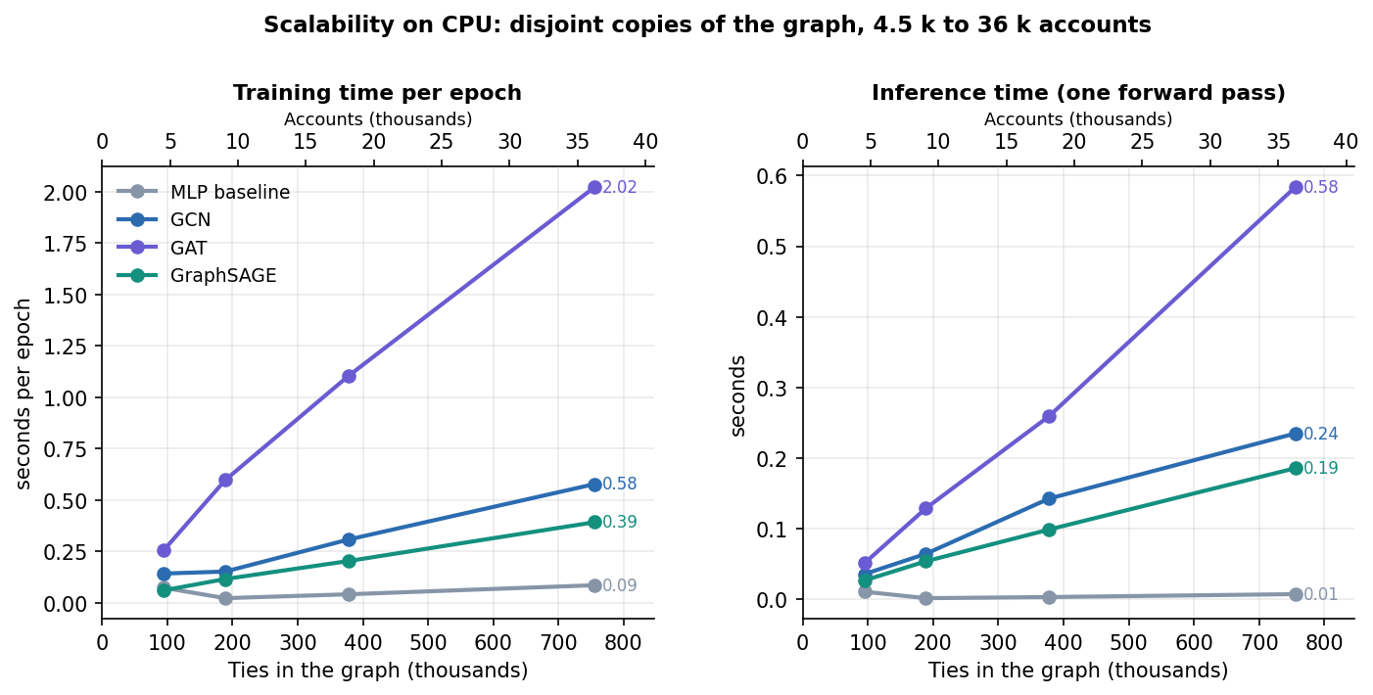
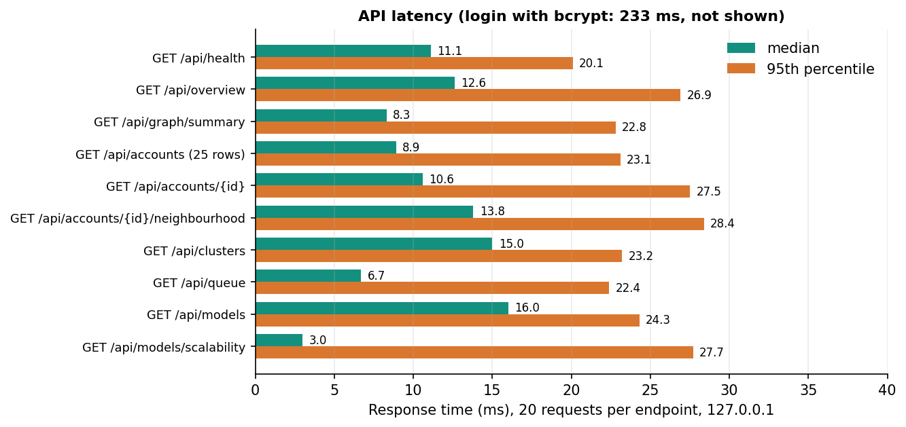
Performance & Testing
36 / 36
3-16 ms
0.39 s
233 ms
smoke-test checks pass
median API latency, 10 endpoints
GraphSAGE epoch, 36,264 accounts
sign-in (bcrypt check)
Check | Result
End-to-end smoke test (own API, scratch database) | 36 of 36 passed: auth and roles, graph, models beat baseline, scores, clusters, decisions, retraining
Scalability, disjoint copies, CPU | 4,533 to 36,264 accounts (94,456 to 755,648 ties): GraphSAGE epoch 0.06 to 0.39 s, GAT 0.26 to 2.02 s
Not tested | load and concurrency, adversarial evasion, platform-scale graphs, formal user acceptance, a pytest suite
Dept. of CSE | Batch A9 | Final Review
20
Notes:
Latency: 20 requests per endpoint on 127.0.0.1, warm server, shared i5-12500 (upper bounds). Cost grows roughly in proportion to the number of ties; disjoint copies understate a well-mixed real graph.

Slide 21
Comparison with Base Paper
Aspect | PruferNET [1] | BotGraph
Task | 3-class depth label in a spanning tree (influence) | Binary fake-account label; botnet clusters
Labels | Derived from tree depth; no fake accounts | 570 of 4,533 accounts fake (12.6%); partly synthetic
Data | SNAP Facebook 4,039 nodes / 88,234 edges; Email-Eu-core | SNAP Facebook topology + 570 injected accounts; Instagram and Twitter rows
Model | GraphSAGE + Prufer features, dropout 0.5, AdamW 0.003, 300 epochs | GCN, GAT, GraphSAGE vs MLP; dropout 0.3, Adam 0.01, <= 160 epochs
Split | 60/20/20 | 60/20/20 stratified, 3 seeds
Reported | Accuracy 99.63% with Prufer, 96.54% without | GraphSAGE F1 0.939, accuracy 0.985; baseline F1 0.827
Beyond the paper | - | Clusters 8 of 8, moderator retraining, scalability sweep
Not comparable: different task, labels and data, so 99.63% and 0.985 measure different things; no ranking is claimed.
Dept. of CSE | Batch A9 | Final Review
21
Notes:
State plainly that tasks, labels and datasets differ. What BotGraph takes from the paper: SNAP Facebook data, GraphSAGE, the 60/20/20 split, and structure-plus-attributes features.

Slide 22
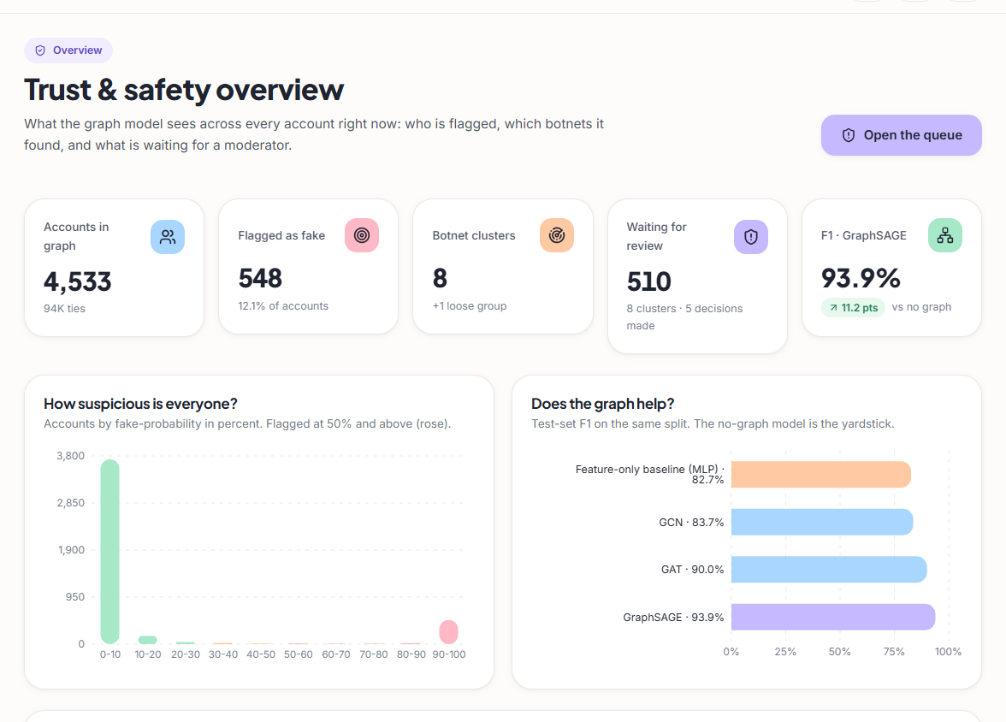
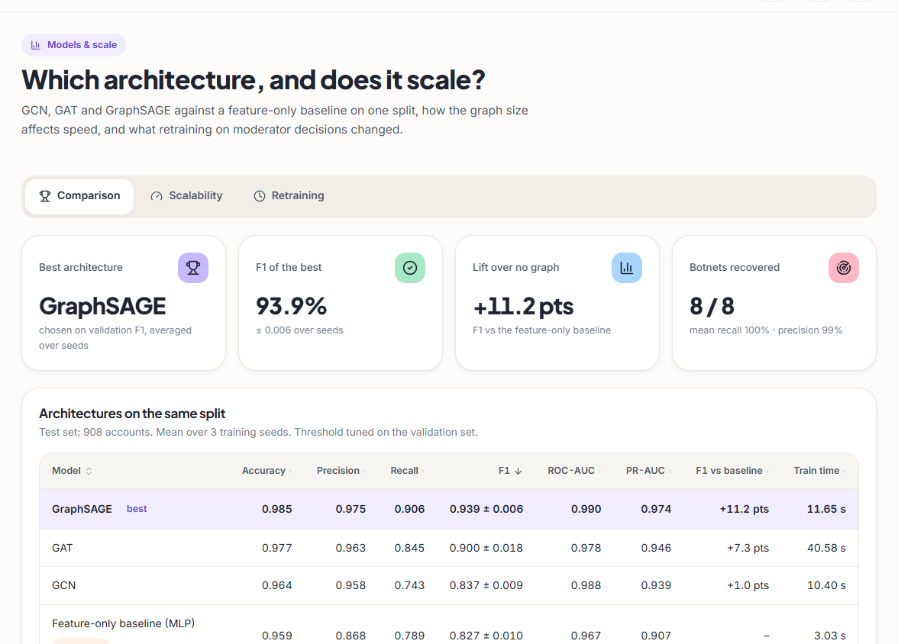
Output – Overview and Model Comparison
Left: trust and safety overview - 4,533 accounts, 548 flagged (12.1%), 8 botnet clusters plus 1 loose group, F1 93.9% (+11.2 points vs no graph). Right: the four architectures on the same split with F1 ± std, ROC-AUC, PR-AUC, lift and training time.
Dept. of CSE | Batch A9 | Final Review
22
Notes:
Real captures of the running app with the shipped model and committed graph.

Slide 23
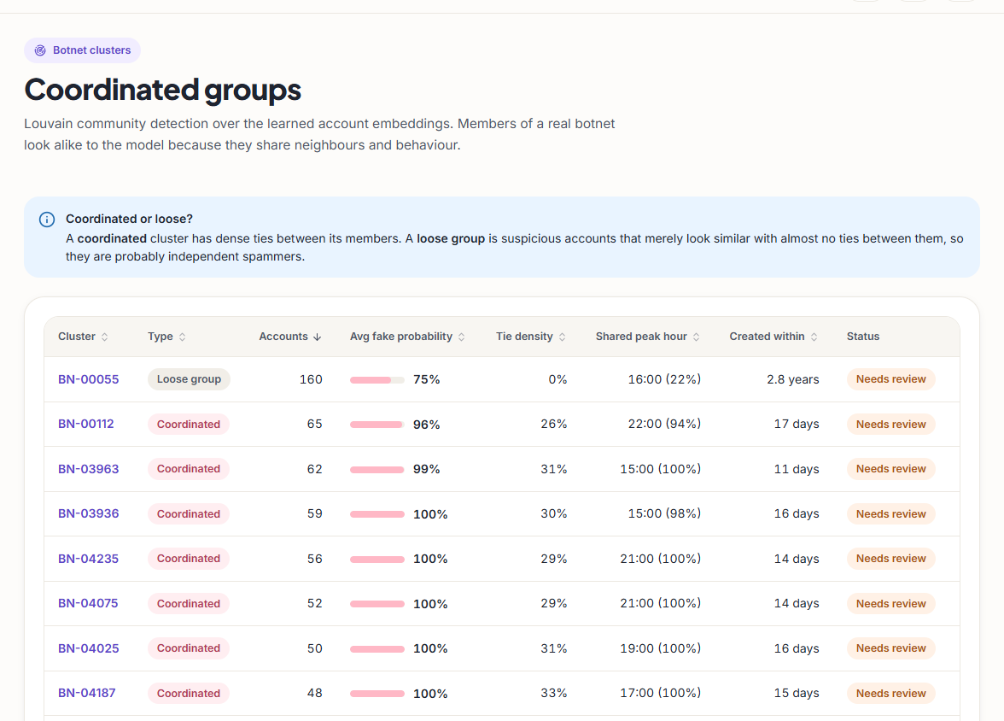
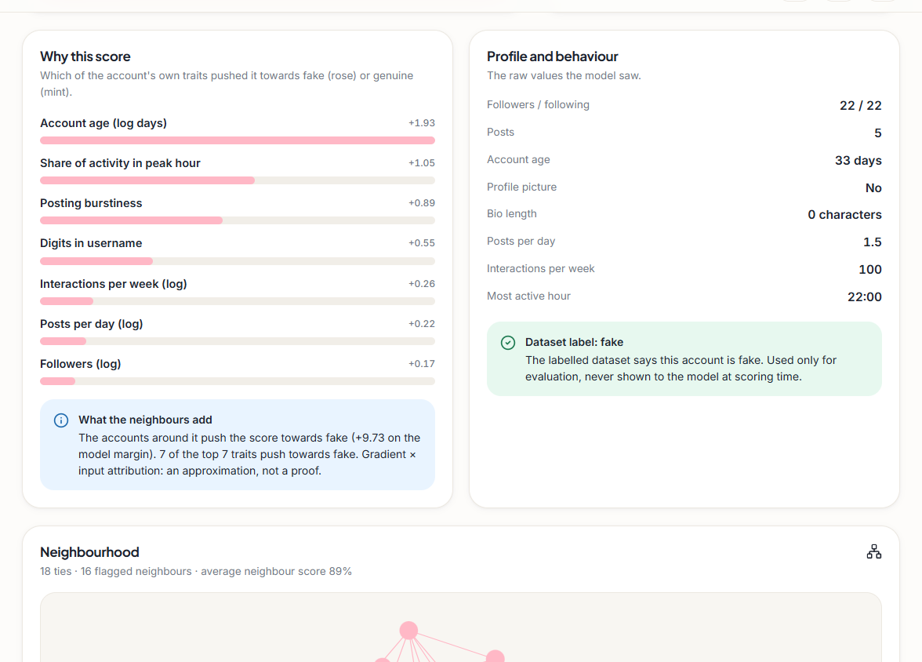
Output – Botnet Clusters and Account Explanation
Left: Louvain groups with size, average fake probability, tie density and shared peak hour - eight coordinated clusters and one 160-account loose group (density 0%). Right: why one account scores high - account age, peak-hour share and burstiness push towards fake, and its 16 flagged neighbours add to the margin.
Dept. of CSE | Batch A9 | Final Review
23
Notes:
Cluster list and the 'Why this score' view (gradient x input attribution, a first-order approximation).

Slide 24
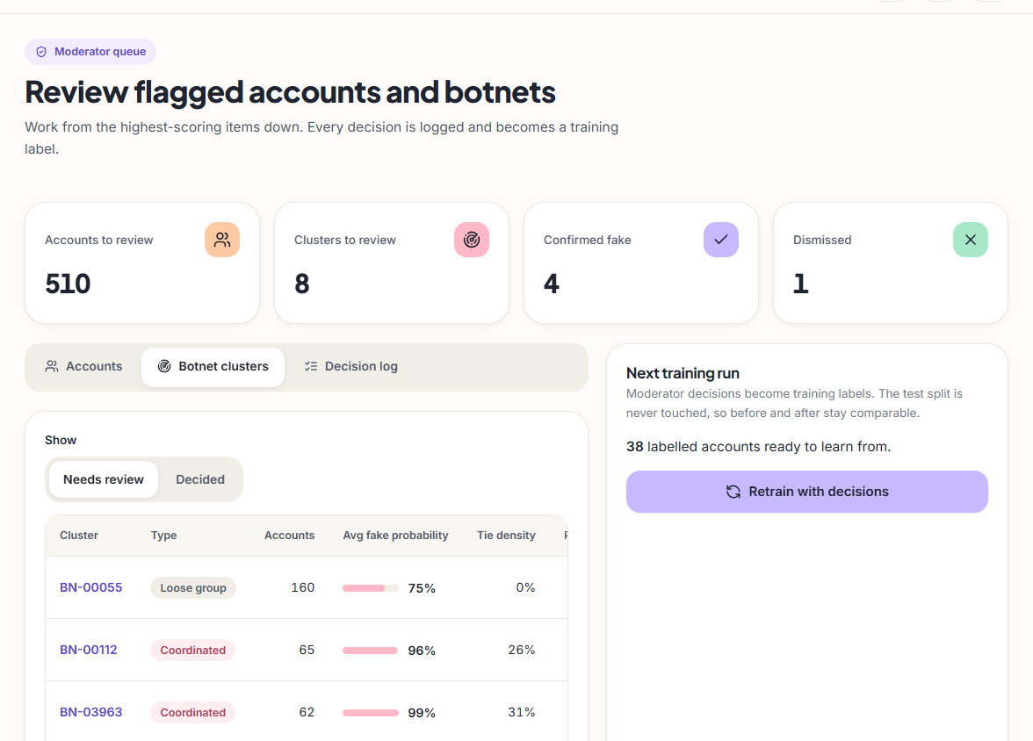
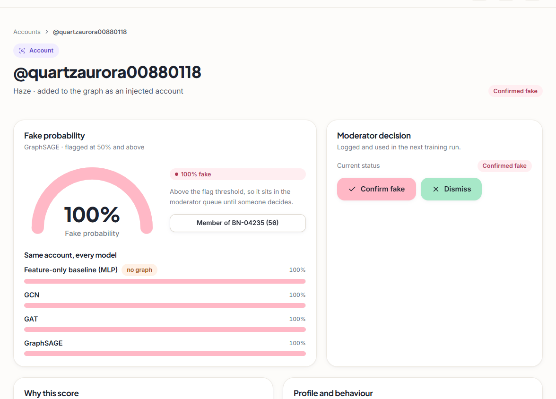
Output – Moderator Queue and Decisions
Left: queue of clusters to review with the retrain panel (demo database: 4 decisions confirmed fake, 1 dismissed, 38 labelled accounts ready for the next run). Right: an account page - fake probability 100% from all four models, member of a 56-account cluster, decision recorded as confirmed fake.
Dept. of CSE | Batch A9 | Final Review
24
Notes:
Decisions are stored in SQLite and used as training labels at the next retraining run; the test split is never touched.

Slide 25
Conclusion & Objectives vs Outcomes
A working end-to-end system: GraphSAGE reaches F1 0.939 against 0.827 without the graph; 8 of 8 injected botnets are recovered; 36 smoke-test checks pass.
Findings: the graph helps, unequally (GCN +1.0 points, GraphSAGE +11.2); node degree alone nearly solves the injected benchmark, so F1 is not real-platform accuracy.
# | Objective | Outcome
1 | Graph of accounts and interactions | Met: 4,533 nodes, 94,456 ties, documented schema
2 | Node features | Met: 23 features in four groups; no text features
3 | Compare GCN, GAT, GraphSAGE | Met: one split, 3 seeds, plus a no-graph baseline
4 | Botnet clusters from embeddings | Met on injected botnets (8 of 8); real botnets untested
5 | Accuracy, precision, recall | Met: six metrics, ROC and PR, confusion matrices; labels partly synthetic
6 | Scalability | Met to 36,264 accounts and 755,648 ties on CPU; platform scale untested
Dept. of CSE | Batch A9 | Final Review
25
Notes:
Be explicit about which objectives were met and what 'met' covers.

Slide 26
Limitations & Future Scope
Known limitations
Future scope
Botnets are injected and seeded
Temporal and interaction features are synthetic; profile and posting rows are resampled
No text or linguistic features; static snapshot graph
One split, 3 seeds; GAT varies by ±0.01 between runs
Scalability only to 36k accounts, on CPU
No adversarial, load or user-acceptance testing; demo authentication only
Prufer / spanning-tree structural features from the base paper
Text features from posts; temporal graphs that follow accounts over time
Neighbour sampling and GPU training for platform-scale graphs
Real labelled botnets; cross-validation and confidence intervals
Robustness to bots that adapt; live ingestion with rate limits and MFA
Dept. of CSE | Batch A9 | Final Review
26
Notes:
Limitations first, then concrete next steps.

Slide 27
References
[1] A. Saha, N. K. Sarkar and S. Pratihar, "PruferNET: An augmented graph neural network for influential node detection in social networks," IEEE Access, vol. 14, pp. 79940-79959, 2026, doi: 10.1109/ACCESS.2026.3695637.
[2] L. Zhang, X. Wang, H. Du, Y. Xu, Z. Liu and Y. Liu, "RABot: Reinforcement-guided graph augmentation for imbalanced and noisy social bot detection," arXiv:2602.21749, Feb. 2026.
[3] Z. Liu, J. Gao, Z. Ji and L. Zhao, "HW-GNN: Homophily-aware Gaussian-window constrained graph spectral network for social network bot detection," arXiv:2511.22493, Nov. 2025.
[4] M. Zhou, D. Zhang, Y. Wang, Y. Geng, Y. Dong and J. Tang, "LGB: Language model and graph neural network-driven social bot detection," arXiv:2406.08762, Jun. 2024.
[8] T. N. Kipf and M. Welling, "Semi-supervised classification with graph convolutional networks," in Proc. Int. Conf. Learn. Represent. (ICLR), 2017, arXiv:1609.02907.
[9] P. Velickovic, G. Cucurull, A. Casanova, A. Romero, P. Lio and Y. Bengio, "Graph attention networks," in Proc. Int. Conf. Learn. Represent. (ICLR), 2018, arXiv:1710.10903.
[10] W. L. Hamilton, R. Ying and J. Leskovec, "Inductive representation learning on large graphs," in Advances in Neural Information Processing Systems (NeurIPS), vol. 30, 2017, pp. 1024-1034.
[11] V. D. Blondel, J.-L. Guillaume, R. Lambiotte and E. Lefebvre, "Fast unfolding of communities in large networks," J. Stat. Mech.: Theory Exp., no. 10, p. P10008, 2008.
[12] J. McAuley and J. Leskovec, "Learning to discover social circles in ego networks," in Advances in Neural Information Processing Systems (NeurIPS), vol. 25, 2012, pp. 539-547.
[13] D. P. Kingma and J. Ba, "Adam: A method for stochastic optimization," in Proc. Int. Conf. Learn. Represent. (ICLR), 2015, arXiv:1412.6980.
[14] A. Paszke et al., "PyTorch: An imperative style, high-performance deep learning library," in Advances in Neural Information Processing Systems (NeurIPS), vol. 32, 2019, arXiv:1912.01703.
Dept. of CSE | Batch A9 | Final Review
27
Notes:
Selected references; the complete numbered list, including the batch-survey titles that could not be verified, is in the report.

Slide 28
THANK YOU
Questions & Suggestions
Dept. of CSE | Batch A9 | Final Review
28
Notes:
Invite questions.

