Slide 1
Detecting AI Generated Images with CNN and Interpretation Using Explainable AI
REVIEW 2 · DESIGN, METHODOLOGY AND PROGRESS
Design, methodology and progress: four CNN routes, logit fusion and Grad-CAM explanations
Presented by
Under the guidance of
Ponugoti Viduranandan 23K91A05J5
Naina Baherji 23K91A05G9
Likki Pranathi 23K91A05D2
Motasani Sathish 23K91A05G0
M Thanmayee, [DESIGNATION]
Department of Computer Science and Engineering
[COLLEGE NAME] · Batch C14 (CSE-C) · [ACADEMIC YEAR]
Notes:
This review shows how VeriVision AI is designed and built: the data and models, what is implemented, the first measured results and the open items.

Slide 2
Contents
01
02
03
Recap and architecture
Methodology and dataset
Preprocessing and models
04
05
06
Training and decision logic
Data flow, database and UML
Technology stack
07
08
09
Implementation progress and results
Output screens and testing
Challenges and next steps
Notes:
Agenda for the design and progress review.

Slide 3
Recap: problem and proposed system
!
Problem
i
Proposed system
B
Base paper link
AI-generated images are realistic enough to fool people. Detectors trained on one generator often fail on another, resizing and compression remove the cues, and a bare verdict is not credible without an explanation.
VeriVision AI runs four CNN routes on every uploaded image, fuses their logits with two gating rules, shows Grad-CAM heat maps, and re-tests the image after JPEG, resize and blur. All on a CPU, all local.
Larue et al. (CTrue) detect face deepfakes one-class. We share the aim of generalisable detection but work on general images, supervised, with explanations; HEDGE is the design reference for fusion and gating. Results are not comparable.
Notes:
One-minute recap of Review 1: the problem, our heterogeneous-ensemble approach, and how the base paper relates (shared aim, different scope and data).

Slide 4
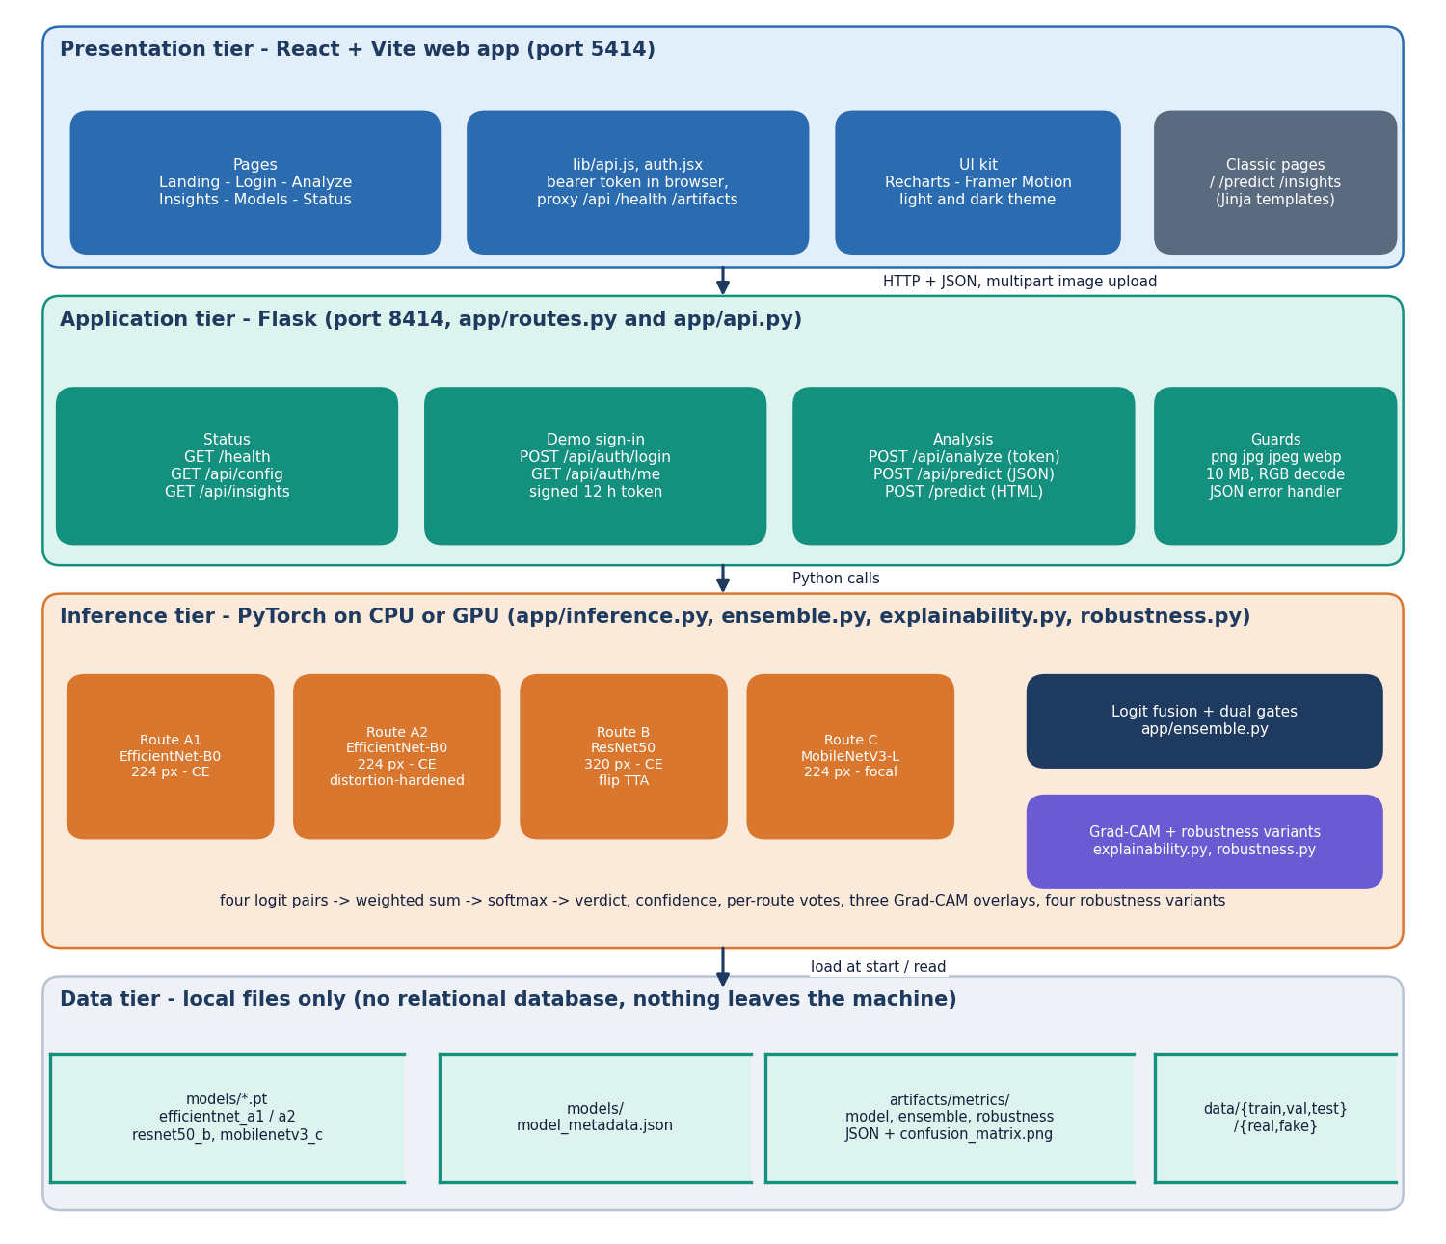
System architecture
Four tiers
Presentation: React and Vite web app (port 5414), six pages: landing, login, analyze, insights, models, status.
Application: Flask (port 8414); /api/analyze, /api/predict, /api/insights, demo sign-in with a signed token; PNG, JPG, JPEG, WEBP up to 10 MB.
Inference: four PyTorch models loaded once, logit fusion, Grad-CAM, robustness variants.
Data: checkpoints, metadata and metric JSON as files. No database.
Notes:
Routes live in app/routes.py and app/api.py; inference, fusion, explanation and robustness are separate modules so each can be tested alone. Storage is local files.

Slide 5
Methodology: end-to-end workflow
Image upload
Validate + RGB
Resize + normalise
Four CNN routes
Fuse + gates
Grad-CAM
Robustness check
One analysis path
Deterministic fusion
Measured, not typed
POST /api/analyze validates the image, runs the four routes and the fusion, adds three Grad-CAM overlays and the three robustness variants, and returns one JSON result.
Weighted logits plus two transparent gates; every response lists the per-route votes, active weights and gate notes, so the verdict can be audited.
scripts/run_cifake_experiments.py writes every reported number to experiments/cifake/metrics.json; the Insights page and the figures read from artifacts, not from typed text.
Notes:
Three design principles: one analysis path, auditable fusion, and numbers that come from scripts. The same pipeline serves the live app and the measurements.

Slide 6
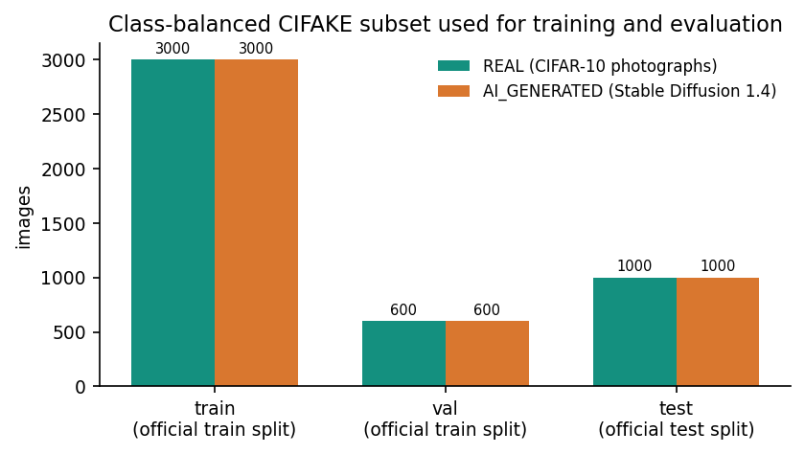
Dataset used
6,000 train
32 x 32 px
1
600
plus 1,200 validation and 2,000 test images, class-balanced
CIFAKE image size (JPEG)
generator in training data: Stable Diffusion 1.4
cross-domain probe images (other sources)
CIFAKE (Bird and Lotfi): 60,000 real CIFAR-10 images and 60,000 Stable Diffusion v1.4 images; official split 100,000 train / 20,000 test.
We use a class-balanced subset (seed 42) because training is CPU-only: validation is drawn from the train split, test from the official test split.
Cross-domain probe: 300 real photographs and 300 AI images from another Hugging Face dataset (MIT), larger and from other generators.
The models that shipped first were trained on synthetic demo images (100% scores, no meaning) and were replaced.
Images per class in each split of the subset.
Notes:
Be frank about the data: 32 px images from one generator, and only 6,000 of the 100,000 training images because of CPU-only training. The cross-domain probe exists precisely to test how far the result transfers.

Slide 7
Data preprocessing and augmentation
Extension and size check
Non-empty, decodes
Convert to RGB, >= 8 px
Resize 224 / 320
ImageNet mean / std
Route | Training augmentation
A1 | Random-resized-crop (0.8-1), flip, colour jitter
A2 | Stronger crop (0.6-1), rotation 12, jitter, blur, noise, JPEG 40-90, down-up resize
B, C | Crop (0.75-1), flip, rotation 8, jitter, blur, JPEG 50-95 with p = 0.35
At inference
PNG, JPG, JPEG or WEBP only, at most 10 MB, at least 8 x 8 px.
Routes A1, A2 and C see 224 px; route B sees 320 px and is averaged with its horizontal flip.
Uploads are decoded in memory and discarded after the reply.
Known effect: 32 px images are up-scaled 7-10x, so detail is interpolated, not real.
Notes:
Validation rejects bad uploads with a JSON error before any model runs. Augmentation differs per route on purpose: A2 is the distortion-hardened route, B and C are moderate.

Slide 8
Models used
Route | Architecture, input, loss | Trainable / total params | Fusion weight
A1 | EfficientNet-B0, 224 px, cross-entropy, normal augmentation | 1,131,954 / 4,010,110 | 0.35
A2 | EfficientNet-B0, 224 px, cross-entropy, distortion-hardened augmentation | 3,158,302 / 4,010,110 | 0.15
B | ResNet50, 320 px, cross-entropy, flip test-time averaging | 14,968,834 / 23,512,130 | 0.25
C | MobileNetV3-Large, 224 px, focal loss (gamma 2) | 2,185,522 / 4,204,594 | 0.25
ImageNet
2 classes
No GPU
pretrained weights, upper blocks fine-tuned
REAL (0) and AI_GENERATED (1)
everything trains and runs on a CPU
Notes:
Four heterogeneous routes: two EfficientNet variants with different augmentation, a larger ResNet at higher resolution, and a light MobileNet trained with focal loss. Weights are the product's configured values, not tuned.

Slide 9
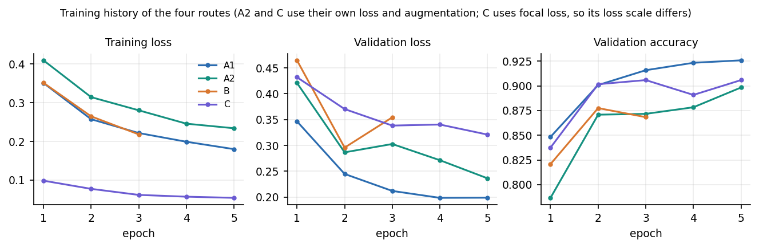
Training configuration
Setting | Value
Optimiser | AdamW, weight decay 1e-4, cosine decay; lr 3e-4 (route B 2e-4); batch 32 (B 16)
Epochs run | A1, A2, C: 5; B: 3 (best validation F1 at epoch 2 kept); early stopping patience 3 on validation F1
Seeds | A1 42, A2 43, B 44, C 45 (single run per route)
Best validation acc. / F1 | A1 0.9258 / 0.9270 ; A2 0.8983 / 0.9047 ; B 0.8775 / 0.8902 ; C 0.9058 / 0.9110
Hardware and time | Intel Core i5-12500, 16 GB, CPU only; about A1 24, A2 22, B 53, C 13 min (upper bounds, shared PC)
Training and validation loss fall for every route; route B overfits after epoch 2 (validation loss rises) and route C trains to a very low loss with a higher validation loss. One run per route, no seed study.
Notes:
Settings from scripts/common.py and the train_* scripts. Validation F1 chose the checkpoint. Only one seed per route was run, so rankings between close routes carry run-to-run uncertainty.

Slide 10
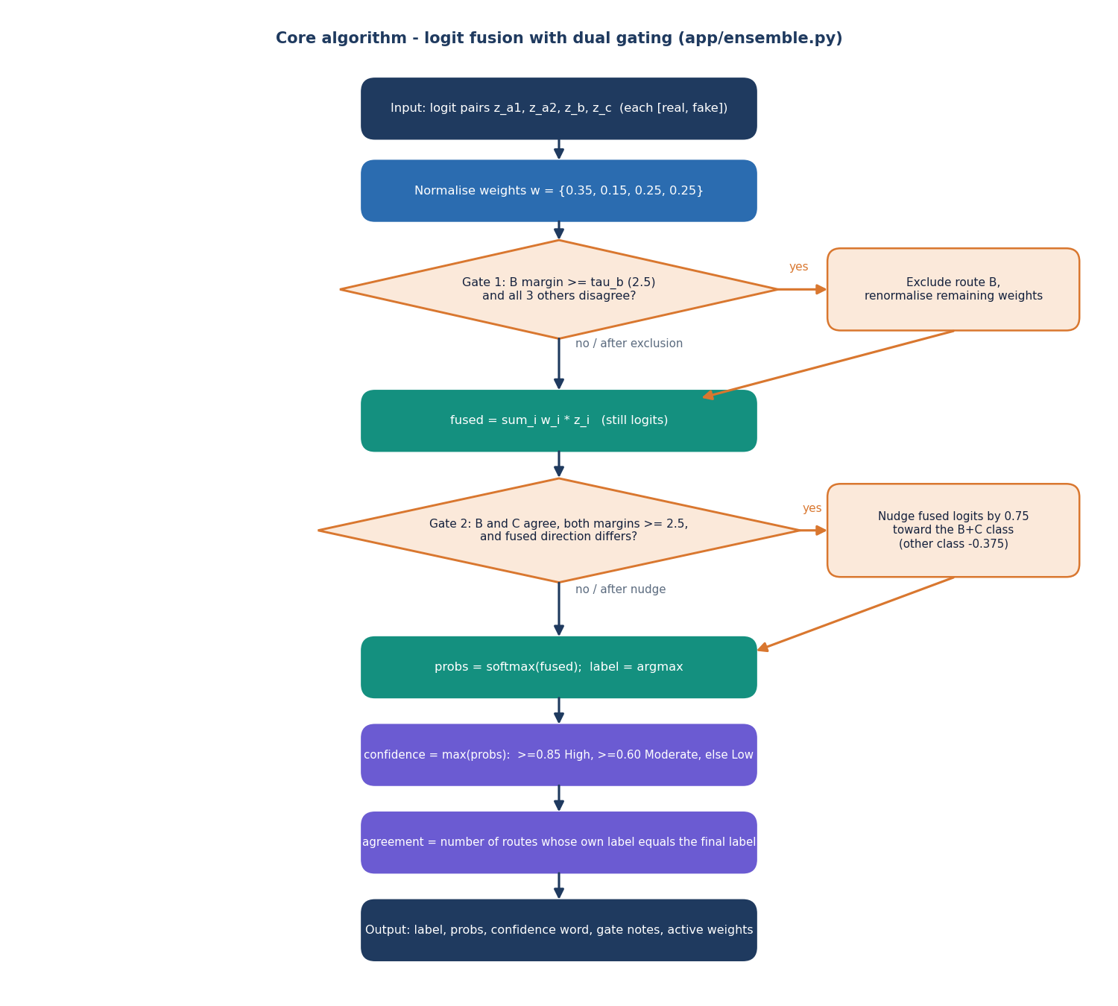
Decision logic: logit fusion with two gates
Fusion. Weighted sum of raw logits (0.35, 0.15, 0.25, 0.25), then softmax; the larger probability is the confidence.
Gate 1. Drop route B when its margin is at least 2.5 and all three other routes disagree.
Gate 2. Nudge the fused logits by 0.75 toward the B + C class when B and C agree with margins of at least 2.5 and the fused direction differs.
Wording. At least 0.85 High, at least 0.60 Moderate, else Low confidence.
Finding. The gates fired on 7 of 2,000 test images (Gate 1) and 0 (Gate 2); without them accuracy is 92.45% against 92.35%. They did not help here.
Notes:
Weights and gate thresholds live in app/config.py and are engineering defaults, not tuned. The ablation on the same logits shows the gates are neutral on this data.

Slide 11
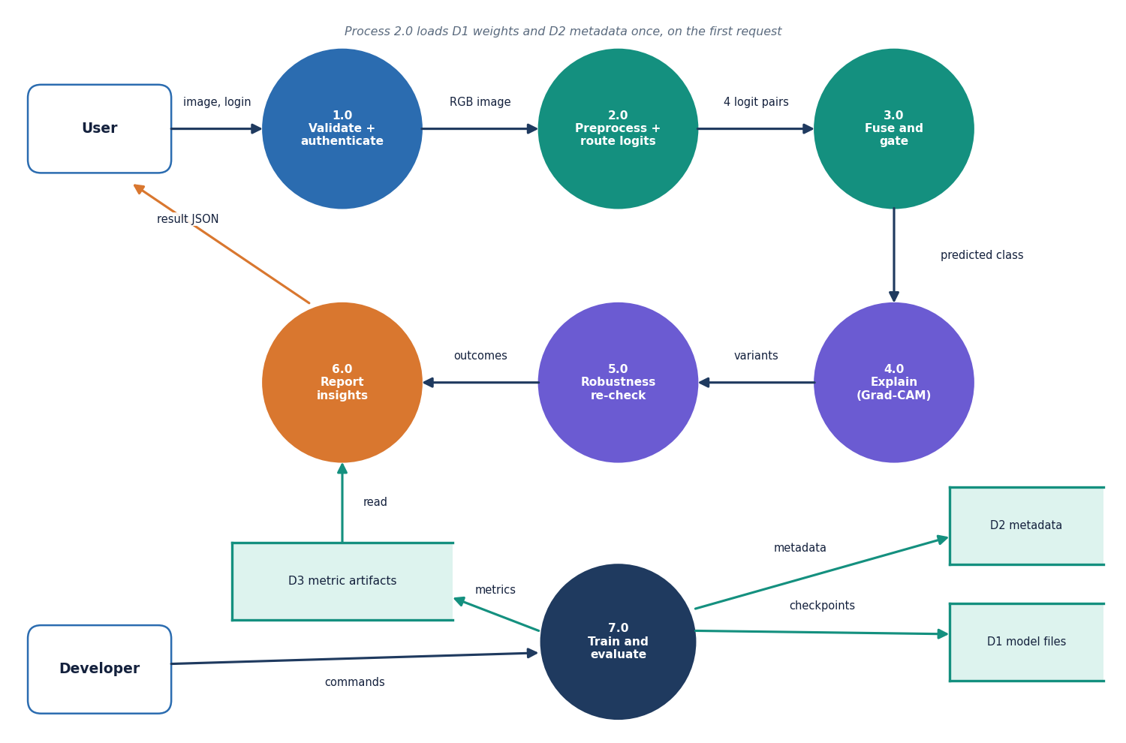
Data flow and modules
Module | Role
preprocessing | upload checks, RGB decode
models | four architectures, checkpoints
inference | per-route logits, flip TTA
ensemble | fusion, Gate 1, Gate 2
explainability | Grad-CAM overlays
robustness | JPEG, resize, blur variants
api / routes | JSON API, classic pages
config | weights, gates, limits
scripts/ | prepare, train, evaluate
Notes:
Level-1 data flow: validation and sign-in, preprocessing and route logits, fusion, Grad-CAM, robustness, insights, and training and evaluation, with three data stores of local files.

Slide 12
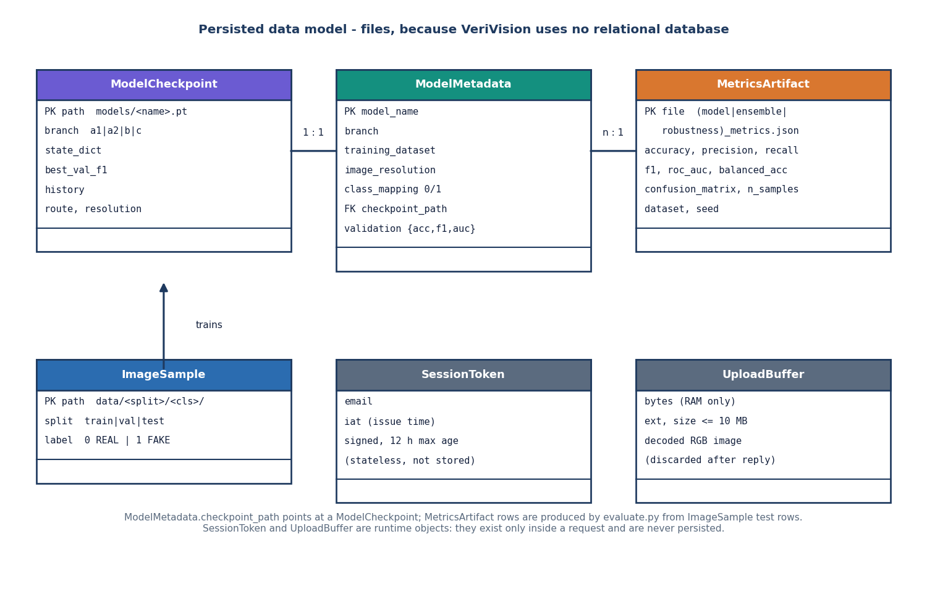
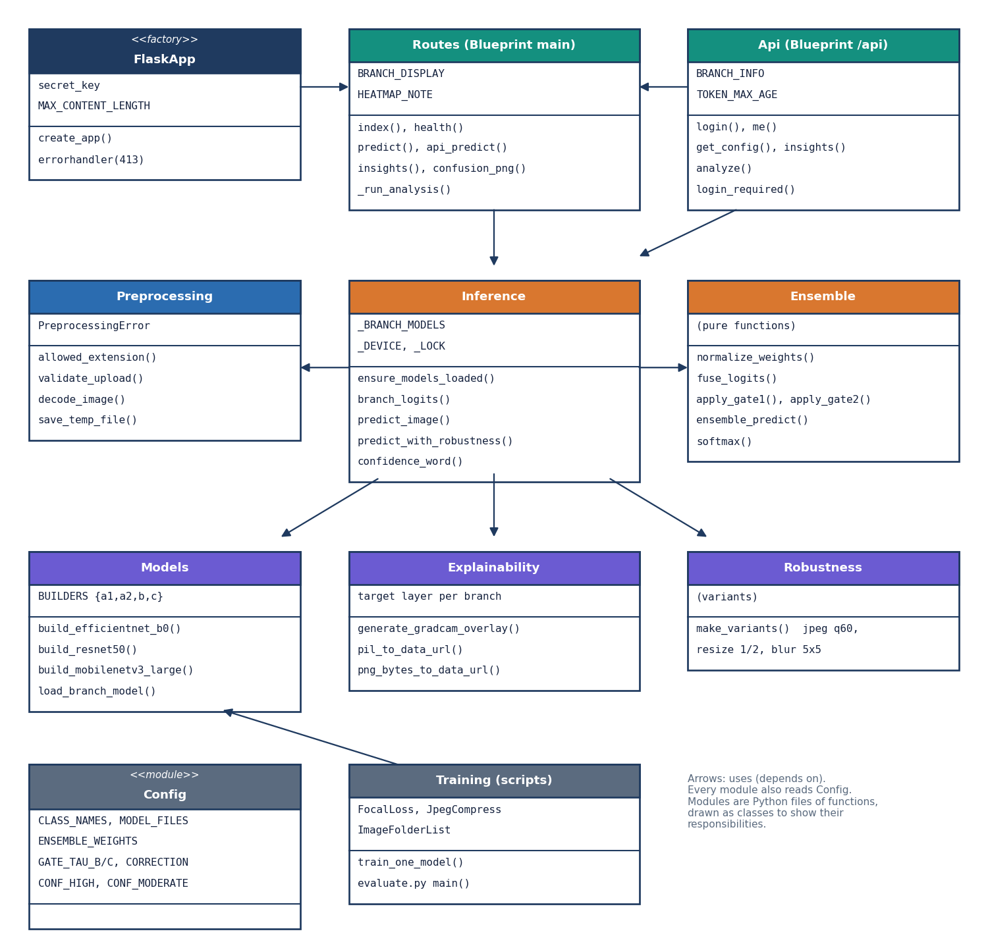
Data model and UML
No relational database: persisted state is four checkpoints, model_metadata.json and the evaluation JSON and PNG. The session token is signed, not stored; uploads live in memory only.
Notes:
Honest point: the service modules are plain Python files of functions, drawn as classes in the UML to show responsibilities. There is deliberately no database for this product.

Slide 13
Technology stack
Layer | Technology
Backend | Python 3.11.9, Flask 3.1.3, signed demo token, JSON error handlers
Deep learning | PyTorch 2.14.1 (CPU build), torchvision 0.29.1 with ImageNet weights: EfficientNet-B0, ResNet50, MobileNetV3-Large
Explainability | pytorch-grad-cam 1.5.7 (Grad-CAM), OpenCV headless 5.0, Pillow 13.0
Data and metrics | NumPy 2.4.6, pandas 3.0.6, scikit-learn 1.9.1, matplotlib 3.11.2, reportlab 5.1
Front end | React 19, Vite 8, React Router 7, Recharts, Framer Motion, GSAP (port 5414)
Testing | pytest 9.1.1, API smoke script, Playwright browser walk of every screen
Hardware | Intel Core i5-12500 (6 cores, 12 threads), 16 GB RAM, no GPU, Windows 11
Notes:
Everything is open source. requirements.txt pins the versions that were tested; run.bat starts both servers.

Slide 14
Implementation progress
Component | Status | Evidence
Data preparation (CIFAKE subset, cross-domain probe) | Done | 6,000 / 1,200 / 2,000 images; 600 probe images
Four CNN routes trained and evaluated | Done | ensemble accuracy 92.35%, single run
Logit fusion, Gate 1 and Gate 2 | Done | gates fired 7 and 0 times: no gain
Grad-CAM on three routes, robustness re-check | Done | qualitative only; consistency k/n shown
Flask API and React web app (6 pages) | Done | 29 of 29 smoke checks; 19 screenshots
Automated tests | Done, partial | 19 of 19 pytest; no unit tests of Grad-CAM or robustness
Cross-generator generalisation | Not achieved | cross-domain accuracy 51.0%, AUC 0.499
Seed study, Grad-CAM faithfulness, GPU run, user study | Not done | listed as future work
Notes:
State of the code base. The honest gaps: cross-generator generalisation was measured and not achieved, and the seed study, Grad-CAM faithfulness test and user study were not done.

Slide 15
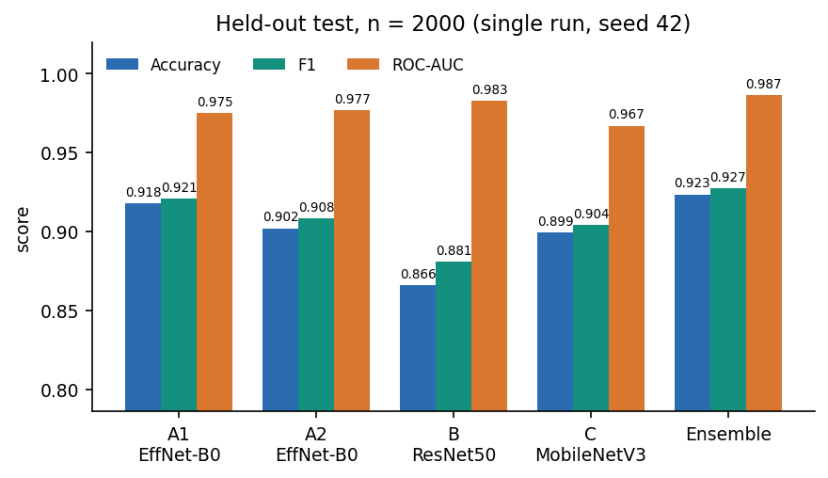
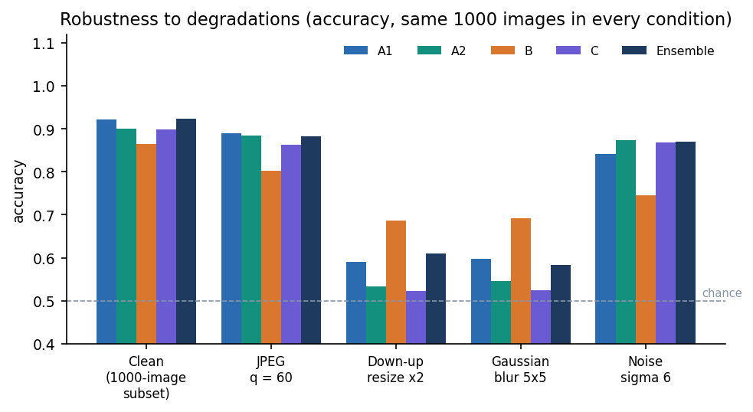
Preliminary results
92.35%
0.9275
0.9865
51.0%
ensemble accuracy, held-out test (n = 2,000)
ensemble F1 score
ensemble ROC-AUC
cross-domain accuracy: chance level
Single run, seed 42, CIFAKE subset (32 px, one generator). 95% CI for accuracy 0.911 to 0.934; the ensemble's edge over route A1 is not statistically distinguishable. It over-predicts AI-generated (false-positive rate 13.1%). Resize and blur cut accuracy to about 58 to 61%.
Notes:
Four headline numbers, each with its caveat. 92.35 percent accuracy and ROC-AUC 0.9865 on 2,000 CIFAKE test images; the same models score 51.0 percent, AUC 0.499, on full-resolution photographs and AI images from other sources, so cross-generator generalisation, objective 4, was measured and not achieved.

Slide 16
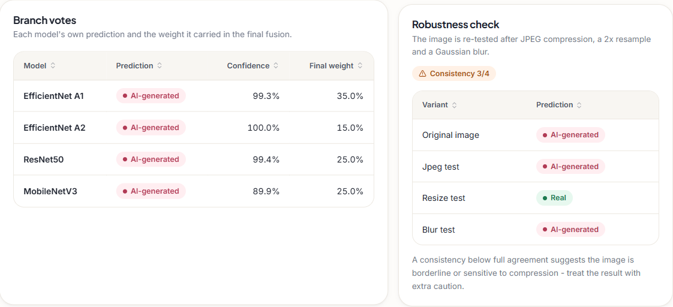
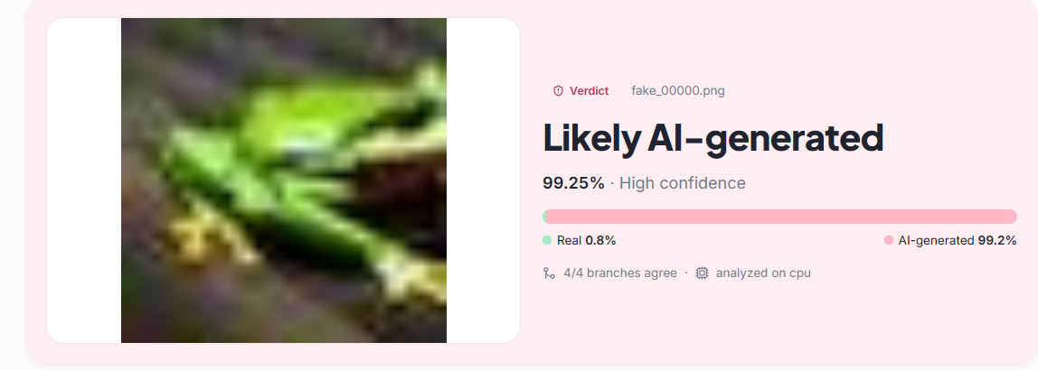
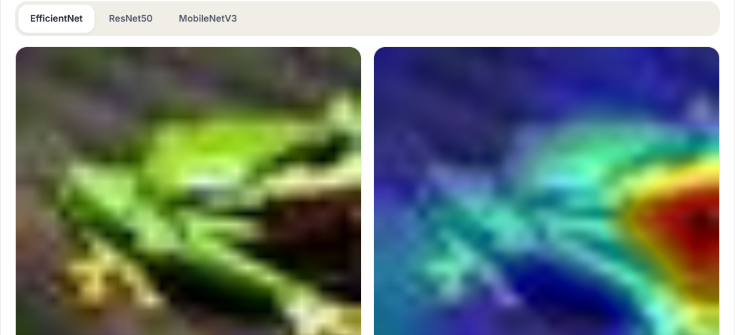
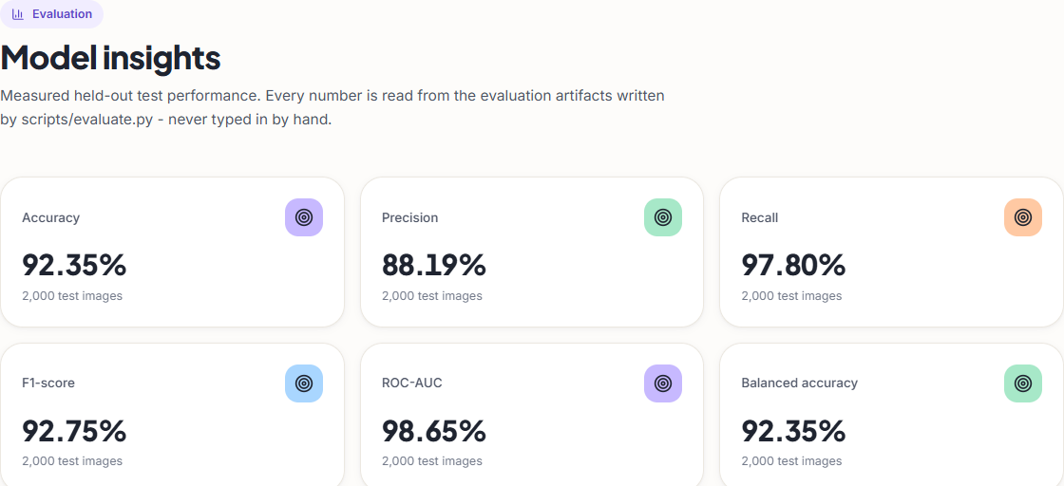
Output screens
Verdict card: label, confidence, 4/4 branches agree (CIFAKE test image).
Per-route votes and the robustness consistency check.
Grad-CAM: original image and heat map for the EfficientNet route.
Model insights: held-out metrics read from the evaluation artifacts.
Notes:
Real screenshots of the running application with the CIFAKE-trained models. They show the interface, not proof of correctness: the verdicts on single images are only as reliable as the measured test results.

Slide 17
Initial testing and observations
19 / 19
29 / 29
0
0.25 s / 1.7 s
pytest tests passed
smoke-test checks passed
console errors in the browser walk
median /api/predict and /api/analyze on a CPU
Observation | Action
The ensemble leans toward AI-generated: false-positive rate 13.1%, false-negative rate 2.2% | Reported; a higher threshold (0.7 to 0.8) lowers false positives but was picked on the test set
Resize and blur drop ensemble accuracy to 61.0% and 58.3%; the hardened route A2 was no better | Reported as a limit; hardening did not transfer to these distortions
Not covered: Grad-CAM and robustness unit tests, load, GPU timing, adversarial attacks, user study | Listed as future work
Notes:
Tests cover preprocessing, fusion, both gates, response structure and the API routes; the smoke script and browser walk cover the running system. Latency was measured on 127.0.0.1 with the machine idle.

Slide 18
Challenges and corrective actions
Challenge | Corrective action
The shipped models were trained on synthetic demo images (100% scores, meaningless) | Retrained all four routes on a real CIFAKE subset; the synthetic numbers are kept only as a footnote
CPU-only training: route B alone took about 53 min | Class-balanced subset of 6,000 training images, 3 to 5 epochs, early stopping
The gates, as designed, never changed a result (fired 7 and 0 times) | Ablation on the same logits; reported as no gain, defaults left unchanged
Cues vanish under resize and blur; distortion-hardened A2 did not help | Measured and reported; the robustness check shown to the user as a consistency score
Cross-domain probe at chance (51.0%, AUC 0.499) | Objective 4 stated as not achieved; multi-generator, higher-resolution data planned
Notes:
Each challenge was met by a concrete step or by measuring it and saying so plainly in the report.

Slide 19
Next steps
1
More and better data
2
Stronger evaluation
3
Explanation quality
4
Hardening
Train on the full 100,000 CIFAKE images and on several generators at higher resolution; evaluate per generator.
Repeat with several seeds, tune weights, gates and the threshold on a validation set, and test on held-out generators.
Test Grad-CAM quantitatively with deletion and insertion, and compare with other attribution methods.
Unit tests for explainability and robustness, a GPU run, load tests, and real user authentication.
Notes:
The first two items address the biggest honest gaps: a small single-generator training set and a cross-domain result at chance.

Slide 20
Thank you
Questions and suggestions are welcome.
Notes:
Likely questions: why four routes (disagreement carries information, and HEDGE motivates heterogeneous routes); why the gates did not help (they rarely fire on 32 px CIFAKE); whether Grad-CAM proves why the model decided (it is a qualitative aid).

