Slide 1

Detecting AI Generated Images with CNN
and Interpretation Using Explainable AI
Final Review · VeriVision AI
Team Details : Batch C14
Under the Esteemed Guidance of
M Thanmayee
[DESIGNATION], Department of CSE
23K91A05J5 Ponugoti Viduranandan
23K91A05G9 Naina Baherji
23K91A05D2 Likki Pranathi
23K91A05G0 Motasani Sathish
DEPARTMENT OF COMPUTER SCIENCE AND ENGINEERING · [COLLEGE NAME] · Academic Year [ACADEMIC YEAR]
Notes:
Introduce the team and the project: VeriVision AI, a local application that tells whether an image is real or AI-generated and shows why.

Slide 2
Table of Contents
Abstract
Base Paper & Literature Survey
Research Gap, Problem Statement & Objectives
Proposed System & Architecture
Methodology, Dataset & Models
Decision Logic, Interaction & Data Model
Implementation Highlights
Results: Held-out, Threshold, Robustness
Performance & Testing
Comparison with Base Paper
Output Screens
Conclusion, Future Scope & References
Dept. of CSE | Batch C14 | Final Review
2
Notes:
The agenda follows the report: problem, design, method, results, comparison, screens, conclusion.

Slide 3
Abstract
AI image generators now produce pictures that people cannot reliably tell from photographs, and a bare real/fake score gives an analyst nothing to defend in a dispute.
VeriVision AI runs four ImageNet-pretrained CNN routes (EfficientNet-B0 x2, ResNet50, MobileNetV3-Large), fuses their logits with two gating rules, explains the verdict with Grad-CAM and re-tests the image under JPEG, resize and blur.
On a held-out CIFAKE test subset (n = 2,000, 32 px) the ensemble scores 92.35% accuracy, F1 0.9275 and ROC-AUC 0.9865; its advantage over the best single route is not statistically distinguishable.
Resize and blur drop accuracy to 61.0% and 58.3%; on 600 full-resolution images from other sources the ensemble is at chance (51.0%). Cross-generator generalisation was measured and not achieved.
A full analysis takes about 1.7 s on a CPU; 19 of 19 tests and 29 of 29 smoke checks pass.
Not done: several generators, full-resolution training data, GPU runs, a user study.
Dept. of CSE | Batch C14 | Final Review
3
Notes:
Give the problem, the system in one breath, the headline number with its protocol, and end on the honest limits.

Slide 4
Base Paper
N. Larue, V. Struc, P. Peer and N.-S. Vu, "Learning the manifold of authenticity: hybrid-curvature representation learning for generalizable deepfake detection," IEEE Access, vol. 14, pp. 101988-102001, 2026, doi: 10.1109/ACCESS.2026.3702429.
Aspect | Base paper: Learning the manifold of authenticity (CTrue)
Method | One-class representation learning: only authentic data is used for training, pseudo-fakes are synthesised, a hybrid-curvature representation separates authentic from deepfake faces
Data and cost | 720 pristine FaceForensics++ videos; EfficientNet-B4 (19.3 M parameters); 200 epochs on two V100 GPUs (about 16 h); 74 fps on an RTX 3060
Reported results | AUC 98.9% on FF++ (in-domain) and 77.0% on DFDC in the lambda = 1 ablation; the cross-dataset table is an image in the paper and is not quoted
Scope | Face deepfakes in video frames; metric is AUC; no per-image explanation of the verdict
What we take | The goal of generalisable detection and the cross-dataset test idea. We do not implement CTrue: our models are supervised CNNs on general images
Dept. of CSE | Batch C14 | Final Review
4
Notes:
Larue et al., IEEE Access 2026. The base paper is a one-class face-deepfake detector. We state clearly that this project does not implement it; HEDGE is our design reference for fusion and gating.

Slide 5
Literature Survey
Work | Year | Approach | Finding / limitation
Larue et al. CTrue [1] (base) | 2026 | One-class face-deepfake detector, EfficientNet-B4, pseudo-fakes, hybrid curvature | AUC 98.9% FF++, 77.0% DFDC (lambda=1); faces only, 2 V100 GPUs, 200 epochs
Wu et al. HEDGE [2] | 2026 | Three heterogeneous routes, logit fusion and dual gating, DINOv3 / MetaCLIP2 | Balanced acc. 98.3% on five benchmarks; gates add 0.37 F1; 8 H800 GPUs
Tasnim et al. [3] | 2025 | Ten forensic detectors on seven GAN/diffusion sets, Grad-CAM analysis | Strong in-distribution, weaker transfer across generators
Bird & Lotfi CIFAKE [8] | 2024 | CNN on 60,000 real vs 60,000 Stable Diffusion images (32 px), Grad-CAM | Small-image benchmark; one generator; used as this project's data
Wang et al. [12] | 2020 | ResNet-50 trained on one GAN, tested on many | Generalises with augmentation; GAN-era generators only
Ojha et al. [13] | 2023 | Frozen CLIP features with a linear probe for universal detection | Better transfer to unseen generators; needs a large pre-trained backbone
Frank et al. [14] | 2020 | Frequency-domain (DCT) analysis of GAN images | Spectral artefacts are visible; fragile after resizing or compression
Corvi et al. [15] | 2023 | Detectors for diffusion-generated images | Diffusion images are harder; detectors lose accuracy on new generators
Selvaraju et al. Grad-CAM [26] | 2017 | Gradient-weighted class activation maps for any CNN | Qualitative heat maps; no guarantee of faithfulness
Dept. of CSE | Batch C14 | Final Review
5
Notes:
Representative work on face deepfakes, diffusion-image detection, foundation-model features, frequency cues and explanation. Batch survey items that could not be verified are marked in the report's reference list and no number from them is used.

Slide 6
Research Gap
The base paper targets face deepfakes with a one-class model, not general images
Most detectors report a verdict only; Grad-CAM pairing is rare in deployable tools
Cross-generator generalisation is claimed often but rarely re-measured on other sources
Heterogeneous ensembles with gating exist (HEDGE) but need large GPU-trained backbones
Robustness to JPEG, resizing and blur is seldom reported next to the verdict
No student-deployable CPU tool joins four CNN routes, Grad-CAM and a robustness check
Dept. of CSE | Batch C14 | Final Review
6
Notes:
Six gaps from the survey. The project addresses the second, fifth and sixth directly; the third is measured and the result is negative.

Slide 7
Problem Statement
Synthetic images are realistic enough to deceive human observers
Detectors trained on one generator degrade sharply on images from another
Compression and resizing on social platforms remove detectable artefacts
A verdict without a visual justification is not credible in a dispute
Need: a detector that identifies AI-generated images and explains its decision
Input
Output
Constraint
One image (png, jpg, jpeg or webp, up to 10 MB)
Verdict, confidence, four route votes, Grad-CAM heat maps, robustness consistency
Runs locally on a CPU; the image never leaves the machine
Dept. of CSE | Batch C14 | Final Review
7
Notes:
The statement has three parts: classify, explain, and stay deployable on ordinary hardware.

Slide 8
Objectives
1. Assemble a dataset of real photographs and AI-generated images
2. Preprocess and augment the images to improve robustness across sources
3. Train CNN classifiers that separate real images from generated ones
4. Evaluate cross-generator performance to test generalisation
5. Apply Grad-CAM to highlight the regions driving each classification
6. Deploy the models behind an interface returning verdict, confidence and explanation
Dept. of CSE | Batch C14 | Final Review
8
Notes:
The six objectives of the proposal. The conclusion states the real status of each: 1 partly met, 4 measured and not achieved.

Slide 9
Proposed System
Image upload
Validate + resize
Four CNN routes
Fusion + gates
Grad-CAM + robustness
Four ImageNet-pretrained CNN routes: EfficientNet-B0 x2, ResNet50, MobileNetV3-Large
Fuse the route logits with weights 0.35 / 0.15 / 0.25 / 0.25 and two gating rules
Explain each verdict with Grad-CAM heat maps on three routes
Re-test every image under JPEG, resize and blur and report a consistency score
Serve it locally: Flask API on 8414 and React web app on 5414, CPU only
The verdict is decision support: every result screen says the heat map is an explanation aid, not proof of authenticity.
Dept. of CSE | Batch C14 | Final Review
9
Notes:
The proposed system as one line of boxes and the design rules behind it.

Slide 10
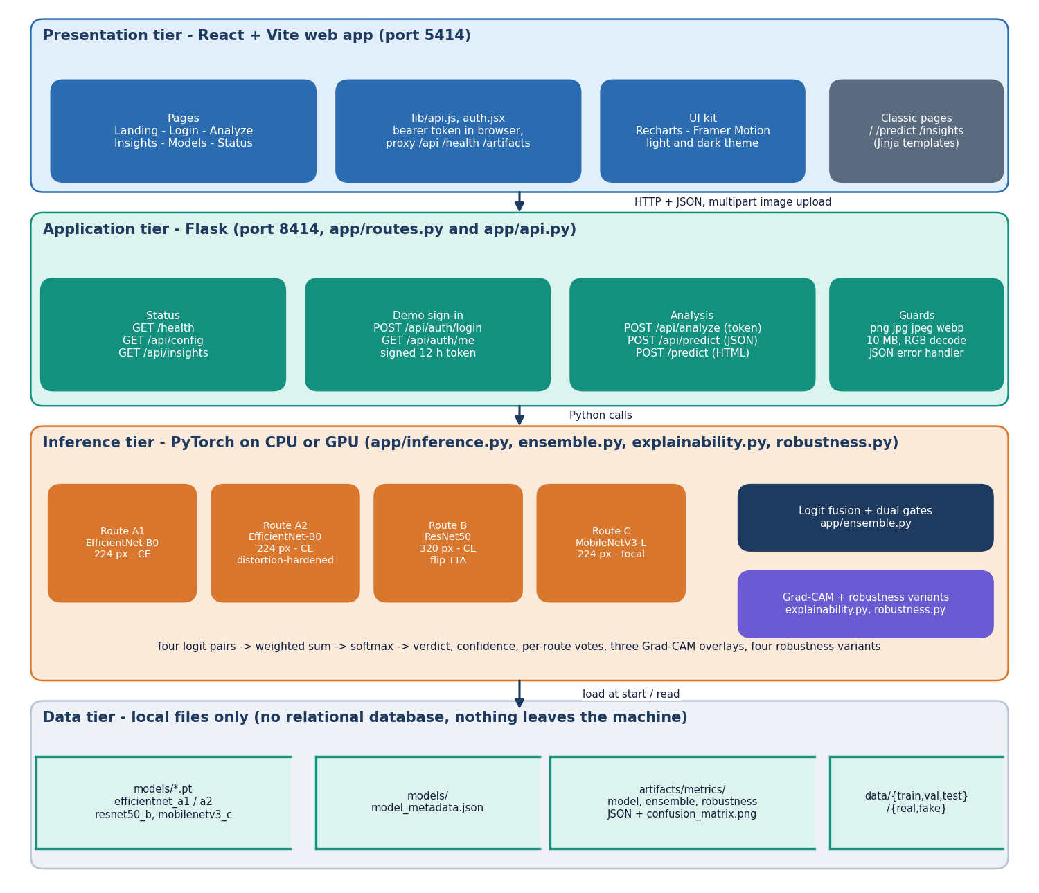
System Architecture
Web app: React + Vite on port 5414
API: Flask on port 8414, token sign-in
Inference: four PyTorch models loaded once, fusion, Grad-CAM, robustness
Storage: checkpoints, metadata and metric files only; no database
Local first: no external service is called
Dept. of CSE | Batch C14 | Final Review
10
Notes:
Four tiers; all analysis runs on the local machine.

Slide 11
Methodology
Validate image
Resize + normalise
Four routes
Weighted logits
Two gates
Softmax + confidence
Grad-CAM + re-test
Training: ImageNet weights, upper blocks fine-tuned; AdamW (weight decay 1e-4), cosine decay, lr 3e-4 (B 2e-4), batch 32 (B 16), early stopping on validation F1, patience 3; seeds 42-45.
Losses and augmentation differ per route: cross-entropy for A1, A2 and B, focal loss (gamma 2) for C; A2 uses distortion-hardened augmentation; B adds horizontal-flip test-time augmentation.
Evaluation on the official CIFAKE test split (2,000 images), bootstrap 95% intervals (2,000 resamples), 15-bin calibration, threshold sweep, fusion ablation on the same logits.
Robustness on 1,000 test images under JPEG q60, 2x resize round trip, Gaussian blur and noise; cross-domain probe on 600 images from another source.
Every number is written by scripts/run_cifake_experiments.py to experiments/cifake/metrics.json.
Dept. of CSE | Batch C14 | Final Review
11
Notes:
The workflow and the measurements added on top of plain accuracy: intervals, calibration, ablation, robustness and a cross-domain probe.

Slide 12
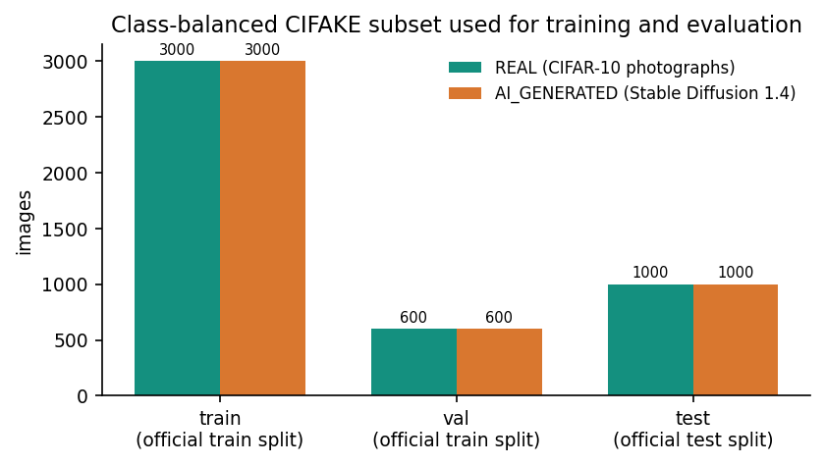
Dataset & Models
6,000
Route | Backbone | Trainable params
A1 | EfficientNet-B0 224 | 1,131,954
A2 | EfficientNet-B0 224 | 3,158,302
B | ResNet50 320 | 14,968,834
C | MobileNetV3-L 224 | 2,185,522
train images (3,000 real + 3,000 AI)
1,200
validation images (600 + 600)
2,000
CIFAKE [8]: 60,000 real CIFAR-10 images and 60,000 Stable Diffusion v1.4 images, 32 x 32 px; official split 100,000 train / 20,000 test.
Class-balanced subset (seed 42): only 6% of the training pool, because training was CPU-only. One generator, tiny images.
Cross-domain probe: 300 real + 300 AI images from another source (Hugging Face AI-vs-Real, MIT), about 640 to 1024 px.
held-out test images (1,000 + 1,000)
Labels: 0 REAL, 1 AI_GENERATED. Subsets are drawn without overlap.
Dept. of CSE | Batch C14 | Final Review
12
Notes:
Be frank about the data: CIFAKE is 32 px and has one generator, and only 6,000 of 100,000 training images were used.

Slide 13
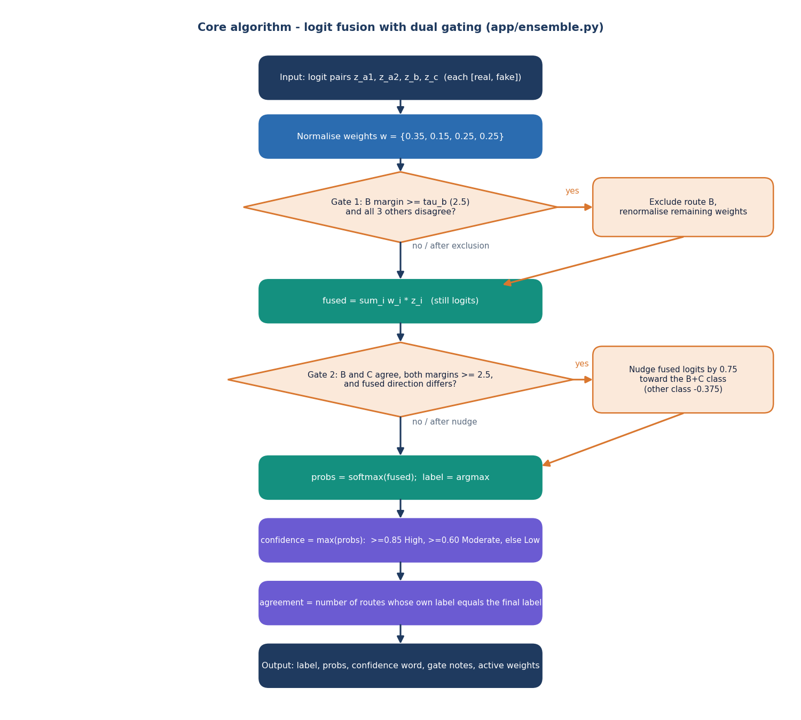
Decision Logic: Fusion and Gates
Weighted sum of raw logits: A1 0.35, A2 0.15, B 0.25, C 0.25, then softmax.
Gate 1: drop route B if its margin is at least 2.5 and the other three all disagree; weights renormalised.
Gate 2: nudge the fused logits by 0.75 toward the B + C class when both agree with margins of at least 2.5.
Confidence word: High at 0.85 or more, Moderate at 0.60 or more, otherwise Low.
Measured effect of the gates: Gate 1 fired on 7 of 2,000 images, Gate 2 on 0; removing them gave 92.45% against 92.35%.
Dept. of CSE | Batch C14 | Final Review
13
Notes:
The core algorithm in app/ensemble.py. The gate thresholds are engineering defaults, not tuned, and the ablation shows they did not help on this data.

Slide 14
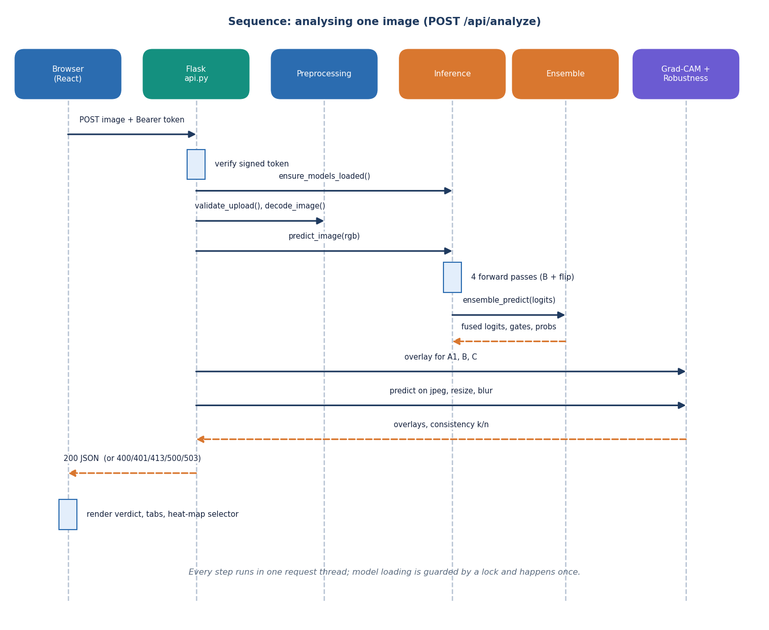
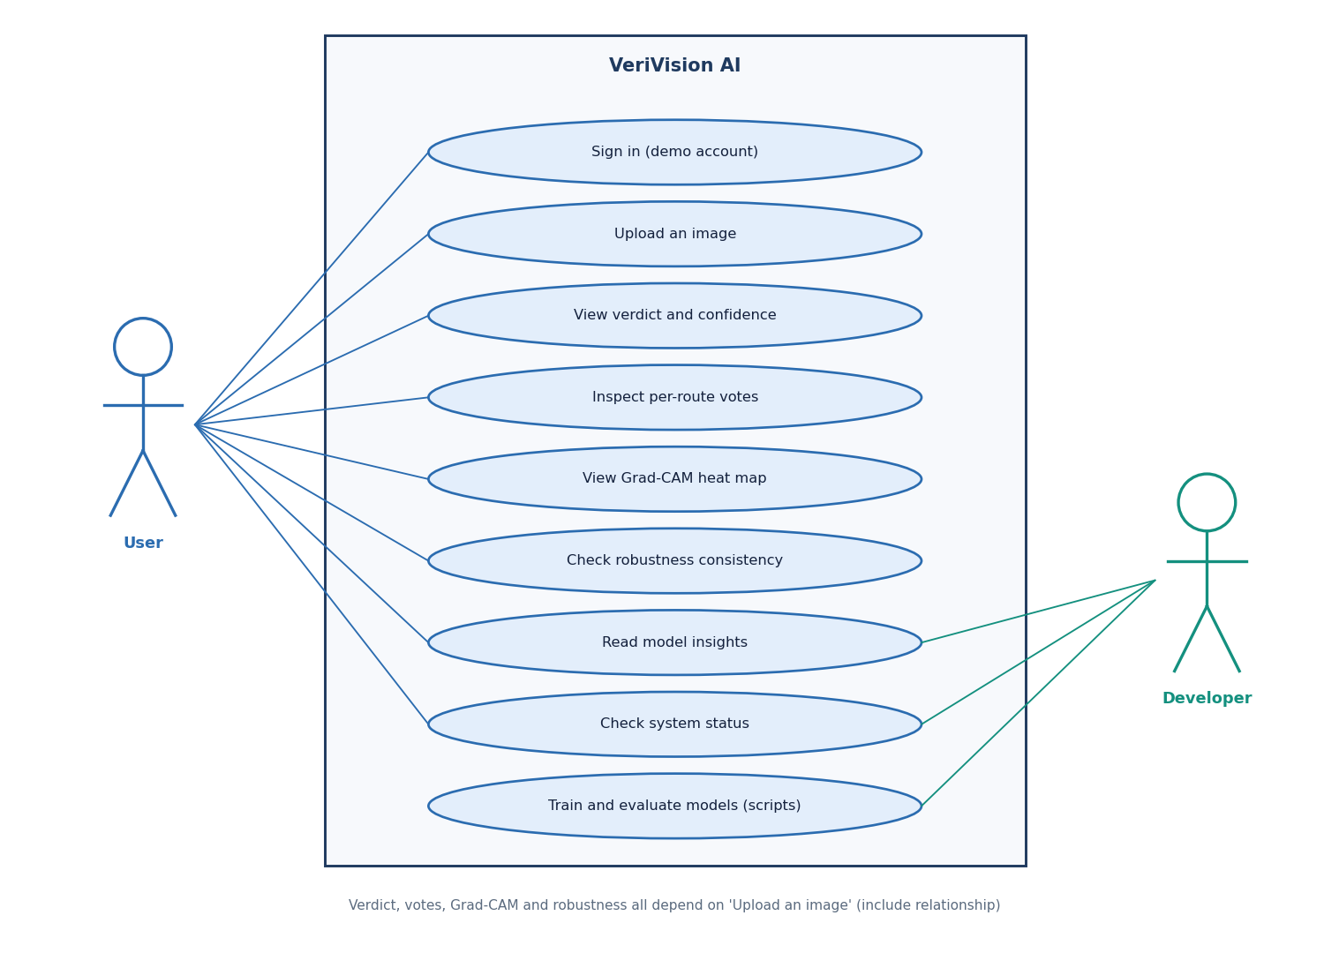
User – System Interaction
Dept. of CSE | Batch C14 | Final Review
14
Notes:
Sequence of one analysis request and the use cases of the user and the developer.

Slide 15
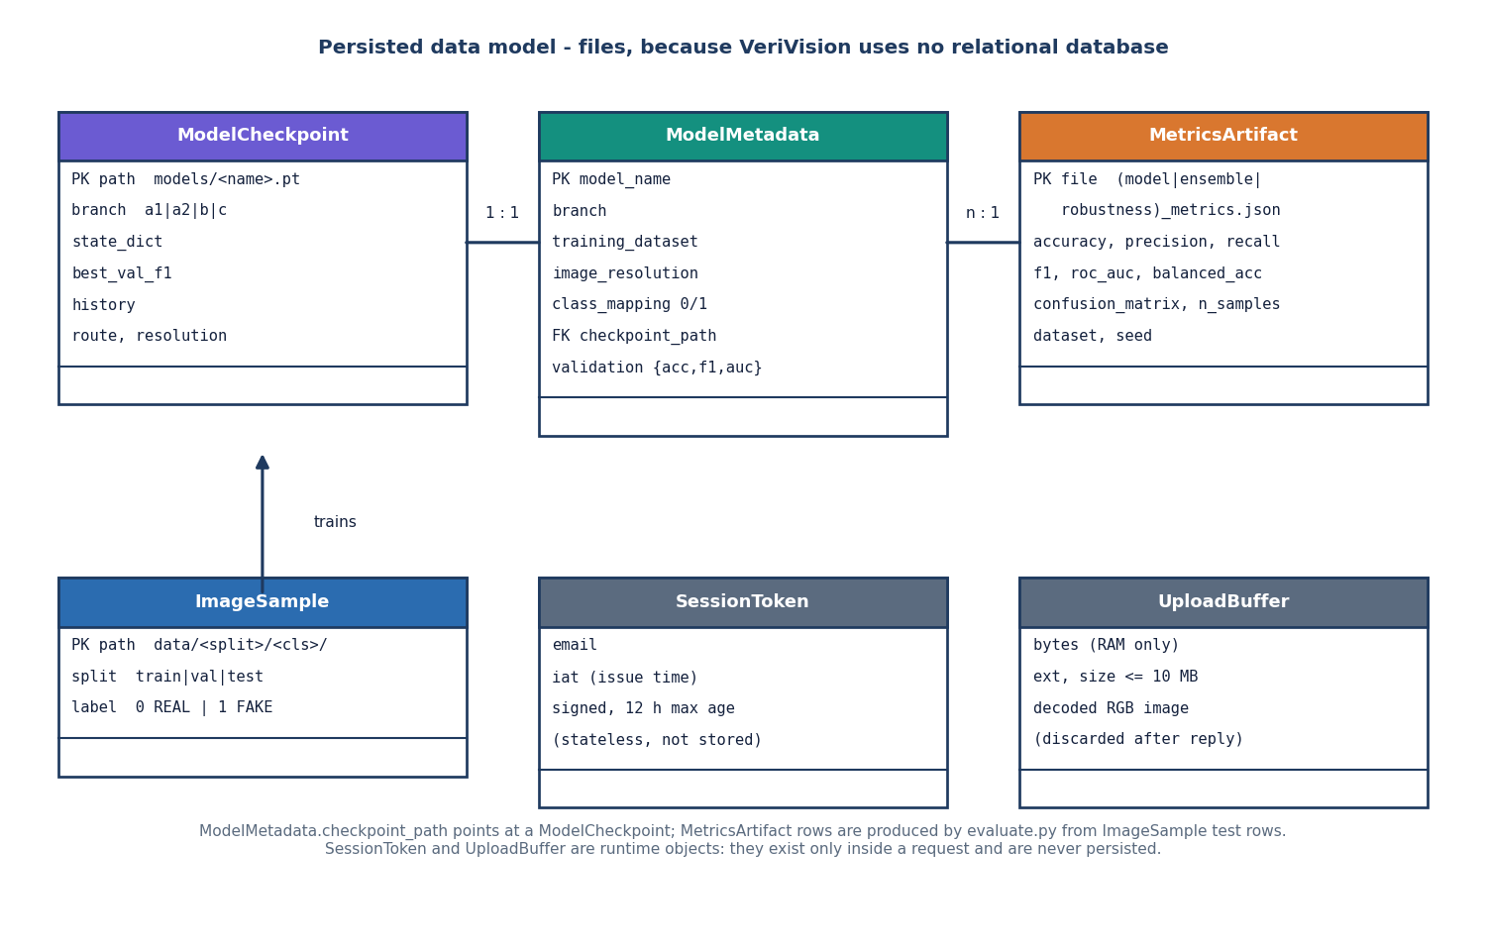
Data Model and Storage
Persisted item | Content
models/*.pt (4 files) | route checkpoints
model_metadata.json | per-route settings and paths
artifacts/metrics/ | evaluation JSON and PNG
data/ folders | train, val, test images
Session token | signed, 12 h, not stored
Upload | decoded in memory, discarded
There is no relational database: a request leaves no record, so nothing about an uploaded image is retained.
Dept. of CSE | Batch C14 | Final Review
15
Notes:
A file-based data model. The no-retention design is deliberate for privacy; it also means there is no analysis history.

Slide 16
Implementation Highlights
4
19 + 29
3
1.7 s
CNN routes fused
pytest tests + smoke checks
routes with Grad-CAM
median full analysis (CPU)
Upload validation: png / jpg / jpeg / webp, up to 10 MB, must decode as RGB and be at least 8 x 8; JSON errors 400, 401, 413, 500, 503.
API: /health, /api/config, /api/insights, /api/auth/login, /api/auth/me, /api/analyze (token), /api/predict (JSON verdict); original Jinja pages kept.
Models load once at start; a missing checkpoint gives 503 and the Status page names the missing files.
React + Vite interface with verdict card, vote table, heat-map tabs, robustness table, insights and a dark theme; one command (run.bat) starts both servers.
Dept. of CSE | Batch C14 | Final Review
16
Notes:
Highlights: validation, API surface, load-once models and the interface.

Slide 17
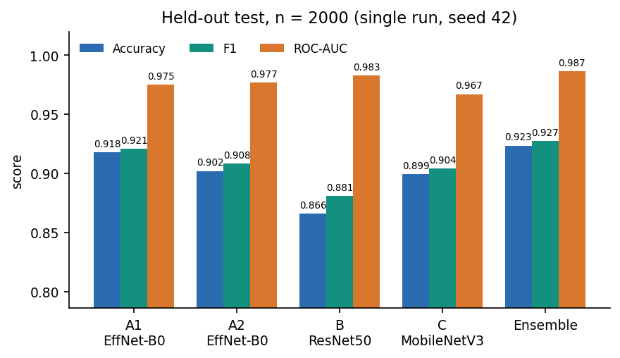
Results – Held-out Performance
92.35%
0.9275
0.9865
13.1%
ensemble accuracy, n = 2,000
ensemble F1
ensemble ROC-AUC
false-positive rate (real called AI)
Model | Acc. | F1 | AUC | 95% CI (acc.)
EfficientNet-B0 A1 | 0.9180 | 0.9208 | 0.9749 | 0.905-0.930
EfficientNet-B0 A2 | 0.9020 | 0.9083 | 0.9769 | 0.888-0.915
ResNet50 B | 0.8660 | 0.8809 | 0.9828 | 0.851-0.881
MobileNetV3-Large C | 0.8995 | 0.9041 | 0.9670 | 0.885-0.912
Ensemble (deployed) | 0.9235 | 0.9275 | 0.9865 | 0.911-0.934
Single run per route (seeds 42-45). The ensemble's accuracy edge over A1 (0.55 points) is inside the overlap of the two intervals, so it is not statistically distinguishable; its AUC is higher. The model leans toward AI-generated (false positives 13.1%, false negatives 2.2%).
Route B is the most biased toward fake (recall 0.991, precision 0.793).
Dept. of CSE | Batch C14 | Final Review
17
Notes:
Headline numbers with their protocol. Be explicit that the ensemble is not significantly better than EfficientNet A1 on accuracy, and that errors are mostly real images called AI-generated.

Slide 18
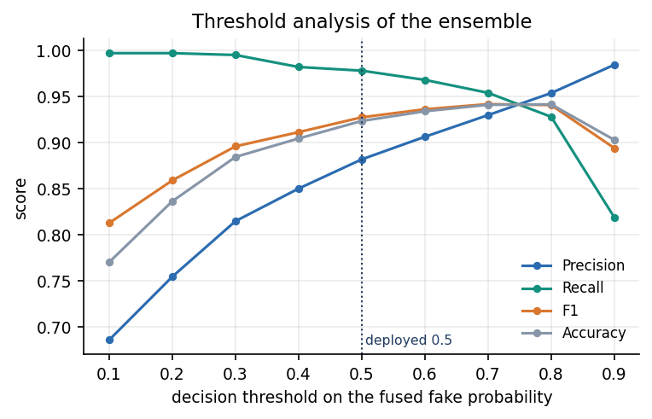
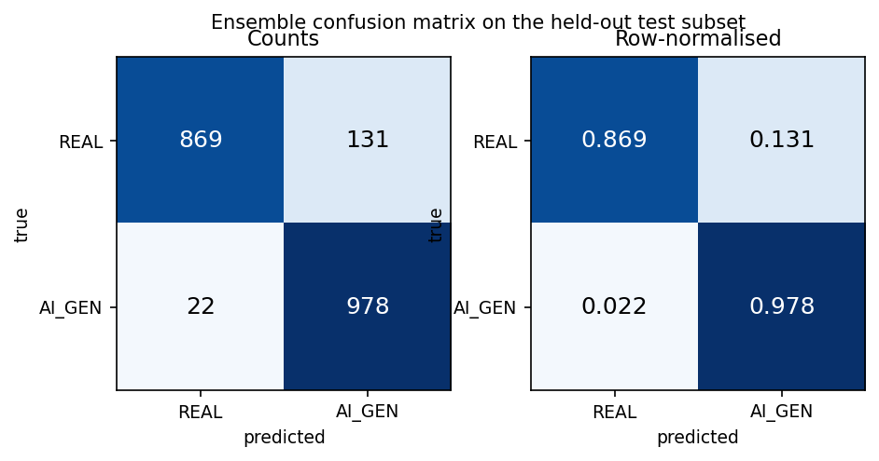
Confusion Matrix & Threshold Analysis
Of 2,000 test images 131 real ones were called AI-generated and 22 AI images were called real.
Mean |margin|: correct 3.56, wrong 1.09: errors sit near the boundary.
Threshold 0.5 (deployed): accuracy 92.35%, FPR 13.1%. At 0.7: 94.1% accuracy, FPR 7.2%; at 0.8: 94.2%, FPR 4.5%, recall 92.8%.
The threshold was swept on the test subset, so the gain is optimistic; a separate validation set would be needed to adopt 0.7.
Dept. of CSE | Batch C14 | Final Review
18
Notes:
Counts and rates of the ensemble, and the effect of the decision threshold. Raising it lowers false positives at some cost in recall, but the choice was made on the test set.

Slide 19
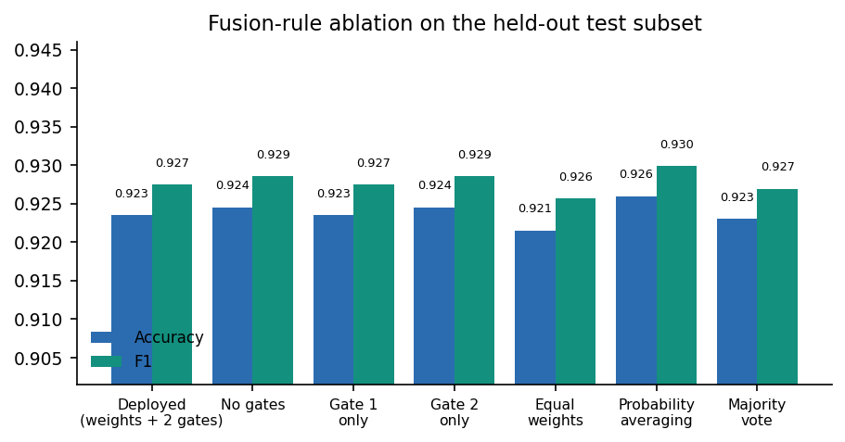
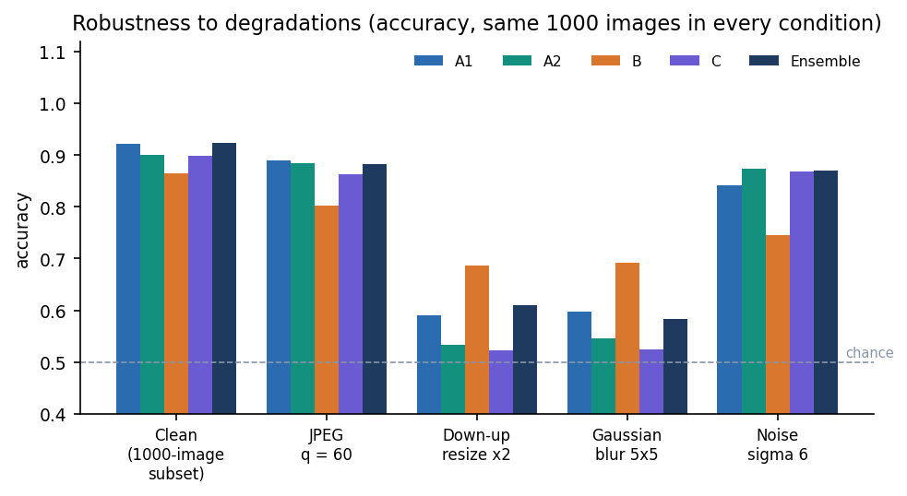
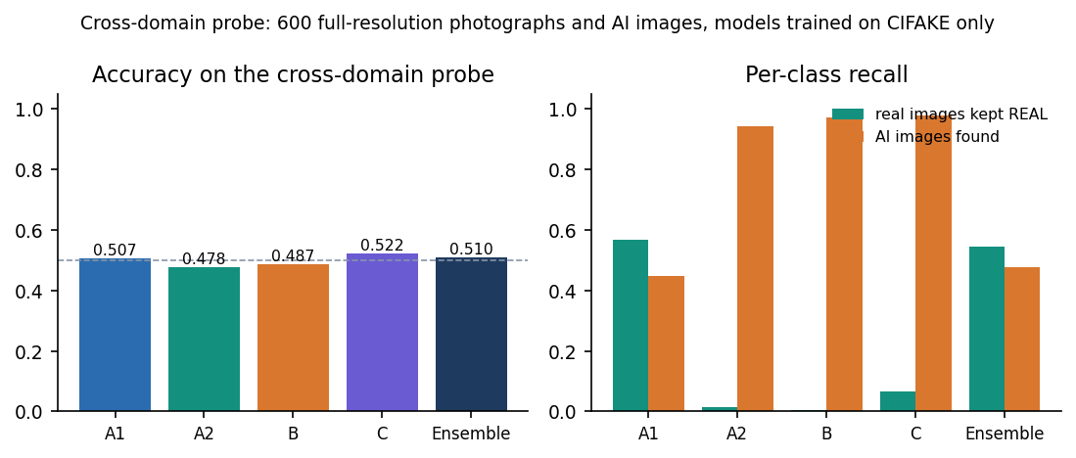
Ablation, Robustness and Cross-Domain
Same logits, seven fusion rules: all within 92.15% to 92.60% accuracy.
No-gate fusion 92.45%; the gates did not help.
Majority vote has a far lower AUC (0.938).
Clean 92.4%, JPEG q60 88.3%, noise 86.9%.
Resize round trip 61.0%, blur 58.3%: the cue is lost on 32 px images.
Distortion-hardened A2 was not more robust than A1.
600 full-resolution images: ensemble 51.0%, AUC 0.499: chance level.
A2, B and C call almost everything AI-generated.
Objective 4 measured and not achieved.
Dept. of CSE | Batch C14 | Final Review
19
Notes:
Three honest findings: the gating rules are neutral, resizing and blur destroy the cue, and the CIFAKE-trained models do not transfer to full-resolution images from other sources.

Slide 20
Performance & Testing
16 ms
0.25 s
1.70 s
1.98 s
GET /health
/api/predict, four routes + fusion
/api/analyze (32 px image)
/api/analyze (1024 px image)
Test layer | What it covers | Result
Unit and API (pytest) | preprocessing, weights, fusion, both gates, response structure, health, bad upload, login, config, insights, oversize | 19 of 19 passed in 35 s
Smoke test | running API and web proxy: login, fake and real analysis, votes, Grad-CAM, robustness, error cases, classic pages | 29 of 29 checks
Browser walk | every screen captured in Chrome (capture_screens.py) | no console errors, no failed requests
Latency | 8 runs each, API on 127.0.0.1, idle machine | medians as above
Not done | explainability / robustness unit tests, load, GPU, adversarial attacks, user study | stated gap
Intel Core i5-12500 (6 cores / 12 threads), 15.7 GB RAM, no GPU. Offline batched inference: 283 ms per image for all four routes.
Dept. of CSE | Batch C14 | Final Review
20
Notes:
A full analysis, including three Grad-CAM overlays and three robustness variants, takes under two seconds on this CPU. Tests pass; the untested areas are listed.

Slide 21
Comparison with Base Paper (context only)
Aspect | Base paper: CTrue [1] | This project: VeriVision AI
Task and data | Face deepfakes, FaceForensics++ and DFDC video frames | General real-vs-AI images, CIFAKE 32 px subset (one generator)
Training | One-class, 720 pristine videos plus pseudo-fakes, 200 epochs | Supervised, 6,000 images, 3-5 epochs per route
Model | EfficientNet-B4, 19.3 M parameters | Four CNN routes (EfficientNet-B0 x2, ResNet50, MobileNetV3-L) fused
Compute | Two V100 GPUs, about 16 h | Intel i5-12500 CPU, 13-53 min per route (upper bounds)
In-domain AUC | 98.9% (FF++) | 98.65% (CIFAKE test)
Cross-dataset AUC | 77.0% (DFDC, lambda = 1 ablation) | 49.9% (600 full-resolution images, another source)
Output | Detection score | Verdict, votes, Grad-CAM heat maps, robustness consistency
Task, data, training and metric emphasis all differ; only AUC is like-for-like, so the numbers are context, not a ranking, and no superiority is claimed. HEDGE [2], our design reference, reports 98.3% balanced accuracy on five benchmarks with 8 H800 GPUs.
Dept. of CSE | Batch C14 | Final Review
21
Notes:
State plainly that 98.65% AUC on 32 px CIFAKE cannot be set against 98.9% on FF++ faces. Cross-dataset, the paper reports 77.0% on DFDC and our cross-domain probe is at chance.

Slide 22
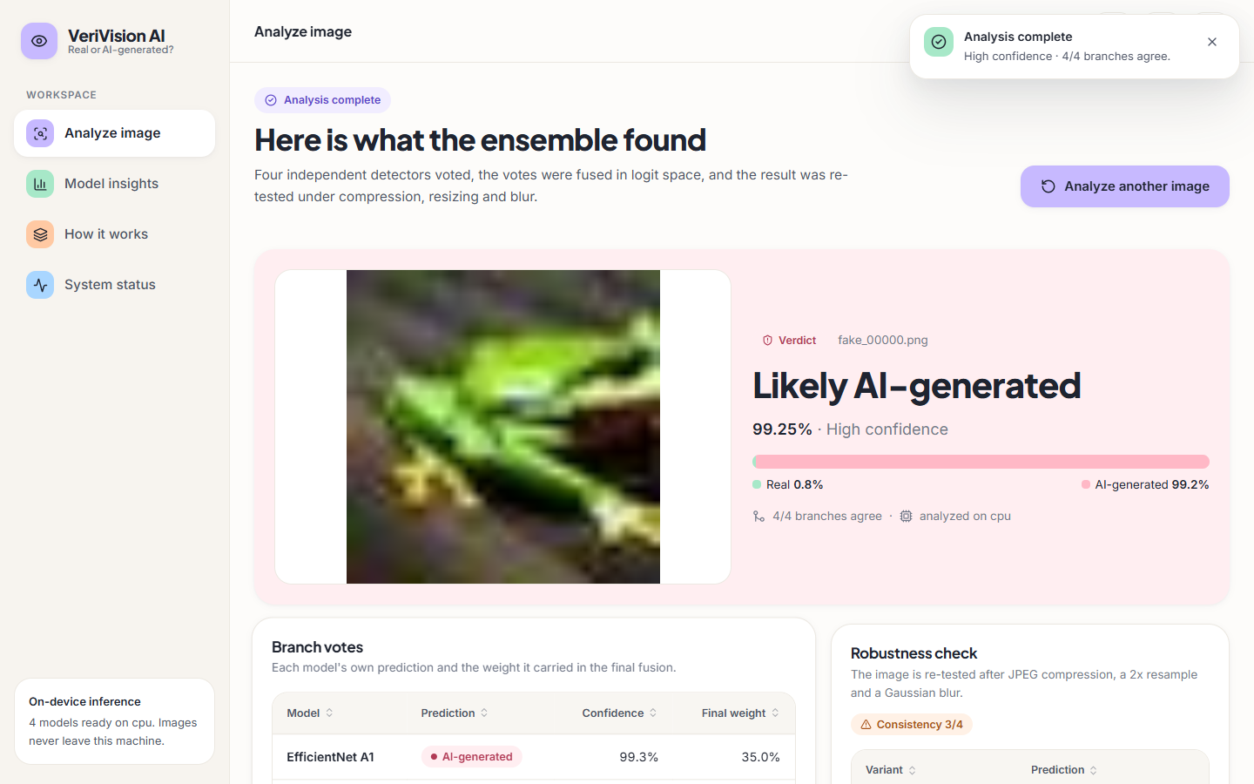
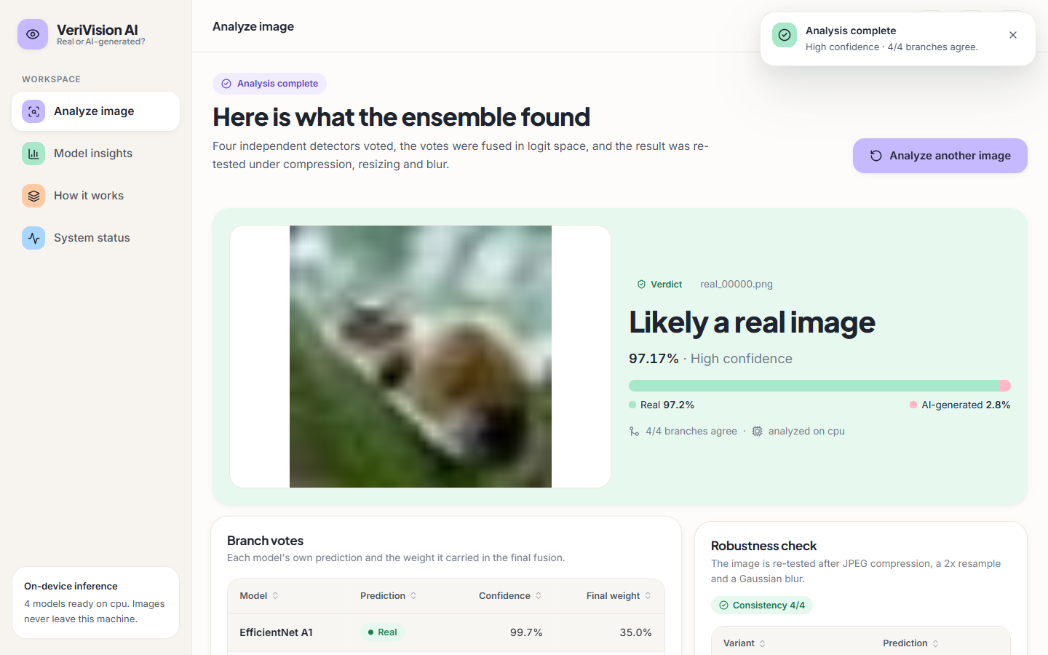
Output – Verdict Screens
A 32 px AI-generated test image: 'Likely AI-generated', 99.25% (High confidence), 4 of 4 routes agree.
A real CIFAR-10 test image: 'Likely a real image', 97.17% (High confidence), 4 of 4 routes agree.
Dept. of CSE | Batch C14 | Final Review
22
Notes:
Real screenshots from the running application with the CIFAKE-trained models.

Slide 23
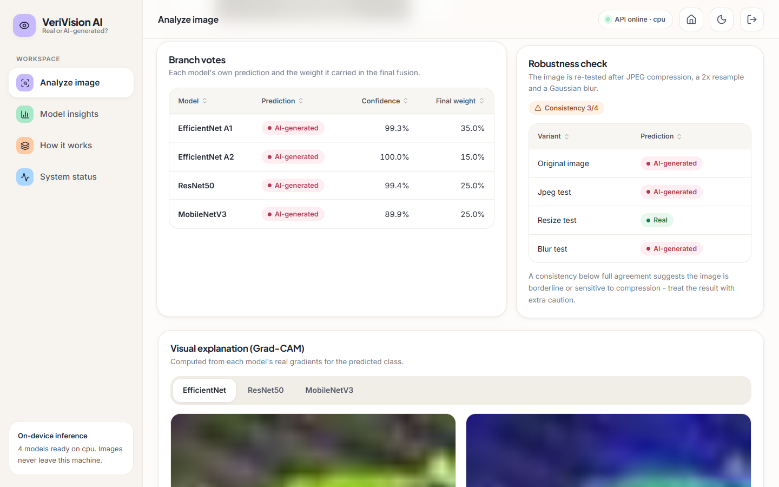
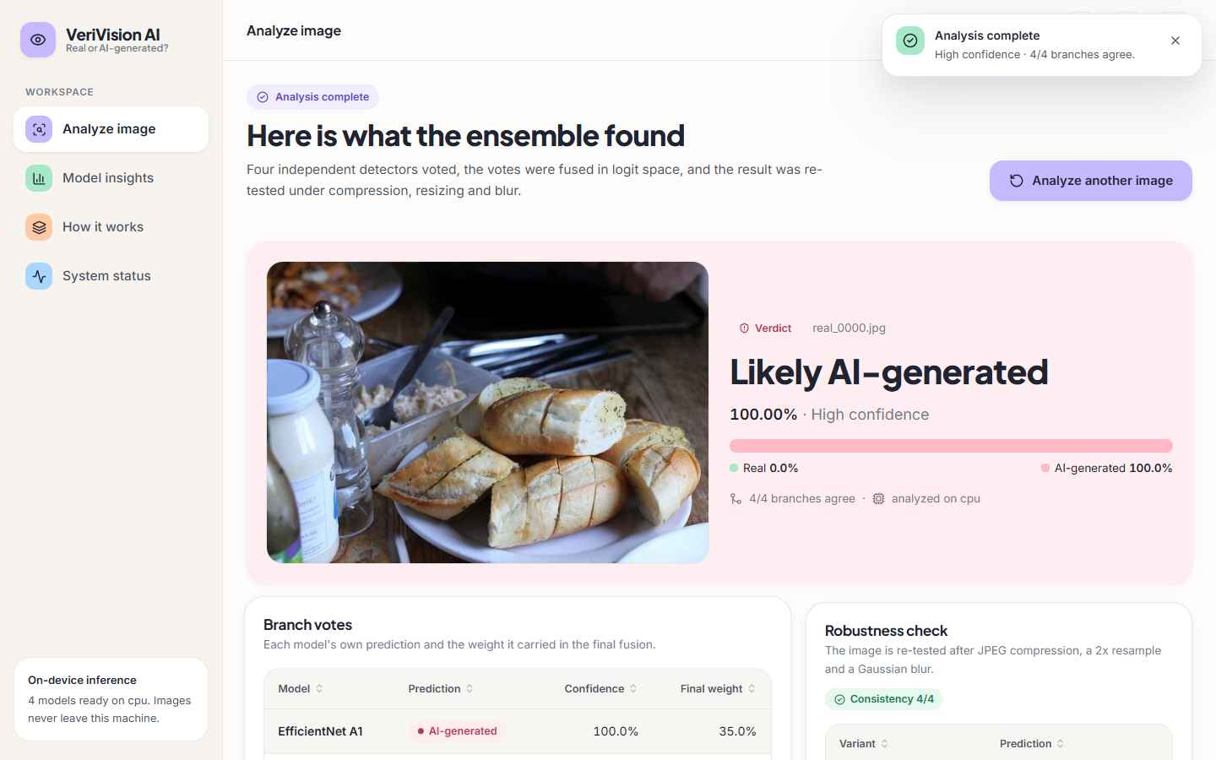
Output – Votes, Robustness and a Failure Case
Per-route votes with fusion weights, and the robustness table: the resize variant flips to Real, so consistency is 3/4 and the UI advises caution.
Failure case: a real full-resolution photograph (food on a plate) is called AI-generated with 100% confidence. This image comes from the cross-domain probe measured on slide 19.
Dept. of CSE | Batch C14 | Final Review
23
Notes:
The right-hand screen is deliberately included: the CIFAKE-trained models mislabel real full-resolution photographs, so a High-confidence label is not evidence outside the training domain.

Slide 24
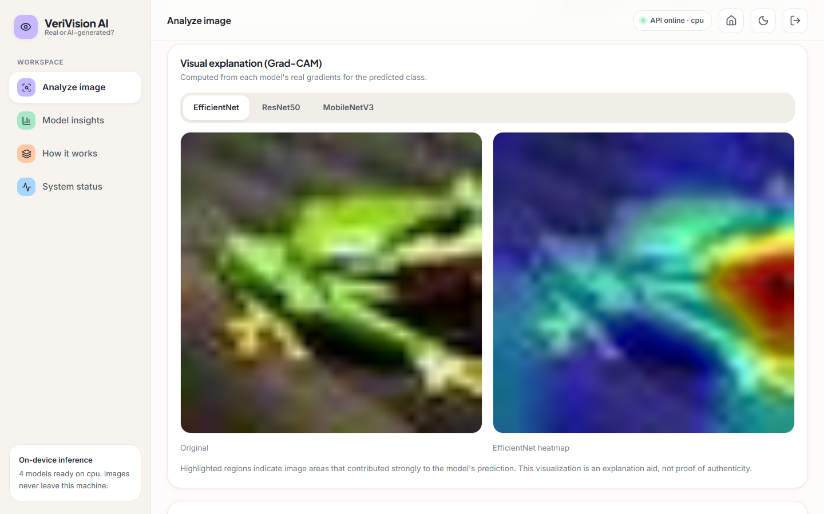
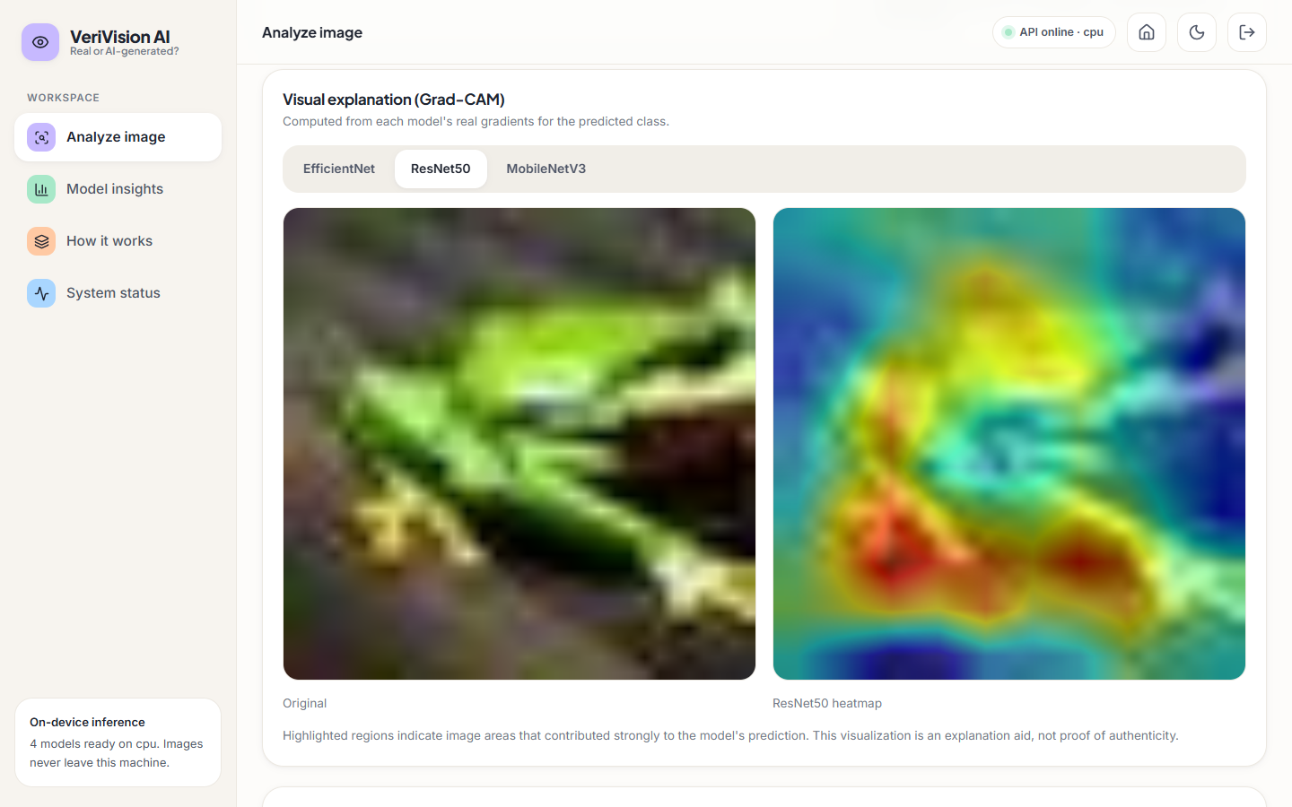
Output – Grad-CAM Explanations
EfficientNet tab: original image and Grad-CAM heat map for the predicted class; the strongest response is on the right edge of the frog.
ResNet50 tab for the same image: a broader response over the lower body. Heat maps were judged by eye only; no faithfulness test was run.
Dept. of CSE | Batch C14 | Final Review
24
Notes:
Different routes attend to different regions of the same image. The explanation is an aid, and the screen says so.

Slide 25
Conclusion
Delivered: a working local application from image upload to verdict, per-route votes, Grad-CAM heat maps and a robustness check; 19 of 19 tests and 29 of 29 smoke checks pass.
Measured: ensemble 92.35% accuracy, F1 0.9275, AUC 0.9865 on 2,000 held-out CIFAKE images; resize and blur cut it to about 58-61%; cross-domain 51.0%.
Objectives: 2, 3, 5 and 6 met (5 judged qualitatively); 1 partly met (one generator, 32 px subset); 4 measured and not achieved.
Findings: the ensemble is not significantly better than its best route; the gates did not help; the models lean toward AI-generated.
Limits: single seed, 6% of the training data, 3-5 epochs, no GPU run, no user study. The verdict is decision support, not proof.
Dept. of CSE | Batch C14 | Final Review
25
Notes:
Be explicit about which objectives were met and which were not, and what was never measured.

Slide 26
Future Scope
Train on the full 100,000 CIFAKE images and on a mix of generators and resolutions; repeat with several seeds to put intervals on the ranking of routes.
Test cross-generator transfer properly with per-generator breakdowns, including newer diffusion models and GAN images.
Add foundation-model or frequency features, as in HEDGE, and tune the gates and the decision threshold on a validation set.
Add a quantitative faithfulness test for Grad-CAM (deletion and insertion curves) and a user study of the explanations.
Add GPU timing, load and adversarial tests, and a hosted deployment with real authentication.
Dept. of CSE | Batch C14 | Final Review
26
Notes:
Concrete next steps, ordered by value.

Slide 27
References
[1] N. Larue, V. Struc, P. Peer and N.-S. Vu, "Learning the manifold of authenticity: hybrid-curvature representation learning for generalizable deepfake detection," IEEE Access, vol. 14, pp. 101988-102001, 2026, doi: 10.1109/ACCESS.2026.3702429.
[2] F. Wu, D. Lu, M. Yao, X. Xu and F. Guo, "HEDGE: Heterogeneous ensemble for detection of AI-generated images in the wild," arXiv:2604.03555, Apr. 2026.
[3] N. Tasnim, K. Uddin and K. M. Malik, "AI-generated image detection: an empirical study and future research directions," arXiv:2511.02791, Nov. 2025.
[8] J. J. Bird and A. Lotfi, "CIFAKE: image classification and explainable identification of AI-generated synthetic images," IEEE Access, vol. 12, pp. 15642-15650, 2024 (arXiv:2303.14126).
[10] R. Rombach, A. Blattmann, D. Lorenz, P. Esser and B. Ommer, "High-resolution image synthesis with latent diffusion models," in Proc. IEEE/CVF Conf. Comput. Vis. Pattern Recognit. (CVPR), 2022, pp. 10684-10695.
[12] S.-Y. Wang, O. Wang, R. Zhang, A. Owens and A. A. Efros, "CNN-generated images are surprisingly easy to spot... for now," in Proc. IEEE/CVF CVPR, 2020, pp. 8695-8704.
[13] U. Ojha, Y. Li and Y. J. Lee, "Towards universal fake image detectors that generalize across generative models," in Proc. IEEE/CVF CVPR, 2023, pp. 24480-24489.
[19] M. Tan and Q. Le, "EfficientNet: rethinking model scaling for convolutional neural networks," in Proc. 36th Int. Conf. Mach. Learn. (ICML), PMLR vol. 97, 2019, pp. 6105-6114.
[20] K. He, X. Zhang, S. Ren and J. Sun, "Deep residual learning for image recognition," in Proc. IEEE Conf. Comput. Vis. Pattern Recognit. (CVPR), 2016, pp. 770-778.
[21] A. Howard et al., "Searching for MobileNetV3," in Proc. IEEE/CVF ICCV, 2019, pp. 1314-1324.
[22] T.-Y. Lin, P. Goyal, R. Girshick, K. He and P. Dollar, "Focal loss for dense object detection," in Proc. IEEE ICCV, 2017, pp. 2980-2988.
[26] R. R. Selvaraju, M. Cogswell, A. Das, R. Vedantam, D. Parikh and D. Batra, "Grad-CAM: visual explanations from deep networks via gradient-based localization," in Proc. IEEE ICCV, 2017, pp. 618-626.
Dept. of CSE | Batch C14 | Final Review
27
Notes:
Selected references; the complete numbered list is in the report.

Slide 28
THANK YOU
Questions & Suggestions
Dept. of CSE | Batch C14 | Final Review
28
Notes:
Invite questions.

