Slide 1
Credit Card Fraud Detection Using Machine Learning
REVIEW 2 · DESIGN, METHODOLOGY AND PROGRESS
Design, methodology and progress: three restricted-Boltzmann-machine classifiers behind a real-time screening interface
Presented by
Under the guidance of
ARELLI PRAVEEN KUMAR 23K91A0513
BANOTHU AJAY 23K91A0529
D CHANDRIKA 23K91A0557
BAIRAGONI VIJAY 23K91A0525
KOTESHWAR RAO, [DESIGNATION]
Department of Computer Science and Engineering
TKR College of Engineering & Technology · Batch A4 (CSE-A) · [ACADEMIC YEAR]
Notes:
This review shows how SecurePay AI is designed and built: the data and models, what is implemented, the first measured results and what is still open.

Slide 2
Contents
01
02
03
Recap and architecture
Methodology and dataset
Preprocessing and model
04
05
06
Training and decision logic
Data flow, database and UML
Technology stack
07
08
09
Progress and preliminary results
Output screens and testing
Challenges and next steps
Notes:
Agenda for the design and progress review.

Slide 3
Recap: problem and proposed system
!
Problem
i
Proposed system
B
Base paper link
Fraud is rare, so a classifier can look accurate while catching almost none of it. Rule systems are static and raise false alarms, and missing a fraud costs far more than reviewing a genuine payment.
SecurePay AI: three Gaussian RBM classifiers trained by PCD, simulated annealing and a quantum-inspired sampler, averaged into one fraud probability with approve, challenge and decline bands.
Neto et al. train the same model on 145 M real transactions and a D-Wave quantum annealer [1]. We use a synthetic 39,000-row set and a classical simulation, so results are not comparable.
Notes:
One-minute recap of Review 1: the imbalance problem, our system, and how the base paper relates: same model family, different data and no quantum hardware.

Slide 4
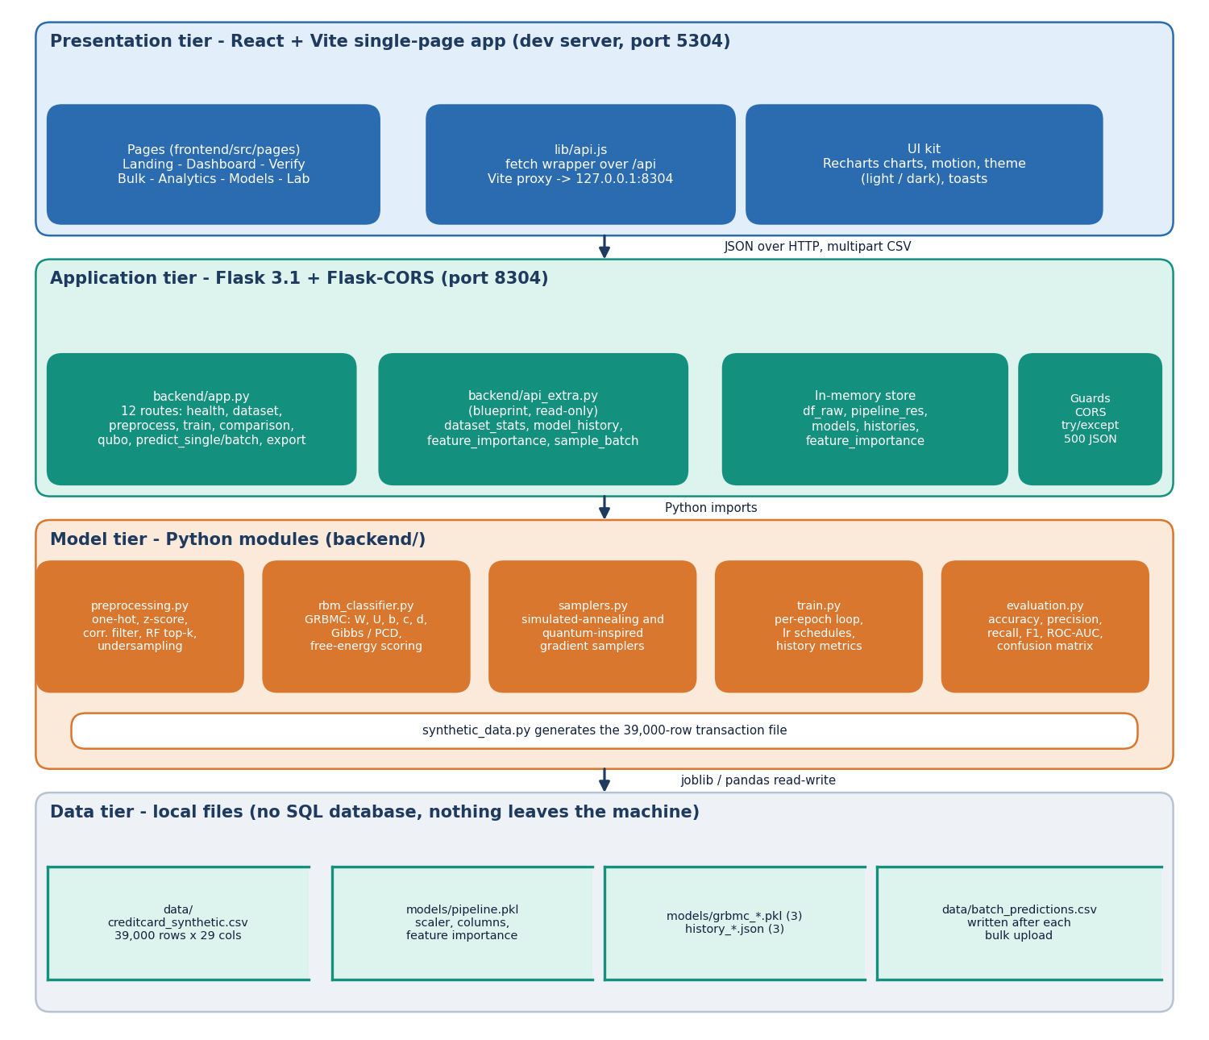
System architecture
Four tiers
Presentation: React and Vite single-page app (port 5304), 7 pages.
Application: Flask 3.1 API (port 8304), 16 routes; 12 in app.py and 4 read-only ones in api_extra.py.
Model tier: preprocessing, the GRBMC class, two samplers, the training loop and the metrics module.
Data tier: a CSV, one pipeline pickle, three model pickles and history files. There is no SQL database and nothing leaves the machine.
Notes:
All routes live in backend/app.py and backend/api_extra.py. Storage is local files; an in-memory dictionary holds the loaded data, pipeline and models.

Slide 5
Methodology: end-to-end workflow
Synthetic transactions
One-hot + z-score
Undersample + top-18
80 / 20 split
Train 3 RBMs
Average + bands
Flask + React
One data path
Same recipe as the paper
Measured, not typed
The Lab page, the seed script and the API call the same preprocessing and training functions, so the application and the measurements use the same code.
Z-scored Gaussian visible units, one-hot categories, correlation filter, importance filter, manual undersampling to 50/50 and an 80/20 split, as in the base paper.
scripts/run_experiments.py writes every reported number to experiments/metrics.json; figures and documents read from it.
Notes:
Three design principles: one data path, the paper's preprocessing recipe, and numbers that come from a script.

Slide 6
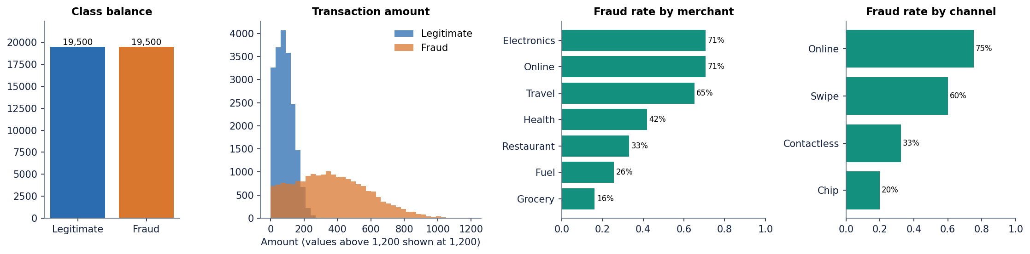
Dataset
39,000
19,500 / 19,500
6,400 / 1,600
1 %
synthetic transactions, 29 columns
fraud / legitimate (50 / 50)
train / test rows used by the app
fraud variant used in experiments
Generated by backend/synthetic_data.py (seed 42) to imitate the base paper's balanced 39 k set. It is not the Stone data.
Fraud is built to look different: mean amount 368 against 85, more online and card-not-present payments, shifts in V3, V7, V10, V14 and V17.
The planted signal makes scores higher than a real stream would give: a pipeline check, not a forecast. A 1 % fraud variant (390 fraud rows) is generated for the imbalance study.
Notes:
Be frank: the data is synthetic and the fraud pattern is planted by the generator. Published figures on real data would be lower and are not claimed.

Slide 7
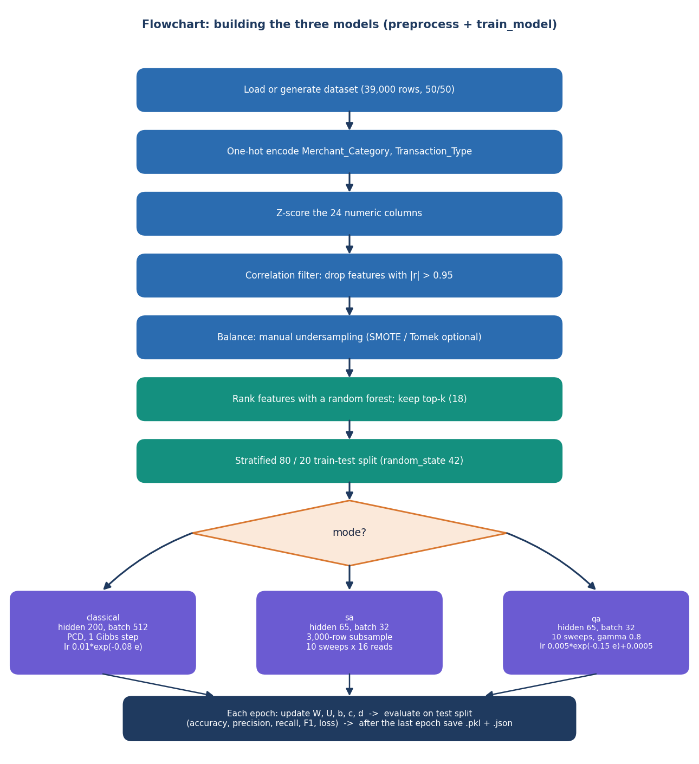
Preprocessing
1 One-hot encode Merchant_Category (7 values) and Transaction_Type (4)
2 Z-score the 24 numeric columns (Amount, Time, V1 to V22)
3 Correlation filter at 0.95: dropped none
4 Manual undersampling to equal class counts (SMOTE and Tomek links are options)
5 Random-forest importance, keep the top 18 features
6 Stratified 80 / 20 split: 6,400 train and 1,600 test rows
Known weakness: undersampling and feature selection happen before the split, so the test rows influenced which features were kept. Effect not measured.
Notes:
The recipe follows the base paper. The one flaw we found: balancing and feature selection run before the split. With synthetic data the effect is probably small, but it is not measured, so it is listed as a limitation.

Slide 8
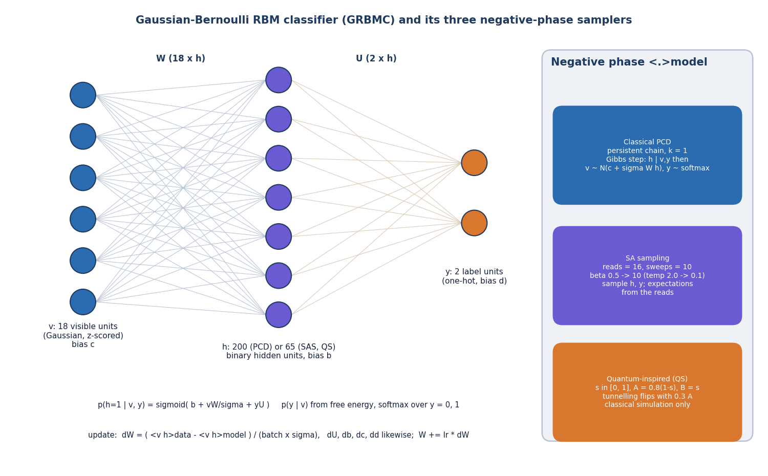
Model: Gaussian RBM classifier
Trainer | Hidden | Batch | Parameters
PCD (classical) | 200 | 512 | 4,220
SAS (simulated annealing) | 65 | 32 | 1,385
QS (quantum-inspired) | 65 | 32 | 1,385
Visible layer: 18 z-scored features. Label layer: 2 units. Hidden units are binary.
Prediction compares the free energy of label 0 and label 1 and turns it into a probability.
The three differ only in how the negative phase is sampled.
numpy
CPU
no deep-learning framework
seconds per run
Notes:
Same architecture and hidden sizes as the base paper (200 for classical, 65 for the annealing variants). Parameter counts are W, U and the three bias vectors. The code is a simplified numpy version of the paper's setup.

Slide 9
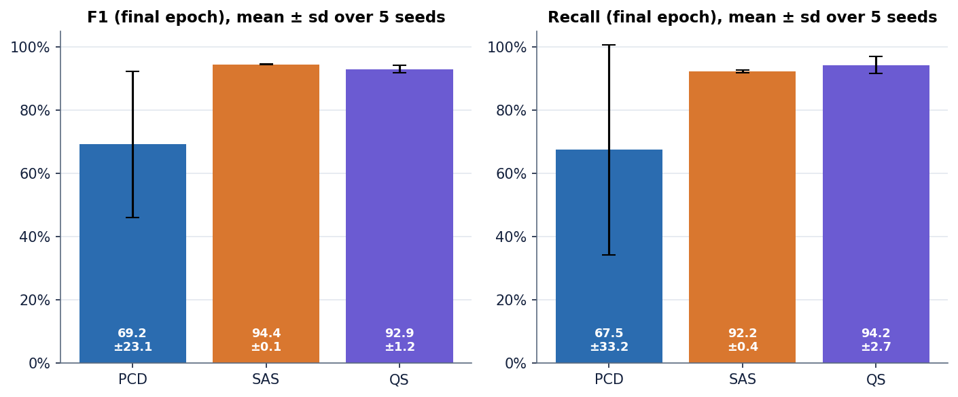
Training configuration
Setting | Value (from backend/train.py and samplers.py)
Epochs, seed | 20 epochs per run in the saved histories; model seed 42; weights N(0, 0.01), sigma = 1
PCD | Persistent chain, one Gibbs step, batch 512, learning rate 0.01 x exp(-0.08 e)
SAS | 10 sweeps x 16 reads, temperature 2.0 to 0.1, batch 32, 3,000 rows per epoch, same learning-rate decay
QS | Transverse-field flip with probability 0.3 x A(s), gamma 0.8, 10 sweeps x 16 reads, rate 0.005 x exp(-0.15 e) + 0.0005
Hardware | Windows 11, Intel i5-12500, CPU only; training takes 4-5 s per trainer
Five retrainings: PCD F1 69.2 +/- 23.1 (unstable), SAS 94.4 +/- 0.1, QS 92.9 +/- 1.2. Metrics are the final epoch, not the best epoch, because best-epoch selection on the test split is optimistic.
Notes:
Settings come from the code. The seed study retrains in memory only and leaves the shipped models untouched. PCD's spread shows one run is not a reliable estimate.

Slide 10
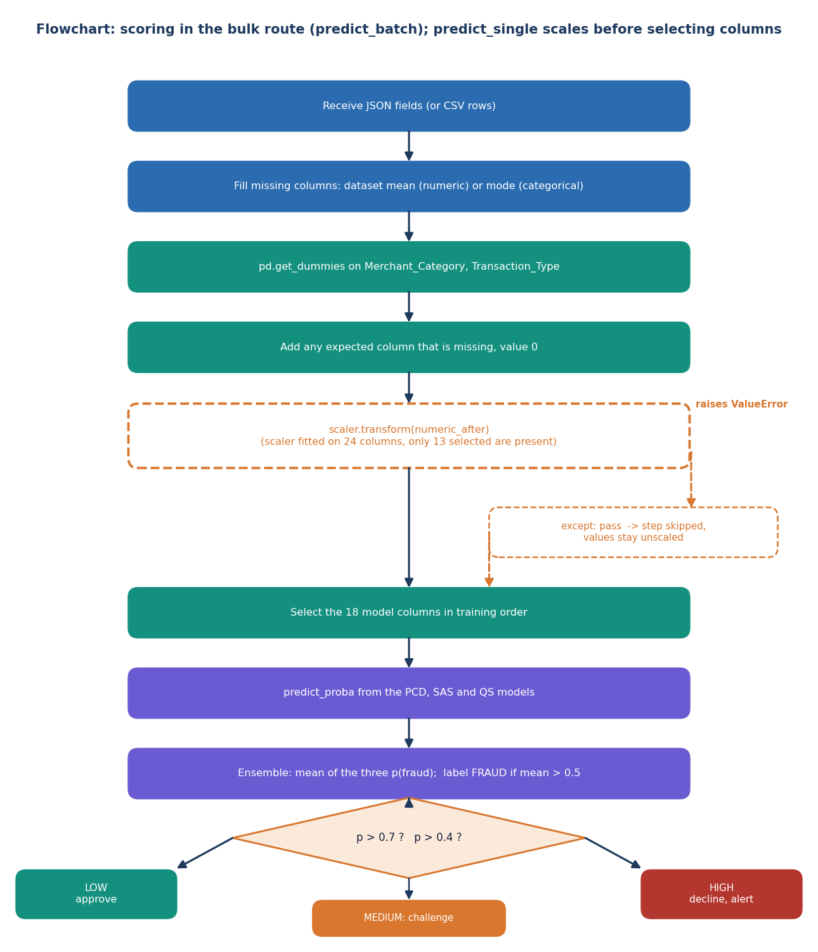
Decision logic: from score to action
Probability. The mean of the three models' fraud probabilities.
Label. FRAUD above 0.5, otherwise LEGITIMATE.
Action bands. Below 40 % approve, 40 to 70 % challenge with 3-D Secure, above 70 % decline and alert.
Threshold matters. On the test split the ensemble gives precision 73% and recall 100% at 0.4, 97% and 93% at 0.5, 100% and 67% at 0.6. The 0.5 cut was never tuned on validation data.
Defect. The scaling step in the batch route is skipped when it raises an exception (dashed box in the flowchart).
Notes:
The decision logic is deliberately simple. We report the threshold trade-off because a fraud team would choose the cut by cost, not by default. The skipped scaling step is explained in the results review.

Slide 11
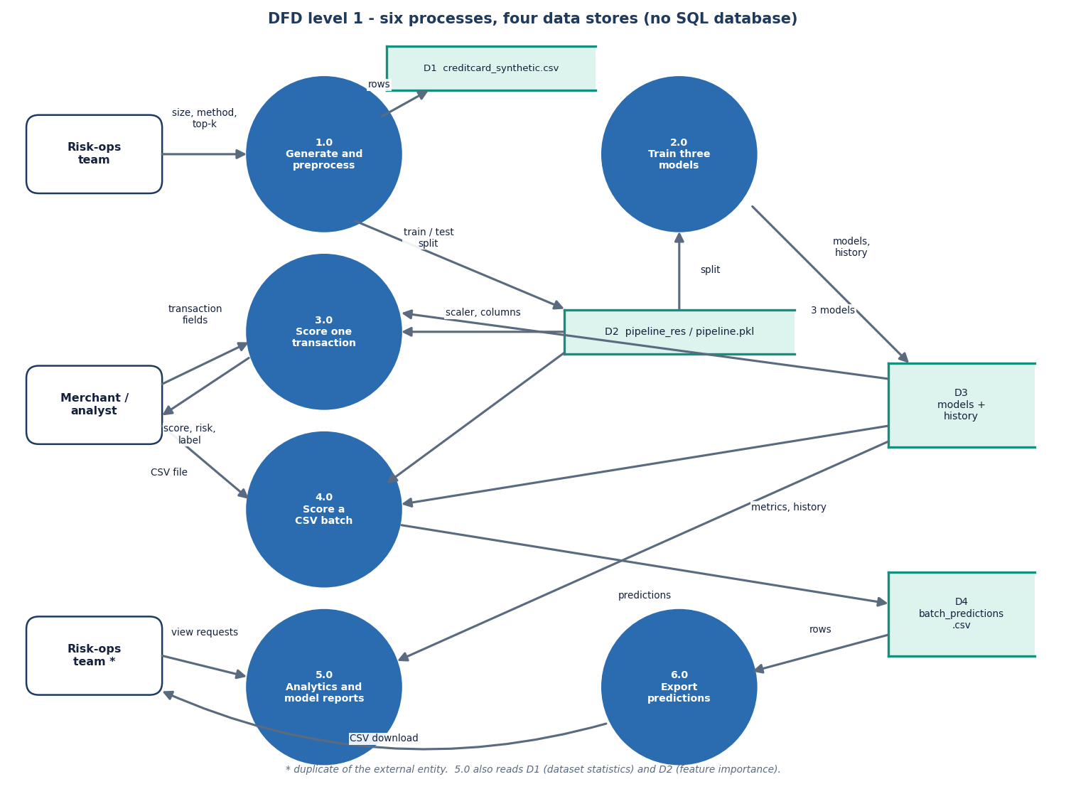
Data flow and modules
Module | Role | Lines
app.py | routes, store, ensemble | 502
api_extra.py | read-only chart data | 110
preprocessing.py | encode, scale, filter, balance | 157
rbm_classifier.py | GRBMC, PCD, free energy | 197
samplers.py | SA and QS gradients | 150
train.py | epoch loop, schedules | 126
evaluation.py | metrics | 20
synthetic_data.py | data generator | 76
Backend 1,338 lines; React front end 3,574 lines.
Notes:
Level-1 data flow: a transaction or CSV is encoded and scaled, scored by the three models, averaged and returned. Training reads the same dataset file and writes model and history files.

Slide 12
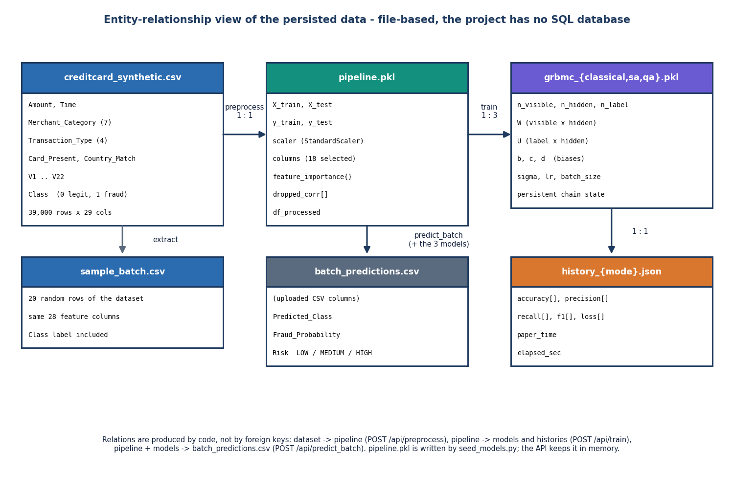
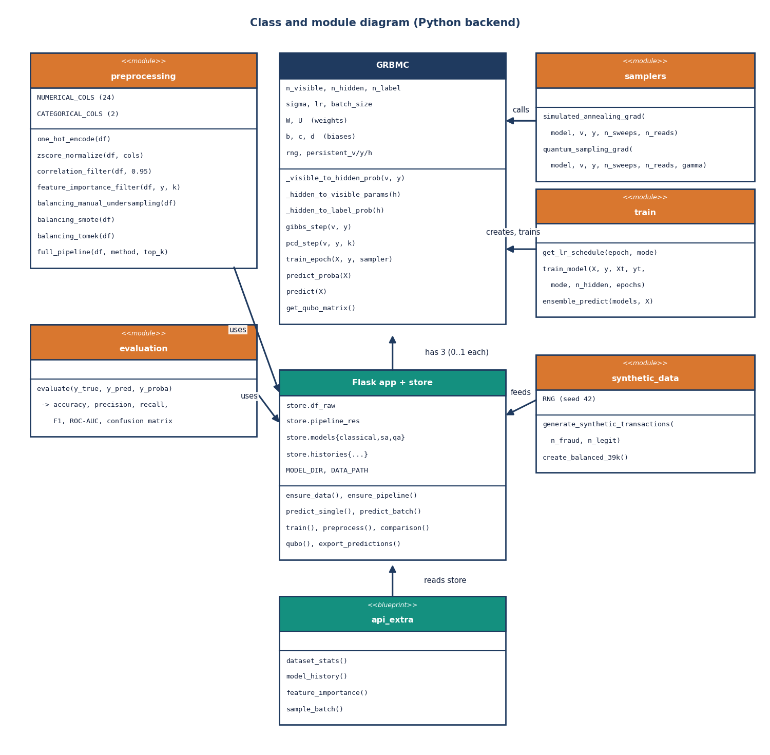
Persistence design and UML
No SQL database. State is a CSV, one pipeline pickle (scaler, columns, importances), three model pickles and three history files; a dictionary in app.py holds them while the server runs.
Notes:
Honest point: persistence is file based, so the ER-style figure shows files and their relations. The class diagram shows GRBMC, the samplers and the Flask store.

Slide 13
Technology stack
Layer | Technology
Backend | Python 3.11.9, Flask 3.1.0, Flask-Cors 5.0.0 (development server)
Data and ML | NumPy 1.26.4 (the RBM itself), pandas 2.2.1, scikit-learn 1.5.0 (scaler, forest, metrics), imbalanced-learn 0.12.4, joblib
Experiments | XGBoost 2.0.3 and scikit-learn baselines, Matplotlib 3.9.0 (figures)
Front end | React 19, Vite 8, React Router 7, Recharts 3, Framer Motion, GSAP, Lenis (port 5304)
Persistence | CSV, joblib pickles and JSON files on local disk
Testing | scripts/smoke_test.py (20 checks, standard library only); Playwright script for screenshots
Run | run.bat or run.ps1: installs requirements, starts Flask on 8304 and Vite on 5304
Notes:
Everything is open source and runs on a CPU. The RBM is plain numpy so every step is visible; scikit-learn is used for preprocessing and metrics.

Slide 14
Implementation progress
Component | Status | Evidence
Data generator and preprocessing pipeline | Done | 39,000 rows; 18 features; 6,400 / 1,600 split
GRBMC with PCD, SA and QS trainers | Done | saved F1 94% (SAS), 94% (QS); PCD needs a tuned threshold
Flask API (16 routes) | Done | 20 of 20 smoke checks pass; median 17 ms per check
React interface (7 pages, light and dark) | Done | 22 real screenshots incl. mobile and offline states
Baselines and imbalance study | Done (scripts) | LR, RF, XGBoost; SMOTE, class weights, undersampling at 1 % fraud
Feature scaling in the batch route | Defect found | accuracy 50% as served, 95% when scaled
Real transaction data, quantum hardware | Not done | synthetic data; classical simulation only
Authentication, production server | Not done | no login; Flask development server
Notes:
State of the code base. The honest gaps: no real data, no quantum hardware, no authentication, and a scaling defect in the batch route found during the code review.

Slide 15
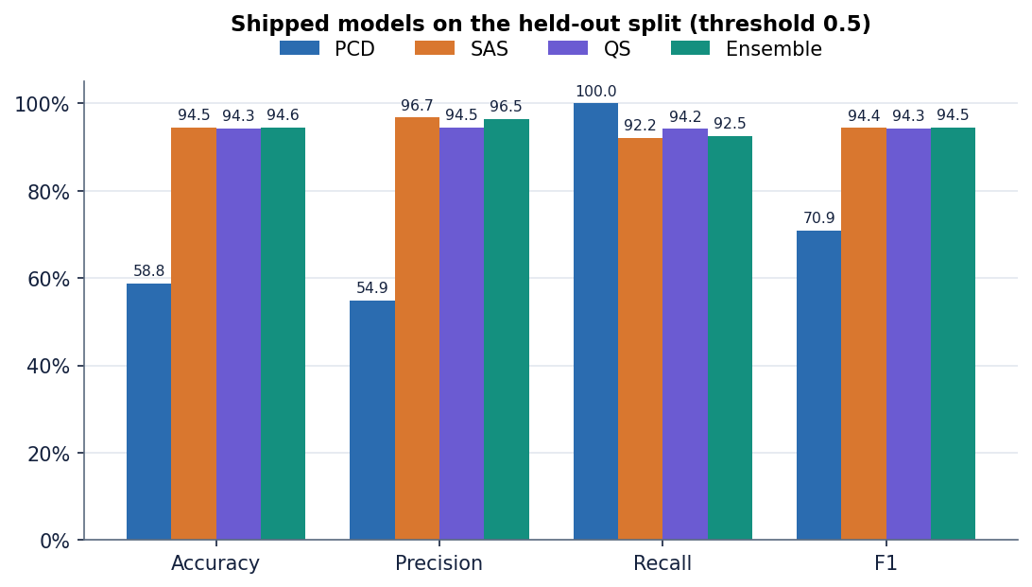
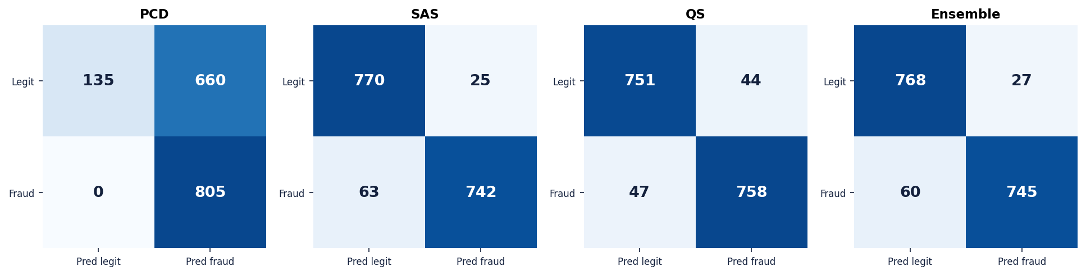
Preliminary results
94.5%
94% / 94%
58.8%
96.7%
ensemble F1 (acc 94.6%, n = 1,600)
SAS / QS F1
PCD accuracy: it flags 92 % of all transactions
logistic regression F1, same split
ROC-AUC is 0.986 for all three, so PCD ranks well but its 0.5 cut is wrong.
Logistic regression, random forest and XGBoost score higher on this synthetic data; the planted signal is easy.
Base-paper F1 (83 / 88 / 84) is on real data and is not comparable.
Shipped models on the held-out 20 % split, threshold 0.5.
Notes:
Headline numbers with their caveats. Ensemble F1 94.5%; SAS 94.4%; QS 94.3%; PCD accuracy 58.8% with recall 100 percent and 660 false positives at 0.5 although its ROC-AUC is 0.986. Baselines: LR 96.7%, RF 96.3%, XGBoost 96.5%.

Slide 16
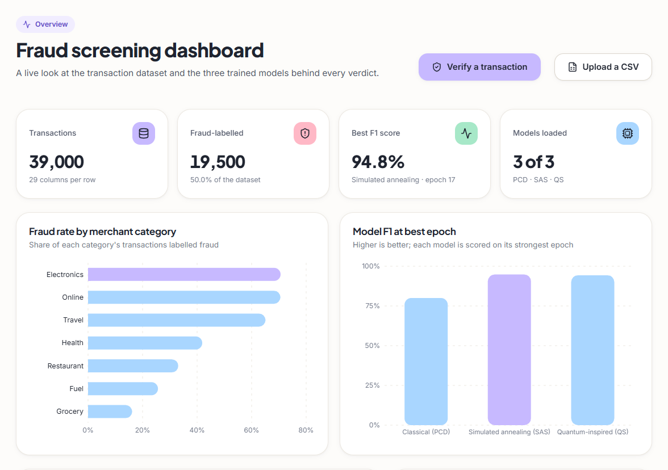
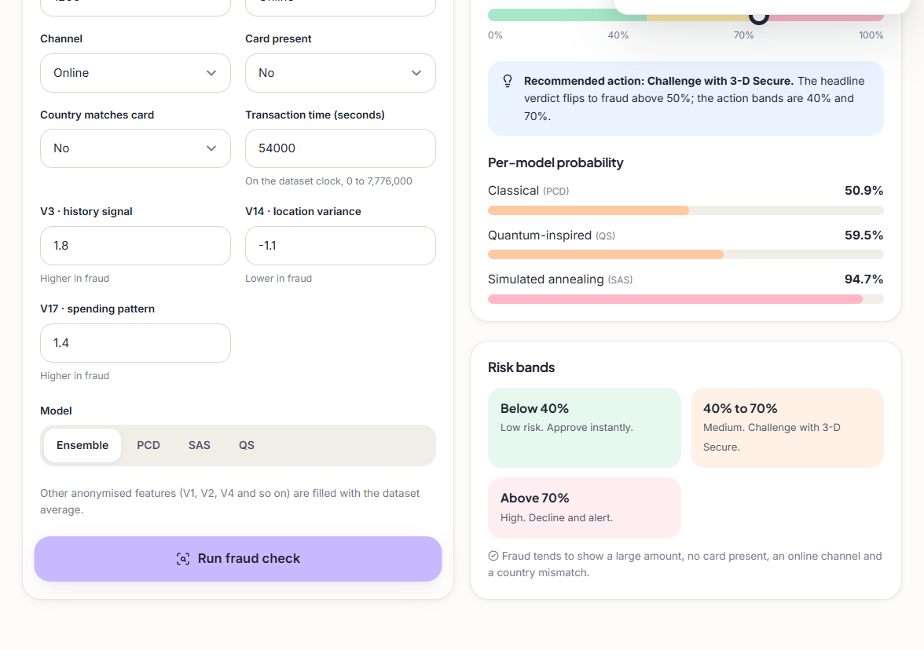
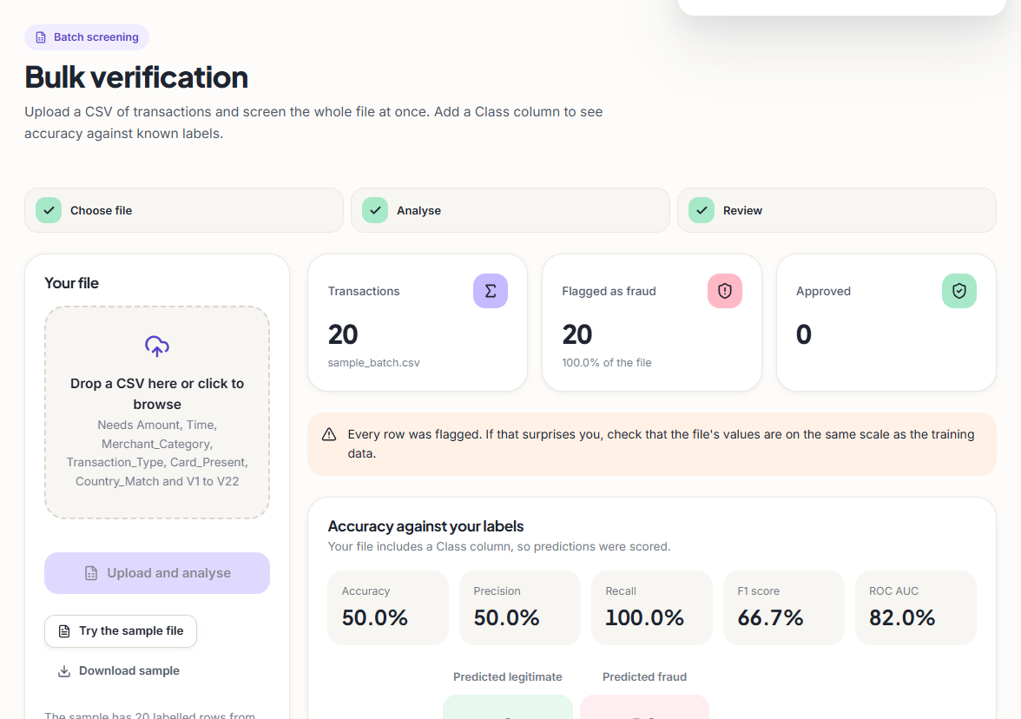
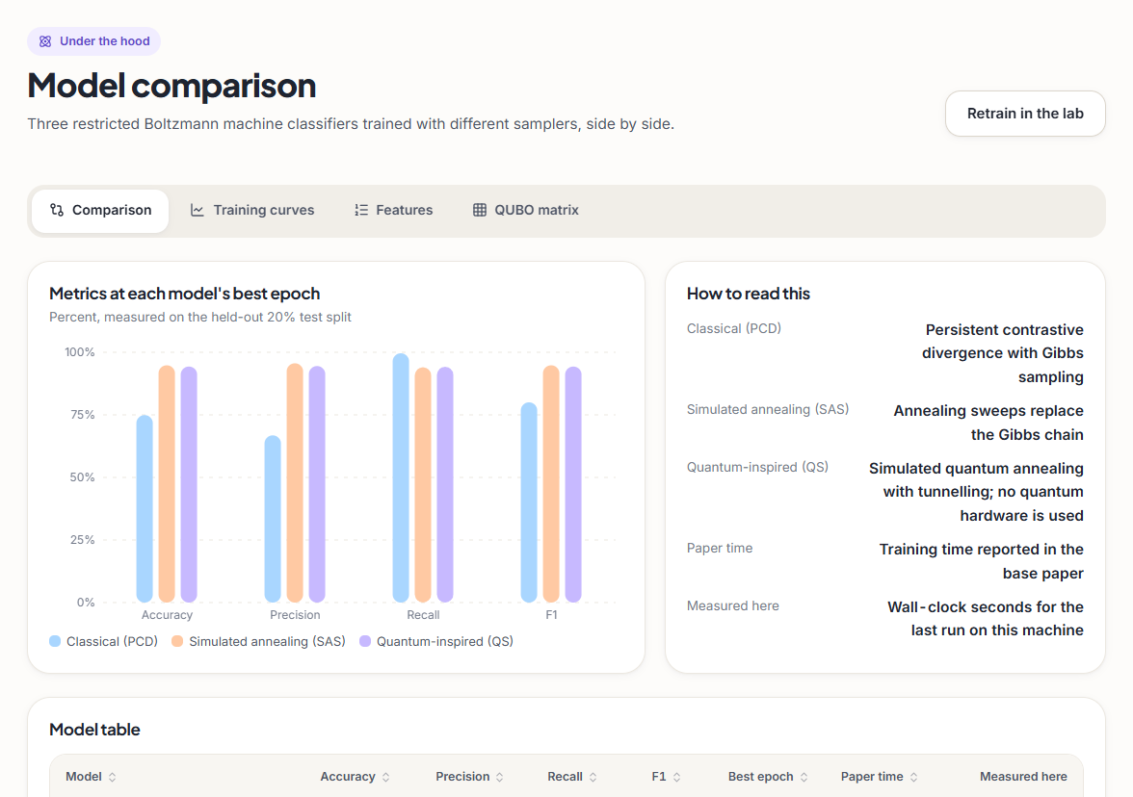
Output screens
Dashboard. Real counts from the 39,000-row file and the best F1 of each model.
Verify. A 1,200 online, card-not-present payment: ensemble 68.4 %, challenge band, per-model bars (50.9 / 59.5 / 94.7 %).
Bulk. The 20-row sample: 20 of 20 flagged, 50 % accuracy. This is the bulk-route unscaled-input defect, shown as captured.
Model comparison. Metrics, curves, features and the QUBO matrix of each trained model.
Notes:
Real captures of the running application at 1440 by 900, with the sidebar cropped off. The bulk screen is kept as captured: it shows the serving defect that the results review explains.

Slide 17
Initial testing and observations
20 / 20
17 ms
30 ms
No pytest
API smoke checks passed
median single check (p95 32 ms)
median 20-row CSV batch
unit suite not written
Observation | Action
The batch route receives unscaled values: a bare except hides the scaler error | Documented with measured impact; fix is first on the next-steps list
PCD at threshold 0.5 flags 83% of legitimate transactions (660 of 795) | Reported with the threshold sweep; threshold to be tuned on validation data
History tables pick the best epoch on the test split | Primary numbers use the final epoch; best-epoch kept as a labelled upper bound
Notes:
The smoke test runs against the live API (read-only). No pytest suite exists; we say so rather than count tests that were never written. Each observation is documented, not hidden.

Slide 18
Challenges and corrective actions
Challenge | Corrective action
No quantum hardware and no real transaction data | Classical simulation of the sampler and a synthetic dataset, stated on every results slide
PCD unstable: F1 69.2 +/- 23.1 over five seeds | Report mean and spread; use SAS and QS in the ensemble; threshold tuning planned
The batch route skips feature scaling | Measured the effect (50% against 95% accuracy); documented, fix planned
Simple baselines beat the RBM on this data | Reported openly: LR F1 96.7% against 94.5%
Shared PC short of memory during experiments | Resumable experiment script with allocation retries; one process at a time
Notes:
Each challenge was met by a concrete step or by measuring it and saying so. The memory problem was environmental: a runaway process on the shared machine.

Slide 19
Next steps
1
Fix and test
2
Tune the decision
3
Real data pilot
4
Strengthen the sampler
Apply the scaler correctly in the batch route and add a regression test that would have caught it.
Choose the threshold on validation data, calibrate PCD, and report cost-based operating points.
Evaluate on a public real card dataset and on imbalance close to real life, with PR-AUC as the main metric.
Replace the mean-field shortcuts with a proper annealing sampler; try D-Wave Leap access if it becomes available.
Notes:
Plan to the final review: fix the defect, tune the decision, test on real data and strengthen the sampler. The first two are small and are the most valuable.

Slide 20
Thank you
Questions and suggestions are welcome.
Notes:
Likely questions: why an RBM when baselines score higher (it is the base paper's model; we report the comparison openly); is it quantum (no, a classical simulation); is the data real (no, synthetic).

