Slide 1

Credit Card Fraud Detection Using Machine Learning
Final Review · SecurePay AI
Team Details : Batch A4
Under the Esteemed Guidance of
KOTESHWAR RAO
[DESIGNATION], Department of CSE
23K91A0513 ARELLI PRAVEEN KUMAR
23K91A0529 BANOTHU AJAY
23K91A0557 D CHANDRIKA
23K91A0525 BAIRAGONI VIJAY
DEPARTMENT OF COMPUTER SCIENCE AND ENGINEERING · TKR College of Engineering & Technology · Academic Year [ACADEMIC YEAR]
Notes:
Introduce the team and the project: SecurePay AI, a fraud-screening application built around the base paper's restricted Boltzmann machine classifier, and measured honestly.

Slide 2
Table of Contents
Abstract
Base Paper & Literature Survey
Research Gap, Problem Statement & Objectives
Proposed System & Architecture
Methodology, Dataset & Models
Decision Workflow, Interaction & Storage
Implementation Highlights
Results: Shipped Models, Threshold, Baselines, Imbalance
Performance, Testing & the Serving Defect
Comparison with the Base Paper
Output Screens
Conclusion, Future Scope & References
Dept. of CSE | Batch A4 | Final Review
2
Notes:
The agenda follows the report: problem, design, method, results, comparison, screens, conclusion.

Slide 3
Abstract
Card fraud is rare, costly and changing: fixed rules are learned and bypassed, and a model trained naively on imbalanced data scores high accuracy while finding almost no fraud.
SecurePay AI follows the base paper: a Gaussian-Bernoulli RBM classifier trained three ways (PCD, simulated-annealing sampling, quantum-inspired sampling), averaged into one score with approve / challenge / decline bands, behind a Flask API and a React interface.
Synthetic 39,000-transaction data, not the base paper's real data. On 1,600 held-out rows the ensemble reaches precision 96.5%, recall 92.5%, F1 94.5%, ROC-AUC 0.986; the shipped PCD model flags nearly everything (accuracy 58.8%).
Logistic regression, random forest and XGBoost score F1 96.7%, 96.3%, 96.5% on the same split: the simple baselines are better here.
Audit finding: the bulk route skips feature scaling, so accuracy on a fresh batch is 50.2% as served against 94.8% when scaled. A single check takes a median 17 ms.
Not done: real transaction data, quantum hardware, drift, a user study.
Dept. of CSE | Batch A4 | Final Review
3
Notes:
Give the problem, the system, then the numbers with their conditions. End on the honest limits: synthetic data, baselines ahead, and the serving defect found by our own audit.

Slide 4
Base Paper
J. M. C. de Albuquerque Neto, G. C. do Amaral and G. P. Temporao, "Fraud detection in credit card transactions using quantum-assisted restricted Boltzmann machines," IEEE Access, vol. 14, pp. 62923-62932, 2026, doi: 10.1109/ACCESS.2026.3683308.
Aspect | Neto, do Amaral and Temporao, IEEE Access 2026
Method | Gaussian RBM classifier (visible, hidden and label layers); energy written as a QUBO / Ising problem; three trainers: classical PCD, simulated-annealing sampling, D-Wave quantum sampling
Data | Real Stone fintech data: 145 million transactions, about 19 thousand fraud; manual undersampling to 39 thousand (50/50); 80/20 split; 50 epochs
Table 1 (acc / prec / rec / F1, time) | PCD 84 / 86 / 81 / 83 %, 2 min; SAS 85 / 94 / 82 / 88 %, 4 h; QS 85 / 91 / 79 / 84 %, 1.8 h
Pre-processing | One-hot, z-score, correlation filter, CatBoost importance; SMOTE and Tomek links performed poorly at this imbalance
Stated limits | Whether the advantage is general is an open question; SA metrics oscillate; hours of training; no interface or public baselines
Dept. of CSE | Batch A4 | Final Review
4
Notes:
Read from the PDF, including Table 1 as an image. We adopt the model family, the preprocessing recipe and the three trainers; we cannot reproduce the real data, the D-Wave runs or the hour-scale training.

Slide 5
Literature Survey
Work | Year | Approach | Data / reported result | Limitation
Neto et al. (base) | 2026 | Gaussian RBM classifier trained with classical PCD, simulated-annealing sampling and D-Wave quantum sampling | Real Stone data, 145 M transactions, about 19 thousand fraud, balanced to 39 thousand; F1 83 / 88 / 84 % (PCD / SAS / QS) | One proprietary dataset; no public baselines; hours of training; no deployable interface
Aburbeian and Ashqar | 2023 | Random forest with SMOTE and hyper-parameter tuning | 94,682 online transactions; accuracy about 98 %, F1 about 98 % | Resampled data scored; accuracy-led comparison on a small public set
Han and Wu | 2026 | Combinatorial fusion of seven classifiers, validation-stage subset and rule selection | IEEE-CIS, 590,540 transactions, 3.5 % fraud; AUC 0.9405, AUPRC 0.6699, F1 0.6373 | Gain over best single model is small; CTGAN augmentation hurt
Shi | 2024 | ANN compared with XGBoost on imbalanced card data | Both about 99.96 % accuracy; XGBoost higher F1 on the fraud class | Accuracy is uninformative at this imbalance; no deployment
Bhattacharyya et al. | 2011 | Logistic regression, SVM and random forest compared | Nonlinear ensemble methods generally stronger than linear ones on card transactions (as summarised by Han and Wu) | Older study; no deployment or imbalance-strategy comparison
Dal Pozzolo et al. | 2018 | Realistic fraud modelling: delayed labels, concept drift, alert precision | Discusses sampling bias, delayed labels and changing fraud patterns in real card streams | Addresses data issues, not model training cost or a usable interface
Carcillo et al. | 2021 | Unsupervised outlier scores added to supervised classifiers | Unsupervised anomaly scores and supervised classifiers complement each other in large-scale systems | Not a single compact model; no deployable interface
Dept. of CSE | Batch A4 | Final Review
5
Notes:
Seven verified works. Three further titles from the batch survey could not be verified and are flagged in the report's reference list, not cited.

Slide 6
Research Gap
Individual classifiers and sampling methods are studied separately; a compared, tuned pipeline is missing.
Evaluation is often accuracy-led; recall, precision and F1 on the fraud class are what an analyst needs.
The base paper's quantum-assisted RBM is shown only on private data and without a usable interface.
Quantum hardware is out of reach for most teams; whether a classical simulation of the sampler is enough is unanswered.
Few works measure how the same pipeline behaves when fraud falls from 50 % to about 1 % of the stream.
Deployable live scoring with a risk band and an explanation of the decision is rarely provided.
Dept. of CSE | Batch A4 | Final Review
6
Notes:
Six gaps from the survey. We address the compared pipeline, the recall-first evaluation, the open implementation with an interface, and the behaviour when fraud falls to 1 percent.

Slide 7
Problem Statement
Fraudulent transactions are rare, so standard classifiers reach high accuracy by predicting everything as genuine.
Rule-based systems raise many false alarms and block legitimate customers.
Fraud patterns change continuously, so a fixed rule set becomes obsolete quickly.
Missing a fraud costs far more than reviewing a false alarm, yet most models treat both errors equally.
Need: A machine learning system that handles severe class imbalance and maximises fraud recall while keeping false alarms acceptable.
Input
Output
Record
A transaction (amount, merchant, channel, card present, country match, time, history signals) or a CSV of rows
Fraud probability, label, risk band and per-model scores; bulk metrics when a Class column is present
Downloadable predictions CSV, saved models and per-epoch histories
Dept. of CSE | Batch A4 | Final Review
7
Notes:
Four statements of the problem and the need, then what goes in and out of the system.

Slide 8
Objectives
1. Acquire a benchmark credit card transaction dataset and quantify the degree of class imbalance.
2. Apply preprocessing including scaling, feature selection and stratified train-test splitting.
3. Balance the training data using SMOTE and compare it against random undersampling.
4. Train Logistic Regression, Random Forest and XGBoost classifiers on the balanced data.
5. Evaluate using precision, recall, F1-score and ROC-AUC rather than accuracy alone.
6. Deploy the best model behind an interface that flags a transaction as genuine or fraudulent.
Dept. of CSE | Batch A4 | Final Review
8
Notes:
The six objectives of the proposal. The conclusion states the status of each: 3 and 4 were met in the experiment script, not in the product.

Slide 9
Proposed System
Transaction / CSV
Pre-process
3 RBM scorers
Ensemble mean
Risk band
Prepare: one-hot encode merchant and channel, z-score the numeric columns, drop highly correlated columns, undersample to 50/50 and keep the 18 most important features.
Model: a Gaussian-Bernoulli RBM classifier with visible, hidden and label layers, trained three ways - classical PCD, simulated-annealing sampling and a quantum-inspired sampler that simulates a transverse field.
Decide: average the three fraud probabilities; below 40 % approve, 40 to 70 % challenge, above 70 % decline and alert.
Serve: a Flask API with 16 routes and a React interface for single checks, CSV bulk screening, analytics, model comparison and a retraining lab.
Measure: precision, recall, F1 and ROC-AUC on a held-out split, against Logistic Regression, Random Forest and XGBoost, across seeds, thresholds and a 1 % fraud variant.
Dept. of CSE | Batch A4 | Final Review
9
Notes:
The proposed system as a line of boxes and the five design rules behind it.

Slide 10
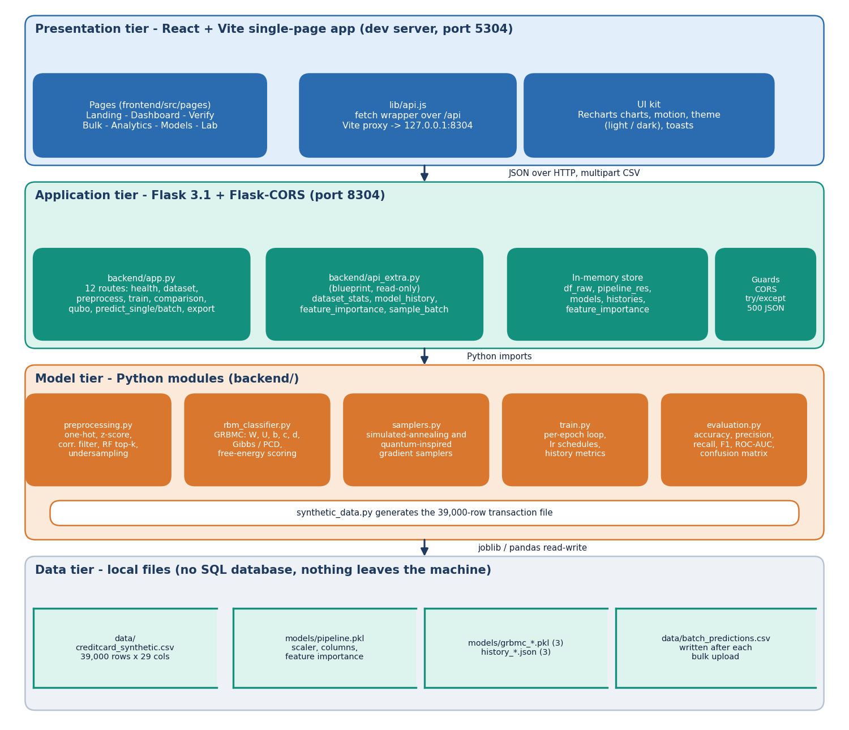
System Architecture
Presentation: React and Vite on port 5304; every call goes through a Vite proxy to the API.
Application: Flask on port 8304, 16 routes, JSON and multipart CSV, 500 responses carry an error message.
Model tier: preprocessing, GRBMC, samplers, training loop, evaluation, synthetic data generator.
Data tier: local files only (CSV, pickles, JSON); there is no SQL database.
In-memory store holds the dataset, pipeline, models and histories after start-up.
Dept. of CSE | Batch A4 | Final Review
10
Notes:
Four tiers. The data tier is files, not a database; the store dictionary in app.py caches everything in memory.

Slide 11
Methodology
One-hot + z-score
Correlation filter
Undersample 50/50
RF top-18
80/20 split
Train GRBMC
Evaluate
Pre-processing as in the base paper: the backend rebuilds it from an 8,000-row sample; 6,400 training and 1,600 test rows; no column exceeded the 0.95 correlation limit.
Training: 20 epochs; PCD with 200 hidden units and batch 512; SAS and QS with 65 hidden units, batch 32, 10 sweeps x 16 reads, 3,000 rows per epoch.
QS is a classical simulation of a transverse-field tunnelling step, so it is quantum-inspired only; no quantum hardware was used.
Added measurements: baselines (LR, RF, XGBoost), five seeds, threshold sweep, a fresh 2,000-row batch, a 1 % fraud variant with SMOTE, class weights and undersampling.
Every number comes from scripts/run_experiments.py, written to experiments/metrics.json.
Dept. of CSE | Batch A4 | Final Review
11
Notes:
The pipeline and what we added around it: baselines, seeds, thresholds, imbalance. The history files choose a best epoch on the test split, so we report final-epoch figures as primary.

Slide 12
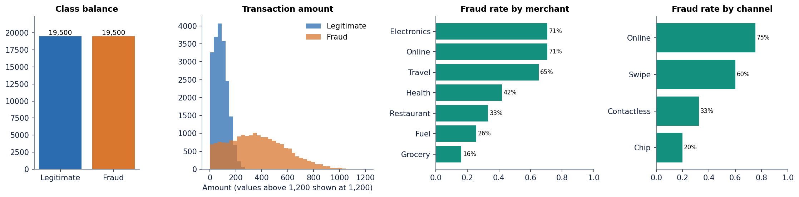
Dataset & Models
39,000
50 / 50
18
6,400 / 1,600
synthetic transactions
19,500 fraud, 19,500 legitimate
features kept by RF importance
train / test rows (80/20)
Trainer | Hidden | Batch | Sampler
PCD | 200 | 512 | Gibbs chain
SAS | 65 | 32 | annealing sweeps
QS | 65 | 32 | tunnelling flips
The data is synthetic: generated by backend/synthetic_data.py to imitate the base paper's balanced 39 thousand set, so it is not comparable with real Stone data. Fraud is generated with larger amounts, online and card-not-present channels and shifted V3, V7, V10, V14, V17.
The backend works from an 8,000-row random sample of this file (6,400 train, 1,600 test rows); every headline number uses that split unless stated.
Mean amount: fraud 368, legitimate 85. Feature names V1 to V22 are generic; the UI's friendly labels for V3, V14, V17 are not real semantics.
Dept. of CSE | Batch A4 | Final Review
12
Notes:
Be frank: synthetic, balanced, and built so that amount, channel and a few V columns carry the signal. That is why simple baselines do so well.

Slide 13
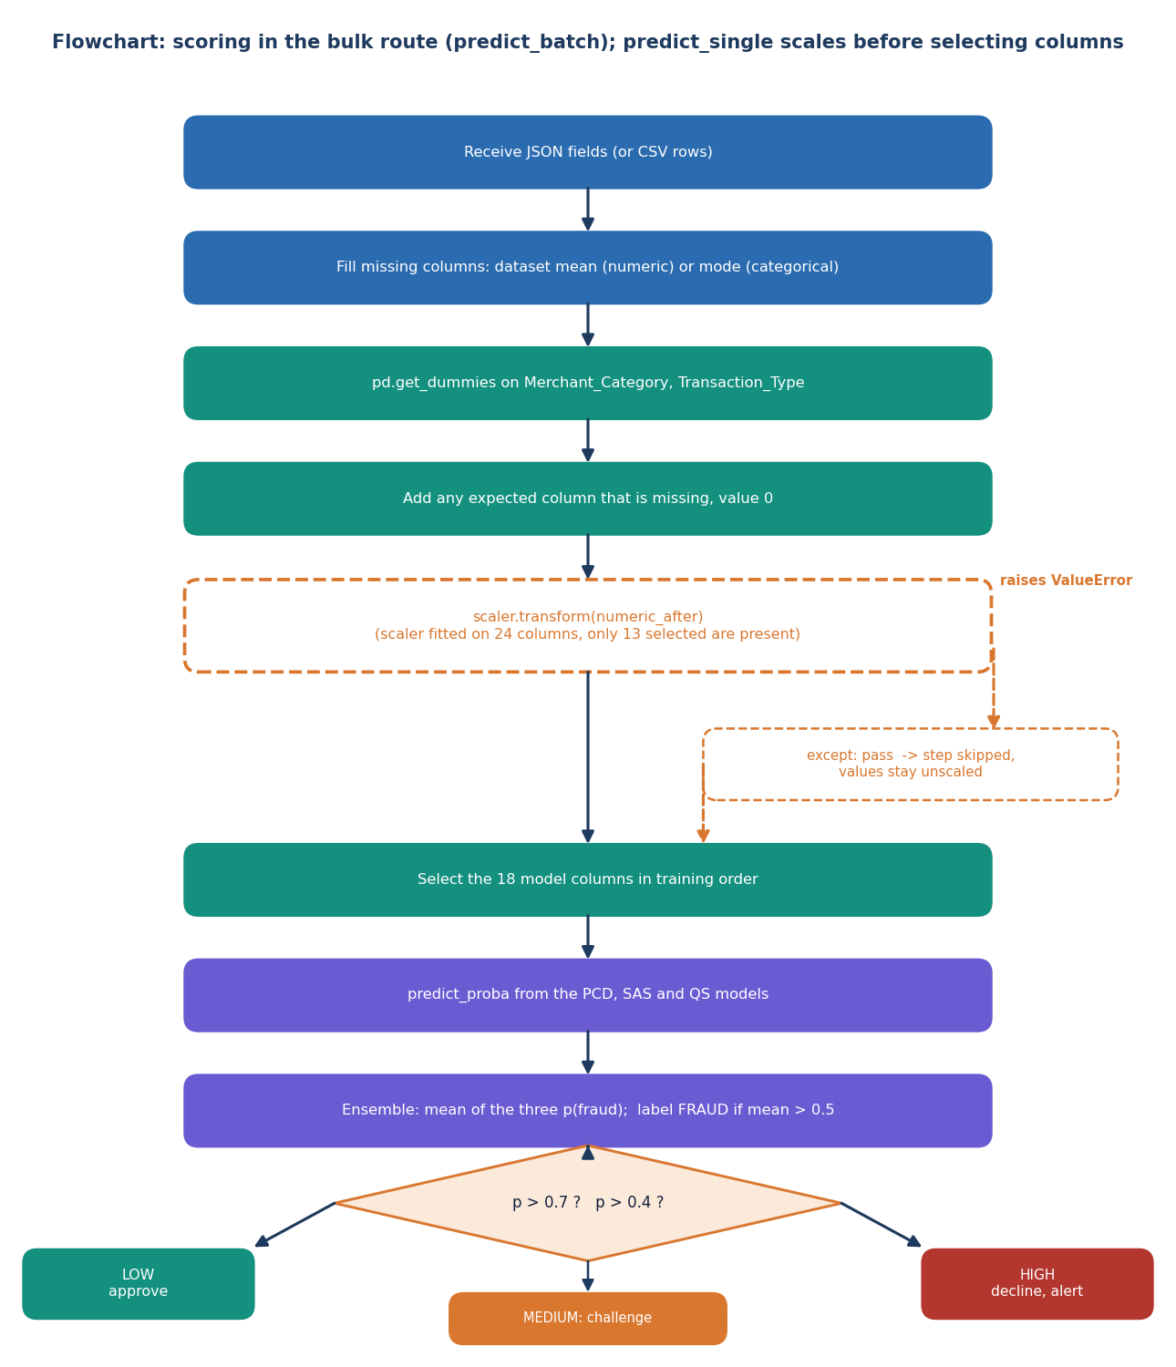
Decision Workflow
< 40 %
40 - 70 %
> 70 %
LOW: approve
MEDIUM: challenge (3-D Secure)
HIGH: decline and alert
Missing fields default to the dataset mean or mode; categorical fields are one-hot encoded; absent columns are filled with 0.
The three models give p(fraud) from the free-energy softmax over the two label hypotheses; the ensemble is their mean, labelled FRAUD above 0.5.
The risk band is chosen from the mean probability (0.4 and 0.7).
The dashed branch is the bulk-route defect: the scaler call raises because it was fitted on 24 columns and only 13 are present, and a bare except lets the unscaled values through.
Dept. of CSE | Batch A4 | Final Review
13
Notes:
The scoring flow of predict_single and predict_batch, drawn as the code actually behaves, including the skipped scaling step.

Slide 14
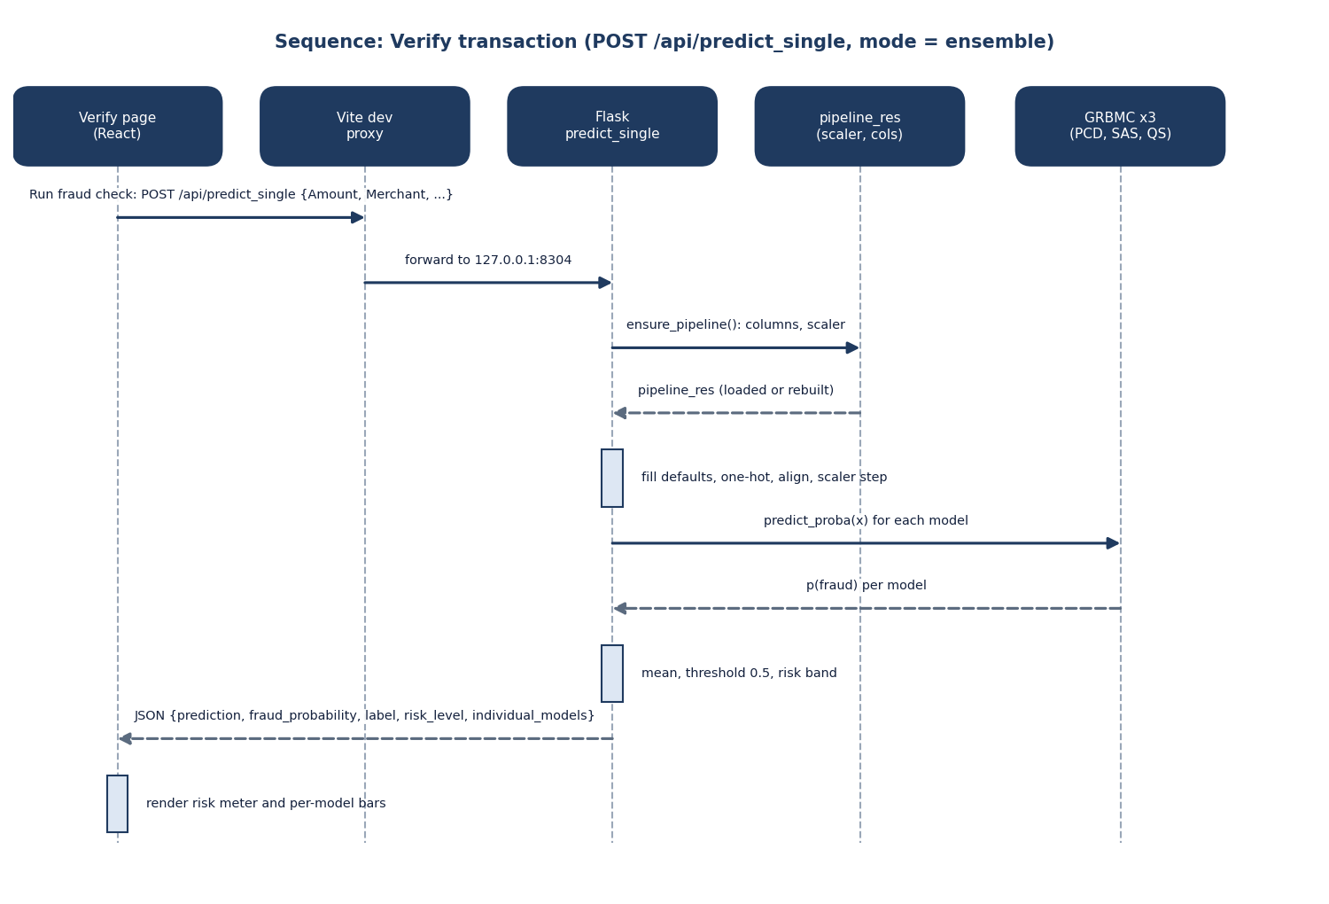
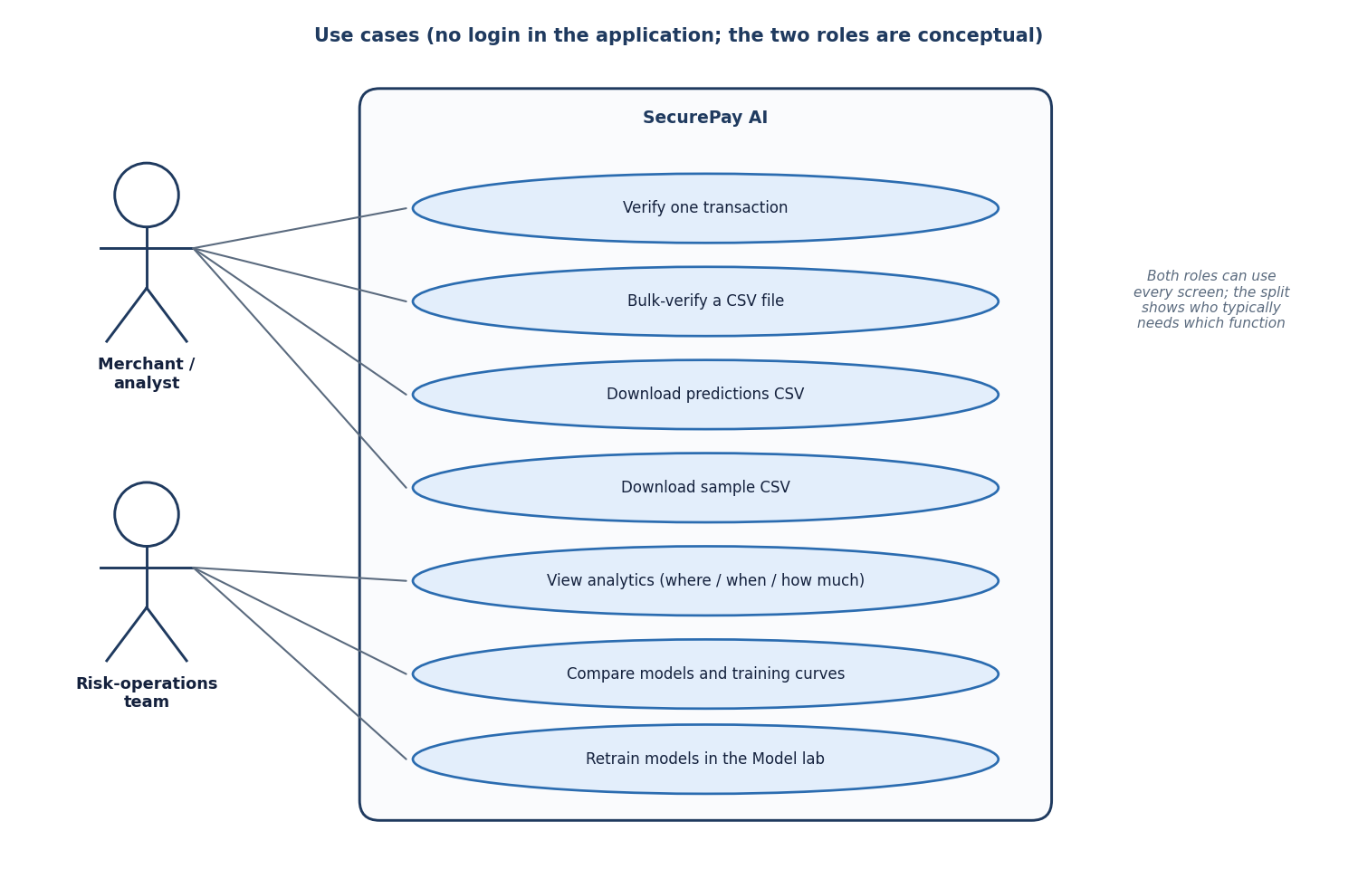
User – System Interaction
Left: one prediction from the browser through the Vite proxy and Flask to the three models. Right: the use cases that exist in the interface for a merchant or analyst and for the risk-operations team. There is no sign-in.
Dept. of CSE | Batch A4 | Final Review
14
Notes:
Sequence of one check and the use cases. There is no authentication in the prototype.

Slide 15
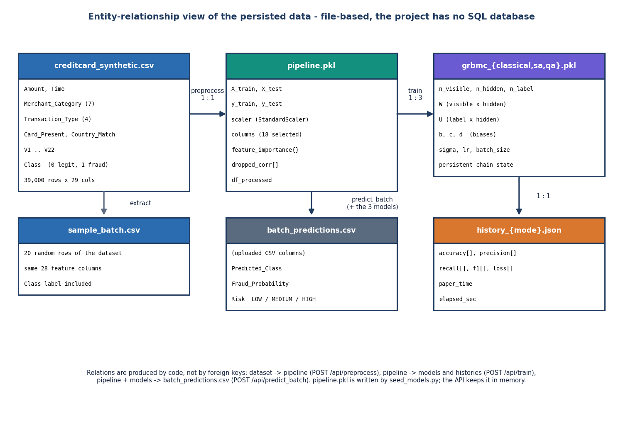
Data Storage Design (no SQL database)
File | Content
creditcard_synthetic.csv | 39,000 rows, 29 columns
pipeline.pkl | scaler, columns, importances
grbmc_*.pkl (3) | trained models
history_*.json (3) | per-epoch metrics
batch_predictions.csv | last bulk upload result
pipeline.pkl was written with a different pandas version and does not load here, so the backend silently rebuilds the same pipeline at start-up (same sample, same seed).
Dept. of CSE | Batch A4 | Final Review
15
Notes:
Persistence is files plus an in-memory dictionary. The pickle issue is a real observation from this machine, handled by the backend's fallback.

Slide 16
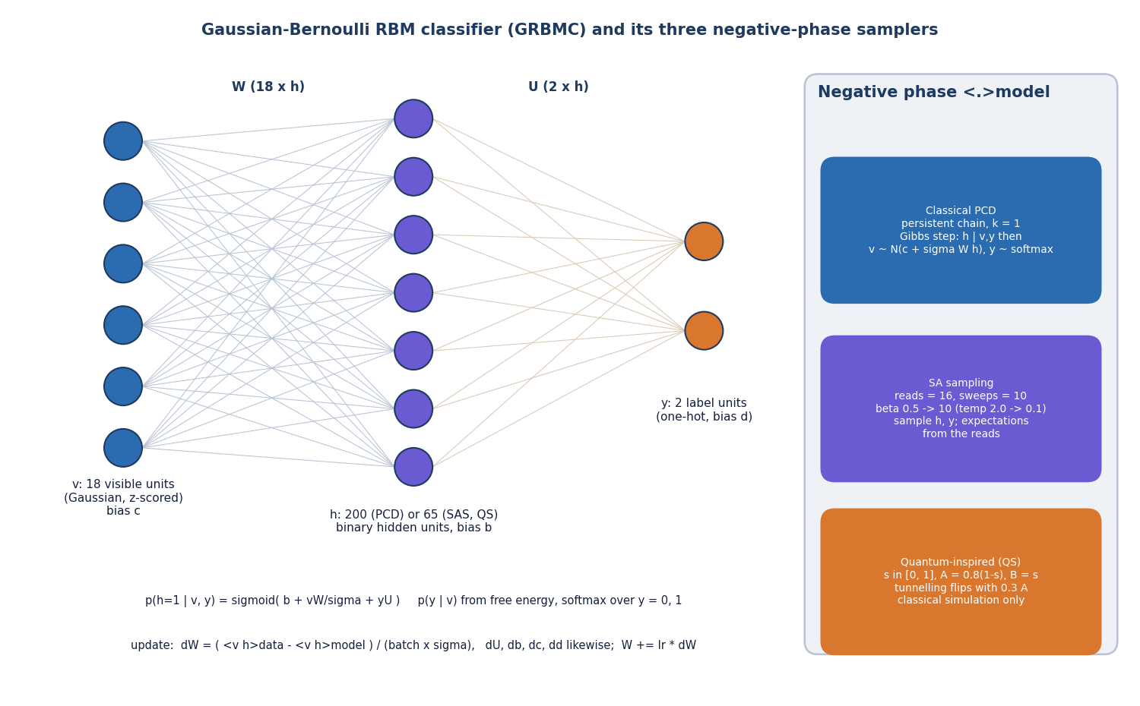
Implementation Highlights
16
7
1,338
3,574
API routes
React pages
backend lines (Python)
frontend lines (React)
GRBMC is plain numpy: weights W (visible-hidden) and U (label-hidden), biases b, c, d, free-energy scoring and PCD gradients.
SAS and QS replace the Gibbs negative phase with annealing-style sampling; they use the batch-mean visible vector, a simplification of the paper's procedure.
Model lab: retrain from the browser with a choice of balancing, features, trainers and epochs; the models are saved on disk.
Interface: light and dark themes, risk meter, toasts, offline banner, responsive layout.
Dept. of CSE | Batch A4 | Final Review
16
Notes:
What was built and how big it is. The samplers are simplified approximations, which the report states plainly.

Slide 17
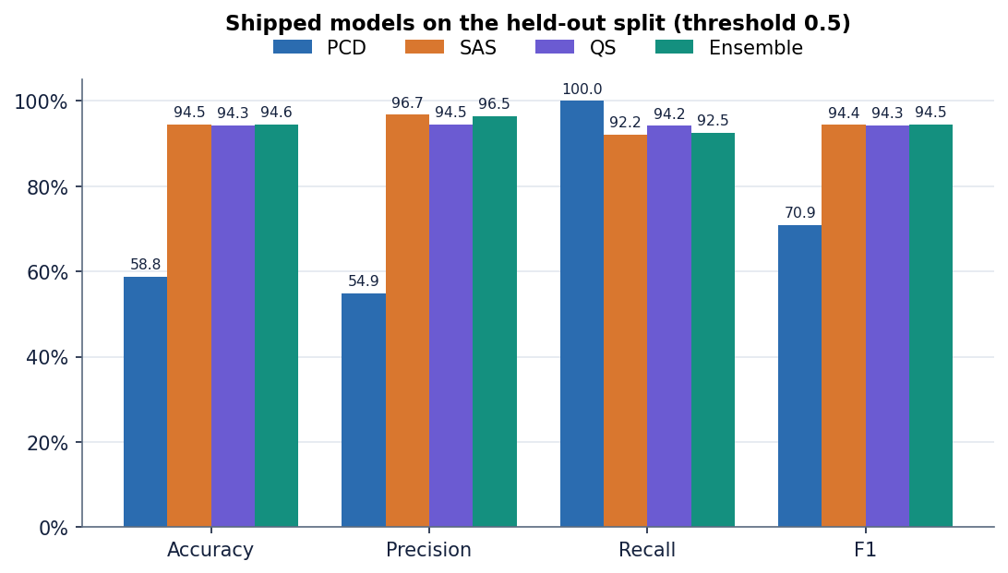
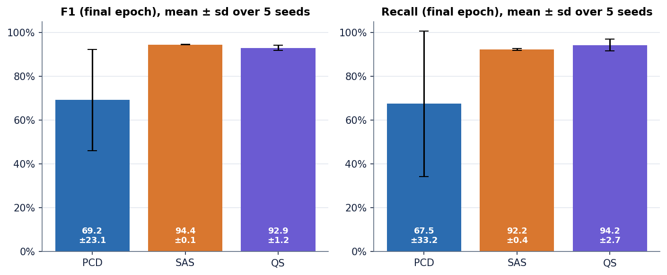
Results – Shipped Models (synthetic data, n = 1,600)
94.5%
94.4%
94.3%
58.8%
ensemble F1
SAS F1
QS F1
PCD accuracy (flags almost all)
All four share ROC-AUC 0.986: PCD ranks well but its 0.5 threshold is badly placed.
Five seeds, final epoch, F1: PCD 69.2 +/- 23.1, SAS 94.4 +/- 0.1, QS 92.9 +/- 1.2.
Threshold 0.5. Best-epoch histories are chosen on the test split, so final-epoch figures are used.
Dept. of CSE | Batch A4 | Final Review
17
Notes:
SAS and QS are around 94 percent F1; the ensemble 94.5. PCD at the 0.5 threshold has recall 100 percent and 660 false positives out of 795 legitimate rows. Across seeds PCD is unstable.

Slide 18
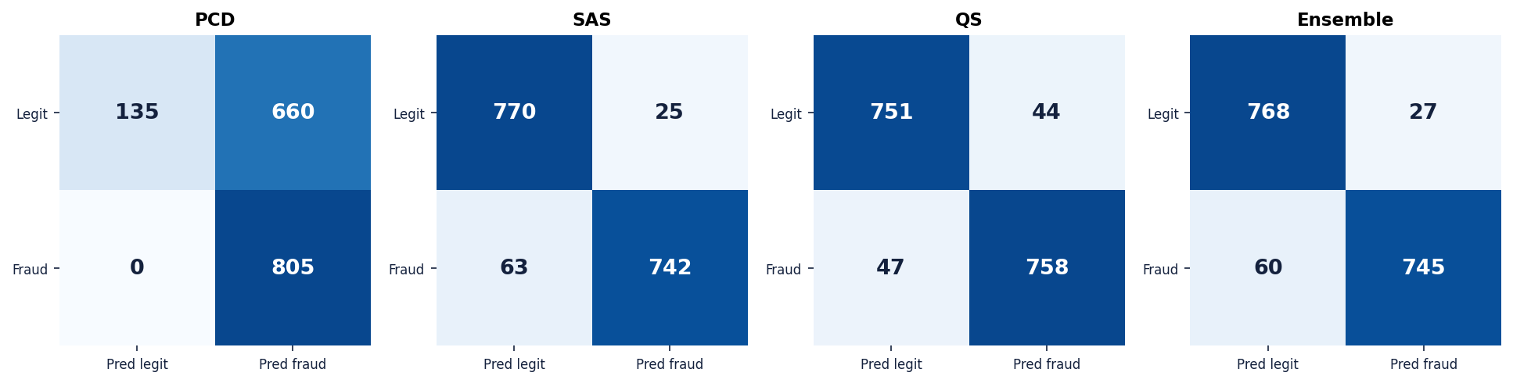
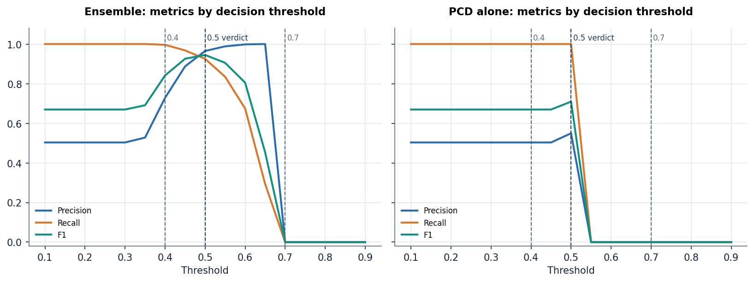
Confusion Matrices & Threshold Analysis
Ensemble: 768 true negatives, 27 false positives, 60 false negatives, 745 true positives.
Threshold 0.4: precision 72.8%, recall 99.6%; 0.5: 96.5% and 92.5%; 0.6: 99.8% and 67.5%.
Above 0.7 nothing is flagged: no test row reaches the 'HIGH' band with the averaged probability.
Dept. of CSE | Batch A4 | Final Review
18
Notes:
Confusion matrices at 0.5 and the ensemble threshold sweep. The curve is steep: between 0.4 and 0.6 precision and recall trade places sharply, and the app's 0.7 band is never reached.

Slide 19
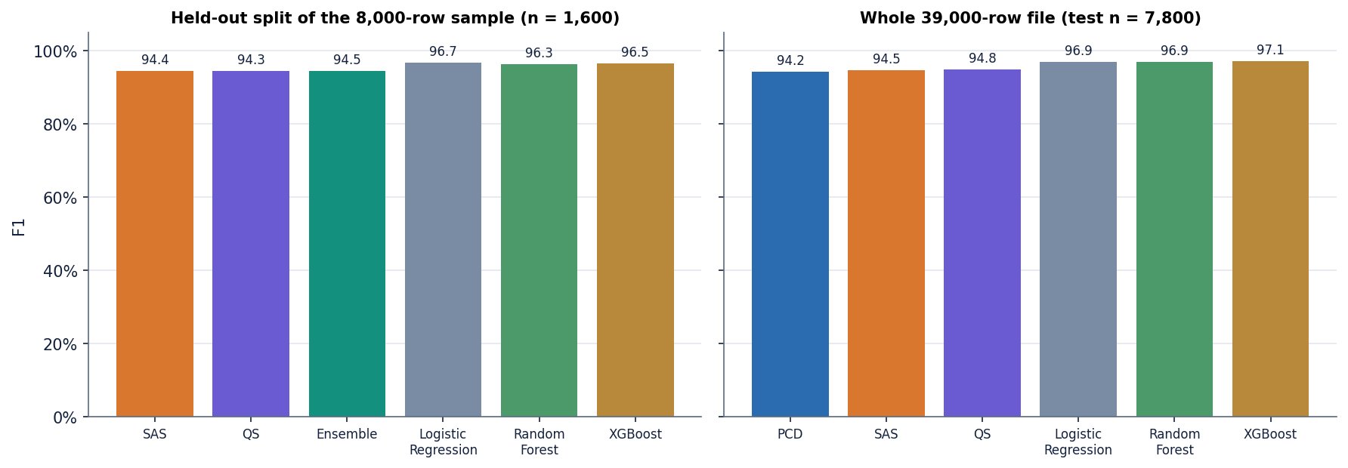
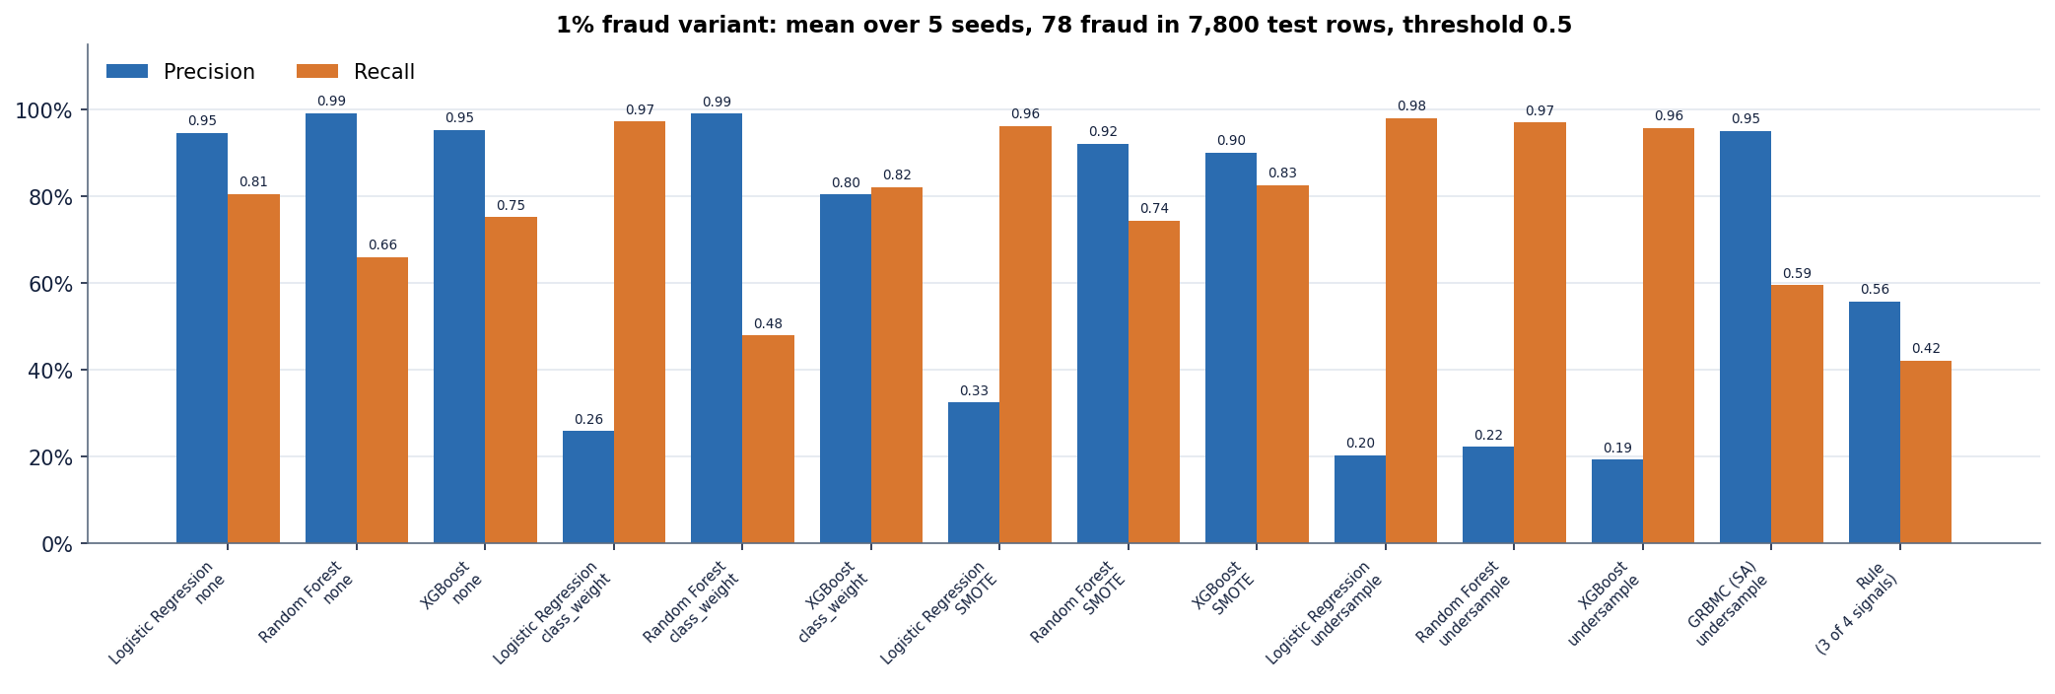
Results – Baselines and a 1 % Fraud Variant
Same split: LR 96.7%, RF 96.3%, XGBoost 96.5% against RBM 94.5%.
Whole 39,000-row file (n = 7,800): XGBoost 97.1%, RBM trainers 94.2% to 94.8%.
Simple models win on this data; the RBM's only edge is that it is the base paper's method.
Undersampling lifts recall to 0.96 - 0.98 but precision falls to about 0.2 (LR 0.20).
No resampling: LR precision 0.95, recall 0.81.
SMOTE with XGBoost: 0.90 / 0.83.
RBM on undersampled data: 0.95 / 0.59.
Dept. of CSE | Batch A4 | Final Review
19
Notes:
At 1 percent fraud (78 fraud among 7,800 test rows, five seeds) undersampling floods the analyst with false alarms.

Slide 20
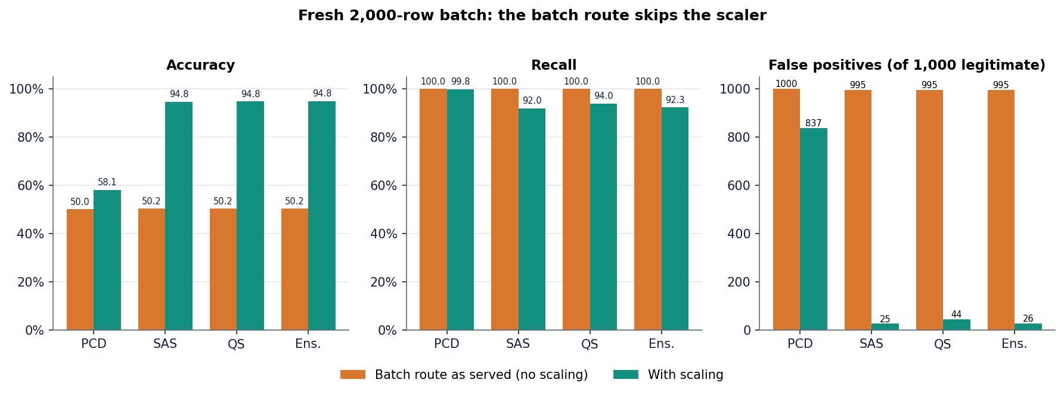
Performance, Testing & the Serving Defect
17 ms
30 ms
4 - 5 s
20 / 20
median, single check (n = 100)
median, 20-row CSV batch
20-epoch training, CPU
smoke-test checks passed
Test layer | What it covers | Result
Smoke test | running API on 8304: all read routes, predict, batch, errors, export | 20 of 20
Latency | 127.0.0.1, Flask dev server | p95 32 ms
Experiments | baselines, seeds, thresholds, 1 % variant | metrics.json
Unit tests | no pytest suite exists | gap
Not tested | concurrency, real data, drift, user study | gap
Fresh 2,000-row batch, ensemble: accuracy 50.2% as served, 94.8% when scaled (false positives 995 against 26).
The bundled sample file flags 20 of 20 rows as fraud; 11 when scaled (true fraud 10).
Intel Core i5-12500, CPU only. The defect is documented, not fixed.
Dept. of CSE | Batch A4 | Final Review
20
Notes:
Latency is far below a second. The defect was found by auditing the serving code and measured on a fresh batch generated with a different seed; the screenshot of the bulk page shows the same behaviour.

Slide 21
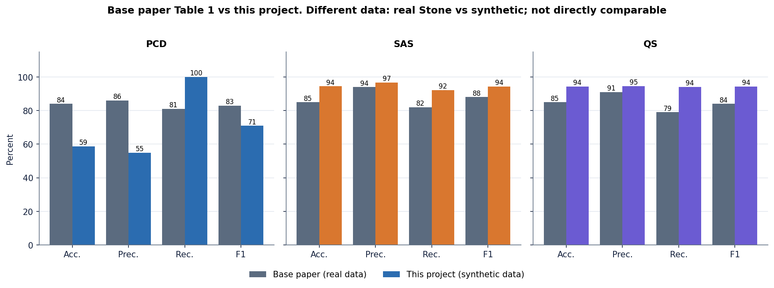
Comparison with Base Paper (context only: different data)
 | Base paper (real data) | This project (synthetic data, simulated samplers)
F1: PCD / SAS / QS | 83 / 88 / 84 % | 70.9% / 94.4% / 94.3% (shipped models); five-seed means 69.2 +/- 23.1 / 94.4 +/- 0.1 / 92.9 +/- 1.2
Precision: SAS | 94 % | 96.7%
Training time | 2 minutes / 4 hours / 1.8 hours | 4 / 5 / 4 seconds (3,000-row subsample, 10 sweeps)
Sampler hardware | Julia QARBoM.jl; D-Wave simulators and quantum annealer | numpy; classical simulation only
Test set | about 7.8 thousand rows (20 % of the 39 thousand balanced set) | 1,600 rows (805 fraud) of generated data
The numbers sit side by side for context only: data, labels, test sets and samplers differ, so no superiority or inferiority is claimed.
SAS is the steadiest of our three trainers and QS is within noise of it; the paper's SAS lead is therefore not contradicted, but our PCD result depends strongly on threshold and seed.
Dept. of CSE | Batch A4 | Final Review
21
Notes:
State plainly that the datasets differ: real Stone data against a generated set that is easier. The time column compares hours of simulator or cloud use with seconds of a simplified sampler.

Slide 22
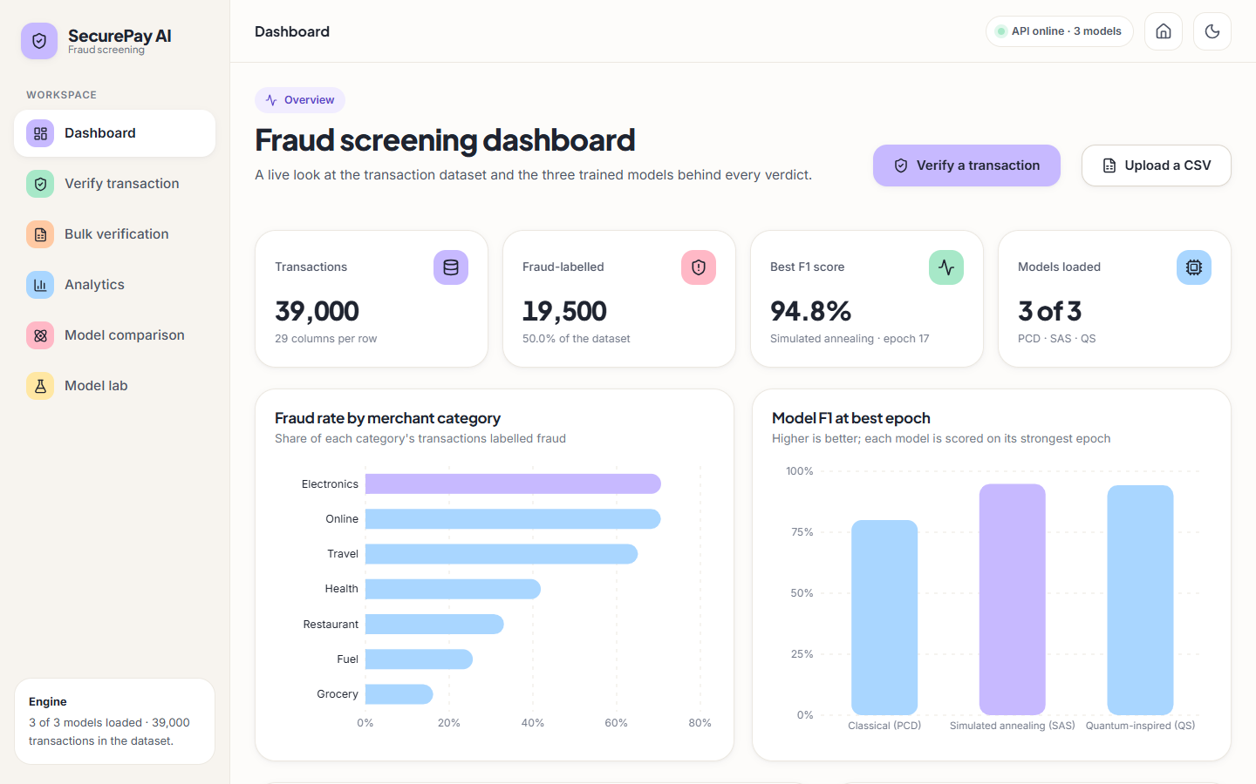
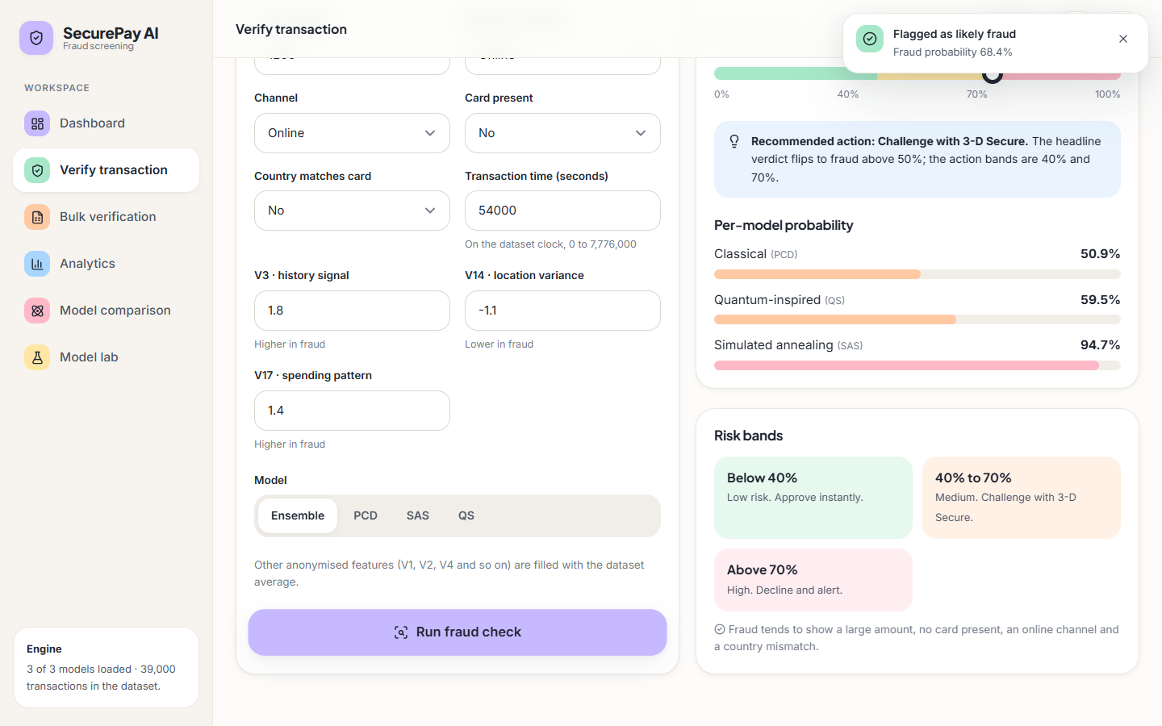
Output Screens – Dashboard and Verify
Dashboard: 39,000 transactions, 50 % fraud-labelled, best F1 94.8 % (simulated annealing, epoch 17, a best-epoch figure) and fraud rate by merchant category computed from the data.
Verify: the fraud example (1,200, online, card not present, country mismatch) is flagged at 68.4 %: PCD 50.9 %, QS 59.5 %, SAS 94.7 %; recommended action 'challenge with 3-D Secure'.
Dept. of CSE | Batch A4 | Final Review
22
Notes:
Real screenshots of the running application. The dashboard's best-F1 tile uses the best epoch chosen on the test split.

Slide 23
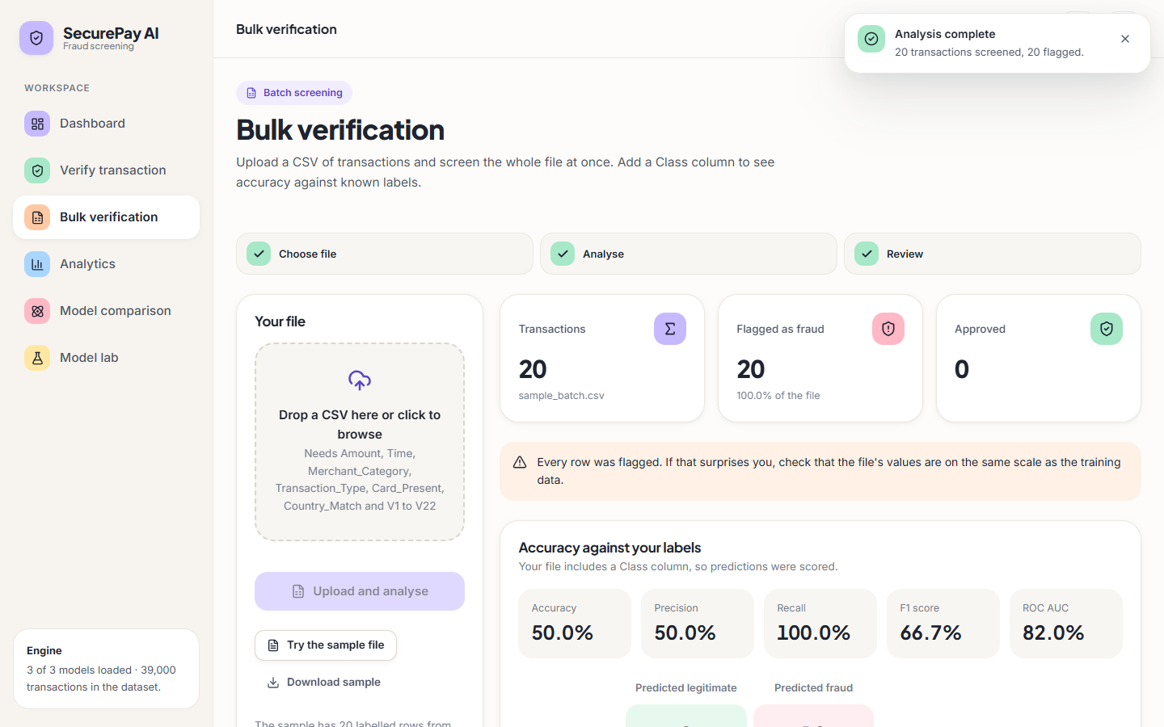
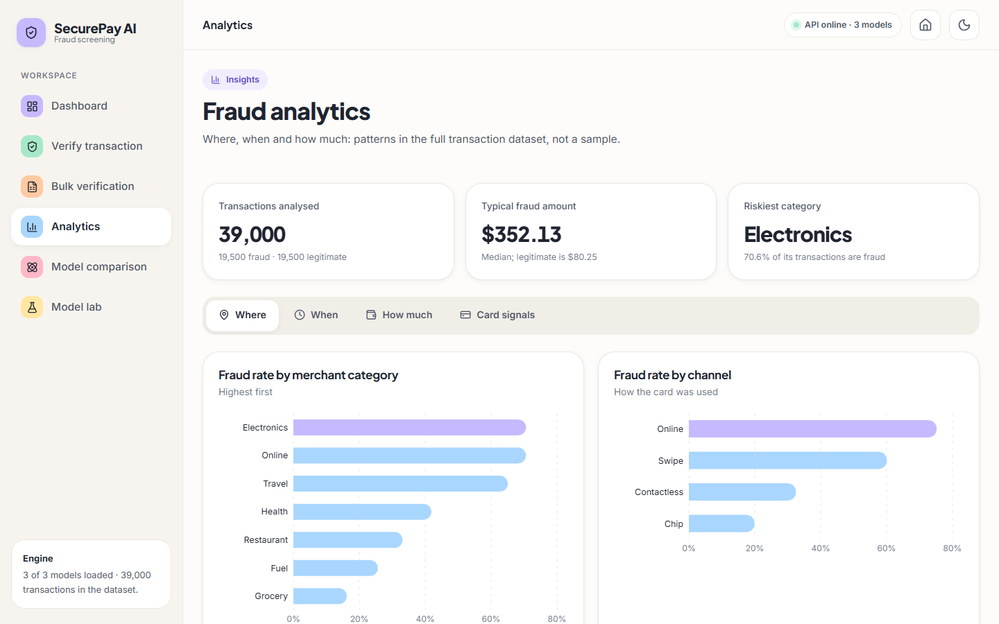
Output Screens – Bulk Verification and Analytics
Bulk: the 20-row sample file is flagged 20 of 20 (accuracy 50.0 %, recall 100 %): the unscaled bulk path in action (the single-check Verify route scales correctly). The page itself warns that every row was flagged.
Analytics: patterns in the full dataset: Electronics and Online have the highest fraud rates, typical fraud amount 352 against a legitimate median of 80.
Dept. of CSE | Batch A4 | Final Review
23
Notes:
The bulk screen is a faithful capture of the defect, not a mock-up. Analytics is computed from the CSV, not from a model.

Slide 24
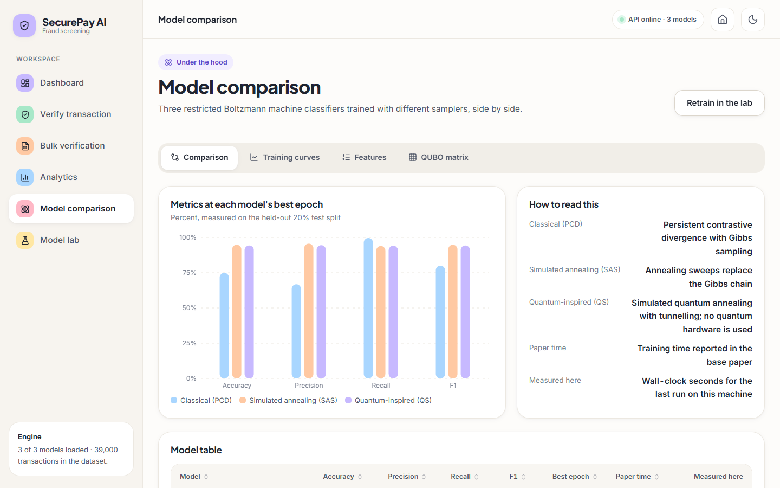
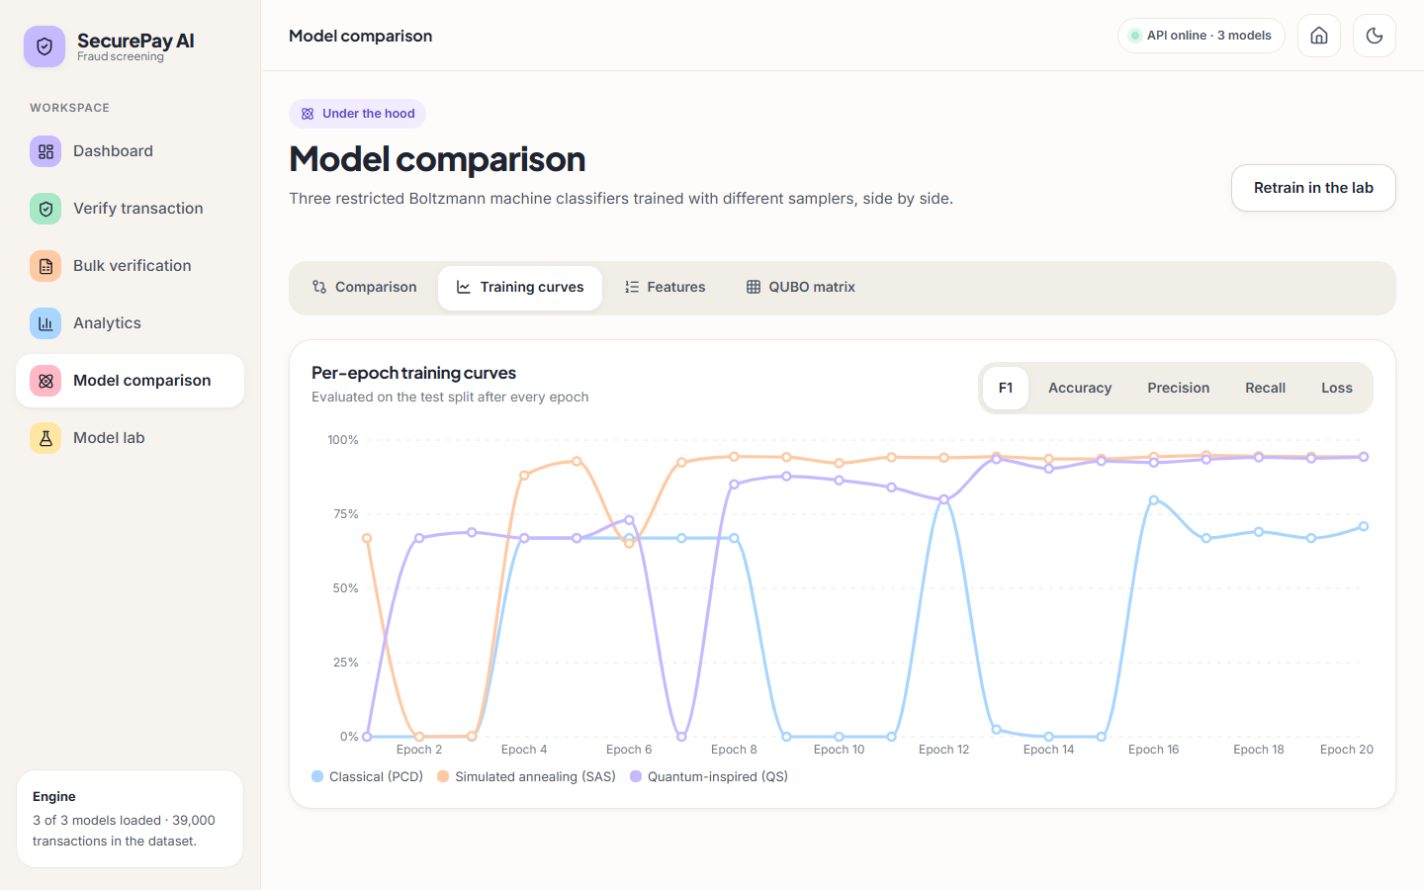
Output Screens – Model Comparison and Training Curves
Model comparison: metrics at each model's best epoch, and, in the table below the fold, the paper's training times next to the measured seconds.
Training curves: per-epoch F1 of the three trainers; PCD jumps between 0 and 80 % while SAS settles near 94 %.
Dept. of CSE | Batch A4 | Final Review
24
Notes:
The curves show the PCD instability that the five-seed study quantifies.

Slide 25
Conclusion
Delivered: a working fraud-screening application (Flask API with 16 routes, React interface, model lab) around the base paper's RBM classifier, with a 20/20 smoke test.
Measured: ensemble F1 94.5% and ROC-AUC 0.986 on synthetic data; LR, RF and XGBoost reach F1 96.3% to 96.7%; PCD is unstable (69.2 +/- 23.1 F1 over five seeds).
Objectives: 2 and 5 met; 3 and 4 met in the experiment script, not in the product; 1 partly (synthetic data, no public benchmark); 6 met, with the scaling defect.
Findings: imbalance handling matters more than model family; undersampling at 1 % fraud costs precision; thresholds and calibration decide the PCD result.
Limits: synthetic data, quantum-inspired simulation, test-split epoch selection, no authentication, no real-world validation.
Dept. of CSE | Batch A4 | Final Review
25
Notes:
Be explicit about which objectives were met and where. The honest result is that simple baselines beat the RBM on this data, and that our own audit found a serving defect.

Slide 26
Future Scope
Fix the scaling defect in the batch route and add a regression test that scores a known batch through the API.
Choose the decision threshold on a validation split and calibrate the PCD model; select epochs on validation data, not the test split.
Pilot on real, imbalanced transaction data with a temporal split; report precision at a fixed alert budget and a PR curve.
Implement a faithful annealing sampler or use quantum cloud access; compare with a gradient-boosting champion model.
Add authentication, HTTPS, a production server, drift monitoring and a database for scored transactions.
Dept. of CSE | Batch A4 | Final Review
26
Notes:
Concrete next steps, ordered by value.

Slide 27
References
[1] J. M. C. de Albuquerque Neto, G. C. do Amaral and G. P. Temporao, "Fraud detection in credit card transactions using quantum-assisted restricted Boltzmann machines," IEEE Access, vol. 14, pp. 62923-62932, 2026, doi: 10.1109/ACCESS.2026.3683308.
[2] A. H. M. Aburbeian and H. I. Ashqar, "Credit card fraud detection using enhanced random forest classifier for imbalanced data," arXiv:2303.06514, Mar. 2023.
[3] X. Han and C. Wu, "Validation-stage combinatorial fusion analysis for imbalanced credit-card fraud detection," arXiv:2606.10393, Jun. 2026.
[4] J. Shi, "Credit card fraud detection based on ANN and XGBoost," in Proc. 1st Int. Conf. E-commerce and Artificial Intelligence (ECAI), SciTePress, 2024, pp. 195-199, doi: 10.5220/0013212700004568.
[5] S. Bhattacharyya, S. Jha, K. Tharakunnel and J. C. Westland, "Data mining for credit card fraud: A comparative study," Decision Support Systems, vol. 50, no. 3, pp. 602-613, 2011.
[6] A. Dal Pozzolo, G. Boracchi, O. Caelen, C. Alippi and G. Bontempi, "Credit card fraud detection: A realistic modeling and a novel learning strategy," IEEE Trans. Neural Netw. Learn. Syst., vol. 29, no. 8, pp. 3784-3797, Aug. 2018.
[12] N. V. Chawla, K. W. Bowyer, L. O. Hall and W. P. Kegelmeyer, "SMOTE: Synthetic minority over-sampling technique," J. Artif. Intell. Res., vol. 16, pp. 321-357, Jun. 2002.
[13] I. Tomek, "Two modifications of CNN," IEEE Trans. Syst., Man, Cybern., vol. SMC-6, no. 11, pp. 769-772, Nov. 1976.
[22] G. E. Hinton, S. Osindero and Y.-W. Teh, "A fast learning algorithm for deep belief nets," Neural Computation, vol. 18, no. 7, pp. 1527-1554, Jul. 2006.
[23] G. E. Hinton, "Training products of experts by minimizing contrastive divergence," Neural Computation, vol. 14, no. 8, pp. 1771-1800, Aug. 2002.
[24] T. Tieleman, "Training restricted Boltzmann machines using approximations to the likelihood gradient," in Proc. 25th Int. Conf. Machine Learning (ICML), 2008, pp. 1064-1071.
[27] H. Larochelle, M. Mandel, R. Pascanu and Y. Bengio, "Learning algorithms for the classification restricted Boltzmann machine," J. Mach. Learn. Res., vol. 13, pp. 643-669, 2012.
[29] S. Kirkpatrick, C. D. Gelatt Jr. and M. P. Vecchi, "Optimization by simulated annealing," Science, vol. 220, no. 4598, pp. 671-680, 1983.
[32] F. Pedregosa et al., "Scikit-learn: Machine learning in Python," J. Mach. Learn. Res., vol. 12, pp. 2825-2830, 2011.
Dept. of CSE | Batch A4 | Final Review
27
Notes:
Selected references; the complete numbered list is in the report.

Slide 28
THANK YOU
Questions & Suggestions
Dept. of CSE | Batch A4 | Final Review
28
Notes:
Invite questions.

