Slide 1
Stock Market Prediction Using Multi-Source Multiple Instance Learning
REVIEW 2 · DESIGN, METHODOLOGY AND PROGRESS
Design, methodology and progress: LSTM, attention, news sentiment and simulated federated learning for short-term stock forecasting
Presented by
Under the guidance of
Pottepaka Lingaswamy 23K91A05J7
Maduna Naveen Kumar 23K91A05D7
Meedigeri Keerthi 24K95A0517
Mareddy Sai Karthik 23K91A05E8
K Anusha, [DESIGNATION]
Department of Computer Science and Engineering
[COLLEGE NAME] · Batch C4 (CSE-C) · [ACADEMIC YEAR]
Notes:
This review shows how QuantPulse is designed and built, what is implemented, the first measured results and the open items. QuantPulse implements the hybrid forecasting pipeline of the base paper; multiple instance learning was studied in a separate offline experiment. Introduce the four team members and the guide.

Slide 2
Contents
01
02
03
Recap and architecture
Methodology and datasets
Preprocessing and models
04
05
06
Training and decision logic
Data flow, entities and UML
Technology stack
07
08
09
Progress and preliminary results
Output screens and testing
Challenges and next steps
Notes:
Agenda for the design and progress review.

Slide 3
Recap: problem and proposed system
!
Problem
i
Proposed system
B
Base paper link [1]
Share prices move with company results, news and mood, so a price-only history misses information; labelling each news item is impractical, so the batch asks for a bag-of-news (multiple instance) view of each trading day.
QuantPulse forecasts 5- and 30-day closes for ten tickers with five classical baselines and four deep-model tiers (LSTM, attention, FinBERT sentiment, simulated FedAvg), shows them on six screens, and an offline study tests the multiple-instance idea on real headlines.
Nejatbakhsh and Aliasgari (IEEE Access, 2026) combine LSTM, transformer attention, FinBERT-tone sentiment and simulated federated learning on ten tech stocks. QuantPulse follows that design; the product does not contain MIL or social-media text.
Notes:
Recap of Review 1: the base paper is the hybrid price-level forecaster; the batch title and objectives ask for multiple instance learning over daily news bags and for accuracy, precision, recall and F1. We say plainly that the product follows the base paper and that the MIL formulation was run offline.

Slide 4
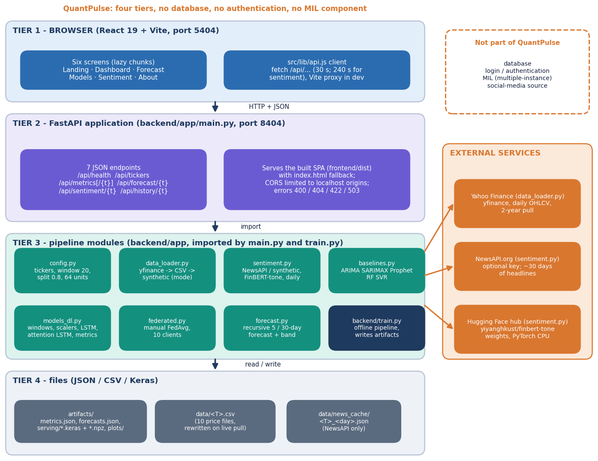
System architecture
Four tiers, no database
Website: React 19 + Vite on port 5404, six screens (landing, dashboard, forecast, model comparison, news sentiment, method).
API: FastAPI on port 8404, seven JSON endpoints plus the built site; 400, 404, 422 and 503 errors carry a message.
Pipeline: data_loader, sentiment, baselines, models_dl, federated, forecast in backend/app; backend/train.py writes the artefacts.
State: JSON, CSV and Keras files only. No login, no database.
Notes:
The API serves the stored artefacts/metrics.json and forecasts.json; it does not load the saved Keras models at run time. Only the history and sentiment endpoints do live work (a Yahoo Finance download and FinBERT scoring).

Slide 5
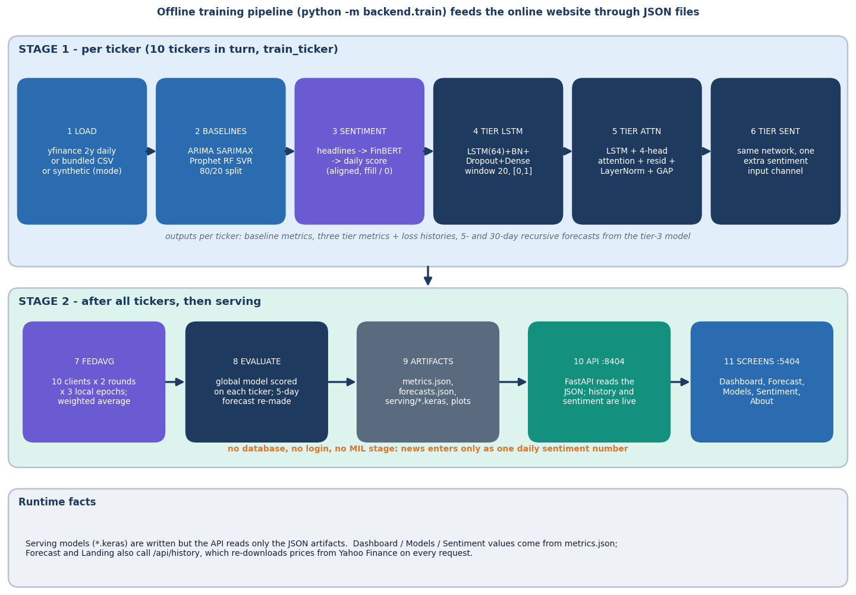
Methodology: load, align, model, evaluate
Load and align
Two years of daily prices per ticker; headlines scored by FinBERT-tone and averaged to one number per trading day.
Model tiers
Five baselines, LSTM, LSTM + attention, + sentiment, and a FedAvg hybrid over ten clients.
Evaluate and serve
MAE, MSE, RMSE, R2 and direction on an 80/20 chronological split; stored forecasts shown on the website. Offline: MIL on real headlines.
High-level workflow of backend/train.py and the serving layer.
Notes:
One command (python -m backend.train) runs the whole ablation per ticker and then the federated stage, then writes the artefacts the API serves.

Slide 6
Data: prices, fallback headlines and real news
10
501
166-191
46.5k
tickers: TSLA, AAPL, AMZN, MSFT, GOOGL, NVDA, META, FDX, IBM, ORCL
daily rows per ticker, 2024-09-09 to 2026-09-08; 97 test windows
synthetic template headlines per ticker (no NewsAPI key)
real FNSPID headlines, 7 tickers (offline MIL study)
 | Shipped product | Offline MIL study
Prices | Yahoo Finance daily OHLCV through yfinance, last two years, chronological 80/20 split | Yahoo Finance 2016-2023, seven tickers, same OHLCV features
News | NewsAPI when a key is set; otherwise 11 template headlines, last 90 trading days only | FNSPID news (Dong et al., KDD 2024), mostly day-level stamps; dense only from 2022
Social media | none - no data source was available | none
Label | next close (regression); trend flag = day-5 forecast vs last close | next-day close above today's (bag-level label)
Split | 80/20 chronological; scalers fitted on the first 80 % of rows | three expanding folds tested on Q2, Q3, Q4 2023: 1,309 test samples
The application re-downloads prices on every history call, so the experiments use a pinned snapshot of the same window.
Notes:
Prices are real. The headlines inside the product are synthetic unless a NewsAPI key is set, and NewsAPI only returns about a month, which is also why the base paper's sentiment runs cover 30 days. The offline study uses real headlines from the public FNSPID dataset.

Slide 7
Preprocessing
Daily OHLCV
20-day sliding window
Min-Max to [0,1]
Sentiment channel added
Chronological 80/20 split
Next-day close target
20 x 5-6
0 - 1
window length x features (Open, High, Low, Close, Volume + sentiment)
scaled range; test values outside the training range are clipped
Scalers are fitted on the first 80 % of rows, then applied to all rows and clipped; where prices rise above the training maximum the target is flat at 1.0.
Sentiment: headline scores (FinBERT-tone, positive minus negative, -1 to 1) are averaged per trading day, forward-filled, and zero before the first headline.
Offline MIL study: a headline joins the bag of the first trading day whose close is not earlier than its time stamp; instances are 3 FinBERT probabilities + 64 PCA components.
Known limit: the product's sentiment channel is exactly zero for every training row (headlines exist for the last 90 days only).
Notes:
make_windows, fit_scalers and apply_scalers in models_dl.py. The clipping and the empty sentiment channel were found while re-running the pipeline and are reported as limitations.

Slide 8
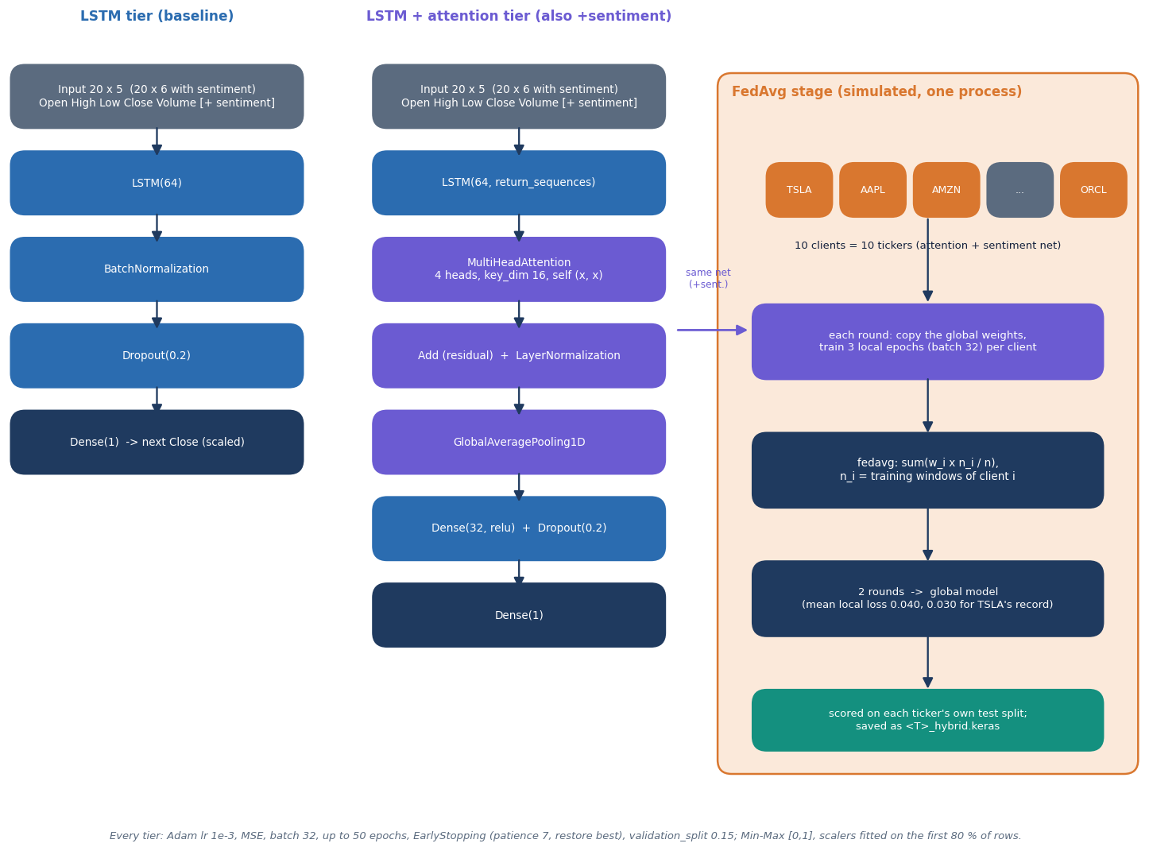
Models: LSTM, attention, sentiment and FedAvg
LSTM tier: LSTM(64), batch norm, dropout 0.2, one dense output.
Attention tier: LSTM(64, sequences), 4-head self-attention, residual, layer norm, average pooling, dense 32.
Sentiment and FedAvg: one extra input channel; ten clients average weights, 2 rounds x 3 epochs.
Offline MIL model: gated attention pools a day's headlines into one vector joined to an LSTM over prices.
Architecture of the model tiers as implemented in models_dl.py and federated.py.
Notes:
The attention in the product runs over the 20 price steps, not over news instances. The MIL model in the offline study attends over headlines.

Slide 9
Training and evaluation configuration
Setting | Value
Deep tiers | Adam, learning rate 1e-3, MSE loss, batch 32, up to 50 epochs, validation split 0.15, early stopping (patience 7, best weights), seed 42
Federated stage | ten ticker clients, 2 rounds x 3 local epochs, weights averaged in proportion to training samples
Baselines | ARIMA(5,1,0), SARIMAX(1,1,1)x(1,1,1,5), Prophet, Random Forest (200 trees, lag 20), SVR (rbf, C = 10)
Re-run for this report | 5 seeds on the same 501 training rows; persistence baseline; true-target scoring; 34 min on a shared CPU
Offline MIL study | AdamW 2e-3, batch 128, up to 60 epochs, patience 7, hidden size 32, 5 seeds x 3 expanding folds, threshold 0.5
Machine | Core i5-12500, 15.7 GB RAM, no GPU; Python 3.11.9, TensorFlow 2.16.2, PyTorch 2.5.1 (CPU)
Hyper-parameters are those in config.py, models_dl.py and federated.py; no tuning was done for this report.
Notes:
The first three rows are the shipped configuration. The last rows describe the added experiments, which reuse the shipped modules unchanged.

Slide 10
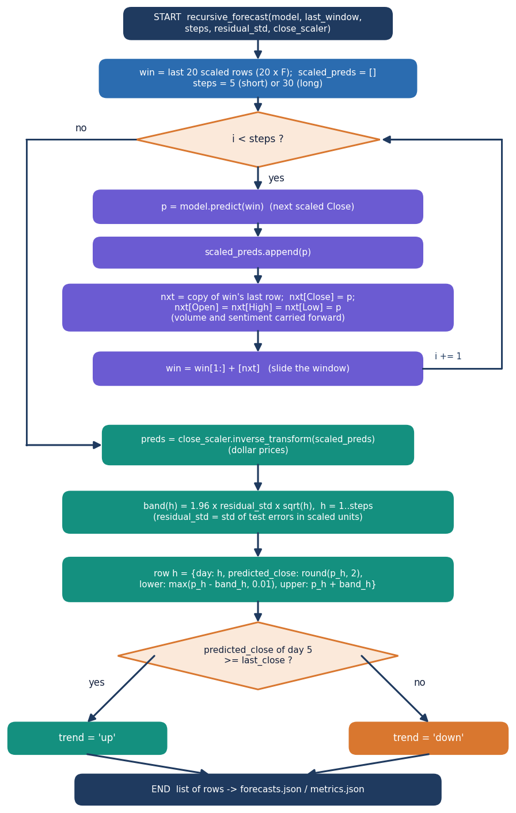
Decision logic: forecast, band and aggregation
Step | Rule
Multi-step forecast | feed each predicted close back into the 20-day window
Rolled-forward bar | Open, High, Low set to the prediction; volume and sentiment kept
Confidence band | prediction +/- 1.96 x residual std x sqrt(h); lower floor 0.01
Trend flag | up if the day-5 forecast is at or above the last close
FedAvg | w = sum over clients of (n_i / n) x w_i
MIL pooling (offline) | z = sum of a_i h_i, a_i = softmax of a gated score
The 5-day forecast stored for each ticker comes from the federated global model; the 30-day forecast comes from the local attention + sentiment model.
Notes:
This mirrors forecast.py (recursive_forecast) and federated.py (fedavg). Because one-step residuals set the band, it widens only with the square root of the horizon and does not reflect model bias.

Slide 11
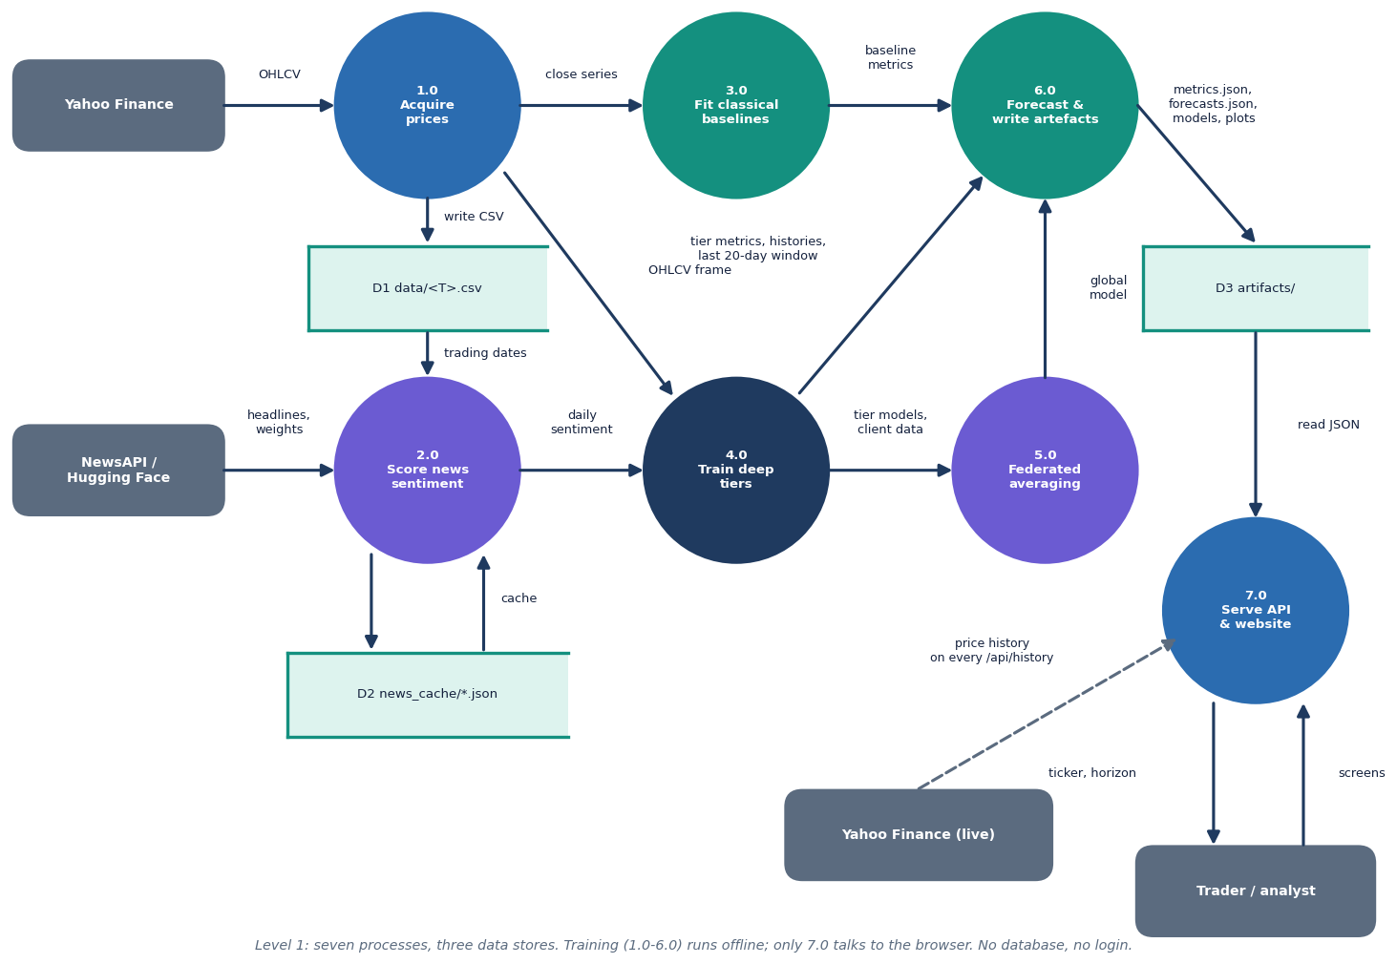
Data flow and modules
Module | Role
data_loader.py | yfinance, CSV, synthetic fallback
sentiment.py | NewsAPI, FinBERT-tone, daily score
baselines.py | ARIMA, SARIMAX, Prophet, RF, SVR
models_dl.py | windows, scalers, LSTM tiers
federated.py | FedAvg simulation
forecast.py | 5- and 30-day forecasts
main.py | 7 endpoints, SPA serving
frontend/src | 6 React screens
tests/, scripts/ | 56 tests, smoke, experiments
Level-1 data-flow diagram of the platform.
Notes:
Level 1: load data, align sentiment, train baselines and deep tiers, aggregate federated weights, write artefacts, serve them, draw screens.

Slide 12
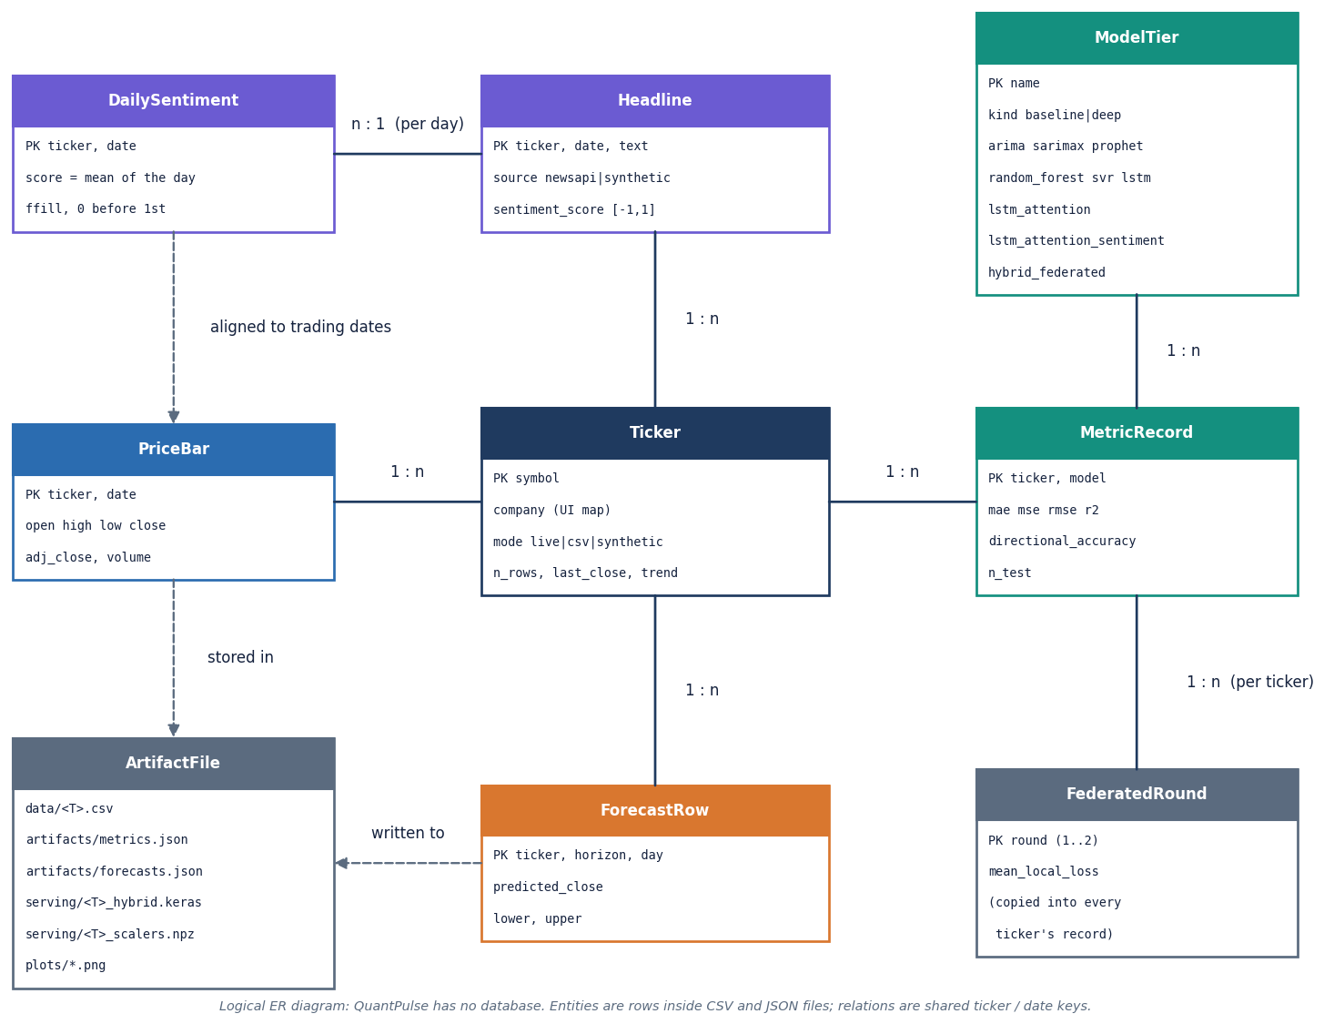
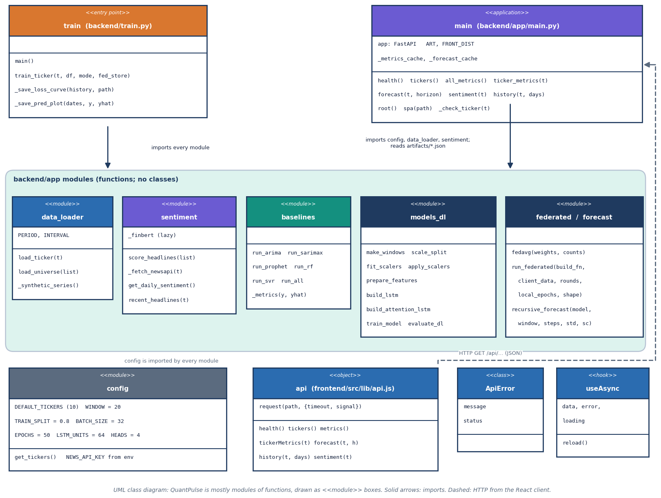
Entities and UML (no database)
QuantPulse keeps no database; the ER diagram is logical (prices, headlines, daily sentiment, model tiers, metrics, forecasts, artefact files).
The backend is mostly functions grouped in modules; the diagram shows modules and the API app.
Notes:
Honest point: there is no persistence layer and no user model. Everything is regenerated by python -m backend.train.

Slide 13
Technology stack
Layer | Technology
Language and API | Python 3.11.9, FastAPI 0.141.1, Uvicorn 0.52.4; CORS limited to localhost origins
Deep learning | TensorFlow 2.16.2 with Keras 3.15.1 (LSTM, MultiHeadAttention, manual FedAvg)
Classical models | scikit-learn 1.9.0 (Random Forest, SVR), statsmodels 0.15.0 (ARIMA, SARIMAX), Prophet 1.4.0
Language model | transformers 4.47.1 with PyTorch 2.5.1 (CPU): FinBERT-tone for inference; offline MIL models in PyTorch
Data | yfinance 1.7.0, pandas 3.0.5, NumPy 1.26.4; NewsAPI (optional key); FNSPID headlines for the offline study
Front end | React 19, Vite 8, Recharts 3, Framer Motion, React Router 7
Testing and run | pytest, FastAPI TestClient, smoke script, Playwright captures; run.bat or Docker; ports 8404 and 5404
Notes:
Versions are those installed on the measurement PC. TensorFlow has to be imported before scikit-learn on this machine, so the tests and experiment scripts import it first.

Slide 14
Implementation progress
Component | Status | Evidence
Data loader, five baselines, LSTM and attention tiers, sentiment channel, FedAvg | Done | python -m backend.train writes metrics, forecasts and models for 10 tickers
FinBERT-tone scoring and daily alignment | Done | headlines are synthetic templates by default (166-191 per ticker)
API (7 endpoints) and React website (6 screens) | Done | 26/26 smoke checks; 56/56 pytest tests
Multiple instance learning on real headlines | Offline only | scripts/mil_study.py; best MIL variant 51.4 % vs always-up 53.6 %
Precision, recall and F1 in the product | Not done | product reports MAE, RMSE, R2 and direction only
Social-media text source | Not done | no data source available
Real federated deployment, database, accounts | Not done | FedAvg is simulated in one process; no persistence or login
Notes:
State of the code base. The last four rows are the honest gaps against the batch objectives.

Slide 15
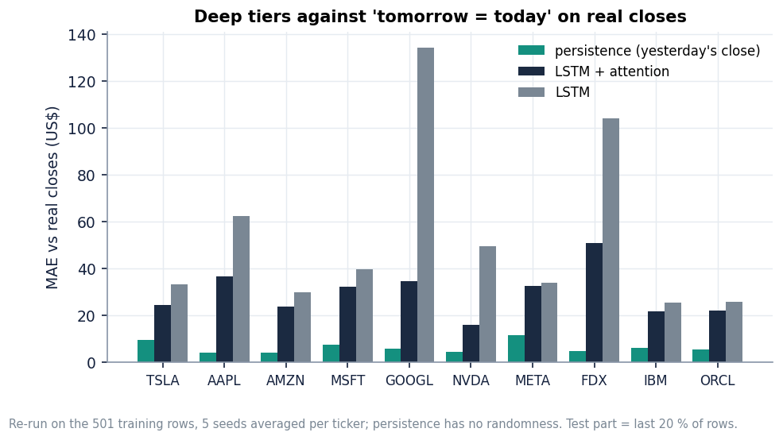
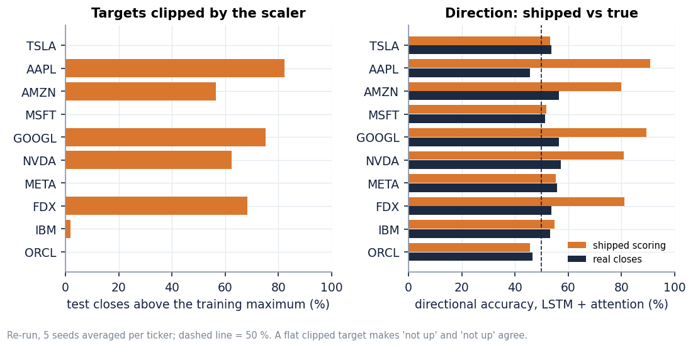
Preliminary results
$6.24
$29.37
53% vs 68%
53.6%
mean error of 'tomorrow = today' (persistence) on the test windows
best deep tier (LSTM + attention) scored against real closes
direction accuracy: real closes vs as reported by the app
always-up accuracy; MIL attention model 49.8%
Shipped artefacts: Random Forest has the lowest error on 6 of 10 tickers; sentiment and FedAvg raise the deep-tier error. Forward test from 2026-09-08: 5-day forecast MAE $59.04 vs $11.09 for no change, trend right for 4 of 10; mean forecast -14.8% vs actual -0.4%. The base paper's R2 of 0.91 was not reproduced (different data and protocol).
Notes:
Persistence beats every deep tier on real closes. The app scores test targets clipped to the training range, which inflates direction from 53 to 68 percent. The MIL study on real headlines found no gain over a price-only LSTM: attention MIL minus price-only is +1.3 points with a 95 percent interval of -1.5 to +4.0.

Slide 16
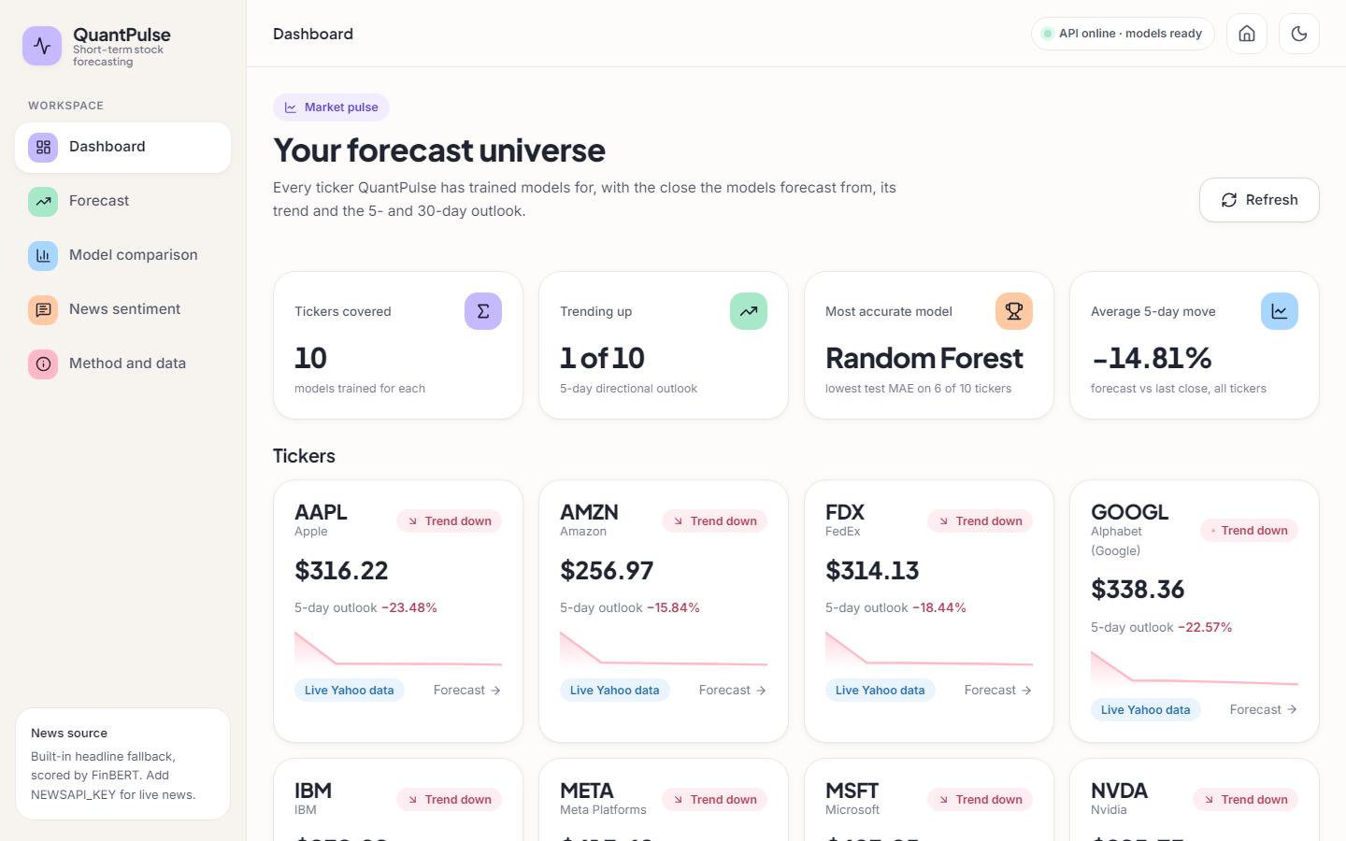
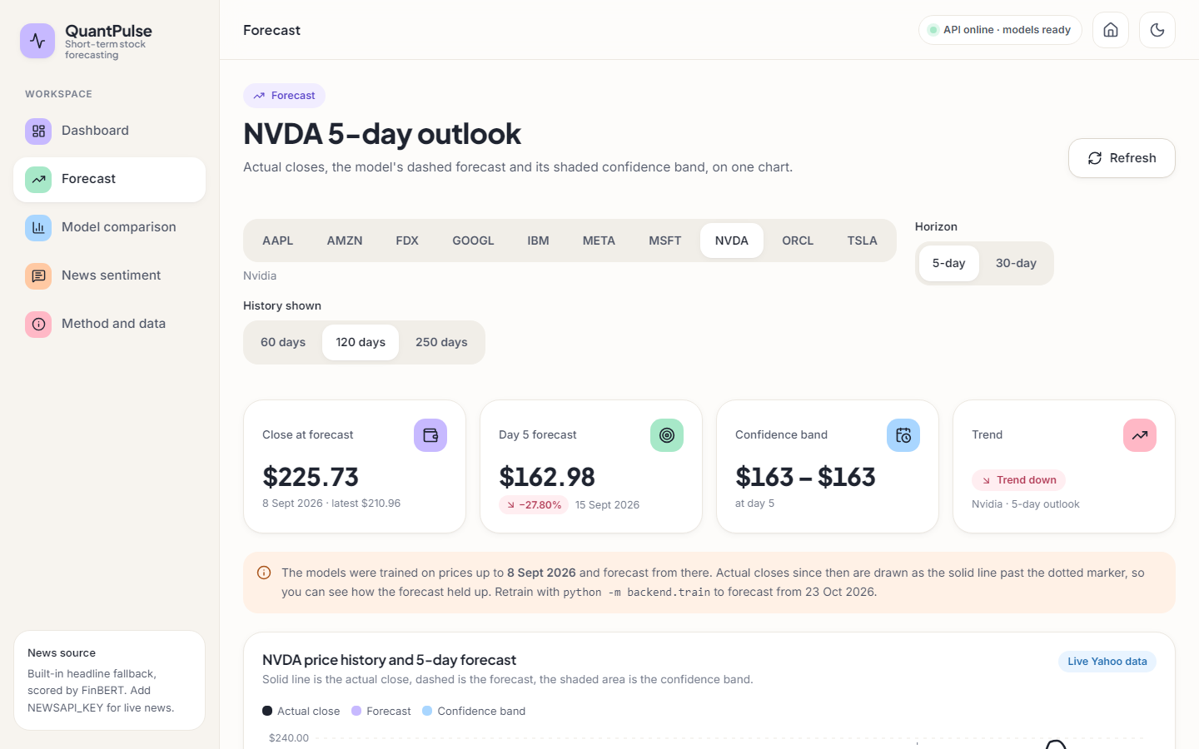
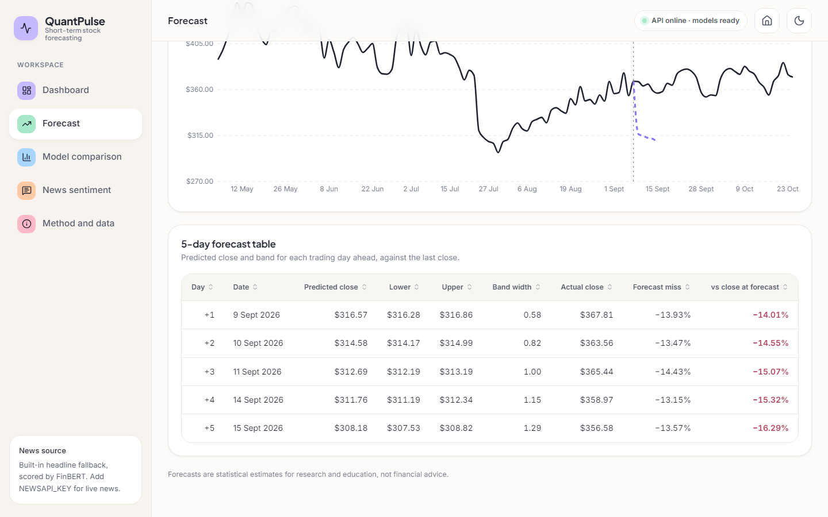
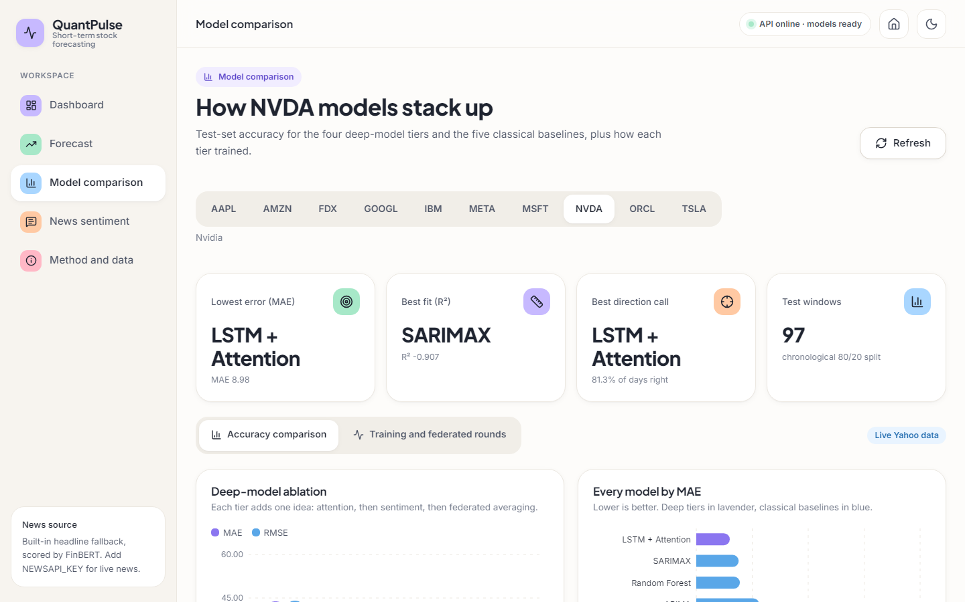
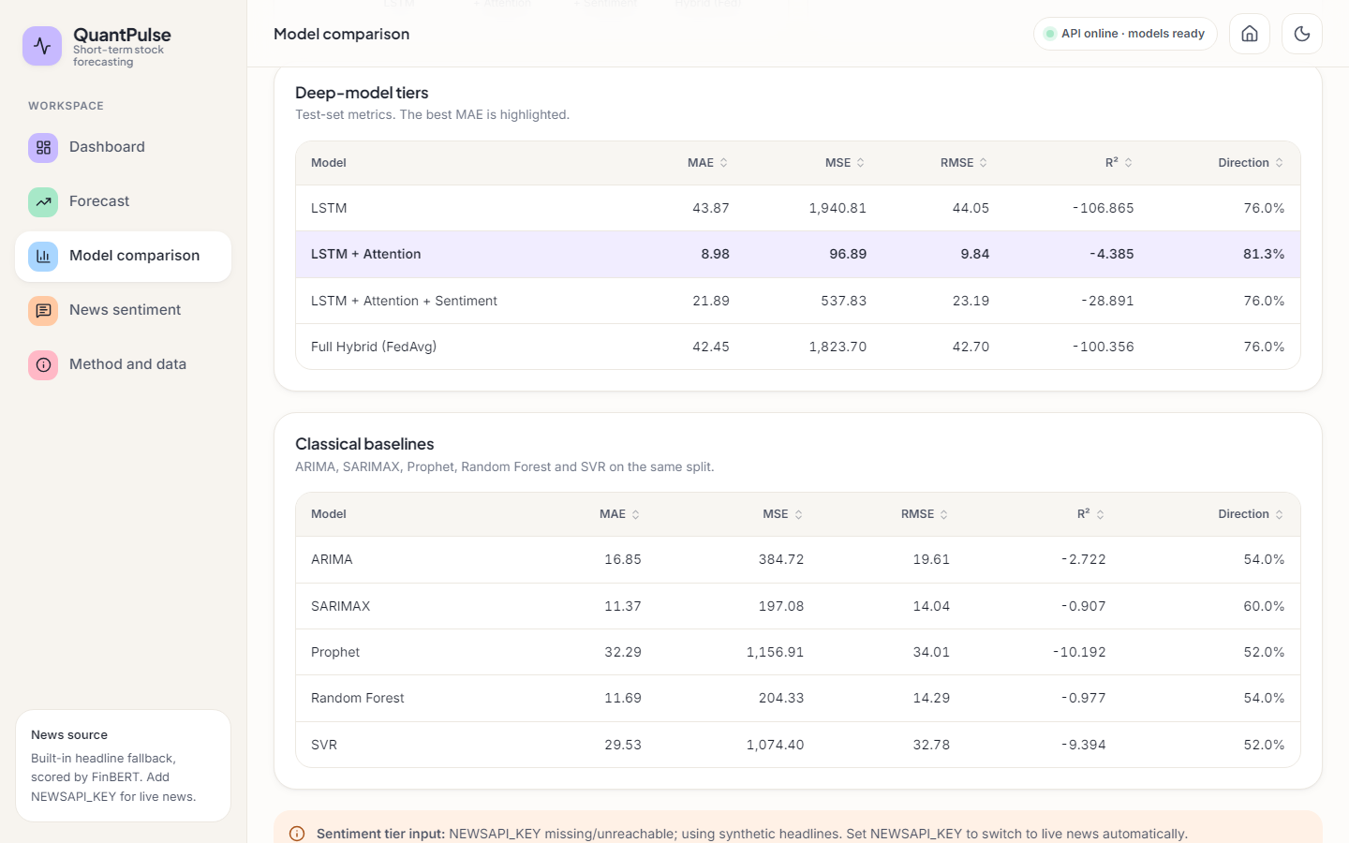
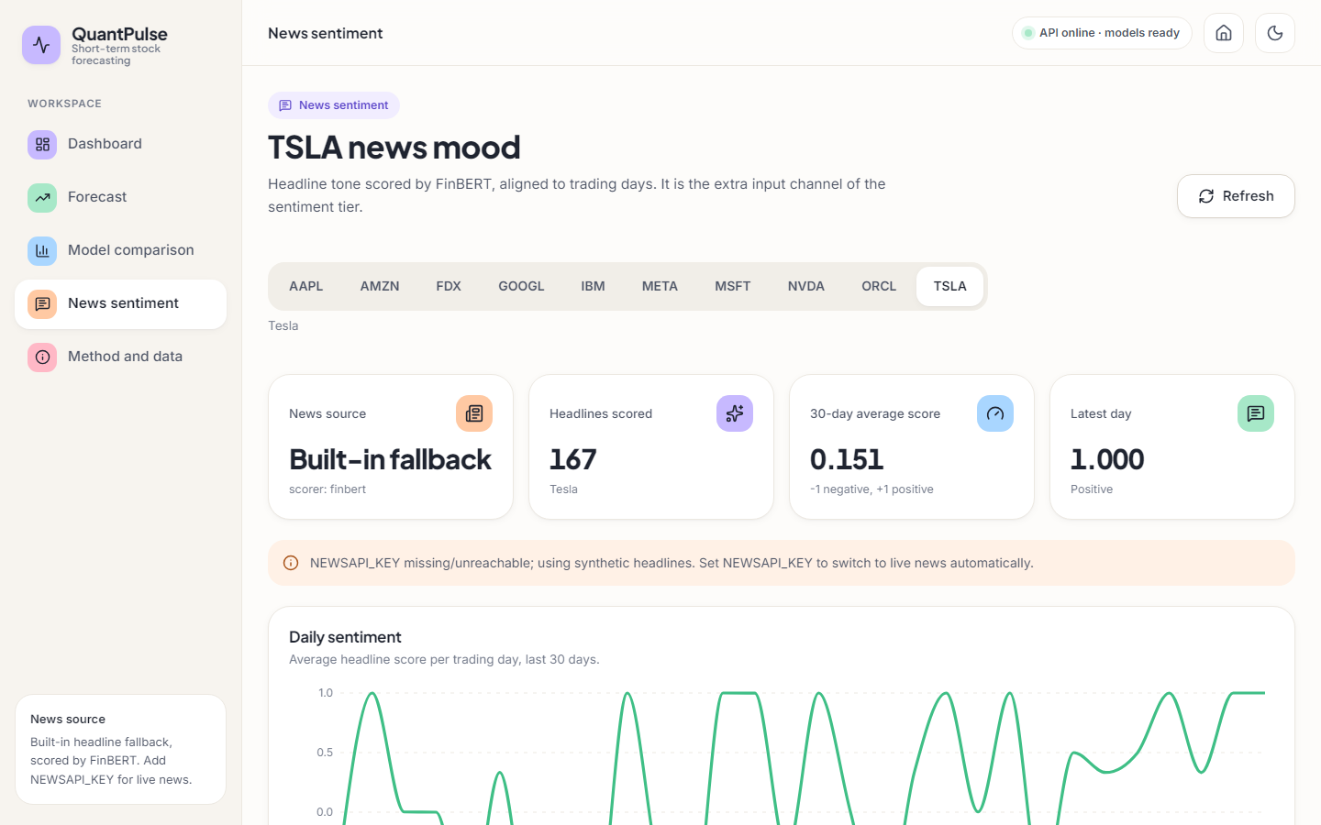
Output screens
Dashboard: ten tickers, last close, trend, 5-day outlook
Forecast: NVDA 5-day outlook and notice about stale artefacts
Forecast table with actual close and forecast miss
Model comparison: ablation charts for NVDA
Deep-tier metrics table
News sentiment: source and FinBERT scorer
Real captures of the running application at 1440 x 900 with the shipped artefacts and live Yahoo Finance prices.
Notes:
Real screenshots from the running website. The forecast table shows the stored forecast next to the closes that actually followed, so the miss is visible to the user.

Slide 17
Initial testing and observations
56 / 56
26 / 26
11 ms
4.6 s
pytest tests passed (pipeline and API)
smoke-test checks passed against the live API
median time of a stored 5-day forecast call (127.0.0.1)
median time of a sentiment call (FinBERT scoring)
Observation | Action
Direction reported by the app 68% vs 53% against real closes (targets clipped to the training range) | Both reported; true-target scoring added in the re-run
Sentiment channel is zero for every training row (headlines only for the last 90 days) | Stated as a limitation; placebo run shows no sentiment effect can be measured
Stored 5-day forecasts averaged -14.8% while prices moved -0.4% | Forward test added; banner on the Forecast screen explains stale artefacts
History call takes 139 ms median because it re-downloads prices | Documented; caching listed as future work
Notes:
Tests run offline with stubs for network and FinBERT; the smoke script drives the live server. Every observation came from running the code and is recorded rather than hidden.

Slide 18
Challenges and corrective actions
Challenge | Corrective action
Free news APIs return about a month of headlines, so real news cannot cover the training window | Labelled synthetic fallback in the product; offline MIL study on the public FNSPID dataset instead
Multiple instance learning and F1 are in the objectives but not in the base paper's pipeline | Added scripts/mil_study.py with bags, gated attention, accuracy, precision, recall, F1 and a placebo
Deep tiers do not beat 'tomorrow = today' ($6.24 vs $29.37) | Persistence baseline and true-target scoring reported next to the shipped numbers
Short, clipped test period: 97 windows per ticker, prices above the training range | Scaler clipping documented; forward test on the 30 days that followed the training end
CPU-only machine shared with other jobs; TensorFlow and scikit-learn DLL order | Experiments run sequentially with TensorFlow imported first; timings reported as indicative
Notes:
Each challenge was met by a concrete design choice or by measuring it and saying so in the report.

Slide 19
Next steps
1
Fix the evaluation
2
Bring MIL into the product
3
Real news and social media
4
Make it deployable
Score against real closes, add the persistence baseline and walk-forward validation, and fill the sentiment channel for the whole history.
Add the bag-of-headlines model with a classification head that reports accuracy, precision, recall and F1.
Use an archived news source for the full window and add a social-media text source.
Cache prices, retrain on a schedule, add a database and accounts, and try federated learning across real clients.
Priority: items 1 and 2 close the largest honest gaps - a trustworthy evaluation and the missing multiple-instance component.
Notes:
Plan to the final review. The first two items address the biggest gaps against the objectives.

Slide 20
Thank you
Questions and suggestions are welcome.
Notes:
Likely questions: why the deep models do not beat persistence; why the sentiment tier is worse; where multiple instance learning is; what the offline study found; how the numbers compare with the base paper.

