Slide 1

Stock Market Prediction Using Multi-Source Multiple Instance Learning
Final Review · QuantPulse
Team Details : Batch C4
Under the Esteemed Guidance of
K Anusha
[DESIGNATION], Department of CSE
23K91A05J7 POTTEPAKA LINGASWAMY
23K91A05D7 MADUNA NAVEEN KUMAR
24K95A0517 MEEDIGERI KEERTHI
23K91A05E8 MAREDDY SAI KARTHIK
DEPARTMENT OF COMPUTER SCIENCE AND ENGINEERING · [COLLEGE NAME] · Academic Year [ACADEMIC YEAR]
Notes:
Introduce the team and QuantPulse: a working forecasting product that follows the base paper, plus an offline multiple-instance-learning study on real headlines.

Slide 2
Table of Contents
Abstract
Base Paper & Literature Survey
Research Gap, Problem Statement & Objectives
Proposed System & Architecture
Methodology, Data & Algorithm Workflow
Interaction & Data Design
Implementation Highlights
Results: Forecasts, Scoring, MIL Study
Parameter Analysis, Performance & Testing
Comparison with Base Paper
Output Screens
Conclusion, Limitations, Future Scope & References
Dept. of CSE | Batch C4 | Final Review
2
Notes:
The agenda follows the report: problem, design, method, results, comparison, screens, conclusion.

Slide 3
Abstract
Price-only forecasts ignore news and sentiment, and labelling every article is impractical. The project asks for multi-source prediction with Multiple Instance Learning (MIL). QuantPulse, the product, implements the base paper's pipeline: LSTM, multi-head attention, FinBERT sentiment and simulated FedAvg, as a FastAPI + React website for ten tickers.
Measured honestly, the forecasts did not hold up: a re-run on the same data scores MAE $29.4 against $6.2 for 'tomorrow = today'; the stored 5-day forecasts averaged -14.8% against an actual -0.4%, with the trend right for 4 of 10 tickers.
The app's directional score (68%) is inflated by clipped test targets; against real closes it is 53%. Its sentiment channel is zero in training and synthetic in test.
An offline MIL study on 46,532 real FNSPID headlines (7 tickers, 1,309 test days) found no gain: the best MIL variant scored 49.8% accuracy against 53.6% for always-up.
56 pytest tests and 26 smoke checks pass. No social-media source, no MIL inside the product, no precision/recall/F1 in the app: stated on every results slide.
Dept. of CSE | Batch C4 | Final Review
3
Notes:
Give the product, then the honest headline results and the limits. The MIL study is offline; the product does not contain MIL.

Slide 4
Base Paper
Y. Nejatbakhsh and M. Aliasgari, "Enhancing stock market prediction with hybrid deep learning: Integrating LSTM, transformer attention, federated learning, and sentiment analysis," IEEE Access, vol. 14, pp. 3926-3942, 2026, doi: 10.1109/ACCESS.2025.3649668.
Aspect | Base paper: hybrid LSTM, Transformer attention, federated learning and sentiment analysis
Models | Baselines ARIMA, SARIMAX, Prophet, Random Forest, SVR vs LSTM (64 units + batch norm + dense); hybrid adds multi-head attention, FinBERT-tone sentiment and simulated FedAvg over ten clients
Data | Yahoo Finance for ten firms (Tesla, Apple, Airbnb, Amazon, FedEx, IBM, Microsoft, Nvidia, Oracle, Google); hybrid on a one-month window because NewsAPI returned 30 days of headlines
Protocol | Chronological split: 80/20 for baselines, 70/15/15 for the hybrid; 5- and 30-day horizons; R², MSE, MAE and a directional measure
Reported | Hybrid average R² 0.91 (all companies above 0.84); TSLA R² 0.888; baseline LSTM average trend accuracy 65.36% (Airbnb 94%, Tesla 34.9%, IBM 18%)
Stated limits | Sentiment limited to 30 days; federated learning only simulated; performance varies across companies
Dept. of CSE | Batch C4 | Final Review
4
Notes:
Nejatbakhsh and Aliasgari, IEEE Access 2026. QuantPulse follows this pipeline. The paper's tables are images, so only figures stated in its text are quoted.

Slide 5
Literature Survey
Work | Year | Approach | Finding / limitation
Nejatbakhsh, Aliasgari [1] (base paper) | 2026 | LSTM + multi-head attention + FinBERT-tone sentiment + simulated FedAvg; ten companies | Average R2 0.91; baseline LSTM trend accuracy 65.36 %; sentiment limited to 30 days
Zhang et al. [6] | 2018 | Multi-source MIL model: news events, Xueqiu sentiment, index data; Shanghai index | F1 +6.9 % / +9.2 % over nMIL (2015 / 2016); one Chinese index, event extraction needed
Deng, Yiu [8] | 2022 | Each trading day is a bag of news instances, bag-level label; S&P 500 direction | Reports better trend accuracy than baselines (abstract); news only, no price branch stated
Liao et al. [7] | 2026 | Attentive pooling of all daily news with stock-name queries; one model for many stocks | 7.11 % lower MAE (0.1913 to 0.1777) with pooling; six TWSE stocks plus BigData23
Officioso et al. [3] | 2026 | Large-language-model news sentiment combined with market data (title only) | Batch survey item; abstract not available, results not quoted
Chang [4] | 2025 | Financial sentiment and feature fusion for Chinese-market prices (title only) | Batch survey item; abstract not available, results not quoted
Xiao [5] | 2024 | Financial news, text mining and investor sentiment for prediction (title only) | Batch survey item; abstract not available, results not quoted
Batch item [2] | 2024 | Hybrid AI with news, social-media sentiment and corporate indicators (title only) | Authors not in Crossref; abstract not available, results not quoted
Fischer, Krauss [18] | 2018 | LSTM networks for financial market prediction (cited by the base paper for LSTM) | LSTM suited to price sequences; used here only as the LSTM reference, no numbers quoted
Dept. of CSE | Batch C4 | Final Review
5
Notes:
Rows marked as title-only could not be verified beyond bibliographic records, so no result is quoted for them. Numbers shown come from the PDFs we read.

Slide 6
Research Gap
The base paper averages a day's headlines into one number; it does not treat the day's news as a bag of instances with only a bag-level label
As far as their descriptions show, the day-bag multiple-instance models [8], [6] are not paired with an LSTM price branch and multi-head attention as in the base paper
Sentiment is tested over a 30-day window only in the base paper; archived multi-year headline data are not used there [1], [11]
Reported gains are mostly price-level errors; a direction metric with precision, recall and F1 against a price-only baseline is the project's stated objective
Evaluation against a naive no-change forecast is rarely reported next to R2, although a level forecast one step ahead can score a high R2 by tracking the last price
Dept. of CSE | Batch C4 | Final Review
6
Notes:
The gap the batch asked us to address: an explicit multiple-instance treatment of a day's news, evaluated with direction metrics against a price-only baseline.

Slide 7
Problem Statement
Price-only models miss the news and sentiment that move markets
Labelling each news article individually is impractical and noisy
Financial data is volatile and non-stationary, so models degrade quickly
Predictions without explanation are not actionable for an investor
Need: a prediction model that fuses price history with news and sentiment under a multiple-instance formulation
Input
Output
Record
Daily OHLCV prices (Yahoo Finance) and financial headlines per ticker
5- and 30-day forecasts with confidence bands, trend flag, model comparison and sentiment views
metrics.json, forecasts.json, experiment JSON files and screenshots of the running website
Dept. of CSE | Batch C4 | Final Review
7
Notes:
The batch's problem statement, then the input, output and record of the product.

Slide 8
Objectives
1. Collect historical prices together with financial news and social-media text for the target stocks
2. Preprocess and align the multi-source data into daily instances grouped per trading day
3. Represent each trading day as a bag of news instances under the Multiple Instance Learning formulation
4. Train a hybrid model combining sequence learning over prices with attention over news content
5. Predict directional movement and evaluate with accuracy, precision, recall and F1-score
6. Compare multi-source performance against a price-only baseline
Dept. of CSE | Batch C4 | Final Review
8
Notes:
The six objectives from the batch document. The conclusion slide gives the status of each.

Slide 9
Proposed System
Data and features
Yahoo prices
20-day windows
Min-Max scaling
Headlines
FinBERT-tone
Daily sentiment
Models and serving
LSTM(64)
+ 4-head attention
+ sentiment channel
FedAvg x10 clients
JSON artefacts
FastAPI + React
Five classical baselines (ARIMA, SARIMAX, Prophet, Random Forest, SVR) are scored next to the four deep-model tiers on an 80/20 chronological split.
Forecasts: 5- and 30-day recursive predictions with a 95% band, shown with actual closes on six screens.
Multiple Instance Learning is not inside the product; it was studied offline on real headlines (bag = one day's news for one ticker).
Dept. of CSE | Batch C4 | Final Review
9
Notes:
The proposed system as two chains. Be explicit that MIL is an offline study and that the product's sentiment is one number per day.

Slide 10
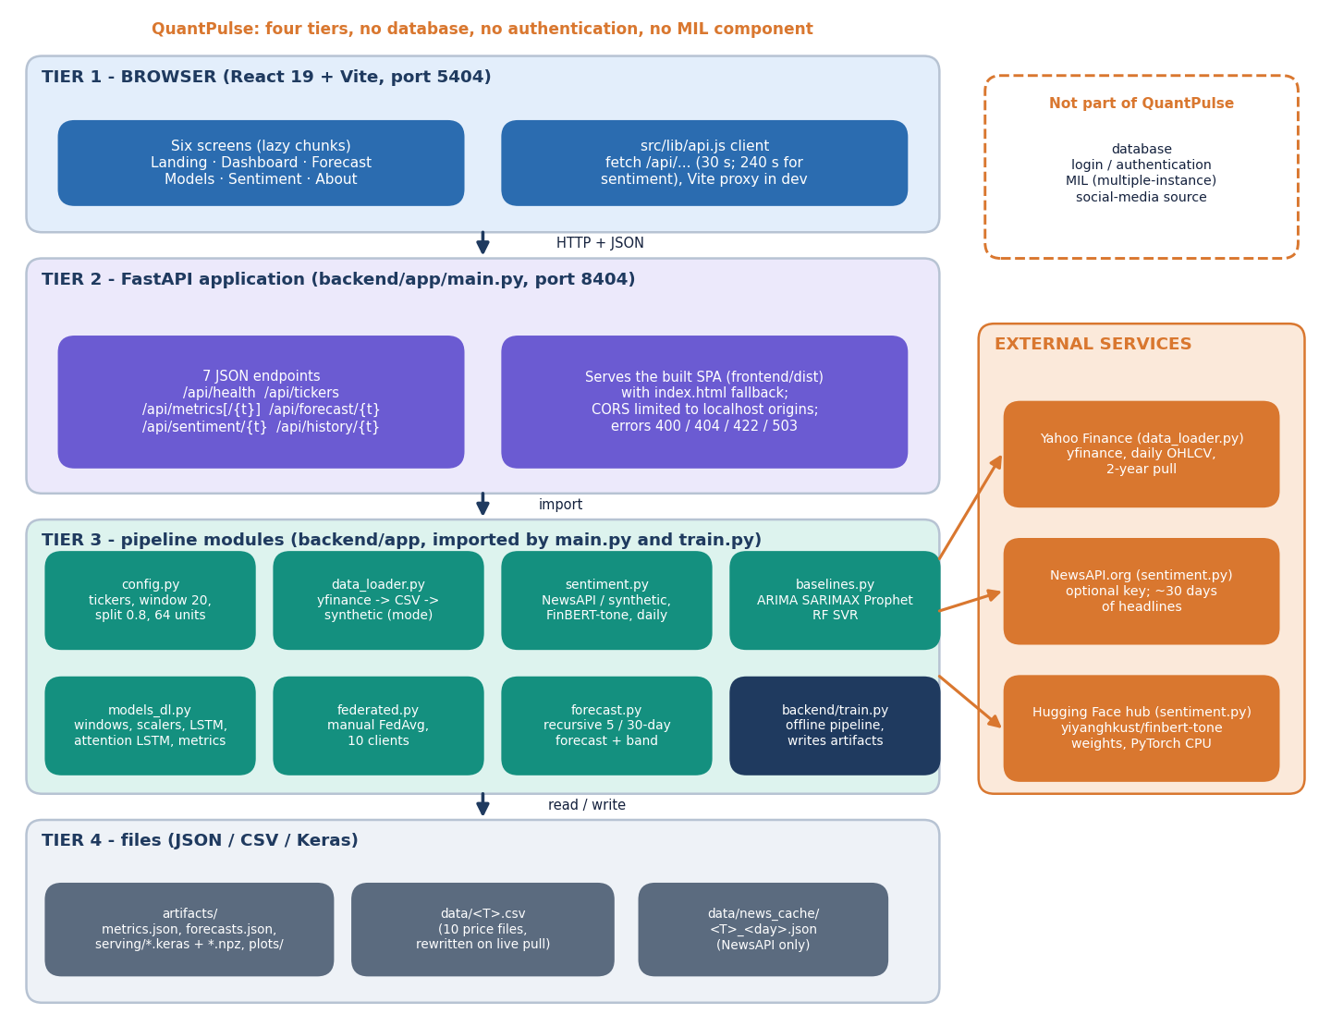
System Architecture
Website: React 19 + Vite, port 5404; six screens
API: FastAPI + Uvicorn, port 8404; 7 JSON endpoints and the static site
Pipeline: data loader, sentiment, baselines, deep models, FedAvg, forecast modules
State: JSON, CSV and Keras files; no database, no login
The API serves stored results; the saved .keras models are not loaded at run time
Dept. of CSE | Batch C4 | Final Review
10
Notes:
Four tiers. No database and no authentication. The API serves metrics.json and forecasts.json.

Slide 11
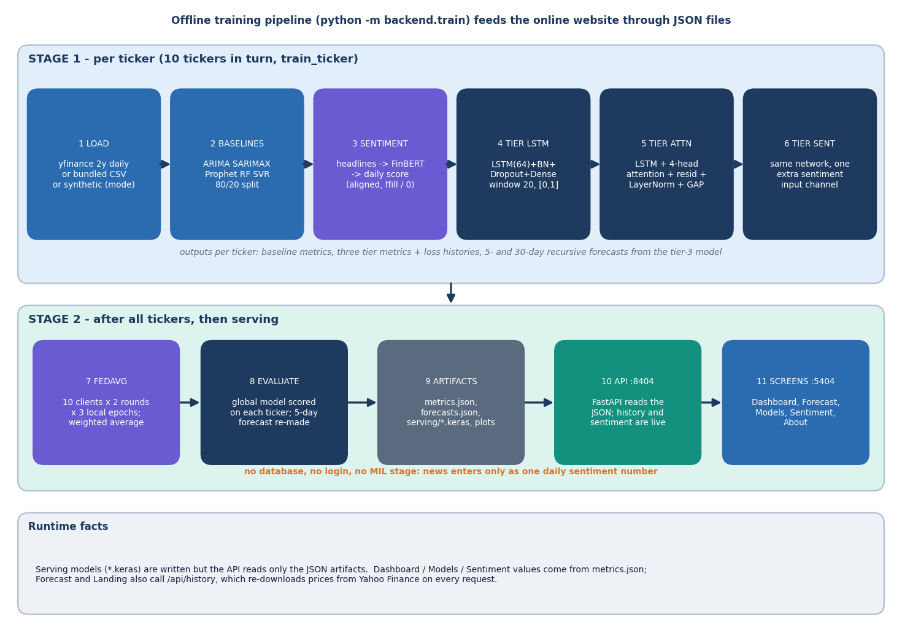
Methodology
Window of 20 trading days of OHLCV (+ sentiment); Min-Max scalers fitted on the first 80% of rows.
LSTM 64 units; attention tier adds 4 heads, residual, LayerNorm, pooling; batch 32, up to 50 epochs, early stopping.
FedAvg: each ticker is a client; 2 rounds x 3 local epochs; weights averaged by sample count.
Added here: five-seed re-run, persistence baseline, true-target scoring, forward test, MIL study.
Dept. of CSE | Batch C4 | Final Review
11
Notes:
Method in one picture, then the extra measurements that were added for the evaluation.

Slide 12
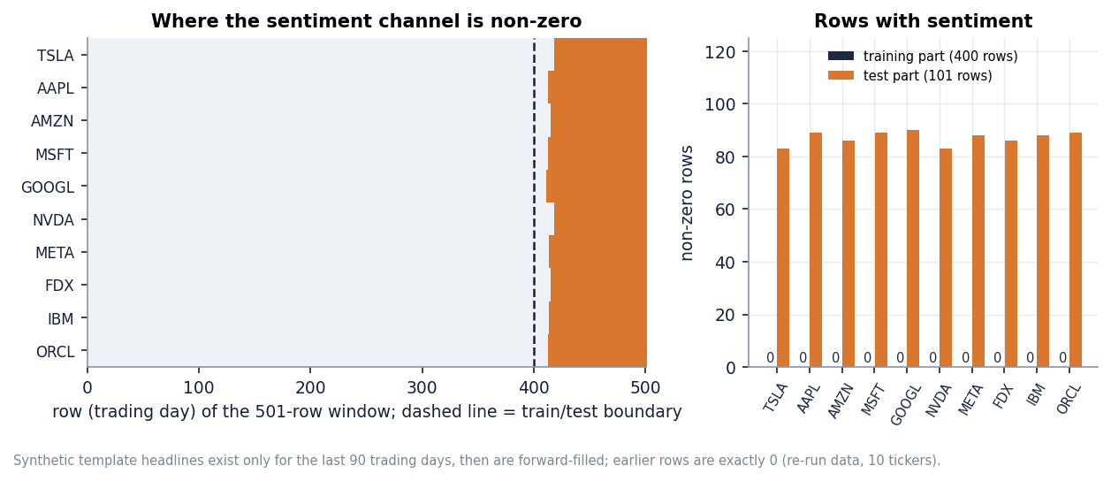
Dataset & Models
10 x 501
46,532
0
tickers x daily rows, 2024-09-09 to 2026-09-08
real FNSPID headlines, 7 tickers (MIL study)
non-zero sentiment rows in the training part (shipped channel)
Data | Size | Used for
Yahoo Finance OHLCV | 10 tickers | all models; pinned snapshot for the experiments
Synthetic template headlines | 166-191 per ticker | sentiment channel (no NewsAPI key); last 90 days only
FNSPID news [11] | 46.5k rows | offline MIL study; dense only in 2022-2023
Models | 9 + MIL | 5 baselines, 4 deep tiers; MIL variants offline
The shipped sentiment channel is zero for every training row and carries synthetic headline scores only in the last 90 trading days, so it cannot show a sentiment effect (right).
Dept. of CSE | Batch C4 | Final Review
12
Notes:
No NewsAPI key was set, so the product uses labelled synthetic headlines. Real headlines are used only in the offline MIL study.

Slide 13
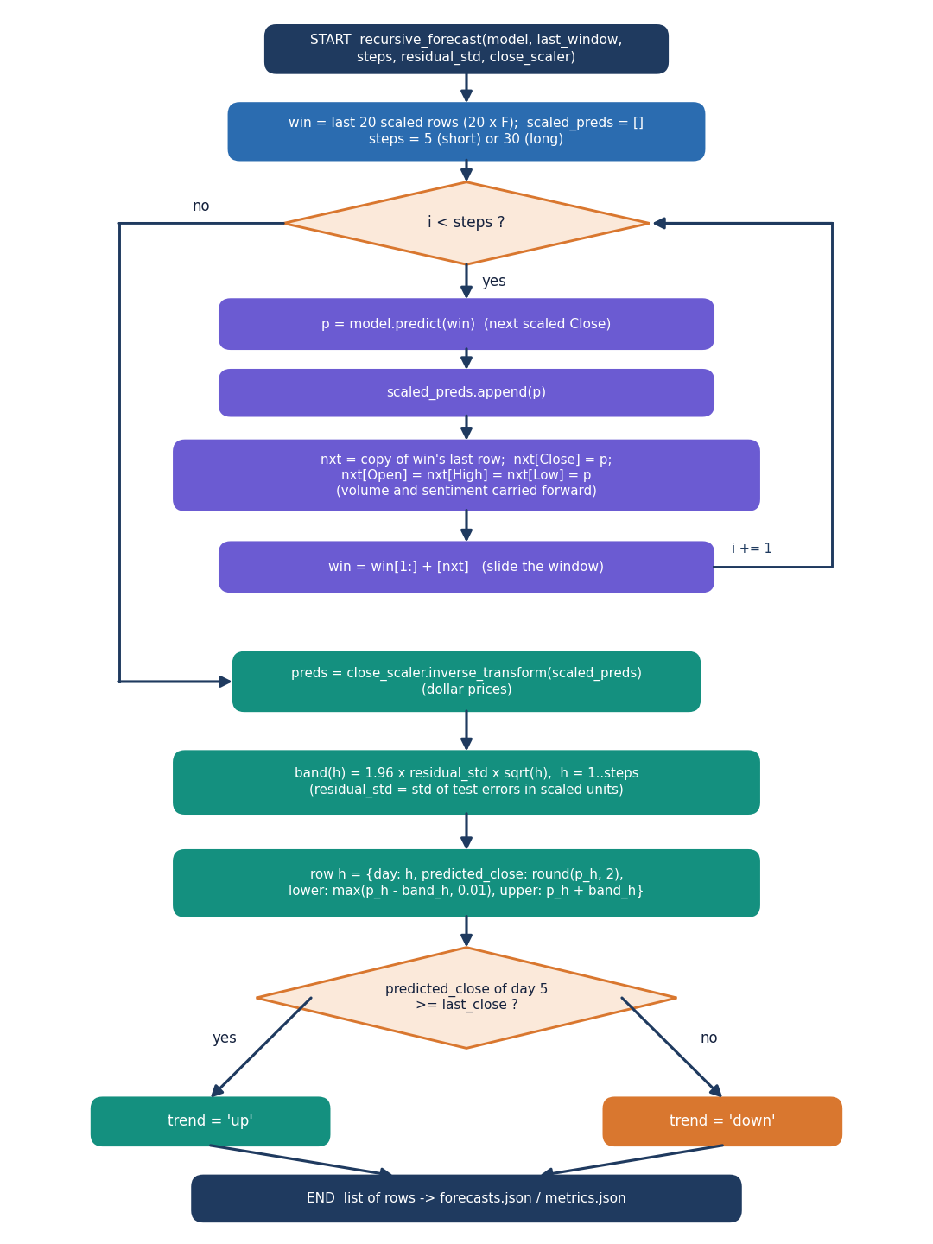
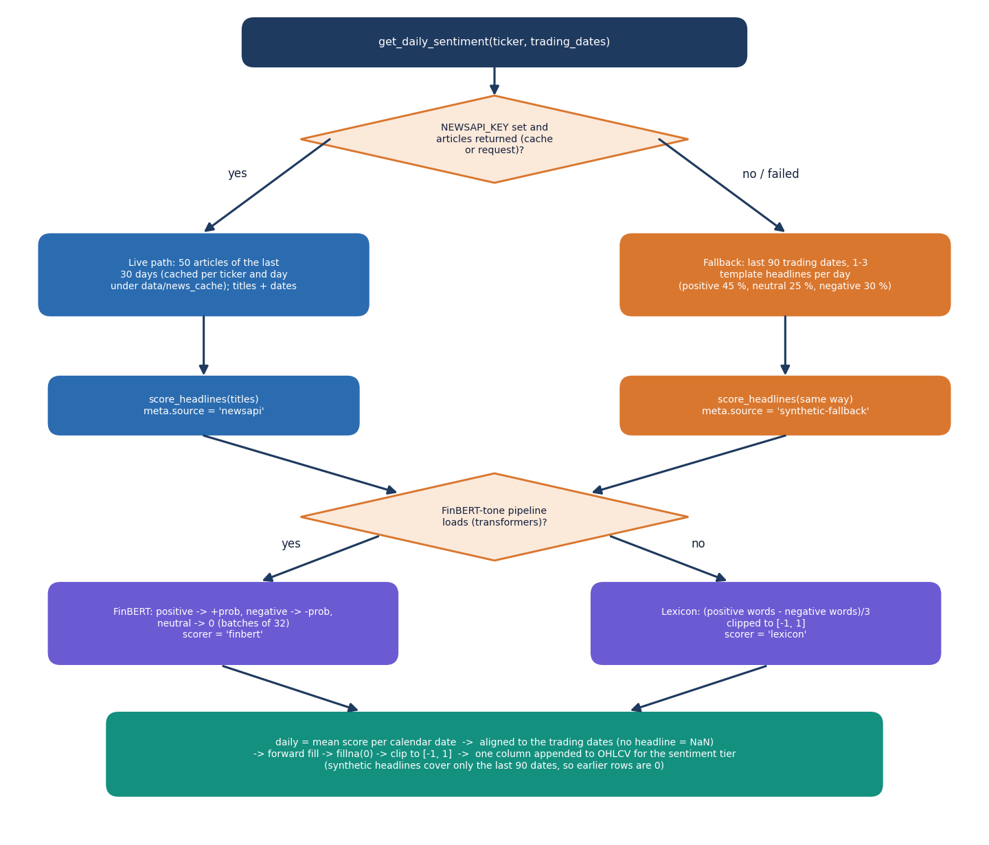
Forecast and Sentiment Workflow
Forecast: roll the predicted close forward, one step at a time.
Band: 1.96 x residual std x sqrt(day).
Sentiment: NewsAPI if a key exists, else synthetic templates; FinBERT-tone or lexicon; daily mean; fill forward, zero before the first headline.
Dept. of CSE | Batch C4 | Final Review
13
Notes:
The recursive forecast and the sentiment path as flowcharts.

Slide 14
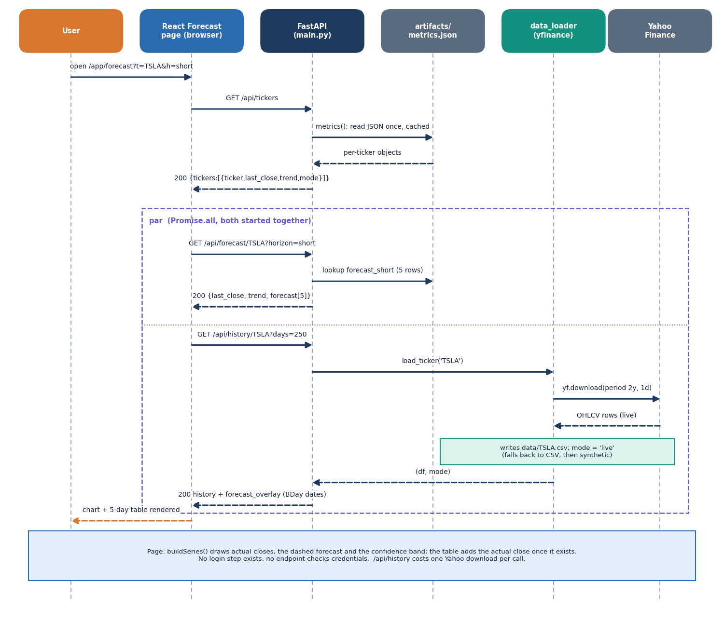
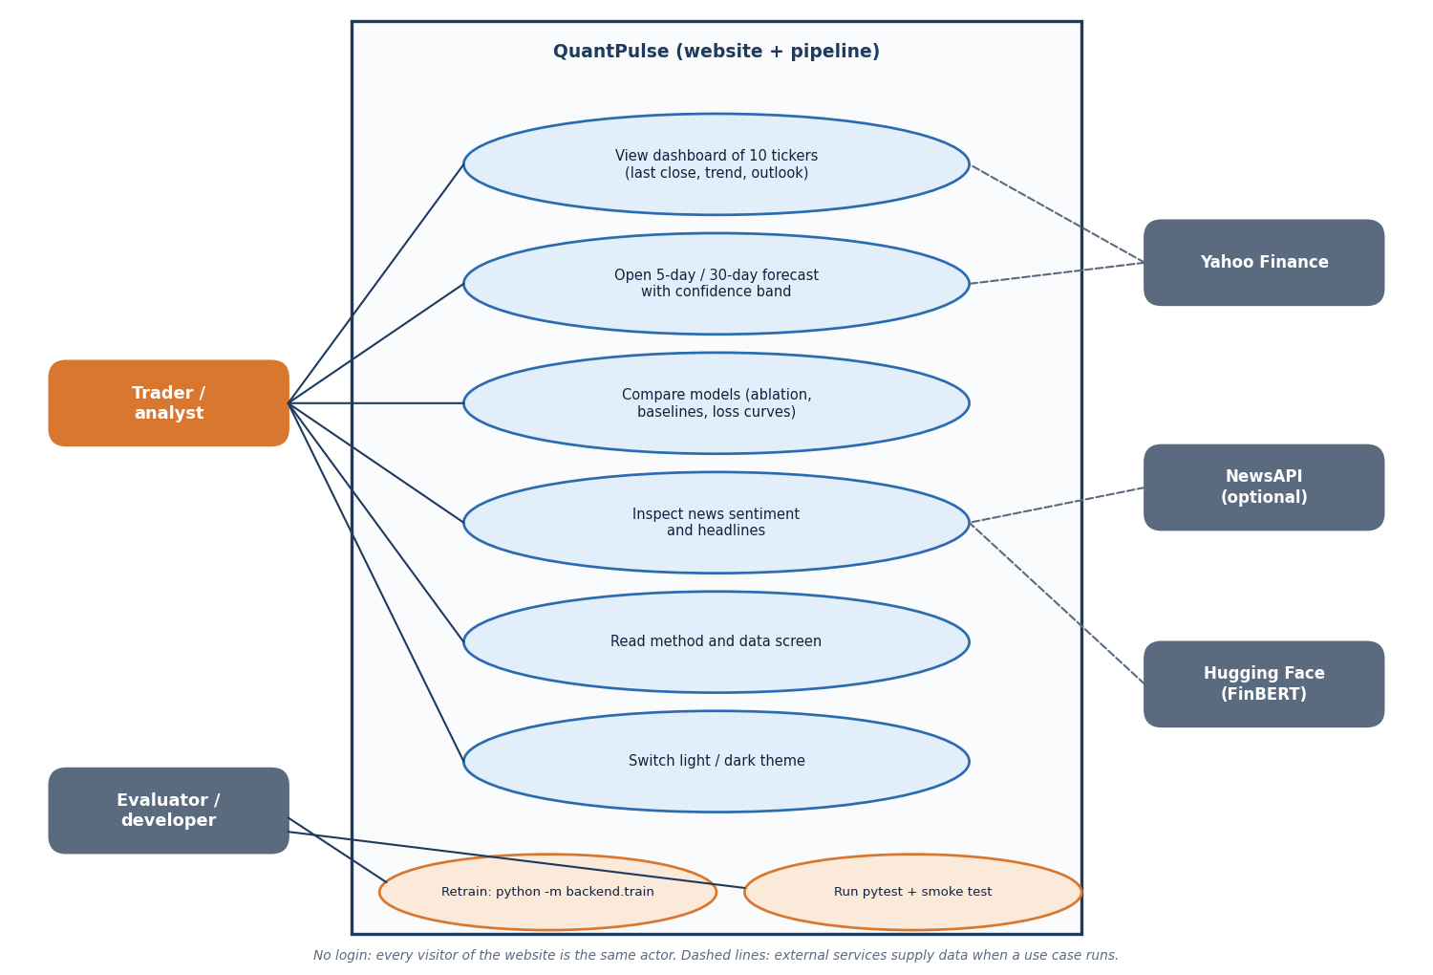
User – System Interaction
Dept. of CSE | Batch C4 | Final Review
14
Notes:
Sequence of the Forecast screen flow and the use cases of the analyst and the evaluator.

Slide 15
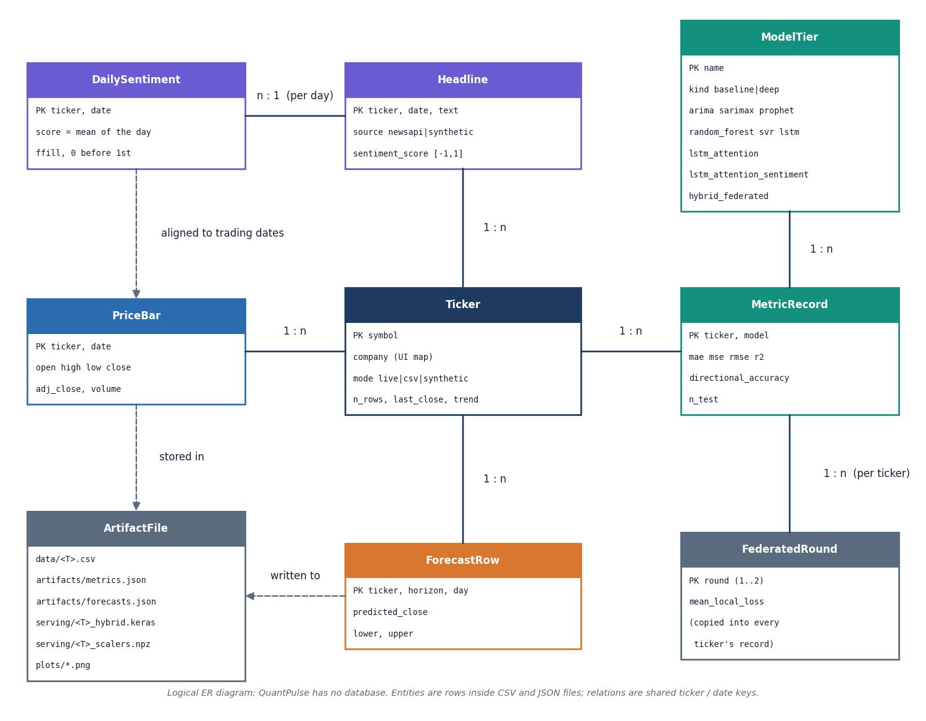
Data Design (no database)
Store | Content
artifacts/metrics.json | per-ticker metrics, histories, forecasts, headlines
artifacts/forecasts.json | 5- and 30-day forecasts
artifacts/serving/*.keras | saved models (not loaded by the API)
data/<T>.csv | prices; rewritten on each live pull
data/news_cache/ | NewsAPI cache (needs a key)
experiments/**/metrics.json | documentation experiments
No foreign keys and no persistence layer: the entities in the diagram are logical, files on disk.
Dept. of CSE | Batch C4 | Final Review
15
Notes:
QuantPulse has no database. The ER diagram shows logical entities.

Slide 16
Implementation Highlights
7
56 + 26
6
11 ms
JSON endpoints
pytest tests + smoke checks
React screens
median forecast response
Stored results are served from JSON; invalid symbols give 400, unknown 404, bad horizon 422, missing artefacts 503.
The Forecast screen overlays the actual closes that followed the forecast date and warns that the models were trained up to 8 Sept 2026.
/api/history downloads from Yahoo Finance on every request and rewrites the CSV; the first sentiment call loads FinBERT.
run.bat sets up the virtual environment, trains if artefacts are missing and starts both servers; Docker files exist but were not run here.
Not present: database, login, real federated deployment, social-media text, MIL inside the product.
Dept. of CSE | Batch C4 | Final Review
16
Notes:
Highlights and honest absences.

Slide 17
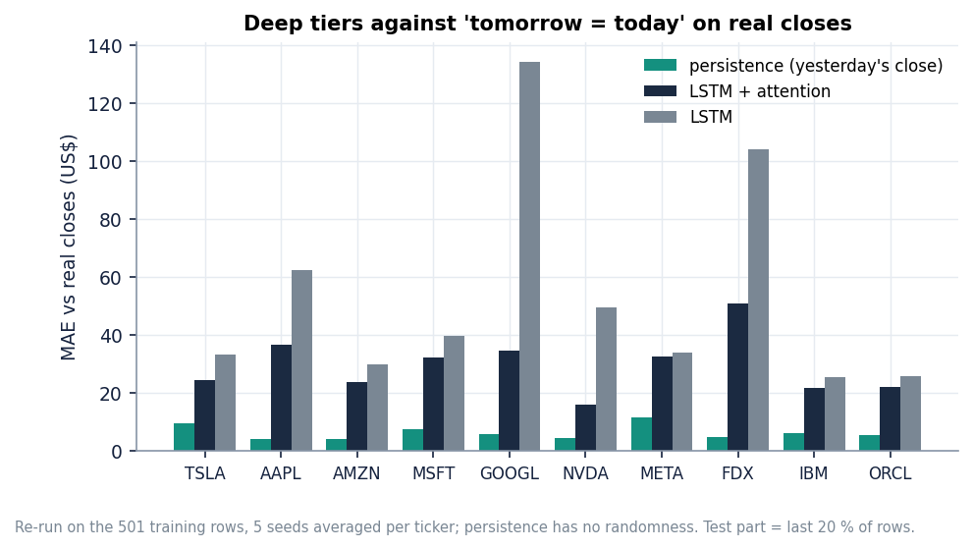
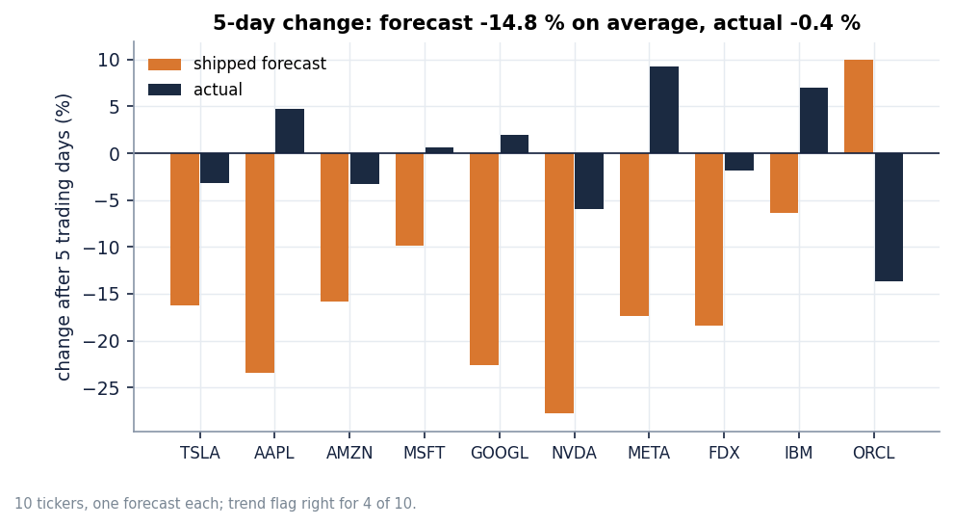
Results – Forecasts versus Reality
-14.8%
4 / 10
$59
$6.2
mean stored 5-day forecast change (actual -0.4%)
5-day trend calls right (30-day: 6 / 10)
5-day MAE vs $11 for 'no change'
persistence MAE vs $29.4 (LSTM + attention, 5 seeds)
Forward test: forecasts stored from the 2026-09-08 close against the 30 closes that followed. Shipped models: Random Forest has the lowest MAE on 6 of 10 tickers; no deep tier beats persistence on real closes. 9 of 10 tickers were flagged 'down' (mean -14.8%).
Dept. of CSE | Batch C4 | Final Review
17
Notes:
The stored forecasts predicted a large fall that did not happen. Persistence beats every deep tier when scored against real closes.

Slide 18
Confusion Matrix & Precision / Recall / F1 (MIL Study)
Model | Acc. | Prec. | Recall | F1
Majority class | 51.3 | 57.4 | 35.5 | 43.8
Logistic regression, price | 48.6 | 53.0 | 36.2 | 43.0
LSTM, price (same window) | 48.8 | 54.4 | 33.0 | 37.4
LSTM, price (since 2016) | 53.6 | 53.8 | 95.5 | 68.8
LSTM + flat sentiment | 49.1 | 55.3 | 27.2 | 35.8
LSTM + MIL mean | 50.0 | 54.3 | 45.1 | 47.2
LSTM + MIL max | 50.1 | 53.6 | 52.1 | 52.5
LSTM + MIL attention | 49.8 | 55.6 | 33.5 | 41.5
MIL attention, news only | 51.4 | 53.6 | 68.3 | 58.9
LSTM + MIL attention, seed 0 (up = positive)
 | Predicted up | Predicted down
Actual up | 275 | 427
Actual down | 239 | 368
Counts reconstructed from the seed-0 precision, recall and the 1,309 test days.
Pooled test: 1,309 days from Q2-Q4 2023, 7 tickers, 53.6% up-days; five seeds. Always-up scores 53.6%, so no model is better than guessing 'up'.
MIL attention vs price-only LSTM: +1.3 points, 95% interval [-1.5, +4.0]; shuffled-bag placebo 49.8%.
Dept. of CSE | Batch C4 | Final Review
18
Notes:
The classification-style evaluation the objectives ask for. The product itself reports price-level errors; this study is offline and shows no gain from news.

Slide 19
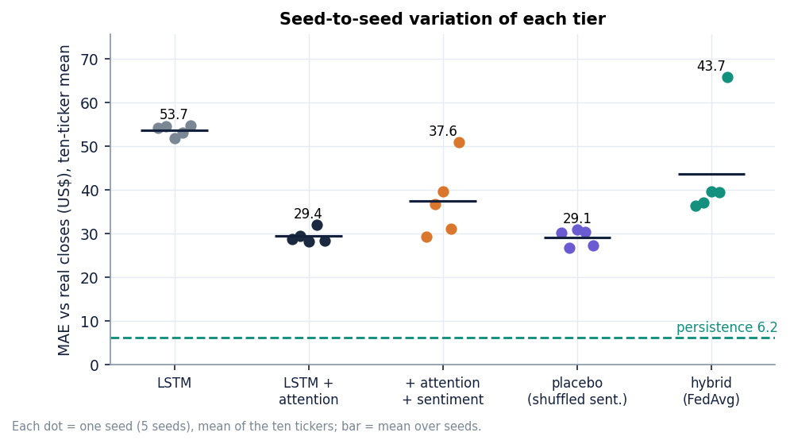
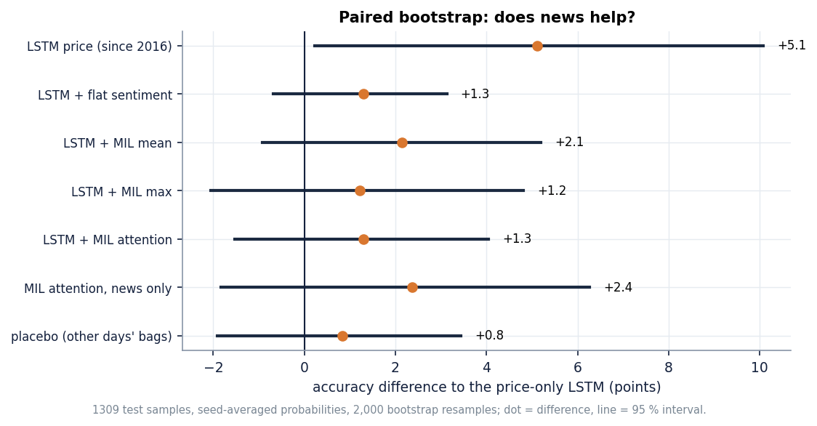
Parameter Analysis – Seeds, Scoring and MIL Pooling
Tier (5 seeds, 10 tickers) | MAE shipped scoring | MAE real closes | Direction shipped / real
LSTM | $47.8 | $53.7 | 68% / 53%
LSTM + attention | $23.5 | $29.4 | 68% / 53%
LSTM + attention + sentiment | $31.7 | $37.6 | 67% / 52%
Hybrid (FedAvg) | $37.8 | $43.7 | 67% / 52%
Persistence (no change) | - | $6.2 | -
Test targets are clipped to the training range: 5 of 10 tickers have over half of the test closes above the training maximum.
Adding sentiment or FedAvg raises error and seed-to-seed spread; attention helps most.
MIL pooling (mean, max, attention) differ by under 1 point in accuracy, inside the intervals.
Dept. of CSE | Batch C4 | Final Review
19
Notes:
Parameter analysis: how much the result depends on the seed, on how the target is scored, and on the MIL pooling choice.

Slide 20
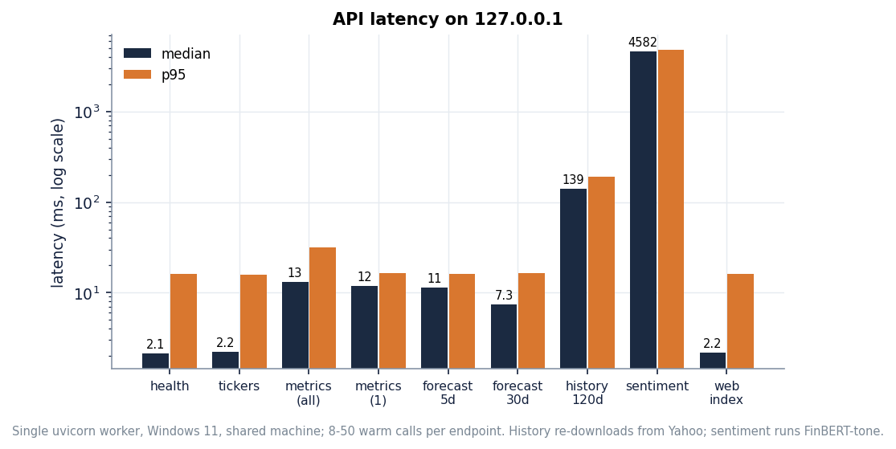
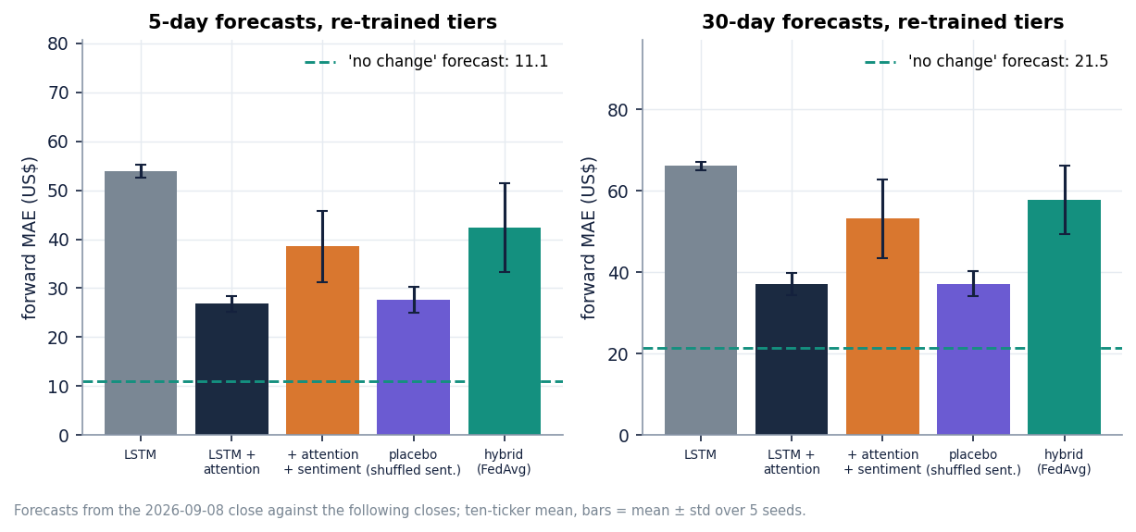
Performance & Testing
2.1 ms
11.7 ms
139 ms
4.6 s
health, median
one ticker's metrics, median
history (live Yahoo download)
sentiment (FinBERT on CPU)
Check | Result
pytest (pipeline units + API endpoints) | 56 of 56 passed; smoke test 26 of 26 checks on the running stack
Not tested | concurrent users, load, security testing (no login exists), Docker build, accessibility
Dept. of CSE | Batch C4 | Final Review
20
Notes:
Latencies on 127.0.0.1, i5-12500, CPU only, machine shared with other jobs. Right: forward-test error of the re-trained tiers against persistence.

Slide 21
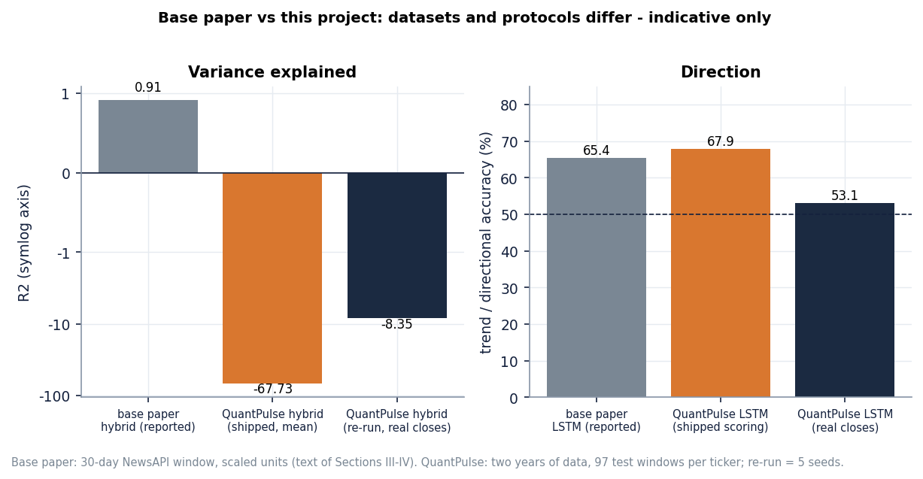
Comparison with Base Paper
Aspect | Base paper [1] | QuantPulse (this project)
Data | Ten firms; hybrid on a one-month (30-day) window; 5-day trend over three months | Ten tickers, two years (501 rows each); 97 test windows per ticker
Split | 70/15/15 hybrid, 80/20 baselines | 80/20 chronological (shipped); three expanding folds in the MIL study
Fit | Hybrid average R² 0.91; TSLA R² 0.888 | Shipped hybrid mean R² -67.7; re-run real-close R² -3.5 (LSTM + attention)
Direction | Baseline LSTM trend accuracy 65.36% | Shipped 68% (inflated); real closes 53%; stored 5-day trend 4/10
Sentiment | FinBERT-tone on NewsAPI headlines, 30 days | Synthetic template headlines (no key); real FNSPID headlines offline: no gain
Datasets and protocols differ: indicative only, not a head-to-head.
The paper's R² 0.91 was not reproduced.
No superiority is claimed.
Dept. of CSE | Batch C4 | Final Review
21
Notes:
State plainly that the paper uses a 30-day window and different units. We did not reproduce its R-squared.

Slide 22
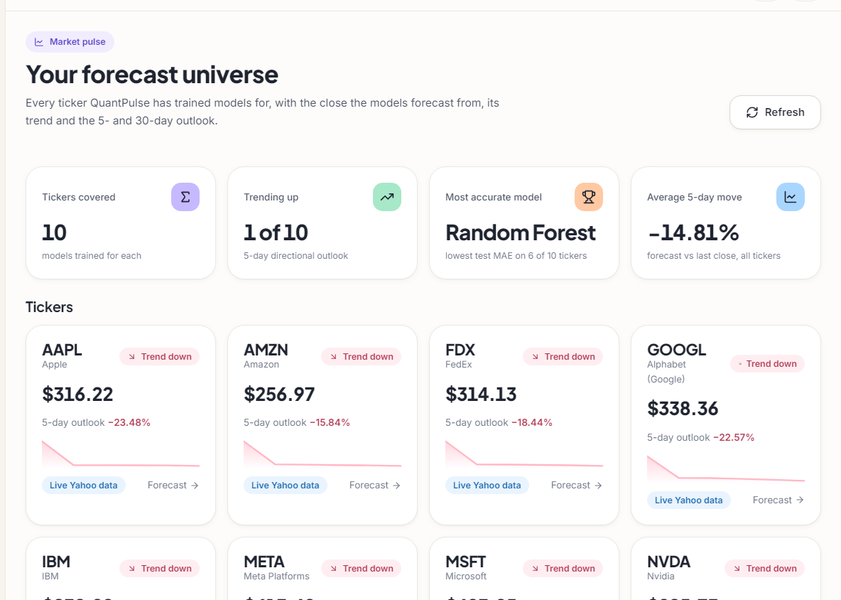
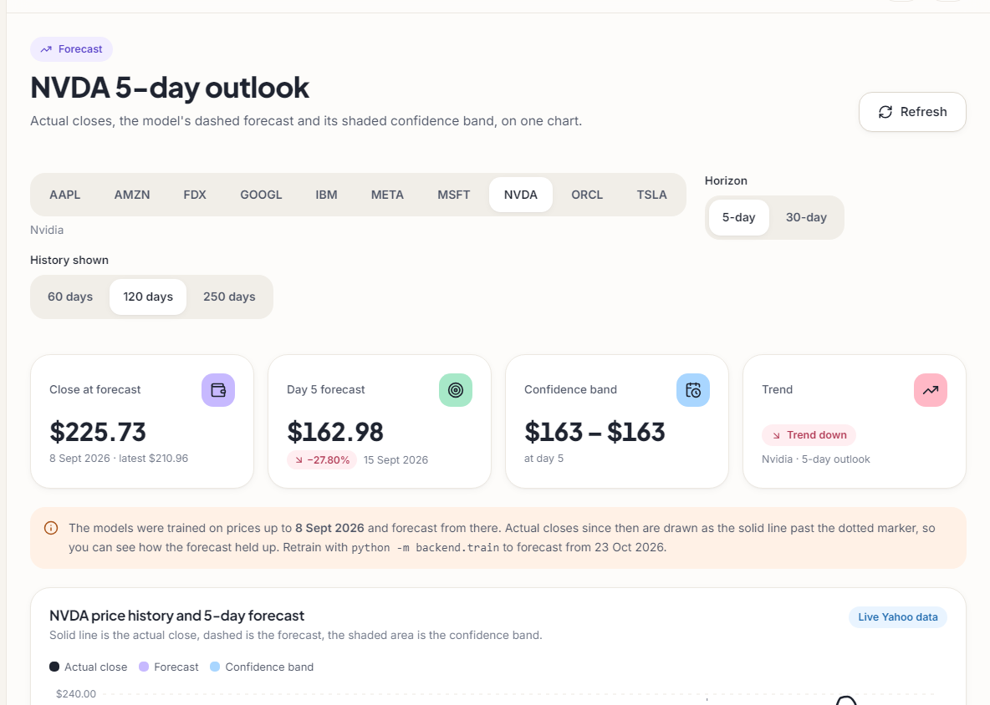
Output – Dashboard and Forecast Overview
Left: dashboard with the ten tickers, last close, trend flag and 5-day outlook from the stored forecasts. Right: NVDA 5-day outlook with the notice that the models were trained up to 8 Sept 2026.
Dept. of CSE | Batch C4 | Final Review
22
Notes:
Real captures of the running website with live Yahoo data and the shipped artefacts.

Slide 23
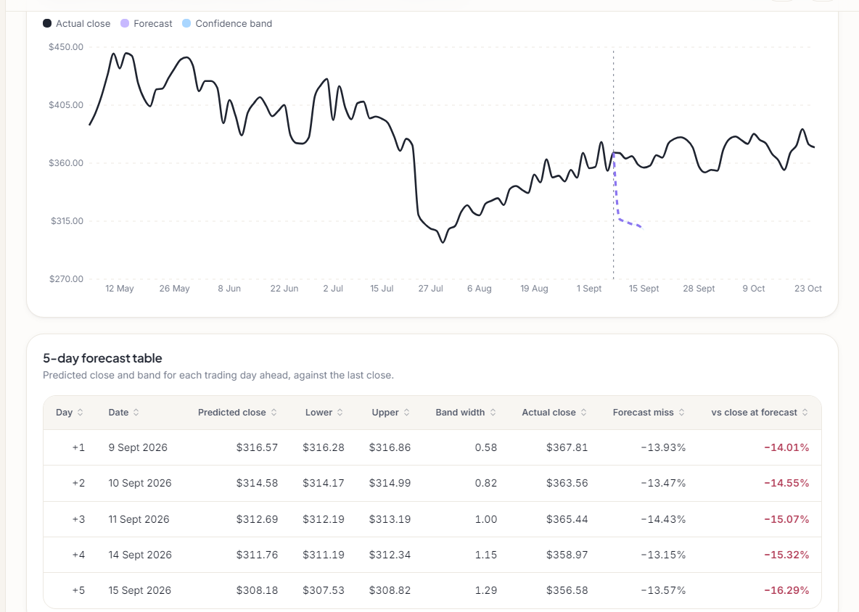
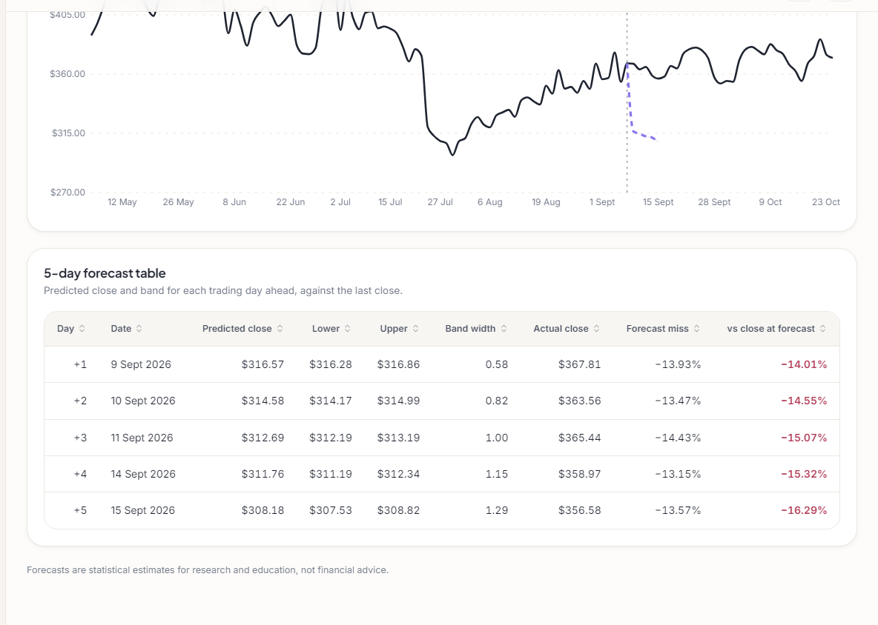
Output – Forecast Chart and Table
TSLA: the dashed forecast drops while the actual close (solid line) stays near its level; the table shows the forecast, band, actual close and forecast miss for each day (about -14% to -16%).
Dept. of CSE | Batch C4 | Final Review
23
Notes:
The Forecast screen shows the miss openly: the stored forecast against the closes that followed.

Slide 24
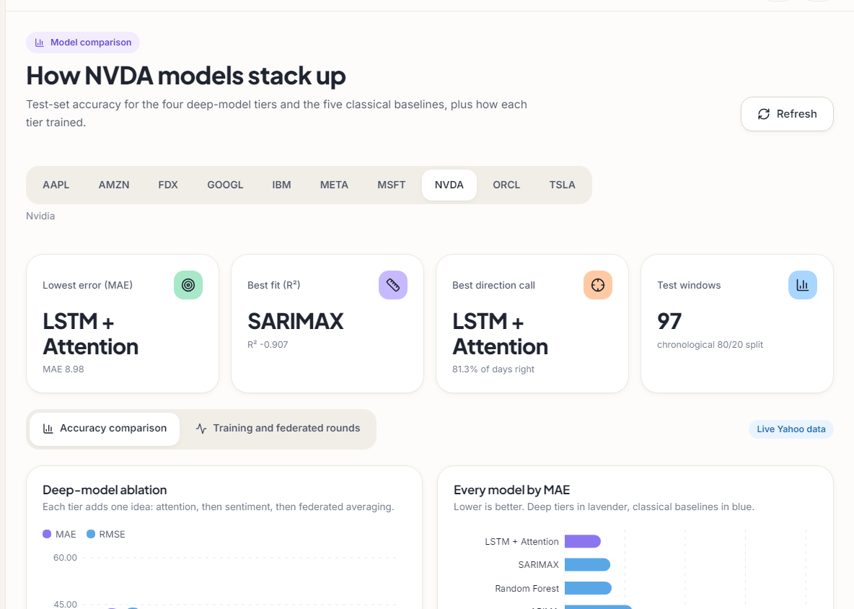
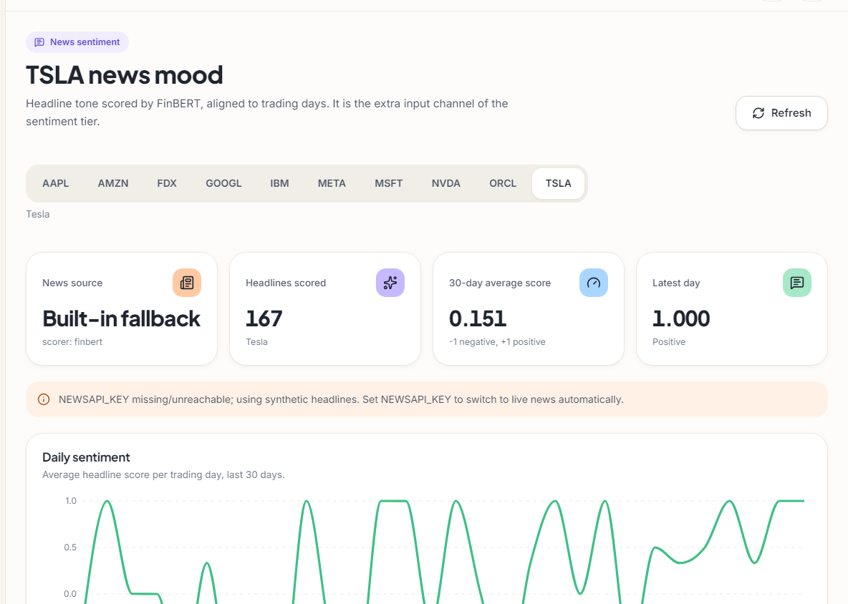
Output – Model Comparison and News Sentiment
Left: NVDA model comparison, four deep tiers and five baselines. Right: TSLA news sentiment; the source badge reads 'Built-in fallback' because no NewsAPI key was set, so the headlines are synthetic.
Dept. of CSE | Batch C4 | Final Review
24
Notes:
Model comparison and sentiment screens. Say clearly that the sentiment shown is synthetic.

Slide 25
Conclusion & Objectives vs Outcomes
A working, tested forecasting product (56 tests, 26 smoke checks) that follows the base paper; Random Forest is the most accurate model on 6 of 10 tickers.
Measured against real closes the deep tiers do not beat 'no change'; stored 5-day trend right for 4 of 10; real headlines gave no measurable gain in the MIL study.
# | Objective | Outcome
1 | Collect prices, news and social media | Partly: prices yes; headlines synthetic unless a key is set; no social-media source
2 | Align into daily instances per day | Partly: one mean sentiment per day in the product; per-headline instances in the offline study
3 | Bags of news under MIL | Not in the product; done offline (FNSPID, 7 tickers, gated attention)
4 | Hybrid LSTM + attention model | Met as built; accuracy poor against real closes
5 | Direction with accuracy, precision, recall, F1 | Offline only: accuracy ~50%, F1 0.36-0.59; the app reports MAE, R² and a direction score
6 | Multi-source vs price-only baseline | Done offline: MIL 49.8% vs price-only 48.8%, within noise
Dept. of CSE | Batch C4 | Final Review
25
Notes:
Be explicit about which objectives were met, partly met or not met.

Slide 26
Limitations & Future Scope
Known limitations
Future scope
No MIL, no social media and no precision/recall/F1 in the product
Test targets clipped to the training range inflate direction scores
Sentiment channel zero in training; synthetic headlines in test
Stored forecasts missed the realised moves; artefacts older than the CSVs
FedAvg is simulated and mixes differently scaled clients
MIL study: 1,309 test days, 7 tickers, 2022-2023; differences under about 3 points are noise
CPU only; no login, database or load testing
Score against real closes and add a persistence baseline in the product
Move MIL into the product with a direction head and P/R/F1
Real news archive and a social-media source for multi-year sentiment
Walk-forward validation over many periods and more tickers
Fix the sentiment channel; retrain on a schedule
A real federated deployment with per-client scalers
Login, persistence and monitoring for deployment
Dept. of CSE | Batch C4 | Final Review
26
Notes:
Limitations first, then concrete next steps.

Slide 27
References
[1] Y. Nejatbakhsh and M. Aliasgari, "Enhancing stock market prediction with hybrid deep learning: Integrating LSTM, transformer attention, federated learning, and sentiment analysis," IEEE Access, vol. 14, pp. 3926-3942, 2026, doi: 10.1109/ACCESS.2025.3649668.
[6] X. Zhang, S. Qu, J. Huang, B. Fang and P. Yu, "Stock market prediction via multi-source multiple instance learning," IEEE Access, vol. 6, pp. 50720-50728, 2018, doi: 10.1109/ACCESS.2018.2869735.
[7] P.-J. Liao, H.-S. Lee, Y.-F. Cheng, L.-W. Chen, H.-y. Lee and H.-M. Wang, "Generalized stock price prediction for multiple stocks combined with news fusion," arXiv:2603.19286, Mar. 2026.
[8] Y. Deng and S. M. Yiu, "Deep multiple instance learning for forecasting stock trends using financial news," in Artificial Intelligence Trends, AIRCC, 2022, pp. 95-111, doi: 10.5121/csit.2022.121008 (arXiv:2206.14452).
[9] T. G. Dietterich, R. H. Lathrop and T. Lozano-Perez, "Solving the multiple instance problem with axis-parallel rectangles," Artif. Intell., vol. 89, no. 1-2, pp. 31-71, Jan. 1997, doi: 10.1016/S0004-3702(96)00034-3.
[10] M. Ilse, J. M. Tomczak and M. Welling, "Attention-based deep multiple instance learning," in Proc. 35th Int. Conf. Mach. Learn. (ICML), PMLR, vol. 80, 2018, pp. 2127-2136, arXiv:1802.04712.
[11] Z. Dong, X. Fan and Z. Peng, "FNSPID: A comprehensive financial news dataset in time series," in Proc. 30th ACM SIGKDD Conf. Knowl. Discovery Data Mining (KDD), Barcelona, Spain, Aug. 2024, pp. 4918-4927, doi: 10.1145/3637528.3671629.
[12] S. Hochreiter and J. Schmidhuber, "Long short-term memory," Neural Comput., vol. 9, no. 8, pp. 1735-1780, Nov. 1997, doi: 10.1162/neco.1997.9.8.1735.
[13] A. Vaswani et al., "Attention is all you need," in Adv. Neural Inf. Process. Syst. (NeurIPS), vol. 30, 2017, pp. 5998-6008, arXiv:1706.03762.
[14] H. B. McMahan, E. Moore, D. Ramage, S. Hampson and B. A. y Arcas, "Communication-efficient learning of deep networks from decentralized data," in Proc. 20th Int. Conf. Artif. Intell. Statist. (AISTATS), PMLR, vol. 54, 2017, pp. 1273-1282, arXiv:1602.05629.
[16] Y. Yang, M. C. S. Uy and A. Huang, "FinBERT: A pretrained language model for financial communications," arXiv:2006.08097, Jun. 2020.
[18] T. Fischer and C. Krauss, "Deep learning with long short-term memory networks for financial market predictions," Eur. J. Oper. Res., vol. 270, no. 2, pp. 654-669, Oct. 2018, doi: 10.1016/j.ejor.2017.11.054.
[19] O. B. Sezer, M. U. Gudelek and A. M. Ozbayoglu, "Financial time series forecasting with deep learning: A systematic literature review: 2005-2019," Appl. Soft Comput., vol. 90, Art. no. 106181, May 2020, doi: 10.1016/j.asoc.2020.106181.
[21] P. C. Tetlock, "Giving content to investor sentiment: The role of media in the stock market," J. Finance, vol. 62, no. 3, pp. 1139-1168, Jun. 2007, doi: 10.1111/j.1540-6261.2007.01232.x.
The full numbered list of 35 references is in the report.
Dept. of CSE | Batch C4 | Final Review
27
Notes:
Selected references; the complete numbered list is in the report.

Slide 28
THANK YOU
Questions & Suggestions
Dept. of CSE | Batch C4 | Final Review
28
Notes:
Invite questions.

