Slide 1
Pneumonia Detection Using Deep Learning
REVIEW 2 · DESIGN, METHODOLOGY AND PROGRESS
Design, methodology and progress: a trained three-class CNN with Grad-CAM, behind a FastAPI service and a React interface
Presented by
Under the guidance of
CHOUDAM AKSHITHA 23K91A0556
BOGGULA SATVIK KUMAR 23K91A0541
ARUTLA ABHI THEJ REDDY 23K91A0515
DUGGARAJU LIKHITHA 23K91A0565
V. MEENAKSHI, [DESIGNATION]
Department of Computer Science and Engineering
TKR College of Engineering and Technology (Autonomous) · Batch A12 (CSE-A) · 2026-2027
Notes:
This review shows how the system is designed and built: the data and model, what has been implemented, the first measured results and the open items.

Slide 2
Contents
01
02
03
Recap and architecture
Methodology and dataset
Preprocessing and model
04
05
06
Training and decision logic
Data flow, database and UML
Technology stack
07
08
09
Implementation progress and results
Output screens and testing
Challenges and next steps
Notes:
Agenda for the design and progress review.

Slide 3
Recap: problem and proposed system
!
Problem
i
Proposed system
B
Base paper link
Pneumonia needs a fast, checkable reading of the chest X-ray. Readers are scarce, readings vary, and most classifiers give a label with no visual justification.
Preprocess with CLAHE, classify into Normal, Bacterial or Viral pneumonia with a compact CNN, explain with Grad-CAM, and keep every scan in a reviewable history.
Reuses 224 x 224 input and Grad-CAM; replaces its semi-supervised research framework by a complete application. Segmentation and Monte Carlo Dropout are not reproduced.
Notes:
One-minute recap of Review 1: the base paper is a research framework; we deliver the end-to-end tool and measure it honestly.

Slide 4
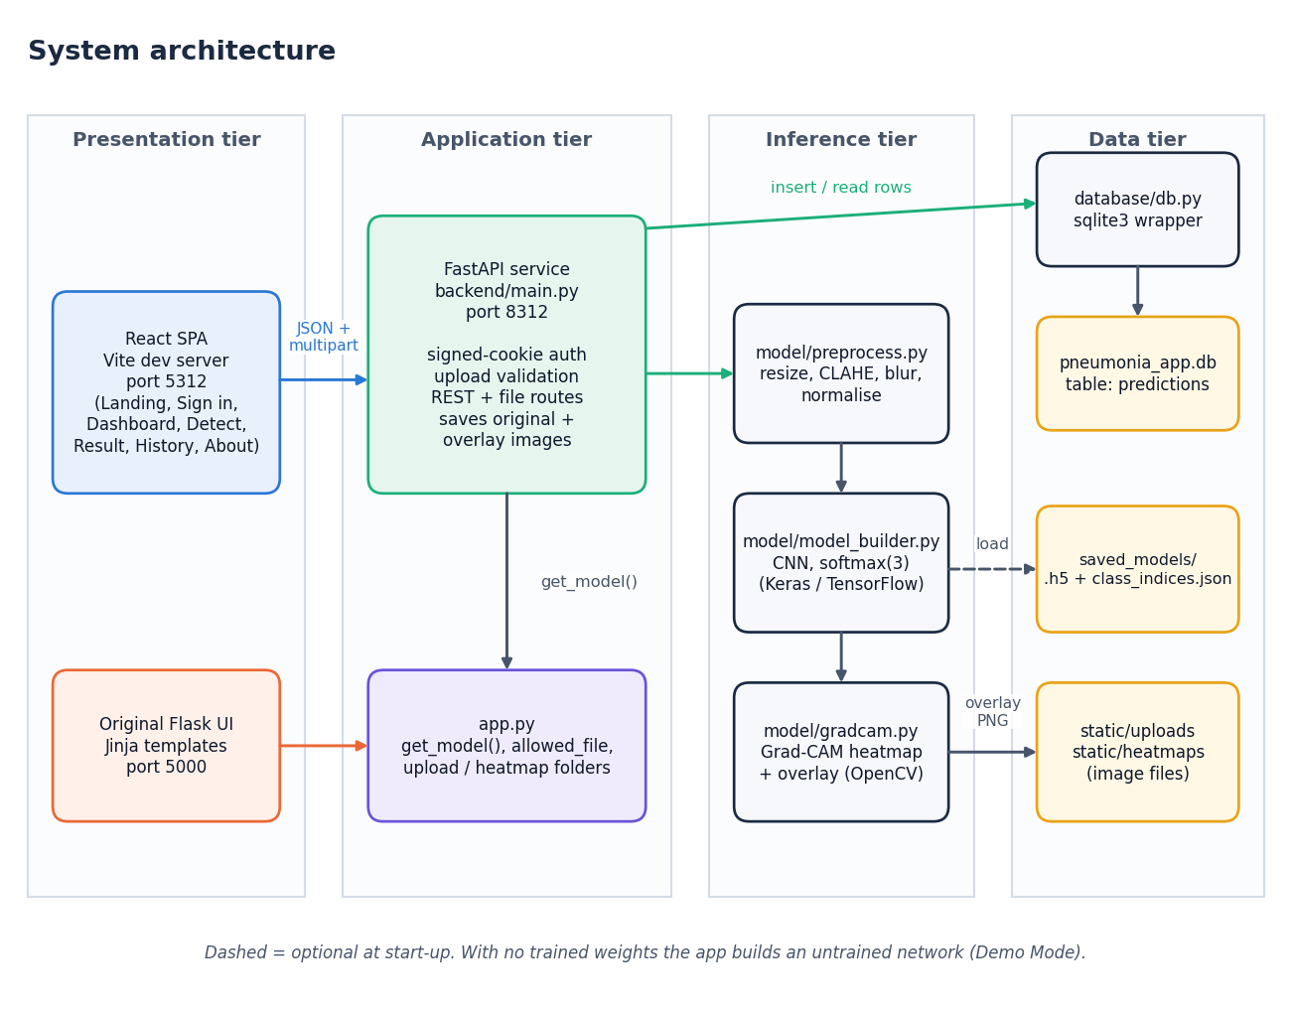
System architecture
Four tiers
Presentation: React SPA (port 5312) and the original Flask UI.
Application: FastAPI service (port 8312) with signed-cookie login and validation.
Inference: preprocess, CNN, Grad-CAM modules shared with the Flask app.
Data: SQLite history, image files, saved model weights.
Notes:
Four tiers. The FastAPI layer imports the original model, Grad-CAM and database modules, so nothing was rewritten.

Slide 5
Methodology: end-to-end workflow
Public chest X-ray data
Label from file names
Preprocess + cache
Patient-level split
Train CNN
Evaluate on test split
metrics.json + figures
Shared preprocessing
Patient-level split
Reproducible
load_and_preprocess_image is used by training, Flask and FastAPI: no train/serve mismatch.
Validation is cut by patient so one patient never sits on both sides; the test split is used once.
Seed 42; every metric, prediction and figure is written to disk and regenerated by scripts.
Notes:
The training script is one command and writes every number to JSON. Preprocessing is the same function the web app uses.

Slide 6
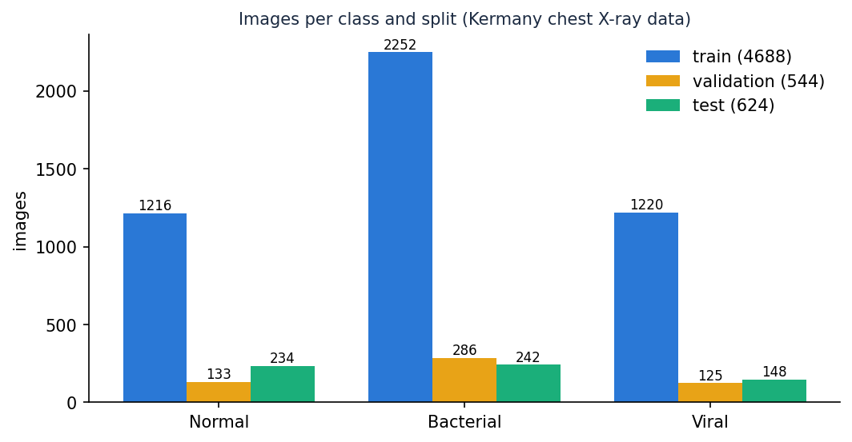
Dataset
5,856
3
624
CC BY 4.0
chest X-ray images, paediatric
classes: Normal, Bacterial, Viral
official test images, held out
Kermany et al., Mendeley Data v3
Pathogen labels come from file names (person12_bacteria_34, person7_virus_21).
Official val folder has only 16 images, so train and val are merged and a 10 % validation set is cut by patient.
Many pneumonia ids in the test folder also occur in training; results are also reported on a patient-disjoint view.
Notes:
Kermany et al. data, CC BY 4.0. Pathogen labels are derived from the file names. The overlap of ids between the official folders is analysed in the results.

Slide 7
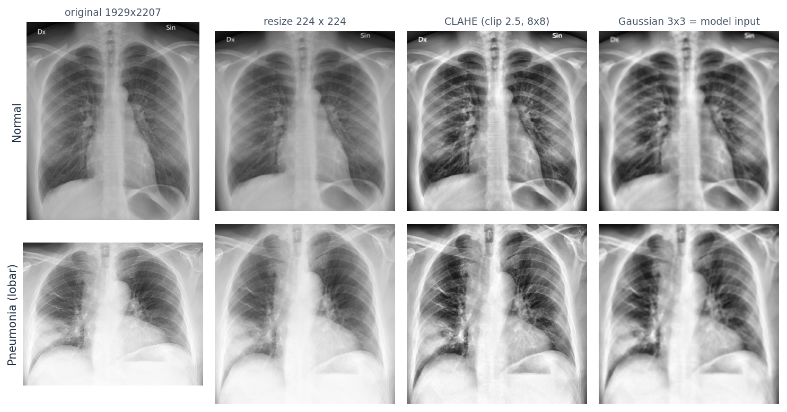
Data preprocessing
1 Decode to grayscale
2 Resize to 224 x 224
3 CLAHE, clip 2.5, 8 x 8 tiles
4 Gaussian blur 3 x 3
5 Three channels, divide by 255
Training adds rotation, shift, shear, zoom and horizontal flip.
Notes:
The same five steps run at training and at inference. Augmentation is training-only.

Slide 8
Model architecture
Block | Layers | Output
1 | Conv 3x3, 32 · BN · MaxPool | 112 x 112 x 32
2 | Conv 3x3, 64 · BN · MaxPool | 56 x 56 x 64
3 | Conv 3x3, 128 · BN · MaxPool | 28 x 28 x 128
4 | Conv 3x3, 256 (last_conv) · BN · MaxPool | 14 x 14 x 256
Head | GAP · Dense 512 · BN · Dropout 0.35 · Dense 128 · Dropout 0.25 | 256 -> 512 -> 128
Output | Dense 3, softmax | 3 class probabilities
590,019
parameters
2.36 MB
weights in float32
No GPU
trains on a desktop CPU
Notes:
A compact CNN written for the project. The convolution layer named last_conv is where Grad-CAM reads its feature maps.

Slide 9
Training configuration
Setting | Value
Optimiser / loss | Adam, learning rate 0.0003 / categorical cross-entropy
Class weights | balanced: 1.29, 0.69, 1.28
Batch / max epochs | 32 / 40
Early stopping | validation loss, patience 10, best weights restored
Learning-rate schedule | halved after 3 epochs without improvement
Augmentation | rotation 12, shift 0.08, shear 0.08, zoom 0.12, horizontal flip
Seed / hardware | 42 / Intel Core i5-12500, CPU only, about 214 s per epoch
Notes:
The base configuration of the project's custom CNN, with class weights for the Bacterial-heavy balance.

Slide 10
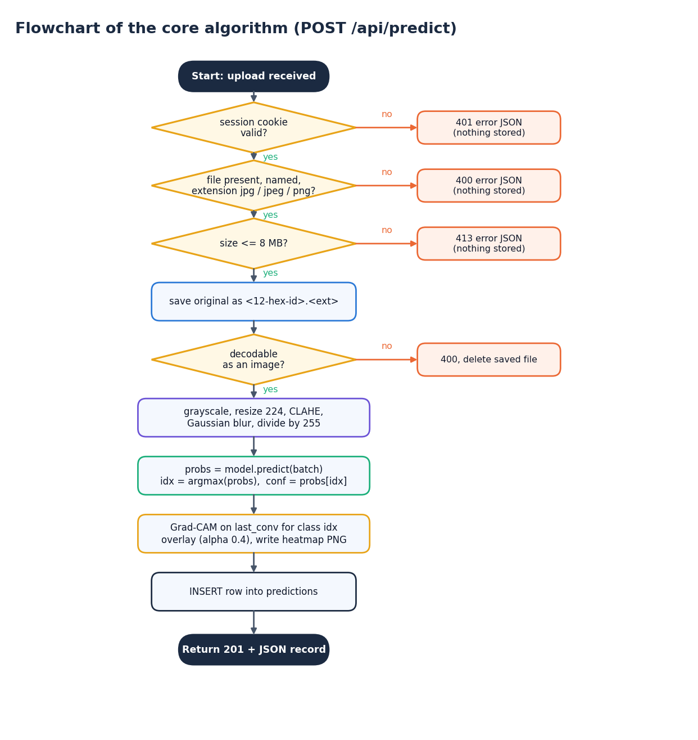
Decision logic
Validation first. Valid session, named file, extension jpg / jpeg / png, size up to 8 MB, decodable image; each failure returns a clear 401, 400 or 413 and stores nothing.
Decision. The class is the arg-max of the three softmax probabilities; the confidence is that probability.
Explanation. Grad-CAM for the predicted class, blended over the display image at alpha 0.4.
Caution. Confidence is a raw softmax value; Results report accuracy against a confidence threshold so that low-confidence scans can be flagged for review.
Notes:
The route validates in the same order as the original Flask route. The confidence threshold is analysed on the results slides, not applied automatically.

Slide 11
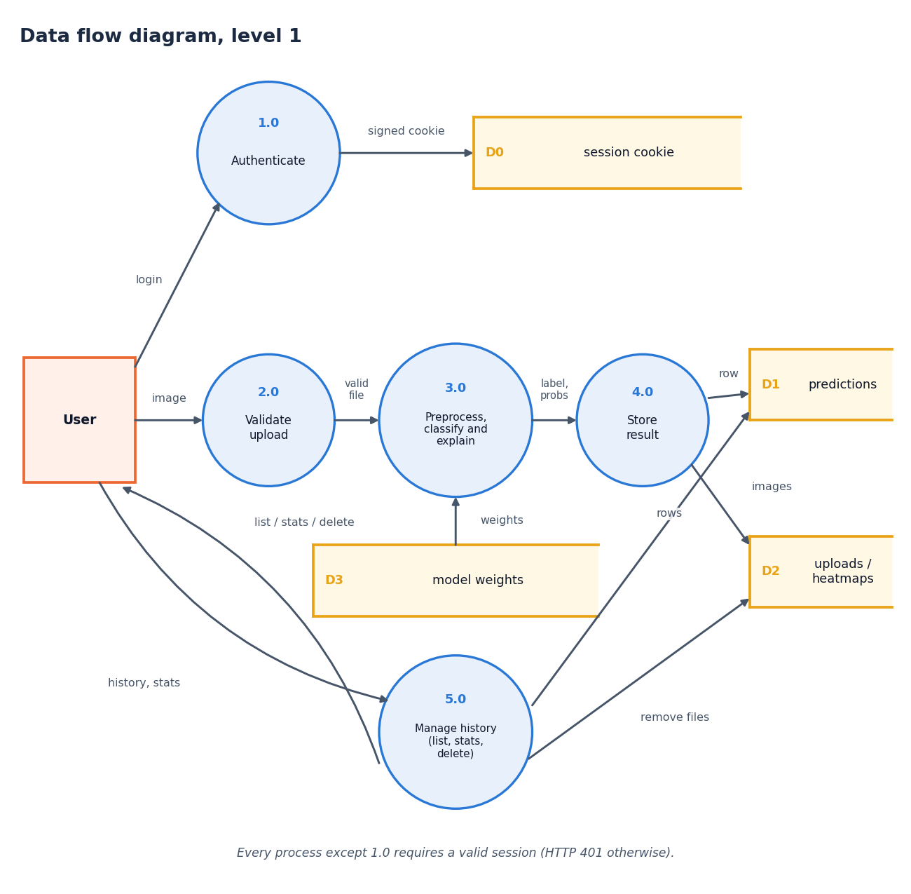
Data flow and modules
Module | Role
model/preprocess.py | decode, resize, CLAHE, blur
model/model_builder.py | CNN, last-conv finder
model/gradcam.py | heat map and overlay
database/db.py | SQLite access
backend/main.py | FastAPI routes, login
frontend/src | React screens
Notes:
Level-1 data flow: five processes. Level 0 and 2 are in the report.

Slide 12
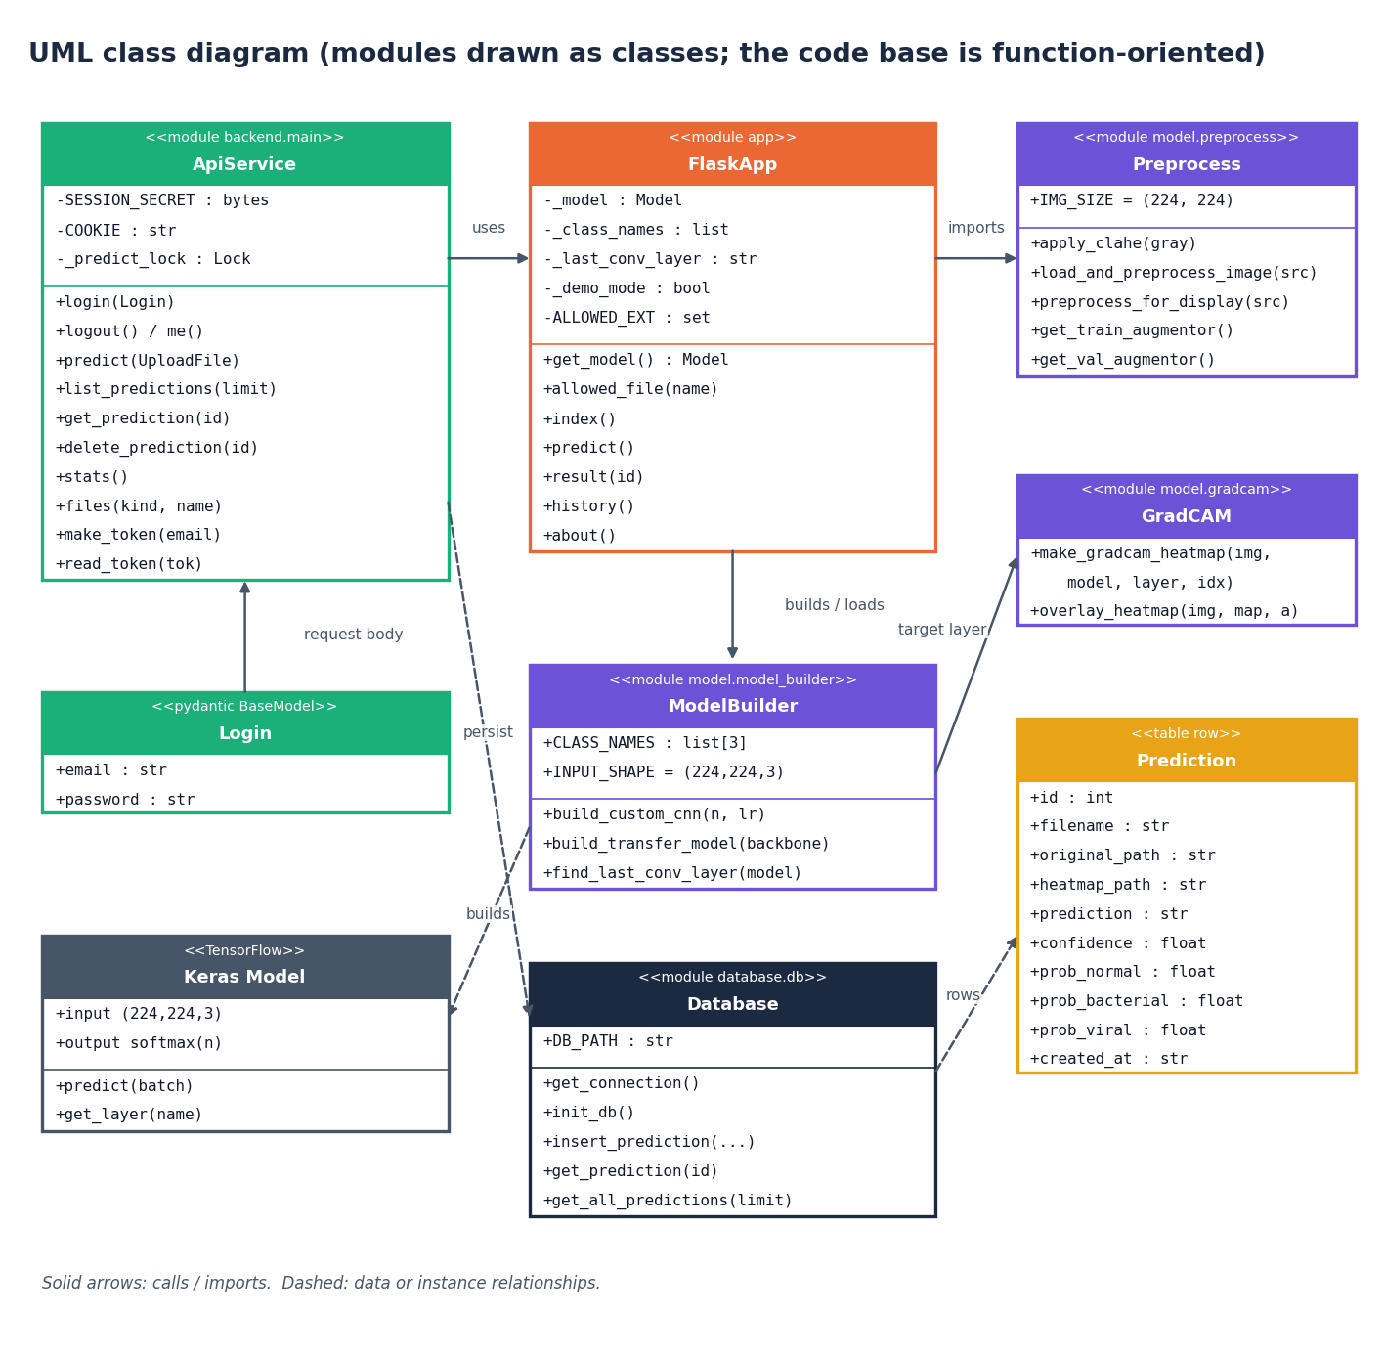
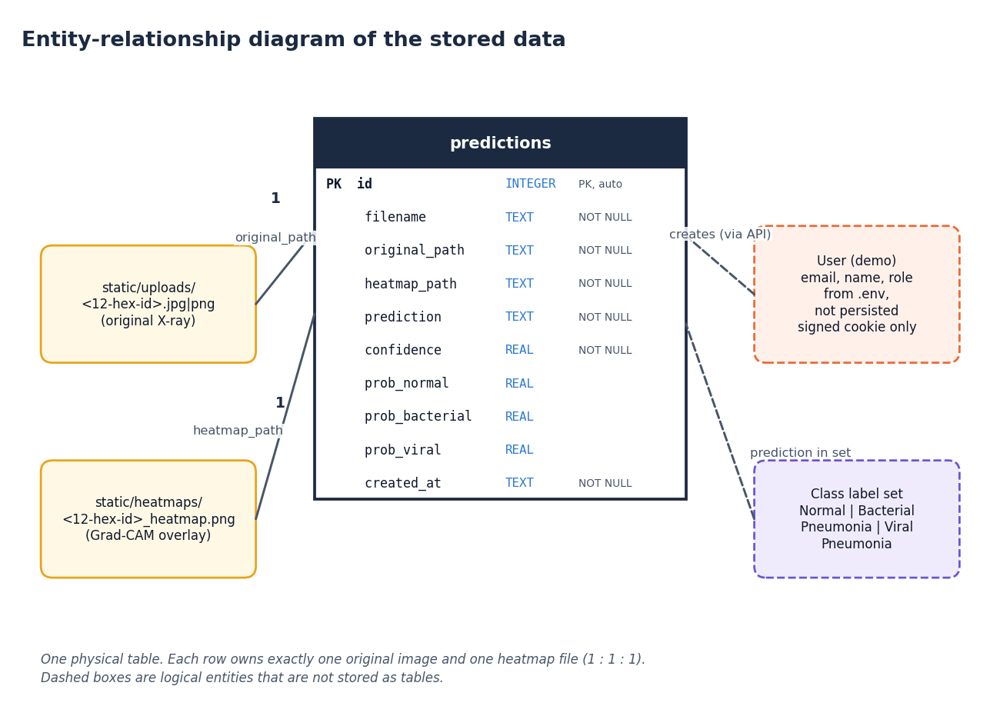
Database design and UML
One table (predictions, 10 columns) with bound-parameter SQL; the code base is function-oriented, so the UML draws modules as classes.
Notes:
A single predictions table; each row owns one original image and one overlay. The UML shows modules as classes because the code is function-oriented.

Slide 13
Technology stack
Layer | Technology
Deep learning | TensorFlow / Keras, NumPy, scikit-learn, matplotlib
Image processing | OpenCV (CLAHE, resize, colour maps), Pillow
API | FastAPI, Uvicorn, python-multipart; Flask (original UI)
Database | SQLite
Front end | React 19, Vite, React Router, Framer Motion, Recharts, Neo Brutal Grid kit
Testing | pytest, FastAPI TestClient, Playwright
Run | run.bat (Windows), ports 8312 / 5312
Notes:
Everything is open source; one script starts the stack.

Slide 14
Implementation progress
Component | Status | Evidence
Preprocessing, CNN, Grad-CAM | Done | model/, 19 unit tests
Training and evaluation script | Done | scripts/train_experiment.py, metrics.json
FastAPI service and demo login | Done | 10 routes, 34 integration tests
React interface (8 screens) | Done | 13 screenshots, UI checks at 360-1440 px
History, dashboard, CSV export | Done | smoke test, screens 09 to 11
U-Net lung segmentation | Not implemented | listed as future work
Monte Carlo Dropout, semi-supervised learning | Not implemented | out of scope; confidence-threshold analysis instead
Notes:
State of the code base. The two honest gaps are segmentation and the base paper's uncertainty and semi-supervised methods.

Slide 15
Preliminary results: official test split
79.5%
0.780
98.7%
62.0%
3-class accuracy
macro F1
pneumonia sensitivity
normal specificity
i
Reading
n = 624 test images. Protocol: official Kermany test split, model trained on the patient-split train pool. Details and caveats in the next review.
Notes:
First measured numbers on the official test split. The protocol is stated beside them; the final review adds the patient-disjoint analysis and the comparison with the base paper.

Slide 16
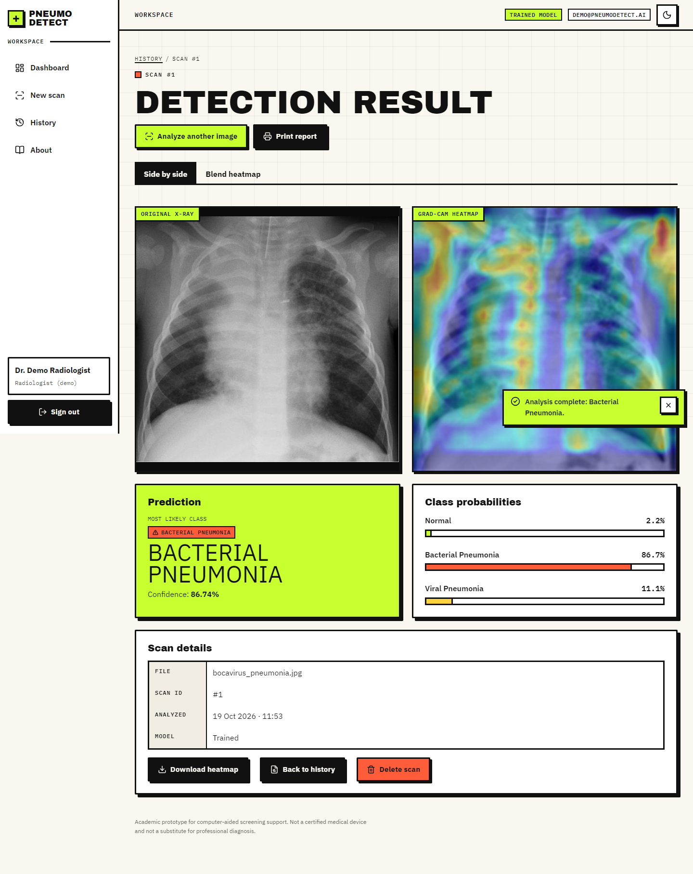
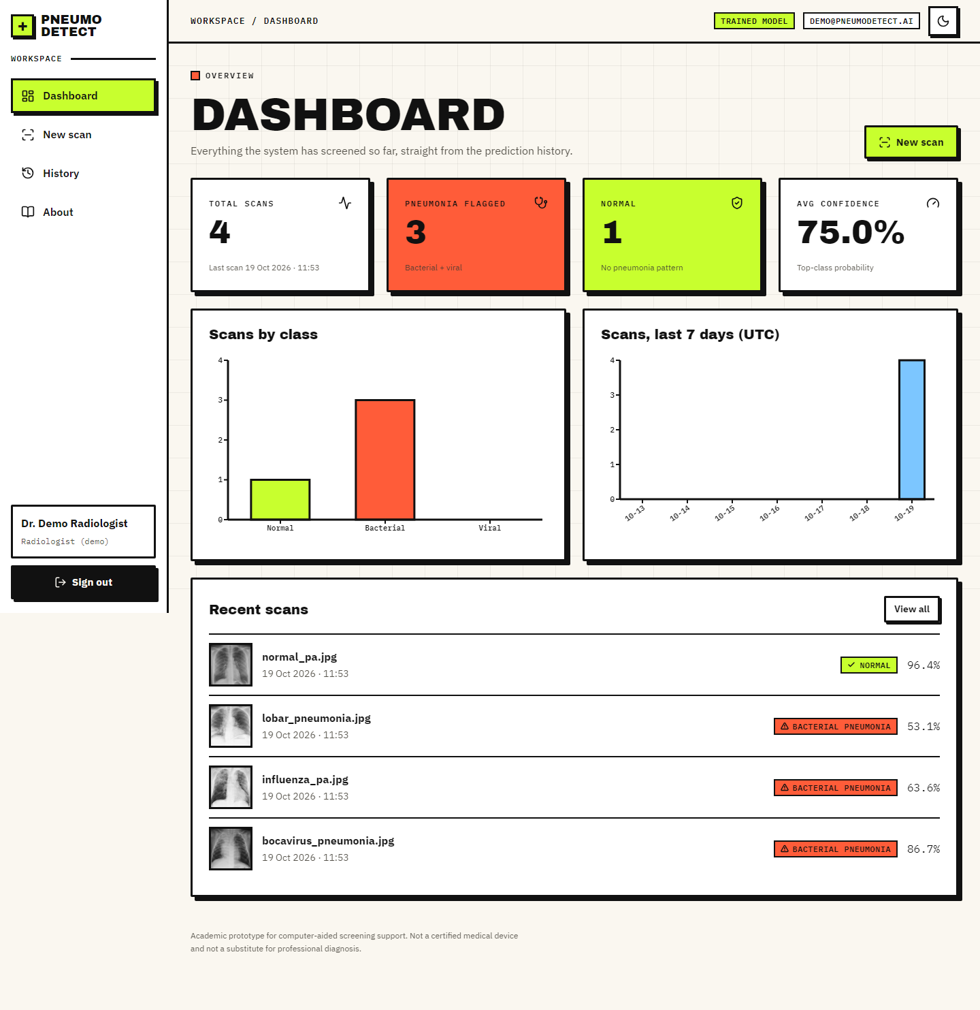
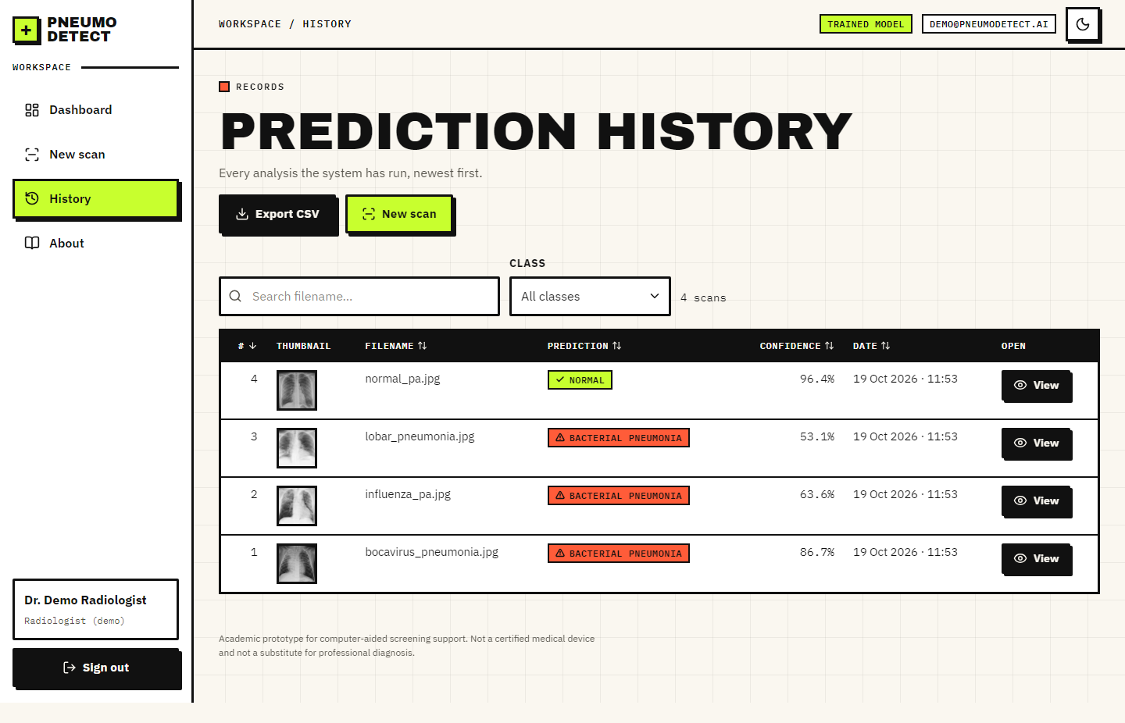
Output screens
Notes:
Real screenshots from the running application with the trained model: a result with the Grad-CAM overlay, the dashboard and the history.

Slide 17
Initial testing and observations
73
25
0
360-1440 px
pytest tests passed
live smoke-test checks
console errors on the screenshot walk
light and dark, no overflow
Observation | Action
Fresh checkout had no trained model; predictions were near-equal | Trained the CNN on the public data; Demo Mode banner kept for the untrained case
Official test split shares pneumonia ids with training | Added a patient-disjoint analysis and a patient-level re-split
Transfer-learning backbones break the shipped Grad-CAM | Deployed the flat custom CNN; documented the limitation
Notes:
The suite runs offline with the real model and a throw-away database. Observations on the right drove three of the design decisions.

Slide 18
Challenges and corrective actions
Challenge | Corrective action
No trained weights or dataset in the repository | Downloaded the public Kermany data; wrote a reproducible training script
Original train.py trains without CLAHE but the app uses it | Experiment script reuses the inference preprocessing
Official validation folder has 16 images | Merged train and val; patient-level 10 % validation
Bacterial images about twice as frequent | Balanced class weights in the loss
CPU-only training, about 4 minutes per epoch | Compact model; few, well-chosen experiments
TensorFlow failed to load after other scientific imports | Import TensorFlow first in the scripts
Notes:
Each challenge was met by a concrete change in the code or the evaluation protocol.

Slide 19
Next steps
1
Evaluate
2
Compare
3
Document
4
Extend (future)
Finish the patient-disjoint evaluation, the CLAHE ablation and a MobileNetV3Small comparison.
Set the results against the base paper, stating where datasets and protocols differ.
Final report, paper and deck with every figure regenerated from JSON.
U-Net segmentation, calibration or Monte Carlo Dropout, external hospital data.
Notes:
Plan to the final review. The extensions at the right are out of scope for this submission.

Slide 20
Thank you
Questions and suggestions are welcome.
Notes:
Likely questions: why the custom CNN; why patient-level splitting; what about segmentation.

