Slide 1

Pneumonia Detection Using Deep Learning
Final Review
Team Details : Batch A12
Under the Esteemed Guidance of
V. MEENAKSHI
[DESIGNATION], Department of CSE
23K91A0556 Choudam Akshitha
23K91A0541 Boggula Satvik Kumar
23K91A0515 Arutla Abhi Thej Reddy
23K91A0565 Duggaraju Likhitha
DEPARTMENT OF COMPUTER SCIENCE AND ENGINEERING · TKR College of Engineering and Technology (Autonomous) · Academic Year 2026 – 2027
Notes:
Introduce the team and the project: an explainable chest X-ray classifier with a complete web application.

Slide 2
Table of Contents
Abstract
Base Paper & Literature Survey
Research Gap & Problem Statement
Objectives
Proposed System & Architecture
Methodology, Dataset & Model
Decision Workflow, Interaction & Database
Implementation Highlights
Results, Threshold Analysis, Performance & Testing
Comparison with Base Paper
Output Screens
Conclusion, Future Scope & References
Dept. of CSE | Batch A12 | Final Review
2
Notes:
The agenda follows the report: problem, design, method, results, comparison, screens, conclusion.

Slide 3
Abstract
Pneumonia is a leading infectious cause of death and chest X-ray readers are scarce where it is most dangerous; manual reading is slow and varies between readers.
We built an end-to-end system: CLAHE preprocessing, a compact CNN that classifies Normal, Bacterial or Viral pneumonia, and a Grad-CAM heat map for every prediction.
The CNN (590,019 parameters, CPU-trained) reaches 79.5% three-class accuracy on the official 624-image test split of the public Kermany data; separating pneumonia from normal gives 98.7% sensitivity and 62.0% specificity. Normal films mistaken for pneumonia are the weak point.
A FastAPI service and a React interface add login, history, dashboard, CSV export and printing; 73 automated tests pass.
U-Net segmentation, calibrated uncertainty and external validation are not done and are stated as limits.
Dept. of CSE | Batch A12 | Final Review
3
Notes:
Read the first two bullets, then give the headline numbers with their protocol (official test split). End on the honest limits.

Slide 4
Base Paper
S. M. Mahin, T. Hasan, S. Karim, M. B. R. Nuha, E. H. Tusher, A. R. Hussain, J. Uddin and D. Ghose, "From Pneumonia to Multi-Disease: Interpretable and Uncertainty-Aware Semi-Supervised Learning Strategies for Chest X-Ray Classification," IEEE Access, vol. 14, pp. 127532-127551, 2026, doi: 10.1109/ACCESS.2026.3722370.
Aspect | Base paper
Method | MobileNet family (V3Small chosen) with FixMatch, FlexMatch, FreeMatch; Grad-CAM; Monte Carlo Dropout, test-time augmentation, ECE
Data | Mendeley paediatric chest X-rays (5,863; Normal / Pneumonia) and a merged 4-class set (7,135); balanced subsets, seed 42
Reported results | Up to 98 % (binary) and 97 % (4-class) supervised; FreeMatch 97 % with 20 % (binary) / 30 % (4-class) labels; latency 0.11 s, 116.9 M FLOPs
Stated limits | Benchmark data, no external validation, confusion among similar diseases, benefit of extra classes not isolated
Dept. of CSE | Batch A12 | Final Review
4
Notes:
A research framework on public benchmarks. We take the input size, Grad-CAM and the lightweight-model idea; we do not reproduce its semi-supervised or uncertainty methods.

Slide 5
Literature Survey
Author / Year | Methodology | Dataset | Key Results | Limitations
Kermany et al., 2018 [3] | Transfer learning on a pretrained network | 5,232 training and 624 test paediatric chest X-rays | 93.2 % sensitivity, 90.1 % specificity, 92.8 % accuracy (Normal vs pneumonia) | Single paediatric centre
Rajpurkar et al., 2017 [7] | DenseNet121 trained on ChestX-ray14 | ChestX-ray14 [8] | Radiologist-level pneumonia detection (as summarised in [1]) | Binary formulation; fully supervised
Ozturk et al., 2020 [20] | DarkNet-based CNN | COVID-19, pneumonia and normal X-rays | 98.08 % binary but 87.02 % three-class (as summarised in [1]) | Large drop when classes overlap
Alshanketi et al., 2024 [22] | VGG16, ResNet50, Vision Transformer on imbalanced data | Pneumonia chest X-rays | VGG16 about 91 %, ahead of deeper models under limited data (as summarised in [1]) | Small-data regime; imbalance
Khadidos et al., 2026 [5] | DenseNet121 and EfficientNet-B0 fine-tuned; Grad-CAM and LIME | Kermany pediatric set, 5,863 images | EfficientNet-B0: accuracy 84.6 %, F1 0.8899, MCC 0.6849; DenseNet121: 79.7 %, 0.8597, 0.5852; recall above 0.99 for both | High recall but modest accuracy: pneumonia over-predicted
Shahi and Bagale, 2025 [6] | Seven pretrained models incl. a ViT, focal loss, patient-wise split, Grad-CAM | Chest X-rays with image-level labels | 96-98 % accuracy; ResNet-18 and EfficientNet-B0 best; MobileNet-V3 efficient | Weak supervision gives coarse localisation only
Dept. of CSE | Batch A12 | Final Review
5
Notes:
Representative work on chest X-ray classification. Figures marked 'as summarised in [1]' come from the base paper's own review.

Slide 6
Research Gap
Application: few works go from an uploaded image to an explained, stored, reviewable prediction.
Pathogen type: bacterial against viral pneumonia is far less studied than pneumonia against normal.
Protocol: results are rarely stated with their split and balance, so numbers on the same dataset (80 % to 98 %) cannot be compared fairly.
Explanation and uncertainty: Grad-CAM, calibration and uncertainty are usually separate post-hoc add-ons.
Segmentation: restricting the classifier to the lungs is discussed but rarely combined with the rest.
Dept. of CSE | Batch A12 | Final Review
6
Notes:
Five gaps drawn from the survey. We address the first three directly and the fourth partly; segmentation is future work.

Slide 7
Problem Statement
Given one frontal chest X-ray, classify it as Normal, Bacterial Pneumonia or Viral Pneumonia, report the probability of each class, show the image regions that supported the decision, and keep a reviewable record, all through a web interface a non-expert can use.
Input
Output
Record
PNG or JPEG chest X-ray, up to 8 MB
Class, confidence, three probabilities, Grad-CAM overlay
History, dashboard, CSV export, printable report
Dept. of CSE | Batch A12 | Final Review
7
Notes:
The statement has three parts: classify, explain, record.

Slide 8
Objectives
1. Acquire and preprocess a chest X-ray dataset with consistent resizing, normalisation and augmentation.
2. Apply U-Net based lung segmentation to isolate the region of interest before classification.
3. Train a CNN classifier to distinguish pneumonia-positive from normal chest X-rays.
4. Evaluate using accuracy, sensitivity, specificity, F1-score and a confusion matrix.
5. Generate heatmap visualisations so each prediction can be verified against the image.
6. Deploy the model behind an interface that returns the prediction with its confidence and heatmap.
Dept. of CSE | Batch A12 | Final Review
8
Notes:
The six objectives of the proposal. The conclusion reports for each whether it was met; objective 2 (U-Net) was not.

Slide 9
Proposed System
Upload X-ray
Preprocess (CLAHE)
CNN classify
Grad-CAM explain
Store + review
Compact three-class CNN written for the project; the same preprocessing at training and at inference.
Grad-CAM overlay and three probabilities for every scan, stored with the scan in SQLite.
FastAPI service reusing the original Flask project's model code; React interface with demo login, dashboard, history, CSV export and print.
Demo Mode warning whenever the network is untrained; clinical disclaimer on every screen.
Dept. of CSE | Batch A12 | Final Review
9
Notes:
The proposed system in one line of boxes, then the four properties that matter.

Slide 10
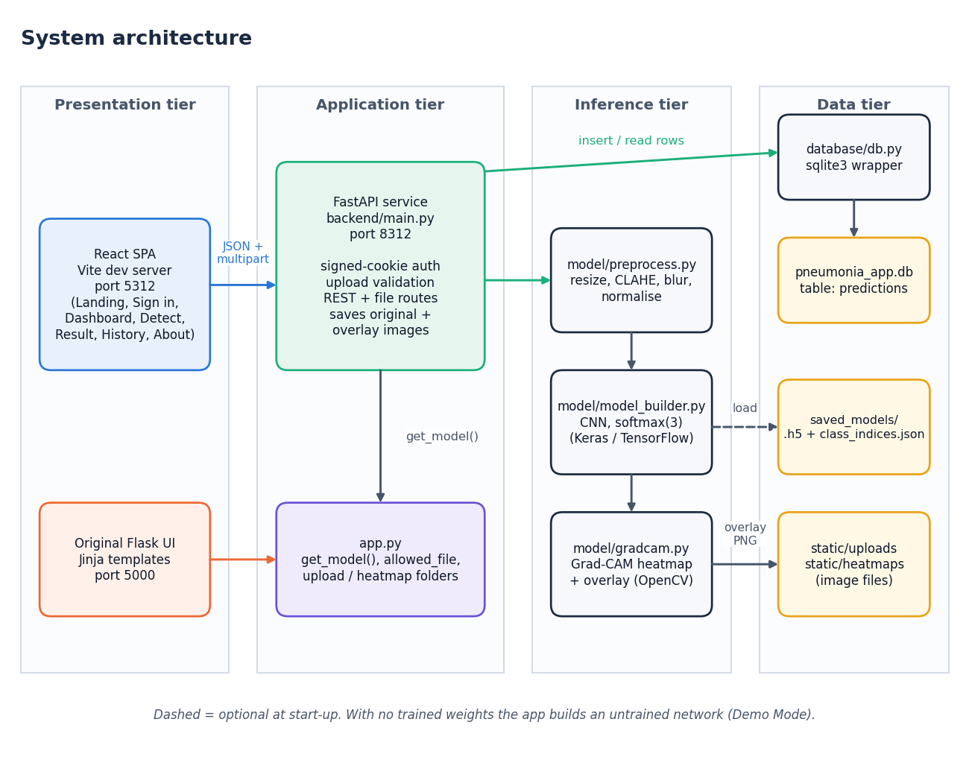
System Architecture
Presentation: React SPA, original Flask UI
Application: FastAPI, signed-cookie login, validation
Inference: preprocess, CNN, Grad-CAM
Data: SQLite, image files, weights
Dept. of CSE | Batch A12 | Final Review
10
Notes:
Four tiers; the model code is shared by both interfaces.

Slide 11
Methodology
Public data
Label from file names
Preprocess + cache
Patient-level split
Train CNN
Test once
metrics.json
Shared preprocessing: the training script calls the same function as the web app.
Validation cut by patient; official test split used once; seed 42; balanced class weights.
Additional views: patient-disjoint part of the test split, a fully patient-level re-partition, a CLAHE ablation and a MobileNetV3Small comparison.
Every metric, prediction and figure is written to disk and regenerated by scripts.
Dept. of CSE | Batch A12 | Final Review
11
Notes:
The workflow, and the additional protocols added because the official test split shares ids with training.

Slide 12
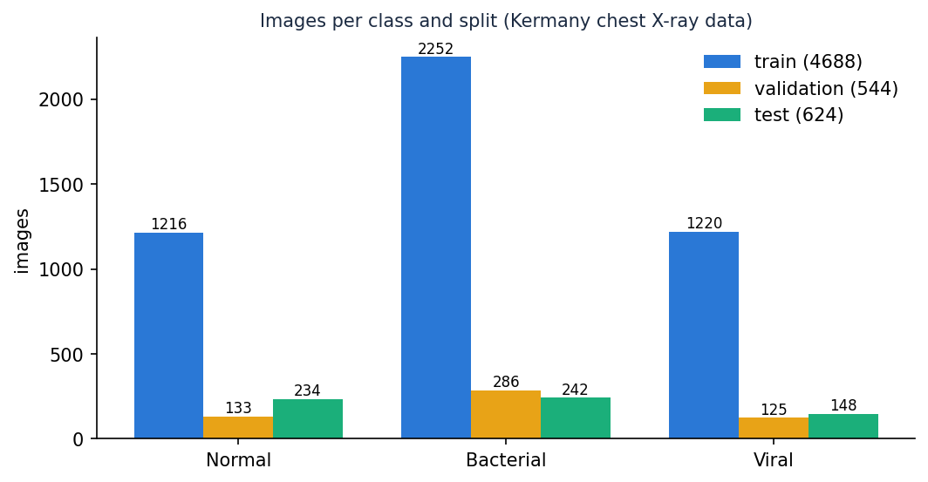
Dataset, Features & Model
5,856
Layer | Output
4 x (Conv3x3 + BN + MaxPool) | 14x14x256
GAP, Dense 512, Dropout 0.35 | 512
Dense 128, Dropout 0.25 | 128
Dense 3, softmax | 3 classes
Kermany chest X-rays (CC BY 4.0)
224 x 224
input, CLAHE + blur, [0, 1]
590,019
Training 4,688 / validation 544 / test 624 images; pathogen labels from file names.
Adam 0.0003, batch 32, early stopping, class weights, augmentation (rotation, shift, shear, zoom, flip).
CNN parameters
Dept. of CSE | Batch A12 | Final Review
12
Notes:
Dataset and model in one view. Pathogen labels are derived from file names, as the dataset authors encoded them.

Slide 13
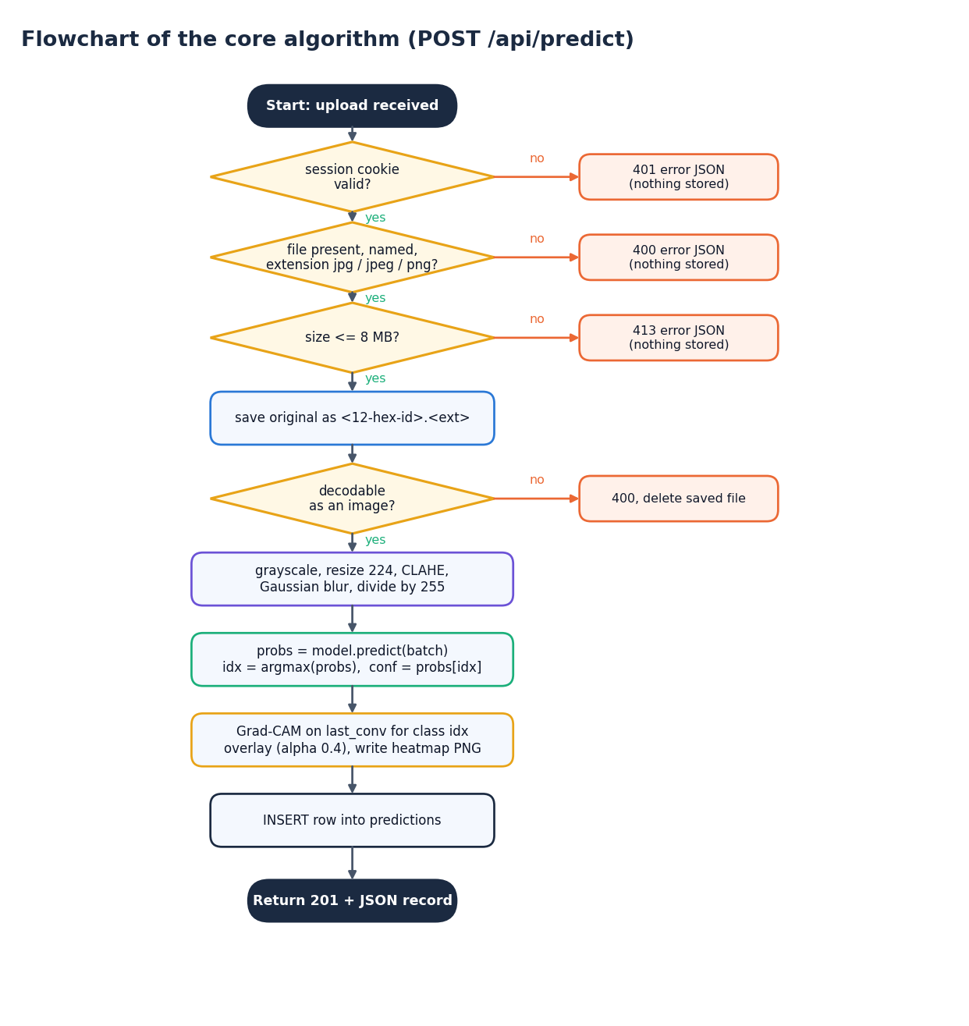
Decision Workflow
Validate: session, name, extension, 8 MB, decodable. Errors return 401 / 400 / 413 and store nothing.
Decide: class = arg-max of the three probabilities; confidence = that probability.
Explain: Grad-CAM for the predicted class, overlay alpha 0.4.
Flag: accuracy against a minimum-confidence threshold is reported so low-confidence scans can be sent for review.
Dept. of CSE | Batch A12 | Final Review
13
Notes:
The prediction route in decision form. The confidence threshold is analysed on slide 19.

Slide 14
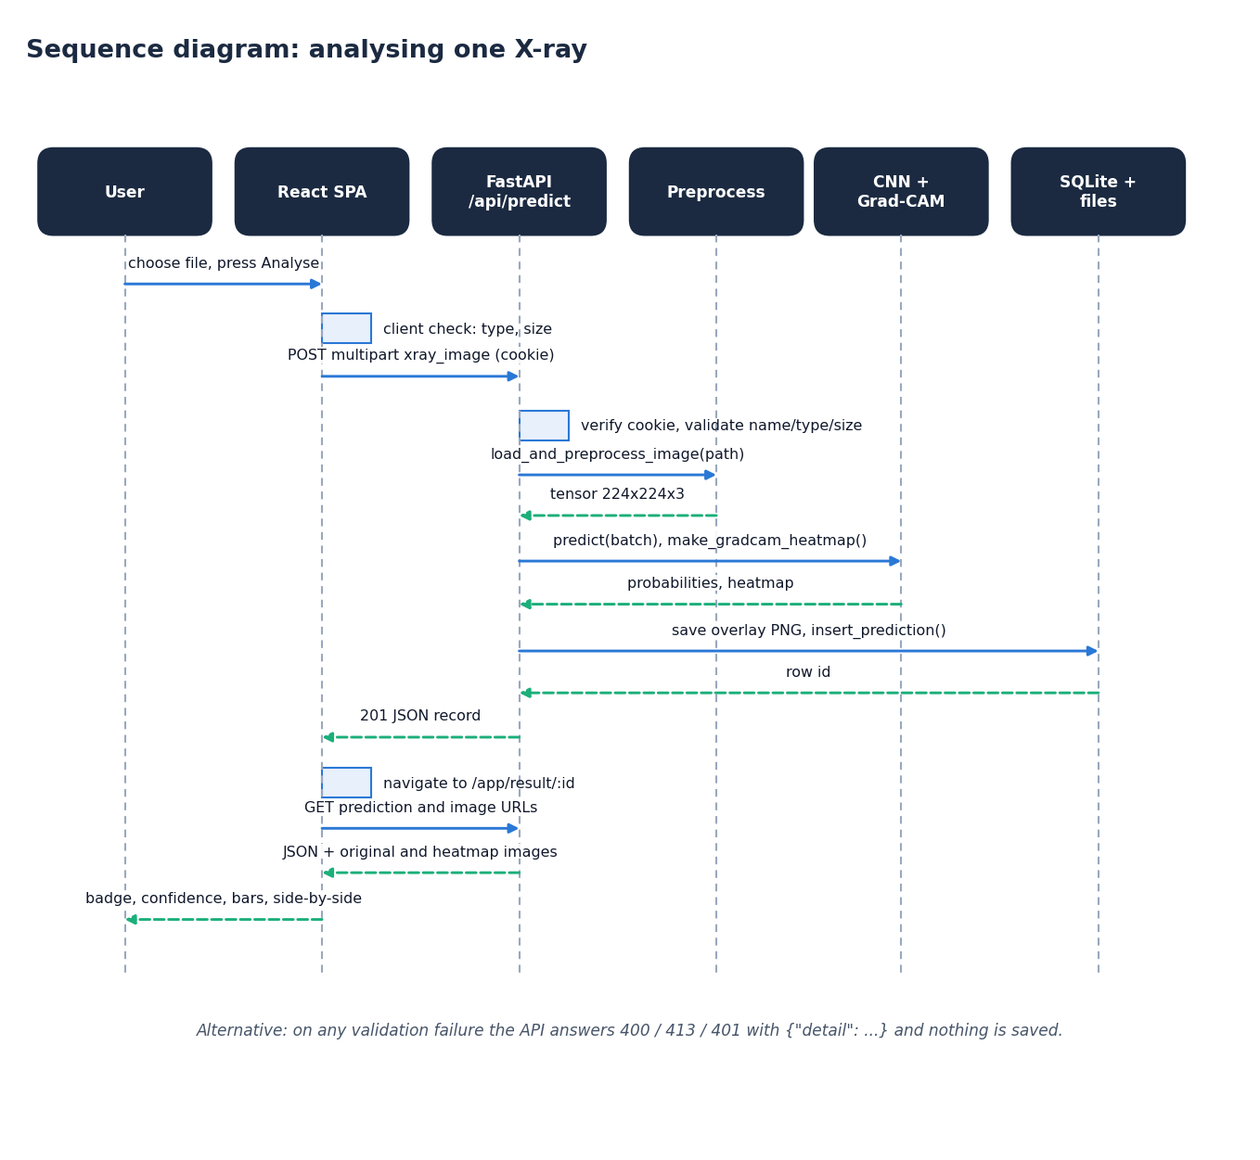
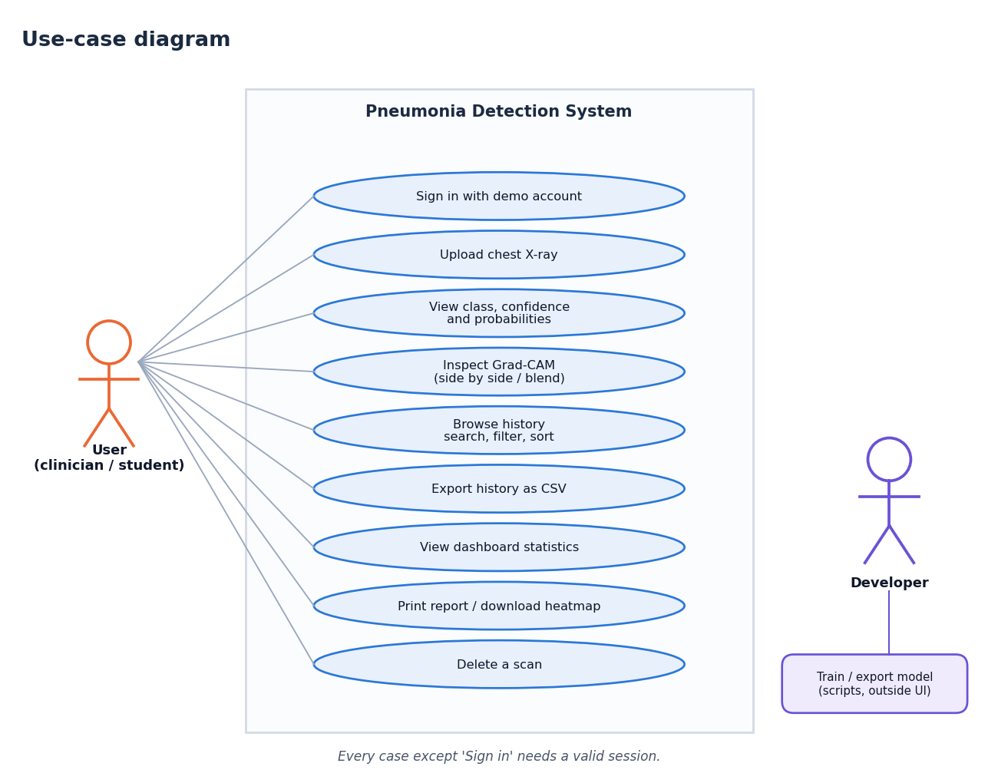
User – System Interaction
Dept. of CSE | Batch A12 | Final Review
14
Notes:
Sequence of one analysis and the use cases of the user and the developer.

Slide 15
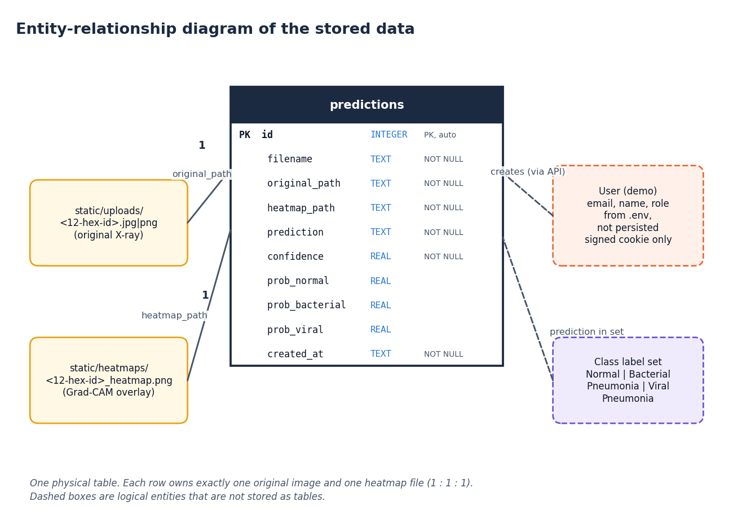
Database Design
Column | Type
id | INTEGER PK
filename | TEXT
original_path | TEXT
heatmap_path | TEXT
prediction | TEXT
confidence | REAL
prob_normal / _bacterial / _viral | REAL
created_at | TEXT (UTC)
Dept. of CSE | Batch A12 | Final Review
15
Notes:
One table; each row owns one original image and one overlay image on disk.

Slide 16
Implementation Highlights
10
73
8
1
REST endpoints
pytest tests
React screens
command to start (run.bat)
Signed HttpOnly session cookie (HMAC-SHA256, 12 h), 401 on protected routes, path-traversal guard on image files, bound-parameter SQL.
One TensorFlow inference at a time under a lock; model loads in a background thread at start-up.
Upload progress bar from a real XMLHttpRequest; side-by-side and blended Grad-CAM views; CSV export; print stylesheet.
Training script reuses the inference preprocessing and records every metric to JSON.
Dept. of CSE | Batch A12 | Final Review
16
Notes:
Highlights of the implementation: security controls, concurrency, interface features and the reproducible training script.

Slide 17
Results – Model Performance (official test split)
Class | Precision | Recall | F1 | Support
Normal | 0.967 | 0.620 | 0.755 | 234
Bacterial Pneumonia | 0.835 | 0.959 | 0.892 | 242
Viral Pneumonia | 0.607 | 0.804 | 0.692 | 148
Macro average / accuracy | 0.803 | 0.794 | 0.780 | acc 0.795
98.7%
62.0%
pneumonia sensitivity
normal specificity
Dept. of CSE | Batch A12 | Final Review
17
Notes:
Protocol: train on 4,688 patient-split training images, validate on 544, test once on the official 624-image test split. Class weights balanced.

Slide 18
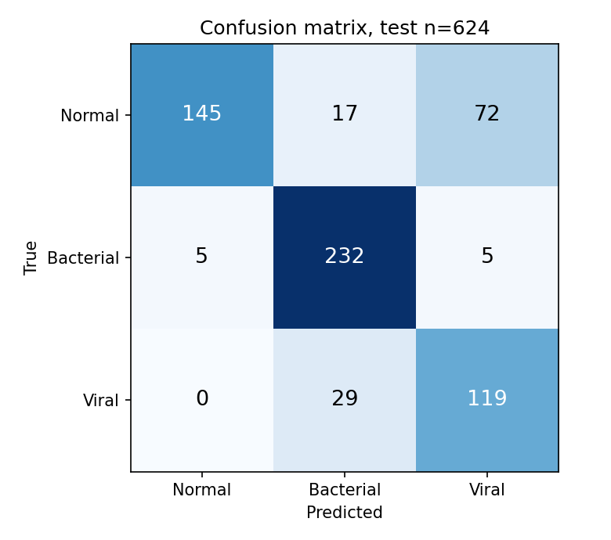
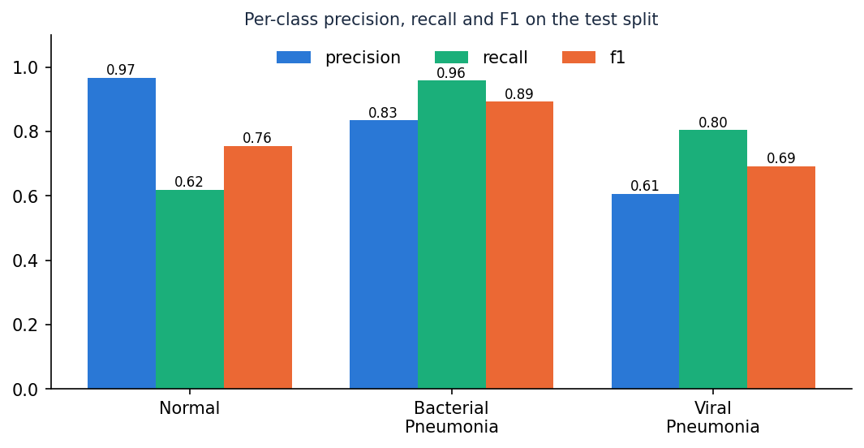
Confusion Matrix & Per-class Metrics
Test n = 624: Normal row [145, 17, 72], Bacterial row [5, 232, 5], Viral row [0, 29, 119] (columns Normal, Bacterial, Viral).
Dept. of CSE | Batch A12 | Final Review
18
Notes:
Rows are the true class, columns the prediction. The largest confusion is normal films predicted as viral pneumonia, then viral predicted as bacterial.

Slide 19
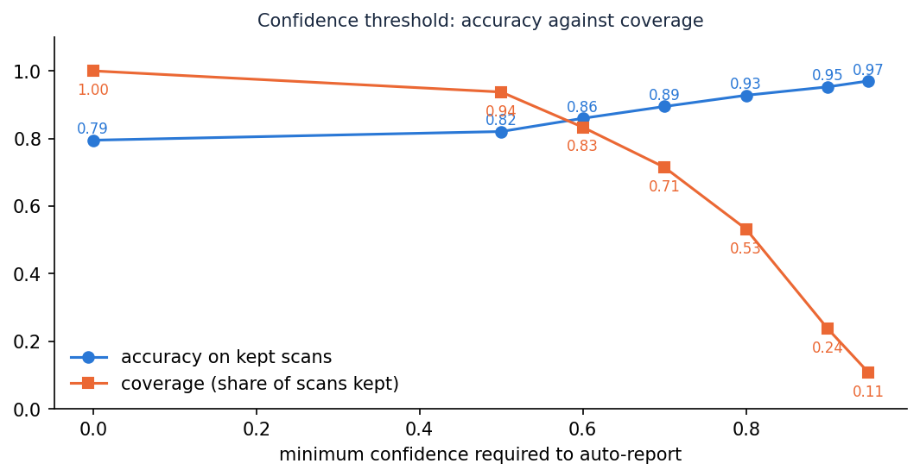
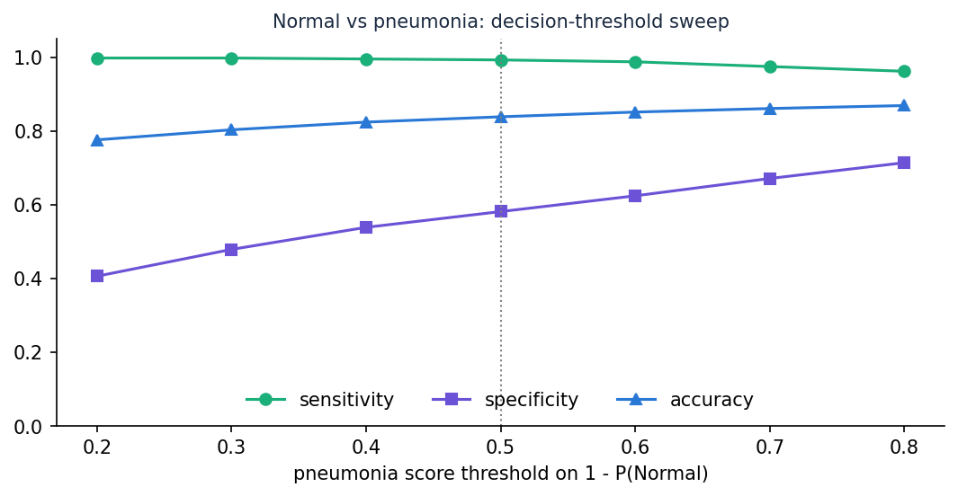
Threshold & Parameter Analysis
Experiment | 3-class acc. | Macro F1 | Sensitivity | Specificity
Baseline: project defaults | 68.1% | 0.655 | 99.0% | 35.5%
Deployed: tuned recipe | 79.5% | 0.780 | 98.7% | 62.0%
Ablation: no CLAHE | 82.2% | 0.810 | 99.2% | 66.7%
MobileNetV3Small (base-paper backbone) | 61.9% | 0.593 | 100.0% | 25.2%
Dept. of CSE | Batch A12 | Final Review
19
Notes:
Left: accuracy against the minimum confidence required to auto-report. Right: moving the pneumonia decision threshold trades sensitivity for specificity. Bottom: the CLAHE ablation and the MobileNetV3Small comparison on the same test images.

Slide 20
Performance & Testing
27 ms
63 ms
110 ms
521 ms
preprocessing
network forward pass
Grad-CAM + overlay
end-to-end POST /api/predict (mean)
Test layer | What it covers | Result
Unit (pytest) | preprocessing, network, Grad-CAM, database, tokens | 31 passed
Integration (pytest) | login, validation, prediction, history, stats, files | 34 passed
Functional (Flask) | upload form, result, history, errors | 8 passed
Live smoke test | running servers through the proxy | 25 checks passed
UI verification | 360 / 768 / 1440 px, light / dark, keyboard, motion | 6 configurations, no overflow or console errors
Dept. of CSE | Batch A12 | Final Review
20
Notes:
Latency was measured on a CPU-only desktop: about half a second per scan through the API. The test table shows every layer passed.

Slide 21
Comparison with Base Paper (context only – different datasets)
Aspect | Base paper [1] | This project
Task | Binary (Normal / Pneumonia) and 4-class (COVID-19, Normal, Pneumonia, TB) | 3-class: Normal / Bacterial / Viral pneumonia; Normal vs pneumonia view derived
Data | Mendeley paediatric set, balanced subset of 1,300 per class (2,080 / 260 / 260) | Same image source, full official data: 4,688 / 544 / 624, imbalanced, class weights
Model | MobileNet family, ImageNet-pretrained; FixMatch / FlexMatch / FreeMatch | Custom 4-block CNN, 590,019 parameters, trained from scratch on a CPU
Accuracy | Up to 98 % (binary), 97 % (4-class); 97 % with 20 % labels | 79.5% 3-class; 84.9% Normal vs pneumonia (official test split)
Explanation / reliability | Grad-CAM, MC Dropout (entropy 0.30), TTA, ECE | Grad-CAM, ECE 0.033, confidence-threshold analysis
Deliverable | Research framework | Working web application with history, dashboard and tests
Not a like-for-like comparison: different class set, balance, split and model family. Where the protocol differs the numbers are context, not a ranking.
Dept. of CSE | Batch A12 | Final Review
21
Notes:
State plainly that datasets and protocols differ: the base paper balances and subsamples, we keep the official imbalanced data and add a third class.

Slide 22
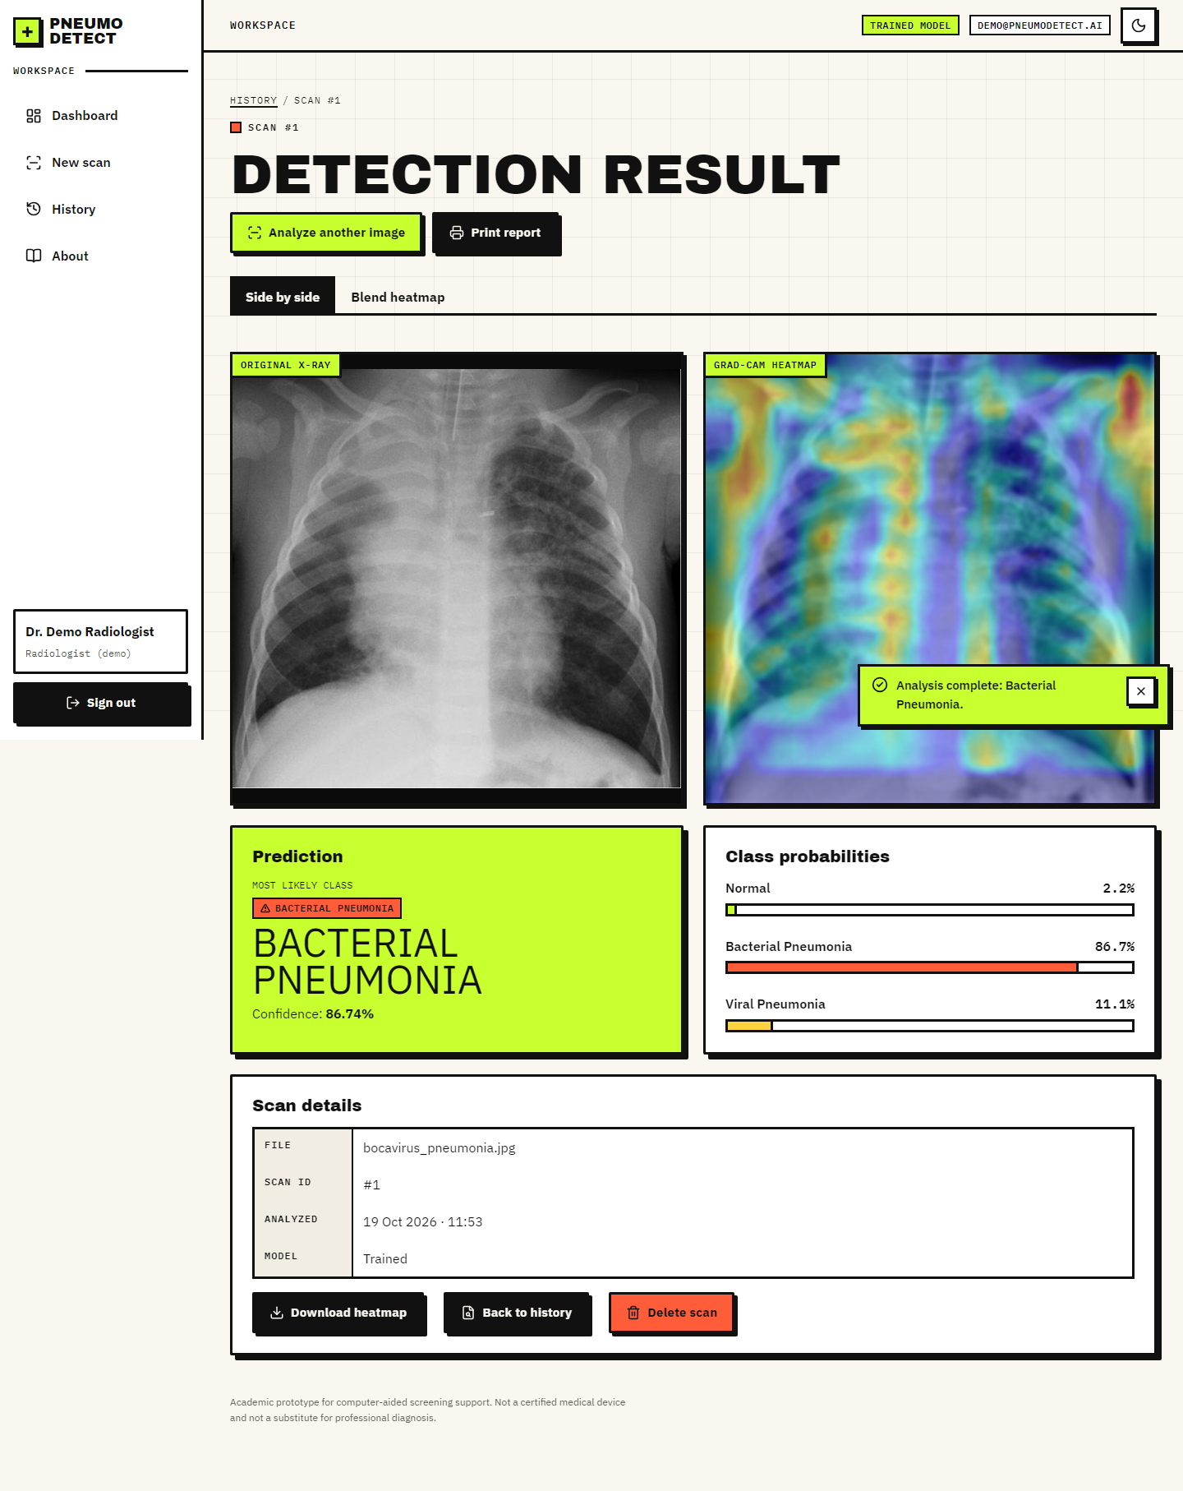
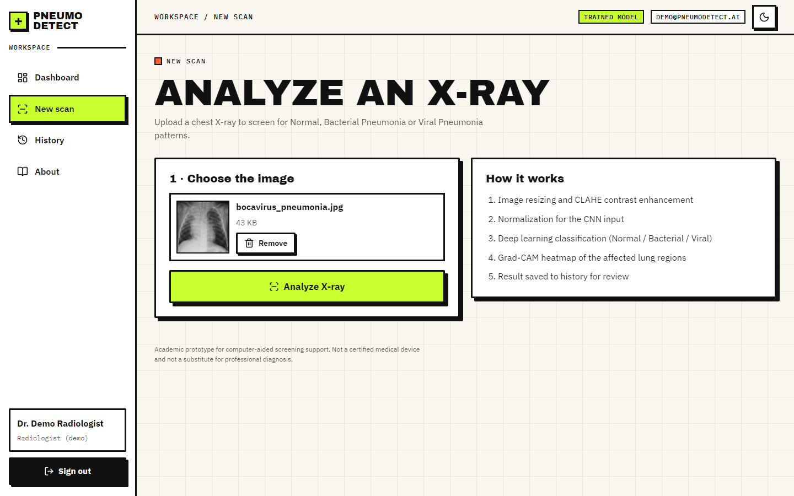
Output – Upload and Analysis
Dept. of CSE | Batch A12 | Final Review
22
Notes:
Left: the detect screen with a preview before analysis. Right: the result page with the class badge, probabilities and the Grad-CAM overlay.

Slide 23
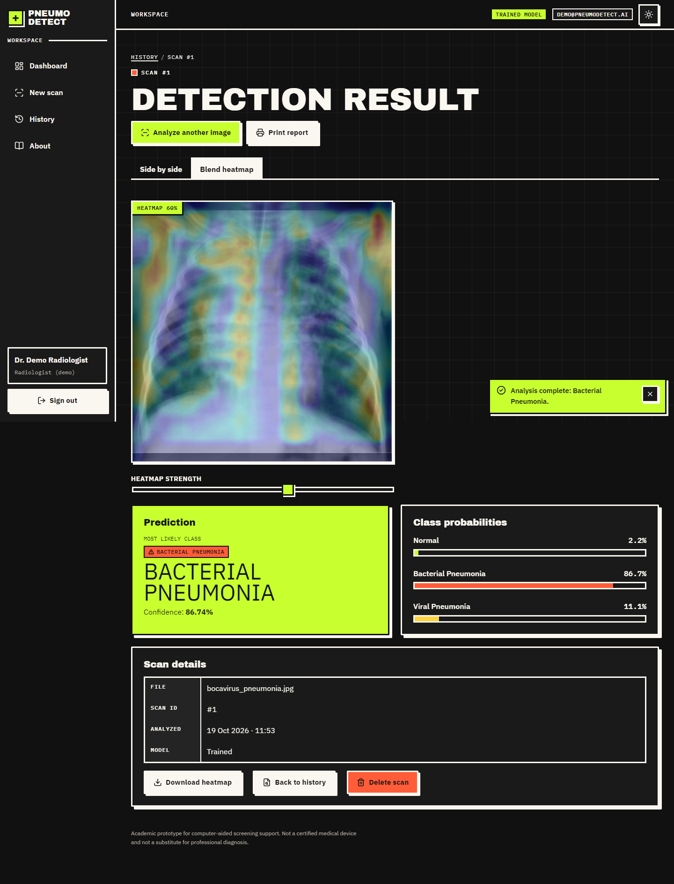
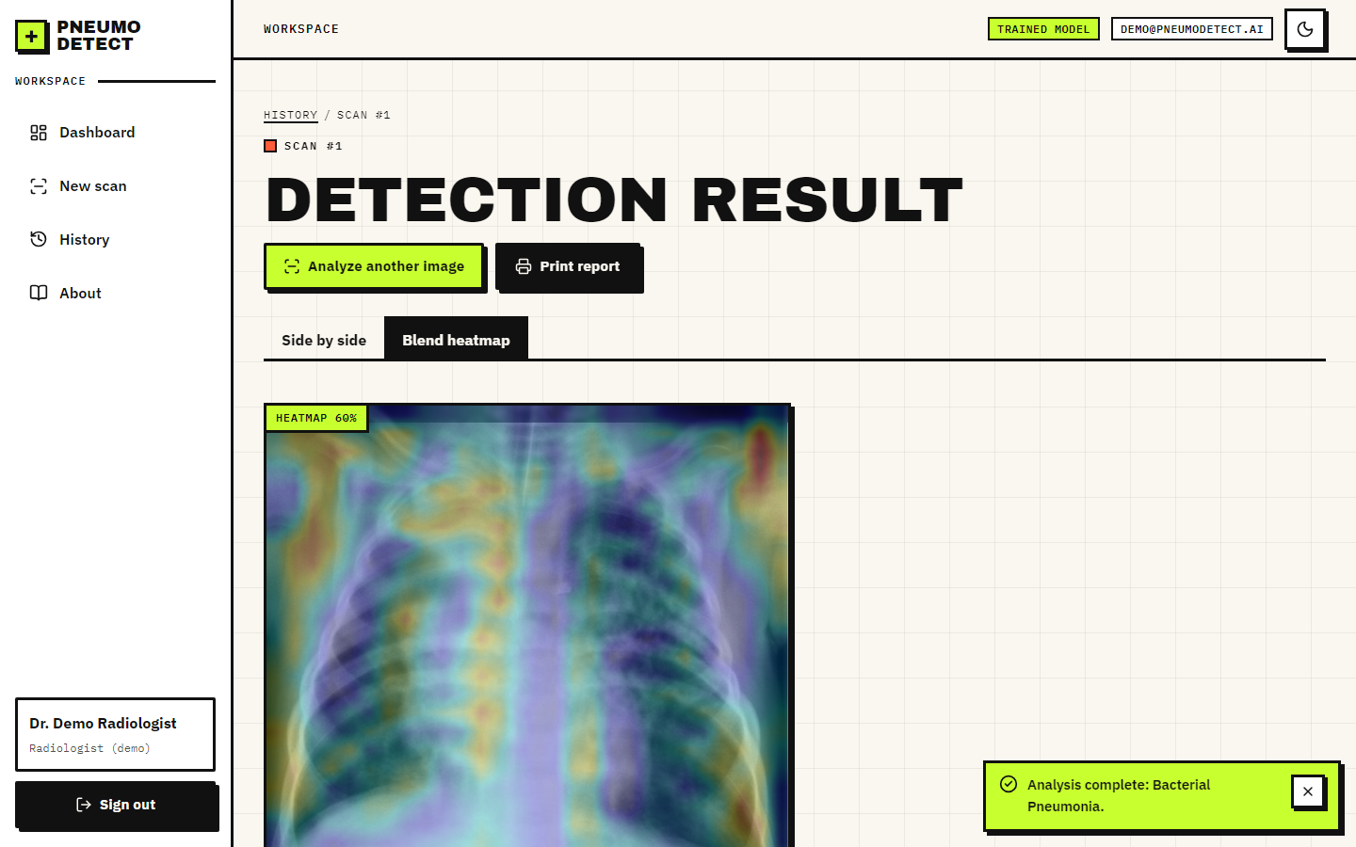
Output – Grad-CAM Result (blend and dark theme)
Dept. of CSE | Batch A12 | Final Review
23
Notes:
The heat-map strength slider blends the overlay over the X-ray; the dark theme is remembered.

Slide 24
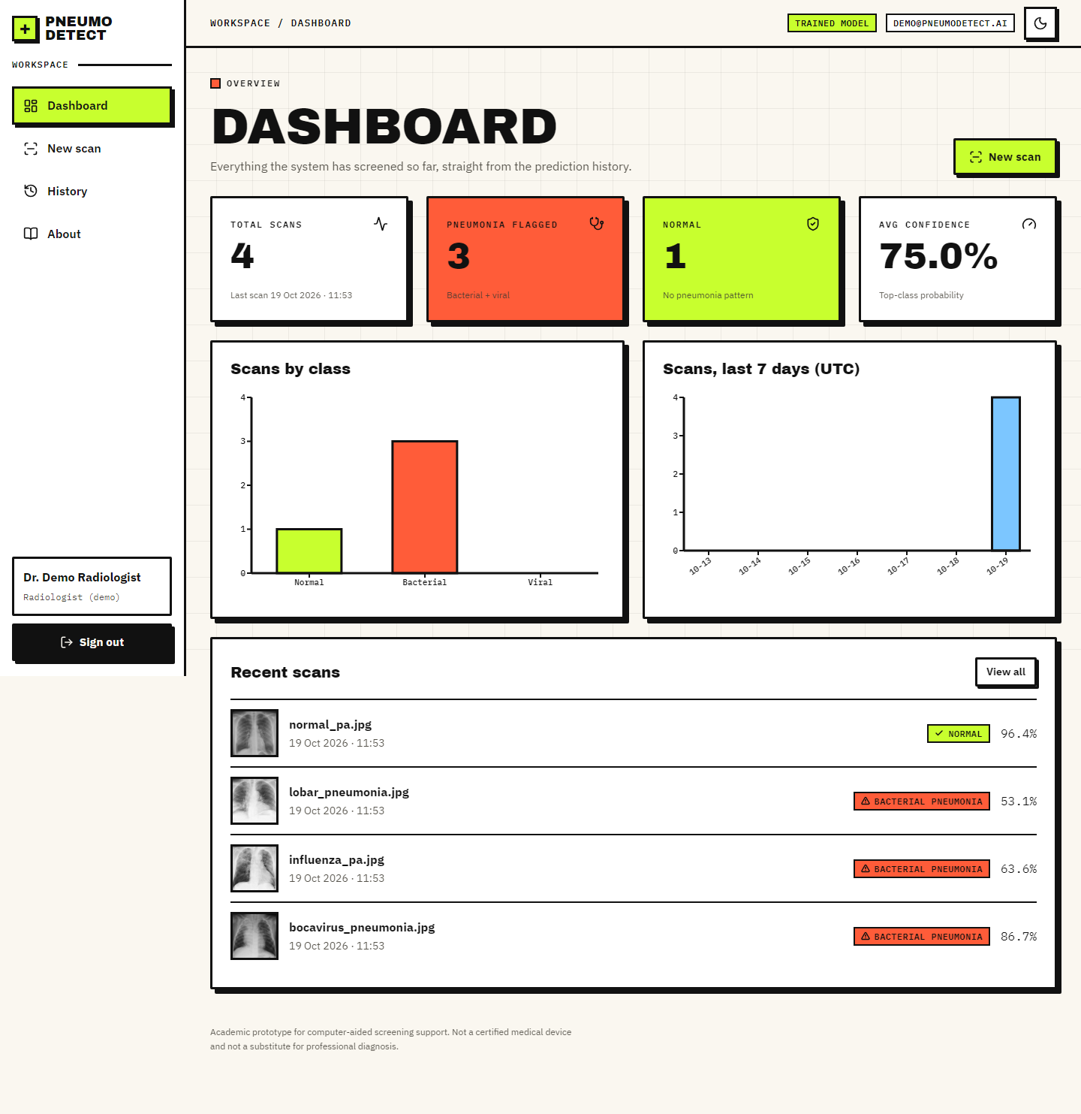
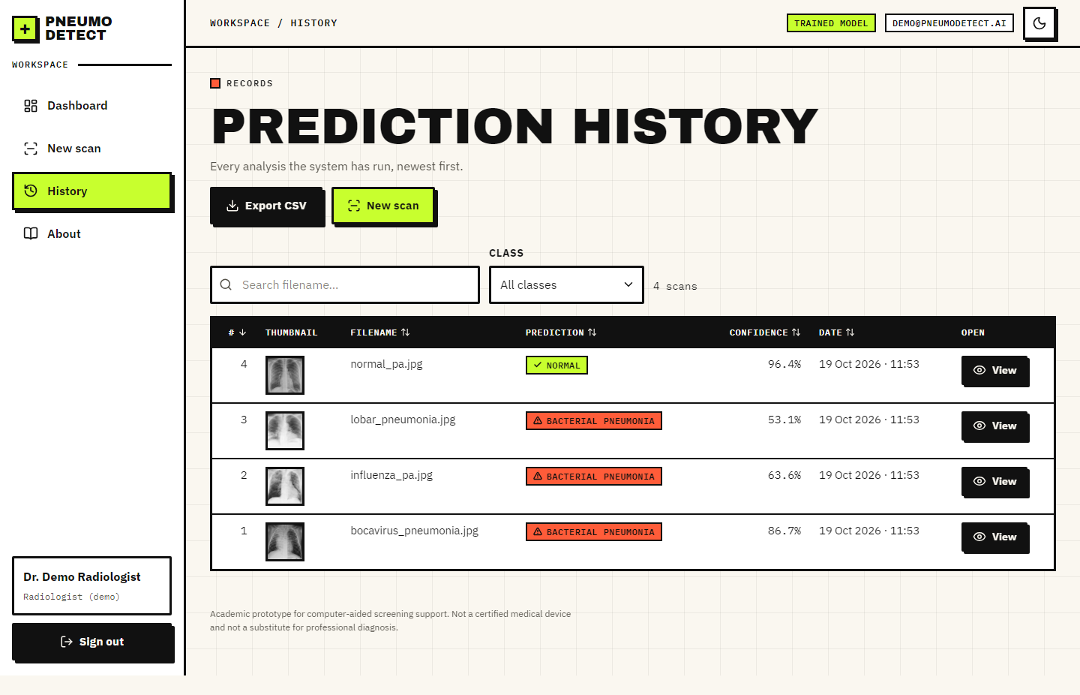
Output – History and Dashboard
Dept. of CSE | Batch A12 | Final Review
24
Notes:
History with search, filter, sort and CSV export; dashboard with totals, class distribution and scans per day.

Slide 25
Conclusion
Delivered: an end-to-end pneumonia detection system: preprocessing, a trained three-class CNN, Grad-CAM, storage, history, dashboard, tests and documentation.
Measured: 79.5% three-class accuracy and 98.7% / 62.0% pneumonia sensitivity / normal specificity on the official test split, with the protocol stated.
Finding: normal versus pneumonia is learnable by a compact CPU-trained CNN; specificity (normal films called pneumonia) is the weak point, and the public test split shares pneumonia ids with training, so patient-disjoint results are reported too.
Not achieved: U-Net lung segmentation (objective 2), calibrated uncertainty, external validation. Not a medical device.
Dept. of CSE | Batch A12 | Final Review
25
Notes:
Five objectives were met in full or in part; objective 2 was not. Findings are stated with their protocol.

Slide 26
Future Scope
U-Net lung segmentation to restrict the classifier to the lungs and make Grad-CAM maps more specific.
Monte Carlo Dropout or temperature scaling for calibrated uncertainty and a built-in review flag.
Transfer-learning backbones (MobileNetV3Small, EfficientNet) with a Grad-CAM that can reach nested layers.
External validation on data from other hospitals; adult cohorts; prospective clinical evaluation.
Real accounts and roles, audit log, DICOM input, container deployment.
Dept. of CSE | Batch A12 | Final Review
26
Notes:
Concrete next steps, ordered by value.

Slide 27
References
[1] S. M. Mahin, T. Hasan, S. Karim, M. B. R. Nuha, E. H. Tusher, A. R. Hussain, J. Uddin, and D. Ghose, "From pneumonia to multi-disease: Interpretable and uncertainty-aware semi-supervised learning strategies for chest X-ray classification," IEEE Access, vol. 14, pp. 127532-127551, 2026
[3] D. S. Kermany et al., "Identifying medical diagnoses and treatable diseases by image-based deep learning," Cell, vol. 172, no. 5, pp. 1122-1131, Feb. 2018.
[5] A. O. Khadidos, A. Nanyonga, A. O. Khadidos, O. M. Mirza, and M. T. Yilmaz, "Explainable deep learning for pediatric pneumonia detection in chest X-ray images," arXiv:2601.09814, Jan. 2026.
[6] K. Shahi and A. Bagale, "Weakly supervised pneumonia localization from chest X-rays using deep neural network and Grad-CAM explanations," arXiv:2511.00456, 2025.
[7] P. Rajpurkar et al., "CheXNet: Radiologist-level pneumonia detection on chest X-rays with deep learning," arXiv:1711.05225, 2017.
[9] R. R. Selvaraju, M. Cogswell, A. Das, R. Vedantam, D. Parikh, and D. Batra, "Grad-CAM: Visual explanations from deep networks via gradient-based localization," Int. J. Comput. Vis., vol. 128, no. 2, pp. 336-359, Feb. 2020.
[10] O. Ronneberger, P. Fischer, and T. Brox, "U-Net: Convolutional networks for biomedical image segmentation," in Proc. Med. Image Comput. Comput.-Assist. Intervent. (MICCAI), 2015, pp. 234-241.
[11] K. Zuiderveld, "Contrast limited adaptive histogram equalization," in Graphics Gems IV, P. S. Heckbert, Ed. San Diego, CA, USA: Academic Press, 1994, pp. 474-485.
[12] A. G. Howard et al., "MobileNets: Efficient convolutional neural networks for mobile vision applications," arXiv:1704.04861, 2017.
[13] A. Howard et al., "Searching for MobileNetV3," in Proc. IEEE/CVF Int. Conf. Comput. Vis. (ICCV), Sep. 2019, pp. 1314-1324.
[14] K. Sohn et al., "FixMatch: Simplifying semi-supervised learning with consistency and confidence," in Proc. Adv. Neural Inf. Process. Syst., vol. 33, 2020, pp. 596-608.
[15] Y. Gal and Z. Ghahramani, "Dropout as a Bayesian approximation: Representing model uncertainty in deep learning," in Proc. Int. Conf. Mach. Learn. (ICML), 2016, pp. 1050-1059.
[16] D. P. Kingma and J. Ba, "Adam: A method for stochastic optimization," arXiv:1412.6980, 2014.
[20] T. Ozturk, M. Talo, E. A. Yildirim, U. B. Baloglu, O. Yildirim, and U. R. Acharya, "Automated detection of COVID-19 cases using deep neural networks with X-ray images," Comput. Biol. Med., vol. 121, Art. no. 103792, Jun. 2020.
[22] F. Alshanketi et al., "Pneumonia detection from chest X-ray images using deep learning and transfer learning for imbalanced datasets," J. Imaging Inform. Med., vol. 38, no. 4, pp. 2021-2040, Nov. 2024.
[29] C. Guo, G. Pleiss, Y. Sun, and K. Q. Weinberger, "On calibration of modern neural networks," in Proc. Int. Conf. Mach. Learn. (ICML), 2017, pp. 1321-1330.
Dept. of CSE | Batch A12 | Final Review
27
Notes:
Selected references; the complete list is in the report.

Slide 28
THANK YOU
Questions & Suggestions
Dept. of CSE | Batch A12 | Final Review
28
Notes:
Invite questions.

