Slide 1
Personalized E-learning Course Recommendation System
REVIEW 2 · DESIGN, METHODOLOGY AND PROGRESS
Design, methodology and progress: an eight-term hybrid ranker, a learner-success model and action-benefit estimates behind a FastAPI service and a React interface
Presented by
Under the guidance of
PITTALA AKHILA 23K91A05J3
MUNDALA SANDHYA 23K91A05G5
MULA THANUJ REDDY 23K91A05G4
MAJJIGAPU JAGADESHWAR REDDY 23K91A05E1
K GAYATHRI, [DESIGNATION]
Department of Computer Science and Engineering
[COLLEGE NAME] · Batch C7 (CSE-C) · [ACADEMIC YEAR]
Notes:
This review shows how the system is designed and built: the data and models, what has been implemented, the first measured results and the open items.

Slide 2
Contents
01
02
03
Recap and architecture
Methodology and dataset
Preprocessing and model
04
05
06
Training and decision logic
Data flow, database and UML
Technology stack
07
08
09
Implementation progress and results
Output screens and testing
Challenges and next steps
Notes:
Agenda for the design and progress review.

Slide 3
Recap: problem and proposed system
!
Problem
i
Proposed system
B
Base paper link
Learners face long catalogues and no reliable way to judge which course suits them. Popularity lists ignore skill, goals and behaviour, new learners have no history, and courses are not put in order.
LearnPathIQ ranks every course with an eight-term hybrid score, adds a learner-success estimate and an estimated best learning action, explains each recommendation and orders a staged learning path.
Reuses its ideas of a predictive success model, uplift-style action benefit, off-policy evaluation and a fairness audit. It does not implement the Actor-Critic agent and does not use real OULAD data.
Notes:
One-minute recap of Review 1. The base paper prescribes actions on real OULAD data; we adapt its components to course recommendation on synthetic OULAD-like data and say so on every results slide.

Slide 4
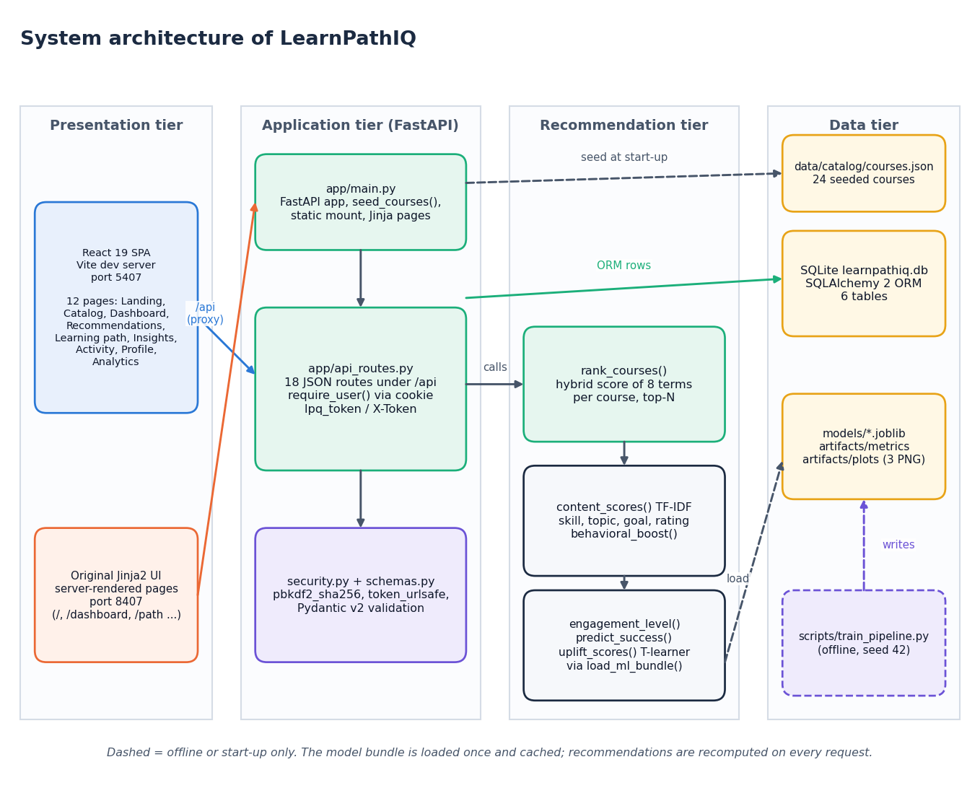
System architecture
Four tiers
Presentation: React 19 SPA (port 5407, 12 pages) and the original Jinja pages (port 8407).
Application: FastAPI with 18 JSON routes, HttpOnly cookie or header token, Pydantic validation.
Recommendation: hybrid ranker, success model, action-benefit models loaded from joblib files.
Data: SQLite (6 tables), 24-course catalogue, model artifacts.
Notes:
Four tiers. The React app proxies /api to the FastAPI service, so the login cookie stays same-origin.

Slide 5
Methodology: end-to-end workflow
Learner profile
TF-IDF + rule terms
Success + action models
8-term hybrid score
Top-N + reasons + log
Events update next ranking
Trained offline
Computed per request
Honest scope
scripts/train_pipeline.py generates the data, fits three success models and the action models, runs policy evaluation and the fairness audit, and saves every artifact. Seed 42.
Every recommendation call re-fits TF-IDF over the profile and 24 course texts, scores all courses and logs the result. No cache; about 33 ms on this machine.
No collaborative filtering across learners (no real interaction log) and no reinforcement-learning agent. The behavioural term is per learner.
Notes:
The workflow splits into an offline training step and an online ranking step. The online step needs no retraining to adapt: new events change the behaviour and engagement terms at once.

Slide 6
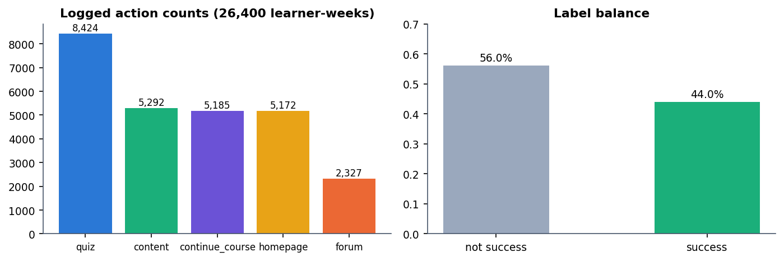
Dataset
26,400
2,200 x 12
44.0%
24
learner-week rows (synthetic)
learners x weeks
positive (success) rate
hand-written courses, 9 categories
Source is a reproducible OULAD-like generator (synthetic-oulad-like-fallback-v1); the real OULAD was not downloaded or used.
Learner-level split 80/10/10: train 21,120, validation 2,640, test 2,640 rows (seed 42).
Success is a noisy function of a hidden assessment score that the app never sees.
Notes:
State the data source first. Every model number in this deck comes from the synthetic generator; no claim is made about real learners.

Slide 7
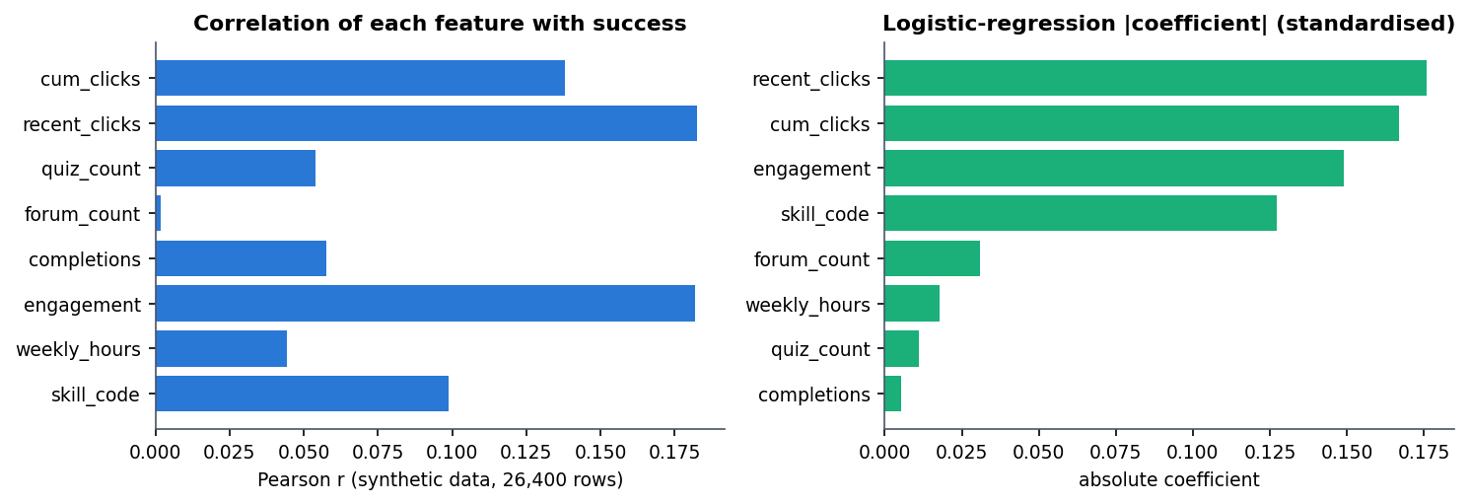
Data preparation and features
1 Profile text and course text
2 TF-IDF and cosine similarity
3 Engagement from recent events
4 8-feature learner state
5 Standard scaling
Weak signal: the strongest feature correlates with success at only r = 0.18.
Text: profile text (interests, topics, goals, preferences, education, skill) and course text (title, description, topic, category, tags, level) go into TF-IDF with English stop words, at most 2,000 terms.
State: 8 features from the profile and logged events, standardised before the models.
Notes:
The same state vector is used in training and at request time. Feature correlations are modest by construction of the generator, which is why test AUC is about 0.60.

Slide 8
Models
Model | Settings | Val AUC | Test AUC
Logistic regression (selected) | max_iter 1000, standardised inputs | 0.604 | 0.603
Random forest | 200 trees | 0.555 | 0.544
XGBoost | 300 trees, depth 5, rate 0.05, subsample 0.9 | 0.601 | 0.599
Action-benefit (T-learner) | 5 actions x 2 logistic regressions | - | -
Behaviour policy | multinomial logistic regression | - | -
0.604
validation AUC of the saved model
5 x 2
uplift models, one pair per action
No GPU
Estimated benefit of an action = P(success | action) - P(success | no action). It is an estimate from a confounded synthetic log, not a proven causal effect.
all training on a desktop CPU
Notes:
The selected model is whichever has the best validation AUC; on the shipped seed that is logistic regression, with XGBoost a close second. Test AUC is reported on the held-out learners.

Slide 9
Training configuration
Setting | Value
Data and split | synthetic OULAD-like generator, 2,200 learners x 12 weeks; learner-level 80/10/10 split, seed 42
Features | cum_clicks, recent_clicks, quiz_count, forum_count, completions, engagement, weekly_hours, skill_code
Success models | logistic regression, random forest (200 trees), XGBoost (300 trees, depth 5); best validation AUC kept
Action models | for quiz, content, forum, homepage, continue_course: two logistic regressions (treated, not treated)
Offline policy evaluation | propensities clipped to [0.02, 0.98], weights capped at 10; IPS, SNIPS, doubly robust
Fairness audit | F1 and mean prediction by age band and gender; audit only, no mitigation
Run time / hardware | about 6 s per seed run; i5-12500, 15.7 GB RAM, CPU only
Notes:
The whole training run takes seconds, so we could repeat it with six seeds to measure variation (next slides and the final review).

Slide 10
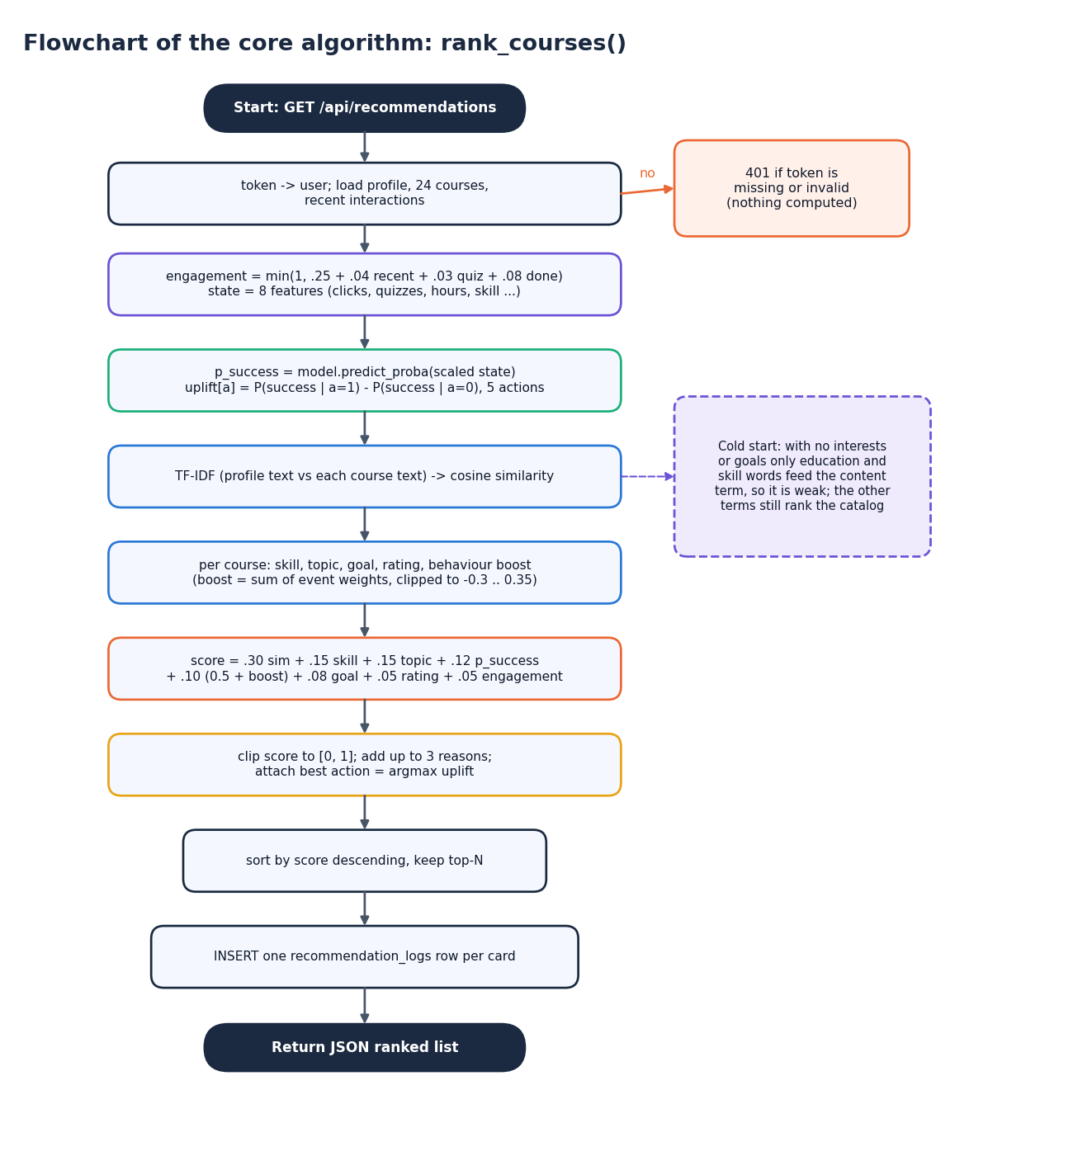
Decision logic: the hybrid score
Score = 0.30 content + 0.15 skill + 0.15 topic + 0.12 predicted success + 0.10 (0.5 + behaviour) + 0.08 goal + 0.05 rating + 0.05 engagement, clipped to [0, 1].
Behaviour adds event weights per course (view 0.05 up to complete 0.20, dismiss -0.25), clipped to [-0.3, 0.35].
Reasons. Up to three plain-language reasons are attached to each card (interest match, skill fit, prior engagement, success estimate).
Next action. The action with the largest estimated benefit is attached; it depends on the learner state only, so every card of one learner shows the same action.
Notes:
The flowchart follows rank_courses() in app/recommender.py. The last bullet is a known limitation that we report rather than hide.

Slide 11
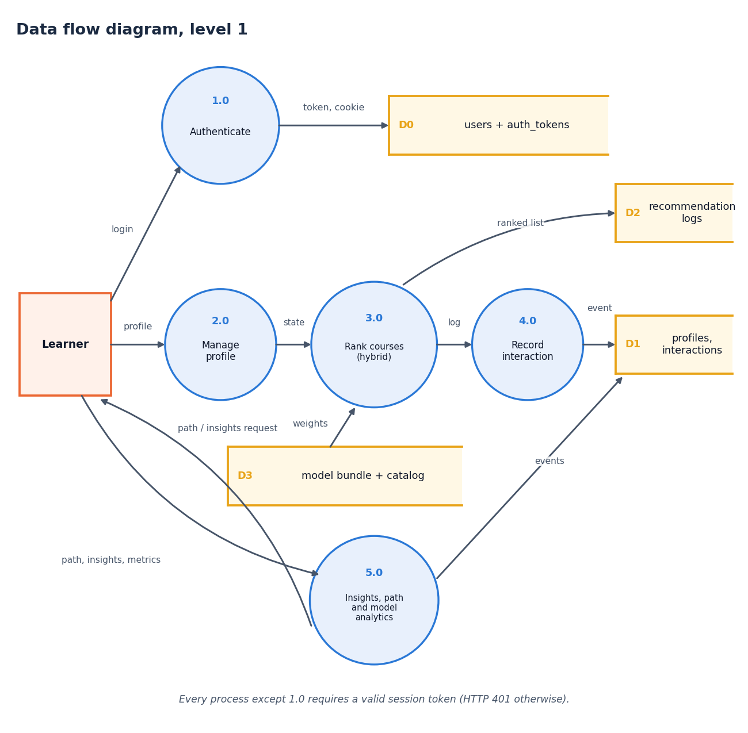
Data flow and modules
Module | Role
app/recommender.py | hybrid ranker, success, uplift
app/api_routes.py | 18 JSON routes
app/models.py | 6 ORM tables
app/security.py | hashing, tokens
scripts/train_pipeline.py | offline training
frontend/src/pages | 12 React pages
Notes:
Level-1 data flow: five processes. Levels 0 and 2 are in the report.

Slide 12
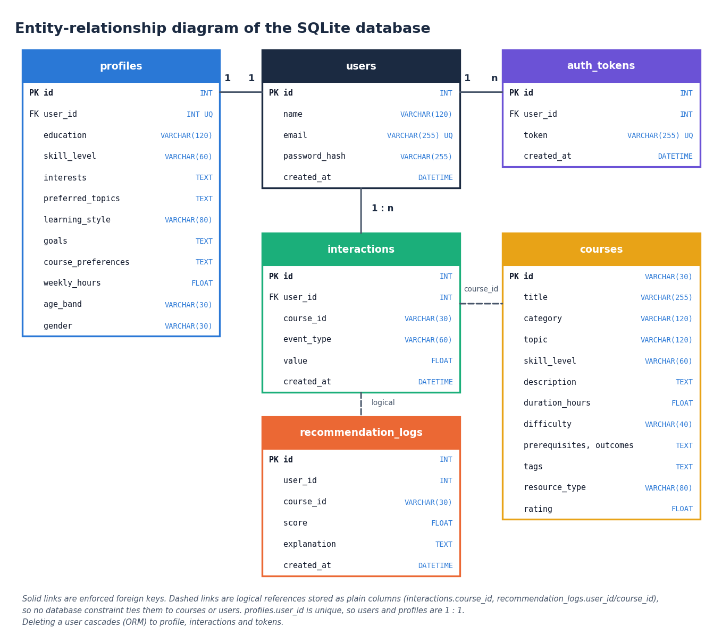
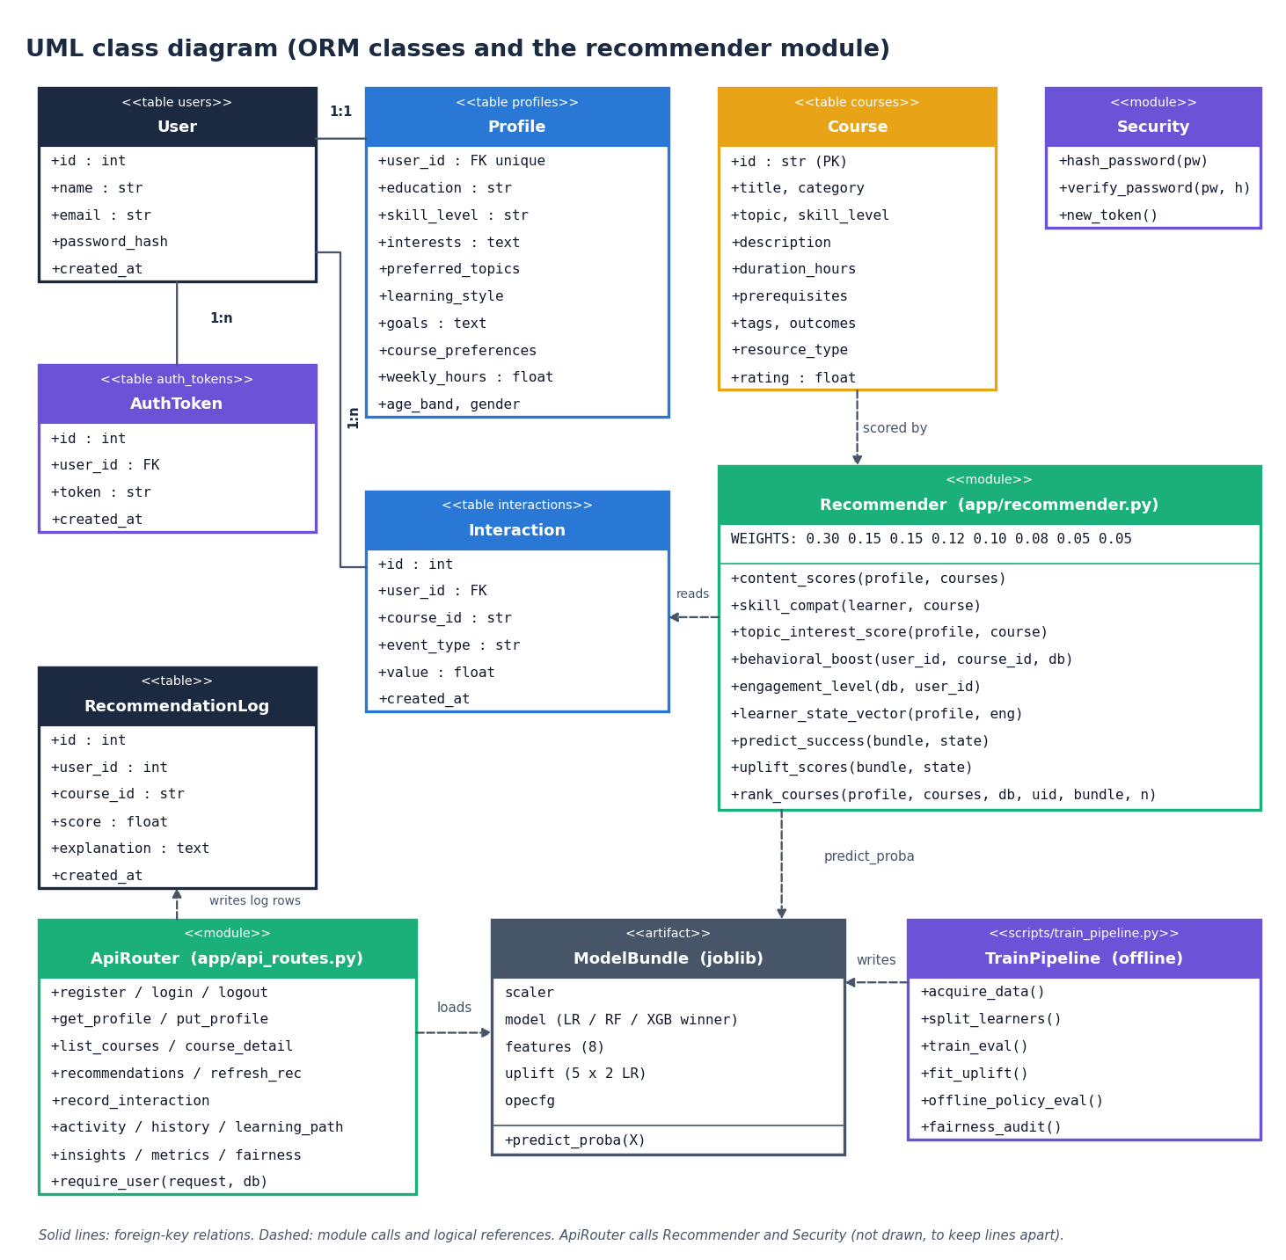
Database design and UML
Six tables; users-profiles is 1:1, users-interactions and users-tokens are 1:n; the UML draws the recommender module as a class.
Notes:
Foreign keys link profiles, interactions and tokens to users. Interaction course ids and recommendation-log columns are plain columns, not constraints.

Slide 13
Technology stack
Layer | Technology
Models | scikit-learn 1.5.2, XGBoost 2.1.3, pandas 2.2.3, NumPy 1.26.4, joblib
API | FastAPI 0.115.6, Uvicorn, Pydantic 2.10.4, passlib (pbkdf2_sha256)
Database | SQLite through SQLAlchemy 2.0.36
Front end | React 19, Vite, React Router, Recharts, Framer Motion
Testing | pytest, an end-to-end smoke script, a Playwright responsive check
Run | Python 3.11.9, Node v24.19.0; backend port 8407, front end port 5407
Notes:
Everything is open source and runs on one laptop.

Slide 14
Implementation progress
Component (objective) | Status | Evidence
Learner profiles (1) | Done | profiles table, profile page
Course catalogue (2) | Done | 24 courses with topic, level, prerequisites, outcomes
Content-based matching (4) | Done | TF-IDF similarity plus skill, topic, goal terms
Hybrid ranking and learning path (5) | Done | 8-term score, staged path, reasons
Evaluation (6) | Partial | AUC/F1, policy evaluation, 10-persona check; no user study
Collaborative filtering (3) | Not implemented | no real interaction log across learners
Actor-Critic RL agent (base paper) | Not implemented | out of scope; uplift and OPE only
Notes:
Objective-by-objective status. The two gaps are cross-learner collaborative filtering and the reinforcement-learning agent.

Slide 15
Preliminary results (synthetic data)
0.603
0.415
0.73
0.20
test AUC, logistic regression
test F1 (2,640 rows)
persona P@3, hybrid
persona P@3, popularity
i
Reading
10 author-written personas over 24 courses: the hybrid beats popularity clearly, but not content-only (P@3 0.73 vs 0.80). Test AUC is modest because the synthetic features carry little signal.
Notes:
First measured numbers. The persona check is a sanity test with relevance defined as category membership, fixed before ranking; it is not a user study. Offline policy evaluation gave SNIPS 0.665 with an effective sample size of 9.1, so it is not evidence of a gain.

Slide 16
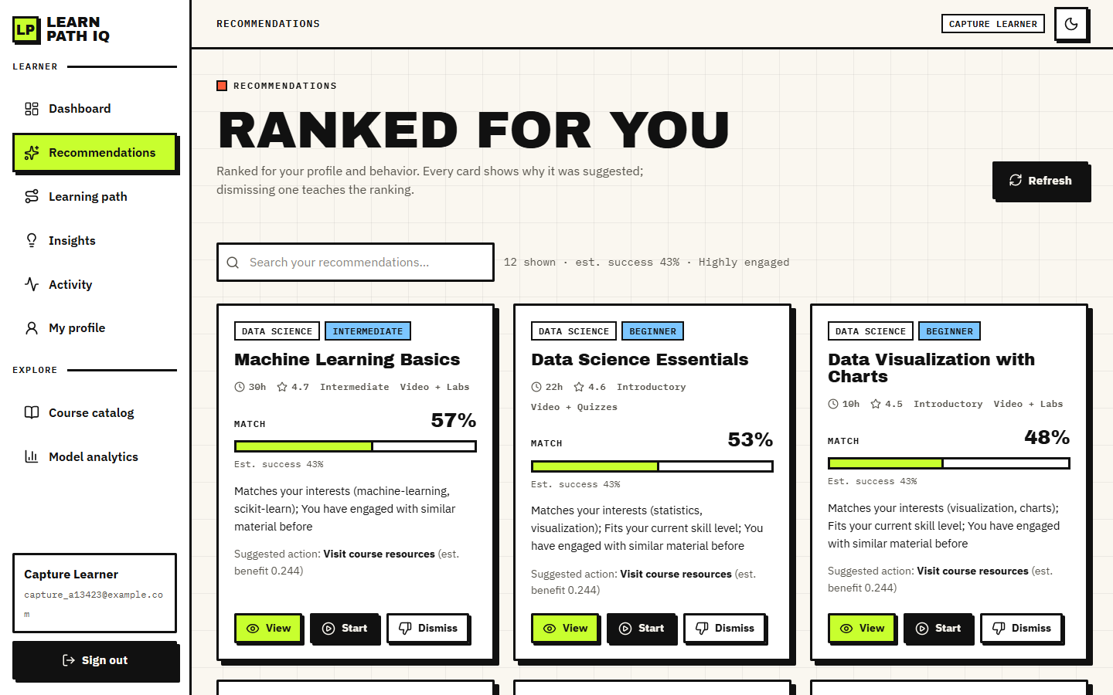
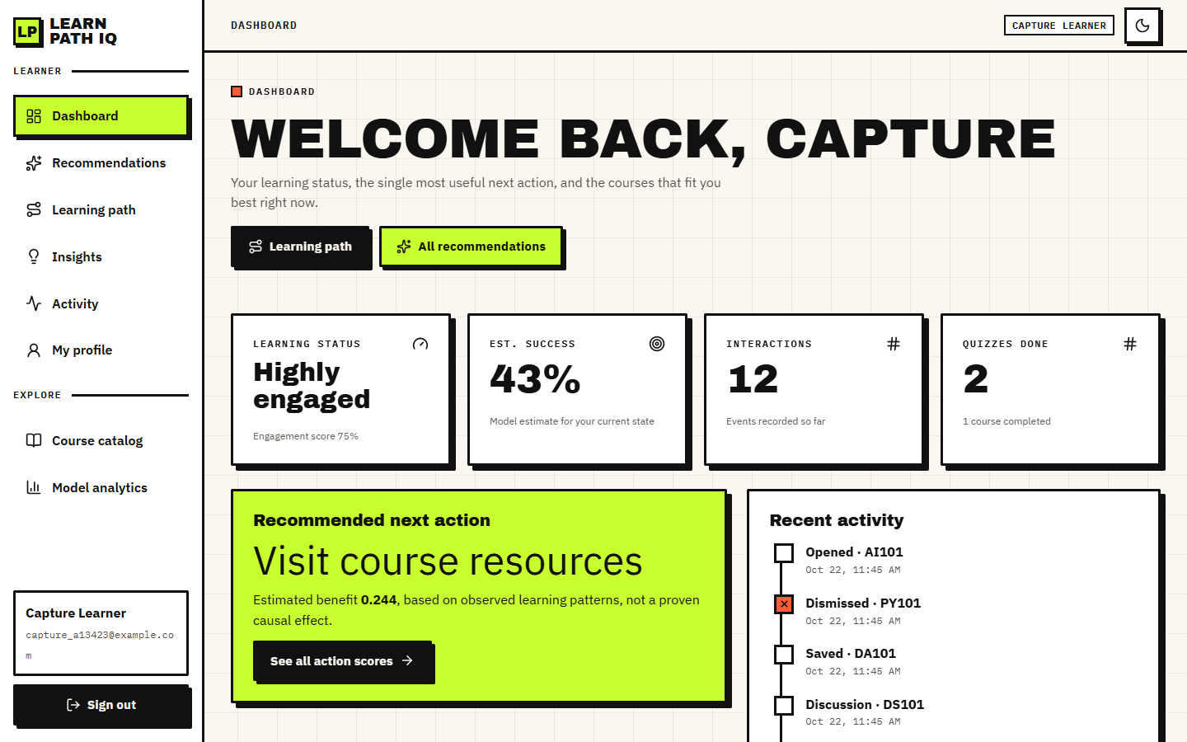

Output screens
Dashboard after 12 recorded events
Ranked recommendations: match %, success estimate, reason
Staged learning path with next action
Notes:
Real screenshots from the running application: one registered learner with a filled profile and 12 logged events.

Slide 17
Initial testing and observations
5 / 5
33 / 33
33 ms
360-1440 px
pytest tests passed
end-to-end smoke checks
mean time, 8 recommendations
light and dark, no overflow
Observation | Action
Estimated action benefits change sign after 6 events (best action quiz becomes homepage) | Presented as an estimate, not a causal claim; documented as a limitation
The suggested action is the same on every card of one learner | Kept (it depends on learner state only); stated in the report
Offline policy evaluation: effective sample size 9.1 of 2,640 | Reported as weak evidence, not as a gain
Notes:
The tests run against the real model and a throw-away database. The latency is a mean over 30 requests on 127.0.0.1.

Slide 18
Challenges and corrective actions
Challenge | Corrective action
Real OULAD was not used | Documented generator as the data source; no external-validity claim
Weak predictive signal, test AUC about 0.60 | Ceiling check: with the hidden assessment score AUC reaches 0.80, so the limit is the generated label
No real interaction log across learners | No collaborative filtering; behaviour term is per learner
Small hand-written catalogue (24 courses) | Evaluated with personas and stated as a sanity check
Ranking recomputed on every request | Acceptable at this size (about 33 ms); caching listed as future work
Notes:
Each challenge is reported with what we did about it, and gaps that remain are stated.

Slide 19
Next steps
1
Evaluate
2
Compare
3
Document
4
Extend (future)
Six-seed study, confusion matrices, ablation of the eight terms, fairness by group.
Set the results against the base paper, stating where data and method differ.
Final report, paper and deck with every figure regenerated from JSON.
Real OULAD data, collaborative filtering, a reinforcement-learning agent, a user study.
Notes:
Plan to the final review. The extensions on the right are outside this submission.

Slide 20
Thank you
Questions and suggestions are welcome.
Notes:
Likely questions: why synthetic data; why the hybrid does not beat content-only on the persona check; what the estimated action benefit means.

