Slide 1

Personalized E-learning Course Recommendation System
Final Review · LearnPathIQ
Team Details : Batch C7
Under the Esteemed Guidance of
K Gayathri
[DESIGNATION], Department of CSE
23K91A05J3 Pittala Akhila
23K91A05G5 Mundala Sandhya
23K91A05G4 Mula Thanuj Reddy
23K91A05E1 Majjigapu Jagadeshwar Reddy
DEPARTMENT OF COMPUTER SCIENCE AND ENGINEERING · [COLLEGE NAME] · Academic Year [ACADEMIC YEAR]
Notes:
Introduce the team and LearnPathIQ: a hybrid course recommendation engine with a learner-success model, built and measured on synthetic data.

Slide 2
Table of Contents
Abstract
Base Paper & Literature Survey
Research Gap & Problem Statement
Objectives
Proposed System & Architecture
Methodology, Dataset & Model
Decision Workflow, Interaction & Database
Implementation Highlights
Results, Threshold Analysis, Performance & Testing
Comparison with Base Paper
Output Screens
Conclusion, Future Scope & References
Dept. of CSE | Batch C7 | Final Review
2
Notes:
The agenda follows the report: problem, design, method, results, comparison, screens, conclusion.

Slide 3
Abstract
Learners on online platforms face a catalogue far larger than they can browse, and generic top-rated lists ignore their level, goals and behaviour.
LearnPathIQ ranks courses with a hybrid score of eight terms (TF-IDF content match, skill fit, topic overlap, predicted success, behavioural boost, goal match, rating, engagement), explains each choice and orders a staged learning path.
A learner-success model (logistic regression selected) reaches test AUC 0.603 on synthetic OULAD-like data (six-seed mean 0.614); one-vs-rest uplift models score five learning actions. The real OULAD data were not used.
On ten hand-written personas, hybrid precision@3 is 0.73 against 0.20 for popularity, and below content-only (0.80).
A FastAPI service and a React interface add login, dashboard, history and model analytics; 5 pytest tests and 33 smoke checks pass. No user study, collaborative filtering or reinforcement-learning agent is included.
Dept. of CSE | Batch C7 | Final Review
3
Notes:
Read the first two bullets, then give the headline numbers with their protocol (synthetic data, held-out learners). End on what is missing.

Slide 4
Base Paper
C. P. Isiwu, L. C. Nnadi, and Y. Watanobe, "From prediction to prescription: A Causal-AI for personalized learning path optimization in MOOCs," IEEE Access, vol. 14, pp. 29105-29118, 2026, doi: 10.1109/ACCESS.2026.3666619.
Aspect | Base paper [1]
Method | XGBoost learner-success model, uplift (T-learner) action scoring, an Actor-Critic reinforcement-learning agent with causal regularisation, off-policy evaluation, fairness audit
Data | Open University Learning Analytics Dataset (OULAD): 32,593 enrolments, about 1.7 million learner-week rows, 25,516 learners
Reported results | XGBoost AUC 0.795, Brier 0.074; logged pass rate 0.589; Greedy-Uplift SNIPS 0.619 [0.613, 0.625]; older learners markedly lower
Stated limits | Offline evidence only; importance weights unstable (IPS 9.956 against SNIPS 0.643); no live A/B test
Dept. of CSE | Batch C7 | Final Review
4
Notes:
A causal-AI framework on a real public dataset. We borrow the success model, uplift scoring, off-policy evaluation and fairness audit; we did not implement the Actor-Critic agent.

Slide 5
Literature Survey
Author / Year | Methodology | Dataset | Key Result | Limitation
Isiwu et al. (2026) [1] | XGBoost + uplift + Actor-Critic RL, off-policy evaluation | OULAD | AUC 0.795; SNIPS 0.619 | Offline only
Khreis et al. (2026) [2] | BERT with contrastive learning and isotropy regularisation | 500+ engineering courses | Better embedding separation than vanilla BERT | Text-only; one institution
Gharahighehi et al. (2025) [3] | Collaborative filtering with survival analysis | Three public MOOC sets | Beats CF baselines on two measures | Needs interaction history
Sujay et al. (2026) [23] | TF-IDF, cosine similarity and ratings, weighted | Coursera course listing | Weighted hybrid score | Results not reviewed in detail
Batch survey (2025) [25] | LightGCN with learning-behaviour data | Authors not recorded | Title and year only | Not independently verified
Batch survey (2025-26) [24], [26] | Machine-learning course recommendation; literature review | Authors not recorded | Title and year only | Not independently verified
Dept. of CSE | Batch C7 | Final Review
5
Notes:
Representative work. The last two rows are entries from the batch survey for which only a title and year were recorded; no result is claimed for them.

Slide 6
Research Gap
Beyond prediction: success models say who may struggle but not which learning action or course helps; few systems connect the two.
Cold start: collaborative filtering needs interaction history; a new learner needs a ranking from profile and content on day one.
Adaptation: rankings are rarely updated from the learner's own events without retraining.
Honest evaluation: offline policy estimates and recommendation quality are rarely reported with their weaknesses (effective sample size, baselines, subgroup gaps).
Explanations: a ranked list without reasons is hard for a learner to trust.
Dept. of CSE | Batch C7 | Final Review
6
Notes:
Five gaps drawn from the survey; the project addresses cold start, adaptation, explanation and evaluation honesty, and only partly the first.

Slide 7
Problem Statement
Given a learner's profile and recent activity, rank the courses of a catalogue by how well they fit, say why, estimate the chance the learner succeeds, suggest the learning action expected to help most, and keep adapting as the learner interacts, all through a web application.
Input
Output
Record
Profile (education, level, interests, goals, hours) and interaction events
Ranked courses with match %, reasons, success estimate, suggested action, learning path
Interaction history, recommendation log, model analytics
Dept. of CSE | Batch C7 | Final Review
7
Notes:
The statement has three parts: rank and explain, estimate and suggest, adapt and record.

Slide 8
Objectives
1. Build a learner profile (education, skill level, interests, goals, weekly hours) and update it from interaction events.
2. Maintain a course catalogue with skills, level, topics, duration and ratings (24 hand-written courses).
3. Collaborative filtering across learners (not implemented; the behavioural term is per learner).
4. Content-based matching of learner and courses with TF-IDF and cosine similarity.
5. A hybrid recommender with explanations and a staged learning path, plus a success model and action-benefit scores.
6. Evaluate with precision, recall and feedback (partly met: AUC and F1 on synthetic data, persona precision@k; no user study).
Dept. of CSE | Batch C7 | Final Review
8
Notes:
The six objectives of the proposal. The conclusion reports which were met: 3 not implemented, 6 partly.

Slide 9
Proposed System
Profile + events
Score 8 terms
Success + uplift
Rank + explain
Log + adapt
Hybrid ranker: 0.30 content, 0.15 skill, 0.15 topic, 0.12 success, 0.10 behaviour, 0.08 goal, 0.05 rating, 0.05 engagement.
Learner-success model (logistic regression, XGBoost and random forest compared) and one-vs-rest uplift models for five actions.
Every logged event changes the next ranking at once, with no retraining.
FastAPI service, SQLite, React interface; offline policy evaluation and fairness audit on a Model analytics page.
Dept. of CSE | Batch C7 | Final Review
9
Notes:
The proposed system in one line of boxes, then the four properties that matter.

Slide 10
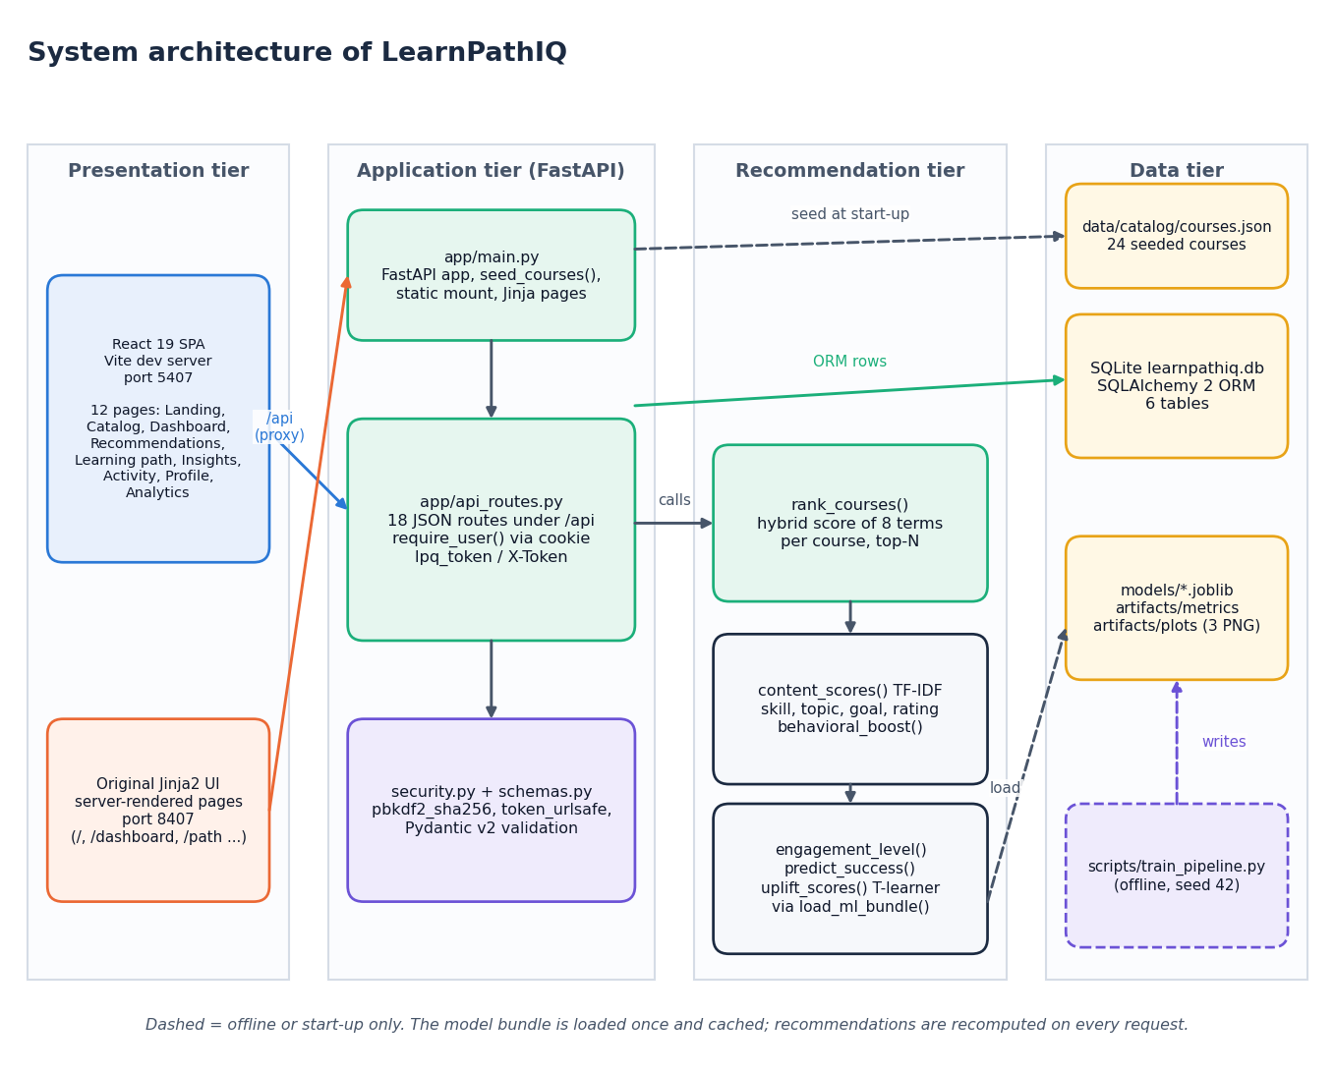
System Architecture
Presentation: React 19 SPA (port 5407) and the original Jinja2 UI
Application: FastAPI (port 8407), token auth, Pydantic validation
Recommendation: ranker, success model, uplift scores
Data: SQLite (6 tables), course catalogue, joblib model bundle
Dept. of CSE | Batch C7 | Final Review
10
Notes:
Four tiers; the model bundle is loaded once and cached, recommendations are recomputed on every request.

Slide 11
Methodology
Synthetic generator
8 features
Learner-level split
LR / RF / XGBoost
Uplift + OPE
Fairness audit
model_metrics.json
Data: 2,200 learners x 12 weeks = 26,400 rows; split by learner 80 / 10 / 10 so no learner is in two sets; seed 42.
Success model chosen by validation AUC; uplift = P(success | action) - P(success | no action), one T-learner pair per action.
Extra experiments added for the documents: six-seed re-run, ceiling check, weight ablation, 10-persona ranking check, feedback-loop test, latency.
Every number on these slides is read from files written by the scripts.
Dept. of CSE | Batch C7 | Final Review
11
Notes:
The workflow, and the extra experiments that were added because the project shipped without a ranking evaluation.

Slide 12
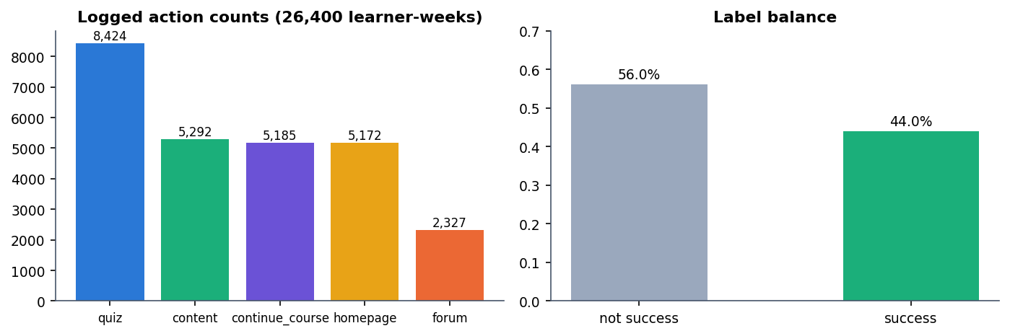
Dataset, Features & Model
26,400
Feature | Corr. with success
cum_clicks | 0.138
recent_clicks | 0.183
quiz_count | 0.054
forum_count | 0.002
completions | 0.058
engagement | 0.182
weekly_hours | 0.044
skill_code | 0.099
synthetic learner-week rows
8
features per learner-week
24
Train 21,120 / validation 2,640 / test 2,640 rows.
Success rate 44.0%; label depends on a hidden assessment score that the model never sees.
The real OULAD was not downloaded or used.
hand-written courses, 9 categories
Dept. of CSE | Batch C7 | Final Review
12
Notes:
Dataset and model in one view. The data are generated; correlations with the label are weak (largest 0.18), which explains the modest AUC.

Slide 13
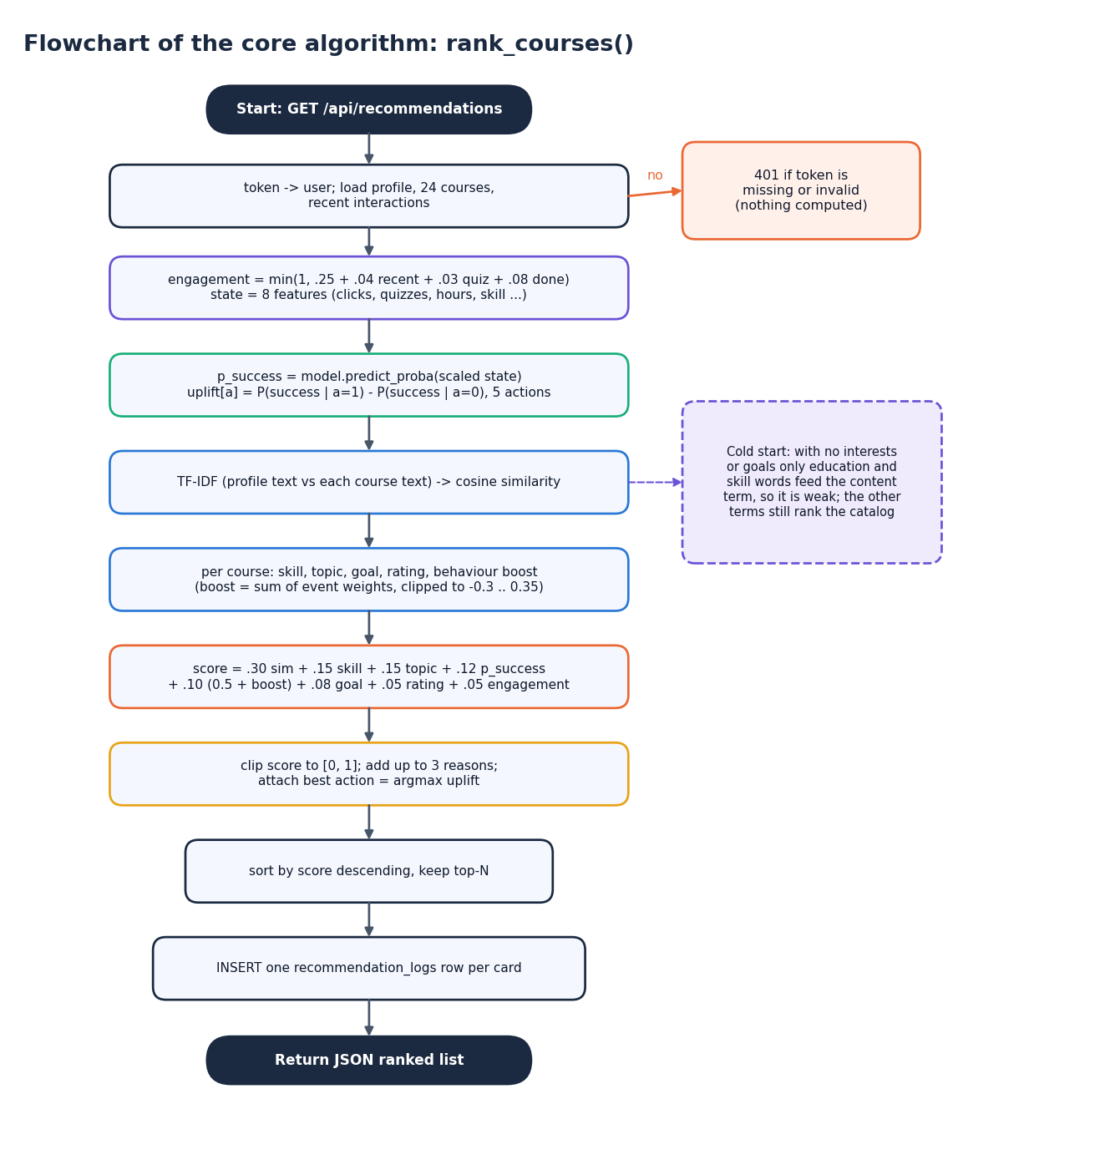
Decision Workflow
Authenticate: token to user; 401 if missing or invalid.
Estimate: engagement score, learner state vector, success probability, uplift per action.
Score: eight terms per course, clipped to [0, 1], sorted, top-N kept.
Explain: up to three reasons per card; the best action is the arg-max of the estimated benefit.
Log: one recommendation_logs row per card.
Dept. of CSE | Batch C7 | Final Review
13
Notes:
The ranking route in decision form. The suggested action depends on the learner state only, so every card of one learner shows the same action; this is stated as a limit.

Slide 14
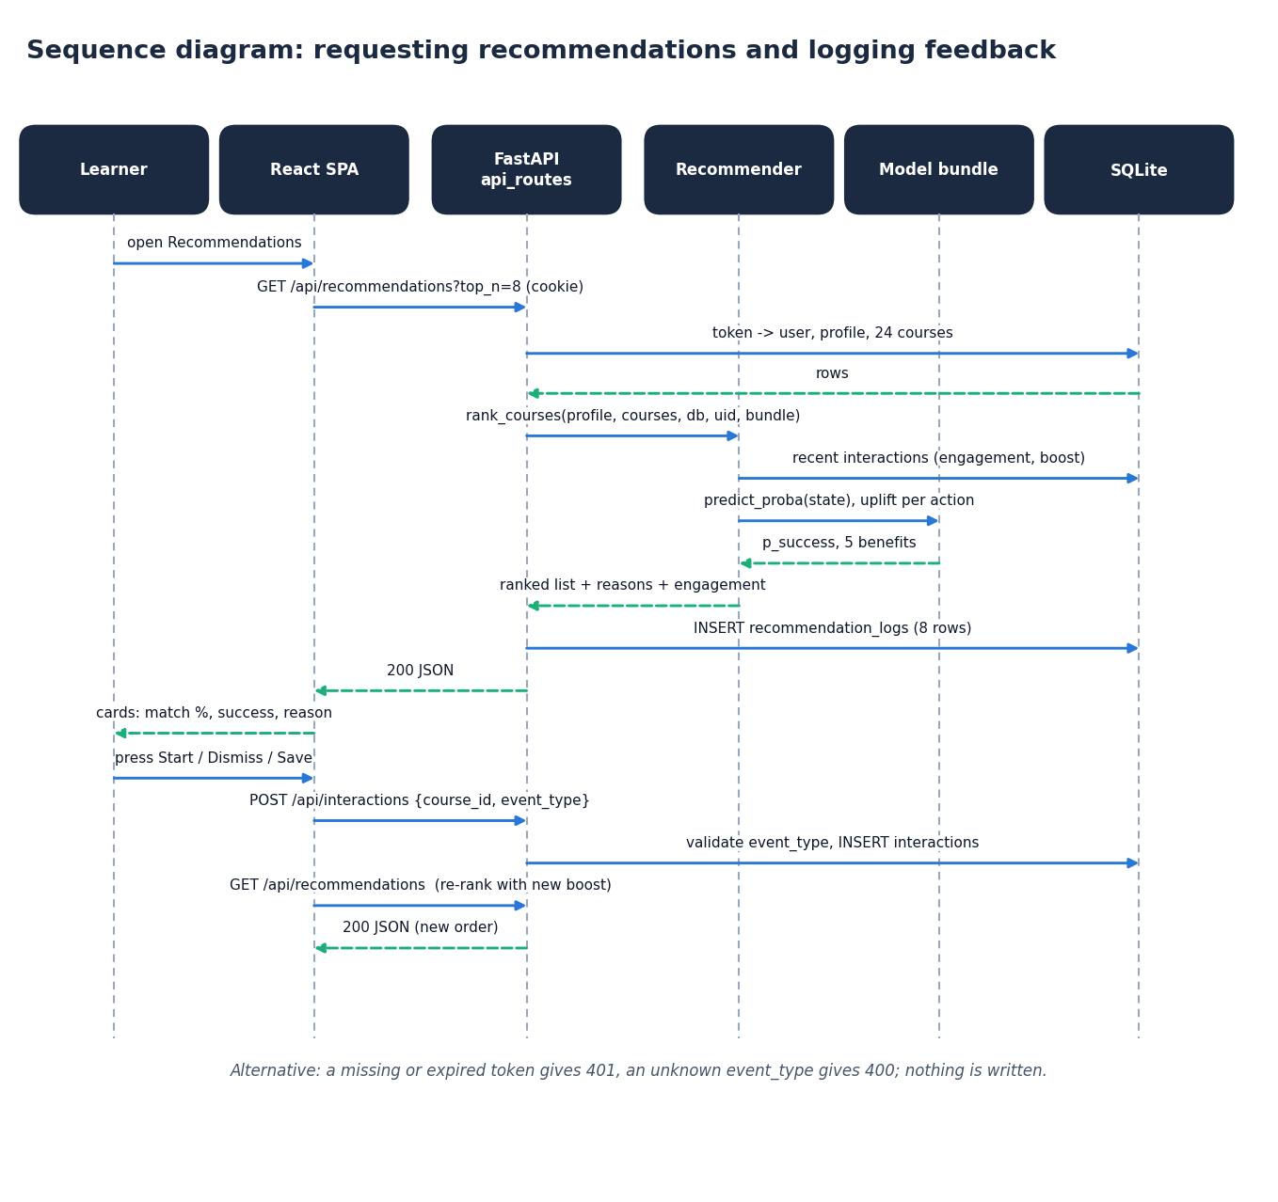
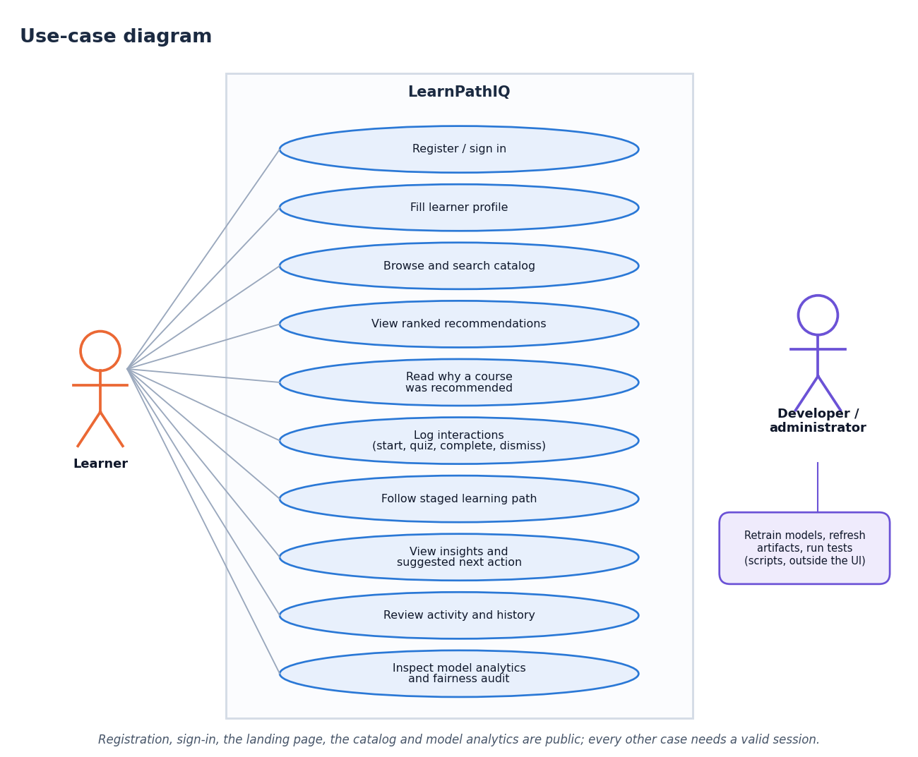
User – System Interaction
Dept. of CSE | Batch C7 | Final Review
14
Notes:
Sequence of requesting recommendations and logging feedback, and the use cases of the learner and the developer.

Slide 15
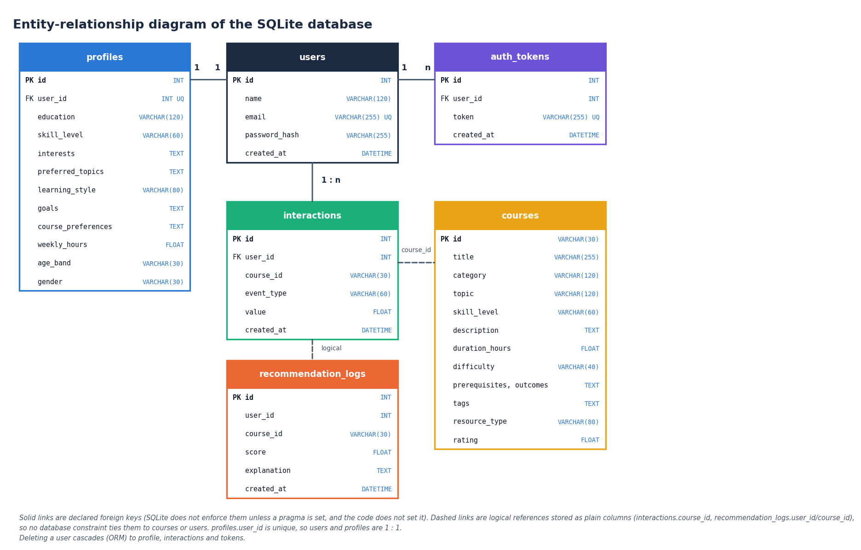
Database Design
Table | Role
users | name, unique email, password hash
profiles | 1:1 with user: level, interests, goals, hours
courses | 24 seeded courses
interactions | view, open, start, quiz, content, forum, complete, dismiss, save
recommendation_logs | score and explanation per card shown
auth_tokens | session tokens
Dept. of CSE | Batch C7 | Final Review
15
Notes:
Six tables. Course and user links in interactions and logs are logical (plain columns), not database constraints.

Slide 16
Implementation Highlights
18
5
12
33 ms
JSON routes under /api
pytest tests passed
React pages
recommendations, mean (n=30)
pbkdf2_sha256 password hashes, random session tokens stored server-side, HttpOnly cookie (72 h) or X-Token header, Pydantic validation, ORM parameterised queries.
Feedback loop tested: after six events the ML101 score rose from 0.487 to 0.551 and the dismissed DA101 fell from rank 3 to 4.
Model analytics page shows model table, confusion matrices, ROC, offline policy values and the fairness audit from the saved metrics.
No caching: TF-IDF is refitted over 25 documents on every request; SQLite single node; demo-grade authentication.
Dept. of CSE | Batch C7 | Final Review
16
Notes:
Highlights of the implementation, with the one behavioural test and the known engineering limits.

Slide 17
Results – Success Model & Ranking Quality
Model | Val AUC | Test AUC | Accuracy | F1 | Brier
Logistic Regression (selected) | 0.604 | 0.603 | 0.594 | 0.415 | 0.238
Random Forest | 0.555 | 0.544 | 0.531 | 0.446 | 0.284
XGBoost | 0.601 | 0.599 | 0.596 | 0.444 | 0.240
Held-out test: 2,640 learner-weeks (220 learners); chance AUC is 0.5.
Six seeds: LR 0.614 +- 0.012, RF 0.551, XGBoost 0.606.
With the hidden assessment score added, AUC rises to 0.80: the weak signal comes from the generated label.
Success estimates are probabilities for ranking, not a reliable predictor.
10 author-written personas, 24 courses. A sanity check, not a user study; hybrid does not beat content-only.
Dept. of CSE | Batch C7 | Final Review
17
Notes:
Left: the three success models on the held-out learners. Right: ranking quality on ten personas whose relevant categories were fixed before ranking. The hybrid beats popularity clearly but not content-only TF-IDF.

Slide 18
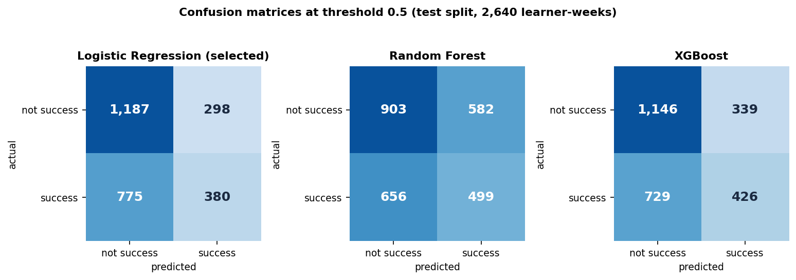
Confusion Matrix & Per-class Metrics
0.560
0.329
0.415
0.305
precision (selected LR)
recall: many successes missed
F1 at threshold 0.5
F1 for the 55+ age band (0-35: 0.415)
Selected LR: TN 1,187, FP 298, FN 775, TP 380. Fairness audit is audit-only: no mitigation is applied.
Dept. of CSE | Batch C7 | Final Review
18
Notes:
Rows are the true class, columns the prediction. At threshold 0.5 the selected model misses most true successes (recall 0.329); the next slide shows the trade-off. The 55+ band has the lowest F1 in the audit.

Slide 19
Threshold & Parameter Analysis
Decision threshold of the success model (test split): recall falls and precision rises as the threshold moves from 0.30 to 0.70; 0.5 is shipped.
Drop-one-term ablation of the hybrid score (full = 0.733): topic and content matter most; success, behaviour, goal and engagement terms did not change the persona ranking.
0.009
0.665
0.435
9.1
IPS
SNIPS
Doubly robust
effective sample size of 2,640
Dept. of CSE | Batch C7 | Final Review
19
Notes:
Top left: threshold sweep, taken from experiments/threshold_sweep.json and matching the shipped confusion matrix at 0.5. Top right: weight ablation. Bottom: offline policy values (propensity clipped to 0.02-0.98, weights capped at 10); with an effective sample size of about 9 they are not evidence that the policy helps.

Slide 20
Performance & Testing
2.7 ms
6.0 ms
32.8 ms
22.2 ms
health check, mean
course list, mean
recommendations (8), mean
learning path, mean
Test layer | What it covers | Result
pytest (tests/test_app.py) | health, homepage, auth_profile_recs_interactions, invalid_inputs, artifacts_load | 5 of 5 passed (10.3 s)
Live smoke test | running backend and front end through the Vite proxy | 33 of 33 checks passed
UI verification | 11 screens at 360 / 768 / 1440 px, light and dark | no overflow, console clean, keyboard OK
Latency probe | 30 requests per read endpoint on 127.0.0.1; recommendations p95 42 ms | first registration 427 ms (hashing)
Machine: 12th Gen Intel(R) Core(TM) i5-12500, 15.7 GB RAM, no GPU. Not done: load tests beyond 30 sequential requests, a user study, cross-browser tests, penetration tests.
Dept. of CSE | Batch C7 | Final Review
20
Notes:
Latency was measured on a CPU-only desktop through the loopback address; recommendations are recomputed on every call because nothing is cached.

Slide 21
Comparison with Base Paper (context only – different data)
Aspect | Base paper [1] | This project
Data | Real OULAD: 32,593 enrolments, about 1.7 million learner-weeks | Synthetic OULAD-like: 2,200 learners, 26,400 learner-weeks
Success model | XGBoost: AUC 0.795, Brier 0.074 | Logistic regression: AUC 0.603, Brier 0.238 (XGBoost 0.599)
Logged outcome | Pass rate 0.589 | Success rate 0.438 on the test rows
Policy | Actor-Critic RL with causal regularisation; Greedy-Uplift SNIPS 0.619 | Uplift arg-max only; SNIPS 0.665, effective sample size 9.1
Fairness audit | By age and gender; older learners markedly lower | By age and gender; 55+ F1 0.305 against 0.415
Deliverable | Research framework | Working web application: ranking, explanations, learning path, analytics, tests
Not a like-for-like comparison: real against generated data, different features and no reinforcement-learning agent here. The numbers are context, not a ranking.
Dept. of CSE | Batch C7 | Final Review
21
Notes:
State plainly that the data differ: the base paper uses real OULAD, this project a generator; a higher or lower number here says nothing about the base paper's method.

Slide 22
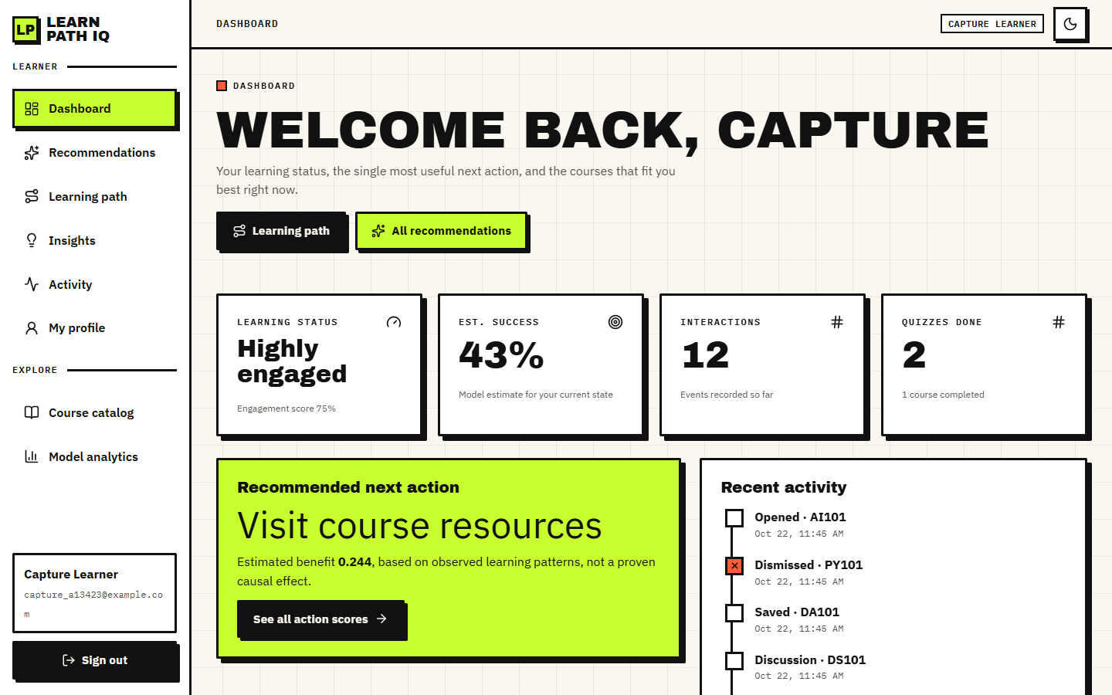
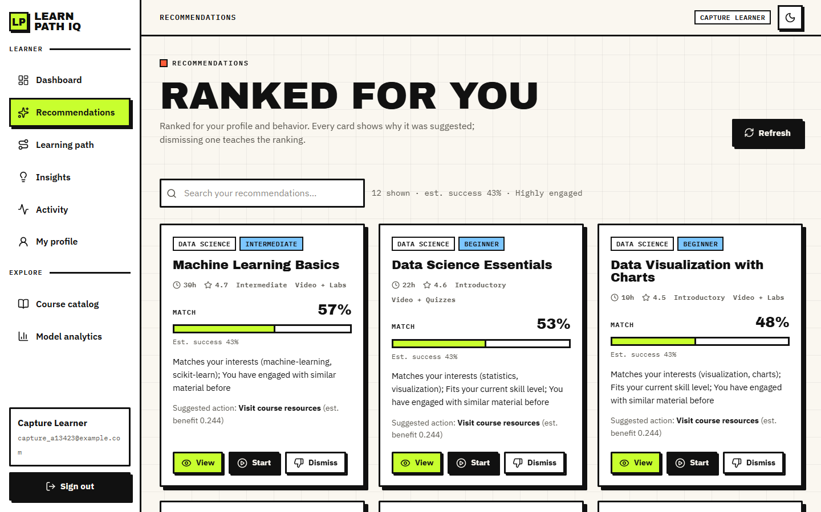
Output – Dashboard and Recommendations
Dashboard of the registered learner after 12 recorded interactions: engagement level, success estimate and shortcuts.
Ranked courses with match percentage, success estimate, reasons and the suggested action (the same action on every card).
Dept. of CSE | Batch C7 | Final Review
22
Notes:
Real captures of the running application with one registered learner and 12 interaction events.

Slide 23

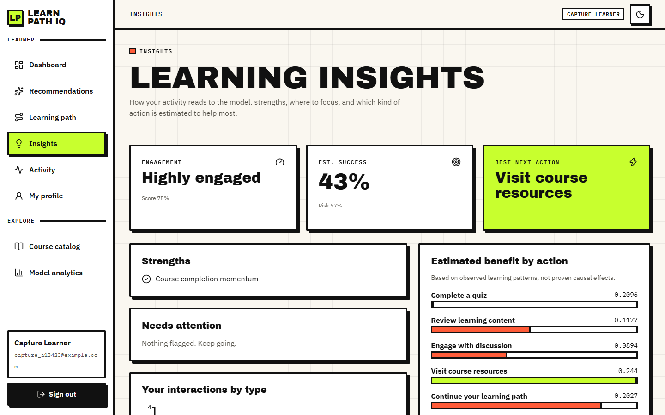
Output – Learning Path and Insights
Staged learning path: courses ordered by level, then score, with the next best action.
Insights: engagement, strengths, estimated benefit of each action (the contributing-features list is empty for the shipped logistic regression).
Dept. of CSE | Batch C7 | Final Review
23
Notes:
The path is ordered by skill level and score; there is no prerequisite graph.

Slide 24
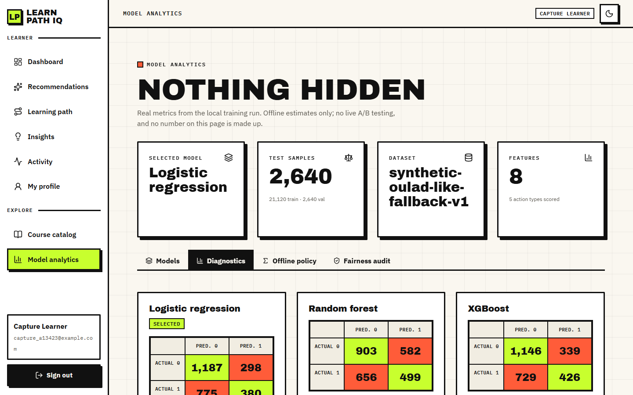
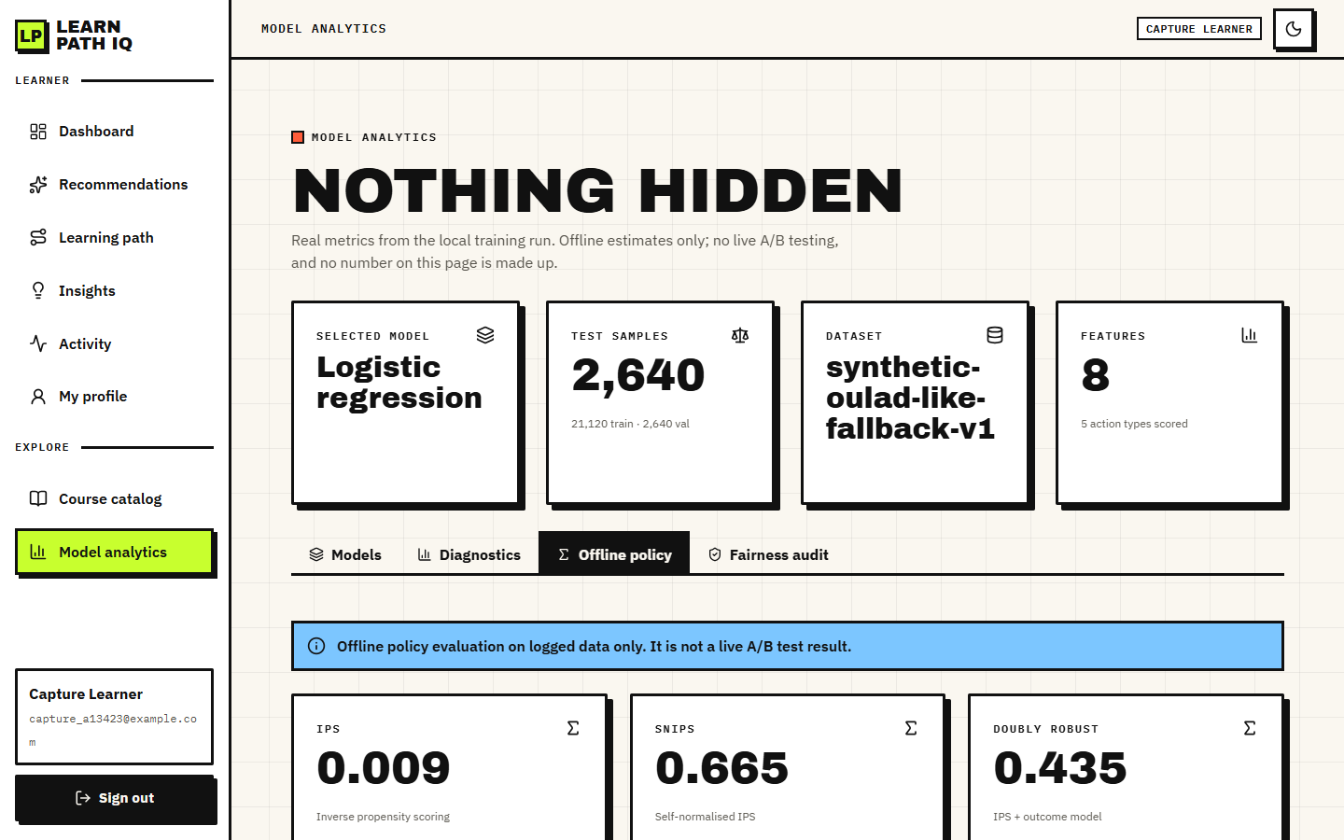
Output – Model Analytics
Diagnostics tab: confusion matrices, ROC curve and feature importance read from the saved metrics.
Offline policy tab: IPS, SNIPS and doubly robust values with the effective sample size and the caveat.
Dept. of CSE | Batch C7 | Final Review
24
Notes:
The page reads artifacts/metrics/model_metrics.json; a fairness tab and a model table complete it.

Slide 25
Conclusion
Delivered: LearnPathIQ: profile, catalogue, hybrid ranker with explanations, learning path, success and uplift models, offline policy evaluation, fairness audit, web application and tests.
Measured: success-model test AUC 0.603 on synthetic data; hybrid P@3 0.73 on ten personas against 0.20 for popularity.
Findings: the hybrid does not beat content-only matching; the offline policy values rest on an effective sample size of about 9; estimated action benefits flip sign after a few events.
Not achieved: real OULAD data, collaborative filtering across learners, an Actor-Critic agent, a user study, live A/B tests.
Dept. of CSE | Batch C7 | Final Review
25
Notes:
Objectives 1, 2, 4 and 5 met, 6 partly, 3 not implemented. Findings are reported with their weaknesses.

Slide 26
Future Scope
Train and evaluate on the real OULAD data so metrics can be compared with the base paper.
Add collaborative filtering across learners once real interaction logs exist; compare with content-only and hybrid.
Learn a policy (the base paper's Actor-Critic agent) and validate it with a larger effective sample size or a live A/B test.
A user study with real precision, recall and satisfaction; prerequisite graph for the learning path; per-card suggested actions.
Caching, a production database, real accounts and roles, container deployment.
Dept. of CSE | Batch C7 | Final Review
26
Notes:
Concrete next steps, ordered by value.

Slide 27
References
[1] C. P. Isiwu, L. C. Nnadi, and Y. Watanobe, "From prediction to prescription: A Causal-AI for personalized learning path optimization in MOOCs," IEEE Access, vol. 14, pp. 29105-29118, 2026
[2] A. Khreis, A. Nasr, and Y. Hilal, "Isotropy-optimized contrastive learning for semantic course recommendation," arXiv:2601.11427, Jan. 2026.
[3] A. Gharahighehi, A. Ghinis, M. Venturini, F. Cornillie, and C. Vens, "Enhancing collaborative filtering-based course recommendations by exploiting time-to-event information with survival analysis," arXiv:2503.00072, 2025.
[4] J. Kuzilek, M. Hlosta, and Z. Zdrahal, "Open university learning analytics dataset," Sci. Data, vol. 4, no. 1, pp. 1-8, Nov. 2017.
[5] M. Dudik, D. Erhan, J. Langford, and L. Li, "Doubly robust policy evaluation and optimization," Stat. Sci., vol. 29, no. 4, pp. 485-511, Nov. 2014.
[8] P. Gutierrez and J.-Y. Gerardy, "Causal inference and uplift modelling: A review of the literature," in Proc. Int. Conf. Predictive Appl. APIs, 2016, pp. 1-13.
[9] J. Zhang, B. Hao, B. Chen, C. Li, H. Chen, and J. Sun, "Hierarchical reinforcement learning for course recommendation in MOOCs," in Proc. AAAI Conf. Artif. Intell., vol. 33, 2019, pp. 435-442.
[11] H. Yu, C. Miao, C. Leung, and T. J. White, "Towards AI-powered personalization in MOOC learning," npj Sci. Learn., vol. 2, no. 1, p. 16, Dec. 2017.
[12] T. Chen and C. Guestrin, "XGBoost: A scalable tree boosting system," in Proc. 22nd ACM SIGKDD Int. Conf. Knowl. Discovery Data Mining, 2016, pp. 785-794.
[13] F. Pedregosa et al., "Scikit-learn: Machine learning in Python," J. Mach. Learn. Res., vol. 12, pp. 2825-2830, 2011.
[14] G. Salton and C. Buckley, "Term-weighting approaches in automatic text retrieval," Inf. Process. Manage., vol. 24, no. 5, pp. 513-523, 1988.
[15] L. Breiman, "Random forests," Mach. Learn., vol. 45, no. 1, pp. 5-32, 2001.
[16] S. R. Kunzel, J. S. Sekhon, P. J. Bickel, and B. Yu, "Metalearners for estimating heterogeneous treatment effects using machine learning," Proc. Nat. Acad. Sci. USA, vol. 116, no. 10, pp. 4156-4165, 2019.
[17] X. He, K. Deng, X. Wang, Y. Li, Y. Zhang, and M. Wang, "LightGCN: Simplifying and powering graph convolution network for recommendation," in Proc. 43rd Int. ACM SIGIR Conf. Res. Develop. Inf. Retrieval, 2020, pp. 639-648.
[21] S. Ramirez, "FastAPI framework, high performance, easy to learn, fast to code, ready for production." [Online]. Available: https://fastapi.tiangolo.com
[23] S. Sujay, G. Harshitha, and M. Monisha, "EduGuide: A hybrid NLP-driven course recommendation system ... TF-IDF and ML," Int. J. Innov. Res. Technol., vol. 13, no. 3, 2026
Dept. of CSE | Batch C7 | Final Review
27
Notes:
Selected references; the complete list is in the report.

Slide 28
THANK YOU
Questions & Suggestions
Dept. of CSE | Batch C7 | Final Review
28
Notes:
Invite questions.

