Slide 1
SafeGrid-AI: An Explainable Multi-Agent System for Dynamic Power Routing
REVIEW 2 · DESIGN, METHODOLOGY AND PROGRESS
Design, methodology and progress: three agents on a simulated feeder, a Symbolic Safety Shield, and the first full measurements
Presented by
Under the guidance of
DISHA KAUSHAL 23K91A0563
BOLLAM RAKESH 23K91A0542
CHINNOLLA RAVINDHAR 23K91A0554
AFFAN MOHAMMED RAMY 23K91A0505
CHANDRASHEKAR, [DESIGNATION]
Department of Computer Science and Engineering
TKR College of Engineering and Technology (Autonomous)
Batch A13 (CSE-A) · [ACADEMIC YEAR]
Notes:
This review shows how the system is designed and built, what is implemented, the first measured results and the open items.

Slide 2
Contents
01
02
03
Recap and architecture
Methodology, scenarios and context
Agent and shield design
04
05
06
Experiment protocol and decision logic
Data flow, database and use cases
Technology stack
07
08
09
Implementation progress and results
Output screens and testing
Challenges and next steps
Notes:
Agenda for the design and progress review.

Slide 3
Recap: problem and proposed system
!
Problem
i
Proposed system
B
Base paper link
Language-model agents can plan power routing, but a non-deterministic model that commands physical equipment can issue an unsafe set-point, and operators need to see why each decision was made.
Agents propose one action each; a deterministic Symbolic Safety Shield approves it, scales it down by bisection or rejects it, and only the validated set-point is executed and logged.
Keeps role-based agents and scenario-based evaluation from the DC-microgrid base paper; adds a model-driven proposer, an independent shield, explanations and an audit log. Its MATLAB/Simulink system is not reproduced.
Notes:
One-minute recap of Review 1. The base paper is a rule-based DC-microgrid study; our system is a different, AC low-voltage simulation, so we compare ideas, not numbers.

Slide 4
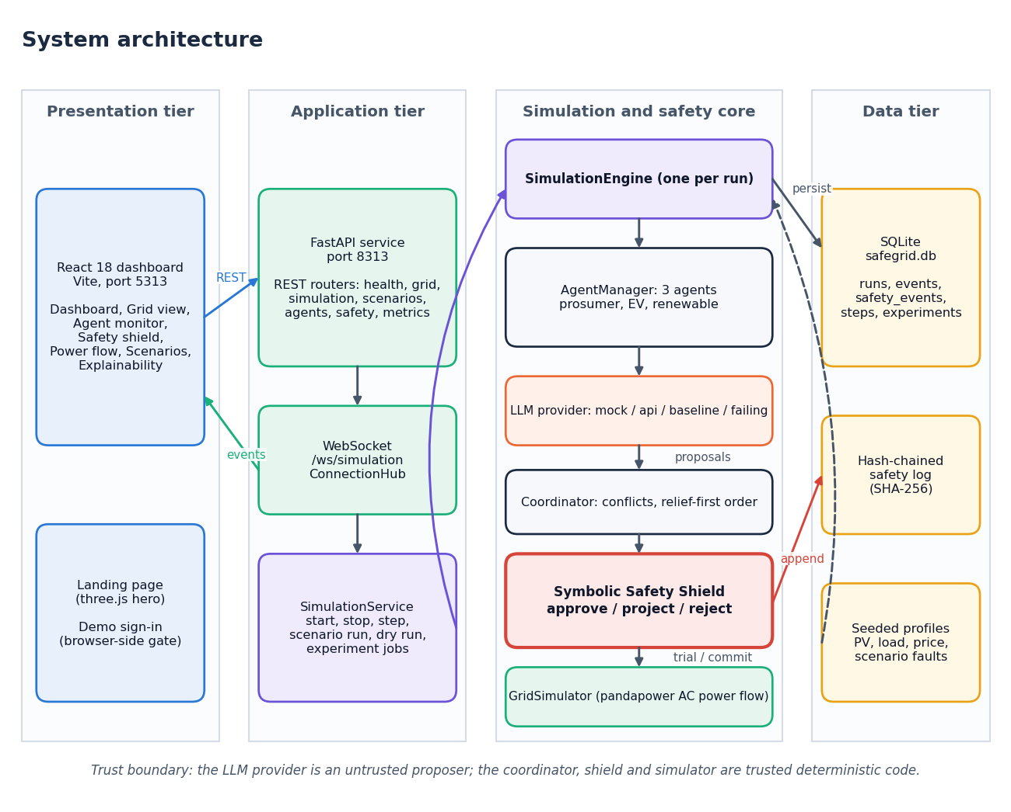
System architecture
Four tiers
Presentation: React dashboard on port 5313 with a three.js landing page.
Application: FastAPI on port 8313, REST routers plus the /ws/simulation WebSocket.
Core: engine, three agents, coordinator, shield and a pandapower simulator.
Data: SQLite store and a SHA-256 hash-chained safety log.
The LLM provider is the only untrusted component.
Notes:
Follow the tiers left to right. The shield imports nothing from the language-model, agent, simulation or grid packages, and a test enforces that.

Slide 5
Methodology: one simulation step
Seeded PV, load, price
No-action power flow
Agents perceive
Agents propose
Coordinator orders
Shield validates
Commit and log
Counterfactual
Fair attribution
Reproducible
The raw proposals are also trial-run, so each step records what would have happened without the shield.
Only violations that are new or worse than the no-action grid are blamed on an action; pre-existing stress is reported separately.
Everything is seeded; the same seed gives the same profiles, proposals and results.
Notes:
A step is 15 simulated minutes. The shield validates the agents one after another against the cumulative grid state, relief actions first.

Slide 6
Scenarios and inputs (no external dataset)
7
3
15 min
No dataset
seeded scenarios
agents on 3 nodes
control step
inputs generated from a seed
Solar follows a daylight curve scaled by a seeded cloud factor; household load has morning and evening peaks with 5 % noise.
Tariff is an illustrative time-of-use table in INR; export is credited at 60 % of the price.
No train, validation or test split exists, so no accuracy or F1 is reported anywhere.
The evaluation runs every scenario for 24 steps.
Notes:
There is no dataset. Profiles are generated at run time from a seed, so every number is reproducible. The chart shows each scenario's native length; the evaluation uses 24 steps for all.

Slide 7
Perception: what each agent sees
1
Own node
2
Neighbours and limits
3
Memory and output
Load, solar output, battery state of charge and rating, local voltage, net exchange, price and weather.
Net exchange, state of charge and voltage of the other nodes, plus the voltage band, line and import limits.
The previous action and its shield result. The agent returns one schema-checked action; anything else becomes a labelled fallback.
The shield never sees this context, any prompt or any model text. It reads only the fields of the proposed action: agent, action type, power, duration, target node, reason codes and confidence.
Notes:
The context is structured data, not free text. The shield never sees this context or any model text; it reads only the action fields.

Slide 8
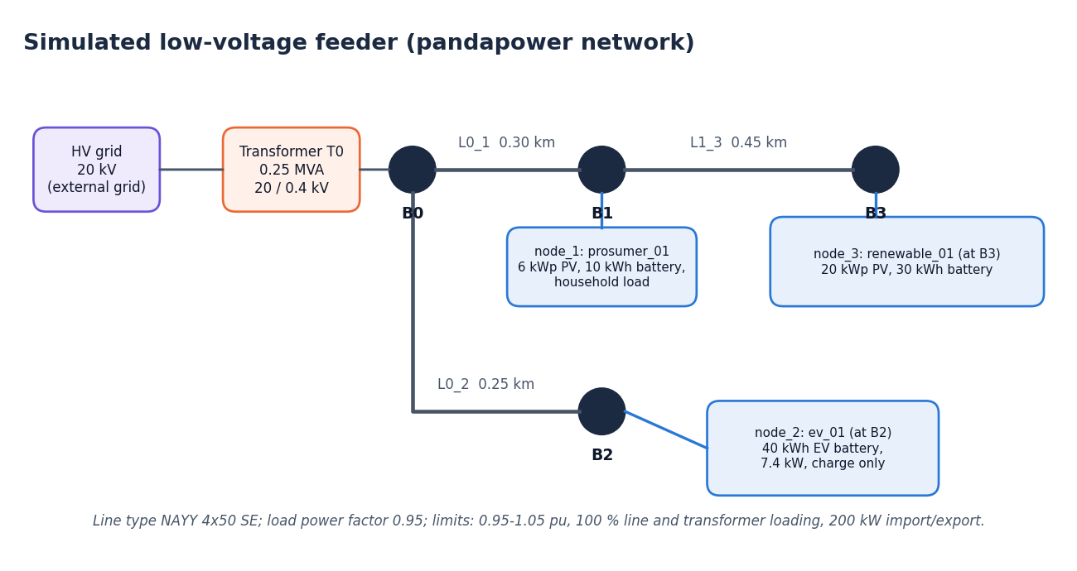
Agent and shield design
Shield check | What it tests
STRUCTURE | schema, known agent and node, finite non-negative power
POWER_LIMITS | request not implausibly large for the node
BATTERY | charge and discharge rating, configured state-of-charge window
NODE_LIMITS | node import and export limits, shiftable load share
POWER_BALANCE | curtailment within generation, reachable direction
POWER_FLOW | trial AC power flow converges
VOLTAGE | every bus between 0.95 and 1.05 pu
LINE_LOADING | every line at or below 100 %
TRANSFORMER | transformer at or below 100 %
GRID_LIMITS | external grid import and export up to 200 kW
prosumer_01 (node 1): 6 kWp PV, 10 kWh battery.
ev_01 (node 2): 40 kWh EV, charge only, 7.4 kW.
renewable_01 (node 3): 20 kWp PV, 30 kWh battery.
Notes:
The feeder and the three agents on the left; the ten ordered checks on the right. 25 violation codes map onto these ten named checks.

Slide 9
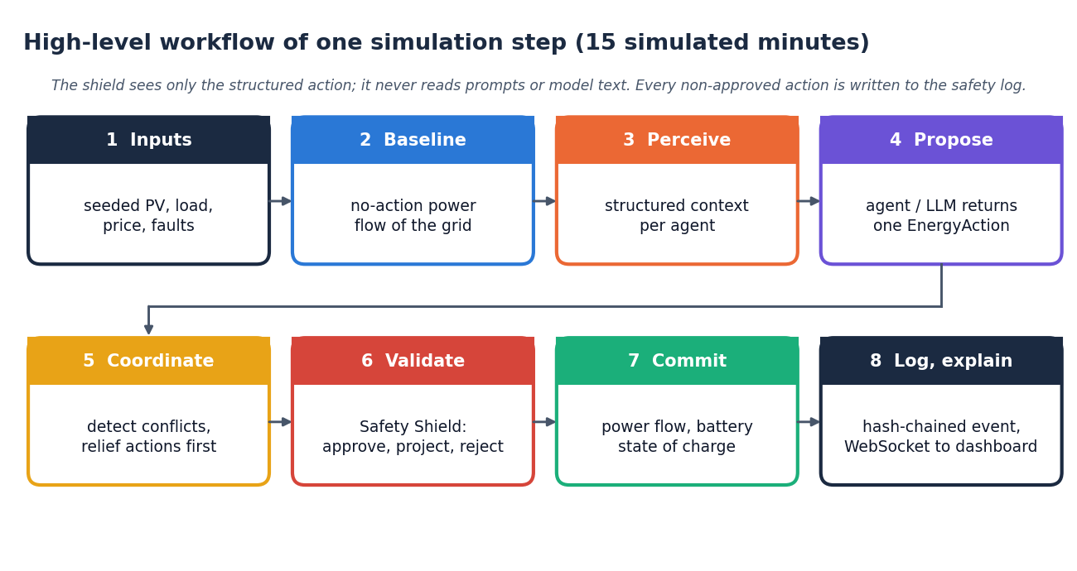
Experiment protocol
Setting | Value
Scenarios x strategies x seeds | 7 x 3 x 3 = 63 simulation runs
Strategies | rule baseline, agents without shield, SafeGrid-AI (agents + shield)
Steps per run | 24 steps of 15 simulated minutes
Seeds | 0, 1, 2 (results are means over 21 runs per strategy)
Language model | deterministic mock provider; no live model
Machine | Intel Core i5-12500, 15.7 GB RAM, no GPU
Wall time | about 10 minutes for all 63 runs
!
Honest limits
Three seeds, a synthetic three-node feeder, an illustrative tariff and a mock model. Results are simulation evidence only.
Notes:
Every number later in the deck comes from this protocol, saved as docs/results/experiment_3seeds_24steps.json.

Slide 10
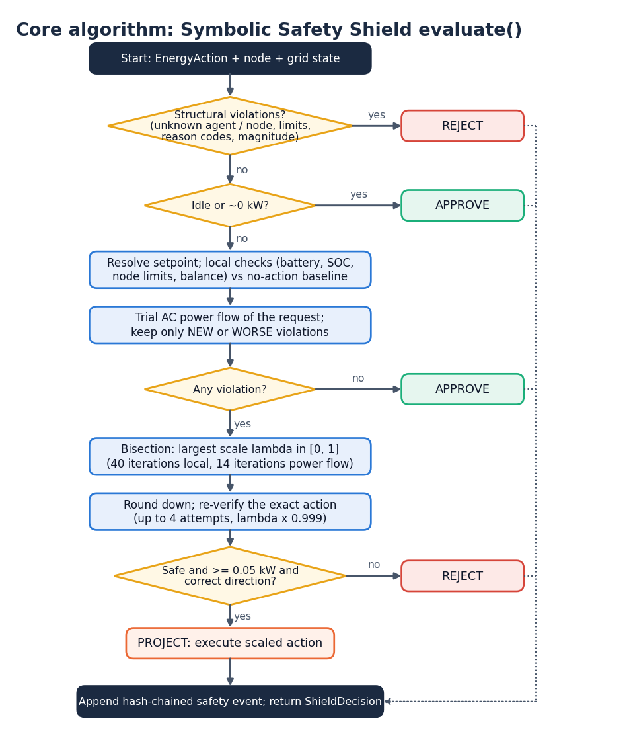
Decision logic of the shield
Reject structurally invalid actions at once; approve idle actions.
Trial power flow of the request; only violations that are new or worse than the no-action grid count.
Project by bisection to the largest safe scale (40 iterations on local limits, 14 on power-flow limits), re-verify the rounded action, reject below 0.05 kW.
Record every non-approved decision as a hash-chained safety event.
Notes:
This is the evaluate() function of the shield. The guarantee is relative to the simulated model: no new or worse violation of the configured limits.

Slide 11
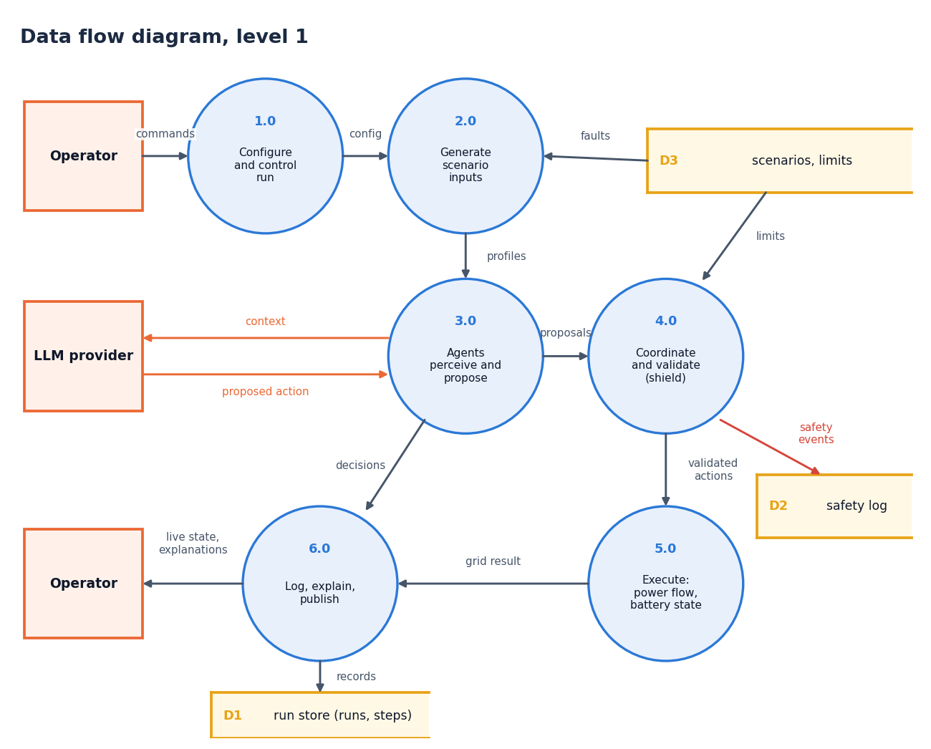
Data flow and modules
Module | Role
safety/shield.py | approve, project, reject
safety/validator.py | checks and attribution
simulation/engine.py | one run, one step
simulation/coordinator.py | conflicts, ordering
agents/manager.py | perceive and decide
llm/provider.py | mock, api, baseline
grid/simulator.py | pandapower trial, commit
database/store.py | SQLite store
Notes:
Level-1 data flow with six processes. Levels 0 and 2 are in the report.

Slide 12
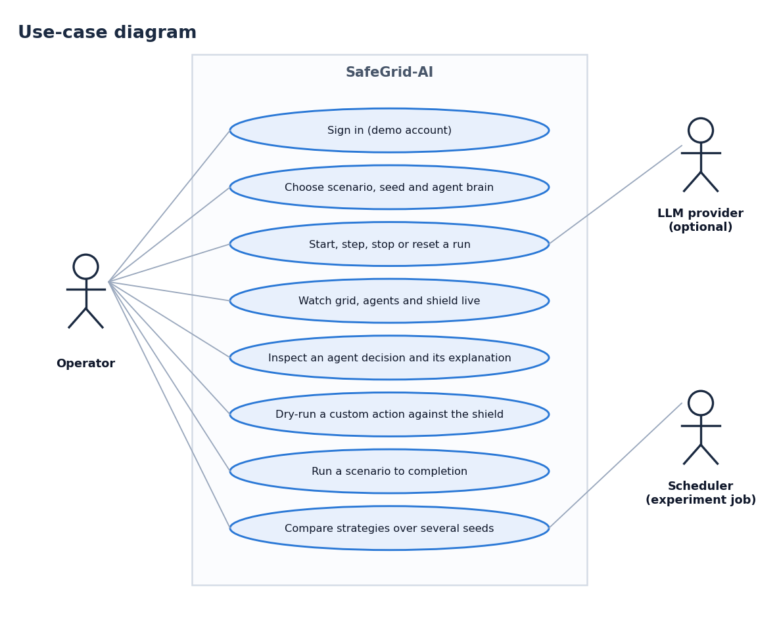
Database design and use cases
Table | Content
runs | configuration, summary, chain fingerprint
events | stream events per run and step
safety_events | hash-chained interventions
steps | full step record (run_id, step)
experiments | specification and results of a comparison
SQLite from the Python standard library; JSON text columns, indexes on (run_id, event_type) and (run_id, status).
Notes:
Five tables. The use-case diagram shows the operator, the optional language-model provider and the experiment job.

Slide 13
Technology stack
S
Simulation
A
Service
D
Storage
pandapower 3.5.6 (AC power flow), numpy 2.4.6, pandas 2.3.3, scipy 1.17.1
Python 3.11.9, FastAPI 0.143.3, Uvicorn 0.54.0, pydantic 2.14.1, httpx
SQLite (standard library) with a SHA-256 hash-chained safety log
U
Dashboard
L
Language-model layer
Q
Quality
React 18, Vite 5, React Router, Recharts, three.js with react-three-fiber
Provider interface: mock, rule-based, failing, and an API provider (Anthropic or OpenAI wire format)
pytest 9.1.1, a 20-check smoke test, Playwright browser walk
Notes:
Everything is open source. The API provider is implemented but was not exercised against a live model.

Slide 14
Implementation progress
3,117
624
6,989
lines of backend code
lines of tests (55 tests)
lines of dashboard code
Component | Status | Evidence
Grid model, simulator, trial power flow | Done | pandapower 3-node feeder, 7 scenarios
Agents, coordinator, mock provider | Done | 3 agents, 3 conflict types
Symbolic Safety Shield, audit log | Done | 0 violations caused in 504 shielded steps
REST and WebSocket service | Done | smoke test 20 of 20
Dashboard (7 screens) | Done | 11 real screenshots
Real LLM provider | Implemented, not run | no API key; mock used for all results
Violation-resolution rate | Not measured | project measures violations prevented
Notes:
State of the code base. The two honest gaps are the live language model and the resolution-rate metric.

Slide 15
Preliminary results: violations caused by actions
0 of 504
shielded steps with a violation caused
99 steps
without shield (144 violations)
76.9%
of 1,512 proposals approved as asked
Pre-existing grid stress is not removed by design: any violation after execution drops from 6.05 (rule) and 6.38 (no shield) to 2.48 steps.
Steps of 24 with violations caused by actions, mean of 3 seeds; mock provider, synthetic feeder.
Notes:
Real measurements from 63 runs. The shield column is zero in every scenario by construction of the metric: violations new or worse than the no-action grid. Steps with any violation are also reduced but not to zero. The rule baseline itself causes violations in peak demand and line congestion.

Slide 16
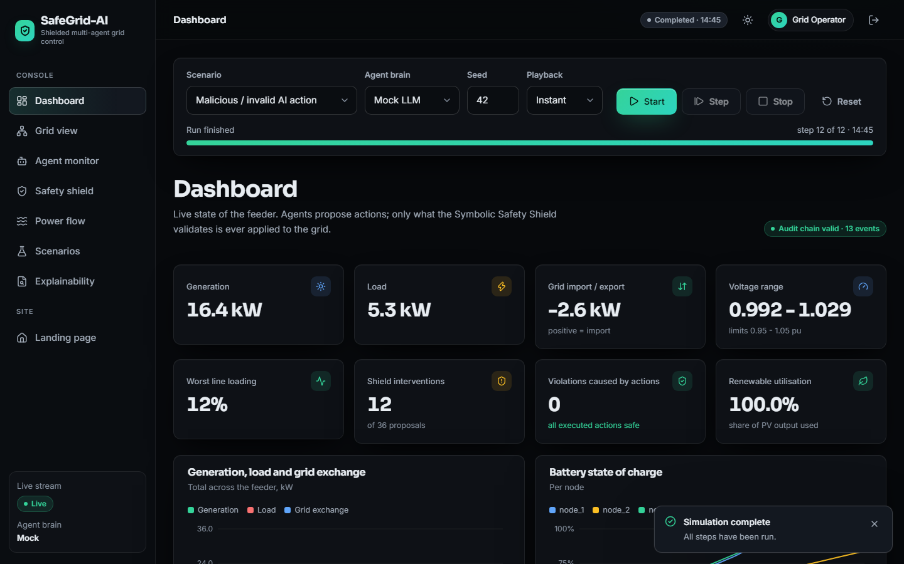
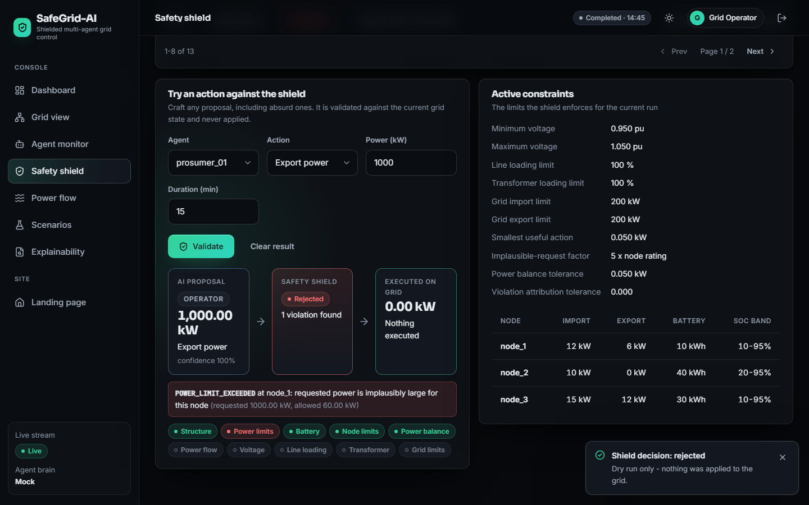
Output screens
Dashboard after a finished run of the unsafe_ai_action scenario: 12 interventions in 36 proposals, 0 violations caused.
Safety shield view: event table, a dry-run rejection of a 1000 kW export, and the active constraints.
Notes:
Real screenshots from the running dashboard (scenario unsafe_ai_action, mock provider, seed 42). The remaining screens are in the report.

Slide 17
Initial testing and observations
52 of 55
20 of 20
2
1
pytest tests passed
live smoke-test checks
tests fail on numeric tolerances
WebSocket test hangs
Observation | Action
test_power_flow_converges_and_balances: 10.995 kW against 10.0 +/- 0.5 | Tolerance was set for an older pandapower; power flow converges. Left unchanged, reported.
test_trial_does_not_change_committed_state: -3.12314 against -3.123 +/- 1e-6 | Same cause. Left unchanged, reported.
test_websocket_receives_events hangs under the installed Starlette test client | Excluded from the run; the live WebSocket works in the dashboard.
Notes:
55 test functions: safety 22, agents 12, simulation 11, grid 6, API 4. The three problems existed before this documentation work; we report them instead of hiding them.

Slide 18
Challenges and corrective actions
1
Pre-existing grid stress
2
Mock language model
3
Cost of validation
Some scenarios break limits even with every agent idle (6.33 steps per run). Reported separately; the shield blocks only what actions add.
Results use a deterministic mock, so model reasoning quality is unmeasured. Provider interface is ready for a live model.
Trial power flows raise step time from about 107 ms to 348 ms.
4
Failing tolerance tests
5
Hanging WebSocket test
6
Strong wording in the abstract
Two grid tests use tolerances tied to an older pandapower; documented, not hidden.
Blocks under the installed Starlette test client; excluded and flagged.
'Mathematically guaranteeing zero violations' is stronger than a model-relative guarantee; the documents say so.
Notes:
Each challenge is either handled in the code or stated plainly in the documents.

Slide 19
Next steps
1
Evaluate
2
Compare
3
Document
4
Extend (future)
Report the full 63-run results with per-scenario tables and traces.
Set the work against the base paper qualitatively, stating the differences.
Final report, paper and deck with every figure regenerated from the saved results.
Live language-model runs, a violation-resolution metric, larger feeders, field data.
Notes:
Plan to the final review. The extensions on the right are out of scope for this submission.

Slide 20
Thank you
Questions and suggestions are welcome.
Notes:
Likely questions: why a mock model; what the guarantee means; why zero shielded violations while some steps still violate (pre-existing stress).

