Slide 1

SafeGrid-AI: An Explainable Multi-Agent System for Dynamic Power Routing
Final Review
Team Details : Batch A13
Under the Esteemed Guidance of
Chandrashekar
[DESIGNATION], Department of CSE
23K91A0563 Disha Kaushal
23K91A0542 Bollam Rakesh
23K91A0554 Chinnolla Ravindhar
23K91A0505 Affan Mohammed Ramy
DEPARTMENT OF COMPUTER SCIENCE AND ENGINEERING · TKR COLLEGE OF ENGINEERING AND TECHNOLOGY (AUTONOMOUS)
Academic Year [ACADEMIC YEAR]
Notes:
Introduce the team and the project: a multi-agent power-routing system in which AI agents propose actions and a deterministic safety shield decides what may run.

Slide 2
Table of Contents
Abstract
Base Paper & Literature Survey
Research Gap & Problem Statement
Objectives
Proposed System & Architecture
Methodology, Scenarios & Agents
Decision Workflow, Interaction & Database
Implementation Highlights
Results, Shield Decisions, Stress & Cost of Safety
Performance, Testing & Comparison with Base Paper
Output Screens
Conclusion, Future Scope & References
Dept. of CSE | Batch A13 | Final Review
2
Notes:
The agenda follows the report: problem, design, method, results, comparison, screens, conclusion.

Slide 3
Abstract
A language model that controls physical infrastructure is non-deterministic and can propose actions that break electrical limits; operators also need to see why each action was taken.
SafeGrid-AI is neuro-symbolic: three agents (prosumer, EV, renewable) on a simulated 3-node low-voltage feeder each propose one action per step, and a deterministic Symbolic Safety Shield approves, scales down (bisection) or rejects it before anything is executed. Every decision is explained and every intervention is written to a hash-chained log.
In 63 simulation runs (1,512 proposals) the shield approved 76.9%, projected 15.7% and rejected 7.5%; executed actions caused 0 violations in all 504 shielded steps, against 144 violations in 99 steps for the same agents without it.
Safety costs time: mean step time 348 ms against about 107 ms; renewable use 0.86 against 0.88.
Limits: the language model is a deterministic mock, the grid is synthetic, and the guarantee holds in the simulated model only.
Dept. of CSE | Batch A13 | Final Review
3
Notes:
Read the problem, the idea, then the headline numbers (63 runs, 0 violations caused by executed actions). End with the limits: mock LLM, synthetic feeder, model-relative guarantee.

Slide 4
Base Paper
S. E. Eyimaya and N. Altin, "Design of multi-agent-based energy management system for DC microgrids," IEEE Access, vol. 14, pp. 39120-39133, 2026, doi: 10.1109/ACCESS.2026.3672618.
Aspect | Base paper
System | DC microgrid with PV, wind, synchronous generator, battery storage, grid, critical and non-critical loads; MATLAB/Simulink, 800 V bus, 20 microsecond sampling
Method | Four rule-based agents (DER, energy storage, load, grid) coordinate generation, storage and load shedding
Reported result | Bus voltage regulated at 800 V and critical loads continuously supplied in all eight operating scenarios
Stated limits | Scalability, software integration, cybersecurity; no experimental validation
What we take | The multi-agent decomposition (generation, storage, load); we add an LLM-driven proposer, an independent safety shield and explanations
Dept. of CSE | Batch A13 | Final Review
4
Notes:
The base paper uses rule-based agents in a DC microgrid and reports regulation in eight scenarios. It has no language model, no formal safety layer and no explanation interface. We keep its agent decomposition and add those three things.

Slide 5
Literature Survey
Work | Approach | Setting | Reported result / limit
Eyimaya & Altin 2026 [1] (base) | Rule-based agents: DER, storage, load, grid | DC microgrid, Simulink, 800 V | Voltage held in 8 scenarios; scalability, cybersecurity, validation open
Zhang et al. 2025 [2] | LLM planner + validation agent with sandbox and rollback | IEEE 69-bus, CIGRE MV, IEEE 30-bus | Best LLMs 100 % success; weaker 63 % and 44 %; no rule layer, no operator explanations
Picault & Goubet 2026 [3] | Position paper: MCP server exposes a simulator to AI agents | TSO grid studies (pypowsybl) | No results; asks for traceability and human validation
McArthur et al. 2007 [8] | Concepts and challenges of multi-agent systems in power engineering | Survey, Part I | Agents fit distributed grids; verification and trust remain open
[4]-[7] Four further surveyed works | Multi-agent deep RL, fault reconstruction, EV scheduling, MAS review (classified from titles) | Smart-grid energy management | Full text not reviewed for this report
Dept. of CSE | Batch A13 | Final Review
5
Notes:
Three papers were read in full (base paper, Grid-Agent, the MCP position paper). The four survey entries in the batch record were classified from title and venue only; the slide says so.

Slide 6
Research Gap
Planning layer: the base paper's agents are rule-based; no language-model proposer is used.
Safety path: Grid-Agent checks actions by sandboxed trial and rollback; an independent rule layer that scales an unsafe request into the permitted region is not part of the surveyed work.
Explanation: operator-facing, per-decision explanations are not reported; the MCP position paper asks for traceability but gives no results.
Audit: tamper-evident records of every blocked or scaled action are not addressed.
Evaluation: few comparisons separate violations caused by an action from stress already on the grid.
Dept. of CSE | Batch A13 | Final Review
6
Notes:
Gaps are stated against the surveyed work only, not against all literature. Our contribution is the combination: agent proposals, an independent shield, explanations, an audit trail and a strategy comparison with identical seeds.

Slide 7
Problem Statement
Given the observed state of a low-voltage feeder with distributed solar, batteries and an electric vehicle, let several autonomous agents propose power set-points at every control step, and execute only set-points that cannot create or worsen a violation of voltage, line, transformer, battery or import/export limits, while recording a reviewable explanation and an audit trail for every decision.
Fixed-rule grid control cannot adapt to renewable variability or changing topology.
Centralised control creates a single point of failure for the whole network.
Autonomous agents acting on physical infrastructure can take unsafe actions if unconstrained.
Operators will not accept control decisions they cannot interrogate.
Input
Feeder state and one proposed action per agent per 15-minute step
Output
Validated action plus explanation and safety result
Record
Hash-chained safety log, dashboard, run history
Dept. of CSE | Batch A13 | Final Review
7
Notes:
The problem is four points from the batch proposal; the statement turns them into an engineering requirement: execute only what cannot create or worsen a violation, and explain every decision.

Slide 8
Objectives
1. Model the grid as a multi-agent system with agents responsible for generation, storage and load.
2. Implement an LLM-driven planning agent that proposes routing actions from observed grid state.
3. Add a safety shielding layer that validates each action against physical and operational constraints.
4. Provide explanations for every routing decision so operators can audit the reasoning.
5. Simulate fault and overload scenarios to test dynamic rerouting behaviour.
6. Evaluate violation resolution rate, decision latency and the number of unsafe actions blocked.
Dept. of CSE | Batch A13 | Final Review
8
Notes:
The six objectives from the proposal. The conclusion reports each outcome; objective 2 ran with a mock model and objective 6 is only partly measured.

Slide 9
Proposed System
Observe feeder
Agents propose
Coordinate
Safety Shield
Execute + log
Three agents (prosumer, EV, renewable) get a structured context and return one schema-validated EnergyAction through a pluggable provider (mock, API, rule baseline, failing).
A coordinator detects peer mismatch, target contention and shared-feeder conflicts and orders relief actions first.
The shield checks ten ordered conditions on a trial AC power flow; only approved or scaled actions are committed.
Each decision has an explanation, each intervention a hash-chained event; a React dashboard shows it live.
Dept. of CSE | Batch A13 | Final Review
9
Notes:
The proposed system in five boxes. The agent is untrusted; the coordinator, shield and simulator are trusted deterministic code.

Slide 10
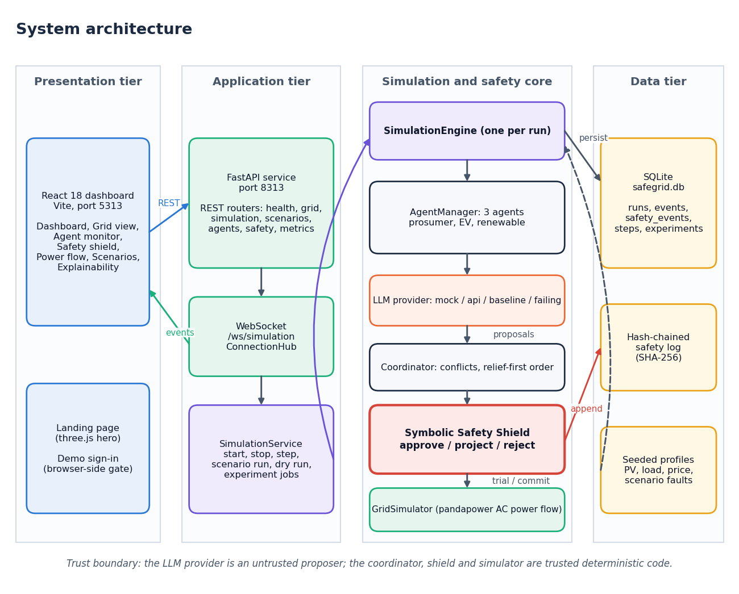
System Architecture
Presentation: React dashboard (Vite, port 5313)
Application: FastAPI REST and WebSocket (port 8313), SimulationService
Core: engine, agents, coordinator, shield, pandapower simulator
Data: SQLite store, hash-chained safety log, seeded profiles
Trust boundary: only the LLM provider is untrusted
Dept. of CSE | Batch A13 | Final Review
10
Notes:
Four tiers. The shield imports nothing from the llm, agents, simulation or grid packages; a test enforces that.

Slide 11
Methodology
Seeded inputs
No-action power flow
Agents propose
Coordinate
Shield validates
Commit power flow
Log + explain
Experiment: 7 scenarios x 3 strategies x 3 seeds x 24 steps = 63 runs (15-minute step). Strategies: rule baseline, agents without shield, SafeGrid-AI.
A violation is blamed on an action only if it is new or worse than the grid state with every agent idle; pre-existing stress is counted separately.
Projection: bisection for the largest scale factor in [0, 1], then up to four re-verifications of the exact rounded action; below 0.05 kW is rejected.
Everything is reproducible: results come from run_experiment and are stored as JSON.
Dept. of CSE | Batch A13 | Final Review
11
Notes:
The method in one line of boxes and the three design decisions that matter: the three strategies, the attribution rule and the projection.

Slide 12
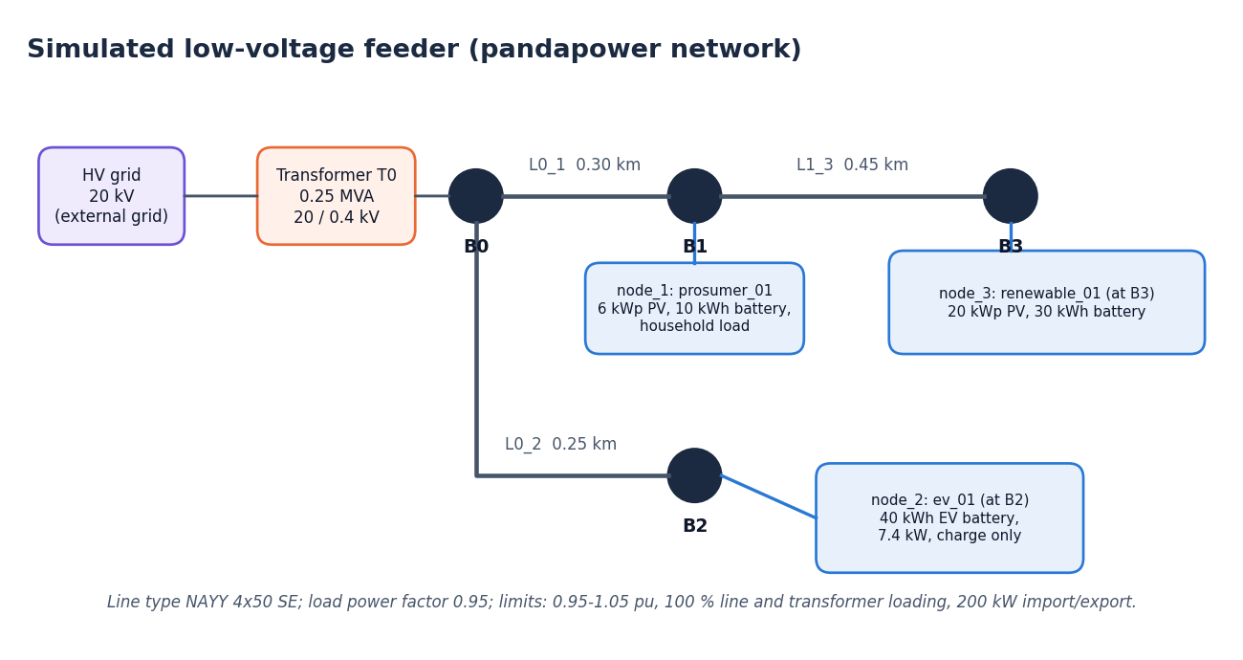
Scenarios, Inputs & Agents
No dataset
inputs are synthetic and seeded; no trained model
7
seeded scenarios, 12 to 32 steps
3
agents on 3 nodes, 0.4 kV feeder
Scenarios: normal, high_solar, peak_demand, battery_stress, line_congestion, voltage_violation, unsafe_ai_action (injects oversized and malformed proposals).
Profiles: solar sin^1.2 with a seeded cloud factor, household load shape with 5 % noise, illustrative time-of-use tariff. The mock LLM is deterministic; a real-LLM provider exists but was not run.
Dept. of CSE | Batch A13 | Final Review
12
Notes:
There is no dataset and no trained model, so no accuracy, F1 or confusion matrix exists for this project. Inputs are generated from a seed. The three agents are a 6 kWp prosumer with a 10 kWh battery, a 40 kWh EV charging at up to 7.4 kW, and a 20 kWp renewable prosumer with a 30 kWh battery.

Slide 13
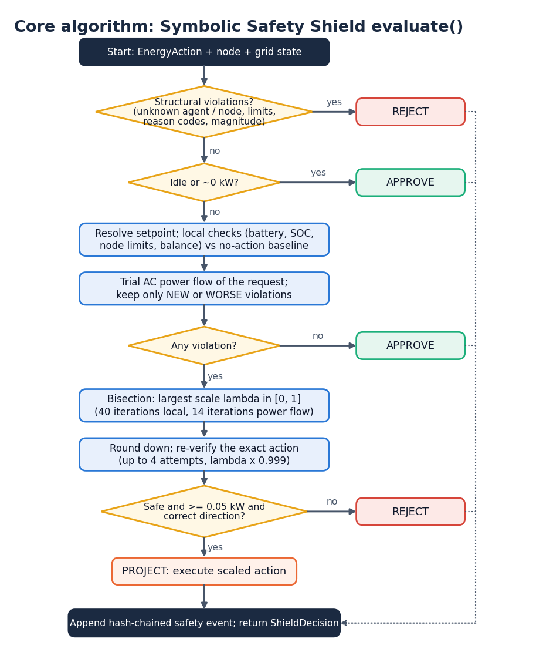
Decision Workflow
Structural checks first: unknown agent or node, limits, reason codes, magnitude; failure means REJECT.
Idle or near-zero actions are approved and still recorded.
Otherwise a trial AC power flow of the request; only new or worse violations count against the action.
Violation found: bisection for the largest safe scale (40 local, 14 power-flow iterations), re-verify, then PROJECT or REJECT.
Every non-approved action becomes a hash-chained safety event.
Dept. of CSE | Batch A13 | Final Review
13
Notes:
This is the core algorithm, evaluate() in the shield. Ten ordered checks: structure, power limits, battery, node limits, power balance, power flow, voltage, line loading, transformer, grid import/export.

Slide 14
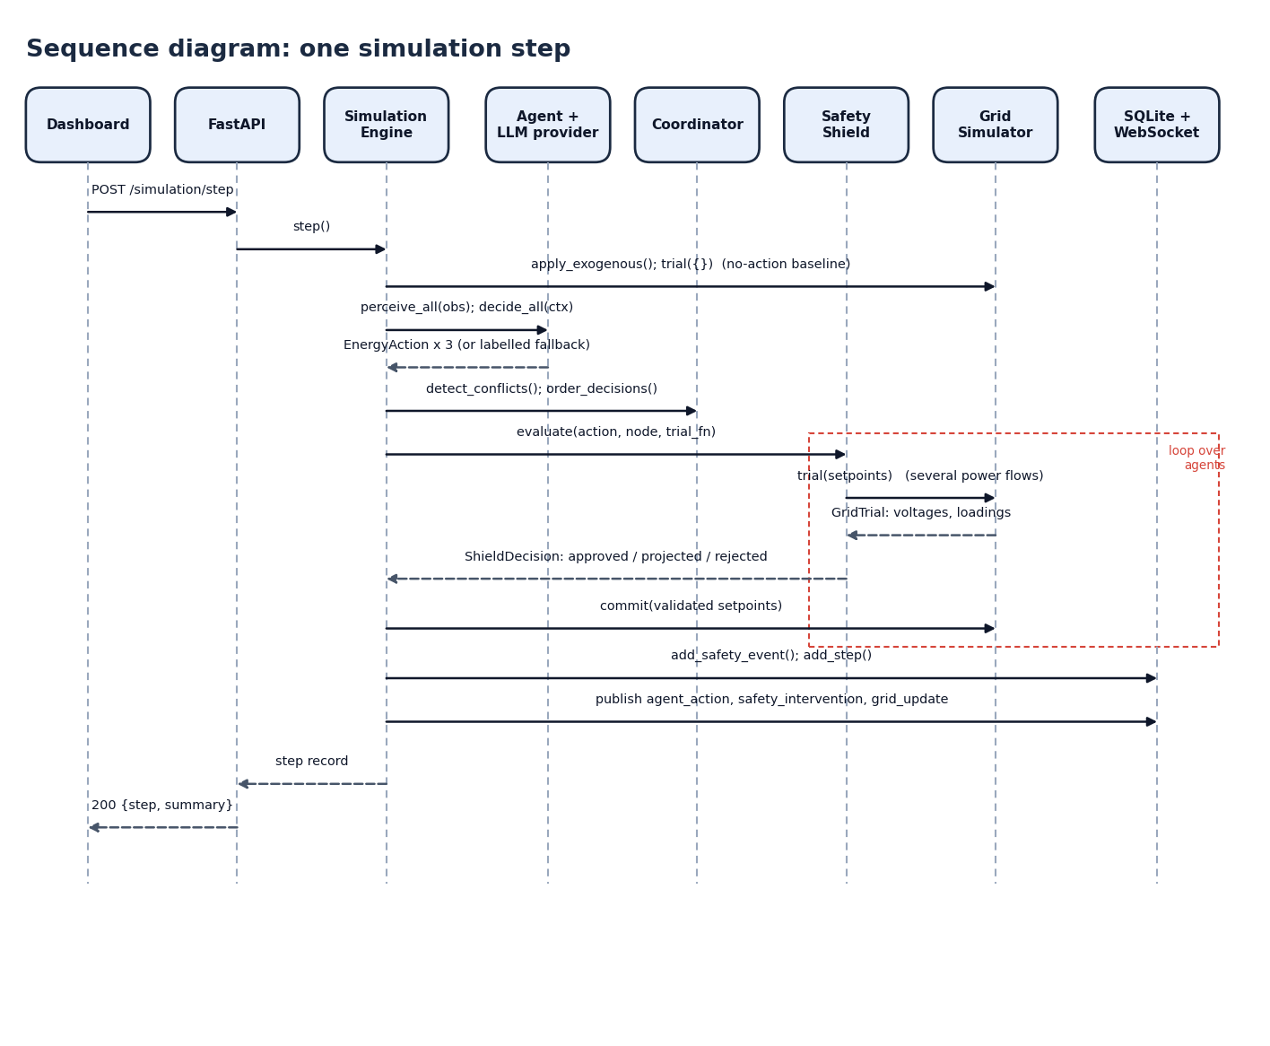
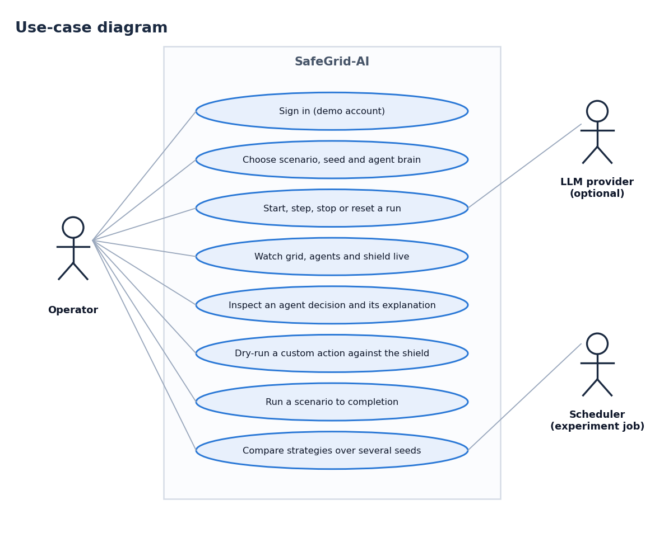
User – System Interaction
Dept. of CSE | Batch A13 | Final Review
14
Notes:
Left: one simulation step from the dashboard through the API, engine, agents, coordinator, shield and simulator. Right: what the operator can do.

Slide 15
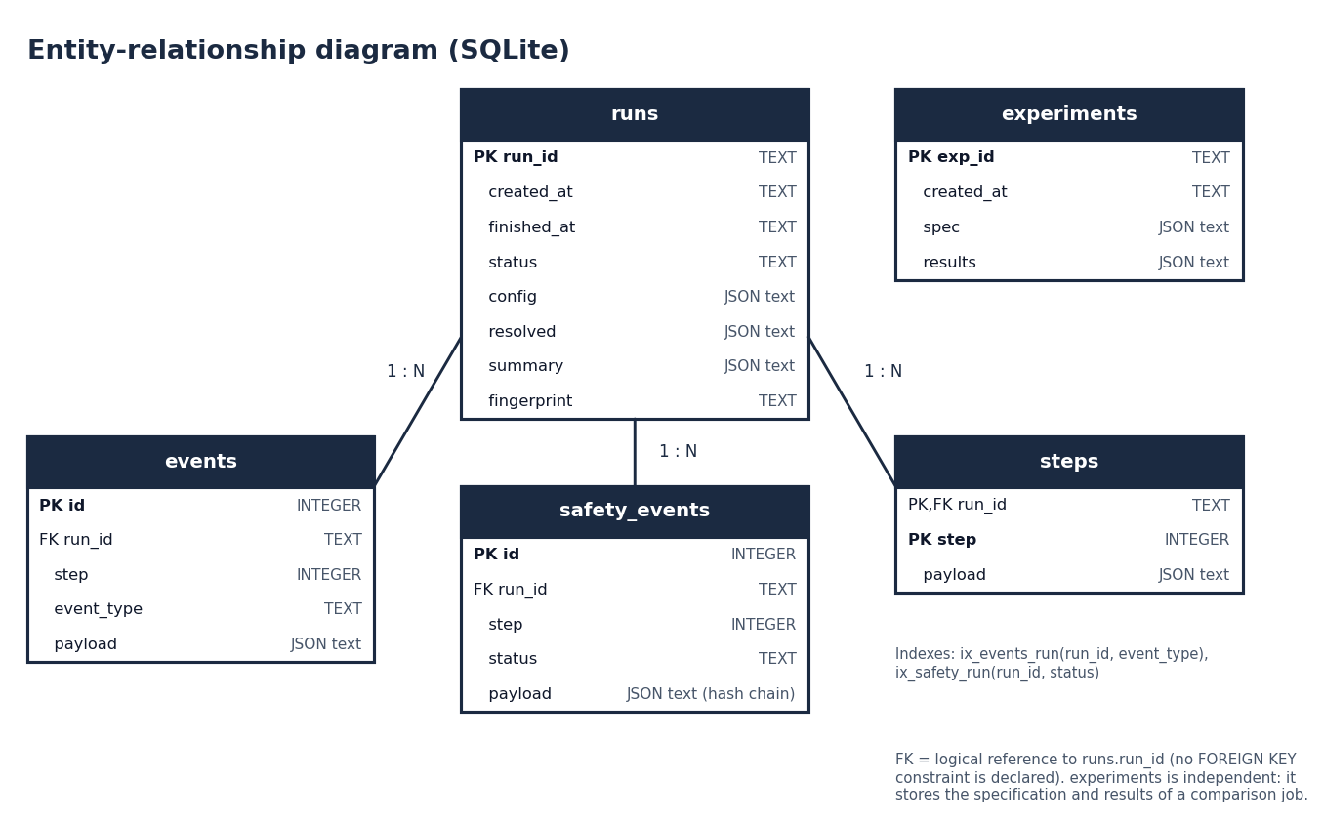
Database Design
Table | Holds
runs | configuration, resolved settings, summary, chain fingerprint
events | live event stream per run (typed payload)
safety_events | hash-chained interventions
steps | one full record per simulated step
experiments | specification and results of a comparison
Dept. of CSE | Batch A13 | Final Review
15
Notes:
Five SQLite tables from the standard library. Payloads are JSON text. The safety log carries prev_hash and hash so any change is detectable.

Slide 16
Implementation Highlights
23 + 1
3,117
6,989
55
REST endpoints + WebSocket
lines of backend Python
lines of dashboard code
test functions
The shield imports nothing from the llm, agents, simulation or grid packages; a test enforces it.
Any provider failure, timeout or invalid output becomes a labelled deterministic fallback decision that is still shielded.
EnergyAction forbids extra fields and non-finite power; model output is never executed as code, SQL or shell.
Explanations are structured (inputs, factors, action, safety result); no chain-of-thought is requested or stored.
React dashboard with live WebSocket updates; run.bat starts backend (8313) and frontend (5313).
Dept. of CSE | Batch A13 | Final Review
16
Notes:
Highlights: isolation of the shield, robust fallbacks, strict input schema, explanations without chain-of-thought, and a one-command start.

Slide 17
Results – Strategy Comparison (63 runs)
Metric (mean of 21 runs) | Rule baseline | Agents, no shield | SafeGrid-AI
Steps with violations caused by actions | 2.19 | 4.71 | 0.00
Violations caused by actions | 2.19 | 6.86 | 0.00
Steps with any violation after execution | 6.05 | 6.38 | 2.48
Voltage violation steps | 4.33 | 4.43 | 3.14
Line overload events | 1.71 | 1.86 | 0.71
Energy cost (INR, illustrative) | 216.4 | 380.8 | 225.0
Renewable utilisation | 1.000 | 0.884 | 0.860
Mean step time (ms) | 107.9 | 106.2 | 347.8
Mean of 7 scenarios x 3 seeds, 24 steps each. Mock LLM, synthetic 3-node feeder: a simulation result, not field data.
Steps with violations caused by actions, per scenario (of 24)
Dept. of CSE | Batch A13 | Final Review
17
Notes:
Table: means over 21 runs per strategy. The key row is the first: 2.19 steps (rule baseline), 4.71 (agents without shield) and 0.00 (SafeGrid-AI). Chart: line congestion and peak demand also hurt the rule baseline (12.0 and 3.3 steps), so the problem is not only an AI problem.

Slide 18
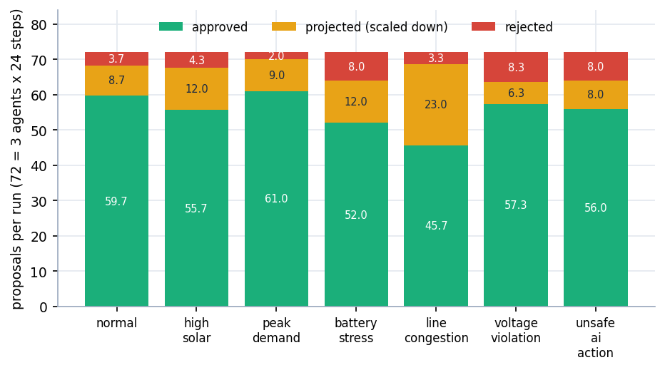
Shield Decisions
76.9%
approved (1,162 of 1,512)
15.7%
projected, scaled down (237)
7.5%
rejected (113)
354 safety events logged; hash chain valid in 21 of 21 runs; 241 coordinator conflicts. Raw shielded-arm proposals would have caused 192 violations in 145 steps; none reached the grid.
No classifier was trained, so a confusion matrix, accuracy or F1 do not apply; the decision counts above take their place.
Dept. of CSE | Batch A13 | Final Review
18
Notes:
Per scenario the intervention load varies: line congestion has the most projections (23 per run), voltage violation and battery stress the most rejections (about 8 per run). Totals are over 21 shielded runs.

Slide 19
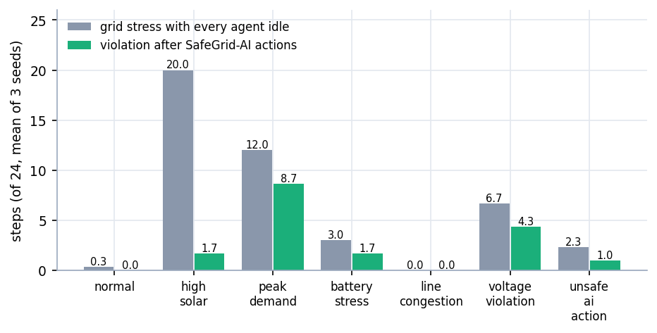
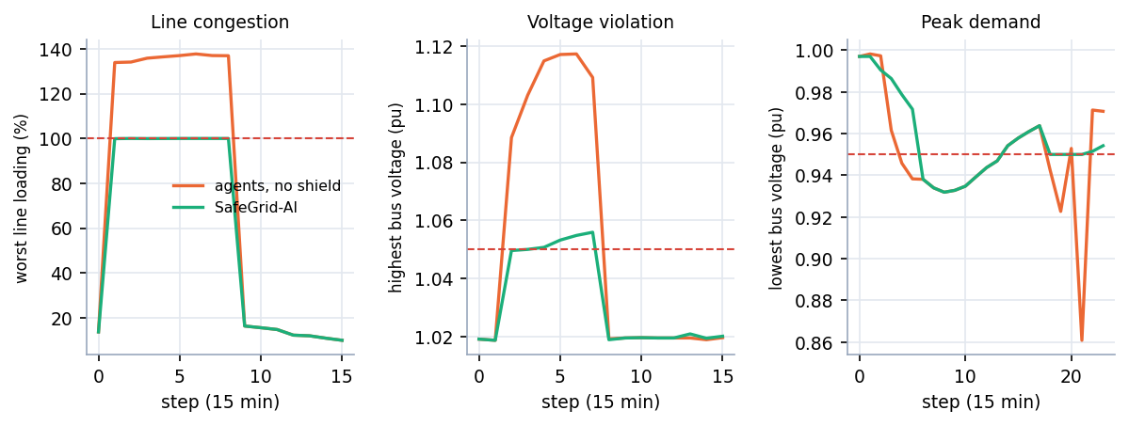
Pre-existing Stress & Cost of Safety
Seed 42: worst loading / voltage with and without the shield (dashed = limit)
Metric (mean of 21 runs) | Rule baseline | Agents, no shield | SafeGrid-AI
Steps with any violation after execution | 6.05 | 6.38 | 2.48
Energy cost (INR, illustrative) | 216.4 | 380.8 | 225.0
Renewable utilisation | 1.000 | 0.884 | 0.860
Mean step time (ms) | 107.9 | 106.2 | 347.8
The shield removes what actions add; stress already on the grid (6.33 steps per run) is not removed by design.
Dept. of CSE | Batch A13 | Final Review
19
Notes:
Left: with every agent idle the grid is already outside its limits in 6.33 of 24 steps on average (20 of 24 in high_solar). The shield does not promise to repair that. Right: in the single seed-42 runs the shield holds line loading at exactly 100 % instead of 137.7 %, the highest voltage at 1.056 pu instead of 1.117 pu, and the lowest voltage at 0.932 pu instead of 0.861 pu. Cost of safety: step time 348 ms against about 107 ms, renewable use 0.860 against 0.884, cost 225.0 INR against 380.8 INR.

Slide 20
Performance & Testing
348 ms
441 ms
63 ms
2.5 ms
mean step, shield on (about 107 ms off)
API step, median (p95 522 ms)
agent dry run, median
grid state read, median
Check | Result
pytest (55 functions) | 52 passed, 2 failed, 1 hangs (excluded)
The 2 failures | numeric tolerances with pandapower 3.5.6
The hanging test | WebSocket test client; live endpoint works
Live smoke test | 20 of 20 checks pass
Browser walk | 360 / 768 / 1440 px, light and dark: no console errors
Live API call (localhost) | median ms | p95 ms
GET /api/health | 1.7 | 15.4
GET /api/grid/state | 2.5 | 25.5
GET /api/scenarios | 2.7 | 23.2
GET /api/agents | 2.7 | 16.2
POST /api/agents/{id}/decision (dry run) | 62.8 | 84.5
dry run: unsafe 1000 kW export (rejected) | 36.6 | 80.5
dry run: 9 kW charge (projected by bisection) | 230.0 | 262.6
POST /api/simulation/step | 440.7 | 522.2
Measured on Intel Core i5-12500 (6 cores, 12 threads), 15.7 GB RAM, Windows 11 Pro, no GPU used. Mock-provider decision latency is 0.1-0.2 ms and says nothing about a real LLM.
Dept. of CSE | Batch A13 | Final Review
20
Notes:
Latency was measured against a live uvicorn server. Step time rises because every proposal triggers trial power flows. The two failing tests are tolerance checks written for an older pandapower; they were left as delivered. No real-LLM latency was measured.

Slide 21
Comparison with Base Paper (qualitative)
Aspect | Base paper [1] | SafeGrid-AI
System modelled | DC microgrid, 800 V bus, MATLAB/Simulink | Three-node AC low-voltage feeder, pandapower AC power flow
Decision makers | Four rule-based agents | Three agents driven by a pluggable LLM provider (mock in all measurements), with a deterministic fallback
Safety mechanism | Control logic keeps the bus voltage regulated; no separate validation layer | Independent Symbolic Safety Shield: approve, project or reject every action before it is executed
Explanation | None reported | Structured explanation per decision, hash-chained audit log, dashboard views
Evidence | Eight Simulink scenarios, bus voltage regulated at 800 V | Seven scenarios x 3 strategies x 3 seeds (63 runs): 0 violations caused by executed actions in 504 shielded steps
Validation reached | Simulation only; authors note the lack of experimental validation | Simulation only; synthetic profiles; mock LLM; no field data
No numeric comparison exists: the systems, benchmarks and metrics differ. The difference is in what is added (LLM proposer, independent shield, explanations, audit), not in a better number.
Dept. of CSE | Batch A13 | Final Review
21
Notes:
Be explicit that a like-for-like numeric comparison is impossible: the base paper is a DC microgrid in Simulink with rule-based agents; ours is an AC feeder with agent proposals under a shield.

Slide 22
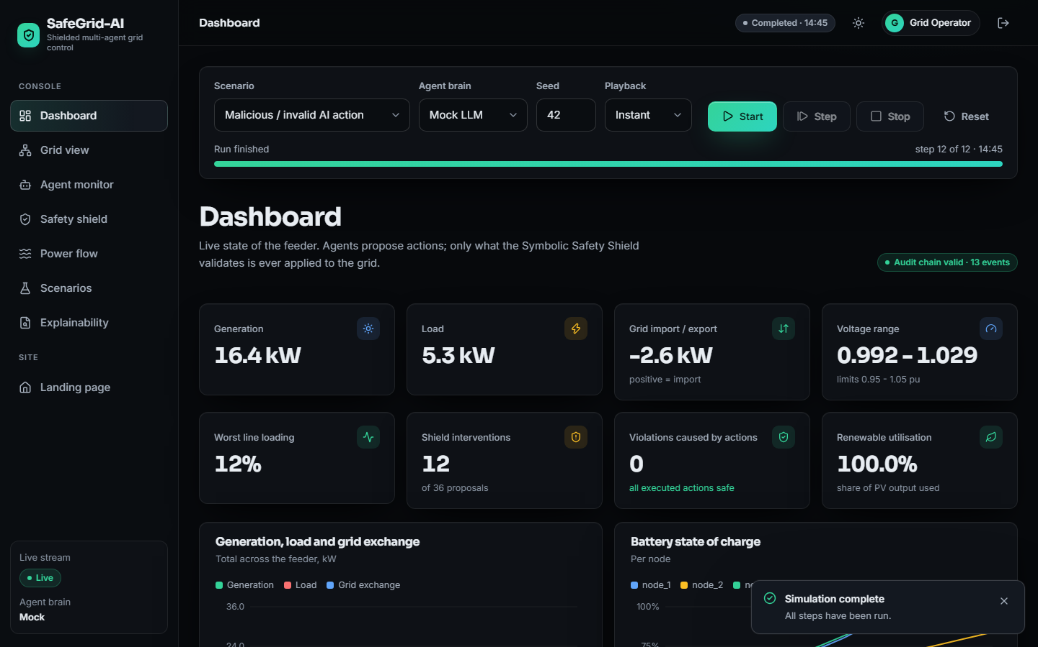
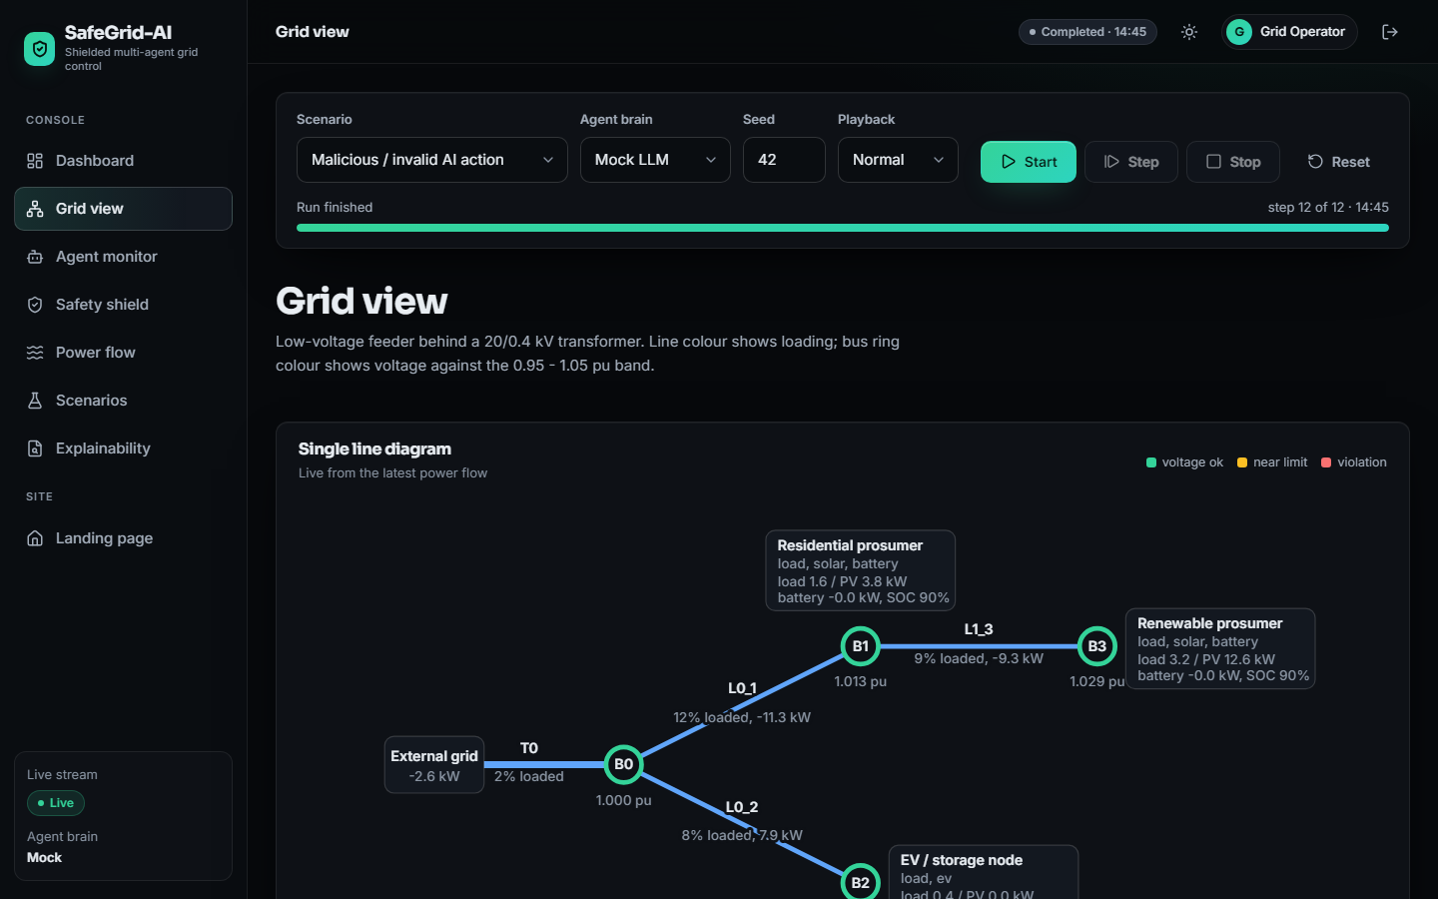
Output – Dashboard and Grid View
Dashboard after the unsafe_ai_action run: 12 interventions of 36 proposals, 0 violations caused
Single-line diagram with bus voltage and line loading colours
Dept. of CSE | Batch A13 | Final Review
22
Notes:
Real captures from the running application: scenario unsafe_ai_action, mock provider, seed 42, 12 of 12 steps.

Slide 23
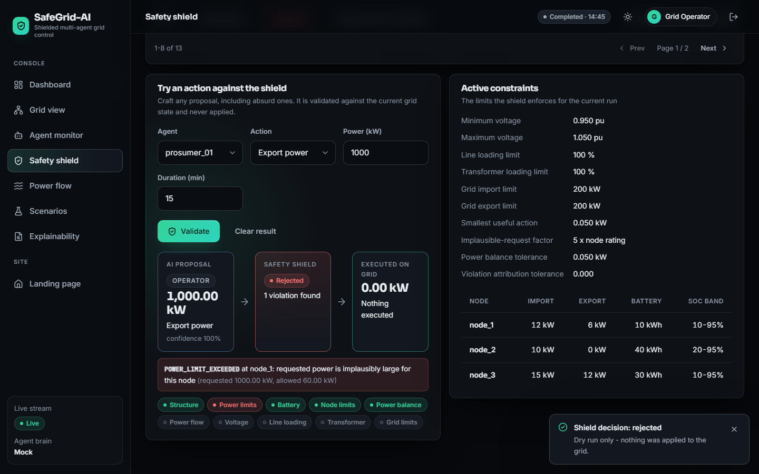
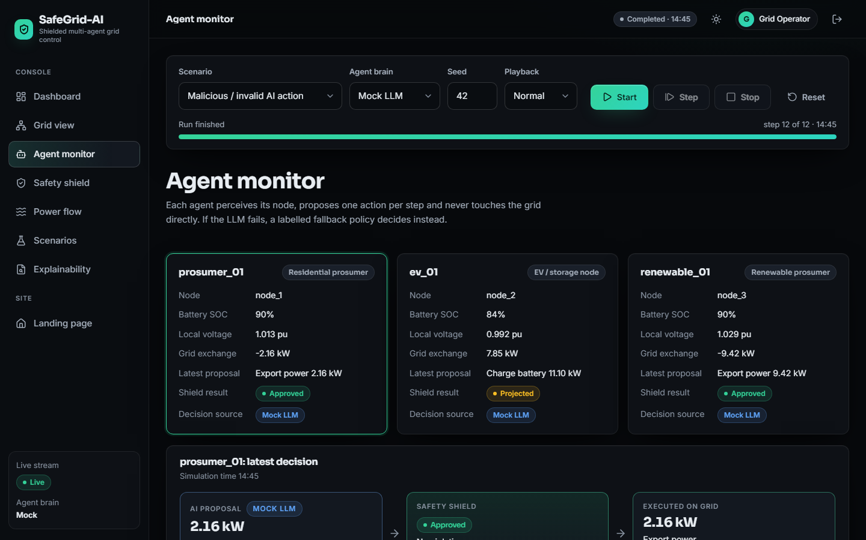
Output – Safety Shield and Agent Monitor
Safety log, dry-run rejection of a 1000 kW export, active constraints
Agent cards: proposal, shield result and source
Dept. of CSE | Batch A13 | Final Review
23
Notes:
The dry run submits a custom action to the shield; nothing is applied. The 1000 kW export is rejected with the failed checks listed.

Slide 24
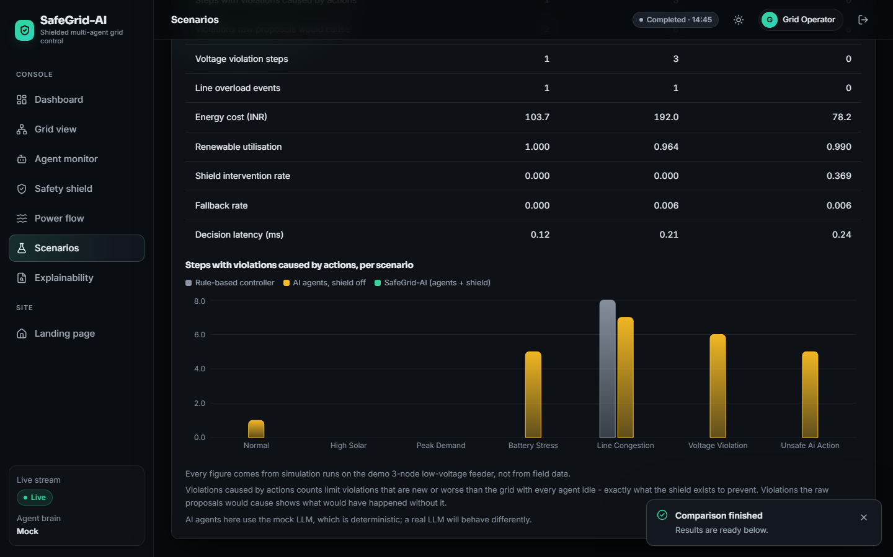
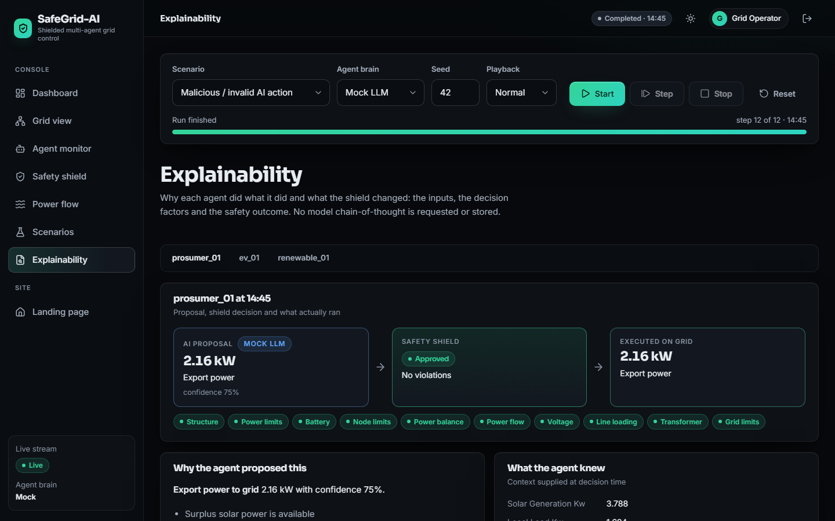
Output – Scenarios and Explainability
Scenario runner and strategy comparison
Decision factors, reason codes and safety result per decision
Dept. of CSE | Batch A13 | Final Review
24
Notes:
Left: scenario runner with the strategy comparison. Right: the explanation of one decision (inputs, factors, action and safety result); no chain-of-thought is stored.

Slide 25
Conclusion
Delivered: a multi-agent power-routing system with a deterministic Symbolic Safety Shield, a hash-chained audit log, per-decision explanations, a React dashboard and a 63-run evaluation.
Measured: 0 violations caused by executed actions in 504 shielded steps (1,512 proposals; 15.7% projected, 7.5% rejected); the same agents without the shield caused 144 violations in 99 steps.
Cost: step time about 3x higher (348 ms against 107 ms); some PV is curtailed in high_solar and voltage_violation.
Honest gaps: mock LLM only (no real-LLM result or latency); violation-resolution rate not measured; three seeds on a synthetic 3-node feeder; the guarantee is model-relative, not a proof; 2 tests fail on numeric tolerances and 1 hangs; no user study.
Dept. of CSE | Batch A13 | Final Review
25
Notes:
Objectives 1, 3, 4 and 5 are met, objective 2 with a mock model, objective 6 partly. Read the gaps slowly: they are part of the result.

Slide 26
Future Scope
Run the implemented API provider against a live language model; measure decision latency, fallback rate and reasoning quality against the mock.
Measure a violation-resolution rate so pre-existing stress can be repaired, not only prevented.
Larger and three-phase unbalanced networks; real load and PV data; more seeds.
Property-based tests or formal verification of the shield; fix the two tolerance tests and the WebSocket test.
An MCP tool interface, operator roles and authentication, and a user study with grid operators.
Dept. of CSE | Batch A13 | Final Review
26
Notes:
Ordered by value: the real-LLM evaluation closes the largest gap in this work.

Slide 27
References
[1] S. E. Eyimaya and N. Altin, "Design of multi-agent-based energy management system for DC microgrids," IEEE Access, vol. 14, pp. 39120-39133, 2026, doi: 10.1109/ACCESS.2026.3672618.
[2] Y. Zhang, A. M. Saber, A. Youssef, and D. Kundur, "Grid-Agent: An LLM-powered multi-agent system for power grid control," arXiv:2508.05702, Aug. 2025.
[3] J. Picault and C. Goubet, "Orchestrating power grid studies with multi-agent AI and MCP servers," arXiv:2607.14158, Jul. 2026.
[4] "Multi-agent deep reinforcement learning for energy-efficient smart grid management," in Proc. 1st Int. Conf. Intelligent Methods and Advanced Computer Scientific Innovations, 2025. (Authors not recorded in the batch survey.)
[5] "Energy system fault reconstruction control strategy based on multi-agent deep reinforcement learning," in Proc. 6th Int. Conf. Energy, Power and Grid (ICEPG), 2024. (Authors not recorded in the batch survey.)
[6] "Distributed optimal scheduling for electric vehicles considering the multi-agent demands of electric vehicles, charging stations and power grid," in Proc. 3rd Int. Conf. Power, Grid and Energy Storage, 2025. (Authors not recorded in the batch survey.)
[7] "Multi-agent systems in power system: A comprehensive review of energy management in power grid," in Smart Grid Security and Protection, Lecture Notes in Electrical Engineering, 2025. (Authors not recorded in the batch survey.)
[8] S. D. J. McArthur et al., "Multi-agent systems for power engineering applications - Part I: Concepts, approaches, and technical challenges," IEEE Trans. Power Syst., vol. 22, no. 4, pp. 1743-1752, Nov. 2007, doi: 10.1109/TPWRS.2007.908471.
[9] R. H. Lasseter, "MicroGrids," in Proc. IEEE Power Eng. Soc. Winter Meeting, vol. 1, 2002, pp. 305-308, doi: 10.1109/PESW.2002.985003.
[10] H. Farhangi, "The path of the smart grid," IEEE Power Energy Mag., vol. 8, no. 1, pp. 18-28, Jan./Feb. 2010, doi: 10.1109/MPE.2009.934876.
[11] L. Thurner et al., "pandapower - An open-source Python tool for convenient modeling, analysis, and optimization of electric power systems," IEEE Trans. Power Syst., vol. 33, no. 6, pp. 6510-6521, Nov. 2018, doi: 10.1109/TPWRS.2018.2829021.
[12] M. Alshiekh, R. Bloem, R. Ehlers, B. Konighofer, S. Niekum, and U. Topcu, "Safe reinforcement learning via shielding," in Proc. AAAI Conf. Artif. Intell., 2018, pp. 2669-2678.
[13] G. Dalal, K. Dvijotham, M. Vecerik, T. Hester, C. Paduraru, and Y. Tassa, "Safe exploration in continuous action spaces," arXiv:1801.08757, 2018.
[14] J. Garcia and F. Fernandez, "A comprehensive survey on safe reinforcement learning," J. Mach. Learn. Res., vol. 16, pp. 1437-1480, 2015.
[15] D. Amodei, C. Olah, J. Steinhardt, P. Christiano, J. Schulman, and D. Mane, "Concrete problems in AI safety," arXiv:1606.06565, 2016.
[16] S. Yao et al., "ReAct: Synergizing reasoning and acting in language models," in Proc. Int. Conf. Learn. Represent. (ICLR), 2023.
[17] M. Turpin, J. Michael, E. Perez, and S. R. Bowman, "Language models don't always say what they think: Unfaithful explanations in chain-of-thought prompting," in Proc. Adv. Neural Inf. Process. Syst. (NeurIPS), 2023.
[18] M. Wooldridge, An Introduction to MultiAgent Systems, 2nd ed. Chichester, U.K.: Wiley, 2009.
[19] Voltage Characteristics of Electricity Supplied by Public Electricity Networks, European Standard EN 50160:2010, CENELEC, 2010.
[20] Secure Hash Standard (SHS), Federal Information Processing Standards Publication FIPS 180-4, NIST, Aug. 2015.
Dept. of CSE | Batch A13 | Final Review
27
Notes:
References [4] to [7] come from the batch literature survey; their author lists were not recorded and are not guessed.

Slide 28
THANK YOU
Questions & Suggestions
Dept. of CSE | Batch A13 | Final Review
28
Notes:
Invite questions.

