Slide 1
Self-Supervised, Explainable GST ITC Fraud Detection
REVIEW 2 · DESIGN, METHODOLOGY AND PROGRESS
JEPA-LLM Tuning Framework for Combating GST and Sales Tax Input Tax Credit Fraud Pattern Detection
Presented by
Under the guidance of
B.ASHRITHA 23K91A6732
B.DIVYA 23K91A6739
A.KISHORE 23K91A6716
A.YAGNESH 23K91A6711
Dr. N. Ch. Ravi, Professor in CSE (Data Science)
Department of Computer Science and Engineering (Data Science)
TKR College of Engineering and Technology (Autonomous) · Batch A5 (CSE-DS) · 2026-2027

Slide 2
Contents
01
02
03
04
Recap
Architecture
Methodology
Dataset
05
06
07
08
Preprocessing
Model and training
Decision logic
Data flow, modules, database
09
10
11
12
Technology stack
Progress
Preliminary results and screens
Testing, challenges, next steps

Slide 3
Recap: problem and proposed system
1
Problem
2
Proposed system
ITC fraud (fake invoices, circular trading, shell companies) is hard to catch with audits and fixed rules; labels are scarce; flags are rarely explained.
TaxSentinel: JEPA behaviour encoder + network and invoice analysis + noisy-OR risk + cited Gemini case notes, served by a secured FastAPI and React application.
Returns, invoices, registrations
19 features in 3 layers
JEPA + network + invoice scores
Risk, evidence, chains
Cited case note
Data: seeded synthetic GST ecosystem with injected fraud labels (no real GST data was available).

Slide 4
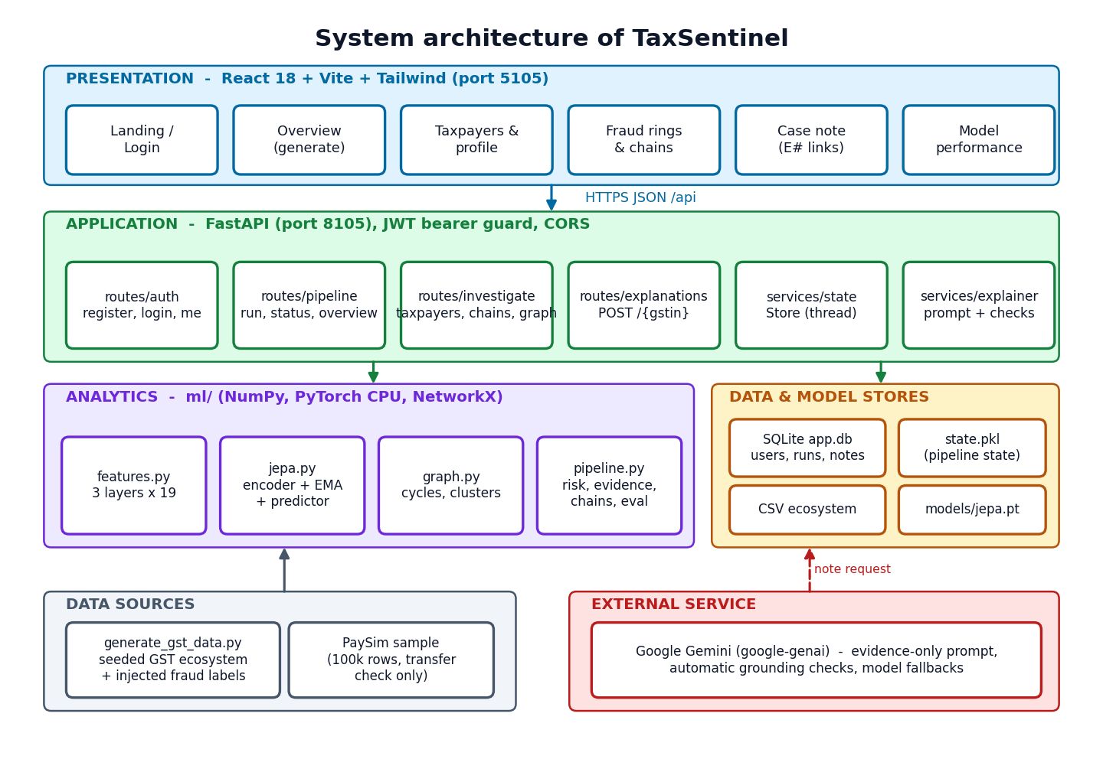
System architecture
Presentation: React 18, Vite, Tailwind; ten screens, route-level code splitting.
Application: FastAPI, JWT guard, five routers, background generation thread.
Analytics: ml/ package with features, JEPA, graph and pipeline.
Stores: SQLite (users, runs, notes), pickled pipeline state, CSV ecosystem, model weights.
External: Google Gemini for case notes.
Read endpoints are lookups of a state computed once per ecosystem.

Slide 5
Methodology: end-to-end workflow
Generate ecosystem
Build 19 features
Train JEPA (no labels)
Network + invoice scores
Combine risk
Evidence + notes
Evaluate vs labels
Self-supervised
Layer attribution
Reproducible
Labels are never used for training; they are used only to score the result.
Four mask variants (whole month; invoice, behaviour or network layer hidden) show which layer deviates.
Seeded generator, torch and numpy seeds; seed 42 reproduces every reported figure.

Slide 6
Dataset and input sources
Item | Bundled ecosystem (seed 42)
Period | Apr 2025 - Mar 2026 (12 months)
Taxpayers | 600 (8 states, 5 sectors)
Invoices | 64,474 (530 fraud)
Monthly returns | 6,977
Fraud taxpayers | 79 (13.2 %)
Hard negatives | Festival seasons, capital purchases, new firms, group companies, late filers
Transfer check | PaySim, 100k rows (CC BY-SA 4.0)
All GST data is synthetic sample data.

Slide 7
Data preprocessing and feature layers
I
Invoice layer (6)
B
Behaviour layer (7)
N
Network layer (6)
Purchase and sales invoice counts (log)
Share of purchases not reported by suppliers
Goods invoices of Rs 50,000+ without e-way bill
Round-value share
Share bought from suppliers under 6 months old
Outward turnover and ITC claimed (log)
ITC to output tax
ITC claimed above GSTR-2B
Share of tax paid in cash
Filing delay; registration age
Suppliers and buyers (log)
Share of new partners
Reciprocal sales share
Largest buyer's share
Value added
Robust scaling (median / IQR, clipped at 10); months without a return are marked absent, not imputed.

Slide 8
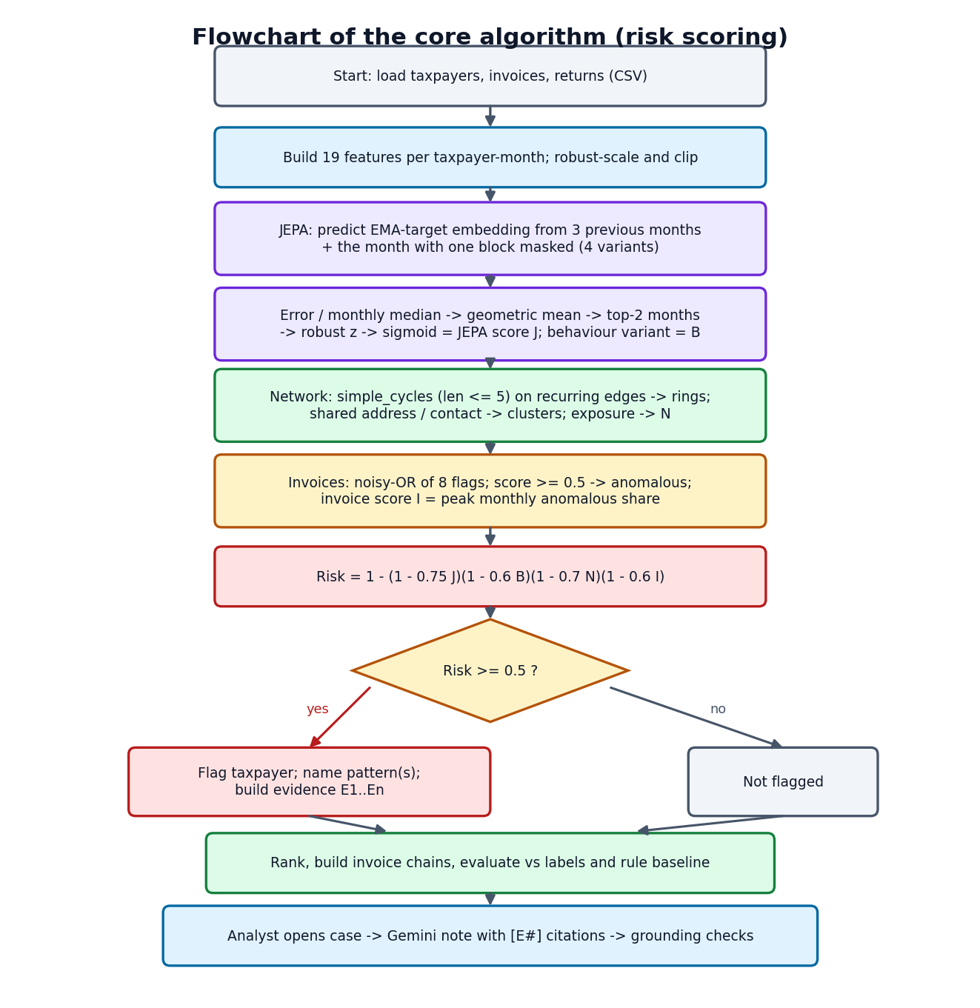
Model architecture and risk model
Component | Specification
Online encoder | 19 > 64 > 64 > 32 (LayerNorm, GELU)
Target encoder | EMA copy, momentum 0.99, no gradient
Predictor | 135 > 128 > 128 > 32
Mask variants | 4 (month, invoice, behaviour, network)
Saved values | 53,420 (45,696 trainable)
Risk | 1 - (1-0.75J)(1-0.6B)(1-0.7N)(1-0.6I)
J = JEPA deviation, B = behaviour-layer deviation, N = network score, I = invoice score. Weights were set on the seed-42 ecosystem.

Slide 9
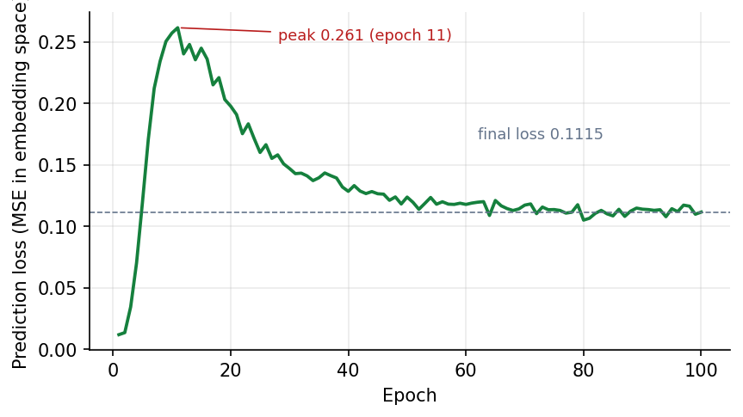
Training configuration
Setting | Value
Samples | 6,977 taxpayer-months, no labels
Window | 3 previous months
Optimiser | AdamW, lr 1e-3, weight decay 1e-4
Batch / epochs | 256 / 100
Loss | MSE in embedding space + variance hinge (weight 1)
Hardware / time | CPU only, 11.7 s
Final loss | 0.1115
Loss per epoch: peaks at 0.261 (epoch 11) as the EMA target moves, then settles near 0.11

Slide 10
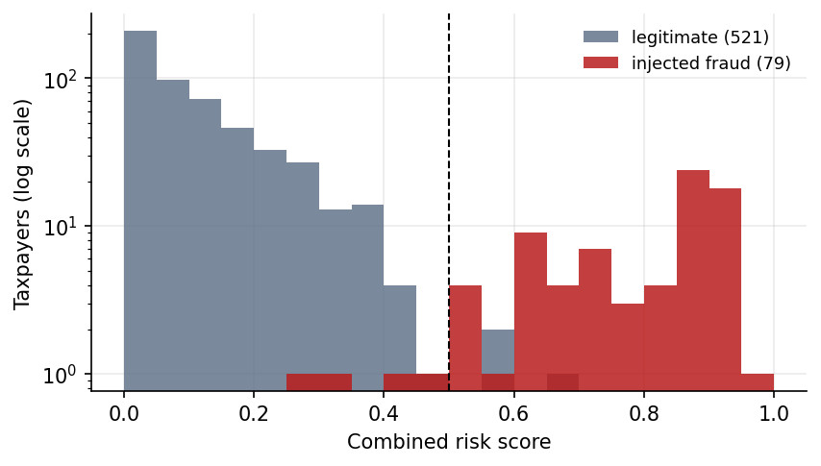
Decision logic
Flag
Risk R >= 0.5 flags a taxpayer; an invoice with anomaly score >= 0.5 is anomalous.
Pattern
Named from the evidence: circular trading, shell entity, fake invoices, ITC spike or unusual behaviour.
Risk score of legitimate (grey) and injected-fraud (red) taxpayers, seed 42
Evidence and note
Evidence items E1..En are built per taxpayer; the note may restate only those, citing each.

Slide 11
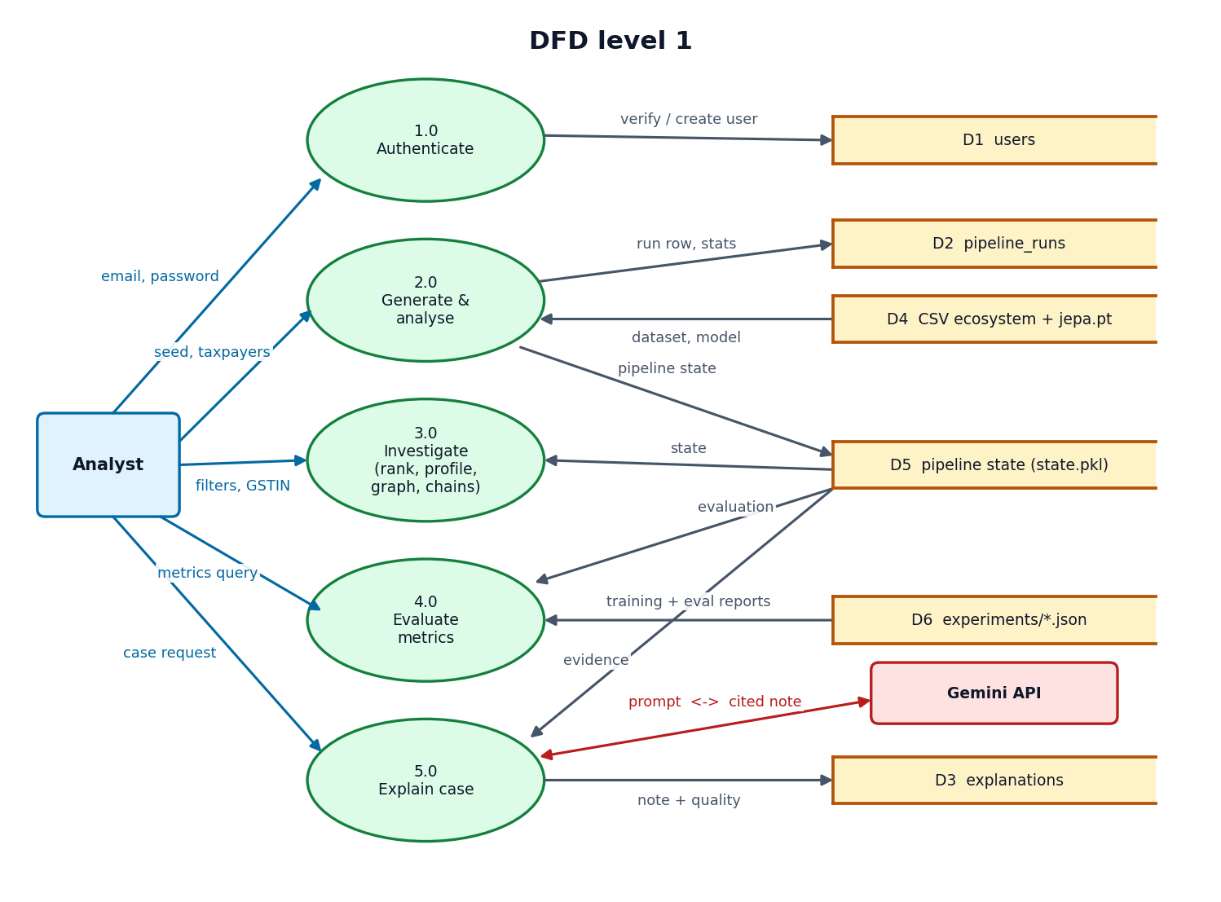
Data flow and modules
Module | File | Lines
Data generator | scripts/generate_gst_data.py | 483
Features | ml/features.py | 169
JEPA | ml/jepa.py | 149
Graph analysis | ml/graph.py | 110
Pipeline | ml/pipeline.py | 530
Evaluation | ml/eval.py | 133
API and services | backend/app/ | 787
Web pages | frontend/src/pages/ | 1,415
DFD level 1 (levels 0 and 2 are in the report)

Slide 12
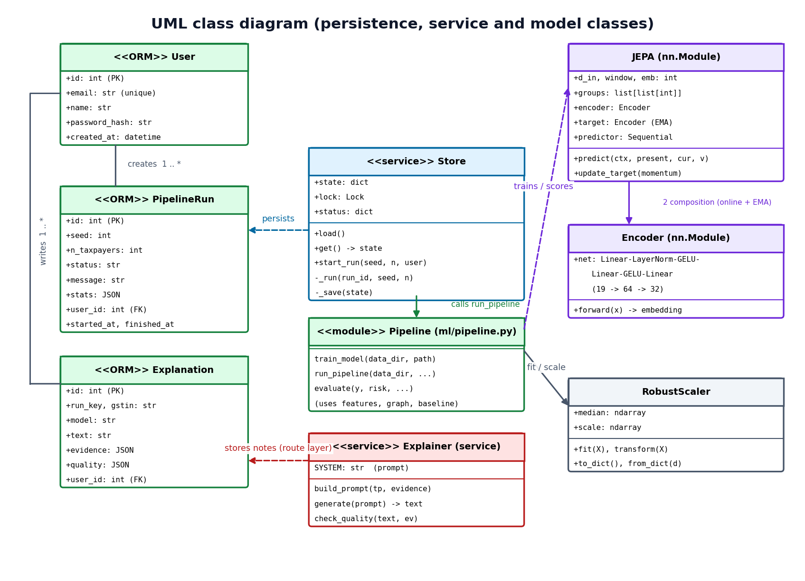
Database design and UML
Table | Columns (keys)
users | id PK, email unique, name, password_hash, created_at
pipeline_runs | id PK, seed, n_taxpayers, status, message, stats JSON, user_id FK, started_at, finished_at
explanations | id PK, run_key, gstin, model, text, evidence JSON, quality JSON, user_id FK, created_at
Analytical data (taxpayers, invoices, returns) stays in CSV files joined by GSTIN; the three SQL tables hold users, runs and stored notes.
UML class diagram

Slide 13
Technology stack
1
Language
2
Machine learning
3
Generative AI
Python 3.11.9, JavaScript (React 18)
PyTorch 2.14 (CPU), NumPy, NetworkX 3.4
Google Gemini through google-genai; prompt + grounding checks
4
Backend
5
Frontend
6
Data and tools
FastAPI 0.115, SQLAlchemy 2.0, PyJWT, bcrypt, SQLite
Vite 6, Tailwind 4, recharts, react-force-graph-2d, framer-motion
kagglehub (PaySim), pytest-free smoke test, setup.bat / run.bat

Slide 14
Implementation progress
Component | Status | Evidence
Synthetic generator | Done | 600 taxpayers, 64,474 invoices, 4 patterns
Features and JEPA | Done | 19 features; 11.7 s CPU training
Graph, invoice and risk | Done | 9 rings, 7 suspicious clusters, 16 chains
Evidence and Gemini notes | Done | Cited notes with grounding checks
API and web app | Done | 10 screens, JWT, background runs
Evaluation | Done | Baseline, ablations, per-pattern, cross-seed
Unit tests | Not done | Smoke and black-box tests only
20/20
smoke-test checks passed
11.7 s
JEPA training on a CPU
2,710
lines of Python (ml, backend, scripts)

Slide 15
Preliminary results: seed-42 ecosystem
0.955
F1 at threshold (rules 0.432)
0.997
ROC-AUC (rules 0.876)
0.949
precision@79 (rules 0.620)
Synthetic data; weights tuned on this seed. Mean F1 on five other seeds: 0.888 (range 0.790 to 0.933).

Slide 16
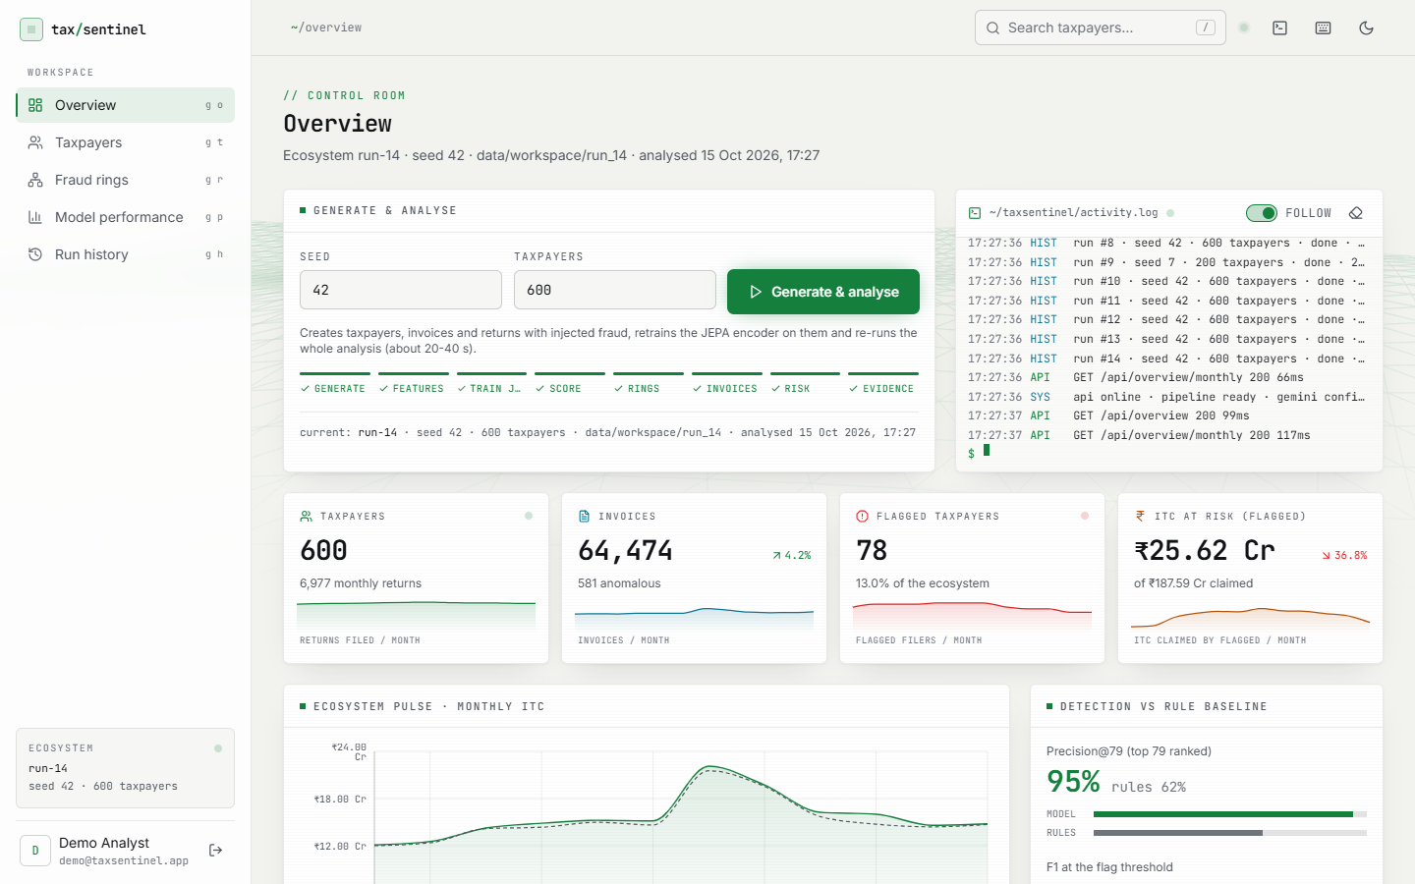
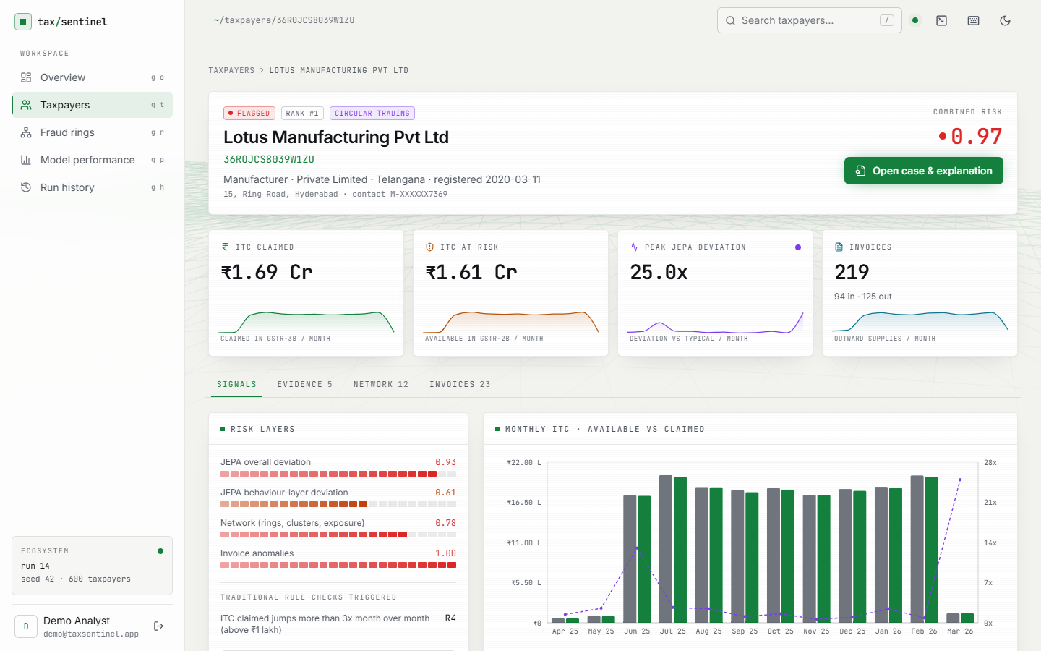
Output screens
Overview after a run: 78 flagged taxpayers, ITC at risk, precision against rules
Top-ranked taxpayer: layer scores and monthly GSTR-2B vs GSTR-3B

Slide 17
Initial testing and observations
Test | Result
End-to-end smoke test | 20 / 20 checks passed (39.4 s)
Edge and security checks | 41 / 41 passed
Median API latency | 1.7 to 12.1 ms (read endpoints)
Full generate + analyse | 18.6 to 29.0 s typical (600 taxpayers)
Unit tests | None; stated as a gap
A wrong password, an altered token, a missing token, bad input and a second concurrent run are all rejected with the expected status codes.
SQL-injection-style and script-tag search text is inert.
Timings were taken on a machine at times heavily loaded by other jobs.
Gemini quota and overload errors (429, 503, 504) stopped 4 of 10 case notes in the evaluation.

Slide 18
Challenges and corrective actions
1
No real GST data
2
JEPA misses shell firms
3
Weights tuned on one seed
Seeded generator with hard negatives; every figure labelled synthetic.
Similar shells form their own normal; the network layer catches them (JEPA-only recall 0.20).
Cross-seed study run; headline figures treated as a best case.
4
Gemini quota and overload
5
Legitimate loops look like fraud
6
Loaded machine
Retries, fallback models, notes on demand; failures reported, not hidden.
2 of 9 detected rings are legitimate reciprocal trade; notes suggest the checks that clear them.
Timings varied widely; typical and worst runs are both reported.

Slide 19
Next steps
Final report and IEEE paper
Head-to-head baselines
Unit-test suite
Final presentation and demo
Train an isolation forest and an autoencoder on the same features and compare them with the JEPA.
Re-fit or learn the risk weights and threshold so that cross-seed F1 is more stable.
Add unit tests and automated UI tests; run a user-acceptance session with analysts.
Evaluate the case notes on all ten planned cases (paid or retried Gemini quota).

Slide 20
Thank you
Questions and suggestions are welcome.

