Slide 1

JEPA-LLM Tuning Framework for Combating GST and Sales Tax Input Tax Credit Fraud Pattern Detection
Final Review · TaxSentinel
Team Details : Batch A5 (CSE-DS)
Under the Esteemed Guidance of
Dr. N. Ch. Ravi
Professor in CSE (Data Science)
23K91A6732 B.ASHRITHA
23K91A6739 B.DIVYA
23K91A6716 A.KISHORE
23K91A6711 A.YAGNESH
DEPARTMENT OF COMPUTER SCIENCE AND ENGINEERING (DATA SCIENCE) · Academic Year 2026 – 2027

Slide 2
Table of Contents
1. Abstract
2. Base paper and literature survey
3. Research gap and problem statement
4. Objectives
5. Proposed system and architecture
6. Methodology, dataset and model
7. Decision workflow and design
8. Implementation highlights
9. Results and threshold analysis
10. Performance and testing
11. Comparison with the base paper
12. Output screens
13. Conclusion and future scope
14. References
Dept. of CSE (Data Science) | Batch A5 | Final Review
2

Slide 3
Abstract
ITC fraud under GST (fake invoices, circular trading, shell companies) causes large revenue losses; audits and fixed rules are slow and easy to evade, labels are scarce and flags are rarely explained. The base paper describes the problem but proposes no model.
TaxSentinel learns normal GST behaviour without labels with a JEPA encoder (53,420 values, 11.7 s on a CPU), combines its deviation with circular-trading, shell-cluster and invoice evidence in a noisy-OR risk, and has Gemini write case notes that cite numbered evidence.
On a synthetic ecosystem (600 taxpayers, 64,474 invoices, 79 injected fraud taxpayers) it reaches precision@79 0.949, F1 0.955 and ROC-AUC 0.997 against 0.620, 0.432 and 0.876 for rules; all 5 injected rings were recovered.
Limits: data is synthetic; the LLM is prompted, not fine-tuned; JEPA alone is the weakest layer; F1 on other generated ecosystems is lower.
Dept. of CSE (Data Science) | Batch A5 | Final Review
3

Slide 4
Base Paper
S. Datta, H. Thakkar and S. Dabhade, "Combating GST Input Tax Credit Fraud in India: Forensic Accounting, Data Analytics, and Legal Enforcement Strategies," Int. J. Management, Public Policy and Research, vol. 5, no. 1, Jan-Mar 2026, doi 10.55829/ykz3ea41.
Qualitative synthesis of public DGGI and CBIC data: detected evasion Rs 1.01 to Rs 2.01 lakh crore (FY23 to FY24), cases 4,872 to 6,084, arrests 97 to 140.
Recommends analytics, network analysis, AI-based risk modelling at registration, forensic capacity and faster recovery.
Limitations: public sources only; no detection model and no accuracy figures. This project builds and evaluates the model it calls for.
Dept. of CSE (Data Science) | Batch A5 | Final Review
4

Slide 5
Literature Survey
Work | Approach | Data | Reported result | Limitation
Datta et al. [1] | Forensic analytics review | DGGI, CBIC data | Evasion Rs 1.01 to 2.01 lakh crore | No model
[2]-[5] (titles only) | ML / AI for tax fraud | Not available | Not quoted | Supervised; no network
Mehta et al. [6] | node2vec + DBSCAN loops | Telangana GST, 77.8 M invoices | Communities found | One pattern; no accuracy
Xu et al. [7] (TED) | Heterogeneous GNN | Two real tax datasets | F1 76.35 to 94.96 % | Needs labels
Assran et al. [8] | I-JEPA | Images | Strong transfer | Not tax data
Dept. of CSE (Data Science) | Batch A5 | Final Review
5

Slide 6
Research Gap
Gap | Existing work | TaxSentinel
Labels | Supervised models need confirmed fraud | Learns normal behaviour without labels
Evidence | One view (returns or graph) | Invoice, behaviour and network layers in one risk
Group fraud | Per-entity scores miss loops and shell clusters | Scored loops (5 of 5 found) and clusters
Explanation | Scores or communities only | Numbered evidence and cited notes, checked automatically
Evaluation | Rarely against a rule baseline | Baseline, ablations, per-pattern and cross-seed results
Dept. of CSE (Data Science) | Batch A5 | Final Review
6

Slide 7
Problem Statement
ITC fraud through fake invoices, circular trading and shell companies causes large revenue losses.
Manual audits and rule-based checks are slow and reactive.
Confirmed fraud labels are scarce, which limits supervised learning.
Existing systems rarely explain why a claim is flagged.
Need: a self-supervised, explainable framework that learns normal GST behaviour and flags and explains suspicious ITC claims.
Dept. of CSE (Data Science) | Batch A5 | Final Review
7

Slide 8
Objectives
Build a multi-layer GST dataset (invoices, behaviour, network).
Learn normal GST behaviour with a self-supervised JEPA encoder.
Detect fake invoices, circular trading and shell-entity activity.
Score and rank taxpayers and invoice chains by deviation.
Explain flagged claims with an LLM (prompt-tuned and checked, not fine-tuned).
Evaluate detection accuracy and explanation quality.
Dept. of CSE (Data Science) | Batch A5 | Final Review
8

Slide 9
Proposed System
1. Generate or load a GST ecosystem (taxpayers, invoices, GSTR returns).
2. Build 19 features per taxpayer-month in invoice, behaviour and network layers.
3. JEPA encoder scores deviation (4 mask variants).
4. Network analysis finds loops and shared-identity clusters.
5. Eight-signal invoice score; noisy-OR risk; flag at 0.5.
6. Evidence list, patterns and ranked invoice chains.
7. Gemini writes a cited note; grounding checks run; analyst reviews.
Dept. of CSE (Data Science) | Batch A5 | Final Review
9

Slide 10
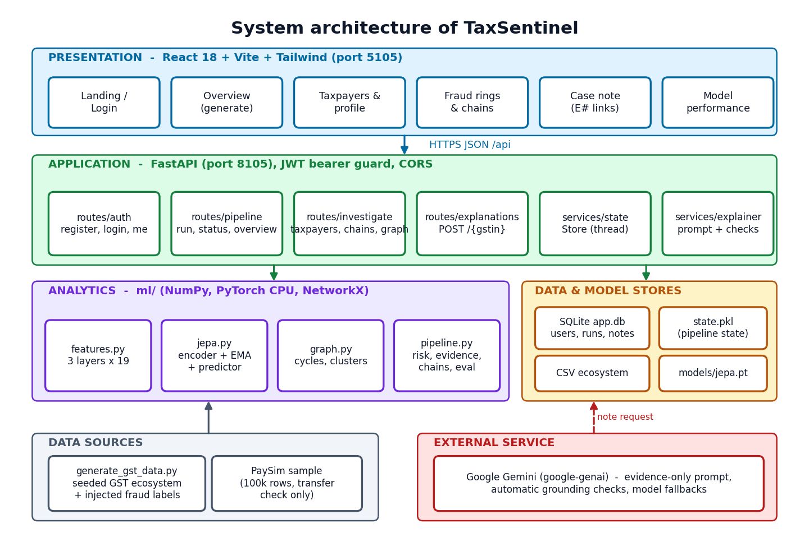
System Architecture
Four-tier architecture: React, FastAPI, analytics layer, stores; Gemini external
Dept. of CSE (Data Science) | Batch A5 | Final Review
10

Slide 11
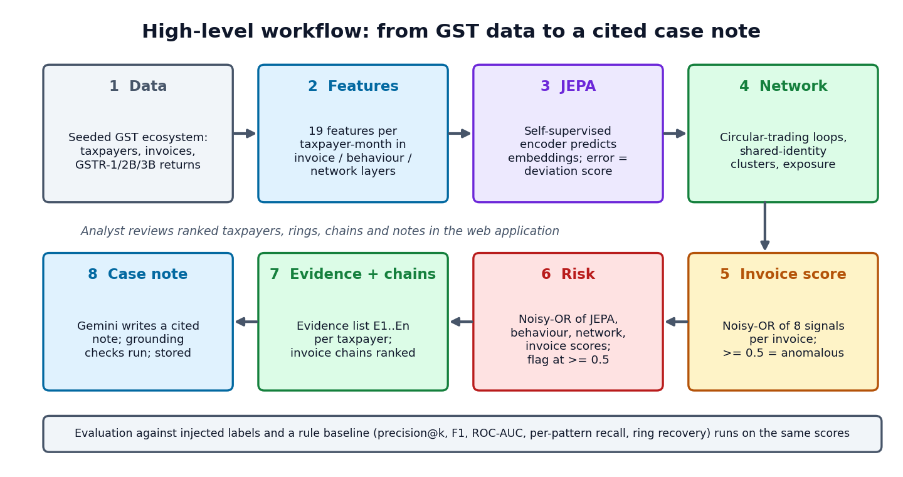
Methodology
End-to-end processing flow
Dept. of CSE (Data Science) | Batch A5 | Final Review
11

Slide 12
Dataset, Features & Model
Synthetic seeded ecosystem (seed 42): 600 taxpayers, 64,474 invoices, 6,977 returns; 79 fraud taxpayers (27 shell, 21 circular, 19 fake-invoice buyers, 12 ITC spikes); hard negatives included.
19 features per taxpayer-month: invoice (6), behaviour (7), network (6); robust-scaled.
JEPA: encoder 19-64-64-32, EMA target, predictor 135-128-128-32, window 3, 4 mask variants; AdamW, 100 epochs, 53,420 values, 11.7 s on a CPU.
Network: bounded cycles scored by balance, recurrence, concentration; address and contact clusters; Louvain communities.
Risk = noisy-OR(0.75 J, 0.6 B, 0.7 N, 0.6 I), flag at 0.5. LLM: Gemini, prompted and grounded.
Dept. of CSE (Data Science) | Batch A5 | Final Review
12

Slide 13
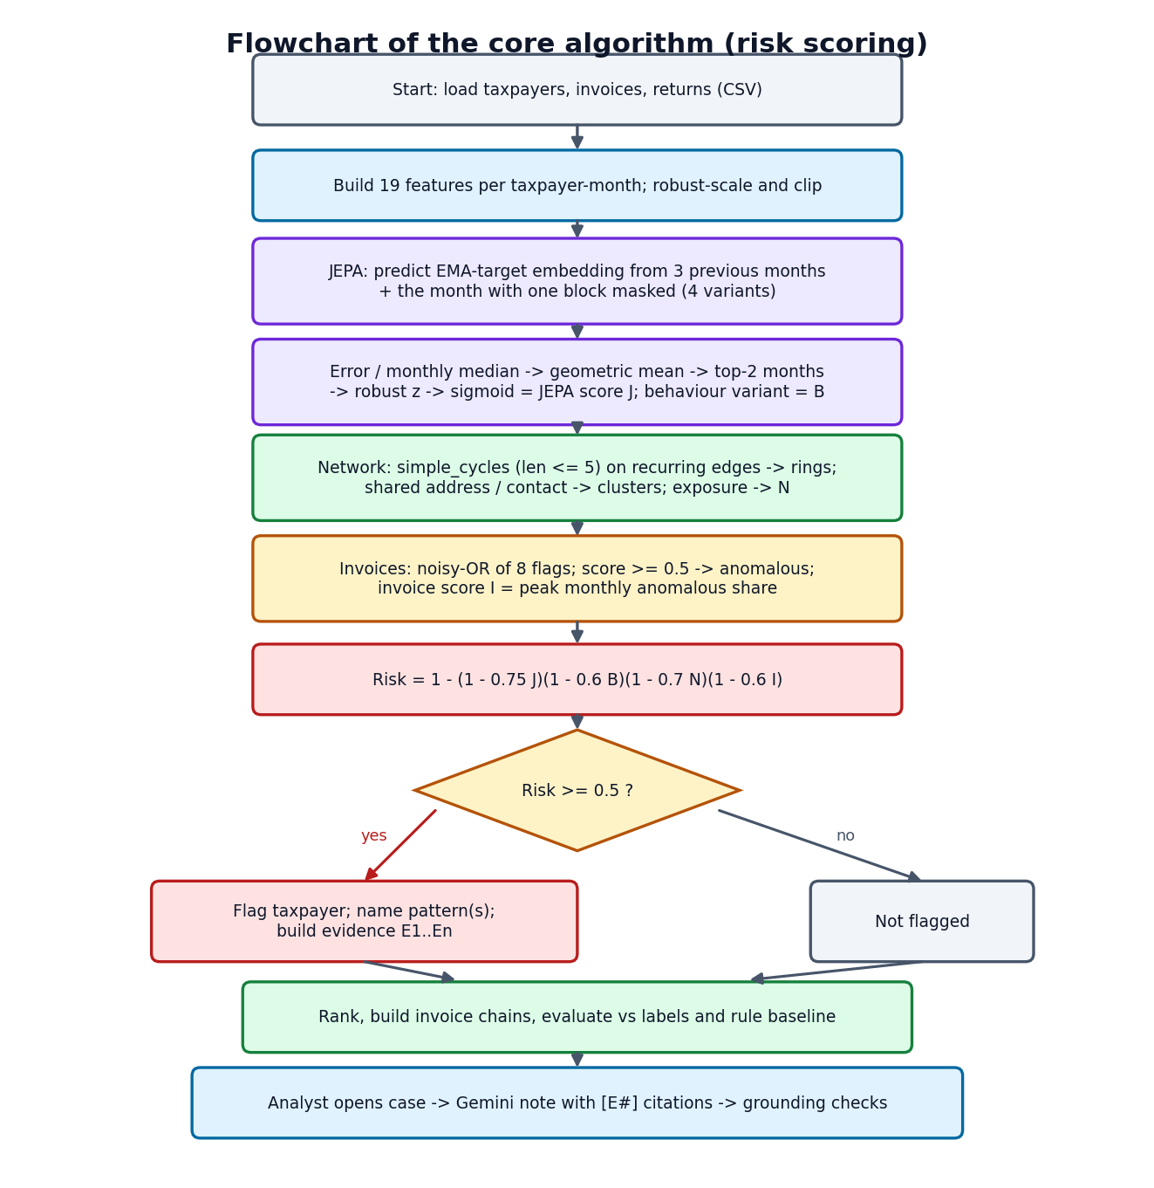
Decision Workflow
Risk scoring: combine layers, flag at 0.5, evidence, note
Dept. of CSE (Data Science) | Batch A5 | Final Review
13

Slide 14
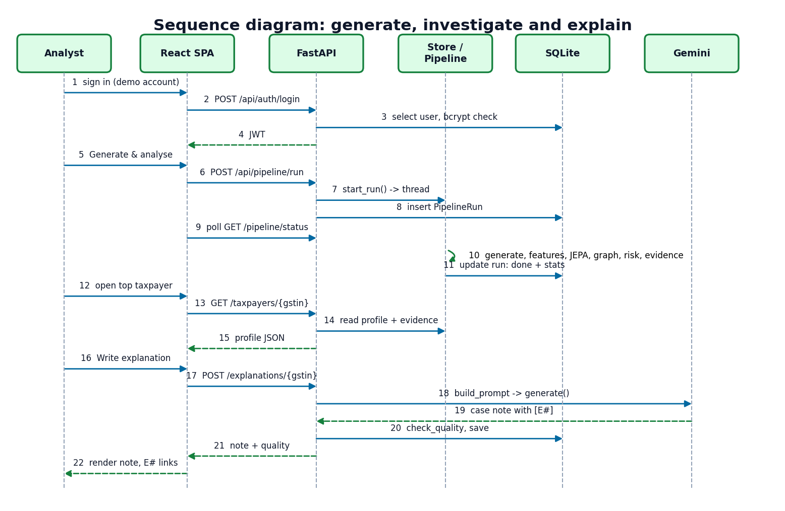
User–System Interaction
Sequence: sign in, generate and analyse (background thread), open taxpayer, write explanation
Dept. of CSE (Data Science) | Batch A5 | Final Review
14

Slide 15
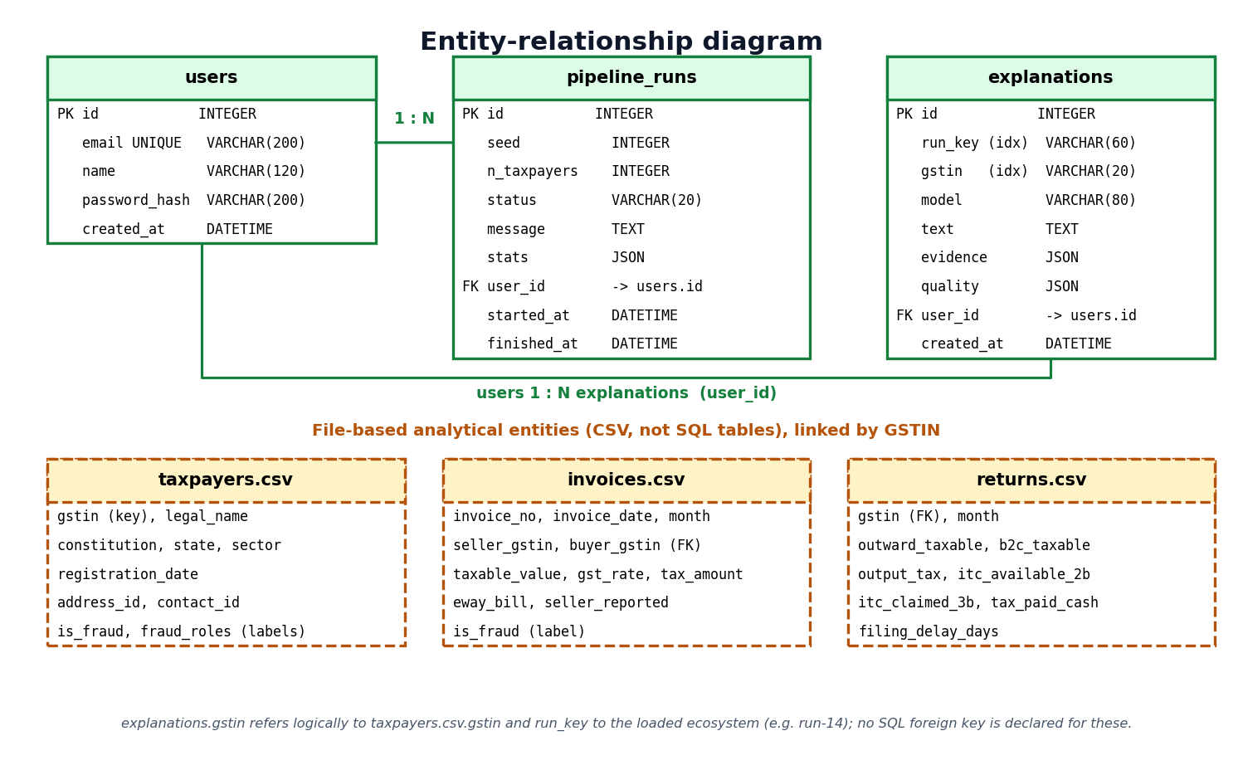
Database Design
Entity-relationship diagram: 3 SQL tables and the CSV entities joined by GSTIN
Dept. of CSE (Data Science) | Batch A5 | Final Review
15

Slide 16
Implementation Highlights
Component | Implementation | Evidence
Generator | Seeded; GSTIN checksum; 4 patterns; hard negatives | 64,474 invoices, 79 fraud taxpayers
JEPA | PyTorch, EMA target, 4 mask variants | 53,420 values; 11.7 s on a CPU
Graph | NetworkX bounded cycles; identity clusters | 5 of 5 rings; 9 rings, 7 suspicious clusters
Explainer | Gemini; evidence-only prompt; grounding checks | 0 invalid citations in 6 notes
API | FastAPI, JWT, bcrypt, SQLite, background runs | 20/20 smoke-test checks
Web app | React, Vite, Tailwind, force graph | 10 screens, dark mode, command palette
Dept. of CSE (Data Science) | Batch A5 | Final Review
16

Slide 17
Results – Model Performance (seed 42, threshold 0.5)
Method | P@79 | Precision | Recall | F1 | ROC-AUC
TaxSentinel (all layers) | 0.949 | 0.962 | 0.949 | 0.955 | 0.997
Rule baseline R1-R5 | 0.620 | 0.288 | 0.861 | 0.432 | 0.876
JEPA + behaviour only | 0.481 | 0.842 | 0.203 | 0.327 | 0.843
Graph + invoice only | 0.848 | 1.000 | 0.798 | 0.887 | 0.940
Five other seeds (mean), TaxSentinel | 0.888 | 0.924 | 0.857 | 0.888 | 0.988
Five other seeds (mean), rules | 0.625 | - | - | 0.457 | 0.877
Synthetic ecosystem with injected labels; weights and threshold were tuned on seed 42, so the first rows are a best case. JEPA alone is the weakest layer (F1 0.327); the layers are complementary. Invoice level: F1 0.924 vs 0.160 for the GSTR-1 mismatch check.
Dept. of CSE (Data Science) | Batch A5 | Final Review
17

Slide 18
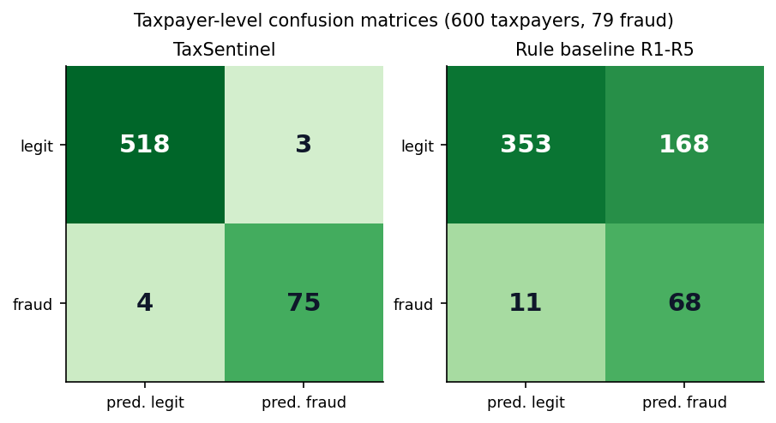
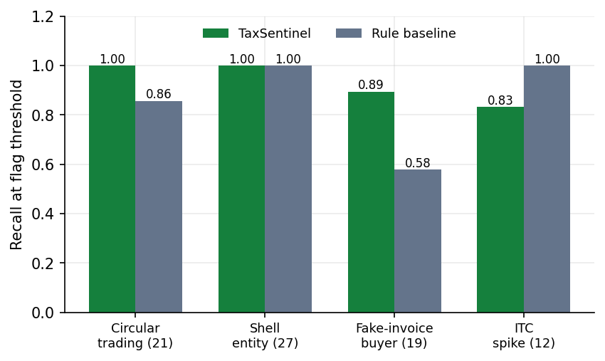
Confusion Matrix & Recall by Pattern
Test: TP 75, FN 4, FP 3, TN 518 (rules: TP 68, FP 168)
Recall by pattern: ITC spikes 0.83, below the rule baseline's 1.00
Dept. of CSE (Data Science) | Batch A5 | Final Review
18

Slide 19
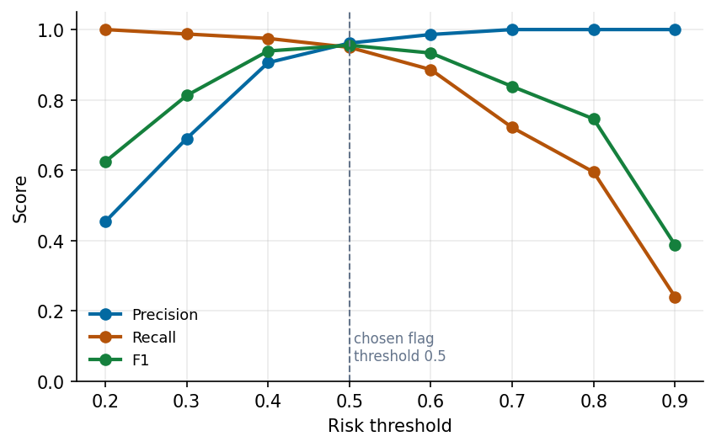
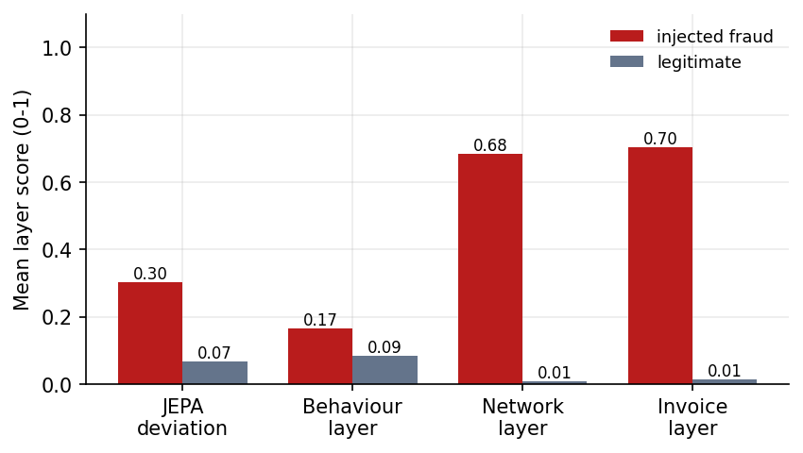
Threshold Analysis & Layer Scores
Network and invoice layers separate fraud best; JEPA adds recall
Flag threshold sweep (seed 42): F1 is highest around 0.4 to 0.6; 0.5 chosen
Dept. of CSE (Data Science) | Batch A5 | Final Review
19

Slide 20
Performance & Testing
Measure | Result
JEPA training (CPU) | 11.7 s, final loss 0.1115
Full generate + analyse, 600 taxpayers | 18.6 to 29.0 s typical (analysis stage 16.0 s)
Read-endpoint latency (median of 20) | 1.7 ms (health) to 12.1 ms (whole graph)
End-to-end smoke test | 20 / 20 checks passed (39.4 s)
Edge and security checks | 41 / 41 passed (wrong password, forged token, bad input, concurrent run)
Unit tests / UI tests / load tests | Not done (stated as gaps); single-client timings on a loaded machine
Dept. of CSE (Data Science) | Batch A5 | Final Review
20

Slide 21
Comparison with Base Paper (context only)
Aspect | Base paper [1] | TaxSentinel
Type | Qualitative review | Implemented and evaluated system
Detection model | None | JEPA + network + invoice noisy-OR
Reported accuracy | None | F1 0.955 (seed 42, synthetic); lower on other seeds
Explanation | Not addressed | Cited, checked case notes
Registration-time scoring | Recommended | Not built
Context only: TED [7] | - | F1 76 to 95 % on real data, supervised: not comparable
The base paper reports no model metrics, so there is no like-for-like number; our comparison is with the recommendations and with a rule baseline.
Dept. of CSE (Data Science) | Batch A5 | Final Review
21

Slide 22
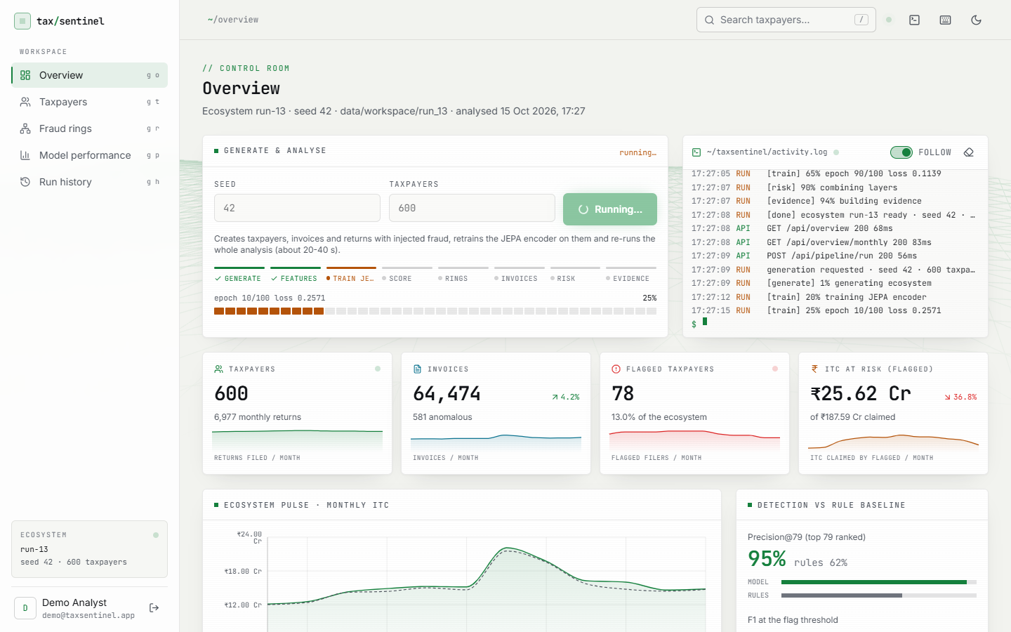
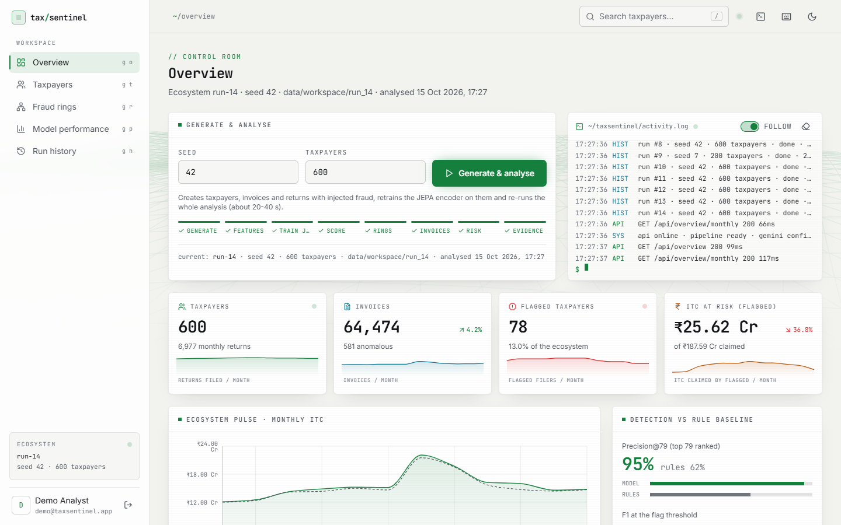
Output – Generate & Analyse
Run in progress: JEPA training epoch 10/100
Overview: 78 flagged taxpayers, ITC at risk, precision vs rules
Dept. of CSE (Data Science) | Batch A5 | Final Review
22

Slide 23
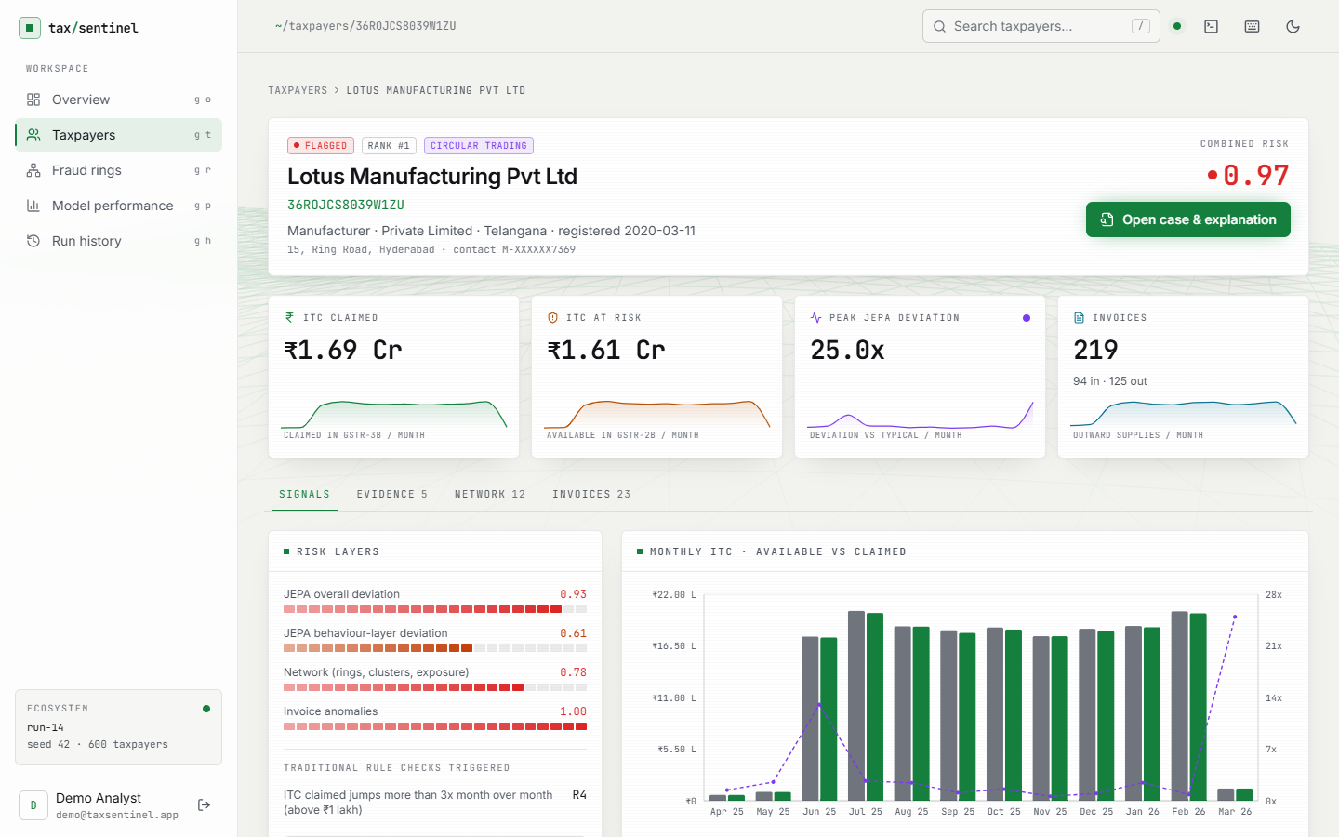
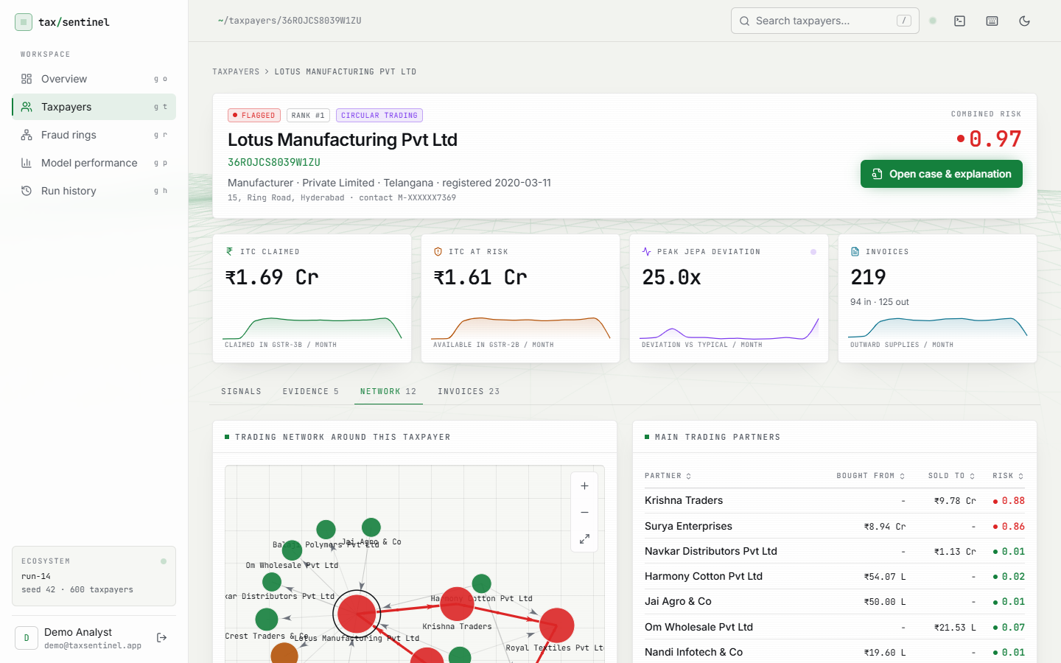
Output – Taxpayer Investigation
Profile: four layer scores, GSTR-2B vs 3B chart
Network tab: circular-trading loop in red
Dept. of CSE (Data Science) | Batch A5 | Final Review
23

Slide 24
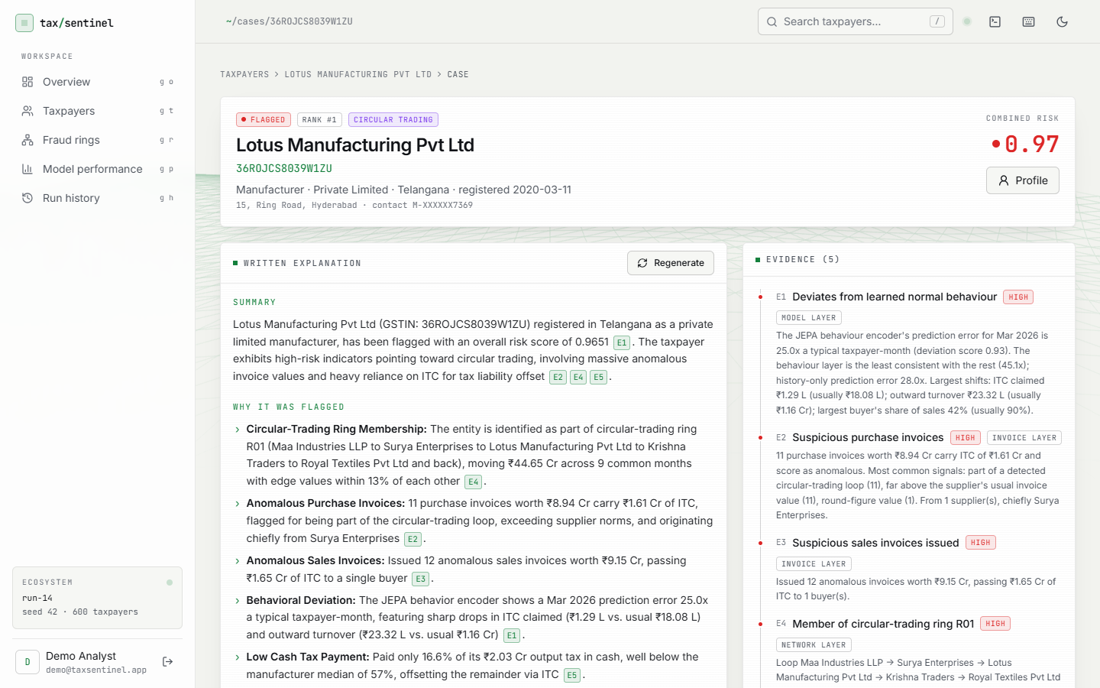
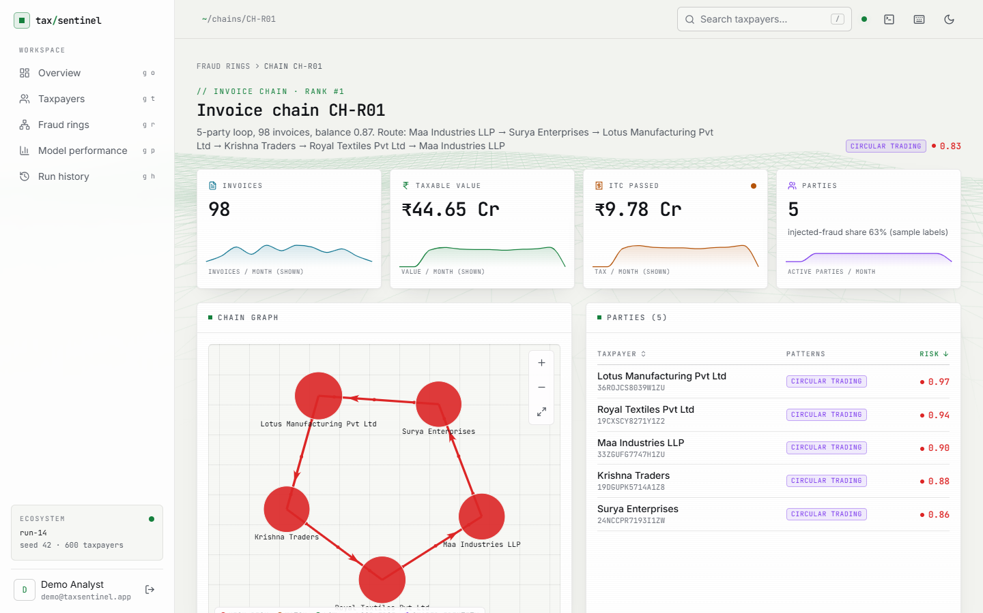
Output – Case Note & Invoice Chain
Gemini case note with [E#] citations beside evidence
Chain CH-R01: 5-party loop, 98 invoices, Rs 44.65 Cr
Dept. of CSE (Data Science) | Batch A5 | Final Review
24

Slide 25
Conclusion
Built TaxSentinel: label-free behaviour learning, network and invoice evidence and cited case notes in a secured web application.
Seed 42: precision@79 0.949, F1 0.955, ROC-AUC 0.997 vs 0.620 / 0.432 / 0.876 for rules; 5 of 5 rings; invoice F1 0.924.
Honest limits: mean F1 0.888 on five other seeds (range 0.790 to 0.933); data is synthetic; JEPA alone F1 0.327; LLM prompted, not fine-tuned; 6 of 10 notes evaluated; no unit-test suite.
Dept. of CSE (Data Science) | Batch A5 | Final Review
25

Slide 26
Future Scope
Validate on real, anonymised returns; recalibrate or learn the risk weights and threshold.
Compare the JEPA with an isolation forest and an autoencoder on the same features.
Add e-invoice, e-way-bill and payment data; scale the graph analysis to state size.
Role-based access, case management and feedback loop; HTTPS, rate limiting, audit logging.
Fine-tune or self-host a language model and run a human evaluation of notes; add unit and UI tests.
Dept. of CSE (Data Science) | Batch A5 | Final Review
26

Slide 27
References
[1] S. Datta, H. Thakkar, S. Dabhade, Int. J. Manage., Public Policy Res., 5(1), 2026.
[2]-[5] Tax-fraud ML and AI papers listed in the batch survey (2025-2026).
[6] P. Mehta et al., arXiv:2208.07660, 2022 (circular trading in GST).
[7] Y. Xu et al., TED, arXiv:2605.26984, 2026.
[8] M. Assran et al., I-JEPA, CVPR 2023.
[9] Y. LeCun, A path towards autonomous machine intelligence, 2022.
[10] J.-B. Grill et al., BYOL, NeurIPS 2020.
[11] A. Bardes et al., VICReg, ICLR 2022.
[12] J. Pearl, Probabilistic Reasoning in Intelligent Systems, 1988.
[13] Gemini Team, arXiv:2312.11805, 2023.
Dept. of CSE (Data Science) | Batch A5 | Final Review
27

Slide 28
THANK YOU
Questions & Suggestions
Dept. of CSE (Data Science) | Batch A5 | Final Review
28

