Slide 1
Attendance Magic
REVIEW 2 · DESIGN, METHODOLOGY AND PROGRESS
A Smart Geo-Fenced Attendance System with Live Challenge Verification
Presented by
Under the guidance of
A.GREESHMA 23K91A6706
B.VINAY 23K91A6740
G.SRIRAM 23K91A6757
B.SAI KUMAR 24K95A6704
[GUIDE NAME], [DESIGNATION]
Department of Computer Science and Engineering (Data Science)
TKR College of Engineering and Technology · Batch A2 (CSE-DS, Section A) · [ACADEMIC YEAR]
Notes:
Review 2 covers design, methodology and progress of Attendance Magic.

Slide 2
Contents
01
02
03
04
Recap
Architecture
Methodology
Evaluation data
05
06
07
08
Inputs and preparation
Verification components
Decision logic
Data flow, modules, database
09
10
11
12
Technology stack
Progress
Preliminary results and screens
Testing, challenges, next steps
Notes:
Twelve parts: recap, design, methodology, data, components, decision logic, data flow, stack, progress, results, testing and next steps.

Slide 3


Recap: problem and proposed system
Problem
Proposed system
Attendance by roll call or a shared link is slow, error-prone and easy to fake: a forwarded link, a photo or a friend can mark an absent student present.
Time-bound sessions with a geo-fence, a random live facial challenge and duplicate-face checks, delivered by a FastAPI and React web application.
Session link + sign-in (JWT, device)
Eligibility + GPS geo-fence
Random live challenge (Face Mesh)
Face match + duplicate check
Record, log, Excel export
Notes:
Recap of Review 1: the problem and the proposed system as a five-step pipeline.

Slide 4
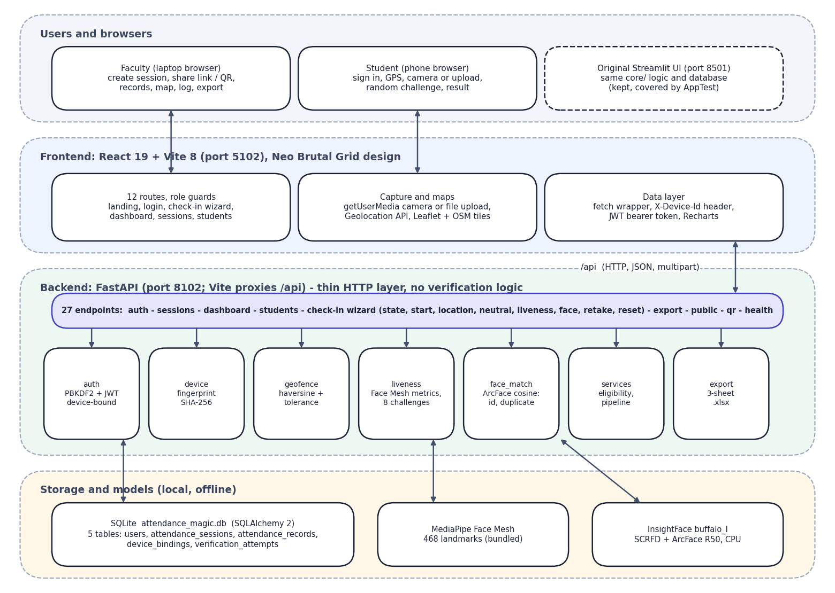

System architecture
Client: React 19 + Vite 8 (port 5102): 12 routes, camera or upload, Geolocation, Leaflet map.
API: FastAPI (port 8102): 27 endpoints; JWT bound to the device; server-side check-in wizard state.
Core services: geofence, liveness (MediaPipe Face Mesh), face_match (InsightFace ArcFace), eligibility, export.
Data: SQLite with 5 tables and a verification-attempt log.
Original Streamlit UI kept on the same core.
Notes:
The browser talks only to the Vite server, which proxies /api to FastAPI. The API is thin: every rule lives in core/, shared with the Streamlit interface.

Slide 5
Methodology: end-to-end workflow
Create session
Share link / QR
Sign in + eligibility
GPS geo-fence
Random live challenge
Face match + duplicate
Record + export
Staged and logged
Rules in one place
Configurable
Each stage can stop the check-in with a plain reason, and every attempt (pass or block) is stored with its stage and reason.
The REST API and the Streamlit UI both call core/, so there is a single implementation of every check.
Radius, tolerance, GPS accuracy, thresholds and device limits are environment settings with documented defaults.
Notes:
End-to-end workflow in seven steps. A failed stage never writes an attendance record.

Slide 6
Evaluation data and input sources
Data | Size | Use
LFW benchmark, pairs.txt protocol | 13,233 images; 6,000 pairs (3,000 + 3,000); 7,701 unique images | Threshold evaluation
LFW stills, random sample | 1,000 photos; 157 identities with 10+ photos | Liveness and attack tests
Demo data | 5 accounts, 2 sessions; LFW photos as stand-ins | Screens, smoke test
Student photos / camera trials | None collected | Not done
Training data | None: models are pre-trained | No train/test split
Notes:
No model is trained in this project, so there is no training set. LFW is a public benchmark used only to evaluate the thresholds of the verification chain.

Slide 7



Inputs and preparation
Photos
Location
Identity and roll data
JPEG or PNG from the camera or an upload; decoded with OpenCV and shrunk so the longest side is at most 1280 px. Exactly one face is required in each frame; the first (neutral) frame must be frontal (|yaw| <= 0.10) with the mouth closed.
Browser GPS latitude, longitude and accuracy (or a manual coordinate in test mode). A fix worse than 150 m is rejected; the distance is a haversine on a 6,371 km sphere.
Each student enrols one reference photo, stored as a 512-dimensional ArcFace embedding. Roll numbers are matched with wildcard patterns (for example 23K91A67*) and an explicit list also gives the absentees.
Notes:
Preparation here means decoding and validating the photos, the GPS fix and the roll numbers before the checks run.

Slide 8
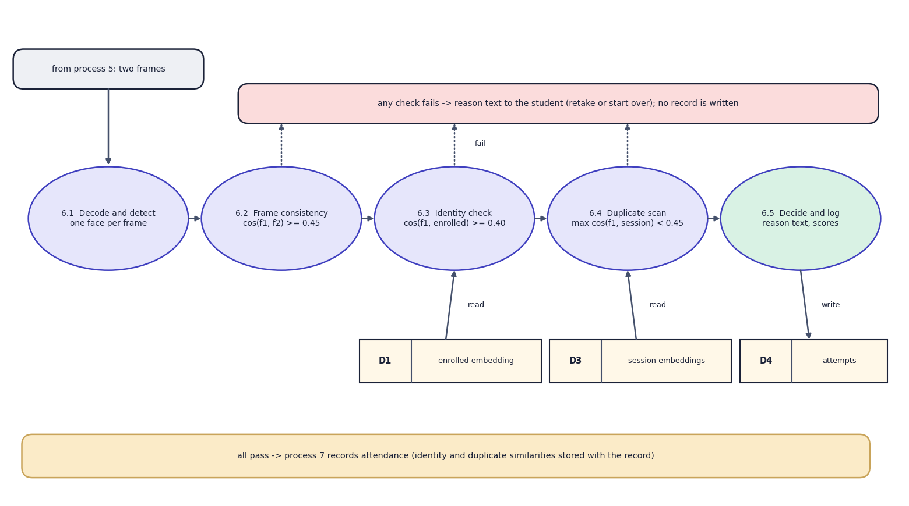

Verification components (pre-trained, not trained here)
Component | Detail
MediaPipe Face Mesh | 468 landmarks; yaw, pitch, roll, MAR, EAR
InsightFace buffalo_l | SCRFD detector + ArcFace R50, 512-d, CPU
Thresholds | consistency 0.45, identity 0.40, duplicate 0.45
Liveness | 8 random challenges, 3 tries
No network is trained: thresholds on landmarks and cosine similarity decide.
Notes:
The data-flow diagram of the face-verification process. The two AI components are used as published; the project contribution is the chain, the thresholds and their measurement.

Slide 9
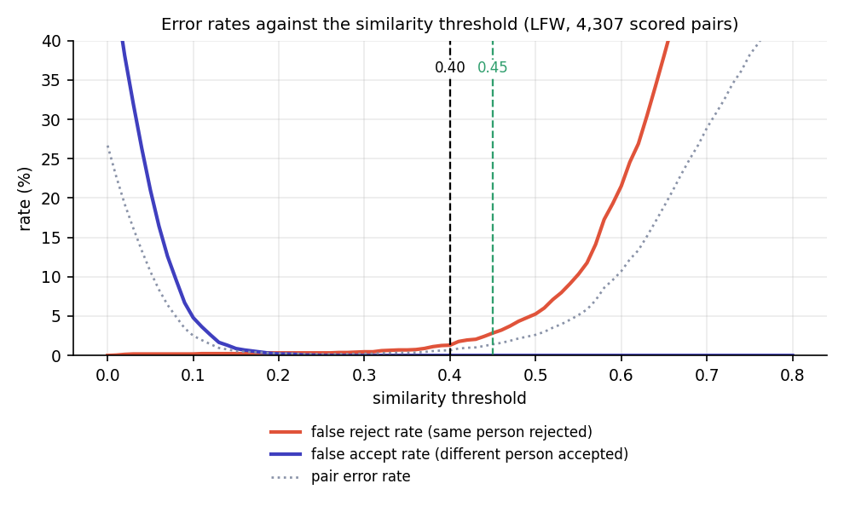

Configuration and threshold analysis (nothing is trained)
Setting | Value
Geo-fence | radius 60 m + 15 m tolerance; GPS accuracy <= 150 m
Challenges | yaw 0.12, pitch 0.08, roll 12 deg, MAR 0.35, EAR 0.18
Neutral frame | |yaw| <= 0.10, MAR <= 0.25, one face
Face thresholds | consistency 0.45, identity 0.40, duplicate 0.45
Session / token | JWT 120 min, device-bound; 1 device per student
Liveness tries | 3, then the wizard locks
Hardware | Intel i5-12500, 15.7 GB, CPU only
Error rates against threshold on LFW: 0.40 gives 1.3% false rejects and 0 false accepts
Notes:
The settings are defaults from config.py. The chart is our measurement on 4,307 LFW pairs: no different-person pair reached 0.40 (highest 0.246).

Slide 10
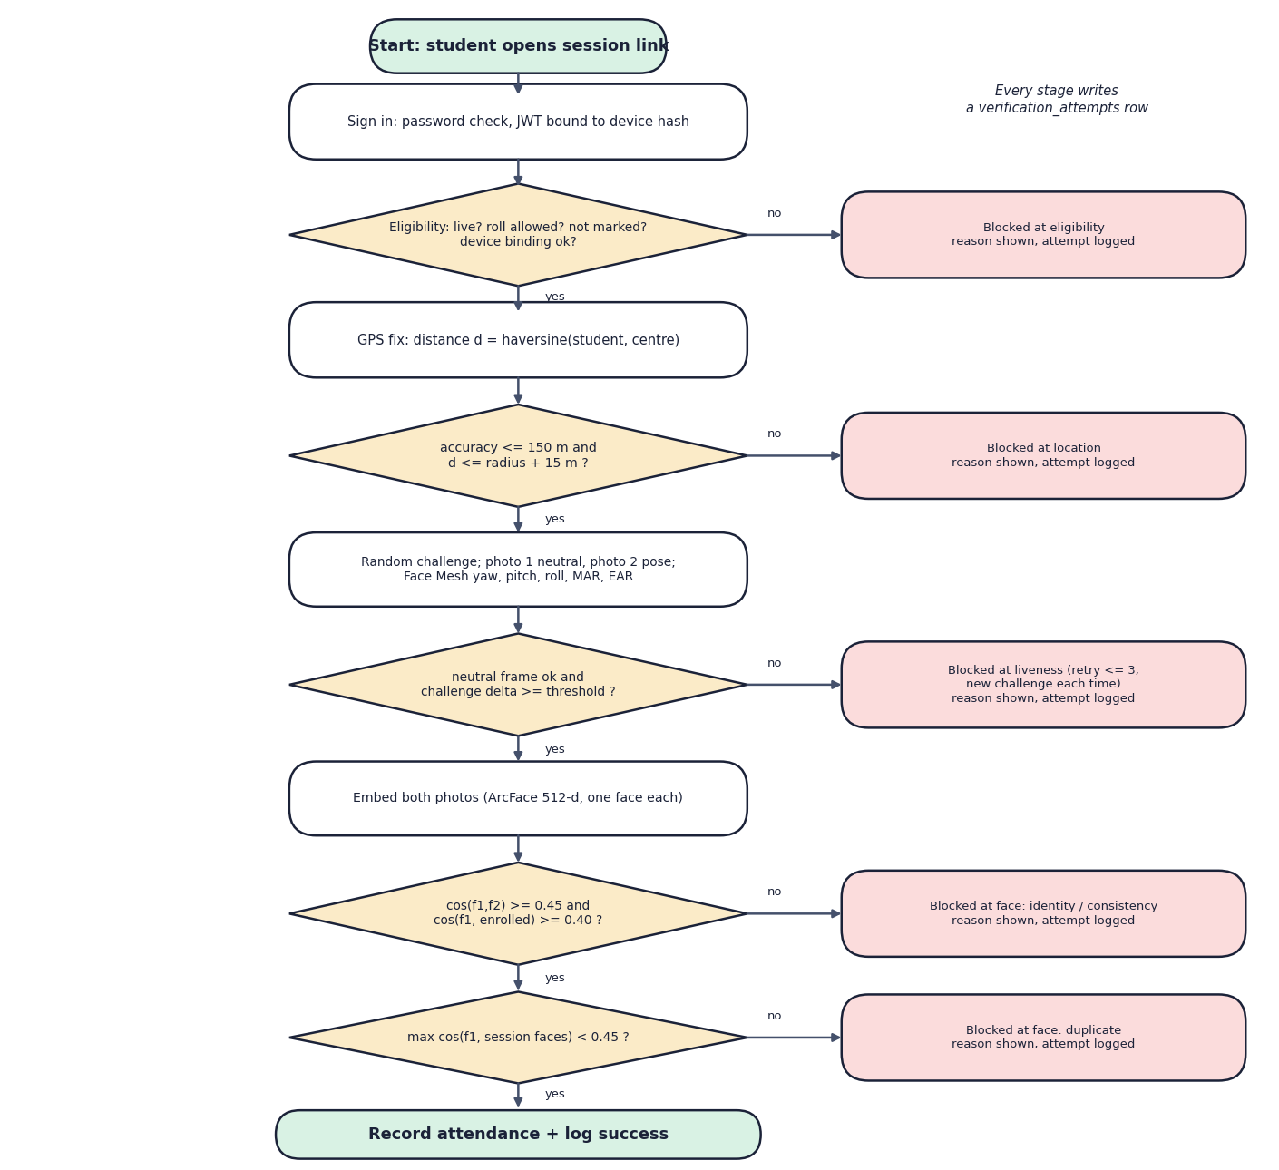

Decision logic
Marked present
Only when eligibility, geo-fence, challenge, frame consistency, identity and duplicate checks all pass is a record written (one per student per session).
Blocked
The first failing stage stops the check-in with a reason; three failed challenges lock the wizard until the student starts over.
Logged
Every attempt is stored with stage, result, reason and device, and shown in the faculty verification log.
Notes:
Decision logic: a strict sequence of checks; the order is the order of the wizard.

Slide 11
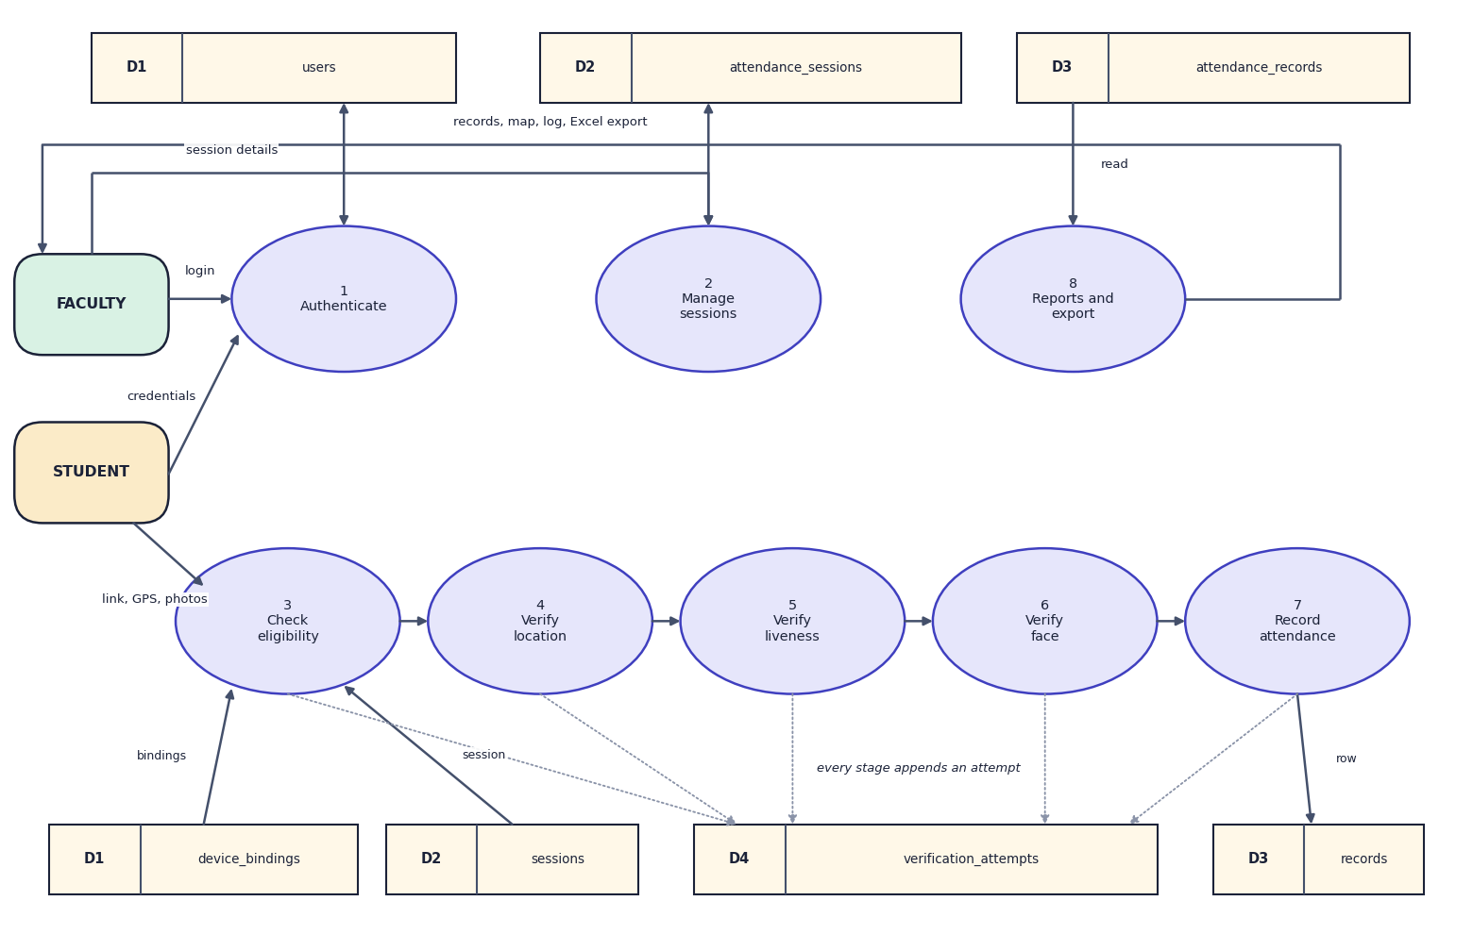
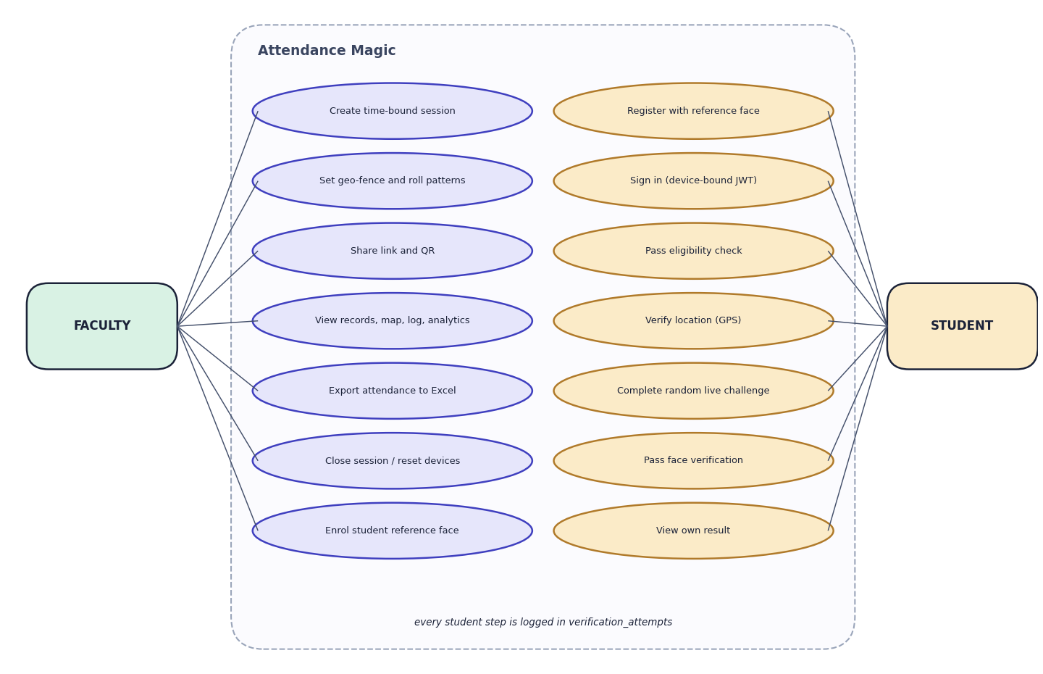

Data flow and modules
DFD level 1 (left) and use-case diagram (right)
Module | Responsibility
auth, device | PBKDF2 passwords, JWT bound to a SHA-256 device hash
geofence, liveness, face_match | haversine check, Face Mesh challenge metrics, ArcFace consistency / identity / duplicate
services, export, api | eligibility, pipeline and records; 3-sheet Excel; 27 REST endpoints
Notes:
Level 1 shows eight processes and four data stores; the use-case diagram shows what faculty and students can do.

Slide 12
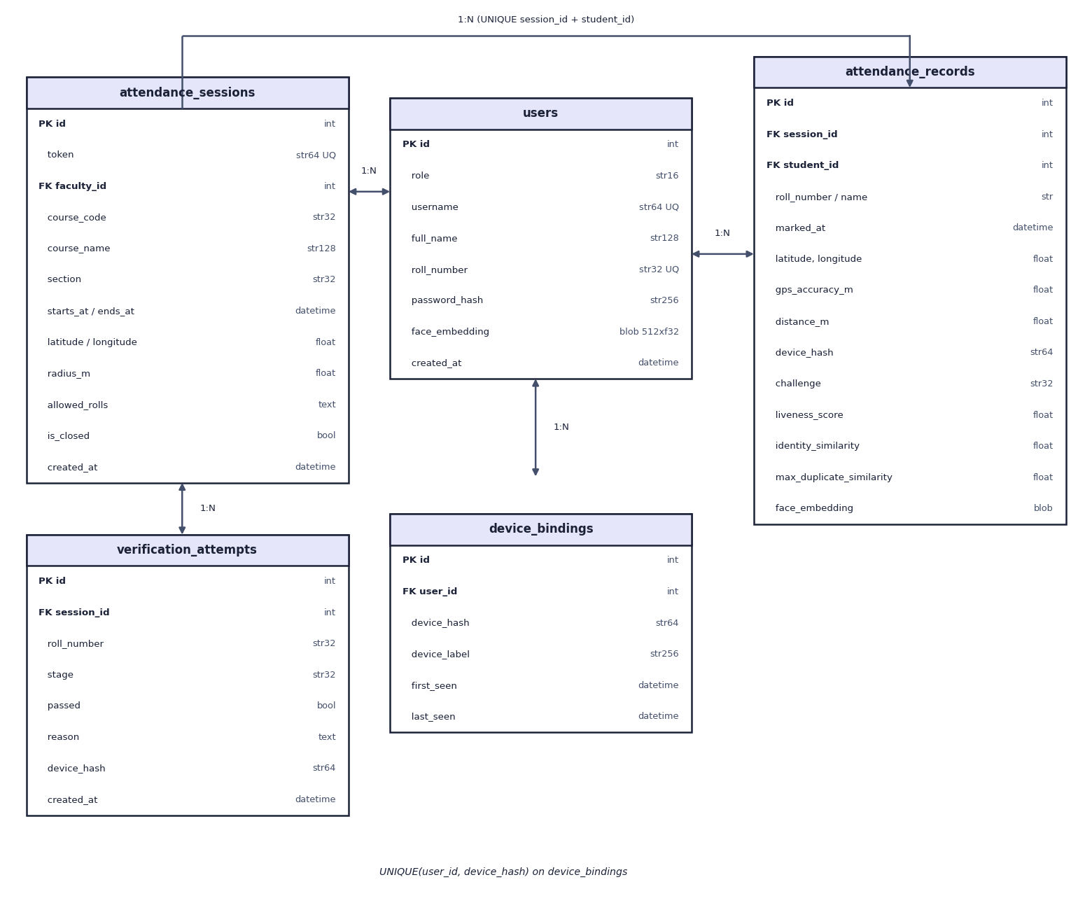
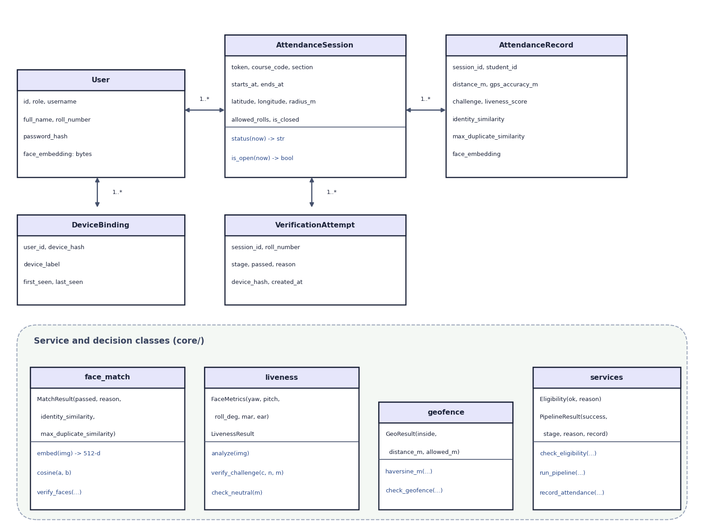

Database design and UML
ER diagram, 5 tables (left) and UML class diagram (right)
Table | Key fields | Constraints
attendance_records | session, student, distance_m, challenge, liveness_score, identity_similarity, max_duplicate_similarity, face_embedding | UNIQUE(session_id, student_id)
device_bindings | user_id, device_hash, label, first/last seen | UNIQUE(user_id, device_hash)
verification_attempts | session, roll, stage, passed, reason, device | one row per stage attempt
Notes:
Five tables created by SQLAlchemy. The UML diagram shows the entities and the decision classes of core/.

Slide 13






Technology stack
Language
Computer vision
Frontend
Python 3.11, JavaScript (ES modules, JSX)
MediaPipe 0.10.21, InsightFace 2.0 (ONNX Runtime), OpenCV 4.10, NumPy
React 19, Vite 8, React Router, Leaflet, Recharts, Framer Motion, GSAP
Backend
Storage and reports
Testing
FastAPI, Pydantic, SQLAlchemy 2, PyJWT, Streamlit (original UI)
SQLite, pandas + openpyxl (Excel), qrcode
pytest (23 tests), 41-check API smoke test, Playwright captures
Notes:
Everything runs offline on a laptop CPU; only the map tiles need the internet.

Slide 14
Implementation progress
Component | Status
Sessions with geo-fence, window, roll patterns, link and QR | Completed
JWT sign-in bound to device; device bindings | Completed
GPS geo-fence check | Completed
Random live challenge (8 actions) | Completed
Face consistency, identity and duplicate checks | Completed
Faculty records, map, log, analytics, Excel export | Completed
Automated tests (23 + 41 checks) and LFW evaluation | Completed
Camera trials with volunteers, HTTPS phone test | Not done
27
REST endpoints
5
database tables
23 + 41
pytest tests + smoke checks, all passing
Notes:
Every planned feature is implemented. Open items are volunteer camera trials and a phone test over HTTPS.

Slide 15
Preliminary results: threshold behaviour on LFW pairs
98.7%
same-person pairs accepted at 0.40
0 of 2,166
different-person pairs accepted (max 0.246)
0.999
ROC AUC; equal error rate 0.30%
Notes:
Measured on the standard LFW verification protocol with our own pipeline: 4,307 scored pairs; 1,693 pairs were dropped because a photo failed the single-face rule.

Slide 16
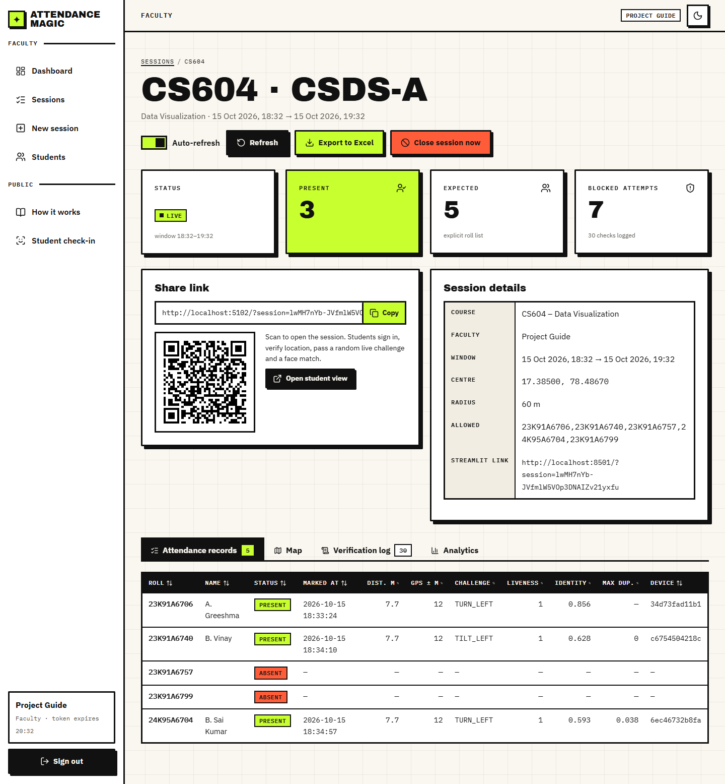
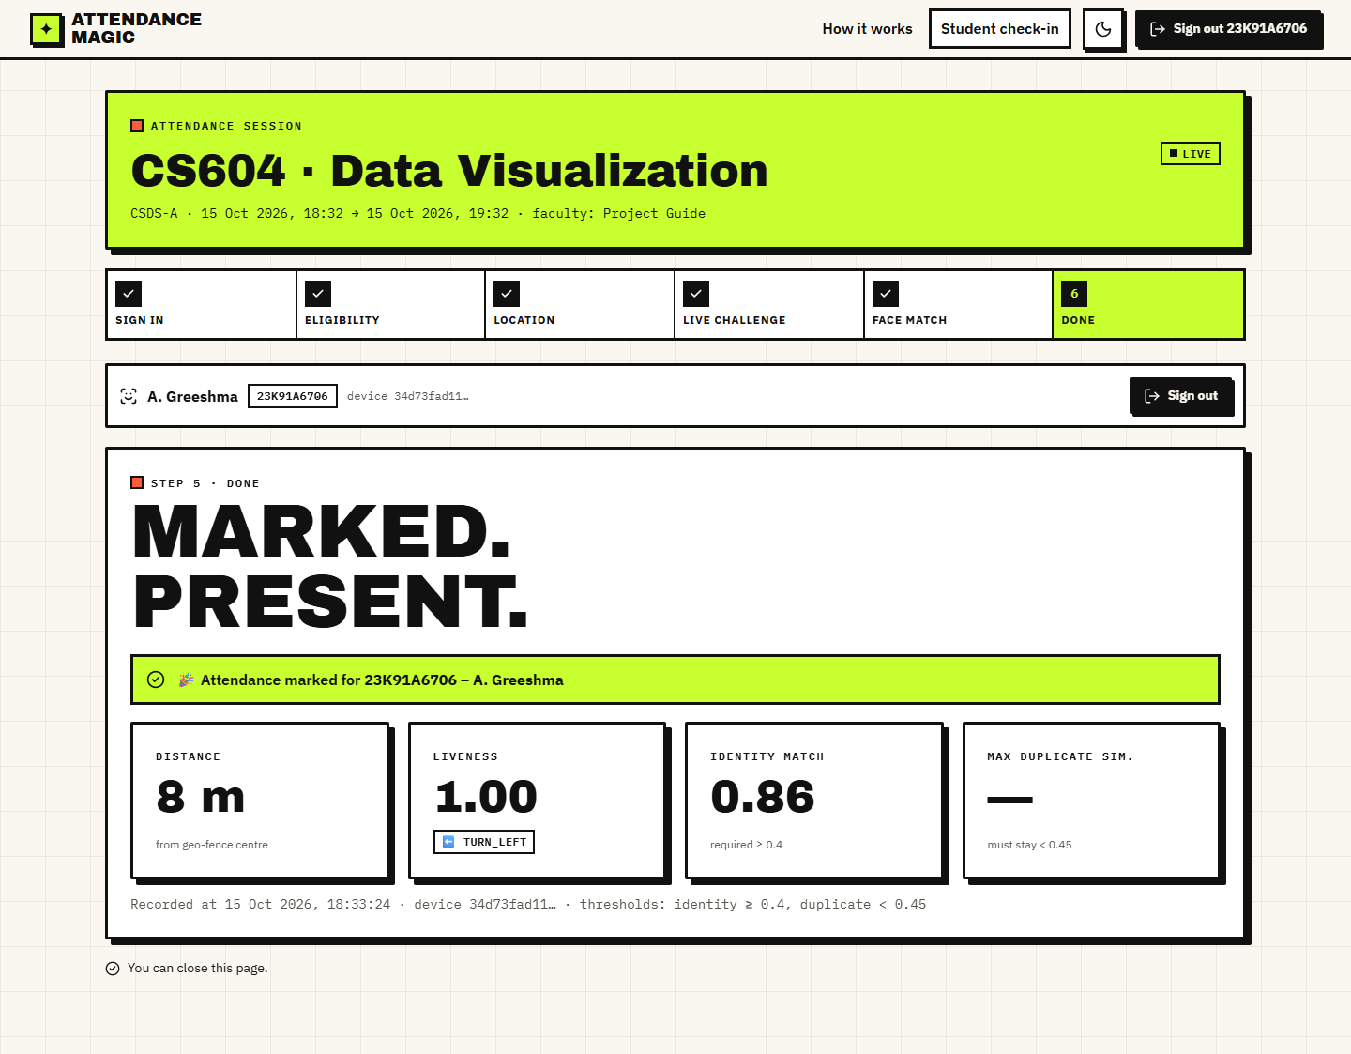


Output screens
Student result: marked present, 7.7 m, liveness 1.00, identity 0.86
Faculty view: live session, 3 present, 7 blocked attempts
Notes:
Real captures of the running application with demo data (LFW photos as stand-ins for student photographs).

Slide 17
Testing and observations
Test group | Tests | Result
Passwords, JWT bound to device | 2 | Passed
Haversine and geo-fence | 2 | Passed
Liveness maths, 11 challenge cases, neutral frame | 13 | Passed
Face logic, roll patterns, services, model test | 4 | Passed
Streamlit end-to-end flows | 2 | Passed
API smoke test (real models) | 41 | 41 / 41 pass
A forwarded link, an outside position, a static photo, another person's face and a duplicate face were each blocked at their stage.
A rotated still photo passes the tilt challenges and several photos of the victim can pass all challenges: a limitation to address.
One check-in takes about 0.56 s of server time on a CPU (median).
15.7% of LFW photos fail the single-face rule, so retakes are expected.
Notes:
Testing so far: automated tests and scripted attacks. The weaknesses found by our own attack experiments are reported openly.

Slide 18



Challenges and corrective actions
No trained model
Photo spoofing
Two-photo capture
Both AI models are pre-trained; evaluation uses a public benchmark and attack experiments.
A random challenge defeats a single photo (0% pass for 7 of 8 actions) but not rotated or multiple photos.
Two still photos replace a video stream; simple, but weaker than continuous liveness.
Camera and GPS need HTTPS
Single-face rule
Duplicate enrolment
On phones they work only over HTTPS; localhost is fine on a laptop.
A second face above 50% of the main face width rejects the photo; 15.7% of LFW photos failed.
A proxy enrolled with the same face passes identity, and is caught by the duplicate check.
Notes:
Six challenges and how each was handled or recorded.

Slide 19
Next steps
Camera trials with volunteers
Phone test over HTTPS
Final report
Final presentation and demo
Collect real selfie captures to measure the genuine pass rate of each challenge and the retake rate.
Test on phones over HTTPS with real GPS and measure drift indoors.
Strengthen liveness: reject rotated photos, add texture or depth cues, time-limit the two photos.
Document every diagram, test and result in the report.
Notes:
What remains: real-user trials and a stronger liveness check, then the report and the final demo.

Slide 20
Thank you
Questions and suggestions are welcome.
Notes:
Thank you. Questions are welcome.

