Slide 1

Attendance Magic: A Smart Geo-Fenced Attendance System with Live Challenge Verification
Final Review
Team Details : Batch A2
Under the Esteemed Guidance of
[GUIDE NAME]
[DESIGNATION], Department of CSE (Data Science)
23K91A6706 A.GREESHMA
23K91A6740 B.VINAY
23K91A6757 G.SRIRAM
24K95A6704 B.SAI KUMAR
DEPARTMENT OF COMPUTER SCIENCE AND ENGINEERING (DATA SCIENCE) · Academic Year [ACADEMIC YEAR]
Notes:
Final review of Attendance Magic: geo-fenced attendance with live challenge verification.

Slide 2
Table of Contents
Abstract
Base Paper & Literature Survey
Research Gap & Problem Statement
Objectives
Proposed System & Architecture
Methodology & Verification Chain
Design & Implementation
Results, Testing & Comparison
Output Screens
Conclusion & Future Scope
References
Dept. of CSE (Data Science) | Batch A2 | Final Review
2

Slide 3
Abstract
Attendance by roll call or shared link is slow and easy to fake; face recognition confirms identity but a photo can still be shown.
Attendance Magic combines, in one time-bound session: JWT and device-bound sign-in, roll restrictions, a GPS geo-fence, a random live facial challenge (MediaPipe Face Mesh) and ArcFace face matching (InsightFace) with a duplicate-face check.
Faculty create sessions and share a link or QR code; students check in from a phone; records, a map, a verification log and an Excel export follow.
No model is trained. Measured on public LFW pairs: AUC 0.999; at the deployed threshold 98.7% of same-person pairs pass and 0 of 2,166 different-person pairs do.
A single stolen photo fails 7 of 8 challenges; a rotated photo or several photos of the victim can still pass, and this is reported as a limitation.
Keywords: attendance, geo-fencing, liveness, face verification, ArcFace, MediaPipe.
Dept. of CSE (Data Science) | Batch A2 | Final Review
3
Notes:
Abstract: problem, combined checks, application, and the measured headline with its limits.

Slide 4
Base Paper
K. B. Dharmaraj, C. N. Dhanushree, H. V. Revanth, N. Shashank and P. M. Tejaswini, "Real-Time Student Face Recognition Attendance System Using AI," International Advanced Research Journal in Science, Engineering and Technology (IARJSET), vol. 12, no. 5, pp. 1067-1072, May 2025, doi: 10.17148/IARJSET.2025.125183.
Method: Python desktop application with a Tkinter GUI; webcam captures 25-30 images per student; Haar cascade face detection and LBPH recognition; subject-wise CSV logs; manual entry and text-to-speech feedback.
Reported results: about 92-95% recognition under good frontal light, 5-8% false negatives, 0% false positives, under 2 s per face; basic hardware, no GPU.
Limitations (our reading): identity only; no liveness, location, session window or duplicate-identity check; accuracy depends on light and pose; no dataset size or protocol reported.
Surveyed in the paper: Haar+LBPH, CNN+SVM/KNN, VGG16/ResNet transfer learning, FaceNet+MTCNN.
Dept. of CSE (Data Science) | Batch A2 | Final Review
4
Notes:
The base paper is a classroom face-recognition attendance system with LBPH. It is silent about spoofing and location.

Slide 5
Literature Survey
Author / Year | Methodology | Dataset | Key Results | Limitations
Dharmaraj et al., 2025 (base) [1] | Haar cascade + LBPH; Tkinter; CSV logs | Classroom simulations | ~92-95% recognition; 0% false positives | No liveness, location or duplicate check
Shandilya and Shah, 2026 [3] | ArcFace (DeepFace), LBP, EAR blink, HSV dress code; FastAPI + Streamlit | Not read beyond abstract | 96.2% recognition; 97.1% liveness; 92.4% dress code | No geo-fence reported (abstract)
Salam et al., 2025 [5] | Silent-face anti-spoofing: CNN + Fourier transform; Raspberry Pi 4 | Varied light and distance | Figures not read | Spoof detection only (abstract)
Classroom system, 2026 [4] | ResNet101 anti-spoofing + ArcFace (title) | Not retrieved | Not retrieved | Not reviewed
Review, 2026 [2] | Review: recognition, liveness, dress code (title) | Not retrieved | Not retrieved | Not reviewed
Face-recognition works in [1] | LBPH; CNN+SVM/KNN; VGG16/ResNet; FaceNet+MTCNN | Various | >99% in controlled light | Poor light, occlusion, look-alikes
Dept. of CSE (Data Science) | Batch A2 | Final Review
5
Notes:
Only the abstracts of [3] and [5] were read; [2] and [4] could not be retrieved, so we do not claim more.

Slide 6
Research Gap
Author / Paper | Research Gap
Base paper [1] | Identity only: no liveness, no location proof, no session window, no duplicate-identity check; small informal tests
Shandilya and Shah [3] | Liveness by LBP and blink; no location or per-session duplicate check reported in the abstract
Salam et al. [5] | Anti-spoofing module for a low-cost device; no attendance-session, location or roll-restriction logic reported
Link / QR systems | Easy to forward to absent students; no identity or presence check
All reviewed work | No single tool joins time-bound sessions, geo-fence, device binding, random challenge, duplicate check and Excel reports, with measured thresholds
Dept. of CSE (Data Science) | Batch A2 | Final Review
6
Notes:
The gap is the combination of checks in one time-bound session, with evidence.

Slide 7
Problem Statement
Manual and link-based attendance is slow, error-prone and shareable with absent students.
Face recognition without liveness can be fooled by a photo, and does not prove the student is in the classroom.
One person can mark several identities if faces in a session are not compared.
Problem: given a faculty-defined session, accept a student's attendance only when the session is live, the student and device are eligible, the position is inside the geo-fence, a random live challenge is performed, and the face matches the enrolled face and no other face already recorded in the session.
Dept. of CSE (Data Science) | Batch A2 | Final Review
7

Slide 8
Objectives
Enable faculty to create time-bound attendance sessions with configurable geo-fences.
Authenticate students with JWT, device identification and roll-number restrictions.
Verify physical presence by comparing GPS location with the session boundary.
Detect liveness through a random live facial challenge using MediaPipe.
Prevent duplicate identities by matching InsightFace embeddings within each session.
Provide attendance summaries and Excel export for faculty.
Verify with automated tests and measure the checks on a public benchmark.
Dept. of CSE (Data Science) | Batch A2 | Final Review
8

Slide 9
Proposed System
1. Session - faculty set course, window, centre, radius (60 m default) and allowed roll patterns; a unique link and QR code are shared.
2. Sign-in - PBKDF2 password check; JWT valid 120 minutes and bound to a device hash.
3. Eligibility - session live, roll allowed, not already marked, one device per student.
4. Geo-fence - GPS inside radius + 15 m tolerance; accuracy worse than 150 m rejected.
5. Live challenge - random head, mouth or eye action on two photos; three tries.
6. Face match - same person in both photos, matches enrolment, not a duplicate in the session.
7. Record and report - verification log, map, analytics, Excel export.
Dept. of CSE (Data Science) | Batch A2 | Final Review
9

Slide 10
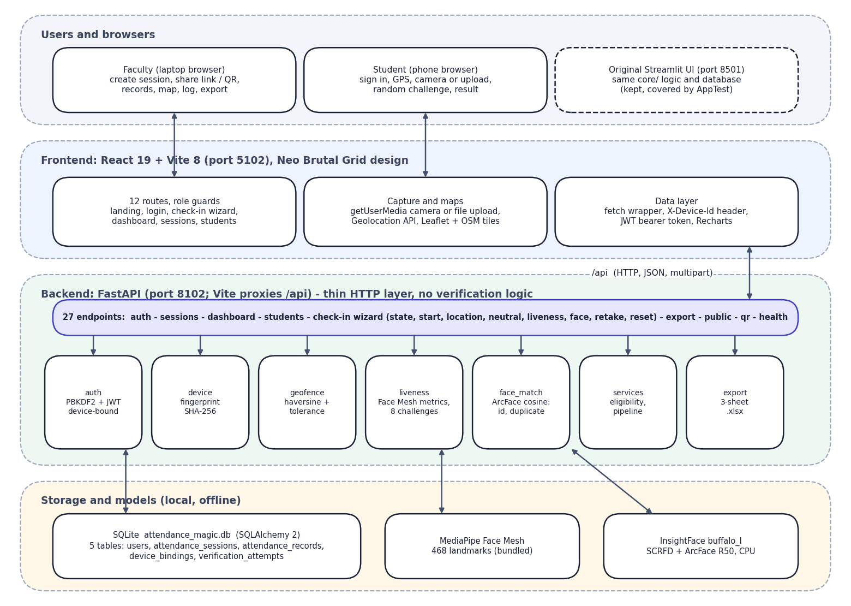

System Architecture
Layered architecture: browsers, React frontend, FastAPI backend with verification services, SQLite and local AI models
Dept. of CSE (Data Science) | Batch A2 | Final Review
10

Slide 11
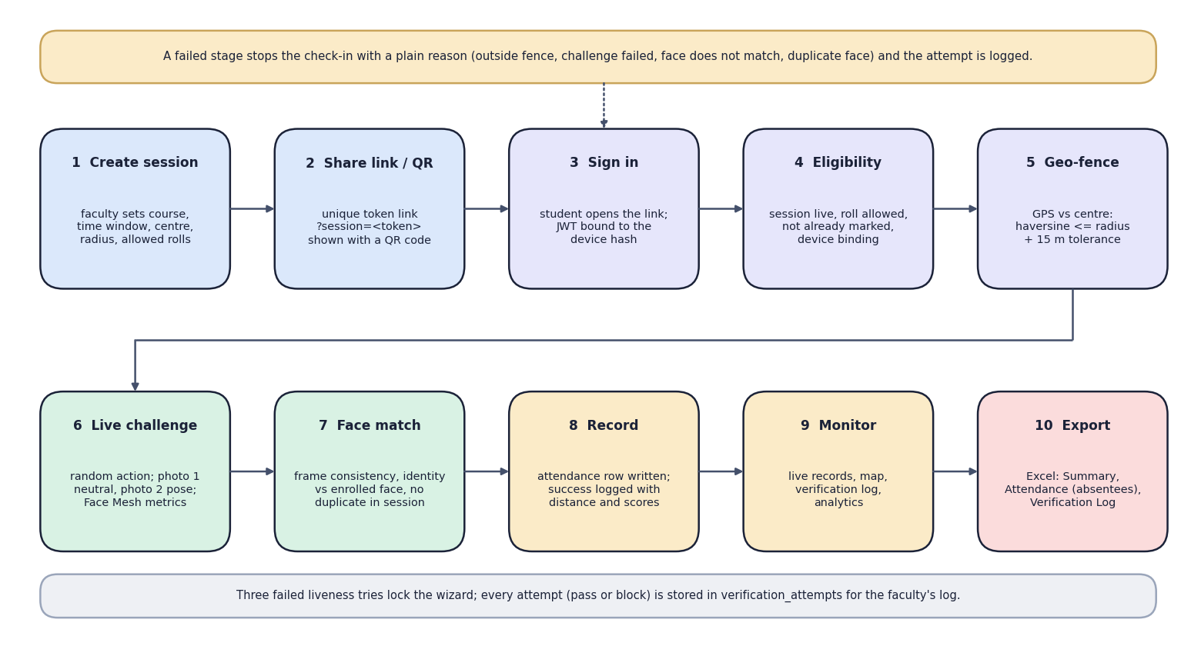

Methodology
End-to-end workflow: create session, share, sign in, eligibility, geo-fence, challenge, face match, record, monitor, export
Dept. of CSE (Data Science) | Batch A2 | Final Review
11

Slide 12
Data, Features & Model
No model is trained: MediaPipe Face Mesh (468 landmarks) and InsightFace buffalo_l (SCRFD + ArcFace R50, 512-d) are used as published, on CPU.
Features: yaw, pitch, roll, mouth aspect ratio and eye aspect ratio from landmarks; 512-d face embeddings; haversine distance.
Challenge thresholds: yaw 0.12, pitch 0.08, roll 12 deg, MAR 0.35, EAR 0.18; neutral frame |yaw| <= 0.10, MAR <= 0.25.
Face thresholds: frame consistency 0.45, identity 0.40, duplicate 0.45 (cosine similarity).
Evaluation data: LFW protocol (6,000 pairs; 4,307 scored), 1,000 LFW photos for liveness, 157 identities with 10+ photos for attack tests. No train/test split of our own.
Demo data: 5 accounts and 2 sessions; LFW photos stand in for student photographs.
Dept. of CSE (Data Science) | Batch A2 | Final Review
12
Notes:
Nothing is trained, so the evaluation is of thresholds and attacks, not of accuracy curves.

Slide 13
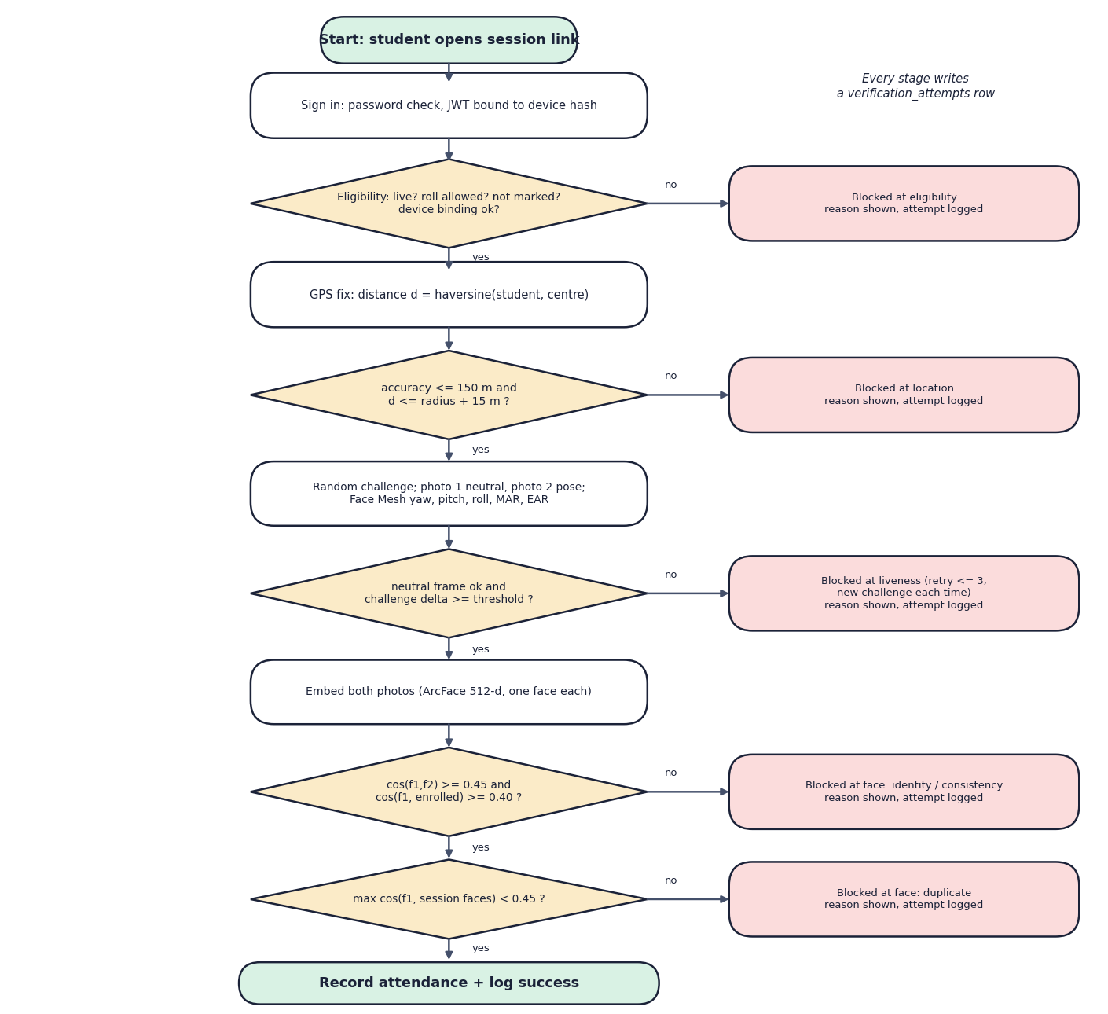

Decision Workflow
Decision flow of one check-in: eligibility, location, liveness, consistency and identity, duplicate scan, record
Dept. of CSE (Data Science) | Batch A2 | Final Review
13

Slide 14
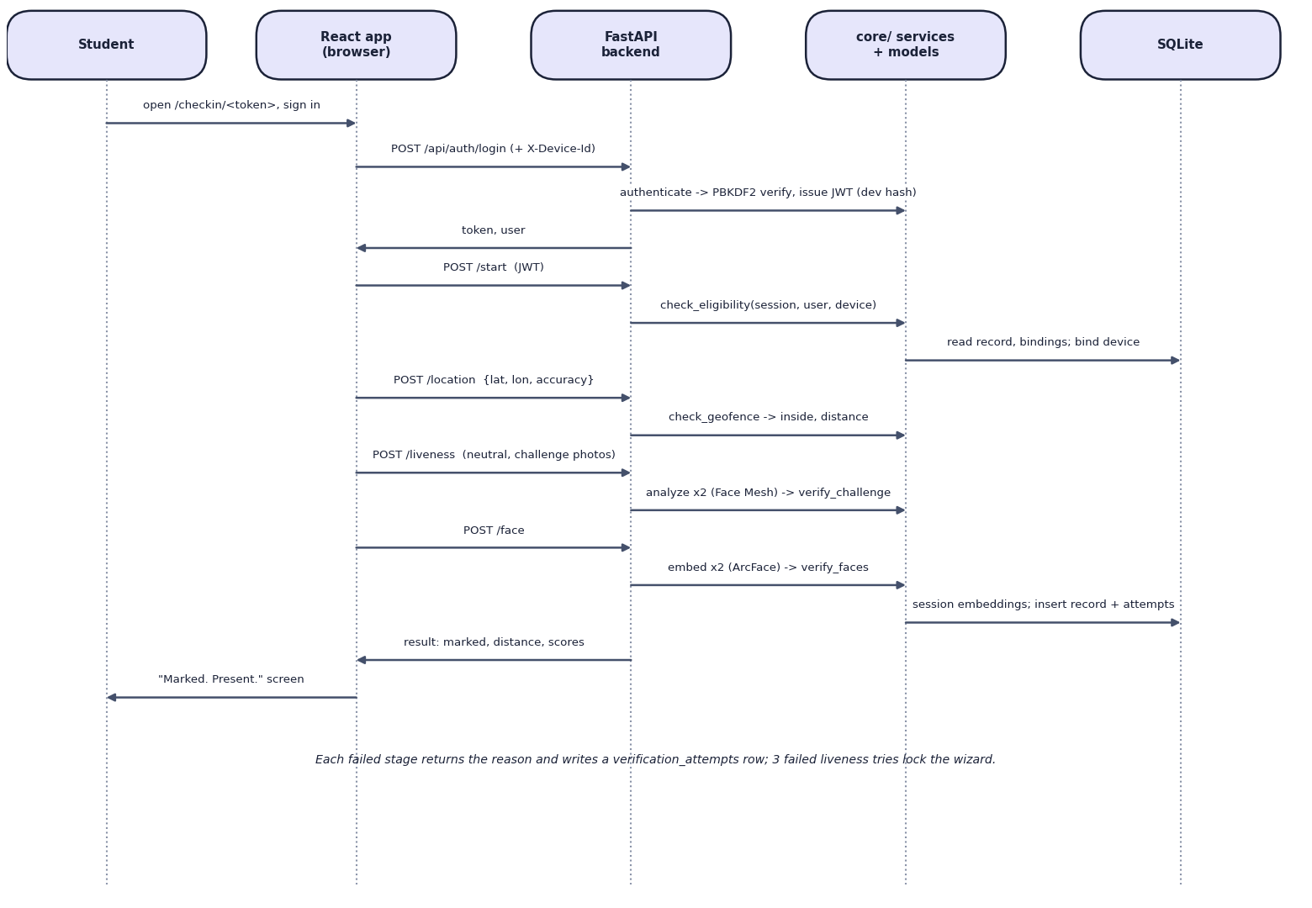

User–System Interaction
Sequence of a student check-in through the React app, FastAPI, core services and SQLite
Dept. of CSE (Data Science) | Batch A2 | Final Review
14

Slide 15
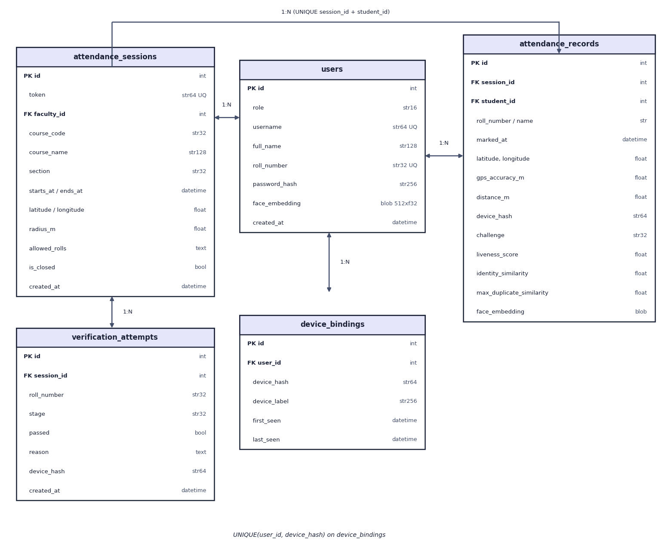

Database Design
Entity–relationship diagram (5 SQLite tables)
Dept. of CSE (Data Science) | Batch A2 | Final Review
15

Slide 16
Implementation Highlights
Module | Implementation
Sessions and roll patterns | secrets.token_urlsafe(24) link tokens; fnmatch roll patterns; explicit lists give absentees
Authentication | PBKDF2-HMAC-SHA256 (200,000 iterations); JWT HS256 bound to a SHA-256 device hash; role guards
Geo-fence | haversine on a 6,371 km sphere (0.47% from WGS-84); radius + 15 m; accuracy gate 150 m
Liveness | Face Mesh landmarks to yaw, pitch, roll, MAR, EAR; 8 random challenges; 3 tries then lock
Face match | ArcFace embeddings, cosine similarity; one face per frame; duplicate scan against session records
API and UI | 27 FastAPI endpoints; React 19 wizard; Excel export (Summary, Attendance, Verification Log)
Dept. of CSE (Data Science) | Batch A2 | Final Review
16

Slide 17
Results – Verification Chain on Public Pairs
Measure | Attendance Magic | Base paper [1]
Same person accepted (identity 0.40) | 98.7% (LFW, 2,141 pairs) | ~92-95% (own classroom data)
Different person accepted | 0 of 2,166 pairs (max 0.246) | 0% false positives (reported)
Duplicate face caught (0.45) | 97.2% of same-person pairs | not provided
Single stolen photo vs live challenge | 0% pass for 7 of 8 actions | no liveness check
Check-in server time (median) | 0.56 s on a CPU | < 2 s per face (reported)
Location proof | geo-fence 75 m limit | none
Different data: LFW press photos (ours) vs the base paper's own classroom data; not a head-to-head comparison.
Dept. of CSE (Data Science) | Batch A2 | Final Review
17
Notes:
There is no accuracy curve because nothing is trained. These are threshold measurements on 4,307 LFW pairs plus attack and timing experiments.

Slide 18
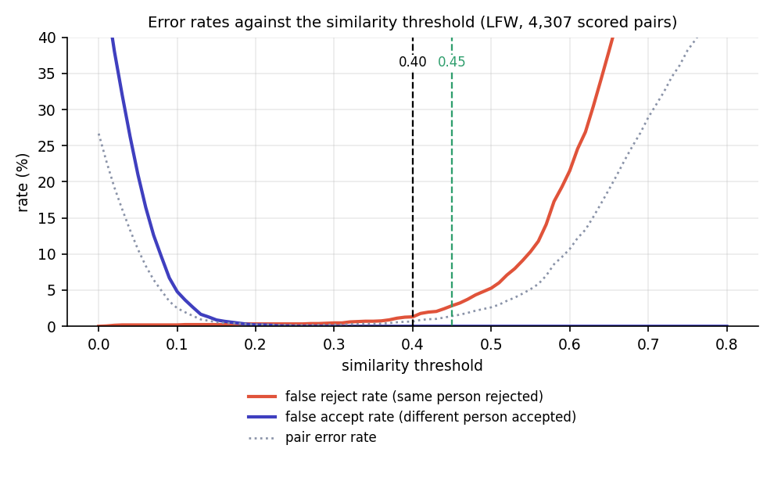
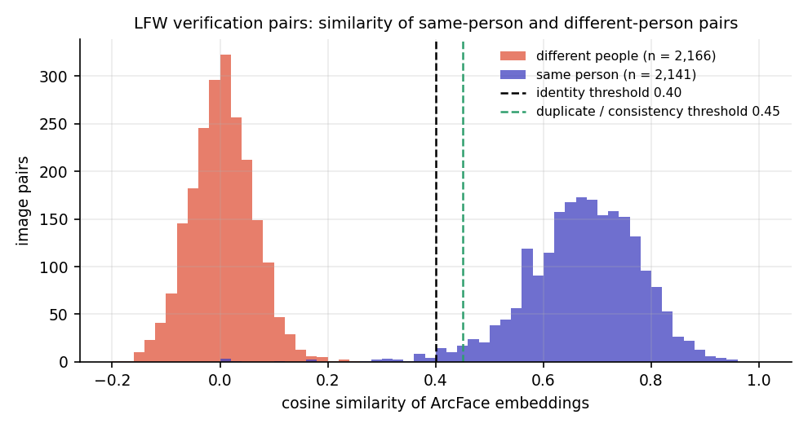


Similarity Distributions & Threshold Behaviour
Same-person and different-person similarity (LFW)
Error rates by threshold: 0.40 gives 1.3% false rejects, 0 false accepts
Dept. of CSE (Data Science) | Batch A2 | Final Review
18
Notes:
This is the equivalent of a confusion matrix for a threshold decision: the two distributions barely overlap.

Slide 19
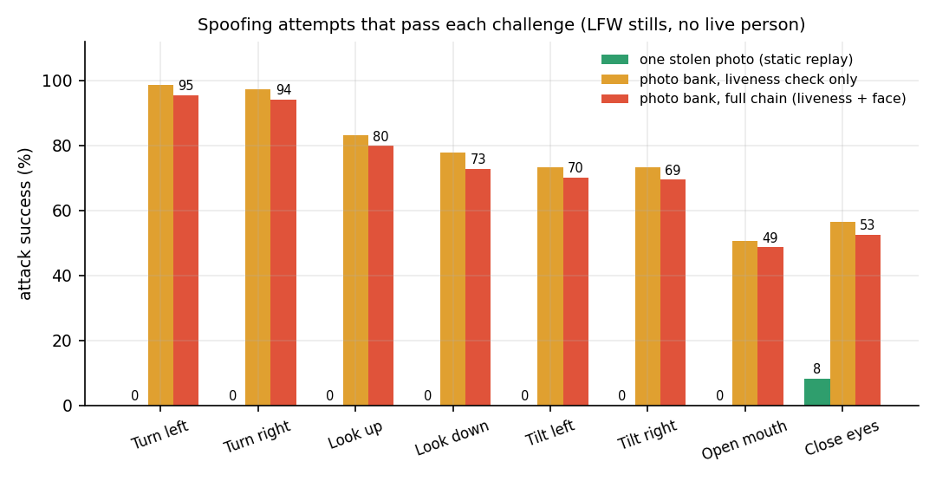
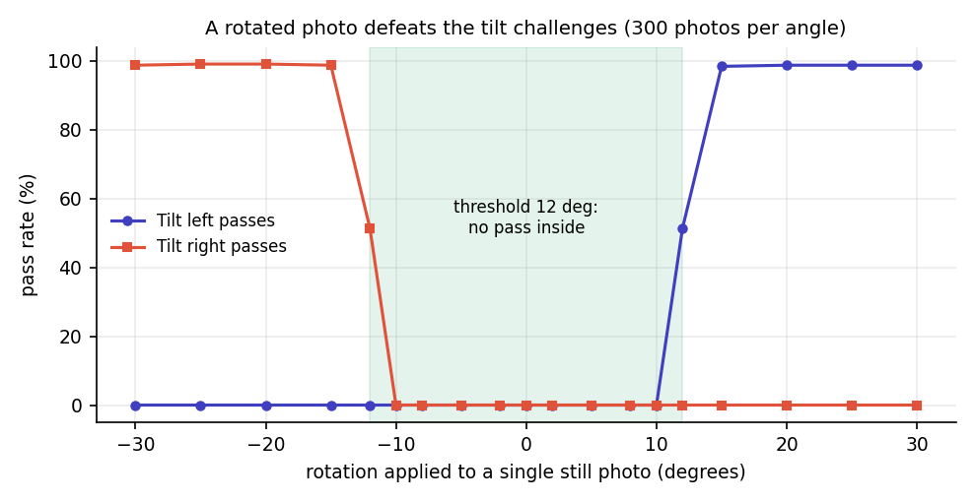


Liveness Attacks & Parameter Analysis
Attack success by challenge (stills; no live person)
Rotating one photo by 15 deg or more passes both tilt challenges
Dept. of CSE (Data Science) | Batch A2 | Final Review
19
Notes:
Our own attack experiments show where liveness is weak: rotated photos and photo banks.

Slide 20
Performance & Testing
Measurement | Result
Model load (cold start) | MediaPipe 0.8 s; InsightFace 1.5 s
Per image (CPU) | landmarks 6.8 ms; ArcFace embedding 176 ms (median)
Whole check-in (HTTP, in-process) | median 564 ms; 95th percentile 806 ms (40 runs)
Duplicate scan | 12 ms for 1,000 faces; 41 ms for 5,000
Automated tests | 23 pytest tests and 41 API smoke checks pass; 8 attack scenarios blocked at the right stage
Not measured | concurrent load, phone GPS error, camera trials with volunteers
Dept. of CSE (Data Science) | Batch A2 | Final Review
20
Notes:
Measured on an i5-12500 laptop-class desktop with other applications running; network time excluded.

Slide 21
Comparison with Base Paper (context only – different datasets)
System | Data | Method | Checks enforced | Reported / measured | Extras
Base paper [1] | Own classroom data; size not reported | Haar + LBPH | Identity only | ~92-95% recognition; 0% false positives | Tkinter GUI, CSV, speech
Shandilya and Shah [3] | Not read | ArcFace + LBP + blink + HSV | Identity, liveness, dress code (abstract) | 96.2% / 97.1% / 92.4% (abstract) | FastAPI, Streamlit, parent alerts
Attendance Magic | LFW pairs and stills (public) | ArcFace + Face Mesh challenge + haversine | Session, device, GPS, challenge, identity, duplicate | 98.7% same-person pass at 0.40; 0 of 2,166 impostors | Web app, map, log, Excel
Different data and protocols: no numeric head-to-head is claimed. Reported figures for [1] and [3] are from their own papers (abstract only for [3]).
Dept. of CSE (Data Science) | Batch A2 | Final Review
21

Slide 22
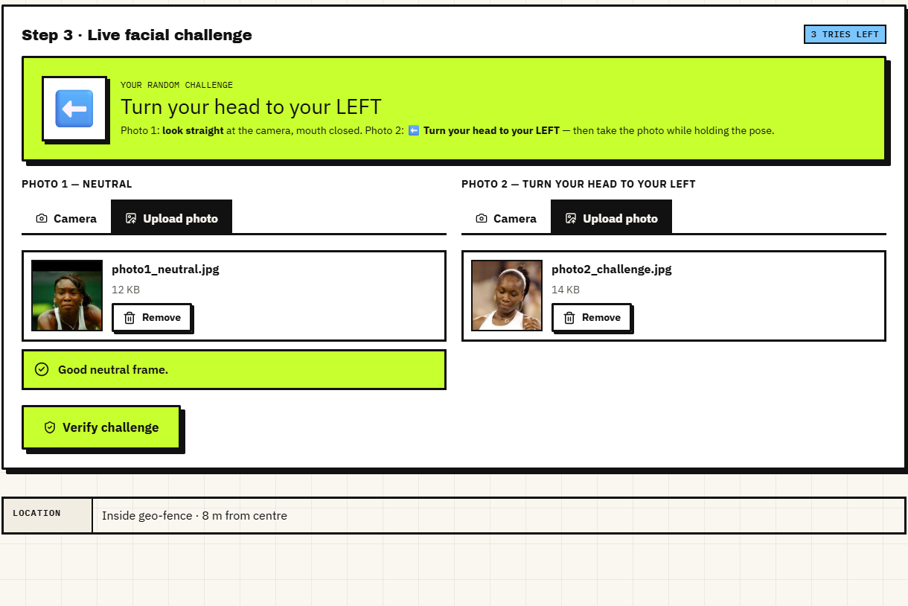
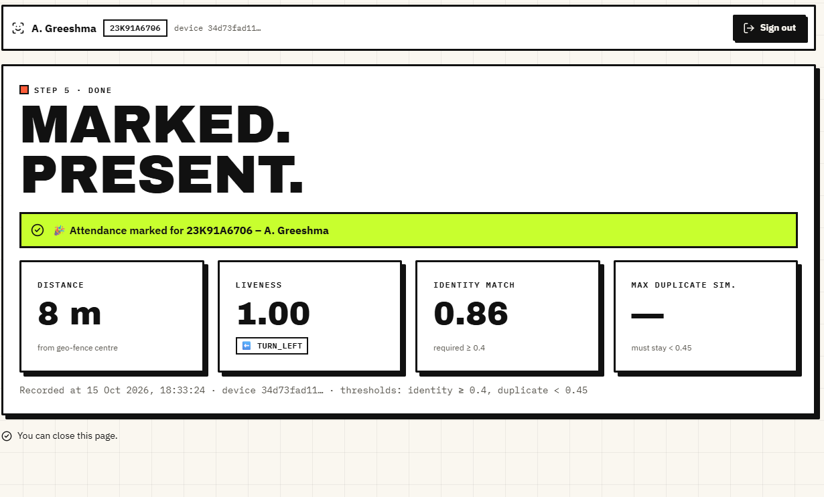


Output – Check-in Challenge and Result
Random challenge with two photos loaded
Marked present: 7.7 m, liveness 1.00, identity 0.86
Dept. of CSE (Data Science) | Batch A2 | Final Review
22

Slide 23
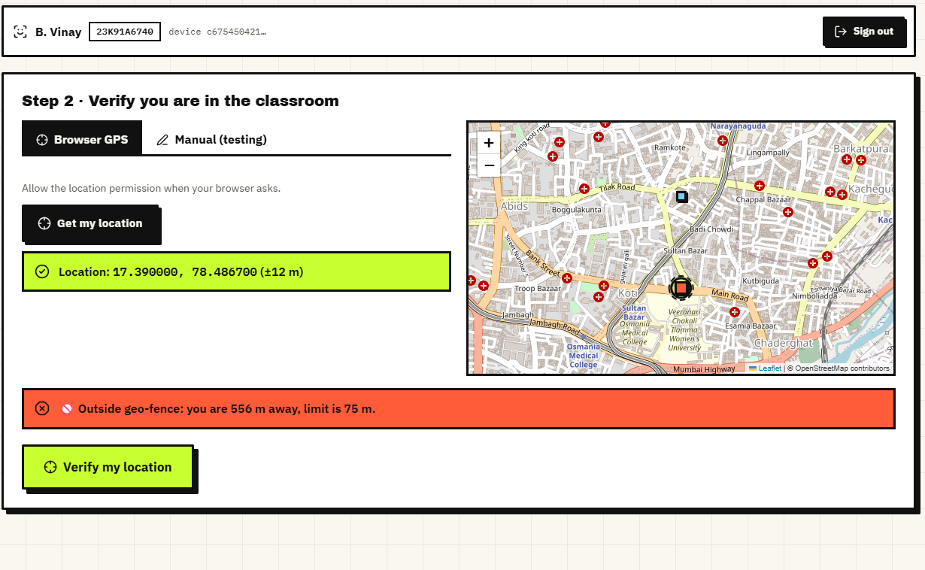
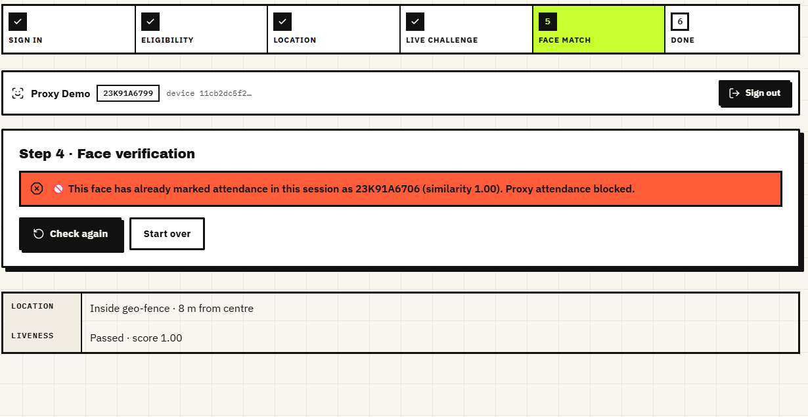


Output – Blocked Attempts
Blocked at location: outside the geo-fence
Blocked at face check: duplicate face in the session
Dept. of CSE (Data Science) | Batch A2 | Final Review
23

Slide 24
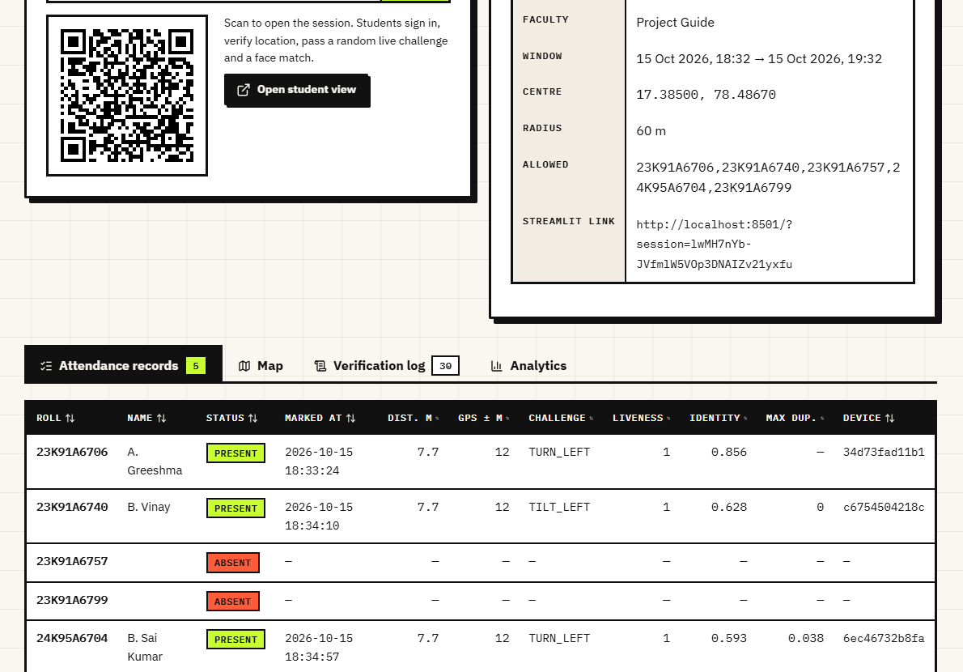
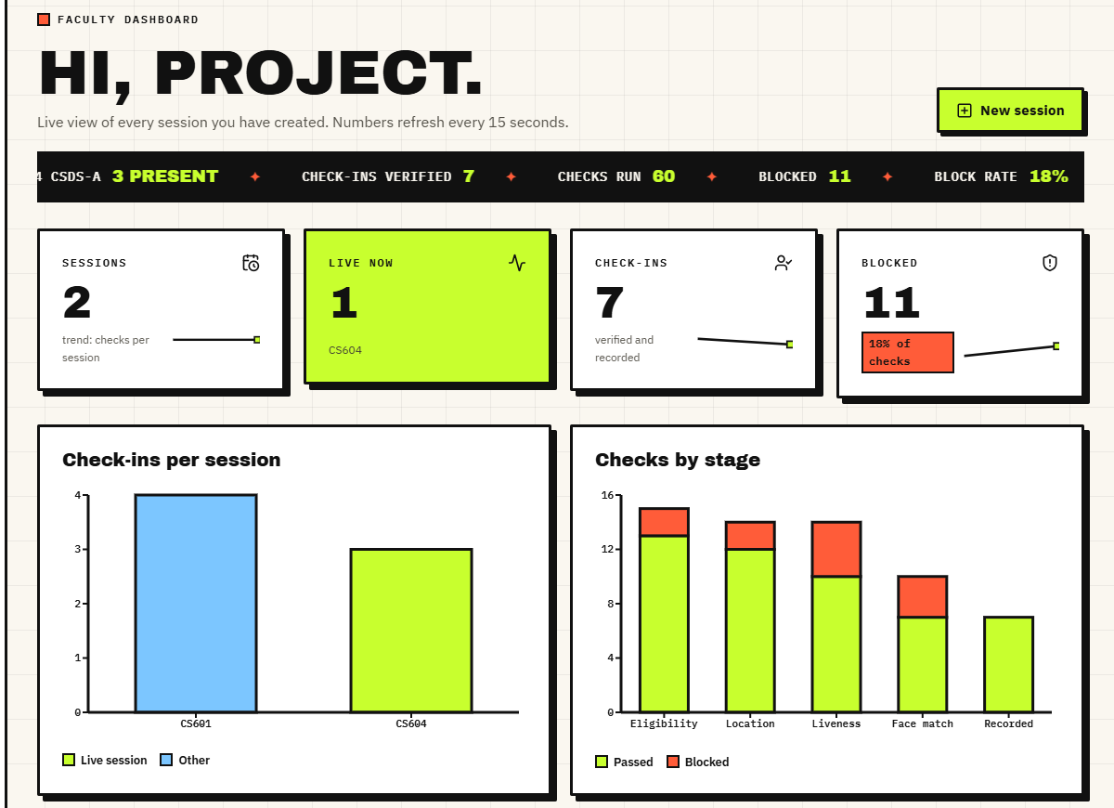


Output – Faculty Records and Dashboard
Live session: share link, QR and records (present, absent)
Dashboard: check-ins per session, checks by stage, latest attempts
Dept. of CSE (Data Science) | Batch A2 | Final Review
24

Slide 25
Conclusion
Built Attendance Magic: a time-bound, geo-fenced attendance system with a random live challenge and duplicate-face check, with a React and FastAPI application.
On 4,307 LFW pairs the deployed thresholds accept 98.7% of same-person pairs and none of 2,166 different-person pairs (AUC 0.999).
A single photo is rejected by 7 of 8 challenges; rotated photos and photo banks still pass, so liveness is the weakest link.
23 pytest tests and 41 API checks pass; a check-in takes about 0.56 s of server time on a CPU.
Limits: no live-camera or phone trials, public-benchmark photos, GPS drift not measured, 15.7% of LFW photos rejected by the single-face rule.
Dept. of CSE (Data Science) | Batch A2 | Final Review
25

Slide 26
Future Scope
Trial with volunteers: genuine pass rate of each challenge, retake rate, usability.
Stronger liveness: reject rotated photos, passive texture or depth cues (for example silent-face anti-spoofing [5]), time-limited capture.
Phone deployment over HTTPS with measured GPS error and indoor drift; optional mock-location detection.
Server database (PostgreSQL) and multi-faculty roles for institution-wide use.
Notifications and LMS integration; privacy review for storing face embeddings.
Dept. of CSE (Data Science) | Batch A2 | Final Review
26

Slide 27
References
[1] K. B. Dharmaraj, C. N. Dhanushree, H. V. Revanth, N. Shashank and P. M. Tejaswini, "Real-Time Student Face Recognition Attendance System Using AI," International Advanced Research Journal in Science, Engineering and Technology (IARJSET), vol. 12, no. 5, pp. 1067-1072, May 2025, doi: 10.17148/IARJSET.2025.125183.
[2] "A comprehensive review on face recognition, anti-spoofing liveness verification and automated dress code enforcement techniques for smart attendance framework," International Journal of Research Publication and Reviews, 2026.
[3] A. Shandilya and H. R. Shah, "Smart attendance framework using face recognition, anti-spoofing liveness verification and automated dress code enforcement," International Journal of Innovative Science and Research Technology (IJISRT), vol. 11, no. 6, Jun. 2026, doi: 10.38124/ijisrt/26jun403.
[4] "A classroom attendance system with anti-spoofing based on ResNet101 and ArcFace for face recognition," Journal of Intelligence and Knowledge Engineering, 2026.
[5] A. E. U. Salam et al., "Automatic attendance system using silent face anti-spoofing to detect spoof on face recognition," in Proc. 2025 Int. Conf. Smart Computing, IoT and Machine Learning (SIML), 2025, doi: 10.1109/SIML65326.2025.11081084.
[6] J. Deng, J. Guo, N. Xue and S. Zafeiriou, "ArcFace: Additive angular margin loss for deep face recognition," in Proc. IEEE/CVF Conf. Computer Vision and Pattern Recognition (CVPR), 2019, pp. 4690-4699.
[7] J. Guo, J. Deng, A. Lattas and S. Zafeiriou, "Sample and computation redistribution for efficient face detection," in Proc. Int. Conf. Learning Representations (ICLR), 2022.
[8] Y. Kartynnik, A. Ablavatski, I. Grishchenko and M. Grundmann, "Real-time facial surface geometry from monocular video on mobile GPUs," in Proc. CVPR Workshops, 2019, arXiv:1907.06724.
[9] G. B. Huang, M. Ramesh, T. Berg and E. Learned-Miller, "Labeled Faces in the Wild: A database for studying face recognition in unconstrained environments," Univ. Massachusetts Amherst, Tech. Rep. 07-49, Oct. 2007.
[10] T. Soukupova and J. Cech, "Real-time eye blink detection using facial landmarks," in Proc. 21st Computer Vision Winter Workshop, 2016.
[11] G. Pan, L. Sun, Z. Wu and S. Lao, "Eyeblink-based anti-spoofing in face recognition from a generic webcamera," in Proc. IEEE Int. Conf. Computer Vision (ICCV), 2007.
[12] Z. Yu, Y. Qin, X. Li, C. Zhao, Z. Lei and G. Zhao, "Deep learning for face anti-spoofing: A survey," IEEE Trans. Pattern Analysis and Machine Intelligence, vol. 45, no. 5, pp. 5609-5631, 2023.
[13] F. Schroff, D. Kalenichenko and J. Philbin, "FaceNet: A unified embedding for face recognition and clustering," in Proc. IEEE CVPR, 2015, pp. 815-823.
[14] R. W. Sinnott, "Virtues of the haversine," Sky and Telescope, vol. 68, no. 2, p. 159, 1984.
[15] T. Vincenty, "Direct and inverse solutions of geodesics on the ellipsoid with application of nested equations," Survey Review, vol. 23, no. 176, pp. 88-93, 1975.
[16] M. Jones, J. Bradley and N. Sakimura, "JSON Web Token (JWT)," RFC 7519, Internet Engineering Task Force, May 2015.
[17] K. Moriarty, B. Kaliski and A. Rusch, "PKCS #5: Password-based cryptography specification version 2.1," RFC 8018, Internet Engineering Task Force, Jan. 2017.
[18] S. Ramirez, "FastAPI documentation." [Online]. Available: https://fastapi.tiangolo.com
[19] M. Bayer, "SQLAlchemy," in The Architecture of Open Source Applications, vol. 2, A. Brown and G. Wilson, Eds., 2012.
[20] Meta Platforms, "React documentation." [Online]. Available: https://react.dev
Dept. of CSE (Data Science) | Batch A2 | Final Review
27

Slide 28
THANK YOU
Questions & Suggestions
Dept. of CSE (Data Science) | Batch A2 | Final Review
28
Notes:
Thank you. Questions are welcome.

