Slide 1
[COLLEGE NAME]
Department of Computer Science and Engineering (Data Science)
AI-Driven Complex Emotion Recognition Using Facial Expression Images
Final Review · Mosaic
Team Details : Batch A16
Under the Esteemed Guidance of
[GUIDE NAME]
[DESIGNATION], Department of CSE (Data Science)
23K91A6730 B. SHIRISHA
23K91A6731 B. ASHRITH
23K91A6724 B. MURALI
23K91A6727 B. GOUTHAM
DEPARTMENT OF COMPUTER SCIENCE AND ENGINEERING (DATA SCIENCE) · [COLLEGE NAME] · Academic Year [ACADEMIC YEAR]
Notes:
Introduce the team and Mosaic: basic and compound emotion estimation from a face, built on a CNN multi-label classifier and a conditional GAN, with an honest evaluation.

Slide 2
[COLLEGE NAME]
Department of Computer Science and Engineering (Data Science)
Table of Contents
Abstract
Base Paper & Literature Survey
Research Gap, Problem Statement & Objectives
Proposed System & Architecture
Methodology, Dataset & Model
Decision Workflow, Interaction & Database Design
Implementation Highlights
Results: Model Performance, Confusion Matrix, Ablation
Parameter Analysis: Compound Threshold & GAN Condition
Performance, Testing & Comparison with Base Paper
Output Screens
Conclusion, Future Scope & References
Dept. of CSE (Data Science) | Batch A16 | Final Review
2
Notes:
The agenda follows the report: problem, design, method, results, comparison, screens, conclusion.

Slide 3
[COLLEGE NAME]
Department of Computer Science and Engineering (Data Science)
Abstract
Most facial-emotion systems name one basic emotion, yet faces often show two at once (happily surprised, sadly fearful) and labelled mixed-emotion data is scarce. Mosaic detects a face, runs a 64x64 CNN with 18 sigmoid outputs (7 basic + 11 compound emotions) and serves the result through a FastAPI service and a Next.js console with accounts and history. A conditional GAN synthesises compound-expression faces to train the compound outputs.
Measured on the real FER2013 test set (7,178 faces): the single-label baseline scores 50.56%, the shipped multi-label model 58.14% (macro-F1 0.538); a real-data-only control trained the same number of epochs scores 58.1 ± 1.6% versus 58.9 ± 0.6% with the synthetic faces, so the gain comes from the extra training, not from the GAN.
Honest finding: the compound outputs stay near zero on real faces (mean top compound probability 0.0002) and rank synthetic compound classes at chance (ROC-AUC 0.50); the 10-epoch GAN reads as its intended emotion on only 15.0% of faces (chance 14.3%). No compound ground truth exists in FER2013.
28 pytest tests pass; the API answers an analysis in about 19 ms on a CPU.
Dept. of CSE (Data Science) | Batch A16 | Final Review
3
Notes:
Product first, then the headline honest results: the multi-label model beats the baseline only through extra epochs; the compound head is not working; the GAN is weak.

Slide 4
[COLLEGE NAME]
Department of Computer Science and Engineering (Data Science)
Base Paper
W. S. S. Khine, P. Siritanawan and K. Kotani, "Complex emotion estimation using analysis-by-synthesis of facial expression images," IEEE Access, vol. 13, pp. 88731-88744, 2025, doi: 10.1109/ACCESS.2025.3570167.
Aspect | Base paper: complex emotion estimation using analysis-by-synthesis
Method | cEmoGANs: an encoder maps a face to an identity-preserving latent, a conditional GAN with a 6-d multi-hot label (anger, disgust, fear, happiness, sadness, surprise) generates mixed expressions; a CNN with sigmoid outputs is trained on the generated images
Data | CK+, JAFFE and MUG; mixed-emotion ground truth made by morphing two peak-expression images; 15,000 generated images split 7:3
Reported | f-beta 0.99 / 0.99 / 0.80 and exact-match ratio 100% / 99% / 68.7% (CK+ / JAFFE / MUG), against EfficientNet-B0 0.45 / 0.60 / 0.51; identity cosine similarity above 0.7 for 98% / 94% / 99% of generated faces
Scored on | Test split of the generated images; real unconstrained photos only shown qualitatively (Fig. 11)
Stated future work | Demographic diversity, better backbones and interpretability, multimodal cues
Dept. of CSE (Data Science) | Batch A16 | Final Review
4
Notes:
Khine et al., IEEE Access 2025. The recogniser is scored on images from its own generator, which matters when comparing numbers.

Slide 5
[COLLEGE NAME]
Department of Computer Science and Engineering (Data Science)
Literature Survey
Work | Year | Approach | Finding / limitation
Khine et al. [1] (base paper) | 2025 | cEmoGANs (encoder + conditional GAN, 6-d multi-hot label) generate mixed faces; CNN with sigmoid outputs | f-beta 0.99 / 0.99 / 0.80 on CK+ / JAFFE / MUG, scored on generated images; qualitative tests only on real photos
Liu, Ni, Cai [2] | 2025 | CD-GAN: separate identity and expression encoders, contrastive + adversarial learning | Abstract: comparable to state of the art on field and laboratory sets; single-label recognition
Khemakhem, Ltifi [4] | 2023 | NST-GAN: style-transfer GAN that removes identity cues, tested on CK+, FER-2013, JAFFE | Single basic label per image; numbers not quoted (abstract only)
Galkaduwa [6] | 2026 | HOG+SVM, LBP+LogReg and a light CNN on FER-2013, CK+ and KDEF | FER-2013 accuracy: CNN 51.6 %, HOG+SVM 44.0 %, LBP 25.0 %; basic labels only
Liu et al. [7] | 2024 | ViT / PosterV2 / ResNet-50 ensemble for compound expressions (ABAW7), pre-trained on RAF-DB | RAF-DB compound validation: accuracy 60.4-64.3 %, F1 51.5-55.4 % (7 classes); needs real compound labels
Du, Tao, Martinez [9] | 2014 | Compound facial expressions of emotion: psychology study of mixed categories | Defines the compound categories used by the base paper and by Mosaic's taxonomy
Li, Deng, Du [12] | 2017 | RAF-DB: crowd-sourced real-world faces including compound labels | Source of real compound labels; licence on request (not available in this project)
Su, Rosdi [8] | 2026 | Systematic review of 62 multimodal emotion-recognition studies (2020-2025) | CNNs remain the main visual extractor; models heavy, poor generalisation across settings
Two further batch-survey items (Ni et al. 2024; Zhou et al. 2024) are known by title and venue only; no result is quoted from them.
Dept. of CSE (Data Science) | Batch A16 | Final Review
5
Notes:
Only facts we could read are quoted: the base paper and archived PDFs, and abstract-level statements recorded in the reference notes.

Slide 6
[COLLEGE NAME]
Department of Computer Science and Engineering (Data Science)
Research Gap
Most facial emotion recognition handles only single basic emotions, and datasets with mixed-emotion samples are small (batch survey).
The base paper scores its recogniser on images produced by its own generator; recognition of compound emotions on real photographs is shown only qualitatively.
Few open implementations connect generation, multi-label training and an end-user application, and the effect of the synthetic images on a real test set is rarely isolated with a no-synthesis control.
Dept. of CSE (Data Science) | Batch A16 | Final Review
6
Notes:
The batch's gap, plus two sharper points: evaluation on generated data only, and the missing no-synthesis control.

Slide 7
[COLLEGE NAME]
Department of Computer Science and Engineering (Data Science)
Problem Statement
Existing systems recognise only single basic emotions.
Real expressions often contain several emotions at once.
Complex-emotion training data is scarce.
Expression-editing methods distort facial identity.
Input
Output
Need
One face photo (upload or webcam frame), optionally with a signed-in account
Scores for 7 basic and 11 compound emotions, the dominant emotion, a face thumbnail and a stored history
A system that generates realistic complex-emotion data and recognises multiple emotions in a single face.
Dept. of CSE (Data Science) | Batch A16 | Final Review
7
Notes:
The batch's problem statement and need, then the input and output of the system.

Slide 8
[COLLEGE NAME]
Department of Computer Science and Engineering (Data Science)
Objectives
1. Generate identity-preserving facial images with complex emotions using cEmoGANs
2. Enlarge the complex-emotion dataset with generated images
3. Train a CNN multi-label classifier for basic and complex emotions
4. Evaluate recognition performance against single-label baselines
5. Provide an interface for emotion recognition from uploaded images
Dept. of CSE (Data Science) | Batch A16 | Final Review
8
Notes:
The five objectives from the batch document; slide 25 gives the status of each.

Slide 9
[COLLEGE NAME]
Department of Computer Science and Engineering (Data Science)
Proposed System
Per-image pipeline
Upload / webcam
Haar face detection
64x64 grayscale
CNN, 18 sigmoids
Rank + dominant
Result + history
Training (offline)
Application
Stage 1: 7-class backbone CNN on FER2013 (28,709 faces)
Stage 2: conditional GAN on 2,800 faces, 10 epochs
Stage 3: 2,200 synthetic compound faces (11 pairs x 200) added; 18-output classifier with BCE
FastAPI: register, login, analyze, history, health (JWT, bcrypt)
SQLite stores each analysis as JSON; only the cropped face is saved
Next.js console: upload or webcam, bar chart, compound bars, history
Dept. of CSE (Data Science) | Batch A16 | Final Review
9
Notes:
Two flows: the offline training in three stages and the online per-image pipeline.

Slide 10
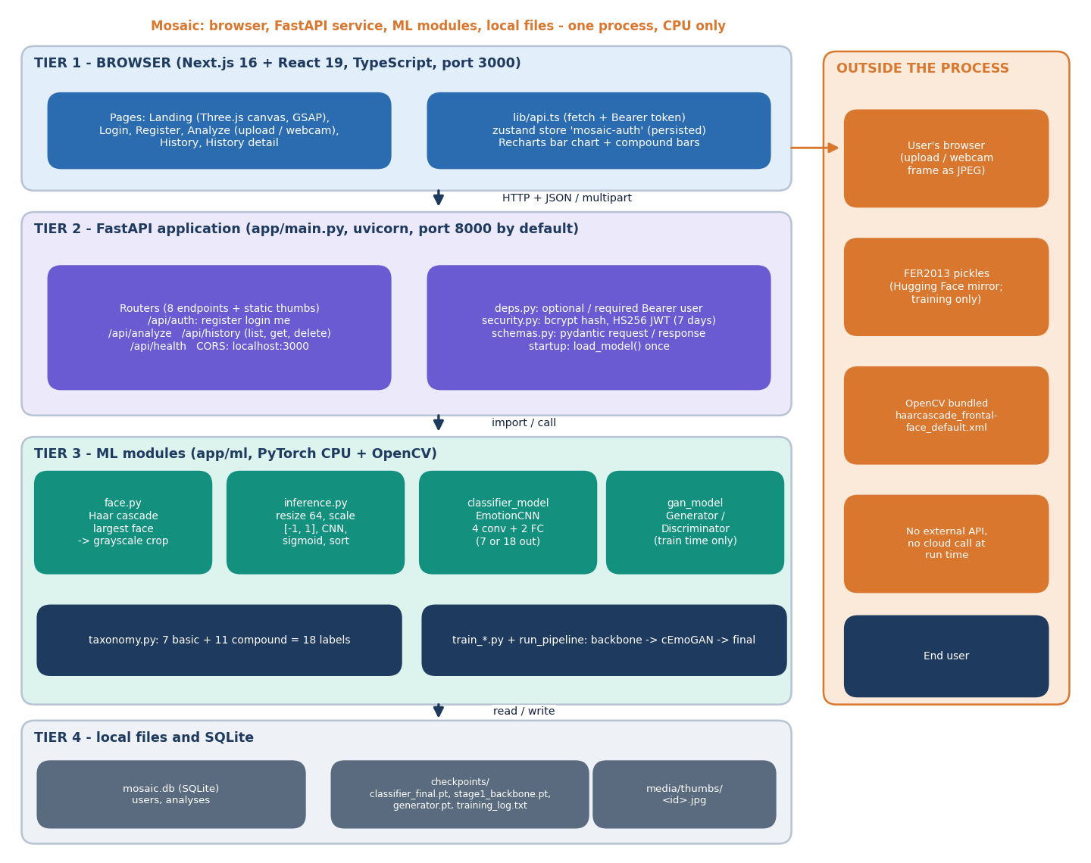
[COLLEGE NAME]
Department of Computer Science and Engineering (Data Science)
System Architecture
Four tiers: browser, FastAPI service, ML modules (PyTorch + OpenCV), local files; no external service at run time
Dept. of CSE (Data Science) | Batch A16 | Final Review
10
Notes:
One process on one CPU machine; the generator is used only at training time.

Slide 11
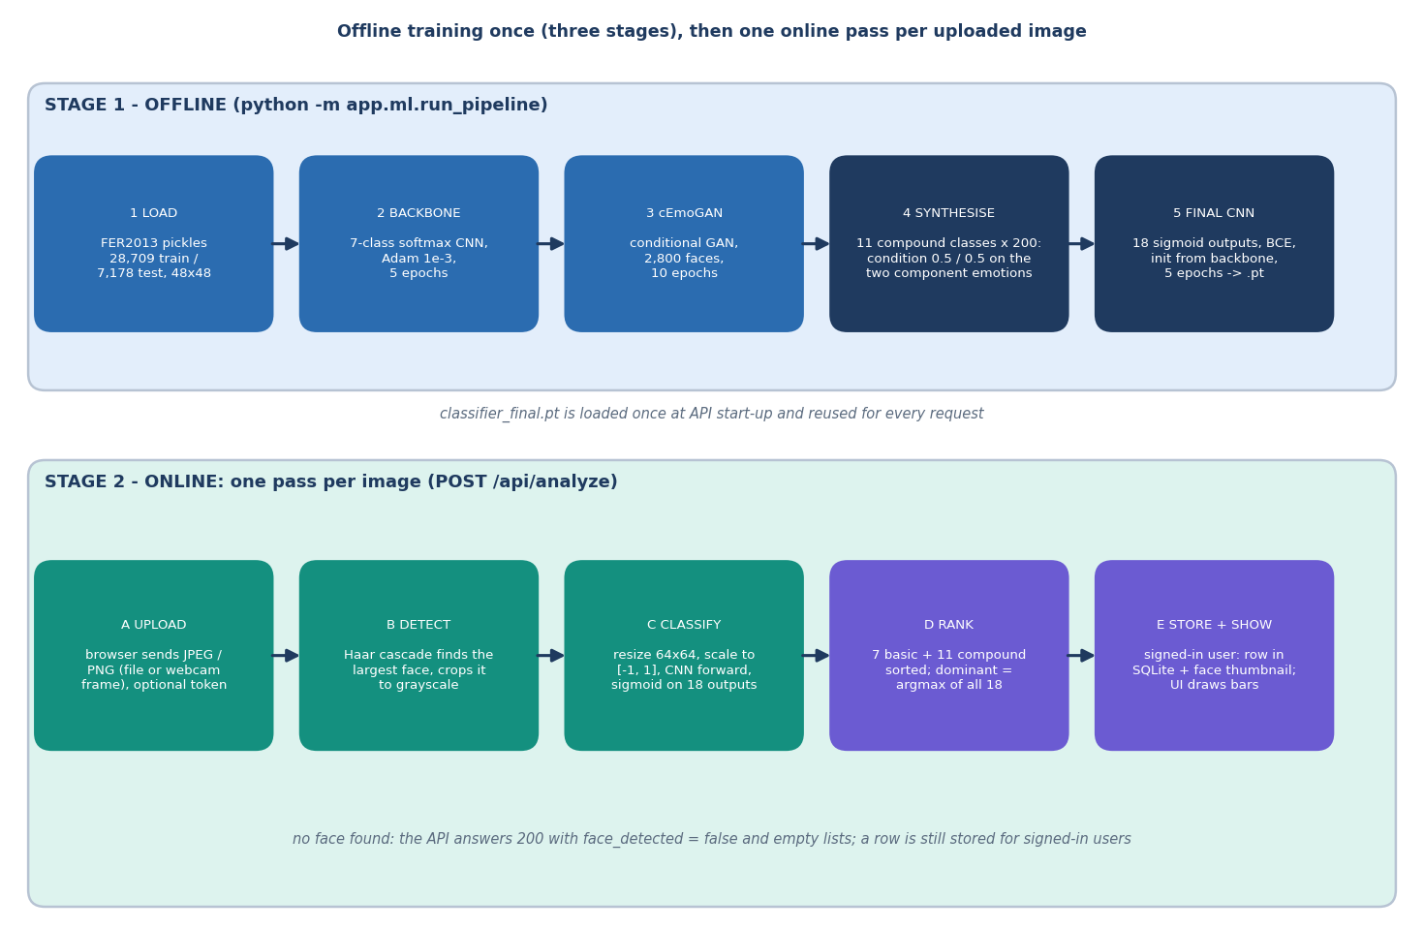
[COLLEGE NAME]
Department of Computer Science and Engineering (Data Science)
Methodology
Three offline stages, then one online pass per image
Dept. of CSE (Data Science) | Batch A16 | Final Review
11
Notes:
Analysis by synthesis: generate compound faces, train a multi-label recogniser on real plus generated data.

Slide 12
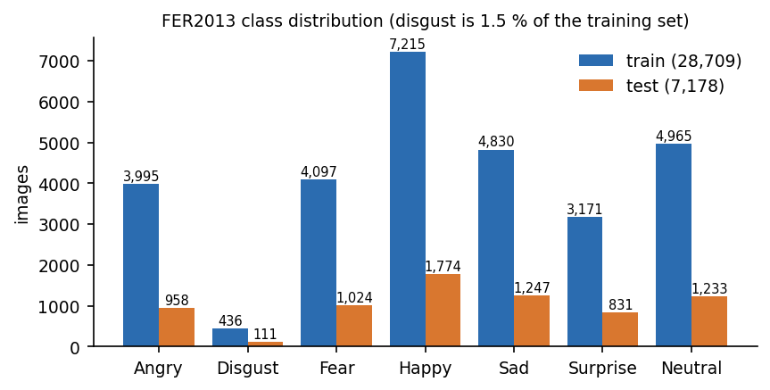
[COLLEGE NAME]
Department of Computer Science and Engineering (Data Science)
Dataset, Preprocessing & Model
FER2013 (Hugging Face mirror, apache-2.0 tag): 28,709 train / 7,178 test faces, 48x48 grayscale, 7 basic labels; no compound labels
Disgust is 1.5% of the training set; the baseline uses class-weighted cross-entropy
Preprocessing: Haar crop, resize 64x64, scale to [-1, 1]
EmotionCNN: 4 conv blocks (32-64-128-128, BatchNorm, ReLU, MaxPool), FC 2048-256, dropout 0.4, out 18; 770,130 parameters
Generator: 5 transposed convs, noise 100 + condition 7, 1,128,353 parameters; compound condition = 0.5 / 0.5 on the two emotions
Adam, batch 256, 5 epochs per CNN; CPU only
Compound taxonomy: 11 two-emotion categories from the compound-expression work of Du, Tao and Martinez, each labelled with its two basic emotions plus the compound bit.
Dept. of CSE (Data Science) | Batch A16 | Final Review
12
Notes:
The dataset has only basic labels; compound targets exist only on the synthetic faces.

Slide 13
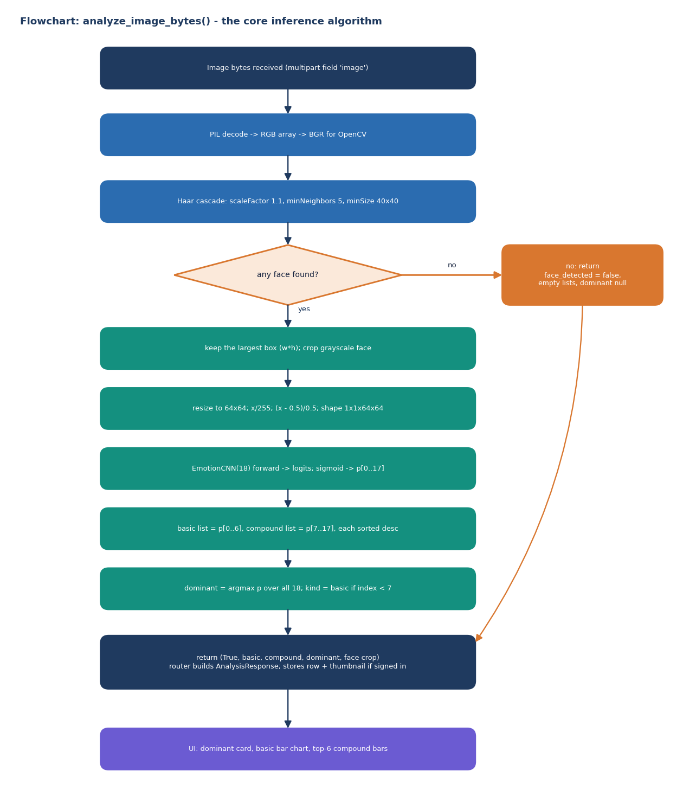
[COLLEGE NAME]
Department of Computer Science and Engineering (Data Science)
Decision Workflow
analyze_image_bytes(): detect face, crop, 64x64, CNN, sigmoid, rank; dominant = argmax of all 18
Dept. of CSE (Data Science) | Batch A16 | Final Review
13
Notes:
No face found returns 200 with face_detected false; the dominant emotion is the argmax over all 18 outputs, so it is basic unless a compound output beats every basic one.

Slide 14
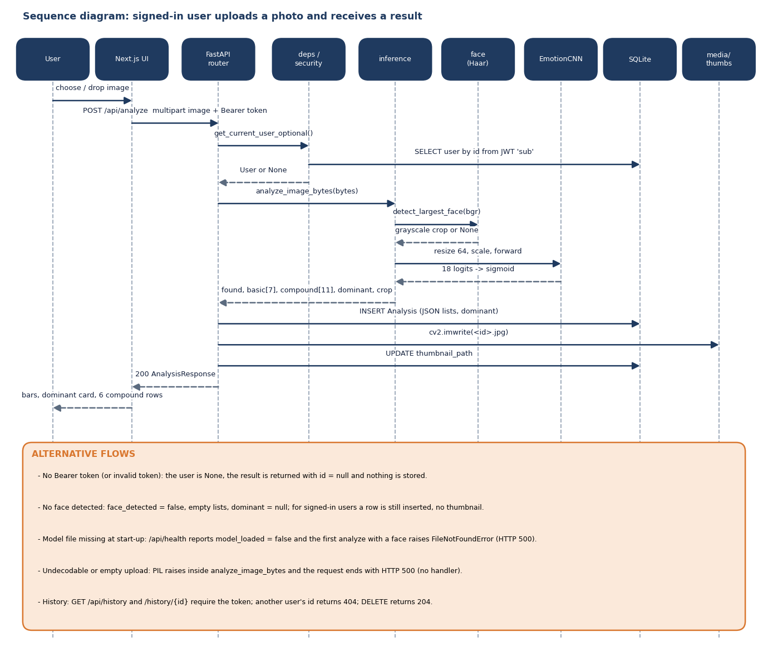
[COLLEGE NAME]
Department of Computer Science and Engineering (Data Science)
User–System Interaction
Sequence of one analysis through the router, Haar detector, CNN and SQLite
Dept. of CSE (Data Science) | Batch A16 | Final Review
14
Notes:
The alternative flows at the bottom of the diagram list anonymous calls, no face, missing model and bad uploads.

Slide 15
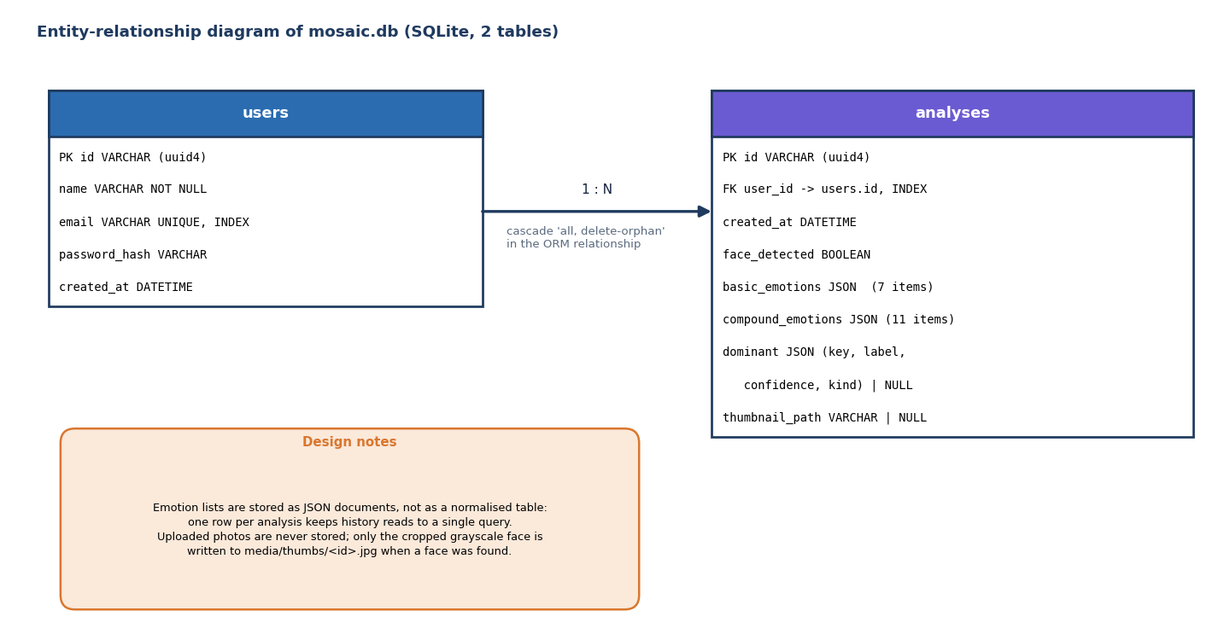
[COLLEGE NAME]
Department of Computer Science and Engineering (Data Science)
Database Design
Entity-relationship diagram: users 1 : N analyses; emotion lists stored as JSON
Dept. of CSE (Data Science) | Batch A16 | Final Review
15
Notes:
Two tables. The uploaded photo is never stored; only the cropped grayscale face is written to the thumbnails folder.

Slide 16
[COLLEGE NAME]
Department of Computer Science and Engineering (Data Science)
Implementation Highlights
Area | What was built
Backend | FastAPI, SQLAlchemy/SQLite, JWT (HS256, 7 days), bcrypt, pydantic schemas, CORS for localhost:3000; 8 endpoints
ML | PyTorch CPU: EmotionCNN (7 or 18 outputs), conditional GAN, Haar detector, 3-stage pipeline (run_pipeline.py)
Frontend | Next.js 16 / React 19 / TypeScript: landing page, login, register, analyze (upload or webcam), history; Recharts
Data | FER2013 pickles (28,709 + 7,178); 2,200 synthetic compound faces generated per training run
Quality | 28 pytest tests (units, API, privacy); 24 abuse probes; production build used for the screens
Added in this run | classifier_final.pt trained (it was missing); experiments, tests and API measurements added under scripts/ and backend/tests/
Dept. of CSE (Data Science) | Batch A16 | Final Review
16
Notes:
Be clear that the final checkpoint did not exist when the batch was received.

Slide 17
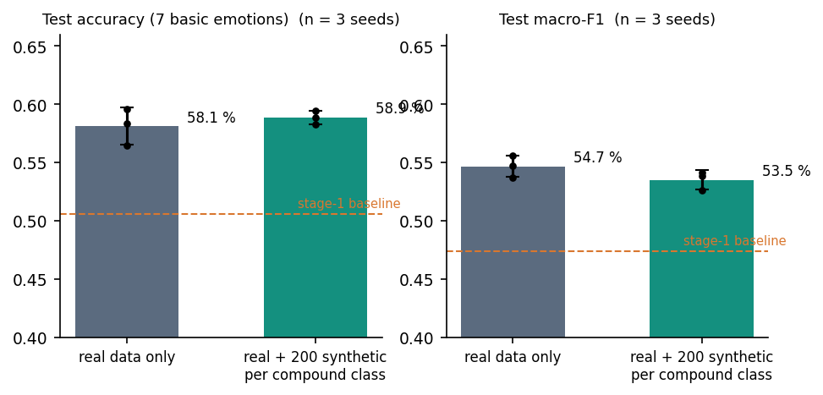
[COLLEGE NAME]
Department of Computer Science and Engineering (Data Science)
Results – Model Performance (FER2013 test, 7,178 faces)
Model | Accuracy | Macro-F1
Single-label baseline (shipped stage-1 CNN, 5 epochs) | 50.56% | 0.473
Final multi-label model (shipped, 5 + 5 epochs, argmax of 7 basic outputs) | 58.14% | 0.538
Control: real data only, same recipe (mean of 3 seeds) | 58.10 ± 1.59% | 54.67 ± 0.92%
Real + 200 synthetic per compound class (mean of 3 seeds) | 58.86 ± 0.57% | 53.51 ± 0.82%
The 7.6-point gain over the baseline is explained by five extra epochs: the real-only control reaches the same level
Synthetic faces change accuracy by less than the seed-to-seed spread and lower macro-F1
Always predicting 'happy' scores 24.7%
Dept. of CSE (Data Science) | Batch A16 | Final Review
17
Notes:
Mean and sample standard deviation over three seeds; the shipped checkpoint is a single run.

Slide 18
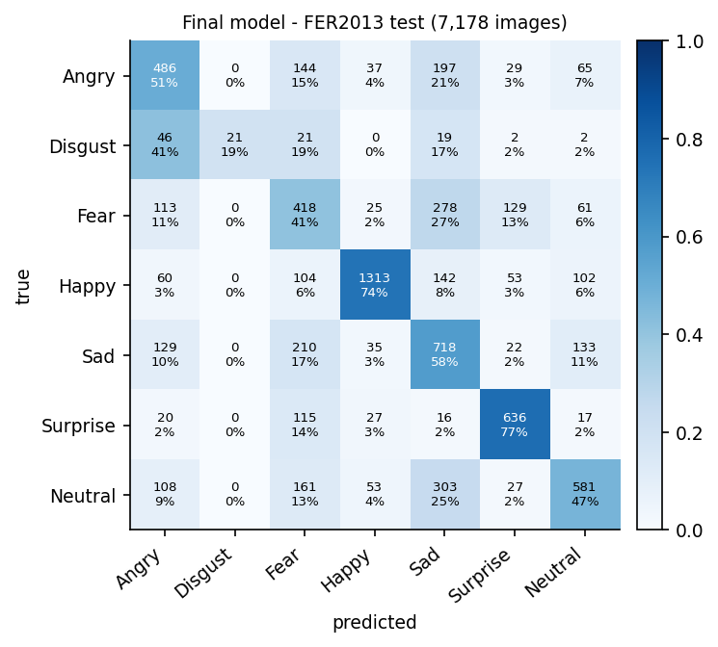
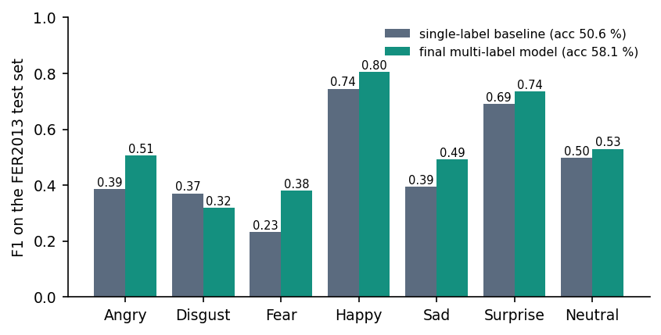
[COLLEGE NAME]
Department of Computer Science and Engineering (Data Science)
Confusion Matrix & Per-Class F1
Strongest: happy F1 0.80, surprise 0.74; weakest: disgust 0.32 (precision 1.00, recall 0.19), fear 0.38
Fear, sad and neutral are confused with each other, the usual FER2013 pattern
Final model, rows = true class, columns = predicted
Dept. of CSE (Data Science) | Batch A16 | Final Review
18
Notes:
The disgust class has only 111 test faces and 436 training faces.

Slide 19
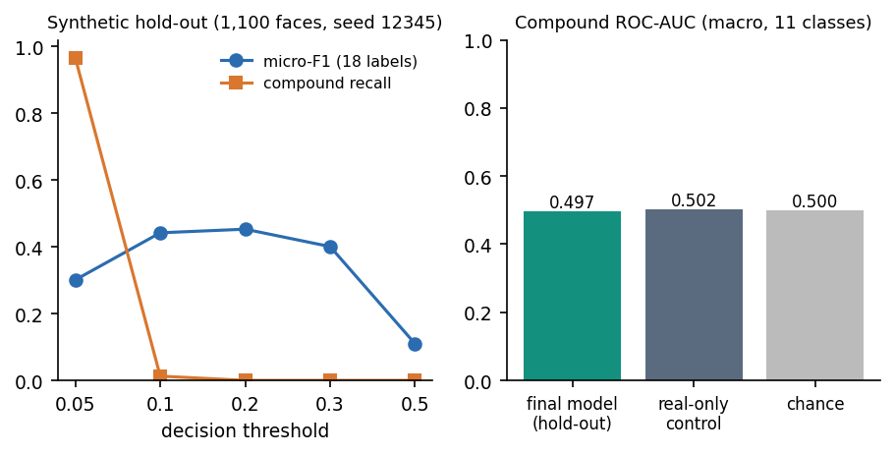
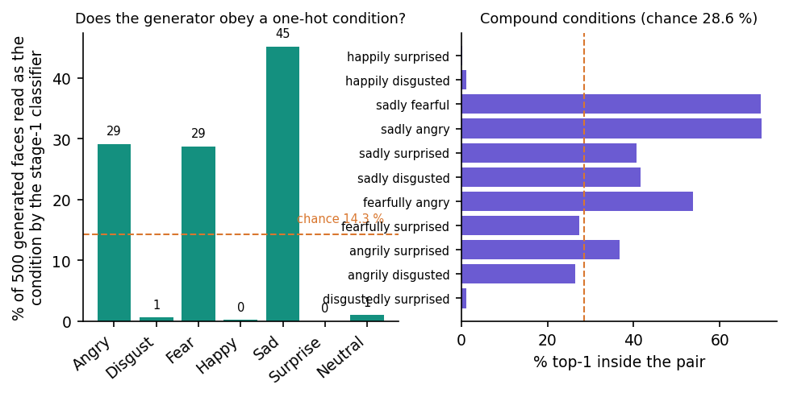
[COLLEGE NAME]
Department of Computer Science and Engineering (Data Science)
Parameter Analysis – Compound Threshold & GAN Condition
Threshold sweep 0.05 to 0.5 on 1,100 fresh synthetic compound faces: compound recall 97% at 0.05 (everything fires, ROC-AUC 0.50) and 0% from 0.2 up; no threshold separates the compound classes
Real-only control scores the same AUC (0.50); on real faces no compound output reaches 0.3 (mean top 0.0002)
Generator test: a classifier reads the intended emotion on 15.0% of generated faces (chance 14.3%); compound pairs: top-2 equals the pair 8.3% (chance 4.8%)
Dept. of CSE (Data Science) | Batch A16 | Final Review
19
Notes:
The decision rule is argmax over all 18 outputs, so the compound head never wins; a lower threshold only makes every compound fire together.

Slide 20
[COLLEGE NAME]
Department of Computer Science and Engineering (Data Science)
Performance & Testing
Measure | Result
API latency (127.0.0.1, CPU) | Analyze p50 19 ms, p95 26 ms (signed-in with storage p50 28 ms); login (bcrypt) p50 219 ms
Automated tests | 28 pytest tests pass in 3.6 s: taxonomy, tokens, shapes, preprocessing, synthesis labels, auth, analyze, history privacy
Abuse probes | 24/24 behave as expected; text, empty and truncated uploads end in HTTP 500 (no handler); unlisted CORS origins refused
Face detection | Haar finds 0% of native 48x48 faces and 56.5% after 3x upscaling; on those faces accuracy is 55.8% through the product path vs 66.2% with a direct resize
Training cost | Final classifier: 10 min 37 s for 5 epochs on a shared CPU (about 2 min per epoch); no GPU used
Dept. of CSE (Data Science) | Batch A16 | Final Review
20
Notes:
Latency numbers come from scripts/measure_api.py; the Haar detection gap is a training/serving mismatch.

Slide 21
[COLLEGE NAME]
Department of Computer Science and Engineering (Data Science)
Comparison with Base Paper (context only – different data and scoring)
Aspect | Khine et al. (base paper) | Mosaic (this project)
Training data | CK+, JAFFE, MUG; cEmoGAN-generated compound faces (15,000) | FER2013 real faces (28,709) + 2,200 synthetic compound faces
Generator | Encoder (identity-preserving latent) + conditional GAN | Conditional GAN only; no identity encoder
Scored on | Split of its own generated images | Real FER2013 test faces, basic labels only (7,178)
Headline | f-beta 0.99 / 0.99 / 0.80; exact match 100% / 99% / 68.7% | Accuracy 58.14%, macro-F1 0.538; compound ROC-AUC 0.50 (chance)
Compound result on real photos | Qualitative examples only | Compound outputs near zero (mean top 0.0002)
Not comparable: different datasets, different test images (generated vs real), different label sets. The base paper's scores say its recogniser reads its own generator's output; ours say a small CNN reaches about 58% on real FER2013.
Closest independent reference: a lightweight CNN on FER-2013 reaches 51.6% [6]; our baseline 50.6%, final 58.1% (splits not guaranteed identical).
Dept. of CSE (Data Science) | Batch A16 | Final Review
21
Notes:
State the 'not comparable' point first; the numbers are context.

Slide 22
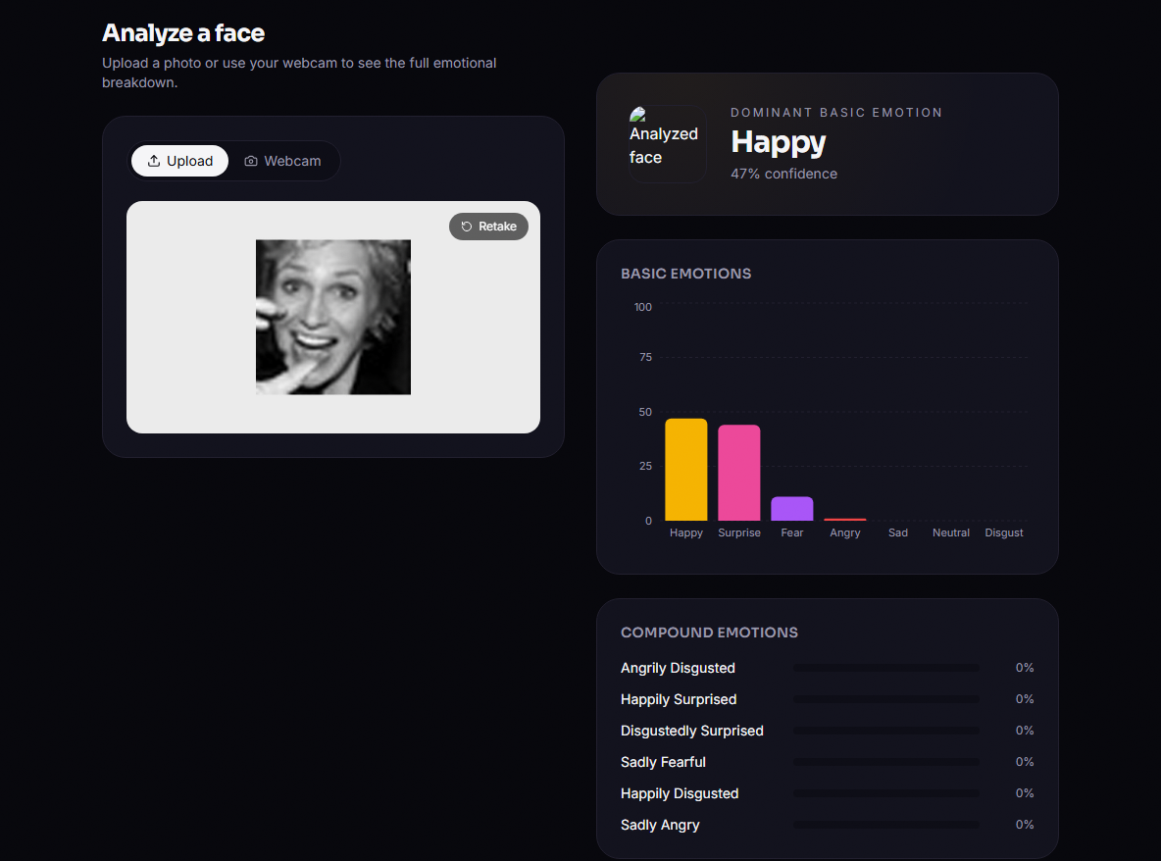
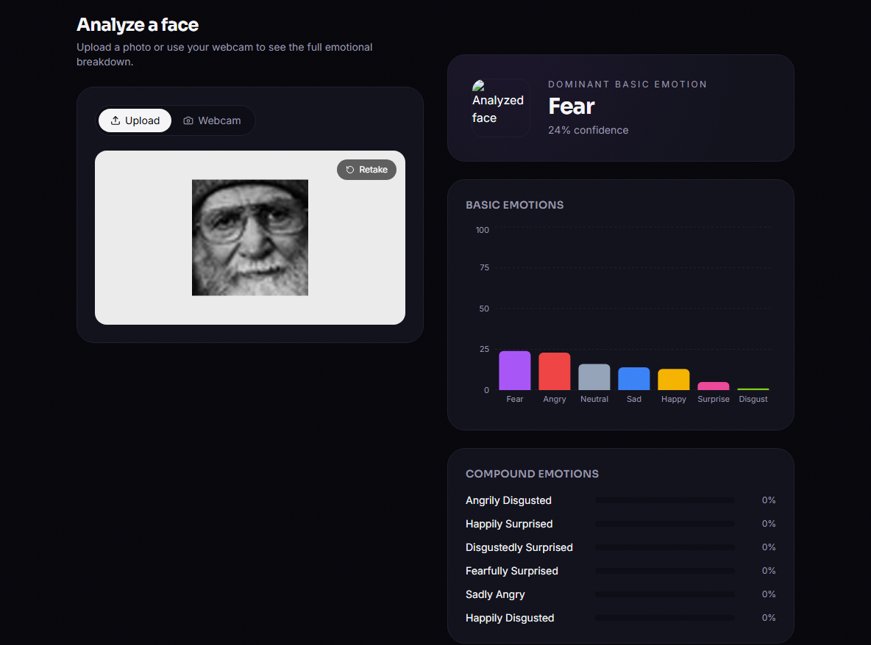
[COLLEGE NAME]
Department of Computer Science and Engineering (Data Science)
Output – Analyze a Face
Left: a happy face is read as Happy (47%) with Surprise close behind; the compound bars all show 0% (real FER2013 test faces, production build). Right: a neutral face read as Fear (24%), one of the misses behind the 58% accuracy. The thumbnail beside the dominant emotion shows a broken image (known defect).
Dept. of CSE (Data Science) | Batch A16 | Final Review
22
Notes:
Real captures of the running application.

Slide 23
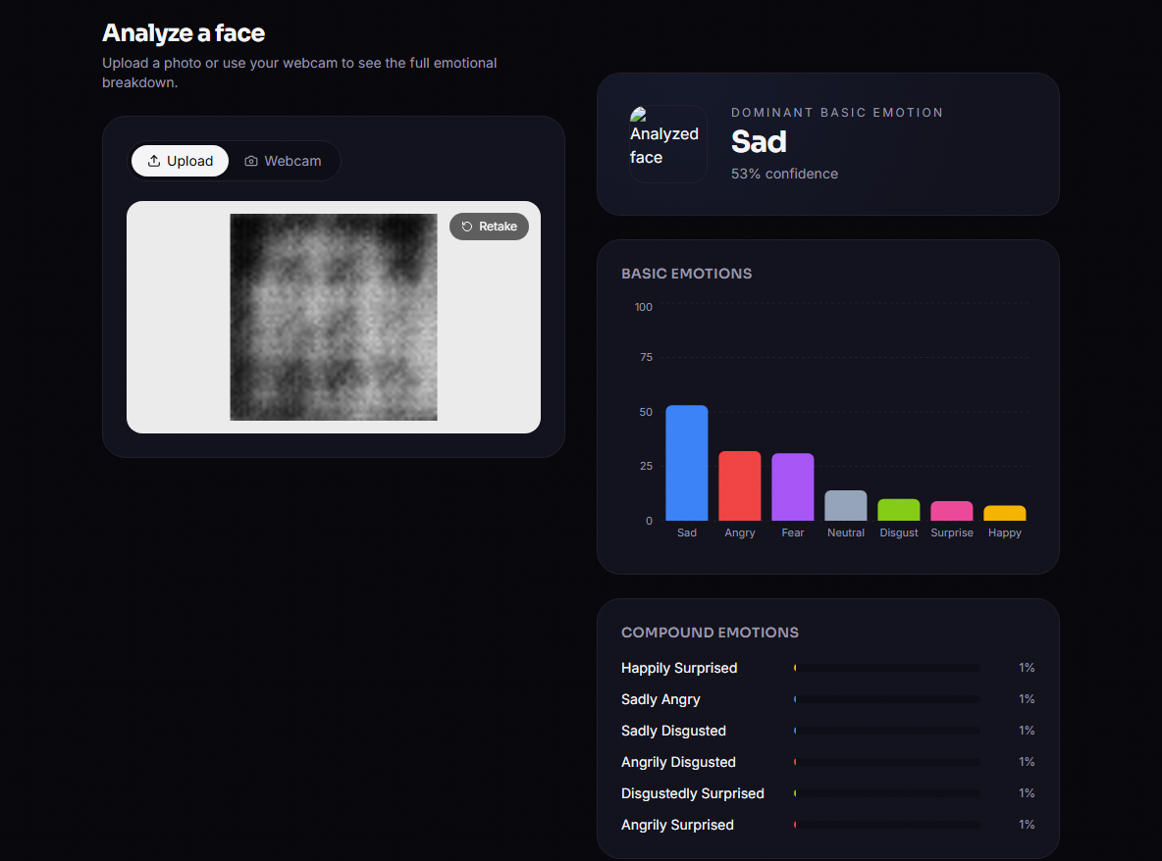
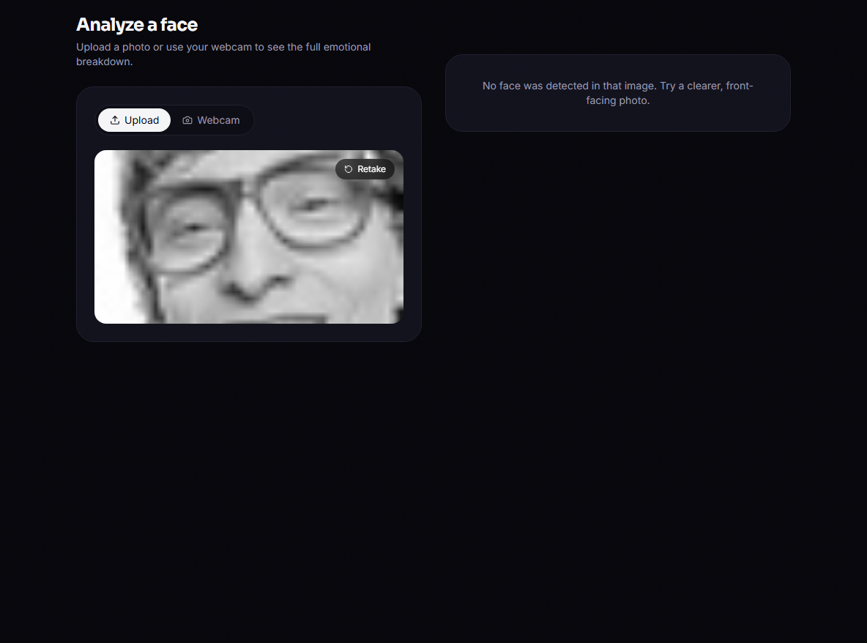
[COLLEGE NAME]
Department of Computer Science and Engineering (Data Science)
Output – Generated Face and No-Face Case
Left: a face from the project's own cEmoGAN conditioned on 'happily surprised': a blurry blob, read as Sad (53%), compound scores about 1%. Right: a real 48x48 FER2013 face as uploaded is not found by the Haar detector: the API answers with face_detected false.
Dept. of CSE (Data Science) | Batch A16 | Final Review
23
Notes:
Shows the generator quality and the detection limit honestly.

Slide 24
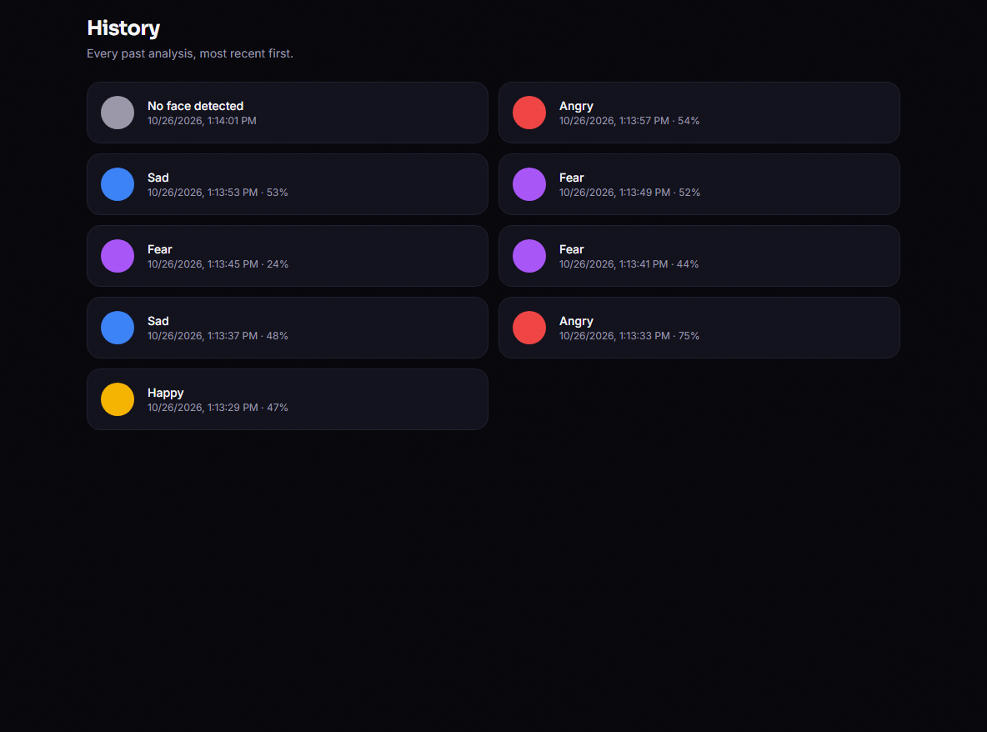
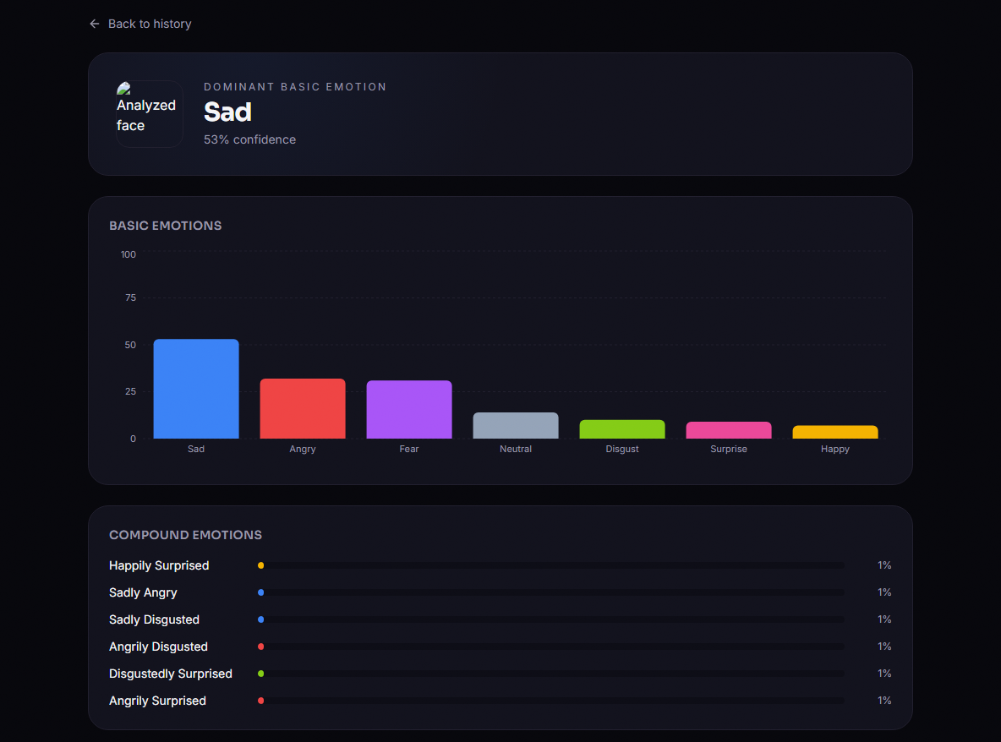
[COLLEGE NAME]
Department of Computer Science and Engineering (Data Science)
Output – History
Left: stored analyses of the signed-in user, newest first, with dominant emotion and confidence (delete on hover). Right: a saved result opened by id; the route exists but nothing in the UI links to it, so it was opened by URL.
Dept. of CSE (Data Science) | Batch A16 | Final Review
24
Notes:
History works per user; the detail page is unreachable from the list.

Slide 25
[COLLEGE NAME]
Department of Computer Science and Engineering (Data Science)
Conclusion & Objectives vs Outcomes
Built and tested end to end: Haar detection, an 18-output CNN, accounts, history and a console; 58.14% on real FER2013 against a 50.56% baseline.
The compound capability is not demonstrated: its outputs are inert on real faces and at chance on synthetic ones, and the GAN does not follow its condition.
# | Objective | Outcome
1 | Identity-preserving compound faces with cEmoGANs | Not achieved: no identity encoder; generator ignores its condition
2 | Enlarge the complex-emotion dataset | Done mechanically (2,200 faces); no accuracy or compound benefit measured
3 | CNN multi-label classifier, basic + compound | Basic: 58.14%; compound outputs not functional
4 | Evaluate against single-label baselines | Done: baseline 50.56%; real-only control 58.1 ± 1.6%
5 | Interface for uploaded images | Achieved; 28 tests; known defects listed in the report
Dept. of CSE (Data Science) | Batch A16 | Final Review
25
Notes:
Be explicit about what was and was not achieved.

Slide 26
[COLLEGE NAME]
Department of Computer Science and Engineering (Data Science)
Future Scope
Train the GAN to convergence on a larger, identity-labelled set and add the base paper's encoder so that identity is preserved
Obtain real compound labels (for example RAF-DB compound subset, licence permitting) to evaluate and fine-tune the compound outputs
Weight or oversample synthetic faces, add a dedicated compound head and report exact-match ratio and per-class F1
Train on Haar-style crops, or use a stronger detector, to close the training/serving gap
Fix the product defects: error handling for bad uploads, thumbnail URL, link to the detail page, session after reload, e-mail validation
Dept. of CSE (Data Science) | Batch A16 | Final Review
26
Notes:
Each item answers a measured weakness.

Slide 27
[COLLEGE NAME]
Department of Computer Science and Engineering (Data Science)
References
[1] W. S. S. Khine, P. Siritanawan and K. Kotani, "Complex emotion estimation using analysis-by-synthesis of facial expression images," IEEE Access, vol. 13, pp. 88731-88744, 2025, doi: 10.1109/ACCESS.2025.3570167.
[2] S. Liu, S. Ni and H. Cai, "Facial expression recognition with contrastive disentangled generative adversarial network," Electronics, vol. 14, no. 19, p. 3795, Sep. 2025, doi: 10.3390/electronics14193795.
[4] F. Khemakhem and H. Ltifi, "Neural style transfer generative adversarial network (NST-GAN) for facial expression recognition," Int. J. Multimedia Inf. Retr., vol. 12, no. 2, Art. no. 26, 2023, doi: 10.1007/s13735-023-00285-6.
[6] C. Galkaduwa, "An empirical study of handcrafted feature learning and convolutional neural networks for facial expression recognition," arXiv:2607.15288, Jun. 2026.
[7] X. Liu et al., "Compound expression recognition via multi model ensemble for the ABAW7 challenge," arXiv:2407.12257, Jul. 2024.
[9] S. Du, Y. Tao and A. M. Martinez, "Compound facial expressions of emotion," Proc. Nat. Acad. Sci. USA, vol. 111, no. 15, pp. E1454-E1462, Apr. 2014, doi: 10.1073/pnas.1322355111.
[11] I. J. Goodfellow et al., "Challenges in representation learning: A report on three machine learning contests," Neural Netw., vol. 64, pp. 59-63, 2015, doi: 10.1016/j.neunet.2014.09.005.
[16] I. Goodfellow et al., "Generative adversarial nets," in Adv. Neural Inf. Process. Syst. (NIPS), vol. 27, 2014, pp. 2672-2680.
[17] M. Mirza and S. Osindero, "Conditional generative adversarial nets," arXiv:1411.1784, Nov. 2014.
[23] P. Viola and M. Jones, "Rapid object detection using a boosted cascade of simple features," in Proc. IEEE Comput. Soc. Conf. Comput. Vis. Pattern Recognit. (CVPR), vol. 1, 2001, pp. I-511-I-518, doi: 10.1109/CVPR.2001.990517.
Dept. of CSE (Data Science) | Batch A16 | Final Review
27
Notes:
Numbering follows the report's reference list.

Slide 28
[COLLEGE NAME]
Department of Computer Science and Engineering (Data Science)
THANK YOU
Questions & Suggestions
Dept. of CSE (Data Science) | Batch A16 | Final Review
28
Notes:
Invite questions.

