Slide 1
SymptoTrackAI
REVIEW 2 · DESIGN, METHODOLOGY AND PROGRESS
Design, methodology and progress: a local hybrid RAG pipeline from symptom text to a grounded, safety-checked answer
Presented by
Under the guidance of
Mariyada Karthika Reddy 23K91A05E9
Nacharam Akshaya 23K91A05G6
Madoori Prabath Teja 23K91A05D6
Pulimadhi Keerthan 23K91A05K1
Dr. Ch. B. Naga Lakshmi, [DESIGNATION]
Department of Computer Science and Engineering
TKR College of Engineering & Technology · Batch C12 (CSE-C) · [ACADEMIC YEAR]
Notes:
This review shows how SymptoTrackAI, implemented as the CareLens AI web application, is designed and built: data, models, what is implemented, the first measured results and the open items.

Slide 2
Contents
01
02
03
Recap and architecture
Methodology and knowledge base
Preprocessing and models
04
05
06
Configuration and decision logic
Data flow, database and UML
Technology stack
07
08
09
Implementation progress and results
Output screens and testing
Challenges and next steps
Notes:
Agenda for the design and progress review.

Slide 3
Recap: problem and proposed system
!
Problem
i
Proposed system
B
Base paper link
People turn to web search or general chatbots for symptoms and get generic, frightening or ungrounded answers, with no source shown and no record of earlier episodes.
Retrieve matching medical records with FAISS and BM25, fuse and rerank them, build the answer only from those records, flag emergencies by rules and save each consultation privately.
Madhury and Ramesh combine RAG, FAISS and a web app with a stored log but report no numbers. We keep the product idea, add BM25, a reranker, safety rules and measurements. Results are not comparable.
Notes:
One-minute recap of Review 1: the access and misinformation problem, our hybrid approach, and how the base paper relates (same idea, no numbers, fewer components).

Slide 4
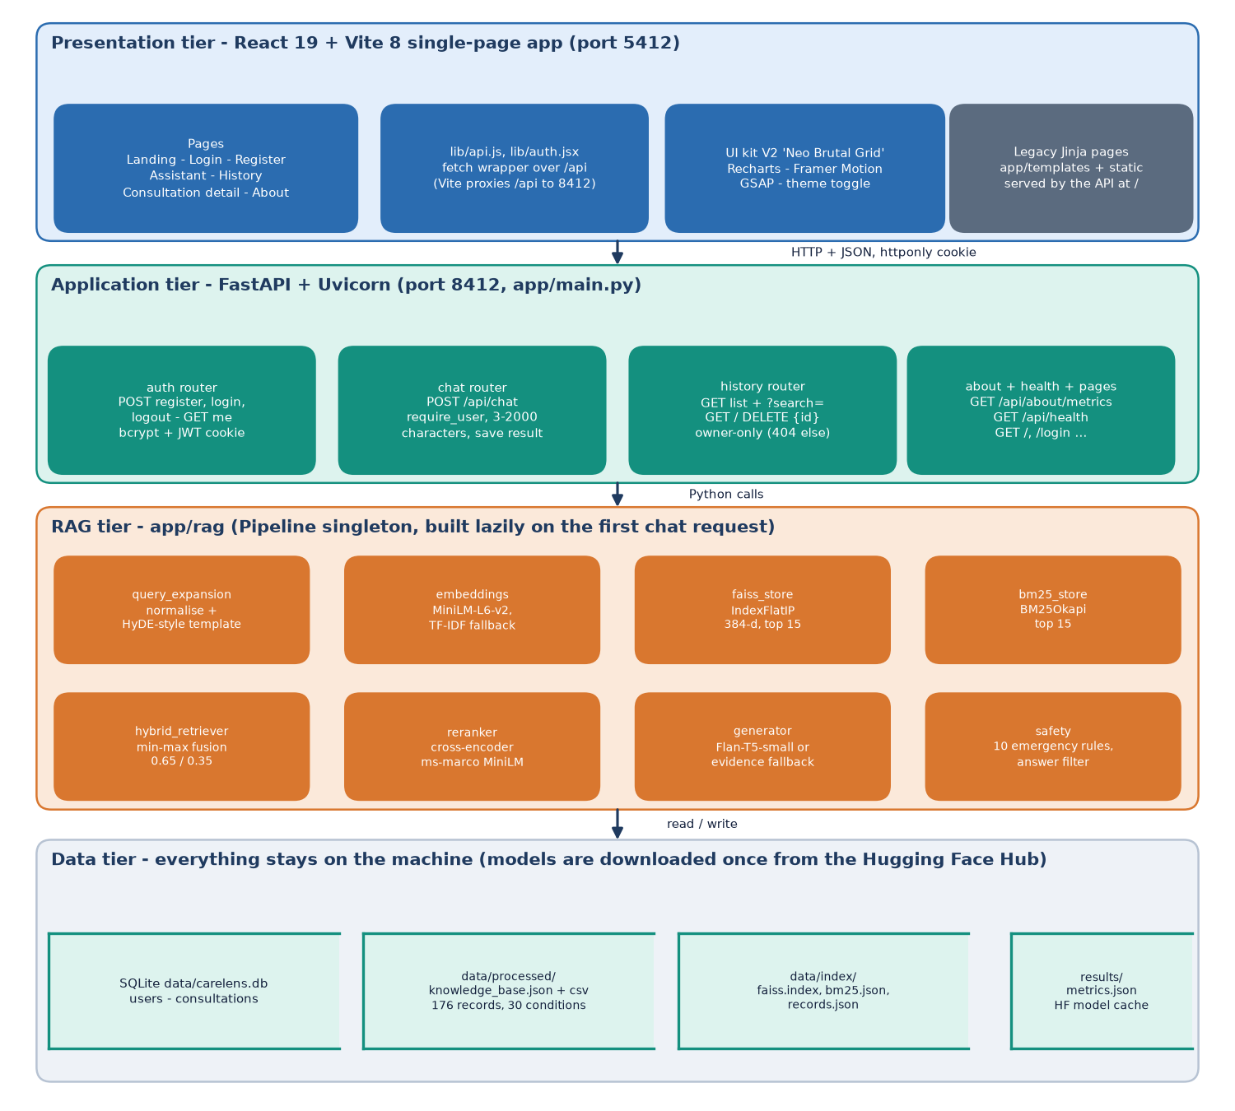
System architecture
Layers
Presentation: React 19 and Vite web app (port 5412), 8 pages.
Application: FastAPI (port 8412), 10 routes: auth, chat, history, about, health.
RAG pipeline: nine modules under app/rag, loaded once as a lazy singleton.
Data: SQLite (users, consultations), FAISS and BM25 index files, the knowledge base JSON and CSV.
Notes:
All routes live in app/routes. The RAG pipeline is one class in app/rag/pipeline.py; each stage is its own module so it can be tested alone. Storage is local.

Slide 5
Methodology: end-to-end workflow
Symptom text
HyDE-style expansion
FAISS + BM25
Fusion 0.65 / 0.35
Cross-encoder rerank
Grounded answer
Safety + store
One pipeline
Graceful fallbacks
Measured, not typed
Pipeline.answer() runs every stage in order, so the web app, the tests and the measurement script exercise the same code.
No MiniLM: TF-IDF embeddings. No reranker: hybrid order. No generator: an evidence-based answer. The app keeps working offline.
scripts/measure_metrics.py writes every reported number to docs/metrics/metrics.json; figures are regenerated from it.
Notes:
The three design principles: one pipeline, honest fallbacks, and numbers that come from a script.

Slide 6
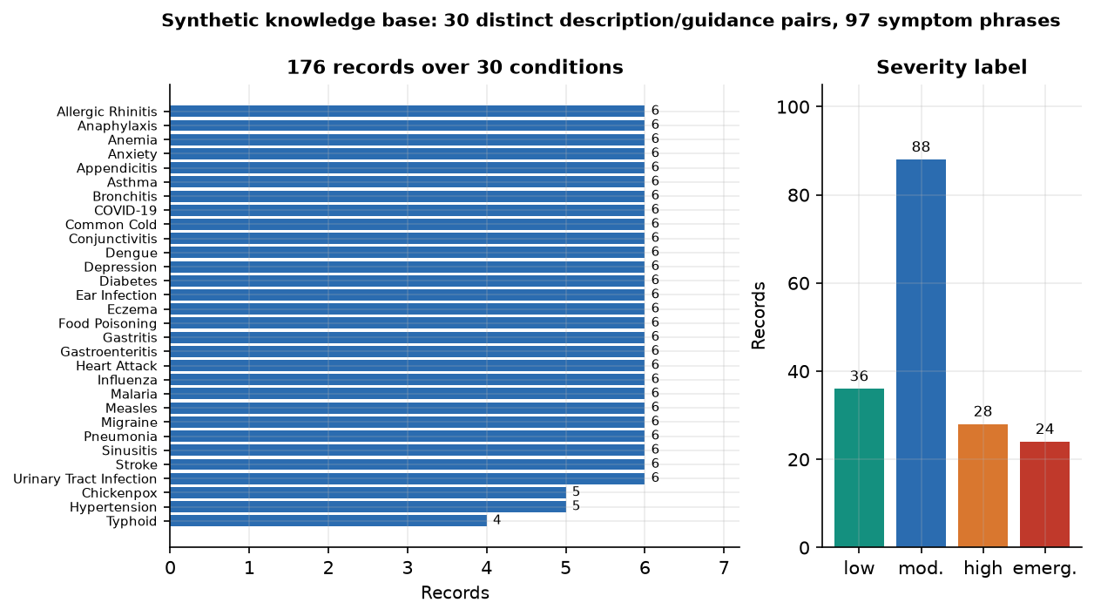
Knowledge base and probe sets
176
30
97
30
records in the knowledge base
conditions, 4 to 6 records each
distinct symptom phrases
description / guidance pairs: one per condition
No public symptom-disease dataset was available, so prepare_data.py writes a hand-made table of 30 conditions with six random symptom-subset variants each (seed 42). It is labelled synthetic in every record.
Severity mix: 88 moderate, 36 low, 28 high, 24 emergency records.
Probe sets written by the team: 60 lay-language descriptions (2 per condition), 15 out-of-base complaints, 40 emergency and 30 non-emergency texts.
Records per condition and severity of the synthetic base.
Notes:
Be frank: the knowledge base is synthetic and written by the team, not clinically reviewed, and all records of a condition share one description and guidance text. That makes retrieval of the condition easy and is why every probe set here is also team-written and small.

Slide 7
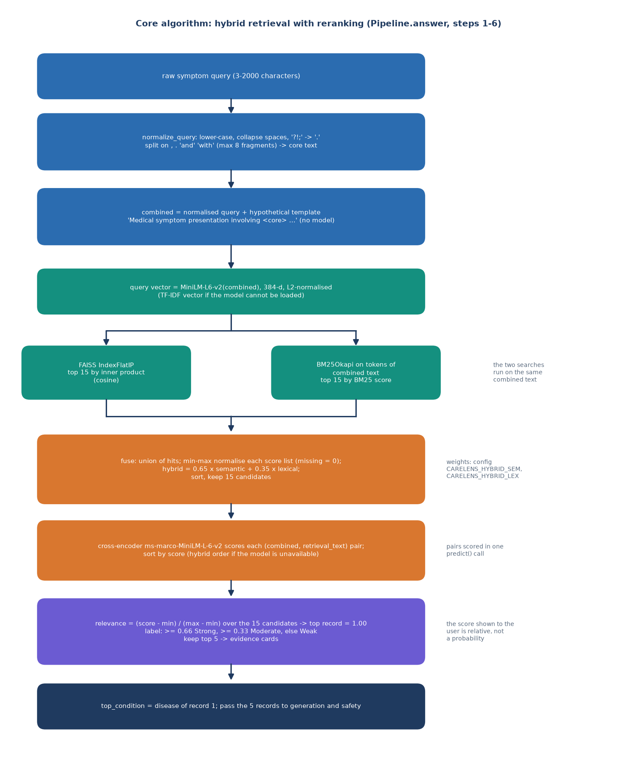
Data preprocessing and query expansion
1 Knowledge base: lower-case symptoms, collapse spaces, drop duplicates
2 Each record becomes 'Disease: .. Symptoms: .. Description: .. Guidance: ..'
3 Query: lower-case, collapse whitespace, ? ! ; become full stops
4 Split on commas, 'and', 'with'; keep up to 8 fragments
5 Wrap in a fixed 'medical symptom presentation' template (HyDE-style)
6 Embed and search the original text plus the template
Honest finding: the template is not a model, and removing it scored as high or higher in every set we measured.
Notes:
The expansion is rule based. On our lay-language probes top-1 was 0.967 with it and 1.000 without it, so the term HyDE is used loosely here and the benefit is not shown.

Slide 8
Models used
Component | Configuration | Role
Dense retriever | all-MiniLM-L6-v2, 384-d, normalised, FAISS IndexFlatIP (exact); TF-IDF 384-d fallback | semantic similarity
Lexical retriever | BM25Okapi (rank-bm25) over [a-z0-9] tokens of the record text | exact symptom words
Reranker | cross-encoder/ms-marco-MiniLM-L-6-v2 on 15 query-record pairs | precision at the top 5
Generator | google/flan-t5-small via transformers, 220 new tokens, greedy; evidence-based fallback | grounded answer text
384
0
No GPU
embedding dimensions
models trained: all four are used pre-trained
everything runs on a CPU
Notes:
Four pre-trained components with separate jobs. Nothing is fine-tuned in this project; the contribution is the pipeline, the safety layer and the measurement.

Slide 9
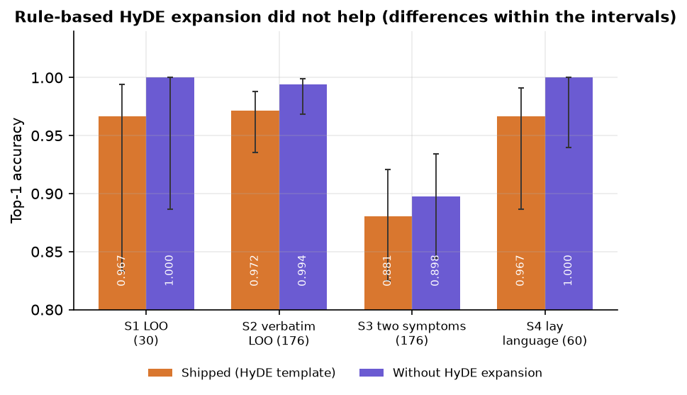
Pipeline configuration and parameter analysis
Setting | Value
Candidates and output | 15 per retriever, fused, 5 records kept after the cross-encoder
Fusion | min-max per retriever, then 0.65 x semantic + 0.35 x lexical (environment-configurable)
Relevance label | reranker score min-max over the pool; Strong >= 0.66, Moderate >= 0.33, else Weak
Limits | query 3 to 2,000 characters; session token 1,440 minutes; HS256 cookie
Machine | 12th Gen Intel Core i5-12500 (6 cores / 12 threads), no GPU, 15.7 GB RAM; Python 3.11.9; no training step
Parameter check: expansion on or off. Lay-language top-1 0.967 with it and 1.000 without; two-symptom queries 0.881 and 0.898. The weights 0.65 / 0.35 were taken from the project configuration and not tuned.
Notes:
Settings are read from app/config.py. The fusion weights were not tuned, and the expansion shows no gain in our measurements.

Slide 10
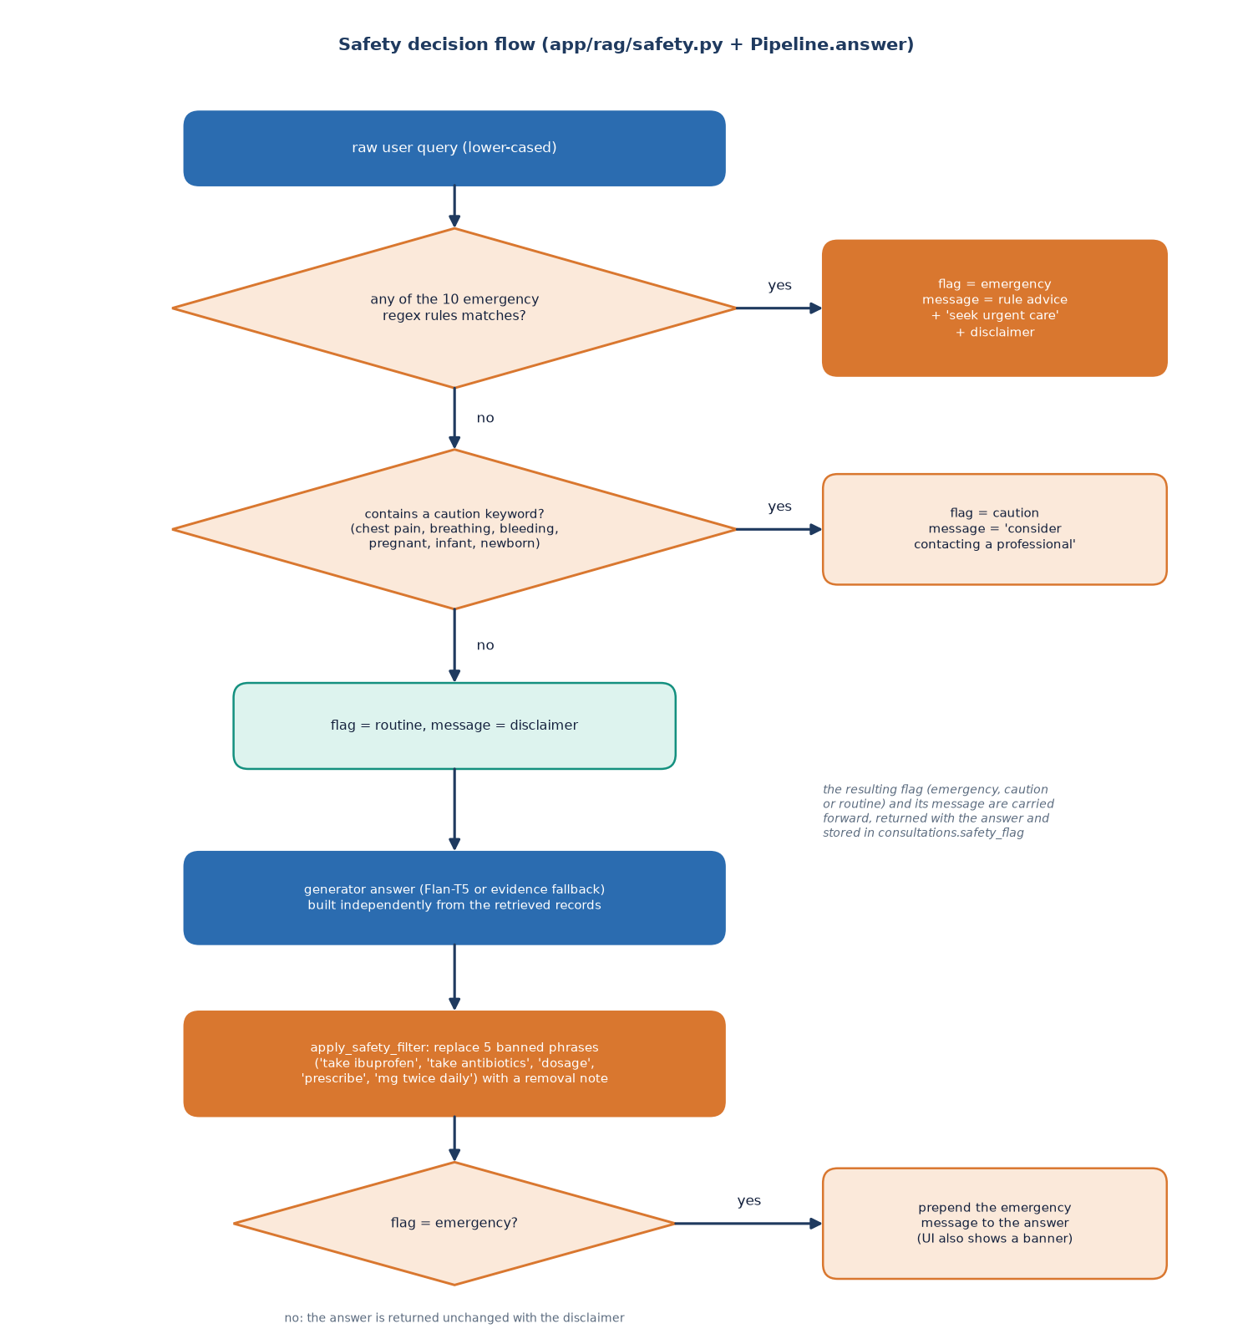
Decision logic: safety layer and relevance
Emergency. 10 regex rules (chest pain, breathing, bleeding, unconsciousness, stroke signs, allergic reaction, self-harm, sudden neurological signs, seizure, severe abdominal pain) prepend an urgent notice.
Caution. 6 keywords such as pregnant, infant, bleeding show a caution banner.
Filter. Five banned phrases (take ibuprofen, dosage, prescribe ...) are replaced in the answer text.
Relevance. Reranker scores are min-max scaled, so the top record always reads 100%.
Always. A non-diagnosis disclaimer on every answer.
Notes:
The safety layer is software rules, not a clinical triage model. We measure it later: it catches literal wording and misses paraphrases. The 100 percent relevance is a display artefact we also measure.

Slide 11
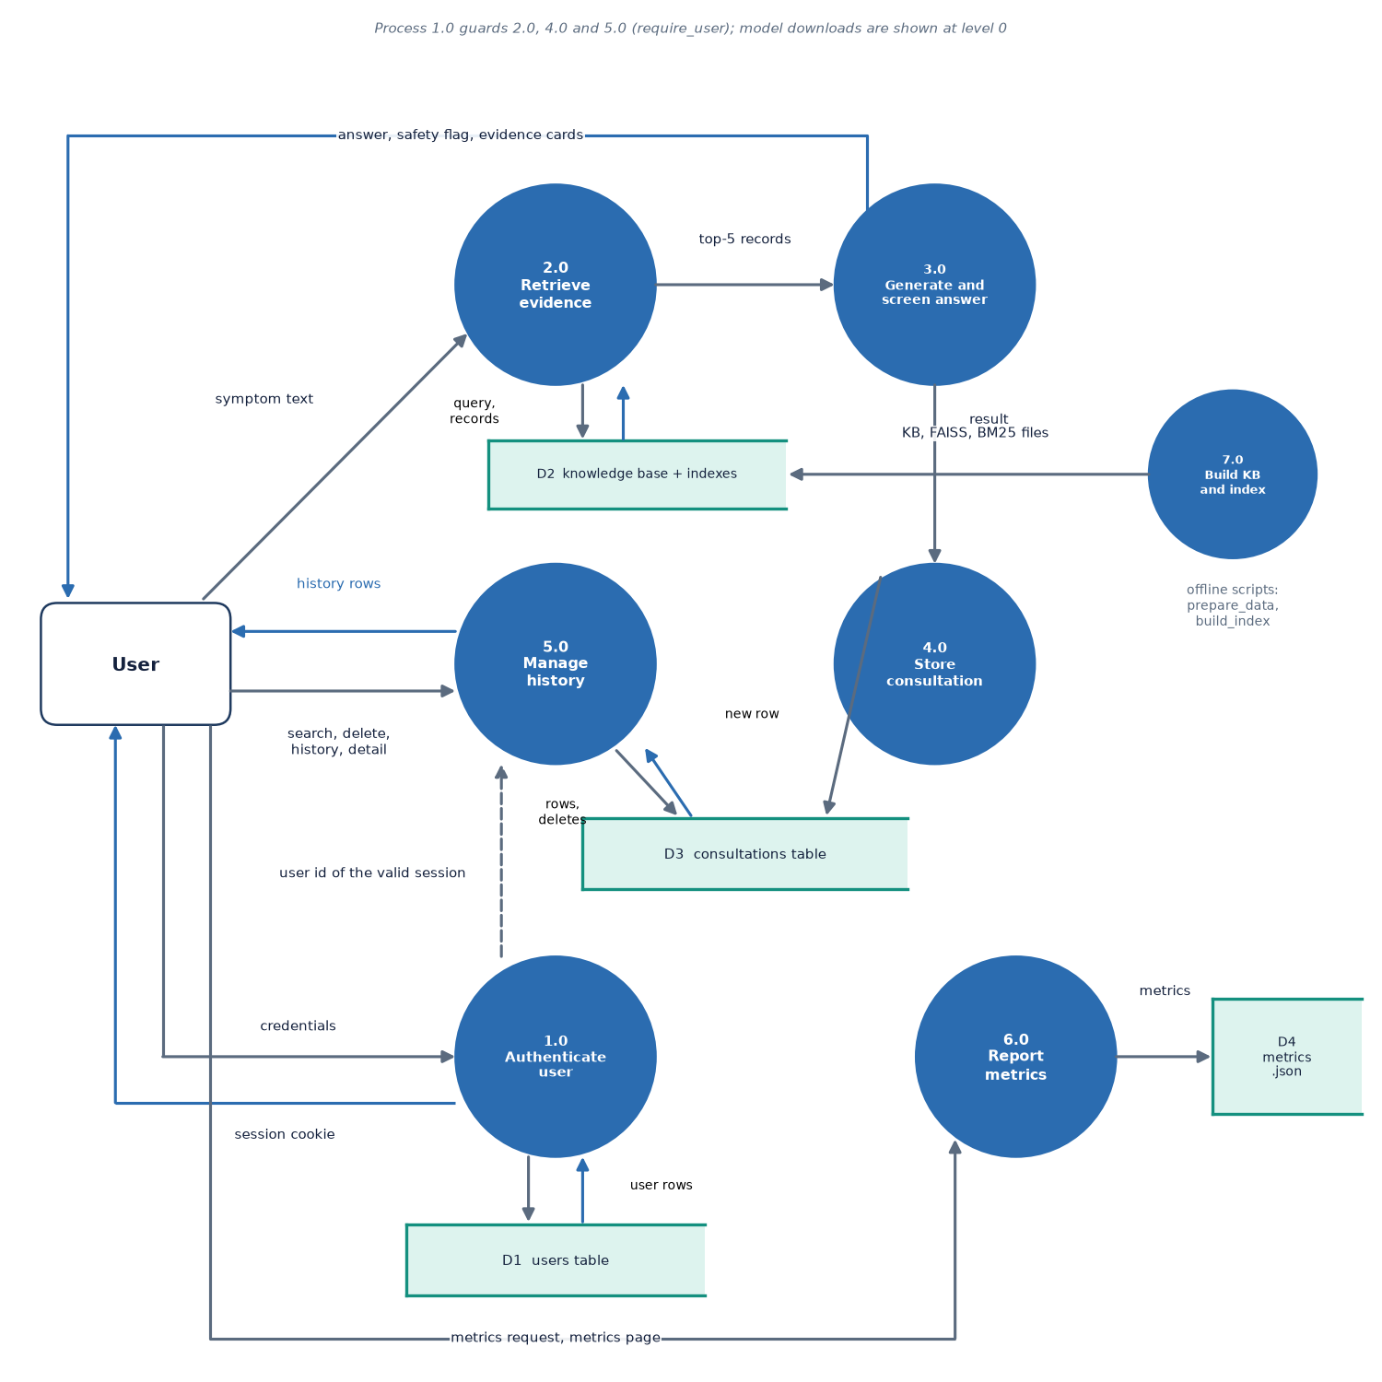
Data flow and modules
Module | Role
query_expansion | normalise + template
embeddings | MiniLM / TF-IDF
faiss_store | exact inner-product index
bm25_store | lexical index
hybrid_retriever | min-max fusion
reranker | cross-encoder, relevance
generator | Flan-T5 / fallback answer
safety | rules + answer filter
pipeline | orchestration, labels
Notes:
Level-1 data flow: the symptom text becomes a retrieval query, the records are fused and reranked, the answer is checked by the safety layer and stored.

Slide 12
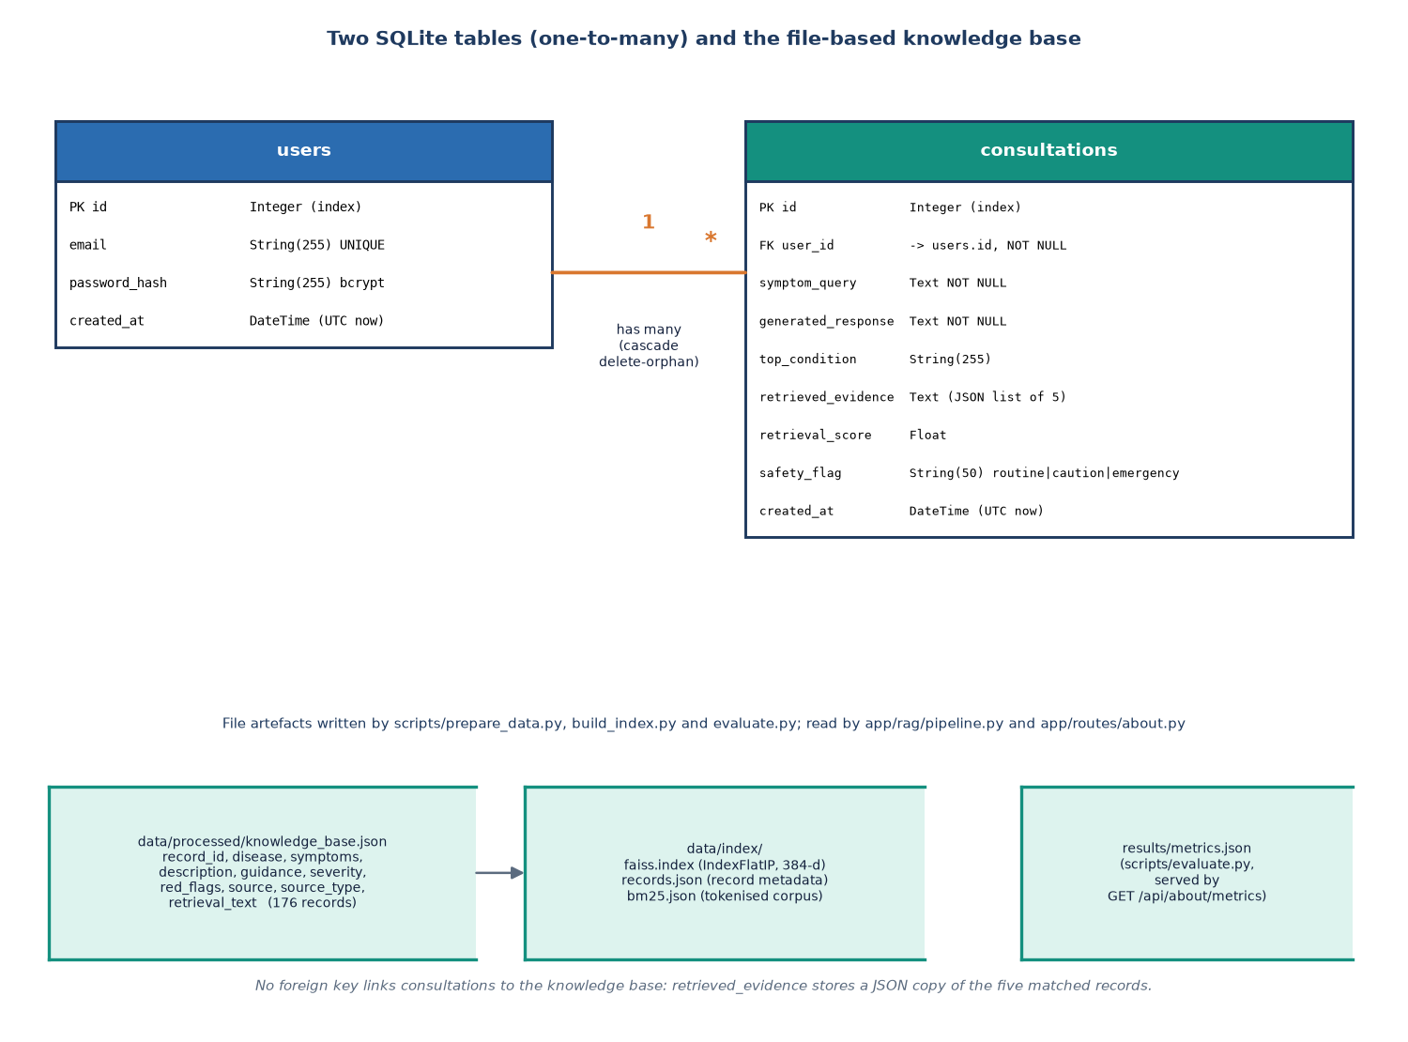
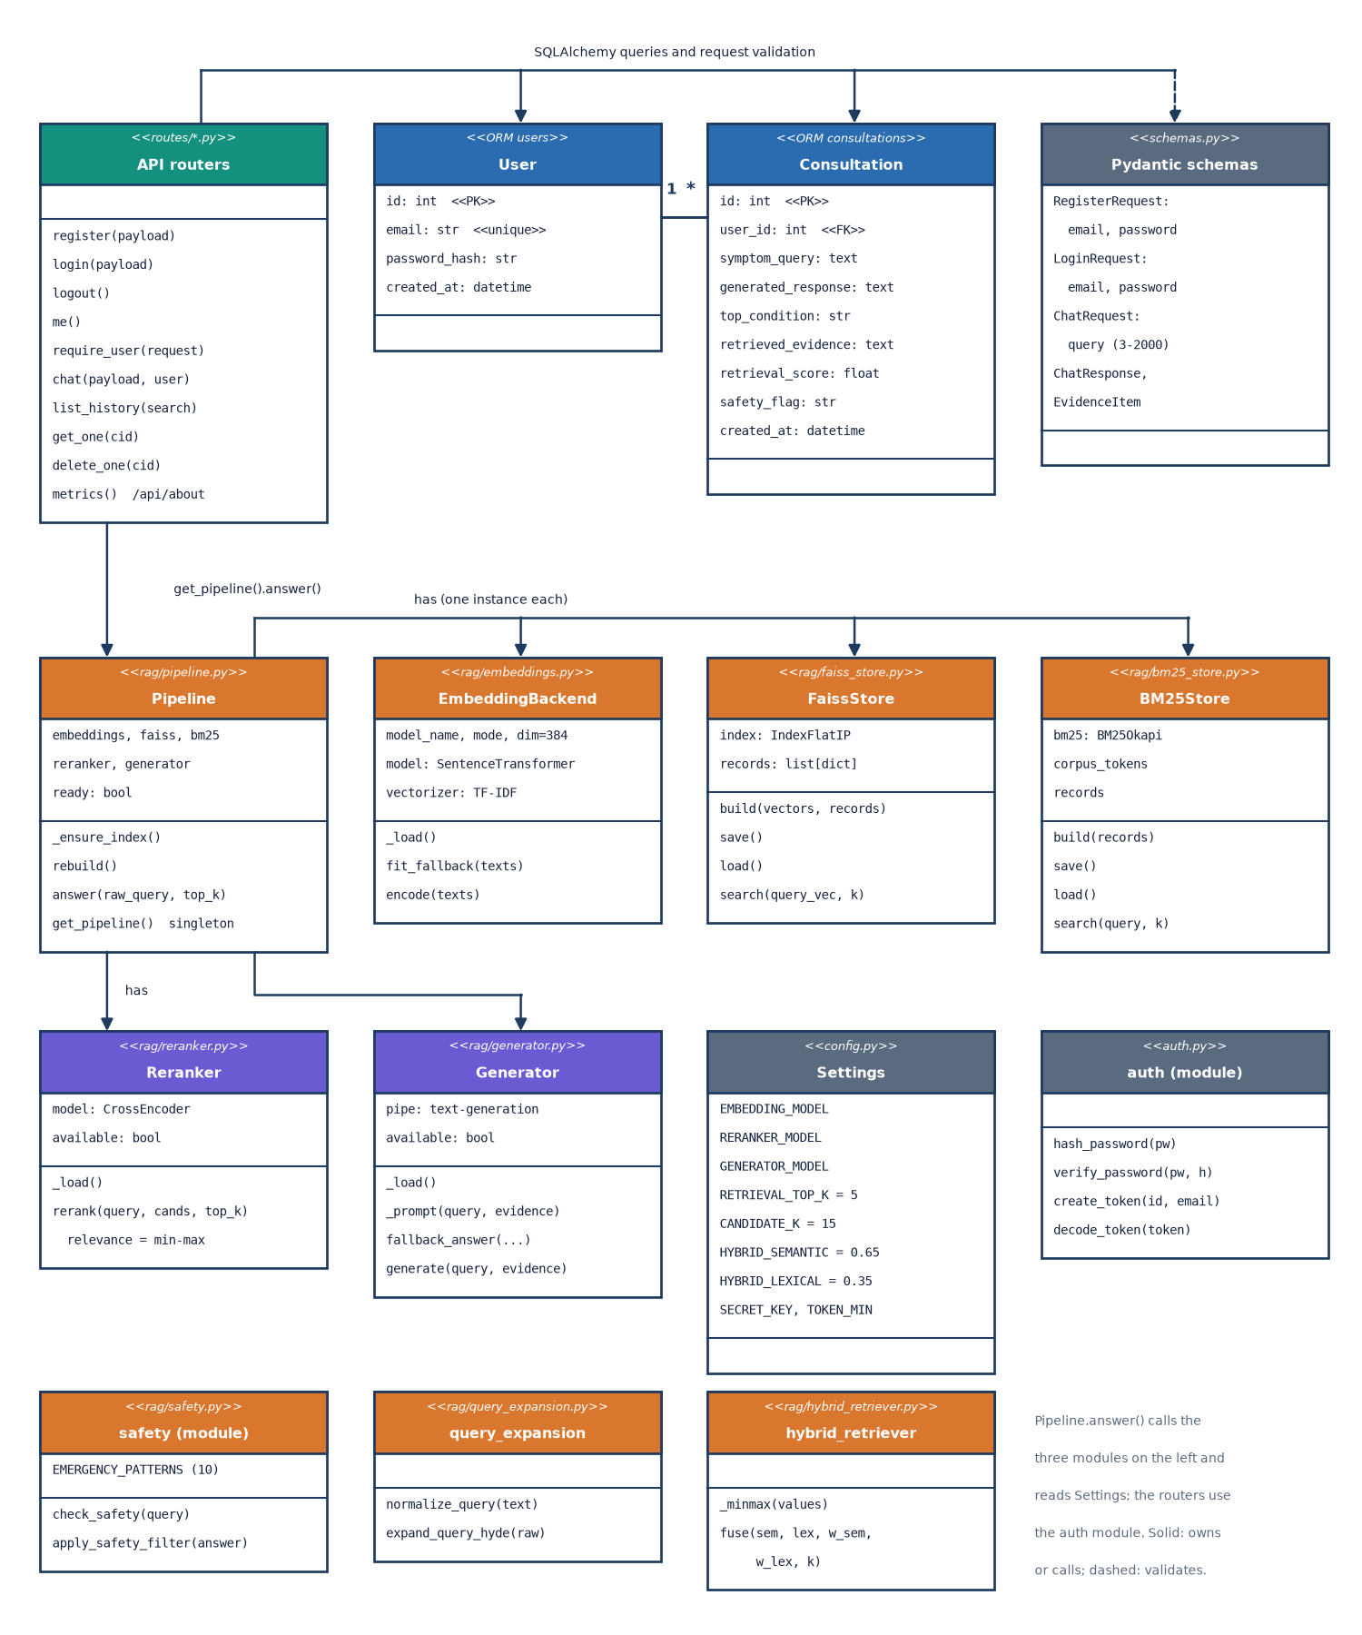
Database design and UML
Two SQLite tables: users and consultations (one user, many consultations, cascade delete). A consultation stores the retrieved evidence as JSON text, so history never depends on the index.
Notes:
Two tables. Each consultation is a frozen snapshot of the answer and its evidence; users can only read or delete their own rows.

Slide 13
Technology stack
Layer | Technology
Backend | Python 3.11.9, FastAPI 0.159.1, Uvicorn, Pydantic v2, SQLAlchemy 2.1.6, SQLite, bcrypt, PyJWT
Retrieval | sentence-transformers 6.2.0 (all-MiniLM-L6-v2, cross-encoder), faiss-cpu 1.15.1, rank-bm25
Generation | PyTorch 2.14.1+cpu, Transformers 5.20.2, google/flan-t5-small
Data and ML utilities | scikit-learn 1.9.1 (TF-IDF fallback, metrics), NumPy, pandas
Front end | React 19, Vite 8, react-router 7, Recharts, Framer Motion, GSAP (port 5412)
Testing | pytest, FastAPI TestClient, smoke-test script, Playwright browser walk
Packaging | run.bat (venv, install, index build, both servers); Dockerfile + docker-compose with nginx
Notes:
Python 3.11.9 on Windows. Everything is open source; the transformers 5 line matters later: it removed the task the generator relies on.

Slide 14
Implementation progress
Component | Status | Evidence
Knowledge base and indexes (FAISS, BM25) | Done | 176 records, 30 conditions; synthetic
Hybrid retrieval, fusion and cross-encoder | Done | lay-language top-1 0.967 (n = 60)
Answer generation | Done, 1 defect | Flan-T5 output echoes its prompt (30/30); fallback answer works
Safety rules and filter | Done, limits | 27/40 emergencies flagged; paraphrases 0/12
Accounts, history, search, delete | Done | 22 of 22 smoke checks; 21 screenshots
React web app and legacy pages | Done | 8 pages, dark mode, mobile layout
Trends and progression over time | Not done | history list only; no timeline or trend analysis
Real medical knowledge base, user study | Not done | synthetic base; no clinician review
Notes:
State of the code base. The honest gaps: trends over time, a real knowledge base and a clinician review.

Slide 15
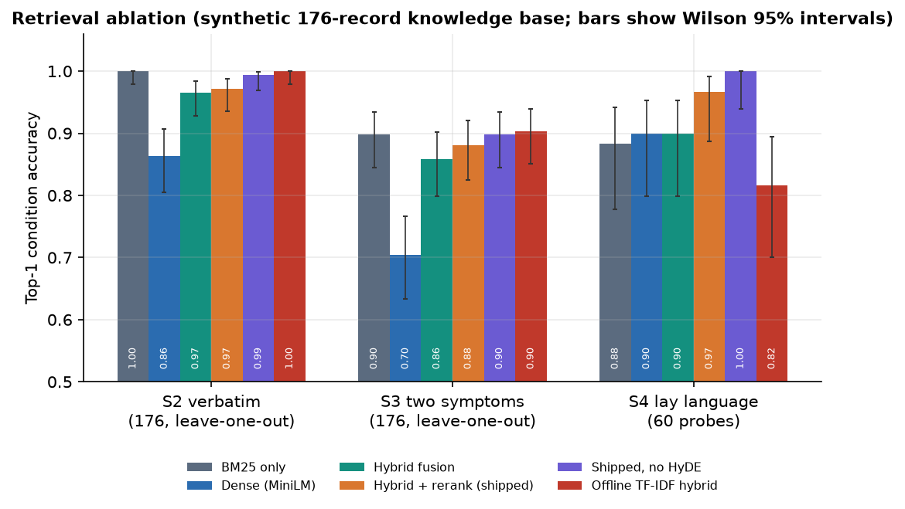
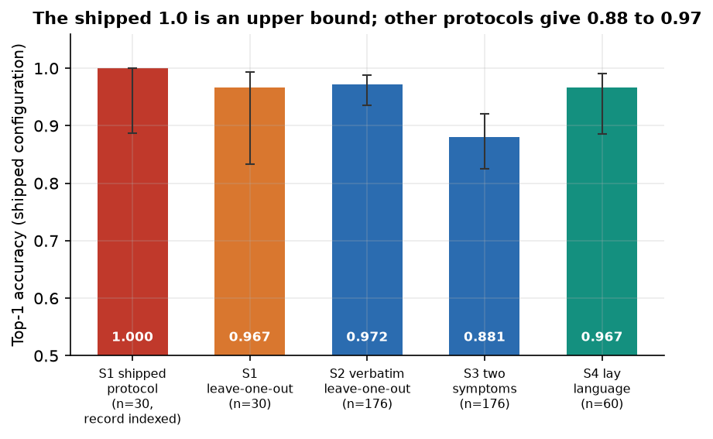
Preliminary results
96.7%
88.1%
81.7%
0.68
lay-language top-1, shipped pipeline (n = 60)
two-symptom queries, leave-one-out (n = 176)
same probes with the offline TF-IDF fallback
emergency recall (paraphrases 0 of 12)
The shipped 100% on the About page counts held-out records that are still in the index; removing them gives 0.967 (n = 30). Probes are written by the team on a synthetic base, so these are pipeline measurements, not clinical accuracy; not comparable with the base paper.
Notes:
Four headline numbers, each with its protocol. Shipped protocol 1.00 is an upper bound; leave-one-out 0.967; two random symptoms 0.881; lay language 0.967. BM25 alone is already strong (0.883 on lay language).

Slide 16
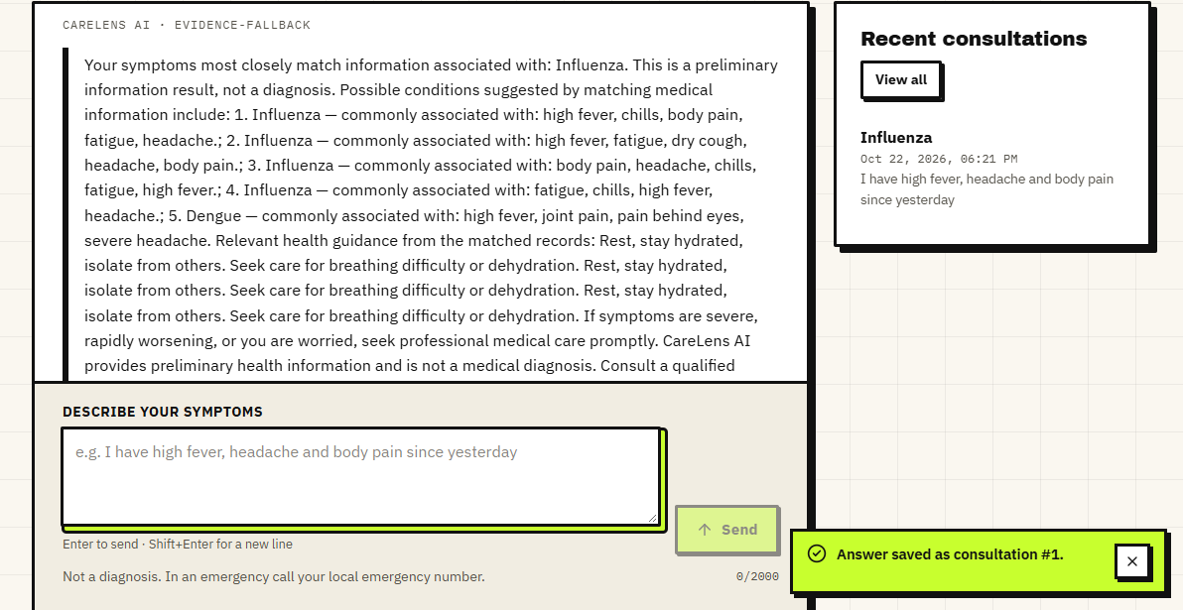
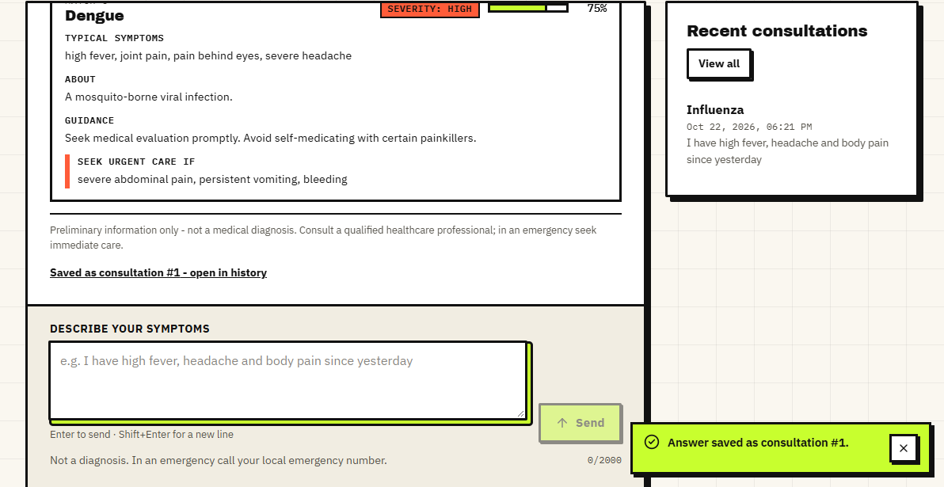
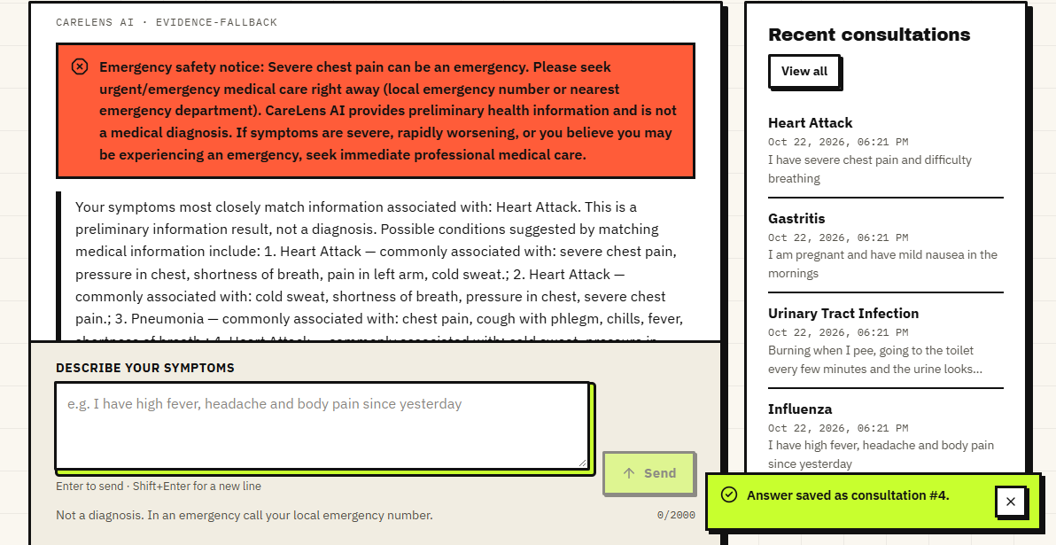
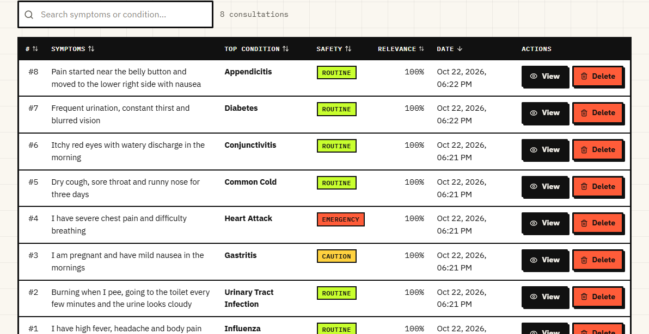
Output screens
Top: answer and evidence card for a fever query. Bottom: emergency banner for chest pain, and the consultation history. All captured from the running app.
Notes:
Real screenshots of the running application. The answer text is the evidence-based fallback; the evidence card shows record symptoms, guidance and red flags.

Slide 17
Initial testing and observations
9 / 9
22 / 22
0
0.74 s
pytest tests passed
smoke-test checks passed
console errors in the browser walk
median /api/chat with the local generator
Observation | Action
Out-of-base complaints (tooth ache, sprained ankle ...) still read 'Strong match' at 100% | Documented; the raw reranker score separates them (AUROC 1.0), a fix is listed
Flan-T5 'answer' is the prompt itself under transformers 5 | Recorded as a defect; fallback answer used for the screens
Safety rules miss paraphrased emergencies and fire on negated or historical mentions | Stated limit; measured on 40 + 30 probes
Notes:
Tests ran against the real pipeline with real models. The observations come from measuring, and each is documented rather than hidden.

Slide 18
Challenges and corrective actions
Challenge | Corrective action
No open symptom-disease dataset could be used | Synthetic, labelled base; every metric states it; ceiling effects explained
Library drift: transformers 5 removed text2text-generation | Defect measured (30 of 30 echoes); evidence-based fallback keeps answers usable
CPU latency: the cross-encoder dominates | Measured 555 ms of a 484 ms answer; caching and a smaller pool are next steps
Relevance shown to the user is relative, not absolute | Measured with out-of-base queries; raw scores kept for a calibrated display
Safety rules are literal regular expressions | Reported recall by wording; synonyms, negation and a classifier listed as future work
Notes:
Each challenge was met by a concrete design choice or by measuring it and saying so in the report.

Slide 19
Next steps
1
Real knowledge
2
Independent evaluation
3
Fix defects
4
Track over time
Replace the synthetic base with a licensed medical source and have a clinician review conditions and guidance.
Test with queries written by people outside the team and report top-k with confidence intervals.
Load Flan-T5 directly for transformers 5, show a calibrated relevance, handle negation and paraphrase in the safety layer.
Add a symptom timeline and trend view over the stored consultations, as the base paper's gap statement asks.
Notes:
Plan to the final review and beyond. The first two items address the biggest honest gaps: the synthetic base and team-made probes.

Slide 20
Thank you
Questions and suggestions are welcome.
Notes:
Likely questions: why BM25 plus dense; why the answer is not diagnosis; what the 100 percent on the About page means; what the safety layer cannot do.

