Slide 1

SymptoTrackAI: Hybrid RAG Based Symptom Tracking and Health Monitoring System
Final Review · SymptoTrackAI
Team Details : Batch C12
Under the Esteemed Guidance of
Dr. Ch. B. Naga Lakshmi
[DESIGNATION], Department of CSE
23K91A05E9 Mariyada Karthika Reddy
23K91A05G6 Nacharam Akshaya
23K91A05D6 Madoori Prabath Teja
23K91A05K1 Pulimadhi Keerthan
DEPARTMENT OF COMPUTER SCIENCE AND ENGINEERING · TKR College of Engineering & Technology · Academic Year [ACADEMIC YEAR]
Notes:
Introduce the team and the project: SymptoTrackAI, implemented as the CareLens AI web application, a local hybrid RAG assistant for symptoms.

Slide 2
Table of Contents
Abstract
Base Paper & Literature Survey
Research Gap, Problem Statement & Objectives
Proposed System & Architecture
Methodology, Knowledge Base & Models
Retrieval Workflow, Interaction & Storage
Implementation Highlights
Results: Retrieval, Confusion Matrix, Safety
Performance & Testing
Comparison with Base Paper
Output Screens
Conclusion, Future Scope & References
Dept. of CSE | Batch C12 | Final Review
2
Notes:
The agenda follows the report: problem, design, method, results, comparison, screens, conclusion.

Slide 3
Abstract
Delayed diagnosis and limited access push people to web search and general chatbots, which give ungrounded answers and keep no record of how symptoms evolve.
SymptoTrackAI, built as the CareLens AI web app, expands a symptom description, retrieves records with FAISS (MiniLM) and BM25, fuses them 0.65 / 0.35, reranks with a cross-encoder and builds the answer only from the retrieved records, with rule-based emergency warnings and a private consultation history.
On a synthetic 176-record, 30-condition base the shipped pipeline puts the right condition first for 96.7% of 60 team-written lay-language probes and 88.1% of two-symptom queries (leave-one-out). The shipped 100% figure is an upper bound.
Emergency rules flag 27 of 28 literally worded cases but 0 of 12 paraphrases; the local Flan-T5 generator echoes its prompt (30 of 30); relevance always shows 100%.
A full answer takes about 0.4 s (fallback answer) or 0.7 s (Flan-T5) on a CPU. 9 of 9 tests and 22 of 22 smoke checks pass.
Not done: trend analysis over time, a real medical knowledge base, clinician review, a user study.
Dept. of CSE | Batch C12 | Final Review
3
Notes:
Read the problem, then the system in one breath. Give each number with its protocol and end on the honest limits.

Slide 4
Base Paper
U. S. Madhury and M. Ramesh, "A hybrid retrieval-augmented generation framework for intelligent symptom monitoring and disease guidance," Int. J. Eng. Res. Sci. Technol., vol. 22, no. 3, pp. 702-707, 2026, doi: 10.62643/ijerst.2026.v22.n3.4170.
Aspect | Base paper: a hybrid RAG framework for intelligent symptom monitoring and disease guidance
Method | Sequence-NQ transformer embeddings of a symptom-disease knowledge base, FAISS similarity search, RAG generation of guidance
Data | A symptom-disease dataset with advice, de-duplicated and indexed; size and source not stated
Application | Registration, login, chatbot symptom analysis and a stored consultation log (health log) for continued monitoring
Reported results | No accuracy, recall, latency or ablation figures; 'experimental observations' only, one example (symptoms leading to Typhoid)
Stated limits | None; future work lists a larger knowledge base, multilingual and multimodal support, cloud deployment
Dept. of CSE | Batch C12 | Final Review
4
Notes:
Madhury and Ramesh, IJERST 2026. We adopt the product idea and the web-app modules; the paper gives no numbers, so nothing can be compared quantitatively.

Slide 5
Literature Survey
Work | Year | Approach | Data / finding / limitation
Madhury & Ramesh [1] (base) | 2026 | Sequence-NQ embeddings + FAISS + RAG over a symptom-disease base; login, history | No numbers reported; one Typhoid example; no ablation or latency
Divya et al. [7] | 2018 | AI self-diagnosis chatbot for symptom conversations | Described in [1] as effective; no figures read
Hsu & Yu [9] | 2022 | Machine learning + natural-language understanding medical chatbot | Better than rule-based chatbots per [1]; no figures read
Babu & Boddu [10] | 2024 | BERT-based medical chatbot for query understanding | Ungrounded generation; no retrieval of sources
Peri et al. [11] | 2024 | RAG chatbot that chats with medical books | Grounds answers in retrieved text; no symptom log or safety layer reported
Son et al. [5] | 2025 | RAG chatbot over hospital EMR manuals, fine-tuned BGE-M3 / E5 embeddings | 5,931 pairs; 97.6% / 89.7% retrieval accuracy; <10 ms; admin, not symptoms
Nananukul & Kejriwal [6] | 2026 | ClinicBot: guideline extraction, evidence priority, citations (diabetes) | System demonstration; no accuracy table; one disease
Gao et al. HyDE [20] | 2023 | LLM writes a hypothetical answer that is embedded for retrieval | Needs an LLM; here replaced by a fixed template
Dept. of CSE | Batch C12 | Final Review
5
Notes:
Representative work: chatbots, RAG over books and hospital manuals, a guideline-grounded demo and HyDE. Three survey items could not be verified and are flagged in the report.

Slide 6
Research Gap
The base paper reports no accuracy, recall or latency, so its retrieval quality is unverified
It uses dense search only: exact symptom words are not matched lexically and nothing is reranked
General medical chatbots rarely show which retrieved record supports each answer
Emergency wording needs a safety layer that a retrieval-only chatbot does not provide
Consultations are stored, but progression and trends over time are not analysed
No student-deployable tool joins hybrid retrieval, safety escalation and a private history
Dept. of CSE | Batch C12 | Final Review
6
Notes:
Six gaps drawn from the survey. We address 1 to 4 and 6 directly; trend analysis (5) is only partly addressed.

Slide 7
Problem Statement
Self-diagnosis through general web search yields inaccurate and frightening results
General chatbots answer from public data with no medical grounding or citation
Symptoms are recorded as isolated events, so progression over time is never visible
An ungrounded health answer can cause real harm if acted upon
Need: an assistant that answers only from a curated knowledge base, cites it and keeps a history
Input
Output
Record
Symptoms in everyday language, 3 to 2,000 characters, from a signed-in user
Evidence-backed answer, possible-condition cards, safety flag, relevance label
Private consultation history: search, open, delete
Dept. of CSE | Batch C12 | Final Review
7
Notes:
The statement has three parts: ground the answer, warn on emergencies, and keep an inspectable private record.

Slide 8
Objectives
1. Build a curated medical knowledge base and index it for semantic retrieval
2. Accept symptoms in natural language and expand the query to improve recall
3. Implement hybrid retrieval combining dense vector search with neural reranking
4. Generate grounded responses that cite the retrieved source for every statement
5. Track reported symptoms over time to reveal progression and trends
6. Evaluate retrieval relevance, answer groundedness and response time
Dept. of CSE | Batch C12 | Final Review
8
Notes:
The six objectives of the proposal. The conclusion states the real status of each: 5 is not met beyond storage, 4 and 6 only partly.

Slide 9
Proposed System
Symptom text
Expand
FAISS + BM25
Fuse + rerank
Answer + safety
Normalise the symptom text and expand it with a local HyDE-style template
Retrieve candidates twice: MiniLM semantic search in FAISS and BM25 lexical search
Fuse the min-max normalised scores 0.65 semantic + 0.35 lexical, then rerank with a cross-encoder
Build the answer only from the retrieved records, with evidence cards and a safety filter
Flag emergencies with rules and store every consultation privately per user
The assistant gives information, never a diagnosis: every screen carries the disclaimer.
Dept. of CSE | Batch C12 | Final Review
9
Notes:
The proposed system as one line of boxes and the design rules behind it.

Slide 10
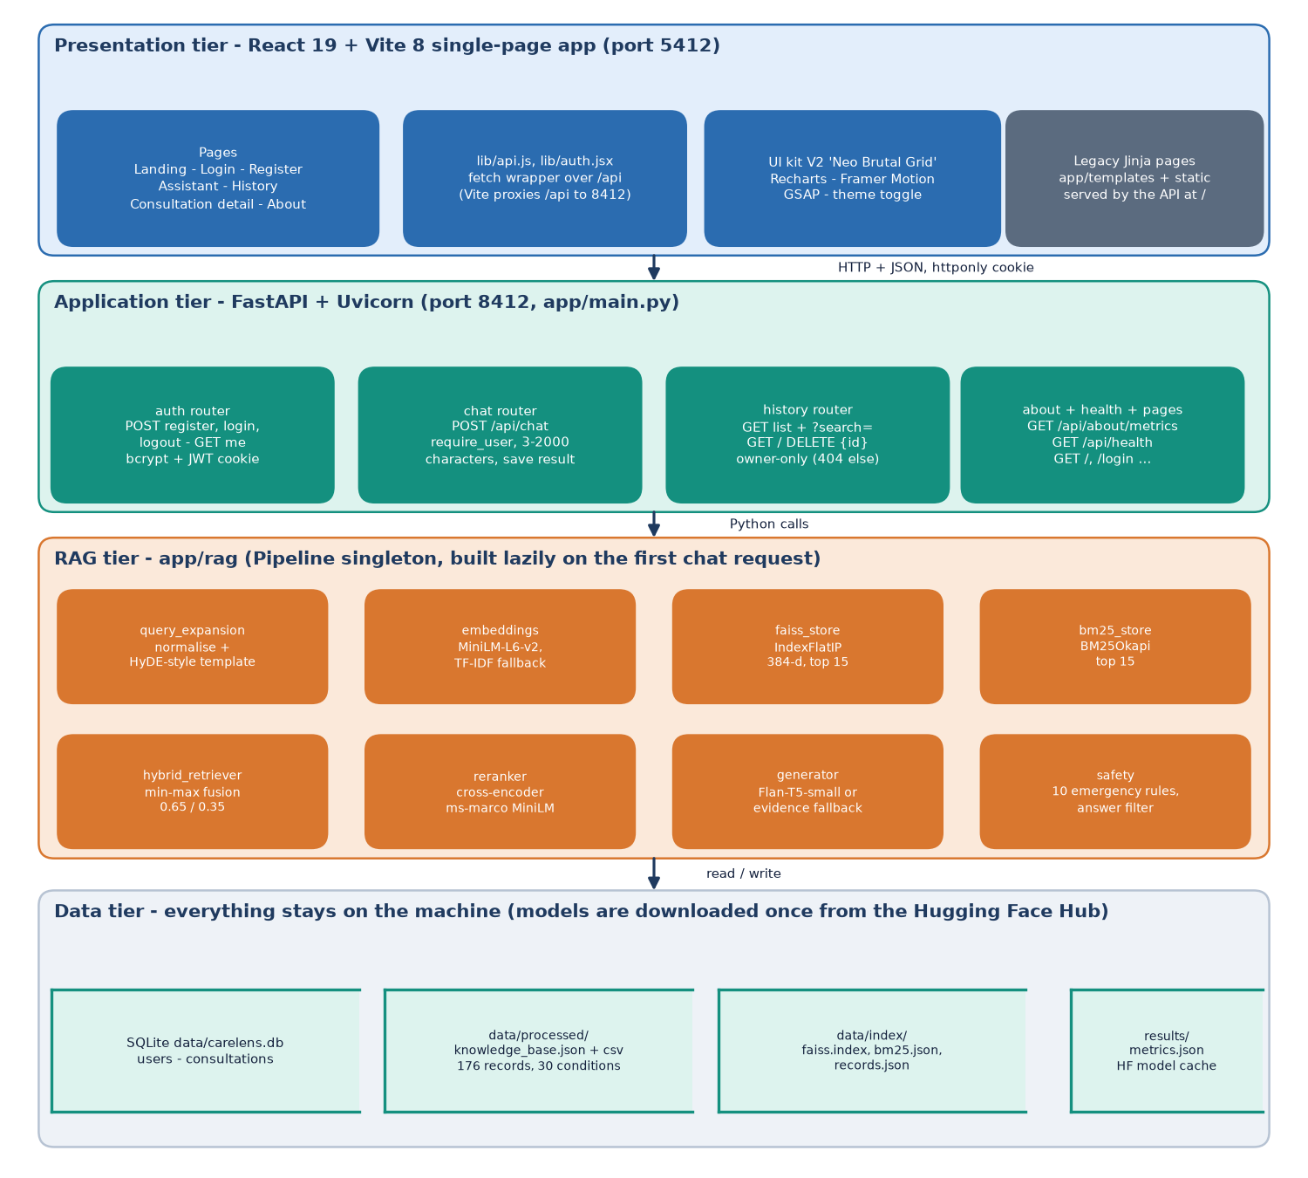
System Architecture
Web app: React + Vite, port 5412
API: FastAPI, port 8412, 10 routes
RAG: expansion, FAISS, BM25, fusion, rerank, generator, safety
Storage: SQLite (users, consultations), index files
Local first: no symptom text leaves the machine
Dept. of CSE | Batch C12 | Final Review
10
Notes:
Layers and storage; all analysis runs on the local machine, with no paid API.

Slide 11
Methodology
Normalise
HyDE template
FAISS + BM25
Fusion
Cross-encoder
Answer
Safety + store
Nothing is trained: MiniLM, the MS-MARCO cross-encoder and Flan-T5 are used as published; the work is the pipeline, the safety layer and the measurement.
Retrieval measured on five query sets: shipped protocol (30), leave-one-out (30 and 176), two random symptoms (176) and 60 team-written lay-language probes.
Seven configurations compared: BM25, dense, hybrid, hybrid + rerank (shipped), shipped without expansion, and two TF-IDF offline modes.
Safety layer probed with 40 emergency and 30 non-emergency texts; displayed relevance probed with 15 out-of-base complaints.
Every number is written by scripts/measure_metrics.py to docs/metrics/metrics.json.
Dept. of CSE | Batch C12 | Final Review
11
Notes:
Workflow and the measurements added on top of the shipped system.

Slide 12
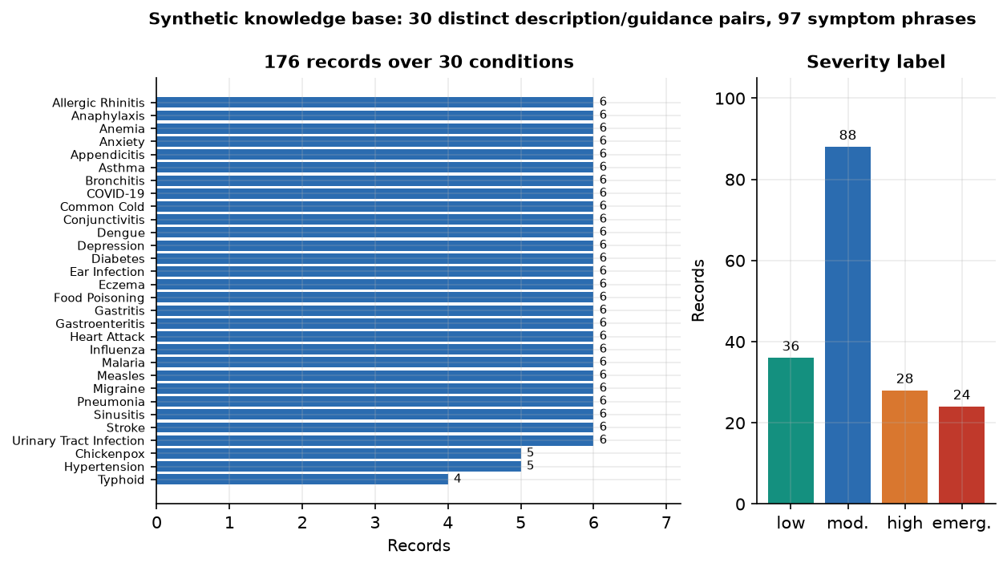
Knowledge Base & Models
176
Component | Choice
Dense | all-MiniLM-L6-v2 + FAISS flat
Lexical | BM25Okapi
Rerank | ms-marco MiniLM cross-encoder
Answer | Flan-T5-small / fallback
records, synthetic (seed 42)
30
conditions, 4 to 6 records each
384
Severity: 88 moderate, 36 low, 28 high, 24 emergency records.
All records of a condition share one description and guidance text (30 distinct pairs), so retrieving the condition is easy.
No public dataset was used; the base is team-written and not clinically reviewed.
embedding dimensions (MiniLM)
Each record is searched as 'Disease: .. Symptoms: .. Description: .. Guidance: ..'.
Dept. of CSE | Batch C12 | Final Review
12
Notes:
Be frank about the data: synthetic and written by the team. It makes the condition easy to find and the metrics optimistic.

Slide 13
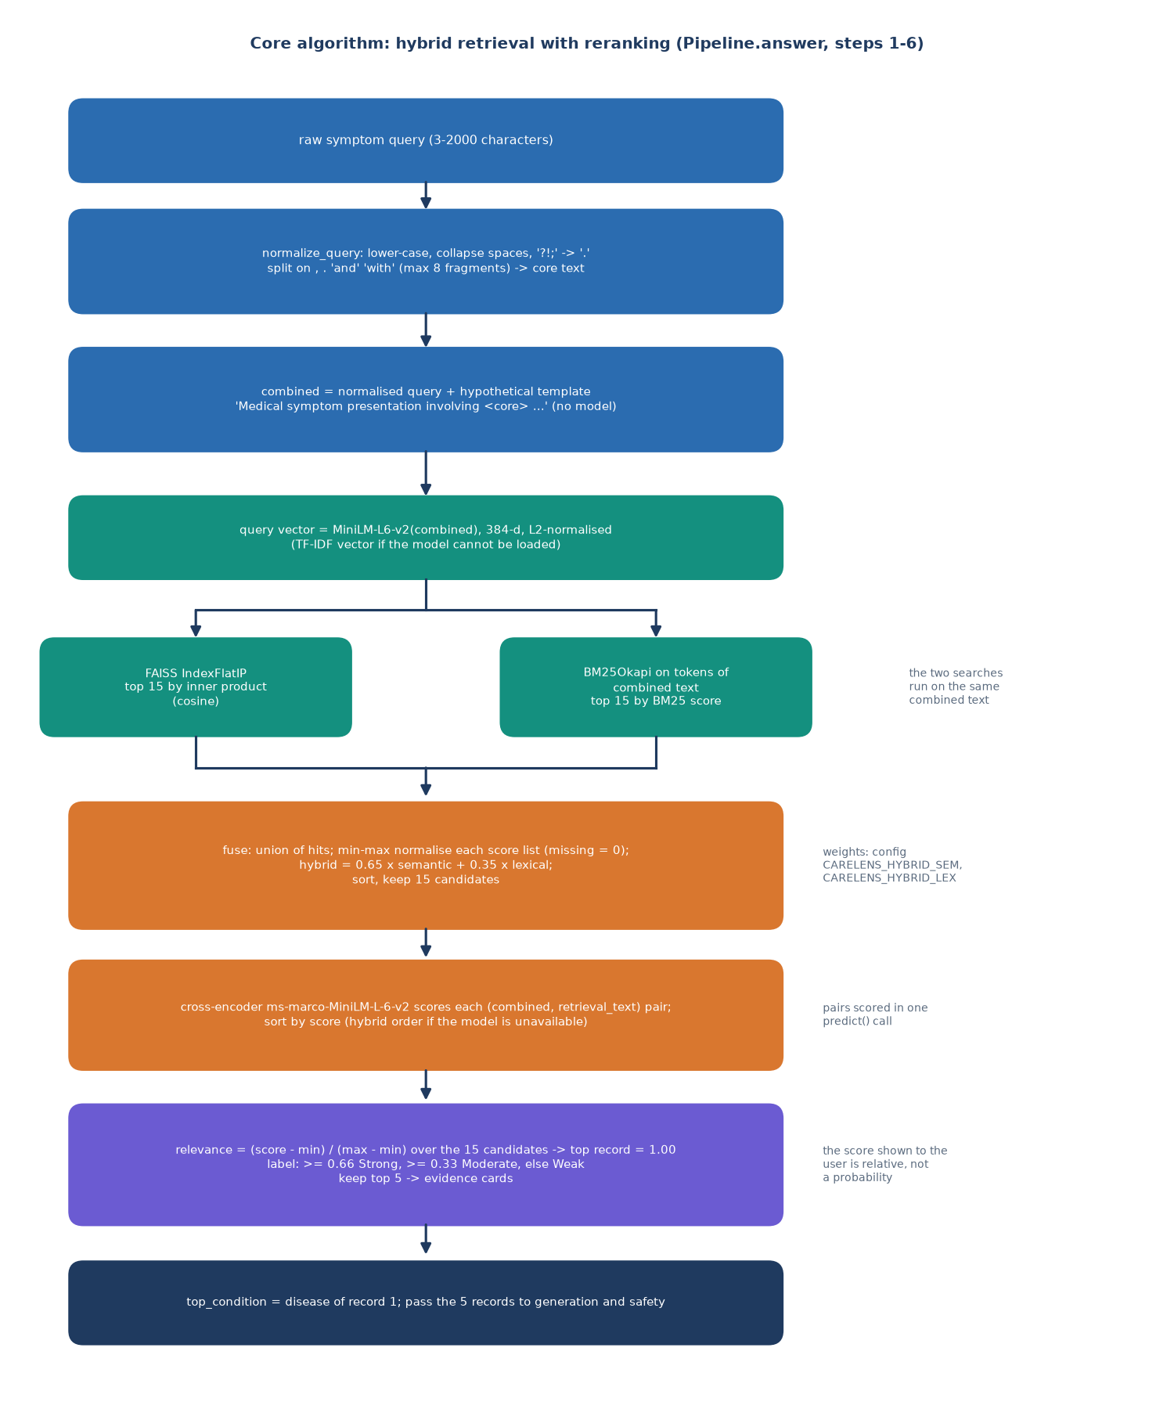
Retrieval Workflow
Query and template are embedded; FAISS returns the 15 nearest records.
BM25 scores the same text lexically and returns 15 records.
Each list is min-max scaled; fused = 0.65 x semantic + 0.35 x lexical.
The cross-encoder scores the 15 query-record pairs; the top 5 are kept and the scores are min-max scaled for display.
The answer is built from those records; rules check the query and filter the answer.
Dept. of CSE | Batch C12 | Final Review
13
Notes:
The core algorithm, in app/rag/pipeline.py.

Slide 14
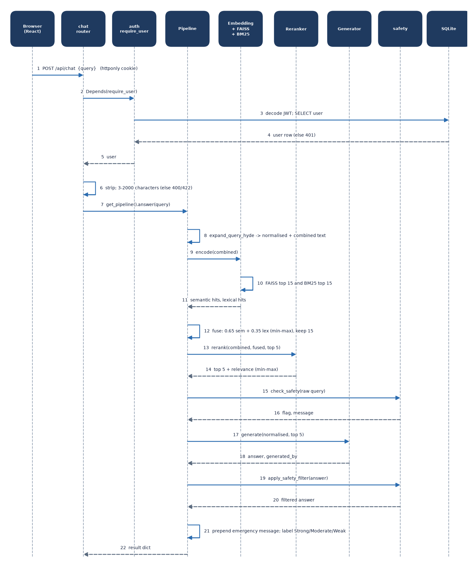
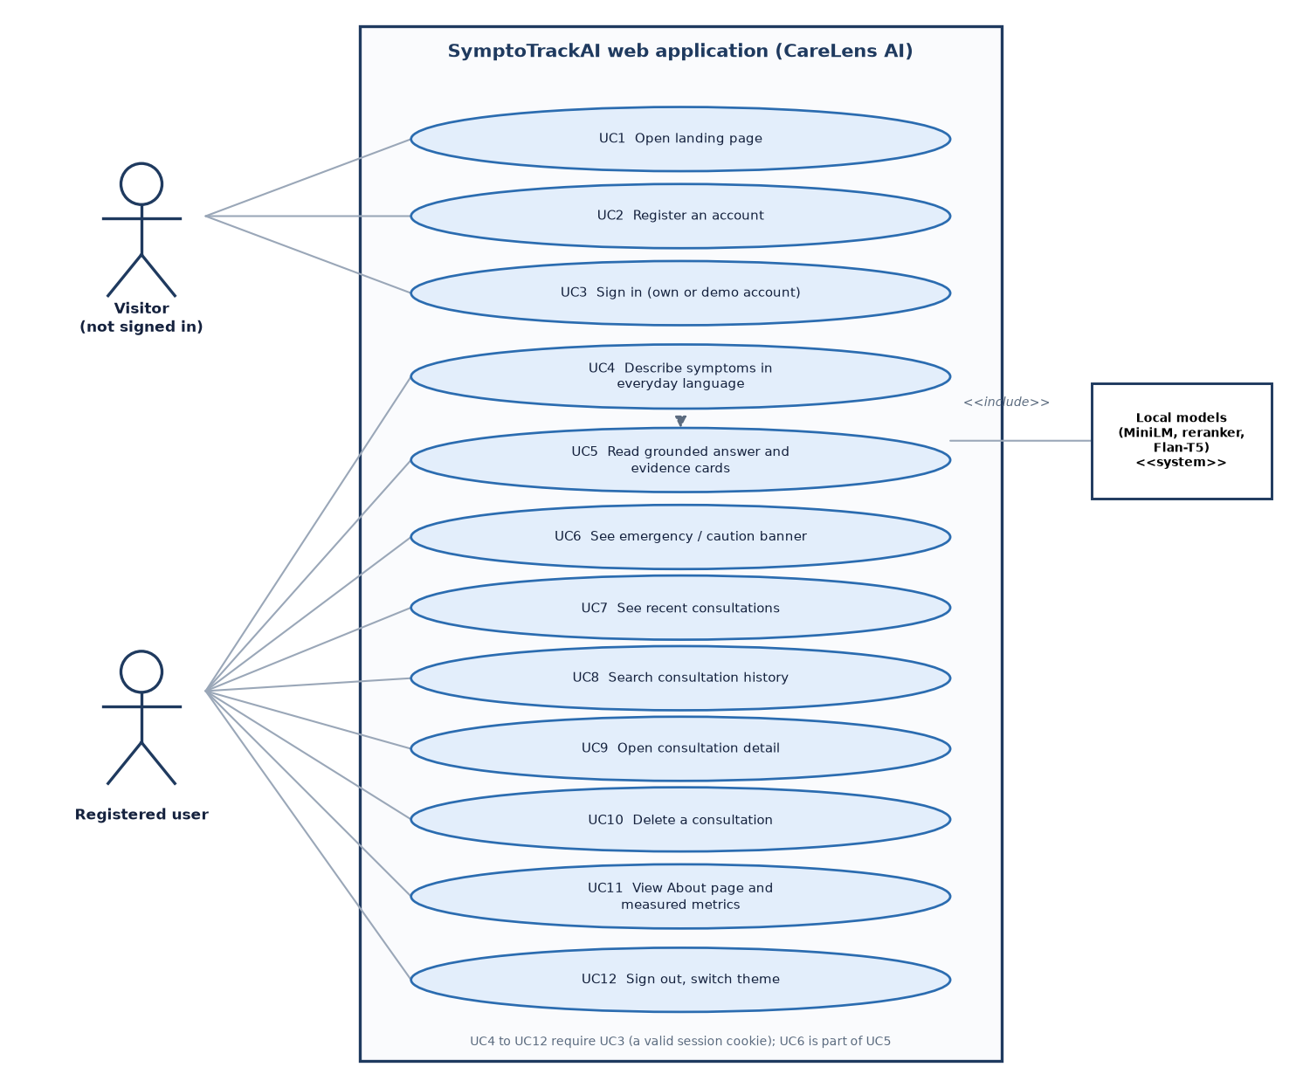
User – System Interaction
Dept. of CSE | Batch C12 | Final Review
14
Notes:
Sequence of one chat request and the use cases of the user.

Slide 15
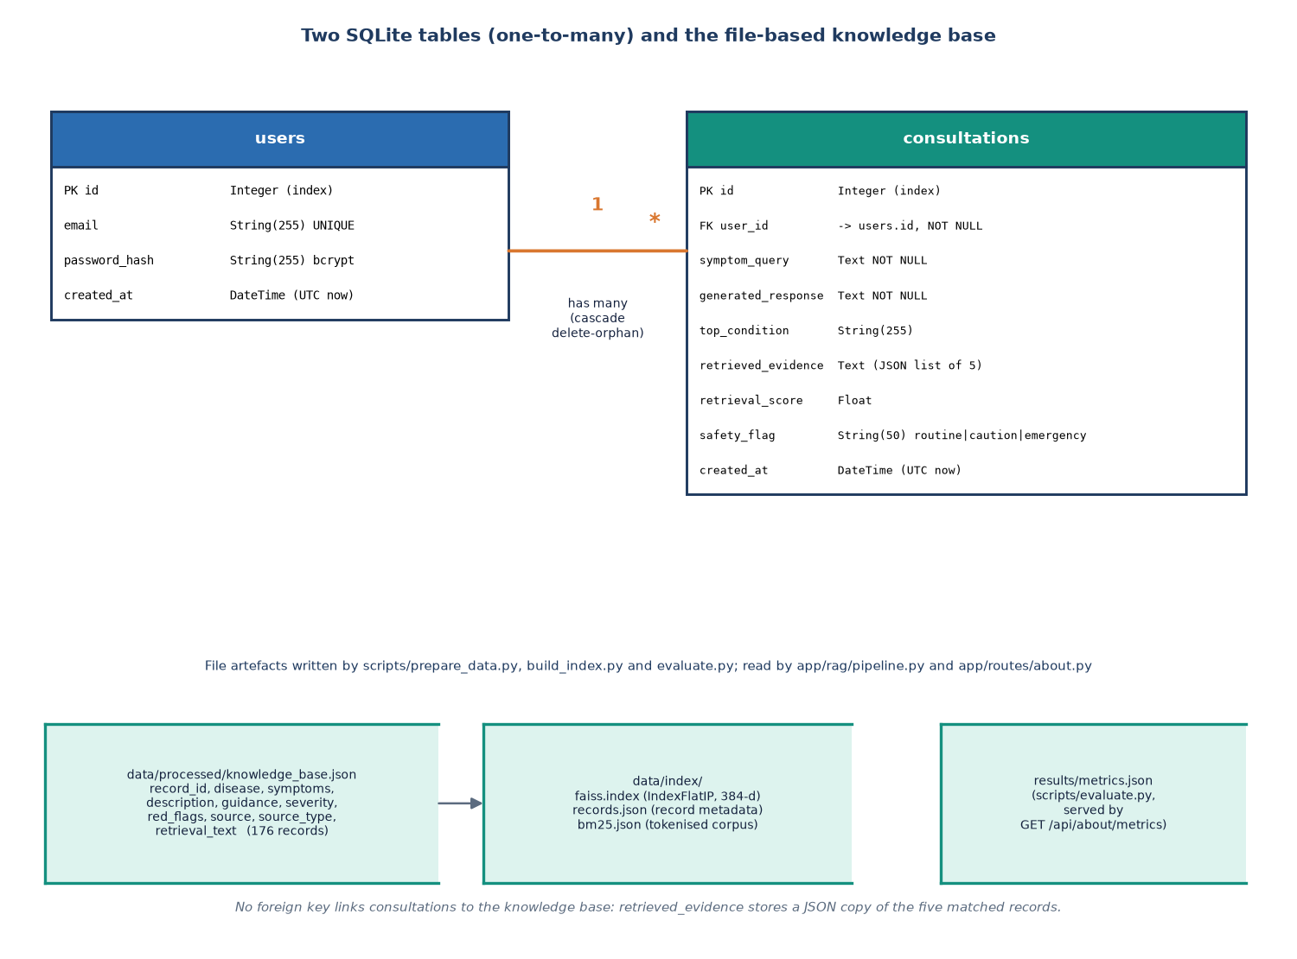
Database Design
Store | Content
table users | id, unique email, bcrypt hash, created_at
table consultations | query, answer, top condition, evidence JSON, score, flag
knowledge_base.json/csv | 176 synthetic records
faiss.index | 384-d flat inner-product index
bm25.json | tokenised corpus
records.json | records aligned with the index
A consultation keeps its evidence as JSON text, so history stays readable even if the knowledge base is rebuilt; deleting a user cascades to the rows.
Dept. of CSE | Batch C12 | Final Review
15
Notes:
Two SQLite tables plus file-based artefacts.

Slide 16
Implementation Highlights
10
9 + 22
8
800
REST routes
pytest tests + smoke checks
React pages
lines of backend code
Accounts: bcrypt hashing, HS256 token in an httponly cookie (1,440 minutes), per-user history isolation checked by a test (404 for another user's record).
Validation: query 3 to 2,000 characters; Pydantic schemas; clear errors for 401, 400, 422, 503 and 500.
Graceful degradation: MiniLM missing -> TF-IDF vectors; reranker missing -> hybrid order; generator missing -> evidence-based answer.
History with search, detail and delete (with confirmation); light and dark themes; one command starts both servers (run.bat); Docker + nginx variant.
Dept. of CSE | Batch C12 | Final Review
16
Notes:
Highlights: accounts and isolation, validation, degradation paths and one-command start.

Slide 17
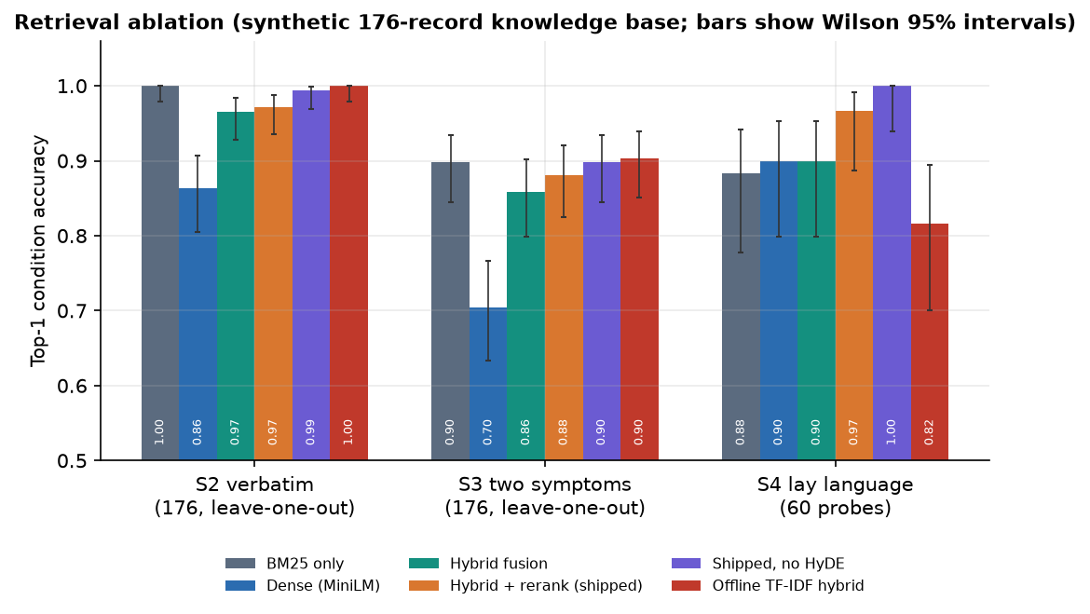
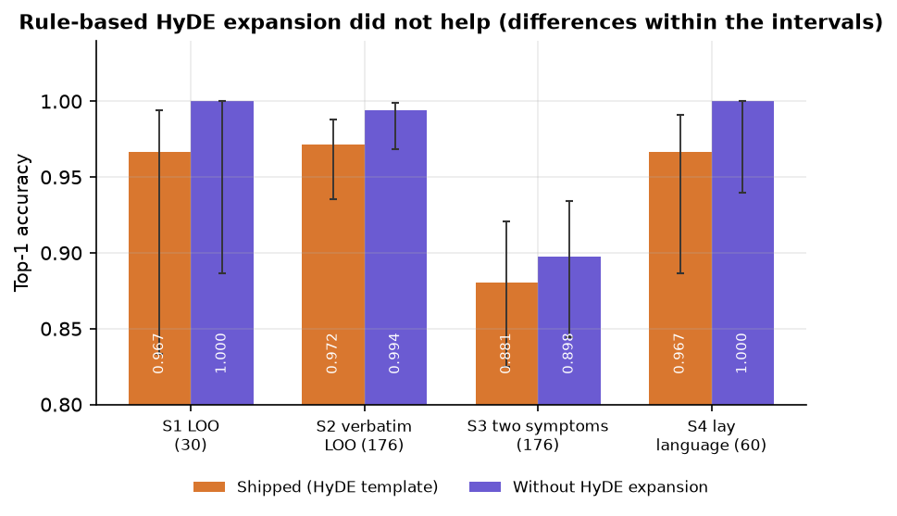
Results – Retrieval Configurations
96.7%
88.1%
88.3%
81.7%
shipped pipeline, lay language (n = 60)
two random symptoms (n = 176)
BM25 alone, lay language
offline TF-IDF mode, lay language
Dropping the HyDE-style template scores 1.000 on lay language against 0.967 shipped; Wilson 95% interval of the shipped result 88.6-99.1%.
Top-1 condition accuracy. The base is synthetic and the probes are team-written: these show how the components behave, not clinical accuracy.
Dept. of CSE | Batch C12 | Final Review
17
Notes:
Lay language: BM25 0.883, dense 0.900, hybrid 0.900, hybrid plus cross-encoder 0.967. Two random symptoms are harder: 0.881. The reranker helps most; the expansion template does not help.

Slide 18
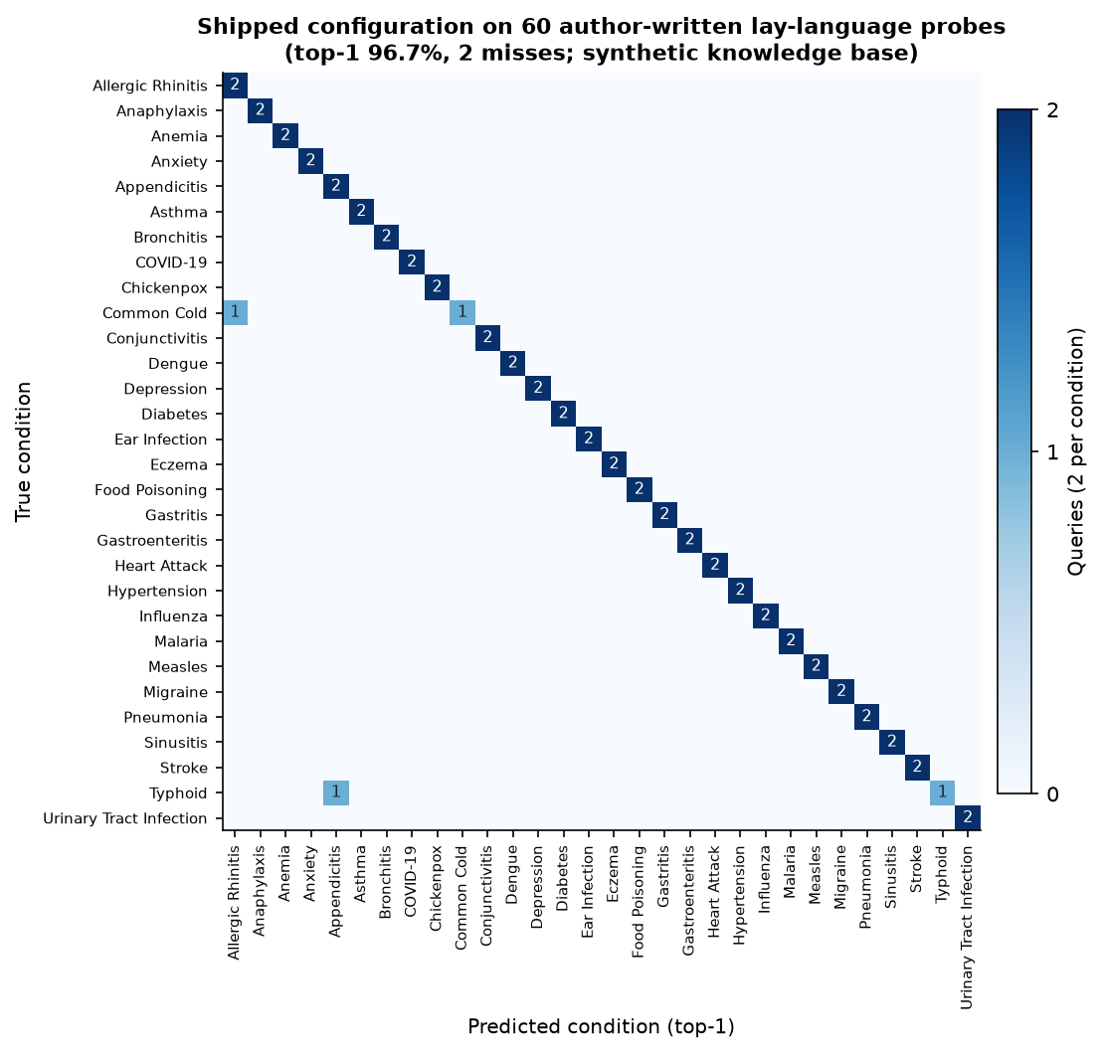
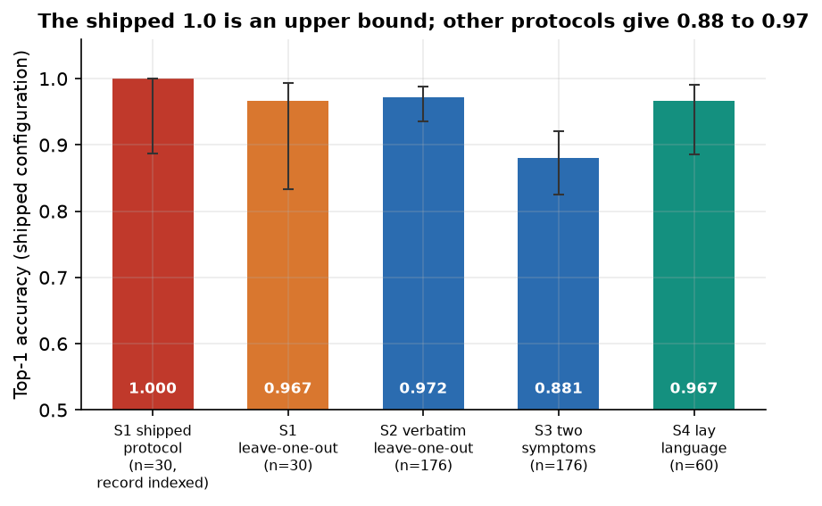
Confusion Matrix & Evaluation Protocol
Two lay-language misses: Common Cold read as Allergic Rhinitis; Typhoid read as Appendicitis.
The shipped evaluation (n = 30, top-1 = 1.0) keeps the held-out record in the index: an upper bound. Leave-one-out gives 0.967.
Rows: true condition; columns: predicted (60 lay-language probes).
Dept. of CSE | Batch C12 | Final Review
18
Notes:
The confusion matrix of the shipped pipeline on the lay-language probes: errors are common cold read as allergic rhinitis and typhoid read as appendicitis. The right figure shows how the protocol changes the number.

Slide 19
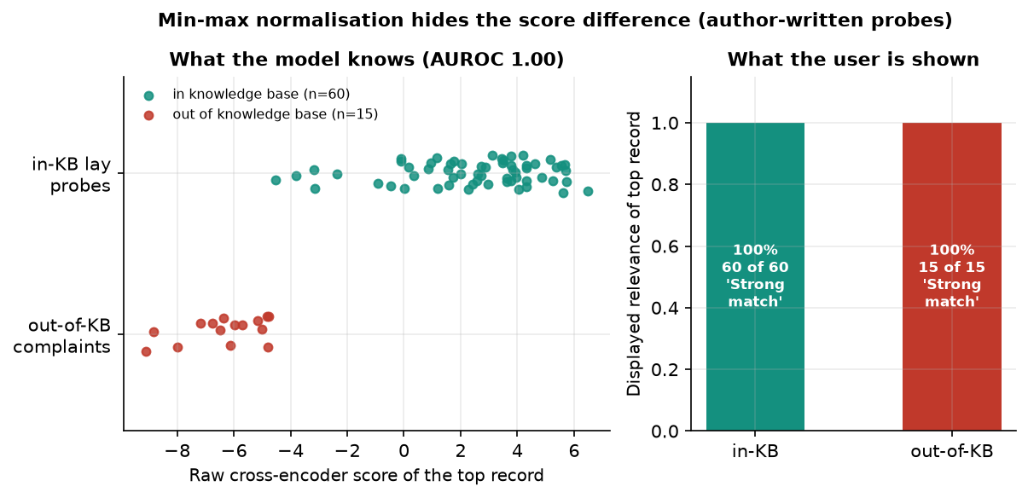
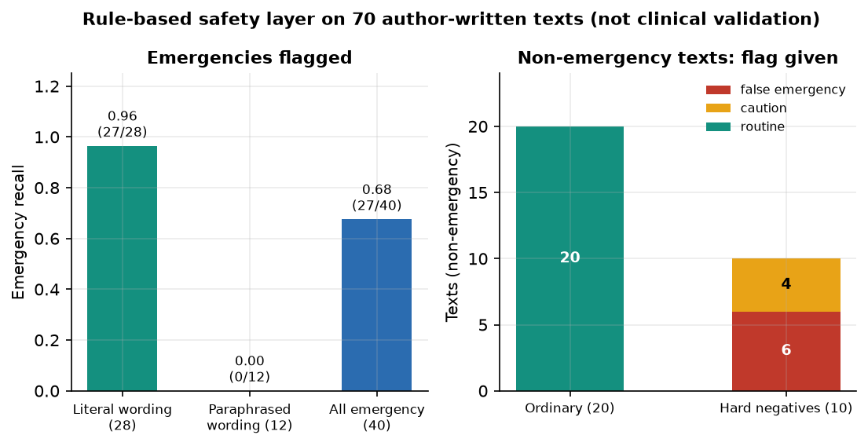
Results – Relevance Display & Safety Layer
All 15 out-of-base complaints show 'Strong match' at 100%, like every in-base query.
The raw cross-encoder score separates them (AUROC 1.0); min-max scaling hides it.
Emergency recall 0.675: literal wording 27/28, paraphrase 0/12.
Ordinary texts: 0 false alarms; hard negatives (negation, history): 6 of 10 wrongly flagged.
Answer filter cleaned 6 of 10 listed-phrase cases.
Dept. of CSE | Batch C12 | Final Review
19
Notes:
Two honest defects of the display and the safety layer, both measured with author-written probes.

Slide 20
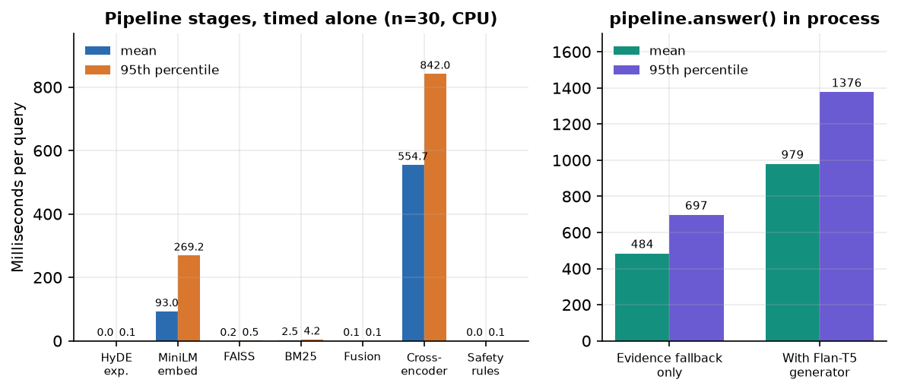
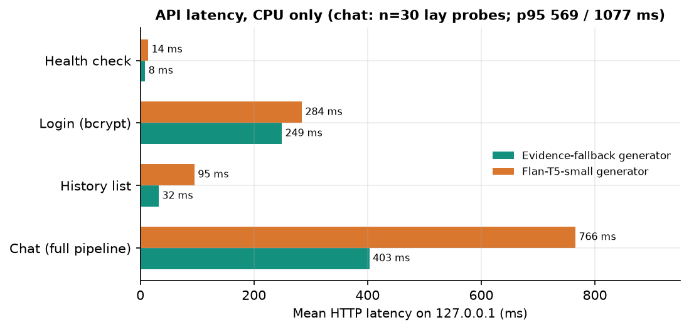
Performance & Testing
56 ms
555 ms
0.40 s
0.74 s
query embedding (median)
cross-encoder, 15 pairs (mean)
/api/chat median, fallback answer
/api/chat median, Flan-T5 on
Tests: pytest 9 of 9 passed in 34 s; smoke test 22 of 22 checks; browser walk of 21 screens with 0 console errors.
12th Gen Intel Core i5-12500 (6 cores / 12 threads), no GPU, 15.7 GB, CPU only, warm models; first start about 62 s to load three models. Not tested: concurrent users, a GPU, accessibility audit, a user study.
Dept. of CSE | Batch C12 | Final Review
20
Notes:
The cross-encoder is the dominant stage; Flan-T5 adds about 0.4 s per answer and, under transformers 5, returns the prompt.

Slide 21
Comparison with Base Paper (context only – different data and scope)
Aspect | Base paper [1] | This project (SymptoTrackAI)
Retrieval | Sequence-NQ embeddings + FAISS | MiniLM + FAISS, BM25, min-max fusion, cross-encoder rerank
Query handling | Direct embedding of the symptom text | Normalisation and a HyDE-style template (no measured gain)
Safety | None described | 10 emergency rules, caution keywords, answer filter, disclaimer
Application | Registration, login, chatbot, health log | Same modules, plus evidence cards, history search / delete, themes
Reported | No numbers; one Typhoid example | Lay-language top-1 0.967; 60 lay-language probes written by the team on a synthetic knowledge base
Trend tracking | Claimed through the stored log | Stored and searchable only; no trend analysis
The base paper gives no quantitative results, so no numerical comparison is possible and no superiority is claimed.
Dept. of CSE | Batch C12 | Final Review
21
Notes:
State plainly that the base paper has no numbers; the comparison is of what each system does, not of how well.

Slide 22
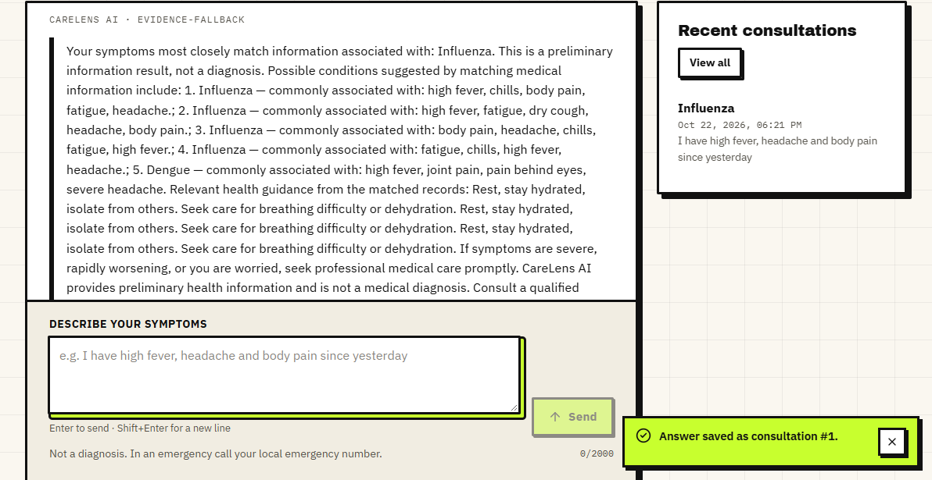
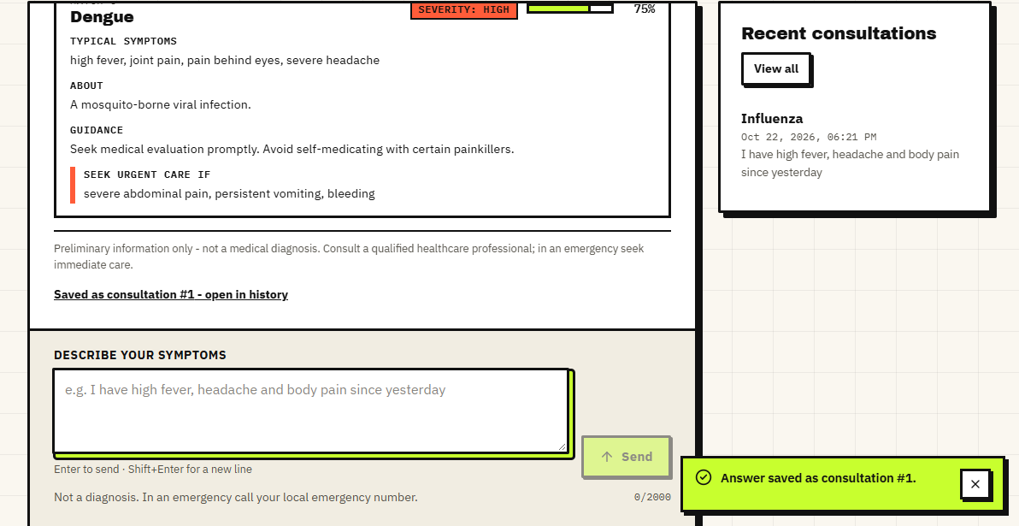
Output – Symptom Assistant
Left: a fever query answered from the retrieved influenza records (evidence-based answer). Right: the matching evidence card for dengue, with typical symptoms, guidance, severity and 'seek urgent care if' red flags.
Dept. of CSE | Batch C12 | Final Review
22
Notes:
Real screenshots from the running app. The answer is built from retrieved records; the evidence cards show what supports it.

Slide 23
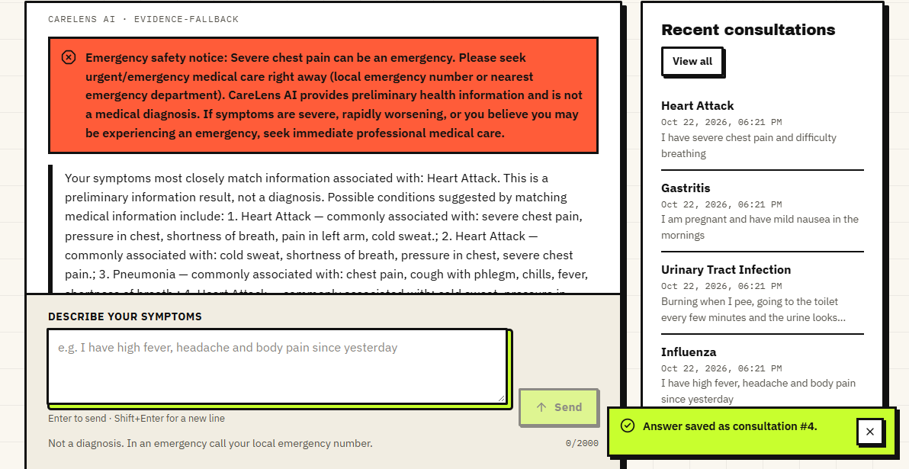
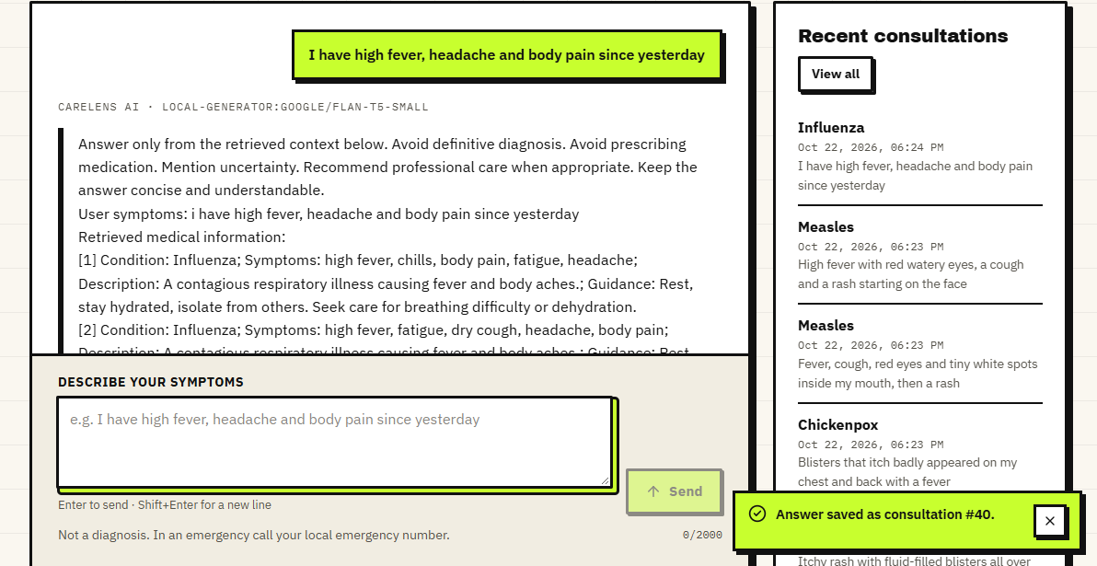
Output – Safety Escalation and Local Generator
Left: the emergency banner for chest pain with breathing difficulty. Right: the same app with the default Flan-T5 generator: the 'answer' is the prompt echoed back, the defect we measured.
Dept. of CSE | Batch C12 | Final Review
23
Notes:
The right screenshot is a failure case shown on purpose: with transformers 5 the generator returns its own prompt.

Slide 24
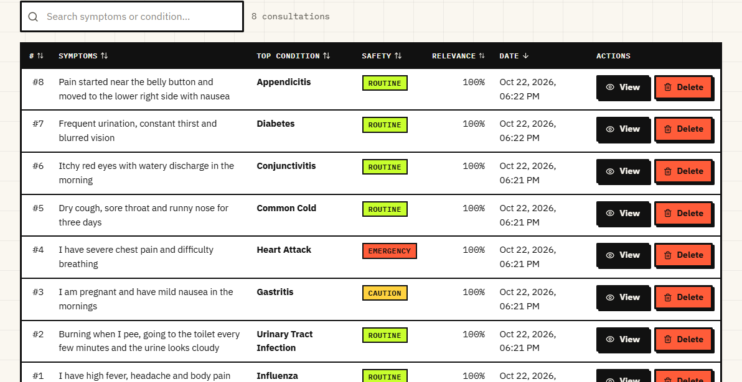
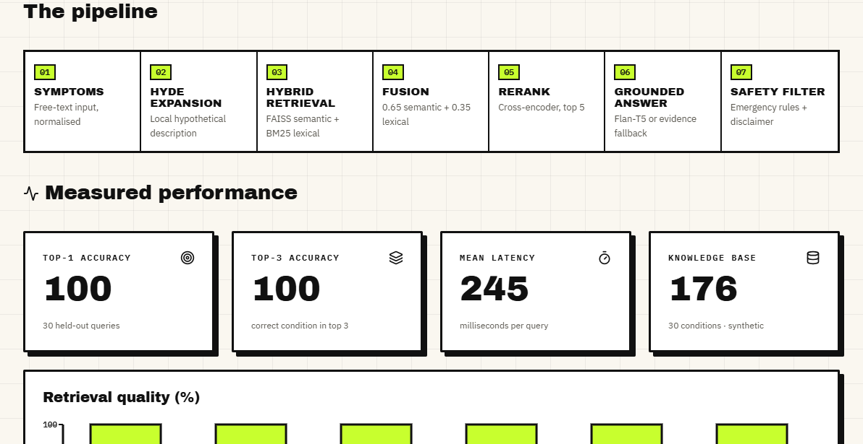
Output – History and About Page
Left: consultation history with safety flag and relevance (every row 100%). Right: the About page, which shows the shipped evaluation (100%, n = 30) and states that these scores are an upper bound on synthetic data.
Dept. of CSE | Batch C12 | Final Review
24
Notes:
The product itself says the shipped metrics are an upper bound; the history shows the relevance display problem.

Slide 25
Conclusion
Delivered: a working local application from symptom text to an evidence-backed answer, emergency warning and private history, with 9 pytest tests and 22 smoke checks passing.
Measured: lay-language top-1 0.967, two-symptom 0.881, leave-one-out verbatim 0.972; BM25 alone 0.883; offline mode 0.817.
Objectives: 1, 2, 3 met on a synthetic base; 4 partly (no per-statement citation); 5 not met beyond storage; 6 partly (groundedness not judged).
Defects: prompt-echo generator, always-100% relevance, safety misses paraphrases, near-duplicate evidence cards.
Position: information only; a clinician decides.
Dept. of CSE | Batch C12 | Final Review
25
Notes:
Be explicit about which objectives were met and which were not, and what was never measured.

Slide 26
Future Scope
Replace the synthetic base with a licensed medical source and have a clinician review conditions, guidance and red flags.
Fix the generator for current transformers, add per-statement citations and a groundedness judge.
Show a calibrated relevance from the raw cross-encoder score; return distinct conditions instead of near-duplicate records.
Safety layer with synonyms, negation handling and a small classifier; evaluate with clinician-written cases.
Symptom timeline and trend view over stored consultations; multilingual input; cache or shrink the reranker for speed.
Dept. of CSE | Batch C12 | Final Review
26
Notes:
Concrete next steps, ordered by value.

Slide 27
References
[1] U. S. Madhury and M. Ramesh, "A hybrid retrieval-augmented generation framework for intelligent symptom monitoring and disease guidance," Int. J. Eng. Res. Sci. Technol. , vol. 22, no. 3, pp. 702-707, 2026, doi: 10.62643/ijerst.2026.v22.n3.4170.
[5] N. Son, I. Kang, I. Kim, K. Lee, S. Nam and D. Lee, "Development and evaluation of a retrieval-augmented generation-based electronic medical record chatbot system," Healthc. Inform. Res. , vol. 31, no. 3, pp. 218-225, Jul. 2025, doi: 10.4258/hir.2025.31.3.218.
[6] N. Nananukul and M. Kejriwal, "ClinicBot: a guideline-grounded clinical chatbot with prioritized evidence RAG and verifiable citations," system demonstration, CAIS 2026, arXiv:2605.00846, 2026.
[8] S. S. Kumar, S. T. Ahmed, A. S. Fathima, M. Nishabai and S. Sophia, "Medical chatbot assistance for primary clinical guidance using machine learning techniques," Procedia Comput. Sci. , vol. 233, pp. 279-287, 2024.
[9] I.-C. Hsu and J.-D. Yu, "A medical chatbot using machine learning and natural language understanding," Multimedia Tools Appl. , vol. 81, no. 17, pp. 23777-23799, Jul. 2022.
[11] S. D. Bhavani Peri, S. Santhanalakshmi and R. Radha, "Chatbot to chat with medical books using retrieval-augmented generation model," in Proc. IEEE North Karnataka Subsection Flagship Int. Conf. (NKCon) , Bagalkote, India, Sep. 2024, pp. 1-5, doi: 10.1109/NKCON62728.2024.10774900.
[15] P. Lewis et al. , "Retrieval-augmented generation for knowledge-intensive NLP tasks," in Proc. Adv. Neural Inf. Process. Syst. (NeurIPS) , vol. 33, 2020, pp. 9459-9474.
[16] V. Karpukhin et al. , "Dense passage retrieval for open-domain question answering," in Proc. Conf. Empirical Methods Natural Language Process. (EMNLP) , 2020, pp. 6769-6781.
[17] J. Johnson, M. Douze and H. Jegou, "Billion-scale similarity search with GPUs," IEEE Trans. Big Data , vol. 7, no. 3, pp. 535-547, Jul. 2021.
[19] S. Robertson and H. Zaragoza, "The probabilistic relevance framework: BM25 and beyond," Found. Trends Inf. Retr. , vol. 3, no. 4, pp. 333-389, 2009.
[20] L. Gao, X. Ma, J. Lin and J. Callan, "Precise zero-shot dense retrieval without relevance labels," in Proc. 61st Annu. Meeting Assoc. Comput. Linguistics (ACL) , 2023, pp. 1762-1777.
[21] R. Nogueira and K. Cho, "Passage re-ranking with BERT," arXiv:1901.04085, 2019.
[24] W. Wang, F. Wei, L. Dong, H. Bao, N. Yang and M. Zhou, "MiniLM: deep self-attention distillation for task-agnostic compression of pre-trained transformers," in Proc. Adv. Neural Inf. Process. Syst. (NeurIPS) , vol. 33, 2020, pp. 5776-5788.
[25] G. V. Cormack, C. L. A. Clarke and S. Buettcher, "Reciprocal rank fusion outperforms Condorcet and individual rank learning methods," in Proc. 32nd Int. ACM SIGIR Conf. Research and Development in Information Retrieval , 2009, pp. 758-759.
Dept. of CSE | Batch C12 | Final Review
27
Notes:
Selected references; the complete numbered list is in the report.

Slide 28
THANK YOU
Questions & Suggestions
Dept. of CSE | Batch C12 | Final Review
28
Notes:
Invite questions.

