Slide 1
KNN

Slide 2
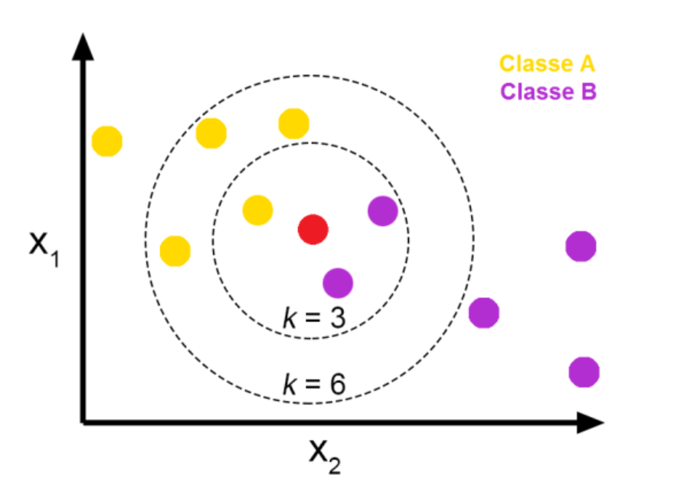
K NEAREST NEIGHBOUR

Slide 3
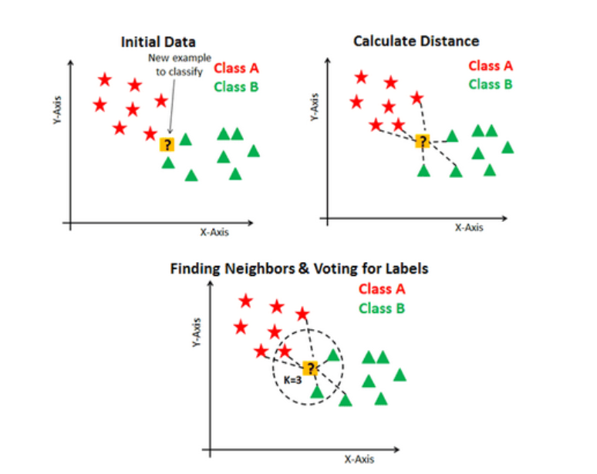
K NEAREST NEIGHBOUR

Slide 4
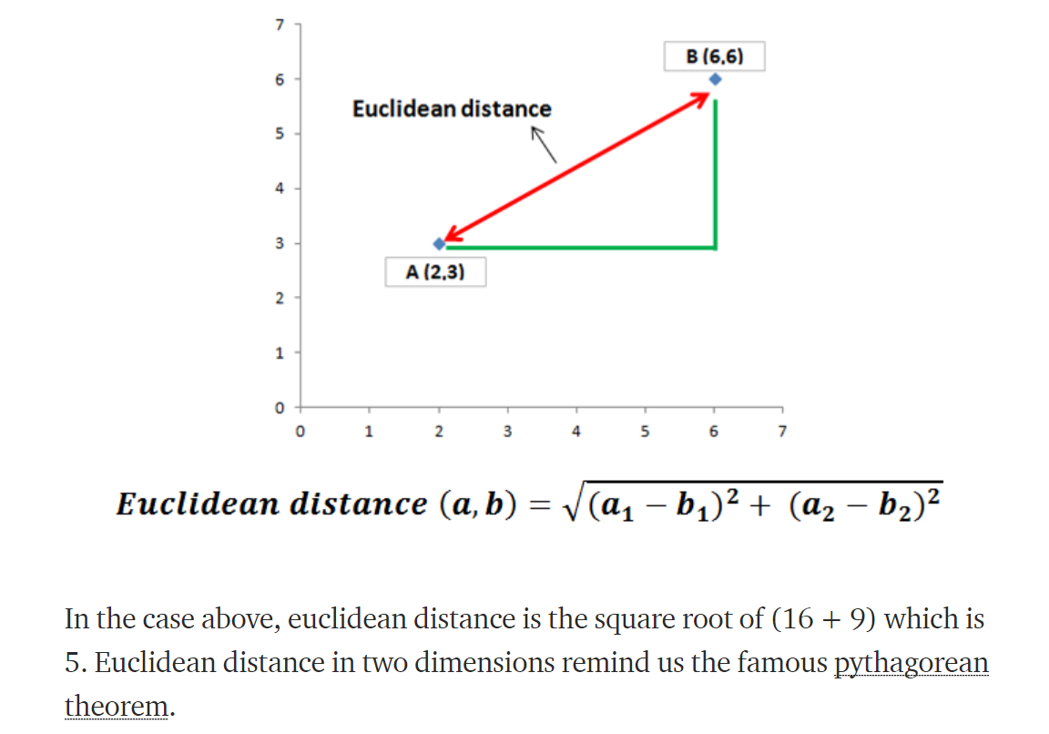
ELUCIDIAN DISTANCE

Slide 5
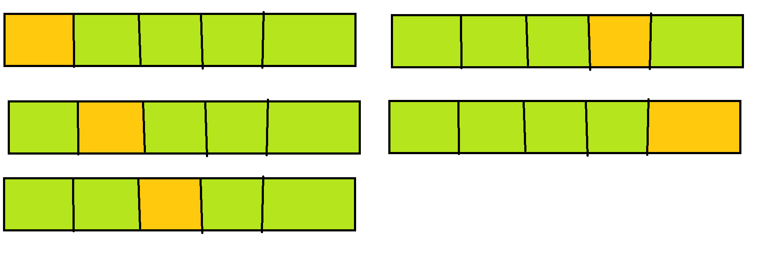
CROSS VALIDATION

