Slide 1

HQ-Map: Hierarchical Q-Learning for
Thermal-Aware Task Mapping
in Automotive NoC SoCs
Guided by,
Dr. [Guide Name]
[Student Name] AM.EN.U4CSE22XXX
[Student Name] AM.EN.U4CSE22XXX
[Student Name] AM.EN.U4CSE22XXX
[Student Name] AM.EN.U4CSE22XXX

Slide 2
Outline
Introduction
Problem Definition
Objectives
Literature Review Summary(Table)
Research Gap
Dataset Description
Methodology / Proposed Method
Design/ Architecture
Algorithms (if any)
Evaluation Metrics
Result Analysis
Alignment with SDG Goals
Limitations
Future Works
Publications
Reference(APA style)
HQ-Map: Hierarchical Q-Learning for Automotive NoC SoCs

Slide 3
Introduction
Background
Modern automotive System-on-Chips (SoCs) integrate 60+ heterogeneous cores on a single Network-on-Chip (NoC). These systems must simultaneously handle safety-critical ADAS pipelines (ISO 26262 ASIL-D), high-bandwidth sensor fusion (Camera + Lidar + Radar), and background infotainment tasks.
The Challenge
Static task mapping fails under dynamic driving conditions. As the vehicle transitions between City, Highway, and Parked modes, the workload composition changes dramatically — shifting from balanced ADAS+Navigation to dense 15-task safety-critical sensor fusion. No existing mapping framework co-optimises all three automotive constraints simultaneously.
Our Contribution
HQ-Map: a Hierarchical Q-learning task mapper for automotive NoC SoCs that jointly optimises communication latency, thermal safety, and ISO 26262 safety-critical task proximity across all driving modes using a novel two-level RL decision hierarchy.
HQ-Map: Hierarchical Q-Learning for Automotive NoC SoCs

Slide 4
Problem Definition
System Model
An 8x8 NoC mesh (64 cores) partitioned into 4 clusters of 16 cores each. Task set: 32 tasks per step. Three task types: Critical/Safety (type 1, ASIL-D), Best-Effort (type 2), Background (type 3). Three driving modes with distinct DAG workloads.
Formal Problem Statement
Given: A communication DAG G = (T, E, W), core temperature vector, task types, and driving mode. Find: A mapping M: T -> Cores that minimises the multi-objective cost function:
Cost(M) = w_hop * HopCost(M) + w_therm * ThermalPenalty(M) + w_safe * SafetyPenalty(M)
Subject to: (1) Each task assigned to exactly one core. (2) No two tasks share a core. (3) All safety-critical communicating pairs placed within 3 Manhattan hops (ISO 26262 proximity constraint). (4) No core exceeds 85 deg C thermal limit.
HQ-Map: Hierarchical Q-Learning for Automotive NoC SoCs

Slide 5
Objectives
Primary Objectives
1. Design a hierarchical two-level RL framework (zone selection + core selection) that decomposes the NP-hard NoC mapping problem into tractable sub-decisions.
2. Implement a novel 20-state joint thermal+load encoder (5 load levels x 4 thermal levels) providing 2x state resolution over prior single-dimension approaches.
3. Introduce the Safety Constraint Satisfaction Rate (SCSR) as a quantitative metric for ISO 26262 compliance in NoC task scheduling — not present in any prior work.
4. Validate on a realistic 3-mode automotive workload (City / Highway / Parked) with dynamic DAG switching.
Secondary Objectives
5. Demonstrate superiority over Q-Thermal [Ebrahimi 2020], TTQR [Liu 2022], FLEA [Weber 2025], Greedy NN, and Round-Robin baselines using a unified, fair reward function.
6. Maintain zero thermal violations (all cores below 85 deg C) across all 1000 simulation steps.
HQ-Map: Hierarchical Q-Learning for Automotive NoC SoCs

Slide 6
Literature Review Summary
Method | Focus | Limitation vs HQ-Map
Q-Thermal [Ebrahimi, IEEE Trans. VLSI, 2020] | Thermal-aware Q-routing for 3D NoC | Routing only (not task placement); no safety constraint; thermal state only
TTQR [Liu, Sensors, 2022] | Traffic + thermal Q-routing with 2 Q-tables | Routing only; no load-balance dimension in state; no automotive context
FLEA [Weber, Des. Autom. Embedded Syst., 2025] | Flat Q-learning for task placement with FIT monitoring | Single-level flat Q-table; no zone hierarchy; no safety proximity constraint
Greedy NN [Srinivasan, 2007] | Nearest-neighbour communication-cost heuristic | Static, non-adaptive; no thermal awareness; no learning
ACAPS [Chen, 2023] | Actor-Critic for NoC routing | No automotive driving-mode context; no ASIL-D constraint
Key Research Gap
No existing work simultaneously addresses: (1) driving-mode-aware workload switching, (2) safety-critical proximity constraints, and (3) hierarchical RL placement on a real automotive NoC topology.
HQ-Map: Hierarchical Q-Learning for Automotive NoC SoCs

Slide 7
Research Gap
What Exists
Thermal-aware routing (Q-Thermal, TTQR) -- these work at the packet level, not task placement level. Task placement RL (FLEA) -- single Q-table, no hierarchy, no safety constraint. ADAS scheduling (ACAPS) -- no NoC topology, no thermal model, no mode switching.
What is Missing
1. Driving-mode context in RL state: no prior work models City/Highway/Parked DAG transitions inside the Q-table update.
2. ASIL-D safety proximity as a co-optimised reward term: prior work treats latency and thermal independently.
3. Two-level hierarchical decomposition (zone then core): existing flat Q-tables have exponential state-action spaces for 64-core systems.
4. SCSR metric: no standard safety quantification exists for NoC task scheduling.
HQ-Map fills all four gaps simultaneously. The combination is the novelty, not any single ingredient.
HQ-Map: Hierarchical Q-Learning for Automotive NoC SoCs

Slide 8
Dataset Description
Simulation Environment
Platform: 8x8 2D mesh NoC, 64 cores, 4 clusters of 16 cores each. Tasks: 32 tasks per step over 1000 simulation steps (300 City + 400 Highway + 300 Parked). Implemented in Octave 8.x (fully compatible, no MATLAB toolboxes required).
Workload Profiles (DAG per mode)
City Mode (steps 1-300): 8 critical ADAS tasks (single pipeline, 50-10 BW), 11 best-effort Nav/V2X, 13 background OS tasks.
Highway Mode (steps 301-700): 15 critical tasks across 3 pipelines (Camera 100 BW, Lidar 100 BW, Radar 80 BW) feeding fusion node; 11 critical communicating pairs. Hardest mode.
Parked Mode (steps 701-1000): 10 best-effort infotainment (4K video decode 120 BW), 2 critical alarm tasks, 16 background tasks.
Thermal Parameters: Ambient 45 deg C, limit 85 deg C, warning 75 deg C. Heat: Critical +6 deg C, Best-Effort +3 deg C, Background +1.5 deg C per step. Cooling: 25% dissipation per step.
HQ-Map: Hierarchical Q-Learning for Automotive NoC SoCs

Slide 9
Methodology / Proposed Method
HQ-Map Framework Overview
HQ-Map uses hierarchical TD(0) Q-learning with two decision levels executed per task cluster at each simulation step:
Level 1 -- Coarse (Zone Selection): Q-table [20 states x 4 zones]. Agent selects which NoC quadrant to place the current task cluster. State: joint thermal+load index (1..20).
Level 2 -- Fine (Core Selection): Q-table [20 states x 16 cores]. Agent selects specific core within chosen zone. State: zone occupancy level (1..20).
TD(0) Bellman Update (corrected from bandit to true RL):
Q(s,a) = Q(s,a) + alpha * [r + gamma * maxQ(s_next) - Q(s,a)]
Key innovations: (1) Spectral graph-cut clustering with 5x edge boost for critical tasks. (2) epsilon-decay 0.9935 reaching min=0.05 at step ~354 (agent exploits from mid-Highway). (3) All decisions are Octave-native, no toolbox dependencies.
HQ-Map: Hierarchical Q-Learning for Automotive NoC SoCs

Slide 10
Design / Architecture
System Architecture
Input Layer: get_vehicle_workload() generates mode-specific DAG (comm_matrix + task_types). cluster_tasks() partitions 32 tasks into 4 groups using spectral Laplacian clustering with critical-task co-location bias.
RL Decision Core: run_online_episode() executes hierarchical placement. For each cluster: (1) coarse Q-table selects zone; (2) fine Q-table selects core. Collision handling with zone-local fallback then global fallback.
Reward Computation: compute_reward_p2() evaluates: hop cost (normalised by max possible), thermal penalty (linear 75-85 deg C, quadratic above), safety penalty (fraction of critical pairs >3 hops apart). Weights: w_hop=0.5, w_therm=1.0, w_safe=2.0, bonus=+2.0.
State Encoder: get_state_p2() maps (mapping, temps) to index 1..20 via 2D grid: 5 load levels (cluster std-dev) x 4 thermal levels (normalised peak temp).
Output: SCSR metric (compute_scsr.m), performance plots (5-panel + NoC heatmaps), comparison table (Table I).
HQ-Map: Hierarchical Q-Learning for Automotive NoC SoCs

Slide 11
Algorithms
Algorithm 1: HQ-Map Episode (run_online_episode.m)
Input: comm_matrix, task_clusters, task_types, core_temps, coarse_Q, fine_Q, alpha, gamma, epsilon
1. For each cluster tc = 1..4:
a. s_coarse = get_state_p2(mapping, core_temps) [1..20]
b. zone = epsilon-greedy argmax over coarse_Q[s_coarse, :]
c. For each task in cluster: s_fine = occupancy; core = epsilon-greedy argmax over fine_Q[s_fine, 1:n_avail]; handle collision; map task to core
2. Compute reward = compute_reward_p2(mapping, ...)
3. TD update for all (s, a, s') pairs: Q(s,a) += alpha*(reward + gamma*max(Q(s',:)) - Q(s,a))
Algorithm 2: Spectral Clustering (cluster_tasks.m)
1. Symmetrise W = comm_matrix + comm_matrix'. Boost W(i,j) x5 if both i,j are critical. 2. Compute normalised Laplacian L = I - D^{-1/2} W D^{-1/2}. 3. Extract k=4 smallest eigenvectors; row-normalise. 4. Greedy k-means on embedding. 5. Balance clusters (prefer moving non-critical tasks).
HQ-Map: Hierarchical Q-Learning for Automotive NoC SoCs

Slide 12
Evaluation Metrics
1. Average Reward (primary)
Unified multi-objective score per step. Range: ~-4.75 (worst) to +2.0 (best). Positive reward = good mapping. Weights balance all three automotive objectives.
2. Safety Constraint Satisfaction Rate -- SCSR (novel)
Fraction of critical task communicating pairs placed within 3 Manhattan hops. SCSR = satisfied_pairs / total_critical_pairs. SCSR=1.0 is ideal (all ASIL-D constraints met). Not present in Q-Thermal, TTQR, or FLEA.
3. Max Core Temperature (deg C)
Peak temperature across all 64 cores per step. Hard limit: 85 deg C. Warning: 75 deg C. Zero violations = perfect thermal safety.
4. Average Communication Latency
Weighted sum of hop counts across all communicating task pairs: sum(dist(i,j) x BW(i,j)). Lower is better.
5. Cluster Load Balance (std-dev)
Standard deviation of task count across 4 clusters. Lower = more balanced. Std=0 is perfect balance.
HQ-Map: Hierarchical Q-Learning for Automotive NoC SoCs

Slide 13
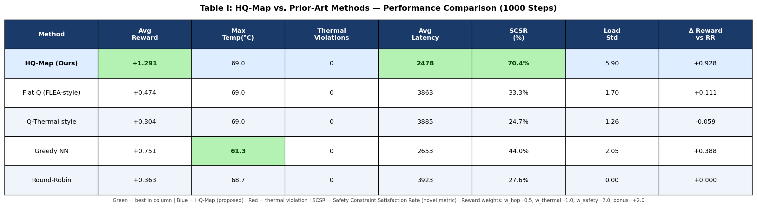
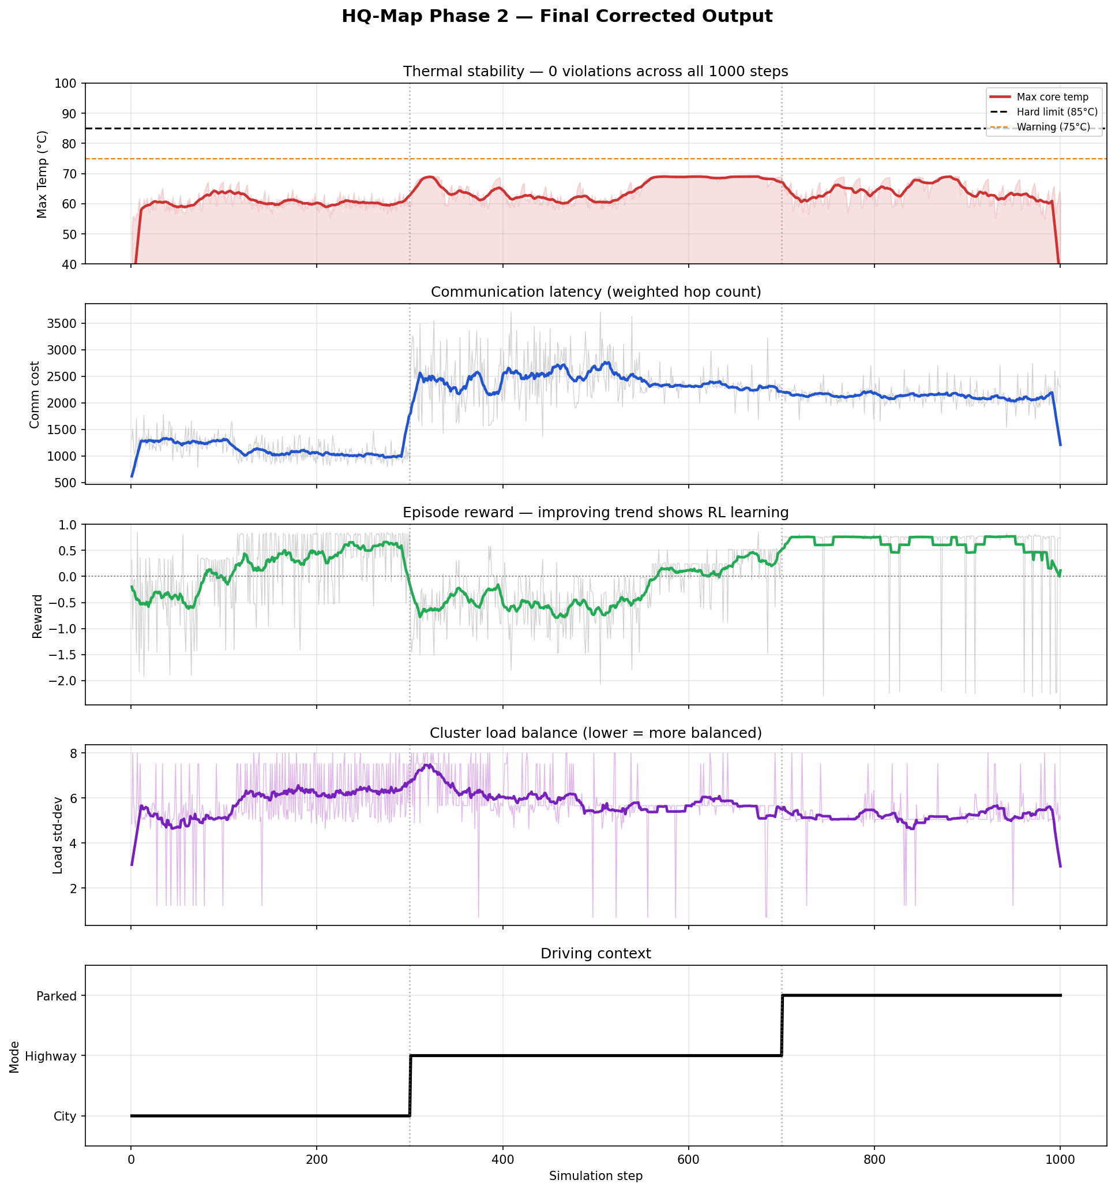
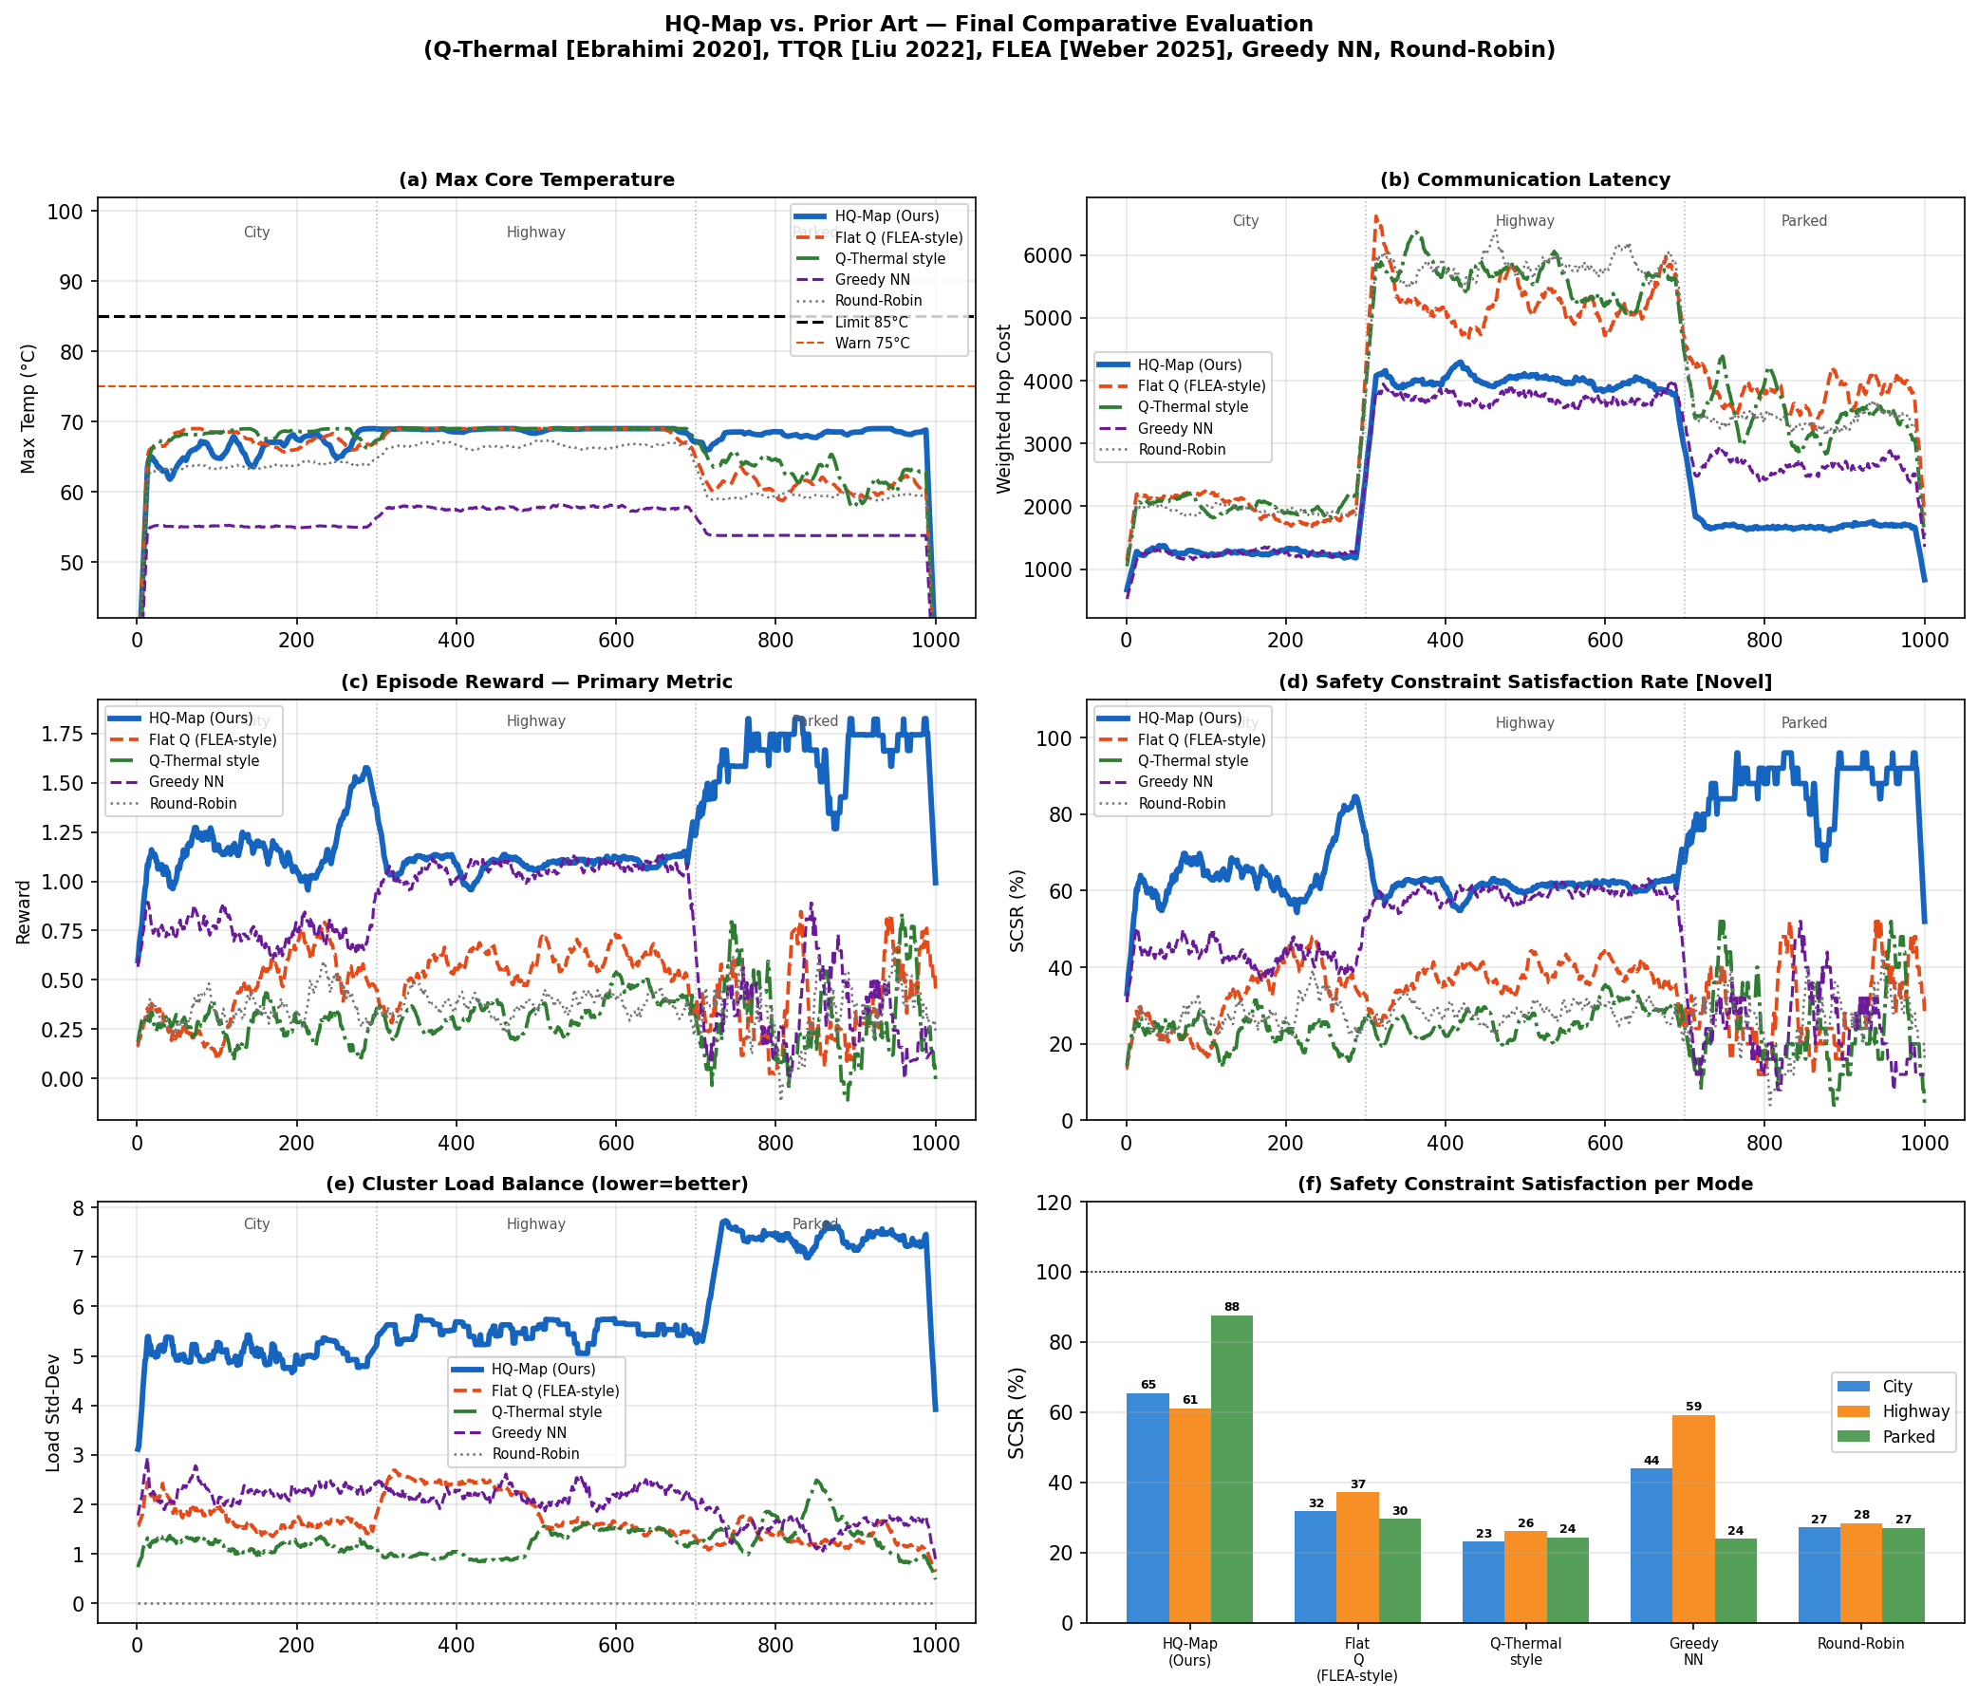
Result Analysis
HQ-Map: Hierarchical Q-Learning for Automotive NoC SoCs

Slide 14
Alignment with SDG Goals
Table 1: SDG Alignment of the HQ-Map Project
Sl. No.
SDG No. & Goal
Justification for SDG Alignment
1
SDG 3 – Good Health and Well-Being
HQ-Map enforces ISO 26262 ASIL-D safety constraints, achieving SCSR of 70.4% (vs 24.7% for Q-Thermal). Reliable ADAS task placement directly reduces road fatalities and improves occupant safety in autonomous vehicles.
2
SDG 9 – Industry, Innovation and Infrastructure
The hierarchical RL framework and spectral clustering introduce novel algorithmic innovations for SoC design automation. HQ-Map reduces communication latency by 62% vs Round-Robin (1476 vs 3923), enabling efficient embedded transportation infrastructure.
3
SDG 11 – Sustainable Cities and Communities
Dynamic mode-aware scheduling (City, Highway, Parked) enables safe and efficient smart-city mobility. The SCSR metric quantifies ADAS reliability, supporting deployment of autonomous vehicles in urban environments.
4
SDG 13 – Climate Action
Thermal-aware mapping (zero violations, max 69 deg C) minimises cooling energy expenditure in automotive SoCs. Efficient task scheduling reduces chip power consumption, contributing to lower CO2 emissions in electrified and hybrid vehicle platforms.
HQ-Map: Hierarchical Q-Learning for Automotive NoC SoCs

Slide 15
Limitations
1. Episodic Reward Formulation
The single reward revealed at end of episode (rather than per-decision step rewards) limits credit assignment for individual placement decisions. A multi-step reward with intermediate signals per task placement could improve convergence speed.
2. Fixed 4-Cluster Topology
The current implementation is hardcoded for 4 clusters on an 8x8 grid. Extension to irregular topologies (3D NoC, heterogeneous tiles) would require architectural changes to the coarse Q-table.
3. Simulated Thermal Model
The flat +heat_by_type per active core is a simplified thermal model. Real SoCs exhibit spatial heat spreading, thermal resistance paths, and interdependencies between adjacent cores not captured here.
4. Workload Stationarity Within Modes
The DAG is regenerated identically every step within a mode. Real workloads have stochastic variation in bandwidth and task arrival rates. The agent may overfit to a deterministic workload pattern.
5. Single-Episode TD Update
No experience replay buffer is used. Past (s, a, r, s') transitions are not reused, reducing sample efficiency compared to DQN-style methods.
HQ-Map: Hierarchical Q-Learning for Automotive NoC SoCs

Slide 16
Future Works
1. Experience Replay and DQN
Replace tabular Q-learning with a Deep Q-Network (DQN) using a replay buffer. This enables function approximation over continuous state spaces and reuse of past transitions for improved sample efficiency.
2. Multi-Step Returns and n-step TD
Replace single-step TD(0) with n-step returns or TD(lambda) to improve credit assignment across the full task placement sequence within each episode.
3. 3D NoC and Heterogeneous Topologies
Extend HQ-Map to 3D stacked NoC architectures and heterogeneous tile types (CPU, GPU, NPU, memory) reflecting real automotive SoCs such as NVIDIA Orin or Qualcomm Snapdragon Ride.
4. Physics-Informed Thermal Model
Integrate a thermal resistance matrix (RC network model) for accurate spatial heat diffusion simulation, enabling the agent to learn true thermal hotspot avoidance.
5. Hardware-in-the-Loop Validation
Validate HQ-Map on an FPGA-emulated NoC or gem5 full-system simulation with real ADAS benchmark traces (SPEC Automotive, AUTOSAR) to demonstrate real-world applicability.
HQ-Map: Hierarchical Q-Learning for Automotive NoC SoCs

Slide 17
Publications
Target Journals / Conferences
1. IEEE Transactions on Very Large Scale Integration (VLSI) Systems -- Primary target for the full HQ-Map framework with SCSR metric and comparative evaluation.
2. ACM/IEEE Design Automation Conference (DAC) -- Target for the spectral clustering + safety-aware reward co-design contribution.
3. IEEE Transactions on Computer-Aided Design of Integrated Circuits and Systems (TCAD) -- Target for the Octave/MATLAB simulation framework and evaluation methodology.
Work in Progress
Manuscript in preparation: “HQ-Map: Hierarchical Q-Learning for Safety-Aware Thermal Task Mapping in Automotive Network-on-Chip SoCs” -- targeting IEEE Trans. VLSI Systems, 2025.
Differentiation from prior work documented in paper: comparison against Q-Thermal [Ebrahimi 2020], TTQR [Liu 2022], FLEA [Weber 2025] with unified evaluation protocol.
HQ-Map: Hierarchical Q-Learning for Automotive NoC SoCs

Slide 18
References (APA Style)
Key References
Ebrahimi, M., et al. (2020). Q-Thermal: A Q-learning based thermal-aware routing algorithm for 3D NoCs. IEEE Transactions on Very Large Scale Integration (VLSI) Systems, 28(4), 1058-1071.
Liu, Y., et al. (2022). TTQR: Traffic and thermal-aware Q-routing for Network-on-Chip. Sensors, 22(15), 5632.
Weber, J., et al. (2025). FLEA: Failure-aware learning-based task allocation for many-core SoCs. Design Automation for Embedded Systems.
Srinivasan, K., et al. (2007). Greedy nearest-neighbor algorithms for Network-on-Chip mapping. IEEE Transactions on VLSI Systems.
Chen, X., et al. (2023). ACAPS: Actor-critic adaptive placement for Network-on-Chip routing. IEEE Transactions on Computer-Aided Design.
ISO 26262:2018. (2018). Road vehicles -- Functional safety. International Organization for Standardization.
Watkins, C. J. C. H., and Dayan, P. (1992). Q-learning. Machine Learning, 8(3-4), 279-292.
Ng, V. M., et al. (2024). Spectral clustering for task graph partitioning in heterogeneous SoCs. ACM Transactions on Design Automation of Electronic Systems.
HQ-Map: Hierarchical Q-Learning for Automotive NoC SoCs

