Slide 1
Rail Track Condition Monitoring using Deep Learning and Computer Vision
Detection of Normal and Damaged Tracks using 3-axis accelerometer signals
Madhavanand Murty

Slide 2
Motivation
Context and Importance:
Metro bogies and tracks operate under constant mechanical stress; undetected degradation leads to increased maintenance costs, service delays, and safety risks.
Onboard accelerometers provide a scalable, low-cost, non-invasive sensing modality to capture mechanical health signatures through vibrations.
Problem Statement:
Given raw 3-axis vibration acceleration at 1024 Hz, build a model to classify the bogie condition as Normal or Failure.
Why this is challenging:
Vibration signals are non-stationary and can vary with speed, track curvature, braking, and environmental conditions.
Failure signatures can be subtle or transient; robust detection requires time-frequency analysis and carefully designed evaluation.
Solution Approach:
Convert raw time series into spectrogram “images” via STFT; learn discriminative patterns with a compact 2D CNN.
Evaluate effect of window overlap and training epochs across multiple seeds for stability.
01

Slide 3
Dataset Overview
Name: MetroDataset
Type:
3-axis accelerometer data (X, Y, Z).
Sampling frequency: 1024 Hz.
Classes: Normal and Failure.
Duration:
50.8 min (Normal),
101.4 min (Failure).
Dataset Structure:
MetroDataset-master/
│
├── Failure/
│ ├── Metro_vibration_v1_x_axis_failure.csv
│ ├── Metro_vibration_v1_y_axis_failure.csv
│ ├── Metro_vibration_v1_z_axis_failure.csv
│ └── README.md
│
├── Normal/
│ ├── Metro_vibration_v1_x_axis_normal.csv
│ ├── Metro_vibration_v1_y_axis_normal.csv
│ ├── Metro_vibration_v1_z_axis_normal.csv
│ └── README.md
│
└── README.md
Collection Setup:
Two sensor nodes mounted on metro bogies; one bogie in a Normal state, one in a Failure state.
3-axis accelerometer per node (X, Y, Z), sampling frequency: 1024 Hz; unit: g (sensitivity: 100 mg).
02

Slide 4
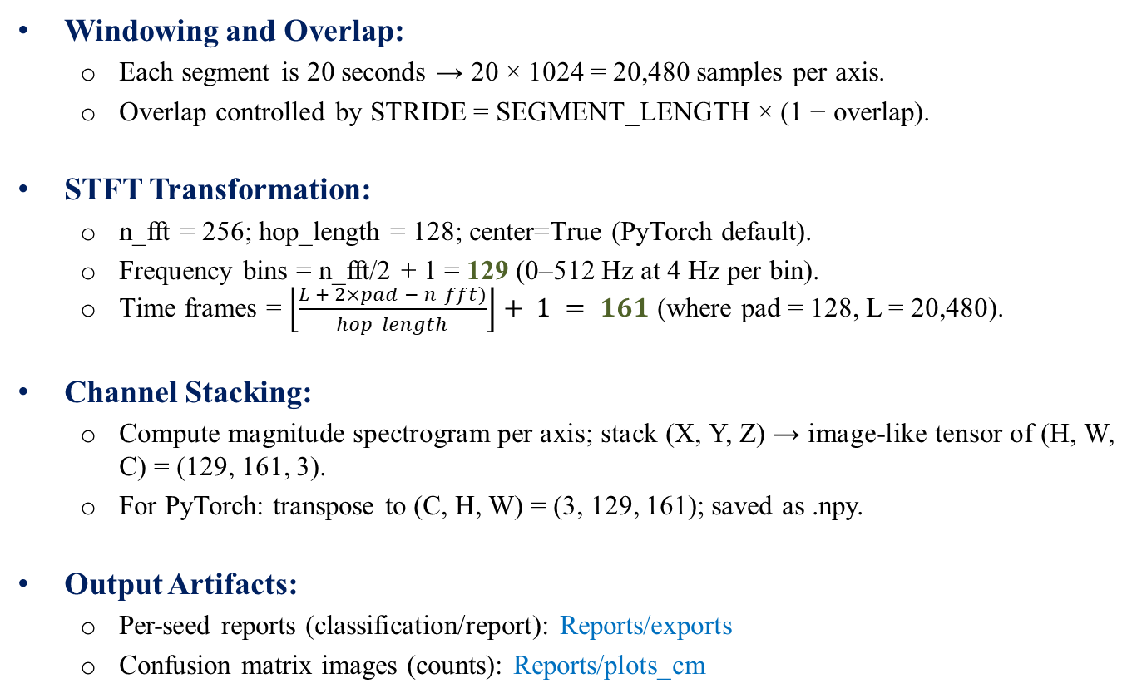
Data Preprocessing Pipeline
Windowing and Overlap:
Each segment is 20 seconds → 20 × 1024 = 20,480 samples per axis.
Overlap controlled by STRIDE = SEGMENT_LENGTH × (1 − overlap).
STFT Transformation:
n_fft = 256; hop_length = 128; center=True (PyTorch default).
Frequency bins = n_fft/2 + 1 = 129 (0–512 Hz at 4 Hz per bin).
Time frames = $\left\lfloor \frac{L + 2×pad − n_fft)}{hop_length}\right\rfloor + 1 = 161$ (where pad = 128, L = 20,480).
Channel Stacking:
Compute magnitude spectrogram per axis; stack (X, Y, Z) → image-like tensor of (H, W, C) = (129, 161, 3).
For PyTorch: transpose to (C, H, W) = (3, 129, 161); saved as .npy.
Output Artifacts:
Per-seed reports (classification/report): Reports/exports
Confusion matrix images (counts): Reports/plots_cm
03

Slide 5
Understanding Overlapping in Segmentation
To maximize the number of samples from limited-duration vibration recordings and ensure smooth signal continuity, we apply sliding window segmentation with overlap.
Why Use Overlap?
• Prevents loss of transitional features at segment boundaries
• Increases training samples without requiring additional data
• Helps capture more nuanced fault signatures
• Improves generalization, especially for deep learning models
Configuration Used
• Sampling Rate: 1024 Hz
• Segment Duration: 20 seconds
• Segment Length: 1024 samples/sec × 20 sec = 20480 samples
• Overlap: 80%
• Stride (step size):
Stride = 20480 × (1−0.80) = 4096 samples
04

Slide 6
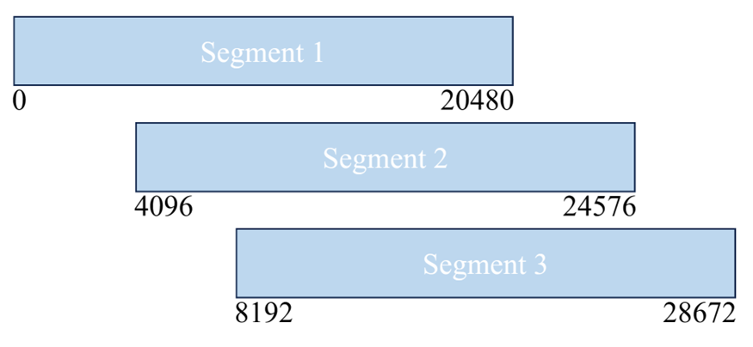
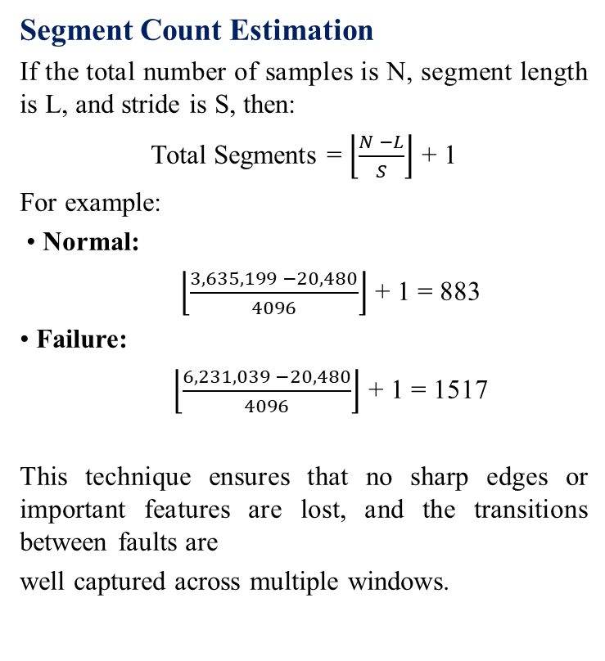
Understanding Overlapping in Segmentation (Contd.)
Overlap Illustration
Raw signal timeline (in samples):
As seen, each segment shares 80% of its data with the previous one, forming a rolling window.
Segment Count Estimation
If the total number of samples is N, segment length is L, and stride is S, then:
Total Segments = $\left\lfloor \frac{N −L}{S}\right\rfloor$ + 1
For example:
• Normal:
$\left\lfloor \frac{3,635,199 −20,480}{4096}\right\rfloor$ + 1 = 883
• Failure:
$\left\lfloor \frac{6,231,039 −20,480}{4096}\right\rfloor$ + 1 = 1517
This technique ensures that no sharp edges or important features are lost, and the transitions between faults are
well captured across multiple windows.
05

Slide 7
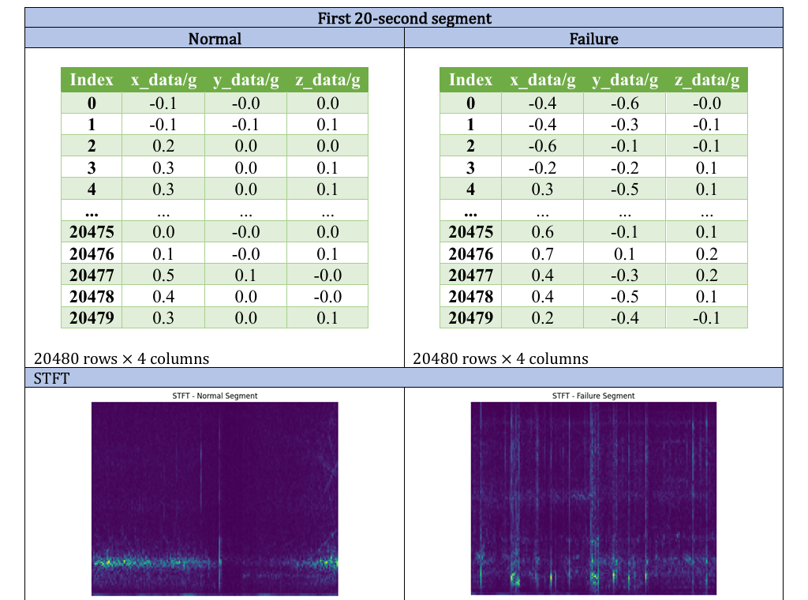
Dataset After Transformation
Example: First segment
06

Slide 8
Model Architecture
# | Layer | Type | Input shape | Output shape | Params | Trainable
1 | conv.0 | Conv2d | [1, 3, 129, 161] | [1, 16, 129, 161] | 448 | 448
2 | conv.1 | ReLU | [1, 16, 129, 161] | [1, 16, 129, 161] | 0 | 0
3 | conv.2 | MaxPool2d | [1, 16, 129, 161] | [1, 16, 64, 80] | 0 | 0
4 | conv.3 | Conv2d | [1, 16, 64, 80] | [1, 32, 64, 80] | 4,640 | 4,640
5 | conv.4 | ReLU | [1, 32, 64, 80] | [1, 32, 64, 80] | 0 | 0
6 | conv.5 | MaxPool2d | [1, 32, 64, 80] | [1, 32, 32, 40] | 0 | 0
7 | conv.6 | Conv2d | [1, 32, 32, 40] | [1, 64, 32, 40] | 18,496 | 18,496
8 | conv.7 | ReLU | [1, 64, 32, 40] | [1, 64, 32, 40] | 0 | 0
9 | conv.8 | MaxPool2d | [1, 64, 32, 40] | [1, 64, 16, 20] | 0 | 0
10 | conv.9 | Conv2d | [1, 64, 16, 20] | [1, 128, 16, 20] | 73,856 | 73,856
11 | conv.10 | ReLU | [1, 128, 16, 20] | [1, 128, 16, 20] | 0 | 0
12 | conv.11 | AdaptiveAvgPool2d | [1, 128, 16, 20] | [1, 128, 1, 1] | 0 | 0
13 | fc.0 | Flatten | [1, 128, 1, 1] | [1, 128] | 0 | 0
14 | fc.1 | Linear | [1, 128] | [1, 64] | 8,256 | 8,256
15 | fc.2 | ReLU | [1, 64] | [1, 64] | 0 | 0
16 | fc.3 | Linear | [1, 64] | [1, 2] | 130 | 130
 |  |  |  | Total | 105,826
Input Shape: [1, 3, 129, 161]
Output Shape: [1, 2]
Trainable: 105,826
Non-trainable: 0

Slide 9
Model Architecture (Contd.)
Architecture:
Input: (N, 3, 129, 161)
Feature extractor: 4 conv layers with ReLU, interleaved with 3× MaxPool2d(2).
Global pooling: AdaptiveAvgPool2d((1, 1)) → removes dependence on exact spatial dimensions.
Classifier: Flatten → Linear(128→64) → ReLU → Linear(64→2).
Design Choices:
Shallow CNN with small receptive fields: enough capacity to learn local TF patterns while controlling overfitting.
Adaptive average pooling enables robustness to minor spectrogram size changes.
No normalization/log-power applied to spectrograms to match baseline results.
Parameters:
Total = 105,826 (Trainable = 105,826); compact and fast.
08

Slide 10
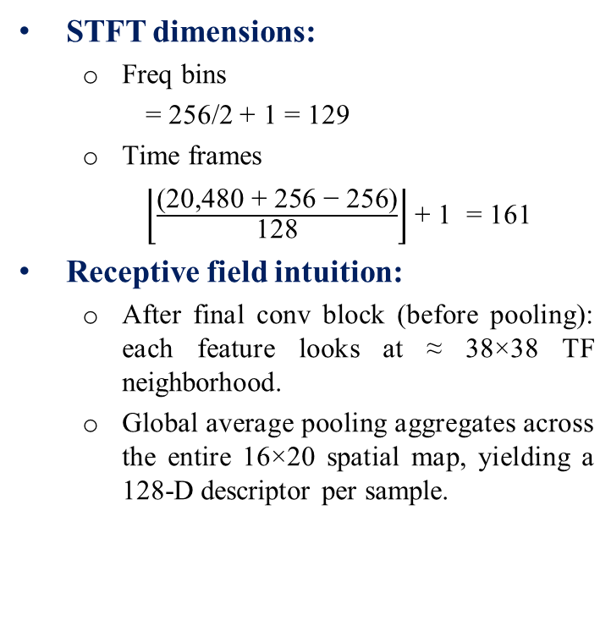
Model Architecture (Contd.)
STFT dimensions:
Freq bins
= 256/2 + 1 = 129
Time frames
$\left\lfloor \frac{\text{(20,480 + 256 − 256)}}{\text{128}}\right\rfloor$ + 1 = 161
Receptive field intuition:
After final conv block (before pooling): each feature looks at ≈ 38×38 TF neighborhood.
Global average pooling aggregates across the entire 16×20 spatial map, yielding a 128‑D descriptor per sample.
CNN flow (N=1 shown for clarity):
Input = (1, 3, 129, 161)
→ Conv3×3,p1 → (1, 16, 129, 161) → MaxPool2d(2) → (1, 16, 64, 80) → Conv3×3 → (1, 32, 64, 80) → MaxPool2d(2) → (1, 32, 32, 40) → Conv3×3 → (1, 64, 32, 40) → MaxPool2d(2) → (1, 64, 16, 20) → Conv3×3 → (1, 128, 16, 20) → AdaptiveAvgPool(1,1) → (1, 128, 1, 1) → Flatten → (1, 128) → Linear 128→64 → (1, 64) → Linear 64→2 → (1, 2) = Output
Parameter formulas:
Conv2d params = Cout × (Cin × k × k) + Cout
Linear params = Cout × Cin + Cout
09

Slide 11
Training Setup
Environment:
Python 3.10.9; PyTorch; GPU if available (auto-detected).
Reproducibility: seeds = [100, 500, 750, 1000, 1200].
Data pipeline:
Training/test split: random, stratified on segments (80/20) per seed.
Batch size: 8; Loss: CrossEntropyLoss; Optimizer: Adam (LR=1e‑3).
Experiment grid:
Overlaps: 50%, 60%, 80%.
Epochs: 30, 50, 100.
Reporting:
Per-seed classification reports (precision/recall/F1) and confusion matrices (counts).
Aggregated CSVs (Reports/exports) and images (Reports/plots_cm).
10

Slide 12
Results: Current Setup
80% Overlap & 50 Epochs
Seed | Accuracy | Loss | TN | FP | FN | TP
100 | 0.9896 | 0.0319 | 177 | 0 | 5 | 298
500 | 0.9875 | 0.0377 | 175 | 2 | 4 | 299
750 | 0.9896 | 0.0377 | 175 | 2 | 3 | 300
1000 | 0.9979 | 0.0111 | 177 | 0 | 1 | 302
1200 | 0.9792 | 0.0470 | 175 | 2 | 8 | 295
Across seeds:
Accuracy (mean ± std): 0.9888 ± 0.0067
Loss (mean ± std): 0.0331 ± 0.0134
F1 Macro Mean: 0.9880; F1 Weighted Mean: 0.9888
Class-wise means:
Normal: Precision 0.9768, Recall 0.9932, F1 0.9849
Failure: Precision 0.9960, Recall 0.9861, F1 0.9910
11

Slide 13
Comparison: Overlap × Epochs
Overlap | Epochs | Acc Mean | Acc Std | Loss Mean
80% | 30 | 0.9842 | 0.0076 | 0.0473
 | 50* | 0.9888 | 0.0067 | 0.0331
 | 100 | 0.9954 | 0.0050 | 0.0388
60% | 30 | 0.9651 | 0.0239 | 0.1294
 | 50 | 0.9876 | 0.0059 | 0.0524
 | 100 | 0.9834 | 0.0078 | 0.0598
50% | 30 | 0.9803 | 0.0043 | 0.0592
 | 50 | 0.9782 | 0.0118 | 0.0732
 | 100 | 0.9731 | 0.0118 | 0.1002
*Current Setup
Observations:
50 epochs often provide the best balance (high accuracy, low variance).
80% overlap yields strongest metrics in this setup but is most redundancy-prone.
60% overlap + 50 epochs is a robust, stable configuration across seeds.
100 epochs can overfit at lower overlaps (accuracy drops, loss increases).
12

Slide 14
Evaluation Protocol & Limitations
Information leakage risk:
With high overlap and random segment splits, many segments share >75% of raw samples; near-duplicates can land in both train and test.
This inflates accuracy and may not reflect true generalization.
Dataset confounding:
One bogie per class → learned features may capture sensor/bogie specifics or mounting differences, not only condition.
Missing context:
No run-level metadata (speed, curve, braking) to control for operating conditions.
Mitigations (planned):
Time-based split before segmenting; build non-overlapping test windows.
Blocked cross-validation with margins between folds.
Collect more bogies/fault modes; add contextual metadata.
13

Slide 15
Error Analysis
What to examine:
Review false negatives and false positives per seed; identify recurring patterns.
Plot representative misclassified spectrograms vs correctly classified ones.
Check if misclassifications correlate with low SNR or specific bands.
Tools/visuals:
Use saved confusion matrices to identify skew.
Plot averaged spectra by class; observe distinguishing band energies.
Potential quick wins:
Remove DC (0 Hz) band; focus on 4–250 Hz.
Try log-power compression; standardize per-channel with training stats.
14

Slide 16
Future Work
Preprocessing:
Hann window for STFT; log1p power; frequency cropping (4–250 Hz).
Per-channel/Per-frequency normalization using training statistics.
Modeling:
1D CNN/TCN baseline on raw signals; spectrogram augmentations (time/freq masking).
Lightweight attention modules to capture long-range dependencies.
Evaluation:
Strict time-based split or same-run vs cross-run testing.
Cross-validation with contiguous folds and buffer zones.
Deployment:
Sliding-window real-time inference; latency/compute profiling for edge devices.
15

Slide 17
Conclusion & Key Takeaways
Built a clean, reproducible STFT → CNN pipeline for 3-axis vibration signals.
Achieved high accuracy across seeds with 80% overlap and 50 epochs (Acc mean ≈ 0.989).
Overlap and training duration materially affect performance; 60% + 50 epochs is a strong balance.
Clear path to more robust evaluation and better generalization with improved preprocessing and splitting strategy.
16

