Slide 1
HEALTHCARE | DATA + AI HACKATHON
Intelligent Data Products
One Framework, Every Data Product
Register a governed data product once.
Get a trusted, natural-language AI agent for it. Without moving the data.
Srinivasa Madhavan | Clifford Benjamin | Sujita Chandran | Saisree Mallineni
Notes:
Opening: IDP turns governed enterprise data into reusable, AI-powered data products. The idea is simple: register once, get a governed agent.

Slide 2
Meet the Team
Photo
Photo
Photo
Photo
Srinivasa Madhavan
Clifford Benjamin
Sujita Chandran
Saisree Mallineni
Four people, one shared goal: make governed data easy to ask questions of, for everyone.
Intelligent Data Products (IDP) | One Framework, Every Data Product
2
Notes:
Replace each 'Photo' circle with the team member's picture (right-click > Format Shape > Fill > Picture). Add roles below the names if needed.

Slide 3
The Problem
Data is available. Insight is not.
Healthcare organisations hold huge volumes of clinical and operational data (encounters, diagnoses, medications, labs, claims) already in the cloud data platform. Yet most business users still cannot get answers without SQL skills and deep knowledge of schemas and clinical terminology.
1. Access needs experts
2. Every team rebuilds
3. No common standard
Users must know tables, joins and clinical codes.
Every question becomes a ticket to a data team.
Days of waiting for a simple answer.
Each domain builds its own AI agent from scratch.
Duplicated engineering and separate security reviews.
Different definitions give different answers to the same question.
No shared pattern for row-level security, data quality, ownership or accountability.
Copying data out to external AI tools adds cost and compliance risk.
The result: slow decisions, duplicated cost, inconsistent answers and unmanaged risk.
Intelligent Data Products (IDP) | One Framework, Every Data Product
3
Notes:
Frame the problem as an access + governance + duplication problem, not a data availability problem.

Slide 4
Our Solution: Intelligent Data Products
One framework that turns governed data into reusable, AI-powered products
A domain registers its data product once. The framework provisions a governed AI agent for it, grounded in the real data model. Users simply ask in plain English.
Every data product ships with five things, built in:
Schema
Semantics
Security
Quality
Owner
What the data is
Business terms, metrics, synonyms
Row-level access role
Reconciliation and rules
Accountable steward
Register once
Ask anywhere
One brain, many domains
Onboard a new domain by describing its data product. No new agent engineering.
Snowflake Intelligence, Streamlit app, SQL, or any tool via MCP (e.g. Sage).
A central orchestrator routes each question to the right domain agent and combines results across products.
Intelligent Data Products (IDP) | One Framework, Every Data Product
4
Notes:
Key message: governed by design. Security, quality and ownership come with the product, not bolted on later.

Slide 5
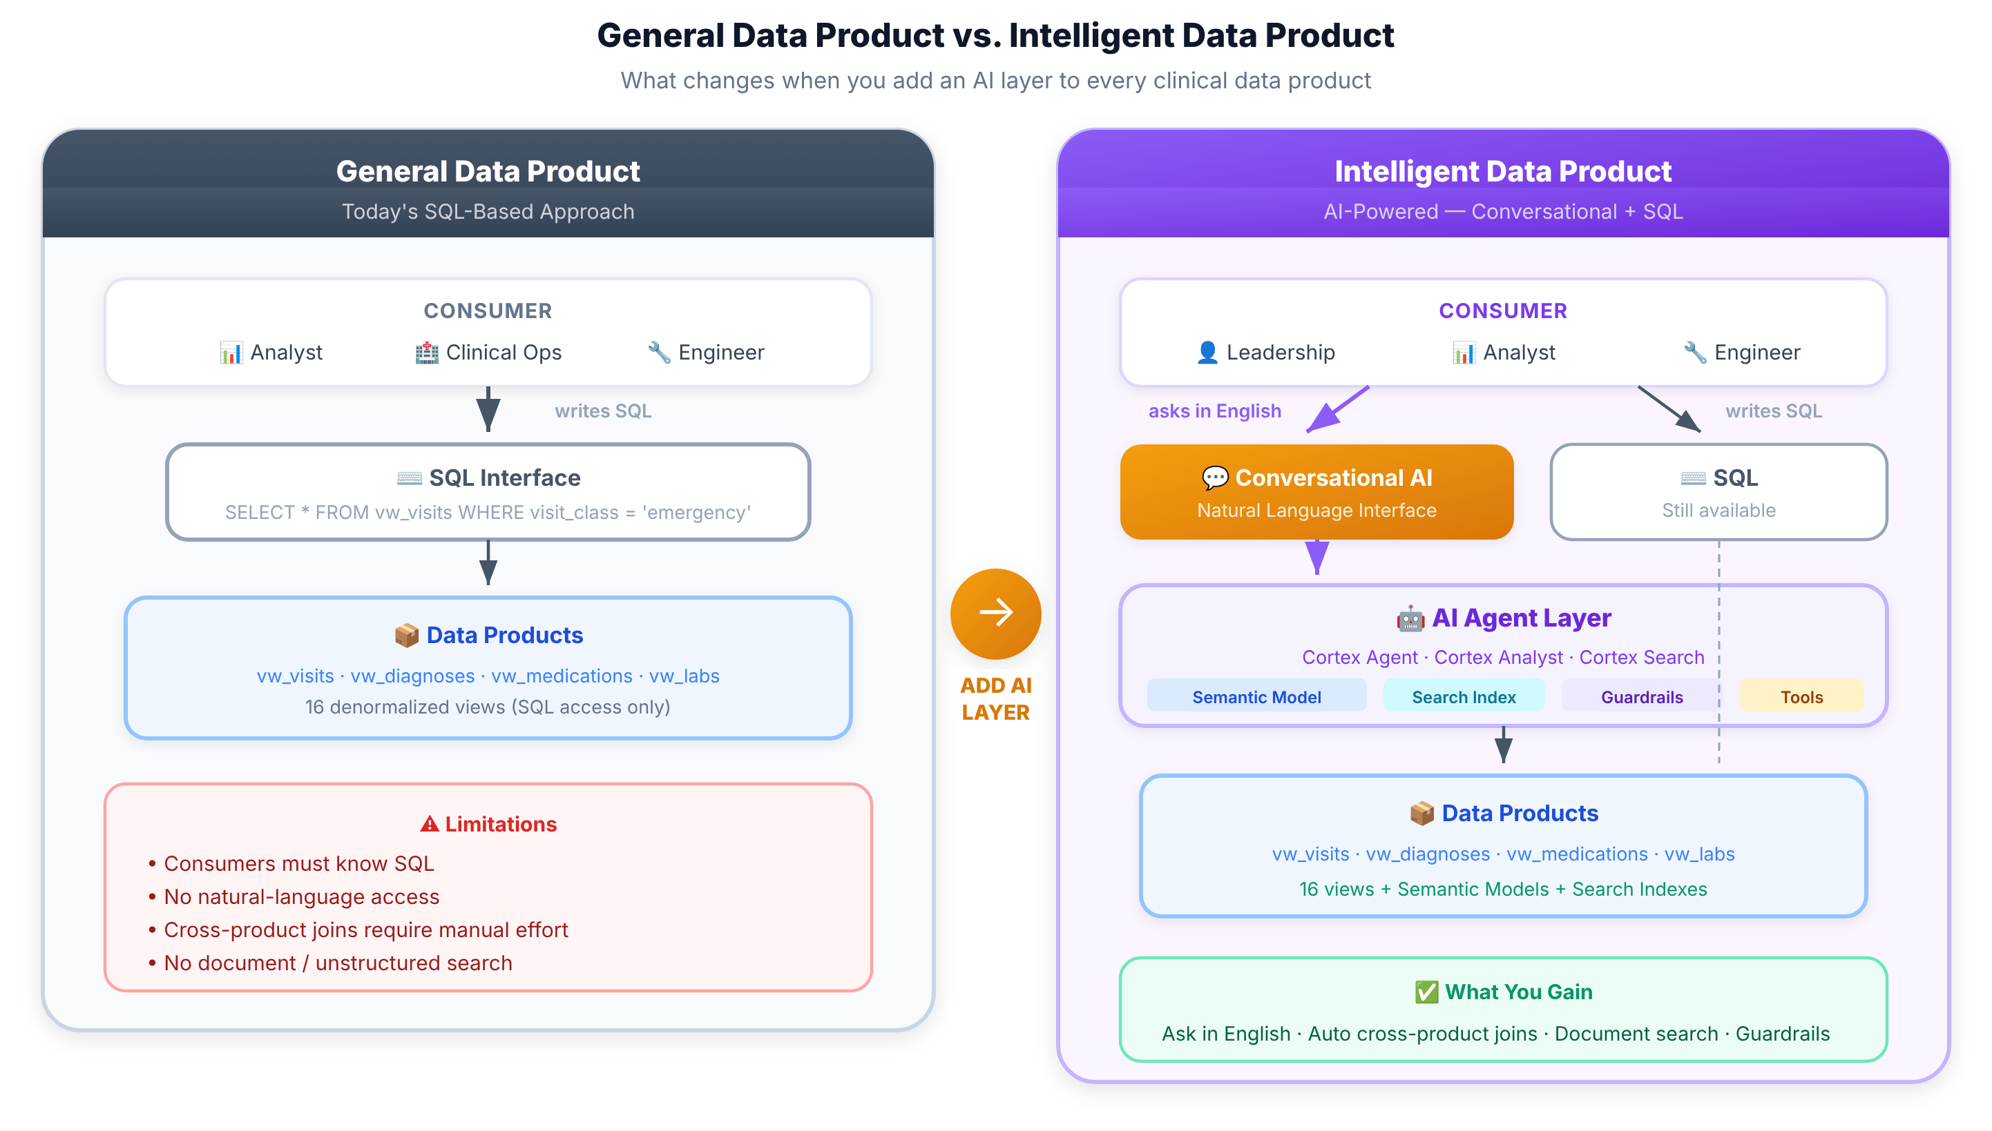
From SQL-Only to Intelligent Data Products
Same data products, with an AI intelligence layer added on top
Key points
Today consumers must know SQL, table names and joins.
The AI agent layer adds plain-English access, semantic models and guardrails.
SQL stays available. The data products themselves do not change.
Intelligent Data Products (IDP) | One Framework, Every Data Product
5
Notes:
Left: today's SQL-only data product. Right: the same data products with a conversational AI layer. Nothing is replaced; intelligence is added on top.

Slide 6
High-Level Architecture: End-to-End Flow
Everything runs inside the data platform. The data never leaves.
INSIDE THE DATA PLATFORM (Snowflake)
6 Consumers
1 Ingest & Validate
2 Data Products
3 Business Semantics
4 Domain Agents
Snowflake Intelligence
Source data
(FHIR healthcare records)
Raw data preserved; reconciliation confirms nothing is lost
Domain views: encounters, diagnoses, medications, labs, claims...
Metrics, relationships and synonyms so AI understands the data
One governed AI agent per data product
Streamlit chat app
SQL / notebooks
5 Orchestrator Agent: routes questions, combines answers across domains
MCP: Sage & other tools
Governance throughout: row-level security | data quality | ownership | audit | observability
Business users ask in plain English
Zero data movement: data, semantics, agents and security all stay in one governed platform.
Intelligent Data Products (IDP) | One Framework, Every Data Product
6
Notes:
Walk left to right. Stress the dotted boundary: nothing is exported to external AI tools. The pattern (data product + semantics + agent + governance) is platform-agnostic.

Slide 7
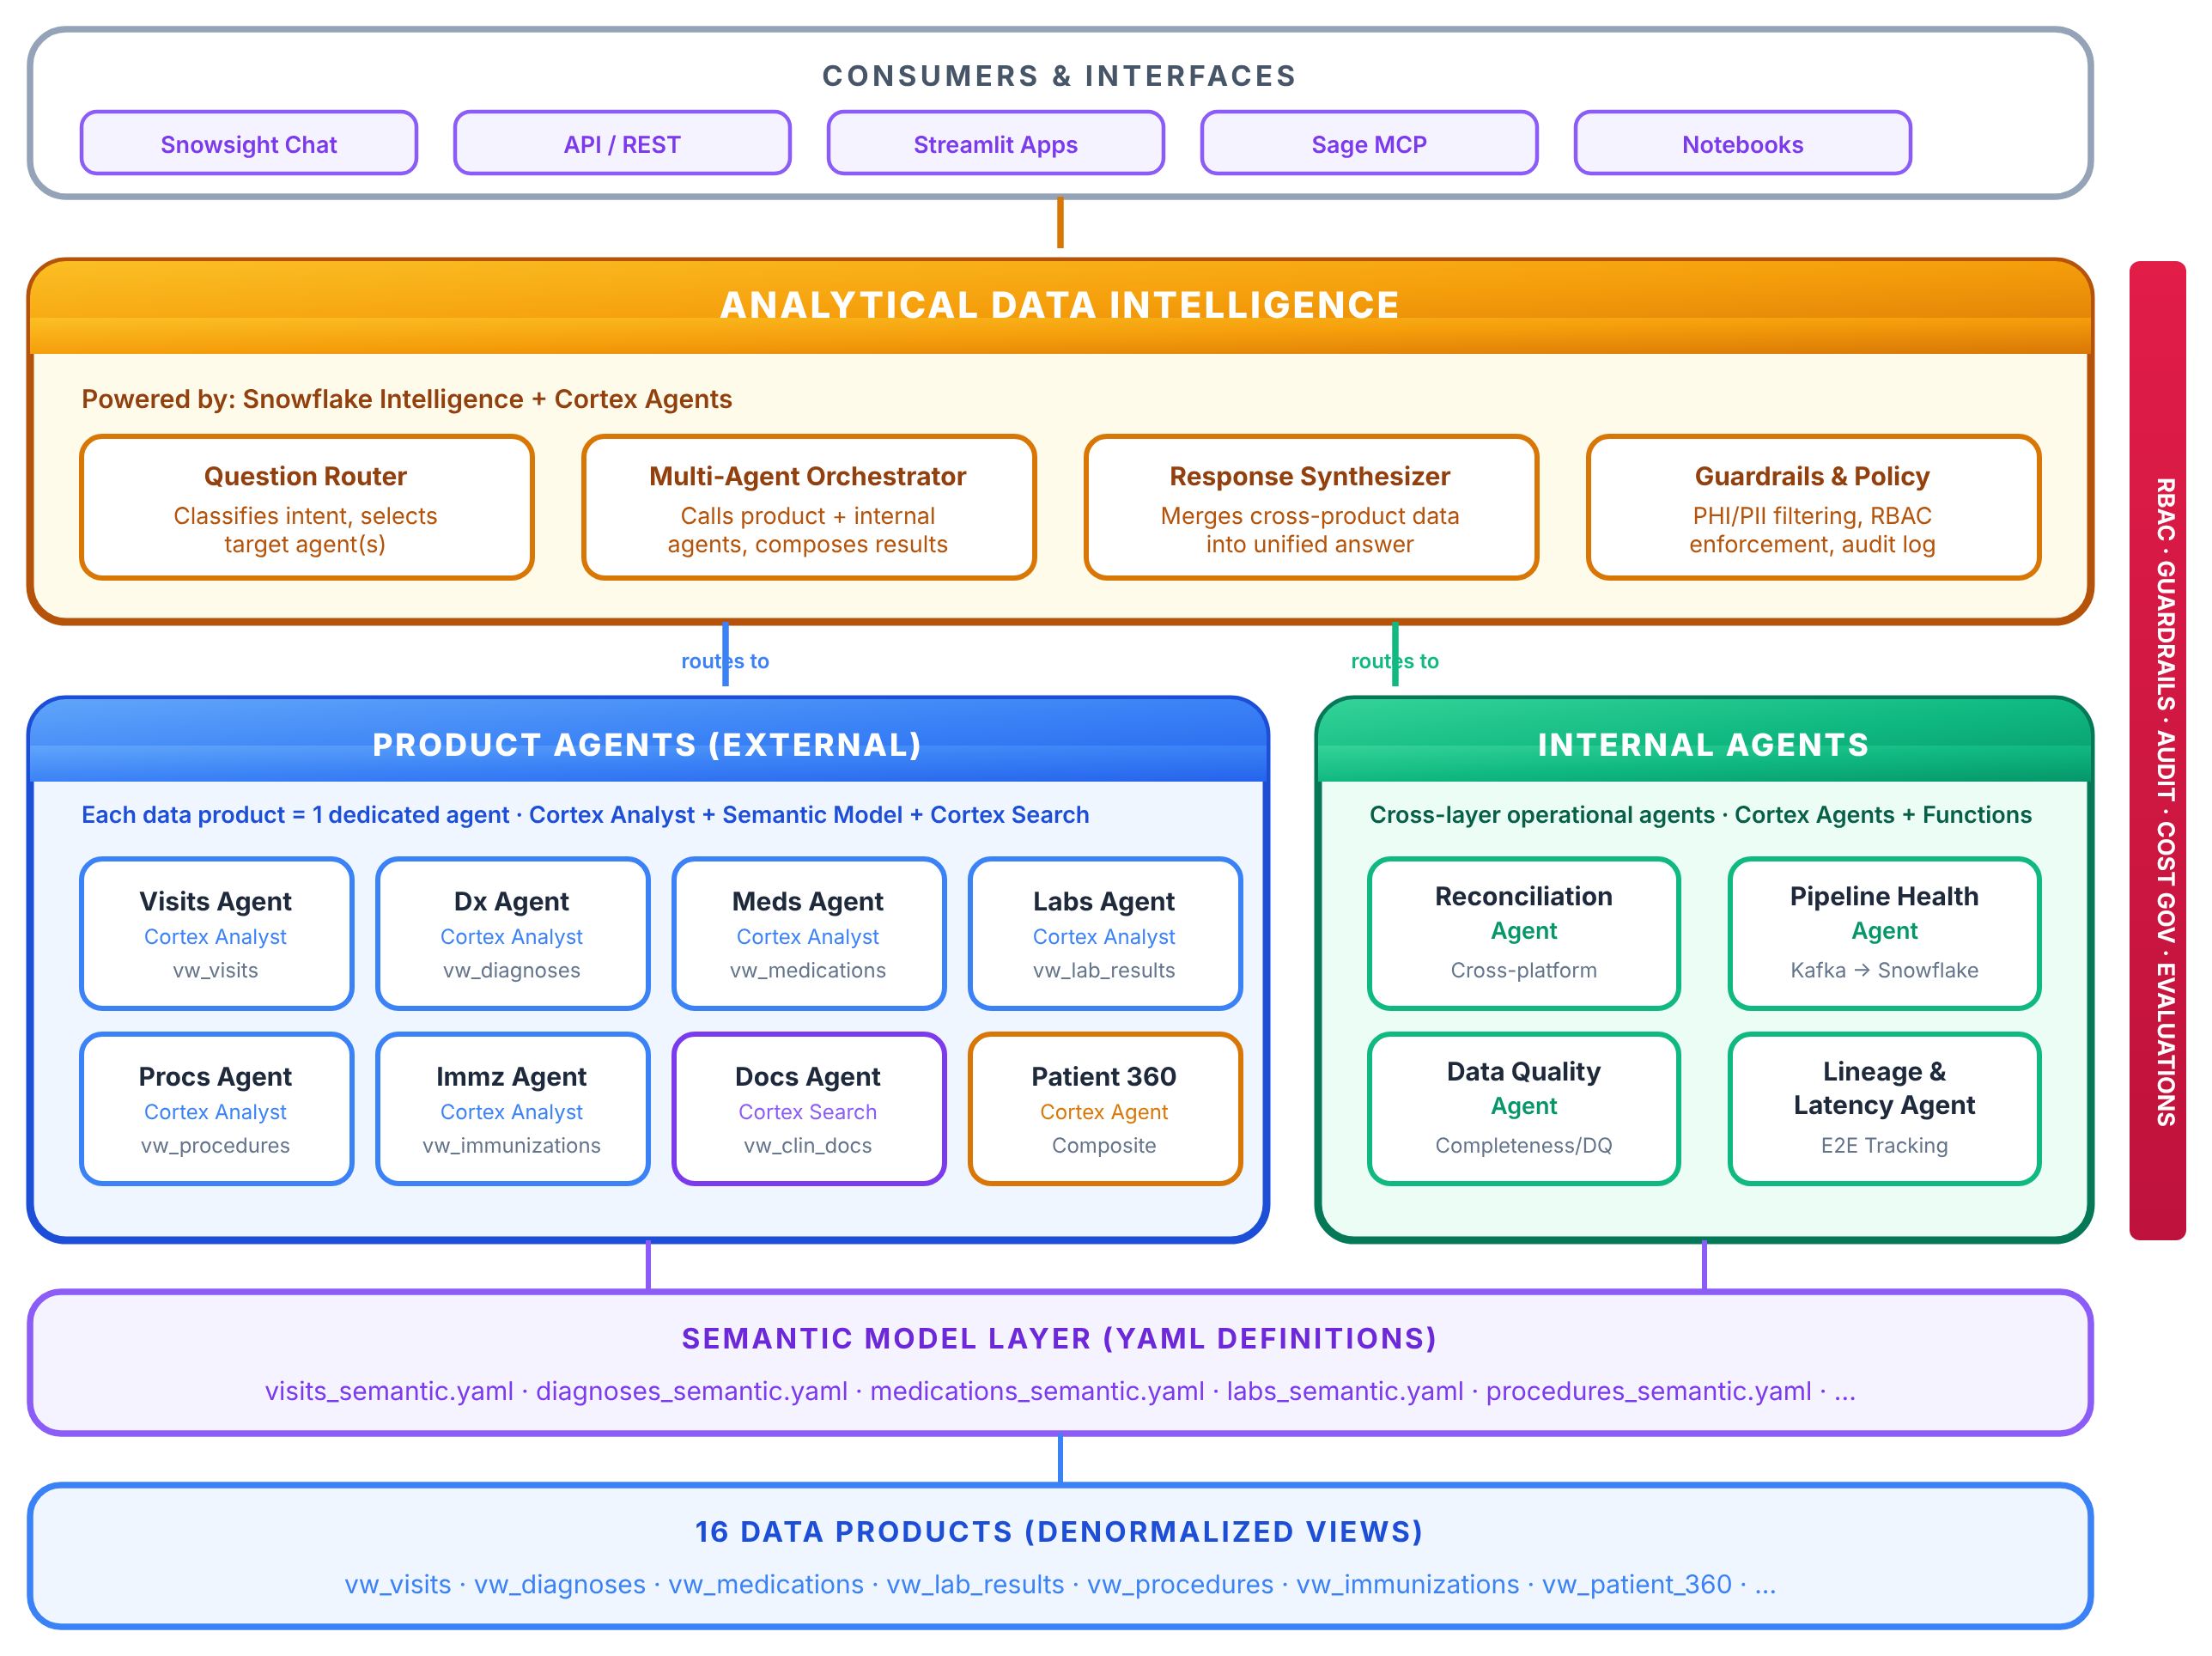
High-Level Design: Three-Tier Agent Architecture
From consumers to data products, governed end to end
Key points
Tier 1: one conversational front door that routes, orchestrates and synthesises answers.
Tier 2: one agent per data product plus internal agents for reconciliation, health and quality.
Tier 3: semantic models over governed data products.
RBAC, guardrails, audit and cost governance cut across every tier.
Intelligent Data Products (IDP) | One Framework, Every Data Product
7
Notes:
Walk top to bottom: consumers, intelligence layer (router, orchestrator, synthesiser, guardrails), product and internal agents, semantic model layer, data products. The red bar on the right is governance across all tiers.

Slide 8
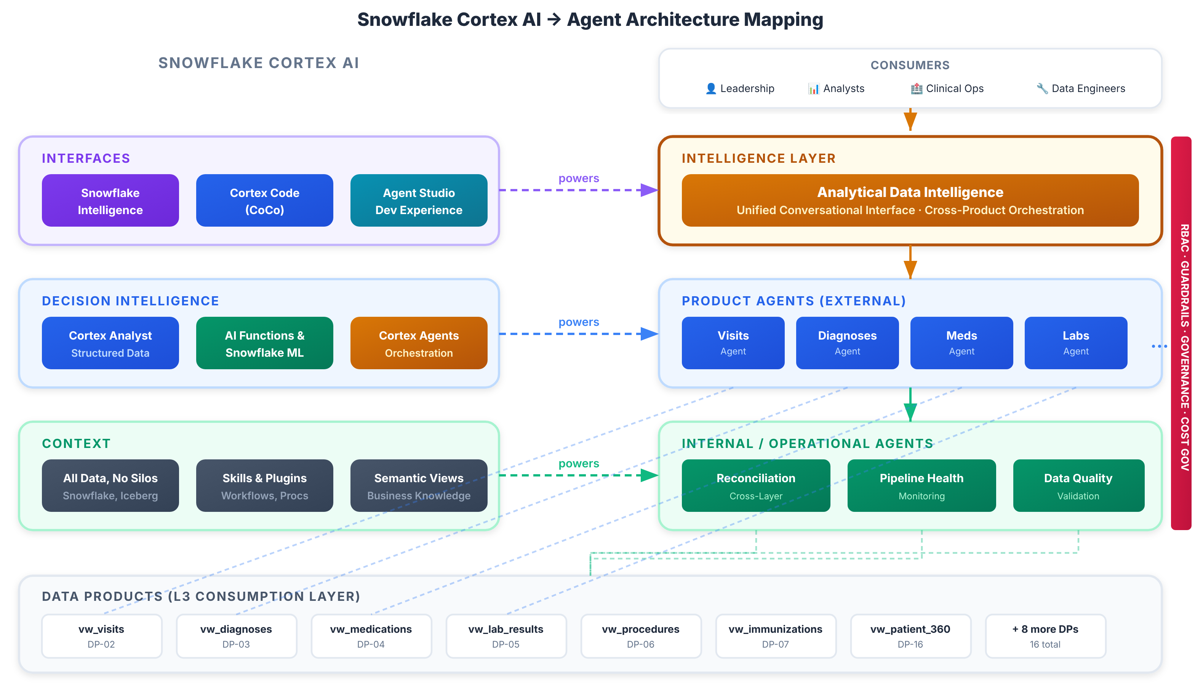
High-Level Architecture: Cortex AI Mapping
Platform AI capabilities mapped to the agent architecture tiers
Key points
Interfaces, decision intelligence and context capabilities of the platform power each tier.
Intelligence layer and agents are built from native building blocks, not custom code.
Grounded on the data products, with governance across all layers.
Intelligent Data Products (IDP) | One Framework, Every Data Product
8
Notes:
Left: native platform AI capabilities. Right: how they map to the architecture tiers. Dotted lines show which capability powers which tier.

Slide 9
Business Impact & Cost Reduction
Indicative estimates, to be validated in the pilot
Area
Today
With IDP
Estimated gain
Time to launch an AI agent for a new domain
4 to 6 weeks of custom engineering
2 to 3 days to register a data product
~85% faster
Time to answer a business question
Hours to days via ticket and SQL
Seconds to minutes in plain English
~90% faster
Security and compliance reviews
One review per team-built agent
Reviewed once at framework level
~70% fewer review cycles
Data copies and pipelines to external AI tools
Extracts, duplicates, egress
None. Data stays in place
~100% of extra copies avoided
Long-running ad-hoc queries on raw schemas
Frequent, wide, repeated scans
Curated semantic views, governed access
~30% less ad-hoc compute
Cost avoided
Risk avoided
Scales beyond one team
Pay once for the framework, reuse for every domain.
No data leaves the platform. Same access rules everywhere.
Each new domain adds value without adding rebuild effort.
Intelligent Data Products (IDP) | One Framework, Every Data Product
9
Notes:
Numbers are rough, directional estimates based on typical effort for building bespoke agents and on avoiding external data movement. Validate with the pilot (Risk & Quality, then a second domain). Example: 10 domains x ~5 weeks = ~50 weeks bespoke vs. one framework plus ~2-3 days per domain.

Slide 10
Innovation & Creativity
What makes the idea original
Agents as a product, not a project
Semantics make AI trustworthy
Instead of every team hand-building an agent, the data product itself is the unit of reuse. Register it and the agent is provisioned automatically.
Business definitions, metrics and synonyms are modelled once, so every answer uses the same vocabulary and the generated queries stay efficient.
Multiple tools, one experience
Platform-agnostic pattern
Domain agents plus an orchestrator for cross-domain questions, exposed through Snowflake Intelligence, a Streamlit app, SQL and MCP into Sage.
Proven on Snowflake, but the blueprint (data product + semantics + agent + governance) extends to any data system.
Intelligent Data Products (IDP) | One Framework, Every Data Product
10
Notes:
AI contributes at three points: understanding the question, planning/generating governed queries, and presenting results as tables and charts.

Slide 11
Technical Foundation & Responsible AI
Built for enterprise use, not just a demo
Security
Quality
Scalability
Row-level security role per data product.
Data never leaves the platform.
Single place to review access.
Reconciliation checks that every record loaded is accounted for.
Data-quality rules owned per product.
A pipeline-health agent monitors freshness.
Add a domain by registering, not rebuilding.
Elastic platform compute.
Same pattern from 1 to many products.
Responsible AI
Auditability & observability
Grounded in governed data and defined business terms, which reduces made-up answers.
Every answer is explainable: generated query and routing are visible.
Humans stay accountable: each product has a named owner.
Sensitive data is only seen by authorised roles.
Every question, user, time and duration is logged.
Step-by-step traces: planning, query, chart, response.
Model used and token counts visible for cost per question.
Evidence ready for compliance reviews.
Intelligent Data Products (IDP) | One Framework, Every Data Product
11
Notes:
This addresses the Technical Implementation & Responsible AI criterion explicitly: security, quality, scalability, RAI and architecture.

Slide 12
Path to Scale
Validate, prove reuse, then roll out
Phase 1
Validate
Phase 2
Prove reuse
Phase 3
Scale out
Phase 4
Extend
Prove the framework with Risk & Quality (working prototype exists).
Onboard a second domain such as Clinical Operations with minimal effort.
Onboard more domains, add a self-service registration flow.
Apply the pattern to other platforms and industries.
Business use cases already in scope
Risk & Quality
Clinical Operations
Data Operations
Care gaps, quality trends, high-risk populations
Admissions, ED visits, readmissions, length of stay
Pipeline health, missing records, data freshness
Intelligent Data Products (IDP) | One Framework, Every Data Product
12
Notes:
Success measures for the pilot: time-to-onboard a domain, time-to-answer, number of governed channels, review cycles avoided.

Slide 13
Why this deserves to move forward
1
Clear business value
Faster answers, lower cost, no data movement.
2
Reusable
Register once, reuse for every domain and team.
3
Trusted
Governance, quality and Responsible AI built in.
4
Ready
A working prototype already proves the approach.
Notes:
Close with the ask.

