Slide 1


JENSON
USA
SQL Project
Presented By : Madhavan M N
https://www.linkedin.com/in/madhavan-m-n-24aaba221

Slide 2

OBJECTIVE
Analyze customer, staff, inventory, and store datasets using SQL to derive insights that support business decision makings.
Key Insights:
High value customers and spending patterns
Top performing staff members
Fast moving and low performing products
Store-wise sales and operational performance

Slide 3
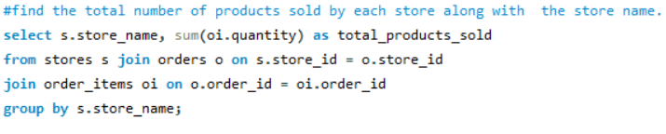
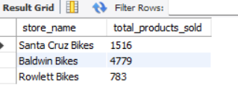
Total number of products sold by each store along the store name.

Slide 4
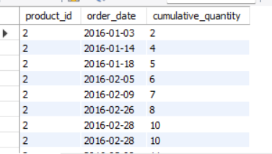
Cumulative sum of quantities sold for each product over time

Slide 5
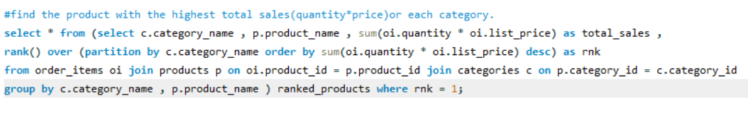
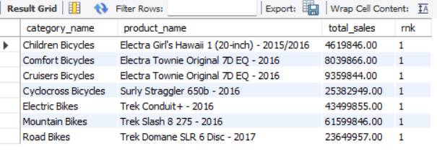
Product with the highest total sales(quantity*price) or each category

Slide 6
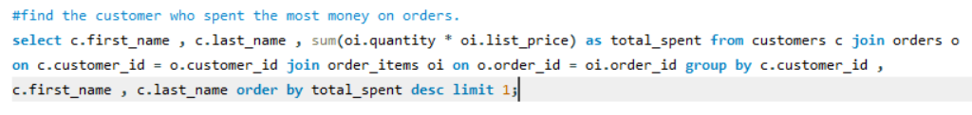
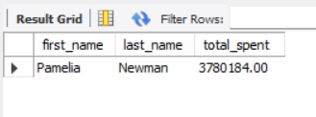
Customer who spent the most money on orders

Slide 7
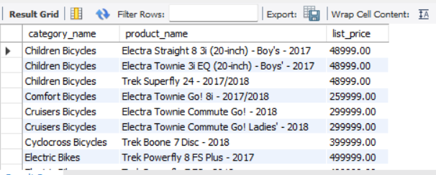
Highest priced product in each category along with the category name

Slide 8
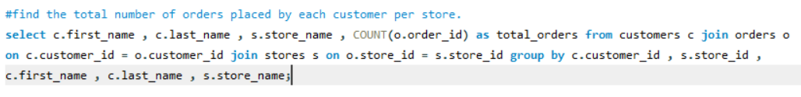
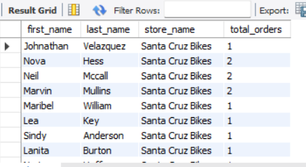
Total number of orders placed by each customer per store

Slide 9
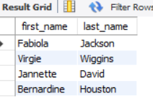
Staff members who have made no sales

Slide 10
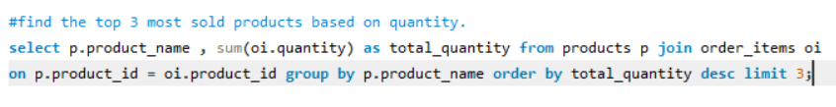
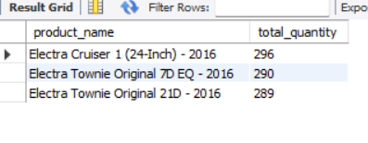
Top 3 most sold products based on quantity

Slide 11
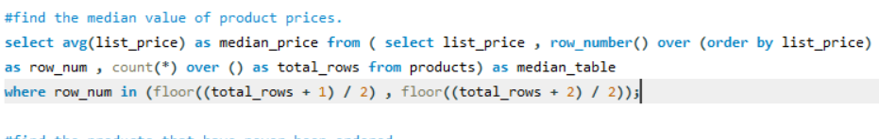
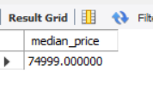
Median value of product prices

Slide 12
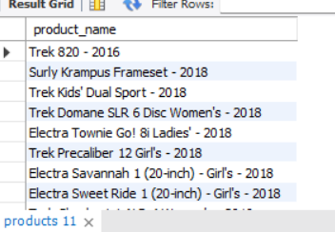
Products that have never been ordered

Slide 13
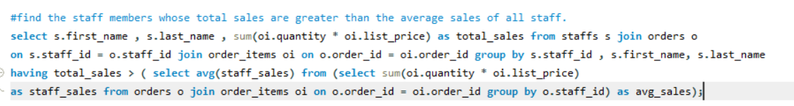
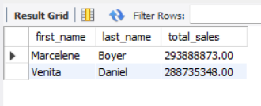
Staff members whose total sales are greater that the average sales of all staff

Slide 14
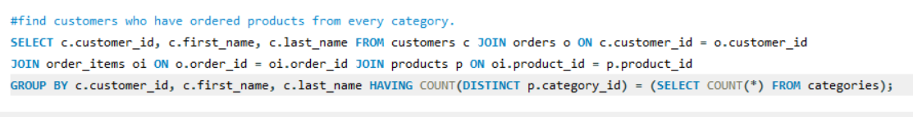

Customers who have ordered products from every category

Slide 15
Conclusion
Key Insights from Jenson USA SOL Analysis
Store Sales Performance: ldentifies top and underperforming stores.
Product Demand Trends: Tracks cumulative sales to forecast inventory needs.
Top-Selling Products by Category: Highlights revenue-driving products.
Top-Spending Customers: Pinpoints high-value customers for targeted engagement.
Pricing Strategy: Assesses highest-priced products and median price points.
Customer Loyalty: Analyzes order frequency per store.· Staff Performance:
Identifies top performers and those needing improvement.
Product Popularity: Lists top-selling and never-ordered products. Engaged Shoppers; Recognizes customers purchasing across all categories,

Slide 16
THANK YOU

