Slide 1

McDonlad’s Sales Analysis
By : MADHAVAN M N

Slide 2

PROJECT OBJECTIVE
To analyze McDonald’s sales data and identify key revenue trends.
To evaluate product performance across categories.
To understand customer ordering behavior (time & day patterns).
To derive actionable business insights using Excel dashboard.
To support data-driven decision making.

Slide 3
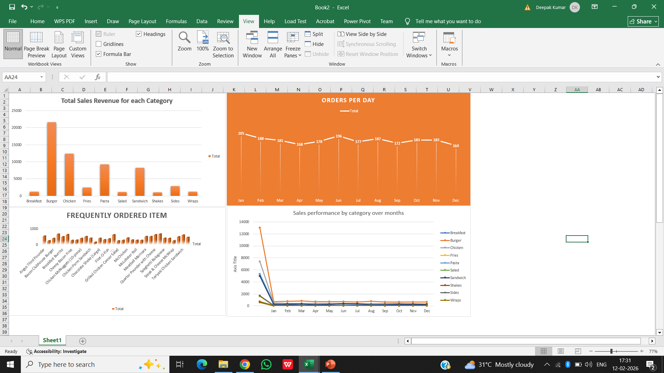
Interactive Sales Dashboard

Slide 4
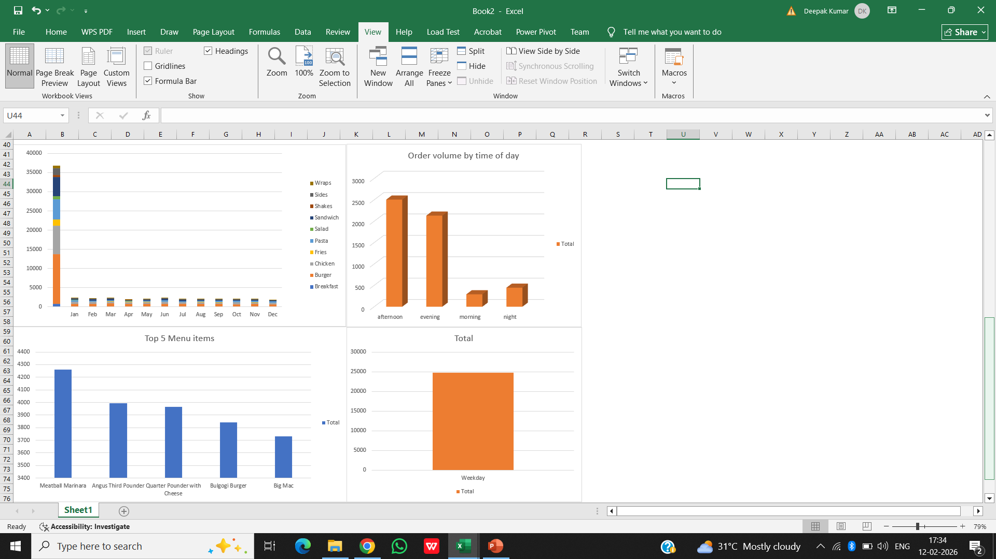
Interactive Sales Dashboard
The dashboard summarizes revenue, order trends, and product performance.
It provides a consolidated view of monthly, category-wise, and customer behavior insights.
Built using Pivot Tables, Pivot Charts, and Excel visualization tools.

Slide 5
KEY INSIGHTS
Burger category generated the highest revenue contribution.
Afternoon time slot recorded the highest order volume.
Weekday sales were higher compared to weekends.
Top 5 menu items significantly contributed to total revenue.
Monthly sales trend showed stable performance with minor fluctuations.
Certain categories showed consistent demand across all months.

Slide 6


BUSINESS RECOMMENDATIONS
1
2
3
4
Focus promotional campaigns on high-performing categories to maximize revenue.
Introduce offers during low-sales time slots to balance demand.
Bundle top-selling items to increase average order value.
Strengthen weekend marketing strategies to boost sales.

Slide 7

CONCLUSION
The analysis provided meaningful insights into sales patterns and customer behavior.
1
Excel dashboard effectively visualized business performance metrics.
2
Data-driven insights can help improve revenue planning and operational strategies.
3

Slide 8
THANK YOU

