Slide 1
FoodHub
Online Food Ordering System
Web Programming Project | HTML, CSS, JavaScript, React
Maddy (241001131) | B.Tech IT, Rajalakshmi Engineering College
Notes:
Introduce yourself and the project: FoodHub is a front-end web app for ordering food online.

Slide 2
Introduction & Problem Statement
FoodHub is a web app to order from 25+ restaurants and snack shops with 250+ dishes
Traditional ordering means phone calls, queues and manual order errors
Customers need a fast, visual way to search, choose and order food
FoodHub gives one responsive interface for the whole journey, from browsing to placing the order
Notes:
Explain why online ordering matters and what problem FoodHub solves.

Slide 3
Objectives
Build an easy-to-use online food ordering interface
Let users search and filter outlets and dishes
Support cart management with quantity control and an automatic bill
Offer delivery address and payment options at checkout
Apply course technologies: HTML, CSS, JavaScript and React
Notes:
Read these as the goals you set at the start of the project.

Slide 4
Technologies Used
HTML
CSS
JavaScript
React
Structure of pages: navbar, outlet cards, menu lists, forms
Styling, layout, theme colors, responsive design
Logic: search, filters, cart totals, event handling
Reusable components, state and props, dynamic UI
Notes:
Be ready to explain what each technology does in your project.

Slide 5
Key Features
Search & Filter
Outlets & Menus
Veg / Non-Veg
Search dishes and filter outlets by category
25 outlets with ratings, offers and menus
Toggle to show pure veg dishes only
Favorites
Cart & Bill
Checkout
Save outlets with the heart icon
Quantity control, delivery fee, 5% tax, total
Saved, manual or map address; COD or card
Notes:
These match the screens in your demo.

Slide 6
Application Flow
Home & Search
Open Outlet Menu
Add to Cart
Address & Payment
Place Order
Notes:
Walk through the user journey step by step.

Slide 7
React Concepts Used
Components: Navbar, Outlet Card, Menu Item, Cart, Bill Summary
Props: pass outlet and dish data from parent to child
State (useState): cart items, quantities, favorites, veg toggle
Event handling: onClick for ADD, +/- and Place Order
List rendering: map() for outlets and menu dishes; conditional rendering for filters
Notes:
Likely viva questions: what is a component, props vs state, why hooks.

Slide 8
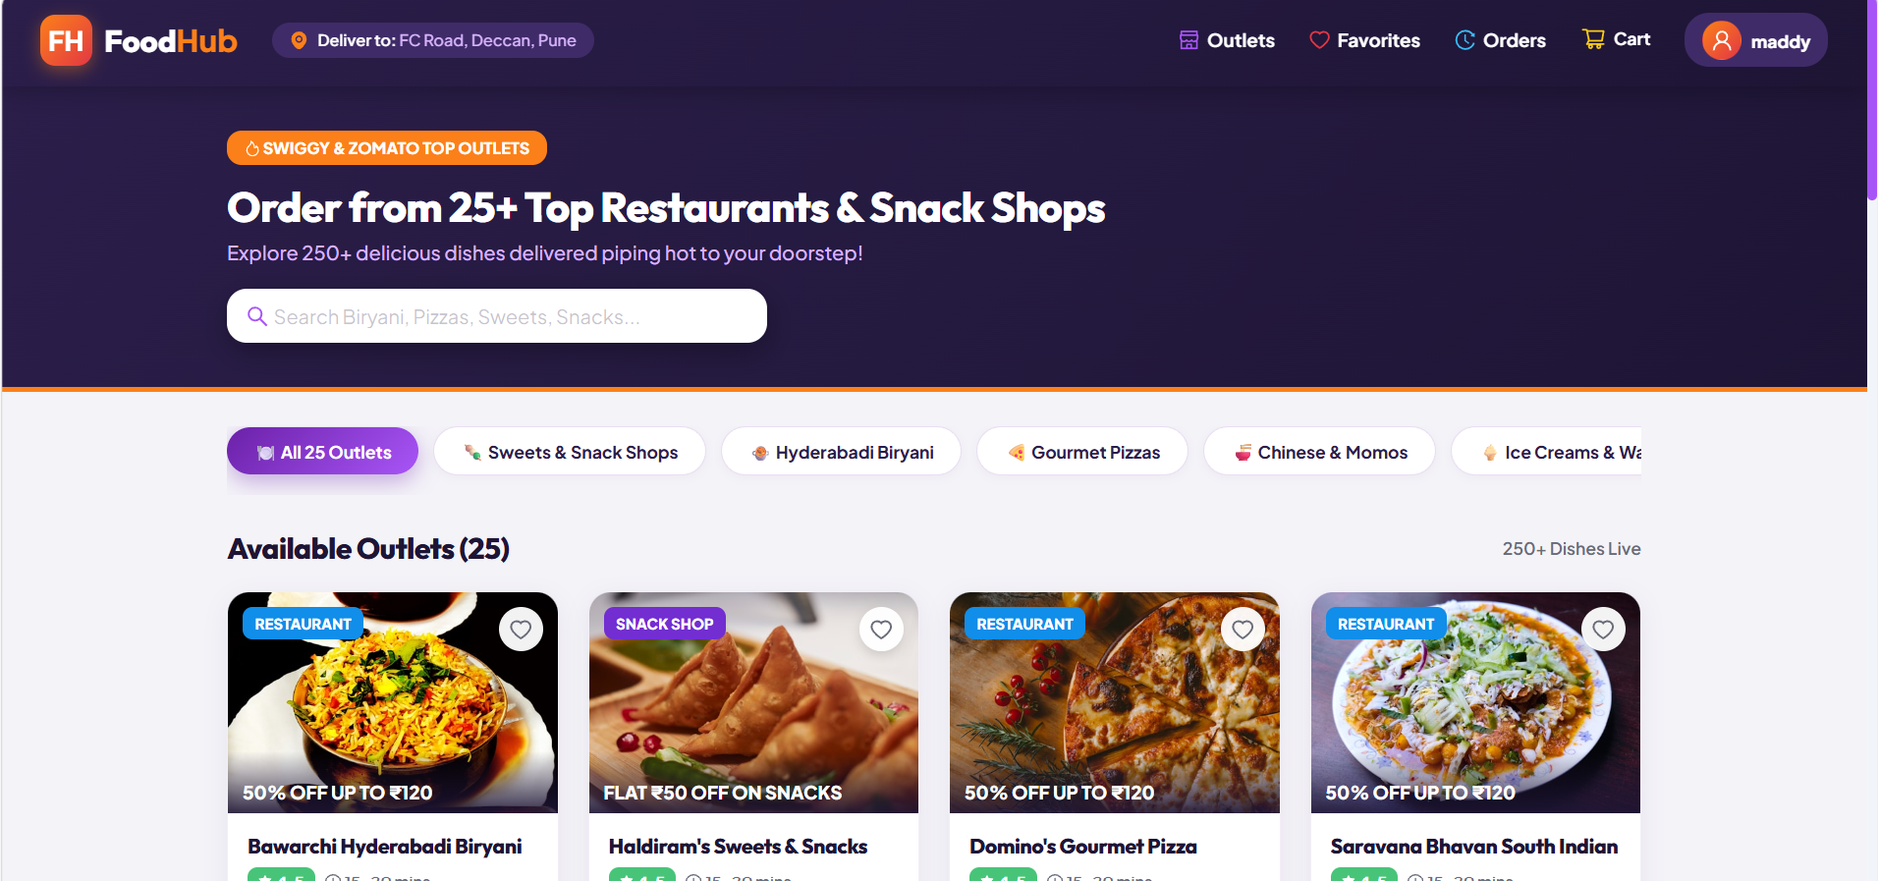
Home Page
What it shows
Hero banner with search bar for dishes
Category chips filter the 25 outlets
Outlet cards show offers and a favorite heart
Navbar: location, Outlets, Favorites, Orders, Cart, profile
Notes:
Show the home page and explain search, categories and outlet cards.

Slide 9
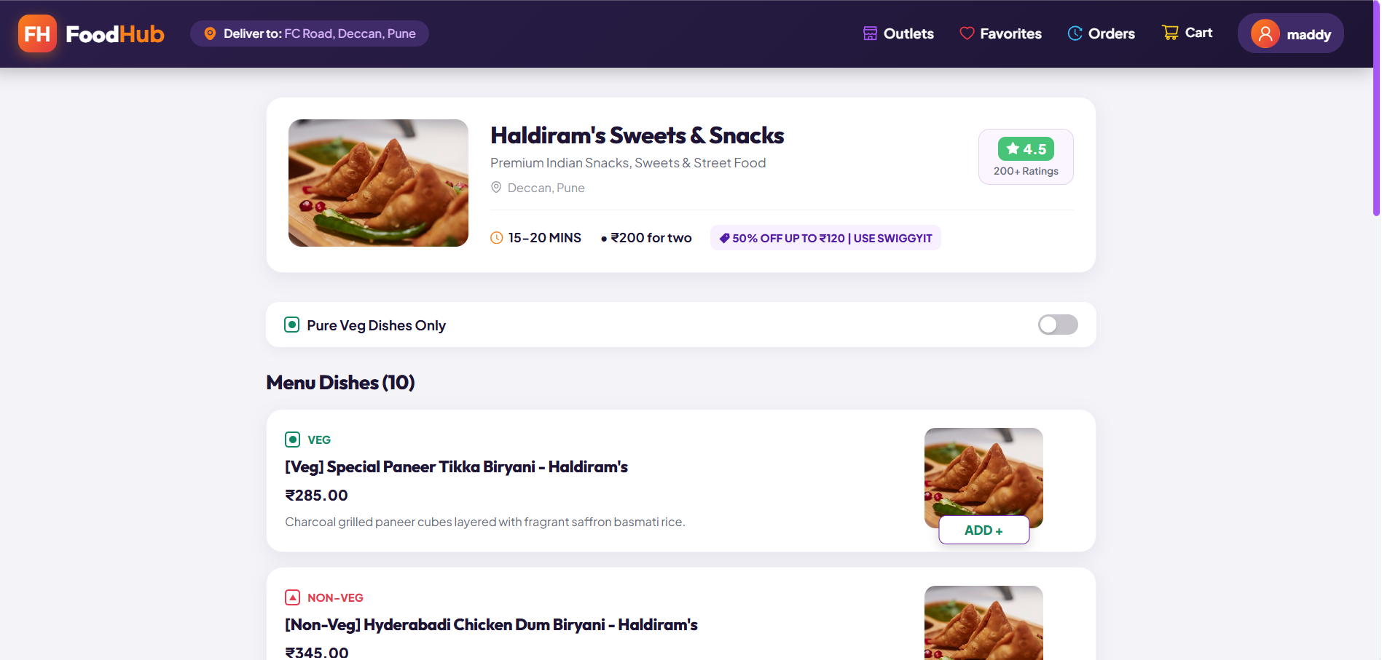
Outlet Menu
What it shows
Outlet header: rating, delivery time, cost for two, offer
Pure Veg toggle filters the dishes
Each dish shows Veg or Non-Veg tag, price and description
ADD button puts the dish in the cart
Notes:
Explain the outlet header, veg toggle and ADD button.

Slide 10
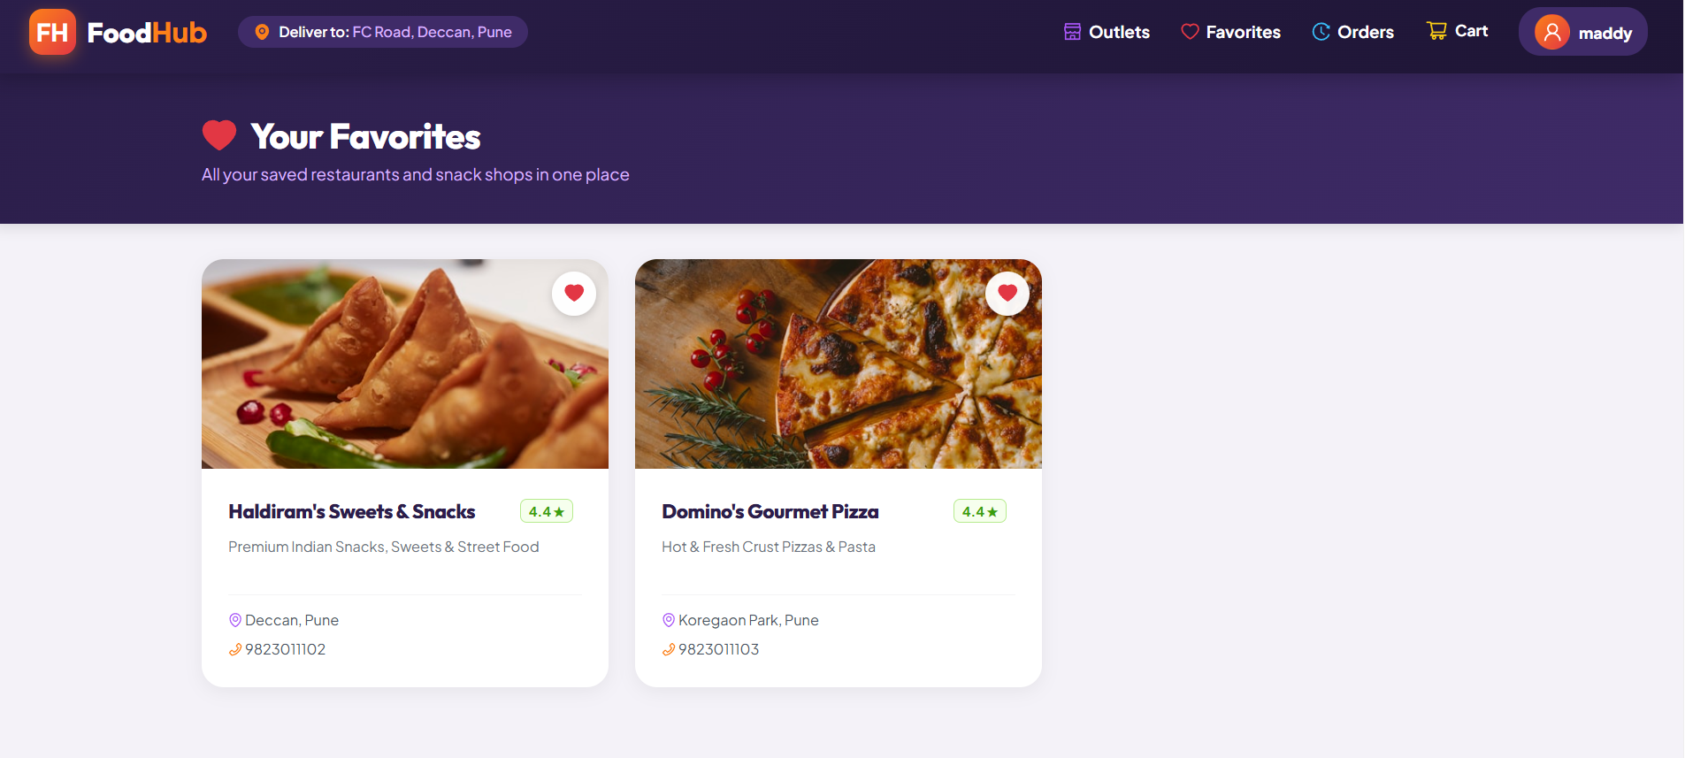
Favorites
What it shows
Heart icon saves an outlet
Favorites page lists all saved outlets
Each card shows rating, cuisine, area and contact number
Notes:
Explain how saved outlets are stored and shown.

Slide 11
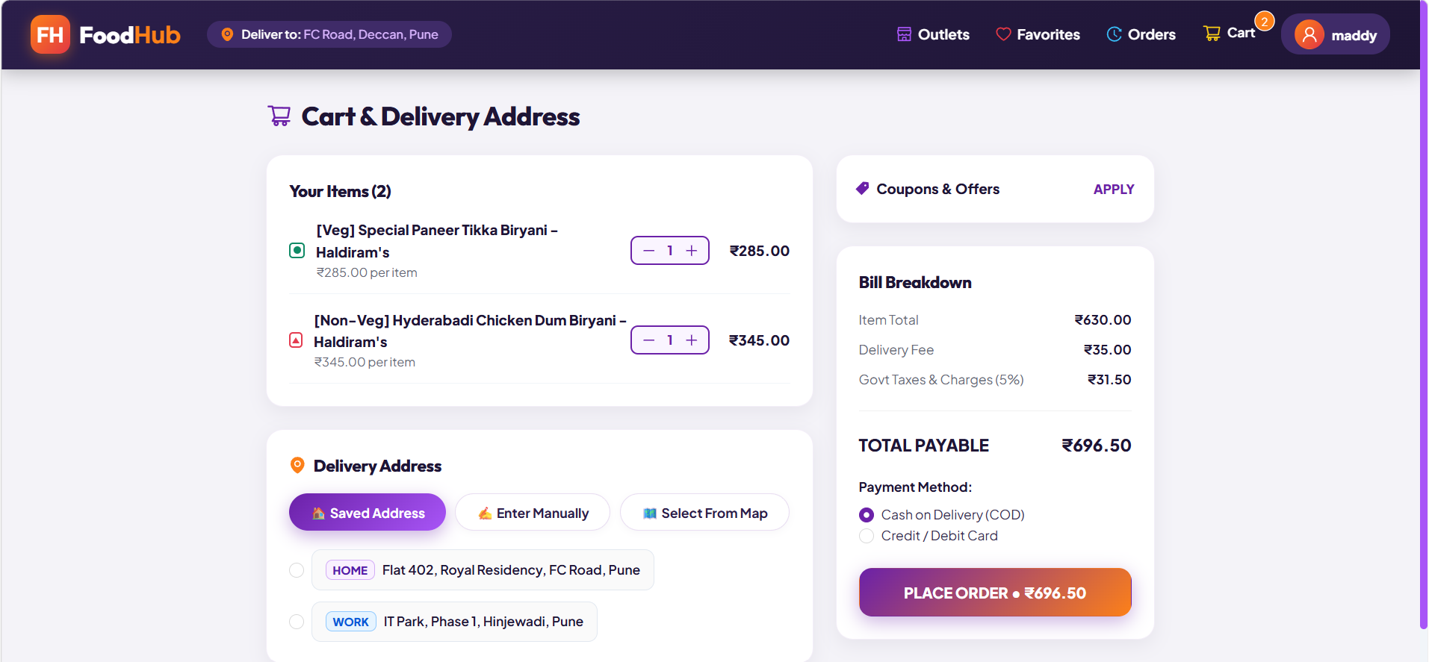
Cart & Checkout
What it shows
+/- buttons update item quantity
Bill: item total, delivery fee, 5% tax and total payable
Delivery address: saved, manual or from map
Payment: Cash on Delivery or card, then Place Order
Notes:
Explain quantity control, the bill breakdown and placing the order.

Slide 12
Future Scope
Backend with Node.js and a database for real orders and users
Real online payment gateway integration
Live order tracking and order history updates
Ratings and reviews for outlets and dishes
Admin panel to manage outlets, menus and orders
Notes:
Mention what you would add with more time.

Slide 13
Conclusion
FoodHub makes ordering food simple, fast and visual
Combines HTML, CSS, JavaScript and React in one working project
Component-based design makes the app easy to extend
Strengthened practical front-end development skills
Notes:
Summarize what you built and learned.

Slide 14
Thank You
Questions?
Notes:
Invite questions.

