Slide 1
Clickbait Challenge at SemEval 2023
PROJECT PRESENTATION
- TEAM ROG 1
- Himani, Madhavan, Eva

Slide 2
Agenda
Introduction
Data Understanding
Baseline Approach
Improvements in Classification
Improvements in Spoiler Generation
Processing Long Sequences
Global Attention and Long-T5
Evaluation
Training Graphs of Long-T5
Sample Results
Conclusion and Future Improvements

Slide 3
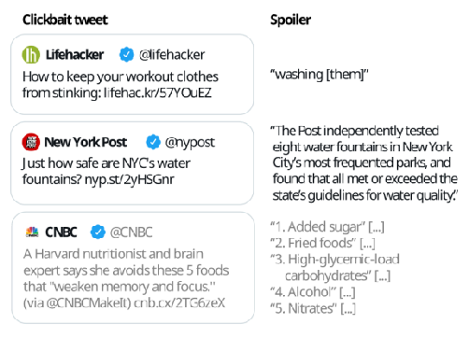
Introduction
Clickbait is a type of online content that uses sensational headlines and misleading information to entice people to click on links and visit websites. While clickbait can be effective at driving traffic to websites, it often creates problems for internet users.
OBJECTIVES:
To train and evaluate a multi-class classification model that can differentiate spoilers into three categories.
To build a domain adaptable spoiler generation model that can generate accurate spoilers for all the three spoiler categories.

Slide 4
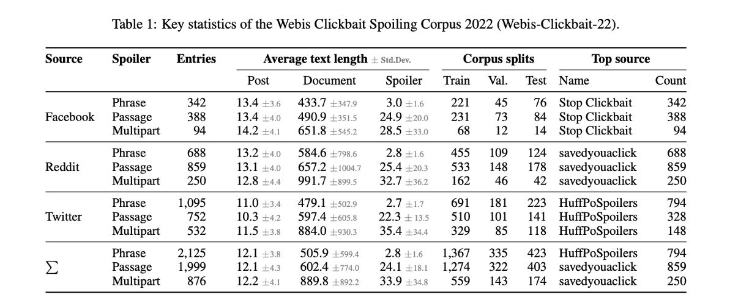
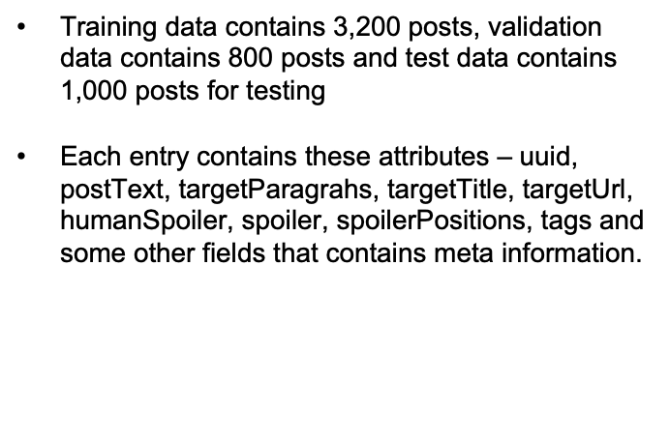
Data Understanding

Slide 5
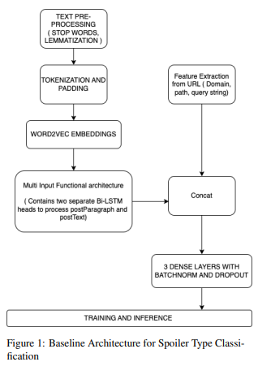
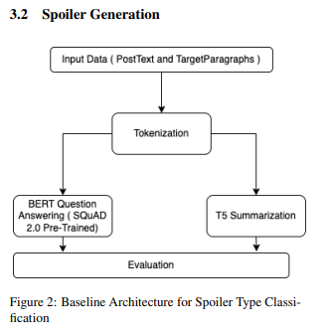
Baseline Approach
For classification, we used feature extraction and Bi-LSTM model with word2vec embeddings.
For spoiler extraction, we used pretrained models such as BERT and T5 summarization.

Slide 6
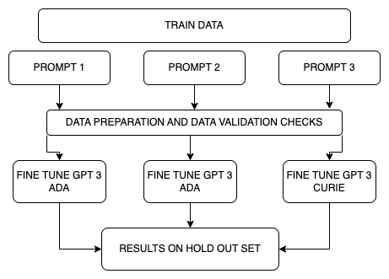
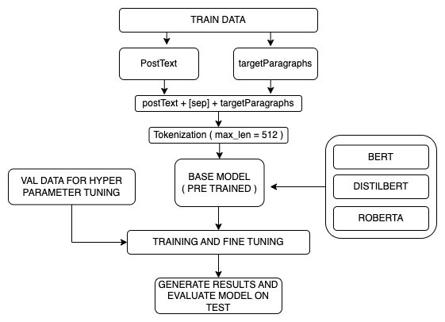
Improvements in Classification
Prompts with different SEP tokens
Prompts with different END token
Prompts with different “Input” and “Context” Pair
Multi Class Classification Pipeline for Spoiler Classification

Slide 7
Question Answering vs Conditional Summarization
It is adapted to take a question and a context as input and provide an answer by predicting the start and end tokens within the context. QA is typically used for extractive question answering tasks, where the answer is directly extracted from the given context.
Conditional summarization involves generating a summary of a given text or passage based on specific conditions or criteria. This is different from general summarization, which aims to provide a summary that captures the most important points of the input text without any specific conditions.
In conditional summarization, the generated summary is tailored to meet certain requirements or address specific aspects of the input text
BERT
ROBERTA
MINI LM
Longformer T5
LED ( Longformer Encoder Decoder )

Slide 8
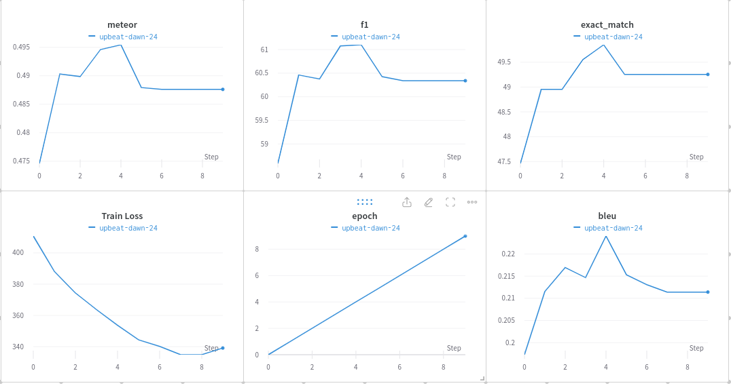
Improvements in Spoiler Extraction
Fine tuned improved the score of models such as BERT while in baseline, we used pre trained models.
Divided the dataset into spoiler types and applied suitable models according to types.
Mapped the spoiler positions with the spoiler texts so that model can learn better.
Bert improved from 0.16 to 0.21 after fine tuning.

Slide 9
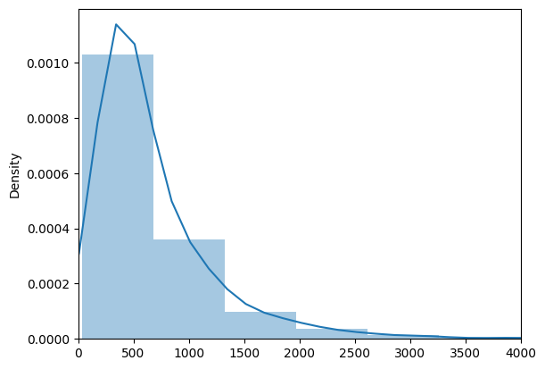
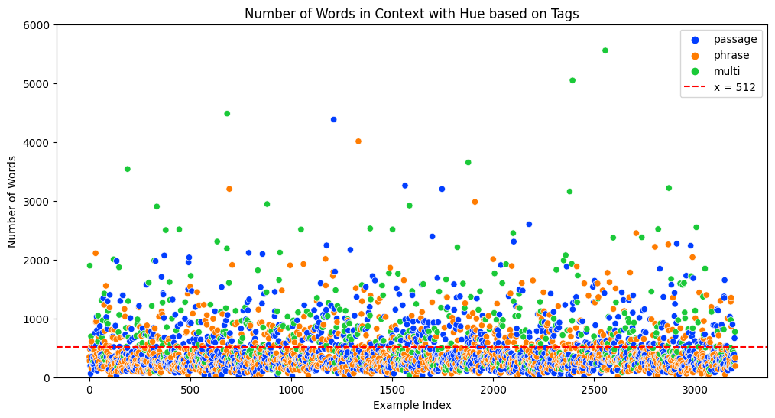
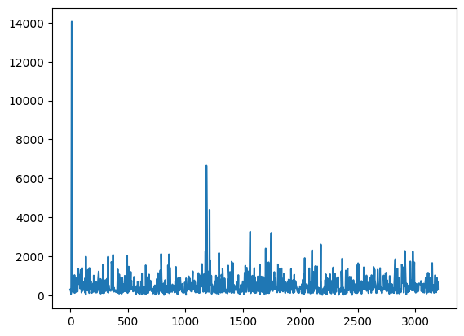
Processing Long Sequences
Picking Max Token Size Based on Analysis ( Fig: Passage Spoiler - Number of Words)

Slide 10
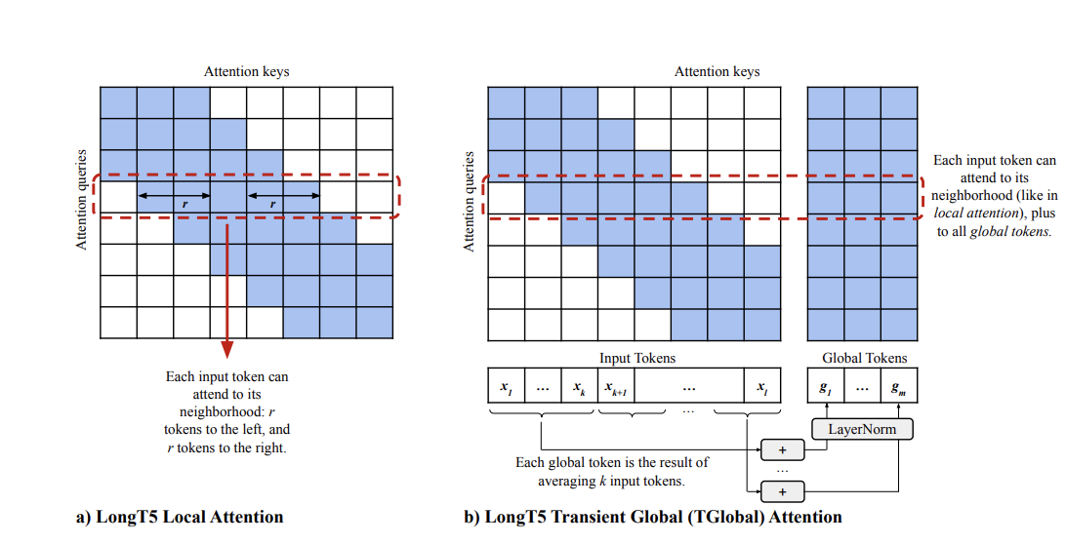
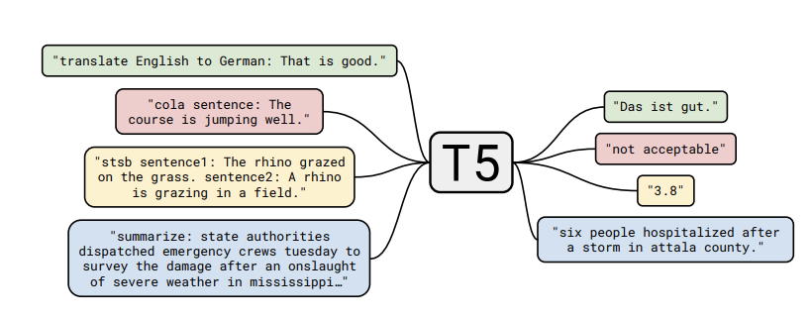
Global Attention and Long-T5
Model | Max Token Size
Most LLM’s | 512 / 1024
T5 | 512
Long T5 | 16384
LED ( Longformer Encoder Decoder ) | 4096 / 16384
LongT5: Efficient Text-To-Text Transformer for Long Sequences ( Mandy et. al)
Generalist Pre-Trained Model
Prefix helps to learn
SOTA Results on Summarization
Can be fine tuned for Conditional Generation
Exploring the Limits of Transfer Learning with a Unified Text-to-Text Transformer ( Colin et. al)

Slide 11
Evaluation
0.08
Model (multi-class classification - Spoiler Type )) | F1 Score
BERT (base uncased) | 61.16
ROBERTA ( base ) | 70.38
DistilBERT | 65.01
Longformer | 67.56
GPT-3 ( Ada - Prompt 1) | 68.50
GPT-3 ( Ada - Prompt 2) | 67.22
GPT-3 ( Curie - Prompt 3) | 70.02
PHRASE
Model | BLEU | Meteor | BERT Score
BERT* | 0.21 | 0.48 | 60.34
ROBERTA* | 0.31 | 0.59 | 71.51
Long T5* | 0.5473 | 0.5991 | 96.68
LED* | 0.553 | 0.5764 | 96.24
PASSAGE
Model | BLEU | Meteor | BERT Score
BERT | 0.13 | 0.27 | 20.63
MiniLM | 0.17 | 0.27 | 24.25
Long T5* | 0.891 | 0.9069 | 98.16
LED* | 0.853 | 0.8857 | 97.70
MULTI
Model | BLEU | Meteor | BERT Score
BERT | 0.032 | 0.12 | 14.05
MiniLM | 0.025 | 0.12 | 13.86
Long T5* | 0.8185 | 0.8620 | 96.57
LED* | 0.7546 | 0.8254 | 95.79

Slide 12
Baseline metrics vs Improved metrics
Spoiler Generation - Baseline
Model | Bleu | meteor | Bert score
BERT | 0.12 | 0.18 | 0.83
BART | 0.11 | 0.11 | 0.84
T5 | 0.14 | 0.21 | 0.23
UnifiedQA | 0.1 | 0.11 | 0.79
Spoiler classification
Model (multi-class classification - Spoiler Type )) | F1 Score
Baseline model best accuracy | 0.49
Improved model best accuracy | 70.38
SPOILER GENERATION - Improved (ONLY FOR THE MODELS THAT WE APPLIED IN BASELINE)
Model | BLEU | Meteor | BERT Score
BERT* | 0.21 | 0.27 | 60.37
ROBERTA* | 0.31 | 0.59 | 71.51
Long T5* | 0.54 | 0.59 | 96.68

Slide 13
ACL Results VS Our Best Results
SPOILER GENERATION
 | Phrases |  | Passage |  | Multi
 | ACL | Our Model | ACL | Our Model | ACL | Our Model
BLEU | 68.80 | 55.37 | 31.44 | 89.18 | NA | 81.85
Meteor | 67.94 | 57.64 | 46.06 | 90.69 | NA | 86.20
SPOILER CLASSIFICATION (MULTI-CLASS)
 | ACL | Our Model
F1 score | 73.63 | 70.38

Slide 14
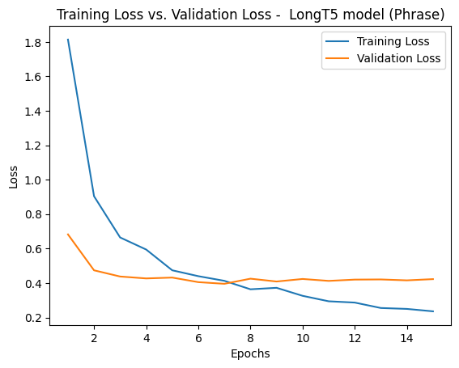
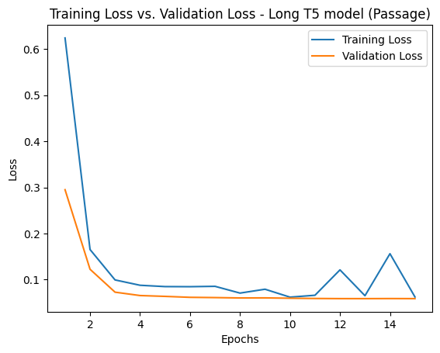
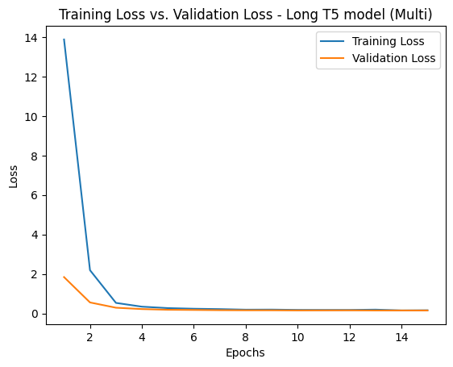
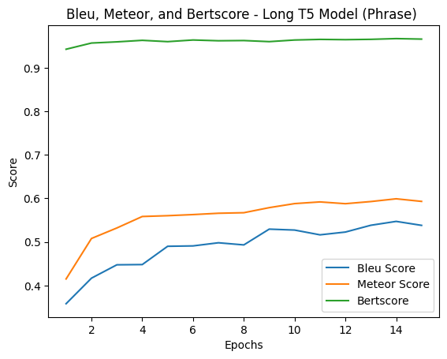
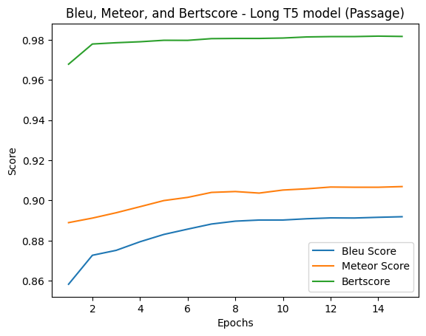
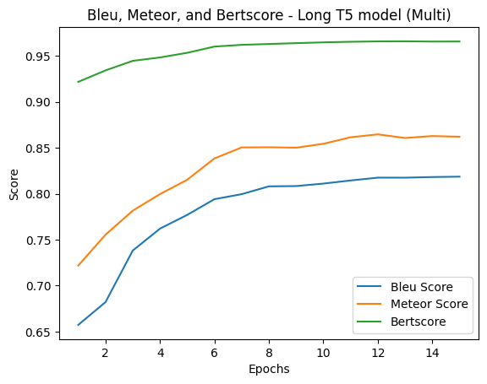
Training Graphs of Long-T5

Slide 15
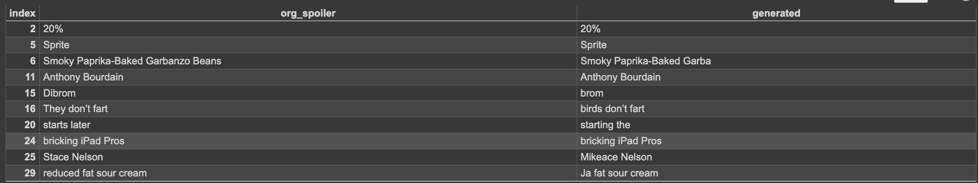
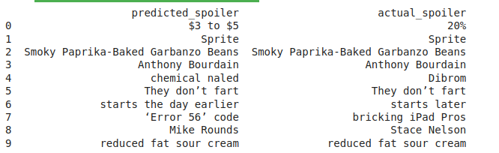
Sample Results - Phrase
LONG T5 results for phrase
Roberta fine tuned for phrase

Slide 16
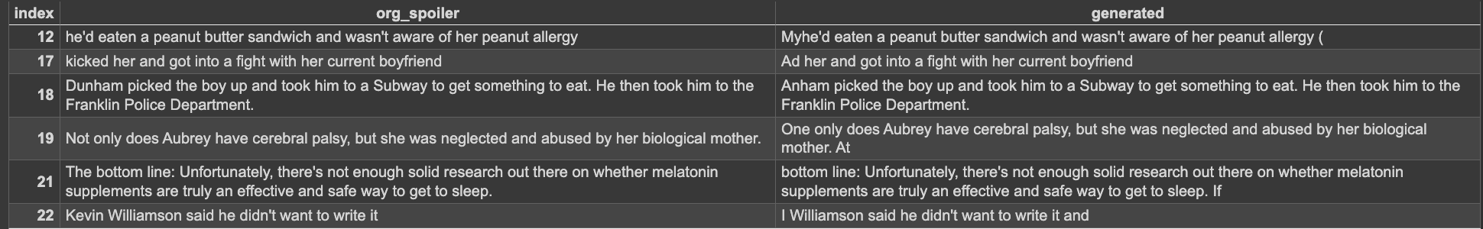
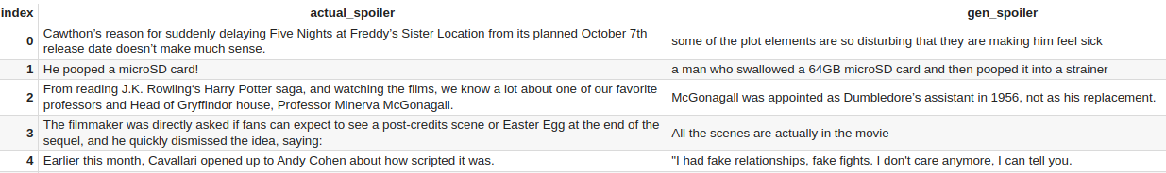
Sample Results - Passage
LONG T5 results for Passage
Mini LM on Passage

Slide 17
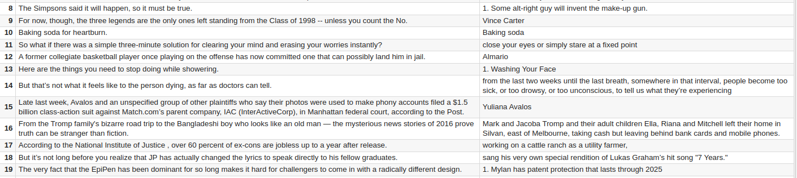
MULTI output samples
Mini LM for multi
Long T5 for multi

Slide 18
Conclusion and Future Improvements
For phrase type of spoiler, QA approach might work better and for passage and multi, summarized extraction provides amazing results. However, we would need a Long T5 model trained on large scale question answering dataset such as SQUAD 2.0.
By introducing Longer Generation Models and Global Attention we are able to get SOTA results on Passage and Multi Spoiler Types.
A pretrained Long T5/ Longformer architecture trained on SQUAD 2 Dataset for Question Answering might be something worth exploring in future.

