Slide 1

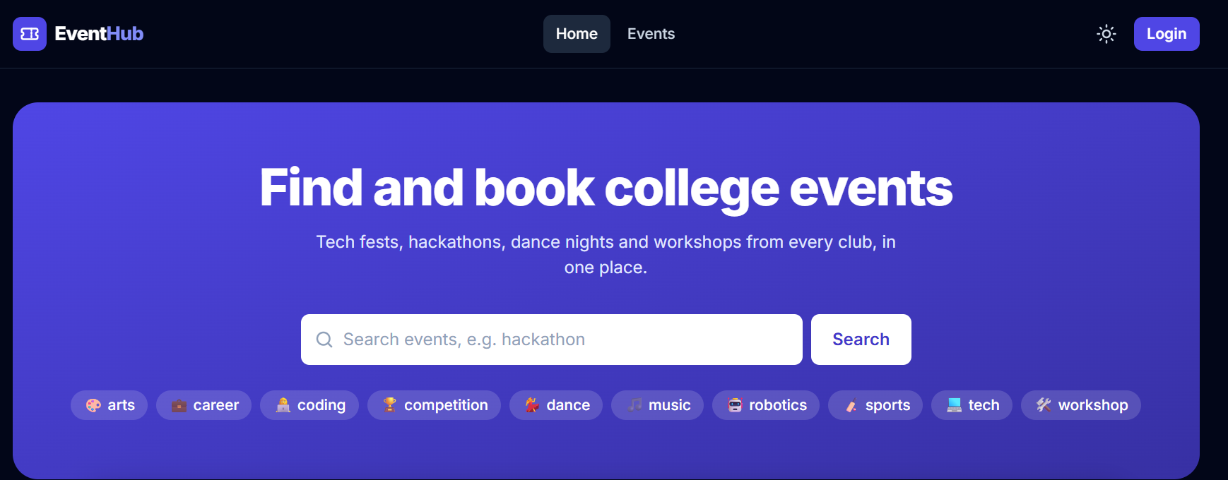
EventHub
College Event Management Platform
Find, book, pay, enter with a QR ticket, get a certificate - all in one place.
Java Full Stack project · React + Spring Boot + MySQL
Madhavan Suresh · September 2026
EventHub · 1
Notes:
Good morning. My project is EventHub, a website where a college runs all its events: students find events, book and pay, enter with a QR ticket and get a certificate. I built it with React for the screens, Spring Boot for the server and MySQL for the data.

Slide 2




The problem
Today most college events run on WhatsApp groups and Google Forms
Overbooking
Two students fill the form for the last seat - both think they are in.
The solution
EventHub puts the whole journey in one place
Fake entries
A screenshot of a ticket is shared; nobody can tell who already entered.
Find
Book and pay (seat held 10 minutes)
Enter with a one-time QR ticket
Get a verifiable PDF certificate
Give feedback - organizers see analytics
Late certificates
Made by hand weeks later, and easy to fake on a resume.
No insight
Organizers cannot see sales, attendance or what students thought.
EventHub · 2
Notes:
Most colleges manage events with WhatsApp and Google Forms. That causes four problems: two people get the same last seat, ticket screenshots are shared, certificates come late and can be faked, and organizers have no numbers. EventHub solves all four in one website.

Slide 3






Objectives
What the project had to achieve
Easy discovery
Fair booking
Smart waitlist
Search and filter events by text, tag, club and date - on the server, with paging.
Never sell more seats than exist, even when 100 students click at the same second.
Freed seats are offered automatically to the next student in the queue.
Fast, safe entry
Proof of attendance
Insight
QR tickets checked at the gate; each ticket works exactly once.
PDF certificates only for students who came, verifiable by anyone.
Ratings, check-in rate and sales charts for organizers and the admin.
EventHub · 3
Notes:
I set six objectives: easy discovery, fair booking that never oversells, a smart waitlist, fast and safe entry with QR codes, certificates only for people who really came, and useful numbers for organizers.

Slide 4





Who uses EventHub
Five kinds of users - the server checks the role on every request
Visitor
Student
Organizer
Volunteer
Admin
Browse and search events
Verify a certificate
Register
Book and pay
QR tickets, waitlist
Certificates, feedback
Create events for their club
Submit for approval
Analytics, feedback
Gate duty for their club
Scan QR tickets
Live check-in counter
Approve or send back events
All-club analytics
Activity (audit) log
EventHub · 4
Notes:
There are five kinds of users. A visitor only browses. A student books and gets tickets and certificates. An organizer runs events for one club. A volunteer scans tickets at the gate. The admin approves events and sees everything. The page hides buttons, but the server is what really protects each action.

Slide 5
The project at a glance
Built step by step in 10 phases, with every change tested on GitHub
29
50
17
pages (routes)
REST API endpoints
database tables
146
91%
60+
automated tests
service test coverage
Git commits
EventHub · 5
Notes:
Some numbers: 29 pages, 50 API endpoints, 17 database tables, 146 automated tests with 91 percent coverage of the business logic, and more than 60 commits on GitHub. About 6,600 lines of Java, 6,000 lines of React and 3,400 lines of tests.

Slide 6




Technologies used
Current, industry-standard tools
Frontend
Backend
Data & services
Quality & tools
React 19 + Vite 8
Tailwind CSS 4 (dark mode)
Redux Toolkit
React Router 7
Recharts (charts)
html5-qrcode (camera)
Java 25, Spring Boot 4.1
Spring Security + JWT
Spring Data JPA / Hibernate
Flyway migrations
ZXing (QR), OpenPDF
Caffeine cache, Spring Mail
MySQL 8.4
Docker Compose
Mailpit (test email)
Stripe Checkout (test mode)
Swagger / OpenAPI docs
JUnit 5 + Mockito
Testcontainers (real MySQL)
JaCoCo coverage
Vitest + Testing Library
GitHub Actions CI
Postman, IntelliJ, Git
EventHub · 6
Notes:
The frontend is React with Tailwind for styling and Redux for shared state. The backend is Spring Boot on Java 25 with Spring Security. Data is in MySQL, running in Docker. For quality I used JUnit, Mockito, Testcontainers and Vitest, and GitHub Actions runs every test on every push.

Slide 7
Architecture
A single-page React app talks to a layered Spring Boot API
Spring Boot API (port 8080)
Stripe
checkout + webhook
Security filters
JWT cookie reader · CSRF · role rules
Browser
React 19 app
Redux store · Axios
Mail server
Mailpit in development
Controllers
50 REST endpoints · validation
Services
business rules · transactions · events
JSON over HTTP · JWT cookie + CSRF token
MySQL 8.4
17 tables · Flyway V1-V9
Repositories
Spring Data JPA · Hibernate
GitHub Actions
tests on every push
EventHub · 7
Notes:
The browser runs the React app. It sends JSON requests to the Spring Boot server. Each request first passes the security filters, which read the login cookie and check the CSRF token. Then a controller receives it, a service applies the business rules inside a database transaction, and a repository reads or writes MySQL. The server also talks to Stripe for payments and to a mail server for emails.

Slide 8
Backend modules
One Java package per business area - easy to find and to test
event
booking
payment
Create, edit, search, approval workflow
Seat holds, confirm, cancel, expiry job
Stripe or test gateway, webhooks, refunds
waitlist
notification
gate
Queue, 30-minute seat offers
In-app bell, emails, reminders
QR images, check-in, live counter
certificate
feedback
analytics
PDF certificates, public verify
Stars and anonymous comments
Charts data, 60-second cache
auth
audit
club · tag · user
Register, login, JWT, club roles
Who did what, and when
Clubs, tags, users, profiles
EventHub · 8
Notes:
The backend is split into packages by business area, not by technical layer. So everything about bookings is in the booking package: the entity, repository, service and controller. This makes the code easy to find and to test.

Slide 9



Database design
17 MySQL tables, created and changed only through Flyway migrations (V1-V9)
People & clubs
Design rules that keep the data correct
users, roles, user_roles, profiles, clubs, club_members
events.available_seats is the ONE seat counter; a @Version column stops two saves from overwriting each other
UNIQUE keys stop duplicates: one certificate and one rating per ticket, one webhook message processed once
CHECK constraints: status values, 1-5 stars, 1-10 tickets
Random codes (EVH-..., EH-2026-...) so nobody can guess other tickets or certificates
Tests run on their own fresh MySQL (Testcontainers)
Events
events, tags, event_tags, audit_log
Bookings & money
bookings, payments, processed_payment_events, waitlist_entries
After the event
notifications, certificates, feedback
EventHub · 9
Notes:
There are 17 tables in four groups. The tables are never changed by hand: every change is a numbered Flyway migration file, V1 to V9, so every laptop and server has exactly the same database. Constraints in the database itself stop wrong data, for example a rating of 6 stars or the same ticket rated twice.

Slide 10
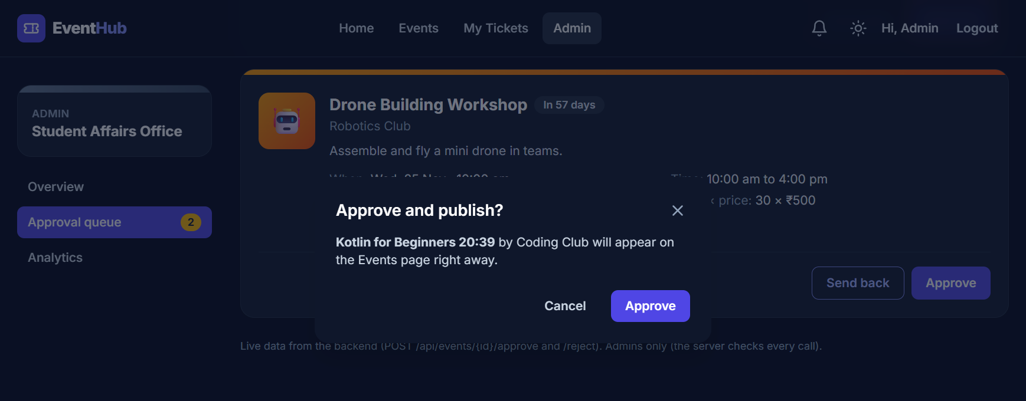
Workflow 1: an event from idea to published
A small state machine - illegal moves are refused by the server
DRAFT
Organizer creates and edits
submit
PENDING APPROVAL
Submitted - cannot be edited
approve
PUBLISHED
Visible and bookable
Admin sends back with a reason → back to DRAFT, the organizer sees the note
Every change is written to the audit log (who, what, when)
The event row has a version number: two admins clicking at once cannot both win
Only organizers of THAT club may edit its events
EventHub · 10
Notes:
An event starts as a draft. The organizer submits it, and while it waits for approval it cannot be edited. The admin either approves it, and it becomes public, or sends it back with a reason. The server refuses any other move, and every step is recorded in the audit log.

Slide 11




Workflow 2: the student journey
From finding an event to getting a certificate
Find
Hold
Pay
QR ticket
Gate
Certificate
Feedback
search, filter
seats kept 10 min
Stripe / test page
booking confirmed
scanned once
PDF after event
1-5 stars
What happens if...
the event is sold out? → join the waitlist ("You are #3"). When someone cancels, the seats are kept 30 minutes for the next student, who gets an email and a bell notification.
the student does not pay? → a job running every minute frees the held seats after 10 minutes.
the payment arrives after the hold ran out? → the seats are taken again if still free, otherwise the money is refunded.
EventHub · 11
Notes:
This is the student journey: find an event, hold the seats for ten minutes, pay, get a QR ticket, get scanned at the gate, receive a certificate after the event, and rate it. The bottom box shows the unhappy paths: a waitlist when it is sold out, automatic release when someone does not pay, and refunds for payments that arrive too late.

Slide 12
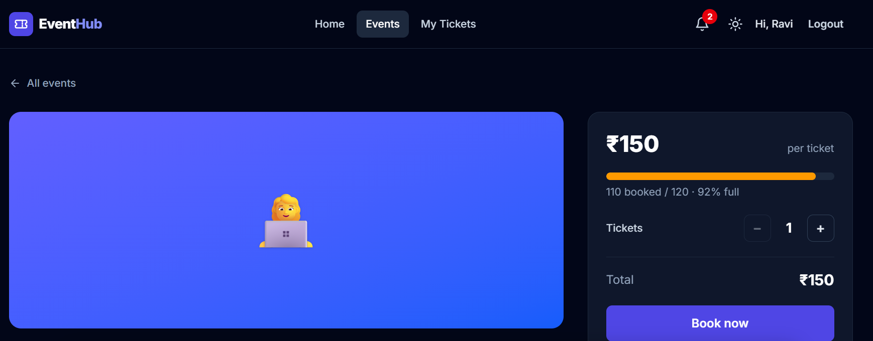
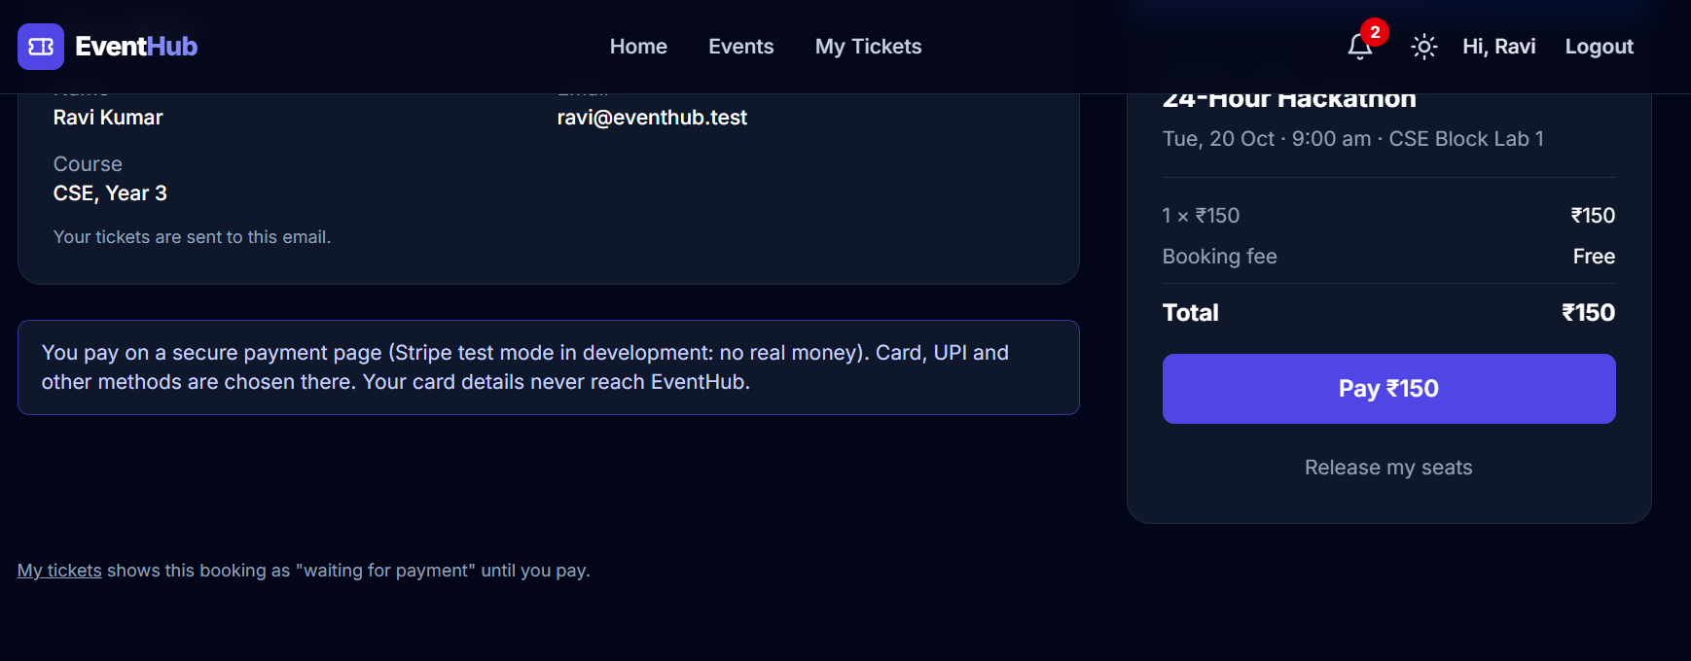
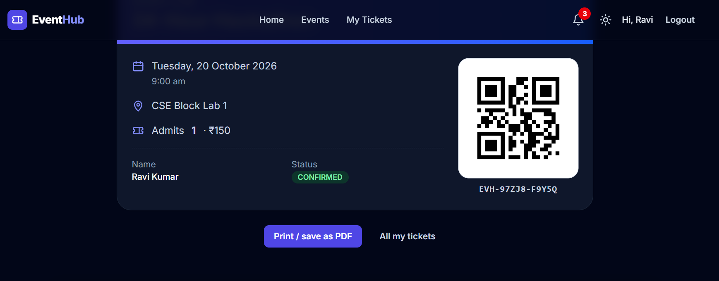
Example 1: Ravi books the 24-Hour Hackathon
Screens from the real running application
1. Live seat count, choose tickets
2. Seat held - server-side timer
3. Paid → QR ticket
Why two students can never get the same last seat
Every save of an event carries its version number. If Ravi and Asha both read "1 seat left, version 7", the first save succeeds (version 8) and the second is refused and retried with fresh data - it now sees 0 seats. A test starts 100 threads for 10 seats: exactly 10 bookings succeed, every time. Without @Version the same test sold 96-99 tickets.
EventHub · 12
Notes:
Here is a real booking. Ravi sees the live seat count, the seats are held for ten minutes while he pays, and after payment he gets a QR ticket. The key point is optimistic locking: the database refuses a save made with old data, so we can never sell the last seat twice. My test with 100 parallel threads proves it.

Slide 13
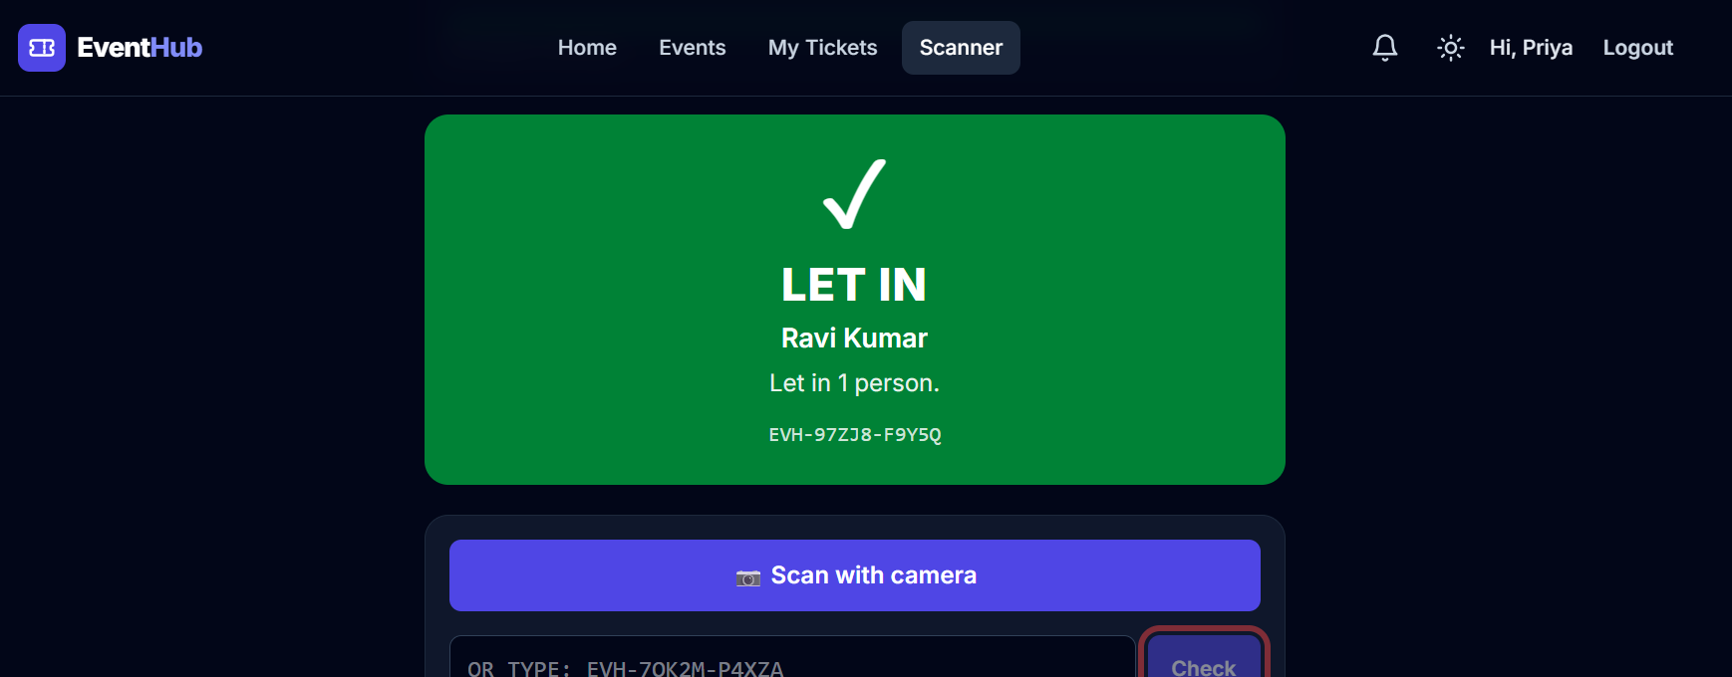
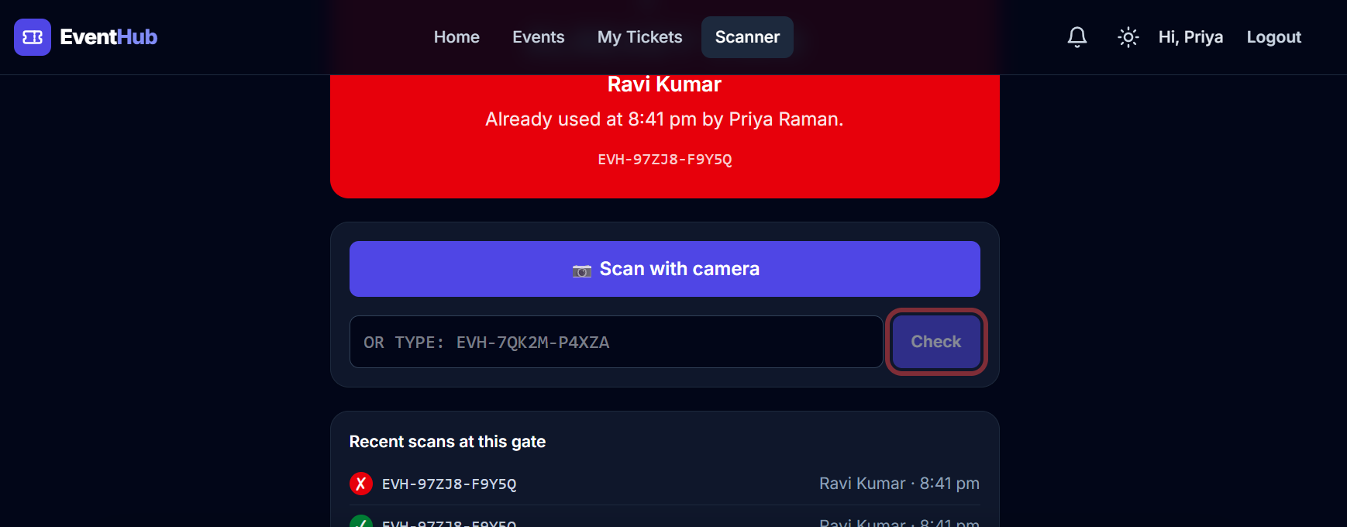
Example 2: the gate - each ticket works once
Volunteer Priya scans Ravi's QR code (camera or typed code)
First scan → LET IN
Same ticket again → ALREADY USED (when, by whom)
One SQL statement does check-and-mark together: UPDATE bookings SET checked_in_at = now WHERE id = ? AND checked_in_at IS NULL. If it changed 1 row → VALID; 0 rows → someone was faster → ALREADY USED. A test with 20 gates scanning the same ticket at the same moment gets exactly one VALID.
EventHub · 13
Notes:
At the gate, the volunteer scans the QR code. The first scan says LET IN in green. The same ticket again says ALREADY USED in red, with the time and the volunteer name. The trick is one SQL update that only marks the ticket if it is not used yet, so even twenty gates at once cannot let the same ticket in twice.

Slide 14
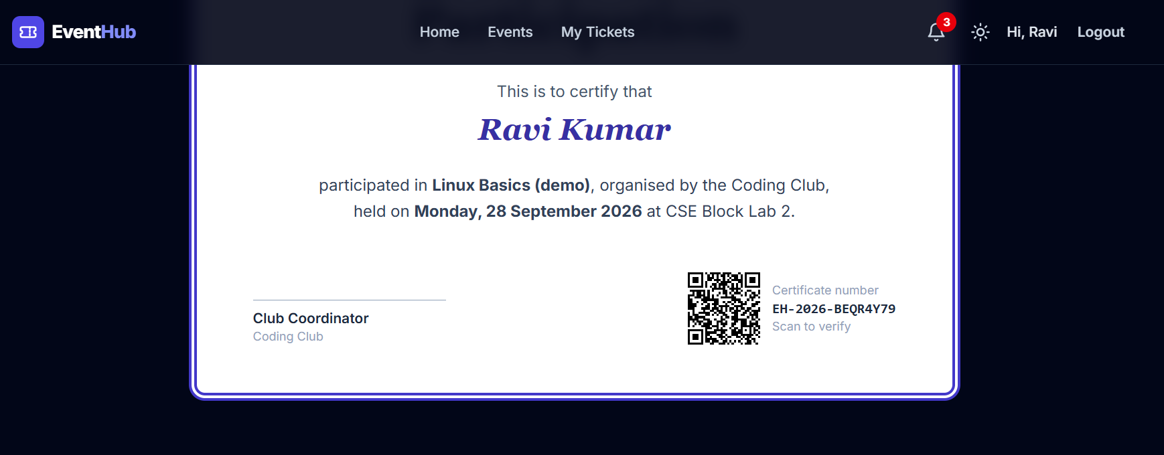
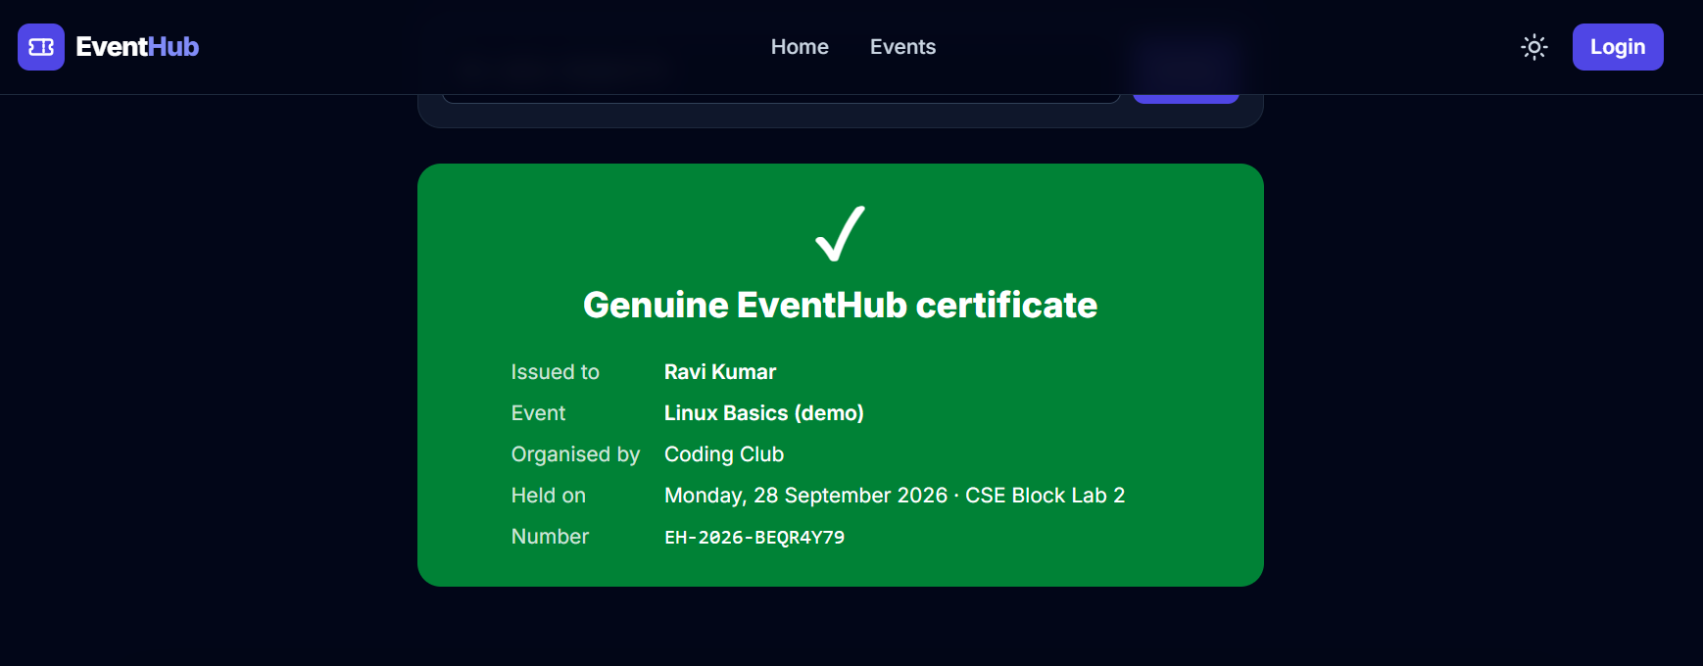



Example 3: certificates anyone can verify
Only for students who were scanned at the gate, after the event ends
PDF drawn by the server (OpenPDF), with a QR code
Public verify page - no login needed
Random number EH-2026-BEQR4Y79 - cannot be guessed
Checked-in + event over = certificate
A company checks it in seconds
EventHub · 14
Notes:
After the event, students who were really scanned at the gate can download a PDF certificate made by the server. Each certificate has a random number and a QR code. Anyone, for example a company reading a resume, can open the public verify page and see that it is genuine.

Slide 15
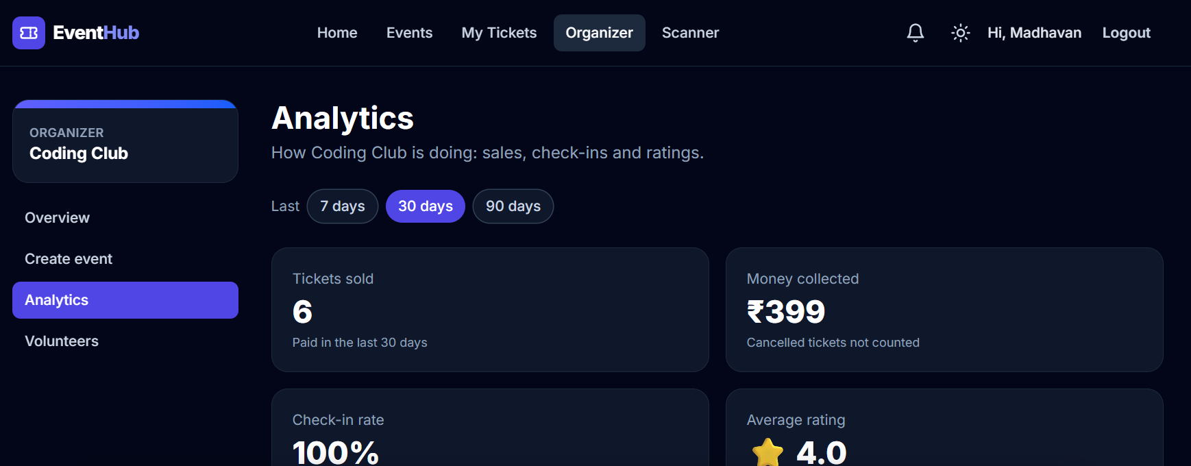
Example 4: analytics for organizers and the admin
Tickets and money per day, check-in rate and average rating
Counted in the database
JPQL GROUP BY, SUM and AVG - Java gets a few small rows, not every booking.
Cached for 60 seconds
@Cacheable + Caffeine: repeated views do not touch MySQL. Seat counts are never cached.
Drawn with Recharts
Bar charts with hover tooltips, a table view for screen readers, light and dark colours checked for contrast.
EventHub · 15
Notes:
Organizers get a dashboard with tickets and money per day, the percentage of ticket holders who actually came, and the average rating. The database does the counting with GROUP BY, and the result is cached for sixty seconds, so opening the dashboard many times does not load the database.

Slide 16

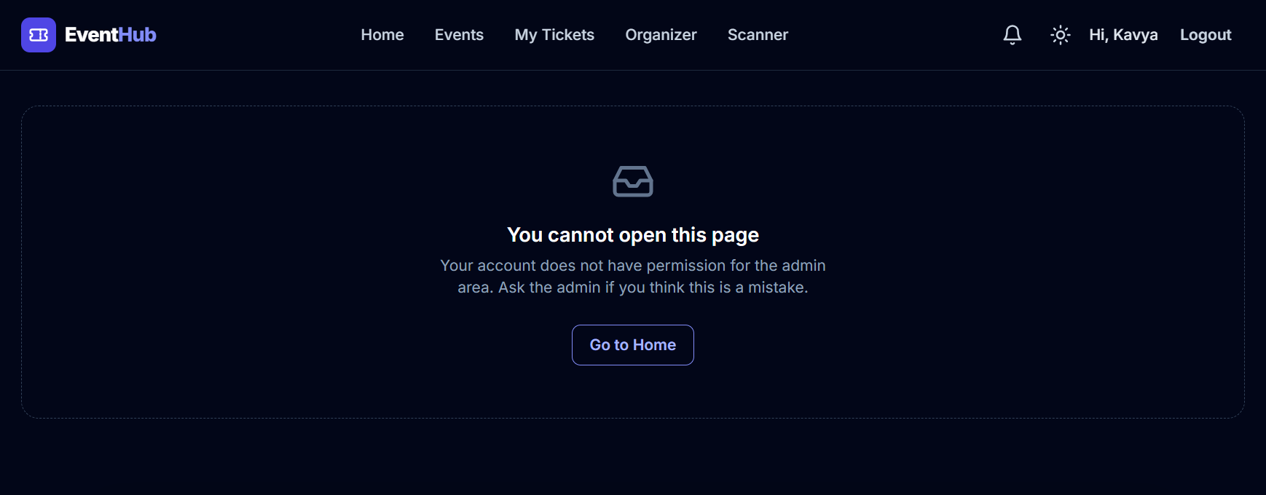





Security
The page only hides buttons - the server protects every action
Passwords hashed with BCrypt
never stored as plain text
JWT in an httpOnly cookie
JavaScript cannot read it, so a script cannot steal it
CSRF protection
other websites cannot send requests as you
Roles checked on every request
club roles read from the database each time → 403
Kavya (organizer of another club) opens the admin area: blocked. The API answers 403 Forbidden too.
Login lock
5 wrong passwords → 15 minutes locked (HTTP 429)
Audit log + admin-only tools
Swagger and Actuator for the admin only
EventHub · 16
Notes:
Security was built in from Phase 5. Passwords are hashed with BCrypt. The login token is a JWT inside an httpOnly cookie, which scripts cannot read. CSRF tokens stop other websites from acting as you. Every request is checked for the right role, and after five wrong passwords the account is locked for fifteen minutes.

Slide 17
Testing and quality
Every push to GitHub runs all tests automatically (GitHub Actions)
133
backend tests
13
React tests
91%
service coverage
EventHub · 17
Notes:
Testing is a big part of the project. There are 133 backend tests: unit tests with Mockito, and integration tests that start a real MySQL in Docker with Testcontainers. There are 13 React tests with Vitest. Coverage of the business logic is 91 percent. The tests also found real bugs, like a scanner crash and a test that failed one time in sixteen.

Slide 18
Hard problems solved
The lessons I would explain in an interview
Last seat race
MySQL deadlock
Emails for undone work
100 students, 10 seats
two transactions waiting on each other
mail sent, then the change rolled back
Fix: Optimistic locking (@Version) + automatic retry
Fix: Always update the event row first, then insert the booking
Fix: Save the message in the same transaction; send only after commit
Stale snapshot
Flaky JWT test
Blank scanner page
REPEATABLE READ kept showing "unused"
failed 1 run in 16
crash after a refactor
Fix: Answer from the UPDATE result instead of reading again
Fix: The last base64 letter has 2 unused bits - change the first letter
Fix: Found by the demo tour; added a page test and a lint rule
EventHub · 18
Notes:
These are the hardest problems I met. Each one is a real bug that I found with a test or a demo, understood, and fixed. For example, a MySQL deadlock between two bookings was solved by always updating the event row first, and emails are now sent only after the database change is committed.

Slide 19
How it was built: 10 phases
Each phase ended with "done when" checks before moving on
Phases 0-8 complete · Phase 9 (deployment) next
0
1
2
3
4
5
6
7
8
9
Java basics
Project setup
Backend API
Frontend
Connecting
Login & roles
Bookings & pay
Signature features
Testing & polish
Launch
Working style: small steps, each one tested and committed; every phase started from a written checklist; CI stayed green; a guided demo tour in Edge replays the whole journey (28 steps) and made the screenshots in this deck.
EventHub · 19
Notes:
I built EventHub in ten phases, from Java basics to launch. Each phase had a checklist and "done when" tests, and I only moved on when they passed. Phases zero to eight are finished; the last phase is putting it online.

Slide 20






Future scope
What would come next in a real product
Go live
Deploy backend, database and frontend (Phase 9)
Password reset
Reset link by email
Mobile / offline gate
Installable app that scans even with weak Wi-Fi
Indian payments
UPI through Razorpay next to Stripe
More servers
Redis for the login lock and cache
Many colleges
One platform, separate data per college
EventHub · 20
Notes:
In the future I would deploy it, add password reset by email, an installable app for the gate that works offline, UPI payments, Redis so it can run on several servers, and support for many colleges.

Slide 21
Conclusion
1
A complete, working full stack product - not just screens: payments, QR entry, PDFs, emails, charts.
Thank you
2
Correct under pressure: no overselling, no double entry, no emails for undone work.
Questions?
Professional practice: security, 146 automated tests, CI, clean modules and documentation.
github.com/madhavansuresh000-sys/eventhub
3
Madhavan Suresh · Java Full Stack
EventHub · 21
Notes:
To conclude: EventHub is a complete product, it stays correct when many people use it at once, and it follows professional practice with security, tests and CI. Thank you. I am happy to take questions, and the code is on my GitHub.

